Slide 1
An In-Depth Correlative Study Between DRAM Errors and Server Failures in Production Data Centers
Zhinan Cheng¹, Shujie Han², Patrick P. C. Lee¹, Xin Li³, Jiongzhou Liu³, and Zhan Li³
¹The Chinese University of Hong Kong
²Peking University ³Alibaba Group
Notes:
I am going to present the work “An in-depth correlative study between
DRAM errors and server failures in production production data centers”
This is a joint work with Peking University and Alibaba Group.

Slide 2
Motivation
DRAM errors are prevalent and lead to server failures in production data centers
Erroneous bits in DRAM that exceed the correctable limit of ECC
Too many DRAM errors in a server that make the server fail to operate
Open questions:
How do DRAM errors cause server failures?
What are the characteristics of DRAM errors before a server failure?
How can we accurately predict imminent server failures based on DRAM error characterization?
Notes:
DRAM errors are reportedly prevalent in production environments and led to server failures if either (i) there exist too many erroneous
bits in DRAM that exceed the correctable limit of ECC or (ii) there exist too many DRAM errors within a server that make the server
fail to operate even though each such DRAM error is correctable by ECC
In the literature, little is known about how DRAM errors are correlated with server failures.
Understanding the correlation between DRAM errors and server failures is critical to proactive reliability maintenance as system administrators can proactively predict imminent server failures by characterizing DRAM errors before server failures happen and apply repair measures in advance.
In particular, the following questions remain unexplored but are important:
(i) How do DRAM errors cause server failures?
(ii) What are the characteristics of DRAM errors before a server failure
(iii) How can we accurately predict imminent server failures based on DRAM error characterization

Slide 3
Our Contribution
An in-depth data-driven correlated analysis between DRAM errors and server failures from server failure prediction perspectives
We provide 14 findings on correlation between DRAM errors and server failures.
Characterization of server failures caused by DRAM errors
Characterization of DRAM errors before server failures
Impacting factors on server failures
Server failure prediction workflow from our characterization
We release our dataset and source code for public use
Notes:
In this work, we present an in-depth data-driven correlated analysis between DRAM errors and
server failures from server failure prediction perspectives.
We provide 14 findings on the correlation between DRAM errors and server failures
We analyze the high-level characterization of server failures caused by DRAM errors
We analyze the characteristics of DRAM errors before server failures.
We also analyze different impacting factors such as DRAM configuration on server failures.
Finally, we design a server failure prediction workflow based on our characterization of server
failures and analysis of impacting factors on server failures.
We release our dataset and source code for public use.

Slide 4
Related Work
Measurement of DRAM reliability
Field studies characterize DRAM errors in production commodity data centers [Meza, DSN’15] and production supercomputing clusters [Sridharan, SC’12]
Our work studies correlation between DRAM errors and server failures and analyzes the predictability of server failures.
Prediction of DRAM reliability
Existing studies analyze predictability of DRAM reliability, e.g., uncorrectable errors [Boixaderas, SC’20] and micro-level component failures [Du, MemSys’18]
Our work targets accurate prediction of DRAM-related server failures collected from trouble tickets.
Notes:
Existing field studies on measurement of DRAM reliability characterize DRAM errors in production commodity data centers or supercomputing clusters. However, they didn’t explore how DRAM errors correlate with DRAM errors, mainly because the unavailability of trouble tickets on server failures.
In contrast, our work studies correlation between DRAM errors and server failures. In particular, we analyze the predictability of server failures to understand how to accurately predict server failures due to DRAM errors.
There are also some studies analyzing the predictability of DRAM reliability. However, they mainly focus on uncorrectable errors and failures in micro-level components inside DRAM.
In contrast, our work targets the accurate prediction of DRAM-related server failures.

Slide 5
Dataset
Collect DRAM errors and server failures from 250 K servers in production data centers over eight-month span at Alibaba
Data types: DRAM error logs (correctable errors (CEs)), trouble tickets of server failures, and inventory logs
Types of server failures due to DRAM errors in trouble tickets:
UE-driven failures: due to occurrence of uncorrectable errors (UEs)
CE-driven failures: due to occurrence of an overwhelmingly large number of correctable errors (CEs) that cannot be properly handled by the server
Miscellaneous failures: intricately related to DRAM errors, e.g., too many DRAM pages are offline
Notes:
We collected data that records the DRAM errors and server failures from 250 K servers deployed in production data centers at Alibaba.
Our dataset spans eight months.
Specifically, the dataset includes three different types of data, namely DRAM error logs that include correctable errors, trouble tickets that describe
server failures due to DRAM errors, and inventory logs that detail the hardware configuration of each server.
Our trouble tickets cover three main types of server failures due to DRAM errors:
UE-driven failures: refer to a server failures due to the occurrence of UEs, in which the server crashes or cannot allow its hosted applications to access data in DRAM
CE-driven failures: refer to a server failures due to the occurrence of an overwhelmingly large number of CEs that cannot be properly handled by the server (e.g., >= 10K CEs in past 24 hours)
Miscellaneous failure: refer to a server failures that is intricately related to DRAM errors, such as when too many DRAM pages are offline or some DIMMs are disconnected from the server and cannot be accessed by host applications.

Slide 6
Overall Distribution
Finding 1: We see a high percentage of servers with CEs and the percentage of server failures per month is stable across months
11.8% of servers experience CEs; higher than 9.62% reported by Facebook
the percentage of server failures per month remains fairly stable across months, with an average of 0.19%
Notes:
We first examine the overall distributions of servers with CEs and server failures over the eight-month span, and make comparisons with Facebook’s study on DRAM errors published in 2015
The left figure shows that the percentage of servers with CEs stays stable with time, with 5.23% in each month on average. Overall, 11.8% of servers experience CEs; the percentage is slightly higher than 9.62% reported by Facebook [39]
The right figure shows that the percentage of server failures per month remains fairly stable across months, with an average of 0.19%
Overall, our results indicate that DRAM errors and the server failures caused by DRAM errors still pose reliability concerns to modern production data centers.

Slide 7
Analysis Methodology
Prediction window
the time interval prior to the server failure at which the failure prediction should be conducted.
Predictable analysis
Predictable server failures: if $t_{0}≤t_{1}−T$
there exists some CEs for our feature extraction
Unpredictable server failures: if $t_{0}>t_{1}−T$
Notes:
To characterize if a server failure is predictable, we first define the prediction window as the time interval prior to the server failure
at which the failure prediction should be conducted.
Furthermore, let t0 be the time at which its first CE occurs, and t1 be the time at which the server failure occurs.
We say that a server failure is predictable if t0 ≤ t1 − T ( as shown in Figure (a)), meaning that there exists some CEs for our feature extraction for
machine-learning-based server failure prediction ; otherwise, a server failure is unpredictable if t0 > t1 − T (as shown in Figure (b)),
as no CE is observed when the prediction is conducted.

Slide 8
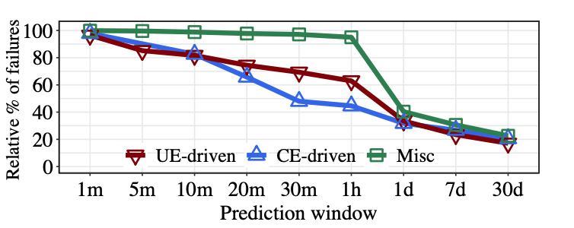
Predictable Analysis
Finding 2: A significant fraction of server failures become unpredictable if the prediction window increases (e.g., over a day)
Keeping a short prediction window (e.g., at the minute granularity) is necessary to achieve accurate server failure prediction.
Notes:
The following figure shows that while large fractions of server failures are predictable
in a short prediction window (e.g., 96.5%- 99.9% when the prediction window is one minute),
the relative percentages of predictable server failures decrease significantly as the prediction
window increases.
For example, the relative percentages of predictable CE-driven, UE-driven, and miscellaneous
failures decrease to 31.8%, 33.5%, and 40.3% when the prediction window increases to one day, respectively.
Thus, keeping a short prediction window is critical for accurate prediction.

Slide 9
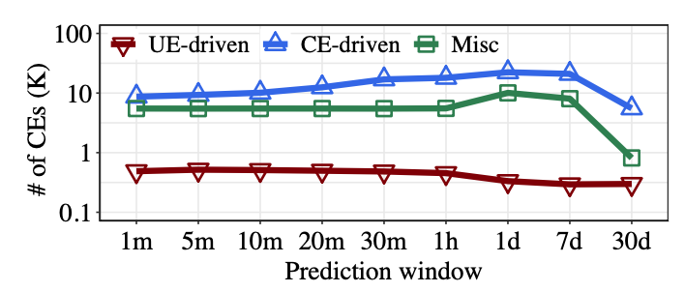
Number of CEs Before Failures
Finding 3: The number of CEs before prediction is significant in both predictable CE-driven and miscellaneous failures
It can serve as an effective indicator for server failure prediction
Notes:
The average numbers of CEs for predictable CE-driven and miscellaneous failures are generally high; for example, they are 8.7-22.3 K and 5.5-10.1 K when the prediction window ranges from one minute to one day, respectively.
On the other hand, the average number of CEs over all healthy servers in the whole eight- month period is 835.
his suggests that the number of CEs can be an effective indicator for distinguishing between healthy servers and CE-driven or miscellaneous failures in server failure prediction.

Slide 10
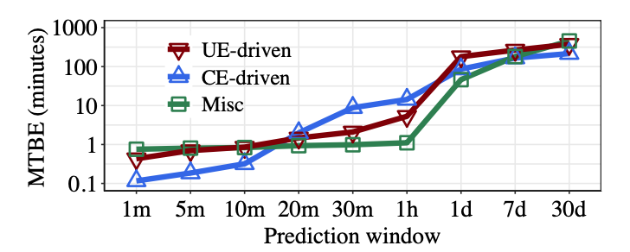
Mean Time Between Errors
Finding 4: Mean Time Between Errors (MTBE) is generally small in all predictable server failures in short prediction windows. Also, the MTBE decreases as the prediction window decreases.
CEs tend to occur in bursts as a server failure is approaching
Notes:
We further study the frequency of CE occurrences before the prediction is conducted by measuring the mean time between error for each server failure.
The following figure shows the median MTBE values for all failure types are generally small in short prediction windows. Also, as the prediction window decreases, the median MTBE values become smaller.
This suggests that the CEs tend to occur in bursts as a server failure is approaching.

Slide 11
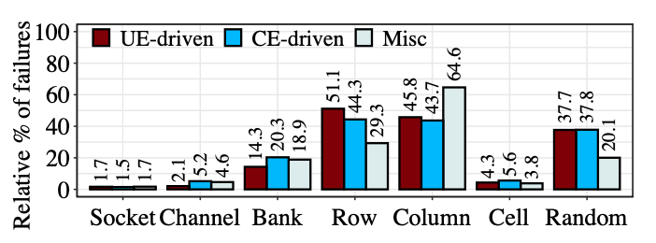
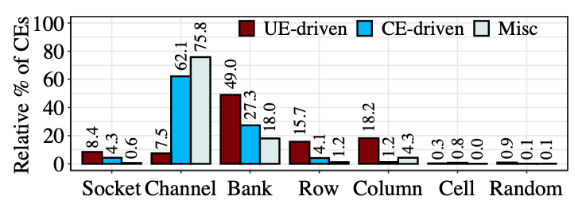
Component Failure Analysis
Finding 5: Most predictable server failures are due to bank failures, row failures, column failures, or random errors, while most CEs are associated with channel and bank failures
Notes:
We examine the impact of different failed components in the memory subsystem on server failures.
The left figure shows the relative percentages of predictable server failures associated with different component failures.
We see that 94.1% of predictable server failures are associated with bank failures, row failures, column failures, or random errors in the memory subsystem.
The right figure shows the relative percentage of CEs across component failures. We see that that channel and bank failures lead to high relative percentages of CEs.
This suggests that a higher-level component in the hierarchical architecture of the memory subsystem has more severe impact on the number of CEs.

Slide 12
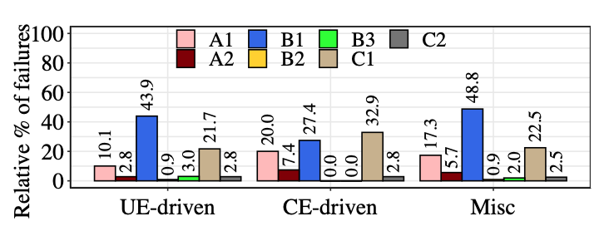
Impact of DRAM Models
Finding 6: A DRAM model with a large number of failures has a large fraction of predictable server failures.
DRAM model “Vendor”“k”: “Vendor” is represented by a letter and “k” means the k-th model in the same vendor.
Notes:
The left figure shows the relative percentages of predictable server failures decomposed by the DRAM model.
We see that A1, B1, and C1 account for high relative percentages of predictable server failures.
On the other hand, Table IV shows that A1, B1, and C1 have more server failures than the other DRAM models,
indicating that a DRAM model with many server failures generally has a large fraction of predicable server failures.

Slide 13
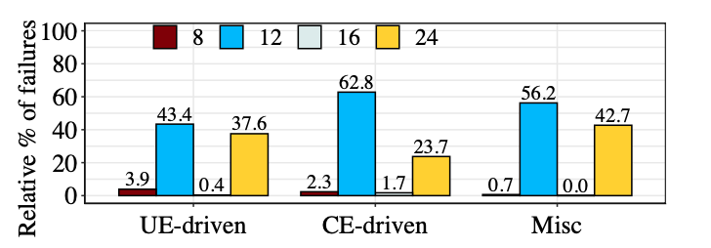
Impact of Number of DIMMs
Finding 7: The fraction of predictable server failures generally increases with the number of DIMMs per server
Notes:
We analyze the impact of of number of DIMMs per server on server failures.
We observer the fraction of predictable server failures generally increases with the number of attached DIMMs.
One exception is that the predictable server failures with 16 DIMMs have the lowest fraction,
as the servers with 16 DIMMs due to its smallest population (2.9% of all servers).

Slide 14
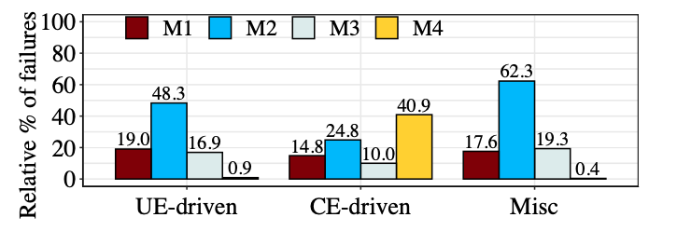
Impact of Server Manufacturer
Finding 8: The fraction of predictable server failures varies across server manufacturers, yet predictable server failures are mainly attributed to the DRAM model
Notes:
The figure shows the relative percentages of predictable server failures decomposed by the server manufacturer.
The UE-driven and miscellaneous failures from M2 account for a large fraction of
predictable server failures while the CE-driven failures from M4 account for the largest fraction.
We observe the reason is that there exist large fractions of such failed servers equipped with the DRAM model B1.

Slide 15
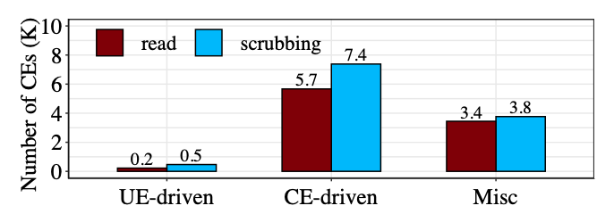
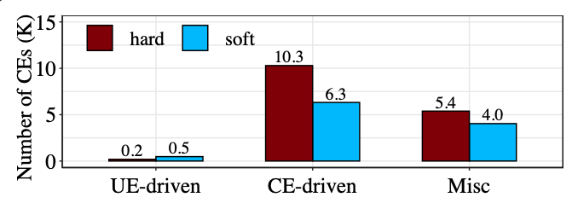
Characteristics of Different Types of CEs
Finding 9: Memory scrubbing generally detects more CEs than memory read transactions before server failures occur
Finding 10: Hard errors generally occur more commonly than soft errors before server failures
Notes:
We study the characteristic of different types of CEs.
Scrubbing errors and memory read transactions errors defined in the MCELog
The left figure shows that the average numbers of scrubbing errors are larger than those of read errors across failure types
It implies that memory scrubbing is critical for detecting CEs before server failures occur.
On the other hand, the right figure shows that the that the average numbers of hard errors are larger than those of soft errors, implies that hard errors occur more commonly than soft errors for CE-driven and miscellaneous failures, conforming to the observation that hard errors are more common in prior studies.

Slide 16
Summary of Measurement
CEs typically occur within a short time before the prediction is conducted, and hence a large fraction of server failures become unpredictable when the prediction window is large
We should use a short prediction window to periodically predict server failures for accurate prediction
Feature generation for machine learning-based prediction should consider different impacting factors
Component failures in the memory subsystem
DRAM configurations
Types of CEs

Slide 17
Server Failure Prediction
Formulation
Server failure prediction → offline classification
Feature generation
Counters, components, statistics, configurations
Models:
logistic regression (LR), support vector machine (SVM), LightGBM, random forest (RF), multilayer perceptron (MLP)
Default setting
Prediction interval: 5 minutes
Notes:
We formulate the server failure prediction problem as an offline classification problem.
And extract four different groups of features based on our measurement analysis.
We also try different prediction models.

Slide 18
Effectiveness of Feature Generation
Finding 11: Using all feature groups generally increases the F1-score. The increase is significant for CE-driven failures.
E.g., compared with using only counter features, using all features increase precision
from 7.7% to 13.0% for UE-driven, from 35.3% to 59.6% for CE-driven, from 19.6% to 33.4% for Misc
Notes:
We first examine the effectiveness of feature generation for different combinations of feature groups.
The following three figures show that using all feature groups generally increases the precision, recall, and F1-score for different failure types.
For example, compared with using the counter features only, the precision using all feature groups increases from 7.7%, 35.3%, and 19.6% to 13.0%, 59.6%, and 33.4% for UE-driven, CE- driven, and miscellaneous failures, respectively.

Slide 19
Effectiveness of Prediction Models
Finding 12: Tree-based prediction models generally achieve the highest F1-score in our server failure prediction.
Prediction of CE-driven failures has the highest F1-score, as a large number of CEs manifest before the CE-driven failures happen.
Notes:
We examine several classical machine learning algorithms, including logistic regression,
support vector machine, LightGBM, Random Forests, as well as a classical deep neural network algorithm Multi-Layer Perceptron.
We observe that tree-based prediction models generally achieve the highest F1-score in our server failure prediction.
Also, the prediction of CE-driven failures has the highest F1-score among the three failure types since a large number of CEs manifest before the CE-driven failures happen.

Slide 20
Impact of Prediction Interval
Finding 13: F1-score decreases significantly when the prediction interval increases.
Notes:
Figures show the prediction accuracy versus the prediction interval.
We see that both the precision and recall generally decrease when the prediction interval increases.
The reason is that the relative percentage of predictable server failures decreases when the prediction window increases.

Slide 21
Post Analysis
Finding 14: Large fraction of correctly predicted server failures can be successfully repaired → reducing thousands of hours of server downtime.
79.4%, 85.2%, and 98.6% of UE-driven, CE-driven, and miscellaneous predicated failures can be successfully repaired
Notes:
We finally analyze whether there is sufficient time to successfully repair the correctly predicted server failures in production.
The table show that 79.4%, 85.2%, and 98.6% of UE-driven, CE-driven, and miscellaneous predicated failures can be successfully repaired.
As a result, a significant amount of server downtime can be reduced by proactively predict and repair these server failures.

Slide 22
Conclusion
We report 14 findings on correlation between DRAM errors and server failures based on large-scale dataset at Alibaba
Characterization of DRAM errors and server failures
Impacting factors on server failures
A server failure prediction workflow
Dataset and source code:
https://github.com/alibaba-edu/dcbrain/tree/master/dramdata
https://github.com/zncheng/dramanalysis
Notes:
To conclude, we report 14 findings on correlation between DRAM errors and server failures based on large-scale dataset at Alibaba.
Our analysis include the characterization of DRAM errors and server failures as well as impacting factors on server failures.
We also propose a server failure prediction workflow based on our measurement analysis.
Finally, we release our dataset and source code for public use.

Slide 23
Thank You! Q & A
Notes:
Thank you. I’d like to take your questions and comments.

