Slide 1
EthCache: A Workload-Aware, Unified
Key-Value Cache for Ethereum
Jia Zhao¹, Yanjing Ren¹, Xianglong Shi², Jingwei Li², and Patrick P. C. Lee¹
¹CUHK ²UESTC
NAS 2026

Slide 2
Introduction
Ethereum executes smart contracts over a persistent world state
  Execution reads account state, contract storage, bytecode, and chain metadata from KV Store.
Storage I/O becomes a block-processing bottleneck
  A logical state lookup can trigger multiple sequential KV reads.
  Geth uses in-memory caches to reduce access to persistent storage.

Slide 3
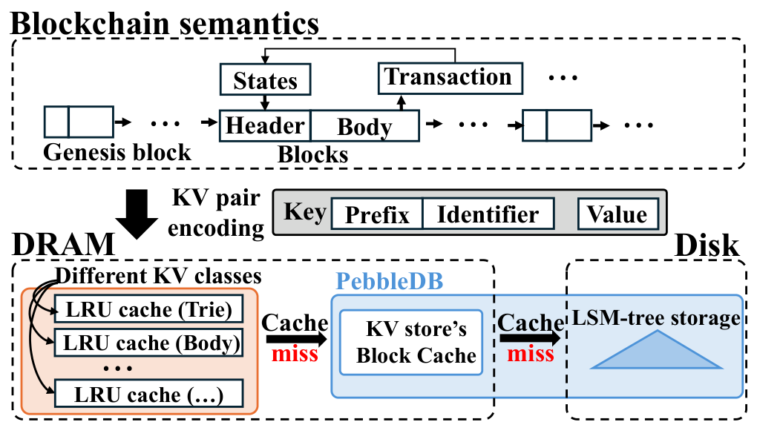
Geth’s Storage and Caching
Two cache levels
  Semantic caches use independent LRU policies.
  PebbleDB caches SSTable blocks.
A read can pass through multiple independent cache spaces.

Slide 4
Limitations of Geth’s Caches
Scattered capacity
  Memory cannot move between semantic caches as reuse changes.
  Upper caches and the block cache may retain the same logical data.
Cache pollution under LRU
  One-time reads evict KV pairs that transaction execution will reuse.
Cache capacity should follow observed reuse !

Slide 5
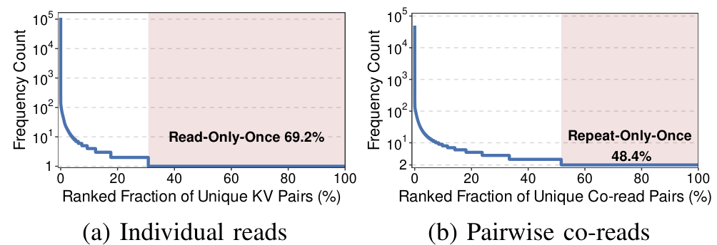
Ethereum KV Read Patterns
69.2% of unique KV pairs are read only once
  Transient reads consume space without contributing future hits
Short-range co-reads recur across semantic boundaries

Slide 6
Cache Policy Choices
Unification alone does not filter transient reuse
Policy | Mechanism | Remaining issue on this workload
Unified LRU | One shared recency queue | Read-once pollution
S3FIFO | FIFO queues filter one-time reads | Useful pairs age by insertion order
ARC | Adaptive recency/frequency split | Transient bursts enter frequent list
LIRS | Protects low reuse-distance entries | Short-lived repeats can gain protection

Slide 7
Contributions
EthCache unifies KV caching across Ethereum semantics
  A dual-tier policy filters transient reads and retains reusable KV pairs
Default cache budget | Geth | EthCache
Read hit rate | 37.68% | 52.24%
Trace replay shows a 14.56 percentage-point hit-rate gain

Slide 8
Design Considerations
Separate transient reads from the stable working set
  A single frequency threshold avoids fine-grained hotness tracking
Capture correlated reuse without pairwise metadata
  Frequently co-read entries accumulate read evidence in repeated contexts
  Age out previously useful entries when the workload shifts

Slide 9
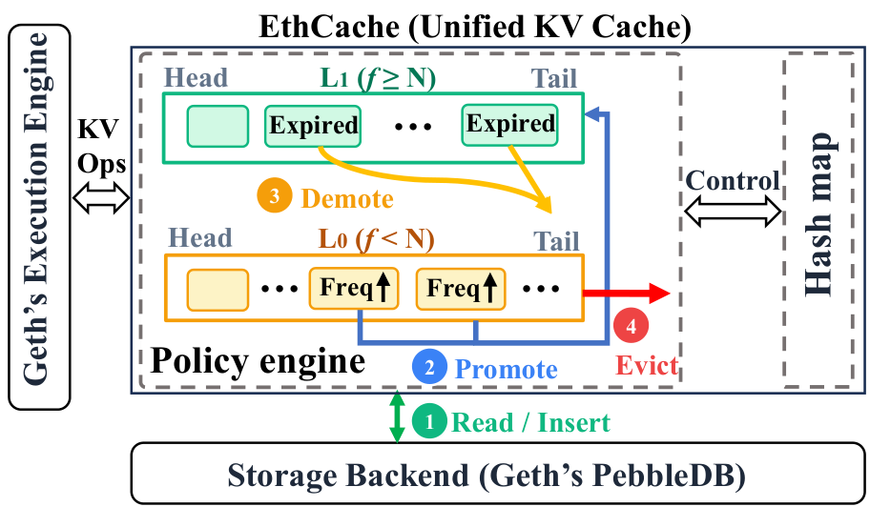
EthCache Architecture
Hash map stores KV payloads in one shared capacity pool
  The policy engine maintains probationary L0 and stable L1 metadata

Slide 10
Frequency-Based Promotion
New entries begin in probationary tier L0
Promote to L1 after N reads, with N = 3 by default
Read evidence | Policy state | Purpose
Below N reads | L0: probationary | Absorb transient accesses
At least N reads | L1: stable | Retain repeatedly useful entries
Correlated entries can qualify through repeated co-reads

Slide 11
Timeout-Based Demotion
Age stable entries with a global KV-operation counter (Tg)
  On each operation, inspect the coldest entry in L1
Idle interval = Tg − t
Demote when the idle interval exceeds E
  Reset frequency to 0 and move the policy entry to L0
  Keep the payload until eviction, giving the entry a second chance

Slide 12
Cache Operations
Operation | Payload and policy action
Read miss | Fetch from KV store and admit to L0
Read hit | Refresh recency and age, increment read frequency
Write | Insert or update, refresh recency and age
Capacity overflow | Evict L0’s LRU entry, fall back to L1 if L0 is empty
Writes alone cannot promote entries into the stable tier

Slide 13
Experimental Setup
Go prototype with trace-driven replay
  Replay reads and writes in original order, count read hits only
Real Ethereum synchronization workload
  50K blocks after 20.5M blocks, 20.1 GB persistent data
  262.5M operations: 61.1M reads and 201.4M writes
Equal cache budgets and representative policies
  Default 1× = 778.2 MB, N = 3, E = 10M operations

Slide 14
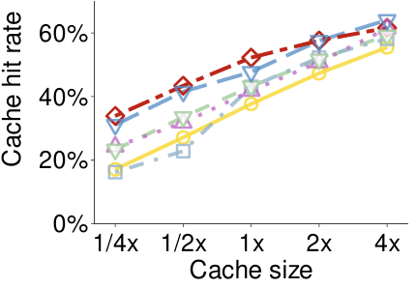
Cache Hit Rate at the Default Budget
EthCache reaches 52.24% with 778.2 MB (1x) of cached payloads
  14.56 pp above Geth and 4.52 pp above LIRS

Slide 15
Cache Hit Rate at the Default Budget
EthCache has the highest hit rate from 1/4× to 2×
The gain is strongest when memory is constrained
  At 4× (about 15% of storage), EthCache remains ahead of Geth but trails LIRS

Slide 16
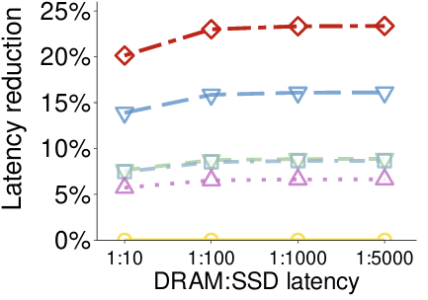
Expected Read Latency Reduction
AAT model
  HitTime + MissRate × MissPenalty
  DRAM-to-SSD latency ratio varies from 1:10 to 1:5000
23.33% expected read-latency reduction at 1:1000
  Model-derived result, end-to-end Geth evaluation remains future work

Slide 17
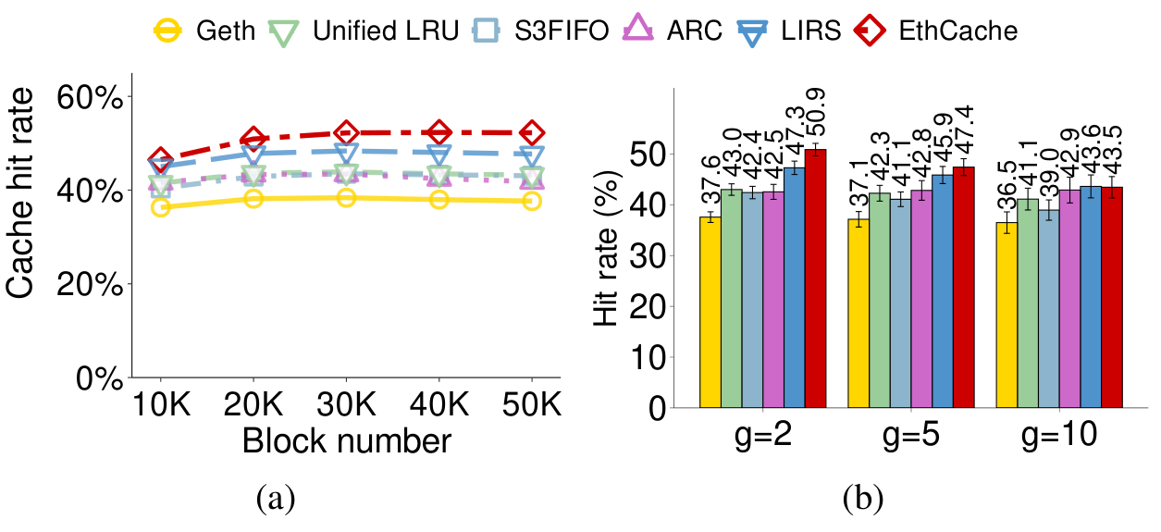
Cache Efficiency under Dynamic Workloads
Cumulative hit rate rises from 46.49% to 52.24%
Cache hit rate of EthCache remain high in independent cold-start partitions
  47.4% at g = 5

Slide 18
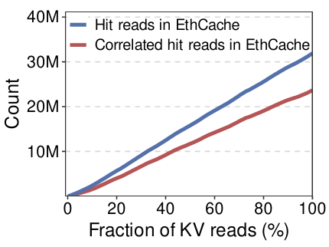
Correlation Analysis
74.3% of EthCache’s hits come from recurring co-read pairs
  23.7M correlated hits out of 31.9M total hit reads

Slide 19
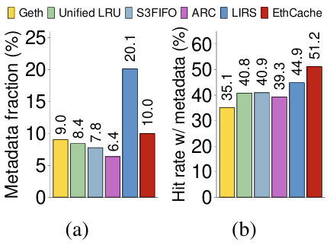
Correlation and Metadata Overhead
10.0% metadata overhead
  Metadata fraction is relative to cached payload size
  EthCache retains a 51.17% hit rate under the total budget (w/ metadata)

Slide 20
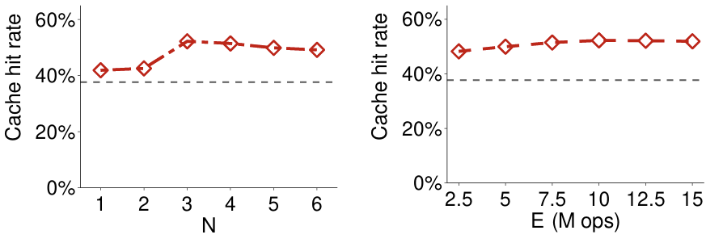
Impact of Policy Parameters
N = 3 balances transient filtering and timely promotion in current trace
Expiration E
  2.5M–15M operations: hit rate 48.23%–52.24%
  Best at E = 10M, relatively flat beyond 7.5M

Slide 21
Conclusions
EthCache provides a unified, workload-aware KV cache
  Frequency-based promotion protects reusable entries
  Timeout-based demotion adapts to changing workloads
  Recency-based eviction absorbs the transient read tail
Trace replay evaluates cache effectiveness under limited memory
  Future work: integrate into Geth for end-to-end evaluation
Source code: https://github.com/adslabcuhk/ethcache

