Slide 1
FeatureSpy: Detecting Learning-Content Attacks via Feature Inspection in Secure Deduplicated Storage
Jingwei Li*, Yanjing Ren#, Patrick P. C. Lee#,Yuyu Wang*, Ting Chen* and Xiaosong Zhang*
*University of Electronic Science and Technology of China #The Chinese University of Hong Kong
IEEE INFOCOM 2023

Slide 2
Outsourced Storage
Outsourcing data management to cloud is common in practice
22% business data are stored in the cloud[*]
Source-based deduplication
Removing duplicate chunks on client side
Network and storage savings
A
Submit fingerprints of A, B and C
Outsourced chunks
A
Already stored
B
Inform to only upload C
B
C
[*]https://www.seagate.com/files/www-content/our-story/rethink-data/files/Rethink_Data_Report_2020.pdf

Slide 3
Protecting Sourced-based Dedup
Encrypted deduplication (ED)
Encryption before deduplication to preserve confidentiality against cloud [Bellare, EuroCrypt’13]
Proof of ownership (PoW)
Verify client’s data ownership [Halevi, CCS’11]
Protect against learning client’s data from other malicious clients
🔒
Working on ciphertext chunks
🔒
🔒
Source-based dedup
🔒
🔒
Submit fingerprints and proof
Inform to upload non-duplicate chunks
Verify if client owns chunks corresponding submitted fingerprints
Does the combination of ED and PoW achieve full security?

Slide 4
Learning-Content Attacks
Assumptions:
Most content of F is known
Message space of unknown content is finite
Rationale: each forged file is owned by client, so PoW is insufficient for defense
Source-based deduplication
🔒
Generate forged files by enumerating all possibilities of unknown contents
The client learns F if a forged file is duplicate in entirety

Slide 5
Case Study
Setting:
F: Google’s offer template[*] (publicly available)
Unknown: Annual Salary and Sign-on Bonus fields
Check duplicate/non-duplicate forged files by monitoring network traffic
Results (10 runs with 95% confidence intervals)
Q: How should learning-content attacks be mitigated?
Setups | #Uploads | Traffic | Time
LAN | 841.0 ± 608.3 | 7.1 ± 5.1 MiB | 105.0 ± 76.1 s
Cloud |  |  | 475.5 ± 339.8 s
[*]https://www.sec.gov/Archives/edgar/data/1288776/000119312508140342/dex101.htm

Slide 6
Contributions
FeatureSpy: detect learning-content attacks via shielded execution
Examine data similarity to catch forged files in learning-content attacks
Similarity-preserving encryption: examine similarity after encryption
Shielded attack detection: securely report attacks against tampering
Extensive experiments:
Detect all tampered snapshots without any false positives in case study
Only 15% and 0.8% throughput drops in upload and download, respectively

Slide 7
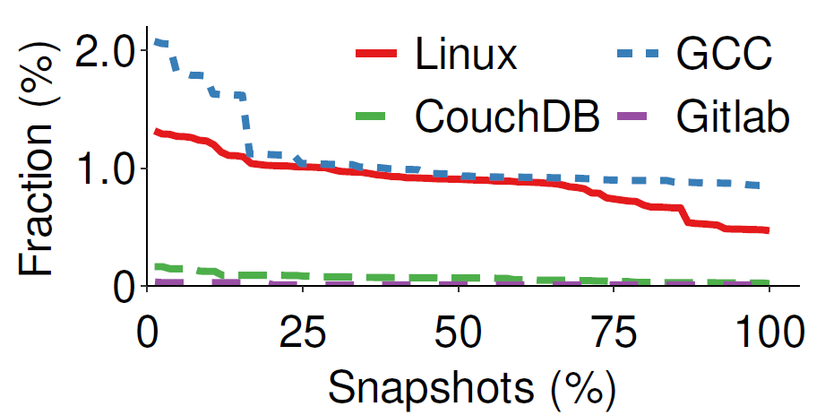
Main Idea
Learning-content attacks generate many similar (non-duplicate) chunks
Practical workloads are unlikely to have too many similar chunks
Extract chunk features
Two chunks are similar with identical features
Only ≤ 2.1% chunks in real snapshots are similar
Our idea: report attack if client generates many chunks with identical features

Slide 8
Architecture
Detect attacks
Compromised by malicious adversary
Source-based
Encrypted Deduplication
🔒
File
Enclave
Cloud
🔒
🔒
Multiple Clients
Client can be malicious to launch learning-content attacks
Build on SGX to securely report attacks against malicious client
Run in small enclave with confidentiality, authenticity, and integrity
Challenge: resource constraints in enclave

Slide 9
Design Overview
Generate a feature key of each chunk based on the concatenation of all features
Build on N-Transfor SF_{[Shilane, FAST’12]} to extract three features for each chunk
FeatureSpy
Enclave
Feature Key Generation
Attack Detection
Chunk
Feature Extraction
Similarity-Preserving
Encryption
Source-based
Deduplication
MLE Key Generation
Generate an MLE key of each chunk based on the cryptographic hash
PoW
Shielded Attack Detection
in Unprotected Memory
Extract features and generate keys
Two new designs:
Similarity-Preserving Encryption
Shielded Attack Detection

Slide 10
Similarity-Preserving Encryption
Build on two keys to perform encryption
Similar chunks have identical feature keys, and distinct chunks have different MLE keys
Encrypt a small part (indicator) of chunk content with feature key, and remaining large part with MLE key
Rationale:
Identify similar chunks by checking indicator
Compromised keys cannot fully decrypt other chunks
MLE Key
E
Plaintext Chunk
Ciphertext Chunk
Indicator
Indicator
E
Feature Key

Slide 11
Shielded Attack Detection
Couple attack detection and PoW together in enclave
Valid PoW proofs are truthfully generated for authenticated chunks examined for attack detection
Detect attacks on ciphertext chunks on a per-batch basis
Rationale: tampered snapshot has many similar chunks in a batch
Report an attack if a large fraction T (1%) of chunks have the same indicator
Small enclave memory overhead (~0.6 MiB)

Slide 12
Experimental Setup
Build on SGXDedup_{[ATC’21]} to implement FeatureSpy
SGXDedup: encrypted deduplication storage based on SGX
FeatureSpy adds 1K LoC to augment SGXDedup with attack detection
Six real-world datasets to drive evaluation
Datasets | Snapshots | Raw Size | Dedup Ratio
Linux | 84 | 42.7 GiB | 3.8
GCC | 85 | 33.0 GiB | 7.2
CouchDB | 83 | 22.9 GiB | 1.8
Gitlab | 79 | 74.4 GiB | 1.1
FSL* | 10 | 407.5 GiB | 9.3
MS* | 10 | 902.6 GiB | 5.6
*Only include chunks’ metadata

Slide 13
Case Study of Attack Detection
Mix forged offer letters (based on realistic case) into raw snapshots
Detect all malicious snapshots when T = 1%
Detection rate decreases since more similar chunks need to be detected
No false positives even with a small T in the case
Raw snapshots unlikely have many similar chunks to trigger

Slide 14
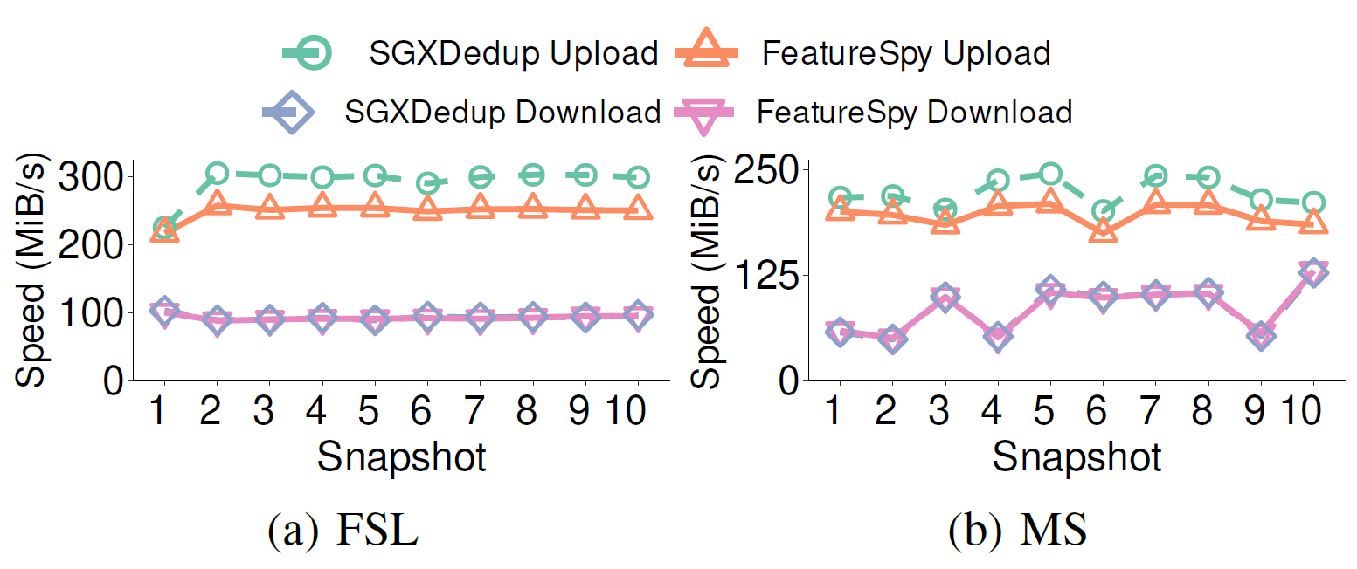
Trace-driven Performance
FeatureSpy incurs 15% upload speed drop from SGXDedup
Download speed is bounded by chunk fragmentation

Slide 15
Conclusion
FeatureSpy: encrypted deduplication storage that effectively detects learning-content attacks via shielded execution
Similarity-preserving encryption: preserve similarity while defeating against key compromise
Shielded attack detection: trustful attack detection without being evaded by adversaries
Source code: https://github.com/tinoryj/FeatureSpy

