Slide 1
Optimal Data Placement for Stripe Merging in Locally Repairable Codes
Si Wu¹, Qingpeng Du¹, Patrick P. C. Lee², Yongkun Li¹, and Yinlong Xu¹
¹University of Science and Technology of China,
²The Chinese University of Hong Kong
INFOCOM 2022

Slide 2
Introduction
Clustered storage architecture
Hierarchical architecture, with nodes partitioned into clusters
Cross-cluster network bandwidth is scarce
Failures are prevalent
Cross-cluster transfer is the bottleneck!
Node
Network Core
Block
D₀
D₁
D₂
D₃
D₄
D₅
L₀
L₁
G₀
G₁
Cluster

Slide 3
Erasure Coding
Erasure coding is a promising technique for fault tolerance
Lower storage redundancy with same reliability than replication
An erasure code encodes k data blocks into m parity blocks
Typical examples are Reed-Solomon codes
High repair penalty (repair of one block needs to access k surviving blocks)
Locally Repairable Codes (LRC) are a family of repair-efficient erasure codes
Deployed in Azure, Facebook’s data centers [Huang et al.,ATC’12, Sathiamoorthy et al.,VLDB’13]

Slide 4
Locally Repairable Codes (LRC)
An LRC can be represented by (k, l, g)
Partition k data blocks into l small-size groups
Add a local parity block for each group, l local parity blocks in total
Add g global parity blocks for high fault tolerance
k + l + g data and parity blocks are called a stripe
Repair of one data block accesses only k/l blocks in a small-size group
D₀
D₁
D₂
D₃
D₄
D₅
G₀
G₁
L₀
L₁
(k, l, g) = (6, 2, 2)

Slide 5
LRC in Clustered Storage
LRC reduces the cross-cluster network traffic for repairing a single data block
Repair cost: average amount (in units of blocks) of cross-cluster traffic to repair all data blocks
LRC achieves multi-node fault tolerance and single-cluster fault tolerance
D₀
D₁
D₂
D₃
D₄
D₅
G₀
G₁
Repair cost =
one block
L₀
L₁
L₀: cross-cluster block

Slide 6
Redundancy Transitioning
Redundancy transitioning is crucial
Change coding parameters k, l, g
Trade between access performance and storage efficiency to adapt to skewed and dynamic workloads [Wu et al.,Infocom'20, Xia et al.,FAST'15]
Trade between fault tolerance and storage overhead to adapt to varying reliability [Kadekodi et al.,OSDI'20, Taranov et al.,Eurosys'18]
Generate wide stripes to achieve extreme storage savings [Hu et al.,FAST’21, Yao et al.,ICDCS’21]
We explore a stripe merging approach for redundancy transitioning of LRC

Slide 7
Stripe Merging of LRC
Merge x LRC(k, l, g) stripes to an LRC(xk, l’, g’) stripe
A (k, l, g) LRC shows a trade-off among
Repair locality, r = k/l
Storage overhead, s = (k+l+g)/k
Minimum hamming distance, d = g+2
Fix two trade-off dimensions, change the third dimension
Problem (1): x LRC(k, l, g) -> LRC(xk, xl, g), storage overhead ↓
Problem (2): x LRC(k, l, g) -> LRC(xk, xl, xg), distance ↑
Goals
Minimize cross-cluster traffic for stripe merging
Preserve minimum repair cost for LRC(k, l, g) & LRC(xk, l’, g’)

Slide 8
Challenges
Stripe merging of LRC involves two bandwidth-intensive operations
Recalculation of g’ new global parity blocks
Migration of data and local parity blocks
Random data placement incurs substantial recalculation cost and migration cost

Slide 9
Challenge in Problem (1)
2 LRC(6, 2, 2) -> LRC(12, 4, 2)
D₀-D₅, L₀, L₁, G₀, G₁: stripe 1; D₆-D₁₁, L₂, L₃, G₂, G₃: stripe 2
Recalculation cost: 6 blocks
Migration cost: D₉-D₁₁, 3 blocks
D₀
D₁
D₂
D₃
D₄
D₅
G₀
G₁
G₂
G₃
D₆
D₇
D₈
G'₀
G'₁
D₉
D₁₀
D₁₁
L₀
L₁
L₂
L₃
D₉
D₁₀
D₁₁
D₃-D₅ (stripe 1), D₉-D₁₁ ( stripe 2), aggregation breaks single-cluster fault tolerance

Slide 10
Challenge in Problem (2)
2 LRC(6, 2, 2) -> LRC(12, 4, 4)
D₀-D₅, L₀, L₁, G₀, G₁: stripe 1; D₆-D₁₁, L₂, L₃, G₂, G₃: stripe 2
Recalculation cost: 10 blocks
Migration cost: 0
D₀
D₁
D₂
D₃
D₄
D₅
G₀
G₁
G₂
G₃
D₆
D₇
D₈
G'₀
G'₁
G'₂
G'₃
D₉
D₁₀
D₁₁
L₀
L₁
L₂
L₃
Aggregation keeps single-cluster fault tolerance, D₀-D₂ (stripe 1), D₆-D₈ ( stripe 2), dispersed

Slide 11
Our Motivation for Problem (1)
2 LRC(6, 2, 2) -> LRC(12, 4, 2)
D₀-D₅, L₀, L₁, G₀, G₁: stripe 1; D₆-D₁₁, L₂, L₃, G₂, G₃: stripe 2
Recalculation cost: 8 blocks
Migration cost: 0 block
D₀
D₁
D₂
D₃
D₄
D₅
G₀
G₁
G₂
G₃
D₆
D₇
D₈
D₉
D₁₀
D₁₁
G'₀
G'₁
L₀
L₁
L₂
L₃
Disperse D₃-D₅ (stripe 1), D₉-D₁₁ ( stripe 2)

Slide 12
Our Motivation for Problem (2)
2 LRC(6, 2, 2) -> LRC(12, 4, 4)
D₀-D₅, L₀, L₁, G₀, G₁: stripe 1; D₆-D₁₁, L₂, L₃, G₂, G₃: stripe 2
Recalculation cost: 8 blocks
Migration cost: 0
D₀
D₁
D₂
D₃
D₄
D₅
G₀
G₁
G₂
G₃
G'₀
G'₁
G'₂
G'₃
D₆
D₇
D₈
D₉
D₁₀
D₁₁
L₀
L₁
L₂
L₃
Aggregate D₀-D₂ (stripe 1), D₆-D₈ ( stripe 2)

Slide 13
Contributions
Formally analyze the impact of random data placement on the cross-cluster transitioning traffic
Design optimal data placement scheme
Judiciously control the number of blocks to be merged in the same cluster
Minimize cross-cluster transitioning traffic
Maintain minimum repair cost of LRC
Conduct testbed experiments to show the efficiency of the data placement scheme

Slide 14
Analysis of Problem (1)
g+i data and local parity blocks (stripe 1), g+j data and local parity blocks (stripe 2), aggregation violates single-cluster fault tolerance for LRC(xk, xl, g)
Migration cost: g+j data and local parity blocks (stripe 2)
By pre-distributing g+j data and local parity blocks (stripe 2) in a different cluster, we save total transitioning bandwidth
Main finding: aggregation increases migration cost (total transitioning bandwidth)

Slide 15
Analysis of Problem (2)
g+i₁ data and local parity blocks (stripe 1), g+i₂ data and local parity blocks (stripe 2), ..., g+i_{x} data and local parity blocks (stripe x), aggregation keeps single-cluster fault tolerance for LRC(xk, xl, xg)
By pre-aggregating the blocks from x small-size stripes in a single cluster, we save total transitioning bandwidth
Main finding: dispersion increases recalculation cost (total transitioning bandwidth)

Slide 16
Data Placement Strategy for Single Stripe
LRC(6, 2, 2)
Keep single-cluster fault tolerance: no more than g+i (1 ≤ i ≤ l) blocks that span i groups in a cluster*
Achieve minimum repair cost: place every g+1 data blocks of each group in one separate cluster
D₀
D₁
D₂
D₃
D₄
D₅
G₀
G₁
Single-cluster fault tolerance
Minimum repair cost: one block
L₀
L₁
*Wu et al., “On the optimal repair-scaling trade-off in Locally Repairable Codes”, Infocom'20

Slide 17
Data Placement Scheme for Multiple Stripes
2 LRC(6, 2, 2)
Key idea: Control the number of blocks to be merged in the same cluster
Aggregation degree of x LRC(k, l, g) stripes, number of clusters that aggregate data blocks from x small-size stripes
Set aggregation degree as 0, get a dispersed data placement
D₀
D₁
D₂
D₃
D₄
D₅
G₀
G₁
G₂
G₃
D₆
D₇
D₈
D₉
D₁₀
D₁₁
L₀
L₁
L₂
L₃
no cluster aggregates data blocks of stripe 1 and stripe 2

Slide 18
Data Placement Scheme for Multiple Stripes
2 LRC(6, 2, 2)
Key idea: Control the number of blocks to be merged in the same cluster
Aggregation degree of x LRC(k, l, g) stripes, number of clusters that aggregate data blocks from x small-size stripes
Set aggregation degree as maximum, get an aggregated data placement
D₀
D₁
D₂
D₃
D₄
D₅
G₀
G₁
G₂
G₃
D₆
D₇
D₈
D₉
D₁₀
D₁₁
L₀
L₁
L₂
L₃
two clusters aggregate data blocks of stripe 1 and stripe 2

Slide 19
Cost Analysis for Problem (1)
2 LRC(6, 2, 2) -> LRC(12, 4, 2)
Aggregation degree | Recalculation cost | Migration cost | Total transitioning cost
0 | 8 | 0 | 8
1 | 6 | 3 | 9
2 | 4 | 6 | 10
Dispersed data placement has smallest transitioning cost

Slide 20
Cost Analysis for Problem (2)
2 LRC(6, 2, 2) -> LRC(12, 4, 4)
Aggregation degree | Recalculation cost | Migration cost | Total transitioning cost
0 | 12 | 0 | 12
1 | 10 | 0 | 10
2 | 8 | 0 | 8
Aggregated data placement has smallest transitioning cost

Slide 21
Optimality Guarantee
We can convert any random data placement to our data placement with less transitioning cost
2 LRC(8, 2, 2)
The random data placement has costs 14 and 13 for Problems (1) and (2)
Our data placement (aggregation degree = 2) has costs 14 and 12
D₀
D₁
D₂
D₄
D₅
D₆
D₃
L₀
G₀
G₁
D₁₂
D₁₃
D₁₄
G₂
G₃
D₁₁
L₂
D₇
L₁
D₈
D₉
D₁₀
D₁₅
L₃

Slide 22
Optimality Guarantee
Theorem 1. For any data placement of the x LRC(k, l, g) stripes that preserves both minimum repair cost and single-cluster fault tolerance, the minimum transitioning bandwidth cost is x×g×(α-1) for Problem (1) and Problem (2)
Dispersed data placement has minimum transitioning cost for Problem (1)
Aggregated data placement has minimum transitioning cost for Problem (2)

Slide 23
Evaluation
Implementation
Prototype with a client, a coordinator and multiple data nodes
Testbed
Local: Multiple 40-core machines with 128 GB RAM, 1 TB SSD
Each node emulates a cluster (Inner-cluster bandwidth: cross-cluster bandwidth = 8:1)
Comparisons:
Ran: random data placement (e.g., HACFS [FAST’15], Stripemerge [ICDCS’21])
Ran-P: random + encode-and-transfer (e.g., LRC [Infocom’20])
DIS, AGG: dispersed and aggregated data placements

Slide 24
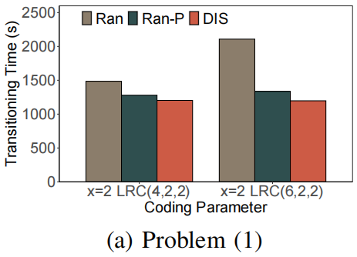
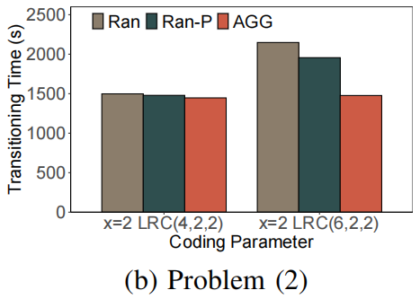
Transitioning Time Performance
Different transitioning parameters
Findings:
DIS has best transitioning performance for Problem (1)
AGG has best transitioning performance for Problem (2)

Slide 25
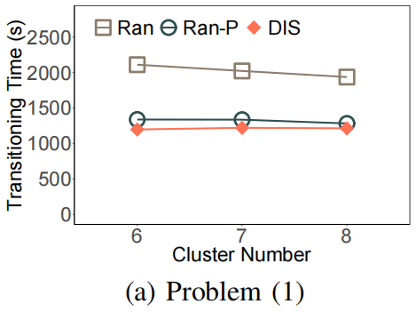
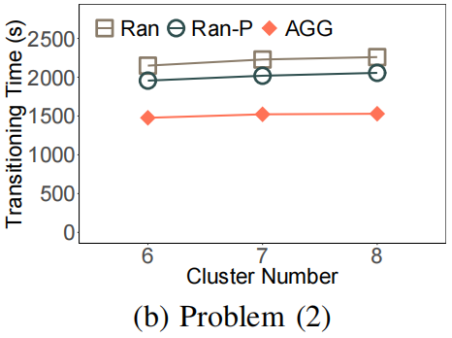
Impact of Number of Clusters
Different number of clusters in the system
Findings:
DIS has larger gains with a smaller cluster number
AGG has larger gains with a larger cluster number

Slide 26
Conclusions
Study stripe merging problems for transitioning LRC in clustered storage systems
Design optimal data placement scheme that minimizes the cross-cluster transitioning cost
Conduct testbed experiments to verify effectiveness
Source code: http://zenodo.org/record/5797775

