Slide 1
Revisiting Frequency Analysis against Encrypted Deduplication via Statistical Distribution
Jingwei Li¹, Guoli Wei¹, Jiacheng Liang¹, Yanjing Ren¹, Patrick P. C. Lee²,
and Xiaosong Zhang¹
¹University of Electronic Science and Technology of China (UESTC)
²The Chinese University of Hong Kong (CUHK)

Slide 2
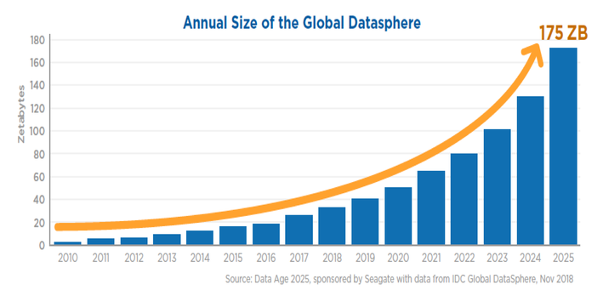
Outsourcing Storage
Outsourcing storage is a prevalant strategy to incorporate with increasing data volumes
Two goals to be fullfilled:
  Confidentiality: prevents outsourced data against unauthorized access
  Storage efficiency: consumes storage footprints as small as possible

Slide 3


Encrypted Deduplication
Deduplication: store one copy of identical data for storage efficiency
  Basic unit: chunk
Encrypted deduplication: augment deduplication with client-side encryption
  Deduplication remains effective on encrypted chunks of different clients
Confidentiality guarantee
Cloud Storage System
🔒
Encryption
Deduplication
🔒
Encryption

Slide 4

Message-locked Encryption
Existing crypto primitive_{[Bellare, EuroCrypt’13]} for encrypted deduplication
  Idea: encrypt each chunk with a key derived from its content
Content-derived key
Plaintext M₁
K
Ciphertext C₁
Can be
dedup’ed
Can be
dedup’ed
Plaintext M₂
K
Ciphertext C₂
Content-derived key

Slide 5
Information Leakage
An adversary eavesdrops sequence of chunks before deduplication
Leakage channels:
  Frequency: number of times each chunk appears in file
  Order: order of each chunk in file
    Rationale: storage systems_{[Zhu, FAST’08]} apply deduplication to the chunks in the same order as they appear in original files
Eavesdropped by adversary
Multiple Clients
🔒
…
🔒
🔒
Backup
…
Deduplication
Cloud Storage System
🔒

Slide 6
Attack Measurements
We consider an inference attack to study how the leakage channels affect the confidentiality of encrypted deduplication
  Input: C = sequence of ciphertext chunks in target (e.g., current) backup
  A = sequence of plaintext chunks in auxiliary (e.g., prior) backup
  Output: {(C, M)} = set of inferred ciphertext-plaintext pairs
    C is in C
Attack measurements:
  Inference rate = #correctly inferred chunks / #total chunks in C
  Inference precision = #correctly inferred chunks / #totally inferred chunks

Slide 7
Our Previous Work^{[Li, DSN’17]}
Exploit chunk locality_{[Zhu, FAST’08]}
  Neighboring chunks co-occur in same order across different backups
  Main idea: if M is mapped to C, then neighbors of M are also probably mapped to neighbors of C
Locality-based attack_{[Li, DSN’17]}
top frequent pairs
C
L_{C} = left chunks of C
L_{M} = left chunks of M
R_{C} = right chunks of C
R_{M} = right chunks of M
Introduce a high number of false positives (i.e., low precision)
top frequent pairs
inferred pairs
G = {(C, M)}
(C, M)
M
main loop
Notes:
Example: if chunk M₁ is surrounded by M₂, M₃, M₄ in one backup, then M₁ is likely to be surrounded by M₂, M₃, M₄ in next backup

Slide 8
Contributions
Extend chunk locality to relative frequency distribution
  Two new insights about relative frequency distribution
Propose distribution-based attack that exploits relative frequency distribution
  High inference rate: 48.7% vs. 12.6% in locality-based attack
  High inference precision: 83.6% vs. 19.2% in locality-based attack

Slide 9
Relative Frequency Distribution
Physical meaning: probability distribution that a chunk appears with distinct chunks
Example:
  Left distribution of M₁: M₃ (Prob = 4/5) and M₄ (Prob = 1/5)
  Right distribution of M₁: M₂ (Prob = 3/5), M₃ (Prob = 1/5), and M₄ (Prob = 1/5)
  Characterize the left/right distribution of each chunk via entropy
Sequence of chunks
…
M₃
M₁
M₂
…
M₄
M₁
M₃
…
M₃
M₁
M₂
…
M₃
M₁
M₄
…
M₃
M₁
M₂

Slide 10
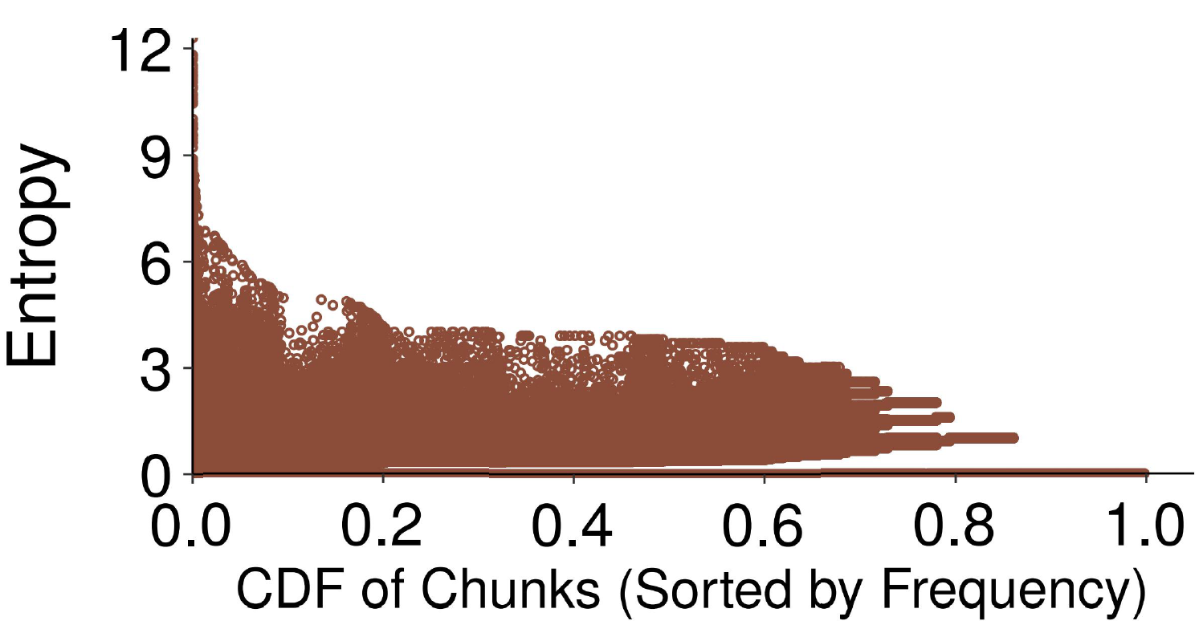
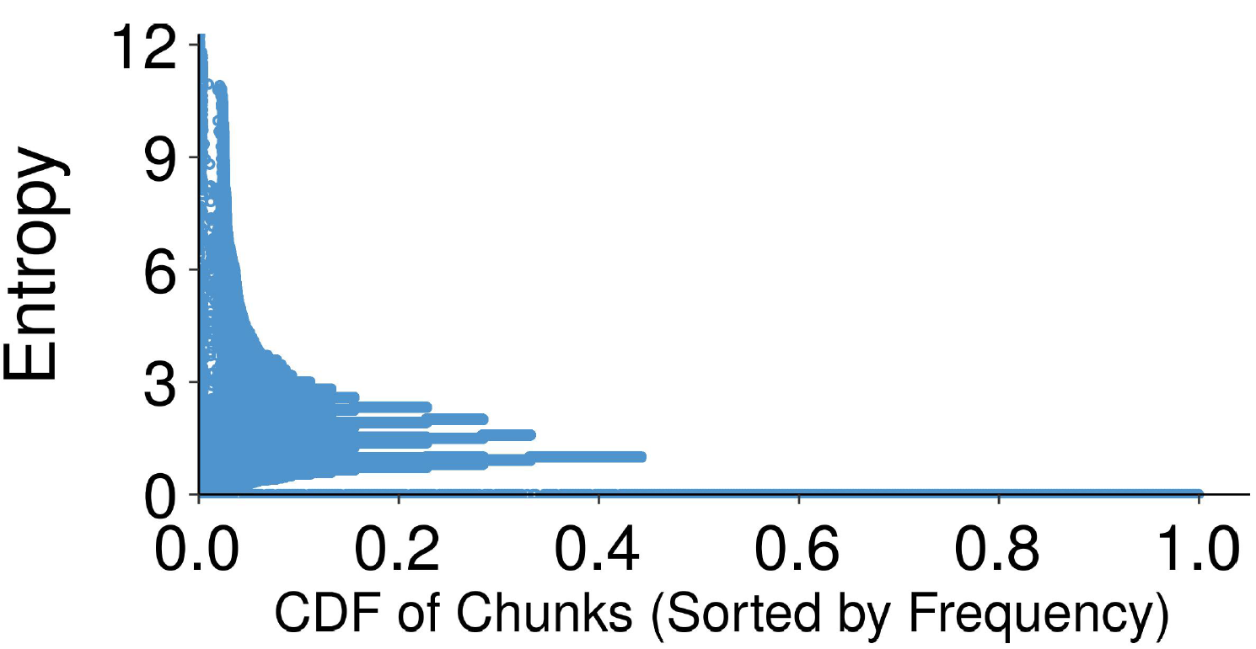
Trace-Driven Analysis
Compare the left/right entropy of each chunk
  The entropies of different frequent chunks vary, significantly
FSL Dataset
VM Dataset
Notes:
Infrequent chunks have a limited number of neighbors, and their entropies only have a few possible values

Slide 11
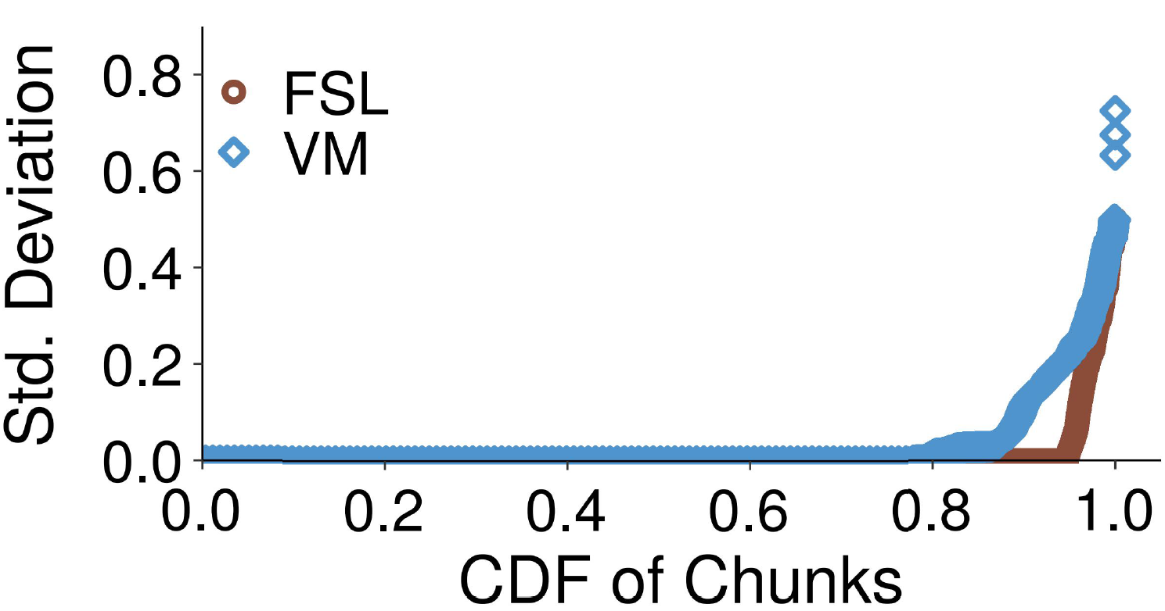
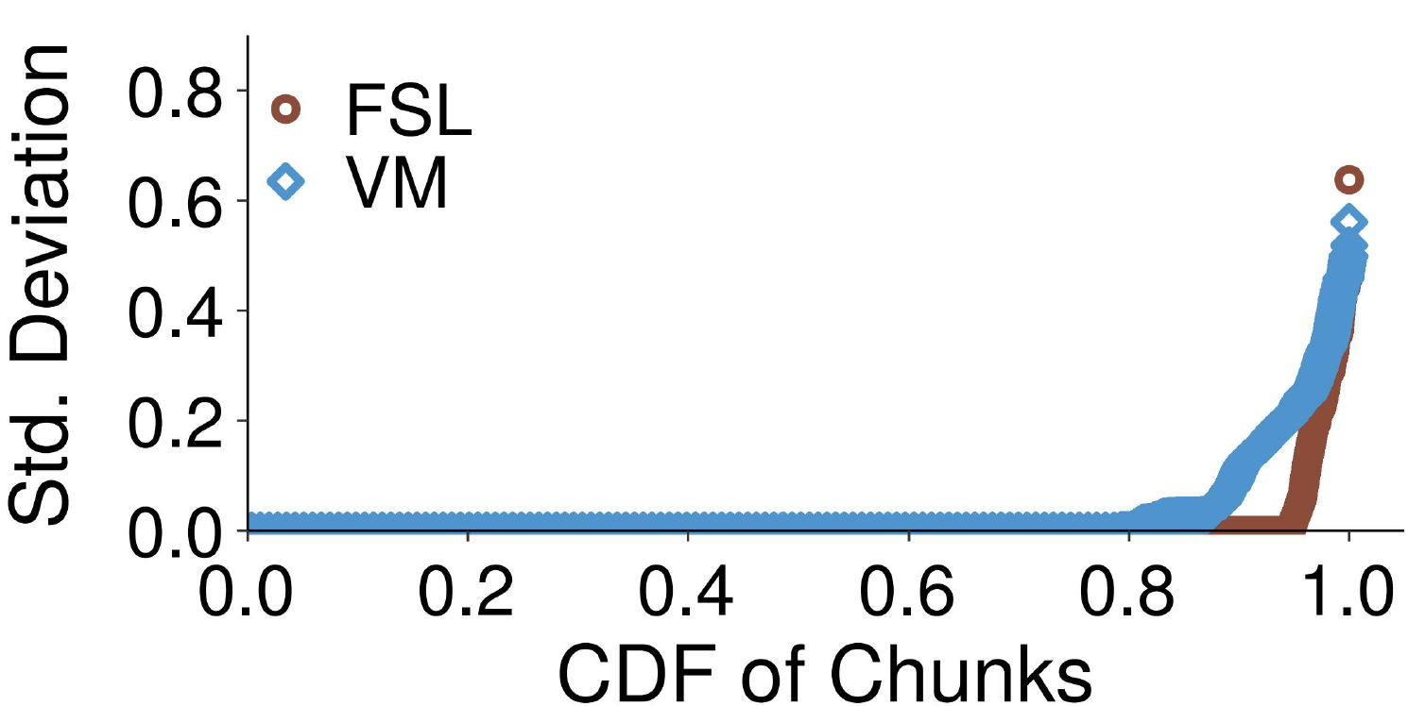
Trace-Driven Analysis (Cont’d)
Compare the left/right entropy of the same chunk across backups
  Characterize the variance of entropies by standard deviation
  A large fraction (e.g., 78.3-94.7%) of chunks have low standard deviation
Left Entropies
Right Entropies

Slide 12
Main Idea
Augment locality-based attack_{[Li, DSN’17]} by filtering out (possibly incorrect) inferred (C, M)
Our insight: if the relative frequency distribution of C differs from that of M, C and M are likely to correspond to distinct chunks
  Rationale: identical chunks have similar relative frequency distribution

Slide 13
Distribution-based Attack
Measure difference of relative frequency distributions based on Euclidean distance (ED) of left/right entropies of C and M
Key designs:
  Examine chunks within a range to address rank disturbance across backups
  Ensure ED of inferred (C, M) is smaller than a threshold
Frequency ranking
Frequency ranking
C⁽¹⁾
C⁽²⁾
C⁽³⁾
C⁽¹⁾
C⁽²⁾
C⁽³⁾
ED(C⁽¹⁾, M⁽¹⁾) <= Min(threshold, ED(C⁽¹⁾, M^{(*)})
ED(C⁽²⁾, M⁽³⁾) <= Min(threshold, ED(C⁽²⁾, M^{(*)})
ED(C⁽³⁾, M^{(*)}) > threshold
M⁽¹⁾
M⁽²⁾
M⁽³⁾
M⁽¹⁾
M⁽²⁾
M⁽³⁾
Freqanalysis_{[Li, DSN’17]}
This work

Slide 14
Distribution-based Attack (Cont’d)
Measure difference of relative frequency distributions based on Euclidean distance (ED) of left/right entropies of C and M
Key designs:
  Examine chunks within a range to address rank disturbance across backups
  Ensure ED of inferred (C, M) is smaller than a threshold
Frequency ranking
Replace
C⁽¹⁾
C⁽²⁾
C⁽³⁾
top frequent pairs
C
L_{C} = left chunks of C
L_{M} = left chunks of M
R_{C} = right chunks of C
R_{M} = right chunks of M
M⁽¹⁾
M⁽²⁾
M⁽³⁾
top frequent pairs
inferred pairs
G = {(C, M)}
(C, M)
This work
M
main loop

Slide 15
Experimental Datasets
FSL: Students’ home directory backups
  Publicly available at https://tracer.filesystems.org
  Deduplication ratio of totally 16 backups is 22.4×
VM: Virtual machine image snapshots of enrolled students of a programming course
  Collected by ourselves
  Deduplication ratio of totally 14 backups is 69.2×

Slide 16
Attack Severity (FSL)
Consider three instances:
  Distribution(0, infinity): locality-based attack_{[Li, DSN’17]}
  Distribution(12, infinity): examine chunks within a range of 12
  Distribution: further set threshold at 1
  Distribution significantly outperforms the other two instances
  More results: impact of parameters of Distribution
Introduce key design I
Introduce both key designs

Slide 17
Attack Damages on Files
  Distribution-based attack preserves high confidence on inferred ciphertext-plaintext chunk pairs
  More results: inference patterns of different files
Extension Name | Inference Rate | Inference Precision
.ppt | 78.9% | 88.7%
.doc | 58.6% | 85.4%
.c | 73.6% | 85.0%
.pdf | 70.3% | 89.1%
.tgz | 6.2% | 99.8%
.gz | 6.5% | 99.6%
Changes preserve duplicate chunks
Changes span across whole files

Slide 18
Conclusion
We extend chunk locality to relative frequency distribution
  Identical chunks have similar relative frequency distribution across backups
Distribution-based attack augments locality-based attack_{[Li, DSN’17]} with inference precision
  Filter incorrect inferred pairs by examining relative frequency distribution
  Prototype: http://adslab.cse.cuhk.edu.hk/software/freqanalysis/
Security alert: adversary not only infers a large fraction of ciphertext-plaintext pairs, but also has high confidence on the correctness of pairs

