Slide 1



Scaling Disk Failure Prediction via
Multi-Source Stream Mining
Shujie Han^{1,2}, Zirui Ou², Qun Huang², and Patrick P. C. Lee³
¹Northwestern Polytechnical University ²Peking University
³The Chinese University of Hong Kong
ICDM 2024
Notes:
Hi, I am Shujie Han from Northwestern Polytechnical University.
I am going to present the work “Scaling Disk Failure Prediction via Multi-Source Stream Mining”.
This is a joint work with folks from Peking University and the Chinese University of Hong Kong.

Slide 2
Background and Motivation
Proactive approaches predict prevalent and imminent disk failures
Conventional disk failure prediction (offline/online approaches)
  Aggregating data into a monitoring system as a whole collection
Attaining global view of data needs extensive hardware resources
  Loading all disk logs in one day requires ~6.98TB of RAM
Scaling disk failure prediction is vital for large-scale deployment
  Scalability of training: distributed ML / stream processing systems
Challenges in scalability of preprocessing before training?
Notes:
To tolerate prevalent disk failures, modern data centers tend to adopt proactive approaches by predicting imminent disk failures.
Conventional disk failure prediction approaches including offline learning and online learning consider the disk set as a whole collection and aggregate data into a monitoring system.
However, attaining a global view of data needs extensive hardware resources as more data is used.
For example, Azure deploys hundreds of millions of disks, where the status data of each disk is recorded hourly.
Each record is identified with more than 400 statistical attributes.
Given that the status data is represented as a 64-bit floating point value, we estimate that loading all disk logs in one day to obtain the global view would require around 6.98TB of RAM.
Thus, scaling disk failure prediction is essential for large-scale disk deployment.
Existing distributed ML systems and stream processing systems are adopted for scalability of data processing, especially in training.
However, there exist several challenges in the scalability of preprocessing before training.

Slide 3
Problem Formulation
Scaling disk failure prediction as multi-source stream mining
  A typical data center
    Multiple racks, each hosting several machines via top-of-rack switch
    Each machine equipped with multiple disks
  Regard each rack as data source
    Originating a data stream consisting of disk logs from disks attached to rack
Three phases
  Preprocessing: extracts disk logs to labeled sample (feature vector, label)
  Training and prediction
Notes:
Before presenting the challenges of scalability of preprocessing,
we first formulate scaling disk failure prediction as a multi-source stream mining problem.
We consider a typical data center composed of multiple racks,
each hosting several machines connected via a top-of-rack switch.
Each machine is equipped with multiple disks.
We regard each rack as a data source that generates a data stream
consisting of disk logs from disks attached to the rack.
We decompose the scaling disk failure prediction process into three phases,
Preprocessing, training, and prediction.
During preprocessing, we extract disk logs
into labeled samples including feature vectors and labels.
For training data, we convert the disk status to numerical values called labels,
while for prediction data, the disk status is unknown.

Slide 4
Challenges in Scalability of Preprocessing
(C1) Lack of integration between data collection and training
  Two types of data transfers
    Data collection from source locations → monitoring system for preparation
    Data allocation from monitoring system → external ML-based platforms for training
(C2) Data inflation in preprocessing
  Generating more statistical attributes
  Buffering a long period of historical data for online labeling
  Larger network overhead for training than preprocessing
Notes:
We next present the challenges in the scalability of preprocessing.
First, the lack of integration between data collection and training leads to two types of data transfers:
(i) data collection from source locations to a monitoring system for preparation and
(ii) Data collection from the monitoring system to external ML-based platforms for training.
The second challenge is data inflation in preprocessing by generating more statistical attributes
and buffering a long period of historical data for online labeling.
Such data inflation incurs larger network overhead of allocating the training data
than distributing original disk logs for preprocessing.

Slide 5
Challenges in Scalability of Preprocessing
(C3) Multiple-to-multiple data allocation
  Distribute training data from multiple sources to multiple base learners
  Absence of global data view and heterogeneity of data sources
  State-of-the-art incremental learning algorithms
    Single continuous data stream to base learners via Poisson sampling
  Open issues
    How to determine parameters of Poisson sampling for multiple data streams?
    How to adapt parameters of Poisson sampling over time for multiple data streams?
Notes:
The third challenge pertains to multiple-to-multiple data allocation, referring to distributing
the training data from multiple sources to multiple base learners.
The absence of a global data view and heterogeneity of data sources necessitate
careful decision-making regarding the allocation of sources to train specific base learners.
State-of-the-art incremental learning algorithms are designed
for allocating a single continuous data stream to base learners via Poisson sampling
However, the application of this allocation approach faces two open issues:
How to determine the parameters of Poisson sampling for multiple data streams?
How to adapt the parameters of Poisson sampling over time for multiple data streams?

Slide 6
Our Contributions
ScaleDFP, a general framework for scaling disk failure prediction
  Design goals
    Scalability, system throughput, and prediction accuracy
  Design techniques
    Near-data preprocessing, random downsampling, and training data allocation
  Complete prototype and open-sourced code
Evaluation of 6 datasets with up to 130 instances
  Scalability of preprocessing
  Significantly improve throughput of preprocessing and training
  Maintain prediction accuracy
Notes:
In this work, we propose ScaleDFP, a general framework for scaling disk failure prediction.
To address the above challenges, we have three design goals:
ScaleDFP should be scalable for disk failure prediction with the number of data streams.
ScaleDFP should be efficient for processing data, especially for preprocessing and training. It is expected to improve the throughput of preprocessing and training.
ScaleDFP is expected to provide prediction accuracy guarantees by properly allocating samples from multiple sources for training.
To achieve these goals, ScaleDFP leverages three techniques, which we will talk next.
We evaluate ScaleDFP with up to 130 instances on 6 datasets to show the effectiveness of ScaleDFP.

Slide 7
Design of ScaleDFP
Components
  Multiple data collectors
  A coordinator
  Multiple receivers
Key elements
  Near-data preprocessing (C1 addressed)
  Random downsampling (C2 addressed)
  Training data allocation (C3 addressed)
Notes:
ScaleDFP consists of three primary components: multiple data collectors, a coordinator, and receivers.
Initially, data collectors, each of which is a machine randomly selected within a rack, gather disk logs
from connected machines periodically, capitalizing on their substantial network bandwidth.
These data collectors conduct near-data preprocessing on continuous streams of disk logs.
To alleviate data inflation, ScaleDFP performs random downsampling on each data collector
to retain all positive samples and relevant negative samples.
It then allocates the training data from data collectors to base learners.

Slide 8
Design of ScaleDFP
Near-data preprocessing
  Straw-man solutions
    Deployment of data collection, preprocessing, and training
    Routing data to dedicated clusters → double data movements
    Routing raw data directly to a cluster for both preprocessing and training → resource contention
  Observation
    Data movement from data collection to distributed preprocessing is redundant
    Raw data is emitted from multiple sources and naturally distributed
    Preprocessing raw data of one data source is independent from others
Notes:
To tackle C1, we consider two straw-man solutions for the deployment of data collection, preprocessing, and training.
The first strategy involves routing the raw data to a dedicated preprocessing cluster.
After preprocessing, the preprocessed data is then transferred to a dedicated training cluster.
However, this approach results in double data movements.
To eliminate double data transfers, the second strategy opts to distribute the raw data directly to a cluster responsible
for both preprocessing and training.
Nevertheless, it introduces the potential for resource contentions.
We observe that data movement from data collection to distributed preprocessing is redundant.
As the raw data is emitted from multiple sources, it means that the raw data is naturally distributed.
Also, preprocessing the raw data of one data source is independent from others.

Slide 9
Design of ScaleDFP
Near-data preprocessing
  Once each data collector collects disk logs
  Execute preprocessing on each data collector locally
    Feature extraction
    Buffering samples into a dedicated local buffering window for online labeling
    Time-window downsampling
  Benefits
    Minimize data movements from data collection to preprocessing
    Alleviate resource contention
      Offload buffering tasks from centralized places to distributed data collectors
      Enabling parallel processing
Notes:
Based on our observation, we propose near-data preprocessing to
reduce data transfers in the preprocessing.
Once each data collector collects disk logs,
ScaleDFP executes the preprocessing on each data collector locally,
including feature extraction, buffering samples into a dedicated local buffering window for online labeling, and time-window downsampling.
Near-data preprocessing minimizes data movements
from data collection to preprocessing
as well as alleviates resource contention by
offloading the buffering tasks from centralized processing units to distributed data collectors, enabling parallel processing.

Slide 10
Design of ScaleDFP
Random downsampling
  Data imbalance issue
    Negative samples are dominant within buffering window
    Depends on L days of negative samples selected by time-window downsampling
  Straw-man solution
    Compression → inefficiency of decompression for multiple data streams (~small files)
  Observation
    Is such preprocessed data all needed for training?
    Actual ratio of negative samples to positive ones is reduced from 100:1 → 10:1^{[1]}
[1] S. Han, P. P. C. Lee, Z. Shen, C. He, Y. Liu, and T. Huang. StreamDFP: A general stream mining framework for adaptive disk failure prediction. IEEE Transactions on Computers, 72(02):520–534, 2023.
Notes:
When we look into the preprocessing workflow, buffering and time-window downsampling
increase the volume of preprocessed data.
As the negative samples are dominant within the buffering window,
the volume of preprocessed data depends on the L days of negative samples
selected by the time-window downsampling.
An intuitive approach is compression.
However, decompressing the preprocessed data from multiple data streams may resemble handling numerous small files,
potentially leading to inefficiencies when accessed with a single thread.
Is such preprocessed data all needed for training?
In the prior work, the actual ratio of negative samples to positive ones is reduced from 100:1 to around 10:1.

Slide 11
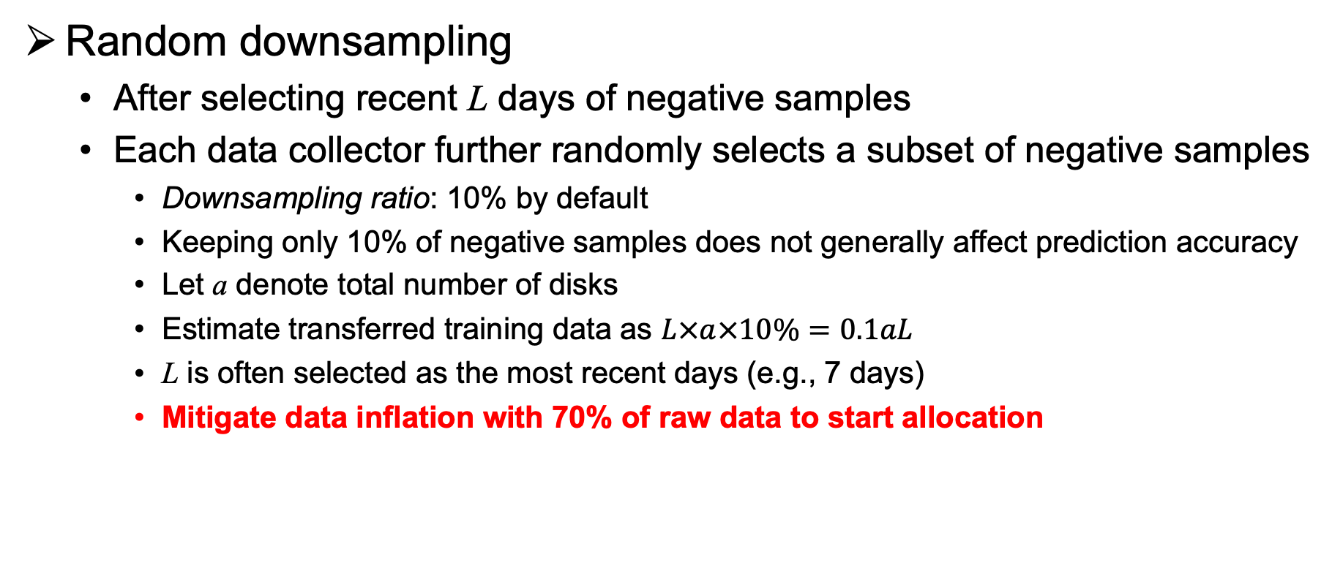
Design of ScaleDFP
Random downsampling
  After selecting recent L days of negative samples
  Each data collector further randomly selects a subset of negative samples
    Downsampling ratio: 10% by default
    Keeping only 10% of negative samples does not generally affect prediction accuracy
    Let a denote total number of disks
    Estimate transferred training data as $L×a×10\%=0.1aL$
    L is often selected as the most recent days (e.g., 7 days)
    Mitigate data inflation with 70% of raw data to start allocation
Notes:
It implies that the preprocessed data can be further downsampled.
ScaleDFP uses random downsampling to prevent the unused negative samples from transferring.
After selecting recent L days of negative samples,
each data collector further randomly selects a subset of negative samples,
called the downsampling ratio.
We evaluate the different percentages of keeping negative samples and
find that only 10% does not generally affect the prediction accuracy.
Let a denote the total number of disks.
As the negative samples are dominant after near-data preprocessing,
we estimate the transferred training data as 0.1aL.
As L is often selected as the most recent days (e.g., 7 days),
ScaleDFP mitigates data inflation with 70% of raw data to start allocation.

Slide 12
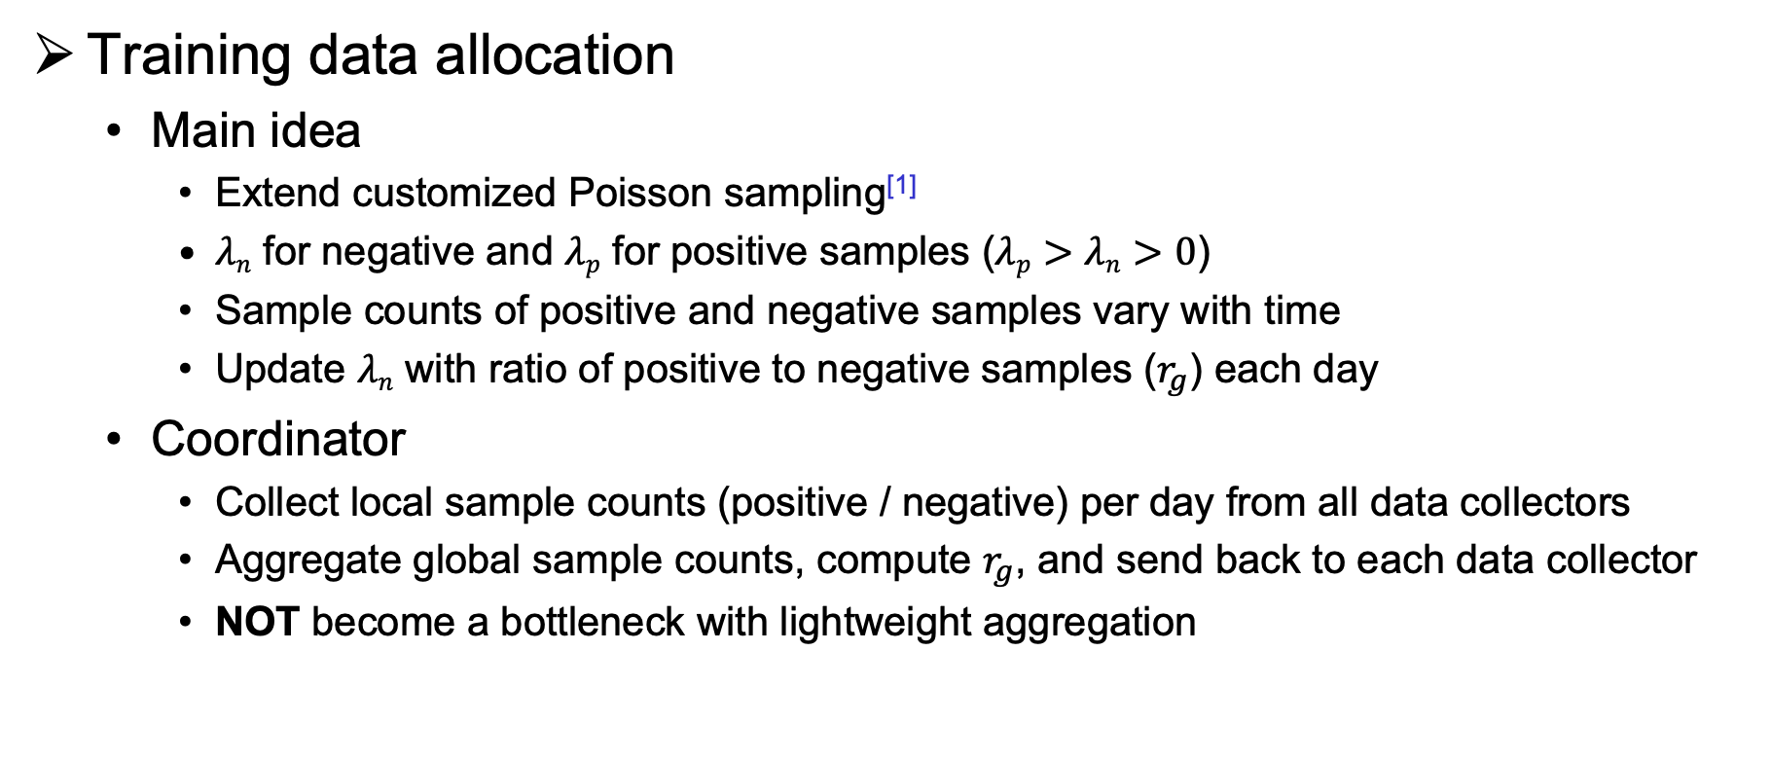
Design of ScaleDFP
Training data allocation
  Main idea
    Extend customized Poisson sampling^{[1]}
    $λn$ for negative and $λp$ for positive samples ($λp>λn>0$)
    Sample counts of positive and negative samples vary with time
    Update $λn$ with ratio of positive to negative samples ($r_{g}$) each day
  Coordinator
    Collect local sample counts (positive / negative) per day from all data collectors
    Aggregate global sample counts, compute $r_{g}$, and send back to each data collector
    NOT become a bottleneck with lightweight aggregation
[1] S. Han, P. P. C. Lee, Z. Shen, C. He, Y. Liu, and T. Huang. StreamDFP: A general stream mining framework for adaptive disk failure prediction. IEEE Transactions on Computers, 72(02):520–534, 2023.
Notes:
To address C3, we extend the customized Poisson sampling to support for multiple data sources,
which configures two hyper-parameters,$λn$ and $λp$, representing the Poisson distribution for negative and positive samples, respectively.
As the sample counts of positive and negative samples vary with time,
we update $λn$ with the ratio of number of positive samples to negative samples each day.
We introduce a coordinator in ScaleDFP which collects the local counts of positive and negative samples per day from all data collectors.
It aggregates the global count of positive and negative samples, computes $r_{g}$ and sends back to each data collector.
With the lightweight aggregation, the coordinator does not become a bottleneck.

Slide 13
Design of ScaleDFP
Training data allocation
  Optimization data transmission
    Each data collector sends only a subset of the matrix to each base learner
    Filter out samples with zero weight
Notes:
We optimize the data transmission in ScaleDFP by ensuring that
each base learner receives all positive samples and only relevant negative samples.
A sequence of weights across base learner is referred to as a weight vector
concatenated with the feature vector for each sample.
This figure shows that each data collector sends only a subset of the matrix to each base learner,
filters out the samples with zero weight, and transmits the remaining samples
along with their feature vectors and the corresponding weight column.

Slide 14
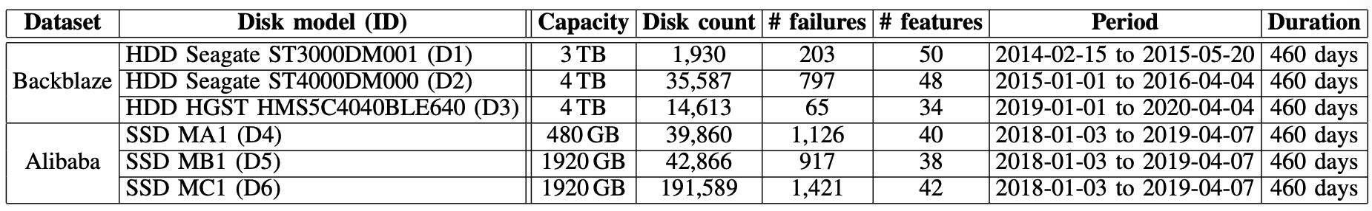
Evaluation
Methodology
  Metrics
    System performance: throughput of preprocessing and training
    Prediction accuracy: precision, recall, and F1-score
  Two decision-tree algorithms
    Bagging with adaptive sliding window (BA) and Adaptive Random Forests (ARF)
  Testbeds
    1) Local testbed with two servers; 2) 130 instances on Alibaba Cloud
  Datasets
Notes:
We conduct a trace-driven evaluation to evaluate the system performance and prediction accuracy of ScaleDFP.
For the system performance, we measure the throughput of preprocessing and training separately.
For the prediction accuracy, we consider three classical metrics including precision, recall, and F1-score.
We mainly consider two decision tree algorithms BA and ARF and will consider deep learning algorithms in our future work.
We evaluate ScaleDFP on a local testbed and Alibaba Cloud with six datasets.

Slide 15
Evaluation
System performance
  Exp#1 (Scalability of preprocessing)
    ScaleDFP scales to a large number of data collectors, achieving up to 41.6x throughput gain compared to StreamDFP
  Exp#2 (Impact of training data allocation)
    Throughput gains of ScaleDFP increase from 1.1x to 4.3x those without training data allocation
Notes:
Due to the time limit, we show partial results of evaluation.
We first evaluate the scalability of preprocessing and impact of training data allocation.
This figure shows that ScaleDFP scales to a large number of data collectors,
With increasing the number of data collectors, ScaleDFP achieves up to 41.6x throughput gain compared to StreamDFP.
Also, the throughput gains of ScaleDFP increase from 1.1x to 4.3x those without training data allocation.

Slide 16
Evaluation
System performance
  Exp#3 (Impact of random downsampling on training throughput)
    Training throughput benefits from random downsampling
    Throughput gains of up to 13.2x for BA and 8.4x for ARF, compared to disabling random downsampling
(a) BA
(b) ARF
Notes:
We also evaluate the impact of random downsampling on training throughput.
This figure shows that random downsampling improves the training throughput by up to 13.2x for BA and 8.4x for ARF compared to without random downsampling,
since random downsampling further reduces the number of negative samples by 90%.

Slide 17
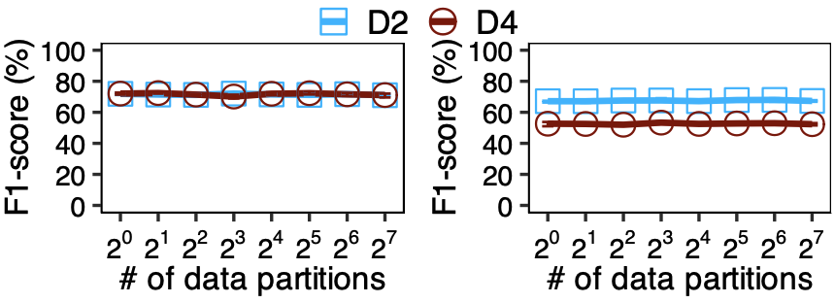
Evaluation
Prediction accuracy
  Exp#5 (Prediction accuracy of multiple data collectors)
    F1-score remains stable over number of data collectors
    Keeping F1-scores of multiple data collectors for BA and ARF close to that of one data collector
(a) BA
(b) ARF
Notes:
We also evaluate the prediction accuracy of multiple data collectors.
This figure shows that the F1-score remains stable over the number of data collectors.
ScaleDFP keeps the F1-scores of multiple data collectors for BA and ARF close to that of one data collector within 1% for both D2 and D4.

Slide 18
Conclusion
ScaleDFP
  Multi-source stream mining framework for scaling disk failure prediction
  Addresses scalability of preprocessing via
    Near-data preprocessing
    Random downsampling
    Training data allocation
  Achieves
    Preprocessing throughput gains of up to 41.6x
    Training throughput gains of up to 13.2x
    Comparable prediction accuracy compared to StreamDFP^{[1]}
https://github.com/shujiehan/ScaleDFP
[1] S. Han, P. P. C. Lee, Z. Shen, C. He, Y. Liu, and T. Huang. StreamDFP: A general stream mining framework for adaptive disk failure prediction. IEEE Transactions on Computers, 72(02):520–534, 2023.
Notes:
To conclude, we present ScaleDFP, a multi-source stream mining framework for scaling disk failure prediction.
It addresses the scalability of preprocessing before training via near-data preprocessing, random downsampling, and training data allocation.
It significantly improves the preprocessing and training throughput, while maintaining a comparable prediction accuracy compared to StreamDFP.
We open-source our project for further research.

Slide 19
Thank You!
Q & A
Notes:
Thank you. I’d like to take your questions and comments.

Slide 20
Background
Prevalent disk failures challenge reliability of modern data centers
  Proactive approaches → predict disk failures via machine learning (ML)
Conventional disk failure prediction
  Offline learning
    All data is available in advance
  Online learning
    A continuous data stream partially available
  Both offline and online learning consider disks as a whole collection
  Aggregating data into a monitoring system
    Easy to obtain global view of data to identify failure patterns
Notes:
Prevalent disk failures challenge the reliability of modern data centers.
To tolerate disk failures, modern data centers tend to adopt proactive approaches
by predicting imminent disk failures via machine learning algorithms.
Conventional disk failure prediction approaches include two categories, offline learning and online learning.
Offline learning approaches assume that all data is available in advance,
while online learning approaches regard data as a continuous data stream with partial availability.
By aggregating data into a monitoring system, both offline and online learning approaches
consider the disk set as a whole collection. This simplifies the process of obtaining the global view of data to identify failure patterns for high accuracy.

Slide 21
Our Contributions
Goals
  Scalability
    Scalable for disk failure prediction with number of data streams
  System throughput
    Efficient for processing data, especially for preprocessing and training
    Improve throughput of preprocessing and training
  Prediction accuracy
    Provide prediction accuracy guarantees
    Properly allocating samples from multiple sources for training
Notes:
We next present the design of ScaleDFP.
To address the above challenges, our design goals are as follows:
Scalability. ScaleDFP should be scalable for disk failure prediction with the number of data streams.
System throughput. ScaleDFP should be efficient for processing data, especially for preprocessing and training. It is expected to improve the throughput of preprocessing and training.
Prediction accuracy. ScaleDFP is expected to provide prediction accuracy guarantees by properly allocating samples from multiple sources for training.

Slide 22
Motivation
Attaining global view of data needs extensive hardware resources
  E.g., Azure deploys hundreds of millions of disks and collects data hourly^{[1]}
  400+ statistical attributes for each record stored in 64-bit floating point
  Loading all disk logs in one day requires ~6.98TB of RAM
Scaling disk failure prediction is vital for large-scale deployment
  Scalability of training: distributed ML / stream processing systems
Challenges in scalability of preprocessing before training?
[1] Y. Xu, K. Sui, R. Yao, H. Zhang, Q. Lin, Y. Dang, P. Li, K. Jiang, W. Zhang, J.-G. Lou, et al. Improving service availability of cloud systems by predicting disk error. In Proc. of USENIX ATC, 2018.
Notes:
However, attaining a global view of data needs extensive hardware resources as more data is used.
For example, Azure deploys hundreds of millions of disks,
where the status data of each disk is recorded hourly.
Each record is identified with more than 400 statistical attributes.
Given that the status data is represented as a 64-bit floating point value,
Loading all disk logs in one day to obtain the global view would require around 6.98TB of RAM.
Thus, scaling disk failure prediction is essential for large-scale disk deployment.
Existing distributed ML systems and stream processing systems
are adopted for scalability of data processing, especially in training.
However, there exist several challenges
in the scalability of preprocessing before training.

Slide 23
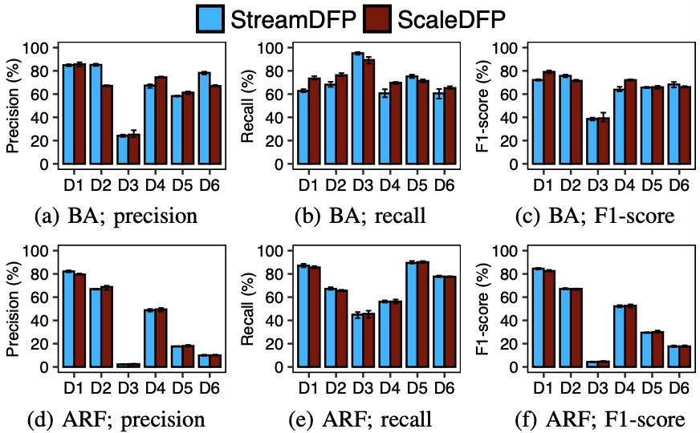
Evaluation
Prediction accuracy
  Exp#4 (Justification of prediction accuracy)

