Slide 1
Enhancing LSM-tree Key-Value Stores for Read-Modify-Writes via Key-Delta Separation
Jinhong Li, Yanjing Ren, Shujie Han, Patrick P. C. Lee
The Chinese University of Hong Kong (CUHK)
Notes:
ICDE 2024, time: about 15 minutes

Slide 2
Key-Value Stores
Organizes data in key-value (KV) pairs
put() inserts a KV pair to the store
get() retrieves a KV pair from the store
An example of an LSM-tree KV store on the SSD
Arrange KV pairs in multiple levels
Immutable
MemTable
Mutable
MemTable
Block
cache
Memory
Flush
logging
SSD
KV pairs
WAL
…
cache
L₀
L₁
…
Compact
SSTable
…
L_{n}
…
Notes:
A typical key-value store arranges data in key-value pairs. It has two interfaces. The put interface inserts a KV pair to the store so that it writes a new KV pair or overwrites an existing KV pair. The get interface retrieves a KV pair from the KV store.
A log-structured-merge tree, or an LSM-tree, is one of the data arrangement schemes for KV pairs.
It arranges the KV pairs in multiple levels. Each level contains files with KV pairs sorted by the keys. Each file is called an SSTable.
To write new KV pairs, the KV pair will go through the in-memory components called the MemTables. When the MemTables are full, they will be flushed to the lowest level of the LSM-tree, called level 0 or L0. When a level size exceeds a limit, the LSM-tree will perform an operation called the compaction, to put the KV pairs to the higher levels.
To read existing KV pairs, the LSM-tree KV store goes through the MemTables, and searches SSTables from the lowest level to the highest level. It will also check an in-memory block cache to find recently accessed KV pairs.

Slide 3
Updates in KV Stores
Data updates
Blind updates: Directly overwrite the old KV pair with put()
Read-Modify-Writes (RMWs): Update the value based on the old value
RMWs are common in key-value stores
92.5% of all requests are RMWs in AI/ML services in RocksDB production ^{[1]}
More than 90% of transaction requests are RMWs in the transactional database benchmarks ^{[2]}
50% of requests are RMWs in Workload F in YCSB benchmarks ^{[3]}
Also common in real-time data processing and social graph databases
^{[1]} Characterizing, modeling, and benchmarking RocksDB key-value workloads at facebook. In Proc. of USENIX FAST 2020.
^{[2]} TPC-C. http://www.tpc.org/tpcc/.
^{[3]} Benchmarking cloud serving systems with YCSB. In Proc. of ACM SoCC 2010.
Notes:
Update-intensive workloads are widely observed in KV stores, in which there are two classes of data updates. The first one belongs to the blind updates which directly overwrite the old KV pair. The new KV pair does not depend on the old KV pair, so it can be done with a simple put() interface. The second class is called read-modify-writes, in which the new KV pair depend on the old KV pair.
In this work, we focus on read modify writes. RMW-intensive workloads are common in key-value stores. For example, 92.5% … More than 90% of the transaction requests are … In benchmarks, 50% of requests are RMWs in Workl…

Slide 4
RMW Approach 1: Get-Put
Get-Put approach: Read a KV pair first with get(), modify the KV pair, and write the KV pair with put()
Limitation:
RMW operations are slow because they repeatedly read the old value
modify
(key, old value)
(key, new value)
(key, new value)
get()
put()
get()
Too slow!
RMW
Read after RMWs
Notes:
To implement RMWs, there are two approaches. The first one is called the Get-Put approach, which is based on a pair of get() and put() operations. It reads … modifies … and writes …
After RMWs, the user can directly read the new value from the KV store.
However, the limitation of the get-put approach is that the get() interface in KV stores are very expensive, because it needs to go through every level in the LSM-tree to get the latest version of the KV pair.

Slide 5
RMW Approach 2: Merge
Merge approach: Write a key-delta (KD) pair
The delta is the change of the value.
Written with support of new interfaces, e.g., merge() in RocksDB
Limitation:
Merge needs to search for the value and all deltas of a key
(key, new value)
(key, delta)
merge()
(key, old value), (key, delta1), …
get()
Too slow!
RMW
Read after RMWs
Notes:
Therefore, some key-value stores use another approach of RMW, called the Merge approach.
The merge approach writes a key-delta pair to the key-value store. Here, the delta identifies how to change the value from an old version to a new version.
The key-delta pair needs the support of new interfaces. For example, a widely used key-value store RocksDB uses the merge interfaces to write a key-delta pair.
However, the Merge approach also has the limitation. Although it can write a key-delta pair very quickly, after rmws, if the user wants to read the value, it has to retrieve a large chain of key-delta pairs from multiple level of the LSM-tree, and the read will be very slow.

Slide 6
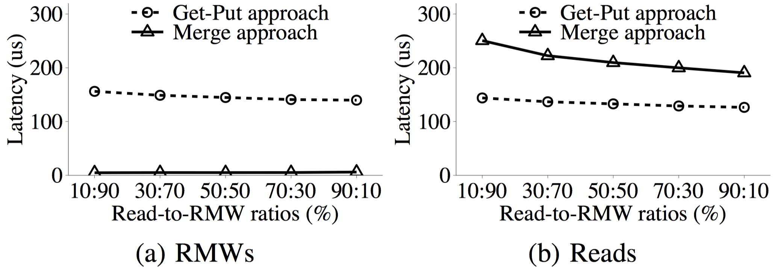
Comparing Get-Put with Merge
Numbers:
Merge signiﬁcantly reduces the RMW latencies of Get-Put by 95.7-96.9%
However, Merge also increases the read latencies of Get-Put by 50.8-74.1%
Problem: How can we reduce the read latencies of Merge?
Notes:
Here we show an example of numbers to compare two RMW approaches. We implement the workload mixed with RMWs and reads, and implement the RMWs with both the Get-Put approach and the Merge approach.
We find that although the merge approach can reduces the RMW latencies significantly, Merge also increases the read latencies by higher than 50%.
Therefore, the problem is how can we reduce the read latencies of Merge in RMW-intensive workloads

Slide 7
Key-Value Separation
KV separation reduces both read and write latencies for KV pairs
Main idea: It keeps keys and metadata in the LSM-tree for indexing, while storing keys and values in a circular value log (vlog).
Limitation:
KV separation cannot simply reduce the overhead introduced by RMWs.
The reason is that the KD pairs are still stored in the LSM-tree.
key
metadata (location, value size)
key, value
LSM-tree
value log
Notes:
A scheme called the key-value separation aims to reduce both read and write amplifications for key-value pairs. Its main idea is to keep keys and metadata in the LSM-tree for indexing, while storing keys and values in a circular log. However, it still cannot solve the problem of RMW-intensive workloads. The reason is that the key-delta pairs are still stored in the LSM-tree, and the user still has to go through multiple levels to retrieve all the deltas.

Slide 8
Contribution
We design KDSep, a middleware layer that integrates key-delta (KD) separation into existing LSM-tree KV stores to efficiently handle RMW-intensive workloads
Main idea: Separate KD pairs from the LSM-tree and store KD pairs into buckets
Bucket-based delta placement
Delta-based garbage collection
Crash recovery
Implementation and evaluation on the KDSep prototype
Notes:
To solve the problem, our contribution is that we design KDSep, a middleware layer that integrates key-delta separation into existing LSM-tree KV stores. Its main idea is to … with three schemes.
Finally, we implement the KDSep prototype and perform thorough evaluation on the prototype.

Slide 9
KDSep Overview
The complete architecture of KDSep
key, meta of values
KD anchor
Write buffer
KD cache
Skip list
Block cache
KD anchor
Bucket table
MemTables
KV
index
Memory
SSD
SSTables
…
Commit log
 |  | …
Manifest file
LSM-tree (key, meta of values)
vLog (values)
Delta store (KD pairs, anchors)
Bucket
Notes:
This is the complete architecture of KDSep. The colored components are added based on the KDSep design.

Slide 10
Bucket-based Delta Placement
An existing KV store with KV separation
KD pairs key, meta of values
Write buffer
Block cache
MemTables
KV
Memory
SSD
SSTables
…
LSM-tree (key, meta of values)
vLog (values)
Notes:
To elaborate our design, we start from an existing KV store and introduce how we introduce our techniques one by one.
The starting point is a key-value store that applies KV separation. It puts the values in the value log and puts the key-delta pairs in the LSM-tree.

Slide 11
Bucket-based Delta Placement
An existing KV store with KV separation
Added: The bucket table, skip list, and delta store
key, meta of values
Write buffer
Skip list
Block cache
KD
Bucket table
MemTables
KV
index
Memory
SSD
SSTables
…
 |  | …
LSM-tree (key, meta of values)
vLog (values)
Delta store (KD pairs)
Notes:
Then we add our first design technique called the bucket-based delta placement.
We add two in-memory components, the bucket table and the skip list, and one on-SSD component, the delta store. The delta store is to save the KD pairs on the SSD, and the skip list is used to index the buckets in the delta store.

Slide 12
Bucket-based Delta Placement
The delta store is separated in multiple on-SSD buckets referenced by an in-memory skip list.
0
80
120
Skip list
60
110
40
70
90
…
Delta store
Bucket | Bucket | Bucket | Bucket | Bucket | Bucket | Bucket | …
Key range:
[0, 40)
[40, 60)
[70, 80)
[80, 90)
[110, 120)
[60, 70)
[90, 110)
Notes:
The delta store is separated into multiple buckets. The buckets are referenced by an in-memory skip list. Here we use a skip list to make sure that we index the buckets in a sorted manner so that it can also support range queries. Each bucket is mapped to a specific key range. To write or read a key-delta pair, the delta store will search the skip list to find the bucket first, and then write or read the key-delta pair in the corresponding bucket.

Slide 13
Bucket-based Delta Placement
A bucket is divided into a sorted part and an unsorted part
Sorted part: For efficient reads that can be finished with a binary search
Unsorted part: For efficient append-only writes
Index
Bloom filters
Buffer
Bucket table
Memory
SSD
…
KD pair
KD pair
…
…
KD pair
KD pair
…
Sorted part
Unsorted part
Delta store
Bucket | Bucket | Bucket | Bucket | Bucket | Bucket | Bucket | …
Notes:
Then we dig into the details of one single bucket. A bucket is divided into a sorted part and an unsorted part. The reason is that it can support both efficient reads and writes.
The sorted part maintains the key-delta pairs in a sorted manner, in order to support efficient reads that can be finished with a binary search.
The unsorted part is designed for efficient append-only write. Although the keys are not sorted, the new key-delta pairs can be directly appended to the end of the bucket.
To support the reads and writes, we have a bucket table. The index of the bucket table supports binary search in the sorted part. The bloom fitlers are used to reduce reads if the key-delta pair is not in the sorted part or the unsorted part. The buffer is used to aggregate the small writes so that the writes can be done in 4KiB.

Slide 14
Bucket-based Delta Placement
KD cache: for fast access to frequently accessed KD pairs
key, meta of values
KD
Write buffer
KD cache
Skip list
Block cache
KD
Bucket table
MemTables
KV
index
Memory
SSD
SSTables
…
 |  | …
LSM-tree (key, meta of values)
vLog (values)
Delta store (KD pairs)
Notes:
In addition of these three components, we also has a KD cache for fast access to …

Slide 15
Delta-based Garbage Collection
Goal of garbage collection on the delta store:
Reclaim storage space
Sort KD pairs according to the key
Control the number and sizes of buckets
An anchor:
A special data record that act as a tombstone of previous KD pairs
Written by put(), i.e., blind updates
…
…
…
(K₁, D₂)
Anchor K₁
(K₁, D₃)
(K₁, D₄)
…
Sorted part
Unsorted part
Sort remaining KD pairs into the sorted part
Notes:
Our second technique of KDSep is called the delta-based garbage collection. The goal of the garbage collection has three aspects. …
To identify the invalid KD pairs, KDSep introduces a special data record called an anchor. The anchor acts as a tombstone of previous KD pairs. It will only be written by put(). It represents a blind update that cleans all the old KD pairs.

Slide 16
Delta-based Garbage Collection
Anchors:
Written to the bucket table, KD cache, and delta store
key, meta of values
KD anchor
Write buffer
KD cache
Skip list
Block cache
KD anchor
Bucket table
MemTables
KV
index
Memory
SSD
SSTables
…
 |  | …
LSM-tree (key, meta of values)
vLog (values)
Delta store (KD pairs, anchors)
Notes:
To support the delta-based garbage collection, we add anchors to the figure of the architecture, which are applied to the bucket table, KD cache, and the delta store.

Slide 17
Delta-based Garbage Collection
Example: Simple steps of garbage collection
…
…
…
(K₁, D₂)
Anchor K₁
(K₁, D₃)
(K₁, D₄)
…
Sorted part
Unsorted part
Sort remaining KD pairs into the sorted part
…
(K₁, D₃+D₄)
…
Sorted part
(Unsorted part is empty)
Notes:
With the anchors, KDSep can perform garbage collection. These are the simple steps of garbage collection.
First, it finds the anchors and identify the keys in the anchor. Then it removes all the key-delta pairs that appears before the anchor, and the anchor itself.
Second, it sorts the remaining KD pairs of both the sorted part and the unsorted part.
Finally, it merges the key-delta pairs that have the same key, and rewrite the KD pairs in an ordered manner to the sorted part of a new bucket. Now the unsorted part is empty.

Slide 18
Crash Recovery
Added:
Commit log and manifest file
key, meta of values
KD anchor
Write buffer
KD cache
Skip list
Block cache
KD anchor
Bucket table
MemTables
KV
index
Memory
SSD
SSTables
…
Commit log
 |  | …
Manifest file
LSM-tree (key, meta of values)
vLog (values)
Delta store (KD pairs, anchors)
Bucket
Notes:
Finally, we briefly introduce the third technique of KDSep for crash recovery.
We add the commit log and the manifest file to the architecture of KDSep.

Slide 19
Crash Recovery
Crash recovery for writes
Attach sequence numbers for each KD pair and anchor
Introduce a commit log to keep KD pairs and anchors (similar to a WAL)
Crash recovery for GC
Introduce a manifest file to record the keys and bucket offsets in the skip list
Notes:
The crash recovery can be divided into two parts.
First, we need to maintain the crash consistency for writes. We attach sequence numbers of each KD pair and anchor, so it can identify the global order of the appearance of the KD pairs and anchors. Then we introduce a commit log to keep the KD pairs and anchors before writing them to the delta store, so during the recovery, KDSep can replay the commit log to find the KD pairs and anchors.
Second, we need to maintain the crash consistency for garbage collection. The key is to maintain the information of the skip list to the SSD. To this end, we introduce a manifest file to record the keys and bucket offsets in the skip list. So after crashes, the system can replay the manifest file to find all the buckets.

Slide 20
Implementation
LSM-tree: RocksDB v7.7.3
Two KV separation implementations:
BlobDB: integrated in RocksDB
vLog: Adopt the implementation from HashKV ^{[4]}
Implemented in C++ on Linux with 14.4 KLOC
^{[4]} HashKV: Enabling efﬁcient updates in KV storage via hashing. In Proc. of USENIX ATC 2018.
Notes:
For implementation, we implement the KDSep prototype as a middleware. We use RocksDB as the LSM-tree and further support two key-value separation techniques, including BlobDB and vLog. Our prototype includes 14.4 thousands lines of code in C++.

Slide 21
Evaluation Results
Exp#1: Custom synthetic (RMW-intensive) workloads
RMWs issued by merge()
Increases throughput by 67.0-80.5%
Reduces average and 99p read latencies by 41.9-49.9% and 36.5-48.2%
Maintain low RMW latencies
Notes:
We introduce results of two experiments. In the first experiments, we synthesize a custom RMW-intensive workload that has 90% of RMWs and 10% of reads. The RMWs are issued by the merge() interfaces. We use three baselines, called RocksDB, BLobDB, and vLogDB. After applying KDSep, the throughput increases by 67% to 80.5%. KDSep also reduces the average and 99th read latencies by more than 41.9% and more than 36.5%, respectively, which is the main reason of the improved throughput. We also find that KDSep maintains low RMW latencies.

Slide 22
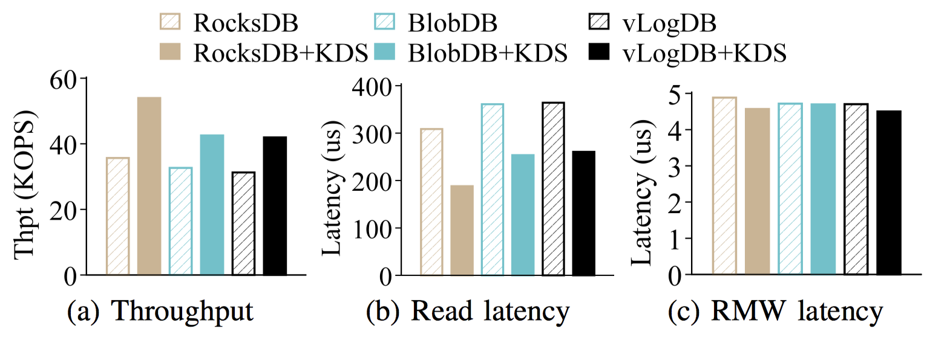
Evaluation Results
Exp#2: UP2X workloads
We synthesize the AI/ML workloads with statistics in UP2X workloads ^{[1]}
KDSep improves the throughput by 30.3-51.3%
^{[1]} Characterizing, modeling, and benchmarking RocksDB key-value workloads at facebook. In Proc. of USENIX FAST 2020.
Notes:
The second experiment synthesizes the UP2X workloads, which is a RMW-intensive workload of AI/ML services in the RocksDB production in Facebook. In such a realistic workload, KDSep improves the throughput by 30.3-51.3%.
There are more experiments in my paper. If you are interested, please read the paper for more details.

Slide 23
Conclusion
KDSep: Separate KD pairs from the LSM-tree and store KD pairs into buckets
Bucket-based delta placement
Delta-based garbage collection
Crash recovery
Source code: https://github.com/adslabcuhk/kdsep
Notes:
To conclude this work, we propose key-delta separation, and design KDSep. The main idea is to separate KD pairs from the LSM-tree and store the KD pairs into buckets with three main techniques. Our source code has been release in this link.

Slide 24
Thank You! Q & A
Notes:
Thanks for your watching. If you have any questions, please feel free to ask.

