Slide 1
SGX-Enabled Encrypted Cross-Cloud Data Synchornization
Jia Zhao¹, Yanjing Ren¹, Jingwei Li², and Patrick P. C. Lee¹
¹ The Chinese University of Hong Kong,
² University of Electronic Science and Technology of China
ICDCS 2025
Notes:
Good morning, everyone. My name is Zhao Jia, and today I'll be presenting SeedSync, a system for SGX-Enabled Encrypted Cross-Cloud Data Synchronization. This work was a collaboration between The Chinese University of Hong Kong and the University of Electronic Science and Technology of China.
In our increasingly data-driven world, managing data across multiple clouds is common, but doing so securely and efficiently is a major challenge. SeedSync is our solution to this problem.

Slide 2




Introduction
Multicloud Storage
  Use of cloud services delivered by more than one vendor (e.g., Microsoft OneDrive, Alibaba Cloud Drive, Google Drive, etc)
  Geographic accessibility, resilience, vendor lock-in avoidance
MultiCloud
Storage
Notes:
Let's start with the context: multicloud storage. Many businesses and individuals now use services from multiple vendors like Microsoft OneDrive, Google Drive, and Dropbox.
The reasons are clear: it improves accessibility across different geographic regions, enhances resilience against service outages, and helps avoid being locked into a single provider.
However, this multicloud strategy introduces complexity, especially when we need to manage the data efficiently and keep the data secure across all these platforms.

Slide 3
Cross-Cloud Data Synchronization
Cross-cloud data synchronization service offloads the burden of manually outsourcing and managing data in multiple clouds
Efficiency issues
  High cost: Network traffic between clouds is expensive
  Slow speeds: limited internet bandwidth slows down synchronization
Security risks
  Data leakage
  Data tampering
How can we synchronize data efficiently and securely?
Notes:
This is where cross-cloud data synchronization comes in. These services automate the process of managing and updating data across multiple clouds. But they face two critical issues.
First, efficiency. Transferring data between clouds can be very expensive, and synchronization speed is often bottlenecked by internet bandwidth. We need to minimize the amount of data we transfer.
Second, and more importantly, security. Using multiple clouds increases the attack surface. We have to be concerned about data leakage, where sensitive information is exposed, and data tampering, where our files are maliciously modified. So the core question we're tackling is: How can we synchronize data both efficiently and securely?

Slide 4
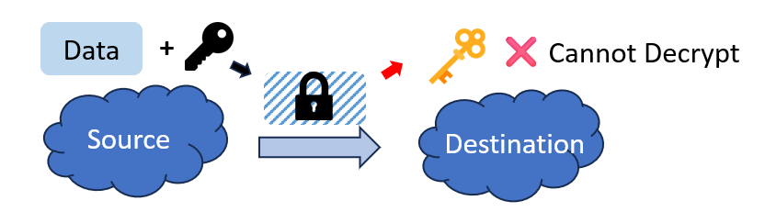
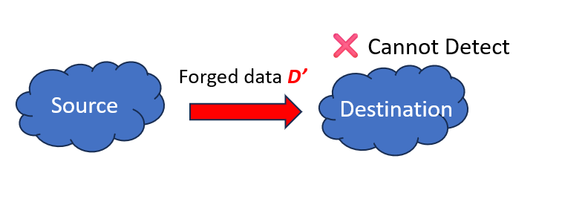
How to Manage Security Across Clouds
Encryption Mismatch
  Clouds use different keys/schemes
  → sync requires decryption/sharing
  keys
Integrity Blind Spots
  Tampered data propagates
  No cross-cloud verification
Notes:
Let's look at the security challenges more closely.
First, we have the Encryption Mismatch problem. Each cloud service uses its own encryption schemes and keys. If the source cloud encrypts data with its key, the destination cloud can't decrypt it. The naive solution of sharing keys between clouds is a major security risk.
Second, there are Integrity Blind Spots. If the data is compromised in the source cloud, the tampered data can be synchronized to the destination. Without a reliable, independent way to verify the data's integrity, the destination cloud would unknowingly accept the forged data, and this corruption would propagate across all your storage.

Slide 5
How to Achieve Network Reduction
Plaintext approaches make efforts to reduce network traffic
  Remove chunk-level redundancy (via deduplication)
  Remove delta-level redundancy (via delta compression)
Approach | Security | Network Traffic Reduction
Rsync [open-sourced tool] | ❌ No encryption ❌ No integrity protection | ❌ Chunk-level only
Plain [Shilane, FAST’12] | ❌ No encryption ❌ No integrity protection | ✅ Delta + chunk-level
Notes:
Now, let's talk about efficiency.
Plaintext synchronization tools have made great strides in reducing network traffic. Approaches like Rsync use chunk-level deduplication to avoid re-sending identical blocks of data. More advanced systems, like the one proposed by Shilane at FAST '12, go even further with delta compression, which only sends the byte-level differences between similar, but not identical, chunks.
However, as you can see in the table, these approaches offer no encryption or integrity protection. They work on plaintext data only.

Slide 6
The Dilemma: Security and Network Efficiency
Encryption Disrupts Redundancy
  Encryption's diffusion property destroys the content redundancy → Hard to detect changes
Unacceptable Trade-off
  Approaches that weaken cryptographic guarantees are not acceptable
Approach | Security | Network Traffic Reduction
Rsyncrypto [open-sourced tool] | ⚠️ Key/IV reuse risks ❌ No integrity protection | ❌ Chunk-level only
FeatureSync [Wu, ICDCS’21] | ⚠️ Key/IV reuse risks ❌ No integrity protection | ❌ Chunk-level only
Notes:
This brings us to the central dilemma.
Encryption, by its very nature, scrambles data and destroys the redundancy that network reduction techniques rely on. This makes it very difficult to detect changes between two encrypted files.
Some existing approaches, like Rsyncrypto and FeatureSync, have tried to solve this. However, they make a dangerous trade-off. To preserve redundancy, they reuse encryption keys and IVs, which opens them up to serious attacks, like dictionary attack. This trade-off between security and efficiency is unacceptable.
Furthermore, they don't provide any integrity protection and are limited to only chunk-level traffic reduction.

Slide 7
Contributions
SeedSync is a system designed to achieve secure and efficient cross-cloud data synchronization
  Explore data sync with shielded execution (via Intel SGX)
Experiments show that SeedSync achieves high performance,and reduces more network traffic
  Up to 8.2x higher throughput, and 5.4x network traffic reduction than Rsyncrypto
Approach | Security | Network Traffic Reduction
SeedSync | ✅Encryption (different keys/IVs) ✅Integrity protection | ✅ Delta + chunk-level
Notes:
This is where SeedSync comes in. Our system is designed from the ground up to provide both strong security and high efficiency, without compromise.
As you can see in the table, SeedSync provides robust encryption using different keys and IVs for each cloud, and it includes end-to-end integrity protection. At the same time, it achieves both chunk-level and fine-grained delta-level network traffic reduction.
We achieve this by exploring data synchronization within a shielded execution environment, specifically Intel SGX. Our evaluation shows that SeedSync achieves up to 8.2 times higher throughput and a 5.4 times greater network traffic reduction compared to existing encrypted approaches like Rsyncrypto.

Slide 8
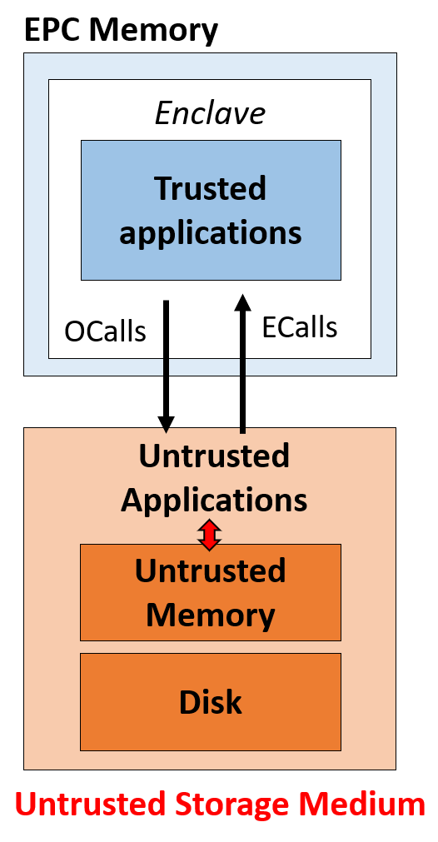
Intel SGX Basics
Enclave, the isolated execution environment that resides within a protected memory region (EPC), realized by Intel SGX
  OCalls and ECalls to interact with untrusted applications
Architectual limitations of SGX
  Untrusted storage medium except enclave
  ECalls and OCalls lead to context-switching overhead
Notes:
The core technology enabling SeedSync is Intel SGX. It allows us to create a secure, isolated execution environment called an enclave. Code and data inside the enclave are protected in encrypted memory, isolated even from the host operating system.
Interaction with the outside, untrusted application happens through controlled interfaces called ECalls and OCalls.
However, SGX has limitations. Any data stored outside the enclave is untrusted, and the context switching for ECalls and OCalls introduces significant performance overhead.

Slide 9
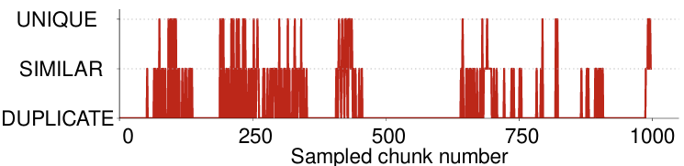
Design Considerations
Offload encryption, and integrity management to SGX enclave
  Resolve key mismatch between clouds
  Simplify users’ management
Perform network reduction within SGX enclave
  Trace analysis: similar chunks are common, while locality pattern is obvious
  Data characteristics→ fine-grained redundancy reduction
  → load correlated data/metadata in enclave to reduce content switching
Notes:
Our design is built on three key ideas.
First, we offload all security-critical operations—like encryption, decryption, and integrity management—into the SGX enclave. This solves the key mismatch problem and simplifies management.
Second, we perform network traffic reduction inside the enclave. By decrypting the data within this secure boundary, we can operate on the plaintext and effectively detect redundancy.
To address the performance overhead of SGX, we analyzed real-world synchronization workloads. As this graph shows, we found that unchanged chunks often appear in contiguous blocks, and modified chunks show strong locality. This insight allows us to pre-fetch related data into the enclave, reducing expensive context switches.

Slide 10
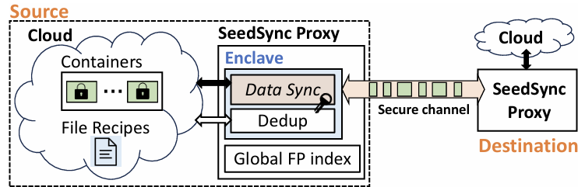
Architecture
SeedSync hosts a proxy near each cloud
Components
  Data storage: data is stored in an encrypted and deduplicated format
    SeedSync integrate with DEBE [Yang, ATC’22]
  SeedSync proxy: perform secure and efficient data sync within enclave
  Secure channel: established between enclaves
Notes:
Here is the high-level architecture of SeedSync. We deploy a SeedSync proxy, which hosts the SGX enclave, near each cloud. These proxies communicate over a secure channel via SGX attestation.
Inside the proxy, our Data Sync module works alongside an encrypted deduplication system. When data is synchronized, it is processed inside the enclave. Unique data is stored in encrypted containers in the cloud, and file recipes track how to reconstruct the original files. A global fingerprint index helps find duplicate chunks efficiently.

Slide 11
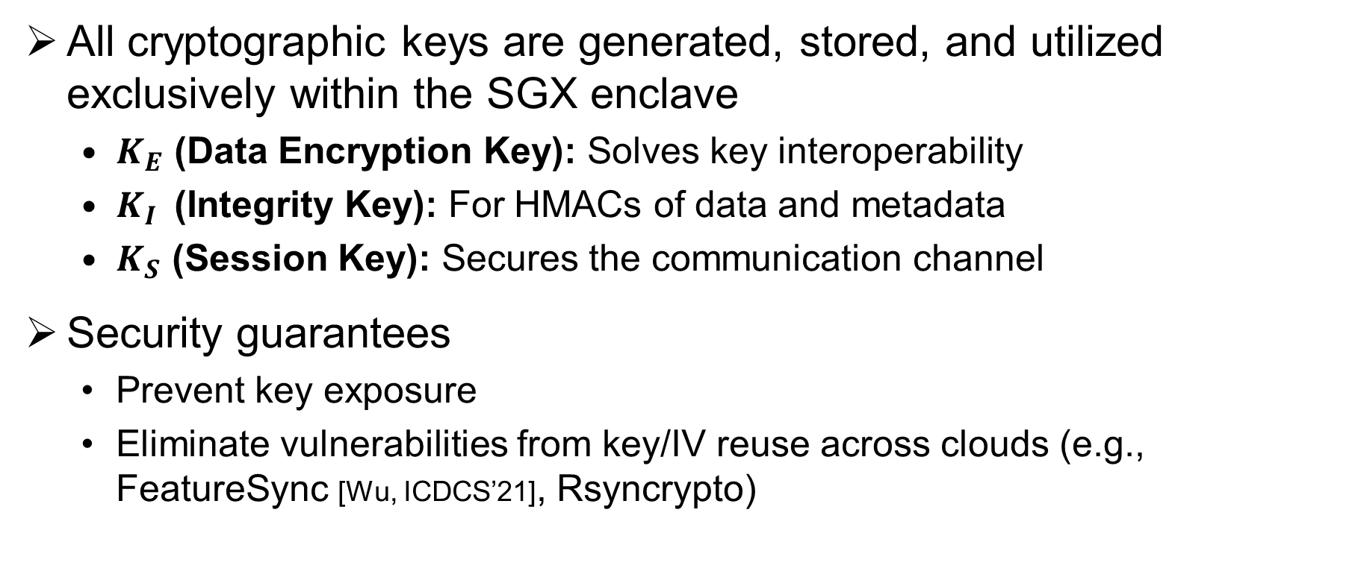
Shielded Key Management
All cryptographic keys are generated, stored, and utilized exclusively within the SGX enclave
  $K_{E}$ (Data Encryption Key): Solves key interoperability
  $K_{I}$(Integrity Key): For HMACs of data and metadata
  $K_{S}$ (Session Key): Secures the communication channel
Security guarantees
  Prevent key exposure
  Eliminate vulnerabilities from key/IV reuse across clouds (e.g., FeatureSync [Wu, ICDCS’21], Rsyncrypto)
Notes:
SeedSync's security starts with shielded key management. All cryptographic keys are generated, stored, and used exclusively within the enclave.
We have a Data Encryption Key, KE​, which solves the interoperability problem since data can be safely decrypted and re-encrypted inside the enclave for each cloud. We have an Integrity Key, KI​, for generating HMACs to verify data integrity. And finally, a Session Key, KS.
Note that the session key is negotiated for every sync operation to secure the communication channel between proxies. It encrypts all data in transfer. And when the destination enclave receives the data, it decrypts with session key to process sync within enclave. After processing, the unique data will be encrypted using its own data encryption key, and integrity tags are generated with integrity key, which are different from the ones of the source cloud.
This design prevents key exposure and eliminates the key reuse vulnerabilities found in other systems – each enclave manages its own keys.

Slide 12
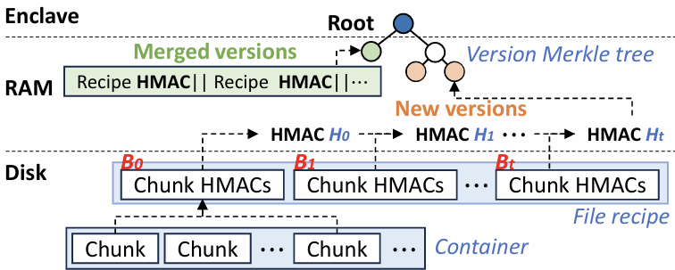
Integrity Protection
A naive approach (HMAC for an entire file) is computationally expensive and does not scale
SeedSync introduces a tree-structured integrity protection mechanism
    A hierarchical structure of cryptographic hashes
    Batch-manner management → efficiently processed within enclave
    Merging of synchronized versions → a compact Merkle tree
Notes:
For data integrity, a naive approach of computing one HMAC for an entire file is too slow and doesn't scale. Instead, SeedSync introduces a tree-structured integrity protection mechanism.
As shown in the diagram, we generate HMACs for individual data chunks and store them in the file recipe. We then build a Merkle tree on top of the file recipes for all versions of a file. The root of this tree provides a single, verifiable hash for the entire version history. This structure is efficient to update and verify within the enclave, and we can merge older, already-synchronized versions to keep the tree compact and fast.

Slide 13
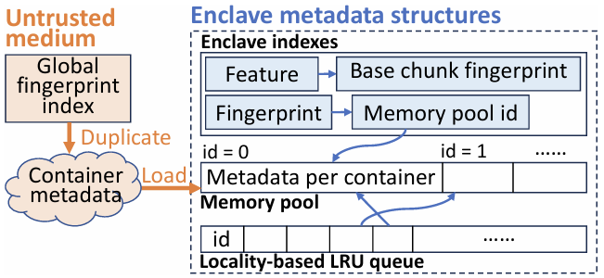
Enclave Management
Enclave indexes
  Fingerprint index → chunk-level deduplication
  Feature index → byte-level delta compression
Locality-based management
  Pre-fetching metadata based on data locality → reduce Ocall overhead
Notes:
To optimize performance, we carefully manage what happens inside the enclave. We maintain two key indexes within the enclave: a fingerprint index for chunk-level deduplication and a feature index for byte-level delta compression.
Based on the data locality patterns we observed, we implement a locality-based management policy. When the destination needs a chunk, instead of just fetching that one chunk's metadata, we pre-fetch the metadata for the entire container it belongs to. This loads the enclave with metadata for chunks that are likely to be needed next, significantly reducing the number of slow OCalls to external storage.

Slide 14
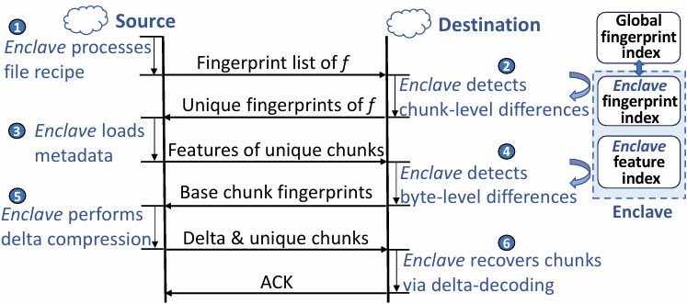
Shielded Data Sync Protocol
The protocol is a six-phase pipeline, with all security-sensitive operations in trusted enclaves
Notes:
This all comes together in our six-phase shielded data synchronization protocol. All security-sensitive operations happen inside the enclaves.
Here's a quick walkthrough:
1. The source sends a list of fingerprints for the file.
2. The destination checks these against its local indexes to find unique chunks.
3. The source sends back features for these unique chunks.
4. The destination uses these features to identify similar chunks that are good candidates for delta compression. It tells the source which chunks are unique and which are similar.
5. The source performs delta compression for similar chunks and sends the resulting deltas, along with the full content of truly unique chunks.
6. Finally, the destination reconstructs the file, verifies integrity, and writes the new version to its cloud storage."
All traffic between the enclaves is encrypted, ensuring end-to-end security.

Slide 15
Experimental Setup
Implement SeedSync in C++ on Linux
  Intel SGXv2 SGX SDK 2.15, OpenSSL 1.1.1
  FastCDC, LZ4
  ~ 35.4 K Loc
Datasets
  Five real-world datasets: TF, GCC, LINUX, CHOROM, DOCKER
Testbeds
  Local cluster connected with 10 Gb/s Ethernet
  Alibaba Cloud connected over Internet
Notes:
To evaluate SeedSync, we built a C++ prototype using the Intel SGX SDK. We used five real-world datasets, including source code repositories like Tensorflow and Linux, and Docker snapshots.
Our testbed consisted of two SGX-enabled servers connected by a 10 Gigabit Ethernet link, allowing us to measure performance without the network being the primary bottleneck. We also conduct real-cloud experiments with VMs of Alibaba cloud, where the internet is the bottleneck.

Slide 16
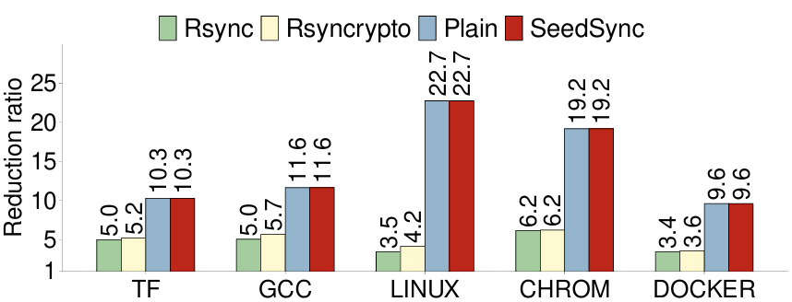
Network Traffic Reduction
Baselines
  Rsync
  Rsyncrypto
  Plain (without encryption, with delta compression)
SeedSync outperforms Rsync and Rsyncrypto
  Up to 5.4x network traffic reduction over Rsyncrypto, thanks to delta compression
SeedSync achieves the same reduction ratio as Plain
  Without degraded network reduction while provide security guarantees
Notes:
First, let's look at network traffic reduction. The bars show the reduction ratio—higher is better.
As you can see, SeedSync and Plain, the non-encrypted version, achieve identical and significantly higher reduction ratios compared to Rsync and Rsyncrypto. For the LINUX dataset, we achieve a reduction ratio of over 22x. This is because SeedSync, like Plain, uses delta compression to remove byte-level redundancy, which Rsync and Rsyncrypto cannot do. This result proves that SeedSync provides security without sacrificing network efficiency.

Slide 17
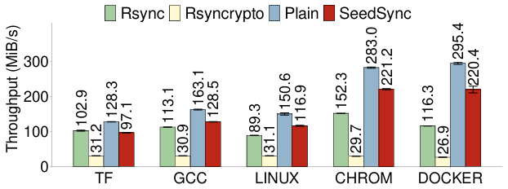
Synchronization Performance
SeedSync outperforms Rsync and Rsyncrypto in both local-cluster and real-cloud
In local cluster
  10GbE, the network is not the bottleneck
  Up to 8.2x speedup over Rsyncrypto (the encrypted baseline approach)
Insights
  SeedSync achieves security guarantees with limited performance overhead
Notes:
Now for throughput. In our local 10-gigabit cluster, SeedSync consistently and dramatically outperforms the other encrypted approach, Rsyncrypto—achieving up to an 8.2x speedup. This is because Rsyncrypto's cryptographic operations are very inefficient.
Compared to Plain, which has no security overhead, SeedSync introduces a modest performance cost, around 22-25%. This is the overhead for providing full confidentiality and integrity, a trade-off we believe is well worth it for secure synchronization.

Slide 18
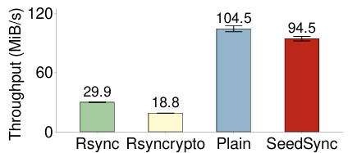
Synchronization Performance
SeedSync outperforms Rsync and Rsyncrypto in both local-cluster and real-cloud
In real-cloud
  Network transfer is the bottleneck
  SeedSync is 3.1x and 5.0x faster than Rsync and Rsyncrypto, respectively
Insights
  SeedSync reduces more network traffic redundancy than chunk-level approaches due to the deployment of delta compression.
Notes:
We also deployed SeedSync in a real-cloud environment using Alibaba Cloud, where the network is the bottleneck. The performance trend remains the same. SeedSync is 5 times faster than Rsyncrypto.
The key insight here is that because SeedSync is much more effective at reducing the amount of data sent over the network, its performance advantage is even more pronounced in real-world, bandwidth-constrained environments.

Slide 19
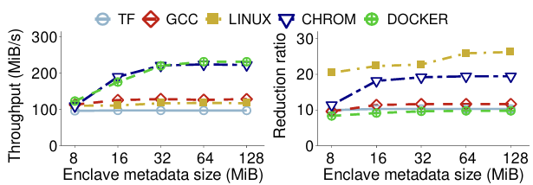
Impact of Enclave Metadata Size
The synchronization throughput and network reduction ratio increase with the size, and converges
  SeedSync achieves efficient network reduction with limited EPC memory overhead
Notes:
Finally, we studied the impact of the enclave's memory size. These graphs show that both throughput and the network reduction ratio improve as we allocate more memory for our in-enclave indexes, and then they level off.
This demonstrates that SeedSync can achieve excellent results with a relatively small and practical amount of EPC memory—we don't need a huge enclave to be effective.

Slide 20
Conclusions
SeedSync realizes secure and efficient cross-cloud data synchronization via Intel SGX
  Shield network traffic reduction in the enclave to guarantee data confidentiality
  Achieve end-to-end integrity guarantee with limited performance overhead
  Achieve fine-grained network reduction (deduplication, delta compression, and local compression) with dedicated enclave designs to achieve high performance
We prototype SeedSync and conduct experiments to verify effectiveness
  SeedSync achieves high performance among baselines with security guarantees
Source code: https://github.com/adslabcuhk/seedsync
Notes:
In conclusion, SeedSync successfully resolves the conflict between security and efficiency in cross-cloud data synchronization. By leveraging Intel SGX, we can perform fine-grained network reduction techniques like delta compression within a secure shielded environment.
Our system provides end-to-end data confidentiality and integrity with limited performance overhead. Our experiments confirm that SeedSync is highly effective, achieving significant improvements in both throughput and network reduction over existing encrypted methods.
The source code for our prototype is available on GitHub. Thank you for your attention, and I'm now happy to take any questions.

