Slide 1
Optimal Wide Stripe Generation in Locally Repairable Codes via Staged Stripe Merging
Si Wu¹, Guantian Lin¹, Patrick P. C. Lee², Cheng Li¹, and Yinlong Xu¹
¹University of Science and Technology of China,
²The Chinese University of Hong Kong
ICDCS 2024

Slide 2
Introduction
Clustered storage architecture
Two-layer architecture: nodes organized into clusters
Cross-cluster bandwidth is scarce
Cross-cluster transfer is the bottleneck!
Cluster
Network Core
D₀
D₁
D₂
D₃
D₄
D₅
L₀
L₁
G₀
G₁
Block
Node

Slide 3
Erasure Coding
Erasure coding is a low-cost technique for fault tolerance
Much less redundancy with same reliability than replication
Encodes data blocks into parity blocks to form a stripe
Wide stripes are future directions of erasure codes
#(data and parity blocks) is large, (parity blocks)% is small → ultra-low-cost fault tolerance
Studied in academia [Hu et al.,FAST’21]
Deployed in VastData and Google [Kadekodi et al.,FAST’23]

Slide 4
Coding Schemes for Wide Stripes
Wide stripes with Reed-Solomon (RS) Codes suffer from high repair cost
Wide stripes with Locally Repairable Codes (LRCs) greatly save repair cost
Studied in academia [Hu et al.,FAST’21] and enterprise [Kadekodi et al.,FAST’23]
D₀
D₁
......
D₂₃
→
P₀
P₁
P₂
P₃
k=24,m=4 RS
24 blocks
D₀
......
D₁₁
D₁₂
......
D₂₃
→
G₀
G₁
k=24,l=2,g=2 LRC
L₀
L₁
12 blocks

Slide 5
Clustered Storage with LRCs
LRCs reduce the cross-cluster network traffic for repairing a single data block
Repair cost: average amount (in units of blocks) of cross-cluster transfers to repair all data blocks
Multi-node fault tolerance & single-cluster fault tolerance
D₀
D₁
D₂
D₃
D₄
D₅
L₀
L₁
G₀
G₁
k=6,l=2,g=2 LRC
L₀: cross-cluster block
Repair cost:
one block

Slide 6
How to Efficiently Generate Wide LRC Stripes
Traditional approaches: (k, l, g) → (k’≥k, l, g)
Huge network transfers for data relocation and parity updates
Recent studies utilize stripe merging: x (k, l, g) → (xk, l′, g′)
saves network transfers
However, existing approaches, stringent settings
HACFS [Xia et al.,FAST'15]: 3 Product Codes(2*5) → Product Codes(6*5)
StripeMerge [Yao et al.,ICDCS’21]: 2 RS(k, m) → RS(2k, m)
LRCMerge [Wu et al.,Infocom'22]: only one stage

Slide 7
How to Guarantee Stripe Merging Efficiency and Repair Efficiency
Stripe Merging Efficiency: merging process of a large number of stripes incurs substantial cross-cluster traffic
Also found in previous work [Kadekodi et al.,OSDI’20]
Merging process should be efficient
Repair Efficiency: stripe merging changes data layout and affects repair cost
Stripe merging should not sacrifice repair performance

Slide 8
Contributions
Propose staged stripe merging to generate wide LRC stripes
Flexibility in stripe merging settings
Complies with real-world access pattern
Design optimal data placement scheme for staged stripe merging
Minimizes cross-cluster traffic for stripe merging across each stage
Minimizes repair cost for LRC in any stage
Validate efficiency on a distributed storage prototype

Slide 9
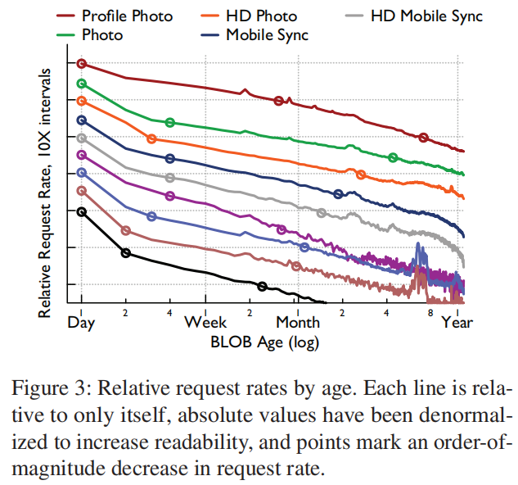
Real-world Data Access Pattern
Data hotness progressively changes over time
Newly written:
hot
A few weeks: warm
A few months: cold
Muralidhar et al., f4: Facebook’s Warm BLOB Storage System, OSDI’14

Slide 10
Staged Stripe Merging for LRCs
Progressively merge x = x₁*x₂*...*x_{n} (x_{i} configurable) narrow LRC(k,l,g) stripes to a wide LRC(xk, l, g) stripe in n stages
hot data
x₁*x₂*...*x_{n} LRC(k, l, g)
→ x₂*...*x_{n} LRC(x₁k, l, g)
→ x₃*...*x_{n} LRC(x₁x₂k, l, g)
...
→ LRC(x₁x₂...x_{n}k, l, g)
1st stage, every x₁ (k,l,g) → (x₁k, l, g)
warm data
2nd stage, every x₂ (x₁k,l,g) → (x₁x₂k, l, g)
n-th stage
cold data

Slide 11
Problem Decomposition
Focus on the i-th (1 ≤ i ≤ n) stage: x_{i} (x₁...x_{i−1}k,l,g) → (x₁...x_{i}k,l,g)
Three sub-operations
Global parity recalculation: recalculate g new global parity blocks from x₁...x_{i}k data blocks
Local parity recalculation: merge every x_{i} old local parity blocks into a new one
Data migration: migrate blocks to restore single-cluster fault tolerance
Data placement of narrow stripes greatly affects the cross-cluster traffic for staged stripe merging

Slide 12
Dispersed Data Placement
2*2 LRC(6,2,2) → 2 LRC(12,2,2) → LRC(24,2,2), 1st stage
Global parity recalculation: D₀-D₁₁ (D₁₂-D₂₃) generate G′₀,G′₁ (G′₂,G′₃) → 16 cross-cluster blocks
Local parity recalculation: L₀+L₂=L′₀; L₁+L₃=L′₁ (L₄+L₆=L′₂; L₅+L₇=L′₃) → 4 cross-cluster blocks
Data migration: none, as data blocks to be merged are dispersed → 0 cross-cluster block
D₀
D₁
D₂
D₃
D₄
D₅
G₀
G₁
L₀
L₁
L'₀
L'₁
G'₀
G'₁
D₆
D₇
D₈
D₉
D₁₀
D₁₁
G₂
G₃
L₂
L₃
D₁₂
D₁₃
D₁₄
D₁₅
D₁₆
D₁₇
G₄
G₅
L₄
L₅
L'₂
L'₃
G'₂
G'₃
D₁₈
D₁₉
D₂₀
D₂₁
D₂₂
D₂₃
G₆
G₇
L₆
L₇

Slide 13
Dispersed Data Placement
2*2 LRC(6,2,2) → 2 LRC(12,2,2) → LRC(24,2,2), 2nd stage
Global parity recalculation: 16 cross-cluster blocks
Local parity recalculation: 2 cross-cluster blocks
Data migration: 0 cross-cluster block
D₀
D₁
D₂
D₃
D₄
D₅
G'₀
G'₁
L'₀
L'₁
L''₀
L''₁
G''₀
G''₁
D₆
D₇
D₈
D₉
D₁₀
D₁₁
D₁₂
D₁₃
D₁₄
D₁₅
D₁₆
D₁₇
G'₂
G'₃
L'₂
L'₃
D₁₈
D₁₉
D₂₀
D₂₁
D₂₂
D₂₃

Slide 14
Aggregated Data Placement
2*2 LRC(6,2,2) → 2 LRC(12,2,2) → LRC(24,2,2), 1st stage
Global parity recalculation: 8 cross-cluster blocks
Local parity recalculation: inner-cluster, 0 cross-cluster block
Data migration: 12 cross-cluster blocks
D₀-D₂ and D₆-D₈ break single-cluster fault tolerance for LRC(12,2,2), migrate D₀-D₂
D₀
D₁
D₂
D₃
D₄
D₅
G₀
G₁
L₀
L₁
L'₀
L'₁
G'₀
G'₁
D₆
D₇
D₈
D₉
D₁₀
D₁₁
G₂
G₃
L₂
L₃
D₁₂
D₁₃
D₁₄
D₁₅
D₁₆
D₁₇
G₄
G₅
L₄
L₅
L'₂
L'₃
G'₂
G'₃
D₁₈
D₁₉
D₂₀
D₂₁
D₂₂
D₂₃
G₆
G₇
L₆
L₇

Slide 15
Aggregated Data Placement
2*2 LRC(6,2,2) → 2 LRC(12,2,2) → LRC(24,2,2), 2nd stage
Global parity recalculation: 12 cross-cluster blocks
Local parity recalculation: 0 cross-cluster block
Data migration: 6 cross-cluster blocks
D₀
D₁
D₂
D₃
D₄
D₅
G'₀
G'₁
L'₀
L'₁
L''₀
L''₁
G''₀
G''₁
D₆
D₇
D₈
D₉
D₁₀
D₁₁
D₁₂
D₁₃
D₁₄
D₁₅
D₁₆
D₁₇
G'₂
G'₃
L'₂
L'₃
D₁₈
D₁₉
D₂₀
D₂₁
D₂₂
D₂₃

Slide 16
Insights
Dispersed data placement
Disperse data blocks → minimize traffic for data migration
Disperse local parity blocks → increase traffic for local parity recalculation
Aggregated data placement
Aggregate data blocks → increase traffic for data migration
Aggregate local parity blocks → eliminate traffic for local parity recalculation
Our idea

Slide 17
Optimal Data Placement
2*2 LRC(6,2,2) → 2 LRC(12,2,2) → LRC(24,2,2), 1st stage
Global parity recalculation: 16 cross-cluster blocks
Local parity recalculation: inner-cluster, 0 cross-cluster block
Data migration: none, 0 cross-cluster block
D₀
D₁
D₂
D₃
D₄
D₅
G₀
G₁
L₀
L₁
L'₀
L'₁
G'₀
G'₁
D₆
D₇
D₈
D₉
D₁₀
D₁₁
G₂
G₃
L₂
L₃
D₁₂
D₁₃
D₁₄
D₁₅
D₁₆
D₁₇
G₄
G₅
L₄
L₅
L'₂
L'₃
G'₂
G'₃
D₁₈
D₁₉
D₂₀
D₂₁
D₂₂
D₂₃
G₆
G₇
L₆
L₇

Slide 18
Optimal Data Placement
2*2 LRC(6,2,2) → 2 LRC(12,2,2) → LRC(24,2,2), 2nd stage
Global parity recalculation: 16 cross-cluster blocks
Local parity recalculation: 0 cross-cluster block
Data migration: 0 cross-cluster block
D₀
D₁
D₂
D₃
D₄
D₅
G'₀
G'₁
L'₀
L'₁
L''₀
L''₁
G''₀
G''₁
D₆
D₇
D₈
D₉
D₁₀
D₁₁
D₁₂
D₁₃
D₁₄
D₁₅
D₁₆
D₁₇
G'₂
G'₃
L'₂
L'₃
D₁₈
D₁₉
D₂₀
D₂₁
D₂₂
D₂₃

Slide 19
Optimality Guarantees
Stripe merging optimality
Our data placement disperses data blocks and aggregates local parity blocks → minimizes cross-cluster traffic across each stage
Repair optimality
2*2 LRC(6,2,2) → 2 LRC(12,2,2) → LRC(24,2,2)
LRCs across all stages | Repair cost (cross-cluster) | Minimum ?
LRC(6,2,2) | one block | ✓
LRC(12,2,2) | two blocks | ✓
LRC(24,2,2) | four blocks | ✓

Slide 20
Applicability to Various LRCs
Our design applies to Azure’s LRC, Azure+1, Google’s LRC
Each LRC operates on every g+1 blocks (in one cluster)
Single-cluster fault tolerance
Stripe merging efficiency
Repair efficiency

Slide 21
Evaluation
Implementation
Distributed storage prototype: multiple clients, a coordinator, multiple clusters (each with a proxy and multiple nodes)
Testbed
Local: 17 physical servers (2 dodeca-core CPUs, 64 GB RAM, 1 TB HDD, 10 Gbps bandwidth)
Each server emulates a cluster
Targets
Azure’s LRC (A-LRC) and Google’s LRC (G-LRC)
Data placements
Ran-1 and Ran-2: random data placements without and with encode-and-transfer
Dis and Agg: dispersed and aggregated data placements
Opt: optimal data placement

Slide 22
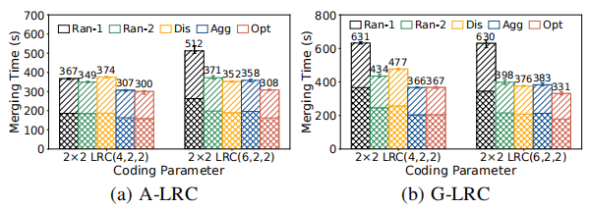
Performance for Different Parameters
2*2 LRC(4,2,2)→2 LRC(8,2,2)→LRC(16,2,2) & 2*2 LRC(6,2,2)→2 LRC(12,2,2)→LRC(24,2,2)
Findings:
Opt reduces the summed stripe merging time of two stages, and the merging time of each stage
Performance gains in G-LRC are larger than in A-LRC

Slide 23
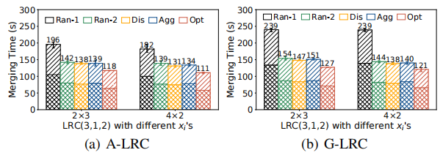
Performance for Different x_{i}’s
2*3 LRC(3,1,2)→3 LRC(6,1,2)→LRC(18,1,2) & 4*2 LRC(3,1,2)→2 LRC(12,1,2)→LRC(24,1,2)
Findings:
Opt performs well with different x_{i}’s in staged stripe merging

Slide 24
Conclusions
Explore wide stripe generation problem in LRCs in clustered storage systems
Propose staged stripe merging with flexibility to gradually widen LRC stripes
Design optimal data placement scheme
Minimizes cross-cluster traffic for stripe merging across each stage
Maintains repair costs of LRCs.
Conduct prototype experiments to verify effectiveness
Source code: https://github.com/hhlgt/staged-stripe-merging

