Slide 1
ELECT: Enabling Erasure Coding Tiering for LSM-tree-based Storage
Yanjing Ren¹, Yuanming Ren¹, Xiaolu Li², Yuchong Hu², Jingwei Li³, Patrick P. C. Lee¹
¹The Chinese University of Hong Kong ²Huazhong University of Science and Technology ³University of Electronic Science and Technology of China
USENIX FAST 2024

Slide 2
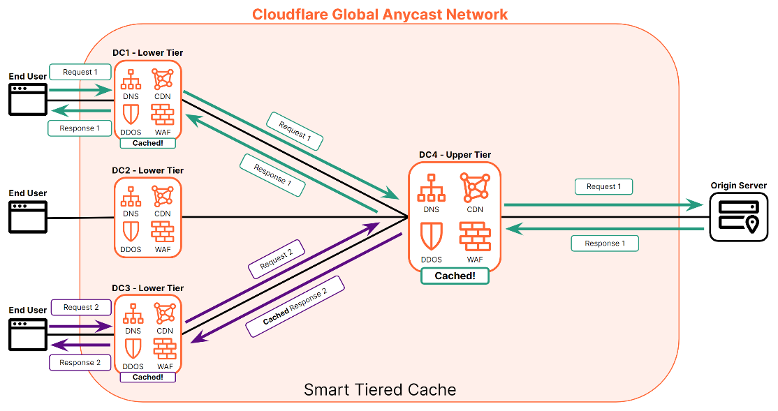
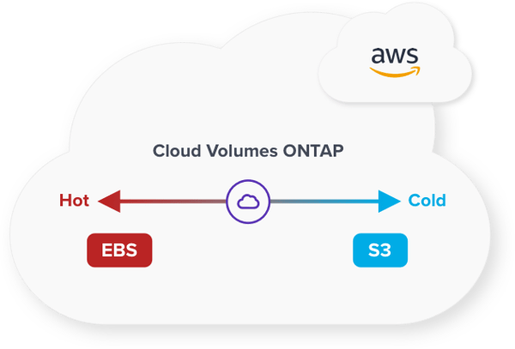
Storage Tiering
Storage tiering balances the trade-off between access performance and storage persistence
Hot tier: high performance but limited storage space
Cold tier: abundant storage space but lower performance
Cloudflare CDN
AWS Cloud Volumes

Slide 3
Storage Tiering
A primary use case of storage tiering: edge-cloud storage
IoT applications will generate over 79.4 ZB data in 2025 [*]
Edge storage mainly builds on distributed key-value (KV) stores
Our goal: Extend a distributed KV store with storage tiering for edge-cloud and general tiered storage environments
Internet
IoT Devices
Edge Storage
Cloud Storage
[*] https://blogs.idc.com/2019/11/04/how-you-contribute-to-todays-growing-datasphere-and-its-enterprise-impact/

Slide 4
Distributed KV Store
Use Cassandra as an example for edge storage
Cassandra is decentralized, high-performance, and fault-tolerant
KV partitioning via consistent hashing
N₀
N₁
N₂
N₃
N₄
N₅
Replication group
ImmuT
MemT
<K, V>
K₀
K₁
Mem
N₀
K₀ K₅ K₄
Disk
Flush
L$0$
$$⋯$$
WAL
K₅
Hash ring
K₂
L$1$
$$⋯$$
N₁
K₁ K₀ K₅
$$⋅ ⋅ ⋅$$
SSTable
Compaction
Internal KV storage via Log-structured Merge tree (LSM-tree)
L_{ℓ}
$$⋯$$
K₄
K₃
N₂
K₂ K₁ K₀
Data
Metadata
Data distribution
LSM-Tree
Drawback: Replication has high storage overhead

Slide 5
Erasure Coding
(n, k) Reed-Solomon (RS) codes:
Encode k data chunks to n-k parity chunks
Each collection of n data/parity chunks forms a coding group
With a redundancy of n/k, any k out of n chunks can recover lost data
Compared with replication, erasure coding
Saves significant storage overhead
Incurs higher degraded read and full-node recovery overhead
Can we maintain storage efficiency via erasure coding, while preserving high performance, in tiered storage?

Slide 6
Skewed Access Patterns
Practical KV workloads have skewed access patterns
10-node Cassandra cluster - Load 100M 1-KiB KV pairs - Issue 1M reads - Keys accessed under Zipf (0.99)
56.2% of SSTables are stored in L₄, but only have 10.2% of accesses
Only 18.2% of SSTables in L₄ are accessed

Slide 7
Our Contributions
ELECT: a distributed LSM-tree-based KV store that enables erasure coding tiering
Extends LSM-tree with hybrid redundancy
Replicates hot KV pairs and erasure-codes cold KV pairs in hot tier
Offloads (selectively) cold KV pairs to cold tier for further hot-tier storage savings
Key techniques
LSM-tree-based redundancy transitioning
Hotness-aware redundancy transitioning and cold-data offloading
Tunable configuration for balancing storage-performance trade-off
Results: 56.1% less hot-tier storage overhead than replication, with similar normal read/write performance

Slide 8
Design Considerations
Q1: At what granularity should KV pairs be encoded?
Q2: Should erasure coding be performed on or off the write path?
Q3: How should skewed access patterns be addressed?
Q4: How should the access overhead in the cold tier be mitigated?
Q5: How should ELECT address the trade-off between storage savings and access performance?

Slide 9
Design Overview
Tunable configuration of storage-performance trade-off
N₀
N₁
N₂
N₃
N₄
N₅
ImmuT
MemT
<K, V>
K₀
K₁
Mem
Hotness-aware offloading
N₀
K₀ K₅ K₄
Disk
Flush
L$0$
$$⋯$$
WAL
K₅
Hash ring
K₂
L$1$
$$⋯$$
N₁
K₁ K₀ K₅
$$⋅ ⋅ ⋅$$
SSTable
Compaction
L_{ℓ}
$$⋯$$
Cloud Storage
K₄
K₃
N₂
K₂ K₁ K₀
Data
Metadata
Data distribution
LSM-Tree
Redundancy transitioning for last LSM-tree level

Slide 10
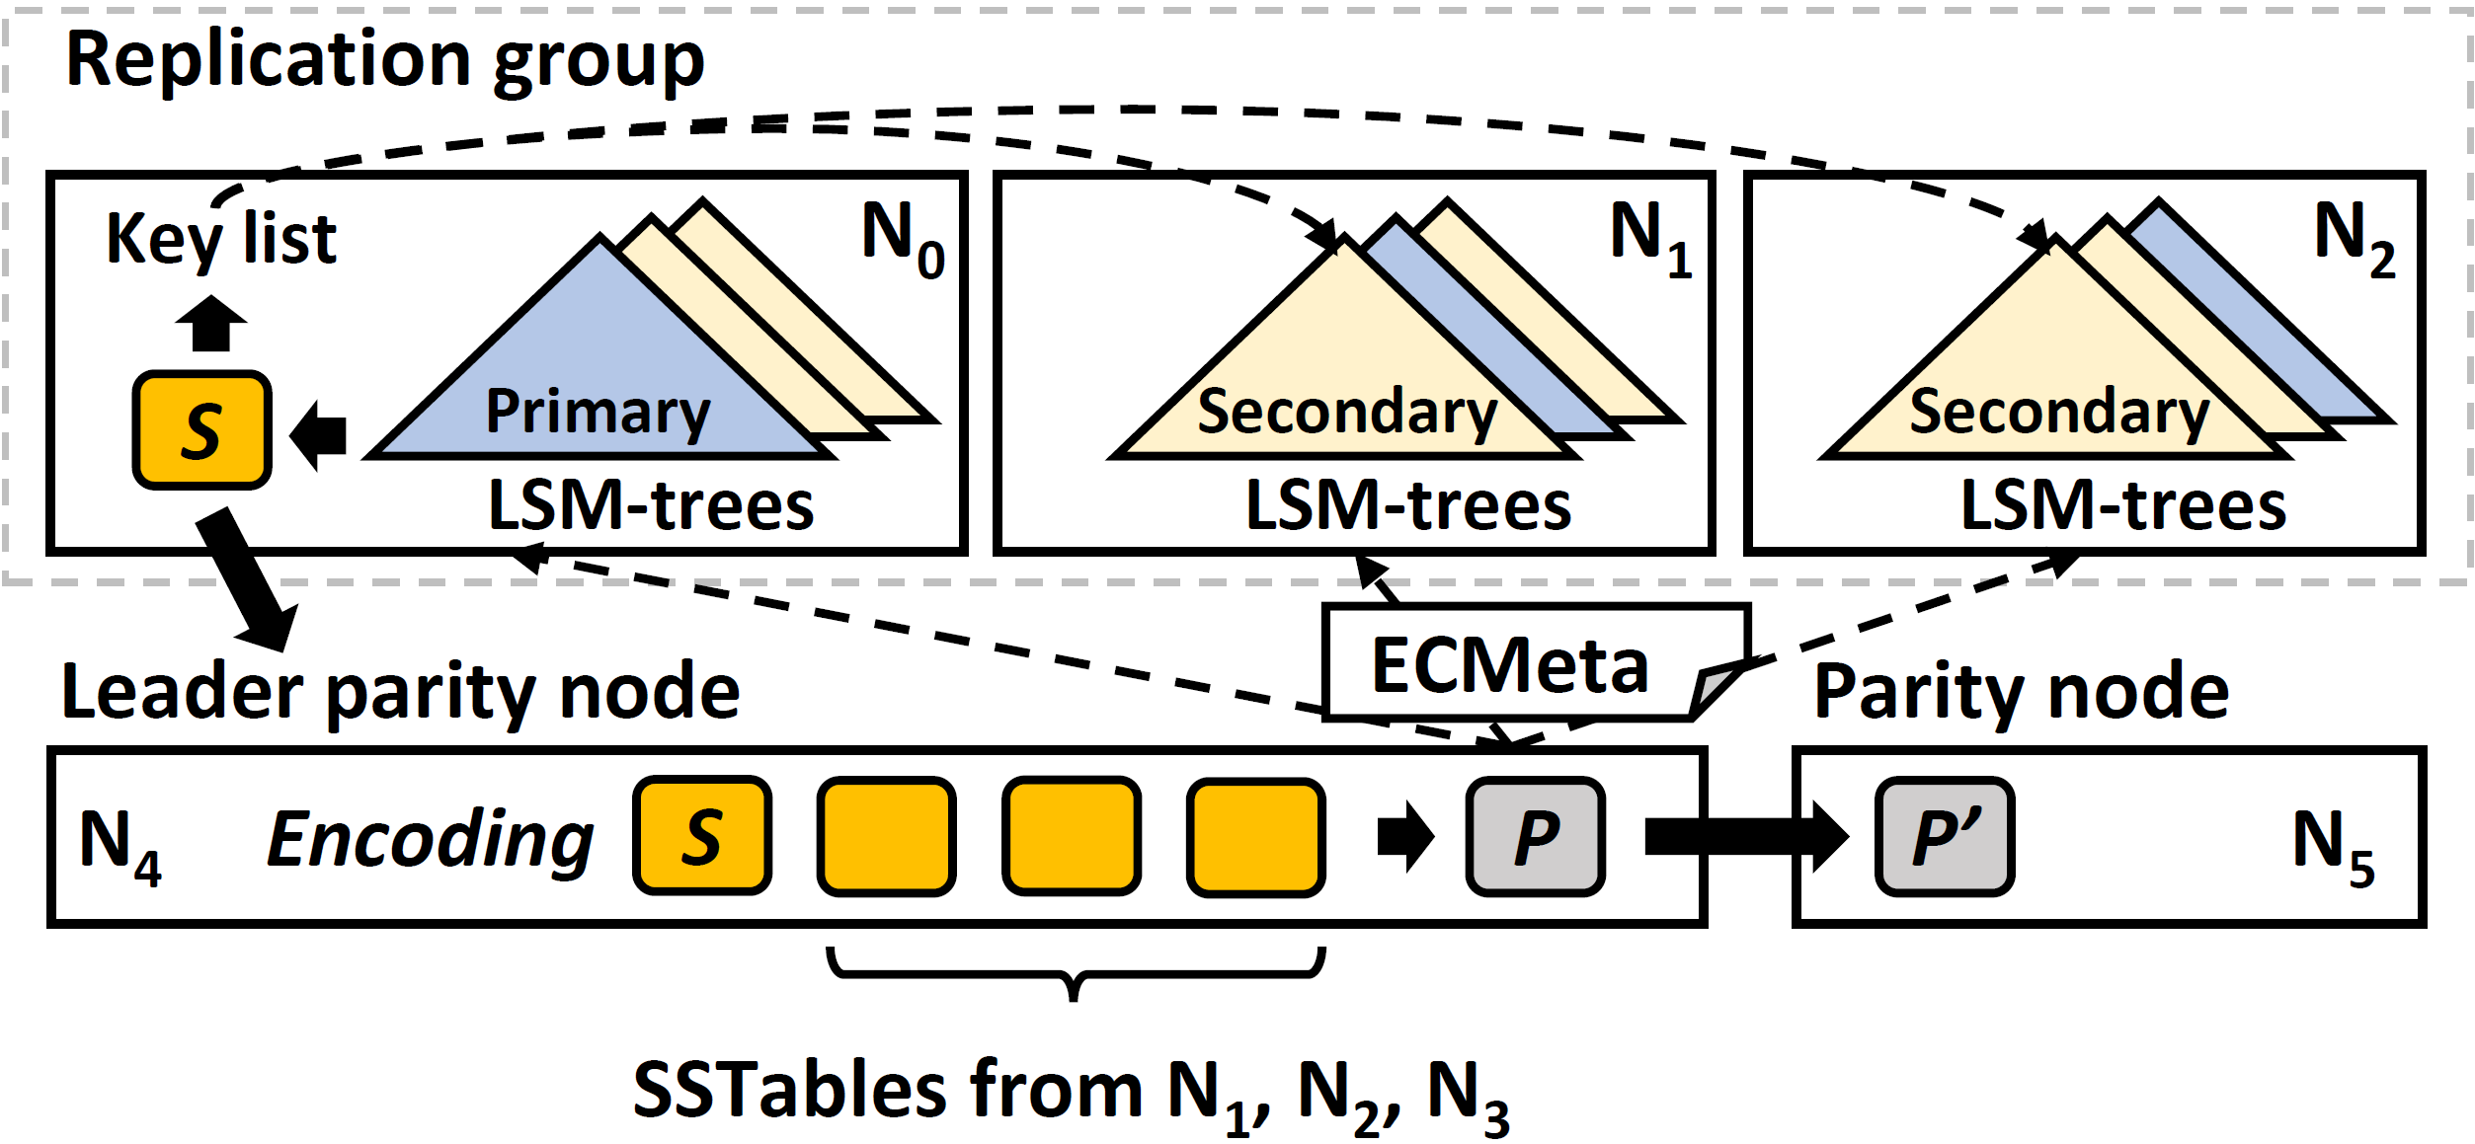
LSM-tree-based Redundancy Transitioning
Q1: At what granularity should KV pairs be encoded?
Decoupled replication management [DEPART, FAST’22; Tebis, EuroSys’22]:
Each node separates R replicas into a primary LSM-tree and R-1 secondary LSM-trees → facilitates secondary replica removal
Apply cross-encoding to SSTables in last LSM-tree level
Parity SSTable

Slide 11
LSM-tree-based Redundancy Transitioning
Q2: Should erasure coding be performed on or off the write path?
Decentralized parity node selection:
Maintains load balancing and fault tolerance for parity SSTables with decentralized placement decisions
Apply erasure coding offline
Secondary replica removal based on key list
Leader parity node encodes k data SSTables into m parity SSTables
Parity SSTable

Slide 12
Hotness Awareness
Q3: How should skewed access patterns be addressed?
Sort last-level SSTables by access frequency
Q4: How should the access overhead in the cold tier be mitigated?
Offload parity SSTables with long lifetime
Offload data SSTables with low access frequency and long lifetime
Hotness-aware redundancy transitioning
Selected for redundancy transitioning and data offloading
Higher
Lower
Access frequency

Slide 13
Balancing Storage-Performance Trade-off
Q5: How should ELECT address the trade-off between storage savings and access performance?
Quantify storage overhead and control how many SSTables are encoded and offloaded in a step-by-step manner
Control redundancy transitioning and cold-data offloading with
a user-specified storage saving target $α$
Redundancy Transitioning
Offloading of parity SSTables
Offloading of data SSTables
High access performance
High
storage saving
0
Storage saving target $α$
1

Slide 14
Experimental Setup
Alibaba Cloud in an edge-cloud setting:
12 instances (10 edge nodes + 2 client nodes) with 3 Gb/s connectivity
Alibaba Object Storage in a different region as cold-tier
Edge-to-edge: 1ms; edge-to-cloud: 45ms
Workloads: YCSB 0.17.0, 1-KiB KV pairs, Zipfian distribution (0.99)
Default settings: 3-way replication, (6,4) encoding, storage saving target $α=0.6$, write consistency level ALL, read consistency level ONE
Compare Cassandra (v4.1.0) and ELECT
Average over 5 runs and 95% confidence interval under Student’s t-dist
Summary of results: ELECT saves storage overhead of Cassandra while maintaining high performance in normal mode

Slide 15
YCSB Core Workloads
ELECT achieves 56.1% edge storage saving from Cassandra
39.1% overall storage savings (in both edge and cloud)
ELECT outperforms Cassandra in workload E (scan-intensive) by 2.84x due to decoupled replication management
Similar throughput for other workloads (up to 3% differences)
Note that the improvement is less on Chameleon Cloud

Slide 16
Individual KV Operations
ELECT maintains performance in normal mode, but has high latency in reads in degraded mode
Due to retrieval of parity SSTables from the cold tier
On Chameleon Cloud, the overhead is reduced from 5x to 1.2x

Slide 17
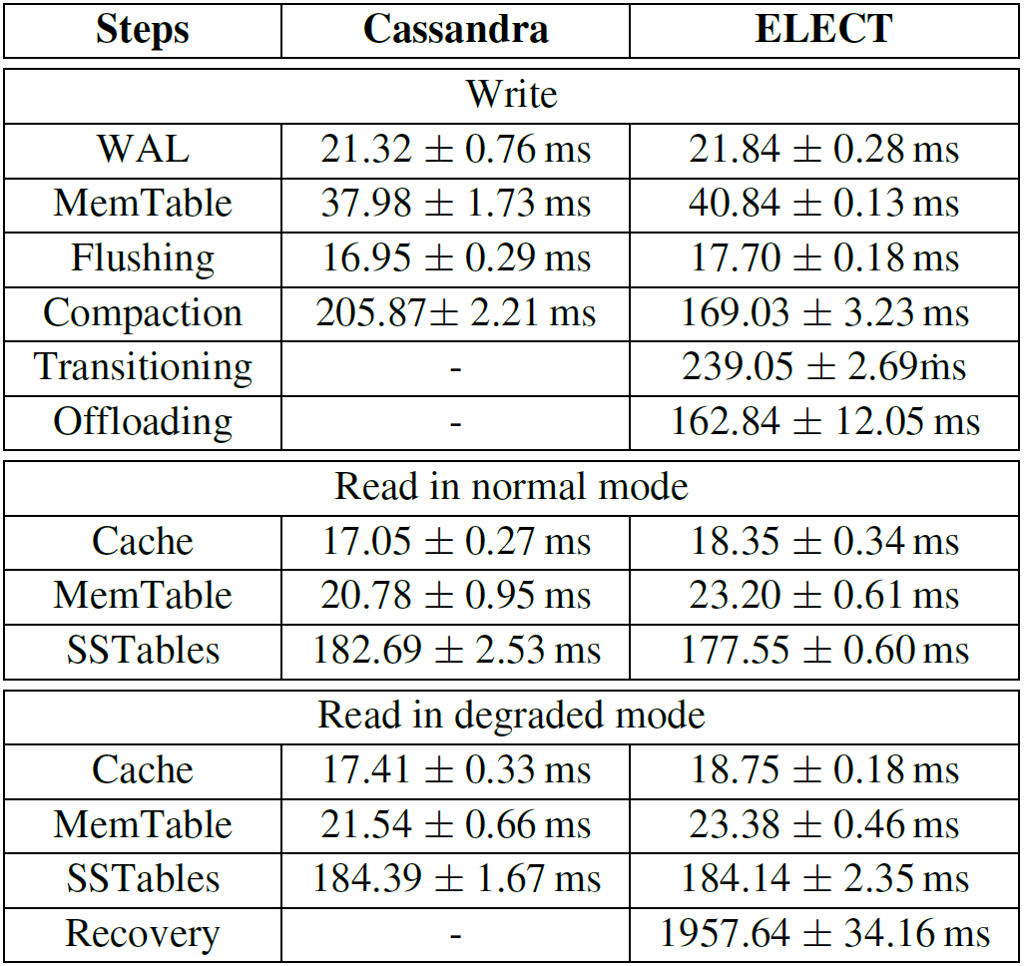
Performance Breakdown
Redundancy transitioning and cold-data offloading have long processing time
Performed offline with limited overhead
ELECT maintains write performance as Cassandra
Average latency of processing 1MiB of writes/reads and 95% confidence interval under Student’s t-distribution

Slide 18
Full-node Recovery
ELECT incurs 50% higher recovery time than Cassandra
ELECT retrieves data and parity SSTables to decode lost SSTables in primary LSM-tree
Recovery performance is network-bounded

Slide 19
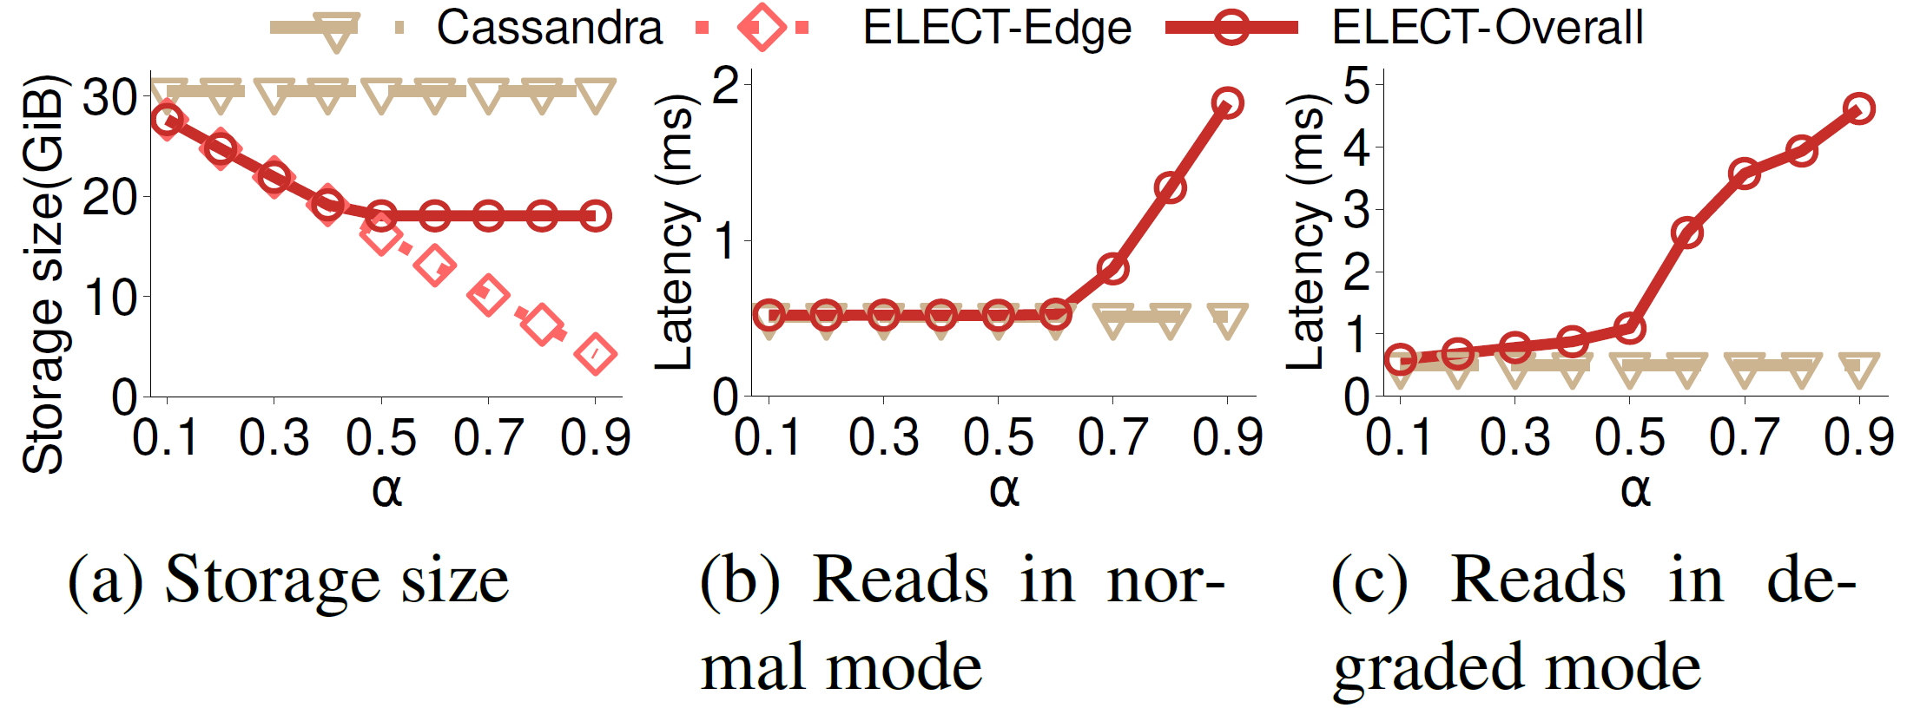
Impact of $α$
ELECT reduces edge storage overhead by 9.2 - 86% over Cassandra when $α$ increases from 0.1 to 0.9
~4% difference from $α$ due to metadata overhead
ELECT maintains read latency in normal mode before offloading data SSTables (i.e., $α≤$ 0.6)

Slide 20
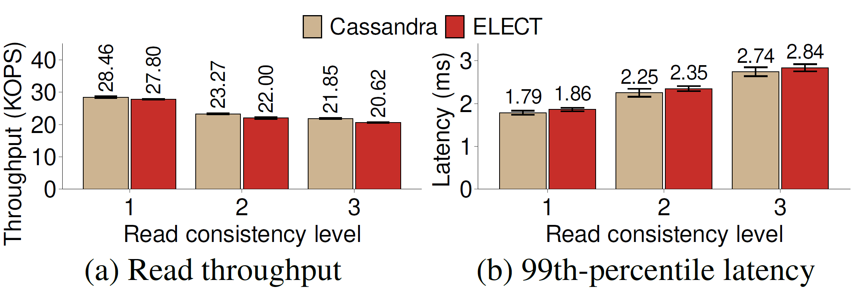
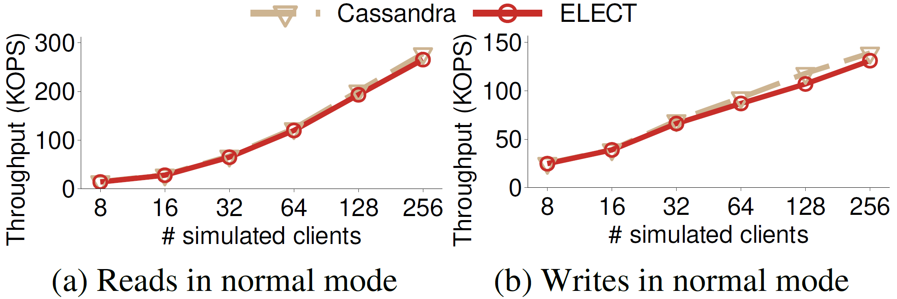
Consistency and Scalability
ELECT maintains consistent read performance as Cassandra
ELECT has 4% (5.7%) less normal read (write) throughput than Cassandra due to redundancy transitioning and offloading
More results in our paper: resource utilization, impact of KV sizes, coding parameters

Slide 21
Conclusions
ELECT: a distributed KV store that enables erasure coding tiering
LSM-tree-based redundancy transitioning (with decentralized parity node selection)
Hotness-aware redundancy transitioning and cold data offloading
Tunable configuration for balancing storage-performance trade-off
Source code: https://github.com/adslabcuhk/elect

