Slide 1
DEPART: Replica Decoupling for Distributed Key-Value Storage
DEPART: Replica Decoupling for Distributed Key-Value Storage
Qiang Zhang†, Yongkun Li†, Patrick P. C. Lee‡, Yinlong Xu†, Si Wu†
†University of Science and Technology of China
‡The Chinese University of Hong Kong
USENIX FAST 2022
Notes:
[0:00]-[0:30]: Hi everybody, I’m Qiang, from the University of Science and Technology of China. I am going to present the work “DEPART: Replica Decoupling for Distributed Key-Value Storage” .

Slide 2




Background
Data is growing exponentially and diversified
  Total amount of data in the wild will reach 175ZB by 2025
  Unstructured data is dominant (> 75% of all data)
Key-value (KV) stores are widely used
  Flexible data model & high scalability
  Simple interface: Put, Get, Scan,…
Google
Facebook
Apache
PingCAP
Notes:
[0:30]-[1:00]: In the era of big data, the data is growing exponentially and expected to reach one hundred and seventy-five ZB by twenty-twenty-five. Besides, there are various data types and more than 75% of the data is unstructured data. To deal with the challenge of data storage, KV stores came into being and are widely used because of its flexible data model, high scalability and simple interface.
Examples of KV stores include LevelDB, RocksDB, Cassandra and so on.

Slide 3
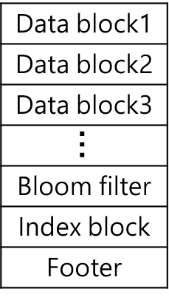
Background
Most KV stores build on log-structured merge tree (LSM-tree)
Immutable MemTable
MemTable
KV pairs
Multiple levels
Log-structured writes
Sorted in each level
Memory
Disk
WAL
Level 0
Compaction
  Advantages:
  Efficient writes, scans high scalability
Level 1
KVs
…
Level 2
  Limitations:
  High read and write amplifications
…
…
…
Level n
SSTable
Notes:
[1:00]-[1:30]: The most common design of persistent KV stores is based on LSM-tree. Its key idea can be illustrated as follows.
It organizes data in multiple levels with an increasing level capacity, and data in each level are sorted and organized into fixed-size files called SSTables. Note that when move data from a lower level to a higher level, data in both levels are required to be read out, merge sort and then written back, this is called compaction.
LSM-tree can transform random writes into sequential writes and keep each level sorted, so it supports efficient writes, scans and high scalability.
However, LSM-tree suffer from large write and read amplifications due to the multi-level log-structured design, which causes multi-level access during reads and frequent compaction during writes.

Slide 4
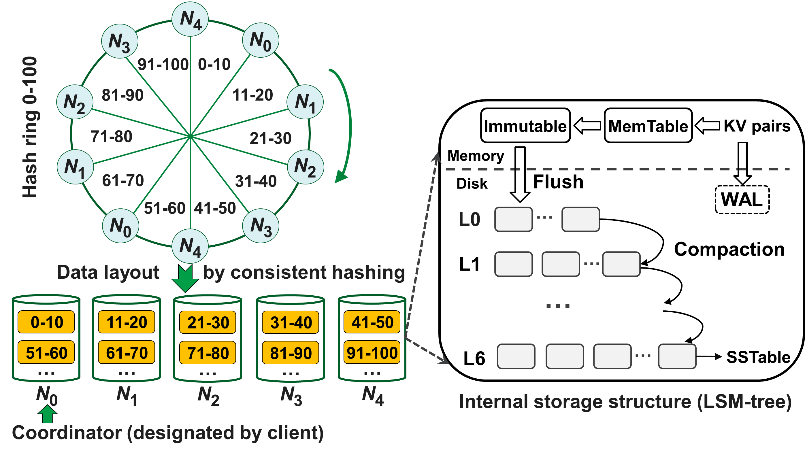
Background
Distributed KV stores
  KV pairs are partitioned based on consistent hashing
  Each node stores KV pairs in LSM-tree
    DynamoDB, Cassandra,
    ScyllaDB, HyperDex, TiKV, …
  Take Cassandra as an example
Notes:
[1:30]-[2:00]: On the other hand, distributed KV stores are widely used for large-scale storage. First, KV pairs are partitioned to different nodes based on consistent hashing or key range, then each node uses the LSM-tree to store all KV pairs. This architecture is adopted by DynamoDB, Cassandra, ScyllaDB, HyperDex, TiKV and so on.
Here we take Cassandra as an example, this figure show its architecture. The KV pairs are partitioned based on consistent hashing, Consistent hashing associates the locations of all nodes with a hash ring and maps each KV pair deterministically to a node. For example, as shown in Figure, there are 5 physical nodes with 2 virtual nodes each, so the hash ring contains10 ranges. Each of the ranges is associated with the nearest virtual node in the clockwise direction in the hash ring and the corresponding physical node.
So each node contains several ranges and stores them in the LSM-tree.

Slide 5
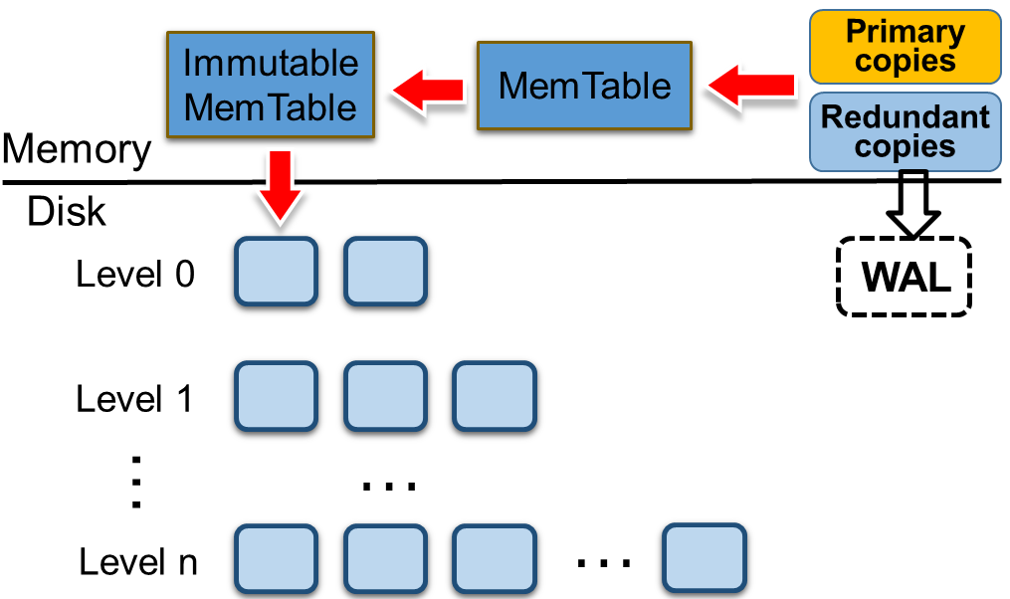
Motivation
Replication makes replicas for each KV pair for fault tolerance
  Primary copy: the main replica, mapped to nodes by consistent hashing
  Redundant copies: remaining replicas, mapped by replication strategy
  Uniform indexing: each node stores primary and redundant copies together in a single LSM-tree → aggravate read & write ampliﬁcations
Primary
copies
Primary
copies
Primary
copies
Redundant
copies
Redundant
copies
Redundant
copies
Node 1
…
Node n
e.g., Cassandra, ScyllaDB, TiKV, HBase, HyperDex
Notes:
[2:00]-[2:30]: Besides, replication is commonly used in modern distributed KV stores for fault tolerance, by distributing the replicas of each KV pair across different nodes to protect against node failures. In Cassandra, replicas are stored in a sequence of nodes along the clockwise direction in the hash ring. So each KV pair has multiple replicas and they are stored in different nodes. And we can divide the replicas into two types: the first is the primary copy, it is the main replica and mapped to nodes by consistent hashing; the second is redundant copies, they are the remaining replicas and mapped to nodes by replication strategy.
However, existing distributed KV stores simply store all replicas (including all primary and redundant copies) together in a single LSM-tree for each node, we call this uniform indexing. It is easy to implement, but signiﬁcantly exacerbates both the write and read ampliﬁcations of the LSM-tree. Because there are more compactions during writes and more data to search during reads for uniform indexing.

Slide 6
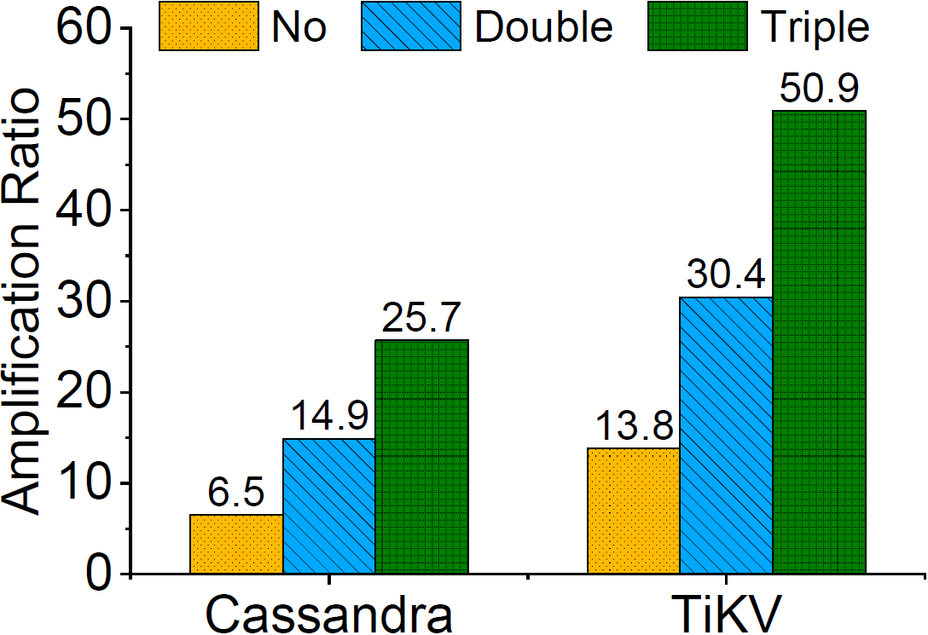
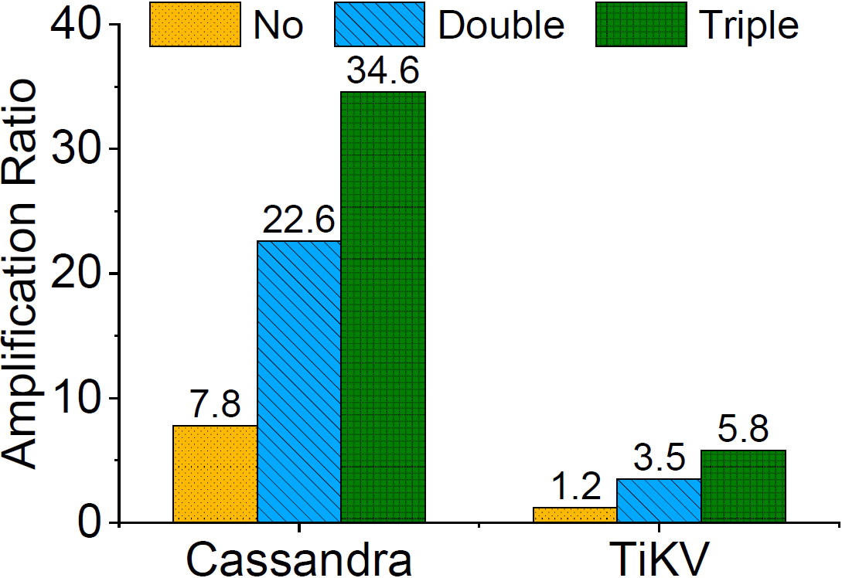
Motivation
Experimental verification on Cassandra & TiKV
“No”: one replica “Double”: two replicas
“Triple”: three replicas
A 5-node cluster
Write 300GiB KV pairs Read 30GiB KV pairs
    (a) Write amplification under different number of replicas
    (b) Read amplification under different number of replicas
A larger replication factor implies higher write/read amplifications
Notes:
[2:30]-[3:00]: We also verificated that uniform indexing exacerbates the write and read ampliﬁcations on Cassandra and TiKV. Speciﬁcally, we deploy Cassandra and TiKV on a 5-node cluster with their default settings. We conﬁgure a client to write 300GiB KV pairs to the cluster, then read 30GiB KV pairs.
Figure(a) and (b) shows that when increasing replicas from one to three, the write ampliﬁcation increases from 6.5× to 25.7× (i.e., 4×increase) for Cassandra, and the read ampliﬁcation increases from 7.8× to 34.6× (i.e., 4.4×increase). We observe a similar trend for TiKV.
Thus, the more the replicas, the more serious the write/read amplifications.

Slide 7
Our Idea
Decoupling primary and redundant copies in storage layer
  Avoid interaction between primary and redundant copies during reads and writes
  How to manage primary and redundant copies separately after replica decoupling?
Notes:
[3:00]-[3:20]: In order to address the issue of uniform indexing in distributed KV stores, our main idea is to decouple primary and redundant copies in the storage layer, so as to avoid interaction between primary and redundant copies during reads and writes. However, another key issue is how to manage primary and redundant copies separately after decoupling?

Slide 8
Naïve Approaches
Replica decoupling with multiple LSM-trees (mLSM)
  Each node manages k replicas with k LSM-trees
  If k=3, a node uses one LSM-tree to store primary copies, and two LSM-trees to store redundant copies from two other nodes
…
…
…
Primary copies
Redundant copies
from node N_{i−1} % n
Redundant copies
from node N_{i−2} % n
Node N_{i}
n: the number of physical nodes
Notes:
[3:20]-[3:40]: We ﬁrst consider naive replica decoupling approaches, and then motivate our design. One simple replica decoupling approach is to manage k LSM-trees for k replicas derived from each KV pair. For example, for Cassandra with triple replication, we use three LSM-trees in each node: one LSM-tree to store primary copies, the other two store redundant copies from two other nodes respectively.

Slide 9
Naïve Approaches
Limitations of mLSM
  L1: k× memory overhead: each LSM-tree has its MemTable
  L2: limited reduction of compaction overhead: each LSM-tree executes frequent compactions to keep each level fully-sorted
If MemTable is m MiB and the cluster size is n, memory cost of k LSM-trees is k×m×n MiB
Client writes 200GiB data under triple replication, total compaction sizes of Cassandra and mLSM are 3.46TiB and 2.72TiB, mLSM only reduces compaction size by 21%
Notes:
[3:40]-[4:00]: However, maintaining multiple LSM-trees incurs both signiﬁcant memory and I/O overheads. Since each LSM-tree has its own MemTable, the memory overhead ampliﬁes by k times for the k replicas. Besides, each LSM-tree incurs its own compaction overhead for maintaining the fully-sorted ordering in each level. Thus, the compaction overhead is still signiﬁcant and the compaction operations of multiple LSM-trees in the same node compete for the disk bandwidth, and hence the overall I/O performance is compromised. Our evaluation shows that when the client writes 200GiB data under triple replication, mLSM only reduces the total compaction size of Cassandra by 21%.

Slide 10
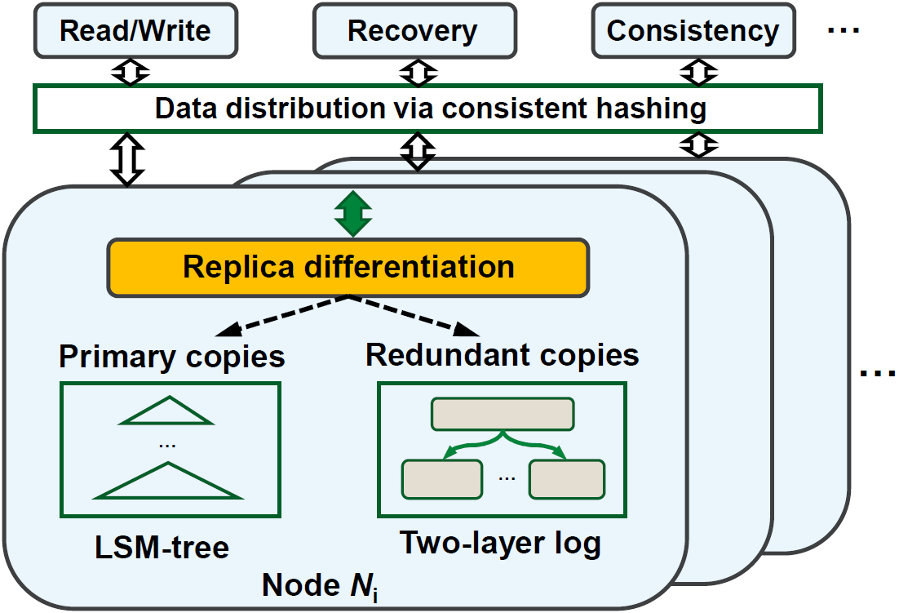
Our Design
DEPART: Replica decoupling for distributed Key-Value storage
  Primary copies: LSM-tree → efficient writes, reads and scans
  Redundant copies: two-layer log → fast writes, tunable trade-off
Key design points
  Replica differentiation
  Two-layer log with tunable ordering
  Parallel recovery scheme
Implementation atop Cassandra
Notes:
[4:00]-[5:00]: Therefore, we propose DEPART, a distributed KV store that builds on Cassandra to realize replica decoupling by separating the storage management of primary and redundant copies. For primary copies, we use LSM-tree to store to achieve efficient writes, reads, and scans simultaneously; for redundant copies, we design the two-layer log to store them, so as to achieve fast writes. Besides, Recall that using a single LSM-tree for all replicas in uniform indexing, or using multiple LSM-trees for replica decoupling, may favor high read performance, but both of them incur substantial high compaction overhead that degrades writes. So we improve the two-layer log with tunable ordering for balanced read & write performance.

Slide 11
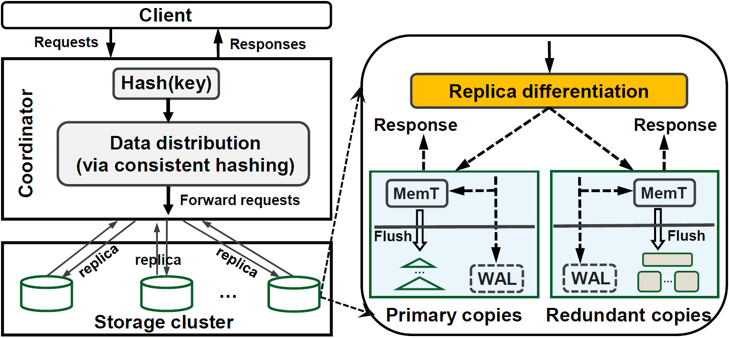
Replica Differentiation
How to differentiate primary and redundant copies?
Lightweight replica differentiation
    Based on simple hash computation
    → Low overhead
  If node ID=current node, the KV is a primary copy;
  Otherwise, it is a redundant copy
  A node receives a KV pair, computes hash(key) → Get node ID to which the KV is mapped by consistent hashing
Notes:
[5:00]-[6:00]: To realize the idea in DEPART. We have to address several key challenges.
First, how to differentiate the primary and redundant copies with limited overhead on the critical I/O path? We propose a lightweight replica differentiation scheme, we differentiates the written KV pairs in the storage module of each node as primary or redundant copies. This figure depicts the replica differentiation workﬂow. Recall that the coordinator forwards k replicas of a KV pair to a sequence of k nodes along the clockwise direction in the hash ring, where the key of the KV pair is hashed to the ﬁrst node in the node sequence. When a node N receives one of the replicas of the KV pair from the coordinator, it performs the same hash computation on the key of the replica and determines the node to which the key is hashed. If the resulting node is the same as N itself, then N is the ﬁrst node in the node sequence and we refer to the replica as a primary copy; otherwise, the replica is a redundant copy. The differentiation scheme only is based on simple hash computation, so it is low overhead.

Slide 12
Two-layer Log
How to manage redundant copies efficiently?
Two-layer log with tunable ordering
  Global log: all redundant copies are appended in a batched manner
Immutable
MemTable
Redundant copies
Memory
Disk
Batch append
  Write to global log in a batched & appended manner → efficient writes
WAL
Global log
…
Segment
Head
Tail
Notes:
[6:00]-[6:30]: Second, How to manage redundant copies efficiently after replica decoupling?
We propose a two-layer log with tunable ordering for the management of redundant copies. To enable fast writes, each node writes all redundant copies of KV pairs (ﬂushed from the immutable MemTable) to an append-only global log. All redundant copies are grouped in units of segments and appended to the head of the global log as sequential batched writes.

Slide 13
Two-layer Log
How to manage redundant copies efficiently?
Two-layer log with tunable ordering
  Local logs: split global log into different local logs in the background
Immutable
MemTable
Redundant copies
Memory
Disk
Batch append
WAL
Global log
…
Segment
A split
  Split global log into local logs → Fine-grained management,
  efficient writes & reads
  for redundant copies
Head
Tail
Split into local logs
Local log
Local log
…
Local log
  LOGi: stores redundant copies whose primary reside in node i
Notes:
[6:30]-[7:00]: To enable fine grained management and fast recovery for redundant copies, a background thread continuously splits the global log into multiple local logs, each of which keeps only the redundant copies whose corresponding primary copies are stored in the same node, for example, Local log LOGi stores redundant copies whose primary copies reside in node i. This allows the recovery of any failed node to access only the local log associated with the failed node.

Slide 14
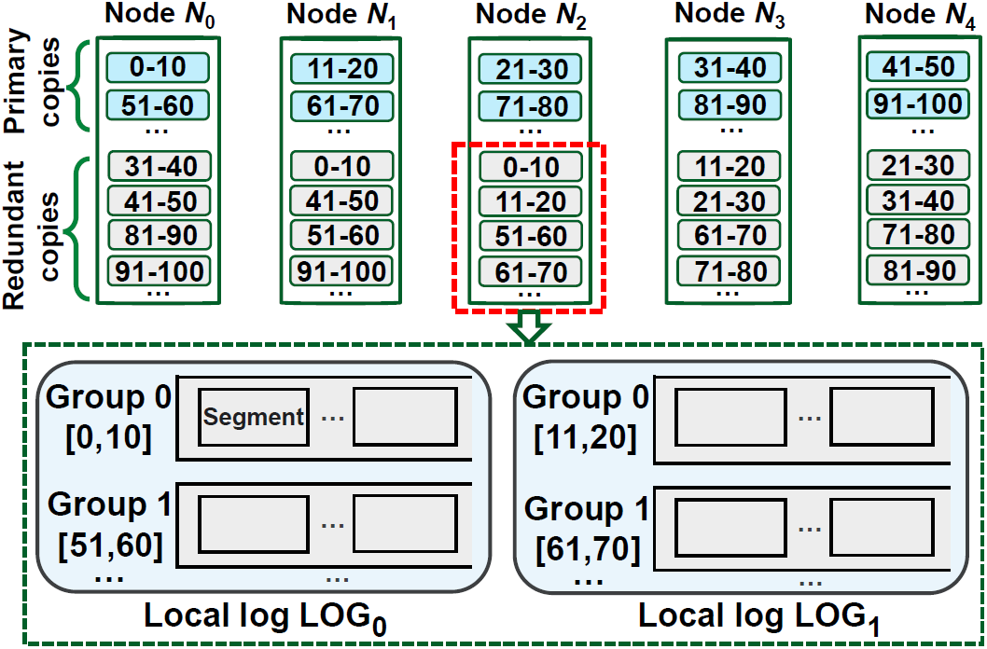
Two-layer Log
How to manage redundant copies efficiently?
  Range-based data grouping within local logs
Each node stores several ranges → divide a local log into different groups
Benefits of range grouping：
  Efficient GC: each GC only selects one group, avoid scanning the whole local log
  Efficient recovery: recovery reads only the corresponding group
Notes:
[7:00]-[8:00]: Besides, since each node stores several ranges according to consistent hashing, each local log is further divided into multiple range groups, each of which corresponds to a range in the hash ring. Note that different range groups within each local log have no overlaps in keys, so they can be managed independently. The range grouping can improve the GC efficiency and recovery, because both of them only need to read the corresponding group, avoid scanning the whole local log.

Slide 15
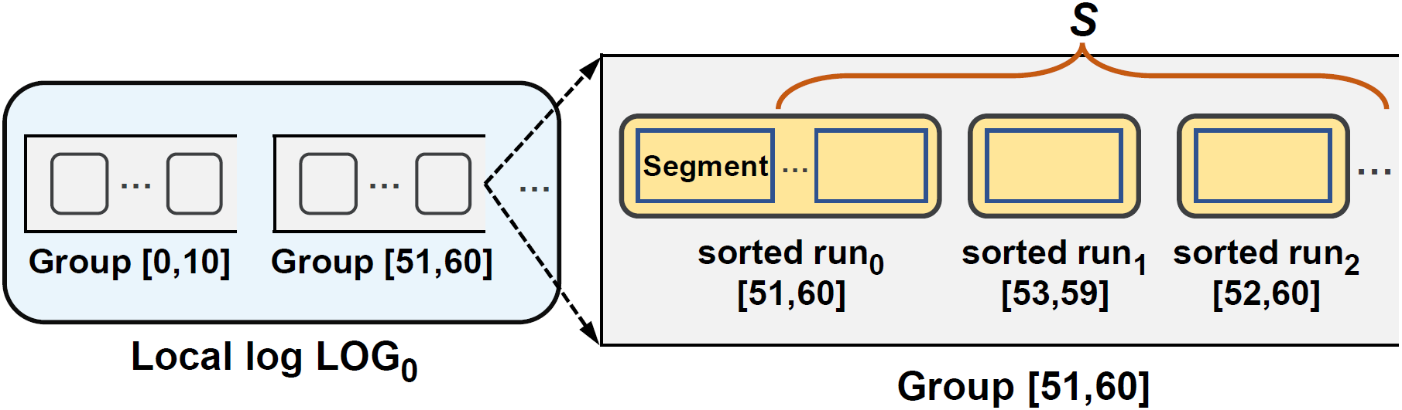
Two-layer Log
How to manage redundant copies efficiently?
  Data organization within each group
    Each group contains several sorted runs
    KV pairs within a sorted run are fully sorted, but unsorted across sorted runs
  Adjust number of sorted runs (S)
  Fewer sorted runs: high ordering, better read performance
  More sorted runs: low ordering, better write performance
Notes:
[8:00]-[9:00]: In addition, each group contains several sorted runs. Note that the internal structure of each sorted run is similar to that of SSTables in the LSM-tree, the KV pairs within sorted run are fully sorted, but unsorted between sorted runs. Therefore, we can adjust the number of sorted runs within the group to balance the read and write performance. If we keep less sorted runs within the group, then we achieve a high degree of ordering for the two-layer log that can ensure better read performance; If we keep more sorted runs within the group, then we achieve a low degree of ordering that can ensure better write performance.

Slide 16
Two-layer Log
How to adjust the ordering of the two-layer log?
  Set different degrees of ordering based on performance requirements
    Fewer sorted runs
Read-dominant workloads / High read consistency level
set a high degree of ordering to favor reads
50-60
53-59
    sorted run₀
    sorted run₁
One group
    More sorted runs
Write-dominant workloads / High write consistency level
set a low degree of ordering to favor writes
50-60
53-59
…
52-60
    sorted run₀
    sorted run₁
    sorted run_{i}
One group
Notes:
[9:00]-[10:00]: Finally, how to adjust the ordering of the two-layer log?
Considering that the ordering S determines the trade-off between the read and write performance. A small S favors the read performance by keeping a small number of sorted runs in a range group, but it incurs a large merge-sort overhead that degrades the write performance. So we can set different degrees of ordering for the two-layer log in DEPART according to the performance requirements.
To support a system setting with the high read consistency level under read-dominant workloads, we should set a high degree of ordering with a small number of sorted runs with the group to beneﬁt reads; otherwise, we should set a low degree of ordering with a large number of sorted runs with the group to beneﬁt writes.

Slide 17
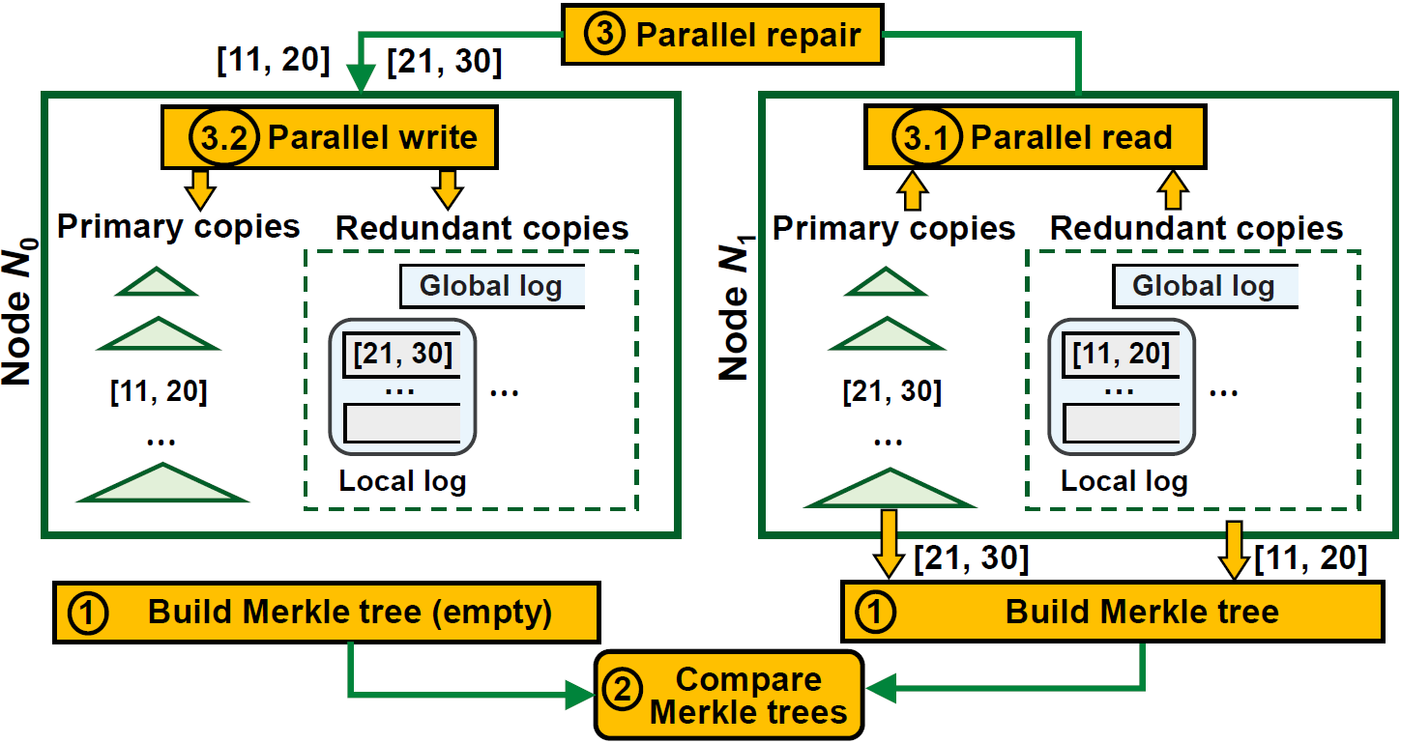
Parallel Recovery
How to perform recovery efficiently?
Parallel recovery to accelerate data repair
  When repairing multiple ranges, reading primary and redundant copies in parallel
  When building Merkle trees to detect lost data, two threads to read primary and redundant copies in parallel
Notes:
[10:00]-[11:00]: the third challenge is how to perform recovery efficiently after replica decoupling?
We propose a parallel recovery scheme that exploits the beneﬁt of decoupling the storage management of primary and redundant copies, to achieve fast recovery of any failed node. When building Merkle trees to detect lost data, we use two threads to read primary from the LSM-tree and redundant copies from the two-layer log in parallel. Besides, when repairing multiple ranges, we also use two threads to read primary and redundant copies in parallel from the surviving nodes, then issue parallel writes for the primary and redundant copies with two threads in the failed node.

Slide 18
Experiments
Setup:
  6 nodes (5 storage nodes + 1 client node), 10 Gb/s Ethernet switch
  Workloads: YCSB 0.15.0, 1KB KV pairs, Zipf distribution (0.99)
  Parameters: three replicas, (WCL=ONE, RCL=ONE) by default
Comparisons:
  Cassandra v3.11.4 VS multiple LSM-trees (mLSM) VS DEPART
  DEPART builds on Cassandra v3.11.4
Server configuration
Machine | CPU | Memory | Disk | OS
6 nodes | 12-core Intel(R) Xeon(R) CPU E5-2650 v4 @ 2.20 GHz 4 | 32-GiB DDR4 2400 MHz | 500 GiB SSD | CentOS 7.6.1810 64-bit Linux kernel 3.10.0
Notes:
[11:00]-[11:30]: We run all experiments in a local cluster that has six machines. Each machine has 32 GiB RAM, 500GiB SSD, and all machines are connected via 10 Gb/s network. We use YCSB tool to generate workloads. By default, we focus on 1KiB KV pairs, and generate requests based on the Zipf distribution. We deploy three replicas and set (WCL=ONE, RCL=ONE) by default. We compare our DEPART prototype with Cassandra and multiple LSM-trees design (mLSM).

Slide 19
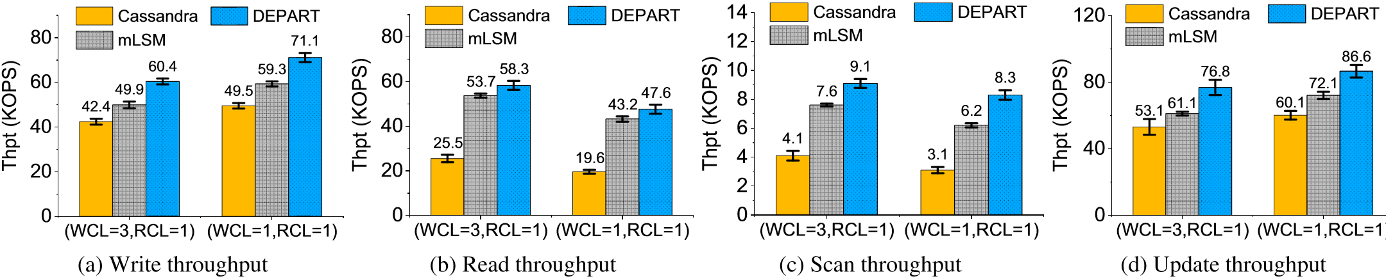
Micro-benchmarks
Client first writes 200M KV pairs, followed by 20M reads, 2M scans, and 200M updates
Compared to Cassandra, DEPART improves writes, reads, scans and updates up to 1.43X, 2.43X, 2.68X and 1.44X;
mLSM notably improves reads, but marginal improvements on writes
Notes:
[11:30]-[12:30]: We ﬁrst compare the performance of Cassandra, mLSM, and DEPART in different KV operations, including writes, reads, scans and updates. Figures show the throughput. First, DEPART improves the overall performance over Cassandra in all cases.
Second, mLSM notably improves the read performance over Cassandra, but only shows marginal improvements on writes. The reason is that mLSM still triggers frequent compaction operations, which compete for disk bandwidth and degrade write performance.

Slide 20
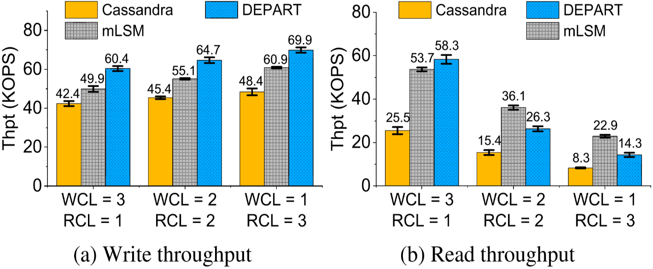
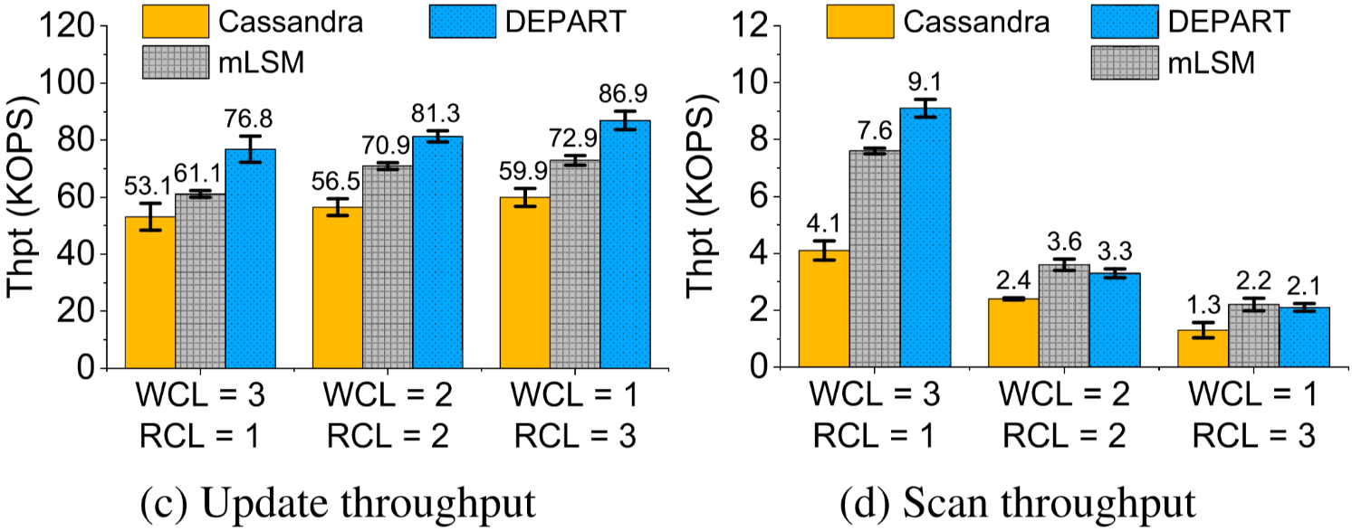
Consistency Configurations
For strong consistency, conﬁgurations under triple replication: (WCL=3, RCL=1), (WCL=2, RCL=2), (WCL=1, RCL=3)
DEPART consistently improves writes, reads, scans, updates over Cassandra;
For RCL ≥ 2, the read gains of DEPART over Cassandra become smaller
Notes:
[12:30]-[13:30]: We also evaluate the performance under different consistency conﬁgurations. In particular, for strong consistency, we consider three different conﬁgurations for WCL and RCL under triple replication.
DEPART consistently improves all the throughput over Cassandra under different consistency conﬁgurations. DEPART also consistently improves the throughput of writes and updates over mLSM.
However, the read performance gains of DEPART over Cassandra become smaller, and DEPART’s read performance is worse than mLSM for RCL≥2. In this case, each read request needs to access at least two replicas successfully, so the redundant copies in the two-layer log must be searched. As the redundant copies in the two-layer log are not fully sorted, the performance is slower than reading the primary copies in the LSM-tree. Nevertheless, DEPART still achieves faster reads than Cassandra, as it searches for less data than Cassandra. Also, mLSM keeps redundant copies being fully sorted in each level, so it achieves higher read performance than DEPART.

Slide 21
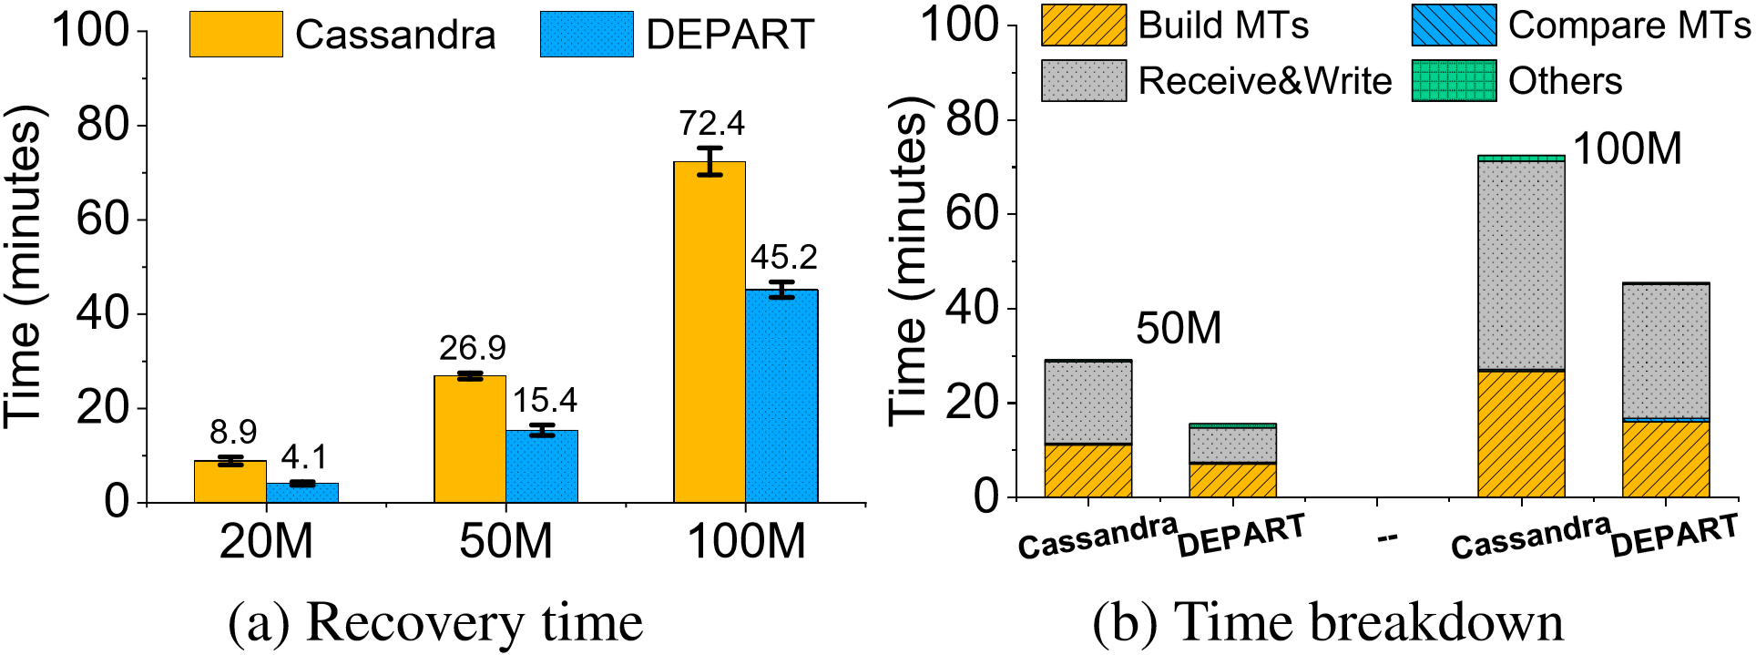
Recovery Performance
Write 20M, 50M,100M KV pairs; erase data in a node; recover
DEPART reduces recovery time of Cassandra by 38-54%; and DEPART reduces the time costs of Build MTs and Receive&Write by nearly one half
Notes:
[13:30]-[14:30]: We also evaluate the recovery performance on recovering a failed node. We consider different write sizes, by conﬁguring the client to write different number of KV pairs to the cluster. We then crash one node and remove all its data, finally perform recovery. The results show that DEPART reduces the recovery time of Cassandra by 38-54%; and DEPART reduces the time costs of Build MTs and Receive&Write by nearly a half of Cassandra by reading/writing the primary and redundant copies in parallel.

Slide 22
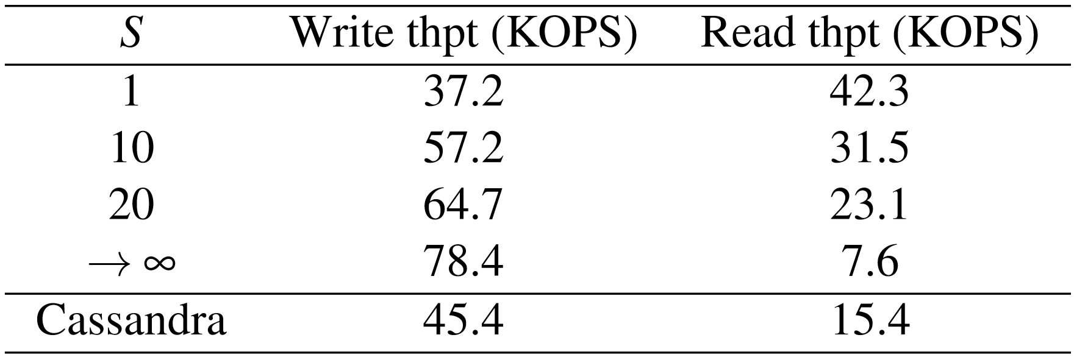
Impact of Ordering Degree S
Write & read performance versus ordering degree S
Increasing S from 1 to $∞$, the ordering of the two-layer log is relaxed and hence merge-sort overhead becomes smaller, so write thpt increases but read thpt decreases
Notes:
[14:30]-[15:30]: We also evaluate the write and read performance under different settings of the ordering degree S in DEPART, so as to show how DEPART can balance the read and write performance gains for the redundant. If S = 1, the two layer log reduces to a two-level LSM-tree, so it achieves the highest read throughput as the KV pairs are fully sorted, but the write throughput is the least due to the frequent merge sorts. As we increase S to 20, the ordering of the two-layer log is relaxed and hence the merge-sort overhead becomes smaller, so the write throughput increases.
As we set S to be a sufﬁciently large value, the two-layer log reduces to the append-only log, so the write throughput is the highest, but the read throughput is the least.

Slide 23
Conclusions
DEPART: Replica decoupling for high-performance & reliable distributed KV storage
  Lightweight replica differentiation
  Two-layer log design for redundant copies for fast writes & recovery
  Tunable ordering to balance reads and writes
  Parallel recovery for fast recovery
More evaluation results and analysis are in the paper
The source code is at https://github.com/ustcadsl/depart
Notes:
[15:30]-[16:00]: To conclude, we propose DEPART, a distributed Key-Value storage with replica decoupling to enable high-performance and reliability. DEPART contains several key designs. Please refer to the paper for detailed results and analysis.
We open source our code in our project website.

Slide 24
Thanks for your attention!
Q&A
Notes:
Thank you. I’d like to take your questions and comments.

