Slide 1
ShieldReduce: Fine-Grained Shielded Data Reduction
Jingyuan Yang*, Jun Wu*, Ruilin Wu*, Jingwei Li*, Patrick P. C. Lee#,
Xiong Li*, and Xiaosong Zhang*
*University of Electronic Science and Technology of China (UESTC)
#The Chinese University of Hong Kong
USENIX ATC 2025

Slide 2
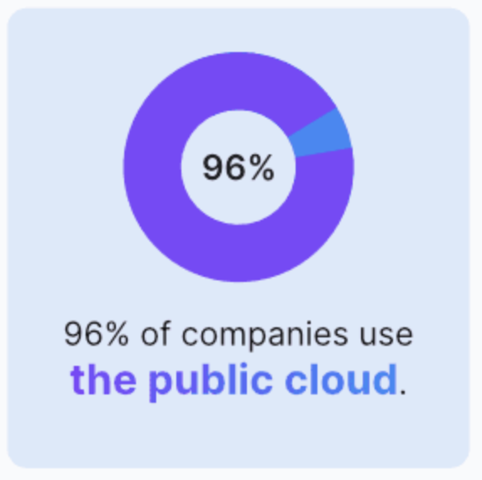


Outsourcing Storage
Data outsourcing is common in organizations
  60% of business data is now stored in cloud
Two goals:
  Storage efficiency: small storage footprints
  Security: no unauthorized access to outsourced data
https://spacelift.io/blog/cloud-computing-statistics

Slide 3
Deduplication
Coarse-grained compression
  Stores only one physical copy for chunks with same content
  ~10x data reduction in backup workloads [Wallace, FAST’12]
Data reduction ratio = 12/7
Chunks with same color have identical content

Slide 4



Encrypted Deduplication
Combine deduplication with encryption for data confidentiality
Content-derived key
Message-locked encryption (MLE)
[Bellare, Eurocrypt’13]
K
🔒
Original chunk
Encrypted chunk
MLE
🔒
……
Deduplication
🔒
MLE
🔒
Multiple clients
Cloud

Slide 5
Limitations of Encrypted Deduplication
Deterministic encryption leaks number of occurrences of chunks
Encrypted chunks are incompressible
MLE
🔒
……
Deduplication
🔒
MLE
🔒
Multiple clients
Cloud

Slide 6
Fine-grained Shielded Data Reduction
Apply deduplication, delta compression, and local compression
  Delta compression encodes content difference between new chunk M’ and previously stored base chunk M similar to M’
Protect whole data reduction via SGX enclave
Protect leakage
Encryption
🔒
Enclave
……
Fine-grained
Data Reduction
🔒
Encryption
🔒
High storage efficiency
Multiple clients
Cloud

Slide 7
Challenges
SGX incurs high context-switch overhead when moving data across enclave boundaries [Weisse, ISCA’17]
Delta compression incurs high I/O overhead in disk I/O and SGX context switching
Frequently load base chunks from disk into enclave
M
Delta compression
Local compression
Deduplication
M’
M’
Enclave boundary
Enclave boundary
Disk

Slide 8
Our Contributions
ShieldReduce: an outsourced backup storage system based on fine-grained shielded data reduction
  Bi-directonal delta compression to mitigate I/O overhead
  Hybrid inline and offline compression to limit I/O interference with normal operations
Testbed experiments
  Up to 3.5x upload speedup with bi-directional delta compression
  Up to 3.6x storage savings
Open-sourced prototype

Slide 9
Main Idea
Insight: If M′ is modified from M (i.e., M is base chunk of M'), neighbors of M are likely base chunks of neighbors of M’
  Extend locality in deduplication to chunk similarity
  Batch-loading base chunks from disk to mitigate I/O overhead
Bi-directional delta compression
  If locality degrades, reconstruct locality via backward delta compression
Forward：
M’
+
Delta_{M’→M}
Old base chunk
M’
Delta compression
New chunk
M
Backward：
M
+
Delta_{M→M’}
New base chunks can be stored together

Slide 10
Example
Suppose backup version V₀ is stored
Challenge: Mitigate backward delta compression’s overhead
A₁
A₀
A₂
A₁
A₀
A₃
A₂
A₁
A₀
V2
V0
B₁
B₀
B₂
B₁
B₀
B₃
B₂
B₁
B₀
C₁
C₀
C₂
C₁
C₀
C₃
C₂
C₁
C₀
D₁
D₀
D₂
D₁
D₀
D₃
D₂
D₁
D₀
V₁
V₀
V₂
V₁
V₀
V₃
V₂
V₁
V₀
Forward
Backward
Forward
Only V₂ is loaded to compress V₃

Slide 11
Design Overview
Extend DEBE[*] with fine-grained data reduction inside enclave
  Perform forward delta compression for high performance on the write path
  Offload backward delta compression off the write path for storage efficiency
On the write path
Off the write path
Persistent Storage
Frequency-based
Deduplication from DEBE
Locality-based Inline Compression
Encryption
Chunk
Batch
SGX
Enclave
Tunable Offline Compression
Decryption
[*] "Secure and Lightweight Deduplicated Storage via Shielded Deduplication-Before-Encryption“, USENIX ATC 2022.

Slide 12
Locality-based Inline Compression
Measure physical locality of a chunk batch based on how base chunks are spread across containers
  For a batch with n chunks, unique chunks have base chunks across q containers → locality = q/n
Duplicate Chunk
Unique Chunk having Similar Chunk
Base Chunk
Chunk Batch
Container
q = 2
Locality = 0.4
n = 5
3 unique chunks
Container

Slide 13
Locality-based Inline Compression
If locality exists (i.e., q/n is less than some threshold), perform forward delta compression inline
  Maintain a delta index that tracks all delta compression relationships
Delta-compress M’ with respect to M
Container
M
M’
Container
Delta_{M→M’}
M’
Locality
Exists
Base
Chunk
New
Chunk
Chunk
Batch
M
M → {…,M’}
...
Delta
Index

Slide 14
Locality-based Inline Compression
If locality doesn’t exist, prepare for offline compression
  Maintain a backward index that maps a base chunk M to data chunks {M’} that will be delta-compressed offline
Container
Container
M’
Container
Locality
Doesn’t Exists
M → {M’,…}
...
Backward
Index
Chunk
Batch
M

Slide 15
Tunable Offline Compression
Perform backward delta compression of M
  Choose most recent chunk M’ in M’s backward index as new base chunk
  Delta-compress chunks with respect to M’
    Type I: Old base chunk M
    Type II: Deferred chunks (e.g., M’’) similar to M
    Type III: Already delta-compressed with respect to M
  Replace old persistent copies by new ones corresponding to M’
Backward Index
Delta Index
Delta_{M’→M}
M’
Delta_{M’→M}
Discard
M → {M’, M’’,…}
M → {…}
Delta_{M’→M}
M
Delta_{M’→*}
M
Type I
Type II
Type III
Disk
New Base Chunk

Slide 16


Tunable Offline Compression
Tunable performance-storage trade-off via a user-specified offline reduction target 𝜶 (smaller 𝜶 means to reduce more data)
  Sort old base chunks by number of associated data chunks
  Apply backward delta compression, starting with old base chunks with fewest associated chunks
  Stop backward delta compression for old base chunks when 𝜶 is reached
Backward delta compression on old base chunks in order until $α$is satisfied
High processing performance
{M} with fewer associated chunks
{M} with more associated chunks
High
storage saving
0
1
Offline reduction target $α$

Slide 17
Experimental Setup
Testbed based on Alibaba Cloud
  Three real-world datasets (Linux, Web and Docker) and one synthetic dataset (SimOS)
Three shielded execution baselines:
  DEBE _{[Yang, ATC’22]}: deduplication and local compression
  SecureMeGA: performance-oriented design _{[Zou, ATC’22]} adapted to shielded execution
  ForwardDelta: forward delta compression only

Slide 18
Overall Data Reduction
A parameter that configures performance-storage trade-off in offline compression
Datasets | DEBE | ShieldReduce |  |  |  | Secure MeGA | Forward Delta
 |  | α=0 | α=0.5 | α=0.7 | α=1
Linux | 5.8 | 25.8 | 12.2 | 8.9 | 6.3 | 12.1 | 25.1
Web | 13.1 | 58.6 | 27.9 | 19.9 | 14.0 | 16.1 | 60.6
Docker | 8.6 | 14.9 | 14.4 | 12.9 | 10.3 | 14.0 | 15.0
SimOS | 59.3 | 63.6 | 63.6 | 63.6 | 61.0 | 60.2 | 63.3
ShieldReduce achieves high storage savings
  Up to 4.5x and 3.6x data reduction ratios compared with DEBE and SecureMeGA, respectively

Slide 19
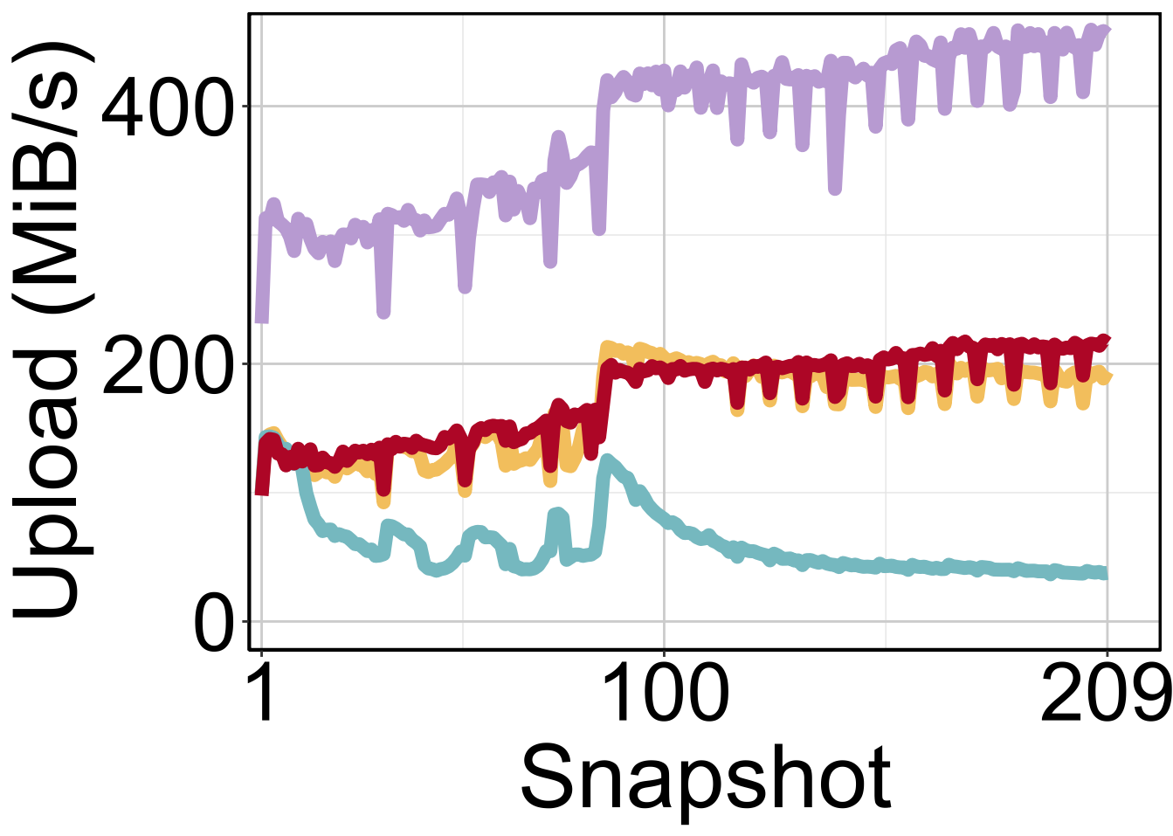
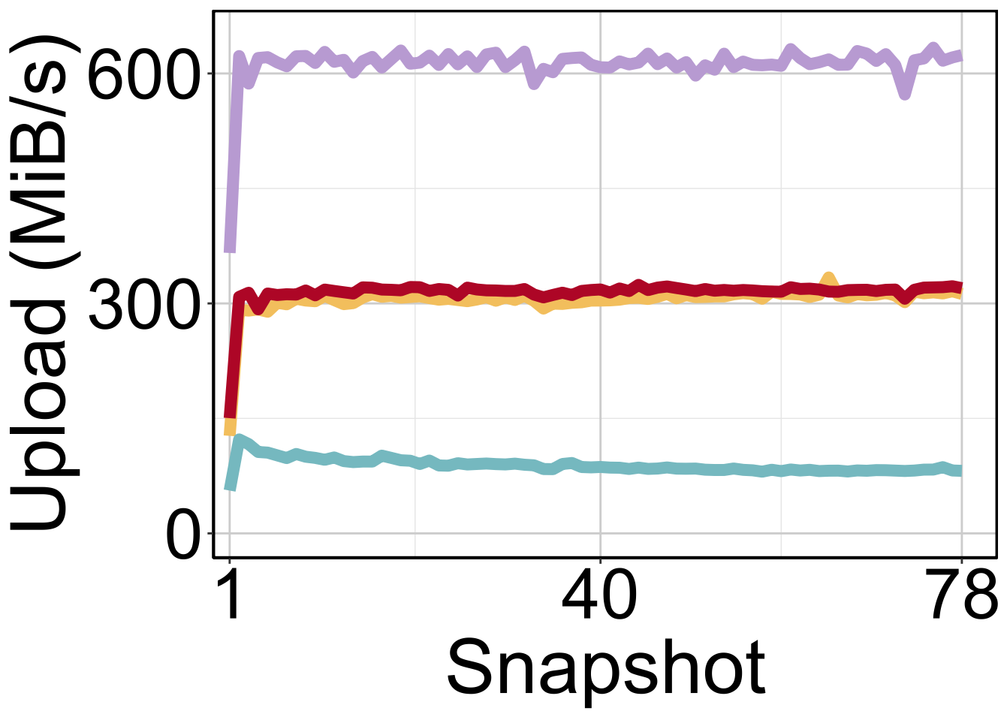
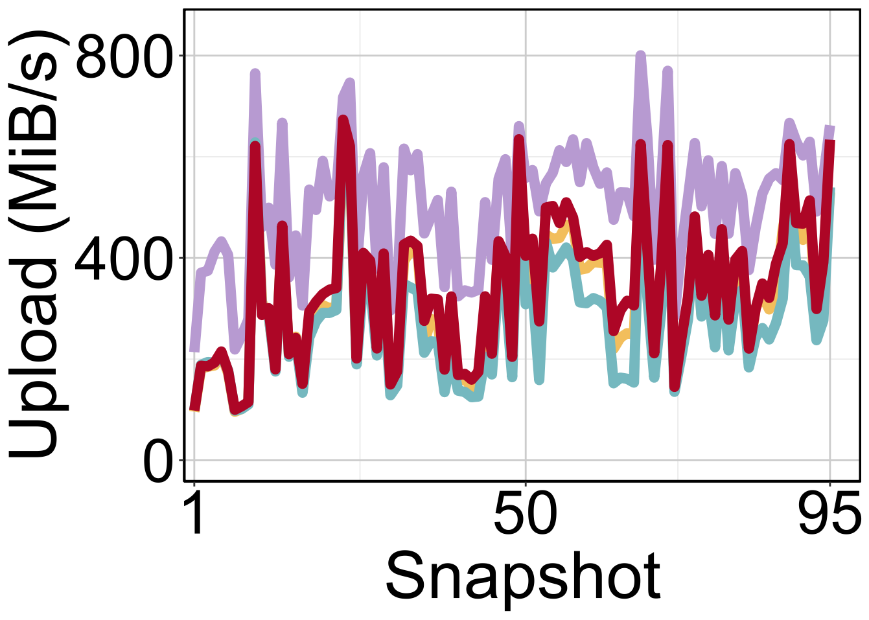
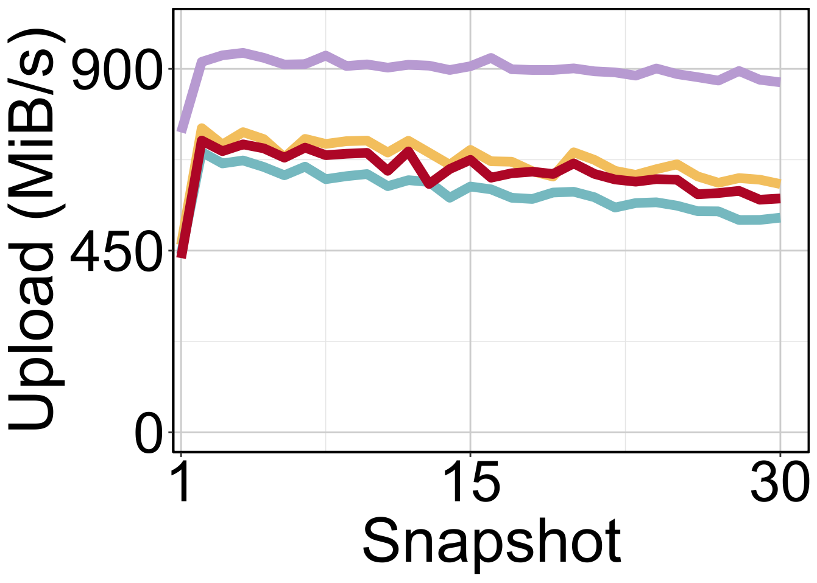
Inline Performance
(a) Linux
(b) Web
(c) Docker
(d) SimOS
ShieldReduce preserves high performance on the write path
  1.1-3.5x throughput gains compared to ForwardDelta
  Slower than DEBE due to delta compression

Slide 20
Enclave Overhead
Dataset |  |  | DEBE | ForwardDelta | ShieldReduce
 |  |  |  |  | Inline | Offline
Linux | #ECall |  | 0.2M |  |  | 209
 | #OCall | Index queries | 0.2M | 0.4M |  | 963.6M
 |  | Index updates | - | - | 0.04M
 |  | Data transfers | 0.03M | 2.6M | 0.06M
 |  | Total | 0.23M | 3.0M | 0.5M
ShieldReduce reduces #OCalls for ForwardDelta by up to 83.3% on the write path
ShieldReduce (with offloading to reconstruct locality) has up to 4.6x data reduction per OCall

Slide 21



Conclusion
ShieldReduce: a secure outsourced backup storage system based on fine-grained shielded data reduction
  Bi-directional delta compression + Hybrid inline and offline compression
Source code: https://github.com/YangJingyuan99/shieldreduce
Offload compression for high inline performance
Inline Compression
Offline Compression
Reconstruct locality to preserve inline performance

