Slide 1
The transformer and large language model
KH Wong

Slide 2
Part 1: Transformer model
KH Wong

Slide 3
Introduction
Basic structure
Processing steps
Encoder
Decoder
Applications
Natural Language Processing (NLP) Question and Answer Demo (English) by Pragnakalp Techlabs
Summary

Slide 4
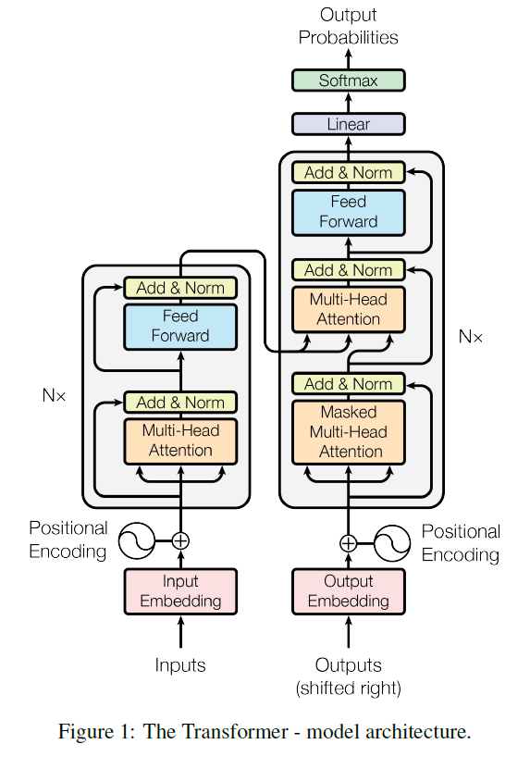
Basic structure encoder + decoder
Decoder
Basic processing
7)Decoder: feed forward network
Encoder
This Encoder can repeat N times to enhance capability.
4b) second add & Norm
4a) feed forward :
6) Decoder:
multi-head self-attention for input/target
3b) first add & Norm :
3a) Multi-head attention
(MHATT) output
2) Positional encoding (XPE)
5) Decoder:
multi-head self-attention for target
1) Input embedding
Input(X)
https://pytorch.org/tutorials/beginner/transformer_tutorial.html
https://bbycroft.net/llm (graphical display of transformer models)

Slide 5
Transformer
Processing steps

Slide 6
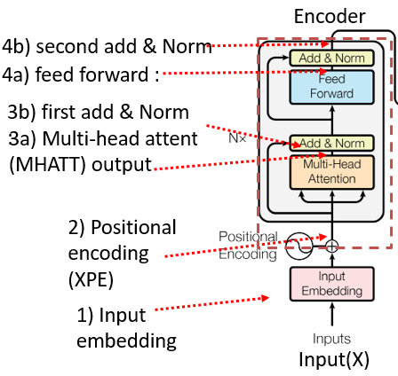
Encoder Processing steps
1) Input embedding, two methods
(1a) By learning
(1b) (subword embedding: wordpiece algo.)
2) Positional encoding
3a) Multi-head attention
3b) First Add and Norm
4a) feed forward network
4b) Second Add and Norm

Slide 7
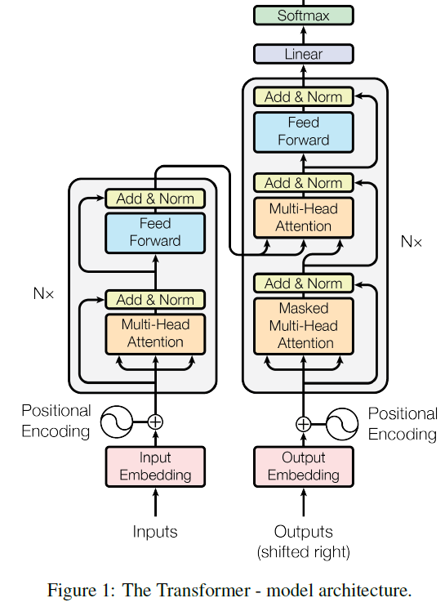
Overview
https://pytorch.org/tutorials/beginner/transformer_tutorial.html
AMMUS : A Survey of Transformer-based Pretrained Models in Natural Language Processing https://arxiv.org/abs/2108.05542
A tutorial: https://jalammar.github.io/illustrated-transformer/
Transformers in Vision: A Survey https://arxiv.org/pdf/2101.01169.pdf

Slide 8
1a) Input embedding using learning
The Transformer (original paper) uses a random initialization of the weight matrix and refines these weights during training – i.e. it learns its own word embeddings.
Reference https://ai.stackexchange.com/questions/26235/what-kind-of-word-embedding-is-used-in-the-original-transformer

Slide 9
1b) Input embedding using subwords
In Natural Language Proecessing NLP, it is common to resent a word using an algorithm called wordpiece
https://huggingface.co/learn/llm-course/chapter6/6 ,
Method: word→ subwords
"playing" → ["play", "##ing"]
"linear" → ["lin", "##ear"]
"algebra" → ["al", "##ge", "##bra"]
There may be 30K subwords
Why?: Reduces Vocabulary Size , words can be combined by subwords, hence total dictionary size is reduced.
It uses a trainable neural net (matrix) to convert each subword ( 30000x1 one hot vector) into a vector of 768x1 for each word. (In GPT3 or BERT)
768x1
X_{in}30000x1
X_{in} is in on-hot
https://mccormickml.com/2019/05/14/BERT-word-embeddings-tutorial/
https://towardsdatascience.com/wordpiece-subword-based-tokenization-algorithm-1fbd14394ed7

Slide 10
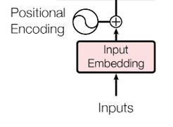
Input/token embedding matrix
X=Xin*W
Xin
W is a linear weight matrix to be learned by training together with the whole transformer. It has no activation function or bias, just a simple linear mapping matrix. Xin is one hot (shape V x1 = 30000 x 1)
X_{(L x dmodel)}=Xin _{(L x V)} *W_{(V x dmodel)} ; Xin is in one-hot
X_{(L=8192 x dmodel=768)}= Xin _{(L=8192 x V=30000)} *W_{(V=30000 x Dmodel =768)}
dmodel= token embedded size (e.g. GPT3 is 768). For GPT4 it is about 12288.
V= vocabulary size (e.g. BERT is 30000). For GPT4 vocab size=100,256.
L=context window=maximum number of tokens (e.g. 512). For GPT4 it is 8,192–128,000

Slide 11
Why Sub-word methods?
Using traditional “word2vec, Glove” have the Out-Of-Vocabulary (OOV) problem -- a word is not in the library.
Sub-word embedding is used to overcome the OOV problem. There are several schemes
Byte Pair Encoding https://en.wikipedia.org/wiki/Byte_pair_encoding
WordPiece (used by BERT) https://paperswithcode.com/method/wordpiece
Etc.

Slide 12
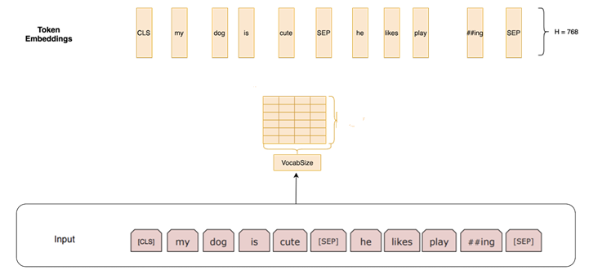
Convert “subword” into “token” (for the Transformer) https://www.exxactcorp.com/blog/Deep-Learning/how-do-bert-transformers-work
Example: A dictionary has VocabSize=≈30000, sub-words=30500
A subword Xin =L x 30500 (one hot; only 1 bit is 1 , other bits are 0)
A token (X _{(L x dmodel)}) has embedded size dmodel=768. (768 floating point numbers ,not one hot)
Using X _{(L x dmodel=768 )} = Xin_{(L x v=30500 )} *W_{(v=30500*dmodel=768)} to convert Xin to X. A learnable weight matrix W is used. For the conversion.
X=768x1
W^{T}=
dmodel=768 (embedded size)
VocabSize=30533
each subword is a vector Xin=(L x 30533) (L x onehot_vector)

Slide 13

Exercise 1
The VocabSize a dictionary is v=10000.
1.a) How to represent a subword token vector?
One-hot vector of size 10000x1 ,
A matrix of size 10000x10000,
A matrix of size 100x100.
1.b) The subword (Xin _{L x v} ) is to be converted to a token X by a weight matrix W . If a token is embedded using dmodel=512, what is the size of the weight matrix (W). Hint: X _{(L x dmodel )} = Xin_{(L x v )} *W
W_{10000 x 512}
W_{512 x 10000}
W_{512 x 512}
W_{10000 x 10000}

Slide 14
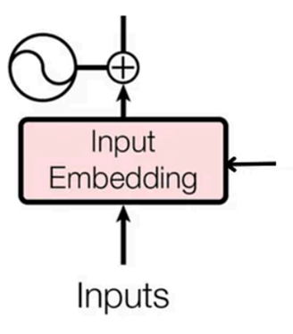
Example: Embedding vector dimension (dmodel) =6 for each word, input sentence length(L) =5 words The sentence (or token sequence) “All men eat hot pie” (Note: context length means the max length of the sequence)
Ans: Q1.a) (1)One hot vector of size 10000x1,(correct). Q1.b) (choice 1) W_{10000 x 512} is correct
Positional encoding
Input=X=
0.8147 0.0975 0.1576 0.1419 0.6557 0.7577
0.9058 0.2785 0.9706 0.4218 0.0357 0.7431
0.1270 0.5469 0.9572 0.9157 0.8491 0.3922
0.9134 0.9575 0.4854 0.7922 0.9340 0.6555
0.6324 0.9649 0.8003 0.9595 0.6787 0.1712
X= All men eat hot pie
Token Embeddingsize is 6

Slide 15
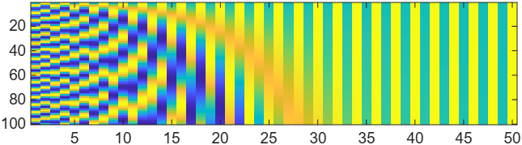
2) Positional encoding
Make sure each position of the input sequence has a different code

Slide 16
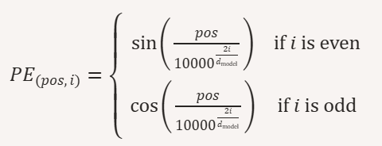
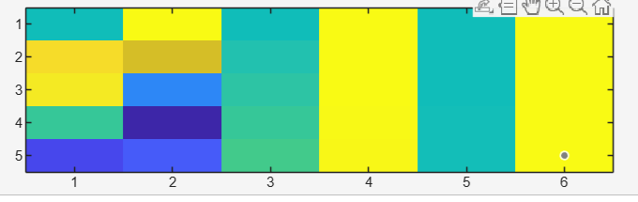
Positional encoding examples
PE = positional_encoding(100, 50);
Example: Sequence length=100, d_model=50
%code generated by copilot 2025.11.10
function PE = positional_encoding(seq_len, d_model)
PE = zeros(seq_len, d_model);
for pos = 0:seq_len-1
for i = 0:floor((d_model-1)/2)
angle = pos / (10000^(2*i/d_model));
PE(pos+1, 2*i+1) = sin(angle); % even indices (1-based)
if 2*i+2 <= d_model
PE(pos+1, 2*i+2) = cos(angle); % odd indices (1-based)
end
end
end
end
% Example usage:
clear
%generated by copilot 2025.11.10
%function PE = positional_encoding(seq_len, d_model)
PE = positional_encoding(5, 6);
%PE = positional_encoding(100,50);
disp(PE);
figure(1)
clf
imagesc(PE)
PE = positional_encoding(5, 6);
Example: Sequence length=5, d_model=6
0 1.0000 0 1.0000 0 1.0000
0.8415 0.5403 0.0464 0.9989 0.0022 1.0000
0.9093 -0.4161 0.0927 0.9957 0.0043 1.0000
0.1411 -0.9900 0.1388 0.9903 0.0065 1.0000
-0.7568 -0.6536 0.1846 0.9828 0.0086 1.0000

Slide 17
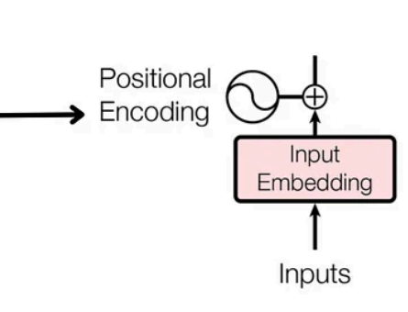
Example: Embedding vector dimension (dmodel) =6 for each word, input sentence length(L) =5 words
Positional encoding(PE) and input(X) have same dimensions, so they can be added
XPE _{(5x6)}
PE_{(5x6)}=Positional encoding =
0 1.0000 0 1.0000 0 1.0000
0.8415 0.5403 0.0464 0.9989 0.0022 1.0000
0.9093 -0.4161 0.0927 0.9957 0.0043 1.0000
0.1411 -0.9900 0.1388 0.9903 0.0065 1.0000
-0.7568 -0.6536 0.1846 0.9828 0.0086 1.0000
https://medium.com/@sumith.madupu123/understanding-transformer-architecture-using-simple-math-be6c2e1cdcc7
X_{(6x5)}
Notes:
import numpy as np
import matplotlib.pyplot as plt
def positional_encoding(seq_length, d_model):
"""Generates a positional encoding matrix where rows are encoding dimensions and columns are sequence positions."""
PE = np.zeros((d_model, seq_length)) # Transpose structure: rows = encoding, columns = sequence positions
for pos in range(seq_length):
for i in range(d_model):
theta = pos / np.power(10000, (2 * (i // 2)) / d_model) # Scaling factor
PE[i, pos] = np.sin(theta) if i % 2 == 0 else np.cos(theta) # Sin for even indices, Cos for odd indices
return np.round(PE, 3) # Round to 4 decimal places for clarity
# Define parameters
seq_length = 6 # Number of words (tokens)
d_model = 5 # Embedding vector size (each row represents a positional encoding dimension)
PE_matrix = positional_encoding(seq_length, d_model)
# Display the transposed positional encoding matrix
print("\nPositional Encoding Matrix (Rounded to 4 Decimal Places):\n")
for row in PE_matrix:
print("\t".join(map(str, row)))
# Visualization
plt.figure(figsize=(8, 5))
plt.imshow(PE_matrix, aspect='auto', cmap='coolwarm')
plt.colorbar(label="Encoding Value")
plt.xlabel("Sequence Position") # X-axis represents token positions
plt.ylabel("Encoding Dimension") # Y-axis represents encoding dimensions
plt.title("Positional Encoding Heatmap (Rows = Encoding, Columns = Sequence)")
plt.show()

Slide 18
Output Shape=
L x dmodel
(XPE_{(L=5 x dmodel=6)})
Input to multi-head attention:
Positional encoding + Input sentence
Input Shape=
L=5 x dmodel=6

Slide 19
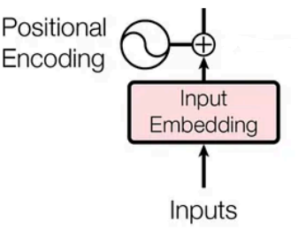
Input to multi-head attention
Exercise 2
Find the value “?” XPE(row=4,col=3)
Choices:
0.6242, (2) 1.6544 ,
0.1223 , (4) 0.2139
XPE=Positional encoding + Input sentence
0.8147 1.0975 0.1576 1.1419 0.6557 1.7577
1.7473 0.8188 1.0170 1.4207 0.0379 1.7431
1.0363 0.1308 1.0499 1.9114 0.8534 1.3922
1.0545 -0.0325 ? 1.7825 0.9405 1.6555
-0.1244 0.3113 0.9849 1.9423 0.6873 1.1712
PE=Positional encoding
PE_{(5x6)}=Positional encoding =
0 1.0000 0 1.0000 0 1.0000
0.8415 0.5403 0.0464 0.9989 0.0022 1.0000
0.9093 -0.4161 0.0927 0.9957 0.0043 1.0000
0.1411 -0.9900 0.1388 0.9903 0.0065 1.0000
-0.7568 -0.6536 0.1846 0.9828 0.0086 1.0000
+
Input=X=
0.8147 0.0975 0.1576 0.1419 0.6557 0.7577
0.9058 0.2785 0.9706 0.4218 0.0357 0.7431
0.1270 0.5469 0.9572 0.9157 0.8491 0.3922
0.9134 0.9575 0.4854 0.7922 0.9340 0.6555
0.6324 0.9649 0.8003 0.9595 0.6787 0.1712
5 words in a sentence (=token or context length)
X= All men eat hot pie

Slide 20
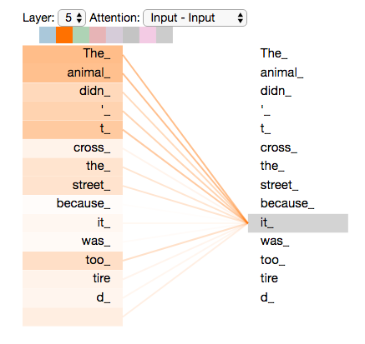
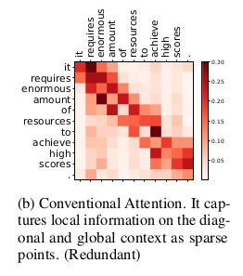
What is attention (in encoder, it is called self-attention)?
Answer 2: choice 1, XPE(row=4,col=3)=0.6242 is correct
It measures how words are related in the same sentence.
Darker color represents higher correlation
https://www.tensorflow.org/text/tutorials/transformer
https://jalammar.github.io/illustrated-transformer/
https://gsarti.com/post/iclr2020-transformers/
https://dmol.pub/dl/attention.html good example

Slide 21
Basic structure encoder + decoder
Decoder
Basic processing
7)Decoder: feed forward network
Encoder
The Encoder can repeat N times to enhance capability.
4b) second add & Norm
4a) feed forward :
6) Decoder:
multi-head self-attention for input/target
3b) first add & Norm :
3a) Multi-head attention
(MHATT) output
2) Positional encoding (XPE)
5) Decoder:
multi-head self-attention for target
1) Input embedding
Input(X)
https://pytorch.org/tutorials/beginner/transformer_tutorial.html
https://bbycroft.net/llm (graphical display of transformer models)

Slide 22
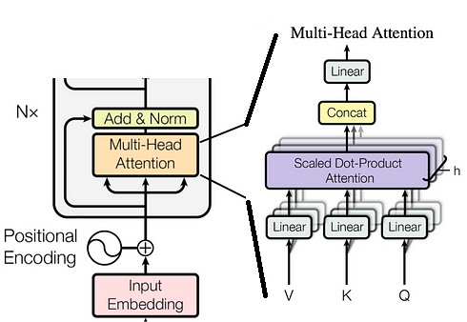
Step3a: Inside the Multi-head attention block
Output shape =
L x dmodel
Input Shape=
L x dmodel
Multi-head
attention

Slide 23

Meaning of Query ,Key ,Value
https://www.freepik.com
When you search for movie in a database , e.g. Netflix, Disney+, YouTube,….
Queries (input in the search bar), against a set of Keys (e.g. USA movies, types, storyline, etc.), then the results are Values (best matched videos).
If Queries = “Classic movie”,
and Keys = “crime, thriller”
Values= search results,“Psycho , Godfather1.. ”
Search Queries (Q)
“Classic movies”
Use Key (K)
“crime , thriller”
Result: Values (V):
“Pycho, Godfather1”

Slide 24
Per head calculation
In this example
Token embedded dimension (dmodel)=6,
or called hidden dimension
Number of head h=3
Dimension per head (dq=dk=dv)= dmodel/h=6/3=2
We will discuss the projection matrices per head (Wq). Dimension of Wq(dmodel*dq)=6x2 etc.

Slide 25
Obtain Q,K,V by learned project matrices Wq(6x2),Wk(6x2),Wv(6x2)
L=length of token
dmodel=token embedded dimension=6
Per head operation, Per_head_dimension(dq,dk,dv)=2
Q(L=5 x dq=2)=XPE(L,dmodel)*Wq (dmodel,dq) +1_{L}*(b_{dq})^{T}
K(L=5 x dk=2)=XPE(L,dmodel)*Wk (dmodel,dk) +1_{L}*(b_{dk})^{T}
V(L=5 x dv=2)=XPE(L,dmodel)*Wv (dmodel,dv) +1_{L}*(b_{dv})^{T}
For the biases (Biases are optional, for small systems, they are skipped)
E.g. dq=2, L=5
1_{L}=a column vector of 1 with length L=[1 1 1 1 1]^{T} =[1;1;1;1;1] shape Lx1
(b_{dq} )^{T} =a row vector of biases of length dq=[b1 ; b2] ^{T} = [b1,b2] shape 1 x dq
1_{L}*(b_{dq})^{T}=[1 1 1 1 1]^{T} *[b1 ; b2] ^{T} = [1 1 1 1 1]^{T} *[b1,b2], shape L=5 x dq=2
1_{L}*(b_{dq})^{T}=[b1 b2
b1 b2
b1 b2
b1 b2
b1 b2]
Note: you may interpret the above formulas (per head) as the operations of neurons.
Since dq=2, hence each head has 2 neurons.
Each row of XPE is referring to a token, b1 and b2 are biases of the 2 neurons
Wq is the weights of 2 neurons to map XPE to Query Q. Each column of Wq are weights of a neuron.

Slide 26
Wq: You may view this system as 2 neurons
Shape of 1_{L}*(b_{dq})^{T} =6x2
1_{L}*(b_{dq})^{T}=[b1 b2
b1 b2
b1 b2
b1 b2
b1 b2
b1 b2 ]
L=length of token=5, dmodel=token embedded dimension=6, Num. of heads =2 ( 2 neurons)
Q(5x2)=XPE(L=5,dmodel=6)*Wq (dmodel=6,dq=2) +1_{L}*(b_{dq})^{T}
The first neuron ( 6 weights , 1 bias)
The Second neuron ( 6 weights , 1 bias)
Q11
Q21
Q31
Q41
Q51
Q61
XPE11 | XPE12 | XPE13 | XPE14 | XPE15
XPE21 | XPE22 | XPE23 | XPE24 | XPE25
XPE31 | XPE32 | XPE33 | XPE34 | XPE35
XPE41 | XPE42 | XPE43 | XPE44 | XPE45
XPE51 | XPE52 | XPE53 | XPE54 | XPE55
XPE61 | XPE62 | XPE63 | XPE64 | XPE65
W11
W21
W31
W41
W51
W61
b1
b1
b1
b1
b1
b1
=
*
+
 | Q12
 | Q22
 | Q32
 | Q42
 | Q52
 | Q62
XPE11 | XPE12 | XPE13 | XPE14 | XPE15
XPE21 | XPE22 | XPE23 | XPE24 | XPE25
XPE31 | XPE32 | XPE33 | XPE34 | XPE35
XPE41 | XPE42 | XPE43 | XPE44 | XPE45
XPE51 | XPE52 | XPE53 | XPE54 | XPE55
XPE61 | XPE62 | XPE63 | XPE64 | XPE65
 | W12
 | W22
 | W32
 | W42
 | W52
 | W62
 | b2
 | b2
 | b3
 | b4
 | b5
 | b6
=
*
+

Slide 27
Examples, biases are skipped (or ignored)
Q =[2.2176 2.0615
3.0460 3.1707
2.3442 2.7305
2.4533 2.4211
1.3157 1.7634]
K =[3.5133 2.9412
4.0181 3.4121
3.3098 3.2083
3.2601 2.9927
2.3509 2.3794]
V =[1.9610 4.0404
2.4879 4.7354
2.6578 4.7753
2.2361 4.7720
2.4111 3.5780]
wq=[0.7060 0.6948
0.0318 0.3171
0.2769 0.9502
0.0462 0.0344
0.0971 0.4387
0.8235 0.3816]
wk=[0.7655 0.7094
0.7952 0.7547
0.1869 0.2760
0.4898 0.6797
0.4456 0.6551
0.6463 0.1626]
wv=[0.1190 0.7513
0.4984 0.2551
0.9597 0.5060
0.3404 0.6991
0.5853 0.8909
0.2238 0.9593]
clear %matlab 1, biases are skipped
PE=[0 1.0000 0 1.0000 0 1.0000
0.8415 0.5403 0.0464 0.9989 0.0022 1.0000
0.9093 -0.4161 0.0927 0.9957 0.0043 1.0000
0.1411 -0.9900 0.1388 0.9903 0.0065 1.0000
-0.7568 -0.6536 0.1846 0.9828 0.0086 1.0000]
X=[0.8147 0.0975 0.1576 0.1419 0.6557 0.7577
0.9058 0.2785 0.9706 0.4218 0.0357 0.7431
0.1270 0.5469 0.9572 0.9157 0.8491 0.3922
0.9134 0.9575 0.4854 0.7922 0.9340 0.6555
0.6324 0.9649 0.8003 0.9595 0.6787 0.1712]
XPE=PE+X
wq=[0.7060 0.6948
0.0318 0.3171
0.2769 0.9502
0.0462 0.0344
0.0971 0.4387
0.8235 0.3816]
wk=[0.7655 0.7094
0.7952 0.7547
0.1869 0.2760
0.4898 0.6797
0.4456 0.6551
0.6463 0.1626]
wv=[0.1190 0.7513
0.4984 0.2551
0.9597 0.5060
0.3404 0.6991
0.5853 0.8909
0.2238 0.9593]
Q=XPE*wq
K=XPE*wk
V=XPE*wv

Slide 28
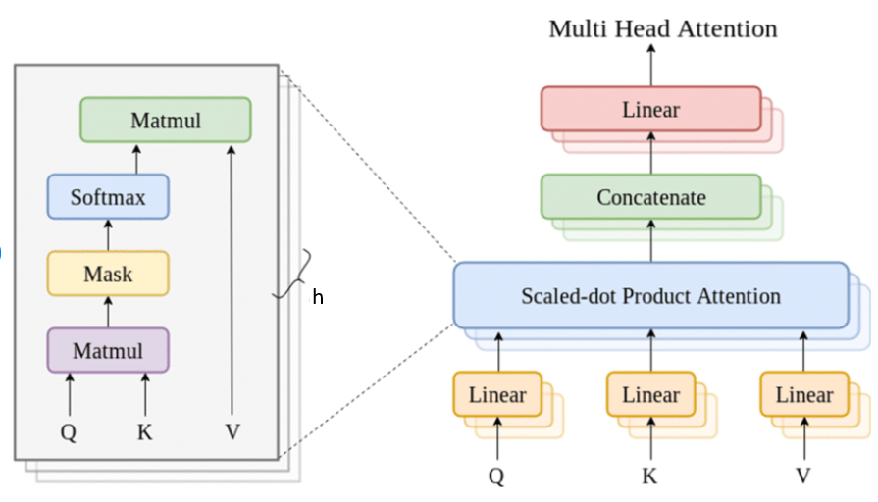
Scaled Dot-product Attention
Attention_score_{(L x L)}=(Q _{(L=5 x dq=2)}* (K _{(L=5 x dk=2)})^{T})/sqrt(dk)
SmAtt _{(L =5 x L =5)} =Softmax(Attention_score_{(LxL)}) _{(LxL)}
Zi _{(L =5 x dv=2)} =Per_head Output of attention_{(L =5 x dv=2)} = SmAtt _{(LxL)} *V_{(Lxdv)}
MHATT _{(L=5 x dmodel=6)} =
Exercise (3) What is the dimension of (Q*K^{T}) in this example?
2x2
5x2
5x5
6x6
Zi =Per_head Output of attention_{(L=5 x dv =2)}
Q _{(L=5 x dq=2)} K _{(L=5 x dk=2)}
V _{(L=5 x dv=2)}
https://www.researchgate.net/figure/Internal-structure-of-the-Multi-Headed-Self-Attention-Mechanism-in-a-Transformer-block_fig2_345482934

Slide 29
Example: Find Per_head_Output_of_attention
Answer (3) LxL=5x5 (choice 3 is correct)
Assume no bias to simplify discussion
Attention_score =
9.7966 11.2744 9.8667 9.4746 7.1549
14.1614 16.3042 14.3217 13.7315 10.3982
11.5024 13.2481 11.6806 11.1821 8.4909
11.1300 12.8117 11.2341 10.7789 8.1517
6.9361 7.9928 7.0797 6.7648 5.1541
SmAtt =
0.1379 0.6044 0.1479 0.0999 0.0098
0.0879 0.7496 0.1032 0.0572 0.0020
0.1149 0.6586 0.1374 0.0834 0.0057
0.1214 0.6523 0.1347 0.0854 0.0062
0.1655 0.4761 0.1911 0.1394 0.0279
%** after SoftMax, sum of each row of SmAtt =1
Per_head_Output_of_attention =
2.4145 4.6377
2.4446 4.6781
2.4293 4.6575
2.4249 4.6524
2.3959 4.6008
sclear %matlab 1
PE=[0 1.0000 0 1.0000 0 1.0000
0.8415 0.5403 0.0464 0.9989 0.0022 1.0000
0.9093 -0.4161 0.0927 0.9957 0.0043 1.0000
0.1411 -0.9900 0.1388 0.9903 0.0065 1.0000
-0.7568 -0.6536 0.1846 0.9828 0.0086 1.0000]
X=[0.8147 0.0975 0.1576 0.1419 0.6557 0.7577
0.9058 0.2785 0.9706 0.4218 0.0357 0.7431
0.1270 0.5469 0.9572 0.9157 0.8491 0.3922
0.9134 0.9575 0.4854 0.7922 0.9340 0.6555
0.6324 0.9649 0.8003 0.9595 0.6787 0.1712]
XPE=PE+X
wq=[0.7060 0.6948
0.0318 0.3171
0.2769 0.9502
0.0462 0.0344
0.0971 0.4387
0.8235 0.3816]
wk=[0.7655 0.7094
0.7952 0.7547
0.1869 0.2760
0.4898 0.6797
0.4456 0.6551
0.6463 0.1626]
wv=[0.1190 0.7513
0.4984 0.2551
0.9597 0.5060
0.3404 0.6991
0.5853 0.8909
0.2238 0.9593]
Q=XPE*wq
K=XPE*wk
V=XPE*wv
dk=2
Attention_score=(Q*K')/sqrt(dk)
SmAtt=(softmax(Attention_score'))' %format for matalb
sum(SmAtt(1,:)) %to check it is 1
Per_head_Output_of_attention =SmAtt*V % it is Zi

Slide 30
Revision1 of formulas for Q,K,V
X_{(L x dmodel)}=Xin _{(L x V)} *W_{(V x dmodel)} ; Xin is in one-hot
L=length of token, dmodel=token embedded dimension (commonly called the hidden dimension)
Per_head_dimension(dq,dk,dv), set dq=dk=dv
Q(L x dq)=XPE(L,dmodel)*Wq (dmodel,dq) +1_{L}*(b_{dq})^{T}
K(L x dk)=XPE(L,dmodel)*Wk (dmodel,dk) +1_{L}*(b_{dk})^{T}
V(L x dv)=XPE(L,dmodel)*Wv (dmodel,dv) +1_{L}*(b_{dv})^{T}
1_{L} = a vector of ones with length L.
Concatenate heads to become MHATT (Multi-head attention)

Slide 31
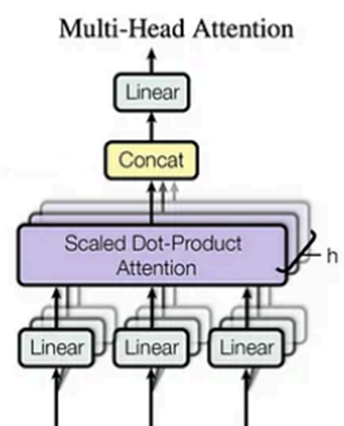
Multi-head
Concatenate heads (h1,h2,..) to become Multi-head

Slide 32
Overview of Multi-head structure
////////// Per head calculation //////////////////////
Dimensions of parameters
Token length (L)=5
Token embedding dimension (dmodel)=6
XPE_{(L=5 x dmodel=6)} (same as PE and X)
Per_head_dimension(dq,dk,dv)=2
Q _{(L=5 x dq=2)}=XPEX_{(L x dmodel)}*Wq_{(dmodel,dq)} +1_{L}*(b_{dq})^{T}
K _{(L=5 x dk=2)}=XPEX_{(L x dmodel)}*Wk_{(dmodel,dk)} +1_{L}*(b_{dk})^{T}
V _{(L=5 x dv=2)}=XPEX_{(L x dmodel)}*Wq_{(dmodel,dv)} +1_{L}*(b_{dv})^{T}
Number of heads (h)=dmodel/dv=6/2=3
///////////Concatenation: concat. Heads //////////
Concat_output (Z _{(L=5 x h*dv=dmodel=6)}) =
Z=Concat( Z1_{(L x dv)}, Z2_{(L x dv)}, Z3_{(L x dv)}) _{(L x h*dv)}
Output projection weight(Wo) _{(dmodel x dmodel)}
MHATT _{(L=5 x dmodel=6)} =
Multihead attention output _{(L x dmodel)} =
Z _{(L x h*dv=dmodel)} * (Wo) _{(dmodel x dmodel)} +(1_{L}*(b_{o})^{T}) _{(L x dmodel)}
Note: (b_{o})^{T} , b_{o} is a row vector length dmodel
Hence 1_{L}*(b_{o})^{T} has size (L x dmodel)
We will discuss the Scaled Dot-product Attention block
Note: h*dq = dmodel is always true
MHATT _{(L=5 x dmodel=6)} =
Linear: Output projection weight
(Wo) _{(dmodel=6 x dmodel=6)}
Z _{(L=5 x h*dv=6)} =
Concat. all Zi
Each
head Zi_{(L=5 x dv=2)}
V _{(L=5 x dv=2)} K _{(L=5 x dk=2)} Q _{(L=5 x dq=2)}

Slide 33
MHATT (Z_{(L=5 x h*dv =2)}) : Multi Head attention
Concatenate each head attention to become Multi Head Attention
Concatenate all Zi to become Z
Z_{(L=5 x h*dv =2)}=concat. [Z_{1 (L=5 x dv =2)},Z_{2 (L=5 x dv =2)} Z_{3 (L=5 x dv =2)} ]
MHATT _{(L=5 x dmodel=6)} =
Zi=Per_head Output of attention_{(L=5 x dv =2)}
Exercise (4) Why do we need the SoftMax step?
To speed up the processing
To make each row of Attention_score a probability
To increase the accuracy.
To make sure Attention score values are positive
Q _{(L=5 x dq=2)} K _{(L=5 x dk=2)} V _{(L=5 x dv=2)}

Slide 34
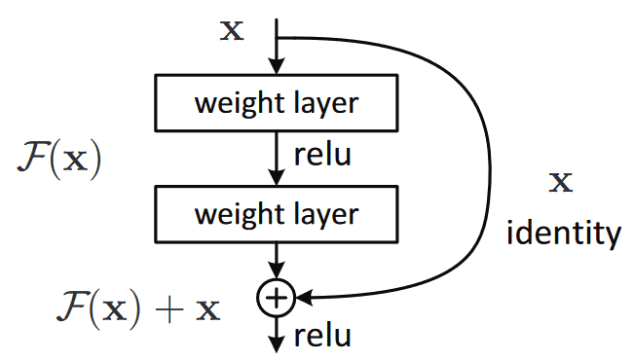
Why “add and normalization” (norm) in the encoder?
Answer (4) choice 2 is correct: To make each row of Attention_score a probability
Reason for Add X :
There is a possibility to skip this encoder block if it performs badly. It also reduces the gradient descent problem if this block performs badly.
https://theaisummer.com/skip-connections/
Normalizing makes data to be on a similar scale. Normally, makes data: mean=0, standard deviation =1
Idea comes from
“Resnet” by He et al. in Deep Residual Learning for Image Recognition
https://paperswithcode.com/method/resnet

Slide 35
Revision2 of formulas for Multi-Head attention (MHATT)
X_{(L x dmodel)}=Xin _{(L x V)} *W_{(V x dmodel)} ; Xin is in one-hot
L=length of token, dmodel=token embedded dimension (commonly called the hidden dimension)
Per_head_dimension(dq,dk,dv), set dq=dk=dv
Q(L x dq)=XPE(L,dmodel)*Wq (dmodel,dq) +1_{L}*(b_{dq})^{T}
K(L x dk)=XPE(L,dmodel)*Wk (dmodel,dk) +1_{L}*(b_{dk})^{T}
V(L x dv)=XPE(L,dmodel)*Wv (dmodel,dv) +1_{L}*(b_{dv})^{T}
1_{L} = a vector of ones with length L.
Attention_score_{(L x L)}=(Q _{(L=5 x dq=2)}* (K _{(L=5 x dk=2)})^{T})/sqrt(dk)
SmAtt _{(L =5 x L =5)} =Softmax(Attention_score_{(LxL)}) _{(LxL)}
Zi _{(L =5 x dv=2)} =Per_head Output of attention_{(L =5 x dv=2)} = SmAtt _{(L x L)} *V_{(L x dv)}
///////////Concatenation: concat. Heads //////////
Concat_output (Z _{(L=5 x h*dv=dmodel=6)}) =
Z=Concat( Z1_{(L x dv)}, Z2_{(L x dv)}, Z3_{(L x dv)}) _{(L x h*dv)}
Output projection weight(Wo) _{(dmodel x dmodel)}
MHATT(Multihead attention output) _{(L x dmodel)} =
Z _{(L x h*dv=dmodel)} * (Wo) _{(dmodel x dmodel)} +(1_{L}*(b_{o})^{T}) _{(L x dmodel)}
Concatenate heads to become MHATT

Slide 36
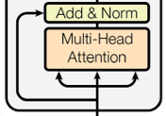
Step 3b: First add and Norm
Output Shape=
L x dmodel
Step 3b: add processing
Residual=XPE+ Multi-head att.
Post attention normalized output (Pano): Pano=Layer_norm(Residual), or
Pano=Layer_norm(XPE+Z)
Pano
Multi-head attention
Output MHATT (or Z)
Input Shape=
L x dmodel
XPE (positional encoded input )

Slide 37
Step3b) Let’s look into the dimension
Residual = Residual_input_to_norm
Residual = XPE_{(L=5 x dmodel=6)} + Multi-head att. Z_{(L=5 x (h*dv) =6)}
Since dmodel= h*dv
Residual_{(L=5 x dmodel=6)}= XPE+ Multi-head att.Z_{(L=5 x dmodel=6)}
Pano=Layer_norm(Residual), or
Pano=Layer_norm(XPE+Z)
Note: Layer Norm does not change the parameter dimensions,&Multi-head att.=Z
Pano=Post attention normalized out
Exercise (5) What are the dimensions of Residual and Pano in this example?
Residual is 2x2 , Pano is 2x2,
Residual is 5x5 , Pano is 2x2,
Residual is 5x6 , Pano is 5x6,
Residual is 5x6 , Pano is 2x2 .
Multi-head attention
Output MHATT (or Z)
XPE (positional encoded input )

Slide 38
Add and normalization: Add step
3.9633
Answer (5) Residual is 5x6 , Pano is 5x6, (choice 3 is correct)
XPE =[0.8147 1.0975 0.1576 1.1419 0.6557 1.7577
1.7473 0.8188 1.0170 1.4207 0.0379 1.7431
1.0363 0.1308 1.0499 1.9114 0.8534 1.3922
1.0545 -0.0325 0.6242 1.7825 0.9405 1.6555
-0.1244 0.3113 0.9849 1.9423 0.6873 1.1712]
Z=[2.4145 4.6377 2.8147 2.0975 2.1576 2.1419
2.4446 4.6781 2.1270 2.5469 2.9572 2.9157
2.4293 4.6575 2.9134 2.9575 2.4854 2.7922
2.4249 4.6524 2.9134 2.9575 2.4854 2.7922
2.3959 4.6008 2.9058 2.2785 2.9706 2.4218]
Residual=XPE+Z, Residual = Residual_input_to_norm
%3.2292 5.7352 2.9723 3.2394 2.8133 3.8996
%4.1919 5.4969 3.1440 3.9676 2.9951 4.6588
%3.4656 4.7883 3.9633 4.8689 3.3388 4.1844
%3.4794 4.6199 3.5376 4.7400 3.4259 4.4477
%2.2715 4.9121 3.8907 4.2208 3.6579 3.5930
Exercise 6: Find Choices:
3.1453,
3.9633 ,
3.2431,
3.2445.
?
?
XPE=5x6
https://medium.com/@sumith.madupu123/understanding-transformer-architecture-using-simple-math-be6c2e1cdcc7

Slide 39



Normalization step (Norm) (Updated 25.11.30)
-
Answer 6: 1.0499+ 2.9134=3.9633 (choice 2 is correct)
Exercise 7: Normalization step: Find mean, Std ( standard deviation normalized by n-1)
Res(idual)=XPE+Z=
Res=[3.2292 5.7352 2.9723 3.2394 2.8133 3.8996
4.1919 5.4969 3.1440 3.9676 2.9951 4.6588
3.4656 4.7883 3.9633 4.8689 3.3388 4.1844
3.4794 4.6199 3.5376 4.7400 3.4259 4.4477
2.2715 4.9121 3.8907 4.2208 3.6579 3.5930]
Pano=Layer_norm(residual)=Layer_norm(XPE+Z)
Mean
Mean (μ)
3.6482
4.0757
4.1016
4.0417
3.7577
Std (σ)
1.0877
0.9403
0.6438
0.6223
0.8730
Pano(Value)=LayerNorm(value) = $\frac{value−μ}{\sqrt{σ^{2}+ε}}∙γ+β$, μ=mean, $σ=$std (standard deviation)
learnable scale factor γ=1, learnable shift(bias) factor β=0 to simplify discussion. γ and β are row vectors with length dmodel. ϵ =0.0001 to avoid divided by 0.
For Res(1,1) find (Value-Mean)/(std+err)
(3.2292-3.6482)/sqrt((1.0877^2+0.0001))= -0.3852
For Res(1,2) find (Value-Mean)/(std+err)
(5.7352-3.6482)/sqrt((1.0877^2+0.0001))=1.9187
Pano=post attention normalized output=
% -0.3852 1.9187 -0.6214 -0.3758 -0.7675 0.2312
% 0.1236 1.5113 -0.9908 -0.1150 -1.1492 0.6201
% -0.9876 1.0665 -0.2147 1.1917 -1.1845 0.1287
% -0.9035 0.9289 -0.8100 1.1219 -0.9895 0.6523
% -1.7023 1.3223 0.1524 0.5305 -0.1143 -0.1886]
Exercise 7:
Find
Choices:
-0.2147 ,
-0.1358,
-0.5898,
0.0956.
?
?

Slide 40
Code (Updated 25.11.30)
Answer 7: -0.2147 (choice 1 is correct)
clear
Res=[3.2292 5.7352 2.9723 3.2394 2.8133 3.8996
4.1919 5.4969 3.1440 3.9676 2.9951 4.6588
3.4656 4.7883 3.9633 4.8689 3.3388 4.1844
3.4794 4.6199 3.5376 4.7400 3.4259 4.4477
2.2715 4.9121 3.8907 4.2208 3.6579 3.5930];
err=0.0001;
norm_att(1,1)=(Res(1,1)-mean(Res(1,:)))/sqrt((std(Res(1,:))^2+err))
norm_att(1,2)=(Res(1,2)-mean(Res(1,:))) /sqrt((std(Res(1,:))^2+err))
norm_att(2,1)=(Res(2,1)-mean(Res(2,:))) /sqrt((std(Res(2,:))^2+err))
[rr,cc]=size(Res)
for i=1:rr
for j=1:cc
norm_att(i,j)=(Res(i,j)-mean(Res(i,:)))/ sqrt((std(Res(i,:))^2+err))
end
end
% norm_att =
%
%Pano=post attention normalized output=
% -0.3852 1.9187 -0.6214 -0.3758 -0.7675 0.2312
% 0.1236 1.5113 -0.9908 -0.1150 -1.1492 0.6201
% -0.9876 1.0665 -0.2147 1.1917 -1.1845 0.1287
% -0.9035 0.9289 -0.8100 1.1219 -0.9895 0.6523
% -1.7023 1.3223 0.1524 0.5305 -0.1143 -0.1886

Slide 41
Step 4a
Answer 7: -1.72 (choice3 is correct)
Step 4a) feed forward
Output Shape=
L x dmodel
Input Shape=
L x dmodel

Slide 42
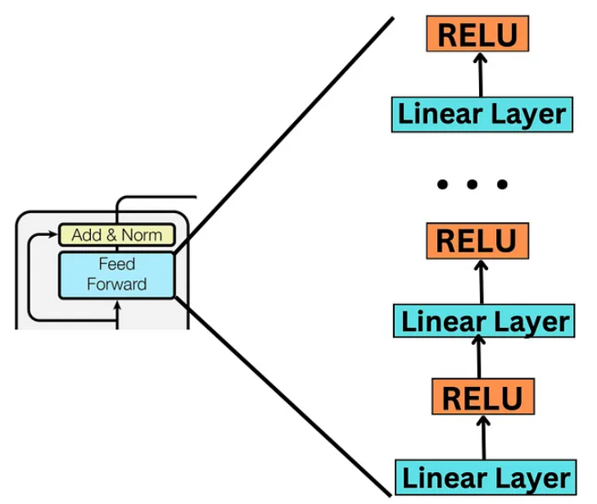
Step 4a,4b: Feed forward (network)
RELU + linear layer
To simplify the discussion we assume we have only one Linear +RELU layer in the “Feed Forward” block in this example. Real transformers may have more Relu-Linear layers
Pano_{(L=5 x dmodel=6)}=normalized residual output
Pano=ADDNORM_MHATT

Slide 43
4) Encoder2: Feed forward (network) (FFN)
Assume we have only one Linear +RELU layer in the “Feed Forward” block in our example
FFN(x)=[Relu(Pano*W1+b1)*W2] + b2
FFN(x) _{(L x dmodel)}
=[Relu(Pano_{(L=5 x dmodel=6)} * W1_{(dmodel x dff)} +b1 )*W2_{(dff x dmodel)}] + b2
Pano means Post attention normalized output_{(L=5 x dmodel=6)}
W1 is dmodel x dff
W2 is dff x dmodel
dff is 4 times of dmodel , if dmodel is 6, dff=4x6=24
Note:
b1 is a vector of length dff (=4* dmodel)
b2 is a vector of length dmodel
FFN output and Pano have same shape (dimensions)
Second add & norm are similar to the first Add & Norm
Reason for using the “Feed forward” with Relu network:
The feed-forward network, combined with a non-linear activation like ReLU, enables the model to learn complex, non-linear transformations.
Pano

Slide 44
Example
If token embedded length (dmodel)=512
Token Length (L)=2048
Number of heads (h)= 8
Per head dq=dk=dv=dmodel/h=512/8=64
How many learnable parameters for this multihead attention and add & block block?
Wq, Wq, Wv =projection weights. Bq,Bk,Bv= projection biases in multiread attention.
W1,W2,b1,b2 are weights and Biases in feedforward network ,
W_gamma= scaling factors in layer norm
W_beta=shift factors in layer_norm.
Answer
Need to multiply 3 because same for q,k,v
Answer: Wq=dmodel * 3*(h*dq)=dmodel*3*dmodel=512*3*512, same for Wk,Wv
Bq= h*demodel=3*(h*dq)=3*dmodel=3*4096, same for Bk,Bv
Since dff=4*512= 2048
W1 is dmodel x dff=512 x 2048
W2 is dff x dmodel= 2048 x 512
b1 is a vector of length dff (=4* dmodel)=2048 x 1
b2 is a vector of length dmodel = 512 x 1

Slide 45
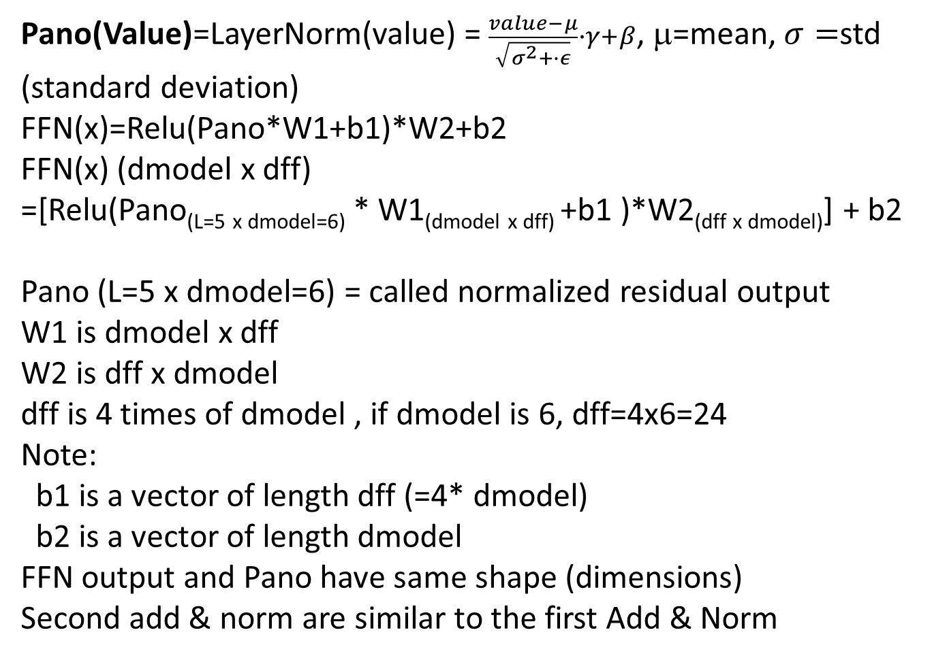
Revision3 of the formulas for Feedforward Network
Pano(Value)=LayerNorm(value) = $\frac{value−μ}{\sqrt{σ^{2}+∙ε}}∙γ+β$, μ=mean, $σ=$std (standard deviation)
FFN(x)=Relu(Pano*W1+b1)*W2+b2
FFN(x) (dmodel x dff)
=[Relu(Pano_{(L=5 x dmodel=6)} * W1_{(dmodel x dff)} +b1 )*W2_{(dff x dmodel)}] + b2
Pano (L=5 x dmodel=6) = called normalized residual output
W1 is dmodel x dff
W2 is dff x dmodel
dff is 4 times of dmodel , if dmodel is 6, dff=4x6=24
Note:
b1 is a vector of length dff (=4* dmodel)
b2 is a vector of length dmodel
FFN output and Pano have same shape (dimensions)
Second add & norm are similar to the first Add & Norm

Slide 46

Revision4 :A summary of trainable weights (w) & biases(b)
///// Feedforward network ///////////////////////////
FFN(x)=Relu(Pano*W1+b1)*W2+b2
FFN(x) _{(L x dmodel)}
=[Relu(Pano_{(L=5 x dmodel=6)} * W1_{(dmodel x dff)} +b1 )*W2_{(dff x dmodel)}] + b2
Pano means Post attention normalized output_{(L=5 x dmodel=6)}
W1 is dmodel x dff
W2 is dff x dmodel
Dff is 4 times of dmodel , if dmodel is 6, dff=4x6=24
Note:
b1 is a row vector of length dff (=4* dmodel)
b2 is a row vector of length dmodel
///// Attention Projection matrices , Weights W and Bias b
Q _{(L=5 x dq=2)}=XPEX_{(L x dmodel)}*Wq_{(dmodel,dq)} +1_{L}*(b_{dq})^{T}
K _{(L=5 x dk=2)}=XPEX_{(L x dmodel)}*Wk_{(dmodel,dk)} +1_{L}*(b_{dk})^{T}
V _{(L=5 x dv=2)}=XPEX_{(L x dmodel)}*Wq_{(dmodel,dv)} +1_{L}*(b_{dv})^{T}
Wq_{(dmodel,dq)}
Wk_{(dmodel,dk)}
Wv_{(dmodel,dv)}
(b_{dq}) a row vector of length dq
(b_{dk}) a row vector of length dk
(b_{dv}) a row vector of length dv
/////////////////////// Layer Norm, γ=1, β=0 are learnable parameters
Pano(Value)=LayerNorm(value) = $\frac{value−μ}{\sqrt{σ^{2}+∙ε}}∙γ+β$, μ=mean, std=standard deviation. Assume learnable scale factor γ=1, learnable shift(bias) factor β=0 to simplify discussion. γ and β are row vectors with length dmodel. ϵ =0.0001 to avoid divided by 0.
Note:
“Add operation” as no weights and bais.
“Norm operation” has trainable scaling and biases (not discussed here)
Input embedding has no bias

Slide 47
Transformer Decoder
Processing steps

Slide 48
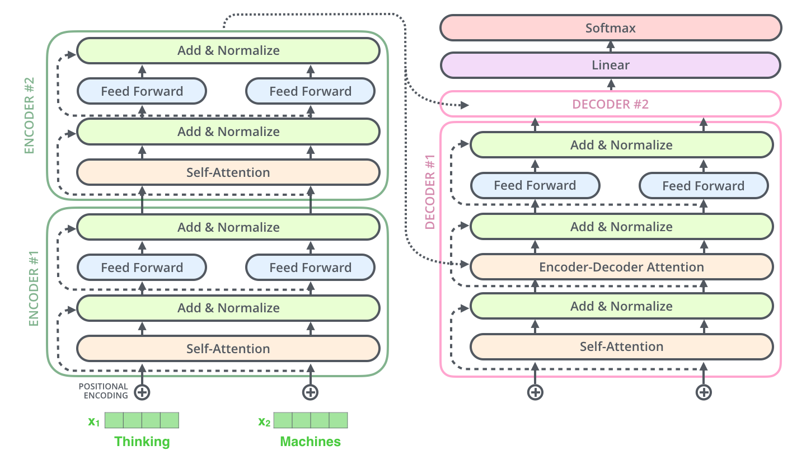
Encoder + decode Architectures are similar except:
In decoder “Key (K) and Query (Q)” are from the Encoder
“Value (V)” is from the decoder input
decoder input
Encoder input

Slide 49
5) Decoder: multi-head self-attention for input/target
target output
In machine translation: decoder is similar to the encoder except input is from the “outputs shift right” , we call this input “target input” here.
See the usage of this input in application1: machine translation, later in this ppt.
target input

Slide 50
6) Decoder: multi-head self-attention for input/target
Similar to the encoder
except
K,Q are from encoder output
V is from encoder below it (target input shifted right)

Slide 51
7)Decoder: feed forward network
The feed-forward layer is weights that is trained during training, and the exact same matrix is applied to each respective token position.
Since it is applied without any communication with or inference by other token positions it is a highly parallelizable part of the model.
The role and purpose is to process the output from one attention layer in a way to better fit the input for the next attention layer.
https://stats.stackexchange.com/questions/485910/what-is-the-role-of-feed-forward-layer-in-transformer-neural-network-architectur

Slide 52
Application1: machine translation
Durring training: enter Target input one by one « I am a student ».
Target output
https://www.youtube.com/watch?v=4Bdc55j80l8
Input: Je suis etudiant (at once)
Every time feed target output to target_input. I.e.
feed « start code » to target input
Taget output at time 1= I,
feed « I » to target input
Taget output at time2= am,
feed « am » to target input
Taget output at time3= a,
feed « a » to target input
Taget output at time4= student
feed « student » to target input
Taget output at time5= end_code
END
For machine translation decoder is step-by-step not parallel. Can be made parallel by teacher forcing https://machinelearningmastery.com/teacher-forcing-for-recurrent-neural-networks/
https://zaai.ai/llms-and-transformers-from-scratch-the-decoder/ - - (The sequential input process at the decoder can be achieved by applying a moving mask to select the target input word to the decoder attention mechanism one by one)
After training, if you input the source langage sentence word-by-word (e.g. in English) , the decoder will output the translated input word (e.g. in Fench) at the output.
Target input
Input : a sentence at one go "Je sui étudiant "

Slide 53
Application 2: Transformer (BERT uses encoder only, no decoder required) can be used for:
Determine positive or negative movie reviews (Sentiment Analysis)
Automatic answering questions. (Question answering)
Predicts next text (Text prediction)
Robotic writer (Text generation)
Summarization of a long article (Summarization)
Determine word meaning (Polysemy resolution)
Using pre-trained BERT for emotion analysis
Ref: https://huggingface.co/blog/bert-101#1-what-is-bert-used-for

Slide 54
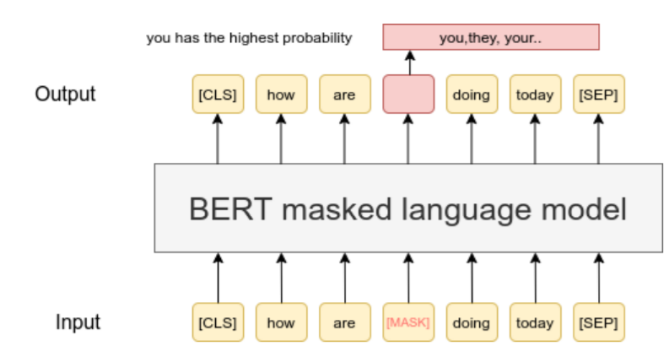
Example of using BERT: Masked word prediction https://www.exxactcorp.com/blog/Deep-Learning/how-do-bert-transformers-work https://www.sbert.net/examples/unsupervised_learning/MLM/README.html
Input a sentence and masked one word off
Train at the output given the missing word
So, when similar sentence appear it can fill in the missing word
E.g., BERT is trained using known missing words

Slide 55
Use BERT (transformer encoder) for emotion analysis: 4 emotions (neutral joy, sadness anger)
Assume training batch size B=1, token length= 512 for simplicity
Add [CLS] and [SEP] to the sentence in Xin
BERT assigns a random number for the first position [CLS] and the position of [SEP].
So X has length sentence length + 2 because you added 2 items to it
Xin = [CLS], input sentence ,[SEP] has code
Convert to Xin (transformer input)
- [CLS] classification code → token ID 101 → one-hot vector with 1 at position 101, for a vocabulary of 30K.
- [SEP] separator code → token ID 102 → one-hot vector with 1 at position 102, for a vocabulary of 30K.
At the output of the transformer encoder , it has shape (L+2) x dmodel. Pick the first vector and use FNN (feed and softmax to find one of the 4 emotions.
FFN has weights 4*dmodel (because one token (CLS) is dmodelx1) and a softmax of 4 outputs (each for an emotion)
The target is the label (one of the 4 emotions of the corresponding sentence)
Why it works: because after learning the transformer encoder builds up relation among the words inside the input sentence , and is reflected in the code CLS --- which is a summary of the whole sentence. Therefore, we just check the CLS code and use it to find the emotion of the sentence.
Note: The output network of CLS is based on a tanh activation function, it is called pooled_output in BERT’s literature.

Slide 56
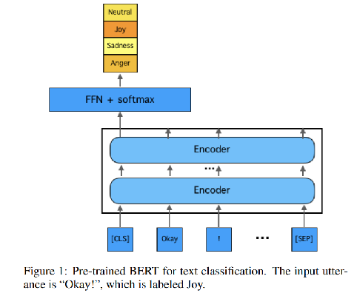
Example of using BERT emotion analysis
Build Down stream task:
FFN = feed forward network
4 outputs
( each represent a probability)
Feed forward Network (FFN)
Has 768x4 weights + siftmax.
Build a downstream model (using a Transfer learning method ) for emotion classification
Downstream building means built you own application based on some pretrained model like BERT.
EmotionX-HSU: Adopting Pre-trained BERT for Emotion Classification https://arxiv.org/abs/1907.09669
Z=Output “CLS” of BERT is a vector of 768 x 1
Z
Based on Pre-trained BERT
https://arxiv.org/abs/1810.04805
Pre-trained BERT can be downloaded from
https://huggingface.co/

Slide 57
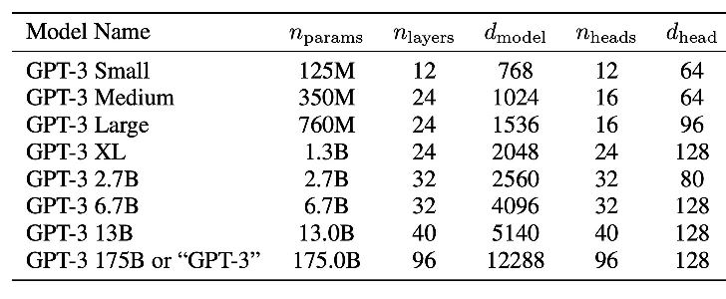
Transformer model parameters
https://www.lesswrong.com/posts/3duR8CrvcHywrnhLo/how-does-gpt-3-spend-its-175b-parameters
d_model = the dimensionality of the representations used as input to the multi-head attention, which is the same as the dimensionality of the output. One word (or token if subword is used) is represented by a vector of d_modle length)
n_heads=number of heads in a multi-head
n_layers = number of layers
d_head=dimension of a single head =d_model / n_heads,
e.g. for GPT3 small: d_head=678/12=64
Also ChatGPT 3.5 has maximum token length around 4096 (a sentence length is about 1000-3000 words, because token are sub words)
https://ai.stackexchange.com/questions/45691/what-should-be-relationship-between-embedding-dimension-and-context-length

Slide 58
Summary on transformer
Basic operation of the transformer model is studied
Applications of transformers are discussed

Slide 59
Extension: Application of transformer models : computer vision
KH Wong

Slide 60
Vision transformer
The Transformer is successful in NLP (Natural Language Processing).
Hence, researchers explore the idea of using it for computer vision -- Vision transformer.
See https://en.wikipedia.org/wiki/Vision_transformer
Transformers are found to overperform classical approaches in object recognition etc.

Slide 61
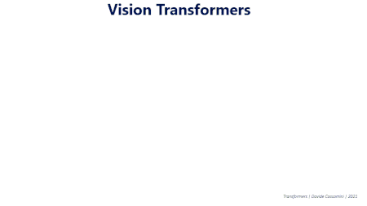
The main idea
The Transformer is designed for sequential data, but image data is parallel. So how to do it? Solution : Divide the picture into patches (in a grid) and the patches are lined up as a sequence for the transformer (SWIN Transformer uses sifted windows) .

Slide 62
The Swin Transformer https://arxiv.org/abs/2103.14030
The Swin Transformer ("Shifted windows")^{[7]} takes inspiration from standard convolutional neural networks:
Instead of performing self-attention over the entire sequence of tokens, one for each patch, it performs "shifted window based" self-attention, which means only performing attention over square-shaped blocks of patches. One block of patches is analogous to the receptive field of one convolution.
After every few attention blocks, there is a "merge layer", which merges neighboring 2x2 tokens into a single token. This is analogous to pooling (by 2x2 convolution kernels, with stride 2). Merging means concatenation followed by multiplication with a matrix.
It is improved by Swin Transformer V2,^{[13]} which modifies upon the ViT by a different attention mechanism (Figure 1):
layernorm immediately after each attention and feedforward layer ("res-post-norm");
scaled cosine attention to replace the original dot product attention;
log-spaced continuous relative position bias, which allows transfer learning across different window resolutions.

Slide 63
Part 2: Large Language Models (LLM)
KH Wong

Slide 64
Induction
Large Language Models (LLM) model can exchange information intelligently with human using text, such as answer questions when asked.
Currently uses Transformer as the work horse
Use decoder-only transformers
Becoming popular and essential in Artificial intelligence

Slide 65
Overview
Decoder-only transformer
Training of Large Language Models LLM
Pretraining
Experiments with Opensource model Lamma3 – fine tuning

Slide 66
Basic concept
of Large Language Models LLM

Slide 67
The key idea: Next token prediction
Next token prediction (also known as the standard language modeling objective)—the workhorse behind all causal language models.
Language Model Training and Inference: From Concept to Code
Background:
The Transformer Architecture [link]
Decoder-Only Transformers [link]
Programming
Neural Nets in PyTorch [link]
PyTorch Distributed Overview [link]
Distributed Data Parallel in PyTorch [link]

Slide 68
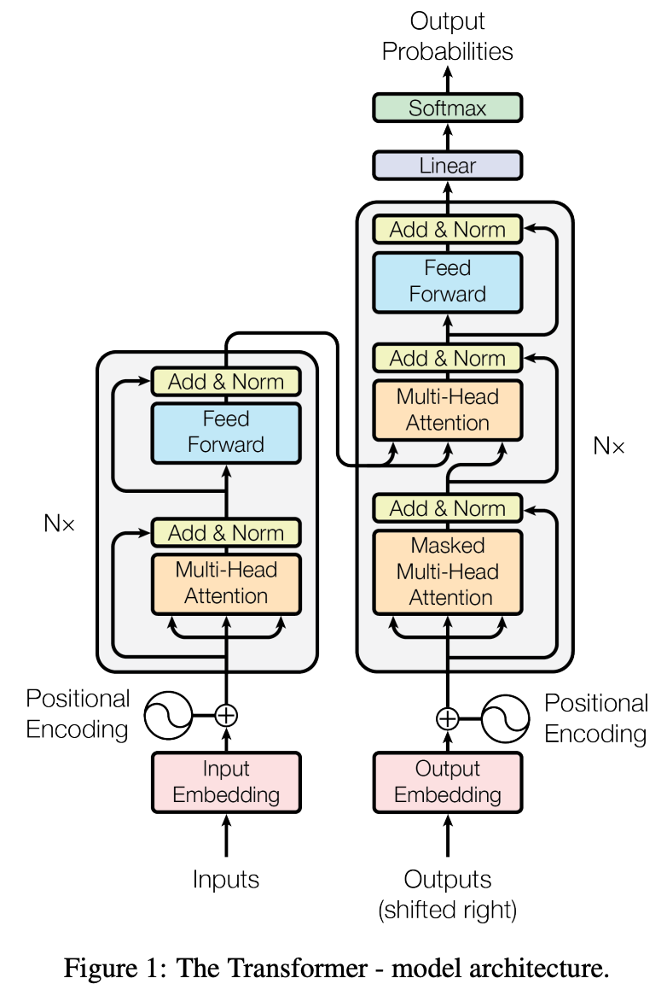
The Transformer model
Language Models: GPT and GPT-2 - by Cameron R. Wolfe, Ph.D.

Slide 69
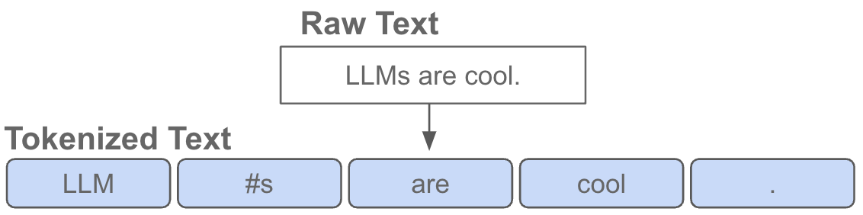
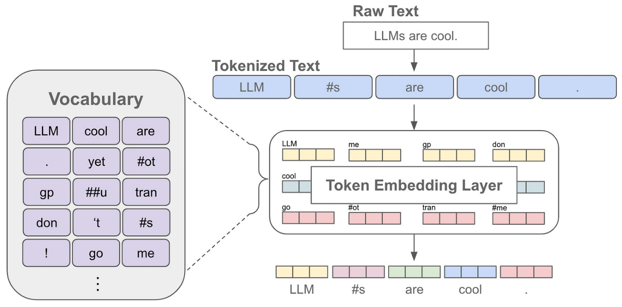
The model : Token embedding
Tokens may contain sub-words : Workpieces Tokenization https://botpenguin.com/glossary/wordpiece-tokenization
Tokenization turns texts into numbers.
According to OpenAI, one token is about four characters and ¾ words in English (100 tokens ≈ 75 words)

Slide 70
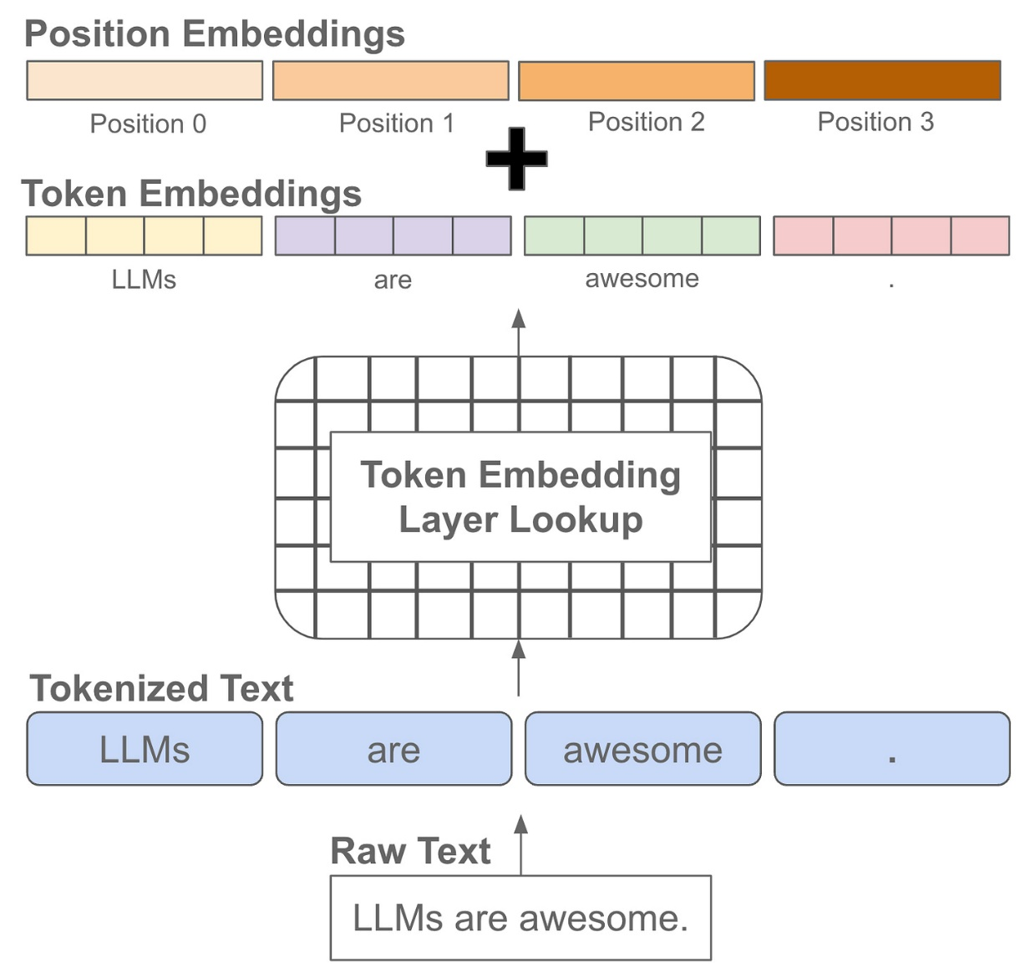
The model: Token embedding- Positional embedding
Trainable
Context window

Slide 71
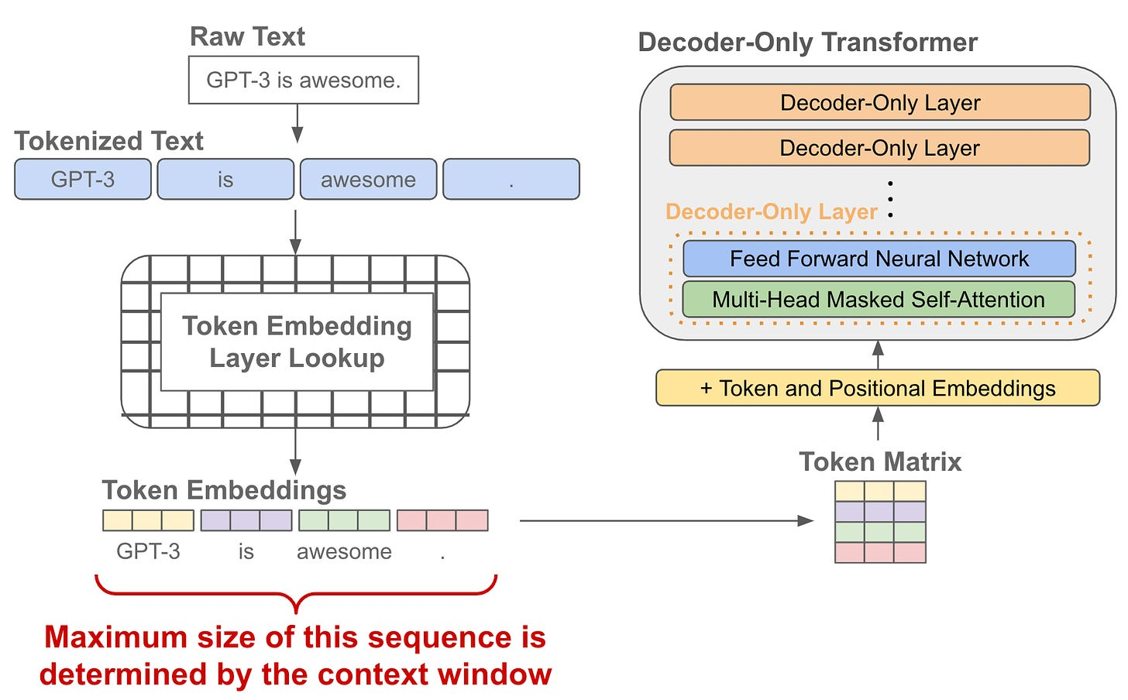
The model: Decoder-only transformer
Trainable
Context window

Slide 72
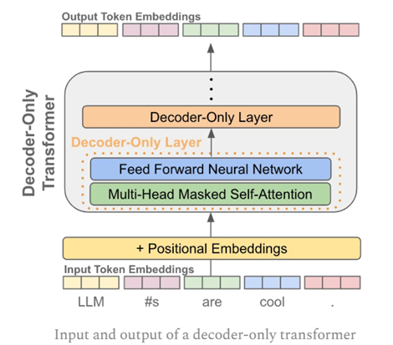
Predicting the next token using encode only model
Input training sentence is: “The cat sat on the mat”
Send this sentence to the input, and also to the output as target.
During training, use masked off method to feed the senetnce to the network gradually
Step1: Decoder only see “The” as input, target is “cat”, do back propagation training
Step2: Decoder only see “The cat” as input target is “sat”, do back propagation training
Step3: Decoder only see “The cat sat ” as input, target is “on”, do back propagation training
etc…. until the whole sentence is learned.
This is to mask off (cover) the future tokens, so the transformer can do prediction during training
Input: pass these vectors into a decoder-only transformer

Slide 73
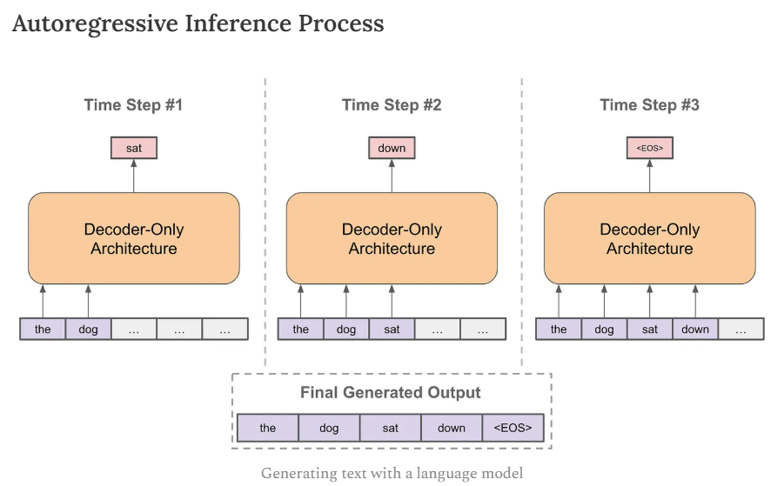
Training by next token prediction: provide the initial sequence, then predict the next token. Can be used for training and inference
d
https://cameronrwolfe.substack.com/p/language-model-training-and-inference

Slide 74
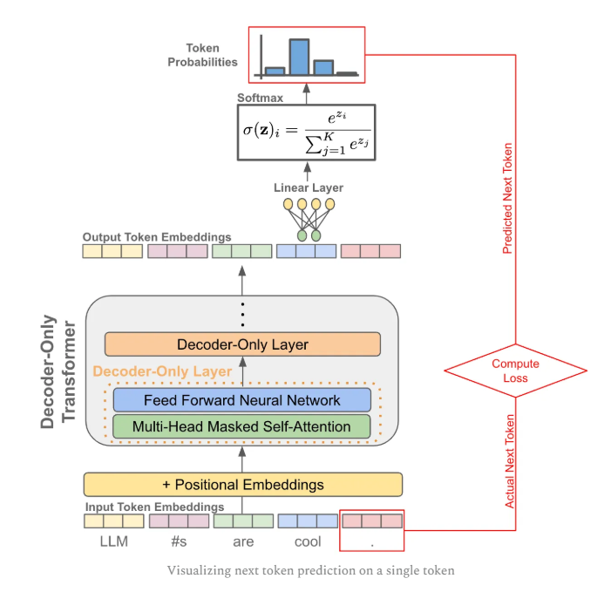
Training
Next token prediction training to minimize Loss

Slide 75
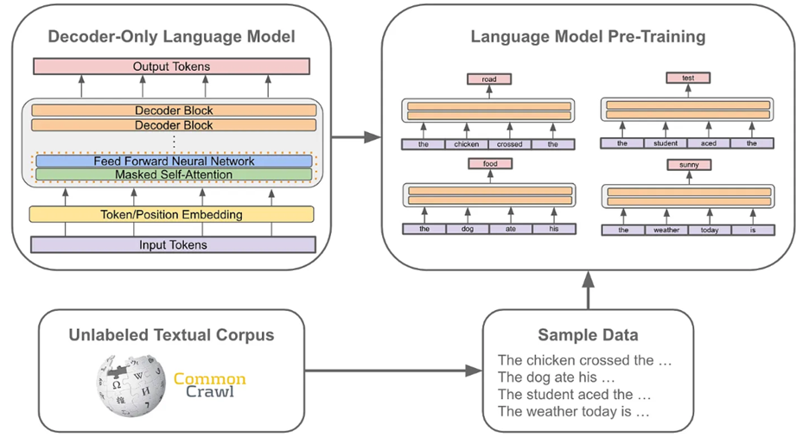
Implementation: Build Pre-train model using Next Token Prediction
Obtain huge data from www:
https://commoncrawl.org/
develop sample sentence data
https://arxiv.org/html/2412.02595v1

Slide 76
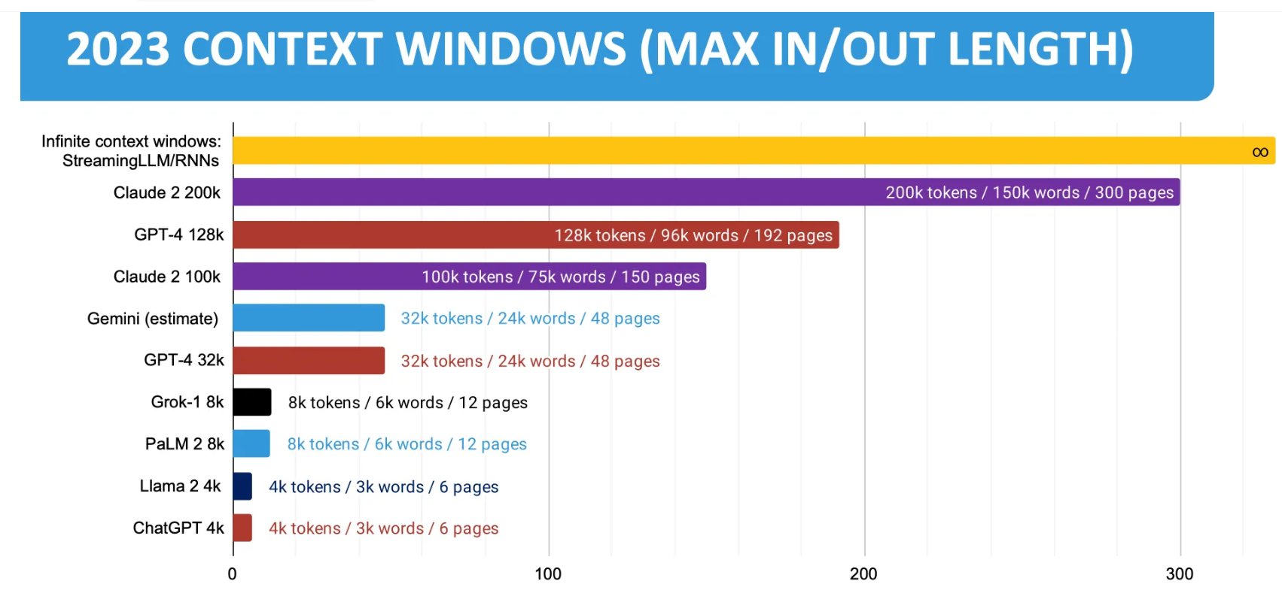
Context window size comparison
https://ogre51.medium.com/context-window-of-language-models-a530ffa49989
Deepseek v3 context window = 128,000
=number tokens that can be handled at the same time
A token is a word or subworld.

Slide 77
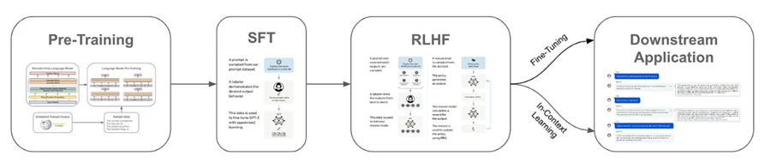
Language model training
https://cameronrwolfe.substack.com/p/language-model-training-and-inference
Pre-training : Use the whole (broad) dataset to train the system to produce the base model. https://www.sapien.io/blog/fine-tuning-vs-pre-training-key-differences-for-language-models
Supervised fine-tuning (SFT) : For a specific application. Use a small set of labeled data (provided by the application engineer) to train the base model for the application.
Reinforcement Learning from Human Feedback (RLHF): Further training by giving reward to correct answers.
https://klu.ai/glossary/supervised-fine-tuning

Slide 78
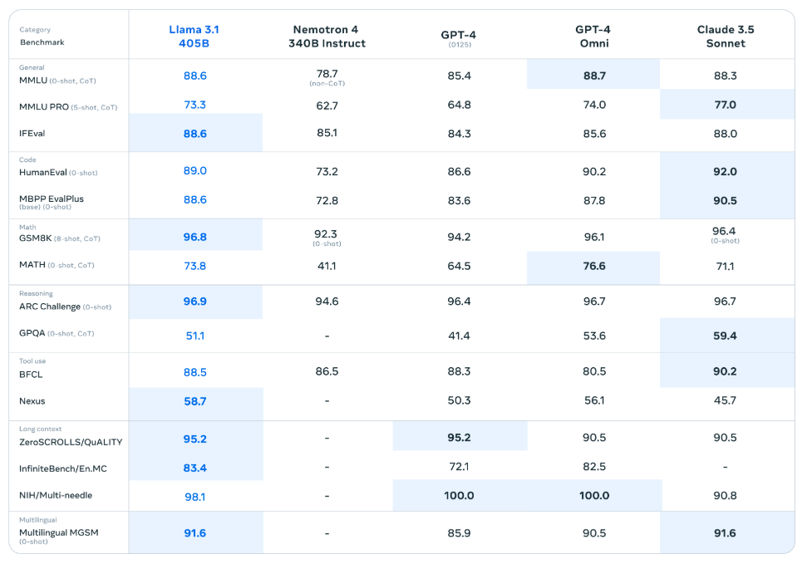
Experiments Llama3.2_(1B_and_3B)-Conversational.ipynb – Colab
MMMLU
HumanEval
GSM8K
ARC challenge
BFCL

Slide 79
How to evaluate a Large Language Model (LLM) : some benchmarks
MMLU:MMLU consists of about 16,000 multiple-choice questions spanning 57 academic subjects including mathematics, philosophy, law, and medicine. It is one of the most commonly used benchmarks for comparing the capabilities of large language models, with over 100 million downloads as of July 2024
https://en.wikipedia.org/wiki/MMLU
HumanEval: HumanEval is a benchmark dataset developed by OpenAI that evaluates the performance of large language models (LLMs) in code generation tasks. https://www.datacamp.com/tutorial/humaneval-benchmark-for-evaluating-llm-code-generation-capabilities
GSM8K: GSM8K tests an LLM’s mathematical reasoning skills. It has a corpus of 8,500 grade-school math word problems. Solutions are collected in the form of natural language instead of mathematical expressions. AI verifiers are trained to evaluate model solutions. https://www.ibm.com/think/topics/llm-benchmarks
AI2 Reasoning Challenge (ARC): ARC measures an LLM’s question answering and reasoning abilities through a series of more than 7,000 grade-school natural science questions.
BFCL Leaderboard: The Berkeley Function Calling Leaderboard V3 (also called Berkeley Tool Calling Leaderboard V3) evaluates the LLM's ability to call functions (aka tools) accurately. https://gorilla.cs.berkeley.edu/leaderboard.html

Slide 80
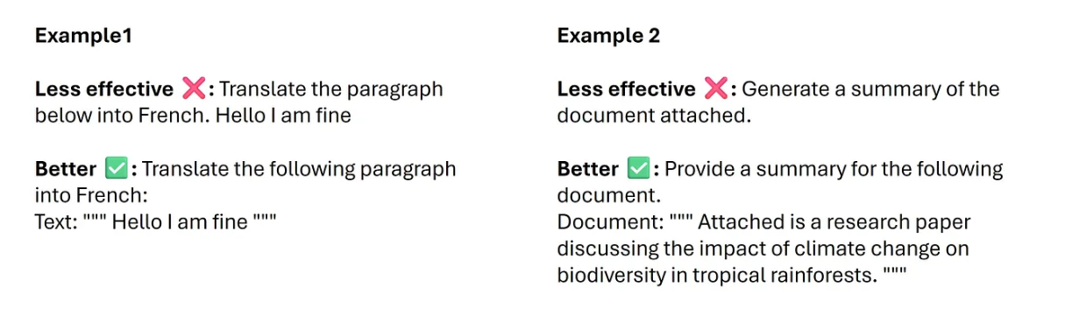
After pre-tuning you may use it in 2 ways:
1) Fine tuning training: Fine-tuning refers to taking the weights trained in the general model and then continuing training a bit using your specific data.
2) Prompt engineering : Prompt engineering, on the other hand, modifies the input prompt to guide the model's output without retraining for data—offering a less resource-intensive customization method.
Prompt engineering example:
https://medium.com/@alishafique3/llm-prompt-engineering-techniques-and-best-practices-7cc0f46467e9

Slide 81
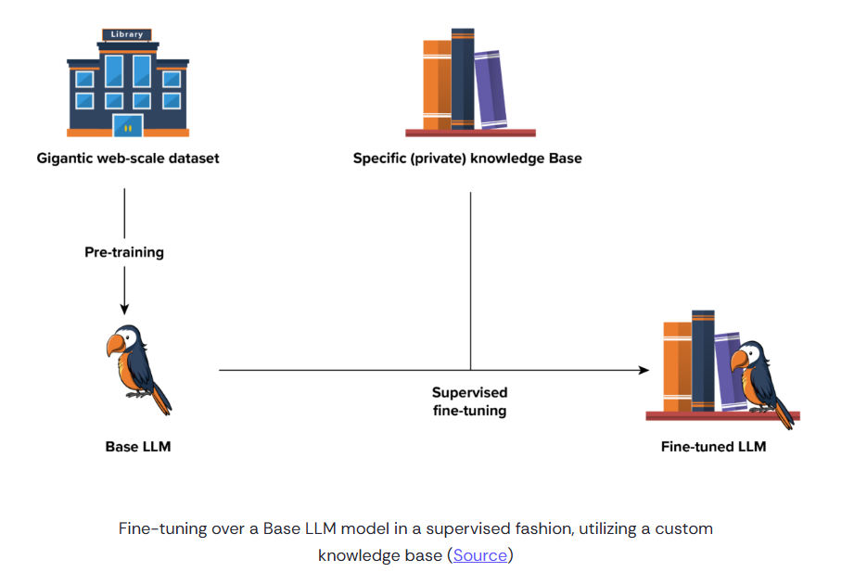
Fine tuning
Common crawl
https://commoncrawl.org/
Specific data set In https://discuss.huggingface.co/
e.g.. https://huggingface.co/datasets/tatsu-lab/alpaca
Base model
e.g. GPT4, Lamma
ChatGPT4
e.g. Lamma question/answer

Slide 82
The fine-tuning process steps
Data selection and preparation : Selecting high-quality, relevant data is an important first step. …Preparing this data involves cleaning, labeling (if applicable), and possibly augmenting it to ensure the model has a robust dataset to learn from.
Hyperparameter adjustments : You can alter the model’s hyperparameters or incorporate task-specific layers to better suit particular tasks. Low-Rank Adaptation (LoRA), may also be used. LoRA is a popular and lightweight training technique that significantly reduces the number of trainable parameters. It works by inserting a smaller number of new weights into the model, and only these are trained.
Training and optimization :The crux of fine-tuning involves training the model further on the selected dataset.

Slide 83
Pros and cons of fine-tuning
Pros include:
Enhanced accuracy and performance on domain-specific tasks.
Ability to leverage pre-existing knowledge from the base model (also called foundation model), reducing the need for extensive training from scratch.
cons include
Requires significant computational resources and time for huge models.
Risk of overfitting, making the model less effective on general tasks or unseen data within the same domain.

Slide 84
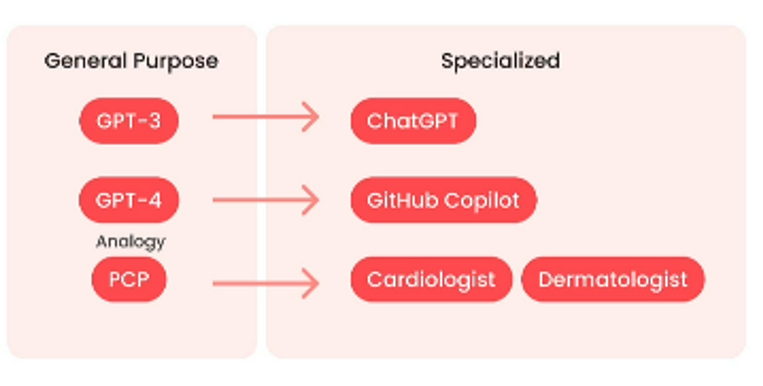
Fine-tuning can make a pre-trained LLM to be come a useful chatbot
Fine-tuning is the training continuation of general large model to make the model capable of a specific task. I.e. train the system to be a cardiologist.
E.g. pre-trained LLM
As a transformer-based model, GPT-4 uses a paradigm where pre-training using both public data and "data licensed from third-party providers" is used to predict the next token.
https://en.wikipedia.org/wiki/GPT-4
After fine tuning
ChatGPT is based on particular GPT foundation models, namely GPT-4, GPT-4o and GPT-4o mini, that were fine-tuned to target conversational usage.^{[18]}
https://en.wikipedia.org/wiki/ChatGPT

Slide 85
Another fine-tuning step:
Reinforcement learning human feedback(RLHF)
It is a trial-and-error interactive method, the system proses a solution ,, it gains reward if correct and lose if fail.
Just like human learning process: make random decisions and gain reward or penalty for their actions.

Slide 86
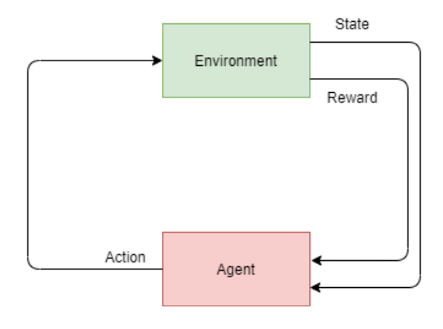
Reinforcement learning (RL)

Slide 87
There are four fundamental terms in Reinforcement Learning (RL):
action,
state,
policy, and
reward. A policy can be thought of as the brain of the agent. At first, there is no policy and the agent takes random actions. And by observing the rewards after certain actions, the policy is being created.

Slide 88
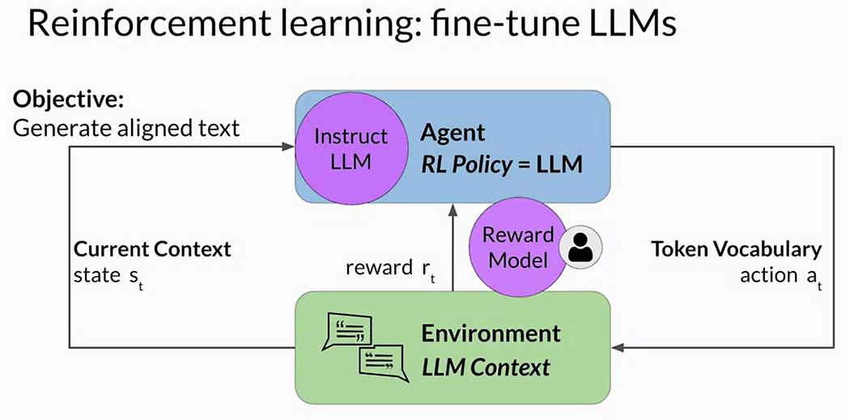
Reinforcement fine tuning LLMs
You can use two methods to update weights
Human expert
Use a reward model to classify outputs of the LLM
Everything to learn about Large Language Models(Part 2/3 Pre-training and Fine-tuning) | by Kerem Aydın | Medium

Slide 89
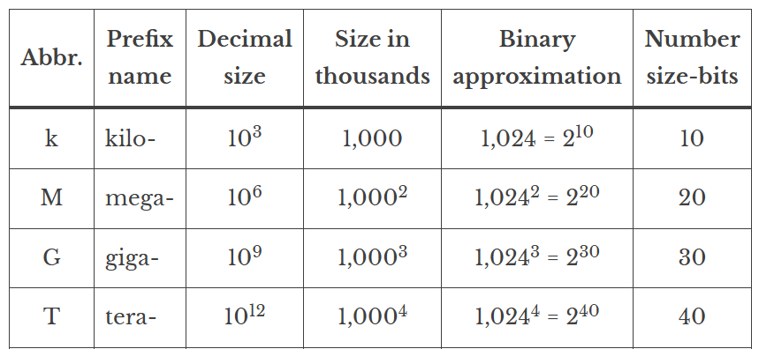
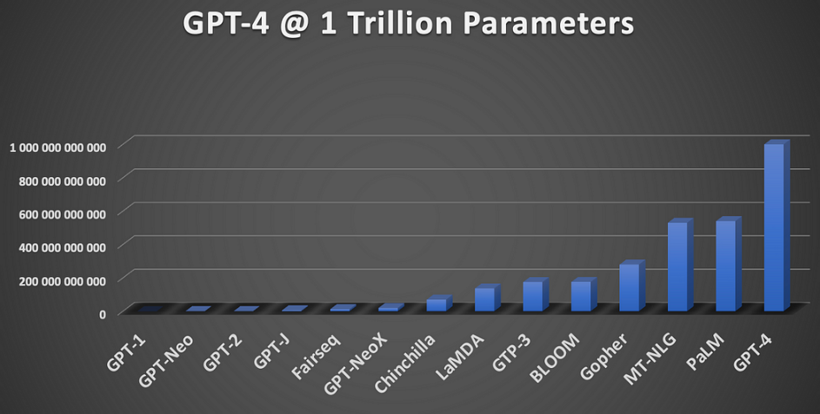
Case study of LLMs: Llama vs GPT https://zh.wikipedia.org/wiki/Facebook https://openai.com/
Llama 3.2 has 90B parameters, trained from about 200 billion tokens.
GPT-3 has 175B parameters, trained on about 45TB of text data from different sources https://www.springboard.com/blog/data-science/machine-learning-gpt-3-open-ai/
GPT-4 is estimated to have >1 trillion parameters https://cobusgreyling.medium.com/what-are-realistic-gpt-4-size-expectations-73f00c39b832
1G=2^30=1073741824 (in binary format)
1 billion(B)=10^9=1000000000 (decimal format) https://cryptosmith.com/2013/10/18/memory-sizes-kilo-mega-giga-tera-peta-exa/

Slide 90
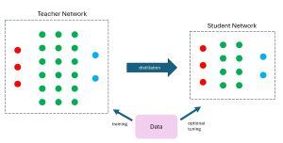
Large language model distillation
Learn from a larger model
It can reduce the storage size of a model which can have similar accuracy as the larger model.
It is less expensive to produce
ref: Model Distillation in the API | OpenAI
Example DeepSeek

Slide 91
Experiment1: Free colab account only have limited use of GPU.
llama (Llama3.1_(8B)-Alpaca.ipynb) tested ok on colab https://colab.research.google.com/github/unslothai/notebooks/blob/main/nb/Llama3.1_(8B)-Alpaca.ipynb#scrollTo=VZ6PSFBnZjnZ
Experiment 1:
# alpaca_prompt = Copied from above
FastLanguageModel.for_inference(model) # Enable native 2x faster inference
inputs = tokenizer(
[
alpaca_prompt.format(
"give the heights ",#instruction
"5 highest mountains on earth", # input
"", # output - leave this blank for generation!
)
], return_tensors = "pt").to("cuda")
outputs = model.generate(**inputs, max_new_tokens = 200, use_cache = True)
tokenizer.batch_decode(outputs)
User can
modify these

Slide 92
Result of experiment 1:
['<|begin_of_text|>Below is an instruction that describes a task, paired with an input that provides further context. Write a response that appropriately completes the request.\n\n### Instruction:\ngive the heights \n\n### Input:\n5 highest mountains on earth\n\n### Response:\nThe 5 highest mountains on earth are:\n\n1. Mount Everest - 8,848 meters (29,029 feet)\n2. K2 (Mount Godwin-Austen) - 8,611 meters (28,251 feet)\n3. Kanchenjunga - 8,586 meters (28,169 feet)\n4. Makalu - 8,485 meters (27,838 feet)\n5. Lhotse - 8,516 meters (27,940 feet)<|end_of_text|>']

Slide 93
Experiment2 with llama (Llama3.1_(8B)-Alpaca.ipynb) tested ok on colab https://colab.research.google.com/github/unslothai/notebooks/blob/main/nb/Llama3.1_(8B)-Alpaca.ipynb#scrollTo=VZ6PSFBnZjnZ
# alpaca_prompt = Copied from above
FastLanguageModel.for_inference(model) # Enable native 2x faster inference
inputs = tokenizer(
[
alpaca_prompt.format(
"write me a story of 500 words starting from the following words", # instruction
"Once upon a time", # input
"", # output - leave this blank for generation!
)
], return_tensors = "pt").to("cuda")
outputs = model.generate(**inputs, max_new_tokens = 500, use_cache = True)
tokenizer.batch_decode(outputs)
modified

Slide 94
Result of experiment 2:
Once upon a time, in a faraway land, there lived a young princess named Arielle. She was known for her kind heart, beautiful voice, and love for adventure. One day, while out exploring the forest, she came across a mysterious crystal that glowed with a bright light. Curious, she picked it up and placed it in her pocket.\n\nThe next day, when she arrived at the castle, she noticed that the crystal had grown brighter and was now glowing with a golden hue. Intrigued, she decided to investigate further. She took the crystal to her father, the king, and he summoned his trusted advisor, the wizard Merlin. Together, they studied the crystal and discovered that it was a powerful artifact that held the key to unlocking a great mystery.\n\nArielle\'s father, the king, decided to send her on a quest to find the answer to the mystery. She set off on her journey, accompanied by her faithful servant, Pippin, and a small band of loyal knights. Along the way, they encountered many dangers and challenges, but Arielle\'s courage and determination never wavered.\n\nAs they traveled, the crystal continued to grow brighter, leading them to the heart of the mystery. They arrived at a hidden valley, where they discovered an ancient temple. Inside, they found a powerful magical force that had been sealed away for centuries. With the help of the crystal, they were able to unlock the force and restore balance to the land.\n\nArielle\'s quest was a success, and she returned to the castle a hero. She was rewarded with a place of honor in the royal court, and her name was remembered for generations to come. The crystal, now known as the "Crystal of Light and Power," was placed in the castle\'s royal treasury, where it remained a source of wonder and inspiration for all who came to see it.<|end_of_text|>']

Slide 95
Experiment 3 Llama 3.2
https://huggingface.co/unsloth/Meta-Llama-3.1-8B
Llama 3.2 Conversational notebook. Free Colab
Llama 3.2 Vision finetuning - Radiography use case. Free Colab
https://colab.research.google.com/github/unslothai/notebooks/blob/main/nb/Llama3.2_(1B_and_3B)-Conversational.ipynb#scrollTo=J-IRbDfRp03Y
Students are encouraged to try it themselves.

Slide 96

Student exercises: Explore more on fine-tuning datasets
You may use these datasets to fine-tune a base LLM model (also called foundation model) for some applications
https://huggingface.co/datasets
10 Datasets for Fine-Tuning Large Language Models
https://odsc.medium.com/10-datasets-for-fine-tuning-large-language-models-d27f5a9b2a9a
Enter your search key, e.g. Conversation, story, Logic, math, calculus, chemistry….etc.

Slide 97
Conclusions
Introduced how transformer is used for building large language model (LLM)
Major steps of pre-training and fine tuning of LLM are discussed
Prompt engineering is mentioned.
Reinforcement learning method fine tunning are discussed,
Distillation method of building LLM are mentioned.
Experiments on an LLM is described

Slide 98
References
https://cameronrwolfe.substack.com/p/language-model-training-and-inference
https://cameronrwolfe.substack.com/p/decoder-only-transformers-the-workhorse
https://ai.meta.com/blog/meta-llama-3-1/
https://snorkel.ai/blog/large-language-model-training-three-phases-shape-llm-training/
https://colab.research.google.com/github/unslothai/notebooks/blob/main/nb/Llama3.2_(1B_and_3B)-Conversational.ipynb#scrollTo=J-IRbDfRp03Y
https://colab.research.google.com/github/unslothai/notebooks/blob/main/nb/Llama3.2_(1B_and_3B)-Conversational.ipynb#scrollTo=zdN0CpBLtsGQ
[PDF] Attention is all you need , A Vaswani, N Shazeer, N Parmar… - Advances in neural …, 2017 - papers.nips.cc
https://jalammar.github.io/illustrated-transformer/
https://towardsdatascience.com/transformers-explained-visually-part-1-overview-of-functionality-95a6dd460452
https://towardsdatascience.com/transformers-explained-visually-part-2-how-it-works-step-by-step-b49fa4a64f34
https://towardsdatascience.com/transformers-explained-visually-part-3-multi-head-attention-deep-dive-1c1ff1024853
Pre-trained bert can be downloaded from
https://huggingface.co/
https://bbycroft.net/llm (graphical display of transformer models)

Slide 99
Appendix :Discussion of Multi-head mechanism
Why “Multi-head mechanism ?”
Using multi-head does not change the input (X) , attention output dimensions
Multi-head learns different weights and approaches for the explanations of attention. Experimental results show it performs better. It is same using different kernel sizes in resnet www.cv-foundation.org/openaccess/content_cvpr_2016/papers/He_Deep_Residual_Learning_CVPR_2016_paper.pdf
Why Multi-head has no activation function?
https://ai.stackexchange.com/questions/30341/why-does-a-transformer-not-use-an-activation-function-following-the-multi-head-a , https://peterbloem.nl/blog/transformers
How weights are Wq, Wk, Wv trained?
https://datascience.stackexchange.com/questions/68220/how-are-q-k-and-v-vectors-trained-in-a-transformer-self-attention
What are the gradients used in Transformer-attention unit during learning by backpropagation ?
https://ai.stackexchange.com/questions/25055/what-is-the-gradient-of-an-attention-unit
https://say-hello2y.github.io/2022-09-07/attention-gradient

Slide 100
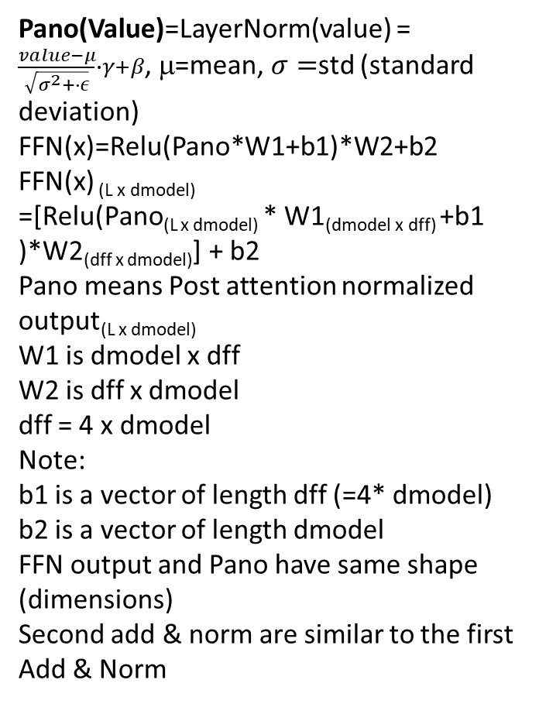
Important Equations for Transformer:
X_{(L x dmodel)}=Xin _{(L x V)} *W_{(V x dmodel)} ; Xin is in L x one-hot
L=length of token, dmodel=token embedded dimension (commonly called the hidden dimension)
Per_head_dimension(dq,dk,dv), set dq=dk=dv
Q(L x dq)=XPE(L,dmodel)*Wq (dmodel,dq) +1_{L}*(b_{dq})^{T}
K(L x dk)=XPE(L,dmodel)*Wk (dmodel,dk) +1_{L}*(b_{dk})^{T}
V(L x dv)=XPE(L,dmodel)*Wv (dmodel,dv) +1_{L}*(b_{dv})^{T}
1_{L} = a vector of ones with length L.
Attention_score_{(L x L)}=(Q _{(L x dq)}* (K _{(L x dk)})^{T})/sqrt(dk)
SmAtt _{(L x L )} =Softmax(Attention_score_{(LxL)}) _{(LxL)}
Zi _{(L x dv)} =Per_head Output of attention_{(L x dv)} = SmAtt _{(L x L)} *V_{(L x dv)}
///////////Concatenation: concat. Heads //////////
Concat_output (Z _{(L x (h*dv)=dmodel)}) =
Z=Concat( Z1_{(L x dv)}, Z2_{(L x dv)}, Z3_{(L x dv)}) _{(L x h*dv)}
Output projection weight(Wo) _{(dmodel x dmodel)}
MHATT(Multihead attention output) _{(L x dmodel)} =
Z _{(L x h*dv=dmodel)} * (Wo) _{(dmodel x dmodel)} +(1_{L}*(b_{o})^{T}) _{(L x dmodel)}
Concatenate heads to become MHATT
Pano(Value)=LayerNorm(value) = $\frac{value−μ}{\sqrt{σ^{2}+∙ε}}∙γ+β$, μ=mean, $σ=$std (standard deviation)
FFN(x)=Relu(Pano*W1+b1)*W2+b2
FFN(x) _{(L x dmodel)}
=[Relu(Pano_{(L x dmodel)} * W1_{(dmodel x dff)} +b1 )*W2_{(dff x dmodel)}] + b2
Pano means Post attention normalized output_{(L x dmodel)}
W1 is dmodel x dff
W2 is dff x dmodel
dff = 4 x dmodel
Note:
b1 is a vector of length dff (=4* dmodel)
b2 is a vector of length dmodel
FFN output and Pano have same shape (dimensions)
Second add & norm are similar to the first Add & Norm

