Slide 1
Robust and efficient pose tracking using perspective-four-point algorithm and Kalman filter
Objective
Our proposal
Perspective-Four-Point
Kalman Filter
Experiments & Results
Conclusion
Kin Hong Wongª,
Ying Kin Yuª , Kwan Pang Tsui^{b}, Ho Yin Fungª and Ho Chuen Kamª
ª Department of Computer Science and Engineering,
The Chinese University of Hong Kong
^{b} Department of Mechanical Engineering,
The Chinese University of Hong Kong
21 May 2017 at ICMSC17

Slide 2
Contents
Objective
Our proposal
Perspective-Four-Point
Kalman Filter
Experiments & Results
Conclusion
Objective
Motivation
Our proposal
Perspective-Four-Points
Experiments and Results
Conclusion

Slide 3
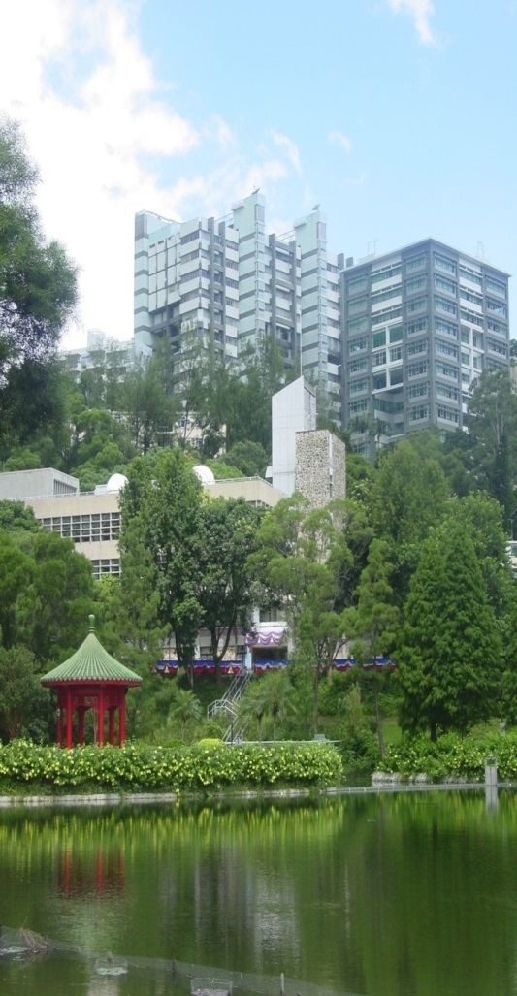
Faculty of Engineering,
The Chinese University of Hong Kong (CUHK)
Electronic Engineering (since 1970)
Computer Science & Engineering (since 1973)
Information Engineering (since 1989)
Systems Engineering & Engineering Management (since 1991)
Electronic Engineering (since 1970)
Computer Science & Engineering (since 1973)
Information Engineering (since 1989)
Systems Engineering & Engineering Management (since 1991)
Mechanical and Automation Engineering (since 1994)
110 faculty members
2,200 undergraduates (15% non-local)
800 postgraduates

Slide 4
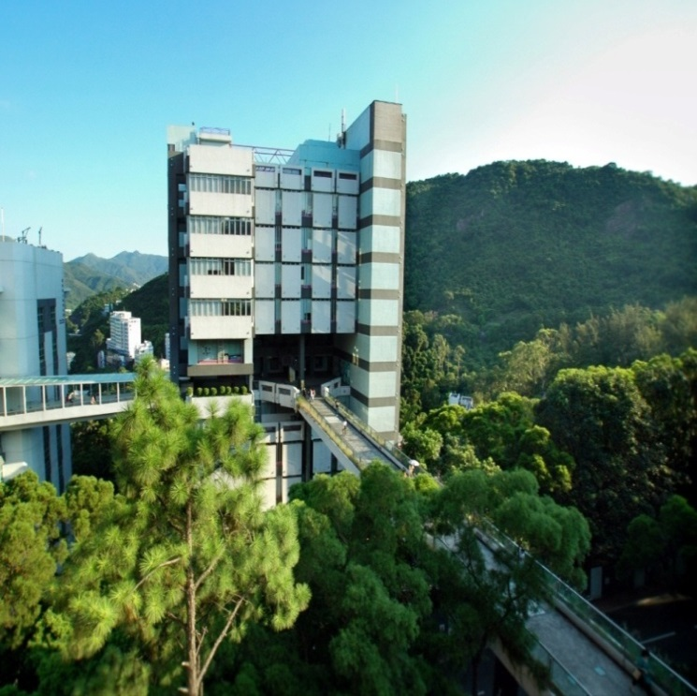
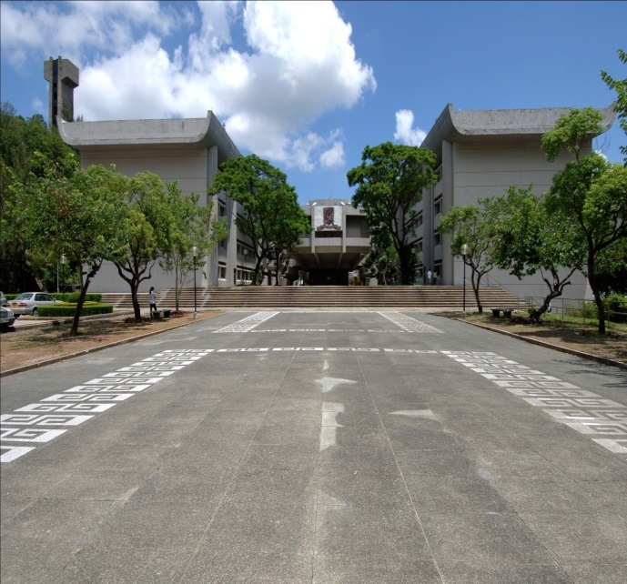
The Chinese University of Hong Kong
Department of Computer Science and Engineering

Slide 5
Contents
Objective
Our proposal
Perspective-Four-Point
Kalman Filter
Experiments & Results
Conclusion
Objective
Motivation
Our proposal
Perspective-Four-Points
Experiments and Results
Conclusion

Slide 6

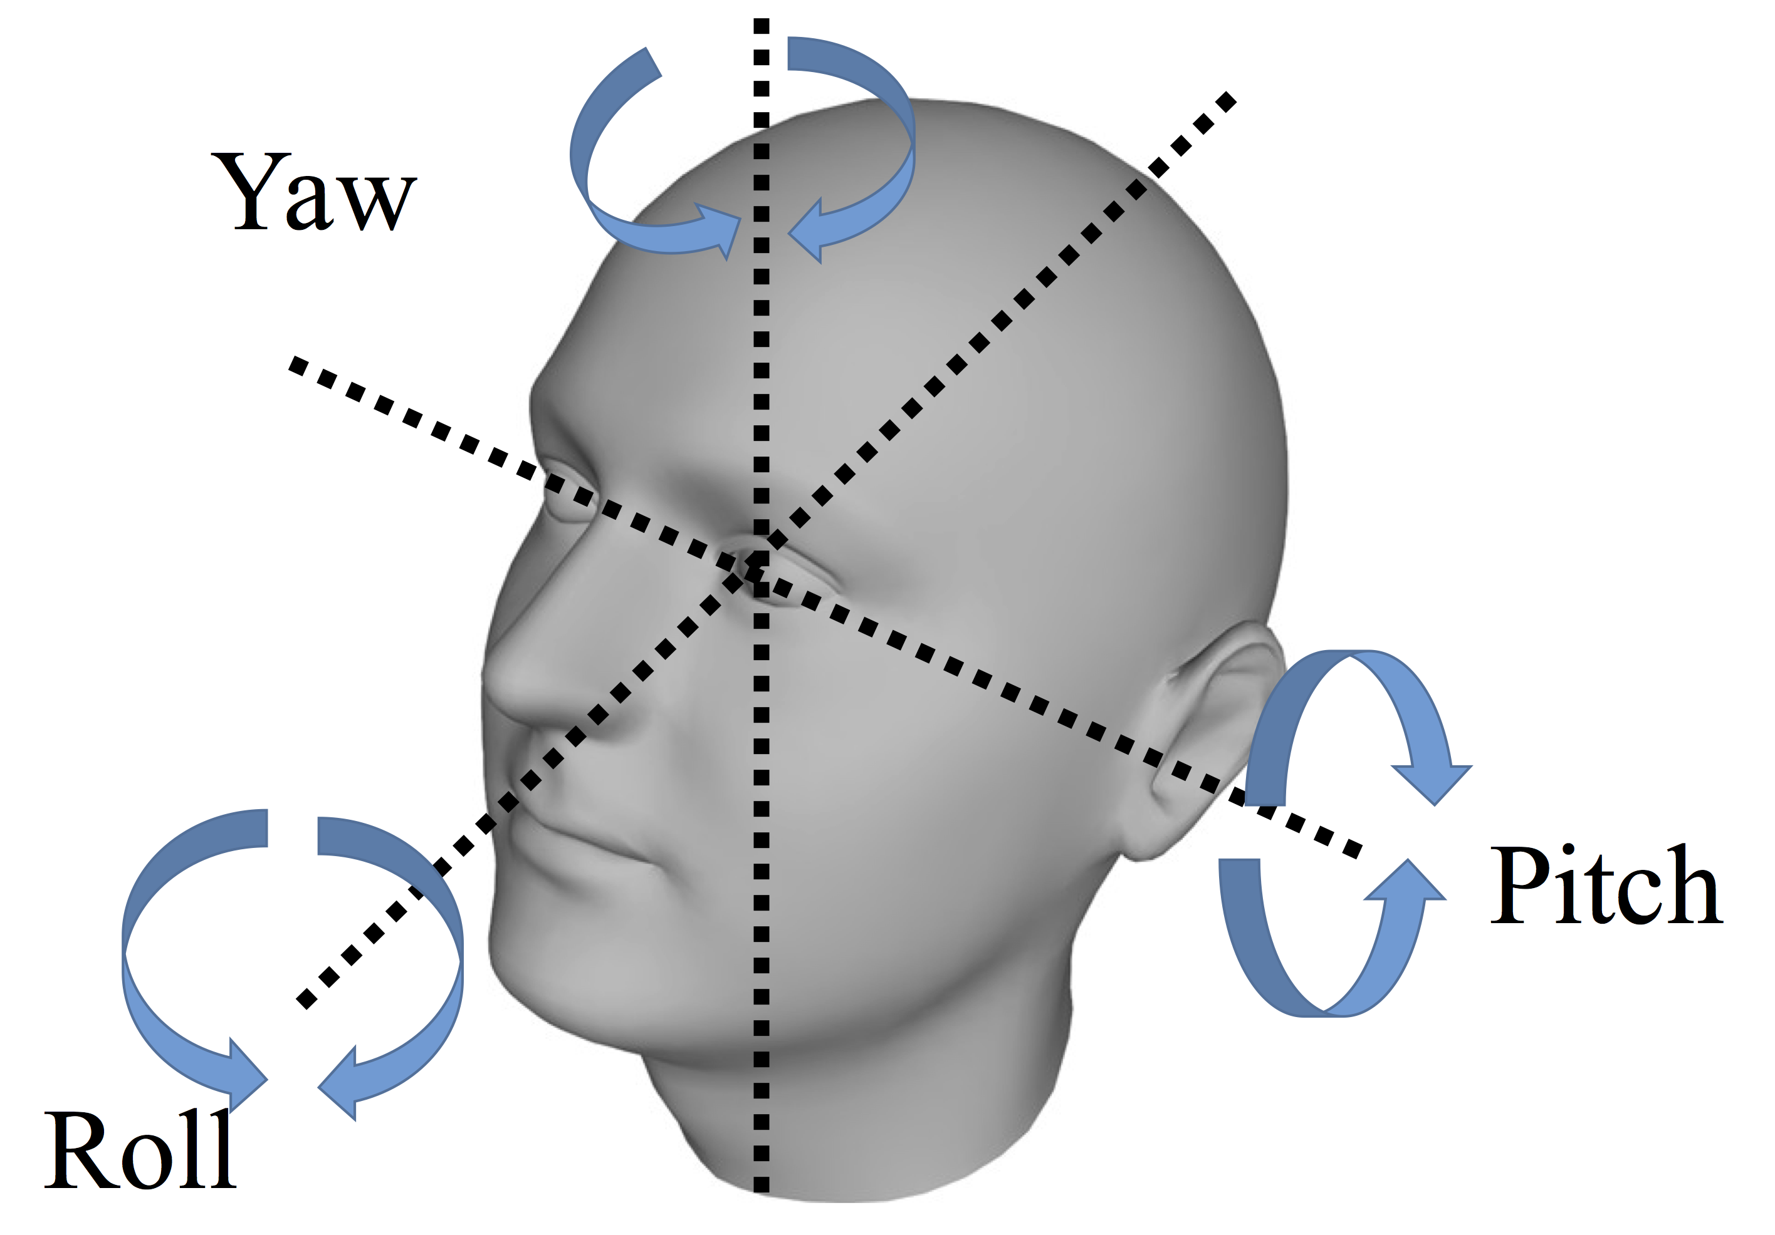
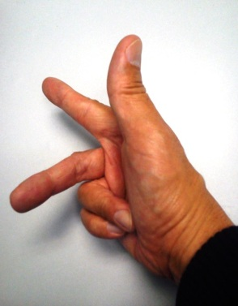
What are Rotation (R) and Translation (T)?: Motion of camera from world to camera coordinates
Camera motion (rotation=R_{c}, translation=T_{c}) will cause change of pixel position (x,y), See p156[1]
Y_{c}
Camera center
Rc,Tc
Y_{w}
X_{c}
Z_{w}
an_y
an_z
Z_{c}
X_{w}
an_x
World center
Cameras v.3d

Slide 7
3D to 2D projection
Perspective model
u=F*X/z
v=F*Y/z
Virtual
Screen
or CCD
sensor
World
center
Thin lens
or a pin hole
Y
v
v
F
Z
F
CCD
sensor

Slide 8
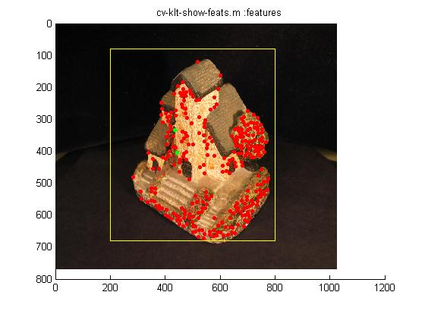
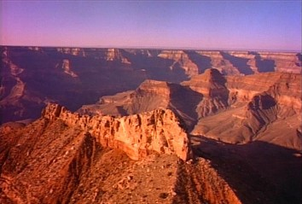
3D computer vision main tasks: SFM structure from motion
http://www.youtube.com/watch?v=2KLFRILlOjc
http://www.youtube.com/watch?v=RXpX9TJlpd0
Input: only image feature points x_{t=1}, x_{t=2}, x_{t=3},
Output : 3-D structure Model M, Motion (Rotation R_{t}, Translation T_{t} of the object )
3D Model=X_{j} : where j=feature index =1,2…n features
R₁,T₁
R₂,T₂
Γ
Time (i)
1 2 3 …

Slide 9
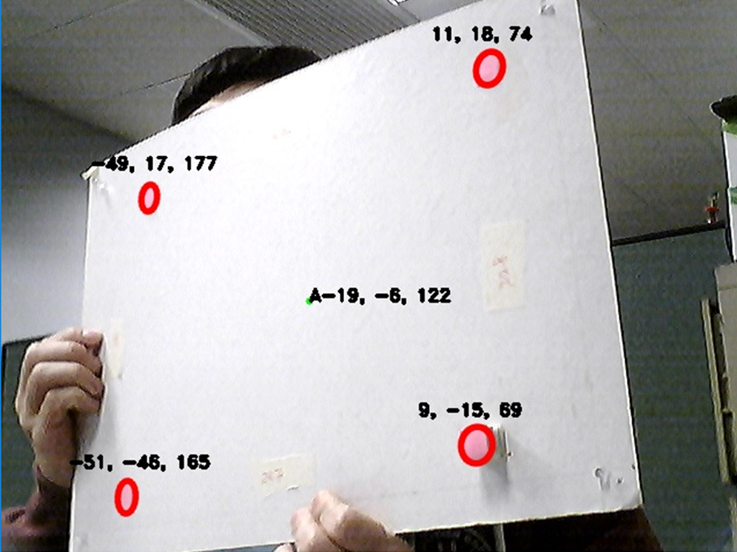
Objective
Objective
Our proposal
Perspective-Four-Point
Kalman Filter
Experiments & Results
Conclusion
We would like to track the pose (rotation R, translation T) of the object with only 4 points.
rotation R

Slide 10
Objective
Objective
Our proposal
Perspective-Four-Point
Kalman Filter
Experiments & Results
Conclusion
Conclusion
We would like to track the pose of the object with only 4 points.
To ensure robustness and accuracy, Kalman filter was implemented for post-processing.

Slide 11
Contents
Objective
Our proposal
Perspective-Four-Point
Kalman Filter
Experiments & Results
Conclusion
Objective
Motivation
Our proposal
Perspective-Four-Points
Experiments and Results
Conclusion

Slide 12
Our proposal
Objective
Our proposal
Perspective-Four-Point
Kalman Filter
Experiments & Results
Conclusion
Images from Camera
Feature Tracking by Camshift
Rotation, translation
Four point algorithm to obtain poses
Kalman Filter for noise removal
Kalman

Slide 13
Our proposal
Objective
Our proposal
Perspective-Four-Point
Kalman Filter
Experiments & Results
Conclusion
Our system has two components , namely
  Pose Estimation
  Kalman Filter
First we extract the four corners of the board using CAMSHIFT.

Slide 14
Our proposal
Objective
Our proposal
Perspective-Four-Point
Kalman Filter
Experiments & Results
Conclusion
Our system has two components , namely
  Pose Estimation
  Kalman Filter
First we extract the four corners of the board using CAMSHIFT.
Then four of the features are selected, are passed to the next steps for pose estimation.
Lastly, the poses are refined by using Kalman filter.

Slide 15
Contents
Objective
Our proposal
Perspective-Four-Point
Kalman Filter
Experiments & Results
Conclusion
Objective
Motivation
Our proposal
Perspective-Four-Points
Experiments and Results
Conclusion

Slide 16
Algorithm part 1
pose estimation by the four point algorithm

Slide 17
Perspective-Four-Point
Objective
Our proposal
Perspective-Four-Point
Kalman Filter
Experiments & Results
Conclusion
Perspective-Four-Point (four-point) is an iterative algorithm.
If we know the models of four 3-D feature points, and their correspondence image points, pose of the object relative to the camera can be found.

Slide 18
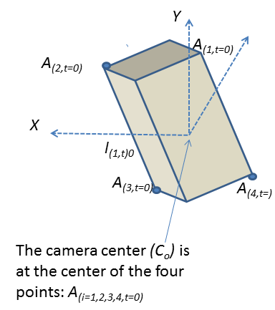
Input/Output of pose estimation
Input: Model: 4 3-D points , can measure manually
Output: Pose
  Rotation (3x3 matrix)
  Translation (3x1 vector)

Slide 19
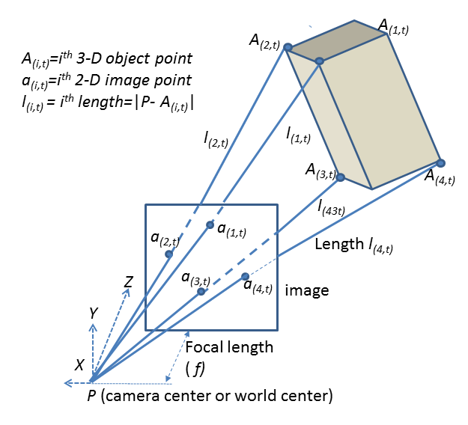
Perspective-Four-Point
Objective
Our proposal
Perspective-Four-Point
Kalman Filter
Experiments & Results
Conclusion
Suppose we have four model points defined as t=0:
Their image projection points can be detected as:

Slide 20
Perspective-Four-Point
Objective
Our proposal
Perspective-Four-Point
Kalman Filter
Experiments & Results
Conclusion
As this is a rigid body, the relative distance among these model points at any time can be found.

Slide 21
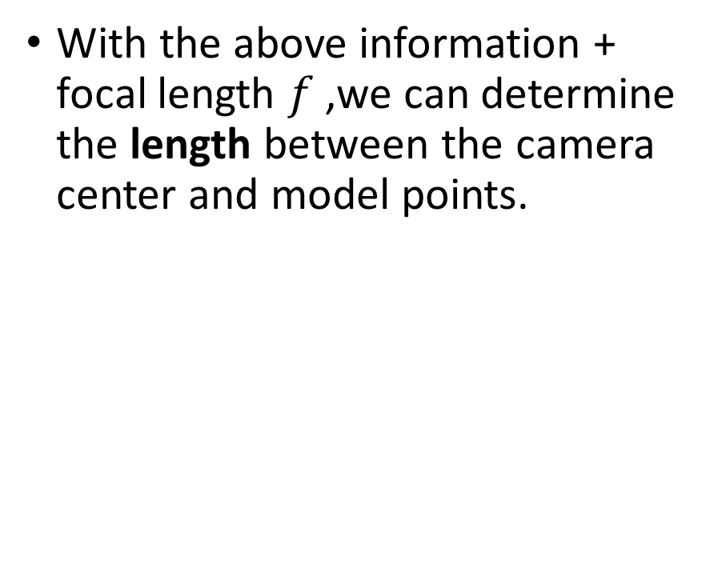
Perspective-Four-Point
Objective
Our proposal
Perspective-Four-Point
Kalman Filter
Experiments & Results
Conclusion
With the above information + focal length $f$ ,we can determine the length between the camera center and model points.

Slide 22
Perspective-Four-Point
Objective
Our proposal
Perspective-Four-Point
Kalman Filter
Experiments & Results
Conclusion
Now we can relate the 3-D Model with the length by the following vector:
Where is the unit vector.

Slide 23
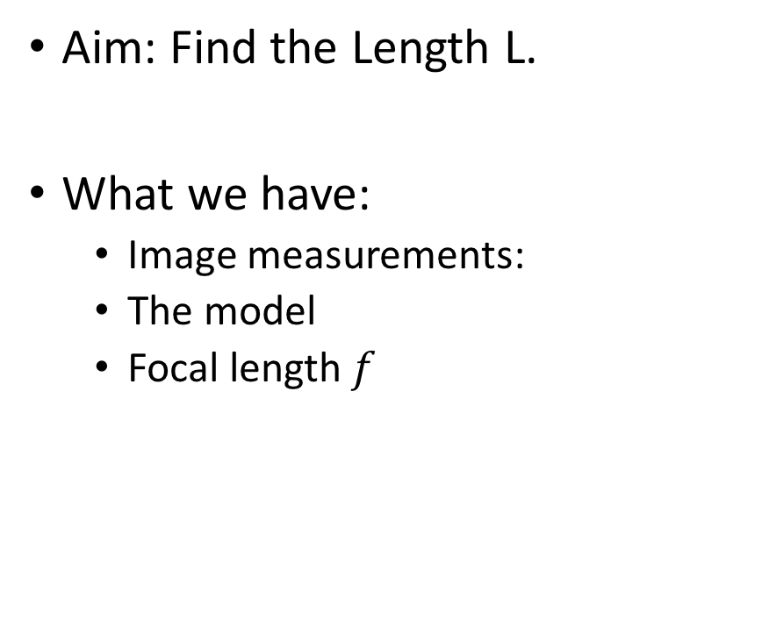
Problem Formulation
Objective
Our proposal
Perspective-Four-Point
Kalman Filter
Experiments & Results
Conclusion
Aim: Find the Length L.
What we have:
  Image measurements:
  The model
  Focal length $f$

Slide 24
Forming Constraints Ｄ＝ｃｏｎｓｔａｎｔ
Objective
Our proposal
Perspective-Four-Point
Kalman Filter
Experiments & Results
Conclusion
By using the distances among four points and , and cosine law:
The predicted form is:

Slide 25

Forming Constraints
Objective
Our proposal
Perspective-Four-Point
Kalman Filter
Experiments & Results
Conclusion
From the above formulae, the generalized error function:
With four points, we have 6 combinations of I and J.
True
Predicted

Slide 26
Extra Constraint
Objective
Our proposal
Perspective-Four-Point
Kalman Filter
Experiments & Results
Conclusion
Using the above 6 constraints is not enough. (Liu & Wong 1999).
One more constraint is added to ensure unique solution.
The difference of true and guessed:

Slide 27



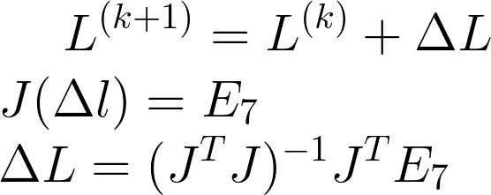
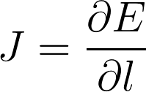
Iterative Processing
Objective
Objective
Our proposal
Perspective-Four-Point
Kalman Filter
Experiments & Results
Conclusion
After developing 7 error functions/constraints, now we minimized the error using a Gauss-Newton method.
At Initialization:
Initial Guess:
For the iteration from k = 0 to K_{max :}
Where
Where J is a Jacobian matrix:

Slide 28
Algorithm part 2
Kalman filter

Slide 29
Kalman Filter
Objective
Our proposal
Perspective-Four-Point
Kalman Filter
Experiments & Results
Conclusion
What is a Kalman Filter?
Long history, invented at 1960.
Used to track the airplane trajectory
In Computer vision, it is useful in tracking and navigation.
Ideal
With fluctuation
caused by wind
Measurement
https://plus.maths.org/content/understanding-unseen

Slide 30

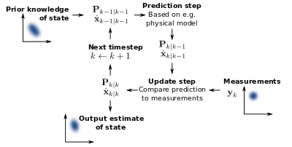
Kalman Filter
Kalman filter has two fundamental equation:
is the state of the system on the time step k.
is the measurement on the time step k.
is the process noise on the time step k-1.
Is the measurement noise on the time step k-1.
is the transition matrix of the dynamic model.
Is the measurement model matrix.
Hartikainen, Jouni, Arno Solin, and Simo Särkkä. "Optimal filtering with Kalman filters and smoothers." Department of Biomedica Engineering and Computational Sciences, Aalto University School of Science, 16th August(2011).

Slide 31
Define the Kalman state and measurement
We need go define them before use.
X=state=12x1 vector
X=[x,y,z,(dx/dt),(dy/dt),(dz/dt), θx, θy, θz,(dθx/dt), (dθx/dt), (dθx/dt)]^{T}
x,y,z are translations, θx, θy, θz are rotational angles
y=measurement=6x1 vector
y =[x,y,z, θx, θy, θz,] ^{T}

Slide 32
Contents
Objective
Our proposal
Perspective-Four-Point
Kalman Filter
Experiments & Results
Conclusion
Objective
Motivation
Our proposal
Perspective-Four-Points
Experiments and Results
Conclusion

Slide 33
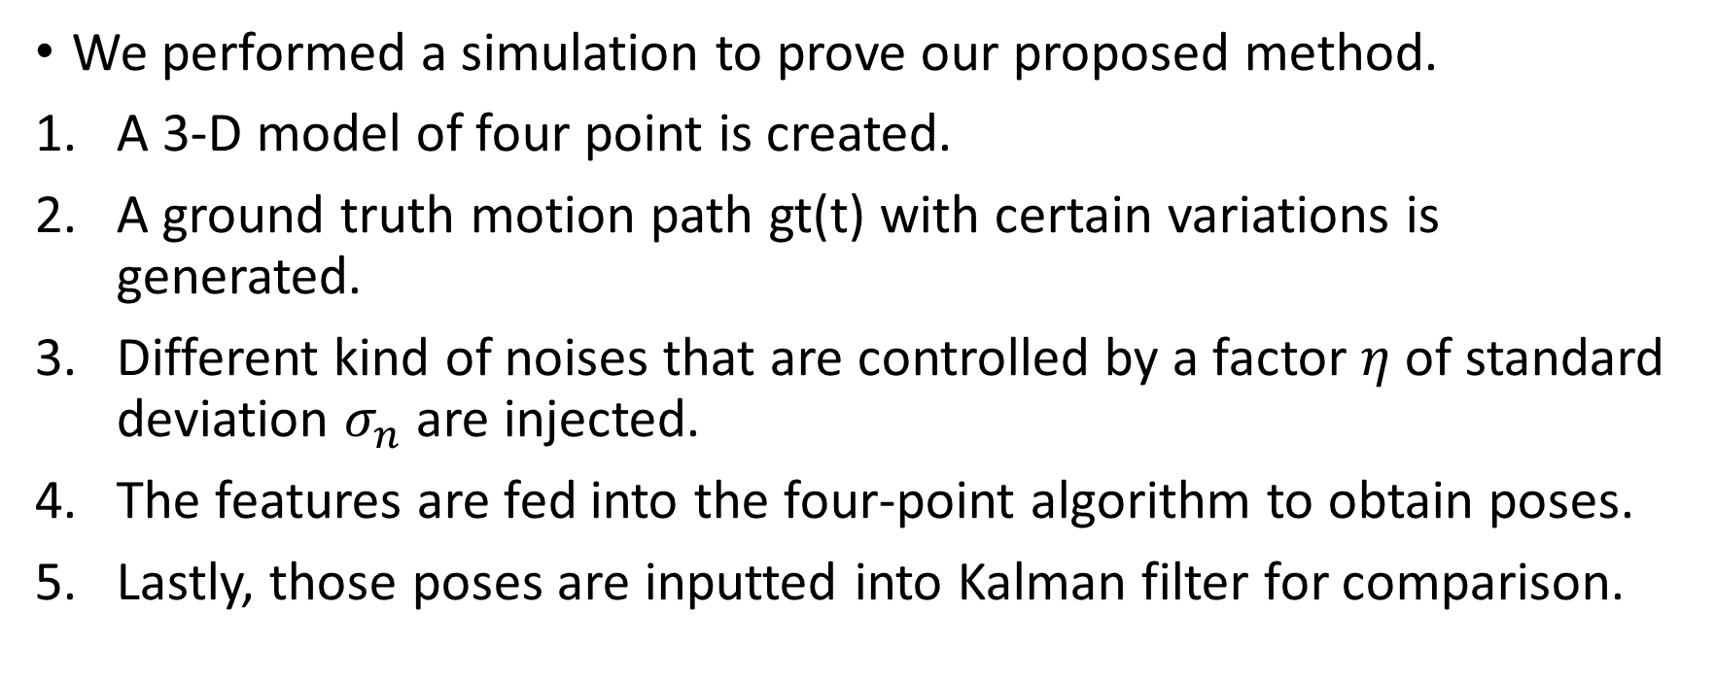
Simulations
Objective
Our proposal
Perspective-Four-Point
Kalman Filter
Experiments & Results
Conclusion
We performed a simulation to prove our proposed method.
A 3-D model of four point is created.
A ground truth motion path gt(t) with certain variations is generated.
Different kind of noises that are controlled by a factor $η$ of standard deviation $σ_{n}$ are injected.
The features are fed into the four-point algorithm to obtain poses.
Lastly, those poses are inputted into Kalman filter for comparison.

Slide 34
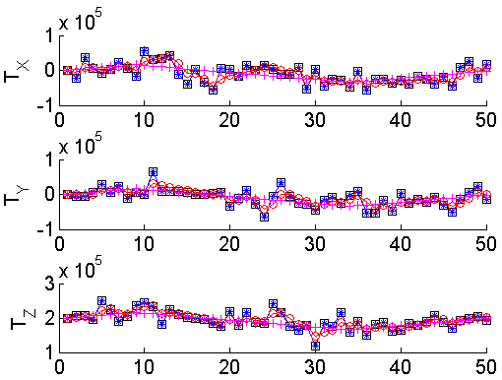
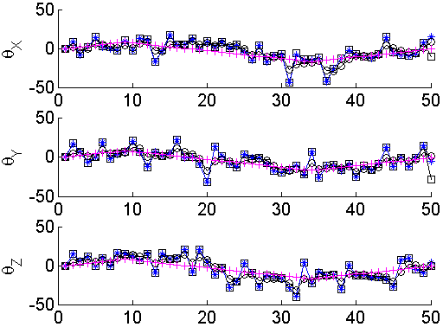
Simulation Results
Objective
Our proposal
Perspective-Four-Point
Kalman Filter
Experiments & Results
Conclusion
Legend:
‘□’: observation
‘*’: By Four-point algorithm
‘O’: By Kalman filter
‘+’: Ground Truth
Translation
Rotation

Slide 35
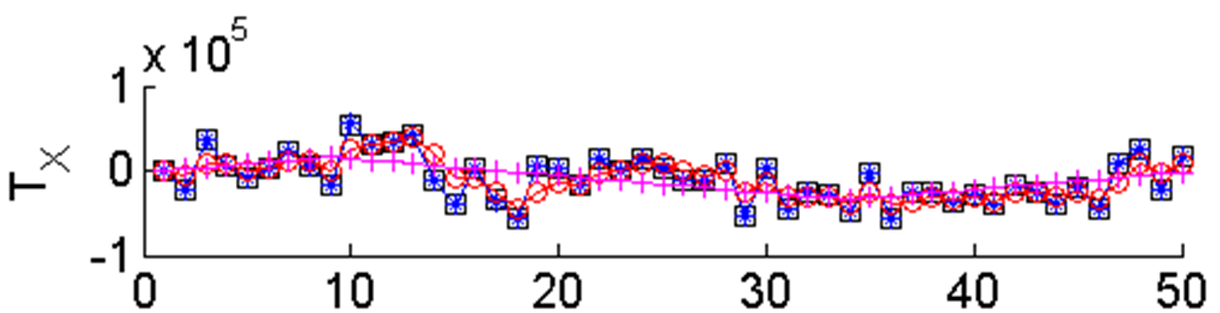
Ideal
Legend:
‘□’: observation
‘*’: By Four-point algorithm
‘O’: By Kalman filter
‘+’: Ground Truth
With fluctuation
caused by wind
Measurement

Slide 36
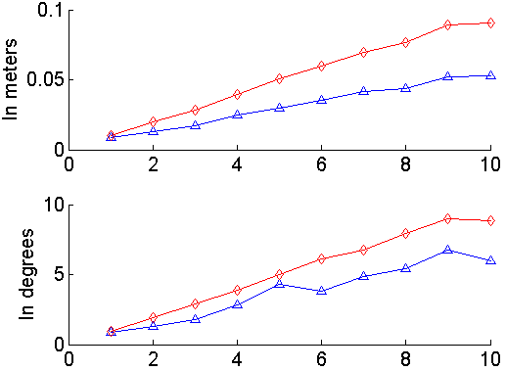


Simulation Result (add noise)
Objective
Our proposal
Perspective-Four-Point
Kalman Filter
Experiments & Results
Conclusion
No Kalman
Less inferenced by noise for kalman approach
Translation versus noise factor $η$
η
No Kalman
Less inferenced by noise for kalman approach
Rotation versus noise factor $η$
η

Slide 37
Real Experiments - Video
Objective
Our proposal
Perspective-Four-Point
Kalman Filter
Experiments & Results
Conclusion
We have built a prototype of using 4 point and Kalman filter to trace face.
Similar, use 4 facial feature points instead of 4 red dots on board.
  Without Kalman (https://youtu.be/XqvpIsX7XRg)
  With Kalman (https://youtu.be/Esp45Xvg1pA )

Slide 38
Contents
Objective
Our proposal
Perspective-Four-Point
Kalman Filter
Experiments & Results
Conclusion
Objective
Motivation
Our proposal
Perspective-Four-Points
Experiments and Results
Conclusion

Slide 39
Discussion & Conclusion
Objective
Our proposal
Perspective-Four-Point
Kalman Filter
Experiments & Results
Conclusion
We successfully built a system to track objects and reduce noises by Kalman filter.
Efficient and robust.
Useful in many engineering applications such as vision-based automatic driving.

Slide 40
Thank You!
Objective
Our proposal
Perspective-Four-Point
Kalman Filter
Experiments & Results
Conclusion
Q & A

Slide 41
Ａｐｐｅｎｄｉｘ：Kalman Filter
Kalman filter has two fundamental equation:
is the state of the system on the time step k.
is the measurement on the time step k.
is the process noise on the time step k-1.
Is the measurement noise on the time step k-1.
is the transition matrix of the dynamic model.
Is the measurement model matrix.
Hartikainen, Jouni, Arno Solin, and Simo Särkkä. "Optimal filtering with Kalman filters and smoothers." Department of Biomedica Engineering and Computational Sciences, Aalto University School of Science, 16th August(2011).

Slide 42
Kalman Filter
Objective
Our proposal
Perspective-Four-Point
Kalman Filter
Experiments & Results
Conclusion
The filter has two phases:
  Prediction step
  Update Step
First the state of a system is defined (system state).
Also process noise and measurement noise can be taken into account.
Prediction
Update
Welch, Greg, and Gary Bishop. "An introduction to the Kalman filter." (1995).

Slide 43
Kalman Filter - Prediction
Objective
Our proposal
Perspective-Four-Point
Kalman Filter
Experiments & Results
Conclusion
The filter has two phases:
  Prediction step
  Update Step
System state, process noise, measurement noise.
With the above information, a optimal estimate is computed.
Prediction
estimate
Update

Slide 44
Kalman Filter - Update
Objective
Our proposal
Perspective-Four-Point
Kalman Filter
Experiments & Results
Conclusion
The filter has two phases:
  Prediction step
  Update Step
The measurement is also input to the system (Real data).
It is used to update the prediction model.
Whether we trust the prediction or the measurement.
Prediction
Update

Slide 45
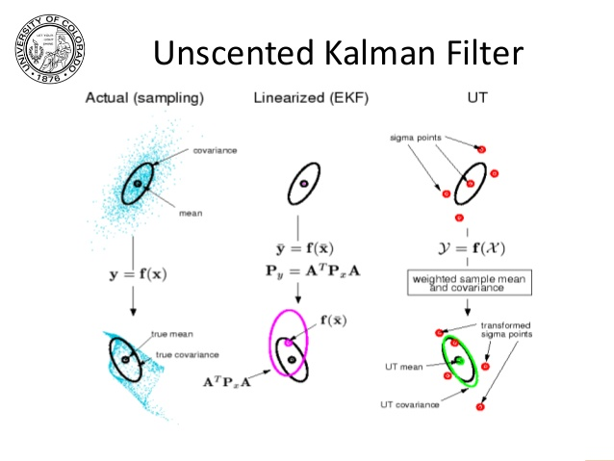
Different type of Kalman Filter
Objective
Our proposal
Perspective-Four-Point
Kalman Filter
Experiments & Results
Conclusion
Ordinary Kalman Filter
  For linear system only.
Modified Kalman filter
  Suitable for non-linear system
  Extended Kalman filter (EKF)
  Unscented Kalman filter (UKF)
  Cubature Kalman filter (CKF)
Hong-de, Dai, et al. "Performance comparison of ekf/ukf/ckf for the tracking of ballistic target." Indonesian Journal of Electrical Engineering and Computer Science 10.7 (2012): 1692-1699.

