Slide 1
Artificial Intelligence (AI) technology for developing systems to help people with vision problems
KH Wong,
Email:khwong@cse.cuhk.edu.hk
Webpage: http://www.cse.cuhk.edu.hk/~khwong/
Invited talk : Research Centre for SHARP Vision (RCSV) and School of Optometry 45th Anniversary Research Seminar - "Artificial Intelligence (AI) technology for developing systems to help people with vision problems" , Room HJ305, School of Optometry of The Hong Kong Polytechnic University , Nov 24, 2023.

Slide 2
Abstract
In this talk, we will review the Artificial Intelligence (AI) technology which may be useful for people with vision problems. Morden AI methods, especially computer vision, natural language processing and speech processing have improved human lives immensely. We will first review the major technologies that may be useful in developing vision assisted tools for people who need them. That include the neural network methods such as CNN, RNN and transformer, and how they can be used for building our proposed target systems. Then, we will also discuss the software tools that may help researchers to develop AI routines easier. Recent developments in image captioning and gesture recognition will also be mentioned. A few vision-assisted systems to help people with vision problems will also be proposed and explained.

Slide 3
Introduction
Our proposed system and motivation
Background
System design
Current work
Conclusion

Slide 4
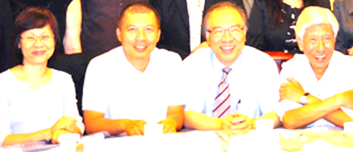

Our proposed system
-- A vision assistance system
Tell visually-impaired people their surrounding using speech and sound effect
Ms. Wu
Mr. Xu
Prof. Yu
Dr. Zu
Describe the scene using by speech
Tell who are in the scene
Visually impaired person
Wearing earphone
Camera
With AI program

Slide 5
Motivation and system requirement
An AI vision system for the visually impaired.
  Similar systems are not available at low cost
  Our proposed system can use low-cost hardware
System requirement
  Vision computer
  Photometry for location identification
  Speech synthesis
  Stereo sound localization

Slide 6
Background
AI techniques

Slide 7
Overview of techniques
  Neural network
    Basic neural network model
    Convolution Neural Network (CNN), parallel method
    Recurrent Neural Network (RNN),sequential method
    Transformer , parallel + sequential method
  Computer Vision
    Object recognition
    You only look once model YOLO
    Photometry for 3d reconstruction & location identification
  Speech synthesis
    Speech signal analysis
    Stereo sound localization

Slide 8
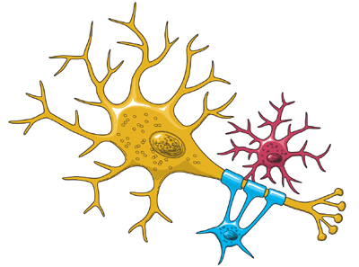
1a) Basic biological neural network
Biological findings inspire the development of Neural Net
  Input →weights →Logic function→ output
Biological relation
  Input
  Dendrites
  Output
  Human computes using a net
Neuron(Logic function)
X=inputs
W=weights
Output
https://www.ninds.nih.gov/Disorders/Patient-Caregiver-Education/Life-and-Death-Neuron

Slide 9
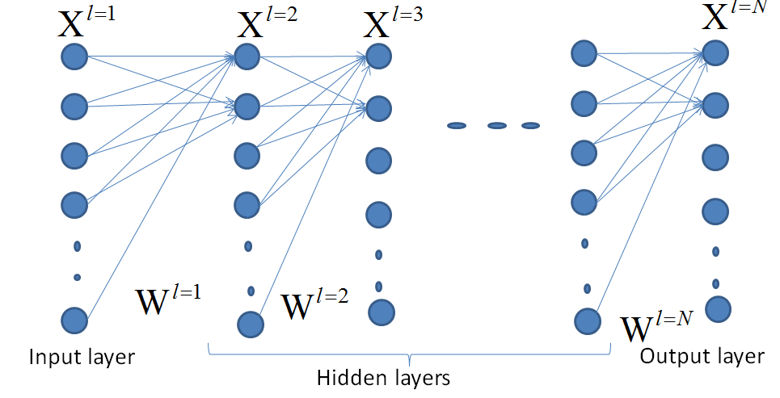

Inside each neuron there is a bias (b)
In between any 2 neighboring neuron layers, a set of weights are found
$$y=f(u)=\frac{1}{1+e^{−\left(\sum_{i=1}^{i=I}{\left[ω(i)x(i)\right]+b}\right)}}$$
Learning by backpropagation
Case1
case2
=
Learning : to update weights/biases by backpropagation
(supervised learning)
https://www.youtube.com/watch?v=tIeHLnjs5U8

Slide 10
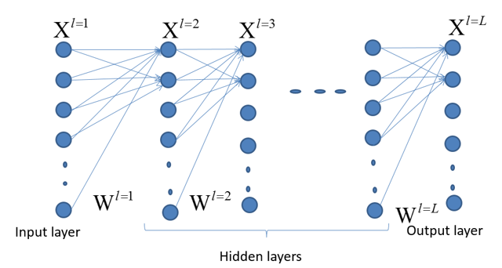
Case 1 of weight updating backpropagation (i): between the hidden layer and the output layer
Definition
Output
t_{i}
Overall picture
(supervised learning)
Neuron n as an output neuron
Output
Sensitivity (S2)
s2 = 1*diag(df2) * e(:,i); %e=A2-T;
df2=f’=f(1-f) of layer2, in bnppx.m
Notes:
%%%%%%%%%%%%%%%%%%%%%%%%%%%%%%%%%%%%%%
%%%%%%%%% slide 43 %%%%%%%%%
\subsection{slide 43 Case 1(i): if the neuron in between the output and the hidden layer}
By definition:
$x_i=f(u_i)=
f \Big( \sum\limits_{j=1}^{j=J}(w_{j,i}x_j+b_j)
\Big)
=\frac{1}{
1+exp
\Big(- \sum\limits_{j=1}^{j=J} (w_{j,i}x_j+b_j) \Big)
}$\\
%%%%%%%%%%%%%%%%%%%%%%%%%%%%%%%%%%%%
$\frac{\partial \varepsilon}{\partial w_{i,j}}=
\frac{\partial \varepsilon}{\partial x_j}
\frac{\partial x_j}{\partial u_j}
\frac{\partial u_j}{\partial w_{i,j}}$
%%%%%%%%%%%%%%%%%%%
update $w_{j,i}$ factor,
=term1 $\cdot$ term2 $\cdot$ term3\\
$term1:\frac{\partial \varepsilon }{x_i}=\frac {\partial (0.5)*(x_i - t_i)^2}{\partial x_i}=(x_i - t_i)$\\
$x_i=f(u_i)$ , by definition\\
%%
$term2: \frac{\partial x_i}{\partial u_i}=\frac{\partial f (u_i)}{\partial u_i}=f(u_i)(1-f(u_i))$, proved earlier\\
since $u_i= \sum\limits_{j=1}^{j=J} w_{j,i} x_j+b_j =w_{j,i} x_j+b_j$, for a particular $(j,i)$ pair\\
%%
$term3=\frac{u_j}{w_{j,i}}=\frac{\partial (w_{j,i} \cdot x_j + b_j ) }{\partial w_{j,i}}$, since $b_j$=constant\\
Note : term1 $\cdot term2=\frac{\partial \varepsilon }{\partial u_i }
=\frac{\partial \varepsilon }{\partial x_i }
\frac{\partial x_i }{\partial u_i }=s_i$ is called the sensitivity\\
$s_i=(x_i-t_i) \cdot f(u)(1-f(u))$---(2)\\
since $\frac{\partial \varepsilon}{\partial w_{j,i}}=term1 \cdot term2 \cdot term3$\\
%
$\frac{\partial \varepsilon}{\partial w_{j,i}}=s_ix_j=[(x_i-t_i) \cdot f(u_i)(1-f(u))] \cdot x_j$\\
Note:$ f(u_i)(1-f(u))] \cdot x_j$ is sensitivity (s2)
\begin{verbatim}
%The code:
s2 = 1*diag(df2) * e(:,i); %e=A2-T;
df2=f’=f(1-f) of layer2, in bnppx.m
\end{verbatim}

Slide 11
Case2 of weight updating(backpropagation )
(i) : if neuron in between a hidden and hidden layer. We want to find
(supervised learning)
A1
Weight
Layer L
Indexed by i
sensitivity of layer indexed by i
Overall picture
Output
layer
S_{j}: sensitivity for layer j to i
Notes:
%%%%%%%%%%%%%%%%%%%%%%%%%%%%%%%%%%%%%%%%
\subsection{Slide 48: Case2 : if neuron in between a hidden to hidden layer. We want to find}
$\frac{\partial \varepsilon }{\partial w_{i,j}}=
\frac{\partial \varepsilon }{\partial x_j}
\frac{\partial x_j}{\partial u_j}
\frac{\partial u_j}{\partial w_{k,j}}$
%
%update $w_{j,i}$ factor,
$=term1 \cdot term2 \cdot term3$\\
$term1=\frac{\partial \varepsilon}{\partial x_j}
=\sum\limits_{i=1}^{i=I}
\Big(
\frac{\partial \varepsilon }{\partial u_i}
\frac{\partial u_i}{\partial x_j }
\Big)
=\sum\limits_{i=1}^{i=I}(part1a \cdot part1b)$
---(*)\\
%
Part1a: $\frac{\partial \varepsilon }{\partial u_i}=s_i $ (sensitivity in layer $i$)\\
%
=$term1 \cdot term2$ in case 1 discussed earlier\\
part1b: $\frac{\partial u_i }{\partial x_j}=w_{j,i} , $ since $u_i=w_{j,i} \cdot x_j $ for the (j,i) pair\\
So put in (*)
to find term1, hence $\frac{\partial \varepsilon }{\partial x_j}=
\sum\limits_{i=1}^{i=I}(s_i \cdot w_{j,i})$\\
%
$term2= \frac{\partial x_j}{\partial u_j}=[f(u_j)(1-f(u_j)]=$df1 in bnppx.m, since $x_j=f(u_j)$\\
%
$term3=\frac{\partial u_j}{\partial w_{k,j}}=x_k,$ since $u_j=w_{k,j} \cdot x_k$ for the $(k,j)$ pair\\
%
$\frac{\partial \varepsilon }{\partial w_{k,j}}= \Big(
\sum\limits_{i=1}^{i=I}(s_i \cdot \cdot w_{j,i})
\Big)
\cdot [f(u_j)(1-f(u_j)] \cdot x_k$\\
Note: $s_i$ is called the ``sensitivity'' for layer $j$ to $i$

Slide 12
Overview of techniques
  Neural network
    Basic neural network model
    Convolution Neural Network (CNN), parallel method
    Recurrent Neural Network (RNN),sequential method
    Transformer , parallel + sequential method
  Computer Vision
    Object recognition
    You only look once model YOLO
    Photometry for 3d reconstruction & location identification
  Speech synthesis
    Speech signal analysis
    Stereo sound localization

Slide 13
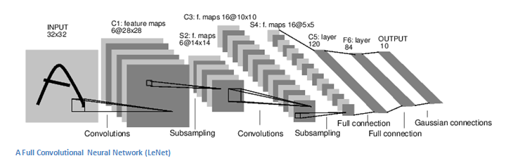
1b)Convolution Neural Networks (CNN)
Input conv. subs. conv subs fully fully output
Alternating Convolution (conv) and subsampling layer (subs)
  But some architectures skip some of the subsampling layers (subs), it is up to the designer to decide
Subsampling allows the features to be flexibly positioned

Slide 14
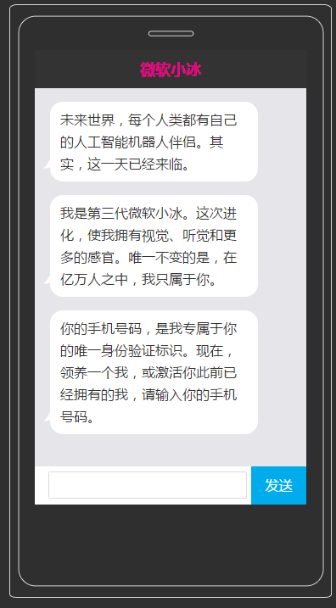
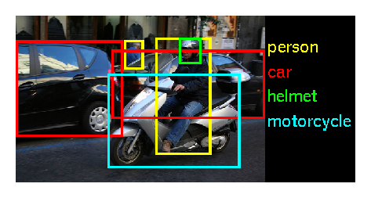
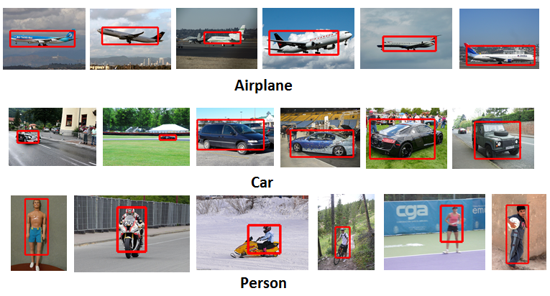
CNN for Object recognition
Microsoft: XiaoIce. AI
http://image-net.org/challenges/LSVRC/2015/
  200 categories: accordion, airplane ,ant ,antelope ….dishwasher ,dog ,domestic cat ,dragonfly ,drum ,dumbbell , etc.
Using Tensor flow
 |  | ILSVRC 2015
Number of object classes |  | 200
Training | Num images | 456567
 | Num objects | 478807
Validation | Num images | 20121
 | Num objects | 55502
Testing | Num images | 40152
 | Num objects | ---

Slide 15
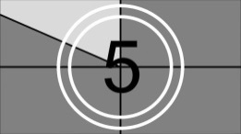
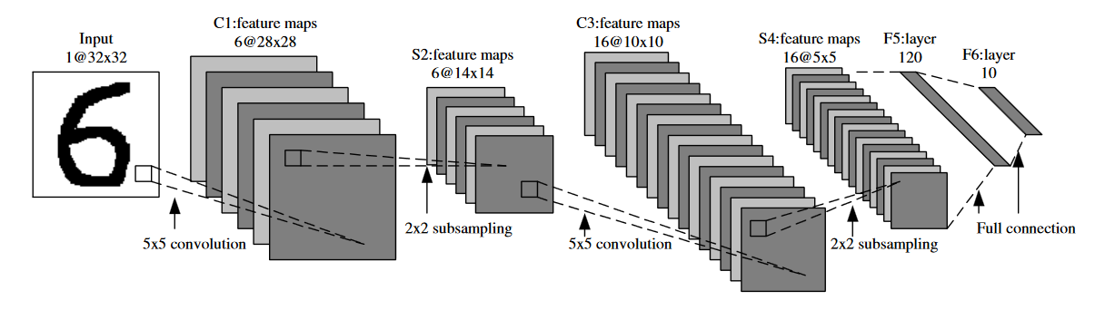
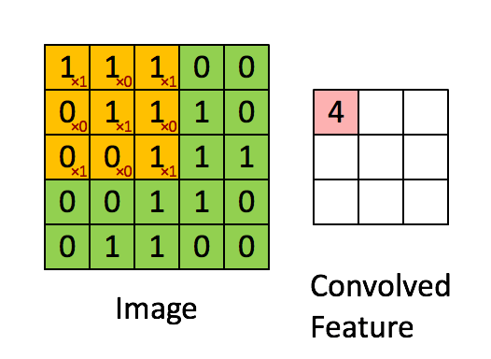
CNN Demo
http://deeplearning.stanford.edu/wiki/images/6/6c/Convolution_schematic.gif , https://link.springer.com/content/pdf/10.1007%2F978-3-642-25191-7.pdf
Filters
Filters
(Softmax)
1 | 0 | 1
0 | 1 | 0
1 | 0 | 1
This is a 3x3 mask(kernel) for illustration purpose,
but noted that the above application uses a 5x5 mask (kernel).
Input image
A different kernel generates a different feature map.
Use softmax to generate the output (see next slide)
A feature map
Correlation mask (kernel) .
Each kernel is a neuron, so it is very efficient

Slide 16
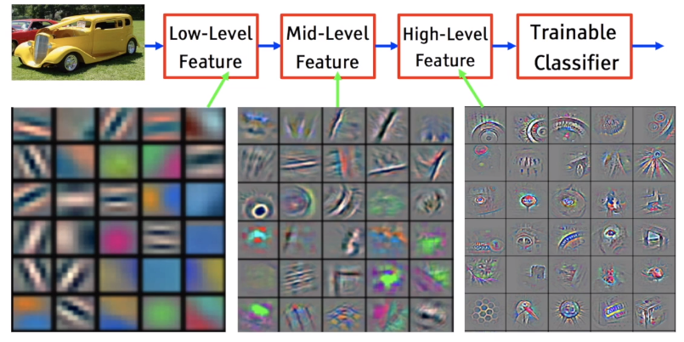
Each kernel corresponds to a feature
https://medium.com/analytics-vidhya/the-world-through-the-eyes-of-cnn-5a52c034dbeb

Slide 17
Overview of techniques
  Neural network
    Basic neural network model
    Convolution Neural Network (CNN), parallel method
    Recurrent Neural Network (RNN),sequential method
    Transformer , parallel + sequential method
  Computer Vision
    Object recognition
    You only look once model YOLO
    Photometry for 3d reconstruction & location identification
  Speech synthesis
    Speech signal analysis
    Stereo sound localization

Slide 18
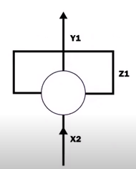
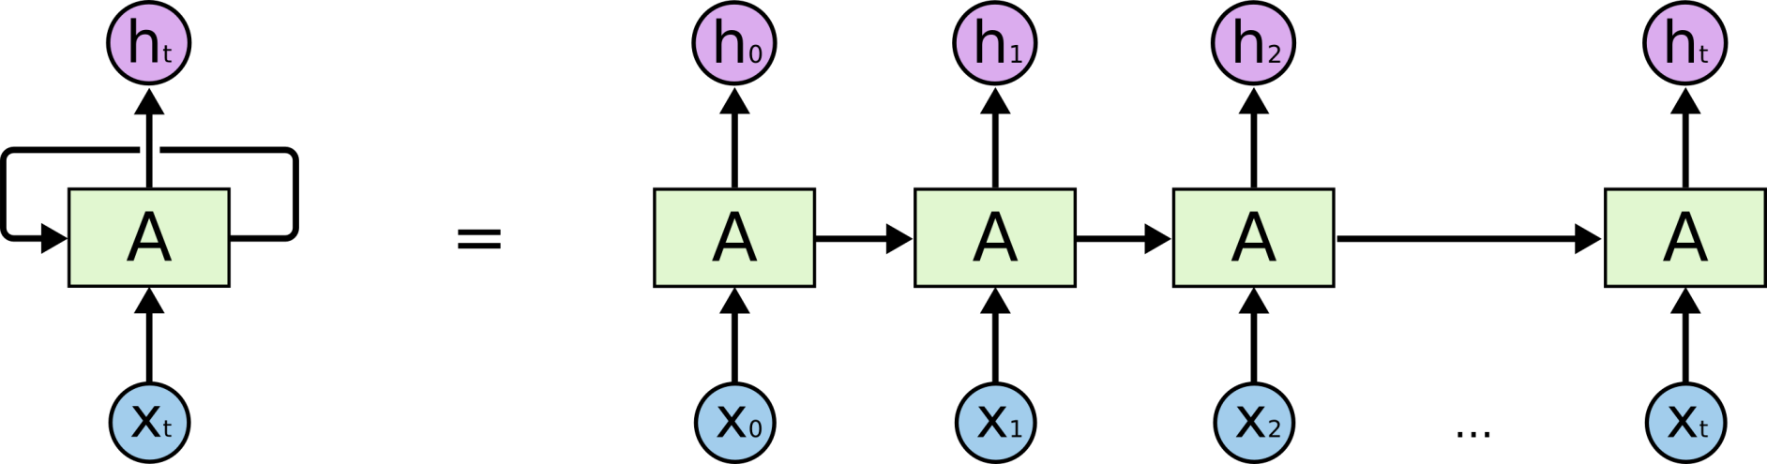
1c) Recurrent Neural Network (RNN) –unrolled model
But RNN suffers from the vanishing gradient problem to be discussed later
https://www.youtube.com/watch?v=zt18u6BgdK8 RNN Animation
Unroll and treat each time sample as a unit.
An unrolled RNN

Slide 19
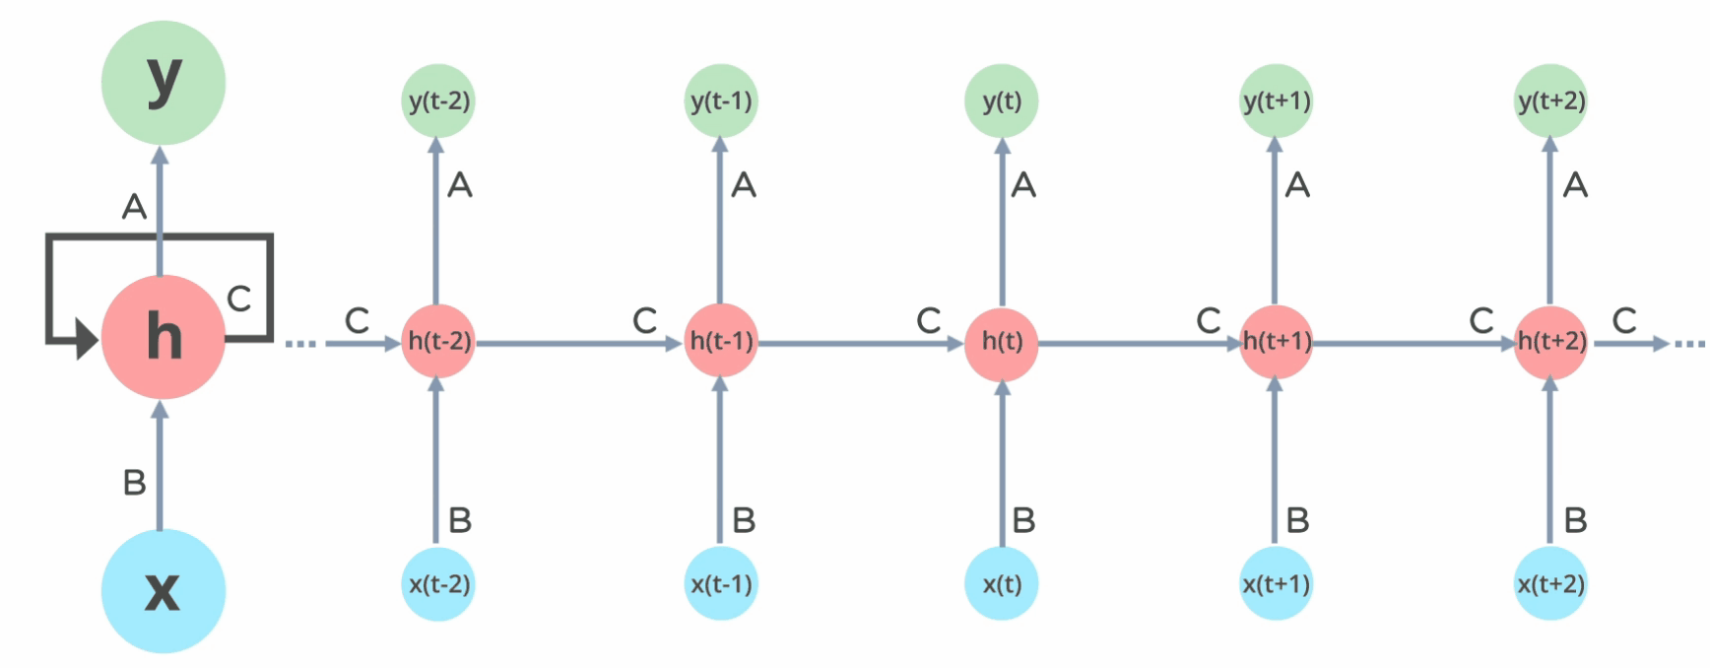
RNN demo (foro English to French machine translation)
Je suis étudiant. <END>
I am a student <end>
https://www.theaidream.com/post/introduction-to-rnn-and-lstm

Slide 20
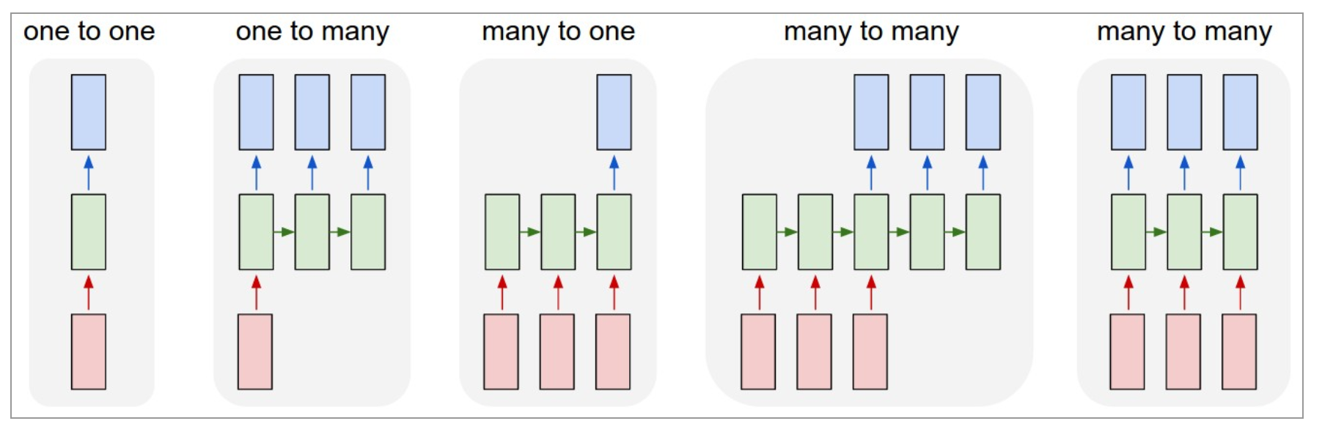
Different types of RNN
(1) Vanilla (classical) mode of processing without RNN, from fixed-sized input to fixed-sized output (e.g., image classification). Feedforward NN
(2) Sequence output (e.g., image captioning takes an image and outputs a sentence of words).
(3) Sequence input (e.g., sentiment analysis where a given sentence is classified as expressing positive or negative sentiment).
(4) Sequence input and sequence output (e.g. Machine Translation: an RNN reads a sentence in English and then outputs a sentence in French).
(5) Synced sequence input and output (e.g. video classification where we wish to label each frame of the video).
http://karpathy.github.io/2015/05/21/rnn-effectiveness/
Output layer
Hidden layer
(recurrent layer)
Input
layer
(1) (2) (3) (4) (5)

Slide 21
Overview of techniques
  Neural network
    Basic neural network model
    Convolution Neural Network (CNN), parallel method
    Recurrent Neural Network (RNN),sequential method
    Transformer , parallel + sequential method
  Computer Vision
    Object recognition
    You only look once model YOLO
    Photometry for 3d reconstruction & location identification
  Speech synthesis
    Speech signal analysis
    Stereo sound localization

Slide 22
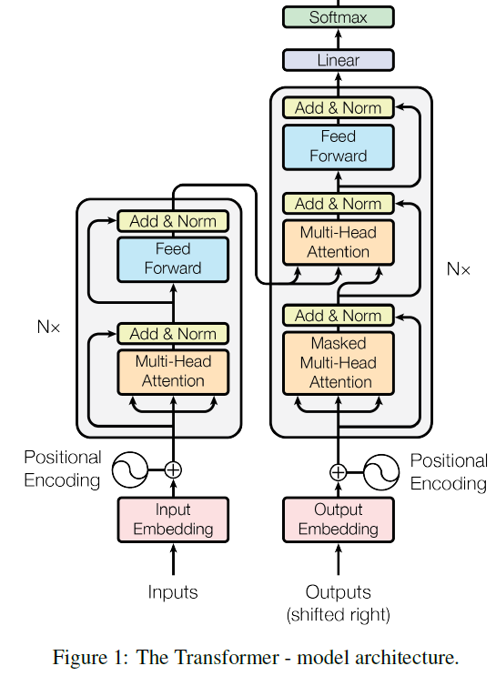
1d) Transformer model
Transformer diagram
ChaptGPT is based on Transformer, the ‘T’=transformer

Slide 23
Transformer Application1: machine translation
Durring training: enter Target input one by one « I am a student ».
Target output
https://www.youtube.com/watch?v=4Bdc55j80l8
Input: Je suis etudiant (at once)
Every time feed target output to target_input. I.e.
feed « start code » to target input
  Taget output at time 1= I,
feed « I » to target input
  Taget output at time2= am,
feed « am » to target input
  Taget output at time3= a,
feed « a » to target input
  Taget output at time4= student
feed « student » to target input
  Taget output at time5= end_code
END
For machine translation decoder is step-by-step not parallel. Can be made parallel by teacher forcing https://machinelearningmastery.com/teacher-forcing-for-recurrent-neural-networks/
Target input
Input : a sentence at one go "Je sui étudiant "
parallel
Sequential

Slide 24
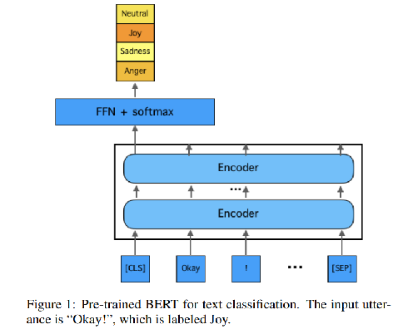
Transformer application2: machine translation Example of using BERT emotion analysis
Build Down stream task:
FFN = feed forward network
Build a downstream model for emotion classification
Downstream building means built you own application based on some pretrained model like BERT.
EmotionX-HSU: Adopting Pre-trained BERT for Emotion Classification https://arxiv.org/abs/1907.09669
Z
Based on Pre-trained BERT
https://arxiv.org/abs/1810.04805
Pre-trained BERT can be downloaded from
https://huggingface.co/

Slide 25
Other transformer Applications : Transformer (BERT uses encoder only, no decoder required) can be used for:
Determine positive or negative movie reviews (Sentiment Analysis)
Automatic answering questions. (Question answering)
Predicts next text (Text prediction)
Robotic writer (Text generation)
Summarization of a long article (Summarization)
Determine word meaning (Polysemy resolution)
Using pre-trained BERT for emotion analysis
Ref: https://huggingface.co/blog/bert-101#1-what-is-bert-used-for

Slide 26
Overview of techniques
  Neural network
    Basic neural network model
    Convolution Neural Network (CNN), parallel method
    Recurrent Neural Network (RNN),sequential method
    Transformer , parallel + sequential method
  Computer Vision
  Speech synthesis

Slide 27
2) Vision computer
  Object recognition
    You Only Look Once (YOLO) model
    Transformer based object recognition
  Photometry for 3d reconstruction & location identification

Slide 28
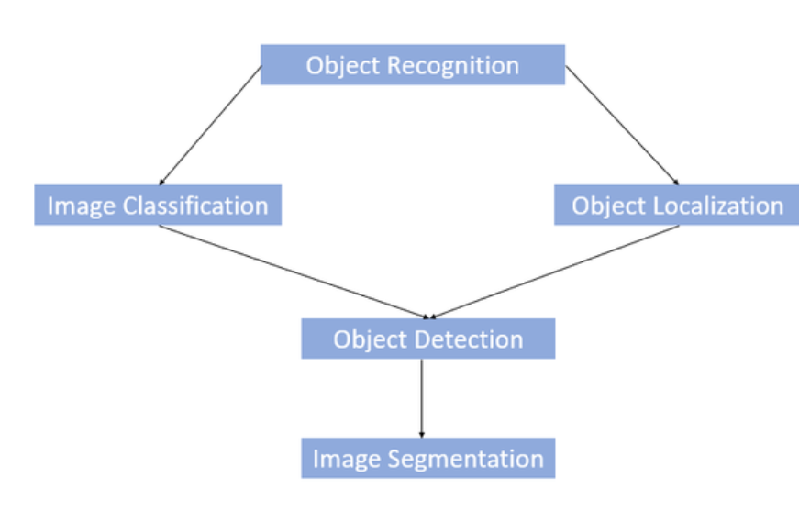
2.I) Object Recognition vs Object Detection vs Image Segmentation
https://www.kaggle.com/getting-started/169984
https://www.geeksforgeeks.org/object-detection-vs-object-recognition-vs-image-segmentation/
What?
Where?

Slide 29
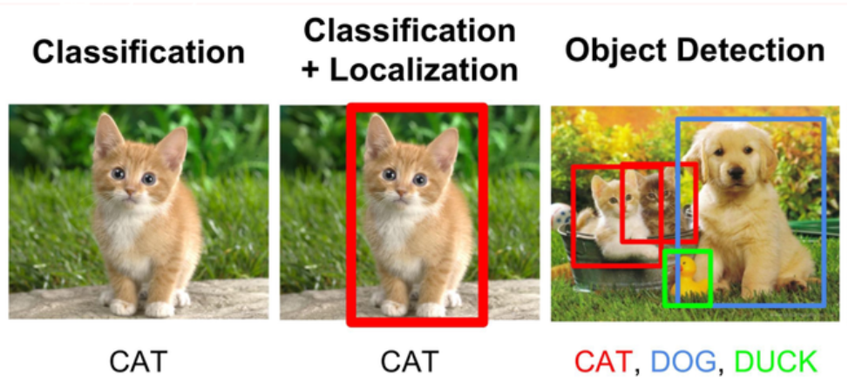
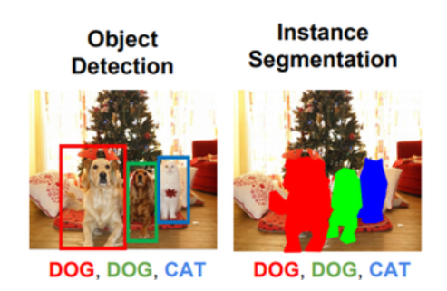
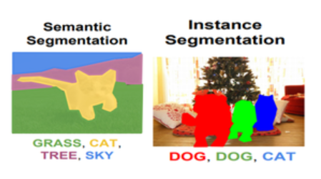
Example
Classification
Segmentation

Slide 30
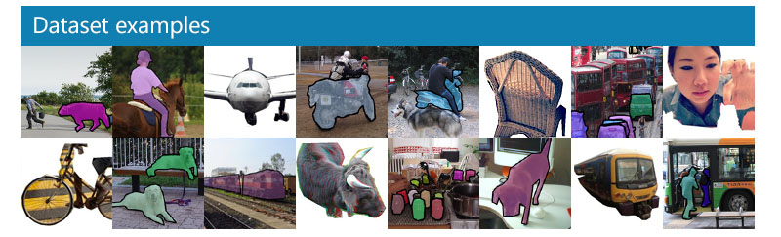
Famous object recognition systems and datasets
2021
COCO - Common Objects in Context (cocodataset.org) and
LVIS 2021 Challenge and Workshop
Classic datasets
  Datasets: Data set VOC2012
  Evaluation: How to evaluate the object recognition system
  System building : ImageNet Large Scale Visual Recognition Challenge (ILSVRC)

Slide 31
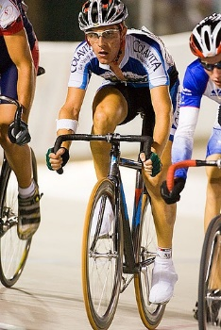
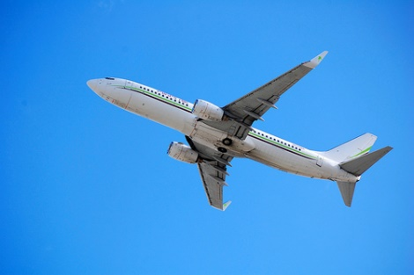
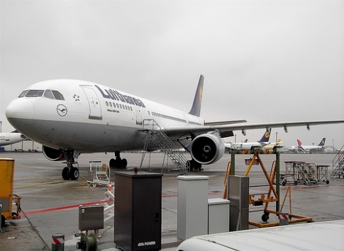
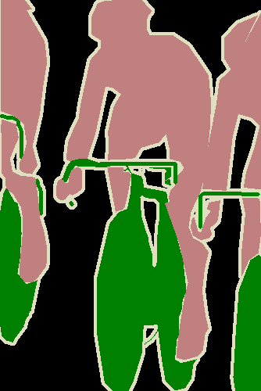


Data set VOC2012 is used in many development systems, images and their Segmentation Classs are given
Download the training/validation data (2GB tar file) http://host.robots.ox.ac.uk/pascal/VOC/voc2012/VOCtrainval_11-May-2012.tar
http://host.robots.ox.ac.uk/pascal/VOC/voc2012/index.html
Source
Images
Group truth Classes and Segmentation Class (pixelwise) are given in dataset
cyclist 2008_000033 airplane
2008_000033
airplane

Slide 32
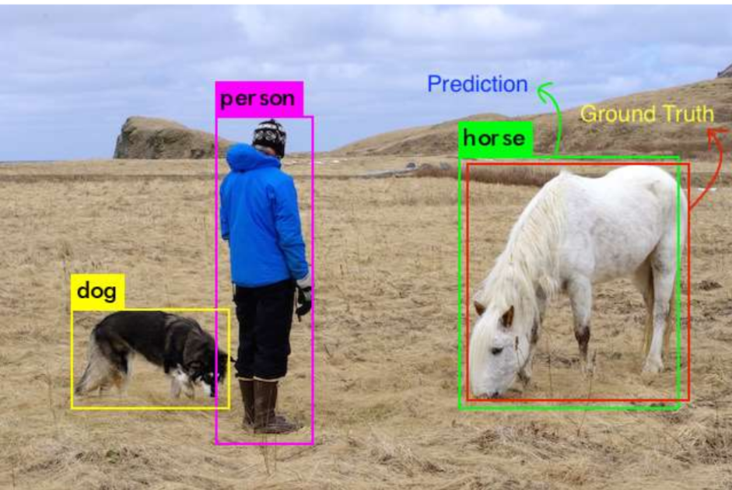
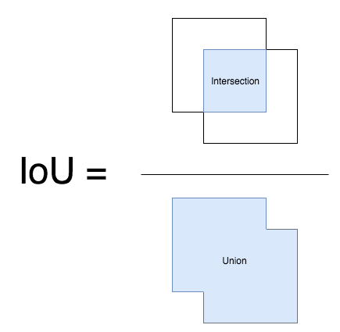
Evaluations: How to measure object detection rate. First find TP(true positive) and FP (false positive) for the result https://towardsdatascience.com/what-is-map-understanding-the-statistic-of-choice-for-comparing-object-detection-models-1ea4f67a9dbd
If the IoU (Intersection Over Union) is > threshold (e.g. 0.5), it is considered a True Positive (TP) else it is considered a False positive(FP).
Intersection over Union (IoU) is a ratio between the intersection and the union of the predicted box and the ground truth box.
Ground truth is given by the data set (i.e. Cifar100)
Prediction is given by the algorithm to be evaluated
object detection demo https://www.youtube.com/watch?v=lVdh571SwOQ

Slide 33
Implementation example: Image segmentation with a U-Net-like architecture https://keras.io/examples/vision/oxford_pets_image_segmentation/
Input image for training
Test result
test image
Ground truth annotations
Result the U-Net FCN (Fully Convolution Network)
Input image for training
Target annotations
for training
Exercise: Count the number of conv2d, con2d_transposed layers

Slide 34
2) Vision computer
  Object recognition
    You Only Look Once (YOLO) model (popular)
    Transformer based object recognition
  Photometry for 3d reconstruction & location identification

Slide 35
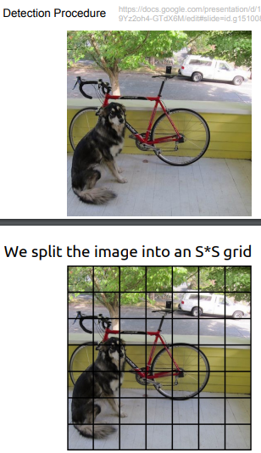
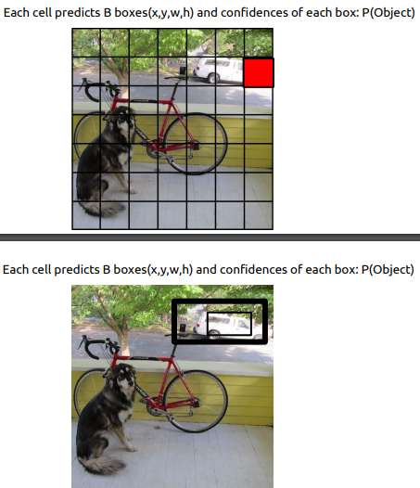
Why Yolo is fast: Rather than searching for 2000 windows in R-CNN, Yolo.v1 divides the input image into SxS grid
S*S=7x7 grid (so, it is faster) https://web.cs.ucdavis.edu/~yjlee/teaching/ecs289g-winter2018/YOLO.pdf
For 20 object classes
Each grid cell predicts 2 anchor boxes, and a set of class probabilities: p1,p2,..,p20 for this cell
7
The two anchor boxes: Each box is defined by 5 parameters: x,y,h,w and P(object)= confidence score which tells how confident that box has an object.
(But not telling you what is that object)
7

Slide 36
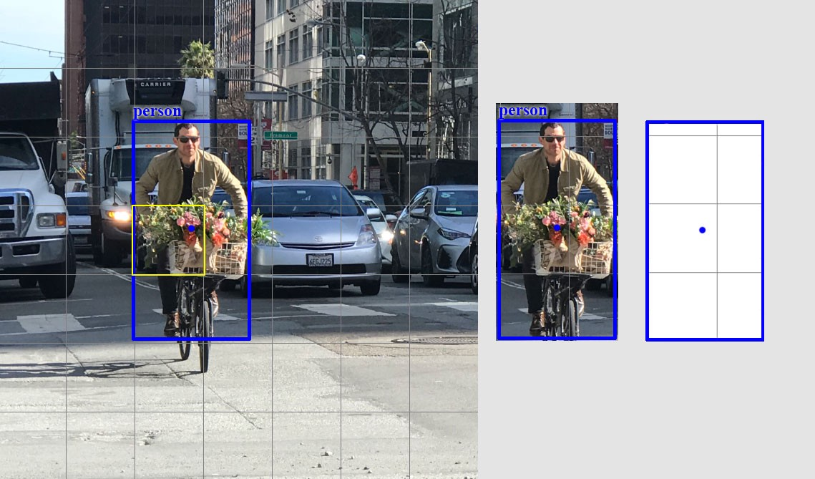
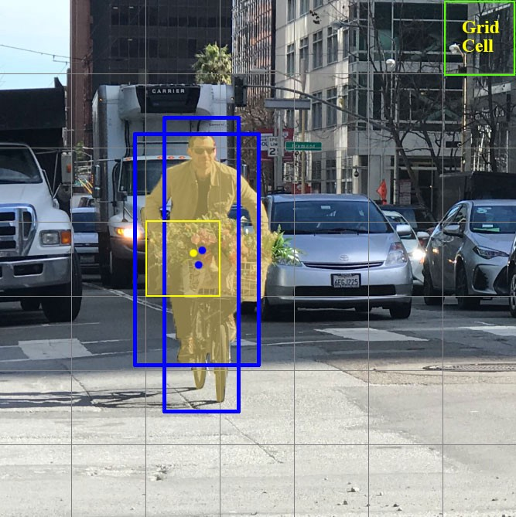
Yolo.v1
Sx7=7x7 grid and anchor boxes
https://jonathan-hui.medium.com/real-time-object-detection-with-yolo-yolov2-28b1b93e2088

Slide 37
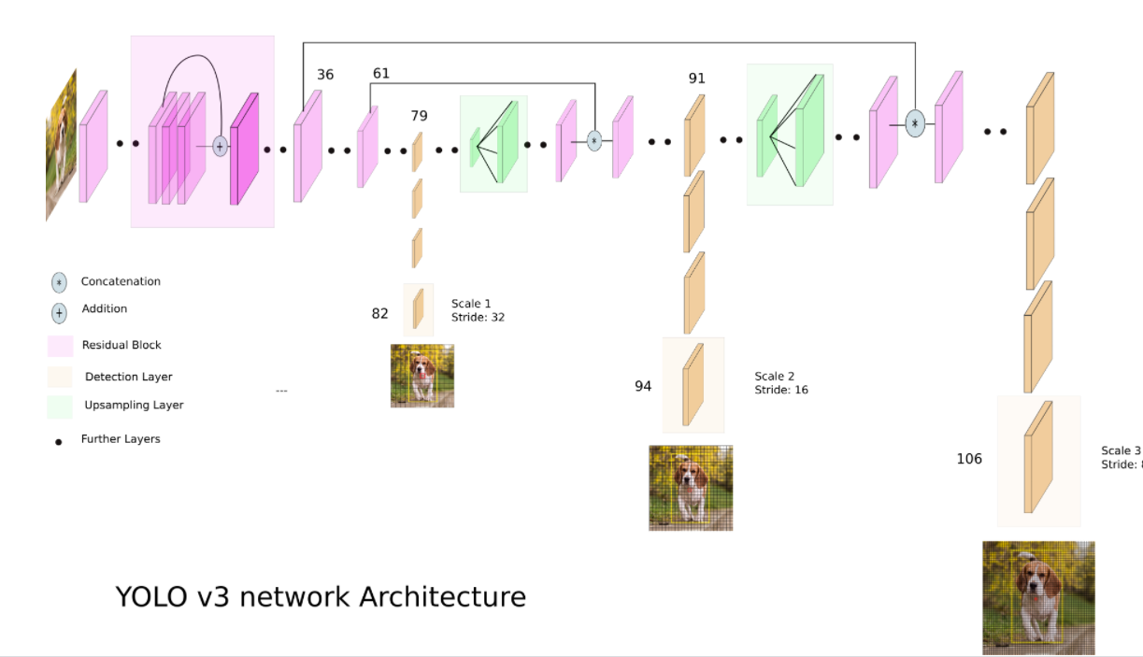
Example:YOLOV3 Architecture https://towardsdatascience.com/yolo-v3-object-detection-53fb7d3bfe6b

Slide 38
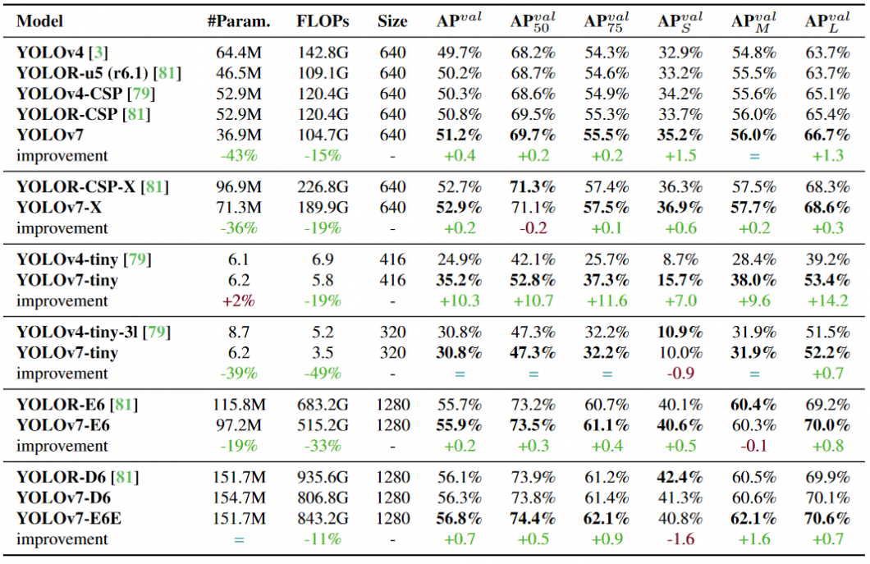
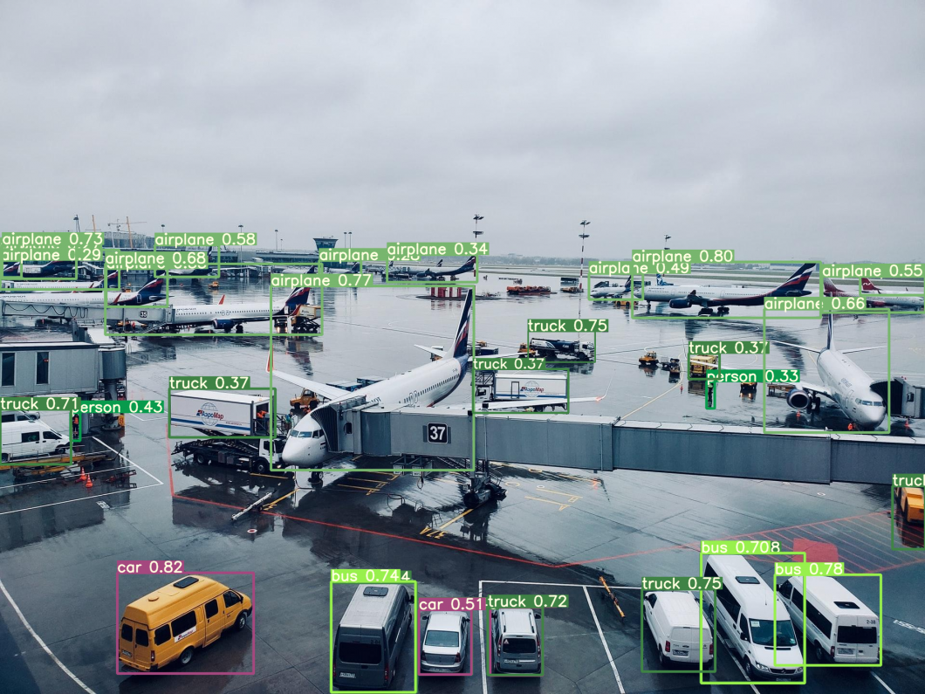
Yolo7 (in a 2023 tutorial)
https://viso.ai/deep-learning/yolov7-guide/
YOLOv7: Trainable bag-of-freebies sets new state-of-the-art for real-time object detectors
By Chien-Yao Wang1 et.al. https://arxiv.org/pdf/2207.02696.pdf

Slide 39
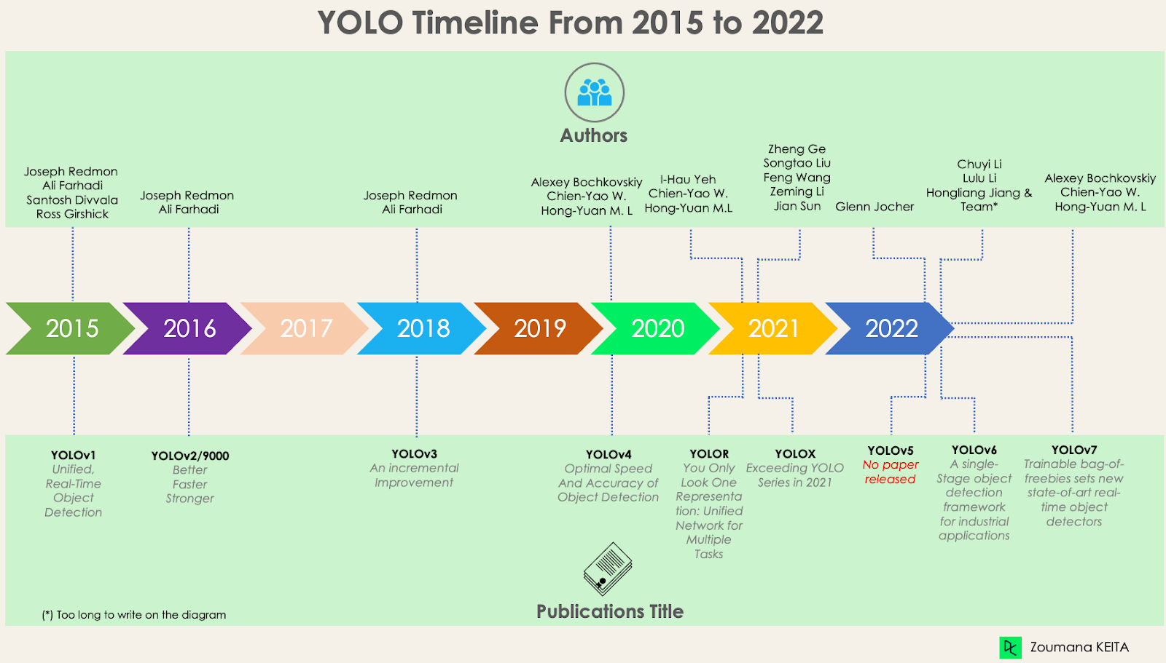
Yolo versions https://www.datacamp.com/blog/yolo-object-detection-explained
d

Slide 40
Real time Object recognition YOLO demo
https://www.youtube.com/watch?v=gRAyOPjQ9_s&list=PLUE9cBml08yiahlgN1BDv_8dAJFeCIR1u&index=3

Slide 41
2) Vision computer
  Object recognition
    You Only Look Once (YOLO) model
    Transformer based object recognition
  Face detection
  Photometry for 3d reconstruction & location identification
  Aruco and OCR Optical Character recognition

Slide 42
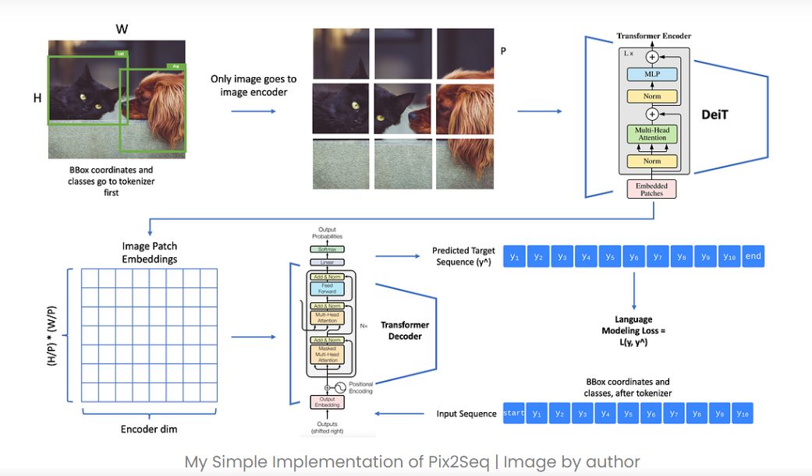
2.I.b)Transformer based object recognition
Idea: convert an image to a sequence of patches and use transformer to perform sequential query.
https://towardsai.net/p/l/easy-object-detection-with-transformers-simple-implementation-of-pix2seq-model-in-pytorch

Slide 43
2) Vision computer
  Object recognition
    You Only Look Once (YOLO) model
    Transformer based object recognition
  Face detection
  Photometry for 3d reconstruction & location identification
  Aruco and OCR Optical Character recognition

Slide 44
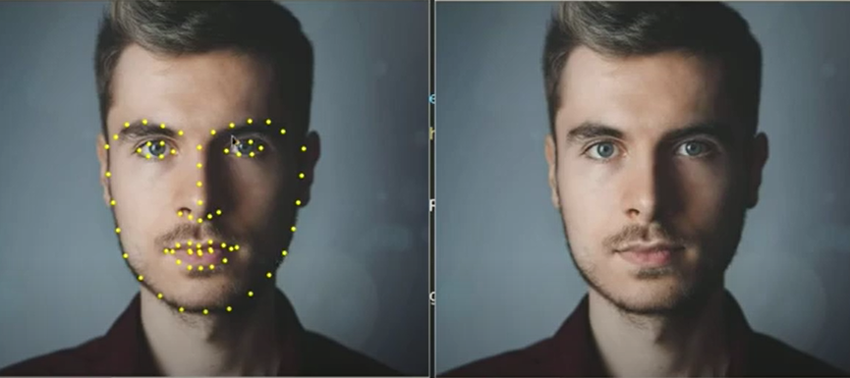
2.II)Face detection (easy to use)
Face Landmark Detection using dlib
https://towardsdatascience.com/facial-mapping-landmarks-with-dlib-python-160abcf7d672
https://www.youtube.com/watch?v=SIZNf_Ydplg
Face landmarks detection - Opencv with Python – YouTube
Automatically locate the 68 landmark points

Slide 45
2) Vision computer
  Object recognition
    You Only Look Once (YOLO) model
    Transformer based object recognition
  Face detection
  Photometry for 3d reconstruction & location identification, Lidar range sensor
  Aruco and OCR Optical Character recognition

Slide 46
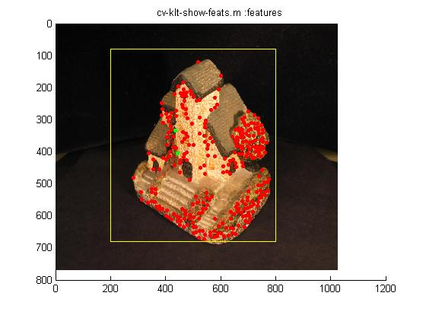
2.III) Photometry for 3d reconstruction & location identification : first step is Feature tracking
http://www.youtube.com/watch?v=RXpX9TJlpd0

Slide 47
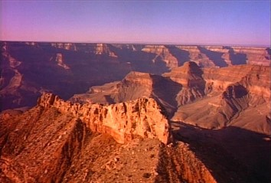
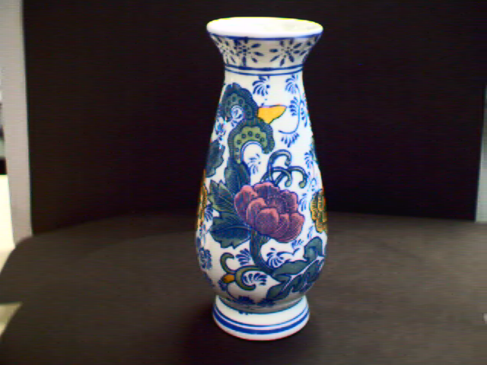
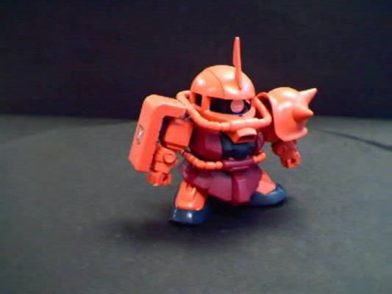
Example: Bundle adjustment 3D reconstruction (see also http://www.cse.cuhk.edu.hk/khwong/demo/index.html)
2.III) Photometry for 3d reconstruction & location identification
3D Reconstruction Demo
From images to reconstruct 3D model
Grand Canyon Demo
Flask
Robot
http://www.youtube.com/watch?v=2KLFRILlOjc
http://www.youtube.com/watch?v=xgCnV--wf2k
http://www.youtube.com/watch?v=ONx4cyYYyrI
http://www.youtube.com/watch?v=4h1pN2DIs6g

Slide 48
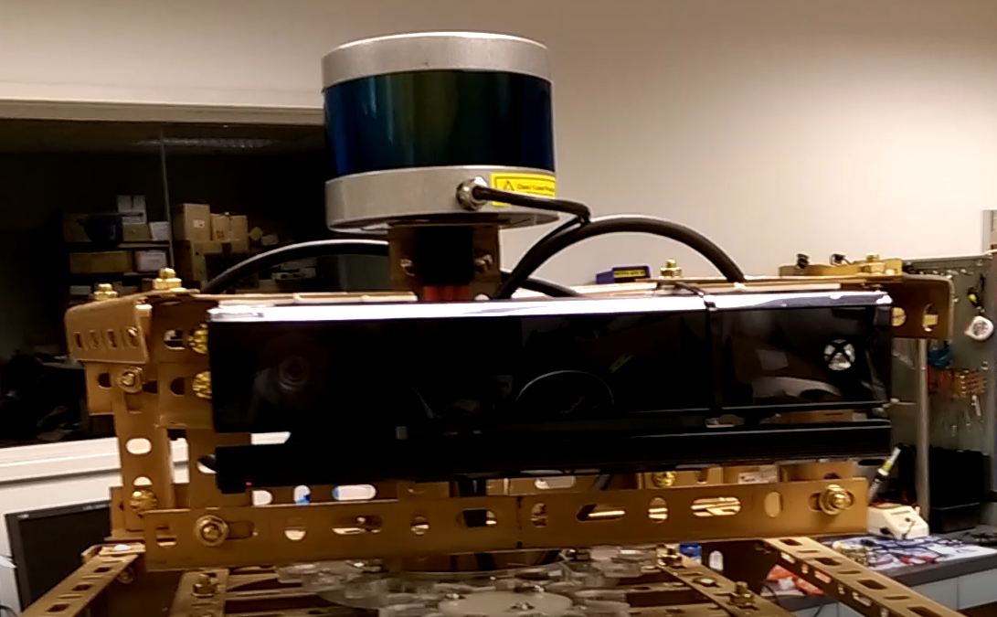
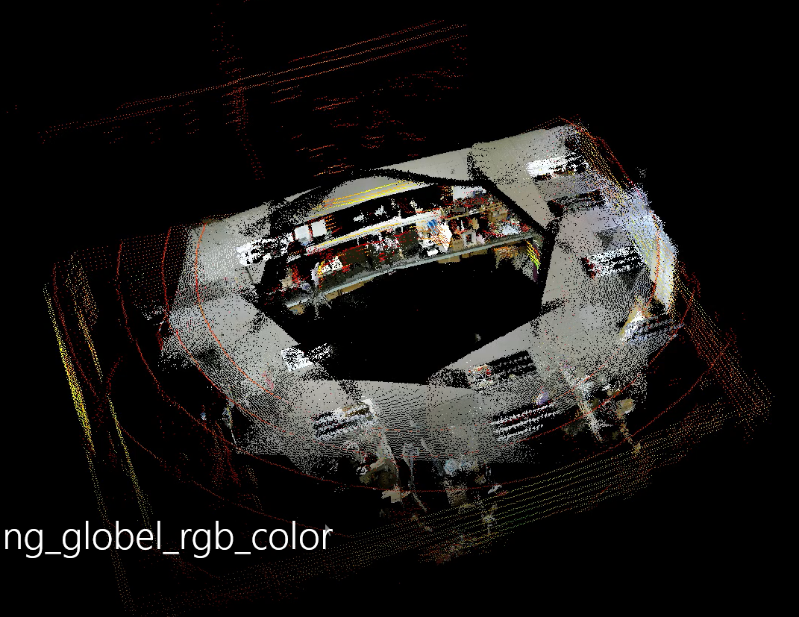
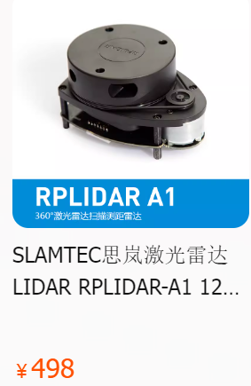
3D (range) scanner by Lidar light detection and ranging
Use time delay of a laser beam between sending out and reflected back to measure distance
Demo1
Demo2
Expensive Lidar by Leica
Low cost Lidar from Taobao
https://youtu.be/quMQ_t8DGNw

Slide 49
2) Vision computer
  Object recognition
    You Only Look Once (YOLO) model
    Transformer based object recognition
  Face detection
  Photometry for 3d reconstruction & location identification
  Aruco and OCR Optical Character recognition

Slide 50
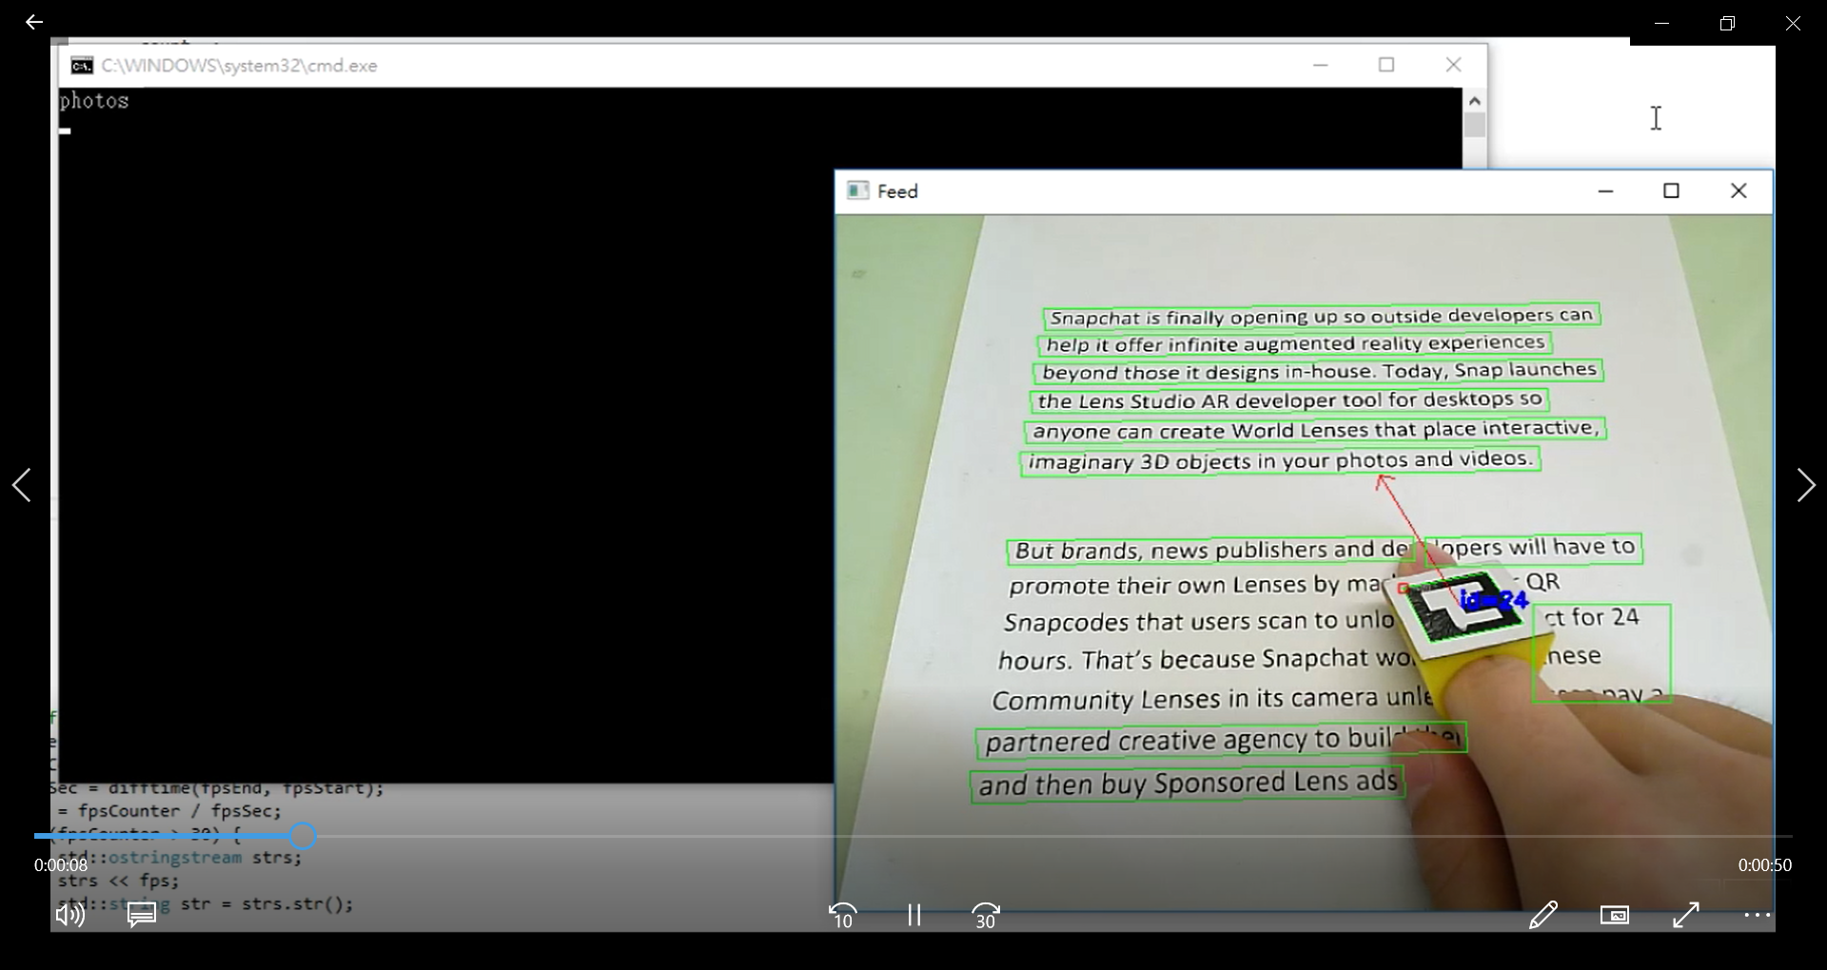
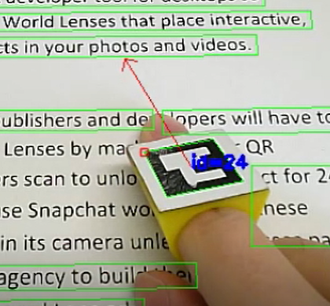
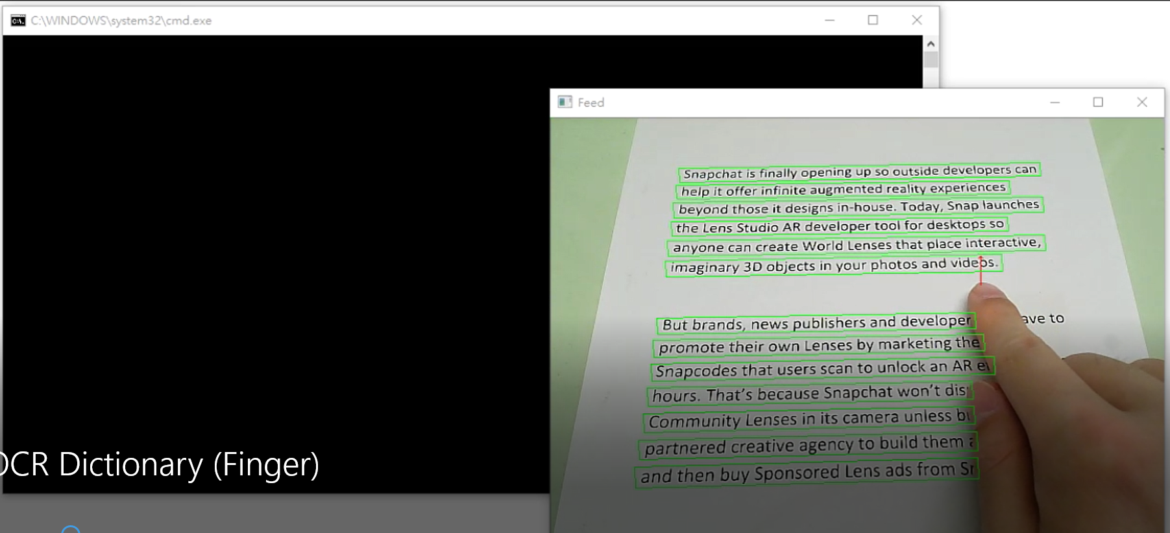
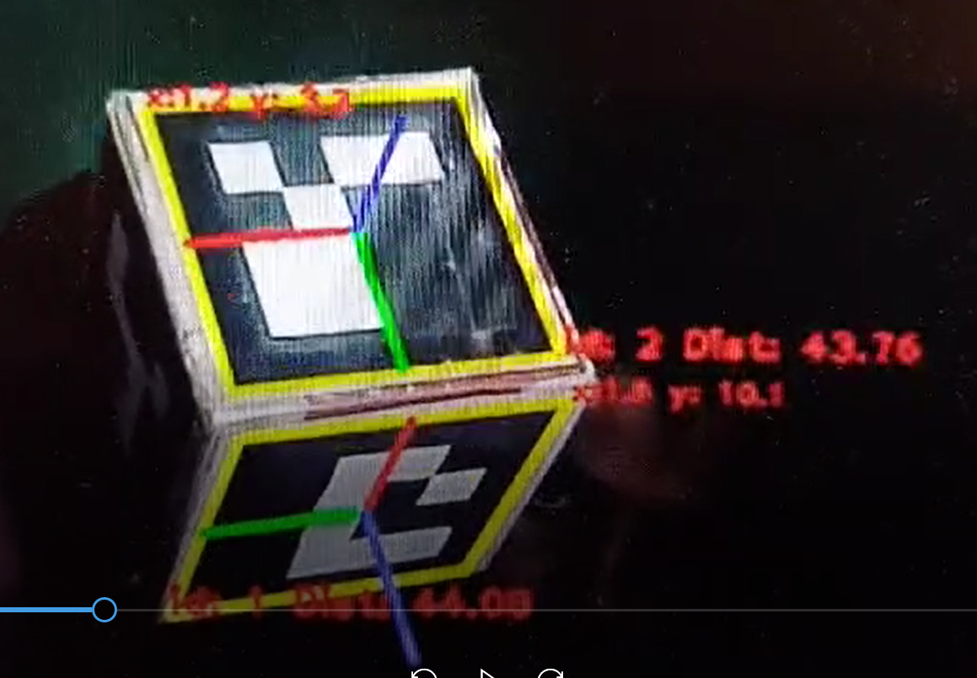
2.IV)Optical Character Recognition and OCR &
Pose estimation
Aruco marker
https://youtu.be/I3bowdnqcHM
Naked finger
https://youtu.be/j7t7a8maBv0
Aruco marker pose estimation
Aruoc dmarker demo: https://www.youtube.com/watch?v=mn-M6Qzx6SE

Slide 51

Can use wearable camera
https://youtu.be/tUxK0GgZ-70
Some possibility
Demo

Slide 52
Software tools
And methods

Slide 53
Software tools
Tensorflow by google (https://www.tensorflow.org/ )
  Keras (https://keras.io/examples/ )
PyTorch (https://pytorch.org/ )
COLAB (https://colab.research.google.com/ )
SKLEARN (https://scikit-learn.org/stable/ )
  Python based library for machine learning and tools
DLIB for face recoigntion (https://pyimagesearch.com/2021/04/19/face-detection-with-dlib-hog-and-cnn/
Sound field https://www.sciencedirect.com/topics/engineering/sound-field

Slide 54
Transfer learning for deep net (e.g. over 50 layers): leaning using pre-trained weights
Slow: Take long tine to train and require a lot of data.
Fast: Can be very efficient to tarin
Use
Pre-trained-CNN NEW TASK
https://neptune.ai/blog/transfer-learning-guide-examples-for-images-and-text-in-keras
https://medium.datadriveninvestor.com/introducing-transfer-learning-as-your-next-engine-to-drive-future-innovations-5e81a15bb56 7

Slide 55
How to implement transfer learning
1) Obtain the pre-trained model
2) Create a base model
3) Freeze layers
4) Add new trainable layers
5) Train the new layers on the dataset
6)Improve the model via fine-tuning
Obtain the pre-trained model
Create a base model
Freeze layers
Add new trainable layers
Train the new layers on the dataset
Improve the model via fine-tuning
Idea: In transfer learning, a downstream task uses the output of a previous task. It applies the knowledge of the pretrained model to a new problem.
https://neptune.ai/blog/transfer-learning-guide-examples-for-images-and-text-in-keras
https://www.baeldung.com/cs/downstream-tasks

Slide 56

Speech synthesis
https://reintech.io/blog/how-to-create-a-speech-synthesis-system-with-gtts
Demo
https://www.youtube.com/shorts/KbWQ2wETInY

Slide 57

Sound localization and sound field generation
https://en.wikipedia.org/wiki/Stereophonic_sound#/media/File:What_is_stereophonic_effect.png

Slide 58

Dept of sound source use reverberation to create depthless
http://www.mh-audio.nl/Acoustics/ReverberationTime.html
By generating direct sound vs reflected sound (with delay), one can create the dept of the sound source

Slide 59
Hardware tools
Nvidia graphic card for machine learning https://www.nvidia.com/en-us/
3D scanner
  Kinect (https://zh.wikipedia.org/zh-hans/Kinect)
  Laser based Lidar (https://geoslam.com/what-is-lidar/ )
Embedded system, small and low-cost systems
  TinyML embedded machine learning https://www.tinyml.org/
  ESP32-cam (https://www.youtube.com/watch?v=hSr557hppwY )

Slide 60
Experiments and demos

Slide 61

Qualitative results on OKVQA dataset (correct samples)
MSC project: Image Caption and External Knowledge-based Visual Question Answering by TANG Haoqing (supervised by KH Wong)

Slide 62

MSC thesis: Image Caption and External Knowledge-based Visual Question Answering by TANG Haoqing (supervised by KH Wong)

Slide 63

4
Training Demos
MSC thesis 2022, Image Caption with Full-Transformer,by Li Jiahao , supervisor KH Wong

Slide 64

MSC thesis 2022, Image Caption with Full-Transformer,by Li Jiahao , supervisor KH Wong

Slide 65

Body scan demo
https://youtu.be/SEnZH2JBIgE
body_scan_demo.mp4
MSC thesis: Application of pose estimation techniques based on Tensorflow by Lee Kin Tak (supervised by KH Wong)

Slide 66

Current prototype
https://youtu.be/ApcUROKajvw
DLIB for face recognition
The process of facial recognition using dlib involves several stages: face detection, face alignment, face feature extraction, and finally face recognition itself. Face_recognition library offers a simplified and efficient interface
Image captioning
gTTS for text to speech : gTTS stands for “Google Text-to-Speech.” It is a web-based service provided by Google that allows users to convert text into spoken words using Google’s high-quality Text-to-Speech technology.
Pydub: PyDub is a Python library for manipulating audio files. It provides a simple and intuitive interface to perform various audio operations such as slicing, concatenating, fading in/out, changing volume, and so on.
Video Demo
Image captioning Output:
“a girl in a black and pink skirt is smiling”

Slide 67
Conclusion
Reviewed AI technology related to build vision assisted tools
Related hardware and software tools are also discussed
Proposed a vision assisted system for visually impaired people

Slide 68
Q & A

