Slide 1
New projects
ESP32
Kh wong

Slide 2
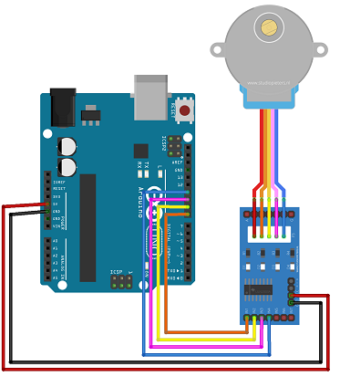
Stepper controlled by PC (python)
Arduino side Python side
// Arduino stepper motor control code
#include <Stepper.h> // Include the header file
// change this to the number of steps on your motor
#define STEPS 32
// create an instance of the stepper class using the steps and pins
Stepper stepper(STEPS, 8, 10, 9, 11);
int val = 0;
void setup() {
Serial.begin(9600);
stepper.setSpeed(200);
}
void loop() {
if (Serial.available()>0)
{ byte b = Serial.read();
int val=(b); // this can be from 0-255, cale up if needed
int scale =10;//can scale up if needed
stepper.step(scale*val);
}
}
#! /usr/bin/env python
import serial
import time
if __name__ == '__main__':
ser = serial.Serial("Com7", 9600, timeout=0.1)
#time.sleep(2) # Wait for Arduino init
time.sleep(2) # Wait a bit more
ser.write(bytes([200]))# byte val(0-255)=steps
https://www.hackster.io/2-bros-team/arduino-uno-stepper-motor-basic-abba3b

Slide 3
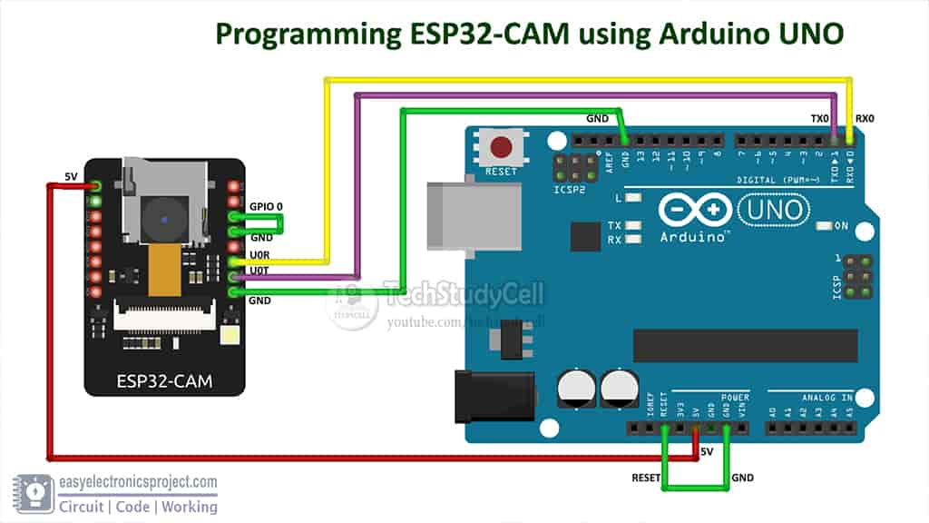
ESP32 Cam, programming via Arduino Uno
Follow the instruction in
https://edgoad.com/2021/02/programming-esp32cam-using-arduino-uno.html
Connect as in the diagram.
Obtain the board (esp32-cam) driver from
https://randomnerdtutorials.com/upload-code-esp32-cam-mb-usb/
Use example, compile /download
IDE/Examples->ESPp32->Camera-->CameraWebServer
Upload (press reset on uno and ESP32 board before upload)
After downloaded the program,
Disconnect ESP32-cam GPIO to ground
In Serial monitor see IP address, open the webpage and see the camera-image/video stream
Reference:
https://randomnerdtutorials.com/getting-started-with-esp32/
ESP32-cam (with camera) about RMB 33 each
d
Run this example in IDE
File/Examples/Esp32/CameraWebServer
Select :
#define CAMERA_MODEL_AI_THINKER // Has PSRAM

Slide 4
Code CameraWebServer
Run this example in IDE
File/Examples/Esp32/CameraWebServer
Modification required: Select :
#define CAMERA_MODEL_AI_THINKER // Has PSRAM
#include "esp_camera.h"
#include <WiFi.h>
//
// WARNING!!! PSRAM IC required for UXGA resolution and high JPEG quality
// Ensure ESP32 Wrover Module or other board with PSRAM is selected
// Partial images will be transmitted if image exceeds buffer size
//
// You must select partition scheme from the board menu that has at least 3MB APP space.
// Face Recognition is DISABLED for ESP32 and ESP32-S2, because it takes up from 15
// seconds to process single frame. Face Detection is ENABLED if PSRAM is enabled as well
// ===================
// Select camera model
// ===================
//#define CAMERA_MODEL_WROVER_KIT // Has PSRAM
//#define CAMERA_MODEL_ESP_EYE // Has PSRAM
//#define CAMERA_MODEL_ESP32S3_EYE // Has PSRAM
//#define CAMERA_MODEL_M5STACK_PSRAM // Has PSRAM
//#define CAMERA_MODEL_M5STACK_V2_PSRAM // M5Camera version B Has PSRAM
//#define CAMERA_MODEL_M5STACK_WIDE // Has PSRAM
//#define CAMERA_MODEL_M5STACK_ESP32CAM // No PSRAM
//#define CAMERA_MODEL_M5STACK_UNITCAM // No PSRAM
#define CAMERA_MODEL_AI_THINKER // Has PSRAM
//#define CAMERA_MODEL_TTGO_T_JOURNAL // No PSRAM
//#define CAMERA_MODEL_XIAO_ESP32S3 // Has PSRAM
// ** Espressif Internal Boards **
//#define CAMERA_MODEL_ESP32_CAM_BOARD
//#define CAMERA_MODEL_ESP32S2_CAM_BOARD
//#define CAMERA_MODEL_ESP32S3_CAM_LCD
#include "camera_pins.h"
// ===========================
// Enter your WiFi credentials
// ===========================
const char* ssid = "ddddddddddddddddddddddddddd";
const char* password = "bbbbbbbbbb";
void startCameraServer();
void setupLedFlash(int pin);
void setup() {
Serial.begin(115200);
Serial.setDebugOutput(true);
Serial.println();
camera_config_t config;
config.ledc_channel = LEDC_CHANNEL_0;
config.ledc_timer = LEDC_TIMER_0;
config.pin_d0 = Y2_GPIO_NUM;
config.pin_d1 = Y3_GPIO_NUM;
config.pin_d2 = Y4_GPIO_NUM;
config.pin_d3 = Y5_GPIO_NUM;
config.pin_d4 = Y6_GPIO_NUM;
config.pin_d5 = Y7_GPIO_NUM;
config.pin_d6 = Y8_GPIO_NUM;
config.pin_d7 = Y9_GPIO_NUM;
config.pin_xclk = XCLK_GPIO_NUM;
config.pin_pclk = PCLK_GPIO_NUM;
config.pin_vsync = VSYNC_GPIO_NUM;
config.pin_href = HREF_GPIO_NUM;
config.pin_sccb_sda = SIOD_GPIO_NUM;
config.pin_sccb_scl = SIOC_GPIO_NUM;
config.pin_pwdn = PWDN_GPIO_NUM;
config.pin_reset = RESET_GPIO_NUM;
config.xclk_freq_hz = 20000000;
config.frame_size = FRAMESIZE_UXGA;
config.pixel_format = PIXFORMAT_JPEG; // for streaming
//config.pixel_format = PIXFORMAT_RGB565; // for face detection/recognition
config.grab_mode = CAMERA_GRAB_WHEN_EMPTY;
config.fb_location = CAMERA_FB_IN_PSRAM;
config.jpeg_quality = 12;
config.fb_count = 1;
// if PSRAM IC present, init with UXGA resolution and higher JPEG quality
// for larger pre-allocated frame buffer.
if(config.pixel_format == PIXFORMAT_JPEG){
if(psramFound()){
config.jpeg_quality = 10;
config.fb_count = 2;
config.grab_mode = CAMERA_GRAB_LATEST;
} else {
// Limit the frame size when PSRAM is not available
config.frame_size = FRAMESIZE_SVGA;
config.fb_location = CAMERA_FB_IN_DRAM;
}
} else {
// Best option for face detection/recognition
config.frame_size = FRAMESIZE_240X240;
#if CONFIG_IDF_TARGET_ESP32S3
config.fb_count = 2;
#endif
}
#if defined(CAMERA_MODEL_ESP_EYE)
pinMode(13, INPUT_PULLUP);
pinMode(14, INPUT_PULLUP);
#endif
// camera init
esp_err_t err = esp_camera_init(&config);
if (err != ESP_OK) {
Serial.printf("Camera init failed with error 0x%x", err);
return;
}
sensor_t * s = esp_camera_sensor_get();
// initial sensors are flipped vertically and colors are a bit saturated
if (s->id.PID == OV3660_PID) {
s->set_vflip(s, 1); // flip it back
s->set_brightness(s, 1); // up the brightness just a bit
s->set_saturation(s, -2); // lower the saturation
}
// drop down frame size for higher initial frame rate
if(config.pixel_format == PIXFORMAT_JPEG){
s->set_framesize(s, FRAMESIZE_QVGA);
}
#if defined(CAMERA_MODEL_M5STACK_WIDE) || defined(CAMERA_MODEL_M5STACK_ESP32CAM)
s->set_vflip(s, 1);
s->set_hmirror(s, 1);
#endif
#if defined(CAMERA_MODEL_ESP32S3_EYE)
s->set_vflip(s, 1);
#endif
// Setup LED FLash if LED pin is defined in camera_pins.h
#if defined(LED_GPIO_NUM)
setupLedFlash(LED_GPIO_NUM);
#endif
WiFi.begin(ssid, password);
WiFi.setSleep(false);
while (WiFi.status() != WL_CONNECTED) {
delay(500);
Serial.print(".");
}
Serial.println("");
Serial.println("WiFi connected");
startCameraServer();
Serial.print("Camera Ready! Use 'http://");
Serial.print(WiFi.localIP());
Serial.println("' to connect");
}
void loop() {
// Do nothing. Everything is done in another task by the web server
delay(10000);
}
By esp32cam.old2
By esp32cam.new1
Quality of the 2 cams are similar

Slide 5
Real NTP time from the Internet, based on wemos D1 processor (8266 NodeMCU)
https://lastminuteengineers.com/esp8266-ntp-server-date-time-tutorial/
Need to install NTPClient for #include <NTPClient.h>
For different time zone
Install timezone and see example (wordltime)
https://github.com/esp8266/Arduino/blob/master/libraries/esp8266/examples/NTP-TZ-DST/NTP-TZ-DST.ino
https://mischianti.org/2020/08/08/network-time-protocol-ntp-timezone-and-daylight-saving-time-dst-with-esp8266-esp32-or-arduino/

Slide 6
Read tine from NTPClient and use time zone to convert to your local time (tested ok)
//https://mischianti.org/2020/08/08/network-time-protocol-ntp-timezone-and-daylight-saving-time-dst-with-esp8266-esp32-or-arduino/
/*
* Simple NTP client
* https://mischianti.org/
*
* The MIT License (MIT)
* written by Renzo Mischianti <www.mischianti.org>
*/
//https://mischianti.org/2020/08/08/network-time-protocol-ntp-timezone-and-daylight-saving-time-dst-with-esp8266-esp32-or-arduino/
const char *ssid = “ddddd";
const char *password = "bbbbbb";
#include <NTPClient.h>
// change next line to use with another board/shield
#include <ESP8266WiFi.h>
//#include <WiFi.h> // for WiFi shield
//#include <WiFi101.h> // for WiFi 101 shield or MKR1000
#include <WiFiUdp.h>
#include <TimeLib.h>
#include <time.h>
#include <Timezone.h> // https://github.com/JChristensen/Timezone
/**
* Input time in epoch format and return tm time format
* by Renzo Mischianti <www.mischianti.org>
*/
static tm getDateTimeByParams(long time){
struct tm *newtime;
const time_t tim = time;
newtime = localtime(&tim);
return *newtime;
}
/**
* Input tm time format and return String with format pattern
* by Renzo Mischianti <www.mischianti.org>
*/
static String getDateTimeStringByParams(tm *newtime, char* pattern = (char *)"%d/%m/%Y %H:%M:%S"){
char buffer[30];
strftime(buffer, 30, pattern, newtime);
return buffer;
}
/**
* Input time in epoch format format and return String with format pattern
* by Renzo Mischianti <www.mischianti.org>
*/
static String getEpochStringByParams(long time, char* pattern = (char *)"%d/%m/%Y %H:%M:%S"){
// struct tm *newtime;
tm newtime;
newtime = getDateTimeByParams(time);
return getDateTimeStringByParams(&newtime, pattern);
}
WiFiUDP ntpUDP;
// By default 'pool.ntp.org' is used with 60 seconds update interval and
// no offset
// NTPClient timeClient(ntpUDP);
// You can specify the time server pool and the offset, (in seconds)
// additionaly you can specify the update interval (in milliseconds).
int GTMOffset = 0; // SET TO UTC TIME
NTPClient timeClient(ntpUDP, "europe.pool.ntp.org", GTMOffset*60*60, 60*60*1000);
// Central European Time (Frankfurt, Paris)
TimeChangeRule CEST = {"CEST", Last, Sun, Mar, 2, 120}; // Central European Summer Time
TimeChangeRule CET = {"CET ", Last, Sun, Oct, 3, 60}; // Central European Standard Time
Timezone CE(CEST, CET);
// United Kingdom (London, Belfast)
TimeChangeRule BST = {"BST", Last, Sun, Mar, 1, 60}; // British Summer Time
TimeChangeRule GMT = {"GMT", Last, Sun, Oct, 2, 0}; // Standard Time
Timezone UK(BST, GMT);
void setup(){
Serial.begin(115200);
WiFi.begin(ssid, password);
while ( WiFi.status() != WL_CONNECTED ) {
delay ( 500 );
Serial.print ( "." );
}
timeClient.begin();
delay ( 1000 );
if (timeClient.update()){
Serial.print ( "Adjust local clock" );
unsigned long epoch = timeClient.getEpochTime();
setTime(epoch);
}else{
Serial.print ( "NTP Update not WORK!!" );
}
}
void loop() {
// I print the time from local clock but first I check DST
// to add hours if needed
Serial.print("Central europe time: ");
Serial.println(getEpochStringByParams(CE.toLocal(now())));
Serial.print("London time: ");
Serial.println(getEpochStringByParams(UK.toLocal(now())));
delay(1000);
}

Slide 7
World time test2 (OK)
// Arduino Timezone Library Copyright (C) 2018 by Jack Christensen and
// licensed under GNU GPL v3.0, https://www.gnu.org/licenses/gpl.html
//
// Arduino Timezone Library example sketch.
// Self-adjusting clock for multiple time zones.
// Jack Christensen Mar 2012
//
// For time zone information:
// http://www.timeanddate.com/worldclock/
#include <Timezone.h> // https://github.com/JChristensen/Timezone
// Australia Eastern Time Zone (Sydney, Melbourne)
TimeChangeRule aEDT = {"AEDT", First, Sun, Oct, 2, 660}; // UTC + 11 hours
TimeChangeRule aEST = {"AEST", First, Sun, Apr, 3, 600}; // UTC + 10 hours
Timezone ausET(aEDT, aEST);
// Moscow Standard Time (MSK, does not observe DST)
TimeChangeRule msk = {"MSK", Last, Sun, Mar, 1, 180};
Timezone tzMSK(msk);
// Central European Time (Frankfurt, Paris)
TimeChangeRule CEST = {"CEST", Last, Sun, Mar, 2, 120}; // Central European Summer Time
TimeChangeRule CET = {"CET ", Last, Sun, Oct, 3, 60}; // Central European Standard Time
Timezone CE(CEST, CET);
// United Kingdom (London, Belfast)
TimeChangeRule BST = {"BST", Last, Sun, Mar, 1, 60}; // British Summer Time
TimeChangeRule GMT = {"GMT", Last, Sun, Oct, 2, 0}; // Standard Time
Timezone UK(BST, GMT);
// UTC
TimeChangeRule utcRule = {"UTC", Last, Sun, Mar, 1, 0}; // UTC
Timezone UTC(utcRule);
// US Eastern Time Zone (New York, Detroit)
TimeChangeRule usEDT = {"EDT", Second, Sun, Mar, 2, -240}; // Eastern Daylight Time = UTC - 4 hours
TimeChangeRule usEST = {"EST", First, Sun, Nov, 2, -300}; // Eastern Standard Time = UTC - 5 hours
Timezone usET(usEDT, usEST);
// US Central Time Zone (Chicago, Houston)
TimeChangeRule usCDT = {"CDT", Second, Sun, Mar, 2, -300};
TimeChangeRule usCST = {"CST", First, Sun, Nov, 2, -360};
Timezone usCT(usCDT, usCST);
// US Mountain Time Zone (Denver, Salt Lake City)
TimeChangeRule usMDT = {"MDT", Second, Sun, Mar, 2, -360};
TimeChangeRule usMST = {"MST", First, Sun, Nov, 2, -420};
Timezone usMT(usMDT, usMST);
// Arizona is US Mountain Time Zone but does not use DST
Timezone usAZ(usMST);
// US Pacific Time Zone (Las Vegas, Los Angeles)
TimeChangeRule usPDT = {"PDT", Second, Sun, Mar, 2, -420};
TimeChangeRule usPST = {"PST", First, Sun, Nov, 2, -480};
Timezone usPT(usPDT, usPST);
//hk, for hk no day time saving
TimeChangeRule hkT1 = {"HKT1", Second, Sun, Mar, 2, +8*60}; //make it the same
TimeChangeRule hkT2 = {"HKT2", First, Sun, Nov, 2, +8*60};//make it the same
Timezone hkT(hkT1, hkT2);
void setup()
{
Serial.begin(115200);
// set the system time to UTC
// warning: assumes that compileTime() returns US EDT
// adjust the following line accordingly if you're in another time zone
setTime(compileTime() + 240 * 60);
}
void loop()
{
time_t utc = now();
Serial.println();
//printDateTime(ausET, utc, "Sydney");
//printDateTime(tzMSK, utc, " Moscow");
//printDateTime(CE, utc, "Paris");
printDateTime(UK, utc, " London");
printDateTime(UTC, utc, " Universal Coordinated Time");
printDateTime(hkT, utc, " Hogn Kong Time");
//printDateTime(usET, utc, " New York");
//printDateTime(usCT, utc, " Chicago");
//printDateTime(usMT, utc, " Denver");
//printDateTime(usAZ, utc, " Phoenix");
printDateTime(usPT, utc, " Los Angeles");
delay(1000);
}
// Function to return the compile date and time as a time_t value
time_t compileTime()
{
const time_t FUDGE(10); // fudge factor to allow for compile time (seconds, YMMV)
const char *compDate = __DATE__, *compTime = __TIME__, *months = "JanFebMarAprMayJunJulAugSepOctNovDec";
char chMon[4], *m;
tmElements_t tm;
strncpy(chMon, compDate, 3);
chMon[3] = '\0';
m = strstr(months, chMon);
tm.Month = ((m - months) / 3 + 1);
tm.Day = atoi(compDate + 4);
tm.Year = atoi(compDate + 7) - 1970;
tm.Hour = atoi(compTime);
tm.Minute = atoi(compTime + 3);
tm.Second = atoi(compTime + 6);
time_t t = makeTime(tm);
return t + FUDGE; // add fudge factor to allow for compile time
}
// given a Timezone object, UTC and a string description, convert and print local time with time zone
void printDateTime(Timezone tz, time_t utc, const char *descr)
{
char buf[40];
char m[4]; // temporary storage for month string (DateStrings.cpp uses shared buffer)
TimeChangeRule *tcr; // pointer to the time change rule, use to get the TZ abbrev
time_t t = tz.toLocal(utc, &tcr);
strcpy(m, monthShortStr(month(t)));
sprintf(buf, "%.2d:%.2d:%.2d %s %.2d %s %d %s",
hour(t), minute(t), second(t), dayShortStr(weekday(t)), day(t), m, year(t), tcr -> abbrev);
Serial.print(buf);
Serial.print(' ');
Serial.println(descr);
}
https://randomnerdtutorials.com/esp32-ntp-timezones-daylight-saving/

Slide 8
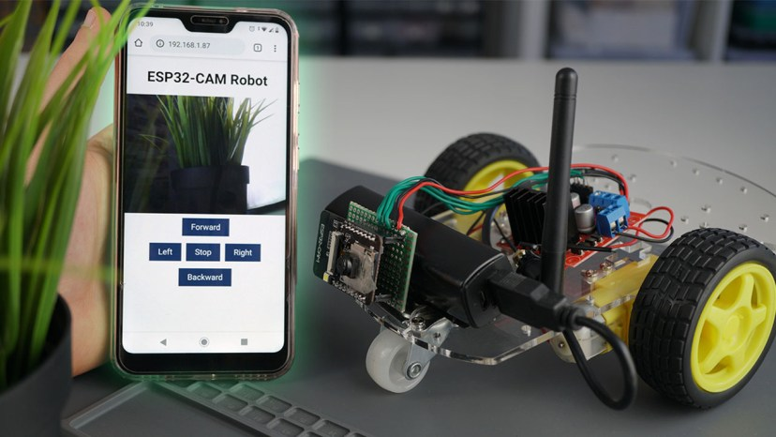
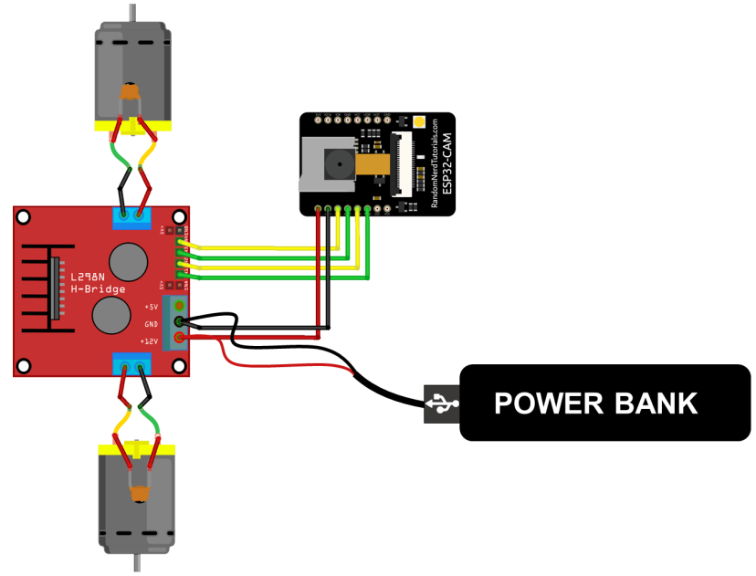
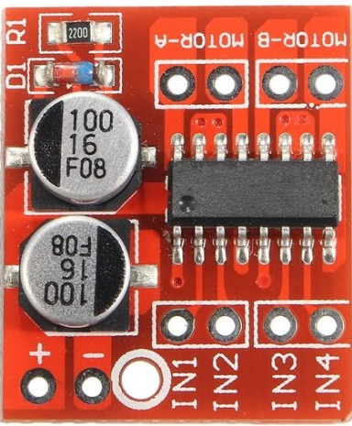
ESP32_cam_robot-control
https://randomnerdtutorials.com/esp32-cam-car-robot-web-server/
Front view

Slide 9
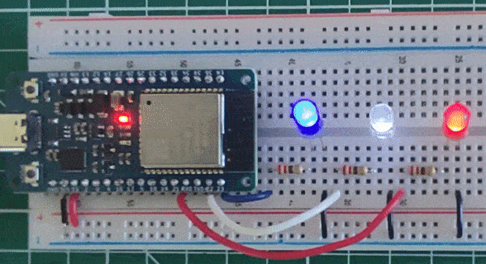
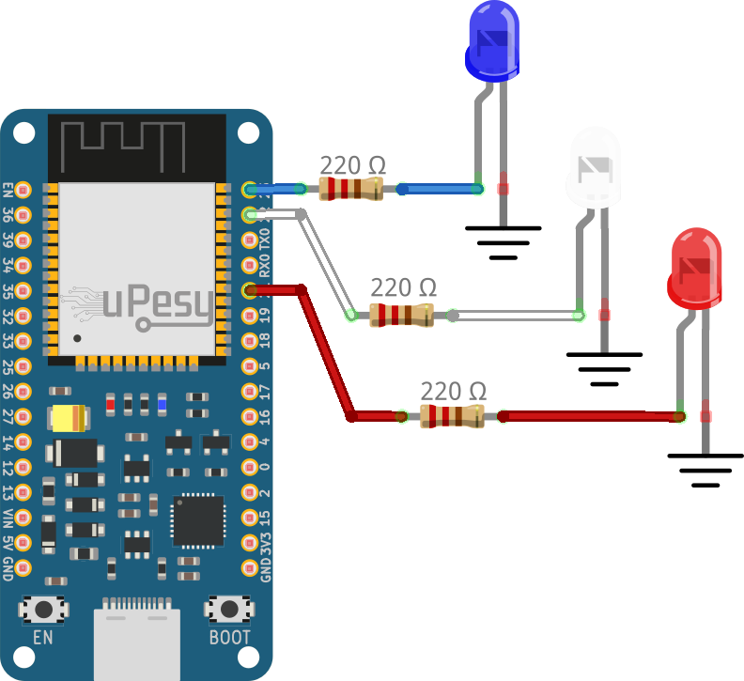
PWM using esp32 https://www.upesy.com/blogs/tutorials/how-to-use-pwm-on-esp32-with-examples#
const int ledPin = 23;
const int ledPin2 = 22;
const int ledPin3 = 21;
// PWM channel 0 parameter
const int freq = 5000; // 5000 Hz
const int ledChannel = 0;
const int resolution = 8; // 8-bit resolution
void setup(){
// Configure the channel 0
ledcSetup(ledChannel, freq, resolution);
// Attach the channel 0 on the 3 pins
ledcAttachPin(ledPin, ledChannel);
ledcAttachPin(ledPin2, ledChannel);
ledcAttachPin(ledPin3, ledChannel);
}
void loop(){
// Increase the brightness of the led in the loop
for(int dutyCycle = 0; dutyCycle <= 255; dutyCycle++){
ledcWrite(ledChannel, dutyCycle);
delay(15);
}
}
Note GPIOI pin assignment for ESP32
is not the same as ESP32-cam

Slide 10
Web control motor with pwm esp32_cam_robot_control_pwm3c.ino
/*********
Rui Santos
Complete instructions at https://RandomNerdTutorials.com/esp32-cam-projects-ebook/
Permission is hereby granted, free of charge, to any person obtaining a copy of this software and associated documentation files.
The above copyright notice and this permission notice shall be included in all copies or substantial portions of the Software.
*********/
#include "esp_camera.h"
#include <WiFi.h>
#include "esp_timer.h"
#include "img_converters.h"
#include "Arduino.h"
#include "fb_gfx.h"
#include "soc/soc.h" // disable brownout problems
#include "soc/rtc_cntl_reg.h" // disable brownout problems
#include "esp_http_server.h"
//for pwm
// const int ledChannel = 0; // possibly form 0 to 15
//const int ledPin = 12;//16;//23;
//const int ledPin2 = 22;
//const int ledPin3 = 21;
// PWM channel 0 parameter
/*
const int freq = 5000; // 5000 Hz
const int ledChannel = 0;
const int resolution = 8; // 8-bit resolution
*/
// Replace with your network credentials
const char* ssid = "dodddddass";
const char* password = "bbbbbbbbbb
#define PART_BOUNDARY "123456789000000000000987654321"
#define CAMERA_MODEL_AI_THINKER
//#define CAMERA_MODEL_M5STACK_PSRAM
//#define CAMERA_MODEL_M5STACK_WITHOUT_PSRAM
//#define CAMERA_MODEL_M5STACK_PSRAM_B
//#define CAMERA_MODEL_WROVER_KIT
#if defined(CAMERA_MODEL_WROVER_KIT)
#define PWDN_GPIO_NUM -1
#define RESET_GPIO_NUM -1
#define XCLK_GPIO_NUM 21
#define SIOD_GPIO_NUM 26
#define SIOC_GPIO_NUM 27
#define Y9_GPIO_NUM 35
#define Y8_GPIO_NUM 34
#define Y7_GPIO_NUM 39
#define Y6_GPIO_NUM 36
#define Y5_GPIO_NUM 19
#define Y4_GPIO_NUM 18
#define Y3_GPIO_NUM 5
#define Y2_GPIO_NUM 4
#define VSYNC_GPIO_NUM 25
#define HREF_GPIO_NUM 23
#define PCLK_GPIO_NUM 22
#elif defined(CAMERA_MODEL_M5STACK_PSRAM)
#define PWDN_GPIO_NUM -1
#define RESET_GPIO_NUM 15
#define XCLK_GPIO_NUM 27
#define SIOD_GPIO_NUM 25
#define SIOC_GPIO_NUM 23
#define Y9_GPIO_NUM 19
#define Y8_GPIO_NUM 36
#define Y7_GPIO_NUM 18
#define Y6_GPIO_NUM 39
#define Y5_GPIO_NUM 5
#define Y4_GPIO_NUM 34
#define Y3_GPIO_NUM 35
#define Y2_GPIO_NUM 32
#define VSYNC_GPIO_NUM 22
#define HREF_GPIO_NUM 26
#define PCLK_GPIO_NUM 21
#elif defined(CAMERA_MODEL_M5STACK_WITHOUT_PSRAM)
#define PWDN_GPIO_NUM -1
#define RESET_GPIO_NUM 15
#define XCLK_GPIO_NUM 27
#define SIOD_GPIO_NUM 25
#define SIOC_GPIO_NUM 23
#define Y9_GPIO_NUM 19
#define Y8_GPIO_NUM 36
#define Y7_GPIO_NUM 18
#define Y6_GPIO_NUM 39
#define Y5_GPIO_NUM 5
#define Y4_GPIO_NUM 34
#define Y3_GPIO_NUM 35
#define Y2_GPIO_NUM 17
#define VSYNC_GPIO_NUM 22
#define HREF_GPIO_NUM 26
#define PCLK_GPIO_NUM 21
#elif defined(CAMERA_MODEL_AI_THINKER)
#define PWDN_GPIO_NUM 32
#define RESET_GPIO_NUM -1
#define XCLK_GPIO_NUM 0
#define SIOD_GPIO_NUM 26
#define SIOC_GPIO_NUM 27
#define Y9_GPIO_NUM 35
#define Y8_GPIO_NUM 34
#define Y7_GPIO_NUM 39
#define Y6_GPIO_NUM 36
#define Y5_GPIO_NUM 21
#define Y4_GPIO_NUM 19
#define Y3_GPIO_NUM 18
#define Y2_GPIO_NUM 5
#define VSYNC_GPIO_NUM 25
#define HREF_GPIO_NUM 23
#define PCLK_GPIO_NUM 22
#elif defined(CAMERA_MODEL_M5STACK_PSRAM_B)
#define PWDN_GPIO_NUM -1
#define RESET_GPIO_NUM 15
#define XCLK_GPIO_NUM 27
#define SIOD_GPIO_NUM 22
#define SIOC_GPIO_NUM 23
#define Y9_GPIO_NUM 19
#define Y8_GPIO_NUM 36
#define Y7_GPIO_NUM 18
#define Y6_GPIO_NUM 39
#define Y5_GPIO_NUM 5
#define Y4_GPIO_NUM 34
#define Y3_GPIO_NUM 35
#define Y2_GPIO_NUM 32
#define VSYNC_GPIO_NUM 25
#define HREF_GPIO_NUM 26
#define PCLK_GPIO_NUM 21
#else
#error "Camera model not selected"
#endif
#define MOTOR_1_PIN_1 14
#define MOTOR_1_PIN_2 15
#define MOTOR_2_PIN_1 13
#define MOTOR_2_PIN_2 12
static const char* _STREAM_CONTENT_TYPE = "multipart/x-mixed-replace;boundary=" PART_BOUNDARY;
static const char* _STREAM_BOUNDARY = "\r\n--" PART_BOUNDARY "\r\n";
static const char* _STREAM_PART = "Content-Type: image/jpeg\r\nContent-Length: %u\r\n\r\n";
httpd_handle_t camera_httpd = NULL;
httpd_handle_t stream_httpd = NULL;
static const char PROGMEM INDEX_HTML[] = R"rawliteral(
<html>
<head>
<title>ESP32-CAM Robot</title>
<meta name="viewport" content="width=device-width, initial-scale=1">
<style>
body { font-family: Arial; text-align: center; margin:0px auto; padding-top: 30px;}
table { margin-left: auto; margin-right: auto; }
td { padding: 8 px; }
.button {
background-color: #2f4468;
border: none;
color: white;
padding: 10px 20px;
text-align: center;
text-decoration: none;
display: inline-block;
font-size: 18px;
margin: 6px 3px;
cursor: pointer;
-webkit-touch-callout: none;
-webkit-user-select: none;
-khtml-user-select: none;
-moz-user-select: none;
-ms-user-select: none;
user-select: none;
-webkit-tap-highlight-color: rgba(0,0,0,0);
}
img { width: auto ;
max-width: 100% ;
height: auto ;
}
</style>
</head>
<body>
<h1>ESP32-CAM Robot</h1>
<img src="" id="photo" >
<table>
<tr><td colspan="3" align="center"><button class="button" onmousedown="toggleCheckbox('forward');" ontouchstart="toggleCheckbox('forward');" onmouseup="toggleCheckbox('stop');" ontouchend="toggleCheckbox('stop');">Forward</button></td></tr>
<tr><td align="center"><button class="button" onmousedown="toggleCheckbox('left');" ontouchstart="toggleCheckbox('left');" onmouseup="toggleCheckbox('stop');" ontouchend="toggleCheckbox('stop');">Left</button></td><td align="center"><button class="button" onmousedown="toggleCheckbox('stop');" ontouchstart="toggleCheckbox('stop');">Stop</button></td><td align="center"><button class="button" onmousedown="toggleCheckbox('right');" ontouchstart="toggleCheckbox('right');" onmouseup="toggleCheckbox('stop');" ontouchend="toggleCheckbox('stop');">Right</button></td></tr>
<tr><td colspan="3" align="center"><button class="button" onmousedown="toggleCheckbox('backward');" ontouchstart="toggleCheckbox('backward');" onmouseup="toggleCheckbox('stop');" ontouchend="toggleCheckbox('stop');">Backward</button></td></tr>
</table>
<script>
function toggleCheckbox(x) {
var xhr = new XMLHttpRequest();
xhr.open("GET", "/action?go=" + x, true);
xhr.send();
}
window.onload = document.getElementById("photo").src = window.location.href.slice(0, -1) + ":81/stream";
</script>
</body>
</html>
)rawliteral";
static esp_err_t index_handler(httpd_req_t *req){
httpd_resp_set_type(req, "text/html");
return httpd_resp_send(req, (const char *)INDEX_HTML, strlen(INDEX_HTML));
}
static esp_err_t stream_handler(httpd_req_t *req){
camera_fb_t * fb = NULL;
esp_err_t res = ESP_OK;
size_t _jpg_buf_len = 0;
uint8_t * _jpg_buf = NULL;
char * part_buf[64];
res = httpd_resp_set_type(req, _STREAM_CONTENT_TYPE);
if(res != ESP_OK){
return res;
}
while(true){
fb = esp_camera_fb_get();
if (!fb) {
Serial.println("Camera capture failed");
res = ESP_FAIL;
} else {
if(fb->width > 400){
if(fb->format != PIXFORMAT_JPEG){
bool jpeg_converted = frame2jpg(fb, 80, &_jpg_buf, &_jpg_buf_len);
esp_camera_fb_return(fb);
fb = NULL;
if(!jpeg_converted){
Serial.println("JPEG compression failed");
res = ESP_FAIL;
}
} else {
_jpg_buf_len = fb->len;
_jpg_buf = fb->buf;
}
}
}
if(res == ESP_OK){
size_t hlen = snprintf((char *)part_buf, 64, _STREAM_PART, _jpg_buf_len);
res = httpd_resp_send_chunk(req, (const char *)part_buf, hlen);
}
if(res == ESP_OK){
res = httpd_resp_send_chunk(req, (const char *)_jpg_buf, _jpg_buf_len);
}
if(res == ESP_OK){
res = httpd_resp_send_chunk(req, _STREAM_BOUNDARY, strlen(_STREAM_BOUNDARY));
}
if(fb){
esp_camera_fb_return(fb);
fb = NULL;
_jpg_buf = NULL;
} else if(_jpg_buf){
free(_jpg_buf);
_jpg_buf = NULL;
}
if(res != ESP_OK){
break;
}
//Serial.printf("MJPG: %uB\n",(uint32_t)(_jpg_buf_len));
}
return res;
}
static esp_err_t cmd_handler(httpd_req_t *req){
char* buf;
size_t buf_len;
char variable[32] = {0,};
buf_len = httpd_req_get_url_query_len(req) + 1;
if (buf_len > 1) {
buf = (char*)malloc(buf_len);
if(!buf){
httpd_resp_send_500(req);
return ESP_FAIL;
}
if (httpd_req_get_url_query_str(req, buf, buf_len) == ESP_OK) {
if (httpd_query_key_value(buf, "go", variable, sizeof(variable)) == ESP_OK) {
} else {
free(buf);
httpd_resp_send_404(req);
return ESP_FAIL;
}
} else {
free(buf);
httpd_resp_send_404(req);
return ESP_FAIL;
}
free(buf);
} else {
httpd_resp_send_404(req);
return ESP_FAIL;
}
sensor_t * s = esp_camera_sensor_get();
int res = 0;
if(!strcmp(variable, "forward")) {
Serial.println("Forward");
// ledcWrite(ledChannel , dutyCycle); //pwm motor control, dutyCycle from 0 to 255
ledcWrite(0 , 175); // for MOTOR_1_PIN_1 PWM, forward
ledcWrite(1 , 0); // for MOTOR_1_PIN_1 PWM, forward
/*
digitalWrite(MOTOR_1_PIN_1, 1);
digitalWrite(MOTOR_1_PIN_2, 0);
digitalWrite(MOTOR_2_PIN_1, 1);
digitalWrite(MOTOR_2_PIN_2, 0);
*/
}
else if(!strcmp(variable, "left")) {
Serial.println("Left");
// ledcWrite(ledChannel , dutyCycle); //pwm motor control, dutyCycle from 0 to 255
ledcWrite(0 , 160); // for MOTOR_1_PIN_1 PWM, forward slower
ledcWrite(1 , 0); // for MOTOR_1_PIN_1 PWM, forward slower
/*
digitalWrite(MOTOR_1_PIN_1, 0);
digitalWrite(MOTOR_1_PIN_2, 1);
digitalWrite(MOTOR_2_PIN_1, 1);
digitalWrite(MOTOR_2_PIN_2, 0);
*/
}
else if(!strcmp(variable, "right")) {
Serial.println("Right");
// ledcWrite(ledChannel , dutyCycle); //pwm motor control, dutyCycle from 0 to 255
ledcWrite(0 , 0); // for MOTOR_1_PIN_1 PWM, backward slower
ledcWrite(1 , 175); // for MOTOR_1_PIN_1 PWM, backward slower
/*
digitalWrite(MOTOR_1_PIN_1, 1);
digitalWrite(MOTOR_1_PIN_2, 0);
digitalWrite(MOTOR_2_PIN_1, 0);
digitalWrite(MOTOR_2_PIN_2, 1);
*/
}
else if(!strcmp(variable, "backward")) {
Serial.println("Backward");
// ledcWrite(ledChannel , dutyCycle); //pwm motor control, dutyCycle from 0 to 255
ledcWrite(0 , 0); // for MOTOR_1_PIN_1 PWM, backward
ledcWrite(1 , 160); // for MOTOR_1_PIN_1 PWM, backward
/*
digitalWrite(MOTOR_1_PIN_1, 0);
digitalWrite(MOTOR_1_PIN_2, 1);
digitalWrite(MOTOR_2_PIN_1, 0);
digitalWrite(MOTOR_2_PIN_2, 1);
*/
}
else if(!strcmp(variable, "stop")) {
Serial.println("Stop");
// ledcWrite(ledChannel , dutyCycle); //pwm motor control, dutyCycle from 0 to 255
ledcWrite(1 , 0); // for MOTOR_1_PIN_1 PWM, stop
ledcWrite(0 , 0); // for MOTOR_1_PIN_1 PWM, stop
/*
digitalWrite(MOTOR_1_PIN_1, 0);
digitalWrite(MOTOR_1_PIN_2, 0);
digitalWrite(MOTOR_2_PIN_1, 0);
digitalWrite(MOTOR_2_PIN_2, 0);
*/
}
else {
res = -1;
}
if(res){
return httpd_resp_send_500(req);
}
httpd_resp_set_hdr(req, "Access-Control-Allow-Origin", "*");
return httpd_resp_send(req, NULL, 0);
}
void startCameraServer(){
httpd_config_t config = HTTPD_DEFAULT_CONFIG();
config.server_port = 80;
httpd_uri_t index_uri = {
.uri = "/",
.method = HTTP_GET,
.handler = index_handler,
.user_ctx = NULL
};
httpd_uri_t cmd_uri = {
.uri = "/action",
.method = HTTP_GET,
.handler = cmd_handler,
.user_ctx = NULL
};
httpd_uri_t stream_uri = {
.uri = "/stream",
.method = HTTP_GET,
.handler = stream_handler,
.user_ctx = NULL
};
if (httpd_start(&camera_httpd, &config) == ESP_OK) {
httpd_register_uri_handler(camera_httpd, &index_uri);
httpd_register_uri_handler(camera_httpd, &cmd_uri);
}
config.server_port += 1;
config.ctrl_port += 1;
if (httpd_start(&stream_httpd, &config) == ESP_OK) {
httpd_register_uri_handler(stream_httpd, &stream_uri);
}
}
// PWM channel 0 parameter
/*
const int freq = 5000; // 5000 Hz
const int ledChannel0 = 0;
const int resolution = 8; // 8-bit resolution
*/
void setup() {
////pwm stuff ///////////////////////////////
// for pwm,Configure the channel 0
//ledcSetup(0, freq, resolution);
ledcSetup(0, 5000, 8);
ledcSetup(1, 5000, 8);
ledcAttachPin(MOTOR_1_PIN_1 , 0);//MOTOR_1_PIN_1 = 14, // ledcAttachPin(ledPin, ledChannel);
ledcAttachPin(MOTOR_1_PIN_2 , 1);//MOTOR_1_PIN_1 = 15, // ledcAttachPin(ledPin, ledChannel);
// wifi stuff /////////////////////////////////
WRITE_PERI_REG(RTC_CNTL_BROWN_OUT_REG, 0); //disable brownout detector
/*
pinMode(MOTOR_1_PIN_1, OUTPUT);
pinMode(MOTOR_1_PIN_2, OUTPUT);
pinMode(MOTOR_2_PIN_1, OUTPUT);
pinMode(MOTOR_2_PIN_2, OUTPUT);
*/
Serial.begin(115200);
//Serial.begin(9600);
Serial.setDebugOutput(false);
camera_config_t config;
config.ledc_channel = LEDC_CHANNEL_0;
config.ledc_timer = LEDC_TIMER_0;
config.pin_d0 = Y2_GPIO_NUM;
config.pin_d1 = Y3_GPIO_NUM;
config.pin_d2 = Y4_GPIO_NUM;
config.pin_d3 = Y5_GPIO_NUM;
config.pin_d4 = Y6_GPIO_NUM;
config.pin_d5 = Y7_GPIO_NUM;
config.pin_d6 = Y8_GPIO_NUM;
config.pin_d7 = Y9_GPIO_NUM;
config.pin_xclk = XCLK_GPIO_NUM;
config.pin_pclk = PCLK_GPIO_NUM;
config.pin_vsync = VSYNC_GPIO_NUM;
config.pin_href = HREF_GPIO_NUM;
config.pin_sscb_sda = SIOD_GPIO_NUM;
config.pin_sscb_scl = SIOC_GPIO_NUM;
config.pin_pwdn = PWDN_GPIO_NUM;
config.pin_reset = RESET_GPIO_NUM;
config.xclk_freq_hz = 20000000;
config.pixel_format = PIXFORMAT_JPEG;
if(psramFound()){
config.frame_size = FRAMESIZE_VGA;
config.jpeg_quality = 10;
config.fb_count = 2;
} else {
config.frame_size = FRAMESIZE_SVGA;
config.jpeg_quality = 12;
config.fb_count = 1;
}
// Camera init
esp_err_t err = esp_camera_init(&config);
if (err != ESP_OK) {
Serial.printf("Camera init failed with error 0x%x", err);
return;
}
// Wi-Fi connection
WiFi.begin(ssid, password);
while (WiFi.status() != WL_CONNECTED) {
delay(500);
Serial.print(".");
}
Serial.println("");
Serial.println("WiFi connected");
Serial.print("Camera Stream Ready! Go to: http://");
Serial.println(WiFi.localIP());
// Start streaming web server
startCameraServer();
}
void loop() {// for pwm, Increase the brightness of the led in the loop
/* for teating pwm only
for(int dutyCycle = 0; dutyCycle <= 255; dutyCycle++){
ledcWrite(0 , dutyCycle); // ledcWrite(ledChannel , dutyCycle);
ledcWrite(1 , dutyCycle); // ledcWrite(ledChannel , dutyCycle);
delay(15);
}
*/
}
References:
https://randomnerdtutorials.com/esp32-cam-car-robot-web-server/
https://lastminuteengineers.com/esp32-cam-pinout-reference/
https://www.upesy.com/blogs/tutorials/how-to-use-pwm-on-esp32-with-examples
Motor connections:
Control pins to l298 H-bridge
GPIo14,15

Slide 11
https://randomnerdtutorials.com/esp32-cam-video-streaming-web-server-camera-home-assistant/ simple webcam display on the webpage
/*********
Rui Santos
Complete project details at https://RandomNerdTutorials.com/esp32-cam-video-streaming-web-server-camera-home-assistant/
IMPORTANT!!!
- Select Board "AI Thinker ESP32-CAM"
- GPIO 0 must be connected to GND to upload a sketch
- After connecting GPIO 0 to GND, press the ESP32-CAM on-board RESET button to put your board in flashing mode
Permission is hereby granted, free of charge, to any person obtaining a copy
of this software and associated documentation files.
The above copyright notice and this permission notice shall be included in all
copies or substantial portions of the Software.
*********/
#include "esp_camera.h"
#include <WiFi.h>
#include "esp_timer.h"
#include "img_converters.h"
#include "Arduino.h"
#include "fb_gfx.h"
#include "soc/soc.h" //disable brownout problems
#include "soc/rtc_cntl_reg.h" //disable brownout problems
#include "esp_http_server.h"
//Replace with your network credentials
const char* ssid = "dddddddddddddddddddddddddddd";
const char* password = "bbbbb";
#define PART_BOUNDARY "123456789000000000000987654321"
// This project was tested with the AI Thinker Model, M5STACK PSRAM Model and M5STACK WITHOUT PSRAM
#define CAMERA_MODEL_AI_THINKER
//#define CAMERA_MODEL_M5STACK_PSRAM
//#define CAMERA_MODEL_M5STACK_WITHOUT_PSRAM
// Not tested with this model
//#define CAMERA_MODEL_WROVER_KIT
#if defined(CAMERA_MODEL_WROVER_KIT)
#define PWDN_GPIO_NUM -1
#define RESET_GPIO_NUM -1
#define XCLK_GPIO_NUM 21
#define SIOD_GPIO_NUM 26
#define SIOC_GPIO_NUM 27
#define Y9_GPIO_NUM 35
#define Y8_GPIO_NUM 34
#define Y7_GPIO_NUM 39
#define Y6_GPIO_NUM 36
#define Y5_GPIO_NUM 19
#define Y4_GPIO_NUM 18
#define Y3_GPIO_NUM 5
#define Y2_GPIO_NUM 4
#define VSYNC_GPIO_NUM 25
#define HREF_GPIO_NUM 23
#define PCLK_GPIO_NUM 22
#elif defined(CAMERA_MODEL_M5STACK_PSRAM)
#define PWDN_GPIO_NUM -1
#define RESET_GPIO_NUM 15
#define XCLK_GPIO_NUM 27
#define SIOD_GPIO_NUM 25
#define SIOC_GPIO_NUM 23
#define Y9_GPIO_NUM 19
#define Y8_GPIO_NUM 36
#define Y7_GPIO_NUM 18
#define Y6_GPIO_NUM 39
#define Y5_GPIO_NUM 5
#define Y4_GPIO_NUM 34
#define Y3_GPIO_NUM 35
#define Y2_GPIO_NUM 32
#define VSYNC_GPIO_NUM 22
#define HREF_GPIO_NUM 26
#define PCLK_GPIO_NUM 21
#elif defined(CAMERA_MODEL_M5STACK_WITHOUT_PSRAM)
#define PWDN_GPIO_NUM -1
#define RESET_GPIO_NUM 15
#define XCLK_GPIO_NUM 27
#define SIOD_GPIO_NUM 25
#define SIOC_GPIO_NUM 23
#define Y9_GPIO_NUM 19
#define Y8_GPIO_NUM 36
#define Y7_GPIO_NUM 18
#define Y6_GPIO_NUM 39
#define Y5_GPIO_NUM 5
#define Y4_GPIO_NUM 34
#define Y3_GPIO_NUM 35
#define Y2_GPIO_NUM 17
#define VSYNC_GPIO_NUM 22
#define HREF_GPIO_NUM 26
#define PCLK_GPIO_NUM 21
#elif defined(CAMERA_MODEL_AI_THINKER)
#define PWDN_GPIO_NUM 32
#define RESET_GPIO_NUM -1
#define XCLK_GPIO_NUM 0
#define SIOD_GPIO_NUM 26
#define SIOC_GPIO_NUM 27
#define Y9_GPIO_NUM 35
#define Y8_GPIO_NUM 34
#define Y7_GPIO_NUM 39
#define Y6_GPIO_NUM 36
#define Y5_GPIO_NUM 21
#define Y4_GPIO_NUM 19
#define Y3_GPIO_NUM 18
#define Y2_GPIO_NUM 5
#define VSYNC_GPIO_NUM 25
#define HREF_GPIO_NUM 23
#define PCLK_GPIO_NUM 22
#else
#error "Camera model not selected"
#endif
static const char* _STREAM_CONTENT_TYPE = "multipart/x-mixed-replace;boundary=" PART_BOUNDARY;
static const char* _STREAM_BOUNDARY = "\r\n--" PART_BOUNDARY "\r\n";
static const char* _STREAM_PART = "Content-Type: image/jpeg\r\nContent-Length: %u\r\n\r\n";
httpd_handle_t stream_httpd = NULL;
static esp_err_t stream_handler(httpd_req_t *req){
camera_fb_t * fb = NULL;
esp_err_t res = ESP_OK;
size_t _jpg_buf_len = 0;
uint8_t * _jpg_buf = NULL;
char * part_buf[64];
res = httpd_resp_set_type(req, _STREAM_CONTENT_TYPE);
if(res != ESP_OK){
return res;
}
while(true){
fb = esp_camera_fb_get();
if (!fb) {
Serial.println("Camera capture failed");
res = ESP_FAIL;
} else {
if(fb->width > 400){
if(fb->format != PIXFORMAT_JPEG){
bool jpeg_converted = frame2jpg(fb, 80, &_jpg_buf, &_jpg_buf_len);
esp_camera_fb_return(fb);
fb = NULL;
if(!jpeg_converted){
Serial.println("JPEG compression failed");
res = ESP_FAIL;
}
} else {
_jpg_buf_len = fb->len;
_jpg_buf = fb->buf;
}
}
}
if(res == ESP_OK){
size_t hlen = snprintf((char *)part_buf, 64, _STREAM_PART, _jpg_buf_len);
res = httpd_resp_send_chunk(req, (const char *)part_buf, hlen);
}
if(res == ESP_OK){
res = httpd_resp_send_chunk(req, (const char *)_jpg_buf, _jpg_buf_len);
}
if(res == ESP_OK){
res = httpd_resp_send_chunk(req, _STREAM_BOUNDARY, strlen(_STREAM_BOUNDARY));
}
if(fb){
esp_camera_fb_return(fb);
fb = NULL;
_jpg_buf = NULL;
} else if(_jpg_buf){
free(_jpg_buf);
_jpg_buf = NULL;
}
if(res != ESP_OK){
break;
}
//Serial.printf("MJPG: %uB\n",(uint32_t)(_jpg_buf_len));
}
return res;
}
void startCameraServer(){
httpd_config_t config = HTTPD_DEFAULT_CONFIG();
config.server_port = 80;
httpd_uri_t index_uri = {
.uri = "/",
.method = HTTP_GET,
.handler = stream_handler,
.user_ctx = NULL
};
//Serial.printf("Starting web server on port: '%d'\n", config.server_port);
if (httpd_start(&stream_httpd, &config) == ESP_OK) {
httpd_register_uri_handler(stream_httpd, &index_uri);
}
}
void setup() {
WRITE_PERI_REG(RTC_CNTL_BROWN_OUT_REG, 0); //disable brownout detector
Serial.begin(115200);
Serial.setDebugOutput(false);
camera_config_t config;
config.ledc_channel = LEDC_CHANNEL_0;
config.ledc_timer = LEDC_TIMER_0;
config.pin_d0 = Y2_GPIO_NUM;
config.pin_d1 = Y3_GPIO_NUM;
config.pin_d2 = Y4_GPIO_NUM;
config.pin_d3 = Y5_GPIO_NUM;
config.pin_d4 = Y6_GPIO_NUM;
config.pin_d5 = Y7_GPIO_NUM;
config.pin_d6 = Y8_GPIO_NUM;
config.pin_d7 = Y9_GPIO_NUM;
config.pin_xclk = XCLK_GPIO_NUM;
config.pin_pclk = PCLK_GPIO_NUM;
config.pin_vsync = VSYNC_GPIO_NUM;
config.pin_href = HREF_GPIO_NUM;
config.pin_sscb_sda = SIOD_GPIO_NUM;
config.pin_sscb_scl = SIOC_GPIO_NUM;
config.pin_pwdn = PWDN_GPIO_NUM;
config.pin_reset = RESET_GPIO_NUM;
config.xclk_freq_hz = 20000000;
config.pixel_format = PIXFORMAT_JPEG;
if(psramFound()){
config.frame_size = FRAMESIZE_UXGA;
config.jpeg_quality = 10;
config.fb_count = 2;
} else {
config.frame_size = FRAMESIZE_SVGA;
config.jpeg_quality = 12;
config.fb_count = 1;
}
// Camera init
esp_err_t err = esp_camera_init(&config);
if (err != ESP_OK) {
Serial.printf("Camera init failed with error 0x%x", err);
return;
}
// Wi-Fi connection
WiFi.begin(ssid, password);
while (WiFi.status() != WL_CONNECTED) {
delay(500);
Serial.print(".");
}
Serial.println("");
Serial.println("WiFi connected");
Serial.print("Camera Stream Ready! Go to: http://");
Serial.print(WiFi.localIP());
// Start streaming web server
startCameraServer();
}
void loop() {
delay(1);
}

Slide 12
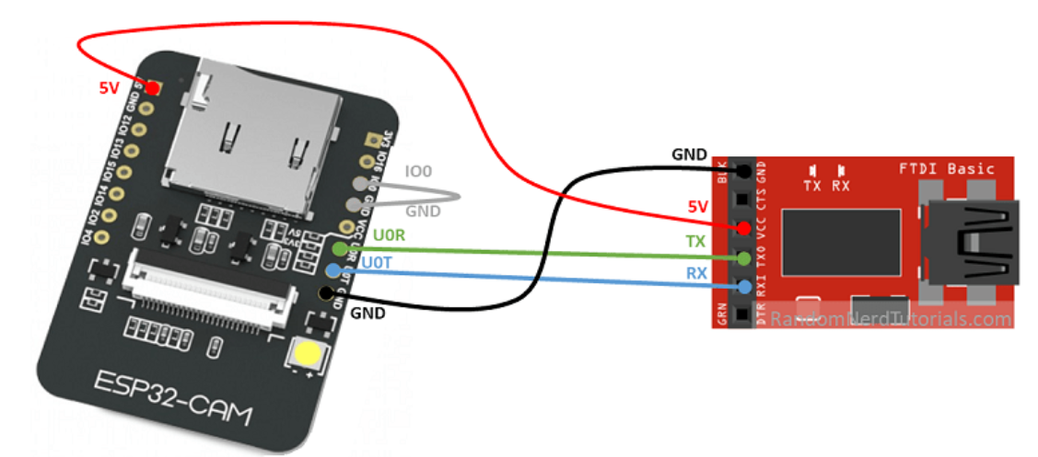
Program ESP32cam using FTDI (TTL-USB) connection
FTDI board

Slide 13
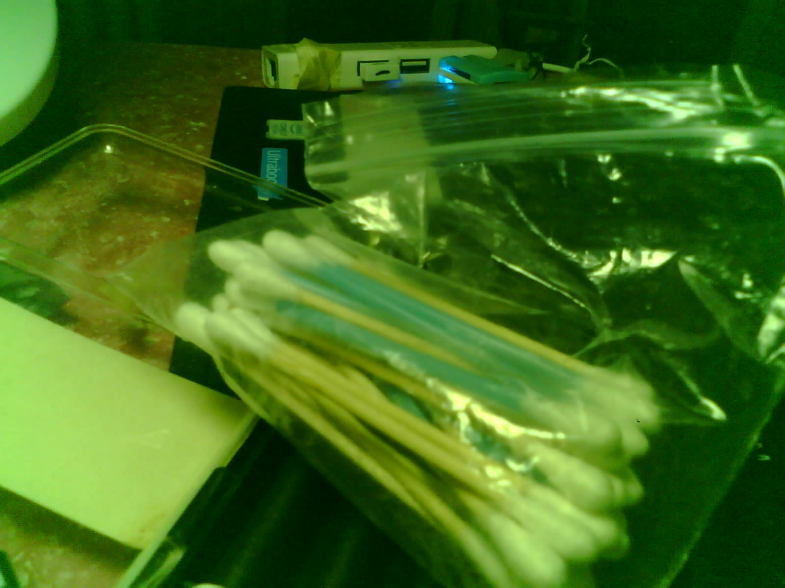
Take picture and save in SD flash memory https://dronebotworkshop.com/esp32-cam-microsd/ or https://randomnerdtutorials.com/esp32-cam-take-photo-save-microsd-card/
/*
ESP32 CAM Camera with MicroSD storage
esp32cam-microsd.ino
Take picture when button pressed
Store image on MicroSD card
DroneBot Workshop 2022
https://dronebotworkshop.com
*/
// Include Required Libraries
// Camera libraries
#include "esp_camera.h"
#include "soc/soc.h"
#include "soc/rtc_cntl_reg.h"
#include "driver/rtc_io.h"
// MicroSD Libraries
#include "FS.h"
#include "SD_MMC.h"
// EEPROM Library
#include "EEPROM.h"
// Use 1 byte of EEPROM space
#define EEPROM_SIZE 1
// Counter for picture number
unsigned int pictureCount = 0;
// Pin definitions for CAMERA_MODEL_AI_THINKER
#define PWDN_GPIO_NUM 32
#define RESET_GPIO_NUM -1
#define XCLK_GPIO_NUM 0
#define SIOD_GPIO_NUM 26
#define SIOC_GPIO_NUM 27
#define Y9_GPIO_NUM 35
#define Y8_GPIO_NUM 34
#define Y7_GPIO_NUM 39
#define Y6_GPIO_NUM 36
#define Y5_GPIO_NUM 21
#define Y4_GPIO_NUM 19
#define Y3_GPIO_NUM 18
#define Y2_GPIO_NUM 5
#define VSYNC_GPIO_NUM 25
#define HREF_GPIO_NUM 23
#define PCLK_GPIO_NUM 22
void configESPCamera() {
// Configure Camera parameters
// Object to store the camera configuration parameters
camera_config_t config;
config.ledc_channel = LEDC_CHANNEL_0;
config.ledc_timer = LEDC_TIMER_0;
config.pin_d0 = Y2_GPIO_NUM;
config.pin_d1 = Y3_GPIO_NUM;
config.pin_d2 = Y4_GPIO_NUM;
config.pin_d3 = Y5_GPIO_NUM;
config.pin_d4 = Y6_GPIO_NUM;
config.pin_d5 = Y7_GPIO_NUM;
config.pin_d6 = Y8_GPIO_NUM;
config.pin_d7 = Y9_GPIO_NUM;
config.pin_xclk = XCLK_GPIO_NUM;
config.pin_pclk = PCLK_GPIO_NUM;
config.pin_vsync = VSYNC_GPIO_NUM;
config.pin_href = HREF_GPIO_NUM;
config.pin_sscb_sda = SIOD_GPIO_NUM;
config.pin_sscb_scl = SIOC_GPIO_NUM;
config.pin_pwdn = PWDN_GPIO_NUM;
config.pin_reset = RESET_GPIO_NUM;
config.xclk_freq_hz = 20000000;
config.pixel_format = PIXFORMAT_JPEG; // Choices are YUV422, GRAYSCALE, RGB565, JPEG
// Select lower framesize if the camera doesn't support PSRAM
if (psramFound()) {
config.frame_size = FRAMESIZE_UXGA; // FRAMESIZE_ + QVGA|CIF|VGA|SVGA|XGA|SXGA|UXGA
config.jpeg_quality = 10; //10-63 lower number means higher quality
config.fb_count = 2;
} else {
config.frame_size = FRAMESIZE_SVGA;
config.jpeg_quality = 12;
config.fb_count = 1;
}
// Initialize the Camera
esp_err_t err = esp_camera_init(&config);
if (err != ESP_OK) {
Serial.printf("Camera init failed with error 0x%x", err);
return;
}
// Camera quality adjustments
sensor_t * s = esp_camera_sensor_get();
/*
// BRIGHTNESS (-2 to 2)
s->set_brightness(s, 0);
// CONTRAST (-2 to 2)
s->set_contrast(s, 0);
// SATURATION (-2 to 2)
s->set_saturation(s, 0);
// SPECIAL EFFECTS (0 - No Effect, 1 - Negative, 2 - Grayscale, 3 - Red Tint, 4 - Green Tint, 5 - Blue Tint, 6 - Sepia)
s->set_special_effect(s, 0);
// WHITE BALANCE (0 = Disable , 1 = Enable)
s->set_whitebal(s, 1);
// AWB GAIN (0 = Disable , 1 = Enable)
s->set_awb_gain(s, 1);
// WB MODES (0 - Auto, 1 - Sunny, 2 - Cloudy, 3 - Office, 4 - Home)
s->set_wb_mode(s, 0);
// EXPOSURE CONTROLS (0 = Disable , 1 = Enable)
s->set_exposure_ctrl(s, 1);
// AEC2 (0 = Disable , 1 = Enable)
s->set_aec2(s, 0);
// AE LEVELS (-2 to 2)
s->set_ae_level(s, 0);
// AEC VALUES (0 to 1200)
s->set_aec_value(s, 300);
// GAIN CONTROLS (0 = Disable , 1 = Enable)
s->set_gain_ctrl(s, 1);
// AGC GAIN (0 to 30)
s->set_agc_gain(s, 0);
// GAIN CEILING (0 to 6)
s->set_gainceiling(s, (gainceiling_t)0);
// BPC (0 = Disable , 1 = Enable)
s->set_bpc(s, 0);
// WPC (0 = Disable , 1 = Enable)
s->set_wpc(s, 1);
// RAW GMA (0 = Disable , 1 = Enable)
s->set_raw_gma(s, 1);
// LENC (0 = Disable , 1 = Enable)
s->set_lenc(s, 1);
// HORIZ MIRROR (0 = Disable , 1 = Enable)
s->set_hmirror(s, 0);
// VERT FLIP (0 = Disable , 1 = Enable)
s->set_vflip(s, 0);
// DCW (0 = Disable , 1 = Enable)
s->set_dcw(s, 1);
// COLOR BAR PATTERN (0 = Disable , 1 = Enable)
s->set_colorbar(s, 0);
*/
s->set_gain_ctrl(s, 1); // auto gain on
s->set_exposure_ctrl(s, 1); // auto exposure on
s->set_awb_gain(s, 1); // Auto White Balance enable (0 or 1)
s->set_brightness(s, 1); // (-2 to 2) - set brightness
}
void initMicroSDCard() {
// Start the MicroSD card
Serial.println("Mounting MicroSD Card");
if (!SD_MMC.begin()) {
Serial.println("MicroSD Card Mount Failed");
return;
}
uint8_t cardType = SD_MMC.cardType();
if (cardType == CARD_NONE) {
Serial.println("No MicroSD Card found");
return;
}
}
void takeNewPhoto(String path) {
// Take Picture with Camera
// Setup frame buffer
camera_fb_t * fb = esp_camera_fb_get();
if (!fb) {
Serial.println("Camera capture failed");
return;
}
// Save picture to microSD card
fs::FS &fs = SD_MMC;
File file = fs.open(path.c_str(), FILE_WRITE);
if (!file) {
Serial.println("Failed to open file in write mode");
}
else {
file.write(fb->buf, fb->len); // payload (image), payload length
Serial.printf("Saved file to path: %s\n", path.c_str());
}
// Close the file
file.close();
// Return the frame buffer back to the driver for reuse
esp_camera_fb_return(fb);
}
void setup() {
// Disable brownout detector
WRITE_PERI_REG(RTC_CNTL_BROWN_OUT_REG, 0);
// Start Serial Monitor
Serial.begin(115200);
// Initialize the camera
Serial.print("Initializing the camera module...");
configESPCamera();
Serial.println("Camera OK!");
// Initialize the MicroSD
Serial.print("Initializing the MicroSD card module... ");
initMicroSDCard();
// initialize EEPROM with predefined size
EEPROM.begin(EEPROM_SIZE);
pictureCount = EEPROM.read(0) + 1;
// Path where new picture will be saved in SD Card
String path = "/image" + String(pictureCount) + ".jpg";
Serial.printf("Picture file name: %s\n", path.c_str());
// Take and Save Photo
takeNewPhoto(path);
// Update EEPROM picture number counter
EEPROM.write(0, pictureCount);
EEPROM.commit();
// Bind Wakeup to GPIO13 going LOW
esp_sleep_enable_ext0_wakeup(GPIO_NUM_13, 0);
Serial.println("Entering sleep mode");
delay(1000);
// Enter deep sleep mode
esp_deep_sleep_start();
}
void loop() {
}
Don’t expect too much on the picture quality.
If the picture is too dark try this
https://forum.arduino.cc/t/about-esp32cam-image-too-dark-how-to-fix/1015490/5

Slide 14
Reference
For Arduino IDE2 , read the following doc to install drivers for the board
  https://randomnerdtutorials.com/installing-esp8266-nodemcu-arduino-ide-2-0/
  Installing ESP8266 NodeMCU Board in Arduino IDE 2.0 (Windows, Mac OS X, Linux) | Random Nerd Tutorials (install this before using Arduino D1 Wemos board)
  ULR: http://arduino.esp8266.com/stable/package_esp8266com_index.json, https://raw.githubusercontent.com/espressif/arduino-esp32/gh-pages/package_esp32_index.json
  Install esp8266 and NodeMCU Board, NodeMCU 1.0 (ESP-12E Module)

