Slide 1
Stem 4
Arduino and Personal computer PC use of computer vision
KH Wong

Slide 2
Overview
Test 4.1: serial communication with PC, echoing etc. Similar to the ones in stem2.
Test 4.2: use PC-python (dlib, camshaft, lkdemo etc.) to control servo motor attached to Arduino via USB bus (response rate 1Hz).
  Learning how to send integers from PC to Arduino

Slide 3
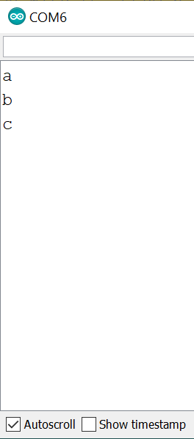
Test 4.1a: serial communication with PC, echo a character
//serial communication with PC, echo a character
void setup()
{
Serial.begin(9600);
}
void loop()
{
if (Serial.available() > 0)
{
char c = Serial.read();
Serial.print( c );
}
delay(10);
}

Slide 4
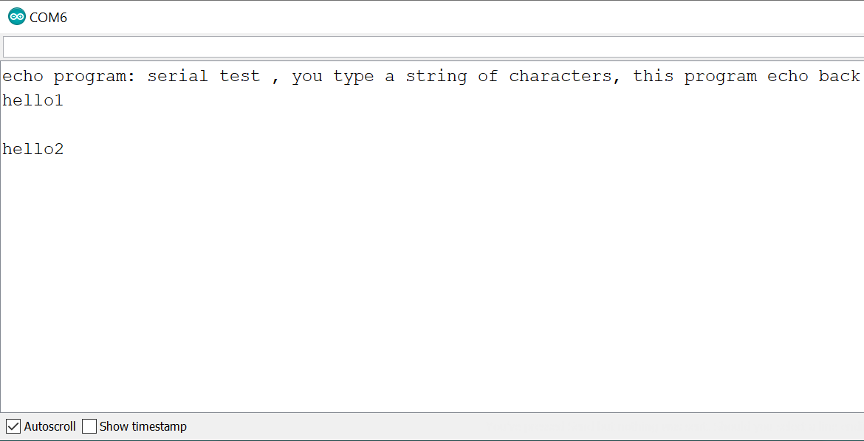
Test 4.1b: serial communication with PC, echo a string of characters
//from https://forum.arduino.cc/index.php?topic=66621.0
String readString; //echo program
void setup() {
Serial.begin(9600);
Serial.println("echo program: serial test , you type a string of characters, this program echo back"); // so I can keep track of what is loaded
}
void loop() {
while (Serial.available()) {
delay(10);
if (Serial.available() > 0) {
char c = Serial.read();
readString += c;
}
}
if (readString.length() > 0) {
Serial.println(readString);
readString = "";
}
}

Slide 5
Test 4.1c: Serial communication with PC(python), send data from Arduino to PC (Python)
REF: https://www.instructables.com/id/Arduino-Python-Communication-via-USB/
//run this on Arduino, AAAAAAAAAAAAAAAAAAAAA
void setup() {
Serial.begin(9600); // use the same baud-rate as the python side
}
void loop() {
Serial.println("Hello world from Ardunio!"); // write a string
delay(1000);
}
#run this on python, PPPPPPPPPPPPPPPPPPPPPPPPPPPPPPPPP
import serial # pip install pyserial (not pip install serial ) # if needed
arduino = serial.Serial('COM6', 9600, timeout=.1)
while True:
data = arduino.readline()[:-2] #the last bit gets rid of the new-line chars
if data:
print (data)

Slide 6

Test 4.1d: Serial communication with PC(python), data sent from PC-python to Arduino and echo back to PC-python for printing
# run on PC-python
import serial, time
arduino = serial.Serial('COM6', 9600, timeout=.1)
time.sleep(1) #give the connection a second to settle
#arduino.write(b"Hello from Python!")
while True:
#arduino.write("Hello from Python!")
arduino.write("Hello from Python!".encode())
time.sleep(1)
data = arduino.readline()
# print(data)
if data:
#print(data.rstrip('\n'))
print(data)
#strip out the new lines for now
# (better to do .read()
#in the long run for this
REF: https://www.instructables.com/id/Arduino-Python-Communication-via-USB/
/// run on Arduino -uno
void setup() {
Serial.begin(9600);}
void loop() {
if (Serial.available() > 0) {
char data = Serial.read();
char strx[2];
strx[0] = data;
strx[1] = '\0';
Serial.print(strx[i]);
}
}
}

Slide 7
Test 4.2a: face control and servo:
Use dlib (use PC-python) to control servo motor attached to Arduino via USB bus (response rate 1Hz)
Run on Pc-python
## run on Arduio
#include <Servo.h>
int servoPin = 3;
Servo Servo1;
void setup() {
Servo1.attach(servoPin);
Serial.begin(9600);
}
void loop()
{
if (Serial.available())
{
String a = Serial.readString();
//Serial.print("Received Value: ");
//Serial.println(a);
//int b = a.toInt();
int b = a.toInt();
Servo1.write(b);
//delay(100);
}
}
#on pc-python -------2020 Jan 31 tested ok----------- test5 : face detection -------------------------------------------
# ########### start of file test5.py ##############################################t
# from https://blog.gtwang.org/programming/python-opencv-dlib-face-detection-implementation-tutorial/
## In anacondas (right click administrator ): conda install -c menpo dlib # to install the latest dlib face track
# run on PC-python
# import serial #pip install pyserial #if needed
import serial
#pip install pyserial
#if needed
# ser = serial.Serial("COM6", 9600)
# while True:
# input_value = input('Enter servo position 0-180: ')
# ser.write(input_value.encode())
import dlib
import time
import cv2
import imutils #>>pip install imutils #if you have no such library
# 開啟影片檔案
ser = serial.Serial("COM6", 9600)#for servo
cap = cv2.VideoCapture(0)
# Dlib 的人臉偵測器
detector = dlib.get_frontal_face_detector()
# 以迴圈從影片檔案讀取影格，並顯示出來
x1=0;x2=0;y1=0;y2=0;
while(cap.isOpened()):
number_as_string_x = str((int)(x1/4))
print(number_as_string_x)
time.sleep(1)
#number_as_string_x = "150"
ser.write(number_as_string_x.encode()) #for servo
ret, frame = cap.read()
# 偵測人臉
face_rects, scores, idx = detector.run(frame, 0)
# 取出所有偵測的結果
for i, d in enumerate(face_rects):
x1 = d.left()
y1 = d.top()
x2 = d.right()
y2 = d.bottom()
text = "%2.2f(%d)" % (scores[i], idx[i])
# 以方框標示偵測的人臉
cv2.rectangle(frame, (x1, y1), (x2, y2), (0, 255, 0), 4, cv2.LINE_AA)
# 標示分數
cv2.putText(frame, text, (x1, y1), cv2.FONT_HERSHEY_DUPLEX,
0.7, (255, 255, 255), 1, cv2.LINE_AA)
# 顯示結果
cv2.imshow("Face Detection", frame)
if cv2.waitKey(1) & 0xFF == ord('q'):
break
cap.release()
cv2.destroyAllWindows()
# ########### end of file test5.py ##############################################t

Slide 8
Test 4.2b: Use camshift (Python) to control servo motor attached to Arduino through the USB bus
#https://opencv-python-tutroals.readthedocs.io/en/latest/py_tutorials/py_video/py_meanshift/py_meanshift.html
import numpy as np
import cv2
import time
import serial #pip install pyserial # if needed
ser = serial.Serial("COM6", 9600)#for servo
#cap = cv2.VideoCapture('slow.flv') #use video file
cap = cv2.VideoCapture(0) # use laptop webcam
# take first frame of the video
ret,frame = cap.read()
# setup initial location of window
r,h,c,w = 250,90,400,125 # simply hardcoded the values
track_window = (c,r,w,h)
# set up the ROI for tracking
roi = frame[r:r+h, c:c+w]
hsv_roi = cv2.cvtColor(frame, cv2.COLOR_BGR2HSV)
mask = cv2.inRange(hsv_roi, np.array((0., 60.,32.)), np.array((180.,255.,255.)))
roi_hist = cv2.calcHist([hsv_roi],[0],mask,[180],[0,180])
cv2.normalize(roi_hist,roi_hist,0,255,cv2.NORM_MINMAX)
# Setup the termination criteria, either 10 iteration or move by atleast 1 pt
term_crit = ( cv2.TERM_CRITERIA_EPS | cv2.TERM_CRITERIA_COUNT, 10, 1 )
init_tag=0;
while(1):
ret ,frame = cap.read()
if ret == True:
hsv = cv2.cvtColor(frame, cv2.COLOR_BGR2HSV)
dst = cv2.calcBackProject([hsv],[0],roi_hist,[0,180],1)
# apply meanshift to get the new location
ret, track_window = cv2.meanShift(dst, track_window, term_crit)
# Draw it on image
x,y,w,h = track_window
if init_tag==0:
init_x=x;
init_tag=1; #store only once, no need again
img2 = cv2.rectangle(frame, (x,y), (x+w,y+h), 255,2)
cv2.imshow('img2',img2)
######## send to servo ---begin----
number_as_string_x = str((int)(x+90-init_x))
print(number_as_string_x)
time.sleep(1)
#number_as_string_x = "150"
ser.write(number_as_string_x.encode()) #for servo
######################---end -------
k = cv2.waitKey(60) & 0xff
if k == 27:
break
else:
cv2.imwrite(chr(k)+".jpg",img2)
else:
break
cv2.destroyAllWindows()
cap.release()
## run on Arduio
#include <Servo.h>
int servoPin = 3;
Servo Servo1;
void setup() {
Servo1.attach(servoPin);
Serial.begin(9600);
}
void loop()
{
if (Serial.available())
{
String a = Serial.readString();
//Serial.print("Received Value: ");
//Serial.println(a);
//int b = a.toInt();
int b = a.toInt();
Servo1.write(b);
//delay(100);
}
}
Run on Pc-python

Slide 9
Test 4.2c: Use lkdemo (Python) to control servo motor attached to Arduino through the USB bus
## run on Arduio
#include <Servo.h>
int servoPin = 3;
Servo Servo1;
void setup() {
Servo1.attach(servoPin);
Serial.begin(9600);
}
void loop()
{
if (Serial.available())
{
String a = Serial.readString();
//Serial.print("Received Value: ");
//Serial.println(a);
//int b = a.toInt();
int b = a.toInt();
Servo1.write(b);
//delay(100);
}
}
# lkdemo.py - Lucas-Kanade optical flow demo
# Adapted from https://docs.opencv.org/3.4/d7/d8b/tutorial_py_lucas_kanade.html
# My version doesn't error-out on failure to find flow; instead, it
# searches for a new set of features to track.
# This program is free software: you can redistribute it and/or modify
# it under the terms of the GNU Lesser General Public License as
# published by the Free Software Foundation, either version 3 of the
# License, or (at your option) any later version.
# This program is distributed in the hope that it will be useful,
# but WITHOUT ANY WARRANTY; without even the implied warranty of
# MERCHANTABILITY or FITNESS FOR A PARTICULAR PURPOSE. See the
# GNU General Public License for more details.
# '''
import time
import numpy as np
import cv2 as cv
import serial
ser = serial.Serial("COM6", 9600)#for servo
# Use camera for capture
cap = cv.VideoCapture(0)
## Create params for ShiTomasi corner detection
# feature_params = dict( maxCorners = 100,
# qualityLevel = 0.3,
# minDistance = 7,
# blockSize = 7 )
# Create params for ShiTomasi corner detection #khw make it small
feature_params = dict( maxCorners = 2,
qualityLevel = 0.3,
minDistance = 7,
blockSize = 7 )
# Create params for lucas kanade optical flow
lk_params = dict( winSize = (15,15),
maxLevel = 2,
criteria = (cv.TERM_CRITERIA_EPS | cv.TERM_CRITERIA_COUNT, 10, 0.03))
# Create some random colors
color = np.random.randint(0,255,(100,3))
# Take first frame and find corners in it
_, old_frame = cap.read()
old_gray = cv.cvtColor(old_frame, cv.COLOR_BGR2GRAY)
p0 = cv.goodFeaturesToTrack(old_gray, mask = None, **feature_params)
# Create a mask image for drawing purposes
mask = np.zeros_like(old_frame)
init_a_tag=1;
while True:
# Capture a frame
_,frame = cap.read()
# Convert it to grayscale
frame_gray = cv.cvtColor(frame, cv.COLOR_BGR2GRAY)
# Calculate optical flow
p1, st, err = cv.calcOpticalFlowPyrLK(old_gray, frame_gray, p0, None, **lk_params)
# If no flow, look for new points
if p1 is None:
old_gray = cv.cvtColor(old_frame, cv.COLOR_BGR2GRAY)
p0 = cv.goodFeaturesToTrack(old_gray, mask = None, **feature_params)
# Get rid of old lines
mask = np.zeros_like(old_frame)
cv.imshow('frame',frame)
# Otherwise, show flow
else:
# Select good points
good_new = p1[st==1]
good_old = p0[st==1]
# Draw the tracks
for i,(new,old) in enumerate(zip(good_new,good_old)):
a,b = new.ravel()
c,d = old.ravel()
mask = cv.line(mask, (a,b),(c,d), color[i].tolist(), 2)
frame = cv.circle(frame,(a,b),5,color[i].tolist(),-1)
if init_a_tag ==1:
init_a=a
init_a_tag=0;
number_as_string_x = str((int)(a+90-init_a))#khw, for servo
print(number_as_string_x)#khw
ser.write(number_as_string_x.encode()) #for servo
time.sleep(1)
# Display the image with the flow lines
img = cv.add(frame,mask)
cv.imshow('frame',img)
# Update the previous frame and previous points
old_gray = frame_gray.copy()
p0 = good_new.reshape(-1,1,2)
# Force display, quitting on ESC
if (cv.waitKey(1) & 0xff) == 27:
break
# Shut down
cv.destroyAllWindows()
cap.release()
Run on Pc-python

Slide 10
Test 4.3a Tesseract Optical Character Recognition (OCR)
From https://digi.bib.uni-mannheim.de/tesseract/
Download: e.g. tesseract-ocr-w64-setup-v5.0.0.20190623.exe ,execute this file and Install tesseract
Add win10-path: C:\Program Files\Tesseract-OCR;
In Anacoda-prompt (administrator user) type
Pip install pytesseract
#https://medium.com/better-programming/beginners-guide-to-tesseract-ocr-using-python-10ecbb426c3d
import pytesseract
from PIL import Image
img = Image.open("c://images//test1.png") #type text and save as image test1.png
text = pytesseract.image_to_string(img, lang='eng')
print(text)

Slide 11
Test 4.3a Tesseract Optical character recognition (OCR), send text to Arduino LCD display
From https://digi.bib.uni-mannheim.de/tesseract/
Download: e.g. tesseract-ocr-w64-setup-v5.0.0.20190623.exe ,execute this file and Install tesseract
Add win10-path: C:\Program Files\Tesseract-OCR;
In Anacoda-prompt (administrator user) type
Pip install pytesseract
#https://medium.com/better-programming/beginners-guide-to-tesseract-ocr-using-python-10ecbb426c3d
import pytesseract
from PIL import Image
img = Image.open("c://images//test1.png") #type text and save as image test1.png
text = pytesseract.image_to_string(img, lang='eng')
print(text)

Slide 12

Tets4.4 Aruco pose tracker https://docs.opencv.org/3.4.0/d5/dae/tutorial_aruco_detection.html
From //https://github.com/njanirudh/Aruco_tracker
Download project.zip ,
unzip to a dir. e.g. \Aruco_Tracker-master
Copy Aruco_Tracker-master\calib_images\checkerboard\*.jpg to Aruco_Tracker-master\calib_images
change line 6 of aruco_tracker.py to :
  cap = cv2.VideoCapture(0).
  Run it
  conda>>pythonaruco_tracker.py
Print the 6x6 aruco marker (in \Aruco_Tracker-master\images\marker_66.jpg) and show to the camera, it will be tracked
https://youtu.be/IsXWrcB_Hvs?t=6
https://www.youtube.com/watch?v=sV7vOTvUCx8

Slide 13
Test 4.5 face landmark detection, Install dlib # In anacondas (right click administrator ): > conda install -c conda-forge dlib #if you are using python 3.7
#older method: In anacondas conda install -c menpo dlib # to install dlib face track https://www.youtube.com/watch?v=MrRGVOhARYY https://pysource.com/2019/03/12/face-landmarks-detection-opencv-with-python/
Download
The .py source file from
https://pysource.com/2019/03/12/face-landmarks-detection-opencv-with-python/
Also shape_predictor_68_face_landmarks.dat from https://github.com/AKSHAYUBHAT/TensorFace/blob/master/openface/models/dlib/shape_predictor_68_face_landmarks.dat
  Place it in a directory, e.g. c:\\images\\
Change line8 in the .py source file
  dlib.shape_predictor("c:\\images\\shape_predictor_68_face_landmarks.dat")
  And run it, you will get
import cv2
import numpy as np
import dlib
cap = cv2.VideoCapture(0)
detector = dlib.get_frontal_face_detector()
predictor = dlib.shape_predictor("c:\\images\\shape_predictor_68_face_landmarks.dat")
while True:
_, frame = cap.read()
gray = cv2.cvtColor(frame, cv2.COLOR_BGR2GRAY)
faces = detector(gray)
for face in faces:
x1 = face.left()
y1 = face.top()
x2 = face.right()
y2 = face.bottom()
#cv2.rectangle(frame, (x1, y1), (x2, y2), (0, 255, 0), 3)
landmarks = predictor(gray, face)
for n in range(0, 68):
x = landmarks.part(n).x
y = landmarks.part(n).y
cv2.circle(frame, (x, y), 4, (255, 0, 0), -1)
cv2.imshow("Frame", frame)
key = cv2.waitKey(1)
if key == 27:
break

Slide 14
Opengl on python and C++
Files used in this slide can be found at http://www.cse.cuhk.edu.hk/~khwong/www2/OSVIP/OSVIP.html
/////////// Opengl installation under anaconda and python if you have problems of using opengl in python////
Install opengl using anaconda_python.
Step1: Check your python version, assume you are in “D:\_project223\teapot_py”
(base) PS D:\_project223\teapot_py >>python –version
e..g you get : Python 3.7.11
////////////////////////////////////////////////////////////////////////////////////////////////////////
step2: check your python version:
(base) PS D:\_project223\teapot_py> python
Python 3.7.11 (default, Jul 27 2021, 09:42:29) [MSC v.1916 64 bit (AMD64)] :: Anaconda, Inc. on win32
Type "help", "copyright", "credits" or "license" for more information.
The above shows it is 64 bit (AMD).
////////////////////////////////////////////////////////////////////////////////////////////////////////
Step3 : download files, goto https://www.lfd.uci.edu/~gohlke/pythonlibs/#pyopengl
find the suitable 2 files for installation, since we use python 3.7.11/64 bit ,use cp37, and 64bit AMD
conda >> pip install PyOpenGL_accelerate-3.1.6-cp37-cp37m-win_amd64.whl
conda >> pip install PyOpenGL-3.1.6-cp37-cp37m-win_amd64.whl
If you are successfully then you are ok. If not you may get the wrong version of .whl, check again.
///////////// CPP (C++) (32-bit) Opengl installation //////////////////////////////////////
Unzip Glew and Glut.zip and place the whole directory in c:\Glew and Glut
In visual studio (e.g. vs2019 ) set the correct directories in C++,and link_dir of the project see the example (see .sln): opengl1_teapot.zip in http://www.cse.cuhk.edu.hk/~khwong/www2/OSVIP/OSVIP.html

Slide 15
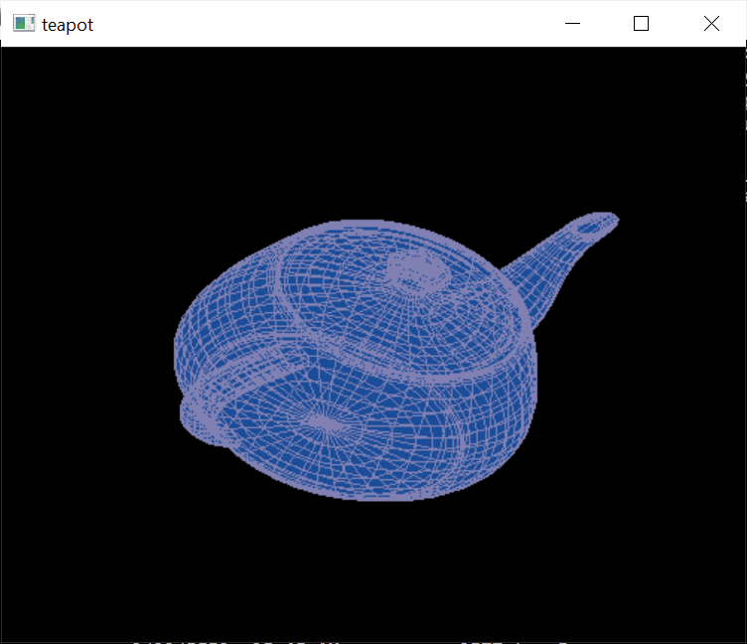
Python - GLUT 3D display
Rotating 3D-Teapot
#demo_glut_3d_teapot_rotate_42_ok.py
import sys
from OpenGL.GL import *
from OpenGL.GLU import *
from OpenGL.GLUT import *
def display():
#glEnable( GL_LIGHTING )#need tuning
#glEnable( GL_LIGHT0 )#need tuning
#glEnable( GL_DEPTH_TEST )#need tuning
glEnable(GL_BLEND)
glColor3f ( 0.10, 0.3, 0.60 )
glClear( GL_COLOR_BUFFER_BIT | GL_DEPTH_BUFFER_BIT )
#glClear(GL_COLOR_BUFFER_BIT)
#glPushMatrix()
#gluLookAt( 0,2.5,-7, 0,0,0, 0,1,0 )$cuase problem
#gluLookAt(0.0,0.0,5.0, 0.0,0.0,0.0, 0.0,1.0,0.0);
#glRotatef(0.01, 1, 0, 0)
glRotatef(0.01, 1, 1, 0)#change color for solid teapot
glutSolidTeapot( 0.5 )
glColor3f ( 0.5, 0.5, 0.70 ) #change color for wireframe
glutWireTeapot(0.5)
#glPopMatrix()
glFlush()
def reshape(w,h):
glViewport( 0, 0, w, h )
glMatrixMode( GL_PROJECTION )
glLoadIdentity()
gluPerspective( 45.0, 1.0*w/h, 0.1, 100.0 )
#gluPerspective( 45.0, 1.0*w/h, 0.1, 13.0 )
#gluPerspective(70, 1*w/h,0.1, 50);
#https://stackoverflow.com/questions/16571981/gluperspective-parameters-what-do-they-mean
glMatrixMode( GL_MODELVIEW )
glLoadIdentity()
def keyboard(key,x,y):
if key==chr(27): sys.exit(0)
glutInit( sys.argv )
#glutInitDisplayMode(GLUT_SINGLE | GLUT_RGBA)
glutInitDisplayMode( GLUT_SINGLE | GLUT_RGB | GLUT_DEPTH )
glutInitWindowSize( 500, 400)
glutCreateWindow( b'teapot' )
#glutReshapeFunc( reshape ) #this cause the problem
glutKeyboardFunc( keyboard )
glutDisplayFunc( display )
glutIdleFunc( display )
glutMainLoop()

Slide 16
Test4.6: Object recognition
Study these links
https://medium.com/%E9%9B%9E%E9%9B%9E%E8%88%87%E5%85%94%E5%85%94%E7%9A%84%E5%B7%A5%E7%A8%8B%E4%B8%96%E7%95%8C/%E6%A9%9F%E5%99%A8%E5%AD%B8%E7%BF%92-ml-note-yolo-%E5%88%A9%E7%94%A8%E5%BD%B1%E5%83%8F%E8%BE%A8%E8%AD%98%E5%81%9A%E7%89%A9%E4%BB%B6%E5%81%B5%E6%B8%AC-object-detection-%E7%9A%84%E6%8A%80%E8%A1%93-3ad34a4cac70
YOLO (You Only Look Once) Object Detection (TensorFlow tutorial)
https://software.intel.com/en-us/articles/a-closer-look-at-object-detection-recognition-and-tracking
https://machinelearningmastery.com/how-to-perform-object-detection-with-yolov3-in-keras/

Slide 17
Test 4.7 Yolo test (not successful)
From 雞雞與兔兔的工程世界: https://medium.com/%E9%9B%9E%E9%9B%9E%E8%88%87%E5%85%94%E5%85%94%E7%9A%84%E5%B7%A5%E7%A8%8B%E4%B8%96%E7%95%8C/%E6%A9%9F%E5%99%A8%E5%AD%B8%E7%BF%92-ml-note-yolo-%E5%88%A9%E7%94%A8%E5%BD%B1%E5%83%8F%E8%BE%A8%E8%AD%98%E5%81%9A%E7%89%A9%E4%BB%B6%E5%81%B5%E6%B8%AC-object-detection-%E7%9A%84%E6%8A%80%E8%A1%93-3ad34a4cac70
In anaconda prompt (administrator mode)
  >conda install git
  >git clone https://github.com/thtrieu/darkflow
  >pip install Cython

Slide 18
LSTM-RNN Keras examples
Download
https://github.com/omerbsezer/LSTM_RNN_Tutorials_with_Demo , 3 demos. Modify headers: keras → tensorflow.keras, or keras.layers.embeddings →tensorflow.python.keras.layers.embeddings etc
  MusicGenerationProject (can work , can use museScore https://musescore.org/zh-hant to display score generated by the generator) (ok with tf-cpu or tf-gpu)
  SentimentAnalysisProject (use with tf-gpu only)
  StockPricesPredictionProject (ok with tf-cpu or tf-gpu)

