Slide 1
Stem3
MIDI—
Musical Instrument Digital Interface and Arduino
KH Wong

Slide 2
Overview for stem3
Test 3.1 Produce sound/music using Arduino
  Synthesizer-With-FM
  Wavetable
  Experiment with MIDI
Test3.2 Electronic woodwind instrument (EWI)
  Use of touch sensors
  Use of Pressure sensors
  System integration
Test3.3 Use of Sound chips YM2612
  YM2612-Arduino (UNO)circuits (not tested)
Test3.4 Electronic Drum projects
  Use of SD card to store drum sound (not tested)

Slide 3
Introduction
Software - code
  https://people.carleton.edu/~jellinge/m208w14/pdf/02MIDIBasics_doc.pdf
  https://www.nyu.edu/classes/bello/FMT_files/9_MIDI_code.pdf
Hardware
  https://learn.sparkfun.com/tutorials/midi-tutorial/all

Slide 4
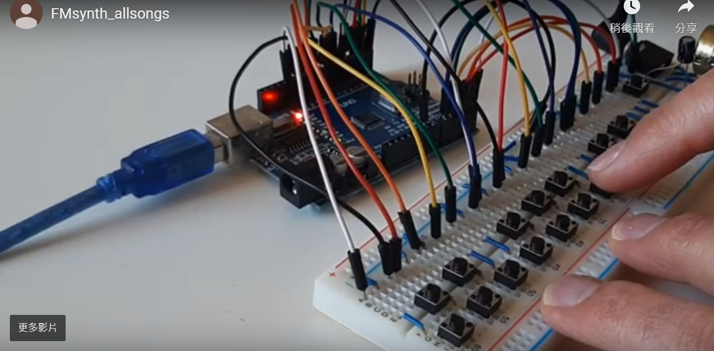
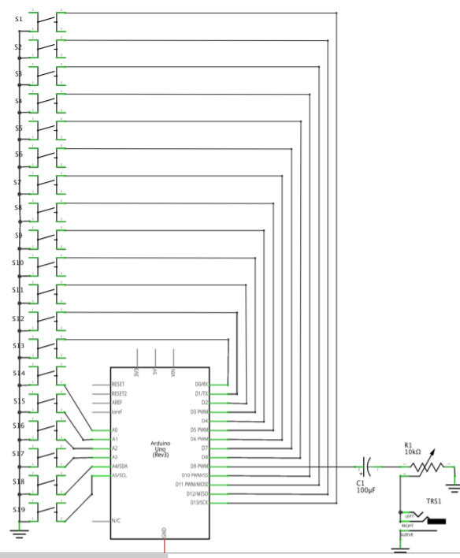
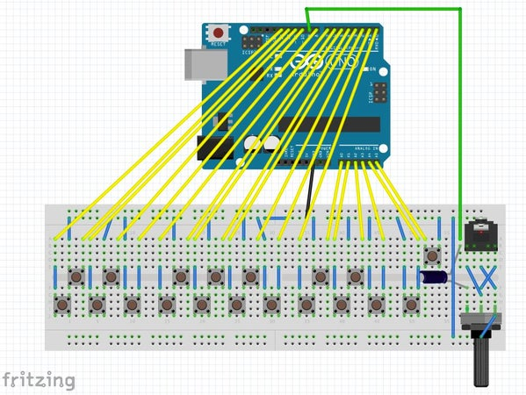
Test 3.1a) Arduino-Synthesizer-With-FM
https://www.instructables.com/id/Arduino-Synthesizer-With-FM/

Slide 5
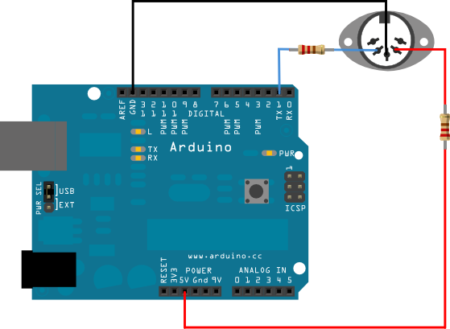
Test 3.1b) MIDI Controlled Analog FM Synthesizer
https://www.instructables.com/id/MIDI-controlled-analog-FM-synthesizer/

Slide 6
Test 3.1c) buzzer
int buzzer=13;//connect buzzer one end to pin13 the other to ground
void setup()
{ pinMode(buzzer,OUTPUT);}
void loop()
{ unsigned char i,j;//定义变量
while(1) {
for(i=0;i<80;i++)//辒出一个频率的声音/////////////////////////
{ digitalWrite(buzzer,HIGH);//发声音
delay(1);//延时1ms
digitalWrite(buzzer,LOW);//不发声音
delay(1);}//延时ms
for(i=0;i<100;i++)//辒出另一个频率癿声音 //////////////////////
{ digitalWrite(buzzer,HIGH);//发声音
delay(2);//延时2ms
digitalWrite(buzzer,LOW);//不发声音
delay(2);}//延时2ms
}}

Slide 7
Test 3.1d) buzzer:play some tunes
//#include "pitches.h“
//https://create.arduino.cc/projecthub/executeli/unravel-preset-piano-easy-arduino-even-a-ghoul-can-make-it-17c472?ref=tag&ref_id=piano&offset=3
#define ACTIVATED LOW
#define NOTE_B0 31
#define NOTE_C1 33
#define NOTE_CS1 35
#define NOTE_D1 37
#define NOTE_DS1 39
#define NOTE_E1 41
#define NOTE_F1 44
#define NOTE_FS1 46
#define NOTE_G1 49
#define NOTE_GS1 52
#define NOTE_A1 55
#define NOTE_AS1 58
#define NOTE_B1 62
#define NOTE_C2 65
#define NOTE_CS2 69
#define NOTE_D2 73
#define NOTE_DS2 78
#define NOTE_E2 82
#define NOTE_F2 87
#define NOTE_FS2 93
#define NOTE_G2 98
#define NOTE_GS2 104
#define NOTE_A2 110
#define NOTE_AS2 117
#define NOTE_B2 123
#define NOTE_C3 131
#define NOTE_CS3 139
#define NOTE_D3 147
#define NOTE_DS3 156
#define NOTE_E3 165
#define NOTE_F3 175
#define NOTE_FS3 185
#define NOTE_G3 196
#define NOTE_GS3 208
#define NOTE_A3 220
#define NOTE_AS3 233
#define NOTE_B3 247
#define NOTE_C4 262
#define NOTE_CS4 277
#define NOTE_D4 294
#define NOTE_DS4 311
#define NOTE_E4 330
#define NOTE_F4 349
#define NOTE_FS4 370
#define NOTE_G4 392
#define NOTE_GS4 415
#define NOTE_A4 440
#define NOTE_AS4 466
#define NOTE_B4 494
#define NOTE_C5 523
#define NOTE_CS5 554
#define NOTE_D5 587
#define NOTE_DS5 622
#define NOTE_E5 659
#define NOTE_F5 698
#define NOTE_FS5 740
#define NOTE_G5 784
#define NOTE_GS5 831
#define NOTE_A5 880
#define NOTE_AS5 932
#define NOTE_B5 988
#define NOTE_C6 1047
#define NOTE_CS6 1109
#define NOTE_D6 1175
#define NOTE_DS6 1245
#define NOTE_E6 1319
#define NOTE_F6 1397
#define NOTE_FS6 1480
#define NOTE_G6 1568
#define NOTE_GS6 1661
#define NOTE_A6 1760
#define NOTE_AS6 1865
#define NOTE_B6 1976
#define NOTE_C7 2093
#define NOTE_CS7 2217
#define NOTE_D7 2349
#define NOTE_DS7 2489
#define NOTE_E7 2637
#define NOTE_F7 2794
#define NOTE_FS7 2960
#define NOTE_G7 3136
#define NOTE_GS7 3322
#define NOTE_A7 3520
#define NOTE_AS7 3729
#define NOTE_B7 3951
#define NOTE_C8 4186
#define NOTE_CS8 4435
#define NOTE_D8 4699
#define NOTE_DS8 4978
const int PIEZO = 11;
const int LED = 13;
int buttonSong = 8;
const int BUTTON_C = 6;
const int BUTTON_AS = 4;
const int BUTTON_A = 3;
const int BUTTON_G = 2;
void setup()
{
Serial.begin(9600);
pinMode(LED, OUTPUT);
pinMode(BUTTON_C, INPUT);
digitalWrite(BUTTON_C,HIGH);
pinMode(BUTTON_AS, INPUT);
digitalWrite(BUTTON_AS,HIGH);
pinMode(BUTTON_A, INPUT);
digitalWrite(BUTTON_A,HIGH);
pinMode(BUTTON_G, INPUT);
digitalWrite(BUTTON_G,HIGH);
pinMode (buttonSong, INPUT);
digitalWrite(buttonSong, HIGH);
digitalWrite(LED,LOW);
}
// notes in the melody:
int melody[] = {
NOTE_AS4, NOTE_C5, NOTE_AS4, NOTE_A4, NOTE_G4, NOTE_C5, NOTE_AS4, NOTE_A4, NOTE_G4, NOTE_G4, NOTE_F4, 0, 0,
NOTE_DS4, NOTE_DS4, NOTE_F4, NOTE_D4, 0, 0, 0, NOTE_D4, NOTE_D4, NOTE_D4, NOTE_D4, NOTE_D5, NOTE_D5,
NOTE_G3, NOTE_AS3, NOTE_C4, NOTE_G3, NOTE_G3, NOTE_AS3, NOTE_AS4, NOTE_A4, NOTE_A4, NOTE_A4, NOTE_AS4, NOTE_AS4,
NOTE_G3, NOTE_AS3, NOTE_C4, NOTE_G3, NOTE_G3, NOTE_AS3,
NOTE_AS4, NOTE_C5, NOTE_AS4, NOTE_A4, NOTE_G4, NOTE_C5, NOTE_AS4, NOTE_A4, NOTE_G4, NOTE_G4, NOTE_F4, 0, 0,
NOTE_DS4, NOTE_DS4, NOTE_F4, NOTE_D4, NOTE_G3, NOTE_AS3, NOTE_C4, NOTE_F3, NOTE_AS3, NOTE_A3, NOTE_F3,
NOTE_D4, NOTE_D4, NOTE_D4, NOTE_D5, NOTE_D5,
NOTE_G3, NOTE_AS3, NOTE_C4, NOTE_F3, NOTE_AS3, NOTE_G3, NOTE_AS4, NOTE_A4, NOTE_A4, NOTE_A4, NOTE_AS4, NOTE_AS4,
};
// note durations: 4 = quarter note, 8 = eighth note, etc.:
int noteDurations[] = {
4.5, 2.25, 2.25, 4.5, 2.25, 2.25, 2.25, 2.25, 2.25, 4.5, 3, 9, 4.5,
4.5, 2.25, 4.5, 2.25, 1.125, 2.25, 4.5, 4.5, 2.25, 4.5, 2.25, 4.5, 2.25,
4.5, 4.5, 4.5, 2.25, 4.5, 4.5, 4.5, 2.25, 4.5, 2.25, 4.5, 2,
4.5, 4.5, 4.5, 2.25, 4.5, 4.5,
4.5, 2.25, 2.25, 4.5, 2.25, 2.25, 2.25, 2.25, 2.25, 4.5, 3, 9, 4.5,
4.5, 2.25, 4.5, 4.5, 4.5, 4.5, 4.5, 4.5, 3, 3, 4.5,
2.25, 4.5, 2.25, 4.5, 2.25,
4.5, 4.5, 4.5, 4.5, 2.25, 4.5, 4.5, 2.25, 4.5, 2.25, 4.5, 2.25,
} ;
void loop()
{
tone(PIEZO,NOTE_C5);
digitalWrite(LED,HIGH);
delay(500);
tone(PIEZO,NOTE_AS4);
digitalWrite(LED,HIGH);
delay(500);
tone(PIEZO,NOTE_A4);
digitalWrite(LED,HIGH);
delay(500);
tone(PIEZO,NOTE_G4);
digitalWrite(LED,HIGH);
delay(500);
while(digitalRead(BUTTON_C) == ACTIVATED)
{
tone(PIEZO,NOTE_C5);
digitalWrite(LED,HIGH);
}
while(digitalRead(BUTTON_AS) == ACTIVATED)
{
tone(PIEZO,NOTE_AS4);
digitalWrite(LED,HIGH);
}
while(digitalRead(BUTTON_A) == ACTIVATED)
{
tone(PIEZO,NOTE_A4);
digitalWrite(LED,HIGH);
}
while(digitalRead(BUTTON_G) == ACTIVATED)
{
tone(PIEZO,NOTE_G4);
digitalWrite(LED,HIGH);
}
if(digitalRead(buttonSong) == ACTIVATED) {
for (int thisNote=0; thisNote <85; thisNote++) {
int noteDuration = 600 / noteDurations[thisNote];
tone(11, melody[thisNote], noteDuration);
int pauseBetweenNotes = noteDuration * 1.50;
delay(pauseBetweenNotes);
noTone(11);
}
}
noTone(PIEZO);
digitalWrite(LED,LOW);
}

Slide 8
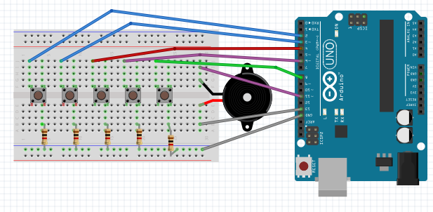
Test 3.1e) Arduino Piano
https://create.arduino.cc/projecthub/executeli/unravel-preset-piano-easy-arduino-even-a-ghoul-can-make-it-17c472?ref=tag&ref_id=piano&offset=3
Test20, play music with buzzer
  https://www.youtube.com/watch?v=vaQVCnPWdxk
  https://www.arduino.cc/en/Tutorial/PlayMelody

Slide 9
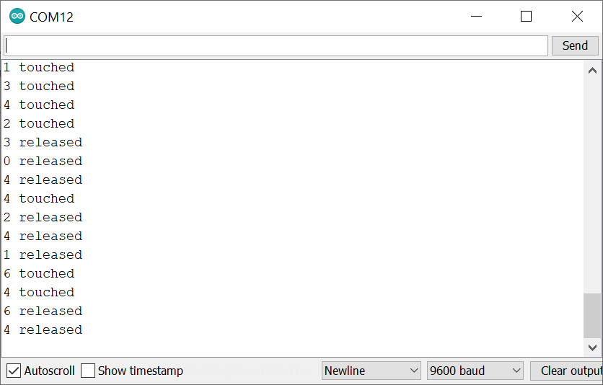
Test3.1f: touch sensor Adafruit MPR121. https://raw.githubusercontent.com/adafruit/Adafruit_MPR121/master/examples/MPR121test/MPR121test.ino
5V GND
Arduino A5
A4
SCL
SDA
MPR121
// https://raw.githubusercontent.com/adafruit/Adafruit_MPR121/master/examples/MPR121test/MPR121test.ino
/********************************************************* MPR121
This is a library for the MPR121 12-channel Capacitive touch sensor
Designed specifically to work with the MPR121 Breakout in the Adafruit shop
----> https://www.adafruit.com/products/
These sensors use I2C communicate, at least 2 pins are required
to interface
Adafruit invests time and resources providing this open source code,
please support Adafruit and open-source hardware by purchasing
products from Adafruit!
Written by Limor Fried/Ladyada for Adafruit Industries.
BSD license, all text above must be included in any redistribution
**********************************************************/
#include <Wire.h>
#include "Adafruit_MPR121.h"
#ifndef _BV
#define _BV(bit) (1 << (bit))
#endif
// You can have up to 4 on one i2c bus but one is enough for testing!
Adafruit_MPR121 cap = Adafruit_MPR121();
// Keeps track of the last pins touched
// so we know when buttons are 'released'
uint16_t lasttouched = 0;
uint16_t currtouched = 0;
void setup() {
Serial.begin(9600);
while (!Serial) { // needed to keep leonardo/micro from starting too fast!
delay(10);
}
Serial.println("Adafruit MPR121 Capacitive Touch sensor test");
// Default address is 0x5A, if tied to 3.3V its 0x5B
// If tied to SDA its 0x5C and if SCL then 0x5D
if (!cap.begin(0x5A)) {
Serial.println("MPR121 not found, check wiring?");
while (1);
}
Serial.println("MPR121 found!");
}
void loop() {
// Get the currently touched pads
currtouched = cap.touched();
for (uint8_t i=0; i<12; i++) {
// it if *is* touched and *wasnt* touched before, alert!
if ((currtouched & _BV(i)) && !(lasttouched & _BV(i)) ) {
Serial.print(i); Serial.println(" touched");
}
// if it *was* touched and now *isnt*, alert!
if (!(currtouched & _BV(i)) && (lasttouched & _BV(i)) ) {
Serial.print(i); Serial.println(" released");
}
}
// reset our state
lasttouched = currtouched;
// comment out this line for detailed data from the sensor!
return;
// debugging info, what
Serial.print("\t\t\t\t\t\t\t\t\t\t\t\t\t 0x"); Serial.println(cap.touched(), HEX);
Serial.print("Filt: ");
for (uint8_t i=0; i<12; i++) {
Serial.print(cap.filteredData(i)); Serial.print("\t");
}
Serial.println();
Serial.print("Base: ");
for (uint8_t i=0; i<12; i++) {
Serial.print(cap.baselineData(i)); Serial.print("\t");
}
Serial.println();
// put a delay so it isn't overwhelming
delay(100);
}

Slide 10
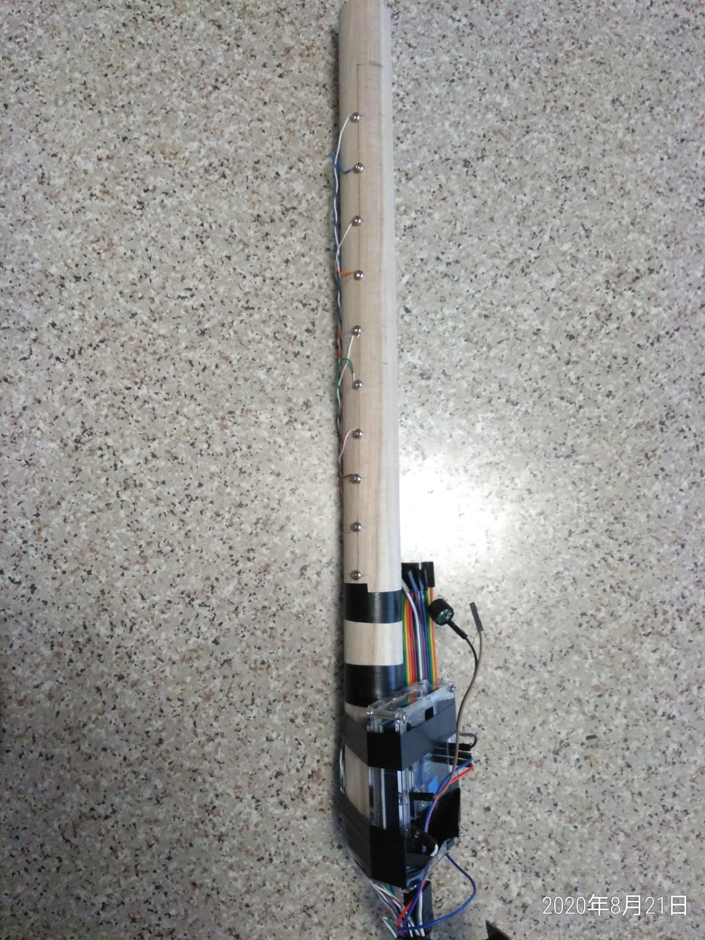
Test 3.1g) Arduino Piano Cello finger training system
Buzzer: pin11, MPR121 sensor inputs connected to metal pins
//AHRS_9DOF_test_ecello_1b, 2020 Aug 26
//============= part 1: touch sensor MPR121 part ==============
//=============================================================
///////////////////
//Combining buzzer pinao and mpr121
//https://create.arduino.cc/projecthub/executeli/unravel-preset-piano-easy-arduino-even-a-ghoul-can-make-it-17c472?ref=tag&ref_id=piano&offset=3
//https://cdn-learn.adafruit.com/downloads/pdf/adafruit-mpr121-12-key-capacitive-touch-sensor-breakout-tutorial.pdf
//https://github.com/adafruit/Adafruit_MPR121
//https://github.com/adafruit/Adafruit_MPR121/tree/master/examples/MPR121test (Out mpr121 test here is based on this code)
/*********************************************************
This is a library for the MPR121 12-channel Capacitive touch sensor
Designed specifically to work with the MPR121 Breakout in the Adafruit shop
----> https://www.adafruit.com/products/
These sensors use I2C communicate, at least 2 pins are required
to interface
Adafruit invests time and resources providing this open source code,
please support Adafruit and open-source hardware by purchasing
products from Adafruit!
Written by Limor Fried/Ladyada for Adafruit Industries.
BSD license, all text above must be included in any redistribution
**********************************************************/
#include <Wire.h>
#include "Adafruit_MPR121.h"//#include "pitches.h"
#define ACTIVATED LOW
#define NOTE_B0 31
#define NOTE_C1 33
#define NOTE_CS1 35
#define NOTE_D1 37
#define NOTE_DS1 39
#define NOTE_E1 41
#define NOTE_F1 44
#define NOTE_FS1 46
#define NOTE_G1 49
#define NOTE_GS1 52
#define NOTE_A1 55
#define NOTE_AS1 58
#define NOTE_B1 62
#define NOTE_C2 65
#define NOTE_CS2 69
#define NOTE_D2 73
#define NOTE_DS2 78
#define NOTE_E2 82
#define NOTE_F2 87
#define NOTE_FS2 93
#define NOTE_G2 98
#define NOTE_GS2 104
#define NOTE_A2 110
#define NOTE_AS2 117
#define NOTE_B2 123
#define NOTE_C3 131
#define NOTE_CS3 139
#define NOTE_D3 147
#define NOTE_DS3 156
#define NOTE_E3 165
#define NOTE_F3 175
#define NOTE_FS3 185
#define NOTE_G3 196
#define NOTE_GS3 208
#define NOTE_A3 220
#define NOTE_AS3 233
#define NOTE_B3 247
#define NOTE_C4 262
#define NOTE_CS4 277
#define NOTE_D4 294
#define NOTE_DS4 311
#define NOTE_E4 330
#define NOTE_F4 349
#define NOTE_FS4 370
#define NOTE_G4 392
#define NOTE_GS4 415
#define NOTE_A4 440
#define NOTE_AS4 466
#define NOTE_B4 494
#define NOTE_C5 523
#define NOTE_CS5 554
#define NOTE_D5 587
#define NOTE_DS5 622
#define NOTE_E5 659
#define NOTE_F5 698
#define NOTE_FS5 740
#define NOTE_G5 784
#define NOTE_GS5 831
#define NOTE_A5 880
#define NOTE_AS5 932
#define NOTE_B5 988
#define NOTE_C6 1047
#define NOTE_CS6 1109
#define NOTE_D6 1175
#define NOTE_DS6 1245
#define NOTE_E6 1319
#define NOTE_F6 1397
#define NOTE_FS6 1480
#define NOTE_G6 1568
#define NOTE_GS6 1661
#define NOTE_A6 1760
#define NOTE_AS6 1865
#define NOTE_B6 1976
#define NOTE_C7 2093
#define NOTE_CS7 2217
#define NOTE_D7 2349
#define NOTE_DS7 2489
#define NOTE_E7 2637
#define NOTE_F7 2794
#define NOTE_FS7 2960
#define NOTE_G7 3136
#define NOTE_GS7 3322
#define NOTE_A7 3520
#define NOTE_AS7 3729
#define NOTE_B7 3951
#define NOTE_C8 4186
#define NOTE_CS8 4435
#define NOTE_D8 4699
#define NOTE_DS8 4978
const int PIEZO = 11;
const int LED = 13;
int buttonSong = 8;
const int BUTTON_C = 6;
const int BUTTON_AS = 4;
const int BUTTON_A = 3;
const int BUTTON_G = 2;
// notes in the melody:
int melody[] = {
NOTE_AS4, NOTE_C5, NOTE_AS4, NOTE_A4, NOTE_G4, NOTE_C5, NOTE_AS4, NOTE_A4, NOTE_G4, NOTE_G4, NOTE_F4, 0, 0,
NOTE_DS4, NOTE_DS4, NOTE_F4, NOTE_D4, 0, 0, 0, NOTE_D4, NOTE_D4, NOTE_D4, NOTE_D4, NOTE_D5, NOTE_D5,
NOTE_G3, NOTE_AS3, NOTE_C4, NOTE_G3, NOTE_G3, NOTE_AS3, NOTE_AS4, NOTE_A4, NOTE_A4, NOTE_A4, NOTE_AS4, NOTE_AS4,
NOTE_G3, NOTE_AS3, NOTE_C4, NOTE_G3, NOTE_G3, NOTE_AS3,
NOTE_AS4, NOTE_C5, NOTE_AS4, NOTE_A4, NOTE_G4, NOTE_C5, NOTE_AS4, NOTE_A4, NOTE_G4, NOTE_G4, NOTE_F4, 0, 0,
NOTE_DS4, NOTE_DS4, NOTE_F4, NOTE_D4, NOTE_G3, NOTE_AS3, NOTE_C4, NOTE_F3, NOTE_AS3, NOTE_A3, NOTE_F3,
NOTE_D4, NOTE_D4, NOTE_D4, NOTE_D5, NOTE_D5,
NOTE_G3, NOTE_AS3, NOTE_C4, NOTE_F3, NOTE_AS3, NOTE_G3, NOTE_AS4, NOTE_A4, NOTE_A4, NOTE_A4, NOTE_AS4, NOTE_AS4,
};
// note durations: 4 = quarter note, 8 = eighth note, etc.:
int noteDurations[] = {
4.5, 2.25, 2.25, 4.5, 2.25, 2.25, 2.25, 2.25, 2.25, 4.5, 3, 9, 4.5,
4.5, 2.25, 4.5, 2.25, 1.125, 2.25, 4.5, 4.5, 2.25, 4.5, 2.25, 4.5, 2.25,
4.5, 4.5, 4.5, 2.25, 4.5, 4.5, 4.5, 2.25, 4.5, 2.25, 4.5, 2,
4.5, 4.5, 4.5, 2.25, 4.5, 4.5,
4.5, 2.25, 2.25, 4.5, 2.25, 2.25, 2.25, 2.25, 2.25, 4.5, 3, 9, 4.5,
4.5, 2.25, 4.5, 4.5, 4.5, 4.5, 4.5, 4.5, 3, 3, 4.5,
2.25, 4.5, 2.25, 4.5, 2.25,
4.5, 4.5, 4.5, 4.5, 2.25, 4.5, 4.5, 2.25, 4.5, 2.25, 4.5, 2.25,
} ;
void play_song_1()
{
int elementCount = sizeof(melody);
for (int i = 1; i < elementCount; i++)
{
tone(PIEZO, melody[i]);
delay( noteDurations[i] * 100);
}
}
//=======================================
#ifndef _BV
#define _BV(bit) (1 << (bit))
#endif
// You can have up to 4 on one i2c bus but one is enough for testing!
Adafruit_MPR121 cap = Adafruit_MPR121();
// Keeps track of the last pins touched
// so we know when buttons are 'released'
uint16_t lasttouched = 0;
uint16_t currtouched = 0;
void setup() {
Serial.begin(9600);
// buzzer_setup();
while (!Serial) { // needed to keep leonardo/micro from starting too fast!
delay(10);
}
setup_IMU();
}
void setup_IMU()
{
// Init serial output
//Serial.begin(OUTPUT_BAUD_RATE);
Serial.begin(9600);
// Init sensors
delay(50); // Give sensors enough time to start
I2C_Init();
Accel_Init();
Magn_Init();
Gyro_Init();
Pressure_Init();
// Read sensors, init DCM algorithm
delay(20); // Give sensors enough time to collect data
reset_sensor_fusion();
Serial.println("Adafruit MPR121 Capacitive Touch sensor test");
// Default address is 0x5A, if tied to 3.3V its 0x5B
// If tied to SDA its 0x5C and if SCL then 0x5D
if (!cap.begin(0x5A)) {
Serial.println("MPR121 not found, check wiring?");
while (1);
}
Serial.println("MPR121 found!");
// play_song_1();
}
//================================================================================
//========================= part2: imu part ====================================
//2019 feb 4, khwong, make sure
//The files Compass.ino, DCM.ino, Math.ino, Sensor.in are in the currect directory of this file (AHRS_9DOF_test_ok1.ino)
//
/***************************************************************************************************************
Razor AHRS Firmware v1.4.0
9 Degree of Measurement Attitude and Heading Reference System
for Sparkfun "9DOF Razor IMU" (SEN-10125 and SEN-10736)
and "9DOF Sensor Stick" (SEN-10183, 10321 and SEN-10724)
Released under GNU GPL (General Public License) v3.0
Copyright (C) 2011 Quality & Usability Lab, Deutsche Telekom Laboratories, TU Berlin
Infos, updates, bug reports and feedback:
http://dev.qu.tu-berlin.de/projects/sf-razor-9dof-ahrs
History:
* * Original code (http://code.google.com/p/sf9domahrs/) by Doug Weibel and Jose Julio,
based on ArduIMU v1.5 by Jordi Munoz and William Premerlani, Jose Julio and Doug Weibel. Thank you!
* * Updated code (http://groups.google.com/group/sf_9dof_ahrs_update) by David Malik (david.zsolt.malik@gmail.com)
for new Sparkfun 9DOF Razor hardware (SEN-10125).
* * Updated and extended by Peter Bartz (peter-bartz@gmx.de):
* * v1.3.0
* * Cleaned up, streamlined and restructured most of the code to make it more comprehensible.
* * Added sensor calibration (improves precision and responsiveness a lot!).
* * Added binary yaw/pitch/roll output.
* * Added basic serial command interface to set output modes/calibrate sensors/synch stream/etc.
* * Added support to synch automatically when using Rovering Networks Bluetooth modules (and compatible).
* * Wrote new easier to use test program (using Processing).
* * Added support for new version of "9DOF Razor IMU": SEN-10736.
--> The output of this code is not compatible with the older versions!
--> A Processing sketch to test the tracker is available.
* * v1.3.1
* * Initializing rotation matrix based on start-up sensor readings -> orientation OK right away.
* * Adjusted gyro low-pass filter and output rate settings.
* * v1.3.2
* * Adapted code to work with new Arduino 1.0 (and older versions still).
* * v1.3.3
* * Improved synching.
* * v1.4.0
* * Added support for SparkFun "9DOF Sensor Stick" (versions SEN-10183, SEN-10321 and SEN-10724).
TODOs:
* * Allow optional use of EEPROM for storing and reading calibration values.
* * Use self-test and temperature-compensation features of the sensors.
* * Add binary output of unfused sensor data for all 9 axes.
***************************************************************************************************************/
// OUTPUT OPTIONS
/*****************************************************************/
// Set your serial port baud rate used to send out data here!
#define OUTPUT_BAUD_RATE 9600 //115200
// Sensor data output interval in milliseconds
// This may not work, if faster than 20ms (=50Hz)
// Code is tuned for 20ms, so better leave it like that
#define OUTPUT_DATA_INTERVAL 20 // in milliseconds
// SENSOR CALIBRATION
/*****************************************************************/
// How to calibrate? Read the tutorial at http://dev.qu.tu-berlin.de/projects/sf-razor-9dof-ahrs
// Put MIN/MAX and OFFSET readings for your board here!
// Accelerometer
// "accel x,y,z (min/max) = X_MIN/X_MAX Y_MIN/Y_MAX Z_MIN/Z_MAX"
#define ACCEL_X_MIN (-250.0f)
#define ACCEL_X_MAX (250.0f)
#define ACCEL_Y_MIN (-250.0f)
#define ACCEL_Y_MAX (250.0f)
#define ACCEL_Z_MIN (-250.0f)
#define ACCEL_Z_MAX (250.0f)
// Magnetometer
// "magn x,y,z (min/max) = X_MIN/X_MAX Y_MIN/Y_MAX Z_MIN/Z_MAX"
#define MAGN_X_MIN (-600.0f)
#define MAGN_X_MAX (600.0f)
#define MAGN_Y_MIN (-600.0f)
#define MAGN_Y_MAX (600.0f)
#define MAGN_Z_MIN (-600.0f)
#define MAGN_Z_MAX (600.0f)
// Gyroscope
// "gyro x,y,z (current/average) = .../OFFSET_X .../OFFSET_Y .../OFFSET_Z
#define GYRO_X_OFFSET (0.0f)
#define GYRO_Y_OFFSET (0.0f)
#define GYRO_Z_OFFSET (0.0f)
// Altymeter
#define ALT_SEA_LEVEL_PRESSURE 102133
/*
// Calibration example:
// "accel x,y,z (min/max) = -278.00/270.00 -254.00/284.00 -294.00/235.00"
#define ACCEL_X_MIN ((float) -278)
#define ACCEL_X_MAX ((float) 270)
#define ACCEL_Y_MIN ((float) -254)
#define ACCEL_Y_MAX ((float) 284)
#define ACCEL_Z_MIN ((float) -294)
#define ACCEL_Z_MAX ((float) 235)
// "magn x,y,z (min/max) = -511.00/581.00 -516.00/568.00 -489.00/486.00"
#define MAGN_X_MIN ((float) -511)
#define MAGN_X_MAX ((float) 581)
#define MAGN_Y_MIN ((float) -516)
#define MAGN_Y_MAX ((float) 568)
#define MAGN_Z_MIN ((float) -489)
#define MAGN_Z_MAX ((float) 486)
//"gyro x,y,z (current/average) = -32.00/-34.82 102.00/100.41 -16.00/-16.38"
#define GYRO_AVERAGE_OFFSET_X ((float) -34.82)
#define GYRO_AVERAGE_OFFSET_Y ((float) 100.41)
#define GYRO_AVERAGE_OFFSET_Z ((float) -16.38)
*/
#include <Wire.h>
// Sensor calibration scale and offset values
#define ACCEL_X_OFFSET ((ACCEL_X_MIN + ACCEL_X_MAX) / 2.0f)
#define ACCEL_Y_OFFSET ((ACCEL_Y_MIN + ACCEL_Y_MAX) / 2.0f)
#define ACCEL_Z_OFFSET ((ACCEL_Z_MIN + ACCEL_Z_MAX) / 2.0f)
#define ACCEL_X_SCALE (GRAVITY / (ACCEL_X_MAX - ACCEL_X_OFFSET))
#define ACCEL_Y_SCALE (GRAVITY / (ACCEL_Y_MAX - ACCEL_Y_OFFSET))
#define ACCEL_Z_SCALE (GRAVITY / (ACCEL_Z_MAX - ACCEL_Z_OFFSET))
#define MAGN_X_OFFSET ((MAGN_X_MIN + MAGN_X_MAX) / 2.0f)
#define MAGN_Y_OFFSET ((MAGN_Y_MIN + MAGN_Y_MAX) / 2.0f)
#define MAGN_Z_OFFSET ((MAGN_Z_MIN + MAGN_Z_MAX) / 2.0f)
#define MAGN_X_SCALE (100.0f / (MAGN_X_MAX - MAGN_X_OFFSET))
#define MAGN_Y_SCALE (100.0f / (MAGN_Y_MAX - MAGN_Y_OFFSET))
#define MAGN_Z_SCALE (100.0f / (MAGN_Z_MAX - MAGN_Z_OFFSET))
// Gain for gyroscope
#define GYRO_GAIN_X (0.06957f)
#define GYRO_GAIN_Y (0.06957f)
#define GYRO_GAIN_Z (0.06957f)
#define GYRO_X_SCALE (TO_RAD(GYRO_GAIN_X))
#define GYRO_Y_SCALE (TO_RAD(GYRO_GAIN_Y))
#define GYRO_Z_SCALE (TO_RAD(GYRO_GAIN_Z))
// DCM parameters
#define Kp_ROLLPITCH (0.02f)
#define Ki_ROLLPITCH (0.00002f)
#define Kp_YAW (1.2f)
#define Ki_YAW (0.00002f)
// Stuff
#define GRAVITY (256.0f) // "1G reference" used for DCM filter and accelerometer calibration
#define TO_RAD(x) (x * 0.01745329252) // *pi/180
#define TO_DEG(x) (x * 57.2957795131) // *180/pi
// RAW sensor data
float accel[3]; // Actually stores the NEGATED acceleration (equals gravity, if board not moving).
//float accel_min[3];
//float accel_max[3];
float magnetom[3];
//float magnetom_min[3];
//float magnetom_max[3];
float gyro[3];
//float gyro_average[3];
//int gyro_num_samples = 0;
float temperature;
float pressure;
float altitude;
// DCM variables
float MAG_Heading;
float Magn_Vector[3] = {0, 0, 0}; // Store the magnetometer turn rate in a vector
float Accel_Vector[3] = {0, 0, 0}; // Store the acceleration in a vector
float Gyro_Vector[3] = {0, 0, 0}; // Store the gyros turn rate in a vector
float Omega_Vector[3] = {0, 0, 0}; // Corrected Gyro_Vector data
float Omega_P[3] = {0, 0, 0}; // Omega Proportional correction
float Omega_I[3] = {0, 0, 0}; // Omega Integrator
float Omega[3] = {0, 0, 0};
float errorRollPitch[3] = {0, 0, 0};
float errorYaw[3] = {0, 0, 0};
float DCM_Matrix[3][3] = {{1, 0, 0}, {0, 1, 0}, {0, 0, 1}};
float Update_Matrix[3][3] = {{0, 1, 2}, {3, 4, 5}, {6, 7, 8}};
float Temporary_Matrix[3][3] = {{0, 0, 0}, {0, 0, 0}, {0, 0, 0}};
// Euler angles
float yaw, pitch, roll;
// DCM timing in the main loop
long timestamp;
long timestamp_old;
float G_Dt; // Integration time for DCM algorithm
// More output-state variables
int num_accel_errors = 0;
int num_magn_errors = 0;
int num_gyro_errors = 0;
void ReadSensors() {
Read_Pressure();
Read_Gyro(); // Read gyroscope
Read_Accel(); // Read accelerometer
Read_Magn(); // Read magnetometer
ApplySensorMapping();
}
// Read every sensor and record a time stamp
// Init DCM with unfiltered orientation
// TODO re-init global vars?
void reset_sensor_fusion()
{
float temp1[3];
float temp2[3];
float xAxis[] = {1.0f, 0.0f, 0.0f};
ReadSensors();
timestamp = millis();
// GET PITCH
// Using y-z-plane-component/x-component of gravity vector
pitch = -atan2(Accel_Vector[0], sqrt(Accel_Vector[1] * Accel_Vector[1] + Accel_Vector[2] * Accel_Vector[2]));
// GET ROLL
// Compensate pitch of gravity vector
Vector_Cross_Product(temp1, Accel_Vector, xAxis);
Vector_Cross_Product(temp2, xAxis, temp1);
// Normally using x-z-plane-component/y-component of compensated gravity vector
// roll = atan2(temp2[1], sqrt(temp2[0] * temp2[0] + temp2[2] * temp2[2]));
// Since we compensated for pitch, x-z-plane-component equals z-component:
roll = atan2(temp2[1], temp2[2]);
// GET YAW
Compass_Heading();
yaw = MAG_Heading;
// Init rotation matrix
init_rotation_matrix(DCM_Matrix, yaw, pitch, roll);
}
// Apply calibration to raw sensor readings
void ApplySensorMapping()
{
// Magnetometer axis mapping
Magn_Vector[1] = -magnetom[0];
Magn_Vector[0] = -magnetom[1];
Magn_Vector[2] = -magnetom[2];
// Magnetometer values mapping
Magn_Vector[0] -= MAGN_X_OFFSET;
Magn_Vector[0] *= MAGN_X_SCALE;
Magn_Vector[1] -= MAGN_Y_OFFSET;
Magn_Vector[1] *= MAGN_Y_SCALE;
Magn_Vector[2] -= MAGN_Z_OFFSET;
Magn_Vector[2] *= MAGN_Z_SCALE;
// Accelerometer axis mapping
Accel_Vector[1] = accel[0];
Accel_Vector[0] = accel[1];
Accel_Vector[2] = accel[2];
// Accelerometer values mapping
Accel_Vector[0] -= ACCEL_X_OFFSET;
Accel_Vector[0] *= ACCEL_X_SCALE;
Accel_Vector[1] -= ACCEL_Y_OFFSET;
Accel_Vector[1] *= ACCEL_Y_SCALE;
Accel_Vector[2] -= ACCEL_Z_OFFSET;
Accel_Vector[2] *= ACCEL_Z_SCALE;
// Gyroscope axis mapping
Gyro_Vector[1] = -gyro[0];
Gyro_Vector[0] = -gyro[1];
Gyro_Vector[2] = -gyro[2];
// Gyroscope values mapping
Gyro_Vector[0] -= GYRO_X_OFFSET;
Gyro_Vector[0] *= GYRO_X_SCALE;
Gyro_Vector[1] -= GYRO_Y_OFFSET;
Gyro_Vector[1] *= GYRO_Y_SCALE;
Gyro_Vector[2] -= GYRO_Z_OFFSET;
Gyro_Vector[2] *= GYRO_Z_SCALE;
}
//void setup()
//{
// // Init serial output
// Serial.begin(OUTPUT_BAUD_RATE);
//
// // Init sensors
// delay(50); // Give sensors enough time to start
// I2C_Init();
// Accel_Init();
// Magn_Init();
// Gyro_Init();
// Pressure_Init();
//
// // Read sensors, init DCM algorithm
// delay(20); // Give sensors enough time to collect data
// reset_sensor_fusion();
//}
// Main loop IMU /////////////
void loop_IMU () ////////////////////
{
int vel_x_old = 0; //old previous time sample vel_x_old, init with 0
int vel_x = 0; //velocity (x-axis) init with 0
// Time to read the sensors again?
if ((millis() - timestamp) >= OUTPUT_DATA_INTERVAL) {
timestamp_old = timestamp;
timestamp = millis();
if (timestamp > timestamp_old)
G_Dt = (float) (timestamp - timestamp_old) / 1000.0f; // Real time of loop run. We use this on the DCM algorithm (gyro integration time)
else
G_Dt = 0;
ReadSensors();
// Run DCM algorithm
Compass_Heading(); // Calculate magnetic heading
Matrix_update();
Normalize();
Drift_correction();
Euler_angles();
//Serial.print(Accel_Vector[0] ); Serial.print(";");
//Serial.println(Accel_Vector[0] );
//-----calculate velocity (vec) from acceleration (acc)
//Using law of physics: v=v_old+acc*t //asseme t=1 unit
if (Accel_Vector[0] > 100) {
Accel_Vector[0] = 100;
}
if (Accel_Vector[0] <-100) {
Accel_Vector[0] = -100;
}
vel_x = vel_x_old + Accel_Vector[0] * 200;
// Serial.println(vel_x ); //print out or us ethis data
Serial.println( Accel_Vector[0]);
vel_x_old = vel_x ; //save current to old for next round
//delay(20);
// Serial.print(Accel_Vector[1] ); Serial.print(";");
//Serial.print(Accel_Vector[2] ); Serial.print(";");
// Serial.print(TO_DEG(yaw)); Serial.print(";");
// Serial.print(TO_DEG(pitch)); Serial.print(";");
// Serial.print(TO_DEG(roll)); Serial.print(";");
// Serial.print(temperature); Serial.print(";");
// Serial.print(pressure); Serial.print(";");
// Serial.print(altitude); Serial.println();
//Serial.println();
}
}
void loop() {
loop_IMU ();
// Get the currently touched pads
currtouched = cap.touched();
for (uint8_t i = 0; i < 12; i++) {
// it if *is* touched and *wasnt* touched before, alert!
if ((currtouched & _BV(i)) && !(lasttouched & _BV(i)) ) {
Serial.print(i); Serial.println(" touched");
//add buzzer sound : begin /////////////////////////////
switch (i) {
case 0:
// statements
tone(PIEZO, NOTE_AS3);
break;
case 1:
// statements
tone(PIEZO, NOTE_B3);
break;
case 2:
// statements
tone(PIEZO, NOTE_C4);
break;
case 3:
// statements
tone(PIEZO, NOTE_CS4);
break;
case 4:
// statements
tone(PIEZO, NOTE_D4);
break;
case 5:
// statements
tone(PIEZO, NOTE_DS4);
break;
case 6:
// statements
tone(PIEZO, NOTE_E4);
break;
case 7:
// statements
tone(PIEZO, NOTE_F4);
break;
default: /// dddddddddddddddddddddddd
// statements
break;
}
//add buzzer sound : end /////////////////////////////
}
// if it *was* touched and now *isnt*, alert!
if (!(currtouched & _BV(i)) && (lasttouched & _BV(i)) ) {
Serial.print(i); Serial.println(" released");
}
}
// reset our state
lasttouched = currtouched;
// comment out this line for detailed data from the sensor!
return;
// debugging info, what
Serial.print("\t\t\t\t\t\t\t\t\t\t\t\t\t 0x"); Serial.println(cap.touched(), HEX);
Serial.print("Filt: ");
for (uint8_t i = 0; i < 12; i++) {
Serial.print(cap.filteredData(i)); Serial.print("\t");
}
Serial.println();
Serial.print("Base: ");
for (uint8_t i = 0; i < 12; i++) {
Serial.print(cap.baselineData(i)); Serial.print("\t");
}
Serial.println();
// put a delay so it isn't overwhelming
delay(100);
}

Slide 11
Test3.1h) Touch sensor mpr121 blow pressure sensor MPX-5010 (A0), e-woodwind AHRS_9DOF_test_ecello_woodwind_ok_1e.ino
//AHRS_9DOF_test_ecello_woodwind_ok_1e
//============= part 1: touch sensor MPR121 part ==============
//=============================================================
//https://raw.githubusercontent.com/adafruit/Adafruit_MPR121/master/examples/MPR121test/MPR121test.ino
///////////////////
//Combining buzzer pinao and mpr121
//https://create.arduino.cc/projecthub/executeli/unravel-preset-piano-easy-arduino-even-a-ghoul-can-make-it-17c472?ref=tag&ref_id=piano&offset=3
//https://cdn-learn.adafruit.com/downloads/pdf/adafruit-mpr121-12-key-capacitive-touch-sensor-breakout-tutorial.pdf
//https://github.com/adafruit/Adafruit_MPR121
//https://github.com/adafruit/Adafruit_MPR121/tree/master/examples/MPR121test (Out mpr121 test here is based on this code)
/*********************************************************
This is a library for the MPR121 12-channel Capacitive touch sensor
Designed specifically to work with the MPR121 Breakout in the Adafruit shop
----> https://www.adafruit.com/products/
These sensors use I2C communicate, at least 2 pins are required
to interface
Adafruit invests time and resources providing this open source code,
please support Adafruit and open-source hardware by purchasing
products from Adafruit!
Written by Limor Fried/Ladyada for Adafruit Industries.
BSD license, all text above must be included in any redistribution
**********************************************************/
#include <Wire.h>
#include "Adafruit_MPR121.h"//#include "pitches.h"
#define ACTIVATED LOW
#define NOTE_B0 31
#define NOTE_C1 33
#define NOTE_CS1 35
#define NOTE_D1 37
#define NOTE_DS1 39
#define NOTE_E1 41
#define NOTE_F1 44
#define NOTE_FS1 46
#define NOTE_G1 49
#define NOTE_GS1 52
#define NOTE_A1 55
#define NOTE_AS1 58
#define NOTE_B1 62
#define NOTE_C2 65
#define NOTE_CS2 69
#define NOTE_D2 73
#define NOTE_DS2 78
#define NOTE_E2 82
#define NOTE_F2 87
#define NOTE_FS2 93
#define NOTE_G2 98
#define NOTE_GS2 104
#define NOTE_A2 110
#define NOTE_AS2 117
#define NOTE_B2 123
#define NOTE_C3 131
#define NOTE_CS3 139
#define NOTE_D3 147
#define NOTE_DS3 156
#define NOTE_E3 165
#define NOTE_F3 175
#define NOTE_FS3 185
#define NOTE_G3 196
#define NOTE_GS3 208
#define NOTE_A3 220
#define NOTE_AS3 233
#define NOTE_B3 247
#define NOTE_C4 262
#define NOTE_CS4 277
#define NOTE_D4 294
#define NOTE_DS4 311
#define NOTE_E4 330
#define NOTE_F4 349
#define NOTE_FS4 370
#define NOTE_G4 392
#define NOTE_GS4 415
#define NOTE_A4 440
#define NOTE_AS4 466
#define NOTE_B4 494
#define NOTE_C5 523
#define NOTE_CS5 554
#define NOTE_D5 587
#define NOTE_DS5 622
#define NOTE_E5 659
#define NOTE_F5 698
#define NOTE_FS5 740
#define NOTE_G5 784
#define NOTE_GS5 831
#define NOTE_A5 880
#define NOTE_AS5 932
#define NOTE_B5 988
#define NOTE_C6 1047
#define NOTE_CS6 1109
#define NOTE_D6 1175
#define NOTE_DS6 1245
#define NOTE_E6 1319
#define NOTE_F6 1397
#define NOTE_FS6 1480
#define NOTE_G6 1568
#define NOTE_GS6 1661
#define NOTE_A6 1760
#define NOTE_AS6 1865
#define NOTE_B6 1976
#define NOTE_C7 2093
#define NOTE_CS7 2217
#define NOTE_D7 2349
#define NOTE_DS7 2489
#define NOTE_E7 2637
#define NOTE_F7 2794
#define NOTE_FS7 2960
#define NOTE_G7 3136
#define NOTE_GS7 3322
#define NOTE_A7 3520
#define NOTE_AS7 3729
#define NOTE_B7 3951
#define NOTE_C8 4186
#define NOTE_CS8 4435
#define NOTE_D8 4699
#define NOTE_DS8 4978
const int PIEZO = 11;
const int LED = 13;
int buttonSong = 8;
const int BUTTON_C = 6;
const int BUTTON_AS = 4;
const int BUTTON_A = 3;
const int BUTTON_G = 2;
// notes in the melody:
int melody[] = {
NOTE_AS4, NOTE_C5, NOTE_AS4, NOTE_A4, NOTE_G4, NOTE_C5, NOTE_AS4, NOTE_A4, NOTE_G4, NOTE_G4, NOTE_F4, 0, 0,
NOTE_DS4, NOTE_DS4, NOTE_F4, NOTE_D4, 0, 0, 0, NOTE_D4, NOTE_D4, NOTE_D4, NOTE_D4, NOTE_D5, NOTE_D5,
NOTE_G3, NOTE_AS3, NOTE_C4, NOTE_G3, NOTE_G3, NOTE_AS3, NOTE_AS4, NOTE_A4, NOTE_A4, NOTE_A4, NOTE_AS4, NOTE_AS4,
NOTE_G3, NOTE_AS3, NOTE_C4, NOTE_G3, NOTE_G3, NOTE_AS3,
NOTE_AS4, NOTE_C5, NOTE_AS4, NOTE_A4, NOTE_G4, NOTE_C5, NOTE_AS4, NOTE_A4, NOTE_G4, NOTE_G4, NOTE_F4, 0, 0,
NOTE_DS4, NOTE_DS4, NOTE_F4, NOTE_D4, NOTE_G3, NOTE_AS3, NOTE_C4, NOTE_F3, NOTE_AS3, NOTE_A3, NOTE_F3,
NOTE_D4, NOTE_D4, NOTE_D4, NOTE_D5, NOTE_D5,
NOTE_G3, NOTE_AS3, NOTE_C4, NOTE_F3, NOTE_AS3, NOTE_G3, NOTE_AS4, NOTE_A4, NOTE_A4, NOTE_A4, NOTE_AS4, NOTE_AS4,
};
// note durations: 4 = quarter note, 8 = eighth note, etc.:
int noteDurations[] = {
4.5, 2.25, 2.25, 4.5, 2.25, 2.25, 2.25, 2.25, 2.25, 4.5, 3, 9, 4.5,
4.5, 2.25, 4.5, 2.25, 1.125, 2.25, 4.5, 4.5, 2.25, 4.5, 2.25, 4.5, 2.25,
4.5, 4.5, 4.5, 2.25, 4.5, 4.5, 4.5, 2.25, 4.5, 2.25, 4.5, 2,
4.5, 4.5, 4.5, 2.25, 4.5, 4.5,
4.5, 2.25, 2.25, 4.5, 2.25, 2.25, 2.25, 2.25, 2.25, 4.5, 3, 9, 4.5,
4.5, 2.25, 4.5, 4.5, 4.5, 4.5, 4.5, 4.5, 3, 3, 4.5,
2.25, 4.5, 2.25, 4.5, 2.25,
4.5, 4.5, 4.5, 4.5, 2.25, 4.5, 4.5, 2.25, 4.5, 2.25, 4.5, 2.25,
} ;
void play_song_1()
{ int pressure;
int elementCount = sizeof(melody);
pressure = analogRead(A0);
Serial.println(pressure);
for (int i = 1; i < elementCount; i++)
{
if (pressure > 100) //for woodwin blow sensor attacehd to A0
{
tone(PIEZO, melody[i]);
delay( noteDurations[i] * 100);
}
}
}
//=======================================
#ifndef _BV
#define _BV(bit) (1 << (bit))
#endif
// You can have up to 4 on one i2c bus but one is enough for testing!
Adafruit_MPR121 cap = Adafruit_MPR121();
// Keeps track of the last pins touched
// so we know when buttons are 'released'
uint16_t lasttouched = 0;
uint16_t currtouched = 0;
void setup() {
Serial.begin(9600);
// buzzer_setup();
while (!Serial) { // needed to keep leonardo/micro from starting too fast!
delay(10);
}
setup_IMU();
}
void setup_IMU()
{
// Init serial output
//Serial.begin(OUTPUT_BAUD_RATE);
Serial.begin(9600);
// Init sensors
delay(50); // Give sensors enough time to start
I2C_Init();
Accel_Init();
Magn_Init();
Gyro_Init();
Pressure_Init();
// Read sensors, init DCM algorithm
delay(20); // Give sensors enough time to collect data
reset_sensor_fusion();
Serial.println("Adafruit MPR121 Capacitive Touch sensor test");
// Default address is 0x5A, if tied to 3.3V its 0x5B
// If tied to SDA its 0x5C and if SCL then 0x5D
if (!cap.begin(0x5A)) {
Serial.println("MPR121 not found, check wiring?");
while (1);
}
Serial.println("MPR121 found!");
// play_song_1();
}
//================================================================================
//========================= part2: imu part ====================================
//2019 feb 4, khwong, make sure
//The files Compass.ino, DCM.ino, Math.ino, Sensor.in are in the currect directory of this file (AHRS_9DOF_test_ok1.ino)
//
/***************************************************************************************************************
Razor AHRS Firmware v1.4.0
9 Degree of Measurement Attitude and Heading Reference System
for Sparkfun "9DOF Razor IMU" (SEN-10125 and SEN-10736)
and "9DOF Sensor Stick" (SEN-10183, 10321 and SEN-10724)
Released under GNU GPL (General Public License) v3.0
Copyright (C) 2011 Quality & Usability Lab, Deutsche Telekom Laboratories, TU Berlin
Infos, updates, bug reports and feedback:
http://dev.qu.tu-berlin.de/projects/sf-razor-9dof-ahrs
History:
* * Original code (http://code.google.com/p/sf9domahrs/) by Doug Weibel and Jose Julio,
based on ArduIMU v1.5 by Jordi Munoz and William Premerlani, Jose Julio and Doug Weibel. Thank you!
* * Updated code (http://groups.google.com/group/sf_9dof_ahrs_update) by David Malik (david.zsolt.malik@gmail.com)
for new Sparkfun 9DOF Razor hardware (SEN-10125).
* * Updated and extended by Peter Bartz (peter-bartz@gmx.de):
* * v1.3.0
* * Cleaned up, streamlined and restructured most of the code to make it more comprehensible.
* * Added sensor calibration (improves precision and responsiveness a lot!).
* * Added binary yaw/pitch/roll output.
* * Added basic serial command interface to set output modes/calibrate sensors/synch stream/etc.
* * Added support to synch automatically when using Rovering Networks Bluetooth modules (and compatible).
* * Wrote new easier to use test program (using Processing).
* * Added support for new version of "9DOF Razor IMU": SEN-10736.
--> The output of this code is not compatible with the older versions!
--> A Processing sketch to test the tracker is available.
* * v1.3.1
* * Initializing rotation matrix based on start-up sensor readings -> orientation OK right away.
* * Adjusted gyro low-pass filter and output rate settings.
* * v1.3.2
* * Adapted code to work with new Arduino 1.0 (and older versions still).
* * v1.3.3
* * Improved synching.
* * v1.4.0
* * Added support for SparkFun "9DOF Sensor Stick" (versions SEN-10183, SEN-10321 and SEN-10724).
TODOs:
* * Allow optional use of EEPROM for storing and reading calibration values.
* * Use self-test and temperature-compensation features of the sensors.
* * Add binary output of unfused sensor data for all 9 axes.
***************************************************************************************************************/
// OUTPUT OPTIONS
/*****************************************************************/
// Set your serial port baud rate used to send out data here!
#define OUTPUT_BAUD_RATE 9600 //115200
// Sensor data output interval in milliseconds
// This may not work, if faster than 20ms (=50Hz)
// Code is tuned for 20ms, so better leave it like that
#define OUTPUT_DATA_INTERVAL 20 // in milliseconds
// SENSOR CALIBRATION
/*****************************************************************/
// How to calibrate? Read the tutorial at http://dev.qu.tu-berlin.de/projects/sf-razor-9dof-ahrs
// Put MIN/MAX and OFFSET readings for your board here!
// Accelerometer
// "accel x,y,z (min/max) = X_MIN/X_MAX Y_MIN/Y_MAX Z_MIN/Z_MAX"
#define ACCEL_X_MIN (-250.0f)
#define ACCEL_X_MAX (250.0f)
#define ACCEL_Y_MIN (-250.0f)
#define ACCEL_Y_MAX (250.0f)
#define ACCEL_Z_MIN (-250.0f)
#define ACCEL_Z_MAX (250.0f)
// Magnetometer
// "magn x,y,z (min/max) = X_MIN/X_MAX Y_MIN/Y_MAX Z_MIN/Z_MAX"
#define MAGN_X_MIN (-600.0f)
#define MAGN_X_MAX (600.0f)
#define MAGN_Y_MIN (-600.0f)
#define MAGN_Y_MAX (600.0f)
#define MAGN_Z_MIN (-600.0f)
#define MAGN_Z_MAX (600.0f)
// Gyroscope
// "gyro x,y,z (current/average) = .../OFFSET_X .../OFFSET_Y .../OFFSET_Z
#define GYRO_X_OFFSET (0.0f)
#define GYRO_Y_OFFSET (0.0f)
#define GYRO_Z_OFFSET (0.0f)
// Altymeter
#define ALT_SEA_LEVEL_PRESSURE 102133
/*
// Calibration example:
// "accel x,y,z (min/max) = -278.00/270.00 -254.00/284.00 -294.00/235.00"
#define ACCEL_X_MIN ((float) -278)
#define ACCEL_X_MAX ((float) 270)
#define ACCEL_Y_MIN ((float) -254)
#define ACCEL_Y_MAX ((float) 284)
#define ACCEL_Z_MIN ((float) -294)
#define ACCEL_Z_MAX ((float) 235)
// "magn x,y,z (min/max) = -511.00/581.00 -516.00/568.00 -489.00/486.00"
#define MAGN_X_MIN ((float) -511)
#define MAGN_X_MAX ((float) 581)
#define MAGN_Y_MIN ((float) -516)
#define MAGN_Y_MAX ((float) 568)
#define MAGN_Z_MIN ((float) -489)
#define MAGN_Z_MAX ((float) 486)
//"gyro x,y,z (current/average) = -32.00/-34.82 102.00/100.41 -16.00/-16.38"
#define GYRO_AVERAGE_OFFSET_X ((float) -34.82)
#define GYRO_AVERAGE_OFFSET_Y ((float) 100.41)
#define GYRO_AVERAGE_OFFSET_Z ((float) -16.38)
*/
#include <Wire.h>
// Sensor calibration scale and offset values
#define ACCEL_X_OFFSET ((ACCEL_X_MIN + ACCEL_X_MAX) / 2.0f)
#define ACCEL_Y_OFFSET ((ACCEL_Y_MIN + ACCEL_Y_MAX) / 2.0f)
#define ACCEL_Z_OFFSET ((ACCEL_Z_MIN + ACCEL_Z_MAX) / 2.0f)
#define ACCEL_X_SCALE (GRAVITY / (ACCEL_X_MAX - ACCEL_X_OFFSET))
#define ACCEL_Y_SCALE (GRAVITY / (ACCEL_Y_MAX - ACCEL_Y_OFFSET))
#define ACCEL_Z_SCALE (GRAVITY / (ACCEL_Z_MAX - ACCEL_Z_OFFSET))
#define MAGN_X_OFFSET ((MAGN_X_MIN + MAGN_X_MAX) / 2.0f)
#define MAGN_Y_OFFSET ((MAGN_Y_MIN + MAGN_Y_MAX) / 2.0f)
#define MAGN_Z_OFFSET ((MAGN_Z_MIN + MAGN_Z_MAX) / 2.0f)
#define MAGN_X_SCALE (100.0f / (MAGN_X_MAX - MAGN_X_OFFSET))
#define MAGN_Y_SCALE (100.0f / (MAGN_Y_MAX - MAGN_Y_OFFSET))
#define MAGN_Z_SCALE (100.0f / (MAGN_Z_MAX - MAGN_Z_OFFSET))
// Gain for gyroscope
#define GYRO_GAIN_X (0.06957f)
#define GYRO_GAIN_Y (0.06957f)
#define GYRO_GAIN_Z (0.06957f)
#define GYRO_X_SCALE (TO_RAD(GYRO_GAIN_X))
#define GYRO_Y_SCALE (TO_RAD(GYRO_GAIN_Y))
#define GYRO_Z_SCALE (TO_RAD(GYRO_GAIN_Z))
// DCM parameters
#define Kp_ROLLPITCH (0.02f)
#define Ki_ROLLPITCH (0.00002f)
#define Kp_YAW (1.2f)
#define Ki_YAW (0.00002f)
// Stuff
#define GRAVITY (256.0f) // "1G reference" used for DCM filter and accelerometer calibration
#define TO_RAD(x) (x * 0.01745329252) // *pi/180
#define TO_DEG(x) (x * 57.2957795131) // *180/pi
// RAW sensor data
float accel[3]; // Actually stores the NEGATED acceleration (equals gravity, if board not moving).
//float accel_min[3];
//float accel_max[3];
float magnetom[3];
//float magnetom_min[3];
//float magnetom_max[3];
float gyro[3];
//float gyro_average[3];
//int gyro_num_samples = 0;
float temperature;
float pressure;
float altitude;
// DCM variables
float MAG_Heading;
float Magn_Vector[3] = {0, 0, 0}; // Store the magnetometer turn rate in a vector
float Accel_Vector[3] = {0, 0, 0}; // Store the acceleration in a vector
float Gyro_Vector[3] = {0, 0, 0}; // Store the gyros turn rate in a vector
float Omega_Vector[3] = {0, 0, 0}; // Corrected Gyro_Vector data
float Omega_P[3] = {0, 0, 0}; // Omega Proportional correction
float Omega_I[3] = {0, 0, 0}; // Omega Integrator
float Omega[3] = {0, 0, 0};
float errorRollPitch[3] = {0, 0, 0};
float errorYaw[3] = {0, 0, 0};
float DCM_Matrix[3][3] = {{1, 0, 0}, {0, 1, 0}, {0, 0, 1}};
float Update_Matrix[3][3] = {{0, 1, 2}, {3, 4, 5}, {6, 7, 8}};
float Temporary_Matrix[3][3] = {{0, 0, 0}, {0, 0, 0}, {0, 0, 0}};
// Euler angles
float yaw, pitch, roll;
// DCM timing in the main loop
long timestamp;
long timestamp_old;
float G_Dt; // Integration time for DCM algorithm
// More output-state variables
int num_accel_errors = 0;
int num_magn_errors = 0;
int num_gyro_errors = 0;
void ReadSensors() {
Read_Pressure();
Read_Gyro(); // Read gyroscope
Read_Accel(); // Read accelerometer
Read_Magn(); // Read magnetometer
ApplySensorMapping();
}
// Read every sensor and record a time stamp
// Init DCM with unfiltered orientation
// TODO re-init global vars?
void reset_sensor_fusion()
{
float temp1[3];
float temp2[3];
float xAxis[] = {1.0f, 0.0f, 0.0f};
ReadSensors();
timestamp = millis();
// GET PITCH
// Using y-z-plane-component/x-component of gravity vector
pitch = -atan2(Accel_Vector[0], sqrt(Accel_Vector[1] * Accel_Vector[1] + Accel_Vector[2] * Accel_Vector[2]));
// GET ROLL
// Compensate pitch of gravity vector
Vector_Cross_Product(temp1, Accel_Vector, xAxis);
Vector_Cross_Product(temp2, xAxis, temp1);
// Normally using x-z-plane-component/y-component of compensated gravity vector
// roll = atan2(temp2[1], sqrt(temp2[0] * temp2[0] + temp2[2] * temp2[2]));
// Since we compensated for pitch, x-z-plane-component equals z-component:
roll = atan2(temp2[1], temp2[2]);
// GET YAW
Compass_Heading();
yaw = MAG_Heading;
// Init rotation matrix
init_rotation_matrix(DCM_Matrix, yaw, pitch, roll);
}
// Apply calibration to raw sensor readings
void ApplySensorMapping()
{
// Magnetometer axis mapping
Magn_Vector[1] = -magnetom[0];
Magn_Vector[0] = -magnetom[1];
Magn_Vector[2] = -magnetom[2];
// Magnetometer values mapping
Magn_Vector[0] -= MAGN_X_OFFSET;
Magn_Vector[0] *= MAGN_X_SCALE;
Magn_Vector[1] -= MAGN_Y_OFFSET;
Magn_Vector[1] *= MAGN_Y_SCALE;
Magn_Vector[2] -= MAGN_Z_OFFSET;
Magn_Vector[2] *= MAGN_Z_SCALE;
// Accelerometer axis mapping
Accel_Vector[1] = accel[0];
Accel_Vector[0] = accel[1];
Accel_Vector[2] = accel[2];
// Accelerometer values mapping
Accel_Vector[0] -= ACCEL_X_OFFSET;
Accel_Vector[0] *= ACCEL_X_SCALE;
Accel_Vector[1] -= ACCEL_Y_OFFSET;
Accel_Vector[1] *= ACCEL_Y_SCALE;
Accel_Vector[2] -= ACCEL_Z_OFFSET;
Accel_Vector[2] *= ACCEL_Z_SCALE;
// Gyroscope axis mapping
Gyro_Vector[1] = -gyro[0];
Gyro_Vector[0] = -gyro[1];
Gyro_Vector[2] = -gyro[2];
// Gyroscope values mapping
Gyro_Vector[0] -= GYRO_X_OFFSET;
Gyro_Vector[0] *= GYRO_X_SCALE;
Gyro_Vector[1] -= GYRO_Y_OFFSET;
Gyro_Vector[1] *= GYRO_Y_SCALE;
Gyro_Vector[2] -= GYRO_Z_OFFSET;
Gyro_Vector[2] *= GYRO_Z_SCALE;
}
//void setup()
//{
// // Init serial output
// Serial.begin(OUTPUT_BAUD_RATE);
//
// // Init sensors
// delay(50); // Give sensors enough time to start
// I2C_Init();
// Accel_Init();
// Magn_Init();
// Gyro_Init();
// Pressure_Init();
//
// // Read sensors, init DCM algorithm
// delay(20); // Give sensors enough time to collect data
// reset_sensor_fusion();
//}
// Main loop IMU /////////////
void loop_IMU () ////////////////////
{
int vel_x_old = 0; //old previous time sample vel_x_old, init with 0
int vel_x = 0; //velocity (x-axis) init with 0
// Time to read the sensors again?
if ((millis() - timestamp) >= OUTPUT_DATA_INTERVAL) {
timestamp_old = timestamp;
timestamp = millis();
if (timestamp > timestamp_old)
G_Dt = (float) (timestamp - timestamp_old) / 1000.0f; // Real time of loop run. We use this on the DCM algorithm (gyro integration time)
else
G_Dt = 0;
ReadSensors();
// Run DCM algorithm
Compass_Heading(); // Calculate magnetic heading
Matrix_update();
Normalize();
Drift_correction();
Euler_angles();
//Serial.print(Accel_Vector[0] ); Serial.print(";");
//Serial.println(Accel_Vector[0] );
//-----calculate velocity (vec) from acceleration (acc)
//Using law of physics: v=v_old+acc*t //asseme t=1 unit
if (Accel_Vector[0] > 100) {
Accel_Vector[0] = 100;
}
if (Accel_Vector[0] < -100) {
Accel_Vector[0] = -100;
}
vel_x = vel_x_old + Accel_Vector[0] * 200;
// Serial.println(vel_x ); //print out or us ethis data
Serial.println( Accel_Vector[0]);
vel_x_old = vel_x ; //save current to old for next round
//delay(20);
// Serial.print(Accel_Vector[1] ); Serial.print(";");
//Serial.print(Accel_Vector[2] ); Serial.print(";");
// Serial.print(TO_DEG(yaw)); Serial.print(";");
// Serial.print(TO_DEG(pitch)); Serial.print(";");
// Serial.print(TO_DEG(roll)); Serial.print(";");
// Serial.print(temperature); Serial.print(";");
// Serial.print(pressure); Serial.print(";");
// Serial.print(altitude); Serial.println();
//Serial.println();
}
}
void loop() {
int pressure;
// loop_IMU ();//remove this if utesting woodwind
// Get the currently touched pads
currtouched = cap.touched();
// for (uint8_t i = 0; i < 12; i++) {
// // it if *is* touched and *wasnt* touched before, alert!
// if ((currtouched & _BV(i)) && !(lasttouched & _BV(i)) )
// {
// Serial.print(i); Serial.println(" touched");
// Serial.print(currtouched, HEX); Serial.println(" touched");
pressure = analogRead(A0);
Serial.println(pressure );
////////////////////////////////////////////////////////
if (pressure > 75 && pressure < 200)
{
switch (currtouched) {
case 0x3F:
// statements
tone(PIEZO, NOTE_D4);
break;
case 0x1F:
// statements
tone(PIEZO, NOTE_E4);
break;
case 0x0F:
// statements
tone(PIEZO, NOTE_F4);
break;
case 0x07:
// statements
tone(PIEZO, NOTE_G4);
break;
case 0x03:
// statements
tone(PIEZO, NOTE_A4);
break;
case 0x01:
// statements
tone(PIEZO, NOTE_B4);
break;
case 0x04:
// statements
tone(PIEZO, NOTE_C6);
break;
default: /// dddddddddddddddddddddddd
// statements
break;
}
}
else {
/////////////////////////////////////////////////
if (pressure > 180)
{
switch (currtouched) {
case 0x3F:
// statements
tone(PIEZO, NOTE_D6);
break;
case 0x1F:
// statements
tone(PIEZO, NOTE_E6);
break;
case 0x0F:
// statements
tone(PIEZO, NOTE_F6);
break;
case 0x07:
// statements
tone(PIEZO, NOTE_G6);
break;
case 0x03:
// statements
tone(PIEZO, NOTE_A6);
break;
case 0x01:
// statements
tone(PIEZO, NOTE_B6);
break;
case 0x04:
// statements
tone(PIEZO, NOTE_C7);
break;
default: /// dddddddddddddddddddddddd
// statements
break;
}
}
else {
noTone(PIEZO);
}
}
////////////////////////////////////////////////////////////
//}
// if it *was* touched and now *isnt*, alert!
//if (!(currtouched & _BV(i)) && (lasttouched & _BV(i)) ) {
//Serial.print(i); Serial.println(" released");
//}
//}
// reset our state
lasttouched = currtouched;
// comment out this line for detailed data from the sensor!
return;
// debugging info, what
//Serial.print("\t\t\t\t\t\t\t\t\t\t\t\t\t 0x"); Serial.println(cap.touched(), HEX);
// Serial.print("Filt: ");
// for (uint8_t i = 0; i < 12; i++) {
// Serial.print(cap.filteredData(i)); Serial.print("\t");
// }
//Serial.println();
//Serial.print("Base: ");
//for (uint8_t i = 0; i < 12; i++) {
//Serial.print(cap.baselineData(i)); Serial.print("\t");
// }
// Serial.println();
// put a delay so it isn't overwhelming
delay(100);
}

Slide 12
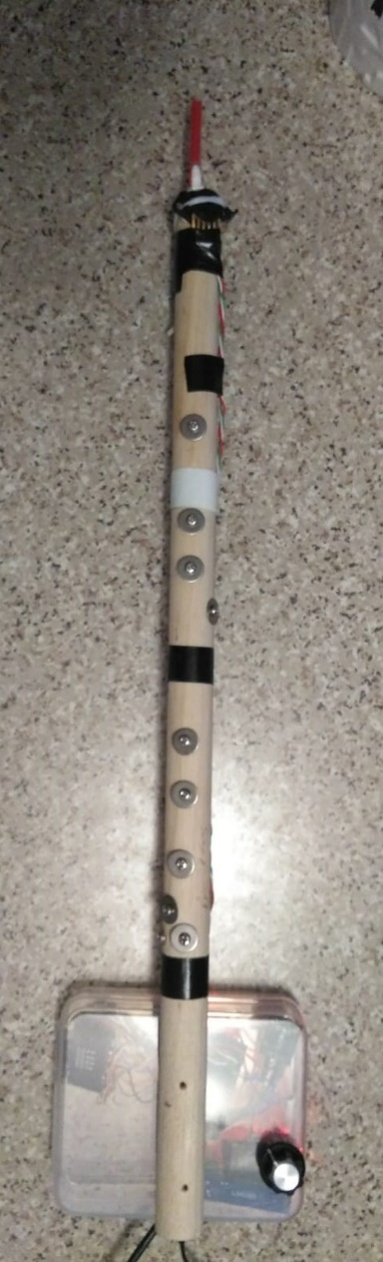
Test3.1i) Woodwind4_dizi.ino
// woodwind4_dizi.ino , 20202 Sept 8, for Dizi, tested ok, beware hardware mpr121 connections
// https://raw.githubusercontent.com/adafruit/Adafruit_MPR121/master/examples/MPR121test/MPR121test.ino
/********************************************************* MPR121
This is a library for the MPR121 12-channel Capacitive touch sensorfiltered_currtouched
Designed specifically to work with the MPR121 Breakout in the Adafruit shop
----> https://www.adafruit.com/products/
These sensors use I2C communicate, at least 2 pins are required
to interface
Adafruit invests time and resources providing this open source code,
please support Adafruit and open-source hardware by purchasing
products from Adafruit!
Written by Limor Fried/Ladyada for Adafruit Industries.
BSD license, all text above must be included in any redistribution
**********************************************************/
#include <Wire.h>
#include "Adafruit_MPR121.h"
#ifndef _BV
#define _BV(bit) (1 << (bit))
#endif
// You can have up to 4 on one i2c bus but one is enough for testing!
Adafruit_MPR121 cap = Adafruit_MPR121();
// Keeps track of the last pins touched
// so we know when buttons are 'released'
uint16_t lasttouched = 0;
uint16_t currtouched = 0;
//uint16_t filtered_currtouched =0;
////////// for buzzer //////////////////////////////////////////////////
//#include "pitches.h" //https://www.arduino.cc/en/Tutorial/toneMelody or see https://github.com/MicroGamerConsole/MicroGamer-Arduino
#define ACTIVATED LOW
#define NOTE_B0 31
#define NOTE_C1 33
#define NOTE_CS1 35
#define NOTE_D1 37
#define NOTE_DS1 39
#define NOTE_E1 41
#define NOTE_F1 44
#define NOTE_FS1 46
#define NOTE_G1 49
#define NOTE_GS1 52
#define NOTE_A1 55
#define NOTE_AS1 58
#define NOTE_B1 62
#define NOTE_C2 65
#define NOTE_CS2 69
#define NOTE_D2 73
#define NOTE_DS2 78
#define NOTE_E2 82
#define NOTE_F2 87
#define NOTE_FS2 93
#define NOTE_G2 98
#define NOTE_GS2 104
#define NOTE_A2 110
#define NOTE_AS2 117
#define NOTE_B2 123
#define NOTE_C3 131
#define NOTE_CS3 139
#define NOTE_D3 147
#define NOTE_DS3 156
#define NOTE_E3 165
#define NOTE_F3 175
#define NOTE_FS3 185
#define NOTE_G3 196
#define NOTE_GS3 208
#define NOTE_A3 220
#define NOTE_AS3 233
#define NOTE_B3 247
#define NOTE_C4 262
#define NOTE_CS4 277
#define NOTE_D4 294
#define NOTE_DS4 311
#define NOTE_E4 330
#define NOTE_F4 349
#define NOTE_FS4 370
#define NOTE_G4 392
#define NOTE_GS4 415
#define NOTE_A4 440
#define NOTE_AS4 466
#define NOTE_B4 494
#define NOTE_C5 523
#define NOTE_CS5 554
#define NOTE_D5 587
#define NOTE_DS5 622
#define NOTE_E5 659
#define NOTE_F5 698
#define NOTE_FS5 740
#define NOTE_G5 784
#define NOTE_GS5 831
#define NOTE_A5 880
#define NOTE_AS5 932
#define NOTE_B5 988
#define NOTE_C6 1047
#define NOTE_CS6 1109
#define NOTE_D6 1175
#define NOTE_DS6 1245
#define NOTE_E6 1319
#define NOTE_F6 1397
#define NOTE_FS6 1480
#define NOTE_G6 1568
#define NOTE_GS6 1661
#define NOTE_A6 1760
#define NOTE_AS6 1865
#define NOTE_B6 1976
#define NOTE_C7 2093
#define NOTE_CS7 2217
#define NOTE_D7 2349
#define NOTE_DS7 2489
#define NOTE_E7 2637
#define NOTE_F7 2794
#define NOTE_FS7 2960
#define NOTE_G7 3136
#define NOTE_GS7 3322
#define NOTE_A7 3520
#define NOTE_AS7 3729
#define NOTE_B7 3951
#define NOTE_C8 4186
#define NOTE_CS8 4435
#define NOTE_D8 4699
#define NOTE_DS8 4978
const int PIEZO = 11;
const int LED = 13;
int buttonSong = 8;
const int BUTTON_C = 6;
const int BUTTON_AS = 4;
const int BUTTON_A = 3;
const int BUTTON_G = 2;
// notes in the melody:
// notes in the melody:
int melody[] = {
NOTE_C4, NOTE_G3, NOTE_G3, NOTE_A3, NOTE_G3, 0, NOTE_B3, NOTE_C4
};
// note durations: 4 = quarter note, 8 = eighth note, etc.:
int noteDurations[] = {
4, 8, 8, 4, 4, 4, 4, 4
};
void play_demo_1()
{
// iterate over the notes of the melody:
for (int thisNote = 0; thisNote < 8; thisNote++) {
// to calculate the note duration, take one second divided by the note type.
//e.g. quarter note = 1000 / 4, eighth note = 1000/8, etc.
int noteDuration = 1000 / noteDurations[thisNote];
tone(11, melody[thisNote], noteDuration);
// to distinguish the notes, set a minimum time between them.
// the note's duration + 30% seems to work well:
int pauseBetweenNotes = noteDuration * 1.30;
delay(pauseBetweenNotes);
// stop the tone playing:
noTone(11);
}
}
//////////////////////////////////////////////////////////
void setup() {
Serial.begin(9600);
play_demo_1();
while (!Serial) { // needed to keep leonardo/micro from starting too fast!
delay(10);
}
Serial.println("Adafruit MPR121 Capacitive Touch sensor test");
// Default address is 0x5A, if tied to 3.3V its 0x5B
// If tied to SDA its 0x5C and if SCL then 0x5D
if (!cap.begin(0x5A)) {
Serial.println("MPR121 not found, check wiring?");
while (1);
}
Serial.println("MPR121 found!");
}
void loop()
{
//play_demo_1();
int pressure;
pressure = analogRead(A0);
// Serial.println(pressure );
// Get the currently touched pads
currtouched = cap.touched();
// filtered_currtouched = (currtouched | 0x2 ) & 0xEF;//assume mpr121 bit 1 is always 1, and bit 5 is always 0
Serial.println(currtouched , HEX);
int pressure_threshold_1 = 50;
int pressure_threshold_2 = 100;
int pressure_threshold_3 = 170;
int pressure_threshold_4 = 230; // not used
if (pressure > pressure_threshold_1 && pressure < pressure_threshold_2)
{
switch (currtouched) {
case 0x2:
// statements
tone(PIEZO, NOTE_CS5);
break;
case 0xE:
// statements
tone(PIEZO, NOTE_C5);
break;
case 0x3:
// statements
tone(PIEZO, NOTE_B4);
break;
case 0x7:
// statements
tone(PIEZO, NOTE_A4);
break;
case 0xF:
// statements
tone(PIEZO, NOTE_G4);
break;
case 0x2F:
// statements
tone(PIEZO, NOTE_FS4);
break;
case 0x6F:
// statements
tone(PIEZO, NOTE_E4);
break;
case 0xEF:
// statements
tone(PIEZO, NOTE_D4);
break;
default: /// dddddddddddddddddddddddd
// statements
break;
}
}
else
{
if ( pressure >= pressure_threshold_2 && pressure < pressure_threshold_3)
{
switch (currtouched) {
case 0x2:
// statements
tone(PIEZO, NOTE_CS6);
break;
case 0xE:
// statements
tone(PIEZO, NOTE_C6);
break;
case 0x3:
// statements
tone(PIEZO, NOTE_B5);
break;
case 0x7:
// statements
tone(PIEZO, NOTE_A5);
break;
case 0xF:
// statements
tone(PIEZO, NOTE_G5);
break;
case 0x2F:
// statements
tone(PIEZO, NOTE_FS5);
break;
case 0x6F:
// statements
tone(PIEZO, NOTE_E5);
break;
case 0xEF:
// statements
tone(PIEZO, NOTE_D5);
break;
default: /// dddddddddddddddddddddddd
// statements
break;
}
}
else
{
if ( pressure >= pressure_threshold_3)
{
switch (currtouched) {
case 0x2:
// statements
tone(PIEZO, NOTE_CS7);
break;
case 0xE:
// statements
tone(PIEZO, NOTE_C7);
break;
case 0x3:
// statements
tone(PIEZO, NOTE_B6);
break;
case 0x7:
// statements
tone(PIEZO, NOTE_A6);
break;
case 0xF:
// statements
tone(PIEZO, NOTE_G6);
break;
case 0x2F:
// statements
tone(PIEZO, NOTE_FS6);
break;
case 0x6F:
// statements
tone(PIEZO, NOTE_E6);
break;
case 0xEF:
// statements
tone(PIEZO, NOTE_D6);
break;
default: /// dddddddddddddddddddddddd
// statements
break;
}
}
else {
noTone(PIEZO);
}
}
}
// for (uint8_t i = 0; i < 12; i++) {
// // it if *is* touched and *wasnt* touched before, alert!
// if ((currtouched & _BV(i)) && !(lasttouched & _BV(i)) ) {
// Serial.print(i); Serial.println(" touched");
// }
// // if it *was* touched and now *isnt*, alert!
// if (!(currtouched & _BV(i)) && (lasttouched & _BV(i)) ) {
// Serial.print(i); Serial.println(" released");
// }
// }
// reset our state
lasttouched = currtouched;
delay(100);
// comment out this line for detailed data from the sensor!
return;
// // debugging info, what
// Serial.print("\t\t\t\t\t\t\t\t\t\t\t\t\t 0x"); Serial.println(cap.touched(), HEX);
// Serial.print("Filt: ");
// for (uint8_t i=0; i<12; i++) {
// Serial.print(cap.filteredData(i)); Serial.print("\t");
// }
// Serial.println();
// Serial.print("Base: ");
// for (uint8_t i=0; i<12; i++) {
// Serial.print(cap.baselineData(i)); Serial.print("\t");
// }
// Serial.println();
// put a delay so it isn't overwhelming
//delay(100);
}

Slide 13
Test3.1j, // woodwind4b_flute.ino , 2020 Sept 8, for western flute, tested ok, beware hardware mpr121 connections
// woodwind4b_flute.ino , 2020 Sept 8, for western flute, tested ok, beware hardware mpr121 connections
// https://raw.githubusercontent.com/adafruit/Adafruit_MPR121/master/examples/MPR121test/MPR121test.ino
/********************************************************* MPR121
This is a library for the MPR121 12-channel Capacitive touch sensorfiltered_currtouched
Designed specifically to work with the MPR121 Breakout in the Adafruit shop
----> https://www.adafruit.com/products/
These sensors use I2C communicate, at least 2 pins are required
to interface
Adafruit invests time and resources providing this open source code,
please support Adafruit and open-source hardware by purchasing
products from Adafruit!
Written by Limor Fried/Ladyada for Adafruit Industries.
BSD license, all text above must be included in any redistribution
**********************************************************/
#include <Wire.h>
#include "Adafruit_MPR121.h"
#ifndef _BV
#define _BV(bit) (1 << (bit))
#endif
// You can have up to 4 on one i2c bus but one is enough for testing!
Adafruit_MPR121 cap = Adafruit_MPR121();
// Keeps track of the last pins touched
// so we know when buttons are 'released'
uint16_t lasttouched = 0;
uint16_t currtouched = 0;
//uint16_t filtered_currtouched =0;
////////// for buzzer //////////////////////////////////////////////////
//#include "pitches.h" //https://www.arduino.cc/en/Tutorial/toneMelody or see https://github.com/MicroGamerConsole/MicroGamer-Arduino
#define ACTIVATED LOW
#define NOTE_B0 31
#define NOTE_C1 33
#define NOTE_CS1 35
#define NOTE_D1 37
#define NOTE_DS1 39
#define NOTE_E1 41
#define NOTE_F1 44
#define NOTE_FS1 46
#define NOTE_G1 49
#define NOTE_GS1 52
#define NOTE_A1 55
#define NOTE_AS1 58
#define NOTE_B1 62
#define NOTE_C2 65
#define NOTE_CS2 69
#define NOTE_D2 73
#define NOTE_DS2 78
#define NOTE_E2 82
#define NOTE_F2 87
#define NOTE_FS2 93
#define NOTE_G2 98
#define NOTE_GS2 104
#define NOTE_A2 110
#define NOTE_AS2 117
#define NOTE_B2 123
#define NOTE_C3 131
#define NOTE_CS3 139
#define NOTE_D3 147
#define NOTE_DS3 156
#define NOTE_E3 165
#define NOTE_F3 175
#define NOTE_FS3 185
#define NOTE_G3 196
#define NOTE_GS3 208
#define NOTE_A3 220
#define NOTE_AS3 233
#define NOTE_B3 247
#define NOTE_C4 262
#define NOTE_CS4 277
#define NOTE_D4 294
#define NOTE_DS4 311
#define NOTE_E4 330
#define NOTE_F4 349
#define NOTE_FS4 370
#define NOTE_G4 392
#define NOTE_GS4 415
#define NOTE_A4 440
#define NOTE_AS4 466
#define NOTE_B4 494
#define NOTE_C5 523
#define NOTE_CS5 554
#define NOTE_D5 587
#define NOTE_DS5 622
#define NOTE_E5 659
#define NOTE_F5 698
#define NOTE_FS5 740
#define NOTE_G5 784
#define NOTE_GS5 831
#define NOTE_A5 880
#define NOTE_AS5 932
#define NOTE_B5 988
#define NOTE_C6 1047
#define NOTE_CS6 1109
#define NOTE_D6 1175
#define NOTE_DS6 1245
#define NOTE_E6 1319
#define NOTE_F6 1397
#define NOTE_FS6 1480
#define NOTE_G6 1568
#define NOTE_GS6 1661
#define NOTE_A6 1760
#define NOTE_AS6 1865
#define NOTE_B6 1976
#define NOTE_C7 2093
#define NOTE_CS7 2217
#define NOTE_D7 2349
#define NOTE_DS7 2489
#define NOTE_E7 2637
#define NOTE_F7 2794
#define NOTE_FS7 2960
#define NOTE_G7 3136
#define NOTE_GS7 3322
#define NOTE_A7 3520
#define NOTE_AS7 3729
#define NOTE_B7 3951
#define NOTE_C8 4186
#define NOTE_CS8 4435
#define NOTE_D8 4699
#define NOTE_DS8 4978
const int PIEZO = 11;
const int LED = 13;
int buttonSong = 8;
const int BUTTON_C = 6;
const int BUTTON_AS = 4;
const int BUTTON_A = 3;
const int BUTTON_G = 2;
// notes in the melody:
// notes in the melody:
int melody[] = {
NOTE_C4, NOTE_G3, NOTE_G3, NOTE_A3, NOTE_G3, 0, NOTE_B3, NOTE_C4
};
// note durations: 4 = quarter note, 8 = eighth note, etc.:
int noteDurations[] = {
4, 8, 8, 4, 4, 4, 4, 4
};
void play_demo_1()
{
// iterate over the notes of the melody:
for (int thisNote = 0; thisNote < 8; thisNote++) {
// to calculate the note duration, take one second divided by the note type.
//e.g. quarter note = 1000 / 4, eighth note = 1000/8, etc.
int noteDuration = 1000 / noteDurations[thisNote];
tone(11, melody[thisNote], noteDuration);
// to distinguish the notes, set a minimum time between them.
// the note's duration + 30% seems to work well:
int pauseBetweenNotes = noteDuration * 1.30;
delay(pauseBetweenNotes);
// stop the tone playing:
noTone(11);
}
}
//////////////////////////////////////////////////////////
void setup() {
Serial.begin(9600);
play_demo_1();
while (!Serial) { // needed to keep leonardo/micro from starting too fast!
delay(10);
}
Serial.println("Adafruit MPR121 Capacitive Touch sensor test");
// Default address is 0x5A, if tied to 3.3V its 0x5B
// If tied to SDA its 0x5C and if SCL then 0x5D
if (!cap.begin(0x5A)) {
Serial.println("MPR121 not found, check wiring?");
while (1);
}
Serial.println("MPR121 found!");
}
void loop()
{
//play_demo_1();
int pressure;
pressure = analogRead(A0);
// Serial.println(pressure );
// Get the currently touched pads
currtouched = cap.touched();
// filtered_currtouched = (currtouched | 0x2 ) & 0xEF;//assume mpr121 bit 1 is always 1, and bit 5 is always 0
Serial.println(currtouched , HEX);
int pressure_threshold_1 = 50;
int pressure_threshold_2 = 110;
int pressure_threshold_3 = 170;
int pressure_threshold_4 = 230; // not used
if (pressure > pressure_threshold_1 && pressure < pressure_threshold_2)
{
switch (currtouched) {
case 0x102:
// statements
tone(PIEZO, NOTE_CS5);
break;
case 0x101:
// statements
tone(PIEZO, NOTE_C5);
break;
case 0x103:
// statements
tone(PIEZO, NOTE_B4);
break;
case 0x123:
// statements
tone(PIEZO, NOTE_AS4);
break;
case 0x107:
// statements
tone(PIEZO, NOTE_A4);
break;
case 0x11F:
// statements
tone(PIEZO, NOTE_GS4);
break;
case 0x10F:
// statements
tone(PIEZO, NOTE_G4);
break;
case 0x14F:
// statements
tone(PIEZO, NOTE_FS4);
break;
case 0x12F:
// statements
tone(PIEZO, NOTE_F4);
break;
case 0x16F:
// statements
tone(PIEZO, NOTE_E4);
break;
case 0x1EF:
// statements
tone(PIEZO, NOTE_DS4);
break;
case 0xEF:
// statements
tone(PIEZO, NOTE_D4);
break;
case 0x2EF:
// statements
tone(PIEZO, NOTE_CS4);
break;
case 0x4EF:
// statements
tone(PIEZO, NOTE_C4);
break;
default: /// dddddddddddddddddddddddd
// statements
break;
}
}
else
{
if ( pressure >= pressure_threshold_2 && pressure < pressure_threshold_3)
{
switch (currtouched) {
case 0x102:
// statements
tone(PIEZO, NOTE_CS6);
break;
case 0x101:
// statements
tone(PIEZO, NOTE_C6);
break;
case 0x103:
// statements
tone(PIEZO, NOTE_B5);
break;
case 0x123:
// statements
tone(PIEZO, NOTE_AS5);
break;
case 0x107:
// statements
tone(PIEZO, NOTE_A5);
break;
case 0x11F:
// statements
tone(PIEZO, NOTE_GS5);
break;
case 0x10F:
// statements
tone(PIEZO, NOTE_G5);
break;
case 0x14F:
// statements
tone(PIEZO, NOTE_FS5);
break;
case 0x12F:
// statements
tone(PIEZO, NOTE_F5);
break;
case 0x16F:
// statements
tone(PIEZO, NOTE_E5);
break;
case 0x1EF:
// statements
tone(PIEZO, NOTE_DS5);
break;
case 0xEF:
// statements
tone(PIEZO, NOTE_D5);
break;
default: /// dddddddddddddddddddddddd
// statements
break;
}
}
else
{
if ( pressure >= pressure_threshold_3)
{
switch (currtouched) {
case 0x102:
// statements
tone(PIEZO, NOTE_CS7);
break;
case 0x101:
// statements
tone(PIEZO, NOTE_C7);
break;
case 0x103:
// statements
tone(PIEZO, NOTE_B6);
break;
case 0x123:
// statements
tone(PIEZO, NOTE_A6);
break;
case 0x107:
// statements
tone(PIEZO, NOTE_A6);
break;
case 0x11F:
// statements
tone(PIEZO, NOTE_GS6);
break;
case 0x10F:
// statements
tone(PIEZO, NOTE_G6);
break;
case 0x14F:
// statements
tone(PIEZO, NOTE_FS6);
break;
case 0x12F:
// statements
tone(PIEZO, NOTE_F6);
break;
case 0x16F:
// statements
tone(PIEZO, NOTE_E6);
break;
case 0x1EF:
// statements
tone(PIEZO, NOTE_DS6);
break;
case 0xEF:
// statements
tone(PIEZO, NOTE_D6);
break;
default: /// dddddddddddddddddddddddd
// statements
break;
}
}
else {
noTone(PIEZO);
}
}
}
// for (uint8_t i = 0; i < 12; i++) {
// // it if *is* touched and *wasnt* touched before, alert!
// if ((currtouched & _BV(i)) && !(lasttouched & _BV(i)) ) {
// Serial.print(i); Serial.println(" touched");
// }
// // if it *was* touched and now *isnt*, alert!
// if (!(currtouched & _BV(i)) && (lasttouched & _BV(i)) ) {
// Serial.print(i); Serial.println(" released");
// }
// }
// reset our state
lasttouched = currtouched;
delay(50);
// comment out this line for detailed data from the sensor!
return;
// // debugging info, what
// Serial.print("\t\t\t\t\t\t\t\t\t\t\t\t\t 0x"); Serial.println(cap.touched(), HEX);
// Serial.print("Filt: ");
// for (uint8_t i=0; i<12; i++) {
// Serial.print(cap.filteredData(i)); Serial.print("\t");
// }
// Serial.println();
// Serial.print("Base: ");
// for (uint8_t i=0; i<12; i++) {
// Serial.print(cap.baselineData(i)); Serial.print("\t");
// }
// Serial.println();
// put a delay so it isn't overwhelming
//delay(100);
}

Slide 14
Test 3.1k, woodwind4d_flute_dizi.ino flute/dizi combined,
// woodwind4d_flute_dizi.ino (selected by a switch attached at the analog input A1)
//https://learn.sparkfun.com/tutorials/mpr121-hookup-guide/all#communicating-with-the-breakout-board for use of pin2 irq pin
// 2020 Sept 8, for western flute, tested ok, beware hardware mpr121 connections
// https://raw.githubusercontent.com/adafruit/Adafruit_MPR121/master/examples/MPR121test/MPR121test.ino
/********************************************************* MPR121
This is a library for the MPR121 12-channel Capacitive touch sensorfiltered_currtouched
Designed specifically to work with the MPR121 Breakout in the Adafruit shop
----> https://www.adafruit.com/products/
These sensors use I2C communicate, at least 2 pins are required
to interface
Adafruit invests time and resources providing this open source code,
please support Adafruit and open-source hardware by purchasing
products from Adafruit!
Written by Limor Fried/Ladyada for Adafruit Industries.
BSD license, all text above must be included in any redistribution
**********************************************************/
#include <Wire.h>
#include "Adafruit_MPR121.h"
int sensorPin = A1;
int sensorValue = 0;
int irqpin = 2; // Digital 2, mpr121 interupt pin
#ifndef _BV
#define _BV(bit) (1 << (bit))
#endif
// You can have up to 4 on one i2c bus but one is enough for testing!
Adafruit_MPR121 cap = Adafruit_MPR121();
// Keeps track of the last pins touched
// so we know when buttons are 'released'
uint16_t lasttouched = 0;
uint16_t currtouched = 0;
//uint16_t filtered_currtouched =0;
////////// for buzzer //////////////////////////////////////////////////
//#include "pitches.h" //https://www.arduino.cc/en/Tutorial/toneMelody or see https://github.com/MicroGamerConsole/MicroGamer-Arduino
#define ACTIVATED LOW
#define NOTE_B0 31
#define NOTE_C1 33
#define NOTE_CS1 35
#define NOTE_D1 37
#define NOTE_DS1 39
#define NOTE_E1 41
#define NOTE_F1 44
#define NOTE_FS1 46
#define NOTE_G1 49
#define NOTE_GS1 52
#define NOTE_A1 55
#define NOTE_AS1 58
#define NOTE_B1 62
#define NOTE_C2 65
#define NOTE_CS2 69
#define NOTE_D2 73
#define NOTE_DS2 78
#define NOTE_E2 82
#define NOTE_F2 87
#define NOTE_FS2 93
#define NOTE_G2 98
#define NOTE_GS2 104
#define NOTE_A2 110
#define NOTE_AS2 117
#define NOTE_B2 123
#define NOTE_C3 131
#define NOTE_CS3 139
#define NOTE_D3 147
#define NOTE_DS3 156
#define NOTE_E3 165
#define NOTE_F3 175
#define NOTE_FS3 185
#define NOTE_G3 196
#define NOTE_GS3 208
#define NOTE_A3 220
#define NOTE_AS3 233
#define NOTE_B3 247
#define NOTE_C4 262
#define NOTE_CS4 277
#define NOTE_D4 294
#define NOTE_DS4 311
#define NOTE_E4 330
#define NOTE_F4 349
#define NOTE_FS4 370
#define NOTE_G4 392
#define NOTE_GS4 415
#define NOTE_A4 440
#define NOTE_AS4 466
#define NOTE_B4 494
#define NOTE_C5 523
#define NOTE_CS5 554
#define NOTE_D5 587
#define NOTE_DS5 622
#define NOTE_E5 659
#define NOTE_F5 698
#define NOTE_FS5 740
#define NOTE_G5 784
#define NOTE_GS5 831
#define NOTE_A5 880
#define NOTE_AS5 932
#define NOTE_B5 988
#define NOTE_C6 1047
#define NOTE_CS6 1109
#define NOTE_D6 1175
#define NOTE_DS6 1245
#define NOTE_E6 1319
#define NOTE_F6 1397
#define NOTE_FS6 1480
#define NOTE_G6 1568
#define NOTE_GS6 1661
#define NOTE_A6 1760
#define NOTE_AS6 1865
#define NOTE_B6 1976
#define NOTE_C7 2093
#define NOTE_CS7 2217
#define NOTE_D7 2349
#define NOTE_DS7 2489
#define NOTE_E7 2637
#define NOTE_F7 2794
#define NOTE_FS7 2960
#define NOTE_G7 3136
#define NOTE_GS7 3322
#define NOTE_A7 3520
#define NOTE_AS7 3729
#define NOTE_B7 3951
#define NOTE_C8 4186
#define NOTE_CS8 4435
#define NOTE_D8 4699
#define NOTE_DS8 4978
const int PIEZO = 11;
const int LED = 13;
int buttonSong = 8;
const int BUTTON_C = 6;
const int BUTTON_AS = 4;
const int BUTTON_A = 3;
const int BUTTON_G = 2;
// notes in the melody:
// notes in the melody:
int melody[] = {
NOTE_C4, NOTE_G3, NOTE_G3, NOTE_A3, NOTE_G3, 0, NOTE_B3, NOTE_C4
};
// note durations: 4 = quarter note, 8 = eighth note, etc.:
int noteDurations[] = {
4, 8, 8, 4, 4, 4, 4, 4
};
void play_demo_1()
{
// iterate over the notes of the melody:
for (int thisNote = 0; thisNote < 8; thisNote++) {
// to calculate the note duration, take one second divided by the note type.
//e.g. quarter note = 1000 / 4, eighth note = 1000/8, etc.
int noteDuration = 1000 / noteDurations[thisNote];
tone(11, melody[thisNote], noteDuration);
// to distinguish the notes, set a minimum time between them.
// the note's duration + 30% seems to work well:
int pauseBetweenNotes = noteDuration * 1.30;
delay(pauseBetweenNotes);
// stop the tone playing:
noTone(11);
}
}
//////////////////////////////////////////////////////////
void setup() {
digitalWrite(irqpin, HIGH); //enable pullup resistor
Serial.begin(9600);
play_demo_1();
while (!Serial) { // needed to keep leonardo/micro from starting too fast!
delay(10);
}
Serial.println("Adafruit MPR121 Capacitive Touch sensor test");
// Default address is 0x5A, if tied to 3.3V its 0x5B
// If tied to SDA its 0x5C and if SCL then 0x5D
if (!cap.begin(0x5A)) {
Serial.println("MPR121 not found, check wiring?");
while (1);
}
Serial.println("MPR121 found!");
}
void loop()
{
sensorValue = analogRead(sensorPin);
//Serial.println(sensorValue);
if (sensorValue <300) //sensorValue 3 cases: 1023, 511, 0 , external control selector
{
play_demo_1();
}
if (sensorValue >300 && sensorValue <900) //sensorValue 3 cases: 1023, 511, 0 , external control selector
{
loop_flute();
}
if (sensorValue >900) //sensorValue 3 cases: 1023, 511/2, 0 , external control selector
{
loop_dizi(); //reserved for future used
}
}
void loop_dizi()
{
//play_demo_1();
int pressure;
pressure = analogRead(A0);
// Serial.println(pressure );
// Get the currently touched pads
if(!checkInterrupt())
{
currtouched = cap.touched();
}
// filtered_currtouched = (currtouched | 0x2 ) & 0xEF;//assume mpr121 bit 1 is always 1, and bit 5 is always 0
Serial.println(currtouched , HEX);
int pressure_threshold_1 = 50;
int pressure_threshold_2 = 100;
int pressure_threshold_3 = 170;
int pressure_threshold_4 = 230; // not used
if (pressure > pressure_threshold_1 && pressure < pressure_threshold_2)
{
currtouched=currtouched & 0xff; // only read 8 bits input
currtouched =currtouched | 0x02; // ignor bit1(mpr121),never use it in dizi
switch (currtouched) {
case 0x2:
// statements
tone(PIEZO, NOTE_CS5);
break;
case 0xE:
// statements
tone(PIEZO, NOTE_C5);
break;
case 0x3:
// statements
tone(PIEZO, NOTE_B4);
break;
case 0x7:
// statements
tone(PIEZO, NOTE_A4);
break;
case 0xF:
// statements
tone(PIEZO, NOTE_G4);
break;
case 0x2F:
// statements
tone(PIEZO, NOTE_FS4);
break;
case 0x6F:
// statements
tone(PIEZO, NOTE_E4);
break;
case 0xEF:
// statements
tone(PIEZO, NOTE_D4);
break;
default: /// dddddddddddddddddddddddd
// statements
break;
}
}
else
{
if ( pressure >= pressure_threshold_2 && pressure < pressure_threshold_3)
{
switch (currtouched) {
case 0x2:
// statements
tone(PIEZO, NOTE_CS6);
break;
case 0xE:
// statements
tone(PIEZO, NOTE_C6);
break;
case 0x3:
// statements
tone(PIEZO, NOTE_B5);
break;
case 0x7:
// statements
tone(PIEZO, NOTE_A5);
break;
case 0xF:
// statements
tone(PIEZO, NOTE_G5);
break;
case 0x2F:
// statements
tone(PIEZO, NOTE_FS5);
break;
case 0x6F:
// statements
tone(PIEZO, NOTE_E5);
break;
case 0xEF:
// statements
tone(PIEZO, NOTE_D5);
break;
default: /// dddddddddddddddddddddddd
// statements
break;
}
}
else
{
if ( pressure >= pressure_threshold_3)
{
switch (currtouched) {
case 0x2:
// statements
tone(PIEZO, NOTE_CS7);
break;
case 0xE:
// statements
tone(PIEZO, NOTE_C7);
break;
case 0x3:
// statements
tone(PIEZO, NOTE_B6);
break;
case 0x7:
// statements
tone(PIEZO, NOTE_A6);
break;
case 0xF:
// statements
tone(PIEZO, NOTE_G6);
break;
case 0x2F:
// statements
tone(PIEZO, NOTE_FS6);
break;
case 0x6F:
// statements
tone(PIEZO, NOTE_E6);
break;
case 0xEF:
// statements
tone(PIEZO, NOTE_D6);
break;
default: /// dddddddddddddddddddddddd
// statements
break;
}
}
else {
noTone(PIEZO);
}
}
}
// for (uint8_t i = 0; i < 12; i++) {
// // it if *is* touched and *wasnt* touched before, alert!
// if ((currtouched & _BV(i)) && !(lasttouched & _BV(i)) ) {
// Serial.print(i); Serial.println(" touched");
// }
// // if it *was* touched and now *isnt*, alert!
// if (!(currtouched & _BV(i)) && (lasttouched & _BV(i)) ) {
// Serial.print(i); Serial.println(" released");
// }
// }
// reset our state
lasttouched = currtouched;
delay(100);
// comment out this line for detailed data from the sensor!
return;
// // debugging info, what
// Serial.print("\t\t\t\t\t\t\t\t\t\t\t\t\t 0x"); Serial.println(cap.touched(), HEX);
// Serial.print("Filt: ");
// for (uint8_t i=0; i<12; i++) {
// Serial.print(cap.filteredData(i)); Serial.print("\t");
// }
// Serial.println();
// Serial.print("Base: ");
// for (uint8_t i=0; i<12; i++) {
// Serial.print(cap.baselineData(i)); Serial.print("\t");
// }
// Serial.println();
// put a delay so it isn't overwhelming
//delay(100);
}
boolean checkInterrupt(void){
return digitalRead(irqpin);
}
void loop_flute()
{
//play_demo_1();
int pressure;
pressure = analogRead(A0);
// Serial.println(pressure );
if(!checkInterrupt())// Get the currently touched pads
{
currtouched = cap.touched();
}
// filtered_currtouched = (currtouched | 0x2 ) & 0xEF;//assume mpr121 bit 1 is always 1, and bit 5 is always 0
Serial.println(currtouched , HEX);
int pressure_threshold_1 = 50;
int pressure_threshold_2 = 110;
int pressure_threshold_3 = 170;
int pressure_threshold_4 = 230; // not used
if (pressure > pressure_threshold_1 && pressure < pressure_threshold_2)
{
switch (currtouched) {
case 0x102:
// statements
tone(PIEZO, NOTE_CS5);
break;
case 0x101:
// statements
tone(PIEZO, NOTE_C5);
break;
case 0x103:
// statements
tone(PIEZO, NOTE_B4);
break;
case 0x123:
// statements
tone(PIEZO, NOTE_AS4);
break;
case 0x107:
// statements
tone(PIEZO, NOTE_A4);
break;
case 0x11F:
// statements
tone(PIEZO, NOTE_GS4);
break;
case 0x10F:
// statements
tone(PIEZO, NOTE_G4);
break;
case 0x14F:
// statements
tone(PIEZO, NOTE_FS4);
break;
case 0x12F:
// statements
tone(PIEZO, NOTE_F4);
break;
case 0x16F:
// statements
tone(PIEZO, NOTE_E4);
break;
case 0x1EF:
// statements
tone(PIEZO, NOTE_DS4);
break;
case 0xEF:
// statements
tone(PIEZO, NOTE_D4);
break;
case 0x2EF:
// statements
tone(PIEZO, NOTE_CS4);
break;
case 0x4EF:
// statements
tone(PIEZO, NOTE_C4);
break;
default: /// dddddddddddddddddddddddd
// statements
break;
}
}
else
{
if ( pressure >= pressure_threshold_2 && pressure < pressure_threshold_3)
{
switch (currtouched) {
case 0x102:
// statements
tone(PIEZO, NOTE_CS6);
break;
case 0x101:
// statements
tone(PIEZO, NOTE_C6);
break;
case 0x103:
// statements
tone(PIEZO, NOTE_B5);
break;
case 0x123:
// statements
tone(PIEZO, NOTE_AS5);
break;
case 0x107:
// statements
tone(PIEZO, NOTE_A5);
break;
case 0x11F:
// statements
tone(PIEZO, NOTE_GS5);
break;
case 0x10F:
// statements
tone(PIEZO, NOTE_G5);
break;
case 0x14F:
// statements
tone(PIEZO, NOTE_FS5);
break;
case 0x12F:
// statements
tone(PIEZO, NOTE_F5);
break;
case 0x16F:
// statements
tone(PIEZO, NOTE_E5);
break;
case 0x1EF:
// statements
tone(PIEZO, NOTE_DS5);
break;
case 0xEF:
// statements
tone(PIEZO, NOTE_D5);
break;
default: /// dddddddddddddddddddddddd
// statements
break;
}
}
else
{
if ( pressure >= pressure_threshold_3)
{
switch (currtouched) {
case 0x102:
// statements
tone(PIEZO, NOTE_CS7);
break;
case 0x101:
// statements
tone(PIEZO, NOTE_C7);
break;
case 0x103:
// statements
tone(PIEZO, NOTE_B6);
break;
case 0x123:
// statements
tone(PIEZO, NOTE_A6);
break;
case 0x107:
// statements
tone(PIEZO, NOTE_A6);
break;
case 0x11F:
// statements
tone(PIEZO, NOTE_GS6);
break;
case 0x10F:
// statements
tone(PIEZO, NOTE_G6);
break;
case 0x14F:
// statements
tone(PIEZO, NOTE_FS6);
break;
case 0x12F:
// statements
tone(PIEZO, NOTE_F6);
break;
case 0x16F:
// statements
tone(PIEZO, NOTE_E6);
break;
case 0x1EF:
// statements
tone(PIEZO, NOTE_DS6);
break;
case 0xEF:
// statements
tone(PIEZO, NOTE_D6);
break;
default: /// dddddddddddddddddddddddd
// statements
break;
}
}
else {
noTone(PIEZO);
}
}
}
// for (uint8_t i = 0; i < 12; i++) {
// // it if *is* touched and *wasnt* touched before, alert!
// if ((currtouched & _BV(i)) && !(lasttouched & _BV(i)) ) {
// Serial.print(i); Serial.println(" touched");
// }
// // if it *was* touched and now *isnt*, alert!
// if (!(currtouched & _BV(i)) && (lasttouched & _BV(i)) ) {
// Serial.print(i); Serial.println(" released");
// }
// }
// reset our state
lasttouched = currtouched;
delay(100);
// comment out this line for detailed data from the sensor!
return;
// // debugging info, what
// Serial.print("\t\t\t\t\t\t\t\t\t\t\t\t\t 0x"); Serial.println(cap.touched(), HEX);
// Serial.print("Filt: ");
// for (uint8_t i=0; i<12; i++) {
// Serial.print(cap.filteredData(i)); Serial.print("\t");
// }
// Serial.println();
// Serial.print("Base: ");
// for (uint8_t i=0; i<12; i++) {
// Serial.print(cap.baselineData(i)); Serial.print("\t");
// }
// Serial.println();
// put a delay so it isn't overwhelming
//delay(100);
}

Slide 15
Test 3.1g) wavetable sound synthesizer demo:https://www.youtube.com/watch?v=znQjGw4kuY4
https://www.instructables.com/id/Turn-your-Arduino-into-a-4-voice-wavetable-synth-w/
download
https://github.com/dzlonline/the_synth
Copy tables.h and synth.h to the directory song
Run song.ino
Use pin11 as output
//Hardware connections: (may use PIN11, PIN13 etc.)
// +10µF
//PIN 11 ---[ 1k ]--+---||--->> Audio out
// |
// === 10nF
// |
// GND

Slide 16
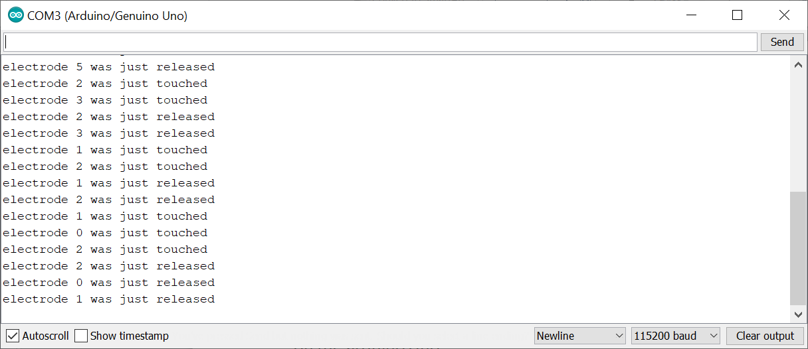
Test3.2a) Touch sensor using MPR121
demo
MPR121 chip Datasheet:
  https://www.sparkfun.com/datasheets/Components/MPR121.pdf
Circuit
  GND – connect that to your Arduino ground pin
  VCC – connect to the Arduino 3.3V (NOTE: 3.3V not 5V !!)
  SDA – connect to the I2C SDA pin – in Arduino Uno its A4
  SCL – connect to the I2C SCL pin – in Arduino Uno its A5
  IRQ – this is the trigger pin, and in our example will connect it to D4 on the arduino Uno
Code:
  https://www.gadgetronicx.com/interface-touch-sensor-mpr121-arduino/
  Get MPR121.h somewhere, (e.g. https://github.com/BareConductive/mpr121/tree/public/MPR121) put MPR121.h in current directory
  Modify code <MPR121.h> to “MPR121.h”

Slide 17
Touch sensor Adafruit MPR121 test https://github.com/adafruit/Adafruit_MPR121/blob/master/examples/MPR121test/MPR121test.ino
/*********************************************************
This is a library for the MPR121 12-channel Capacitive touch sensor
Designed specifically to work with the MPR121 Breakout in the Adafruit shop
----> https://www.adafruit.com/products/
These sensors use I2C communicate, at least 2 pins are required
to interface
Adafruit invests time and resources providing this open source code,
please support Adafruit and open-source hardware by purchasing
products from Adafruit!
Written by Limor Fried/Ladyada for Adafruit Industries.
BSD license, all text above must be included in any redistribution
**********************************************************/
#include <Wire.h>
#include "Adafruit_MPR121.h"
#ifndef _BV
#define _BV(bit) (1 << (bit))
#endif
// You can have up to 4 on one i2c bus but one is enough for testing!
Adafruit_MPR121 cap = Adafruit_MPR121();
// Keeps track of the last pins touched
// so we know when buttons are 'released'
uint16_t lasttouched = 0;
uint16_t currtouched = 0;
void setup() {
Serial.begin(9600);
while (!Serial) { // needed to keep leonardo/micro from starting too fast!
delay(10);
}
Serial.println("Adafruit MPR121 Capacitive Touch sensor test");
// Default address is 0x5A, if tied to 3.3V its 0x5B
// If tied to SDA its 0x5C and if SCL then 0x5D
if (!cap.begin(0x5A)) {
Serial.println("MPR121 not found, check wiring?");
while (1);
}
Serial.println("MPR121 found!");
}
void loop() {
// Get the currently touched pads
currtouched = cap.touched();
for (uint8_t i=0; i<12; i++) {
// it if *is* touched and *wasnt* touched before, alert!
if ((currtouched & _BV(i)) && !(lasttouched & _BV(i)) ) {
Serial.print(i); Serial.println(" touched");
}
// if it *was* touched and now *isnt*, alert!
if (!(currtouched & _BV(i)) && (lasttouched & _BV(i)) ) {
Serial.print(i); Serial.println(" released");
}
}
// reset our state
lasttouched = currtouched;
// comment out this line for detailed data from the sensor!
return;
// debugging info, what
Serial.print("\t\t\t\t\t\t\t\t\t\t\t\t\t 0x"); Serial.println(cap.touched(), HEX);
Serial.print("Filt: ");
for (uint8_t i=0; i<12; i++) {
Serial.print(cap.filteredData(i)); Serial.print("\t");
}
Serial.println();
Serial.print("Base: ");
for (uint8_t i=0; i<12; i++) {
Serial.print(cap.baselineData(i)); Serial.print("\t");
}
Serial.println();
// put a delay so it isn't overwhelming
delay(100);
}

Slide 18
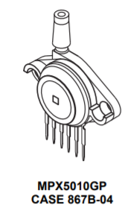
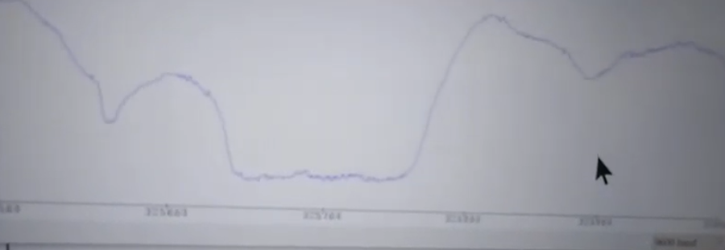
Test3.2b) Pressure sensor
Pressure sensor
  https://www.nxp.com/docs/en/data-sheet/MPX5010.pdf
  Demo: https://www.youtube.com/watch?v=R-7dhWGzxD4

Slide 19
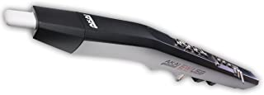
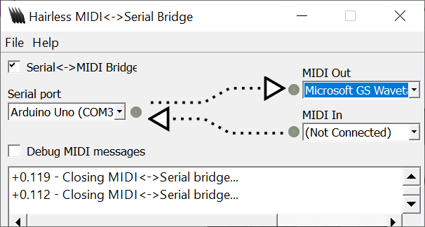
Test 3.2c) Electronic woodwind instrument (EWI)
https://www.akaipro.com/ewi-usb
https://hackaday.io/project/11843-miniwi-woodwind-midi-controller
  Construct the hardware based on the circuit diagrams shown in the above web link
  Using Arduino Uno instead: Code: https://cdn.hackaday.io/files/11843506690912/MiniWI-cap-pmt.ino
  Use “Adafruit_MPR121.h” of Adafruit_MPR121-1.0.3.zip from https://www.arduinolibraries.info/libraries/adafruit-mpr121 (tested ok)
Based on test 23(touch sensor), https://www.sparkfun.com/datasheets/Components/MPR121.pdf
Based on test 24(pressure sensor) https://www.nxp.com/docs/en/data-sheet/MPX5010.pdf
The EWI generates Midi code and send it to the USB
Use hairless midi bridge to receive MIDI code from USB and play MIDI instrument sound on a PC (win10)
https://projectgus.github.io/hairless-midiserial/

Slide 20
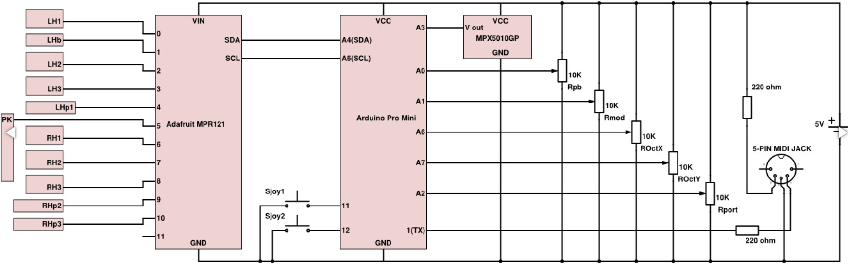
Test3.2d) Circuit for test 1.25 Electronic woodwind instrument (EWI)
MPR121 chip
VSS=Pin 6
VDD=Pin 20
SCL= pin2
SDA = pin 3

Slide 21
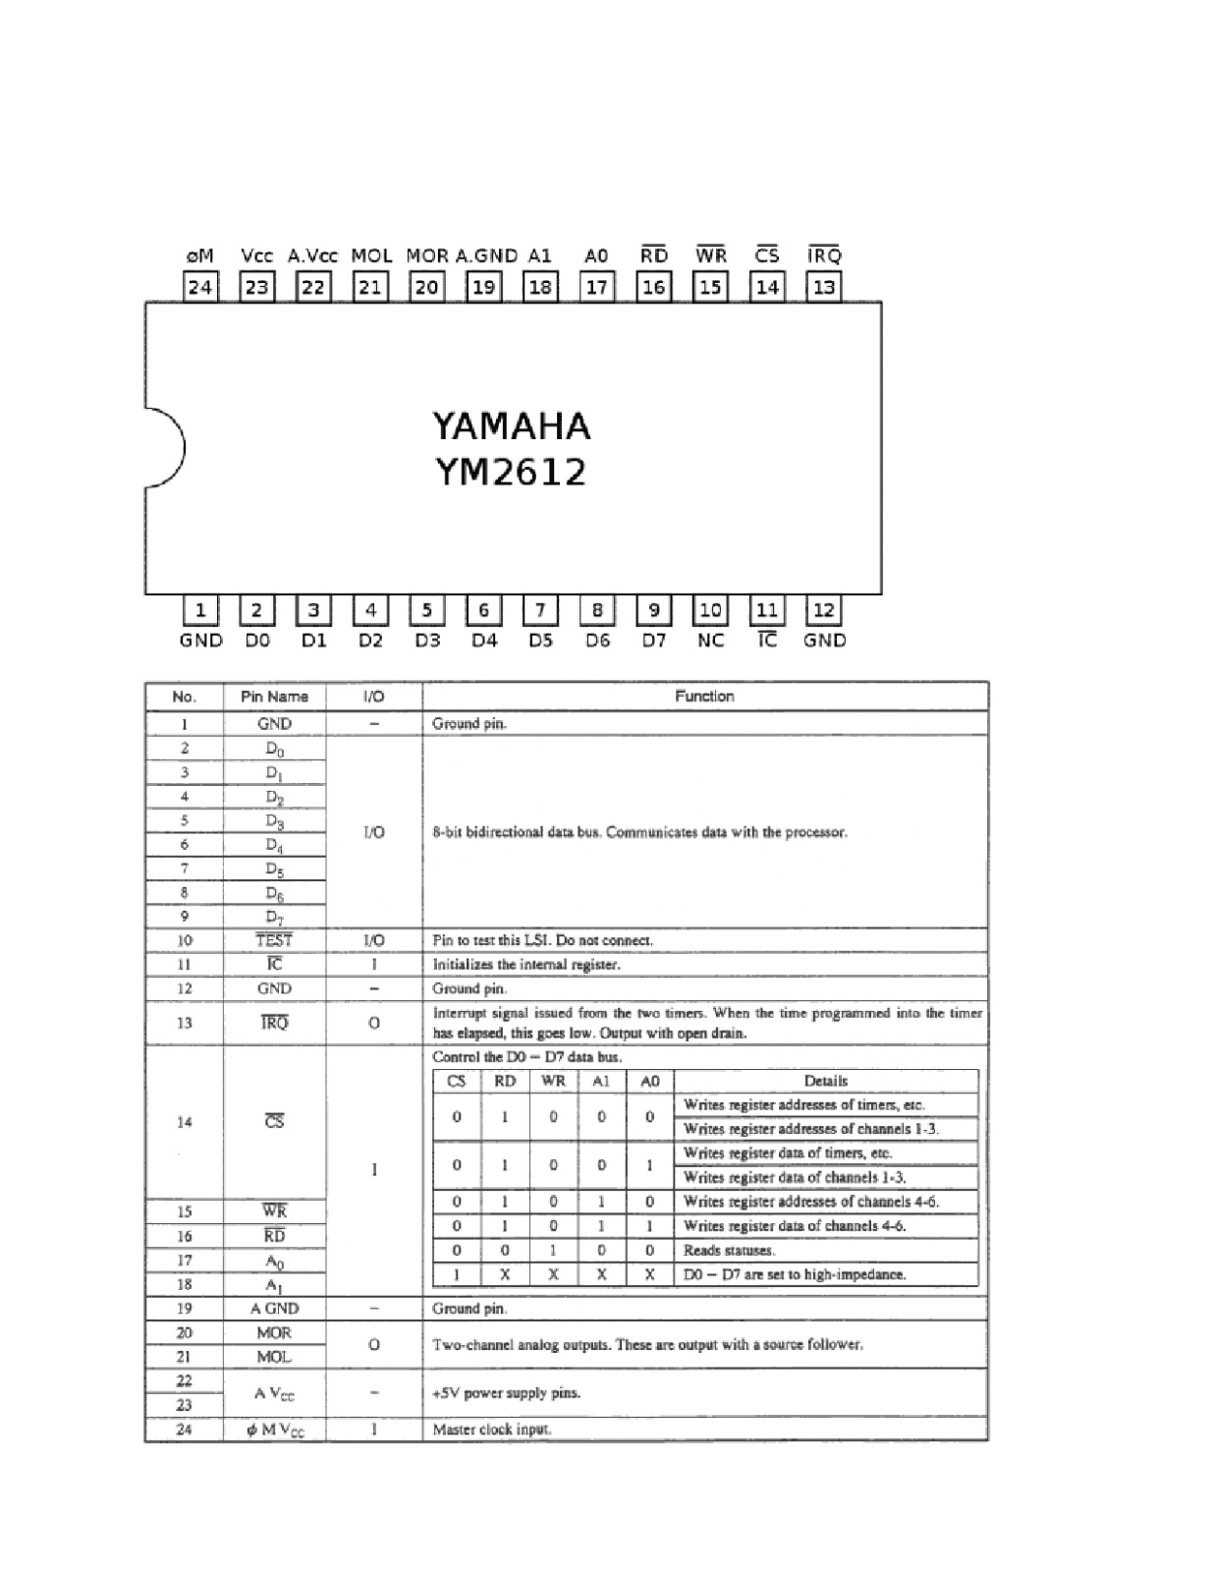
Test3.3a) YM6212 FM music synthesizer chip
http://davesblog.fo.am/2017/10/adventures-with-fm-sound-and-the-ym2612/
The wikipedia entry for the pinout,
Full software documentation
putting it all together, with schematics – in French.
hardware synth module with similar YMF262 chips.

Slide 22
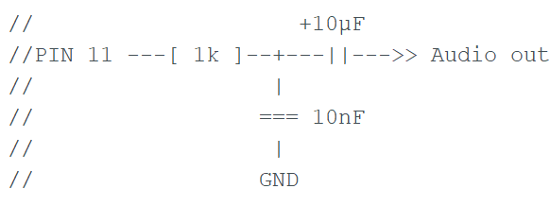
Test3.3b) YM6212 FM music synthesizer chip (set timer on Arduino UNO)
#ifdef _AVR_ATmega2560_
const byte CLOCKOUT = 11; // Mega 2560
#else
const byte CLOCKOUT = 9; // Uno, Duemilanove, etc.
#endif
void setup ()
{
// set up 8 MHz timer on CLOCKOUT (OC1A)
pinMode (CLOCKOUT, OUTPUT);
// set up Timer 1
TCCR1A = bit (COM1A0); // toggle OC1A on Compare Match
TCCR1B = bit (WGM12) | bit (CS10); // CTC, no prescaling
OCR1A = 0; // output every cycle
} // end of setup
void loop ()
{
// whatever
} // end of loop
Audio output pin

Slide 23
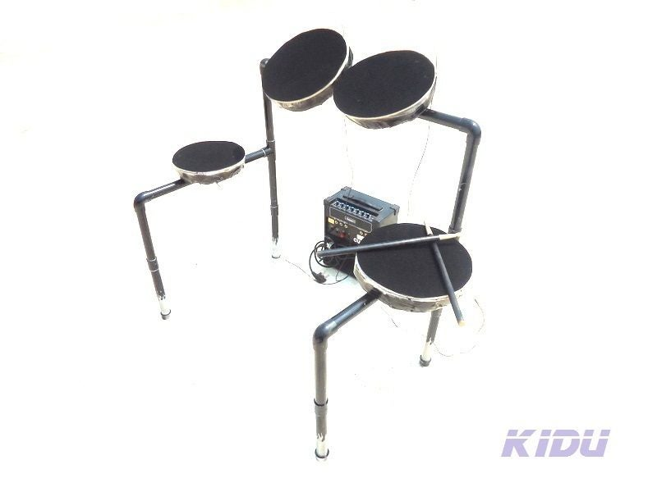
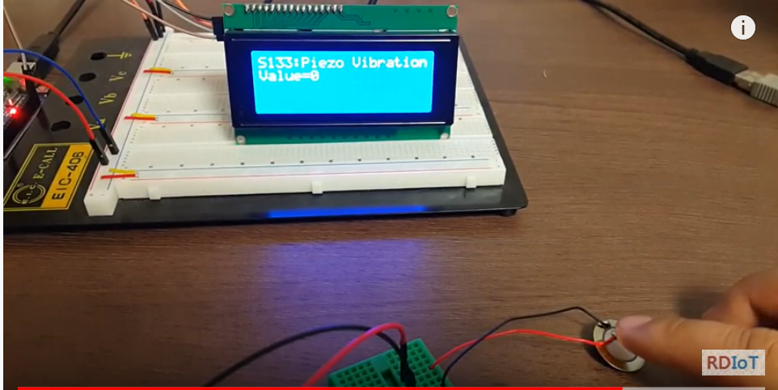
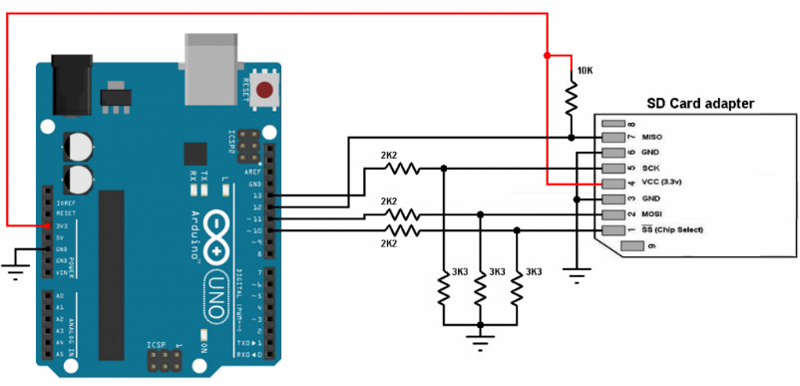
Test3.4a) Electronic drum set reference only , not tested
https://www.instructables.com/id/ELECTRONIC-DRUMnot-a-MIDI-sampler-aka-KIDU/
Or
https://www.instructables.com/id/Arduino-Minimal-Drum-Kit/
Use of “aka piezo disk” https://www.youtube.com/watch?v=YRrDOdgsokU
https://www.dfrobot.com/product-399.html
And “SD card” for recording drum sounds to be played back.

Slide 24
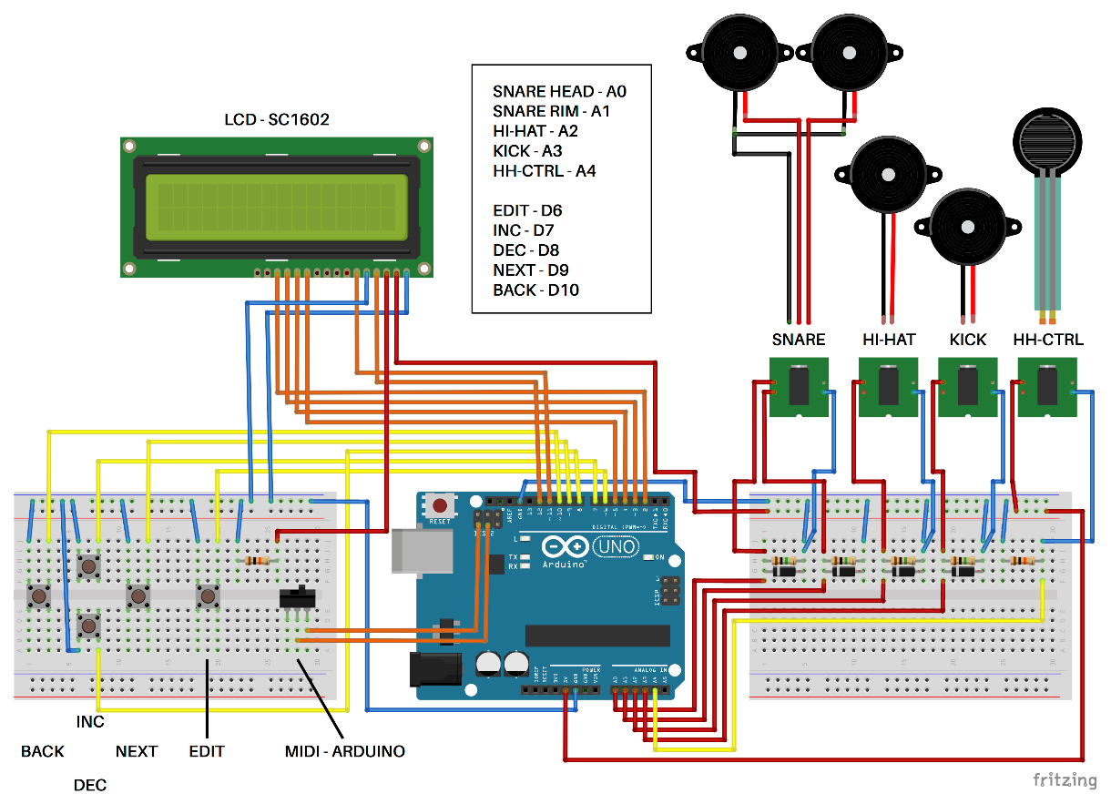
Test3.4b) Electronic Drum project
Reference only , not tested
https://create.arduino.cc/projecthub/ryokosaka/minimal-midi-drum-kit-with-3d-printer-5633d2

Slide 25

Test3.4 c) Use of SD card to store drum sound (Not tested)
https://simple-circuit.com/arduino-sd-card-interfacing-example/

Slide 26
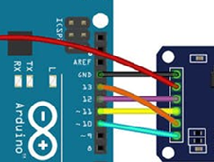
Test3.5d) Micro-SD CARD write/read
Library manager: SD build-IN by Arduino , SparkFun version v.1.2.3 using #include <SPI.h> and #include <SD.h>
https://create.arduino.cc/projecthub/electropeak/sd-card-module-with-arduino-how-to-read-write-data-37f390
Micro-SD card reader
GND
VCC
MISO
MOSI
SCK
CS

Slide 27
Test program for test.3.5d micro-sdcard write/read
Library manager: SD build-IN by Arduino , SparkFun version v.1.2.3 using #include <SPI.h> and #include <SD.h>
// micro-sdcard_read.ino
#include <SPI.h>
#include <SD.h>
File myFile;
void setup() {
// Open serial communications and wait for port to open:
Serial.begin(9600);
while (!Serial) {
; // wait for serial port to connect. Needed for native USB port only
}
Serial.print("Initializing SD card...");
if (!SD.begin(10)) {
Serial.println("initialization failed!");
while (1);
}
Serial.println("initialization done.");
// open the file for reading:
myFile = SD.open("test.txt");
if (myFile) {
Serial.println("test.txt:");
// read from the file until there's nothing else in it:
while (myFile.available()) {
Serial.write(myFile.read());
}
// close the file:
myFile.close();
} else {
// if the file didn't open, print an error:
Serial.println("error opening test.txt");
}
}
void loop() {
// nothing happens after setup
}
//micro-sdcard_write.ino
#include <SPI.h>
#include <SD.h>
File myFile;
void setup() {
// Open serial communications and wait for port to open:
Serial.begin(9600);
while (!Serial) {
; // wait for serial port to connect. Needed for native USB port only
}
Serial.print("Initializing SD card...");
if (!SD.begin(10)) {
Serial.println("initialization failed!");
while (1);
}
Serial.println("initialization done.");
// open the file. note that only one file can be open at a time,
// so you have to close this one before opening another.
myFile = SD.open("test.txt", FILE_WRITE);
// if the file opened okay, write to it:
if (myFile) {
Serial.print("Writing to test.txt...");
myFile.println("This is a test file :)");
myFile.println("testing 1, 2, 3.");
for (int i = 0; i < 30; i++) {
myFile.println(i);
}
// close the file:
myFile.close();
Serial.println("done.");
} else {
// if the file didn't open, print an error:
Serial.println("error opening test.txt");
}
}
void loop() {
// nothing happens after setup
}

Slide 28
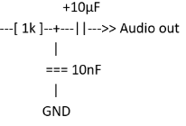
Test3.5e) Play sound stored in SD CARD
Arduino
Micro-SD card reader
https://www.instructables.com/id/Audio-Player-Using-Arduino-With-Micro-SD-Card/
Click on then Sketch >> Include Library >> Add zip Library
Select "TMRpcm.zip" that is in zip folder.
Tested ok
GND
VCC
MISO
MOSI
SCK
CS

Slide 29
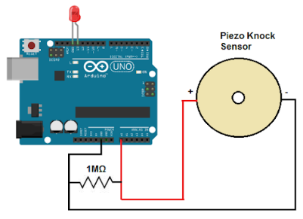
Test3.4f Two-finger Digital drum set using Arduino,micro-sd-card and piezo sensors (tested ok)
Drum sound files are stored in the sd-card
Demo:
https://www.youtube.com/watch?v=sBGWCcR5_lI
// use https://www.instructables.com/id/Audio-Player-Using-Arduino-With-Micro-SD-Card/
#include "SD.h"
// two-finger digital drum set
#define SD_ChipSelectPin 10
#include "TMRpcm.h"
#include "SPI.h"
//Upload your audio you want to convert to WAV
//Change bit resolution to " 8bit ".
//Change sampling rate to " 16000Hz ".
//Change audio channels " mono " .
//file format chnage : https://audio.online-convert.com/convert-to-wav
//PCM format " unsigned 8 bit ".
TMRpcm tmrpcm;
int sensorPin1 = A0; // select the input pin for the potentiometer
int sensorPin2 = A1; // select the input pin for the potentiometer
void setup()
{
tmrpcm.speakerPin = 9;
Serial.begin(9600);
if (!SD.begin(SD_ChipSelectPin))
{
Serial.println("SD fail");
return;
}
tmrpcm.setVolume(6);
Serial.println("Playing file.wav");
tmrpcm.play("test1.wav");
//tmrpcm.play("tz1.wav");
}
int sensorValue1 ;
int sensorValue2 ;
void loop() {
// put your main code here, to run repeatedly:
sensorValue1 = analogRead(sensorPin1);
sensorValue2 = analogRead(sensorPin2);
if ( sensorValue1 > 100)
tmrpcm.play("test1.wav");
if ( sensorValue2 > 100)
tmrpcm.play("test2.wav");
}
Arduino Uno
A0
Piezo sensor1
1 M Ohms
GND
A1
Piezo sensor2
1 M Ohms
GND
D9 is the audio out
http://www.learningaboutelectronics.com/Articles/Piezo-knock-sensor-circuit.php

Slide 30
Test3.4a Two finger Digital drum set test (tested ok)
// use https://www.instructables.com/id/Audio-Player-Using-Arduino-With-Micro-SD-Card/
#include "SD.h"
// two-finger digital drum set
#define SD_ChipSelectPin 10
#include "TMRpcm.h"
#include "SPI.h"
//Upload your audio you want to convert to WAV
//Change bit resolution to " 8bit ".
//Change sampling rate to " 16000Hz ".
//Change audio channels " mono " .
//file format chnage : https://audio.online-convert.com/convert-to-wav
//PCM format " unsigned 8 bit ".
TMRpcm tmrpcm;
int sensorPin1 = A0; // select the input pin for the potentiometer
int sensorPin2 = A1; // select the input pin for the potentiometer
void setup()
{
tmrpcm.speakerPin = 9;
Serial.begin(9600);
if (!SD.begin(SD_ChipSelectPin))
{
Serial.println("SD fail");
return;
}
tmrpcm.setVolume(6);
Serial.println("Playing file.wav");
tmrpcm.play("test1.wav");
//tmrpcm.play("tz1.wav");
}
int sensorValue1 ;
int sensorValue2 ;
void loop() {
// put your main code here, to run repeatedly:
sensorValue1 = analogRead(sensorPin1);
sensorValue2 = analogRead(sensorPin2);
if ( sensorValue1 > 100)
tmrpcm.play("test1.wav");
if ( sensorValue2 > 100)
tmrpcm.play("test2.wav");
}

Slide 31
Test3.6 A working EWI
Use on-off-switches and pressure sensor https://www.nxp.com/docs/en/data-sheet/MPX5010.pdf
Use hairless midi bridge to receive MIDI code from USB and play MIDI instrument sound on a PC (win10) https://projectgus.github.io/hairless-midiserial/

Slide 32
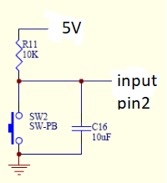



Test 3.6 (continue) EWI-by-switches
// pin D8 the thumb switch (L1)(pressed=high pitch)
//Finger (Li=Left hand finger i) i=1->5
//Finger (Ri=Right hand finger i) i=1->5
// L2,L3,L4; R2,R2,R3 (only 6 fingers are used)
// D7,D6,D5;D4,D3,D2
Known problems
  Switch debouche
  Midi runaway
  stability
To be added
  Try standalone sound generator (not nidi)
  R5 (finger 5)
  Low/high Pitch select
    Use pressure reading
    Use Accelerometer (gravitation vector)
5V
A3
pin2 (R4)
pin3 (R3)
pin4 (R2)
pin5 (L3)
pin6 (L3)
pin7 (L2)
pin8 (L1:left- thumb)
SW
Switches are similar to all pins
Arduino
UNO
GND
(thumb for low-high pitch select)
L1 Pin8
SW
L2 (pin7)
L3 (pin6)
L4 (pin5)
SW
R2 (pin4)
R3 (pin3)
R4 (pin2)
R5(optional)
https://www.youtube.com/watch?v=w4zxqRNTPb0

Slide 33
Test3.6 code
// pin D8 the thumb switch (L1)(pressed=high pitch)
//Finger (Li=Left hand finger i) i=1->5
//Finger (riRight hand finger i) i=1->5
// L2,L3,L4;R2,R2,R3
// D7,D6,D5;D4,D3,D2
////////////////essential part/////////
if ( digitalRead(8) == 0)
//thumb switch is unpressed, normal pitch
{
switch (cur_inkey)
{ case B111111: cur_tone = MIDI_Cs5; break;
//--pressure L_to_H: --Normal pitch
case B100111: cur_tone = MIDI_C5; break;
case B011111: cur_tone = MIDI_B4; break;
case B010111: cur_tone = MIDI_As4; break;
case B001111: cur_tone = MIDI_A4; break;
//--pressure L_to_H: --Normal pitch
case B001011: cur_tone = MIDI_Gs4; break;
case B000111: cur_tone = MIDI_G4; break;
case B000101: cur_tone = MIDI_Fs4; break;
case B000011: cur_tone = MIDI_F4; break;
case B000001: cur_tone = MIDI_E4; break;
case B000000: cur_tone = MIDI_D4; break;
}
}
////to do: try local sound generator
////
// if (cur_tone != old_tone)
// { delay(50); //seems to affect stablity, over 50 is btter?
//
//
#include "ardumidi.h"
#include "midi_table_full_1.h" //http://www.cse.cuhk.edu.hk/~khwong/www2/stem/midi_table_full1.h
int debug = 0; // set debug =1 if you want to Serial.print results
//http://newt.phys.unsw.edu.au/jw/notes.html
// B4-C6
// Hardware: pin D8 is in input mode,it is for the thumb switch (L1)(pressed=high pitch)
// Hardware:Finger L2,L3,L4;R2,R2,R3 (left hand L1 to L5), Right hand finger R1-R5
// input PIND pins: D7,D6,D5;D4,D3,D2
////////////////// data structure for MIDI ////////////////
int ledPin = 13;
int potpin = 3; //pressor sensor
//int note_on = 0;
byte voice = 75;
byte cur_tone = 0;//MIDI_C4;
byte old_tone = 0;//MIDI_C4;
char state;
int prs_threshold = 40;
int gap_L_to_H = 0;//2
int gap_H_to_L = 0;// testign the value by experiment
byte cur_inkey = 0;
byte old_inkey = 0;
byte key_change_tag = 0;
int cur_prs = 0;
int vel = 0;
byte old_prs = 0;
byte prs_changed_tag = 0;
/////////////////////////////////////////////////////////////
void setup()
{
Serial.begin(9600);
// Serial.begin(115200);
DDRD = 0b00000000; //All pins in PORTD are inputs
// pinMode(ledPin, OUTPUT);
pinMode(8, INPUT);
midi_note_off(0, old_tone, 127);//off first
voice = 75;
midi_program_change(0, voice); //mid
state = 'L'; //init to state //low_prs
}
// pressure profile /-----B------\
//-----------------+--------------+---------
//____________A___/ \___A___
//
void loop()
{
cur_prs = analogRead(potpin); // read pressure
//vel = (cur_prs / 2) + 50; //trial-an-error, max 1021, turn cur_prs(0-1023) into byte (0-127)
vel = 127; //fixed vecloity (volumn of the sound)
switch (state)
{
case 'L'://LLLLLLLLLLLLLLLLLLLLLLLLLLLLLLLLLLLLLL
if ( cur_prs < prs_threshold + gap_L_to_H)
{
state = 'L'; //keep at pressure L state no action
}
else
{
state = 'H'; //from pressure low to high , action is requie
midi_program_change(0, voice); //mid
// Hardware:Finger L2,L3,L4;R2,R2,R3
// input PIND pins: D7,D6,D5;D4,D3,D2
cur_inkey = (PIND & B11111100) >> 2;//PIND Reads the PORTD and put the values in the
/////////////////////////////////////////////////////////////
if ( digitalRead(8) == 0) //thumb switch is unpressed, normal pitch
{
switch (cur_inkey)
{ case B111111: cur_tone = MIDI_Cs5; break;//--pressure L_to_H: --Normal pitch
case B100111: cur_tone = MIDI_C5; break;
case B011111: cur_tone = MIDI_B4; break;
case B010111: cur_tone = MIDI_As4; break;
case B001111: cur_tone = MIDI_A4; break;//--pressure L_to_H: --Normal pitch
case B001011: cur_tone = MIDI_Gs4; break;
case B000111: cur_tone = MIDI_G4; break;
case B000101: cur_tone = MIDI_Fs4; break;
case B000011: cur_tone = MIDI_F4; break;
case B000001: cur_tone = MIDI_E4; break;
case B000000: cur_tone = MIDI_D4; break;
}
}
else //thumb switch is pressed, high pitch
{
switch (cur_inkey)
{ case B111111: cur_tone = MIDI_Cs6; break;//--pressure L_to_H: --high pitch
case B100111: cur_tone = MIDI_C6; break;
case B011111: cur_tone = MIDI_B5; break;
case B010111: cur_tone = MIDI_As5; break;
case B001111: cur_tone = MIDI_A5; break;//--pressure L_to_H: --high pitch
case B001011: cur_tone = MIDI_Gs5; break;
case B000111: cur_tone = MIDI_G5; break;
case B000101: cur_tone = MIDI_Fs5; break;
case B000011: cur_tone = MIDI_F5; break;
case B000001: cur_tone = MIDI_E5; break;
case B000000: cur_tone = MIDI_D5; break;
}
}
/////////////////////////////////////////////////////////////
midi_note_on(0, cur_tone, vel);//midi--
}
break;
case 'H'://HHHHHHHHHHHHHHHHHHHHHHHHHHHHHHHHHHHHHHHH
if ( cur_prs > prs_threshold - gap_H_to_L)
{
state = 'H'; //keep at pressure H state no action, inkey may change to chnage tone
// read_inkey(); //cancall a function, but may take time, so write directly below
cur_inkey = PIND >> 2; //PIND Reads the PORTD and put the values in the
/////////////////////////////////////////////////////////////
if ( digitalRead(8) == 0) //thumb switch is unpressed, normal pitch
{
switch (cur_inkey)
{ case B111111: cur_tone = MIDI_Cs5; break;//--pressure L_to_H: --Normal pitch
case B100111: cur_tone = MIDI_C5; break;
case B011111: cur_tone = MIDI_B4; break;
case B010111: cur_tone = MIDI_As4; break;
case B001111: cur_tone = MIDI_A4; break;//--pressure L_to_H: --Normal pitch
case B001011: cur_tone = MIDI_Gs4; break;
case B000111: cur_tone = MIDI_G4; break;
case B000101: cur_tone = MIDI_Fs4; break;
case B000011: cur_tone = MIDI_F4; break;
case B000001: cur_tone = MIDI_E4; break;
case B000000: cur_tone = MIDI_D4; break;
}
}
else //thumb switch is pressed, high pitch
{
switch (cur_inkey)
{ case B111111: cur_tone = MIDI_Cs6; break;//--pressure L_to_H: --high pitch
case B100111: cur_tone = MIDI_C6; break;
case B011111: cur_tone = MIDI_B5; break;
case B010111: cur_tone = MIDI_As5; break;
case B001111: cur_tone = MIDI_A5; break;//--pressure L_to_H: --high pitch
case B001011: cur_tone = MIDI_Gs5; break;
case B000111: cur_tone = MIDI_G5; break;
case B000101: cur_tone = MIDI_Fs5; break;
case B000011: cur_tone = MIDI_F5; break;
case B000001: cur_tone = MIDI_E5; break;
case B000000: cur_tone = MIDI_D5; break;
}
}
/////////////////////////////////////////////////////////////
if (cur_tone != old_tone)
{ //delay(50); //seems to affect stablity, over 50 is btter?
midi_note_off(0, old_tone, vel);//midi--
//delay(50);
midi_note_on(0, cur_tone, vel);//midi--
old_tone = cur_tone;
}
}
else
{
state = 'L'; //H to L transition action is required
midi_program_change(0, voice); //mid
midi_note_off(0, cur_tone, vel);//midi-
//should (may need to ) turn off all midi channels
// midiPanic();///////////check may ned to remove///////new???????
}
break;
default:
state = 'L';
//should (may need to ) turn off all midi channels
break;
}
//delay(20);
// if (debug == 1 ) {
// Serial.println(state);
// }
old_prs = cur_prs;
old_tone = cur_tone;
}
//////////////////////// run this to turn off all sounds //////////////////////////
void midiPanic() {
for (int i = 0; i < 128; i++) {
// midiSend((0x80 | MIDIchannel), i, 0);
// midiSend((0x80 | 0), i, 0);
midi_note_off(0, i, vel);
}
}

Slide 34
Test3.7 Music Tuner using Arduino
(not tested yet, will follow up)
https://circuitdigest.com/microcontroller-projects/arduino-uno-guitar-tuner
https://www.youtube.com/watch?v=EJltXLUTFHk
https://circuitdigest.com/microcontroller-projects/arduino-uno-guitar-tuner
motorized Guitar aromatic tuner
https://www.youtube.com/watch?v=EJltXLUTFHk

Slide 35
Tets3.8 Voice Recoding machine using ISD1820 Voice rec. chip
https://www.allelectronics.com/mas_assets/media/allelectronics2018/spec/ME-63.pdf
Not tested, will follow up

Slide 36
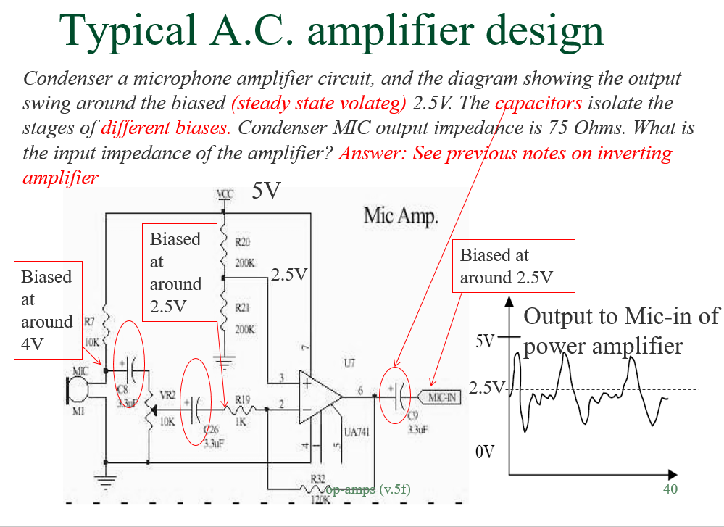
Test3.9a Audio sound level meter using LM741 op-amp amplifier (don’t use LM386, it is a power amp not designed for mic-pre-amp)
http://www.learningaboutelectronics.com/Articles/Arduino-microphone-circuit.php (Not tested)
https://circuitdigest.com/microcontroller-projects/arduino-sound-level-measurement (Not tested)
//#simple test program
void setup() {
Serial.begin(9600);
}
void loop() {
Serial.println(analogRead(0));
//delay(300);
}
Output display

Slide 37
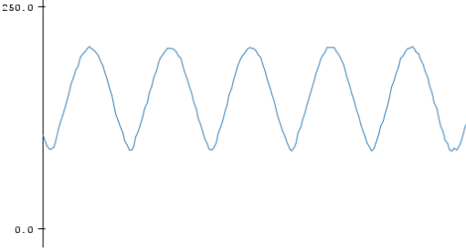
Test3.9b Sound sampling using interrupt https://arduino.stackexchange.com/questions/45927/arduino-continuously-reading-adc-value-using-interrupt
const byte adcPin = 0; // A0
const int MAX_RESULTS = 256;
volatile int results [MAX_RESULTS];
volatile int resultNumber;
void setup ()
{
Serial.begin (9600);
Serial.println ();
// reset Timer 1
TCCR1A = 0;
TCCR1B = 0;
TCNT1 = 0;
TCCR1B = bit (CS11) | bit (WGM12); // CTC, prescaler of 8
TIMSK1 = bit (OCIE1B);
OCR1A = 39;
OCR1B = 39; // 20 uS - sampling frequency 50 kHz
ADCSRA = bit (ADEN) | bit (ADIE) | bit (ADIF); // turn ADC on, want interrupt on completion
ADCSRA |= bit (ADPS2); // Prescaler of 16
// ADCSRA |= (1 << ADPS1) | (1 << ADPS0); // 8 prescaler for 153.8 KHz
ADMUX = bit (REFS0) | (adcPin & 7);
ADCSRB = bit (ADTS0) | bit (ADTS2); // Timer/Counter1 Compare Match B
ADCSRA |= bit (ADATE); // turn on automatic triggering
}
// ADC complete ISR
ISR (ADC_vect)
{
results[resultNumber++] = ADC;
if(resultNumber == MAX_RESULTS)
{
ADCSRA = 0; // turn off ADC
}
}
EMPTY_INTERRUPT (TIMER1_COMPB_vect);
void loop () {
while (resultNumber < MAX_RESULTS)
{ }
for (int i = 0; i < MAX_RESULTS; i++)
{
Serial.println (results [i]);
}
resultNumber = 0;
ADCSRA = bit (ADEN) | bit (ADIE) | bit (ADIF)| bit (ADPS2) | bit (ADATE);
// turn ADC back on
}
Can use the array: results [MAX_RESULTS] for pitch analysis.

Slide 38
Test3.9c Music tuner
https://www.instructables.com/id/Arduino-Guitar-Tuner/
Should use Center clipping and autocorrelation to get a better result

Slide 39
Test3.10a Arduino FFT
(To be done)
See http://wiki.openmusiclabs.com/wiki/ArduinoFFT
https://www.youtube.com/watch?v=jJ7lzkrQIFk
http://www.arduinoos.com/2010/10/fast-fourier-transform-fft/
https://www.youtube.com/watch?v=_GI7QWVvzas

Slide 40
Test3.10b Arduino FFT
(To be done)
https://www.norwegiancreations.com/2017/08/what-is-fft-and-how-can-you-implement-it-on-an-arduino/

Slide 41
Test 3.11, Use Arduino to find MFCC and build a simple speech recognition system (to be done)
https://github.com/Infineon/XMC-for-Arduino/blob/master/arm/libraries/DSP/src/mfcc.cpp
https://hackaday.com/2013/12/31/an-arduino-with-better-speech-recognition-than-siri/

Slide 42
Test 3. 12: Explore wekinator
http://www.wekinator.org/
he Wekinator is free, open source software originally created in 2009 by Rebecca Fiebrink. It allows anyone to use machine learning to build new musical instruments, gestural game controllers, computer vision or computer listening systems, and more.

Slide 43
Test 3.13: Computerized mouth to generate speech
control a mechanical mouth to generate speech signal

Slide 44
Test 3.14 Midi chips
AY-3-8910A DIP-40 IC芯片 AY-3-8910 宏宝利 ￥5.50
SN76489AN DIP-16 集成电路 IC芯片 SN76489N ￥1.80
YM2612 正品{保质量} ￥10.00
----------- not acquired yet-------------
YM2151 原装正品{保质量}¥4.00

Slide 45
Test3.14 YM2151 (not tested)
SN76489AN DIP-16 ￥1.80 (Taobo)
Experimenting with an Arduino and a SN76489 http://danceswithferrets.org/geekblog/?p=93
https://www.youtube.com/watch?v=Xz3ZNvXIEVQ
(Texas instruction data sheet) https://retrocdn.net/images/e/e0/SN76489_Application_Manual.pdf
Instruct able SN76489 Synthesizer project https://www.instructables.com/id/SN76489-Synthesizer/
SMS power SN76489 programming menu: https://www.smspower.org/Development/SN76489

Slide 46
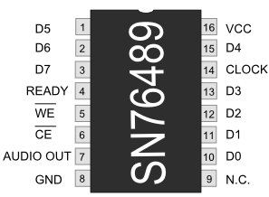
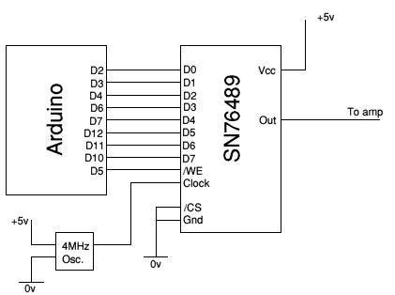
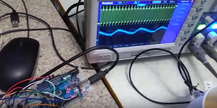
Test 3.15 SN76489
Digital Complex Sound Generator (DCSG) http://danceswithferrets.org/geekblog/?p=93
//SN76489 sound chip test
// 2020.3 .12 driving sn76489 using an arduino-uno, modifed from the follwowng references.
//http://danceswithferrets.org/geekblog/?p=93
//https://www.smspower.org/Development/SN76489#AccessingTheSN76489FromSoftware
//https://www.smspower.org/Development/SN76489#SN76489Sightings
//http://danceswithferrets.org/geekblog/wp-content/uploads/2014/01/sn76489_test.txt
//http://members.casema.nl/hhaydn/howel/parts/76489.htm
//can drive using a 4MHz or a sign gen of 3.759545 MHz (from the orginal ref.)
#define PIN_D0 2
#define PIN_D1 3
#define PIN_D2 4
#define PIN_D3 6
#define PIN_D4 7
#define PIN_D5 12
#define PIN_D6 11
#define PIN_D7 10
#define PIN_NotWE 5
void setup() {
// put your setup code here, to run once:
Serial.begin(9600);
pinMode(PIN_D0, OUTPUT);
pinMode(PIN_D1, OUTPUT);
pinMode(PIN_D2, OUTPUT);
pinMode(PIN_D3, OUTPUT);
pinMode(PIN_D4, OUTPUT);
pinMode(PIN_D5, OUTPUT);
pinMode(PIN_D6, OUTPUT);
pinMode(PIN_D7, OUTPUT);
pinMode( PIN_NotWE , OUTPUT);
digitalWrite( PIN_NotWE , HIGH);
SilenceAllChannels();
delay(500);
}
void SilenceAllChannels()
{
SendByte(0x9f);
SendByte(0xbf);
SendByte(0xdf);
SendByte(0xff);
}
void SendByte(byte b)
{
digitalWrite(PIN_D0, (b & 1) ? HIGH : LOW);
digitalWrite(PIN_D1, (b & 2) ? HIGH : LOW);
digitalWrite(PIN_D2, (b & 4) ? HIGH : LOW);
digitalWrite(PIN_D3, (b & 8) ? HIGH : LOW);
digitalWrite(PIN_D4, (b & 16) ? HIGH : LOW);
digitalWrite(PIN_D5, (b & 32) ? HIGH : LOW);
digitalWrite(PIN_D6, (b & 64) ? HIGH : LOW);
digitalWrite(PIN_D7, (b & 128) ? HIGH : LOW);
digitalWrite(PIN_NotWE, HIGH);
digitalWrite(PIN_NotWE, LOW);
digitalWrite(PIN_NotWE, HIGH);
}
uint8_t g_SoundData[] =
{
0, 0x84, 0, 0x27, // C0 tone 0x274
0, 0x90, // C0 vol 15
5, 0x91, // C0 vol 14
4, 0x92, // C0 vol 13
4, 0x93, // C0 vol 12
6, 0x8f, 0, 0x22, // C0 tone 0x22f
0, 0x90, // C0 vol 15
4, 0x91, // C0 vol 14
4, 0x92, // C0 vol 13
2, 0x84, 0, 0x27, // C0 tone 0x274
0, 0x90, // C0 vol 15
4, 0x91, // C0 vol 14
4, 0x92, // C0 vol 13
4, 0x93, // C0 vol 12
8, 0x80, 0, 0x2c, // C0 tone 0x2c0
0, 0x90, // C0 vol 15
4, 0x91, // C0 vol 14
4, 0x92, // C0 vol 13
2, 0x8b, 0, 0x2e, // C0 tone 0x2eb
0, 0x90, // C0 vol 15
4, 0x91, // C0 vol 14
4, 0x92, // C0 vol 13
4, 0x93, // C0 vol 12
8, 0x8c, 0, 0x3a, // C0 tone 0x3ac
0, 0x90, // C0 vol 15
4, 0x91, // C0 vol 14
4, 0x92, // C0 vol 13
2, 0x85, 0, 0x34, // C0 tone 0x345
0, 0x90, // C0 vol 15
4, 0x91, // C0 vol 14
4, 0x92, // C0 vol 13
4, 0x93, // C0 vol 12
8, 0x84, 0, 0x3e, // C0 tone 0x3e4
0, 0x90, // C0 vol 15
4, 0x91, // C0 vol 14
4, 0x92, // C0 vol 13
2, 0x8c, 0, 0x3a, // C0 tone 0x3ac
0, 0x90, // C0 vol 15
4, 0x91, // C0 vol 14
4, 0x92, // C0 vol 13
4, 0x93, // C0 vol 12
48, 0x90, // C0 vol 15
4, 0x91, // C0 vol 14
1, 0x85, 0, 0x34, // C0 tone 0x345
0, 0x90, // C0 vol 15
4, 0x91, // C0 vol 14
1, 0x8b, 0, 0x2e, // C0 tone 0x2eb
0, 0x90, // C0 vol 15
4, 0x91, // C0 vol 14
1, 0x80, 0, 0x2c, // C0 tone 0x2c0
0, 0x90, // C0 vol 15
4, 0x91, // C0 vol 14
1, 0x84, 0, 0x27, // C0 tone 0x274
0, 0x90, // C0 vol 15
4, 0x91, // C0 vol 14
1, 0x83, 0, 0x1f, // C0 tone 0x1f3
0, 0x90, // C0 vol 15
4, 0x91, // C0 vol 14
1, 0x87, 0, 0x1d, // C0 tone 0x1d7
0, 0x90, // C0 vol 15
4, 0x91, // C0 vol 14
2, 0x92, // C0 vol 13
2, 0x93, // C0 vol 12
1, 0x94, // C0 vol 11
2, 0x95, // C0 vol 10
1, 0x96, // C0 vol 9
2, 0x97, // C0 vol 8
2, 0x98, // C0 vol 7
1, 0x99, // C0 vol 6
2, 0x9a, // C0 vol 5
1, 0x9b, // C0 vol 4
2, 0x9c, // C0 vol 3
2, 0x9d, // C0 vol 2
1, 0x9e, // C0 vol 1
2, 0x9f, // C0 vol 0
// Done. 90 lines.
// Multiplier for time required = 10
};
int g_iLine = 0; // current line (command, really)
void loop() {
int size_of_g_SoundData = sizeof(g_SoundData);
byte iDelay = g_SoundData[g_iLine];
g_iLine ++;
byte iByte = g_SoundData[g_iLine];
Serial.println(iDelay, HEX); //send out for inspection
Serial.println(iByte, HEX);
Serial.println("---");
SendByte(iByte);
delay(iDelay * 1);
if ( g_iLine > size_of_g_SoundData )
g_iLine = 0;
else
g_iLine++;
}
Demo video: https://www.youtube.com/watch?v=wBzdjRDGK9E

Slide 47
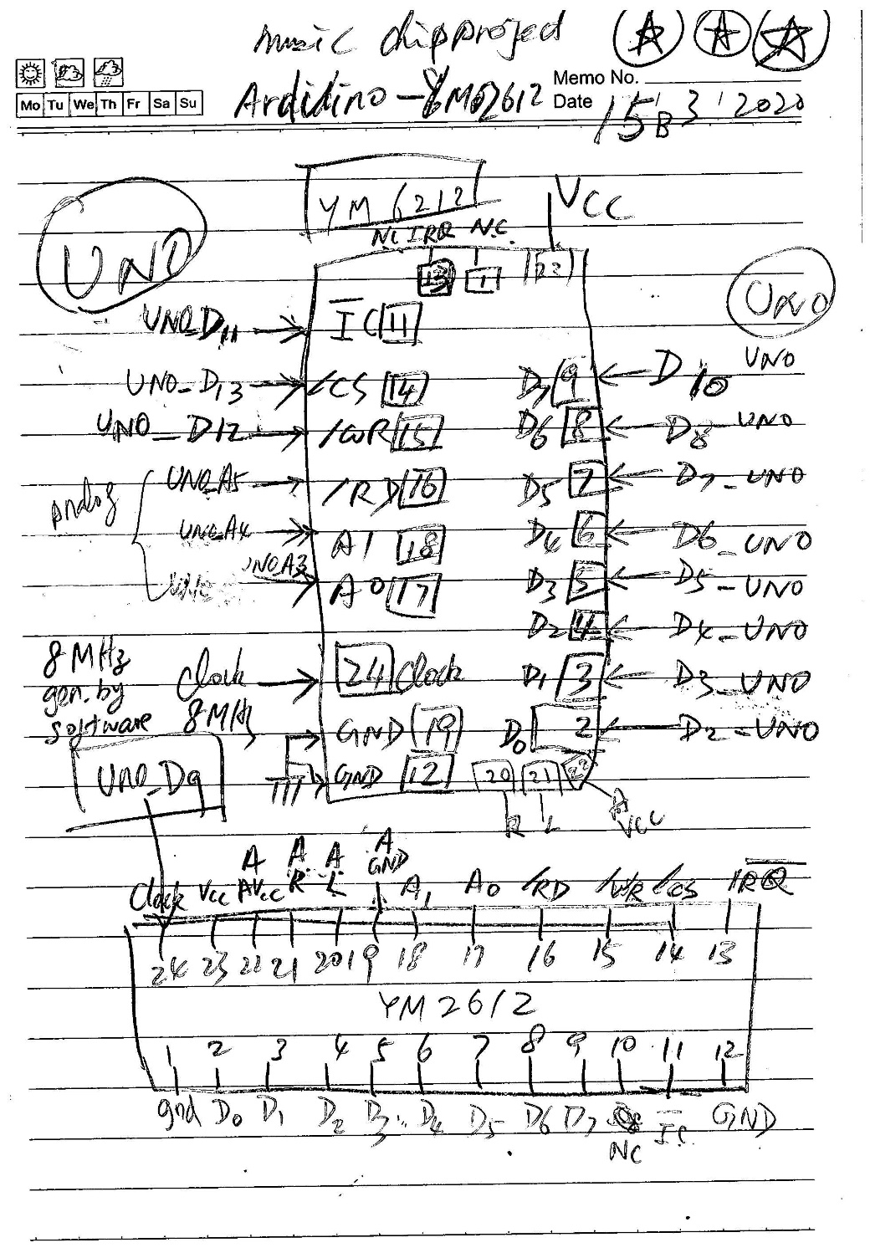
Test3.16) YM2612-Arduino (UNO)circuits (tested_ok
Use software generated 8MHz clock at D9.
Several schemes to save pins. Use Digital pins only.
Demo video: https://www.youtube.com/watch?v=Gc54n8f-gAs

Slide 48
Test3.16) YM2612-Arduino
YM2612-Arduino Program: YM2612_1b_test5a_ok
//YM2612 driving programing by Arduino Uno, 2020 March 17 , 9:50am
//adduino -->YM2612
/*
https://blog.thea.codes/genesynth-part-2-basic-communication/
https://www.smspower.org/maxim/Documents/YM2612#testprogram (datasheet)
https://console5.com/wiki/YM2612
https://github.com/AidanHockey5/STM32_VGM_Player_YM2612_SN76489/blob/master/README.md
https://github.com/skywodd/avr_vgm_player/tree/master/ym2612_test
https://github.com/skywodd/avr_vgm_player/blob/master/ym2612_test/README.md
https://github.com/skywodd/avr_vgm_player/blob/master/ym2612_test/ym2612_test.c
The YM2612 requires a 7.670442MHz clock signal. Crystals at this exact speed are next to impossible to find, though rare 7.68 MHz crystals do exist and would probably work for this project.
https://www.aidanlawrence.com/hardware-sega-genesis-video-game-music-player/
http://www.midibox.org/dokuwiki/doku.php?id=mbhp_genesis
*/
/*
The YM2612 on the other hand has six different control pins that we need to worry about:
https://www.aidanlawrence.com/hardware-sega-genesis-video-game-music-player/
IC: System reset (completely clears all data from the YM2612)
CS: Chip Select, active LOW
WR: Write Mode on data bus, active LOW
RD: Read Mode on Data bus, active LOW
A0: Read/Write enable, active HIGH
A1: Part 1 / Part 2 select (LOW for Part 1, HIGH for Part 2)
*/
/*
The YM-2612 is accessed through memory locations 4000H - 4003H in the Z80 case,
or A04000H - A04003H in the 68000 case. These will be referred to as 4000 to 4003.
To write to Part I, write the 8 bit address to 4000 and the data to 4001.
To write to Part II, write the 8-bit address to 4002 and the data to 4003
That means
[A1,A0]=[0,0]=address part 1,
[A1,A0]=[0,1]=data part 1,
[A1,A0]=[1,0]=address part 2,
[A1,A0]=[1,1]=data part 2,
Part I : address 21H -->B6H (LFO,Timers,keyon/ff,DAC ,FM-channels 1-3)
Part II: address 30H -->B6H (FM-channels 4-6)
CAUTION: Before writing, read from any address to determine if the
YM-2612 I/O is still busy from the last write. Delay until bit 7 returns to 0.
*/
//http://gendev.spritesmind.net/forum/viewtopic.php?t=386&start=480
//2020 March 17, khw
//This program generate the fnum , LSB, MSB for YM2612 registers at address : A4H(MSB), A0H(LSB)
//ref //https://www.aidanlawrence.com/mega-midi-a-playable-version-of-my-hardware-sega-genesis-synth/
//// the intermediate values of the number in the question is very large,
//so use float and transfer back to int afterward. see the program.
// The block(octactves) are controlled by 3-bits : bit5,4,3 of reg. at A4H, so 7 octaves altogther
int freq[] =
{ 262, 277, 294, 311, 330, 349, 370, 392, 415, 440, 466, 494,};//from C4
//0C 1C# 2D 3D# 4E 5F 6F# 7G 8G# 9A 10A# 11B
//0 2 4 5 7 9 11 //white notes
//int fnum[] = { 618, 654, 693, 734, 778, 824, 873, 925, 980, 1038, 1100, 1165,}; //from C4
String note[] = { "C", "C#", "D", "D#", "E", "F", "D#", "G", "G#", "A", "A#", "B",}; //from C4
//byte fnum_MSB[] = { 0x02, 0x02, 0x02, 0x02, 0x03, 0x03, 0x03, 0x03, 0x03, 0x04, 0x04, 0x04,};//from C4
//byte fnum_LSB[] = { 0x6A, 0x8E, 0xB5, 0xDE, 0x0A, 0x38, 0x69, 0x9D, 0xD4, 0x0E, 0x4C, 0x8D,};//from C4
float osc_freq =8000000; //oscillator frequency at Pin24 of YM2612
float fnum_float;
unsigned int fnum_int;
byte fnum_MSB[12], fnum_LSB[12];
void setup_gen_fnum()
{
// put your main code here, to run repeatedly:
for (int i = 0; i < 12; i++)
{
fnum_float = (float)144 * freq[i] * (pow(2 , 20) / osc_freq) / pow(2, 4 - 1);
fnum_int = (unsigned int)fnum_float;
fnum_MSB[i] = fnum_int >> 8;
fnum_LSB[i] = fnum_int & 0x00FF;
}
}
#define WAIT_BUSY_DELAY 10
#define HIGH_an 255
#define LOW_an 0
#define Pin_D0 2 //YM2612 pin_2 is data /D0
#define Pin_D1 3 //YM2612 pin_3 is data /D1
#define Pin_D2 4 //YM2612 pin_4 is data /D2
#define Pin_D3 5 //YM2612 pin_5 is data /D3
#define Pin_D4 6 //YM2612 pin_6 is data /D4
#define Pin_D5 7 //YM2612 pin_7 is data /D5
#define Pin_D6 8 //YM2612 pin_8 is data /D6
#define Pin_D7 10 //YM2612 pin_9 is data /D7
#define not_IC 11 //YM2612 pin_11 is /IC
#define not_WR 12 //YM2612 pin_15 is /WR
#define not_CS 13 //YM2612 pin_14 is /CS
#define Addr0_an A3 //using analog pin, YM2612 pin_17 is address /A0
#define Addr1_an A4 //using analog pin, YM2612 pin_18 is adddres /A1
#define not_RD_an A5 //using analog pin, YM2612 pin_16 is /RD, /can remove to save pins
/////////////////////// gen. freq. begins /////////////////////////
// gen.freq. 8MHz, 4MHz, 2MHZ, 1MHz by Arduino-UNO, assume CPU-clock is 16MHz
//https://forum.arduino.cc/index.php?topic=432538.0
const int freqOutputPin = 9;//OC1A output pin for ATmega32u4 (Arduino-UNO)
const int ocr1aval = 0;//ocr1aval=0->8MHz; 1->4MHz,3->2MHz,7->1MHz
void setup_clock()
{
pinMode(freqOutputPin, OUTPUT);
TCCR1A = ( (1 << COM1A0));
TCCR1B = ((1 << WGM12) | (1 << CS10));
TIMSK1 = 0;
OCR1A = ocr1aval;
}
/////////////////////// gen. freq. ends /////////////////////////
// the setup function runs once when you press reset or power the board
void setup() {
setup_gen_fnum();
Serial.begin(9600);
setup_clock();
// initialize digital pin LED_BUILTIN as an output.
pinMode(Pin_D0, OUTPUT);
pinMode(Pin_D1, OUTPUT);
pinMode(Pin_D2, OUTPUT);
pinMode(Pin_D3, OUTPUT);
pinMode(Pin_D4, OUTPUT);
pinMode(Pin_D5, OUTPUT);
pinMode(Pin_D6, OUTPUT);
pinMode(Pin_D7, OUTPUT);
pinMode(not_IC, OUTPUT);
pinMode(not_WR, OUTPUT);
pinMode(not_CS, OUTPUT);
pinMode(not_RD_an, OUTPUT); // can be removed to safe pins,this sys. always write
pinMode(Addr0_an, OUTPUT);
pinMode(Addr1_an, OUTPUT);
//initilization: set all control signal high
digitalWrite(not_IC, HIGH); //IC
digitalWrite(not_WR, HIGH); //WR
digitalWrite(not_CS, HIGH); //CS
analogWrite(not_RD_an, HIGH_an); //analog : RD
//reset all registers by setting /IC HIGH-LOW-HIGH
digitalWrite(not_IC, HIGH);
delay(100);
digitalWrite(not_IC, LOW); //IC
delay(100);
digitalWrite(not_IC, HIGH); //IC
delay(100);
}
////////wait_till_not_busy()/////////////////////////////////////
void wait_till_not_busy()
{
delay(WAIT_BUSY_DELAY); //may wait until read-reg D7 is 0, not implemented here
}
//// write reg function/////////////////////////////////////
void write_reg(byte part, byte address, byte data )
{
// Serial.println(part, HEX);
// Serial.println(address, HEX);
// Serial.println(data, HEX);
// Serial.println("............................");
//---------- step 3 setup address-----------------------------------
analogWrite(Addr0_an, LOW_an); //*****about to write address to register..
analogWrite(Addr1_an, LOW_an); //*****part1 ........
digitalWrite(Pin_D0, (address & 1) ? HIGH : LOW);
digitalWrite(Pin_D1, (address & 2) ? HIGH : LOW);
digitalWrite(Pin_D2, (address & 4) ? HIGH : LOW);
digitalWrite(Pin_D3, (address & 8) ? HIGH : LOW);
digitalWrite(Pin_D4, (address & 16) ? HIGH : LOW);
digitalWrite(Pin_D5, (address & 32) ? HIGH : LOW);
digitalWrite(Pin_D6, (address & 64) ? HIGH : LOW);
digitalWrite(Pin_D7, (address & 128) ? HIGH : LOW);
//wait_till_not_busy(); /// for address register write
actual_writing_operation();
// ---------step4 send data --------------------------------------
analogWrite(Addr0_an, HIGH_an); //*****about to write data to register............
analogWrite(Addr1_an, LOW_an); //*****part1 ........
digitalWrite(Pin_D0, (data & 1) ? HIGH : LOW);
digitalWrite(Pin_D1, (data & 2) ? HIGH : LOW);
digitalWrite(Pin_D2, (data & 4) ? HIGH : LOW);
digitalWrite(Pin_D3, (data & 8) ? HIGH : LOW);
digitalWrite(Pin_D4, (data & 16) ? HIGH : LOW);
digitalWrite(Pin_D5, (data & 32) ? HIGH : LOW);
digitalWrite(Pin_D6, (data & 64) ? HIGH : LOW);
digitalWrite(Pin_D7, (data & 128) ? HIGH : LOW);
//wait_till_not_busy(); /// for address register write
actual_writing_operation();
}
void actual_writing_operation()
{ //write 100 times to make sure the data is written into the reg.
// for (int n = 0; n < 10; n++)
{
delay(1);
analogWrite(not_RD_an, HIGH_an); //write prcess, set RD to HIGH
digitalWrite(not_CS, LOW); //CS
digitalWrite(not_WR, LOW); //WR
delay(1);//delay to give enough time to latch data
digitalWrite(not_WR, HIGH); //WR, actual writing at this point
digitalWrite(not_CS, HIGH); //CS
delay(1);//delay for write operation to finish
}
}
//////// main loop ////////////////////////////////
byte freq1 = 0;
void loop()
{
byte part = 1;
//https://www.smspower.org/maxim/Documents/YM2612
write_reg(part, 0x22, 0x00); //LFO off
write_reg(part, 0x27, 0x00); //Channel3 mode normal
write_reg(part, 0x28, 0x00); //All channnels off
write_reg(part, 0x28, 0x01);
write_reg(part, 0x28, 0x02);
write_reg(part, 0x28, 0x04);
write_reg(part, 0x28, 0x05);
write_reg(part, 0x28, 0x06);
write_reg(part, 0x2B, 0x00); // DAC off
write_reg(part, 0x30, 0x71); // DT1/MUL
write_reg(part, 0x34, 0x0D);
write_reg(part, 0x38, 0x33);
write_reg(part, 0x3C, 0x01);
write_reg(part, 0x40, 0x23); // Total Level
write_reg(part, 0x44, 0x2D);
write_reg(part, 0x48, 0x26);
write_reg(part, 0x4C, 0x00);
write_reg(part, 0x50, 0x5F); // RS/AR
write_reg(part, 0x54, 0x99);
write_reg(part, 0x58, 0x5F);
write_reg(part, 0x5C, 0x94);
write_reg(part, 0x60, 0x05); // AM/D1R
write_reg(part, 0x64, 0x05);
write_reg(part, 0x68, 0x05);
write_reg(part, 0x6C, 0x07);
write_reg(part, 0x70, 0x02); // D2R
write_reg(part, 0x74, 0x02);
write_reg(part, 0x78, 0x02);
write_reg(part, 0x7C, 0x02);
write_reg(part, 0x80, 0x11); // D1L/RR
write_reg(part, 0x84, 0x11); //
write_reg(part, 0x88, 0x11); //
write_reg(part, 0x8C, 0xA6);
write_reg(part, 0x90, 0x00); // Proprietary
write_reg(part, 0x94, 0x00);
write_reg(part, 0x98, 0x00);
write_reg(part, 0x9C, 0x00);
write_reg(part, 0xB0, 0x32); // Feedback/algorithm
write_reg(part, 0xB4, 0xC0); // Both speakers on
write_reg(part, 0x28, 0x00); // Key off
write_reg(part, 0xA4, 0x22); // Set frequency
write_reg(part, 0xA0, 0x69); //
//write_reg(part, 0x28, 0xF0); // Key on
//wait
//delay(500); // delay for some time
//write_reg(part, 0x28, 0x00); // Key off
// delay(100); // delay for some time
//
//https://github.com/skywodd/avr_vgm_player/blob/master/ym2612_test/ym2612_test.c
// write_reg(part, 0x70, 0x02); //
// write_reg(part, 0x74, 0x02); //
// write_reg(part, 0x78, 0x02); //
// write_reg(part, 0x7C, 0x02); // D2R
// write_reg(part, 0x80, 0x11); //
// write_reg(part, 0x84, 0x11); //
// write_reg(part, 0x88, 0x11); //
// write_reg(part, 0x8C, 0xA6); // D1L/RR
// write_reg(part, 0x90, 0x00); //
// write_reg(part, 0x94, 0x00); //
// write_reg(part, 0x98, 0x00); //
// write_reg(part, 0x9C, 0x00); // Proprietary
// write_reg(part, 0xB0, 0x32); // Feedback/algorithm
// write_reg(part, 0xB4, 0xC0); // Both speakers on
// write_reg(part, 0x28, 0x00); // Key off
// write_reg(part, 0xA4, 0x22); //Set frequency,MSB
// write_reg(part, 0xA0, 0x69); // Set frequency, LSB
//A0H+ Frequency number LSB, A4H+ Block Frequency Number MSB
//https://plutiedev.com/ym2612-registers
/* Program loop */
for (;;)
{ for (byte b = 0; b < 7; b++)//for each octave
{
for (int i = 0; i < 12; i++)// each note
{
//int freq[] ={ 262, 277, 294, 311, 330, 349, 370, 392, 415, 440, 466, 494,};//from C4
// 0C 1C# 2D 3D# 4E 5F 6F# 7G 8G# 9A 10A# 11B
// 0 2 4 5 7 9 11
if (i ==0 || i == 2 || i == 4 || i == 5|| i == 7 || i == 9 || i == 11)//white piano notes only
//if (i ==1 || i == 3 || i == 6 || i == 8 || i == 10) //black piano notes only
{//Serial.print(i);
Serial.print(note[i]);
Serial.print(b);
Serial.print("----------------i=");
Serial.print(i);
Serial.print(", note[i]=");
Serial.print(note[i]);
Serial.print(", freq[i]=");
Serial.print(freq[i]);
Serial.println(" Hz----------------");
Serial.print(" fnum_int = 0x");
Serial.println(fnum_int, HEX);
Serial.print(" fnum_MSB [i]=0x");
Serial.println(fnum_MSB[i], HEX);
Serial.print(" fnum_LSB [i]=0x");
Serial.println(fnum_LSB[i], HEX);
//http://gendev.spritesmind.net/forum/viewtopic.php?t=386&start=480
// A4=> Fum(A4)=144 * 440 * (2^20 / 8000000) / 2^(4- 1) = 1038 = 0x040E
// C => Fnum(C)=144 * 262 * (2^20 / 8000000) / 2^(4- 1) = 618 = 0x026A
// write_reg(part, 0x28, 0x00); // Key off
write_reg(part, 0xA4, fnum_MSB[i] | b << 3); //MSB freq,https://plutiedev.com/ym2612-registers#reg-26
// Serial.println((b*8),HEX);
write_reg(part, 0xA0, fnum_LSB[i]); // Set LSB frequency,https://md.railgun.works/index.php?title=YM2612#DAC
delay(10);//_delay_ms(2000);
write_reg(part, 0x28, 0xF0); // setreg(0x28, 0xF0); // Key on
delay(1000);//_delay_ms(2000);
write_reg(part, 0x28, 0x00); //setreg(0x28, 0x00); // Key off
}
}
}
}
}

Slide 49
Gen_fnum for ym2612
//2020 March 17, khw
//This program generate the fnum , LSB, MSB for YM2612 registers at address : A4H(MSB), A0H(LSB)
//ref //https://www.aidanlawrence.com/mega-midi-a-playable-version-of-my-hardware-sega-genesis-synth/
//// the intermediate values of the number in the question is very large,
//so use float and transfer back to int afterward. see the program.
// The block(octactves) are controlled by 3-bits : bit5,4,3 of reg. at A4H, so 7 octaves altogther
int freq[] =
{ 262, 277, 294, 311, 330, 349, 370, 392, 415, 440, 466, 494,};//from C4
//0C 1C# 2D 3D# 4E 5F 6F# 7G 8G# 9A 10A# 11B
//0 2 4 5 7 9 11 //white notes
//int fnum[] = { 618, 654, 693, 734, 778, 824, 873, 925, 980, 1038, 1100, 1165,}; //from C4
String note[] = { "C", "C#", "D", "D#", "E", "F", "D#", "G", "G#", "A", "A#", "B",}; //from C4
//byte fnum_MSB[] = { 0x02, 0x02, 0x02, 0x02, 0x03, 0x03, 0x03, 0x03, 0x03, 0x04, 0x04, 0x04,};//from C4
//byte fnum_LSB[] = { 0x6A, 0x8E, 0xB5, 0xDE, 0x0A, 0x38, 0x69, 0x9D, 0xD4, 0x0E, 0x4C, 0x8D,};//from C4
void setup() {
// put your setup code here, to run once:
setup_gen_fnum();
Serial.begin(9600);
}
float osc_freq =8000000; //oscillator frequency at Pin24 of YM2612
float fnum_float;
unsigned int fnum_int;
byte fnum_MSB[12], fnum_LSB[12];
void setup_gen_fnum()
{
// put your main code here, to run repeatedly:
for (int i = 0; i < 12; i++)
{
fnum_float = (float)144 * freq[i] * (pow(2 , 20) / osc_freq) / pow(2, 4 - 1);
fnum_int = (unsigned int)fnum_float;
fnum_MSB[i] = fnum_int >> 8;
fnum_LSB[i] = fnum_int & 0x00FF;
}
}
void loop() {
/// for display resulst only
for (int i = 0; i < 12; i++)
{
Serial.print("----------------i=");
Serial.print(i);
Serial.print(", note[i]=");
Serial.print(note[i]);
Serial.print(", freq[i]=");
Serial.print(freq[i]);
Serial.println(" Hz----------------");
Serial.print(" fnum_int = 0x");
Serial.println(fnum_int, HEX);
Serial.print(" fnum_MSB [i]=0x");
Serial.println(fnum_MSB[i], HEX);
Serial.print(" fnum_LSB [i]=0x");
Serial.println(fnum_LSB[i], HEX);
delay(1000);
}
}

Slide 50
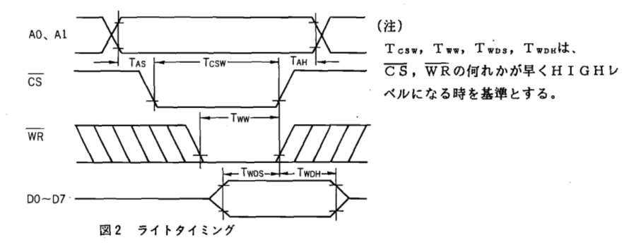
Test3.16) :Timing diagram for YM2612
http://davesblog.fo.am/2017/10/adventures-with-fm-sound-and-the-ym2612/

Slide 51
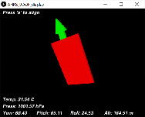
How to use MPU6050_DMP6 (IMU) with processing
GY80-master _tested_ok_200831.zip
How to run GY80-master _tested_ok_200831, 2020 Aug 31
Download GY80-master _tested_ok_200831 from
http://www.cse.cuhk.edu.hk/%7Ekhwong/www2/stem/GY80-master%20_tested_ok_200831.zip and unzip to a directory , say,
C:\Users\khwong\Documents\Arduino\GY80-master _tested_ok_200831, you have two major directories
directory 1: \ C:\Users\khwong\Documents\Arduino\GY80-master _tested_ok_200831\AHRS_9DOF_arduino\AHRS_9DOF
    It contains AHRS_9DOF.ino,
edit AHRS_9DOF.ino to check the correct Badu rate
      (line 51 #define OUTPUT_BAUD_RATE 57600 //115200)
    compile this .ino and upload to an Arduino–uno etc.
check which comm port you are using say “Com12”
You may open the Arduino/Tools/Serial_monito to see the data sending out from the Arduino, close the Com_window after the observation, otherwise processing cannot read this pot.
directory 2: C:\Users\khwong\Documents\Arduino\GY80-master _tested_ok_200831\AHRS_9DOF_processing\AHRS_9DOF_display
    That contains the “processing” code: AHRS_9DOF_display.pde
Install “processing”: Download processing (I tested the 32-bit version) from https://processing.org/download/
Save in somewhere: say c:\processing-3.5.4\
Go to the directory c:\processing-3.5.4\, double click “processing.exe” to start processing
In the processing window, open the *.pde (i.e. file AHRS_9DOF_display.pde) in directory 2(see above)
In AHRS_9DOF_display.pdeC , ceck if the correct prot is used, in
    line 24 of AHRS_9DOF_display, should conatin
      final static int SERIAL_PORT_BAUD_RATE = 57600; //115200; // choose the correct that matches the Arduino output baud rate, see above
Reference:
3D display is achieved by using
https://processing.org/

Slide 52
SOUNDCIPHE with processing
2020.9.1 khw
Use of SOUNDCIPHER ( http://explodingart.com/soundcipher/download.html ) under processing. Assume you have installed processing (tested 32-bit) under C:\processing-3.5.4
Download http://explodingart.com/soundcipher/soundcipher.zip from http://explodingart.com/soundcipher/download.html
unzip \soundcipher and place the unzipped directory in
C:\processing-3.5.4\modes\java\libraries\soundcipher
also copy C:\processing-3.5.4\modes\java\libraries\soundcipher\examples
to C:\processing-3.5.4\ examples
run C:\processing-3.5.4\examples\Bing\Bing.pde to test if it is ok.

Slide 53
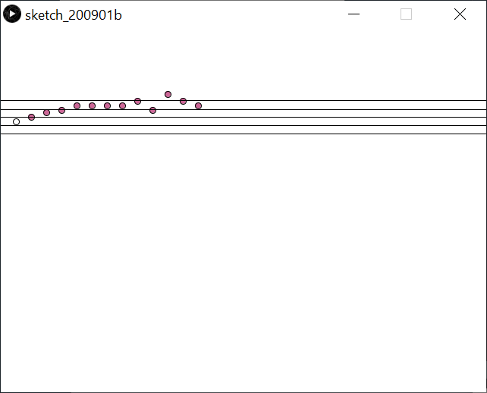
Draw music score using SOUNDCIPHE/processing https://forum.processing.org/two/discussion/298/assign-times-to-musical-notes
//https://forum.processing.org/two/discussion/298/assign-times-to-musical-notes
import arb.soundcipher.*;
import arb.soundcipher.constants.*;
//import processing.serial.*; //llama a todas las intruccionnes con todas las extenciones
SoundCipher part1 = new SoundCipher(this);
SCScore score = new SCScore();
float[] pitches = {
69, 71, 73, 74, 76, 76, 76, 76, 78, 74, 81, 78, 76
};
float[] durations = {
0.5, 0.5, 0.5, 0.5, 0.5, 0.5, 0.5, 0.5, 0.5, 0.5, 0.5, 0.5, 2.0
};
float[] dynamics = new float[pitches.length];
int n = 0;
int a = 0;
int b = 0;
float xLoc = 0;
float yLoc = -150;
float lineDistY = 100;
float posX = 0;
float posX2 = 0;
void setup() {
size(640, 480);
for (int i=0; i<durations.length; i++) {
dynamics[i] = random(40) + 70;
}
background(255);
stroke(0);
frameRate(2);
// double newPitches = pitches[a];
// double newDurations = durations[a];
for (int a = 0; a<pitches.length; a++) {
score.addNote( a, 0, 34, pitches[a], 20, durations[a]*10, 0.2, 64);
// a+=1;
// score.play(1);
}
a=0;
score.play();
// noLoop();
}
void draw()
{
if (score.isPlaying() && a < pitches.length) {
//
// if (a >= pitches.length-1) {
// a = 0;
// }
if (xLoc >= width) {
xLoc = 0;
yLoc = yLoc + lineDistY;
}
line(0, 139.5, 640, 139.5);
line(0, 128.5, 640, 128.5);
line(0, 117.5, 640, 117.5);
line(0, 107, 640, 107);
line(0, 95.5, 640, 95.5);
ellipse(xLoc+20, height-3*pitches[a]+yLoc, 8, 8);
fill(204, 102, 150); //rellena la ellipse con un color determinado
// a += 1;
xLoc += 20.0;
println(a);
double newPitches = pitches[a];
double newDurations = durations[a];
//for (int a = 0; a<pitches.length; a++) {
// score.addNote(0, 0, 34, pitches[a], 20, durations[a], 0.2, 64);
// }
//println(pitches[a]);
//println(newPitches);
a+=1;
// println(pitches);
}
}
//

Slide 54
Appendix

Slide 55
Appendix 1) Midi chips
YM2616 Yamaha sound synthesizer chip
  https://www.youtube.com/watch?v=DrbxkKNY-pk
  https://www.smspower.org/maxim/Documents/YM2612
  http://www.vgmpf.com/Wiki/index.php?title=YM2612
  https://skyduino.wordpress.com/2013/09/15/avrarduino-code-de-test-pour-chipset-ym2612/
Ym2149f
  http://www.florentflament.com/blog/driving-ym2149f-sound-chip-with-an-arduino.html
  https://electronicfields.wordpress.com/2012/04/09/ym2149-sound-generator-arduino-fast-pin-switching/
The TNDY SN76489 3 Voice Sound Card
  https://ko-fi.com/post/The-TNDY-SN76489-3-Voice-Sound-Card-M4M715TFL
Software
  https://easyeda.com/shaungoda/arduino-fm-midi-synth
  https://pdf1.alldatasheet.com/datasheet-pdf/view/391581/PTC/PT2399.html
  http://www.music-software-development.com/midi-tutorial.html
  https://link.springer.com/chapter/10.1007/978-1-4842-1583-8_5

Slide 56
Appendix 1) MIDI hardware projects
How to Make an Arduino Sound Synthesizer With MIDI Interface: https://www.instructables.com/id/How-to-make-an-Arduino-sound-synthesizer-with-MIDI/
use of DSP-G1 Voice Chip: http://static6.arrow.com/aropdfconversion/96e92579182fd1d52fd332098d395568a2fb8c42/pgurl_5145954282070200.pdf
Build a sound synthesizer using YM2612: https://www.smspower.org/maxim/Documents/YM2612

Slide 57
Appendix 3) Midi software Projects
https://www.instructables.com/id/Arduino-Flute-Synth/
https://www.instructables.com/id/Arduino-Synthesizer-With-FM/
https://www.instructables.com/id/The-Arduino-Synthesizer/
https://www.instructables.com/id/Arduino-Synthesizer-With-FM/
https://projectgus.github.io/hairless-midiserial/

Slide 58
Appendix 4) Links
https://www.instructables.com/id/Turn-your-Arduino-into-a-4-voice-wavetable-synth-w/
https://github.com/Wohlstand/libOPNMIDI
https://forum.arduino.cc/index.php?topic=530559.0
http://danceswithferrets.org/geekblog/?p=93
https://www.instructables.com/id/Arduino-Flute-Synth/
https://www.instructables.com/id/Arduino-Synthesizer-With-FM/
https://www.instructables.com/id/The-Arduino-Synthesizer/

Slide 59
Appendix 5 : Open music lab
http://www.openmusiclabs.com/

Slide 60
LSTM-RNN Keras music examples
Download
https://github.com/omerbsezer/LSTM_RNN_Tutorials_with_Demo , 3 demos. Modify headers: keras → tensorflow.keras, or keras.layers.embeddings →tensorflow.python.keras.layers.embeddings etc
  MusicGenerationProject (can work , can use museScore https://musescore.org/zh-hant to display score generated by the generator) (ok with tf-cpu or tf-gpu)

