Slide 1
Introduction to Arduino
Integrated Development system (IDE) and Software development
Dr. KH Wong

Slide 2
Introduction to Arduino
Arduino is a computation tool for sensing and controlling signals
It is more convenient and cost effective than using a personal computer PC.
It's an open-source system in terms of hardware and software.
You can download the Integrated Development Environment (IDE) for your own OS from http://arduino.cc/en/Main/Software
  Follow the instruction to install the IDE
  Useful Reference: https://forum.arduino.cc/t/pdf-version-of-the-project-book/999501

Slide 3
Embedded system comparison https://en.wikipedia.org/wiki/STM32
ARM7, LPC2100, LPC2131, runs at 11Mz
Arduino UNO ATmega328 Runs at 20Mz
STM32F1 (M3) ,¥7.5
Cortex M4, NuMicro family M4, STM32F4 ,180 MHz STM32F4,@¥19.40,
Raspberry Pi 3:1.1GHz Cortex-A53 550MHz
Raspberry Pi 4:uses 64/32-bit quad-core ARM Cortex-A72, runs at 1.5 GHz
Apple A13,ARMv8.3-A,instruction A64,7µm,6 (2xLightning+ 4xThunder)2.65 GHz

Slide 4
Download Arduino IDE, from
https://www.arduino.cc/en/software. Pick “Just download” if asked, it is ok if you don’t want to donate money.
Pick your choice

Slide 5
Run the first test
Select: File→Example-01 Basics→ Blink
//The main part of the code
// the setup function runs once when you press reset or power the board
void setup() {
// initialize digital pin LED_BUILTIN as an output.
pinMode(LED_BUILTIN, OUTPUT);
}
// the loop function runs over and over again forever
void loop() {
digitalWrite(LED_BUILTIN, HIGH); // turn the LED on (HIGH is the voltage level)
delay(1000); // wait for a second
digitalWrite(LED_BUILTIN, LOW); // turn the LED off by making the voltage LOW
delay(1000); // wait for a second
}

Slide 6
Working with Arduino IDE 2: Select your board and USB
After installation you need to pick setup the board-library .

Slide 7
Verify/compile and upload
Sketch → Verify/Compile
  If it is successful
Sketch → upload
You may have to run “select board” and select USB num.
  Find Arduino UNO , and select the suitable USB-COM. etc.

Slide 8
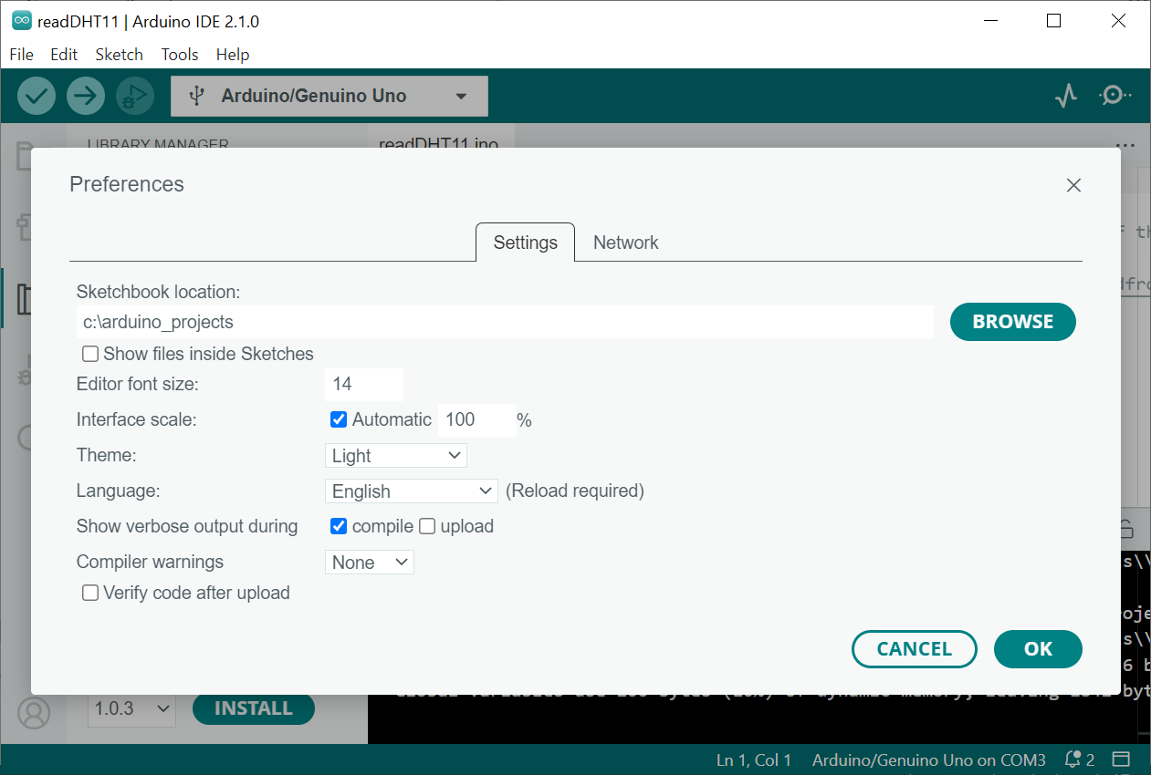
Setup sketch and library directory
The default position may cause problems when using Chinese Windows, set it to “c:\Arduino_project” should work

Slide 9
Add libraries for hardware/sensors
E.g. If your code needs DHT.h
#include <Adafruit_Sensor.h>
#include <DHT.h>
#include <DHT_U.h>
You may download the libraries
Step1: Click “tools/manage libraries”
Step2: the “LIBRARY MANAGER” will be shown. Type “DHT” or “Adafruit_Sensor” in the search windows for libraries
Step3: if you see suitable library click INSTALL

Slide 10
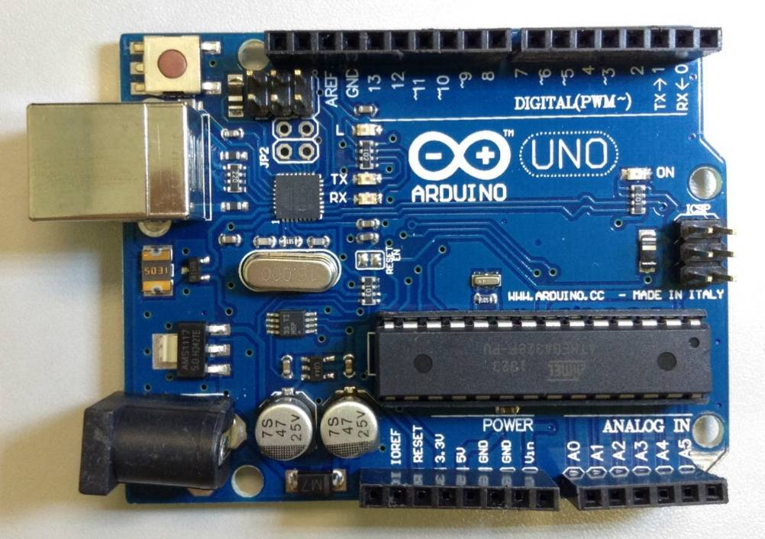
Arduino UNO
Microcontroller is based on ATmega328
  If needed , download Arduino Integrated Development Environment IDE http://arduino.cc/en/Main/Software#toc1
14 digital input/output (I/O) pins plus
6 analog input pins (these pins can also be programmed to be digital I/O pins)
A 16 MHz ceramic resonator
14 digital input/output (I/O) pins
13,12,… ………2,1,0
A0-→A5
6 Analog inputs, they can also be used as digital I/O pins

Slide 11
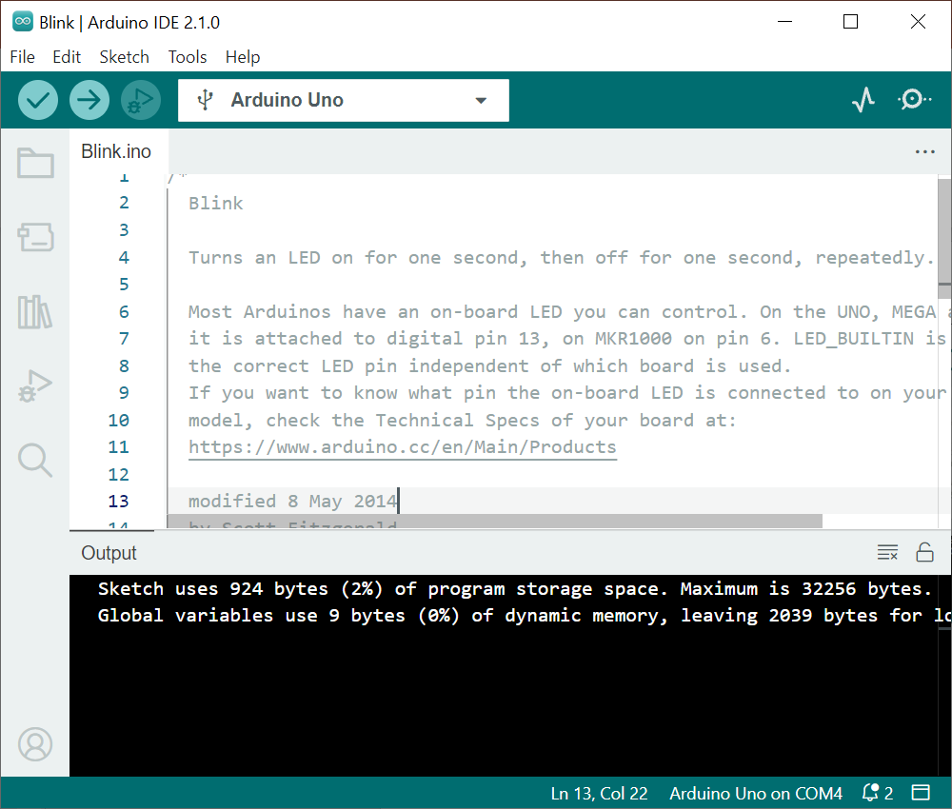
Start to use the Arduino. This I is IDE1. IDE2 may looks slightly different but similar fucntion.
To start Arduino IDE, click Start Menu → All Programs → Arduino
Make sure the board model (Arduino Uno) and connected port (depends on your PC) are correct
Your board Model
The port that your board connected to

Slide 12
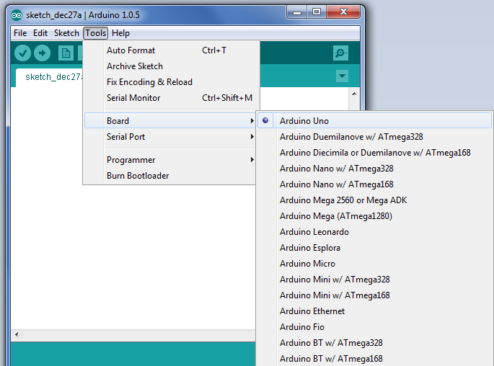
Select Board
Select a correct board

Slide 13
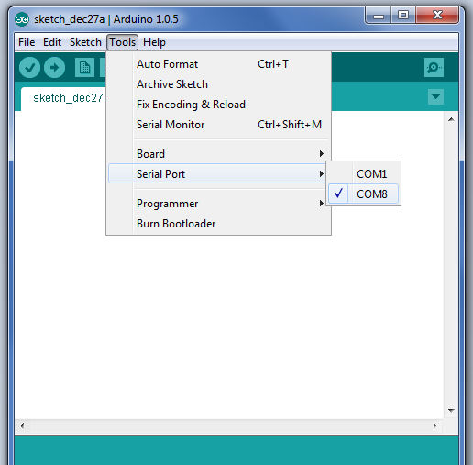
Select Port
Select a correct port.
The actual number depends on your system.
Find Port Number on Windows
Open WIN10-Device Manager, and expand the Ports (COM & LPT) list. Note the number on the USB Serial Port.
Unplug-and pulg the USB cable connected to the Arduino board will see the port displayed

Slide 14
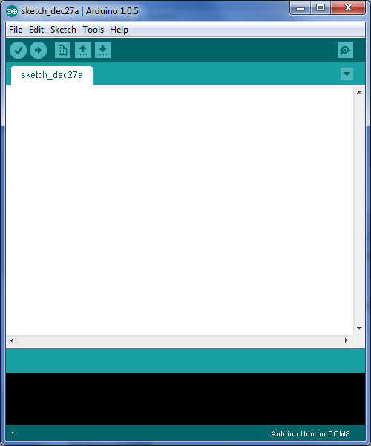
Arduino IDE (integrated development environment )
Tool Bar
Serial monitor,
Can use this to issue commands to the board, and read outputs from the board.
This programming Area
is called “Sketch”.
The program code are placed here.
Status Message
Messages from the system

Slide 15
Toolbar
Verify
  Checks code for errors
Upload
  Compiles and uploads code to the Arduino I/O board
New
  Creates a new sketch
Open
  Open sketch
Save
  Save sketch
Serial Monitor
  Display serial data being sent from the Arduino board

Slide 16
Arduino Code
To run a program in Arduino, your sketch should contain two methods
void setup()
{
// initialization of variables, pin modes, libraries
// run once after each power up or reset
}
void loop()
{
// loops the content consecutively
// allowing the program to change and respond
}

Slide 17
Simple experiment
Try in the main Arudino IDE window:
Step1: Click File → Examples→ 01. basics → Blink
Step2: Click Sketch → upload (will run automatically) or Click on the tick will has the effect
// the setup function runs once when you press reset or power the board
void setup() {
// initialize digital pin LED_BUILTIN as an output.
pinMode(LED_BUILTIN, OUTPUT);
}
// the loop function runs over and over again forever
void loop() {
digitalWrite(LED_BUILTIN, HIGH); // turn the LED on (HIGH is the voltage level)
delay(1000); // wait for a second
digitalWrite(LED_BUILTIN, LOW); // turn the LED off by making the voltage LOW
delay(1000); // wait for a second
}
The program code (The LED on the Arduino -Uno board will blink)
File
01Basics
Blink
Example

Slide 18
Basic software functions
Hardware related
  pinMode(), setup the functions of hardware pins
  digitalWrite() , set a pin to a digital level : either HIGH or LOW
  Digitalread(), read the digital level of a pin: either HIGH or LOW
  delay()
Software related
  If-then-else
  For
  Switch-case
Additional useful functions: Analog read/write
  analogRead() , read the level of an analog pin (any one of A0-A5), data value is from 0 to 1024 (equivalent to 0 - 5V)
  analogWrite(), set an analog pin (any one of A0-A5) to 0-5V

Slide 19
System setup procedures
(Step 1) Setup the direction of the pins:
  using pinMode(),
(Step 2) Then you can set a pin to : HIGH or LOW
  (Step 2a) digitalWrite() //set pin to : HIGH ‘1’ or LOW ‘0’
  or
  (step 2b) digitalRead(), //read state of pin: HIGH ‘1’ or LOW ‘0’

Slide 20
Basic Function (step1) – pinMode()
pinMode() is used to configure the specified pin to behave either as an input or output, or input_pullup
Syntax
  pin: the index number of the pin whose mode you wish to set
  mode: INPUT, OUTPUT, INPUT_PULLUP
  Example:
    pinMode(1, OUTPUT)//setup pin1 =digital out
    pinMode(3, INPUT)//setup pin3 =digital in
    pinMode(A3, INPUT)//setup A3 for digital in
    pinMode(A3, OUTPUT)//setup A3 for digital out
    If no PinMode applied to A0->A5, they are analog_in by default.
Pin =0,..,13, or A0,A1,..,A5
for Digital I/O, or
Write comment for you to read
pinMode(pin, mode) // comment

Slide 21
  Meaning of INPUT, OUTPUT, INPUT_PULLUP
INPUT:
OUTPUT:
INPUT_PULLUP: When the pin is not connect to anything, it is HIGH
HIGH(5V) or LOW(0V)
Arduino
Arduino
HIGH(5V) or LOW (0V)
High(5V))
1KΩ
Arduino
HIGH(5V) or LOW)
or not_connected_to_anything

Slide 22
Basic Function(step2a) – digitalWrite()
digitalWrite() is used to write a HIGH or a LOW value to a digital pin
Syntax
  pin: the number of the pin whose value you wish to set
  value: HIGH (5 V) or LOW (Ground)
  Example:
    digitalWrite(pin, value) // comment
    E.g
    digitalWrite(1, HIGH)//set pin1 to HIGH
digitalWrite(pin, value) // comment

Slide 23
Basic Function(step2b) – digitalRead()
digitalWrite() is used to read the value from a specified digital pin, either HIGH or LOW
Syntax
  pin: the number of the pin whose mode you want to read (integer)
  Example:
    digitalRead(pin)// read the state of the
    // it can be “HIGH” or “LOW”
digitalRead(pin)

Slide 24
Some other basic Function – delay()
delay() is used to pause the program for the amount of time (in milliseconds)
Syntax
  ms: the number of milliseconds to pause (unsigned long)
delay(ms)

Slide 25
Basic Control Structure – IF
Syntax
IF(condition1){
// do stuff if condition1 is true
}ELSE IF (condition2){
// do stuff only if condition1 is false
// and conition2 is true
}ELSE{
// do stuff when both condition1 and
// condition2 are false
}

Slide 26
Basic Control Structure – FOR
Syntax
FOR(initialization; condition; increment){
// statement(s);
}

Slide 27
Basic Control Structure
– SWITCH-CASE
switch (var) {
case label1:
// statements when var=label1
break;
case label2:
// statements when var=label2
break;
default:
// statements
}

Slide 28
More Functions
Please visit http://arduino.cc/en/Reference/ for Arduino Language Reference

Slide 29
Conclusion
Learned how to use the IDE (interactive development environment) of Arduino
Learned how to upload program to the Arduino board
We studied the basic functions of an Arduino system

Slide 30
Reference
https://forum.arduino.cc/t/pdf-version-of-the-project-book/999501

