Slide 1
Digital Logic
Basic ideas
Dr. Kin Hong Wong
Department of Computer Science and Engineering

Slide 2
Overview
Part 1: Introduction
  1.1 What is Digital logic?
  1.2 Digital operations (AND, OR, NOT)
  1.3 Truth table
  1.4 Robot Hardware
  1.5 Software implementation of digital operations
Part 2 (next week): Hardware/software Implementation
  2.1 Robot system
  2.1 Use of If-then-else (software method 1)
  2.2 Use of switch case (software method 2)
  2.3 Finite state machines

Slide 3
Motivations and plans
The brain of our robot is a set of digital logic functions
We will introduce three techniques in digital logic design
  Logic formula
  Truth table
  Finite state machine
We will use a program in a micro-controller system to implement these techniques

Slide 4
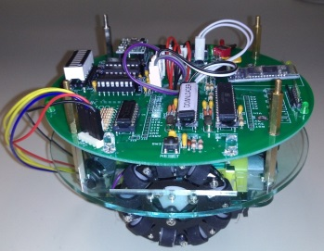
Example
Terminal
Magnetic sensors
S1 S2
How to keep the robot to move forward? Method:
  If the robot deviates to the left, turn right
  If the robot deviates to the right, turn left
The above rules are logic functions and operations.
Magnetic
strip following robot
(2013-4)
Light following robot
(2014-5)

Slide 5
Numbers and Arithmetic Operations

Slide 6
Counting to 1
Binary numbers (0, 1) are used in computers as they are easily represented as off/on electrical signals
Different number systems are used in computers
Numbers represented as binary vectors
B=b_{n-1}…b₁b₀
Unsigned numbers are in range 0 to 2^{n}-1 and are represented by V(B)=b_{n-1}×2^{n-1} +…+b₁ ×2¹ +b₀ ×2⁰
MSB=Most significant bit (leftmost digit in a binary vector)
LSB=Least significant bit (rightmost digit in a binary vector)

Slide 7
Negative Numbers
Sign-and-magnitude
  Most significant bit determines sign, remaining unsigned bits represent magnitude
1’s complement
  Most significant bit determines sign. To change sign from unsigned to negative, invert all the bits
2’s complement
  Most significant bit determines sign. To change sign from unsigned to negative, invert all the bits and add 1
  This is equivalent to subtracting the positive number from 2^{n}

Slide 8
Number Systems
B
V
alues represented
Sign and
b
3
b
2
b
1
b
0
magnitude
1'
s complement
2'
s complement
0
1
1
1
+
7
+
7
+
7
0
1
1
0
+
6
+
6
+
6
0
1
0
1
+
5
+
5
+
5
0
1
0
0
+
4
+
4
+
4
0
0
1
1
+
3
+
3
+
3
0
0
1
0
+
2
+
2
+
2
0
0
0
1
+
1
+
1
+
1
0
0
0
0
+
0
+
0
+
0
1
0
0
0
-
0
-
7
-
8
1
0
0
1
-
1
-
6
-
7
1
0
1
0
-
2
-
5
-
6
1
0
1
1
-
3
-
4
-
5
1
1
0
0
-
4
-
3
-
4
1
1
0
1
-
5
-
2
-
3
1
1
1
0
-
6
-
1
-
2
1
1
1
1
-
7
-
0
-
1

Slide 9
Addition (1-bit)
0
1
0
1
+
0
+
0
+
1
+
1
0
1
1
1
0
Carry-out

Slide 10
2’s Complement
2’s complement numbers actually make sense since they follow normal modulo arithmetic except when they overflow
Range is -2^{n-1} to 2^{n-1}-1
0
1111
0000
0001
N
-
1
1
N
-
2
2
1110
-
1
0
+
1
0010
1101
-
2
+
2
0011
-
3
+
3
1100
-
4
+
4
0100
-
5
+
5
1011
-
6
+
6
0101
1010
-
7
-
8
+
7
0110
1001
1000
0111
(a) Circle representation of integers mod N
(b) Mod 16 system for 2's-complement numbers

Slide 11
Convert decimal to 2’s complement
Negative number to 2’s complement
  From the positive value to binary
  Reverse all bits and add 1
  E.g. convert -5
  Positive value of 5 is 0101
  Reverse all bits 1010 and add one becomes
  1011, SO the 2’s complement of -5 of 1011

Slide 12
Convert 2’s complement to decimal
If the first MSB is 0, convert binary to decimal as usual
If the first MSB is 1, it is negative, the value can be found by
  Subtract 1
  Reverse all bit and get the value
  Add –ve sign to the value, e.g.
    Convert 1011, it is negative because MSB is 1
    Subtract 1 from 1011 becomes 1010,
    reverse all bits becomes 0101, so the value is 5
    Add –ve sign so the decimal value of the 2’s complement number 1011 is -5.
    Reference: Introduction to Computing Systems: From Bits and Gates to C and Beyond, By Yale N. Patt

Slide 13
Add/sub
X+Y – use 1-bit addition propagating carry to the next most significant bit
X-Y – add X to the 2’s complement of Y

Slide 14
Add/Sub (2’s comp)
(a)
0 0 1 0
(
+
2
)
(b)
0 1 0 0
(
+
4
)
+
0 0 1 1
(
+
3
)
+
1 0 1 0
(
-
6
)
0 1 0 1
(
+
5
)
1 1 1 0
(
-
2
)
(c)
1 0 1 1
(
-
5
)
(d)
0 1 1 1
(
+
7
)
+
1 1 1 0
(
-
2
+
)
1 1 0 1
(
-
3
)
1 0 0 1
(
-
7
)
0 1 0 0
(
+
4
)
(e)
1 1 0 1
(
-
3
)
1 1 0 1
-
1 0 0 1
(
-
7
)
+
0 1 1 1
0 1 0 0
(
+
4
)
(f)
0 0 1 0
(
+
2
)
0 0 1 0
-
0 1 0 0
(
+
)
4
+
1 1 0 0
1 1 1 0
(
-
2
)
(g)
0 1 1 0
(
+
6
)
0 1 1 0
-
0 0 1 1
(
+
3
)
+
1 1 0 1
0 0 1 1
(
+
3
)
(h)
1 0 0 1
(
-
7
)
1 0 0 1
1 0 1 1
(
-
5
0 1 0 1
-
)
+
1 1 1 0
(
-
2
)
(i)
1 0 0 1
(
-
7
)
1 0 0 1
-
0 0 0 1
(
+
1
)
+
1 1 1 1
1 0 0 0
(
-
8
)
(j)
0 0 1 0
(
+
2
)
0 0 1 0
-
1 1 0 1
(
-
3
)
+
0 0 1 1
0 1 0 1
(
+
)
5

Slide 15
Sign Extension
Suppose I have a 4-bit 2’s complement number and I want to make it into an 8-bit number
The reason to extend the bits is to avoid overflow (see following slides)
Positive number – add 0’s to LHS
  e.g. 0111 -> 00000111
Negative number – add 1’s to LHS
  e.g. 1010 ->11111010
  c.f. circle representation

Slide 16
Overflow
The result is too big for the bits
In 2’s complement arithmetic
  addition of opposite sign numbers never overflow
  If the numbers are the same sign and the result is the opposite sign, overflow has occurred (Range is -2^{n-1} to 2^{n-1}-1). Usually CPU overflow status bit will be setup and use software to deal with it.
  E.g. 0111+0100=1011 (but 1011 is -5)
  7 + 4= 12 (too large to be inside the 4-bit 2’s)
  Because 4-BIT 2’S complement range is only -2³ to 2³-1
  Or -8 to 7

Slide 17
Range of 2’s complement numbers
See http://en.wikipedia.org/wiki/Integer_(computer_science)
Previous examples are small numbers. In our usual programs they are bigger.
What is the range for a signed char type -- -- char (8-bit number)?
What is the range for a signed integer type -- int₃₂ (32-bit number)?
What will you do if the result is overflowed?
Answer: sign extension, see previous slides, e.g., turn a 4-bit number to 8-bit etc.
Positive number – add 0’s to LHS
  e.g. 0111 -> 00000111
Negative number – add 1’s to LHS
  e.g. 1010 ->11111010

Slide 18
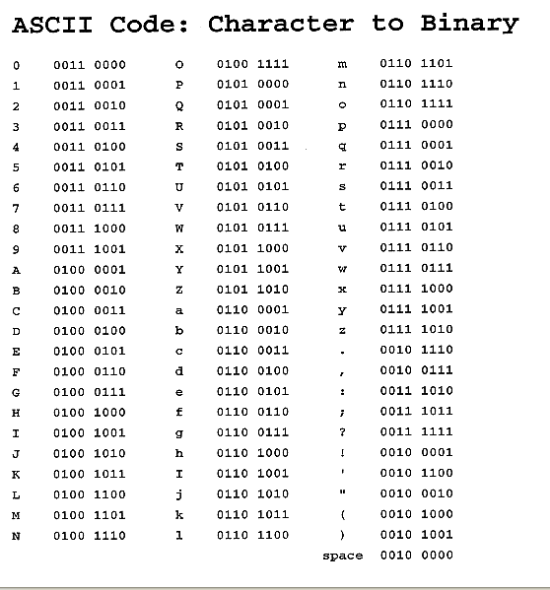
Characters
Typically represented by 8-bit numbers

Slide 19
exercise
Assuming 4-bit 2’s complement numbers
  What is the binary for -2?
  Calculate 2+3
  Calculate -2-3
  Calculate 5+5
Assuming 5-bit numbers
  What is the largest 2’s complement number?
  What is the smallest 2’s complement number?
Convert 56 to unsigned binary
(http://www.wikihow.com/Convert-from-Decimal-to-Binary)
What is the decimal value of 10110101 in 2’s complement? What is the unsigned value of the same binary number?

Slide 20
1.1 What is digital logic?
Understanding the difference between Digital and Analog operations

Slide 21
Analog and digital signals
Analog signals: the signal can be any values within the valid range
  Example: Range =0 → 10 Volts
  E.g. The signal can be 1.356 Volts or 2.432 Volts
Digital signals: It can only be HIGH (or called ‘1’ )or LOW (or called ‘0’). Examples:
  In TTL Transistor-transistor-logic standard:
    High=‘1’ ≈ 5 volts, Low=‘0’ ≈ 0 Volt
  Usually several bits (more than one digital bit) are used to represent a number corresponding to an analog value
    E.g. 8-bit to represent a value from 0 to 2⁸-1 =255, or 32-bit to represent a value from 0 to 2³²-1
Voltage
10 V
0 V
Analog value
1
Time (ms)
Voltage
One Digital Bit
5 V
0 V
1
Time (ms)

Slide 22




What is the meaning of digital logic?
A signal is represented by ‘1’ or ‘0’
  Advantages:
    Easy to be implemented in a circuit.
    Less likely to be interfered by noise, temperature and radiation.
Application, digital music
Digital data saved in CDs
Analog to Digital conversion (ADC)
Digital to Analog conversion (DAC)

Slide 23
1.2 Digital Operations
AND, OR, NOT

Slide 24
Digital Operations
Study how to combine inputs to generate outputs
  In arithmetic operations: 2 Add 3= 5, result is 5
  In digital operations: we need a truth table to see the result
3 popular digital operations you will learn here
  AND
  OR
  NOT (Negation)
Digital
Input1
Digital
Input2
Digital operation
Digital
Output

Slide 25
Exercises
Multiple choice questions
Are these values digital or analog?
  Temperature : Ans: _________?
  Humidity : Ans: _________?
Are you a Chinese Univ. student,
  the answer is : Ans_____?
  Is the above answer Analog or digital? : Ans:_________?
Do you have a mobile phone in your pocket,
  the answer is : Ans:______?
  Is the above answer Analog or digital? Ans: ________?
What is the temperature in this room,
  the answer is Ans:___?
  Is the above answer Analog or digital? Ans: ________?
Answers: 1) Analog, analog 2) Yes, digital
3) Yes, digital 4) 20 Degrees, analog

Slide 26
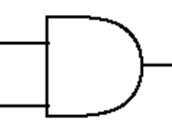
AND operation, example in real life
You get a Degree from CUHK if you take 123 units and your GPA is greater than 1.5
  You may write a formula
    (X=take 123 units) AND (Y=GPA>1.5) then you can get a Degree from CUHK (W)
You must eat and drink in order to live
  You may write a formula
    (X=eat ) AND (Y=drink) then you can live (W)
Notation
X
Y
W=X AND Y

Slide 27
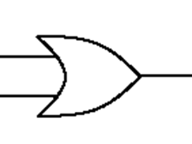
OR operation, example in real life
If you live in Mongkok, you either take a bus or train to come to the Chinese University
  You may write a formula
    (X=take bus) or (Y=take train) then you can come to the University (W)
You can ride on a bus if you pay cash or pay using octopus
  You may write a formula
    (X=pay by cash) or (Y=pay by octopus) then you can ride on the bus (W)
Notation
X
Y
W=X OR Y

Slide 28
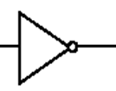
NOT operation, example in real life
I don’t love you = Not (I love you)
  You may write a formula
    NOT (X=I love you) means I don’t love you (W)
You are not rich = NOT (you are rich)
  You may write a formula
    NOT(X=you are rich) that means you are poor (W)
Notation
X
W=NOT X

Slide 29
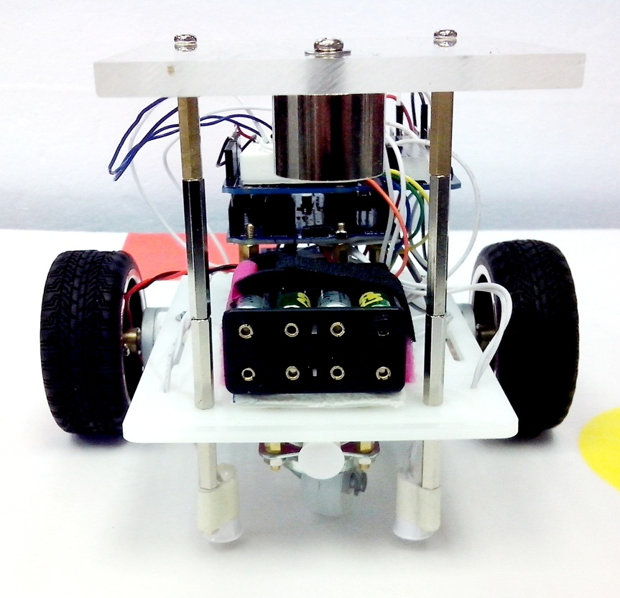
Exercise for robot control to follow the magnetic path
Terminal
Magnetic sensors
S1 S2
Sensors: S2 S1
If S2 detects the magnetic strip, but not S1, has the robot deviated to the right or left of the path?
Answer (right or left) : ______?
Answer: left
S2 S1

Slide 30
1.3 Truth table
A method to represent logic functions for digital signals

Slide 31
Truth table
The idea is to have all different combinations of inputs arranged in a table
Each combination gives one output
For n digital inputs , there will be 2^{n} different combinations
The truth table has 2^{n} rows
Example:
  n=2 (X and Y as inputs), so there are 2^{n}=4 rows
  You can see that no two rows have the same combination of inputs
  All possible combinations of the inputs (X,Y) are found in the truth table
Example
Input: X | Input: Y | W= Output for the operation
0 | 0 | ?
0 | 1 | ?
1 | 0 | ?
1 | 1 | ?
? = depends on the operation

Slide 32
Truth table example for “AND” operation
X
Y
W=
X AND Y
X , Y are 2 digital input signals
We can use a “Truth table” to find the output
Because there are n=2 inputs: X,Y
So there are 2^{n}=4 rows in the truth table
Steps to fill in the table
  Fill in Y: 0,1,0,1 (from top)
  Fill in X: 0,0,1,1
  Fill in the outputs
  Compute output:
    Output=1 only when
    both inputs are 1
Input : X=eat | Input: Y=drink | Output W= X AND Y =live
0 | 0 | 0
0 | 1 | 0
1 | 0 | 0
1 | 1 | 1

Slide 33
Truth table example for “OR” operation
X
Y
W=
X OR Y
X , Y are 2 digital input signals
We can use a “Truth table” to find the output
Because there are n=2 inputs: X,Y
So there are 2^{n}=4 rows in the truth table
Steps:
  Fill in Y: 0,1,0,1(from top)
  Fill in X: 0,0,1,1
  Fill in the outputs
  Compute output:
    Output=1 only when
    either input is 1
Input: X(pay by cash) | Input: Y (pay by Octopus) | Output W= X OR Y= (ride on a bus)
0 | 0 | 0
0 | 1 | 1
1 | 0 | 1
1 | 1 | 1

Slide 34
NOT (or called negation)
X
W=
NOT X
X is a digital input signal
We can use a “Truth table” to find the output
Because there are n=1 input: X
So there are 2^{n}=2 rows in the truth table
Step:
  Fill in X: 0,1
  Fill in the outputs
  Compute output:
    Output=Reverse the input
X= you are rich | NOT X (you are not rich)
0 | 1
1 | 0

Slide 35
Exercises
How many rows are required in the truth table for 3 inputs?
Give examples of
  AND
  OR
  NOT
Answer: 2³=8 rows

Slide 36
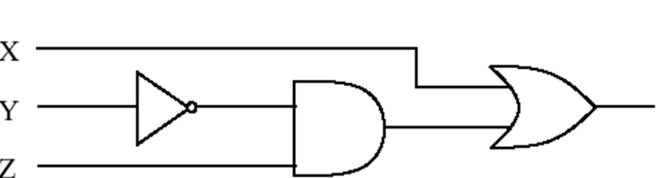
Combinational logic
(Combine NOT, AND, OR)
X , Y , Z are 3 digital input signals
We can use a “Truth table” to find the output
Because there are n=3 inputs: X,Y,Z
So there are 2^{n}=8 rows in the truth table
Fill in Z: 0,1,0,1,0,1,0,1
Fill in Y: 0,0,1,1,0,0,1,1
Fill in X: 0,0,0,0,1,1,1,1

Slide 37
Truth table
W
We want to find : W=X OR (NOT (Y) AND Z)
Step 1: fill in different combinations of inputs
2 inputs, so 2³=8 rows
X | Y | Z |  |  | W=X OR (NOT ( Y) AND Z)
0 | 0 | 0 |  |  | ?
0 | 0 | 1 |  |  | ?
0 | 1 | 0 |  |  | ?
0 | 1 | 1 |  |  | ?
1 | 0 | 0
1 | 0 | 1
1 | 1 | 0
1 | 1 | 1

Slide 38
We can solve it step by step
W
Step2
X | Y | Z | NOT(Y)
0 | 0 | 0 | 1
0 | 0 | 1 | 1
0 | 1 | 0 | 0
0 | 1 | 1 | 0
1 | 0 | 0 | 1
1 | 0 | 1 | 1
1 | 1 | 0 | 0
1 | 1 | 1 | 0
Produce NOT (Y)
from Y first.
X,Z are not used in this step.
output
input

Slide 39
We can solve it step by step
W
Step 3
X | Y | Z | NOT(Y) | Z AND (NOT(Y))
0 | 0 | 0 | 1 | 0
0 | 0 | 1 | 1 | 1
0 | 1 | 0 | 0 | 0
0 | 1 | 1 | 0 | 0
1 | 0 | 0 | 1 | 0
1 | 0 | 1 | 1 | 1
1 | 1 | 0 | 0 | 0
1 | 1 | 1 | 0 | 0
Then, produce
[Z AND (NOT (Y))].
X , Y are not used directly in this step.
input
input
output

Slide 40
We can solve it step by step
W=X OR (Z AND (NOT(Y)))
Step 4
X | Y | Z | NOT(Y) | Z AND (NOT(Y) | W=X OR (Z AND (NOT(Y)))
0 | 0 | 0 | 1 | 0 | 0
0 | 0 | 1 | 1 | 1 | 1
0 | 1 | 0 | 0 | 0 | 0
0 | 1 | 1 | 0 | 0 | 0
1 | 0 | 0 | 1 | 0 | 1
1 | 0 | 1 | 1 | 1 | 1
1 | 1 | 0 | 0 | 0 | 1
1 | 1 | 1 | 0 | 0 | 1
input
input
output

Slide 41
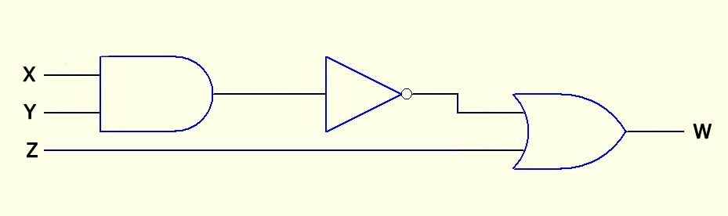
Exercise 1.1
Use a truth table to find the output of
NOT( X AND Y ) OR Z

Slide 42
Exercise1.1: NOT( X AND Y ) OR Z
Fill the blanks in X,Y, Z columns
X | Y | Z | X AND Y | NOT (X AND Y) | W=(NOT (Z AND Y)) OR Z
0 |  | 0
 |  | 1
 |  | 0
 |  | 1
 |  | 0
 |  | 1
 |  | 0
 |  | 1

Slide 43
Exercise1.1: NOT( X AND Y ) OR Z
Fill the blanks
The answer is in the appendix
X | Y | Z | X AND Y | NOT (X AND Y) | W=(NOT (Z AND Y)) OR Z
0 | 0 | 0
0 | 0 | 1
0 | 1 | 0
0 | 1 | 1
1 | 0 | 0
1 | 0 | 1
1 | 1 | 0
1 | 1 | 1

Slide 44
Summary
Learned
  Digital logic
  The use of the truth table
  Our robot system design
  To implement logic functions using if-then-else

Slide 45
END

Slide 46
Appendix 1
ANSWER1.1: W=(NOT( X AND Y )) OR Z
Fill the blanks
X | Y | Z | X AND Y | NOT (X AND Y) | W=(NOT (X AND Y)) OR Z
0 | 0 | 0 | 0 | 1 | 1
0 | 0 | 1 | 0 | 1 | 1
0 | 1 | 0 | 0 | 1 | 1
0 | 1 | 1 | 0 | 1 | 1
1 | 0 | 0 | 0 | 1 | 1
1 | 0 | 1 | 0 | 1 | 1
1 | 1 | 0 | 1 | 0 | 0
1 | 1 | 1 | 1 | 0 | 1

