Slide 1
World clock DS3231, humidity sensor DHT11 and LCD12864
KH Wong

Slide 2
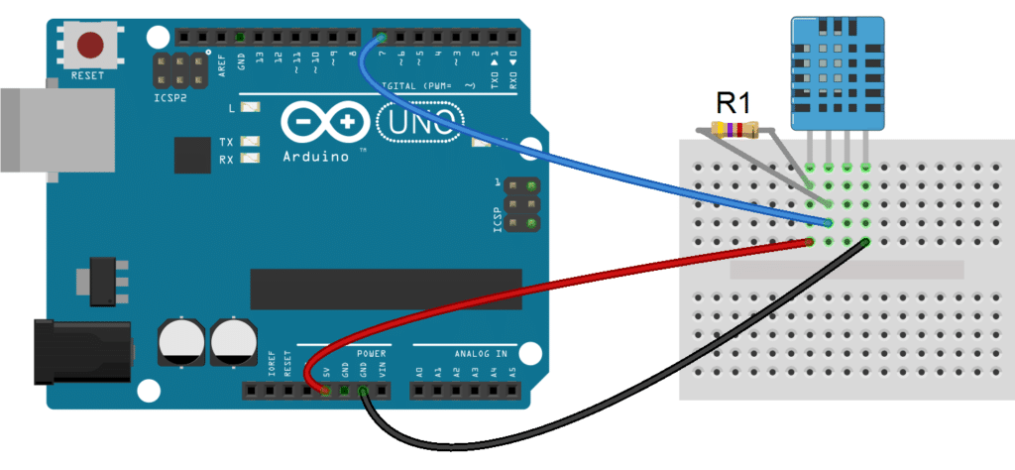
DHT11 Humidify temperature sensor
hardware
Arduino DHT11 sensor
GPIO pin 7 ←----→DHT11

Slide 3
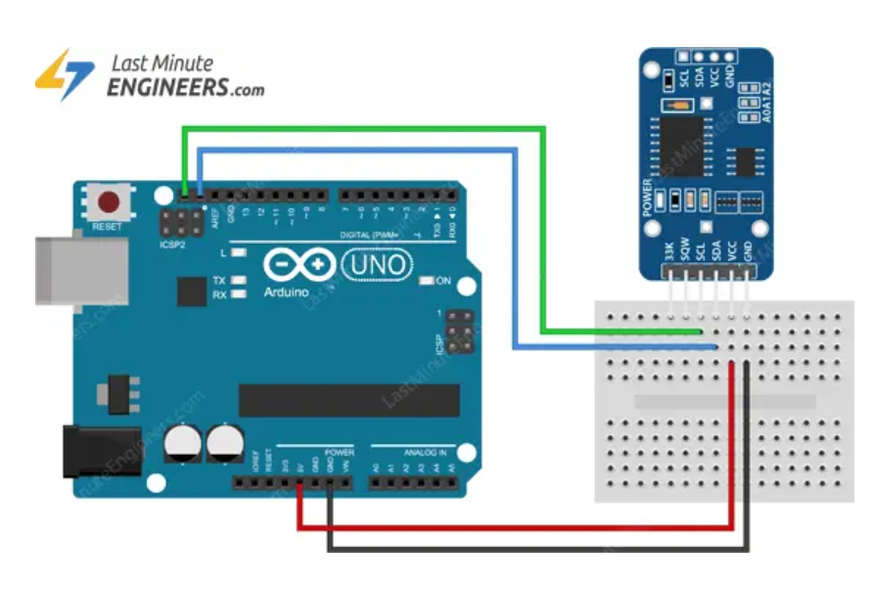
(Real time clock (DS3231)
Arduino LCD12864
SCL ←---------→ SDL
SDA ←---------→SCL
https://microcontrollerslab.com/ds3231-rtc-module-pinout-interfacing-with-arduino-features/
RTC
Using SCL, SDA
https://lastminuteengineers.com/ds3231-rtc-arduino-tutorial/
demo:
https://www.youtube.com/watch?v=9-BqlcY1Bsw

Slide 4
Test2.19 Large LCD 12864 SPI (thru ST7920) size 73mm x 39mm
//12864_spi_grahicstest_1a.ino https://github.com/olikraus/U8glib_Arduino
//12864_spi_grahicstest_1a.ino
U8GLIB_ST7920_128X64_4X u8g(13,11,10);
// SPI Com:
//U8GLIB_ST7920_128X64_4X u8g(E, R/W, /RS );
//can change to another pin assignment scheme
//MODULE..........................Uang
//K (backlight cathode).........GND
//A (backlight anode)..........+5V
//PSD (SPI Mode).................GND or NC
//E (SCK)..........................D13
//R/W (MOSI)....................D11
//RS (CS)..........................D10*
//VDD.............................+5V
//VSS..............................GND
//12864_spi_grahicstest_1a.ino
/*https://github.com/olikraus/U8glib_Arduino
GraphicsTest.pde
>>> Before compiling: Please remove comment from the constructor of the
>>> connected graphics display (see below).
Universal 8bit Graphics Library, https://github.com/olikraus/u8glib/
Copyright (c) 2012, olikraus@gmail.com
All rights reserved.
Redistribution and use in source and binary forms, with or without modification,
are permitted provided that the following conditions are met:
* Redistributions of source code must retain the above copyright notice, this list
of conditions and the following disclaimer.
* Redistributions in binary form must reproduce the above copyright notice, this
list of conditions and the following disclaimer in the documentation and/or other
materials provided with the distribution.
THIS SOFTWARE IS PROVIDED BY THE COPYRIGHT HOLDERS AND
CONTRIBUTORS "AS IS" AND ANY EXPRESS OR IMPLIED WARRANTIES,
INCLUDING, BUT NOT LIMITED TO, THE IMPLIED WARRANTIES OF
MERCHANTABILITY AND FITNESS FOR A PARTICULAR PURPOSE ARE
DISCLAIMED. IN NO EVENT SHALL THE COPYRIGHT HOLDER OR
CONTRIBUTORS BE LIABLE FOR ANY DIRECT, INDIRECT, INCIDENTAL,
SPECIAL, EXEMPLARY, OR CONSEQUENTIAL DAMAGES (INCLUDING, BUT
NOT LIMITED TO, PROCUREMENT OF SUBSTITUTE GOODS OR SERVICES;
LOSS OF USE, DATA, OR PROFITS; OR BUSINESS INTERRUPTION) HOWEVER
CAUSED AND ON ANY THEORY OF LIABILITY, WHETHER IN CONTRACT,
STRICT LIABILITY, OR TORT (INCLUDING NEGLIGENCE OR OTHERWISE)
ARISING IN ANY WAY OUT OF THE USE OF THIS SOFTWARE, EVEN IF
ADVISED OF THE POSSIBILITY OF SUCH DAMAGE.
*/
#include "U8glib.h"
// setup u8g object, please remove comment from one of the following constructor calls
)_
U8GLIB_ST7920_128X64_4X u8g(13,11,10); // SPI Com: U8GLIB_ST7920_128X64_4X u8g(pin_E, pin_R/W, pin_/RS );//can chnage to another pin assignment scheme
//MODULE..........................Uang
//K (backlight cathode).........GND
//A (backlight anode)..........+5V
//PSD (SPI Mode).................GND or NC
//E (SCK)..........................D13
//R/W (MOSI)....................D11
//RS (CS)..........................D10*
//VDD.............................+5V
//VSS..............................GND
void u8g_prepare(void) {
u8g.setFont(u8g_font_6x10);
u8g.setFontRefHeightExtendedText();
u8g.setDefaultForegroundColor();
u8g.setFontPosTop();
}
void u8g_box_frame(uint8_t a) {
u8g.drawStr( 0, 0, "drawBox");
u8g.drawBox(5,10,20,10);
u8g.drawBox(10+a,15,30,7);
u8g.drawStr( 0, 30, "drawFrame");
u8g.drawFrame(5,10+30,20,10);
u8g.drawFrame(10+a,15+30,30,7);
}
void u8g_disc_circle(uint8_t a) {
u8g.drawStr( 0, 0, "drawDisc");
u8g.drawDisc(10,18,9);
u8g.drawDisc(24+a,16,7);
u8g.drawStr( 0, 30, "drawCircle");
u8g.drawCircle(10,18+30,9);
u8g.drawCircle(24+a,16+30,7);
}
void u8g_r_frame(uint8_t a) {
u8g.drawStr( 0, 0, "drawRFrame/Box");
u8g.drawRFrame(5, 10,40,30, a+1);
u8g.drawRBox(50, 10,25,40, a+1);
}
void u8g_string(uint8_t a) {
u8g.drawStr(30+a,31, " 0");
u8g.drawStr90(30,31+a, " 90");
u8g.drawStr180(30-a,31, " 180");
u8g.drawStr270(30,31-a, " 270");
}
void u8g_line(uint8_t a) {
u8g.drawStr( 0, 0, "drawLine");
u8g.drawLine(7+a, 10, 40, 55);
u8g.drawLine(7+a*2, 10, 60, 55);
u8g.drawLine(7+a*3, 10, 80, 55);
u8g.drawLine(7+a*4, 10, 100, 55);
}
void u8g_triangle(uint8_t a) {
uint16_t offset = a;
u8g.drawStr( 0, 0, "drawTriangle");
u8g.drawTriangle(14,7, 45,30, 10,40);
u8g.drawTriangle(14+offset,7-offset, 45+offset,30-offset, 57+offset,10-offset);
u8g.drawTriangle(57+offset*2,10, 45+offset*2,30, 86+offset*2,53);
u8g.drawTriangle(10+offset,40+offset, 45+offset,30+offset, 86+offset,53+offset);
}
void u8g_ascii_1() {
char s[2] = " ";
uint8_t x, y;
u8g.drawStr( 0, 0, "ASCII page 1");
for( y = 0; y < 6; y++ ) {
for( x = 0; x < 16; x++ ) {
s[0] = y*16 + x + 32;
u8g.drawStr(x*7, y*10+10, s);
}
}
}
void u8g_ascii_2() {
char s[2] = " ";
uint8_t x, y;
u8g.drawStr( 0, 0, "ASCII page 2");
for( y = 0; y < 6; y++ ) {
for( x = 0; x < 16; x++ ) {
s[0] = y*16 + x + 160;
u8g.drawStr(x*7, y*10+10, s);
}
}
}
void u8g_extra_page(uint8_t a)
{
if ( u8g.getMode() == U8G_MODE_HICOLOR || u8g.getMode() == U8G_MODE_R3G3B2) {
/* draw background (area is 128x128) */
u8g_uint_t r, g, b;
b = a << 5;
for( g = 0; g < 64; g++ )
{
for( r = 0; r < 64; r++ )
{
u8g.setRGB(r<<2, g<<2, b );
u8g.drawPixel(g, r);
}
}
u8g.setRGB(255,255,255);
u8g.drawStr( 66, 0, "Color Page");
}
else if ( u8g.getMode() == U8G_MODE_GRAY2BIT )
{
u8g.drawStr( 66, 0, "Gray Level");
u8g.setColorIndex(1);
u8g.drawBox(0, 4, 64, 32);
u8g.drawBox(70, 20, 4, 12);
u8g.setColorIndex(2);
u8g.drawBox(0+1*a, 4+1*a, 64-2*a, 32-2*a);
u8g.drawBox(74, 20, 4, 12);
u8g.setColorIndex(3);
u8g.drawBox(0+2*a, 4+2*a, 64-4*a, 32-4*a);
u8g.drawBox(78, 20, 4, 12);
}
else
{
u8g.drawStr( 0, 12, "setScale2x2");
u8g.setScale2x2();
u8g.drawStr( 0, 6+a, "setScale2x2");
u8g.undoScale();
}
}
uint8_t draw_state = 0;
void draw(void) {
u8g_prepare();
switch(draw_state >> 3) {
case 0: u8g_box_frame(draw_state&7); break;
case 1: u8g_disc_circle(draw_state&7); break;
case 2: u8g_r_frame(draw_state&7); break;
case 3: u8g_string(draw_state&7); break;
case 4: u8g_line(draw_state&7); break;
case 5: u8g_triangle(draw_state&7); break;
case 6: u8g_ascii_1(); break;
case 7: u8g_ascii_2(); break;
case 8: u8g_extra_page(draw_state&7); break;
}
}
void setup(void) {
// flip screen, if required
//u8g.setRot180();
#if defined(ARDUINO)
pinMode(13, OUTPUT);
digitalWrite(13, HIGH);
#endif
}
void loop(void) {
// picture loop
u8g.firstPage();
do {
draw();
} while( u8g.nextPage() );
// increase the state
draw_state++;
if ( draw_state >= 9*8 )
draw_state = 0;
// rebuild the picture after some delay
//delay(150);
}

Slide 5
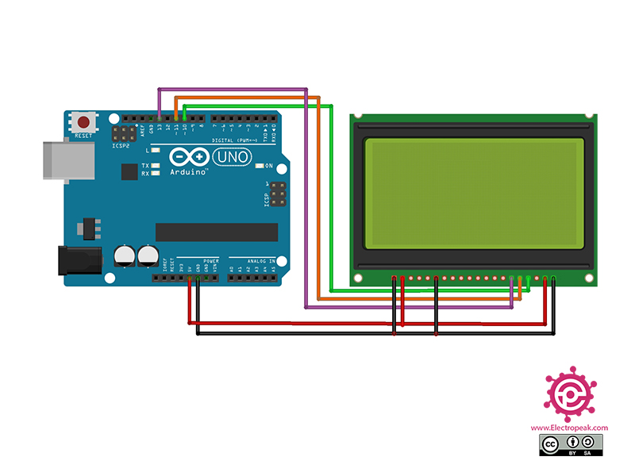
Use of LCD12864
https://electropeak.com/learn/interfacing-128x64-graphical-lcd-display-with-arduino/
https://detail.tmall.com/item.htm?_u=q2qidpvo4ba0&id=605042136571&spm=a1z09.2.0.0.4e382e8d2R3e3h

Slide 6
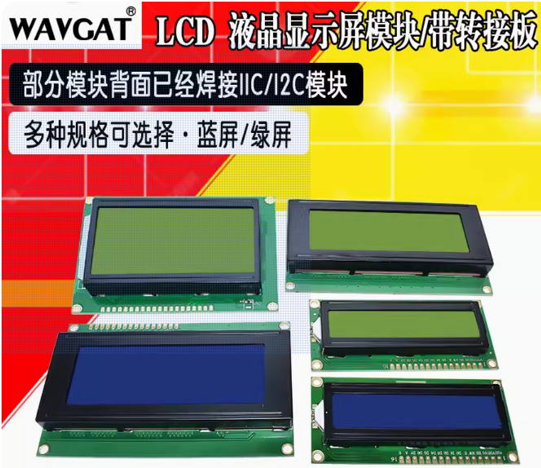
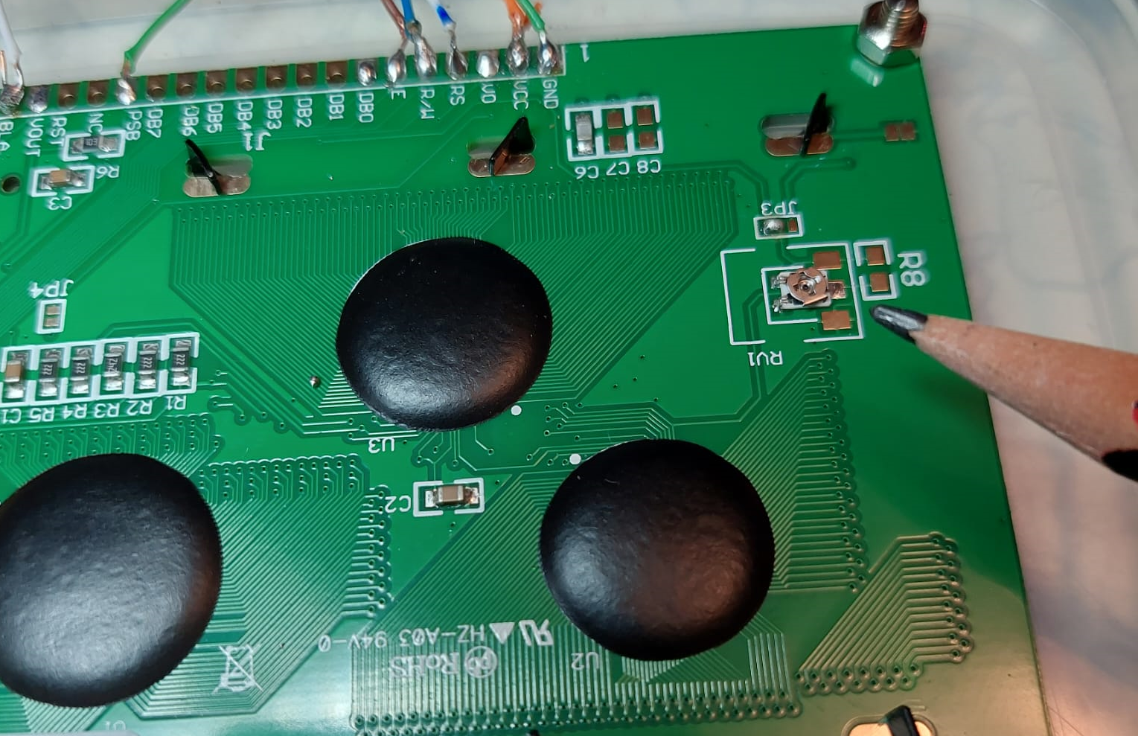
Adjust black light using the onboard trimmer
https://detail.tmall.com/item.htm?_u=q2qidpvo4ba0&id=605042136571&spm=a1z09.2.0.0.4e382e8d2R3e3h
LCD12864 ←----------→ Arduino
Using WAVGAT LCD12864
//U8GLIB_ST7920_128X64_4X u8g(13,11,10);
// SPI Com:
//U8GLIB_ST7920_128X64_4X u8g(E, R/W, /RS );
//can change to another pin assignment scheme
//MODULE..........................Uang
//K (backlight cathode).........GND
//A (backlight anode)..........3.3 V from uno board
//PSD (SPI Mode).................GND or NC
//E (SCK)..........................D13
//R/W (MOSI)....................D11
//RS (CS)..........................D10*
//VDD.............................+5V
//VSS..............................GND
Trimmer

Slide 7
LCD12864
https://www.electronicshub.org/interfacing-128x64-graphical-lcd-with-arduino/
..consists of ST7920 Controller. It is manufactured by Sitronix and supports three types of bus interfaces i.e., 8-bit mode, 4-bit mode and Serial interface.
Hardware Connections
There are three different ways in which you can interface the Graphical LCD with Arduino. They are:
4-bit Parallel Mode
8-bit Parallel Mode
Serial Mode
3.3V from Arduino_UNO board
(To make back light weaker)
No need because using onboard trimmer

Slide 8
Add a digital button
5V
4.7K Ohms
Arduino GPIO 2
switch button
56 Ohms

Slide 9
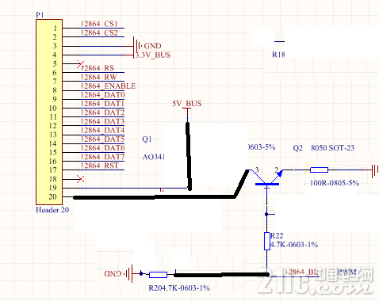
PWM of backlight
https://bbs.21ic.com/icview-2384942-1-1.html

Slide 10
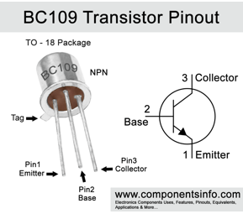
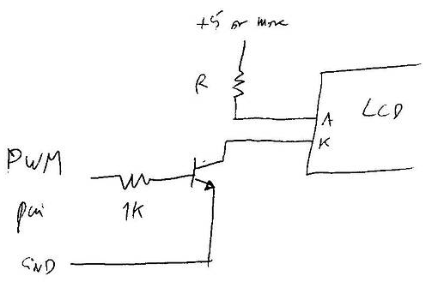
PWM of backlight
https://forum.arduino.cc/t/lcd-backlight-brightness-control-tm12864l-2/73125/10
R=100 ohms

Slide 11
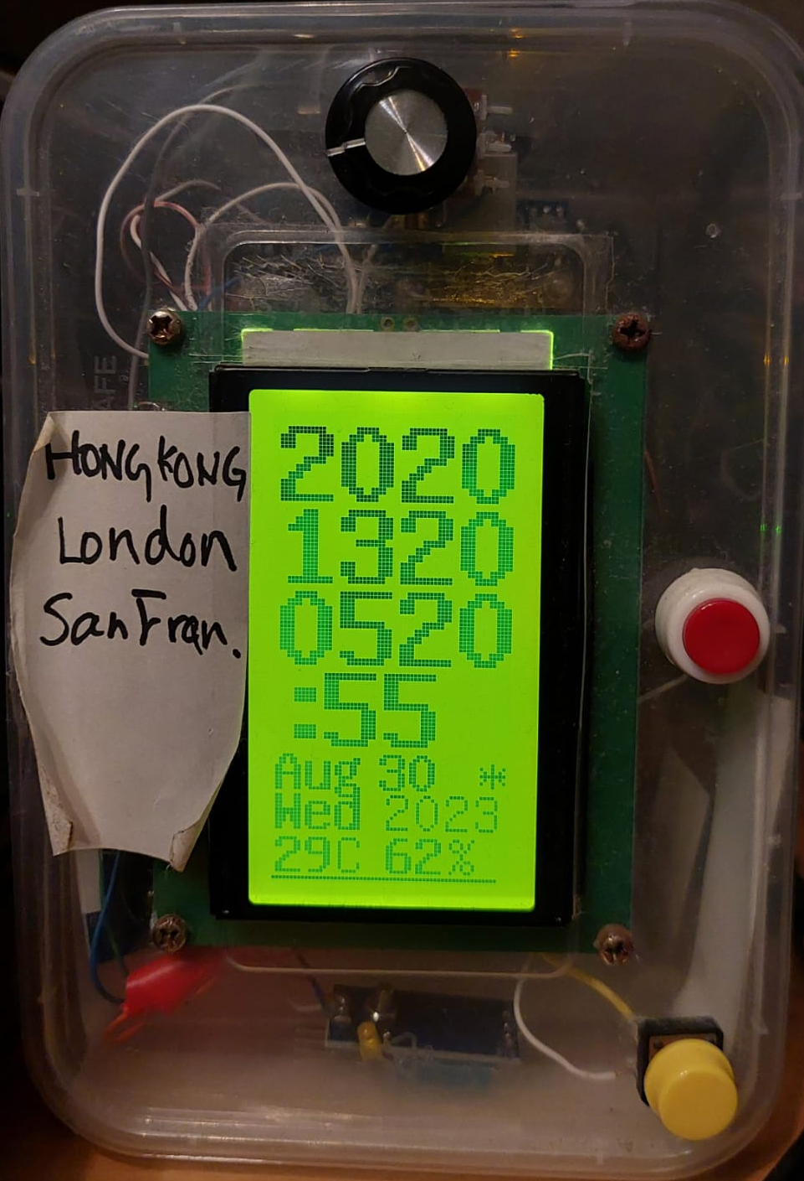
LCD12864 ,world time USA/UK/HK time temperature/humidity/RTC demo, day light fix
RTC_world_time_230830.ino
// 2023.8.30 fix the bug of resetting the clock
// use setup_new_time_RTC_DS3231 for setting the clock
// //remember to comment all after time is set correctly. Otherewise when power off it will affect the current time.
// 2022.3.16 rtc3b5.ino See http://misclab.umeoce.maine.edu/boss/Arduino/bensguides/DS3231_Arduino_Clock_Instructions.pdf
/* khwong 2020 march 22, combining DS3231+LCD+serail-port display
using DS3231 library, by Andrew Wickert, Eric Ayars, Jean-Claude Wippler version 1.02
installation: //Sketch/inlucde_library/manage librray/type DS3231,
Can try examples : Files/Exaples/DS3231/
Reference :DS3231_test.pde
Eric Ayars
4/11
Test/demo of read routines for a DS3231 RTC.
Turn on the serial monitor after loading this to check if things are
working as they should.
*/
/*
DS3231_test.pde
Eric Ayars
4/11
Test/demo of read routines for a DS3231 RTC.
Turn on the serial monitor after loading this to check if things are
working as they should.
*/
//////////////////////// LCD //////////////////////
#include <Wire.h>
#include "DHT.h"
#define DHTPIN 7
#define DHTTYPE DHT11
int sval;
int command_tag1 = 0;
int old_sval = 1;
#include "U8glib.h" // for lcd 128x64 display
U8GLIB_ST7920_128X64_4X u8g(10);
DHT dht(DHTPIN, DHTTYPE);
#include <LiquidCrystal_I2C.h>
LiquidCrystal_I2C lcd(0x27, 16, 2);
// set the LCD address to 0x27 for a 16 chars and 2 line display
//LiquidCrystal_I2C lcd(0x3F,20,2); // set the LCD address to 0x27 for a 16 chars and 2 line display
//LiquidCrystal_I2C lcd(0x3F,16,2); // set the LCD address to 0x27 for a 16 chars and 2 line display
int count;
float dht11_temperature , dht11_humidity; // make global because many modules are using it
int minute_count = 0;
void setup()
{
// u8g.setRot90();// u8g.setRot180();
Serial.begin(9600);
lcd.init(); // initialize the lcd
lcd.backlight();
lcd.setCursor(3, 0); //first row: line 0,cursor index 3. first postion is index 0
lcd.print("By KH WONG");
lcd.setCursor(0, 1); //second row : line 1, position index 2
lcd.print("ver. 2023.08.30");
delay(3000);
lcd.clear ();
////////////////////////////////
setup_new_time_RTC_DS3231();// if you want to change the time////////////////
Serial.println("DHTxx test!");
dht.begin();
pinMode(2, INPUT_PULLUP); //google input pin (yellow reset button)
}
#include <DS3231.h>
#include <Wire.h>
DS3231 Clock;
bool Century = false;
bool h12;
bool PM;
byte ADay, AHour, AMinute, ASecond, ABits;
bool ADy, A12h, Apm;
//remember to comment all after time is set correctly. Otherewise when power off it will affect the current time.
void setup_new_time_RTC_DS3231() {
// edit the following for clock adjustment
// Clock.setSecond(00);//Set the second
// Clock.setMinute(16);//Set the minute
// Clock.setHour(21); //Set the hour
// Clock.setDoW(3); //Set the day of the week
// Clock.setDate(2); //Set the date of the month
// Clock.setMonth(3); //Set the month of the year
// Clock.setYear(22); //Set the year (Last two digits of the year)
}
void clear_screen_12864() {
uint8_t x, y;
u8g.setColorIndex(0);
for ( y = 0; y < 128; y++ ) {
for ( x = 0; x < 64; x++ ) {
u8g.drawPixel(x, y);
}
}
u8g.setColorIndex(1); //restore color to 1
}
void u8g_prepare(void) {
u8g.setFont(u8g_font_6x10);
u8g.setFontRefHeightExtendedText();
u8g.setDefaultForegroundColor();
u8g.setFontPosTop();
}
void u8g_drawStr_12864_2digits(int x, int y, int val) {
char buf[12];
if (val <= 9) {
u8g.drawStr(x, y, "0");
u8g.drawStr(x + 8, y, itoa(val, buf, 10));
}
else {
u8g.drawStr(x, y, itoa(val, buf, 10));
}
}
///////////////////////////////////////////////////////////////////////////
void draw_vert_hk_uk_usa_time_LCD12864(int month, int date, int dow, int hour, int minute, int second) {
// graphic commands to redraw the complete screen should be placed here
u8g.setRot270();
u8g.setFont(u8g_font_unifont);
u8g.setFontPosTop();
//////////// draw style 2 //////////////////
//-------------HK ----------------------------------------
u8g.setScale2x2(); // Scale up all draw procedures
char buf[12]; // "-2147483648\0"
u8g_drawStr_12864_2digits(0, 0, hour);
u8g_drawStr_12864_2digits(0 + 1, 0, hour);
u8g_drawStr_12864_2digits(16, 0, minute);
u8g_drawStr_12864_2digits(16 + 1, 0, minute);
//-------------UK ----------------------------------------
byte summer_uk ;
////////////////////////////////////////////////////////////////////
//UK 2022 27 March sunday begins, 30 October sunday ends, Last sunday of march/oct
if (3 < month || month > 10) {
summer_uk = 0;
}
if (month >= 3 && month <= 10) {
summer_uk = 1;
}
if (month == 3 && ((31 - date) - dow) >= 0) { // for march only ??????
summer_uk = 0;
}
if (month == 10 && ((30 - date) - dow) <= 0) { // for nov only ????
summer_uk = 1;
}
////////////////////////////////////////////////////////////////
if (summer_uk == 1) {
u8g_drawStr_12864_2digits(0, 11, (hour + 16 + 1) % 24);
u8g_drawStr_12864_2digits(0 + 1, 11, (hour + 16 + 1) % 24);
} else {
u8g_drawStr_12864_2digits(0, 11, (hour + 16) % 24);
u8g_drawStr_12864_2digits(0 + 1, 11, (hour + 16) % 24);
}
u8g_drawStr_12864_2digits(16, 11, minute);
u8g_drawStr_12864_2digits(16 + 1, 11, minute);
//-------------US ----------------------------------------
// handle day_light_saving_us //////////////////////////////////////
// https://stackoverflow.com/questions/5590429/calculating-daylight-saving-time-from-only-date
byte summer_us ;
////////////////////////////////////////////////////////////////////
//USA summer time: //begin march 13 sunday; //end Nov.6 sunday
//January, february, and december are out.
if (3 < month || month > 11) {
summer_us = 0;
}
if (month >= 3 && month <= 11) {
summer_us = 1;
}
if (month == 3 && (date - dow) < 0) { // for march only
summer_us = 0;
}
if (month == 11 && (date - dow) > 0) { // for nov only
summer_us = 0;
}
////////////////////////////////////////////////////////////////
if (summer_us == 1) {
u8g_drawStr_12864_2digits(0, 22, ((hour + 8 + 1) % 24) ); //summer ; day light saving :usa time
u8g_drawStr_12864_2digits(0 + 1, 22, ((hour + 8 + 1) % 24)); //summer; day light saving :write again to make font larger
}
else {
u8g_drawStr_12864_2digits(0, 22, ((hour + 8) % 24) ); //usa time
u8g_drawStr_12864_2digits(0 + 1, 22, ((hour + 8) % 24)); //write again to make font larger
}
u8g_drawStr_12864_2digits(16, 22, minute);
u8g_drawStr_12864_2digits(16 + 1, 22, minute);
//---- second
u8g.drawStr(0, 33, ":");
u8g.drawStr(0 + 1, 33, ":");
u8g_drawStr_12864_2digits(6, 33, second);
u8g_drawStr_12864_2digits(6 + 1, 33, second);
//////////////////////////////////////////////////////////////
u8g.undoScale(); // IMPORTANT: Switch back to normal mode
// u8g.drawStr(112, 10, "HK");
// u8g.drawStr(112 + 1, 10, "HK");
if (summer_uk == 1 ) {
int y_pos_s = 90; //display light saving logo
int x_pos_s = 55; //display light saving logo
u8g.drawStr(x_pos_s, y_pos_s, "*");//display light saving logo *
}
if (summer_us == 1 ) {
int y_pos_s = 90; //display light saving logo
int x_pos_s = 55; //display light saving logo
u8g.drawStr(x_pos_s, y_pos_s, "+");//display light saving logo +
}
}
//////////////////////////////////////////////////////////////////////////////
void draw_vert_year_date_temp_humidity_LCD12864() {
char buf[12]; // "-2147483648\0"
int y_pos = 90;
int x_pos = 0;
////u8g.drawStr(x_pos,y_pos,"20");
//u8g_drawStr_12864_2digits(0,y_pos,Clock.getYear());
int x_pos1 = 0;
switch (Clock.getMonth(Century)) {
case 1: u8g.drawStr(x_pos1, y_pos, "Jan"); u8g.drawStr(x_pos1 + 1, y_pos, "Jan"); break;
case 2: u8g.drawStr(x_pos1, y_pos, "Feb"); u8g.drawStr(x_pos1 + 1, y_pos, "Feb"); break;
case 3: u8g.drawStr(x_pos1, y_pos, "Mar"); u8g.drawStr(x_pos1 + 1, y_pos, "Mar"); break;
case 4: u8g.drawStr(x_pos1, y_pos, "Apr"); u8g.drawStr(x_pos1 + 1, y_pos, "Apr"); break;
case 5: u8g.drawStr(x_pos1, y_pos, "May"); u8g.drawStr(x_pos1 + 1, y_pos, "May"); break;
case 6: u8g.drawStr(x_pos1, y_pos, "Jun"); u8g.drawStr(x_pos1 + 1, y_pos, "Jun"); break;
case 7: u8g.drawStr(x_pos1, y_pos, "Jul"); u8g.drawStr(x_pos1 + 1, y_pos, "Jul"); break;
case 8: u8g.drawStr(x_pos1, y_pos, "Aug"); u8g.drawStr(x_pos1 + 1, y_pos, "Aug"); break;
case 9: u8g.drawStr(x_pos1, y_pos, "Sep"); u8g.drawStr(x_pos1 + 1, y_pos, "Sep"); break;
case 10: u8g.drawStr(x_pos1, y_pos, "Oct"); u8g.drawStr(x_pos1 + 1, y_pos, "Oct"); break;
case 11: u8g.drawStr(x_pos1, y_pos, "Nov"); u8g.drawStr(x_pos1 + 1, y_pos, "Nov"); break;
case 12: u8g.drawStr(x_pos1, y_pos, "Dec"); u8g.drawStr(x_pos1 + 1, y_pos, "Dec"); break;
default: lcd.print("???"); break;
}
// u8g.drawStr(22, 46, ".");
// u8g.drawStr(22 + 1, 46, ".");
u8g_drawStr_12864_2digits(x_pos + 28, y_pos, Clock.getDate());
u8g_drawStr_12864_2digits(x_pos + 28 + 1, y_pos, Clock.getDate());
//u8g.drawStr(40, y_pos, "(");
int x_pos2 = 0;
int y_pos2 = 101;
int x_pos3 = 0;
int y_pos3 = 113;
// u8g_drawStr_12864_2digits(90-38,46,Clock.getDoW());
switch (Clock.getDoW()) {
case 1: u8g.drawStr(x_pos2, y_pos2, "Mon"); u8g.drawStr(x_pos2 + 1, y_pos2, "Mon"); break;
case 2: u8g.drawStr(x_pos2, y_pos2, "Tue"); u8g.drawStr(x_pos2 + 1, y_pos2, "Tue"); break;
case 3: u8g.drawStr(x_pos2, y_pos2, "Wed"); u8g.drawStr(x_pos2 + 1, y_pos2, "Wed"); break;
case 4: u8g.drawStr(x_pos2, y_pos2, "Thu"); u8g.drawStr(x_pos2 + 1, y_pos2, "Thu"); break;
case 5: u8g.drawStr(x_pos2, y_pos2, "Fri"); u8g.drawStr(x_pos2 + 1, y_pos2, "Fri"); break;
case 6: u8g.drawStr(x_pos2, y_pos2, "Sat"); u8g.drawStr(x_pos2 + 1, y_pos2, "Sat"); break;
case 7: u8g.drawStr(x_pos2, y_pos2, "Sun"); u8g.drawStr(x_pos2 + 1, y_pos2, "Sun"); break;
default: u8g.drawStr(x_pos2, y_pos2, "???"); break;
}
u8g.drawStr(30, y_pos2, "20");
u8g_drawStr_12864_2digits(46, y_pos2, Clock.getYear());
//u8g.drawStr(68, y_pos, ")");
///////////////////////////////////////////////////////////////
//////// draw temperture/ humidity //////////////////////
u8g.drawStr(x_pos3, y_pos3, itoa( dht11_temperature, buf, 10));
u8g.drawStr(x_pos3 + 1, y_pos3, itoa( dht11_temperature, buf, 10));
u8g.drawStr( x_pos3 + 17, y_pos3, "C");
u8g.drawStr(x_pos3 + 30, y_pos3, itoa( dht11_humidity, buf, 10));
u8g.drawStr(x_pos3 + 30 + 1, y_pos3, itoa( dht11_humidity, buf, 10));
u8g.drawStr(x_pos3 + 47, y_pos3, "%");
switch (command_tag1) {
case 0: u8g.drawLine(0, 126, 60, 126); break;
case 1: u8g.drawLine(40, 126, 80, 126); break;
case 2: u8g.drawLine(80, 126, 120, 126); break;
}
}
void draw_vert_LCD12864() {
char buf[12]; // "-2147483648\0"
//int year = Clock.getYear();
int date = Clock.getDate();
int month = Clock.getMonth(Century);
int dow = Clock.getDoW();
int hour = Clock.getHour(h12, PM); // (Clock.getHour(h12, PM) + 16) % 24); //uk time
int minute = Clock.getMinute();
int second = Clock.getSecond();
draw_vert_hk_uk_usa_time_LCD12864(month, date, dow, hour, minute, second); // upper part
draw_vert_year_date_temp_humidity_LCD12864(); //lower part
int dual_time_tag = 2; // 0 HK time only; 1= hk and uk time; 2 hk, uk and usa time
//////////////////////////////////////////////////////////////
// if (dual_time_tag == 0)
if (command_tag1 == 2)
{ //u8g.setRot270();
char buf[12]; // "-2147483648\0"
}
}
//////////////////////////////////////////////////////////////
void loop() {
// sval = digitalRead(2); // not used yet, keep, may use later
// if ( old_sval == 1 && sval == 0) { //pressed once , falling edge
// command_tag1++;
//
// if (command_tag1 >= 3) { //set max command value
// command_tag1 = 0;
// }
// }
// old_sval = sval;
// Serial.print(command_tag1);
count++; //since the loop is executed once in 1 second, 1 sec delay loop at
if (count >= 3) // read temperature/ humdity at a period of 3 seconds
{
dht11_temperature = dht.readTemperature();
dht11_humidity = dht.readHumidity();
count = 0;
}
////-------------------------------------------------------------------
u8g.firstPage();
u8g_prepare();
clear_screen_12864();
draw_vert_LCD12864();
do {
draw_vert_LCD12864();
} while ( u8g.nextPage() );
minute_count++;
delay(100); // rebuild the picture after some delay
}

Slide 12
Code: clock231128a.ino
// 2023.11.27 add button fto control backlight
// 2023.8.30 fix the bug of resetting the clock
// use setup_new_time_RTC_DS3231 for setting the clock
// //remember to comment all after time is set correctly. Otherewise when power off it will affect the current time.
// 2022.3.16 rtc3b5.ino See http://misclab.umeoce.maine.edu/boss/Arduino/bensguides/DS3231_Arduino_Clock_Instructions.pdf
/* khwong 2020 march 22, combining DS3231+LCD+serail-port display
using DS3231 library, by Andrew Wickert, Eric Ayars, Jean-Claude Wippler version 1.02
installation: //Sketch/inlucde_library/manage librray/type DS3231,
Can try examples : Files/Exaples/DS3231/
Reference :DS3231_test.pde
Eric Ayars
4/11
Test/demo of read routines for a DS3231 RTC.
Turn on the serial monitor after loading this to check if things are
working as they should.
*/
/*
DS3231_test.pde
Eric Ayars
4/11
Test/demo of read routines for a DS3231 RTC.
Turn on the serial monitor after loading this to check if things are
working as they should.
*/
//////////////////////// LCD //////////////////////
#include <Wire.h>
#include "DHT.h"
#define DHTPIN 7
#define DHTTYPE DHT11
const int buttonPin = 2; // the number of the pushbutton pin
const int backlight_pin = 4; // High=light_on, Low =light_off
// variables will change:
int buttonState = 0; // variable for reading the pushbutton status
int count1, count2;
int sval;
int command_tag1 = 0;
int old_sval = 1;
#include "U8glib.h" // for lcd 128x64 display
U8GLIB_ST7920_128X64_4X u8g(10);
DHT dht(DHTPIN, DHTTYPE);
#include <LiquidCrystal_I2C.h>
LiquidCrystal_I2C lcd(0x27, 16, 2);
// set the LCD address to 0x27 for a 16 chars and 2 line display
//LiquidCrystal_I2C lcd(0x3F,20,2); // set the LCD address to 0x27 for a 16 chars and 2 line display
//LiquidCrystal_I2C lcd(0x3F,16,2); // set the LCD address to 0x27 for a 16 chars and 2 line display
float dht11_temperature, dht11_humidity; // make global because many modules are using it
int flash_tag_am,flash_tag_pm;
//int minute_count = 0;
void setup() {
// u8g.setRot90();// u8g.setRot180();
Serial.begin(9600);
lcd.init(); // initialize the lcd
lcd.backlight();
lcd.setCursor(3, 0); //first row: line 0,cursor index 3. first postion is index 0
lcd.print("By KH WONG");
lcd.setCursor(0, 1); //second row : line 1, position index 2
lcd.print("ver. 2023.08.30");
delay(1000);
lcd.clear();
//////////backlight_setup //////////////////////////
pinMode(backlight_pin, OUTPUT); //botton and backlight
pinMode(buttonPin, INPUT); //// initialize the pushbutton pin as an input:
////////////////////////////////
setup_new_time_RTC_DS3231(); // if you want to change the time////////////////
Serial.println("DHTxx test!");
dht.begin();
pinMode(2, INPUT_PULLUP); //google input pin (yellow reset button)
digitalWrite(backlight_pin, HIGH); // backlight, HIGH = on;LOW = off
flash_tag_am=1;
flash_tag_pm=1;
}
#include <DS3231.h>
#include <Wire.h>
DS3231 Clock;
bool Century = false;
bool h12;
bool PM;
byte ADay, AHour, AMinute, ASecond, ABits;
bool ADy, A12h, Apm;
//remember to comment all after time is set correctly. Otherewise when power off it will affect the current time.
void setup_new_time_RTC_DS3231() {
// edit the following for clock adjustment
// Clock.setSecond(00);//Set the second
//Clock.setMinute(59);//Set the minute
// Clock.setHour(12); //Set the hour
//Clock.setDoW(7); //Set the day of the week
//Clock.setDate(26); //Set the date of the month
// Clock.setMonth(11); //Set the month of the year
//Clock.setYear(23); //Set the year (Last two digits of the year)
}
void clear_screen_12864() {
uint8_t x, y;
u8g.setColorIndex(0);
for (y = 0; y < 128; y++) {
for (x = 0; x < 64; x++) {
u8g.drawPixel(x, y);
}
}
u8g.setColorIndex(1); //restore color to 1
}
void u8g_prepare(void) {
u8g.setFont(u8g_font_6x10);
u8g.setFontRefHeightExtendedText();
u8g.setDefaultForegroundColor();
u8g.setFontPosTop();
}
void u8g_drawStr_12864_2digits(int x, int y, int val) {
char buf[12];
if (val <= 9) {
u8g.drawStr(x, y, "0");
u8g.drawStr(x + 8, y, itoa(val, buf, 10));
} else {
u8g.drawStr(x, y, itoa(val, buf, 10));
}
}
///////////////////////////////////////////////////////////////////////////
void draw_vert_hk_uk_usa_time_LCD12864(int month, int date, int dow, int hour, int minute, int second) {
// graphic commands to redraw the complete screen should be placed here
u8g.setRot270();
u8g.setFont(u8g_font_unifont);
u8g.setFontPosTop();
//////////// draw style 2 //////////////////
//-------------HK ----------------------------------------
u8g.setScale2x2(); // Scale up all draw procedures
char buf[12]; // "-2147483648\0"
u8g_drawStr_12864_2digits(0, 0, hour);
u8g_drawStr_12864_2digits(0 + 1, 0, hour);
u8g_drawStr_12864_2digits(16, 0, minute);
u8g_drawStr_12864_2digits(16 + 1, 0, minute);
//-------------UK ----------------------------------------
byte summer_uk;
////////////////////////////////////////////////////////////////////
//UK 2022 27 March sunday begins, 30 October sunday ends, Last sunday of march/oct
if (3 < month || month > 10) {
summer_uk = 0;
}
if (month >= 3 && month <= 10) {
summer_uk = 1;
}
if (month == 3 && ((31 - date) - dow) >= 0) { // for march only ??????
summer_uk = 0;
}
if (month == 10 && ((30 - date) - dow) <= 0) { // for nov only ????
summer_uk = 1;
}
////////////////////////////////////////////////////////////////
if (summer_uk == 1) {
u8g_drawStr_12864_2digits(0, 11, (hour + 16 + 1) % 24);
u8g_drawStr_12864_2digits(0 + 1, 11, (hour + 16 + 1) % 24);
} else {
u8g_drawStr_12864_2digits(0, 11, (hour + 16) % 24);
u8g_drawStr_12864_2digits(0 + 1, 11, (hour + 16) % 24);
}
u8g_drawStr_12864_2digits(16, 11, minute);
u8g_drawStr_12864_2digits(16 + 1, 11, minute);
//-------------US ----------------------------------------
// handle day_light_saving_us //////////////////////////////////////
// https://stackoverflow.com/questions/5590429/calculating-daylight-saving-time-from-only-date
byte summer_us;
////////////////////////////////////////////////////////////////////
//USA summer time: //begin march 13 sunday; //end Nov.6 sunday
//January, february, and december are out.
if (3 < month || month > 11) {
summer_us = 0;
}
if (month >= 3 && month <= 11) {
summer_us = 1;
}
if (month == 3 && (date - dow) < 0) { // for march only
summer_us = 0;
}
if (month == 11 && (date - dow) > 0) { // for nov only
summer_us = 0;
}
////////////////////////////////////////////////////////////////
if (summer_us == 1) {
u8g_drawStr_12864_2digits(0, 22, ((hour + 8 + 1) % 24)); //summer ; day light saving :usa time
u8g_drawStr_12864_2digits(0 + 1, 22, ((hour + 8 + 1) % 24)); //summer; day light saving :write again to make font larger
} else {
u8g_drawStr_12864_2digits(0, 22, ((hour + 8) % 24)); //usa time
u8g_drawStr_12864_2digits(0 + 1, 22, ((hour + 8) % 24)); //write again to make font larger
}
u8g_drawStr_12864_2digits(16, 22, minute);
u8g_drawStr_12864_2digits(16 + 1, 22, minute);
//---- second
u8g.drawStr(0, 33, ":");
u8g.drawStr(0 + 1, 33, ":");
u8g_drawStr_12864_2digits(6, 33, second);
u8g_drawStr_12864_2digits(6 + 1, 33, second);
//////////////////////////////////////////////////////////////
u8g.undoScale(); // IMPORTANT: Switch back to normal mode
// u8g.drawStr(112, 10, "HK");
// u8g.drawStr(112 + 1, 10, "HK");
if (summer_uk == 1) {
int y_pos_s = 90; //display light saving logo
int x_pos_s = 55; //display light saving logo
u8g.drawStr(x_pos_s, y_pos_s, "*"); //display light saving logo *
}
if (summer_us == 1) {
int y_pos_s = 90; //display light saving logo
int x_pos_s = 55; //display light saving logo
u8g.drawStr(x_pos_s, y_pos_s, "+"); //display light saving logo +
}
}
//////////////////////////////////////////////////////////////////////////////
void draw_vert_year_date_temp_humidity_LCD12864() {
char buf[12]; // "-2147483648\0"
int y_pos = 90;
int x_pos = 0;
////u8g.drawStr(x_pos,y_pos,"20");
//u8g_drawStr_12864_2digits(0,y_pos,Clock.getYear());
int x_pos1 = 0;
switch (Clock.getMonth(Century)) {
case 1:
u8g.drawStr(x_pos1, y_pos, "Jan");
u8g.drawStr(x_pos1 + 1, y_pos, "Jan");
break;
case 2:
u8g.drawStr(x_pos1, y_pos, "Feb");
u8g.drawStr(x_pos1 + 1, y_pos, "Feb");
break;
case 3:
u8g.drawStr(x_pos1, y_pos, "Mar");
u8g.drawStr(x_pos1 + 1, y_pos, "Mar");
break;
case 4:
u8g.drawStr(x_pos1, y_pos, "Apr");
u8g.drawStr(x_pos1 + 1, y_pos, "Apr");
break;
case 5:
u8g.drawStr(x_pos1, y_pos, "May");
u8g.drawStr(x_pos1 + 1, y_pos, "May");
break;
case 6:
u8g.drawStr(x_pos1, y_pos, "Jun");
u8g.drawStr(x_pos1 + 1, y_pos, "Jun");
break;
case 7:
u8g.drawStr(x_pos1, y_pos, "Jul");
u8g.drawStr(x_pos1 + 1, y_pos, "Jul");
break;
case 8:
u8g.drawStr(x_pos1, y_pos, "Aug");
u8g.drawStr(x_pos1 + 1, y_pos, "Aug");
break;
case 9:
u8g.drawStr(x_pos1, y_pos, "Sep");
u8g.drawStr(x_pos1 + 1, y_pos, "Sep");
break;
case 10:
u8g.drawStr(x_pos1, y_pos, "Oct");
u8g.drawStr(x_pos1 + 1, y_pos, "Oct");
break;
case 11:
u8g.drawStr(x_pos1, y_pos, "Nov");
u8g.drawStr(x_pos1 + 1, y_pos, "Nov");
break;
case 12:
u8g.drawStr(x_pos1, y_pos, "Dec");
u8g.drawStr(x_pos1 + 1, y_pos, "Dec");
break;
default: lcd.print("???"); break;
}
// u8g.drawStr(22, 46, ".");
// u8g.drawStr(22 + 1, 46, ".");
u8g_drawStr_12864_2digits(x_pos + 28, y_pos, Clock.getDate());
u8g_drawStr_12864_2digits(x_pos + 28 + 1, y_pos, Clock.getDate());
//u8g.drawStr(40, y_pos, "(");
int x_pos2 = 0;
int y_pos2 = 101;
int x_pos3 = 0;
int y_pos3 = 113;
// u8g_drawStr_12864_2digits(90-38,46,Clock.getDoW());
switch (Clock.getDoW()) {
case 1:
u8g.drawStr(x_pos2, y_pos2, "Mon");
u8g.drawStr(x_pos2 + 1, y_pos2, "Mon");
break;
case 2:
u8g.drawStr(x_pos2, y_pos2, "Tue");
u8g.drawStr(x_pos2 + 1, y_pos2, "Tue");
break;
case 3:
u8g.drawStr(x_pos2, y_pos2, "Wed");
u8g.drawStr(x_pos2 + 1, y_pos2, "Wed");
break;
case 4:
u8g.drawStr(x_pos2, y_pos2, "Thu");
u8g.drawStr(x_pos2 + 1, y_pos2, "Thu");
break;
case 5:
u8g.drawStr(x_pos2, y_pos2, "Fri");
u8g.drawStr(x_pos2 + 1, y_pos2, "Fri");
break;
case 6:
u8g.drawStr(x_pos2, y_pos2, "Sat");
u8g.drawStr(x_pos2 + 1, y_pos2, "Sat");
break;
case 7:
u8g.drawStr(x_pos2, y_pos2, "Sun");
u8g.drawStr(x_pos2 + 1, y_pos2, "Sun");
break;
default: u8g.drawStr(x_pos2, y_pos2, "???"); break;
}
u8g.drawStr(30, y_pos2, "20");
u8g_drawStr_12864_2digits(46, y_pos2, Clock.getYear());
//u8g.drawStr(68, y_pos, ")");
///////////////////////////////////////////////////////////////
//////// draw temperture/ humidity //////////////////////
u8g.drawStr(x_pos3, y_pos3, itoa(dht11_temperature, buf, 10));
u8g.drawStr(x_pos3 + 1, y_pos3, itoa(dht11_temperature, buf, 10));
u8g.drawStr(x_pos3 + 17, y_pos3, "C");
u8g.drawStr(x_pos3 + 30, y_pos3, itoa(dht11_humidity, buf, 10));
u8g.drawStr(x_pos3 + 30 + 1, y_pos3, itoa(dht11_humidity, buf, 10));
u8g.drawStr(x_pos3 + 47, y_pos3, "%");
switch (command_tag1) {
case 0: u8g.drawLine(0, 126, 60, 126); break;
case 1: u8g.drawLine(40, 126, 80, 126); break;
case 2: u8g.drawLine(80, 126, 120, 126); break;
}
}
void draw_vert_LCD12864() {
char buf[12]; // "-2147483648\0"
//int year = Clock.getYear();
int date = Clock.getDate();
int month = Clock.getMonth(Century);
int dow = Clock.getDoW();
int hour = Clock.getHour(h12, PM); // (Clock.getHour(h12, PM) + 16) % 24); //uk time
int minute = Clock.getMinute();
int second = Clock.getSecond();
draw_vert_hk_uk_usa_time_LCD12864(month, date, dow, hour, minute, second); // upper part
draw_vert_year_date_temp_humidity_LCD12864(); //lower part
//Serial.print(",sec="); //serial print second to show the clock is clicking
//Serial.print(second); //serial print second to show the clock is clicking
flash_back_light_check(hour, minute, second);
int dual_time_tag = 2; // 0 HK time only; 1= hk and uk time; 2 hk, uk and usa time
//////////////////////////////////////////////////////////////
// if (dual_time_tag == 0)
if (command_tag1 == 2) { //u8g.setRot270();
char buf[12]; // "-2147483648\0"
}
}
void flash_back_light_check(int hour, int minute, int second) {
buttonState = digitalRead(buttonPin); //will clear flashing
if ((hour == 0 && hour <6 )|| buttonState==0) { flash_tag_am = 0; } //reset flash_tag_am at the degining of the day
if (hour >= 6 && flash_tag_am==1) { flash_tag_am = 1; }
if (hour == 12 || buttonState==0) { flash_tag_pm = 0; } //reset flash_tag_am at the degining of the day
if (hour >=20 && flash_tag_pm==1) { flash_tag_pm = 1; }
if (flash_tag_am == 0) digitalWrite(backlight_pin, HIGH); // backlight, HIGH = on;LOW = off
if (flash_tag_am == 1) {
if (second % 2 == 0) {
digitalWrite(backlight_pin, HIGH); // backlight, HIGH = on;LOW = off
} else {
digitalWrite(backlight_pin, LOW);
} // backlight, HIGH = on;LOW = off
}
if (flash_tag_pm == 0) digitalWrite(backlight_pin, HIGH); // backlight, HIGH = on;LOW = off
if (flash_tag_pm == 1) {
if (second % 2 == 0) {
digitalWrite(backlight_pin, HIGH); // backlight, HIGH = on;LOW = off
} else {
digitalWrite(backlight_pin, LOW);
} // backlight, HIGH = on;LOW = off
}
}
////////////////////////////////////////////////////////////
void loop() {
///////////// read dht tempertaure, humdity sensor ////////
count2++; //since the loop is executed once in 1 second, 1 sec delay loop at
if (count2 >= 3) // read temperature/ humdity at a period of 3 seconds
{
dht11_temperature = dht.readTemperature();
dht11_humidity = dht.readHumidity();
// Serial.println("; "); //serial print second to show the clock is clicking
// Serial.print("dht11_temperature=");
// Serial.print(dht11_temperature);
// Serial.print("; dht11_humidity =");
// Serial.print(dht11_humidity);
count2 = 0;
}
////-------------------------------------------------------------------
u8g.firstPage();
u8g_prepare();
clear_screen_12864();
draw_vert_LCD12864();
do {
draw_vert_LCD12864();
} while (u8g.nextPage());
//minute_count++;
delay(100); // rebuild the picture after some delay
}

Slide 13
Conclusion
Made a real clock with 3 time zones (with day-time-saving time adjustment) using DS3231
The clock is with humidity and temperature sensor DHT11
The display is large using LCD12864

Slide 14
Reference
LCD12864 datasheet: https://www.waveshare.com/datasheet/LCD_en_PDF/LCD12864-ST.pdf

