Slide 1
Diffusion model
Draft only
KH Wong

Slide 2
Introduction
Mathematical models of diffusion
Unet
Application
How diffusion models work: the math from scratch | AI Summer

Slide 3
Diffusion from a clear picture
In multidimensions, variances $(β_{t})$ is a vector of many variances .The current Mean ($μ_{t}$) is calculated from the current variance and the previous step input ($x_{t−1}$).
The logic of this equation is if we allow a little variance $(β_{t})$ of the data at $x_{t−1}$, the mean ($μ_{t}$) of the next $x_{t}$will also be changed accordingly to $\sqrt{1−β_{t}}$ $x_{t−1}$
$\text{T}\text{he} \text{Forward} \text{process}\text{:} q\left(x_{t} | x_{t−1}\right)=N(x_{t}$; $μ_{t}=\sqrt{1−β_{t}}$ $x_{t−1}$,$Σ_{t}=β_{t}I)$
$$q\left(x_{t=1:T} | x_{0}\right)=\prod_{t=1}^{T}{q\left(x_{t} | x_{t−1}\right)}$$
$${hence x}_{t}\sim q\left(x_{t} | x_{0}\right)$$
$$q\left(x_{t} | x_{t−1}\right)$$

Slide 4
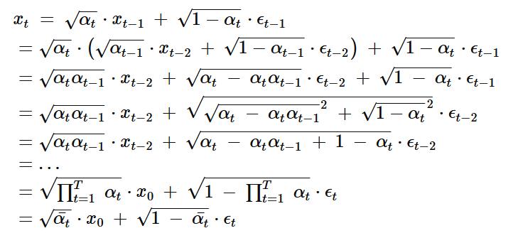
$\text{The} \text{Parametrict} \text{trick} \text{will} \text{be} \text{used}$ https://en.wikipedia.org/wiki/Reparameterization_trick
$\text{The} \text{Parametrict} \text{trick}$ara
$recall : q\left(x_{t} | x_{t−1}\right)=N(x_{t}$; $μ_{t}=\sqrt{1−β_{t}}$ $x_{t−1}$,$Σ_{t}=β_{t}I),$
$σ=standrad deviation,β= variance$, so $σ=\sqrt{β}$
$x_{t}$=mean + standard_dev*N(0,1)=μ+ σ∈---(*), (reparameterization trick)
${set α}_{t}=1−β_{t}, {\overline{α}}_{t}$= $\prod_{s=0}^{T}{α_{s}}$,
where $ε_{0},…..,ε_{t−2},$
$ε_{t−1}\sim N(0,1)$= $\sqrt{{\overline{α}}_{t}}$ $x_{0}$+ $\sqrt{1−{\overline{α}}_{t}}ε_{0}$
$ε$=Gaussian noise for all steps
${set α}_{t}=1−β_{t}$, from (*)
$x_{t}$= μ $+{\sqrt{β}ε}_{0}=\sqrt{{\overline{α}}_{t}}$ $x_{0}$+ $\sqrt{1−{\overline{α}}_{t}}ε_{0}$
$μ_{t}=\sqrt{1−β_{t}}$ $x_{t−1}=\sqrt{α_{t}}x_{t−1}$
$$α_{t} and {\overline{α}}_{t} can be repcomputed \left(\text{using} \text{a} \text{variance} \text{schedule} \text{to} \text{be} \text{discussed} \text{later}\right)for all timesteps\text{.}Hence, we can sample$$
$$our latent variables x_{t} at$$
$$any arbitry time step. This will be used for$$
$$finding objective loss L_{t}$$
https://stats.stackexchange.com/questions/595852/how-is-the-variance-for-a-diffusion-kernel-derived-for-a-diffusion-model
$x_{t}$= $\sqrt{{\overline{α}}_{t}}$ $x_{0}$+ $\sqrt{1−{\overline{α}}_{t}}ε_{0}$

Slide 5
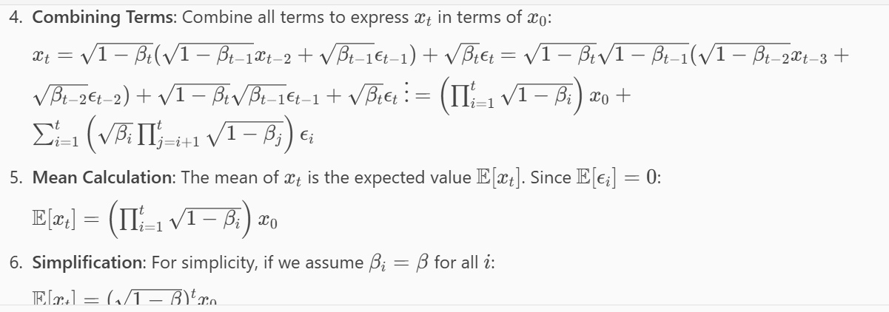
From copilot
The mean from beta

Slide 6
Variance schedule
The variance parameter $β_{t}$​ can be fixed to a constant or chosen as a schedule over the T timesteps. In fact, one can define a variance schedule, which can be linear, quadratic, cosine etc. A possible scheme is a linear schedule increasing from $β_{t=1}$10^-4 to $β_{t=T}=0.02$

Slide 7
Reverse diffusion
As T→∞, the latent $x_{t}$is nearly an isotropic Gaussian distribution. Therefore, if we manage to learn the reverse distribution $\text{:} q\left(x_{t−1} | x_{t}\right)$ , we can sample $x_{t}$ N(0,I), run the reverse process and acquire a sample from $q(x_{0})$ $,$ generating a novel data point from the original data distribution.
The question is how we can model the reverse diffusion process.

Slide 8
Approximating the reverse process with a neural network
In practical terms, we don't know $q\left(x_{t−1} | x_{t}\right)$. It's intractable since statistical estimates of $q\left(x_{t−1} | x_{t}\right)$ require computations involving the data distribution. Instead, we approximate $q\left(x_{t−1} | x_{t}\right)$with a parameterized model $P_{θ}$​ (e.g. a neural network). Since $q\left(x_{t−1} | x_{t}\right)$will also be Gaussian, for small enough $P_{θ}$we can choose to be Gaussian and just parameterize the mean and variance:
$P_{θ}\left(x_{t−1} | x_{t}\right)$= $N(x_{t−1}$; $μ_{θ}\left(x_{t},t\right), Σ_{θ}(x_{t},t)$
$$q\left(x_{t} | x_{t−1}\right)$$
$$P_{θ}\left(x_{t−1} | x_{t}\right)$$

Slide 9
If we apply the reverse formula for all timesteps $(P_{θ}\left(x_{0:T}\right)$, also called trajectory), we can go from $x_{t}$ to the data distribution:
By additionally conditioning the model on timestep t, it will learn to predict the Gaussian parameters (meaning the mean $μ_{θ}\left(x_{t},t\right)$ and the covariance matrix $Σ_{θ}\left(x_{t},t\right)$for each timestep.
But how do we train such a model?
$P_{θ}\left(x_{0:T}\right)$=$P_{θ}\left(x_{T}\right)\prod_{t=1}^{T}{P_{θ}\left(x_{t−1} | x_{t}\right)}$

Slide 10
Diffusion with Unet https://towardsdatascience.com/what-are-stable-diffusion-models-and-why-are-they-a-step-forward-for-image-generation-aa1182801d46/

Slide 11
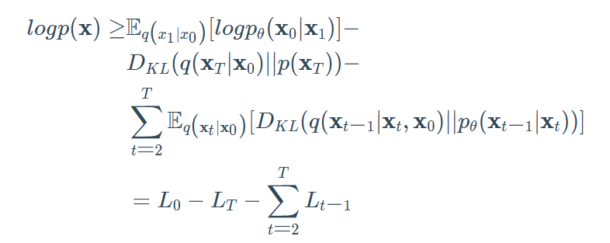
Training the diffusion model
If we take a step back, we can notice that the combination of q and p is very similar to a variational autoencoder (VAE). Thus, we can train it by optimizing the negative log-likelihood of the training data. After a series of calculations, which we won't analyze here, we can write the evidence lower bound (ELBO) as follows:
${logp\left(X\right)≥E}_{q\left(x_{1} | x_{0}\right)}\left[{logp}_{θ}\left(X_{0} | X_{1}\right)\right]−D_{KL}\left(q\left(X_{T} | X_{0}\right)\right)||p(X_{T}$)
$$−\sum_{t=2}^{T}{E_{q\left(x_{t} | x_{0}\right)}\left[D_{KL}\left(q\left(X_{t−1} | X_{t},X_{0}\right)\right){||P}_{θ}\left(X_{t−1} | X_{t}\right)\right]}$$
= $L_{0}$ $−$ $L_{T}$ $−\sum_{t=2}^{T}{L_{t−1}}$

Slide 12
Let's analyse these terms:
Let's analyze these terms:
The Eq(x1∣x0)[logpθ(x0∣x1)] term can been as a reconstruction term, similar to the one in the ELBO of a variational autoencoder. In Ho et al 2020 , this term is learned using a separate decoder.
DKL(q(xT∣x0)∣∣p(xT)) shows how close xTxT​ is to the standard Gaussian. Note that the entire term has no trainable parameters so it's ignored during training.
The third term ∑t=2T​Lt−1​, also referred as LtLt​, formulate the difference between the desired denoising steps pθ(xt−1∣xt)) and the approximated ones q(xt−1∣xt,x0).
It is evident that through the ELBO, maximizing the likelihood boils down to learning the denoising steps Lt​.
Important note: Even though q(xt−1​∣xt​) is intractable Sohl-Dickstein et al illustrated that by additionally conditioning on x0x0​ makes it tractable.
Intuitively, a painter (our generative model) needs a reference image (x0​) to slowly draw (reverse diffusion step q(xt−1∣xt,x0) an image. Thus, we can take a small step backwards, meaning from noise to generate an image, if and only if we have x0x0​ as a reference.

Slide 13
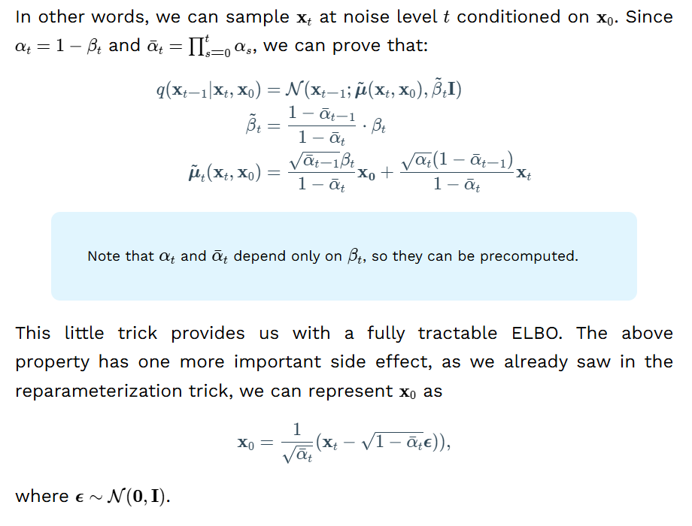
In other words, we can sample xt​ at noise level t conditioned on x0​. Since αt​=1−βt​ and αˉt​=∏s=0t​αs​, we can prove that:
$q\left(x_{t} | x_{t−1}\right)=N(x_{t−1}$;$\tilde{μ}(x_{t},x_{0})),\tilde{β_{t}}I)$
$\tilde{β_{t}}$= $\frac{1−{\overline{α}}_{t−1}}{1−{\overline{α}}_{t}}β_{t}$
$\tilde{μ_{t}(}x_{t}$, $x_{0})\text{=} \frac{\sqrt{1−{\overline{α}}_{t−1}}}{1−{\overline{α}}_{t}}$ $x_{0}$+ $\frac{\sqrt{α_{t}}(1−{\overline{α}}_{t−1})}{1−{\overline{α}}_{t}}$ $x_{t}$
Note that $α_{t}$ and ${\overline{α}}_{t−1}$depend only on $β_{t}$​, so they can be precomputed.
This little trick provides us with a fully tractable ELBO. The above property has one more important side effect, as we already saw in the reparameterization trick, we can represent x0x0​ as
$x_{0}=\frac{1}{\sqrt{1−{\overline{α}}_{t}}}(x_{t}−\sqrt{1−{\overline{α}}_{t−1}}ε)$, where $ε\sim$N(0,I)

Slide 16
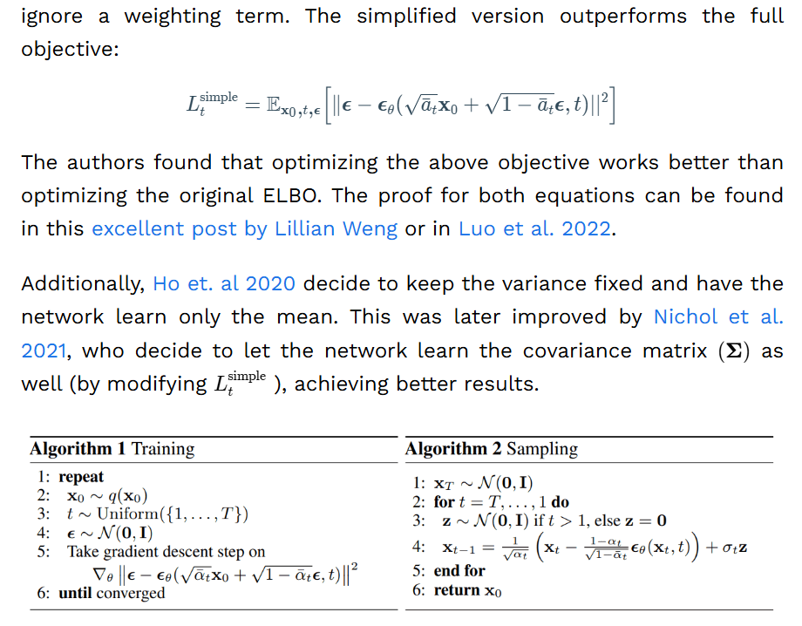

Slide 17
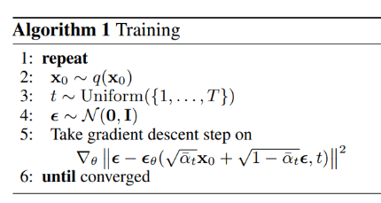
Training
This is how to get the next image by adding noise at x0, α1, α2, α3,…, αt,
πα= α1* α2* α3*… αt
∈=noise N(0,1)
So xt=sqrt(πα)*x0+sqrt(1- πα)*∈
∈_{θ}=neural network(θ) to be learned, so that it will produce a random number similar to ∈
The gradient decent target is to minimize

Slide 18
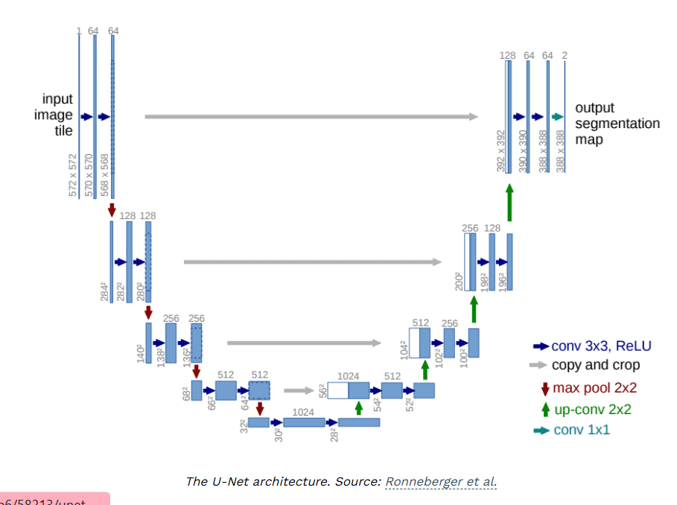

Slide 19
Why use UNET
https://ai.stackexchange.com/questions/37178/why-diffusion-model-always-use-u-net

Slide 20
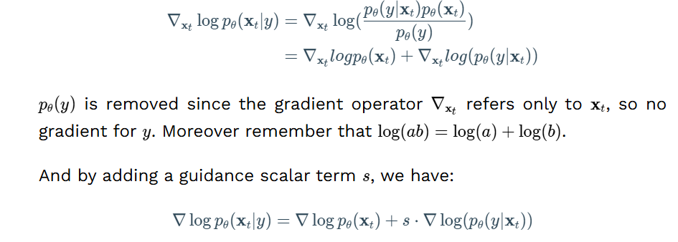
Conditional Image Generation: Guided Diffusion
A crucial aspect of image generation is conditioning the sampling process to manipulate the generated samples. Here, this is also referred to as guided diffusion.
There have even been methods that incorporate image embeddings into the diffusion in order to "guide" the generation. Mathematically, guidance refers to conditioning a prior data distribution p(x)p(x) with a condition yy, i.e. the class label or an image/text embedding, resulting in p(x∣y)p(x∣y).
To turn a diffusion model pθpθ​ into a conditional diffusion model, we can add conditioning information yy at each diffusion step.
pθ(x0:T∣y)=pθ(xT)∏t=1Tpθ(xt−1∣xt,y)pθ​(x0:T​∣y)=pθ​(xT​)t=1∏T​pθ​(xt−1​∣xt​,y)
The fact that the conditioning is being seen at each timestep may be a good justification for the excellent samples from a text prompt.
In general, guided diffusion models aim to learn ∇log⁡pθ(xt∣y)∇logpθ​(xt​∣y). So using the Bayes rule, we can write:
∇xtlog⁡pθ(xt∣y)=∇xtlog⁡(pθ(y∣xt)pθ(xt)pθ(y))=∇xtlogpθ(xt)+∇xtlog(pθ(y∣xt))∇xt​​logpθ​(xt​∣y)​=∇xt​​log(pθ​(y)pθ​(y∣xt​)pθ​(xt​)​)=∇xt​​logpθ​(xt​)+∇xt​​log(pθ​(y∣xt​))​
pθ(y)pθ​(y) is removed since the gradient operator ∇xt∇xt​​ refers only to xtxt​, so no gradient for yy. Moreover remember that log⁡(ab)=log⁡(a)+log⁡(b)log(ab)=log(a)+log(b).
And by adding a guidance scalar term ss, we have:
∇log⁡pθ(xt∣y)=∇log⁡pθ(xt)+s⋅∇log⁡(pθ(y∣xt))∇logpθ​(xt​∣y)=∇logpθ​(xt​)+s⋅∇log(pθ​(y∣xt​))
Using this formulation, let's make a distinction between classifier and classifier-free guidance. Next, we will present two family of methods aiming at injecting label information.

Slide 21
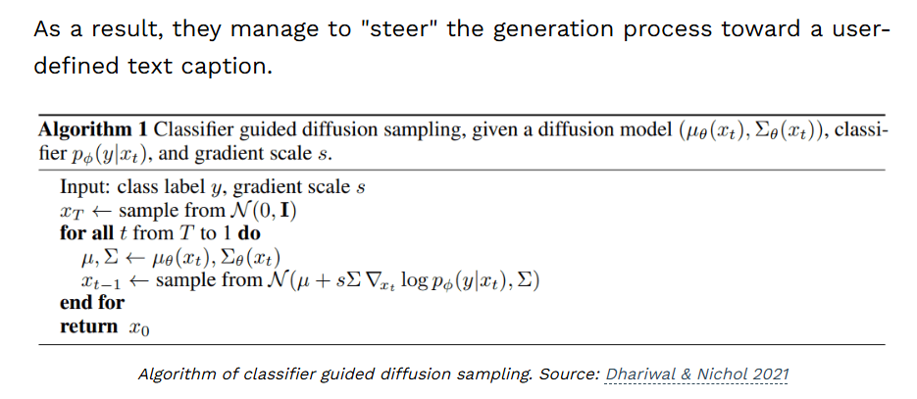
v

Slide 22
d
d

Slide 23
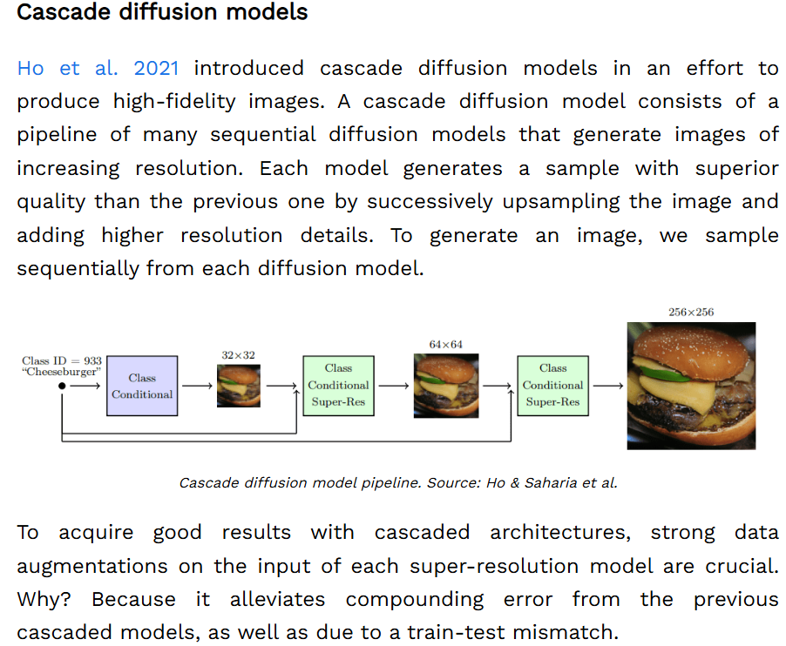
d
d

Slide 24
dStable diffusion: Latent diffusion models
Latent diffusion models are based on a rather simple idea: instead of applying the diffusion process directly on a high-dimensional input, we project the input into a smaller latent space and apply the diffusion there.
In more detail, Rombach et al. proposed to use an encoder network to encode the input into a latent representation i.e. zt=g(xt)zt​=g(xt​). The intuition behind this decision is to lower the computational demands of training diffusion models by processing the input in a lower dimensional space. Afterward, a standard diffusion model (U-Net) is applied to generate new data, which are upsampled by a decoder network.
If the loss for a typical diffusion model (DM) is formulated as:
LDM=Ex,t,ϵ[∥ϵ−ϵθ(xt,t)∣∣2]LDM​=Ex,t,ϵ​[∥ϵ−ϵθ​(xt​,t)∣∣2]
then given an encoder EE and a latent representation zz, the loss for a latent diffusion model (LDM) is:

Slide 25
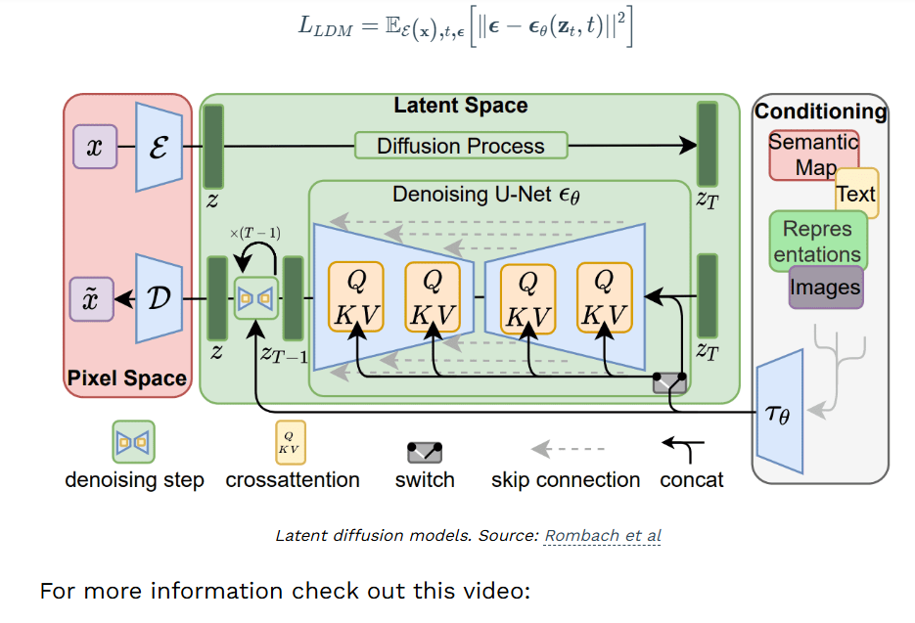
d

Slide 27
c

Slide 30
CLIP
CLIP: Connecting text and images
https://towardsdatascience.com/simple-implementation-of-openai-clip-model-a-tutorial-ace6ff01d9f2
https://openai.com/index/clip/

Slide 31
Reference
https://theaisummer.com/diffusion-models/
https://stabledifffusion.com/tools/ai-image-generator
https://openai.com/index/clip/

Slide 32
UNET, Diffusion model
KH Wong

Slide 33
What is the output of U-Net model?
The output has three channels corresponding to the three classes that the model will classify each pixel for: background, foreground object, and object outline. And we can visualize the model architecture with model.
https://pyimagesearch.com/2022/02/21/u-net-image-segmentation-in-keras/

Slide 34
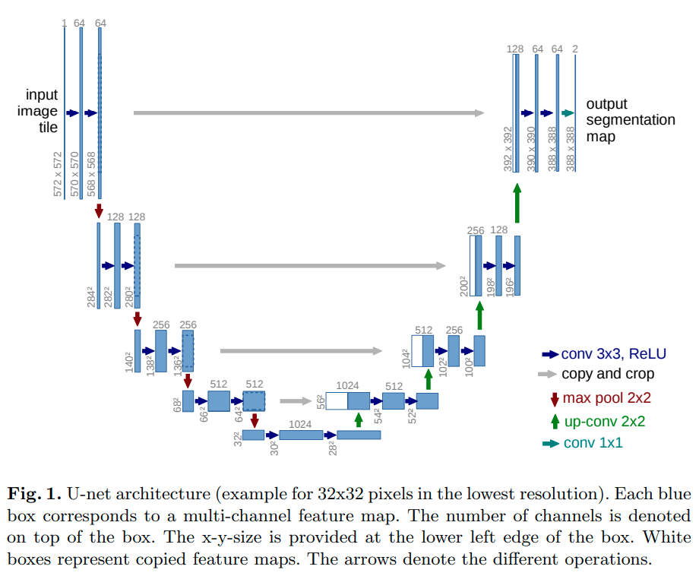
https://dzdata.medium.com/intro-to-diffusion-model-part-5-d0af8331871
d

Slide 35
Note that this concatenation must be cropped to match the expanding path's dimensions. Two 3x3 convolution layers (unpadded) are applied ...
https://stackoverflow.com/questions/53068877/u-net-copy-and-crop

