Slide 1
Radiance Field Rendering techniques: 1) Neural Radiance Fields (Nerfs) 2) Gaussian splatting (3dGS)
KH Wong

Slide 2
Introduction
Nerfs and Gaussian Splatting are rendering techniques for creating virtual images of any viewing angles from real images
After training users can see objects in 3D in any selected viewing angles.
Useful in the virtual reality and gaming industries
Nerfs is neural network based, so it is slow.
Gaussian Splatting is non-neural based , it works much fasters

Slide 3
NeRF Demos (neural network approach)
https://www.matthewtancik.com/nerf
From a few shots of an environment, you can generate virtual images of any viewing directions of your choice

Slide 4
3dGS demos (faster) Non neural network approach. Use iterative optimization method instead
https://repo-sam.inria.fr/fungraph/3d-gaussian-splatting/
Can produce similar result as NeRF but works much faster

Slide 5
Tools
To generate virtual images of an environment, you need to capture images and record the camera poses (intrinsic parameters) as inputs.
Camera poses can be obtained by the tool colmap. COLMAP - Structure-from-Motion and Multi-View Stereo
Then you may use NeRF or 3dGS to produce the virtually generated views.

Slide 6
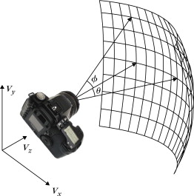
Background: The Plenoptic function
7D Plenoptic function (full):
P(θ, φ, ω, τ, Vx, Vy, Vz):
The camera center coordinates (Vx, Vy, Vz)
Camera viewing direction; θ and φ
Can be simplified, if
τ (the time) is stable , so ignored
ω (frequency, color) is stable, so ignored
So, it becomes a 5D Plenoptic function:
P(θ, φ, Vx, Vy, Vz) (simplified)
https://www.sciencedirect.com/topics/engineering/plenoptic-function

Slide 7
In graphics, the Ray tracing framework is used to generate images
You have the camera or viewpoint in the scene.
Rays are "casted" into the 3D environment ; the ray may hit some objects.
An algorithm calculates how the light interacts with the surfaces of the objects.
These include reflections, refractions (light bending through transparent objects), and shadows etc.
This Ray tracing framework is used in Radiance-based rendering such as Nerf and 3D gaussian splatting
https://en.wikipedia.org/wiki/Ray_tracing_(graphics)

Slide 8
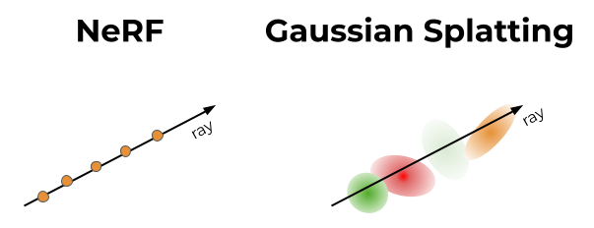
Alpha blending in NERF and Gaussian Splatting (3DGS)
The opacity (α) affects how much light can pass the object:
α=0 fully transparent;
α =large for opaque objects
center
Only 3D feature points along the ray affect the opacity
Each 3D Gaussian (approx. by ellipsoid) has an opacity (α) value
How much (α) affects the light passing through depends on how close the ray is to the center of the ellipsoid
https://towardsdatascience.com/a-comprehensive-overview-of-gaussian-splatting-e7d570081362/

Slide 9
Alpha composing (blending)
Basic equation: $C={_{f}C}_{f}+(1−_{f}$)$C_{b}$, where $=opacity, C=color$, $f$=foreground, $b$=background
For a ray shown in the diagram
For object $i=1$ , color =$C_{i=1} , Opacity=_{i=1}$, background color= $C_{b,i=1}$
For object $i=2$, color =$C_{i=2} , Opacity=_{i=2}$, background color= $C_{b,i=2}$
$C_{total}={_{1}C}_{1}+(1−_{1}$)$C_{b1}$, where
$C_{b1}={α_{2}C}_{2}+(1−α_{2}\text{)}$ $C_{b2}$, hence
$C_{total}={_{1}C}_{1}+(1−_{1}$) (${_{2}C}_{2}+(1−α_{2}\text{) }C_{b2}\text{)}$
$C_{total}={_{1}C}_{1}+(1−_{1}$)$C_{b1}$,
$$C_{b1}={α_{2}C}_{2}+(1−α_{2}\text{)}C_{b2}$$
Light
source
Object
$$i=1$$
Object
$i$=2
$$C_{total}$$
$$C_{b1}$$
$$C_{b2}$$
ray
$${_{i=1}C}_{i=1}$$
$${_{i=2}C}_{i=2}$$
Direct or reflected light
source
Exercise 1: Given $C_{b2}$=0.22 , $_{i=2}$=0.26, $C_{i=2}$=0.24, $_{i=1}$=0.13 , $C_{i=1}$=0.15
Which answer is true?
$${choice1: C}_{total}=\text{0.13∗0.15+(1−0.13)∗}\text{(}\text{0.26∗0.24+(1−0.26)∗0.23}\text{)}$$
$${choice2: C}_{total}=\text{0.13∗0.15+(1−0.15)∗}\text{(}\text{0.26∗0.24+(1−0.26)∗0.22}\text{)}$$
$${choice3: C}_{total}= \text{0.13∗0.15+(1−0.13)∗}\text{(}\text{0.26∗0.24+(1−0.26)∗0.22}\text{)}$$
$${choice4: C}_{total}=\text{0.13∗0.15+(1−0.13)∗}\text{(}\text{0.26∗0.24+(1−0.22)∗0.23}\text{)}$$

Slide 10
Basic idea of Alpha composing (blending)
$${Answer Ex.1: C}_{total=}= \text{0}\text{.}\text{13}\text{∗}\text{0}\text{.}\text{15}\text{+(}\text{1}\text{−}\text{0}\text{.}\text{13}\text{)}\text{∗}\text{(}\text{0}\text{.}\text{26}\text{∗}\text{0}\text{.}\text{24}\text{+(}\text{1}\text{−}\text{0}\text{.}\text{26}\text{)}\text{∗}\text{0}\text{.}\text{22}\text{) (}\text{answer} \text{3 }\text{is} \text{correct}\text{)}$$
Basic equation: $C={_{f}C}_{f}+(1−_{f}$)$C_{b}$, where $=opacity, C=color$, $f$=foreground, $b$=background
$_{f}$= opacity or foreground , that is how much light can pass and reaching the object with color $C_{f}$.
For object $i=1$ , color =$C_{i=1} , Opacity=_{i=1}$, background color= $C_{b,i=1}$
For object $i=2$, color =$C_{i=2} , Opacity=_{i=2}$, background color= $C_{b,i=2}=0$
$C_{total}={_{1}C}_{1}+(1−_{1}$)$C_{b1}$, where
$C_{b1}={α_{2}C}_{2}+(1−α_{2}\text{)}$ 0, hence
$C_{total}={_{1}C}_{1}+(1−_{1}$) (${_{2}C}_{2}\text{)}$
If $C_{b,i=2} is not 0, we can extend this idea to$
${{C_{total}=}_{1}c}_{1}+(1−_{1}$)$_{2}c_{2}$
+$(1−_{1}$) $(1−_{2}$) $_{3}c_{3}$
+$(1−_{1}$) $(1−_{2}$) $(1−_{3}$) $_{4}c_{4}+…$
$+(1−α_{1}\text{)}$ $(1−_{2}$) $(1−_{3}$)(1$−_{4}$) $_{5}c_{5}+$…
$+$………………………………$(1−_{N−1}$)$c_{N}$
$C_{total}= \sum_{i=1}^{N}{\left(α_{i}c_{i}\prod_{j=1}^{i−1}{\left(1−α_{j}\right)}\right)}$
$C_{total}={_{1}C}_{1}+(1−_{1}$)$C_{b1}$,
$$C_{b1}={α_{2}C}_{2}+(1−α_{2}\text{)}C_{b2}$$
Object
$$i=1$$
Object
$i$=2
$$C_{b1}$$
$$C_{b2}$$
$$C_{total}$$
ray
$${_{i=1}C}_{i=1}$$
$${_{i=2}C}_{i=2}$$
Direct or reflected light
source
$_{i}$= how much light can pass and reach object $i$
Opaque or transparent objects
source

Slide 11
Important parameters to model alpha composing
Alpha (α): Represents opacity of an object. Determine how much light can pass. E.g. Fully transparent , α =0 . If α=higher value , it is an opaque object
Density ($σ$): $α=1−\exp\left(−σ∙∆t\right)$, $∆t$=width of the object
Transmittance (T): Fraction of light that passes through a region without being absorbed.
$T\left(t\right)=\exp\left(−\int_{0}^{t}{σ\left(s\right)ds}\right),$ where σ(s) is the density along the ray.
Transmittance decreases as density increases, meaning less light gets through.$α=1−\exp\left(−σ∙∆t\right), \text{where} ∆t \text{is} \text{the} \text{step} \text{size} \text{along} \text{the} \text{ray}\text{.}$
E.g. For a fully transparent object $σ$=0, $α$=1-exp(0)=0,
Alpha (α) and Transmittance (T) relation : α=1−T.
Summary:
$$α=1−\exp\left(−σ∙∆t\right)$$
$$T\left(t\right)=\exp\left(−\int_{0}^{t}{σ\left(s\right)ds}\right)$$
α =1 $−$T

Slide 12
NeRFS : volume rendering https://www.cs.utexas.edu/~robertom/cs391r_fall2022/slides/2022-09-06-NeRF-Elvin-Yang.pdf
In Nerfs these calculations will be modeled by a neural network
α=alpha
https://medium.com/@rparikshat1998/nerf-from-scratch-fe21c08b145d

Slide 13
In NeRF:
stratified sampling method
sampling points
Viewing
Image pixel
The ray (r)
Object
object
${ c}_{i}$
color
0 1 2 3 N-1 N
$\hat{C}\left(r\right)=\sum_{i=1}^{N=1}{T_{i}∗(1−exp⁡({−σ}_{j} δ_{j})){∗c}_{i}}$, where $T_{i}=$ $exp(−\sum_{j=1}^{i−1}{σ_{j} δ_{j}) }$
Assume there is only one color (e.g. red) and ${ c}_{i}$ represents the intensity of the color.
Term1: $T_{i}= exp(−\sum_{j=1}^{i−1}{σ_{j} δ_{j}) }$ =cumulated Transmission from sample 1 to $i−1$ .
$At i, if{ the previous σ}_{j=1,2,3,..,i−1}=0 \left(fully transparent\right),$
$T_{i}= exp(−\sum_{j=1}^{i−1}{σ_{j} δ_{j}) }$=exp(0)=1 that means, the current color $c_{i }will contribte full to this ray.$
If i-1 density ${ σ}_{i−1}=10$ is high, $T_{i}= exp(−10)$=0, hence current and later sample color will be blocked. I.e.${ c}_{i}$, ${ c}_{i+1}$,${ c}_{i+2},…. has no contribution to the ray$
Term2: $At current sample i, current \text{alpha}{= α}_{i}= (1−exp⁡({−σ}_{i}$ $δ_{i}))$,
${if current density is transparent , σ}_{i}$=0,$α_{i}=(1−exp⁡({−σ}_{i}$ $δ_{i}))=(1−\exp\left(0\right))=0 , current color{ c}_{i} has no contrintion to the ray$.(transparent object has no color)
${if, σ}_{i}$=high=10, $α_{i}=\left(1−\exp\left(−10\right)\right)=0.999, current color{ c}_{i} will make high contribution$ to the ray. But term 1 of next sample will be 0, that means it will block color of later samples **.
${Sampling means: δ}_{j}$=1 at the sampling point j, otherwise 0
Term1
Transmission
Up to sample $i−1$
Term2 Current $i$
Alpha
Term3 Current $i$
object color

Slide 14
Exercise 2
${Sampling means: δ}_{j}$=1 at the sampling point j, otherwise 0
sampling points
Viewing image pixel
The ray (r)
Sample 1 2 3 4
$c_{i=1 }$=0.11
$σ_{i=1 }$=0.12
$c_{i=2 }$=0.21
$σ_{i=2 }$=0.22
$c_{i=3 }$=0.31
$σ_{i=3 }$=0.32
$c_{i=4 }$=0.41
$σ_{i=4 }$=0.42
$\hat{C}\left(r\right)=\sum_{i=1}^{N=1}{T_{i}∗(1−exp⁡({−σ}_{j} δ_{j})){∗c}_{i}}$, where $T_{i}=$ $exp(−\sum_{j=1}^{i−1}{σ_{j} δ_{j}) }$
C(r)= $T_{i=1}∗\left(1−\exp\left({−σ}_{j=1} δ_{j=1}\right)\right){∗c}_{i=1}+$
$$T_{i=2}∗\left(1−\exp\left({−σ}_{j=2} δ_{j=2}\right)\right){∗c}_{i=2}+$$
$$T_{i=3}∗\left(1−\exp\left({−σ}_{j=3} δ_{j=3}\right)\right){∗c}_{i=3}+$$
$$T_{i=4}∗(1−exp⁡({−σ}_{j=4} δ_{j=4})){∗c}_{i=4}$$
$T_{i=2}$= $exp(−\sum_{j=1}^{i−1=1}{σ_{j} δ_{j}) }$=exp(- $σ_{j=1}$)
$T_{i=3}$= $exp(−\sum_{j=1}^{i−1=2}{σ_{j} δ_{j}) }$=exp(- $σ_{j=1}\text{−} σ_{j=2}$)
Exercise 2a: Calculate $T_{i=4}$= $exp(−\sum_{j=1}^{i−1=3}{σ_{j} δ_{j}) }$=exp(- $σ_{j=1}$-$σ_{j=2}\text{−} σ_{j=3}$)
(1) exp(-0.12-0.22-0.41), (2) exp(-0.12-0.22-0.31),
(3) exp(-0.12-0.22-0.32) , (4) exp(-0.12-0.22-0.42),
Exercise 2b: Calculate C(r). (student exercise)

Slide 15
Answer 2ab
${Sampling means: δ}_{j}$=1 at the sampling point j, otherwise 0
sampling points
Viewing image
Pixel
The ray (r)
Sample 1 2 3 4
$c_{i=1 }$=0.11
$σ_{i=1 }$=0.12
$c_{i=2 }$=0.21
$σ_{i=2 }$=0.22
$c_{i=3 }$=0.31
$σ_{i=3}$=0.32
$c_{i=4 }$=0.41
$σ_{i=4 }$=0.42
$\hat{C}\left(r\right)=\sum_{i=1}^{N=1}{T_{i}∗(1−exp⁡({−σ}_{j} δ_{j})){∗c}_{i}}$, where $T_{i}=$ $exp(−\sum_{j=1}^{i−1}{σ_{j} δ_{j}) }$
Exercise 2a: Calculate $T_{i=4}$= $exp(−\sum_{j=1}^{i−1=3}{σ_{j} δ_{j}) }$=exp(- $σ_{j=1}$-$σ_{j=2}\text{−} σ_{j=3}$)
Answer 2a(choice3 is correct)= exp(-0.12-0.22-0.32)=0.5168.
Exercise 2b: find C(r)= $T_{i=1}∗\left(1−\exp\left({−σ}_{j=1} δ_{j=1}\right)\right){∗c}_{i=1}+$
$$T_{i=2}∗\left(1−\exp\left({−σ}_{j=2} δ_{j=2}\right)\right){∗c}_{i=2}+$$
$$T_{i=3}∗\left(1−\exp\left({−σ}_{j=3} δ_{j=3}\right)\right){∗c}_{i=3}+$$
$$T_{i=4}∗(1−exp⁡({−σ}_{j=4} δ_{j=4})){∗c}_{i=4}$$
clear %answer
%%s0=0 %( no object)
c1=0.11, s1=0.12,c2=0.21,s2=0.22,c3=0.31,s3=0.32,c4=0.41,s4=0.42
t1=1 % fully transparent between sample 1 and the viewing pixel
t2=exp(-s1), t3=exp(-s1-s2), t4=exp(-s1-s2-s3)
ray_color=t1*(1-exp(-s1))*c1+ t2*(1-exp(-s2))*c2+t3*(1-exp(-s3))*c3+ t4*(1-exp(-s4))*c4
%answer 2b=0.1823

Slide 16
Exercise 3 at sample3, density $σ_{i=3}$ is high
${Sampling means: δ}_{j}$=1 at the sampling point j, otherwise 0
sampling points
Viewing pixel Image
The ray (r)
Sample 1 2 3 4
$c_{i=1 }$=0.11
$σ_{i=1 }$=0.12
$c_{i=2 }$=0.21
$σ_{i=2 }$=0.22
$c_{i=3 }$=0.31
$σ_{i=3}$=10
$c_{i=4 }$=0.41
$σ_{i=4 }$=0.42
$\hat{C}\left(r\right)=\sum_{i=1}^{N=1}{T_{i}∗(1−exp⁡({−σ}_{j} δ_{j})){∗c}_{i}}$, where $T_{i}=$ $exp(−\sum_{j=1}^{i−1}{σ_{j} δ_{j}) }$
C(r)= $T_{i=1}∗\left(1−\exp\left({−σ}_{j=1} δ_{j=1}\right)\right){∗c}_{i=1}+$
$$T_{i=2}∗\left(1−\exp\left({−σ}_{j=2} δ_{j=2}\right)\right){∗c}_{i=2}+$$
$$T_{i=3}∗\left(1−\exp\left({−σ}_{j=3} δ_{j=3}\right)\right){∗c}_{i=3}+$$
$$T_{i=4}∗(1−exp⁡({−σ}_{j=4} δ_{j=4})){∗c}_{i=4}$$
$T_{i=2}$= $exp(−\sum_{j=1}^{i−1=1}{σ_{j} δ_{j}) }$=exp(- $σ_{j=1}$)
$T_{i=3}$= $exp(−\sum_{j=1}^{i−1=2}{σ_{j} δ_{j}) }$=exp(- $σ_{j=1}\text{−} σ_{j=2}$)
Exercise 3a: Find approx. $T_{i=4}$= $exp(−\sum_{j=1}^{i−1=3}{σ_{j} δ_{j}) }$=exp(- $σ_{j=1}$-$σ_{j=2}\text{−} σ_{j=3}$)
(1) -1, (2)0 , (3) 1, (4) 10.
Exercise 3b: Calculate C(r). (student exercise). Explain your answer

Slide 17
Answer 3. at sample3, density $σ_{i=3}$ is high
0
${Sampling means: δ}_{j}$=1 at the sampling point j, otherwise 0
sampling points
Viewing image pixel)
The ray (r)
Sample 1 2 3 4
$c_{i=1 }$=0.11
$σ_{i=1 }$=0.12
$c_{i=2 }$=0.21
$σ_{i=2 }$=0.22
$c_{i=3 }$=0.31
$σ_{i=3}$=10
$c_{i=4 }$=0.41
$σ_{i=4 }$=0.42
$\hat{C}\left(r\right)=\sum_{i=1}^{N=1}{T_{i}∗(1−exp⁡({−σ}_{j} δ_{j})){∗c}_{i}}$, where $T_{i}=$ $exp(−\sum_{j=1}^{i−1}{σ_{j} δ_{j}) }$
Exercise 3a: Calculate $T_{i=4}$= $exp(−\sum_{j=1}^{i−1=3}{σ_{j} δ_{j}) }$=exp(- $σ_{j=1}$-$σ_{j=2}\text{−} σ_{j=3}$)
Answer3a (choice2 is correct)=T4= exp(-0.12-0.22-10)=0.00003≈0
Exercise 3: find C(r)= $T_{i=1}∗\left(1−\exp\left({−σ}_{j=1} δ_{j=1}\right)\right){∗c}_{i=1}+$
$$T_{i=2}∗\left(1−\exp\left({−σ}_{j=2} δ_{j=2}\right)\right){∗c}_{i=2}+$$
$$T_{i=3}∗\left(1−\exp\left({−σ}_{j=3} δ_{j=3}\right)\right){∗c}_{i=3}+$$
$$T_{i=4}∗(1−exp⁡({−σ}_{j=4} δ_{j=4})){∗c}_{i=4}$$
clear %answer
%%s0=0 %( no object)
c1=0.11, s1=0.12,c2=0.21,s2=0.22,c3=0.31,s3=10,c4=0.41,s4=0.42
t1=1 % fully transparent between sample 1 and the viewing pixel
t2=exp(-s1), t3=exp(-s1-s2), t4=exp(-s1-s2-s3)
ray_color=t1*(1-exp(-s1))*c1+ t2*(1-exp(-s2))*c2+t3*(1-exp(-s3))*c3+ t4*(1-exp(-s4))*c4, % answer3b= 0.2699. Explanation:T4=0, so, the last term (t4 = t4*(1-exp(-s4))*c4 =0) is gone. But density 3 ($σ_{i=3})$ is high so object 3 is not transparent, and object 3 has high color value, hence the total ray color is increased as a result

Slide 18
Part1 : Nerfs
Use Neural networks,
Better results in rendering
but slow in training and rendering

Slide 19
Nerfs paper and tutorials
Nerfs was first described by the paper
“NeRF: Representing Scenes as Neural Radiance Fields for View Synthesis” By Ben Mildenhall etal.
https://arxiv.org/pdf/2003.08934
A tutorial can be found at
https://www.matthewtancik.com/nerf
Demo
https://www.youtube.com/watch?v=JuH79E8rdKc&t=5s

Slide 20
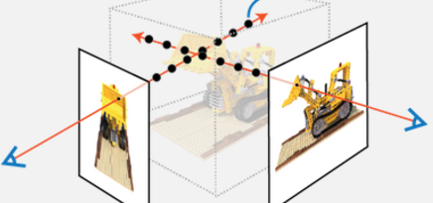
Neural Radiance Fields (Nerfs)
Sampling (x,y,z) at these dot-positions
https://en.wikipedia.org/wiki/Light_field , https://dtransposed.github.io/blog/2022/08/06/NeRF/
Ray2
Ray1
View2
(θ2,ϕ2)
View (θ1,ϕ1)
If we have a reference camera pose any rays can be described by a vector (x,y,z,θ,ϕ) , e.g.
Ray1 is a vector define by (θ1,ϕ1)
Ray2 is a vector define by (θ2,ϕ2)
Each ray is sampled at regular intervals, at each sampling point we measure the color (RGB) and Density (σ ).
Density (σ ) measures how light can pass/stop at that point by the object . Note: Opacity $α=1−\exp\left(−σ∙∆t\right) , ∆t$=1 at the sampling position
If density(σ)=0, the object is fully transparent. $α$=(1-exp(-0))=0 (fully transparent). Samples beyond that sample (farther away from the camera) will pass through.
The higher the density(σ) , the higher the probability of the ray stopping at that point. E.g. $σ$=10, $α=1−\exp\left(−σ=−10\right)$=0.999≈1. That means, color at this position will be contribute fully to the ray, but sampling points beyond that point will be blocked.
https://www.sciencedirect.com/topics/engineering/plenoptic-function

Slide 21
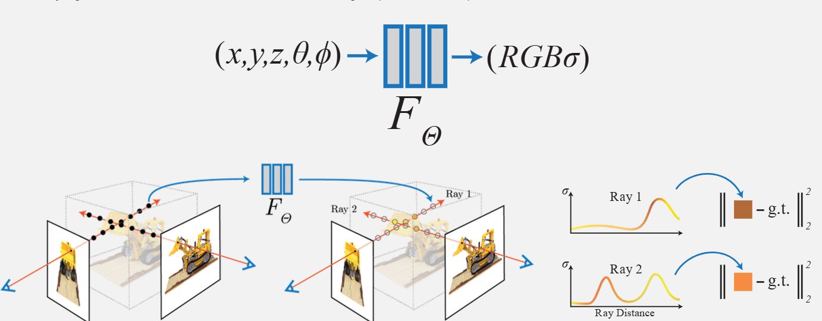
The idea
The color “g.t.” is the ground truth at a particular position (x,y,z) in 3D space, it is obtained by the Structure-from-motion SFM methods (e.g. Colmap) required to execute before the use of NeRF ,
By reading how color “g.t.” changes along the ray we can estimate Density (σ) at that point.
Neural
Network
Target:
RGBσ at the
sampling position
Input
Each sampling
position (x,y,z)
Neural net
RGB, σ along ray
g.t.=
Ground turth color
Ray1 reaching view1
Density (σ).
View1
View2
Camera
viewing angle (θ,ϕ)
Ray Distance
Predicted color on View
Ray2 reaching view2
https://theaisummer.com/nerf/
https://dtransposed.github.io/blog/2022/08/06/NeRF/

Slide 22
Ideas of NeRF
F(Θ)
N images are captured of an object
Rays are casted from each pixel of the image into 3D
Along each ray, points (x,y,z) are sampled at regular intervals
Use SFM, find ground truth color “RGB_gt” of sample points
For each sampled point i,
The sampling 3D positions (x,y,z)_{i} and viewing axis-viewing angle (θ,ϕ) are passed into neural network (F(Θ)) as input
Color “RGB_i” and density “σ_i” are generated by network (F(Θ)) .
For each ray
Use alpha composing to find RGB_predicted from “RGB_i” and density “σ_i” of that ray
Network Training F(Θ) : reduce error =|| RGB_predicted – RGG_gt ||
Density (σ ) is also an output of F(Θ), σ should also agree with the alpha composing mechanism along the ray.
Rendering: After training, given viewing angles (θ,ϕ), network (F(Θ) can predict the color (R’G’B’) and density (σ’) along rays. We can use them to find the color of the required image by alpha composing

Slide 23
Exercise 4: Number of samples calculation example
It is computationally intensive because it requires evaluating the neural network multiple times for each ray. E.g. you take N pictures of an object (or environment), image resolution is H*W and each ray has S sampling points. Then, you have N*H*W*S sampling points to process.
Exercise : If image resolution is 1920x1080, capture 50 frames of an object, and 128 samples along a ray. How many sampling points the neural network is needed to handle?
1) Less than 1 million samples
2) More than 1 million samples
3) More than 100 million samples
4) More than 10000 million samples

Slide 24
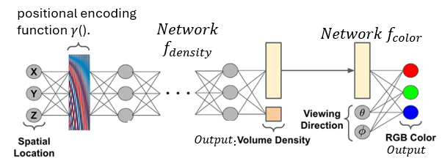
Architecture of the network for color and density Generation
Ex4.Answer4 is correct: 1920*1080*50*128= 13,271,040,000=13,271 million samples
Input1 : A spatial Location (X,Y,Z) along the ray
Input2 : Viewing Direction d=g(θ,ϕ), or d=[dx,dy,dz] ray unit vector
Output 1: Density
The encoded coordinates are passed through the neural network $f_{density}$, for predicting the density
$σ=Relu(f_{density}(x,y,z)$),
Output 2: Color (R,G,B)
The RGB color is predicted based on the density and the view direction d using the network $f_{color} .$
Positional encoding $γ$() is used to calculate the data to be fed to the rest of the network (to be discussed later)
$$c=f_{color}(γ,\text{(}\text{d}\text{)}\text{)}$$
Input1
output2
output1
Input2 (θ,ϕ)

Slide 25
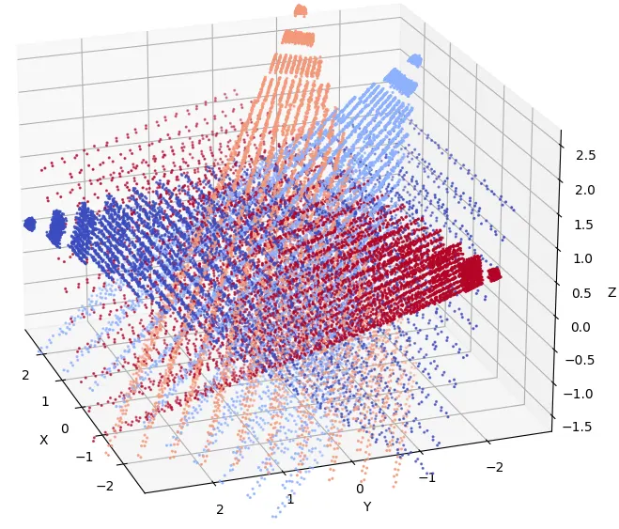
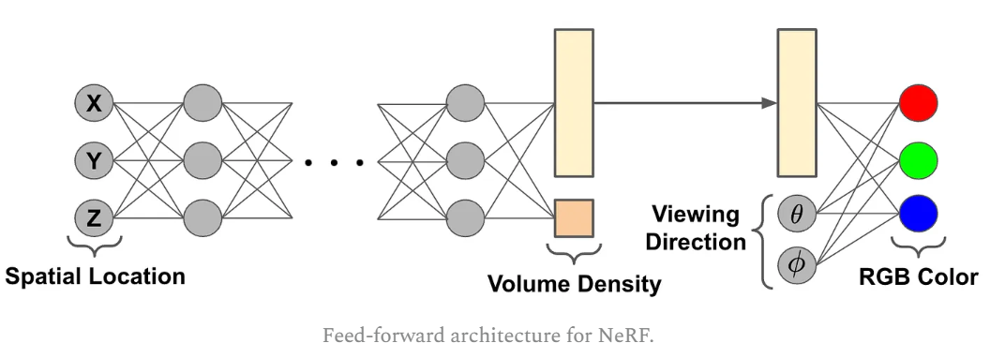
Dat processing procedure of NeRF
θ1,ϕ1
view1
θ2,ϕ2
Capture N images and use SFM to generate inputs for each sampling point:
sampling points (x,y,z) along the ray (θ,ϕ)
sampling point ground truth color (g.t.) RGB =$c_{i}$
Training the neural net: for each sampling point
Input: x,y,z of a sampling point and related θ,ϕ
Output predicted color: $c_{predicted}$
Target: RGB =$c_{i}$ (Found by SFM)
Training is to minimize $e_{i}$= ${||c}_{i} −c_{predicted}||$
Rendering (to produce an image of a given view):
You are given (x’,y’,z’,θ’,ϕ’) , you want the network to find the generated image.
After training , the neural network can produce the color and density of (x’,y’,z’,θ’,ϕ’), hence you may use the color and density to estimate the color of the required image using alpha composing.
view2
θ3,ϕ3
view3
The meeting points are sampling points
(x,y,z)

Slide 26
Implementation example of a NeRF network https://cameronrwolfe.substack.com/p/understanding-nerfs
Run this for all pixels in all sample images (so very slow). E.g.100 images of resolution 1000x1000. One pixel has one ray. Often, θ,φ is modeled by unit vector d =[d1,d2,d3]’
Input Layer: from a pixel (Target R,G,B color) of a picture of a calibrated camera
(camera center is at X,Y,Z) form the ray (viewing) direction (θ,φ)
Hidden Layers: 8 (with a skip connection after the 4th layer)
Density Output Layer: drive 2 outputs (see below)
Intermediate Feature Vector: 256x1 (vector) concatenated with the viewing direction (θ,φ) and passed to an extra feed-forward layer to predict RGB color
Output: 4 neurons: 1 Density (σ) output neuron , 3 RGB neurons
Target for training :(target R,G,B in the image)
Note: there is no target Volume Density (σ), it is found automatically by the network because the network adjusts itself to produce the correct color C(R,G,B)
Intermediate Feature Vector
Output (R,G,B)
C=
3 Target values
R G
B
For training
Output(σ)
Input: Camera center
Input:
Ray viewing direction (θ,φ)

Slide 27
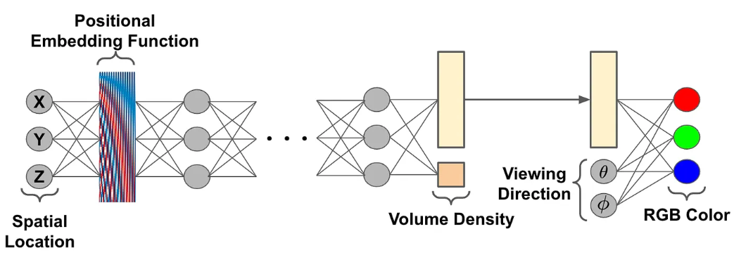
Improvement Trick1: Positional encoding γ(p) is used to add high frequency components to inputs to increase accuracy
For each input p, which is one of the 5 input s :(X,Y,Z,θ,φ), then add an L-order vector γ(p)
Note: some implementation uses a unit vector of 3 terms d=[d1, d2, d3] to represent (θ,φ )for the viewing direction (d). Hence the input dimension is 6 in stead of 5. Each input is normalized to 1
In theory, L=10, each p which is a scalar will become 1+2L values. 2L because sin and cos elements. Hence total input is 6*(1+2L)=6*(1+20)
$γ\left(p\right)=(\sin\left(2^{0}πp\right),\cos\left(2^{0}πp\right),…,\sin\left(2^{L−1}πp\right),\cos\left(2^{L−1}πp\right))$
https://cameronrwolfe.substack.com/p/beyond-nerfs-part-one
https://cameronrwolfe.substack.com/p/understanding-nerfs
(Additional 3*2L inputs for X,Y,Z)
3
inputs
Additional 2*2L inputs for θ,φ .
If using d1,d2,d3 format, it is 3*2L

Slide 28
Example: Positional encoding increase the complexity of the input (a common method in neural computing)
If X=0.3,L=4, find the $γ\left(p\right)$ vector.
X=0.3 put in X=p (because p is one of (X,Y,Z,d1,d2,d3)
Let's calculate the values for p=0.3 L=4:
Given $γ\left(p\right)=(\sin\left(2^{0}πp\right),\cos\left(2^{0}πp\right),…,\sin\left(2^{L−1}πp\right),\cos\left(2^{L−1}πp\right))$
sin(20πp)=sin(1⋅0.3)=sin(π⋅0.3)≈sin(0.9425)≈0.8090
cos⁡(2^0πp)=cos⁡(1⋅0.3)=cos⁡(π⋅0.3)≈cos⁡(0.9425)≈0.5878cos(20πp)=cos(1⋅0.3)=cos(π⋅0.3)≈cos(0.9425)≈0.5878
sin⁡(2^1πp)=sin⁡(2⋅π⋅0.3)=sin⁡(2π⋅0.3)≈sin⁡(1.885)≈0.9511sin(21πp)=sin(2⋅π⋅0.3)=sin(2π⋅0.3)≈sin(1.885)≈0.9511
cos⁡(2^1πp)=cos⁡(2⋅π⋅0.3)=cos⁡(2π⋅0.3)≈cos⁡(1.885)≈−0.3090cos(21πp)=cos(2⋅π⋅0.3)=cos(2π⋅0.3)≈cos(1.885)≈−0.309
sin⁡(2^2πp)=sin⁡(4⋅π⋅0.3)=sin⁡(4π⋅0.3)≈sin⁡(3.770)≈−0.5878sin(22πp)=sin(4⋅π⋅0.3)=sin(4π⋅0.3)≈sin(3.770)≈−0.5878
cos⁡(2^2πp)=cos⁡(4⋅π⋅0.3)=cos⁡(4π⋅0.3)≈cos⁡(3.770)≈−0.8090cos(22πp)=cos(4⋅π⋅0.3)=cos(4π⋅0.3)≈cos(3.770)≈−0.809
sin⁡(2^3πp)=sin⁡(8⋅π⋅0.3)=sin⁡(8π⋅0.3)≈sin⁡(7.540)≈0.9511sin(23πp)=sin(8⋅π⋅0.3)=sin(8π⋅0.3)≈sin(7.540)≈0.9511
cos⁡(2^3πp)=cos⁡(8⋅π⋅0.3)=cos⁡(8π⋅0.3)≈cos⁡(7.540)≈0.3090cos(23πp)=cos(8⋅π⋅0.3)=cos(8π⋅0.3)≈cos(7.540)≈0.3090
γ(0.3)=(0.8090,0.5878,0.9511,−0.3090,−0.5878,−0.8090,0.9511,0.3090)

Slide 29
Improvement Trick 2: Hierarchical sampling https://skannai.medium.com/neural-radiance-fields-a3d4206832e5
Uniform sampling at the beginning
If sampling encounter high density, use fine sampling
(Uniform sampling)
Coarse sampling
(Uniform sampling)
Coarse sampling: When density is 0 (air or completely transparent region) use coarse sampling .
E.g. Coase sampling 100 points, (typically 64-128)
Fine sampling : If density is high (object found, it may have some other object behind it ) use fine sampling for that section
E.g. Fine sampling 100 points within one coarse sampling interval, (typically 64-128)

Slide 30
In NeRF, the number of samples taken along a ray involves two stages:
Coarse Sampling:
Fixed : around 64-128 at regular fixed positions
Fine Sampling:
Based on the results from the coarse sampling, additional samples (often 64 to 128, or more) are taken in regions with higher importance,
such as areas with more detail or higher density.
Actual number varies depending on the complexity of the scene and the resolution required.
In practice
many implementations use 128 to 256 samples per ray (coarse + fine sampling stages).
Can increase or decrease for performance considerations

Slide 31
Training
Sample a batch of camera rays from the dataset (may choose batch size=4096)
Use hierarchical sampling to query coarse and fine points
$\hat{C}c$(r)= predicted coarse resolution color of ray r,
$\hat{C}f$(r)=predicted fine resolution color of ray r,
$C$(r)=measured (group truth) color of ray r.
Use the volume rendering equation to calculate the color of the ray
Compute the squared error between rendered and true pixel colors
Optimize network parameters using Adam
Coarse resolution
error
Fine resolution
error

Slide 32
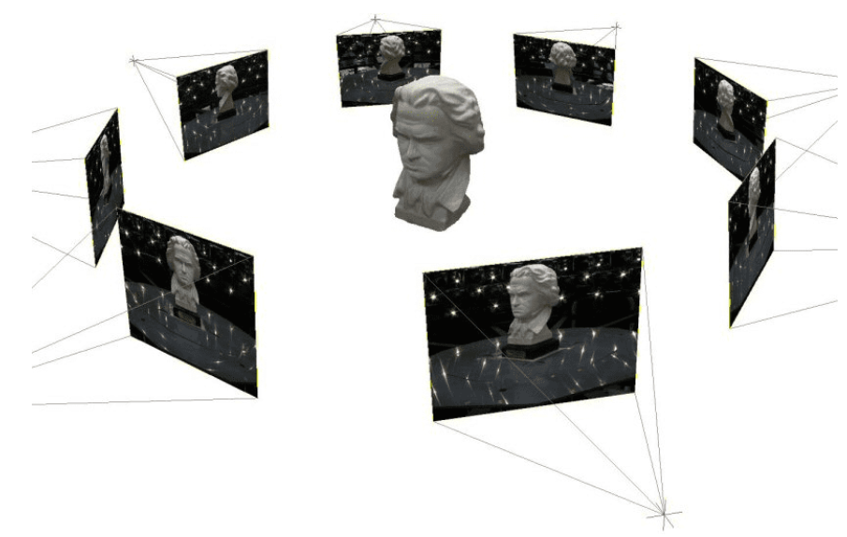
How many rays are required?
Example: capture 30 pictures of an object, all in 1920 * 1080 resolution. We need 30 * 1920 * 1080 = 62,208,000 =62.2 Million rays.
If we take 128 samples along a ray , we need to handle 128 * 62,208,000 = 7,962,624,000 , about 8 Billion samples
So, it is a very slow and painful process
https://theaisummer.com/nerf/
https://pyimagesearch.com/2024/10/28/nerfs-explained-goodbye-photogrammetry/

Slide 33
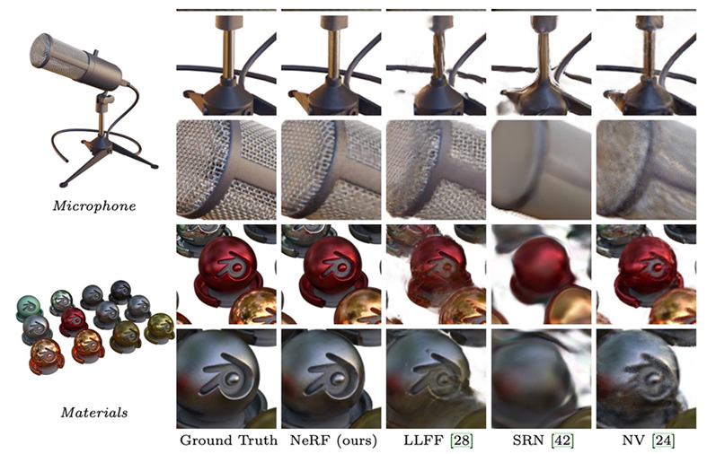
Qualitative results: realistic synthesized objects

Slide 34
Limitations
NeRF only works with static scenes (Not practice for making videos – too slow)
A trained NeRF model can work for one scene only.
Training is slow: Computationally expensive: 1-2 days to train each individual scene on a modern GPU
Rendering is slow too: each pixel in a synthesized image requires around one minute or more to generate a view.

Slide 35
Summary of Neural Radiance Fields (NeRF)
Basic theory of the Neural Radiance Fields (Nerf) 3D generative views method is discussed
Explained the architecture and optimization learning methods
Limitation of the approach is discussed

Slide 36
References
https://medium.com/@rparikshat1998/nerf-from-scratch-fe21c08b145d
https://ucladeepvision.github.io/CS188-Projects-2023Winter/2023/03/26/team50-intro-to-NeRF.html
https://www.sush.one/docs/Computer%20Vision/NERF.html
chrome-extension://efaidnbmnnnibpcajpcglclefindmkaj/https://theialab.ca/pubs/tagliasacchi2022volume.pdf
https://radiancefields.com/understanding-nerf-on-a-small-scale
https://yconquesty.github.io/blog/ml/nerf/nerf_rendering.html#the-rendering-formula
https://www.peterstefek.me/nerf.html
Volume density https://yconquesty.github.io/blog/ml/nerf/nerf_rendering.html#numerical-quadrature
Very detailed about density calculation: https://yconquesty.github.io/blog/ml/nerf/nerf_rendering.html#background
Review the paper on youtube https://www.youtube.com/watch?v=2SQUMYw0h0A&t=9s

Slide 37
Part2: 3D Gaussian splatting (3dGS)
No neural networks,
run faster in training and rendering

Slide 38
Overview of 3D Gaussian Splatting
Introduction
3D gaussian splatting architecture
Spherical harmonics color presentation
Optimization -- overall scheme
Detailed algorithms
Summary

Slide 39
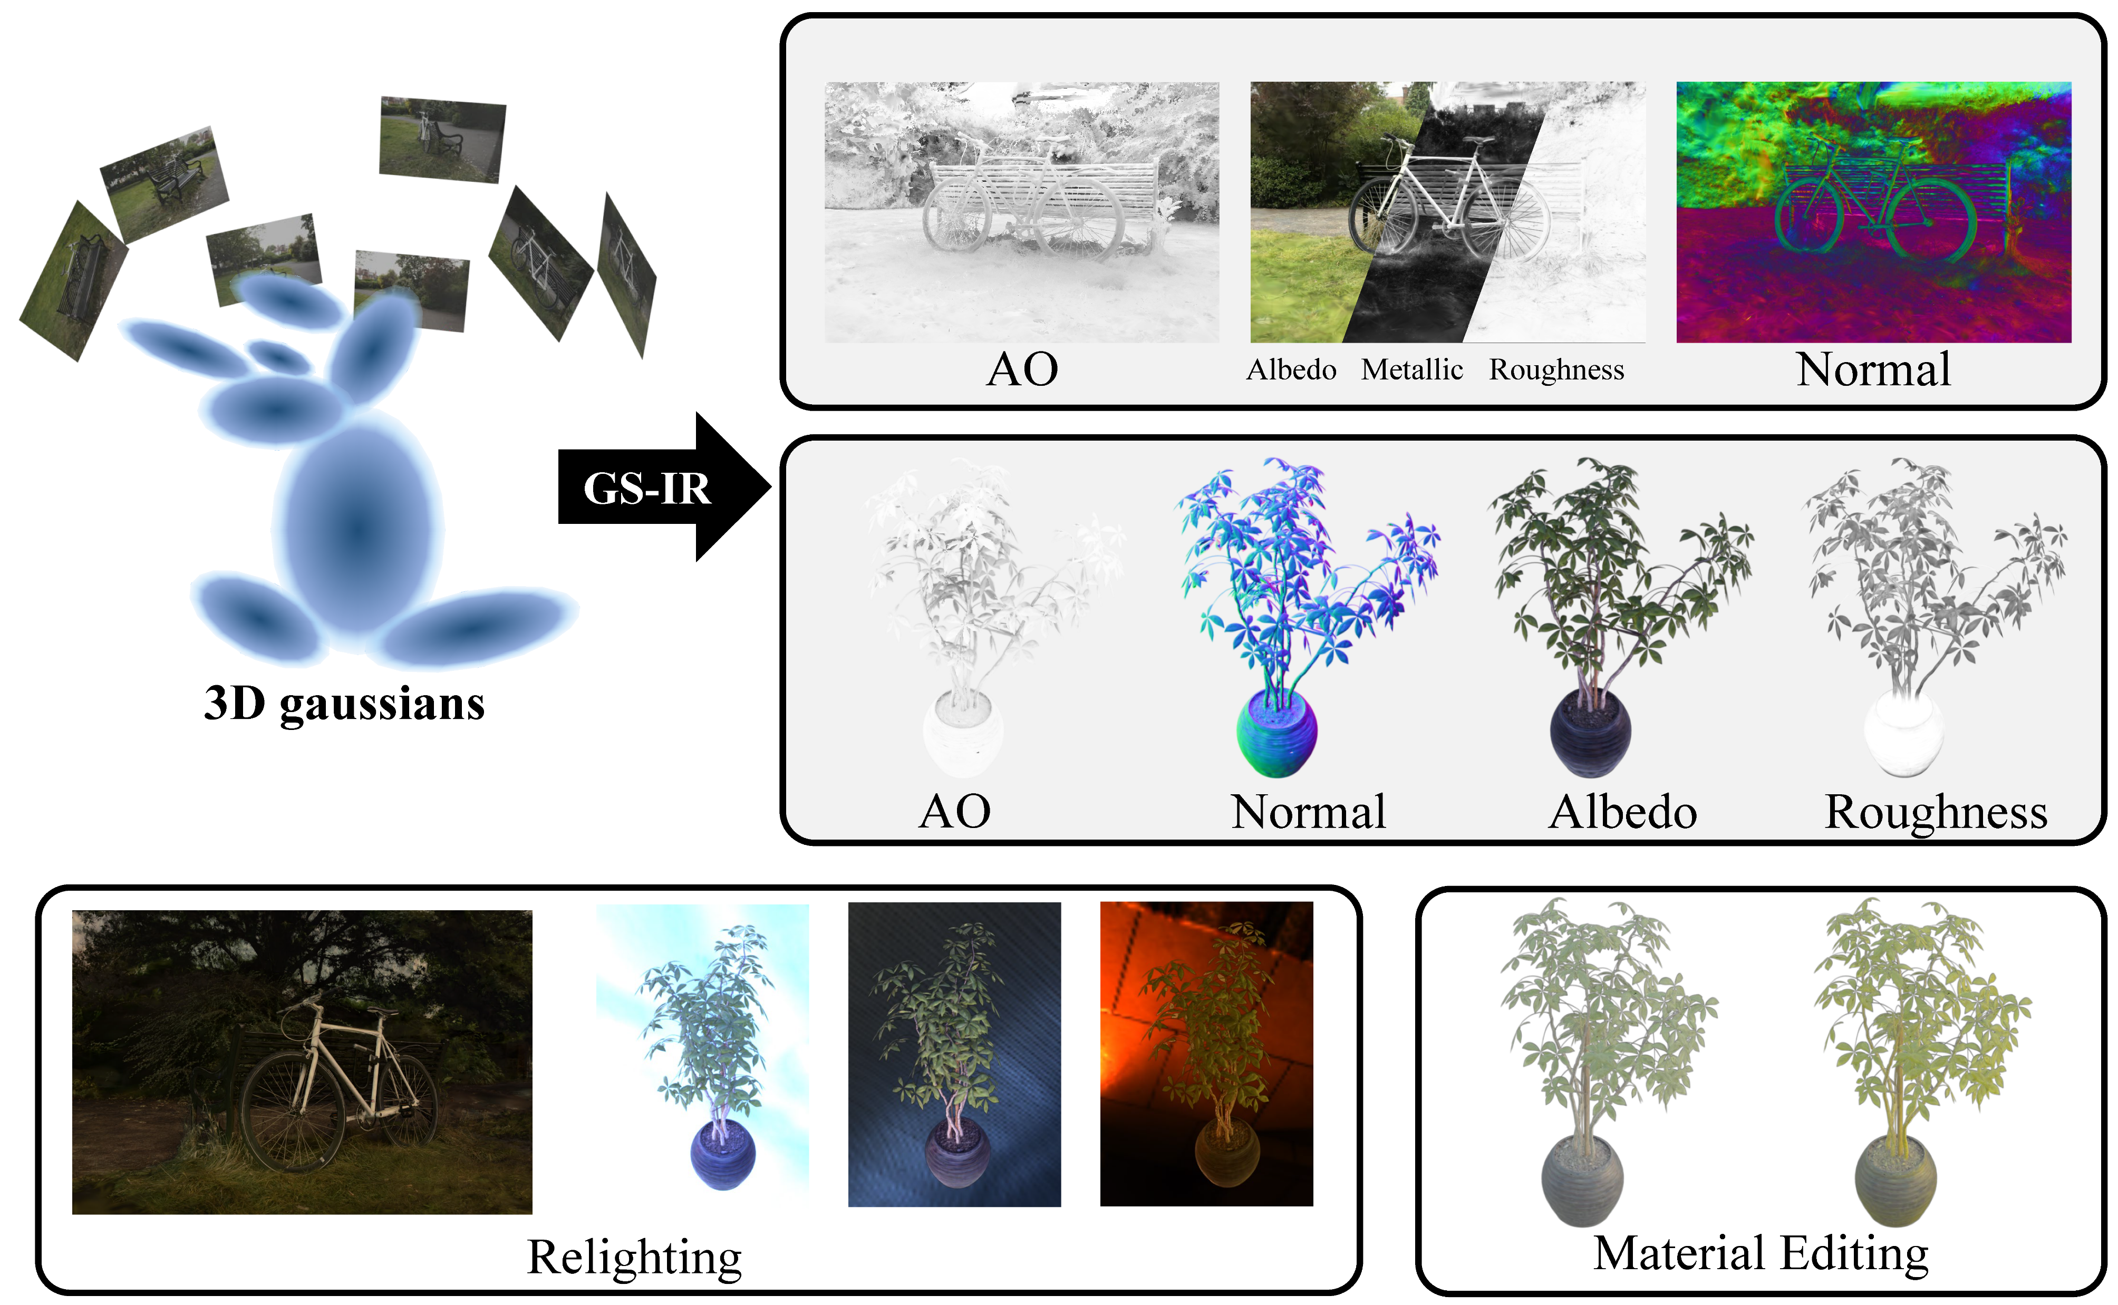
1) Introduction What is Gaussian splatting?
https://repo-sam.inria.fr/fungraph/3d-gaussian-splatting/
https://lzhnb.github.io/project-pages/gs-ir.html

Slide 40
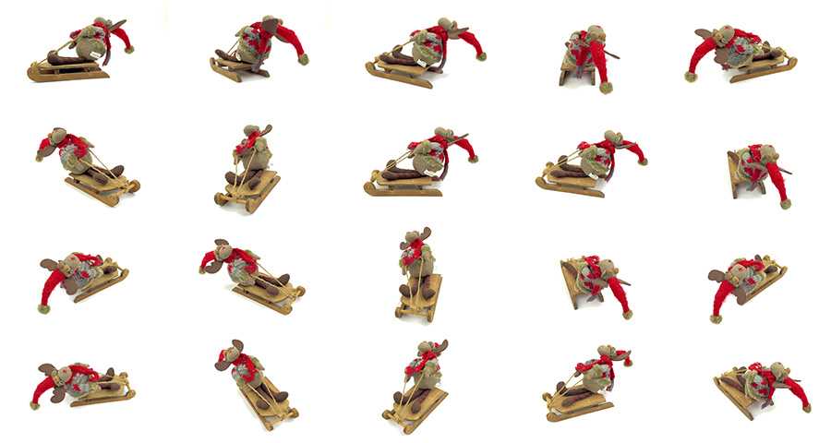
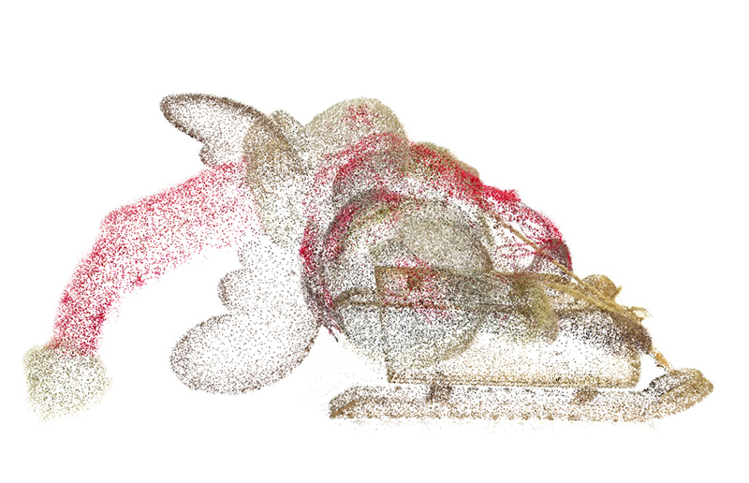
Gaussian splatting demos https://www.reshot.ai/3d-gaussian-splatting https://towardsdatascience.com/a-comprehensive-overview-of-gaussian-splatting-e7d570081362 https://logessiva.medium.com/understanding-and-exploring-3d-gaussian-splatting-a-comprehensive-overview-b4004f28ef1c
The 3D point cloud can be obtained by Structure from motion (SFM) , using Laser LIDAR, or 2D images by https://github.com/colmap/colmap
3D features point cloud. Each point is represented by a gaussian (approx. by ellipsoid). The views (on the left) are generated by the lights emitted from the episodes at different directions.
Images generated by 3DGS ,
each is the image from a different views.
The video: https://media.reshot.ai/uploads/PmK_zDEAe-bjKSqszCsqy.mp4

Slide 41
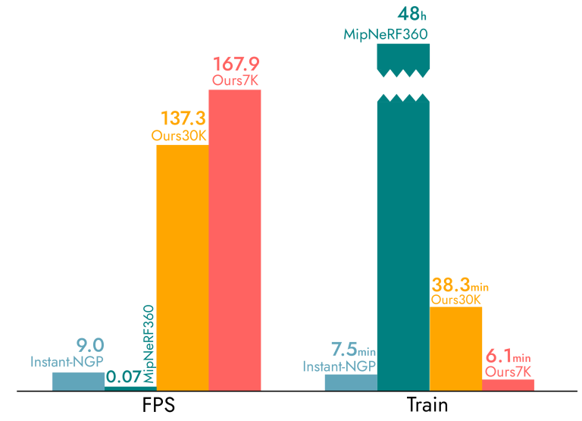
NeRF vs Gaussian splatting(3dGS) speed
Why Gaussian Splatting?
Original NeRF on GPU
Training:, took 1-2 days
Render: several minutes per frame
3dGS is much faster
training 6.1 minutes per second
Render 167.9 frames per second
https://mr-for-example.medium.com/from-nerf-to-3d-gaussian-splatting-the-frontiers-of-text-to-3d-3fd543696f66

Slide 42
2) 3D Gaussian Splatting architecture
The architecture: From the paper “ 3D Gaussian Splatting for Real-Time Radiance Field Rendering” Bernhard Kerbl etal. https://arxiv.org/abs/2308.04079

Slide 43
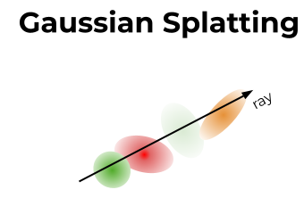
Simplified 3D GS algorithm
For a particular environment
Get many views , use Stucture_from_motion tools (SFM) to capture 3D data points.
E.g. SFM tool Colmap (https://colmap.github.io/ )
Turn each data point to a 3D Gaussian (approx. by ellipsoid) with major and minor axes (scales), orientation (Rotation) , position, opacity and color etc.
Use captured views to train
Gaussian parameters: major/minor axes ,orientation (Rotation) locations , opacity etc.
Colour of the Gaussian using Spherical Harmonics (SH)
Rendering: for a required viewing angle, generate pixels
(1) use alpha composing based on the Gaussian and its opacity
(2) use Spherical Harmonics (SH) to find the colour

Slide 44
Demo
3D Gaussian Splatting
3D Gaussian Splatting - Paper Explained, Training NeRFStudio

Slide 45
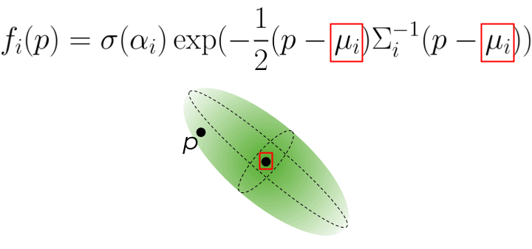
3D Gaussian Parameters
P is a point in 3D space
Mean μ(3x1) = location x, y, z;
$S=\left[\begin{matrix}s_{x} & 0 & 0 \\ 0 & s_{y} & 0 \\ 0 & 0 & s_{z}\end{matrix}\right] Gaussian scale$
$S$ controls the scale / shape of the ellipsoid
R (3x3)=rotation of Gaussian (use Quaternion which uses 4 parameters q1,q2,q3,q4)
$By eigen decomposition$
$Σ=RSS^{T}R^{T}−−−\left(1\right)$ Covariance in 3D
Entries of$Σ$depend on $S$ and $R$
Opacity function σ(𝛼) is a sigmoid applied to 𝛼 (a scalar range in [0,1])
Color parameters, spherical harmonics (SH) coefficients – will be discussed later
See the animation for α(opacity), p, μ, Σ
σ ()=sigmoid function
T
$Σ$ depends on
R=rotation matrix ,
S=scale matrix
p
Σ
μ
Similar idea if it is in 1D: highest at the mean)

Slide 46
Exercise 5
Exercise 5a) What is the purpose of each of the followings
μ , S , R, $Σ$, σ(), 𝛼 ?
Choices:
1) Scale in x,y,z, directions
2) Covariance of 3D Gaussian
3) Sigmoid function
4) Opacity
5) Mean
6) Rotation
Exercise 5b) what are the matrix sizes?

Slide 47
Image formation model
Answer 5a,b: S=scale in x,y,z directions (3x3); μ=mean of the Gaussian (3x1), R=rotation (3x3), $Σ$= covariance of 3D Gaussian (3x3); σ(): Sigmoid function (scalar) ; 𝛼 Opacity (scalar )
Revision: see the part on alpha composing (blending)
Assume a ray is passing through object $N.$then $N$-1,,,. $2,1$.
C= ${_{f}C}_{f}+(1−_{f}$)$C_{b}$, where $f$=foreground, $b$=background
$\text{C}= \sum_{i=1}^{N}{\left(α_{i}c_{i}\prod_{j=1}^{i−1}{\left(1−α_{j}\right)}\right)}$ discussed before.
For 3D gaussian object $i$ with color $c_{i}$, opacity ${of the Gaussain ′}_{i}$ , $the function$ $f_{i}\left(p\right)$ governs how much light can pass through that object
$f_{i}\left(p\right)=σ\left({α′}_{i}\right)∗\exp\left(−\frac{1}{2}\left({\left(p−μ_{i}\right)}^{T}Σ^{−1}\left(p−μ_{i}\right)\right)\right)\text{−−−}\text{(}\text{is} \text{a} \text{scalar}\text{)−−}(2a),$
Note:${{\left(p−μ_{i}\right)}^{T}}_{(1×3)}Σ_{(3×3)}^{−1} {\left(p−μ_{i}\right)}_{(3×1)}$ is a scalar,$σ( )$=sigmoid function
A ray, sending out from a pixel to the 3D space, is passing though transparent objects N and the color of the pixel is
$C=\sum_{iεN}{c_{i}f_{i}(p)\prod_{j=1}^{i−1}{(1−}f_{i}(p))}$--------------------(2b)
ray
Density of the Gaussian $i$

Slide 48
Gaussian Transformation
T
3D Gaussian Representation:
A point $p=\left[X,Y,Z\right]′$ ,
opacity of the 3D Gaussian
$f_{i}\left(p\right)=σ\left(α′\right)∗exp⁡\left(−\frac{1}{2}\left(\left(p−μ_{i}\right)Σ^{−1}\left(p−μ_{i}\right)\right)\right)$----(2a),
$where Σ=RSS^{T}R^{T}(by eigen decomp.)$
Projection to 2D: Project the 3D Gaussian mean to 2D first.
mean $μ={\left[\begin{matrix}μ_{x} & μ_{y} & μ_{z}\end{matrix}\right]}^{T}$, $\text{K}\text{=}$ camera Intrinsic parameter., $W=\left[R|t\right]$, $R$=camera rotation, $t$=camera translation .
$\left[\begin{matrix}su \\ sv \\ s\end{matrix}\right]=KW\left[\begin{matrix}μ_{x} \\ μ_{y} \\ μ_{z} \\ 1\end{matrix}\right],$ $μ^{2D}=\left[\begin{matrix}μ_{X}^{2d} \\ μ_{Y}^{2d}\end{matrix}\right]=\left[\begin{matrix}su/s \\ sv/s\end{matrix}\right],$ $μ^{2D}$ in camera space
Covariance Transformation from camera to ray space (to be discussed):
$J=\frac{∂μ^{2D}}{∂u}$ is used to affine transform 2D camera space to ray space. Hence , $Σ_{Ray}=JWΣW^{T}J^{T}$, $Σ_{Ray}$ will be used in alpha composing in equ. (2a)
Projected 2D Image
of the 3D Gaussian
https://towardsdatascience.com/a-comprehensive-overview-of-gaussian-splatting-e7d570081362/

Slide 49
Ray space: Alpha composing and ray tracking are working along the ray path, so ray space is a suitable choice for modelling the problem
3D Gaussian Splatting - Paper Explained, Training NeRFStudio
Ray
3D Gaussian
Σ in object space
μ, Σ
3D
Object
Gaussian
μ_{cam ,}
Σ_{cam}
_{Camera space}
μ_{ray ,}
Σ_{ray}
_{Ray space}
World
reference
Σ_{cam} in camera space
Σ_{cam} can be transformed to $Σ_{Ray}$
$\text{K}\text{=}$ Intrinsic para.
$W=\left[R|t\right]$,
$R$=rotation
$t$=translation
of the camera
$J=\frac{∂μ^{2D}}{∂u}$
$$Σ_{ray}=J Σ_{cam}{ J}^{T}$$
$$Σ_{Ray}=JWΣW^{T}J^{T}$$
Σ appear as Σ_{cam}
in image
u
$$\left[R|t\right]$$
49

Slide 50
What is ray space?
$$ray space \left(\begin{matrix}x_{0} \\ x_{1} \\ x_{2}\end{matrix}\right)$$
Camera space
$$\left(\begin{matrix}u_{0} \\ u_{1} \\ u_{2}\end{matrix}\right)$$
Axis u₁
Axis u₂
Ray space is represented by $\left(\begin{matrix}x_{0} \\ x_{1} \\ x_{2}\end{matrix}\right)$
Camera space is represented by $\left(\begin{matrix}u_{0} \\ u_{1} \\ u_{2}\end{matrix}\right)$
Camera Space
$$l=\left\|{\left(\begin{matrix}u_{0} & u_{1} & u_{2}\end{matrix}\right)}^{T}\right\|$$
Axis u₀
Camera space to ray space Transformation
$\left(\begin{matrix}x_{0} \\ x_{1} \\ x_{2}\end{matrix}\right)=m\left(u\right)=\left(\begin{matrix}{u_{0}}/{u_{2}} \\ {u_{1}}/{u_{2}} \\ l=\left\|{\left(\begin{matrix}u_{0} & u_{1} & u_{2}\end{matrix}\right)}^{T}\right\|\end{matrix}\right)$, or the reverse
$\left(\begin{matrix}u_{0} \\ u_{1} \\ u_{2}\end{matrix}\right)=m^{−1}\left(x\right)=\left(\begin{matrix}{x_{0}}/{l∙x_{2}} \\ {x_{1}}/{l∙x_{2}} \\ 1/{l∙x_{2}}\end{matrix}\right)$, Where $l=\left\|{\left(\begin{matrix}u_{0} & u_{1} & u_{2}\end{matrix}\right)}^{T}\right\|$
It is useful because for view generation, the calculation for each pixel color is based on a ray. It makes processing easier.

Slide 51
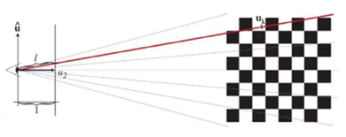
The idea of ray space
$$l=$$
$$\left\|{\left(\begin{matrix}u_{0} & u_{1} & u_{2}\end{matrix}\right)}^{T}\right\|$$
a point
${\left[u_{0},u_{1},u_{2}\right]}^{T}$
Focal length=1
A 3D point ${\left[u_{0},u_{1},u_{2}\right]}^{T}$ in camera space is projected to a point $f∗$( $\frac{u_{0}}{u_{2}},\frac{u_{1}}{u_{2}})$^{T} at a screen of focal length $f$=1 (normalized screen)
Add the third component $l=\left\|{\left(\begin{matrix}u_{0} & u_{1} & u_{2}\end{matrix}\right)}^{T}\right\|$
To make the ray space.
$$\left(\begin{matrix}x_{0} \\ x_{1} \\ x_{2}\end{matrix}\right)=m\left(u\right)=\left(\begin{matrix}{u_{0}}/{u_{2}} \\ {u_{1}}/{u_{2}} \\ l=\left\|{\left(\begin{matrix}u_{0} & u_{1} & u_{2}\end{matrix}\right)}^{T}\right\|\end{matrix}\right)$$

Slide 52
Exercise 6
$$\left(\begin{matrix}x_{0} \\ x_{1} \\ x_{2}\end{matrix}\right)=m\left(u\right)=\left(\begin{matrix}{u_{0}}/{u_{2}} \\ {u_{1}}/{u_{2}} \\ l=\left\|{\left(\begin{matrix}u_{0} & u_{1} & u_{2}\end{matrix}\right)}^{T}\right\|\end{matrix}\right)$$
Given a point in camera space [1,2,10]
Calculate the ray space component, which is true?
Choice1: [2/10,1/10, (1^2+2^2+10^2)]
Choice2: [1/10,2/10, sqrt(1^2+2^2+10^2)]
Choice3: [2/10,1/10, sqrt(2^2+2^2+10^2)]
Choice4: [1/10,2/10, (2^2+2^2+10^2)]

Slide 53
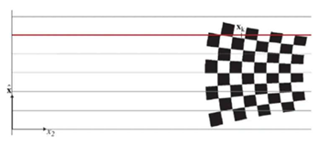
Ray space
Ans6: [1/10,2/10, L=sqrt(1^2+2^2+10^2)], L=10.24 (choice3 is correct)
$\hat{u }$=[u0,u1]’
Ray space is more suitable for ray tracing and radiance-based methods, because color received at each pixel is through a ray passing through it.
For a feature at ${\left[u_{0},u_{1},u_{2}\right]}^{T}$ in camera space, ray space coordinate is defined as the first 2 components as the normalized pixel $\left({u_{0}}/{u_{2}},{u_{1}}/{u_{2}}\right)$ in the camera screen with focal length =1, and the third component is the length of the ray reaching that 3d point
$u$ is 3D
$$l$$
$$1$$
Camera space
$\hat{x}$ =[x0,x1]’
Camera space to ray space Transformation
$$\left(\begin{matrix}x_{0} \\ x_{1} \\ x_{2}\end{matrix}\right)=m\left(u\right)=\left(\begin{matrix}{u_{0}}/{u_{2}} \\ {u_{1}}/{u_{2}} \\ l=\left\|{\left(\begin{matrix}u_{0} & u_{1} & u_{2}\end{matrix}\right)}^{T}\right\|\end{matrix}\right)$$
$$\left(\begin{matrix}u_{0} \\ u_{1} \\ u_{2}\end{matrix}\right)=m^{−1}\left(x\right)=\left(\begin{matrix}{x_{0}}/{l∙x_{2}} \\ {x_{1}}/{l∙x_{2}} \\ 1/{l∙x_{2}}\end{matrix}\right)$$
Where $l=\left\|{\left(\begin{matrix}u_{0} & u_{1} & u_{2}\end{matrix}\right)}^{T}\right\|$
$$x_{2}$$
Ray space
For a camera pixel at ${(u}_{0},u_{1}),$distance of a point in 3D along the ray in ray-space is [$\frac{u_{0}}{u_{2}},\frac{u_{1}}{u_{2}},\left\|{\left(\begin{matrix}u_{0} & u_{1} & u_{2}\end{matrix}\right)}^{T}\right\|]={[x}_{0},x_{1},x_{2}]T.$ The first two coordinates $: x_{0},x_{1}$are stable, you only need to change one parameter $x_{2}$, to point to different objects along the ray. That makes radiance-based method simpler to implement.

Slide 54
q
Object space to camera space Transformation
W= affine rotation, P=0, no translation is needed since the is passing through the Gaussian mean.
P=translation(position of the 3D feature point)
u=W$u=Wμ+P=Wμ,$
${ Σ}_{cam}=WΣW^{T}$ =covariance of Gaussian in camera space
Where $μ=a=\left[a_{0},a_{1},a_{2}\right]′=mean of Gaussuan$
$Σ$=covariance
$u$ is 3D
$\hat{u }$=[u0,u1]’
$$l$$
e
$$u_{2}$$
$$1$$
Camera space
Camera space to ray space Transformation
$$\left(\begin{matrix}x_{0} \\ x_{1} \\ x_{2}\end{matrix}\right)=m\left(u\right)=\left(\begin{matrix}{u_{0}}/{u_{2}} \\ {u_{1}}/{u_{2}} \\ l\left\|{\left(\begin{matrix}u_{0} & u_{1} & u_{2}\end{matrix}\right)}^{T}\right\|\end{matrix}\right)$$
$$\left(\begin{matrix}u_{0} \\ u_{1} \\ u_{2}\end{matrix}\right)=m^{−1}\left(x\right)=\left(\begin{matrix}{x_{0}}/{l∙x_{2}} \\ {x_{1}}/{l∙x_{2}} \\ 1/{l∙x_{2}}\end{matrix}\right)$$
Where $l=\left\|{\left(\begin{matrix}u_{0} & u_{1} & u_{2}\end{matrix}\right)}^{T}\right\|$, transform covariance matrix ${:Σ}_{ray}=J{ Σ}_{cam}J^{T}=JWΣW^{T}J^{T}$
W=camera rotation
$\hat{x}$ =[x0,x1]’
$$x_{2}$$
Ray space
From : EWA Volume Splatting by Matthias Zwicker etal. https://www.cs.umd.edu/~zwicker/publications/EWAVolumeSplatting-VIS01.pdf

Slide 55
Implementation issue if full perspective is used: World to camera coordinate. Each camera/screen should have a camera pose matrix W=[R|t] which is a projection matrix of 3x4
If you have a 3d gaussian after rotated and scaled, from (1) the covariance is $Σ \left(3x3\right)$
Fill 0 and 1 to make $the orginal Σ_{(3x3)} to be Σ_{(4x4)}$
$Σ_{(4x4)}=\left[\begin{aligned}\begin{matrix}σ_{xx} & σ_{xy} & σ_{xz} \\ σ_{xy} & σ_{yy} & σ_{yz} \\ σ_{xz} & σ_{yz} & σ_{zz}\end{matrix} \begin{matrix}0 \\ 0 \\ 0\end{matrix} \\ \begin{matrix}0 & 0\end{matrix} \begin{matrix}0 & 1\end{matrix}\end{aligned}\right]$
The camera pose is W=[R|t] (3x4), R=rotation_{(3x3)}, Translation_{(3x1)} of the camera
So, multiplication to generate $Σ_{cam(3x3)}$ is possible:
$Σ_{cam(3x3)}=W_{(3x4)}Σ_{(4x4)}W_{(4x3)}^{T}$
Mathematical Proof
https://math.stackexchange.com/questions/332441/affine-transformation-applied-to-a-multivariate-gaussian-random-variable-what

Slide 56
Exercise 7 Covariance matrix transformed from screen to ray space
$$\left(\begin{matrix}x_{0} \\ x_{1} \\ x_{2}\end{matrix}\right)=m\left(u\right)=\left(\begin{matrix}{u_{0}}/{u_{2}} \\ {u_{1}}/{u_{2}} \\ \left\|{\left(\begin{matrix}u_{0} & u_{1} & u_{2}\end{matrix}\right)}^{T}\right\|\end{matrix}\right)$$
$$\text{Where} l=\left\|{\left(\begin{matrix}u_{0} & u_{1} & u_{2}\end{matrix}\right)}^{T}\right\|$$
$\frac{∂x_{0}}{∂u_{0}}$= $\frac{∂{u_{0}}/{u_{2}}}{∂u_{0}}=1/{u_{2}}$
$$find$$
$$\frac{∂x_{0}}{∂u_{0}}=____________?$$
$$\frac{∂x_{1}}{∂u_{2}}=____________?$$
$$\frac{∂x_{2}}{∂u_{2}}=____________?$$
Choice 1 : $1/{u_{2}}$
Choice 2 :$1/l$
Choice 3 :${ −u_{1}}/{u_{2}^{2}}$
Choice 4 :${−u_{2}}/l$
Covariance matrix transformed to ray space
$$J=\left[\begin{matrix}\frac{∂x_{0}}{∂u_{0}} & \frac{∂x_{0}}{∂u_{1}} & \frac{∂x_{0}}{∂u_{2}} \\ \frac{∂x_{1}}{∂u_{0}} & \frac{∂x_{1}}{∂u_{1}} & \frac{∂x_{1}}{∂u_{2}} \\ \frac{∂x_{2}}{∂u_{0}} & \frac{∂x_{2}}{∂u_{1}} & \frac{∂x_{2}}{∂u_{2}}\end{matrix}\right]$$

Slide 57
Answer 7 :Covariance matrix transformed from screen to ray space
$$\left(\begin{matrix}x_{0} \\ x_{1} \\ x_{2}\end{matrix}\right)=m\left(u\right)=\left(\begin{matrix}{u_{0}}/{u_{2}} \\ {u_{1}}/{u_{2}} \\ \left\|{\left(\begin{matrix}u_{0} & u_{1} & u_{2}\end{matrix}\right)}^{T}\right\|\end{matrix}\right)$$
$$\text{Where} l=\left\|{\left(\begin{matrix}u_{0} & u_{1} & u_{2}\end{matrix}\right)}^{T}\right\|$$
$\frac{∂x_{0}}{∂u_{0}}$= $\frac{∂{u_{0}}/{u_{2}}}{∂u_{0}}=1/{u_{2}}$
$\frac{∂x_{0}}{∂u_{1}}$= $\frac{∂{u_{0}}/{u_{2}}}{∂u_{1}}$=0
$\frac{∂x_{0}}{∂u_{2}}$= $\frac{∂{u_{0}}/{u_{2}}}{∂u_{2}}$= ${−u_{0}}/{u_{2}^{2}}$
:
$\frac{∂x_{2}}{∂u_{0}}$= $\frac{∂\left\|{\left(\begin{matrix}u_{0} & u_{1} & u_{2}\end{matrix}\right)}^{T}\right\|}{∂u_{0}}={u_{0}}/l$
$\frac{∂x_{2}}{∂u_{1}}$= $\frac{∂\left\|{\left(\begin{matrix}u_{0} & u_{1} & u_{2}\end{matrix}\right)}^{T}\right\|}{∂u_{0}}={u_{1}}/l$
$\frac{∂x_{2}}{∂u_{2}}$= $\frac{∂\left\|{\left(\begin{matrix}u_{0} & u_{1} & u_{2}\end{matrix}\right)}^{T}\right\|}{∂u_{0}}={u_{2}}/l$
$$J=\left[\begin{matrix}1/{u_{2}} & 0 & {−u_{0}}/{u_{2}^{2}} \\ 0 & 1/{u_{2}} & {−u_{1}}/{u_{2}^{2}} \\ {u_{0}}/l & {u_{1}}/l & {−u_{2}}/l\end{matrix}\right]$$
$$Answer5:$$
$$\frac{∂x_{0}}{∂u_{0}}=1/{u_{2}}$$
$$\frac{∂x_{1}}{∂u_{2}}={−u_{1}}/{u_{2}^{2}}$$
$$\frac{∂x_{2}}{∂u_{2}}={−u_{2}}/l$$
Choice 1 :$1/{u_{2}}$
Choice 2 :$1/l$
Choice 3 :${−u_{1}}/{u_{2}^{2}}$
Choice 4 :${−u_{2}}/l$
Covariance matrix transformed to ray space
$$J=\left[\begin{matrix}\frac{∂x_{0}}{∂u_{0}} & \frac{∂x_{0}}{∂u_{1}} & \frac{∂x_{0}}{∂u_{2}} \\ \frac{∂x_{1}}{∂u_{0}} & \frac{∂x_{1}}{∂u_{1}} & \frac{∂x_{1}}{∂u_{2}} \\ \frac{∂x_{2}}{∂u_{0}} & \frac{∂x_{2}}{∂u_{1}} & \frac{∂x_{2}}{∂u_{2}}\end{matrix}\right]$$
$$Σ^{′}=Σ_{ray}=J Σ_{cam}{ J}^{T}$$
$$Since{ Σ}_{cam}=W Σ W^{T}$$
W=[R|t]=camera pose
$Σ^{′}=Σ_{ray}=J W Σ{ W}^{T}{ J}^{T}$----(3)
$Σ_{ray}$can be used to calculate how much light can pass through the object.
This is differentiable, so we can use gradient decent to find it.

Slide 58
An affine transformation is applied to the 3D Gaussian
$Σ_{ray}=J Σ_{cam}{ J}^{T}$
$J$=Jacobian of camera to ray transform
Mathematical Proof
https://math.stackexchange.com/questions/332441/affine-transformation-applied-to-a-multivariate-gaussian-random-variable-what

Slide 59
Recall: Ray space: Alpha composing and ray tracking are working along the ray path, so ray space is a suitable choice for modelling the problem
3D Gaussian Splatting - Paper Explained, Training NeRFStudio
Ray
μ, Σ
3D
Object
Gaussian
μ_{cam ,}
Σ_{cam}
_{Camera space}
μ_{ray ,}
Σ_{ray}
_{Ray space}
World
reference
3D Gaussian
Σ
For pixel u, a ray is formed,
the 3d Gaussian Σ appears as $Σ_{Ray}$
$\text{K}\text{=}$ Intrinsic para.
$W=\left[R|t\right]$,
$R$=rotation
$t$=translation
of the camera
$J=\frac{∂μ^{2D}}{∂u}$
$$Σ_{ray}=J Σ_{cam}{ J}^{T}$$
$$Σ_{Ray}=JWΣW^{T}J^{T}$$
Σ appear as Σ_{cam}
in image
u
$$\left[R|t\right]$$
59

Slide 60
Training: based on all captured images of an environment
d
Training: From SFM obtain all N 3D-features with 3D position $p.$
For each feature$n,$ true color is $C_{n,m}$ taken by camera $m$ pose ${ [R,t]}_{m}$
Initialize$the Gaussian{ μ_{n,m} ,Σ}_{n,m},opacity α_{n,m}^{′} related to feature p_{n,m}$.$Find each featur n of pose m, guess the color C_{guess:n,m}$ as follow:
$Σ_{Ray:n,m}=JW{ Σ}_{n,m}W^{T}J^{T}$ --------(3), where W= ${ [R,t]}_{m}$, $J=\frac{∂X}{∂u}$ see previous slide
$f\left(p_{n,m}\right)=σ\left(α_{n,m}^{′}\right)exp⁡\left(−\frac{1}{2}\left({\left(p_{n,m}−μ_{n,m}\right)}^{T}{Σ_{Ray:n,m}}^{−1}\left(p_{n,m}−μ_{n,m}\right)\right)\right)$--(2a),(scalar)
$C_{guess:n,m}=\sum_{iεN}{c_{n.m}f_{j}(p_{n,m})\prod_{j=1}^{i−1}{(1−} f(p_{n,m}))}$--------------------(2b)
Optimization all ${ Σ}_{n,m},opacity α_{n,m}^{′}$, by Minimizing || $C_{n,m}−$ $C_{guess:n,m}\left(p_{n,m}\right)||$
$f\left(p_{n,m}\right)$=Gaussian opacity is a Scalar

Slide 61
Rendering: generate a novel frame
d
After training $all parameters of the 3D gaussians { Σ}_{n,m},opacity α_{n,m}^{′} are obtained.$
Find all pixels in the required frame by using the following alpha composing formulas:
Based the required pixel, calculate the required ray vector
Find $Σ_{Ray:n,m}$ from ${ Σ}_{n,m}$
$f\left(p_{n,m}\right)=σ\left(α_{n,m}^{′}\right)∗exp⁡\left(−\frac{1}{2}\left({\left(p_{n,m}−μ_{n,m}\right)}^{T}{Σ_{Ray:n,m}}^{−1}\left(p_{n,m}−μ_{n,m}\right)\right)\right)$----(2a),
$C_{rendered}=\sum_{iεN}{c_{n.m}f_{j}(p_{n,m})\prod_{j=1}^{i−1}{(1−} f(p_{n,m}))}$--------------------(2b)
Execute above for all pixels of the required frame
Done!

Slide 62
Examples of
https://learnopencv.com/3d-gaussian-splatting/
3dGS Gaussian Splatting

Slide 63
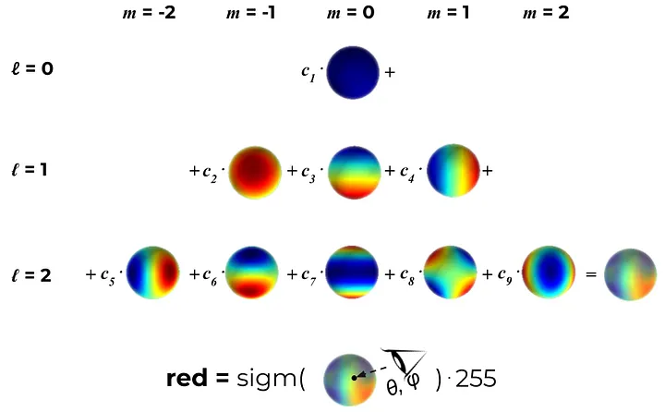
4) Spherical harmonics color representation
Instead of using RGB values for representing colors, Gaussian splatting uses Spherical Harmonics SH to encode the color as a function of the viewing direction.
It has 2 set of parameters l and m
The idea is : after training the Spherical Harmonics SH parameters, for a given viewing direction (θ, φ), it will generate the correct color for that Gaussian.

Slide 64
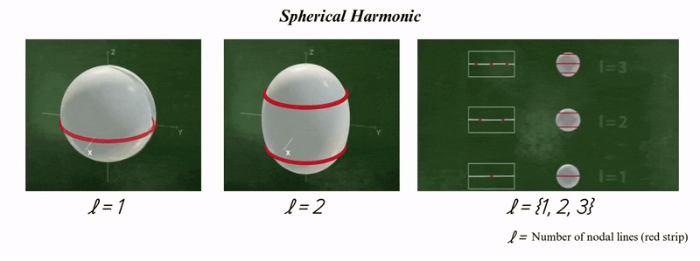
w
Spherical Harmonics can represent color on the surface of a sphere(spherical coordinate system) using a series of harmonic (wave-like) basis functions.
Like Fourier transform of 1D audio periodic function/signal, it can be represented as a sum of sine and cosine waves.
Spherical Harmonic Function is parameterized by two integers, $l$ and $m$,
$l$ = the number of azimuth or nodal lines (red strip)m. Typically select $l$=2
$m$ = number of oscillations/variations. Typically select $m$=9
$Y_{l}^{m}\left(θ,φ\right)={\left(−1\right)}^{m}\sqrt{\frac{\left(2l+1\right)\left(l+m\right)!}{4π\left(l+m\right)!}}e^{imφ}P_{l}^{m}(\cos{θ})$,
where the complex exponential $e^{iφ}=$ $\cos\left(φ\right)+i∗sin\left(φ\right)$ and$i=\sqrt{−1}$.
Hence $e^{imφ}=\cos\left(mφ\right)+i∗sin\left(mφ\right),$
$P_{l}^{m}\left(x\right)={(1−x)}^{\frac{m}{2}} \frac{d^{m}}{dx^{m}}P_{l}(x)is called$ Associated Legendre polynomials – Wikipedia, https://en.wikipedia.org/wiki/Spherical_harmonics
A MATLAB example program for this can be found at the Appendix.

Slide 65
For the color of a 3D Gaussian, $α_{l,m}$ are learned coefficients and instead of using a static RGB value, each channel is expressed as a linear combination of SH functions up to a maximum degree .
Note: m depends on l , example
When ( l = 0 ), ( m ) can be ( 0 ). Total =1
When ( l = 1 ), ( m ) can be ( -1, 0, 1 ). Total =3
When ( l = 2 ), ( m ) can be ( -2, -1, 0, 1, 2 ). Total =5
When ( l = 3 ), ( m ) can be ( -3, -2, -1, 0, 1, 2, 3). Total =7 and so on.
So, if l=3 (typical choice for 3dGS) , total number of $α_{l,m}$ Parameters per color channel is 1+3+5+7=16,
For RGB, total number of $α_{l,m}$ SH parameters =3x16=48 to be trained
After training , given the viewing angles : $θ,φ$ , the color $C(θ,φ$) of the ray can be calculated.
If l=3, it will range from 0 to $l_{max}$ =3.
$α_{l,m}$ Parameters are to be trained.
C $\left(θ,φ\right)=\sum_{l=0}^{l_{max}}{\sum_{m=−l}^{l}{α_{l,m }{|Y}_{l}^{m}\left(θ,φ\right)|}}$, where
$$Y_{l}^{m}\left(θ,φ\right)={\left(−1\right)}^{m}\sqrt{\frac{\left(2l+1\right)\left(l+m\right)!}{4π\left(l+m\right)!}}e^{imφ}P_{l}^{m}(\cos{θ})$$
https://learnopencv.com/3d-gaussian-splatting/#View-dependant-Colors-with-Spherical-Harmonics

Slide 66
Exercise 8:
C $\left(θ,φ\right)=\sum_{l=0}^{l_{max}}{\sum_{m=−l}^{l}{α_{l,m }{|Y}_{l}^{m}\left(θ,φ\right)|}}$, where
$$Y_{l}^{m}\left(θ,φ\right)={\left(−1\right)}^{m}\sqrt{\frac{\left(2l+1\right)\left(l+m\right)!}{4π\left(l+m\right)!}}e^{imφ}P_{l}^{m}(\cos{θ})$$
If l=4, how many number of parameters ($α_{l,m}$) for all color (RGB) of a 3D Gaussian are needed to be trained. Hints:
When ( l = 0 ), ( m ) can be ( 0 ). Total =1
When ( l = 1 ), ( m ) can be ( -1, 0, 1 ). Total =3
When ( l = 2 ), ( m ) can be ( -2, -1, 0, 1, 2 ). Total =5 and so on.
Which of the followings is true?
25
30
75
100
66
Nerfs v.250330b

Slide 67
Answer 8:
C $\left(θ,φ\right)=\sum_{l=0}^{l_{max}}{\sum_{m=−l}^{l}{α_{l,m }{|Y}_{l}^{m}\left(θ,φ\right)|}}$, where
$$Y_{l}^{m}\left(θ,φ\right)={\left(−1\right)}^{m}\sqrt{\frac{\left(2l+1\right)\left(l+m\right)!}{4π\left(l+m\right)!}}e^{imφ}P_{l}^{m}(\cos{θ})$$
If l=4, how many number of parameters ($α_{l,m}$) are to be trained
Note: m depends on l , example
When ( l = 0 ), ( m ) can be ( 0 ). Total =1
When ( l = 1 ), ( m ) can be ( -1, 0, 1 ). Total =3
When ( l = 2 ), ( m ) can be ( -2, -1, 0, 1, 2 ). Total =5
When ( l = 3 ), ( m ) can be ( -3, -2, -1, 0, 1, 2, 3). Total =7
When ( l = 4 ), ( m ) can be ( -4, -3, -2, -1, 0, 1, 2, 3,4). Total =9
Total number of parameters ($α_{l,m}$) per channel is 1+3+5+7+9=25
For all 3 channels (R,G,B), it is 3x25=75 (choice 3 is correct)
Nerfs v.250330b

Slide 68
Loss Function for Spherical Harmonics (SH)
Loss = $\frac{1}{2}\sum{\left\|L_{pred}\left(θ_{i},φ_{i}\right)−L_{target}\left(θ_{i},φ_{i}\right)\right\|}2$
Where:
- $L_{pred}\left(θ_{i},φ_{i}\right)$: Lighting or color predicted using SH coefficients.
- $L_{target} \left(θ_{i},φ_{i}\right)$:Target lighting or color (e.g., from the environment map or ground truth).
We need this Loss function for optimization (i.e. Gradient descent) to find the SH parameters.

Slide 69
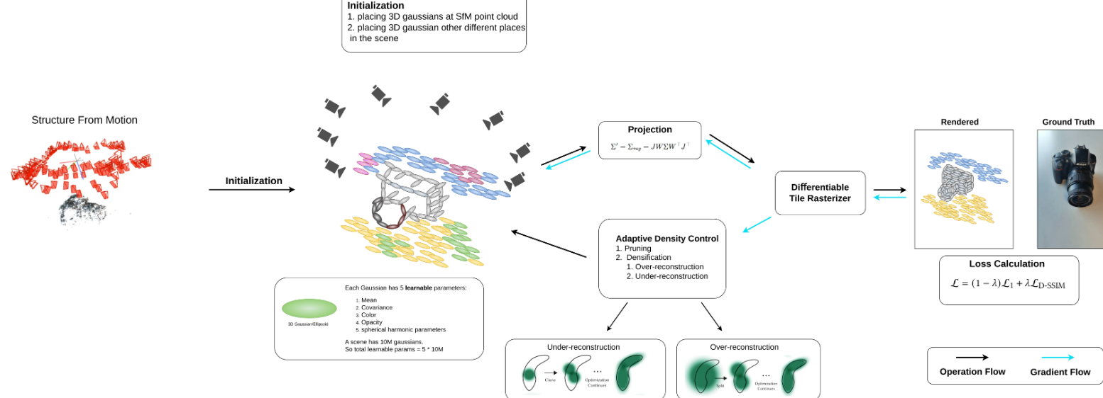
4) Optimization -- overall scheme Explanation of the algorithm presented in the original paper by Bernhard Kerbl, etal
d
https://learnopencv.com/3d-gaussian-splatting/
“3D Gaussian Splatting for Real-Time Radiance Field Rendering” by
Bernhard Kerbl, etal https://arxiv.org/abs/2308.04079

Slide 70
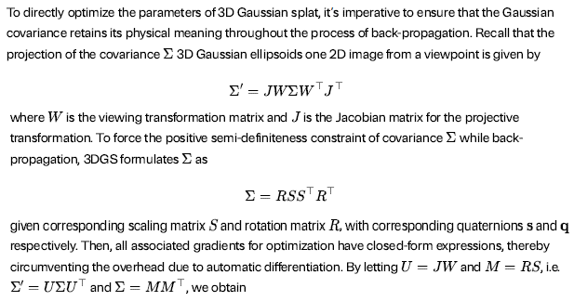
Optimization to find 3D gaussian parameters
https://leeyngdo.github.io/blog/computer-graphics/2024-04-09-gaussian-splatting/

Slide 71
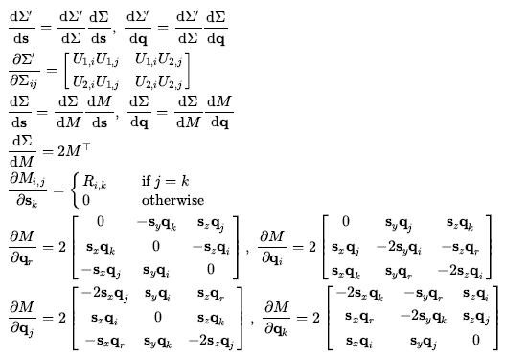

Slide 72
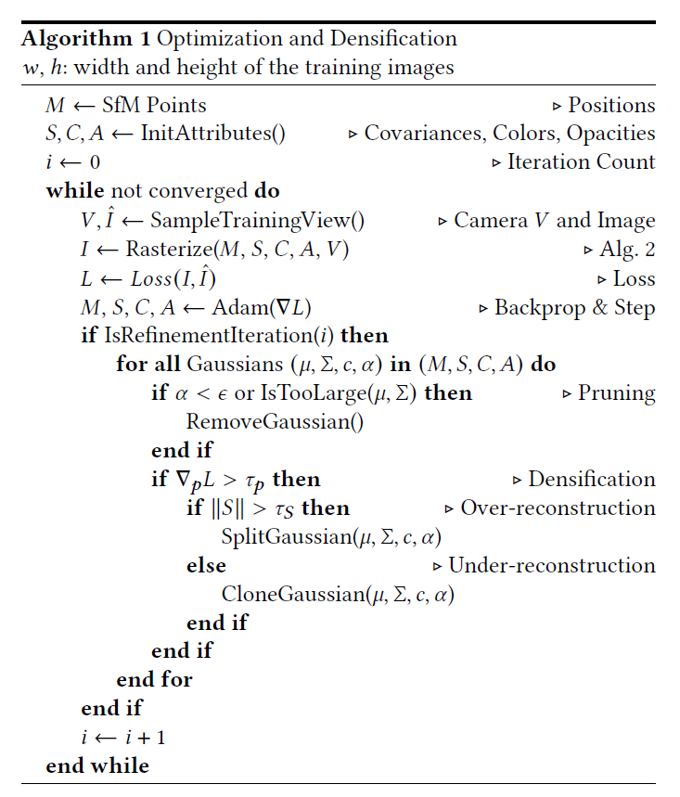
Detailed Algo1
Step
1
2
3
4
5
6
7
8
9
10
11
12
13
14
15
16
17
18
19
20
21
22
23
24

Slide 73
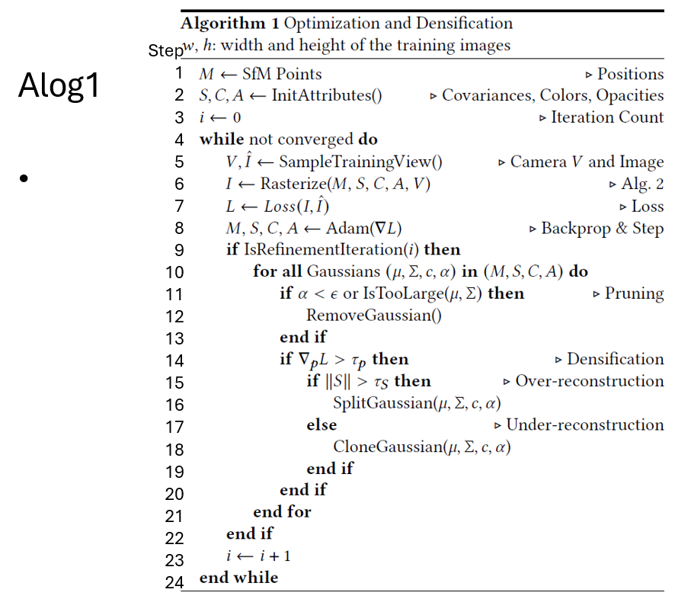

Slide 74
Step1 -3: Initialization
M= model or feature points
S=covariances,
C=Colour ,
A=Opacities (volume density)
i=count

Slide 75
Step 3-9: create preliminary data
Step5: Get the camera view
V=([x,y,z]=camera center; [d1,d2,d3]) camera principal axis) , and ground truth image $(I)$
Step6: Get the predicted colour ($\hat{I})$by
M= model or feature points
S=covariances,
C=Colour ,
A=Opacities (volume density)
V=camera view
Step7: Find L=Loss between truth colour $(I)$ and predicted colour ($\hat{I})$

Slide 76
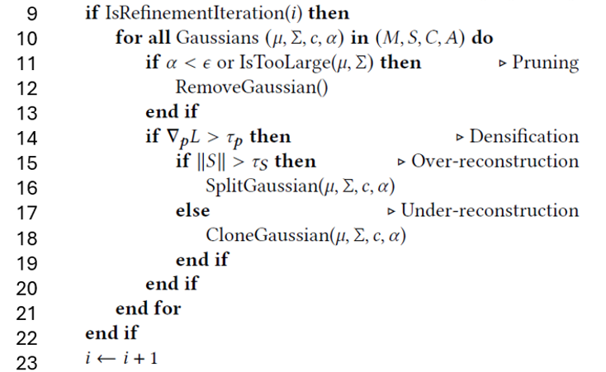
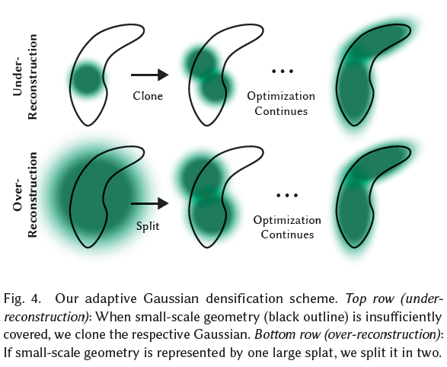
Step9 -23: Pruning: If refinement is needed: split/merge Gaussians (ellipsoids)
Kerbl, Bernhard, et al. "3d gaussian splatting for real-time radiance field rendering." ACM Trans. Graph. 42.4 (2023): 139-1. https://arxiv.org/pdf/2308.04079

Slide 77
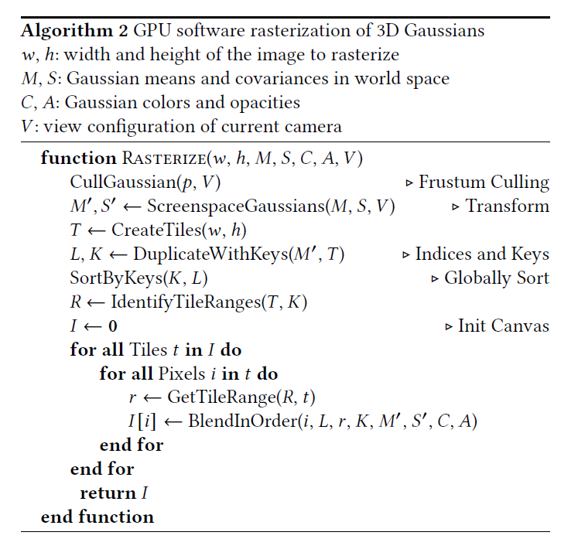
Detailed Algo2
Step
1
2
3
4
5
6
7
8
9
10
11
12
13
14
15
16

Slide 78
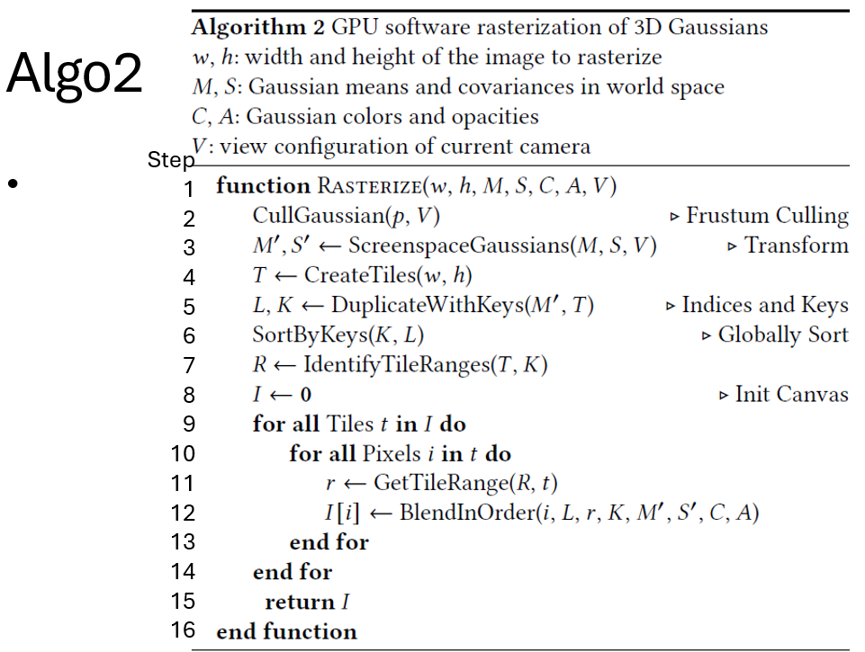

Slide 79
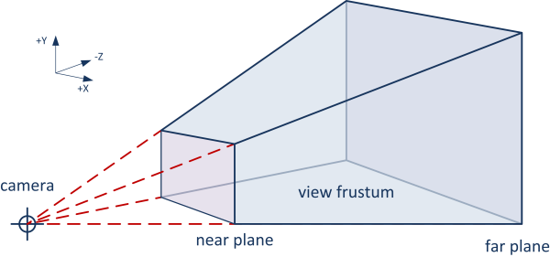
Step1-16 of aglo2 Rasterization (generate the novel image by given viewing angles)
Form your viewing space
Algo2:
Step2: Frustum culling: remove objects outside the frustrum
Step3, project M,S,V to screen gaussian (Project 3D Ellipsoids to 2d ellipses)
Step4-5: work on tiles , Create K,L, index them
Step6: for each tile
Step7:R ,← Identify tile range (T,K)
Step8:15: find pixel values I(i)
r← get tile range *R,t)
I(i)=find color (I,L,r,K,M’,S’,C,A)
https://learnopengl.com/Guest-Articles/2021/Scene/Frustum-Culling

Slide 80
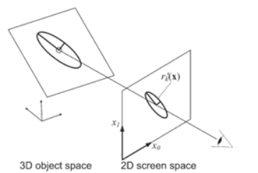
Discussion of some steps
Step3, project M,S,V to screen gaussian (Project 3D Ellipsoids to 2d ellipses)
M= model or feature points
S=covariances,
C=Colour ,
A=Opacities (volume density)
V=camera view
https://www.cs.umd.edu/~zwicker/publications/EWASplatting-TVCG02.pdf

Slide 81
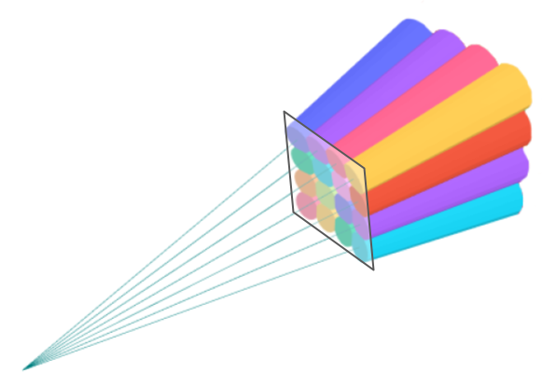
Methods to speed up the tasks: tiling
Step4-5: work on tiles (using tiles, jobs can run in parallel by GPU) , Create K,L, index them
The sorting algorithm mentioned above is one of the contributions of the paper. Its purpose is to prepare for color rendering with the formula (3): sorting of the 3D points by depth (proximity to an image plane) and grouping them by tiles. The first is needed to compute transmittance, and the latter allows to limit the weighted sum for each pixel to α-blending of the relevant 3D points only (or their 2D projections, to be more specific). The grouping is achieved using simple 16×16 pixel tiles and is implemented such that a Gaussian can land in a few tiles if it overlaps more than a single view frustum. Thanks to sorting, the rendering of each pixel can be reduced to α-blending of pre-ordered points from the tile the pixel belongs to.
Figure 5: View frustums, each corresponding to a 16×16 image tile. Colors have no special meaning. The result of the sorting algorithm is a subset of 3D points within each tile sorted by depth. [Source: Based on the plots from here]

Slide 82
Methods to speed up the tasks
Figure 5: View frustums, each corresponding to a 16×16 image tile. Colors have no special meaning. The result of the sorting algorithm is a subset of 3D points within each tile sorted by depth. [Source: Based on the plots from here]
Step4-5: work on tiles (using tiles, jobs can run in parallel by GPU) , Create K,L, index them
Step6: for each tile
Step7:R ,← Identify tile range (T,K)
Step8:I=0, Set up the environment for each tile
Step9: for all tiles t in I do
Step10: for all pixels i in t do
https://towardsdatascience.com/a-comprehensive-overview-of-gaussian-splatting-e7d570081362/

Slide 83
Step11, 12
Step9: for all tiles t in I do
Step10: for all pixels i in t do
Step11: r← get tile range (R,t)
Step12: I(i)=BlendInOrder(i,L,r,K,M’,S’,C,A)
i= pixle index
L=index of the Gaussian splat?
r=tile range
K= We assign a key for each splats instance with up to 64 bits where the lower 32bits encode its projected depth and the higher bits encode the index of the overlapped tile. M’=screen based gaussian means (ellipses)
S’= screen based gaussian covariance (ellipses)
C=colour and A=opacities of the gaussians

Slide 84
I(i)=BlendInOrder(i,L,r,K,M’,S’,C,A)
The BlendInOrder function in 3D Gaussian Splatting (3DGS) is typically used to handle the blending of Gaussian splats in a specific order, ensuring correct rendering results. Here's a general explanation of its purpose:
Back-to-Front Blending:
In 3DGS, Gaussian splats are semi-transparent, so they need to be blended in a back-to-front order (from farthest to nearest relative to the camera).
This ensures that the colors and opacities of splats are composited correctly, producing realistic transparency effects.
Alpha Compositing:
The function likely uses alpha compositing to combine the colors and opacities of overlapping splats.
It calculates the final color of each pixel by blending the contributions of all splats along the viewing ray.
Sorting:
Before blending, the splats are sorted based on their depth (distance from the camera). This sorting step is crucial for achieving accurate results.
Efficiency:
The function is optimized to handle large numbers of splats efficiently, often leveraging GPU parallelism for sorting and blending.

Slide 85
Summary of 3D Gaussian Splatting (3dGS)
3D Gaussian splatting explained
The use of Spherical harmonics to represent color is explained
Optimization of the method is discussed
Formulars used in the algorithms are also discussed

Slide 86
Overall Conclusions
Discussed the problems and issues of applying Radiance field rendering methods for generating novel views of an environment being studied
Learned the Radian Field rendering method (NeRG)
learned the Gaussian Field Splatting method (3dGS)
Implementations of both methods are introduced
Comparison of both techniques are discussed.

Slide 87
Matlab spherical_harmonic %generated by copilot
function Y = spherical_harmonic(l, m, theta, phi)
% Calculate the associated Legendre polynomial P_l^m(cos(theta))
P_lm = associated_legendre(l, m, cos(theta));
% Calculate the normalization factor
normalization = sqrt((2*l+1)/(4*pi) * factorial(l-m)/factorial(l+m));
% Calculate the spherical harmonic
Y = normalization * P_lm * exp(1i * m * phi);
end
function P_lm = associated_legendre(l, m, x)
% Calculate the associated Legendre polynomial P_l^m(x)
P_lm = (-1)^m * (1-x^2)^(m/2) * diff_legendre(l, m, x);
end
function P_l = diff_legendre(l, m, x)
% Calculate the l-th Legendre polynomial and its m-th derivative
P_l = legendreP(l, x);
for k = 1:m
P_l = (2*l-1) * (1-x^2) * P_l - l * (l-1) * P_l;
l = l - 1;
end
end
function P_l = legendreP(l, x)
% Calculate the l-th Legendre polynomial using recursion
if l == 0
P_l = 1;
elseif l == 1
P_l = x;
else
P_l = ((2*l-1) * x * legendreP(l-1, x) - (l-1) * legendreP(l-2, x)) / l;
end
end
% Example usage
theta = pi/4;
phi = pi/2;
l = 2;
m = 1;
Y_21 = spherical_harmonic(l, m, theta, phi);
'result'
disp(['Y_2^1(', num2str(theta), ', ', num2str(phi), ') = ', num2str(Y_21)]);

