Slide 1
3D computer vision
Structure from motion
using Kalman filter
KH Wong

Slide 2
Aims
To obtain structure and camera motion from an image sequence
Utilize inter-picture dynamics of a sequence
  Such as constant speed, acceleration of the camera etc.

Slide 3
Tracking methods
Kalman filtering, suitable for systems with Gaussian noise
Condensation (or called particle filter), suitable for systems with Non-Gaussian noise

Slide 4
Part 0
Basic concept of Kalman filter

Slide 5
Introduction
A system (e.g. radar tracking a plane) can be modelled by a system transition dynamic function using the Newtons’ law (linear).
Measurement may contain noise (assume Gaussian)
Kalman filter predict and update the system to reduce the effect of noise.

Slide 6
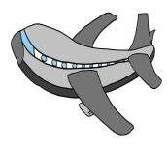
System state and dynamic
x_{k} is the state at time k
  x_{k}=A*x_{k-1}
  A is the motion model
  Q is system noise (by wind)
Z is measurement on the radar screen,
  R is measurement noise
  Assume u>>h, so Z≈u
h
z
Radar
screen

Slide 7
Can add acceleration if we want

Slide 8
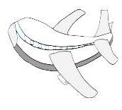
Kalman filter
Always predict and update to find the state of the plane x
Kalman filter offers optimum prediction by considering the system and measurement noise
e_{k+1}=error
e_{k}=error
e_{k-1}=error
x_{k+1}
At time k+1
x_{k}
At time k
x_{k-1}(actual state at time k-1)

Slide 9
Part 1
Introduction to Kalman filter (KF) and Extended Kalman filters (EKF)

Slide 10
Kalman filter introduction
Based on
An Introduction to the Kalman FilterSourceTechnical Report: TR95-041 Year of Publication: 1995 Authors Greg Welch Gary Bishop Publisher University of North Carolina at Chapel Hill Chapel Hill, NC, US (http://www.cs.unc.edu/~welch/media/pdf/kalman_intro.pdf)

Slide 11
The process : state= position, velocity, acceleration

Slide 12
Noise
https://en.wikipedia.org/wiki/Expected_value

Slide 13
Kalman Computation: Using the current information (a priori) to estimate the predicted future information (a posteriori)
x is a state (e.g. position, velocity & acceleration, etc)
z is measurement (image position [u,v]^{T} etc)
k is time step index

Slide 14
How good is the prediction? We judge it by looking at the error covariance: the smaller P_{k} the better.

Slide 15
How to make P_{k} small?
Find optimal gain K_{k} to make P_{k} small
Note: For Linear Kalman Filter, K(Kalman gain) and P (covariance) depend on Q (system noise setting) and R(measurement noise setting) only and not Z (measurement). So If Q ,R are given, K and P can be pre-calculated.

Slide 16
Error covariance P_{k} for update estimate

Slide 17
Error covariance prediction

Slide 18
Kalman filter (KF) recursive functions

Slide 19
Kalman Filter (KF) Iteration flow
x_{k}= n state variables, and z_{k}= m measurement variables

Slide 20
Kalman Filter (KF) Iteration flow with matrix dimensions
x_{k}= n state variables, and z_{k}= m measurement variables

Slide 21
A simple example of
Linear Kalman filter
Measure a noisy accelerometer output L
H=1 (scalar) measurement is the stated
x=Hz, hence x=z
Linear dynamic motion model A=1 (scalar)
Define the problem:
  By raw measurement z, we want to find L (the true value of the accelerometer output)
  Q is system noise
  R is measurement noise

Slide 22
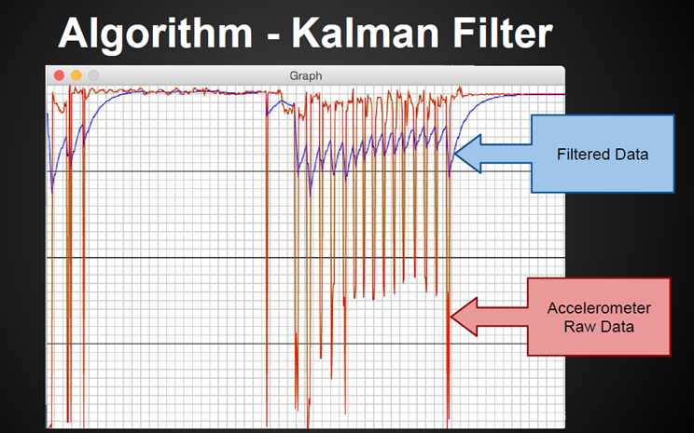
Kalman filter for an accelerometer

Slide 23
Kalman Filter (KF) Iteration flow
All terms are scalar here, A=1, H=1, and set Q=0.0001, R=0.1

Slide 24
Processing set Q=0.0001, R=0.1,
P_{k=0}=1000 (random setting, but cannot be 0) x_{k=0}=0 (it is unknown, so set an arbitrary value)
Predict:
Update

Slide 25
Time from K=1 to K=2
Predict using Q=0.0001
  x_est_pos(k=2)= x_est_pos(k=1)= 0 (arbitury set)
    Set p_pos(1)=1000, Q=0.0001
  p_est_pri(k=2)=p_pos(k=1)+Q
  p_pri(2)=1000+0.0001=1000.0001
Update using R=0.1,z=0.9
  K(2)=p_pri(2)*/(p_pri(2)+R)
    K(2)=1000.0001/(1000.0001+0.1)=0.9999
  x_est_pos(2)=x_est_pri(2)+K(2)*[z-x_est_pri(2)]=
    x_est(2)=0+0.9999*[0.9-0]=0.8999
  p_pos(2)=(1-K)*p_pri(2)
    p_pos(2)=(1- 0.9999)*1000.0001=0.1

Slide 26
Kalman test v.17
%Kalman test1
clear
'testi g kalman'
%generate data
kmax=100 % max time
x_real=1 * (ones(kmax,1)) %max x1 dimentation , assume a contant value
z=x_real+randn(kmax,1) %rand std=1,mean=0
clf
plot(z,'+')
hold on
plot(x_real)
%Init k=1
Q=0.0001
R=0.1
k=2
x_est_pos(1)= 0
p_pos(1)=1000;
% predict
x_est_pri(k)=x_est_pos(1);
p_pri(k)=p_pos(1)+Q;
% update;
Kgain(k)=p_pri(k)/(p_pri(2)+R);
x_est_pos(k)=x_est_pri(k)+ Kgain(k)*[z(k)-x_est_pri(k)];
p_pos(k)=(1-Kgain(k))*p_pri(k);
'test--'
k
x_est_pri
x_est_pos
p_pri
p_pos
Kgain
figure(1)
clf
title('result')
for k=2:kmax
x_est_pri(k)=x_est_pos(k-1);
% p_pos(k-1)=1000 ;
p_pri(k)=p_pos(k-1)+Q;
% update
Kgain(k)=p_pri(k)/(p_pri(k)+R)
x_est_pos(k)=x_est_pri(k)+Kgain(k)*[z(k)-x_est_pri(k)]
p_pos(k)=(1-Kgain(k))*p_pri(k)
'test--'
k
x_est_pri
x_est_pos
p_pri
p_pos
Kgain
plot(x_est_pos,'o-')
% pause
end
xlabel('sample time')
ylabel('x\_est\_pos')
figure(2), clf
plot(Kgain)
title('Kgain vs time, Kgain will stablise after sometime')
xlabel('sample time')
ylabel('Kgain')

Slide 27
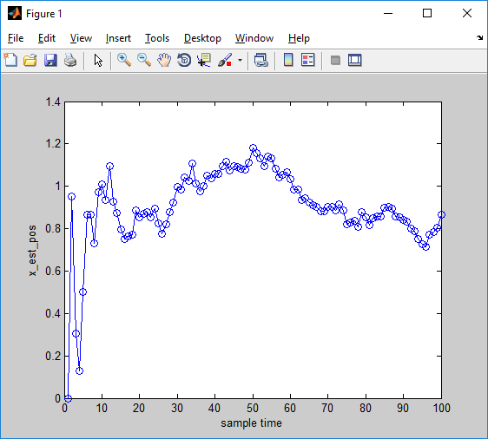
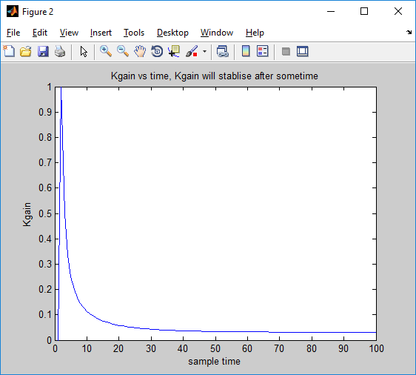
Test result
For this simple exercise, state (x_est_pos) and variable are the same
We see that Kgain depends on noise (Q,R) , if they are constant, Kgain will stabilize after some time

Slide 28
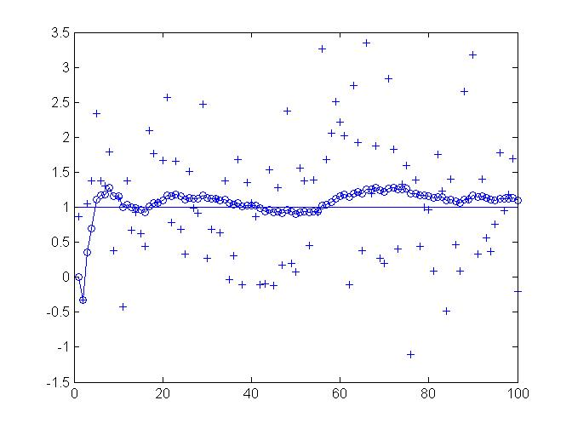
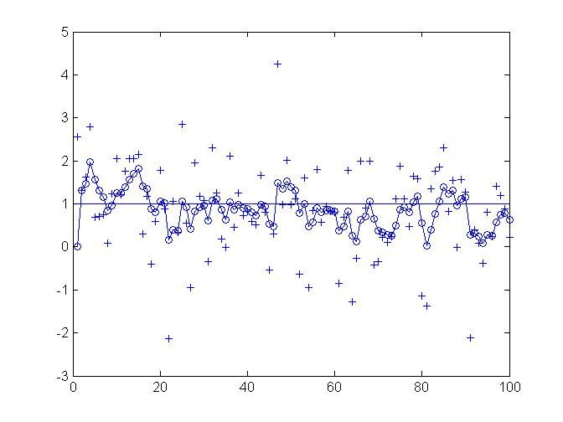
Test result
Test1
  Q = 0.00001, R= 0.1000
  Measurment error is assumed to be higher, trust the model more
  x_est_pos fluctates less
  circle line =x_est_pos
  Solid line= True value
Test2
  Q = 0.00001, R= 0.001000
  Measurment error is assumed to be lower, trust the measurmnet more: x_est_pos fluctates more
  circle line =x_est_pos
  Solid line= True value

Slide 29
Time K=2
Predict
  x1=x0=0
  P1=1000+0.0001
Update
  K1=1000.0001/(1000.0001+0.1)=0.9999
  X1=0+0.9999(0.9-0)=0.8999
  P1=(1-0.9999)1000.0001=0.1

Slide 30
Numerical results
%display
fprintf('Q=%5.5f;R=%5.5f\n',Q,R)
fprintf('x_real(%2d)=%5.5f;\n',1,x_real(1))
for k=1:kmax
fprintf('k=%2d;',k)
fprintf('x_est_pri(%2d)=%5.5f;',k,x_est_pri(k))
fprintf('x_est_pos(%2d)=%5.5f;',k,x_est_pos(k))
fprintf('p_pri(%2d)=%5.5f;',k,p_pri(k))
fprintf('p_pos(%2d)=%5.5f;',k,p_pos(k))
fprintf('Kgain(%2d)=%5.5f;',k,Kgain(k))
fprintf('z(%2d)=%5.5f;',k,z(k))
% fprintf('x_real(%2d)=%5.5f;',k,x_real(k))
fprintf('\n');
end
fprintf('\n');
%%the resulst is
Q=0.00010;R=0.00100
x_real( 1)=1.00000;
k= 1;x_est_pri( 1)=0.00000;x_est_pos( 1)=0.00000;p_pri( 1)=0.00000;p_pos( 1)=1000.00000;Kgain( 1)=0.00000;z( 1)=-0.36584;
k= 2;x_est_pri( 2)=0.00000;x_est_pos( 2)=1.45851;p_pri( 2)=1000.00010;p_pos( 2)=0.00100;Kgain( 2)=1.00000;z( 2)=1.45851;
k= 3;x_est_pri( 3)=1.45851;x_est_pos( 3)=1.89194;p_pri( 3)=0.00110;p_pos( 3)=0.00052;Kgain( 3)=0.52381;z( 3)=2.28598;
k= 4;x_est_pri( 4)=1.89194;x_est_pos( 4)=1.51447;p_pri( 4)=0.00062;p_pos( 4)=0.00038;Kgain( 4)=0.38416;z( 4)=0.90935;
k= 5;x_est_pri( 5)=1.51447;x_est_pos( 5)=1.09337;p_pri( 5)=0.00048;p_pos( 5)=0.00033;Kgain( 5)=0.32622;z( 5)=0.22363;
k= 6;x_est_pri( 6)=1.09337;x_est_pos( 6)=0.41734;p_pri( 6)=0.00043;p_pos( 6)=0.00030;Kgain( 6)=0.29885;z( 6)=-1.16877;
k= 7;x_est_pri( 7)=0.41734;x_est_pos( 7)=0.95893;p_pri( 7)=0.00040;p_pos( 7)=0.00029;Kgain( 7)=0.28512;z( 7)=2.31684;
k= 8;x_est_pri( 8)=0.95893;x_est_pos( 8)=1.14236;p_pri( 8)=0.00039;p_pos( 8)=0.00028;Kgain( 8)=0.27804;z( 8)=1.61863;
k= 9;x_est_pri( 9)=1.14236;x_est_pos( 9)=1.22263;p_pri( 9)=0.00038;p_pos( 9)=0.00027;Kgain( 9)=0.27433;z( 9)=1.43496;
k=10;x_est_pri(10)=1.22263;x_est_pos(10)=1.63283;p_pri(10)=0.00037;p_pos(10)=0.00027;Kgain(10)=0.27237;z(10)=2.72864;

Slide 31
Kalman code (lab5: IMU)
float kalmanCalculate(float newAngle, float newRate,int looptime) {
dt = float(looptime)/1000;
x_angle += dt * (newRate - x_bias);
P_00 += - dt * (P_10 + P_01) + Q_angle * dt;
P_01 += - dt * P_11;
P_10 += - dt * P_11;
P_11 += + Q_gyro * dt;
y = newAngle - x_angle;
S = P_00 + R_angle;
K_0 = P_00 / S;
K_1 = P_10 / S;
x_angle += K_0 * y;
x_bias += K_1 * y;
P_00 -= K_0 * P_00;
P_01 -= K_0 * P_01;
P_10 -= K_1 * P_00;
P_11 -= K_1 * P_01;
return x_angle;}
// Kalman filter module
float Q_angle = 0.001;
float Q_gyro = 0.003;
float R_angle = 0.03;
float x_angle = 0;
float x_bias = 0;
float P_00 = 0, P_01 = 0, P_10 = 0, P_11 = 0;
float dt, y, S;
float K_0, K_1;

Slide 32
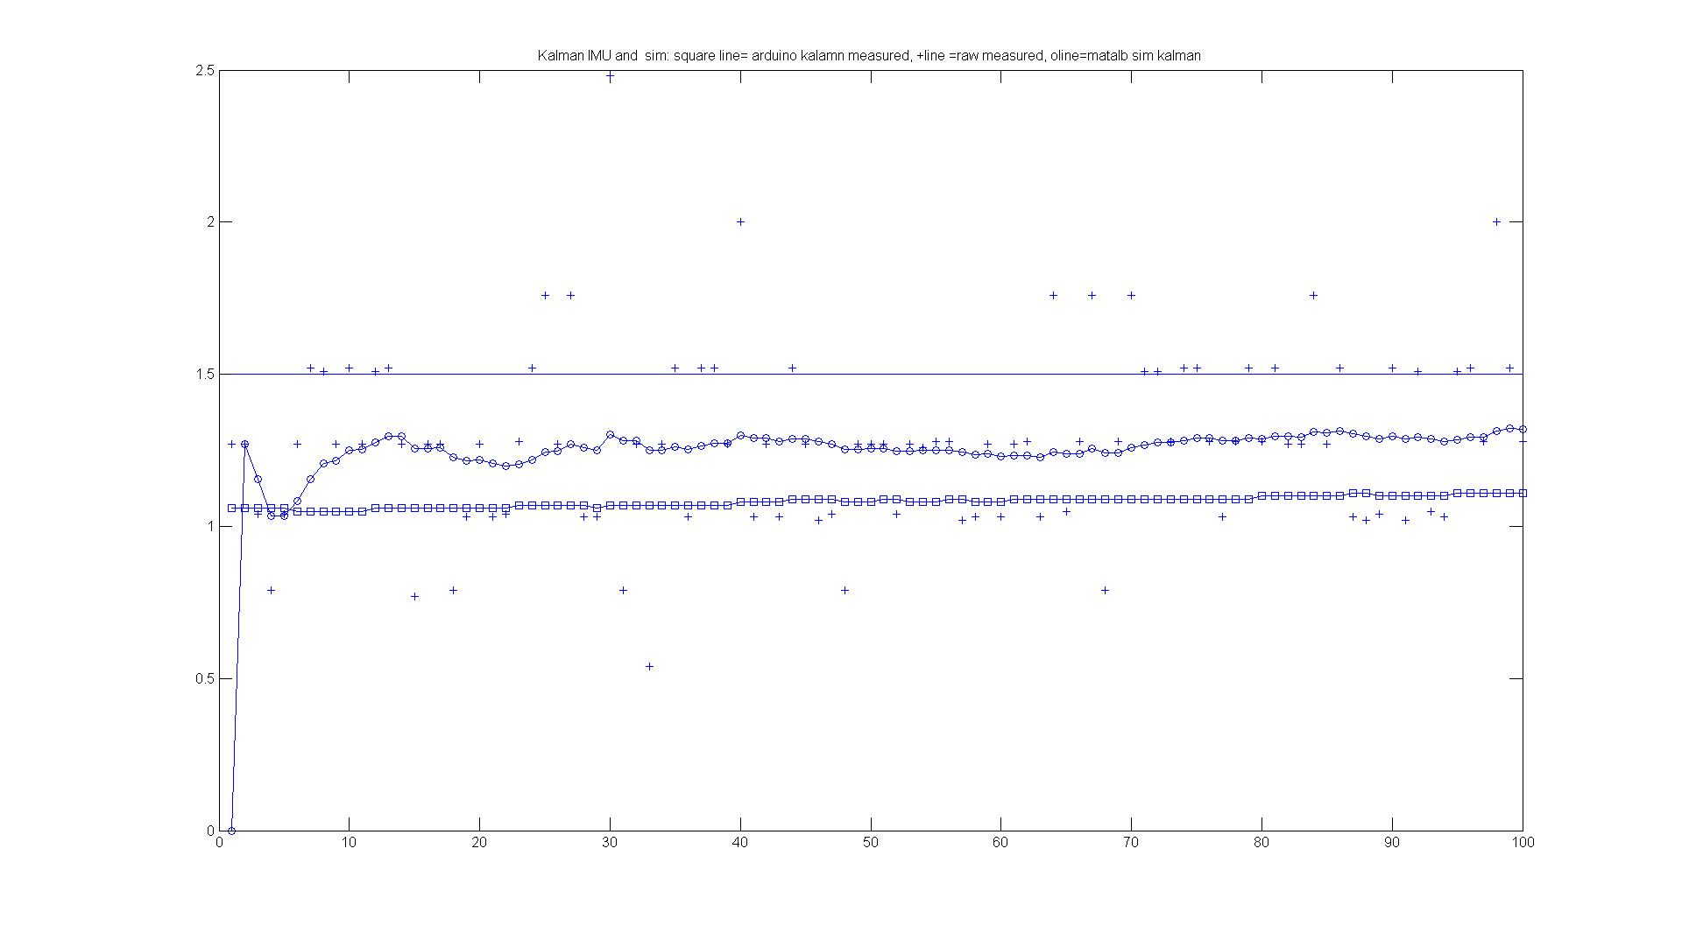
Experiment using a real imu title('Kalman IMU and sim: square line= arduino kalamn measured, +line =raw measured, oline=matalb sim kalman')

Slide 33
Derivation of the noise covariance matrix Q
Ref:
[1] http://becs.aalto.fi/en/research/bayes/ekfukf/ manual
[2] Mehrotra, Kishore, and Pravas R. Mahapatra. "A jerk model for tracking highly maneuvering targets." IEEE Transactions on Aerospace and Electronic Systems 33.4 (1997): 1094-1105.
[3] https://en.wikipedia.org/wiki/Discretization
[4] https://en.wikipedia.org/wiki/Kalman_filter
[5] http://math.stackexchange.com/questions/881182/how-to-derive-the-process-noise-co-variance-matrix-q-in-this-kalman-filter-examp
pending

Slide 34
Derivation

Slide 35
Derivation 3

Slide 36
Derivation 4

Slide 37
Continue

Slide 38
Matlab demo for task1
syms a T real
F=[ 0 1 0 0 ;
0 0 1 0 ;
0 0 0 1 ;
0 0 0 -a];
A=expm(F*T)
A =
[ 1, T, T^2/2, -(2*exp(-T*a) + 2*T*a - T^2*a^2 - 2)/(2*a^3)]
[ 0, 1, T, (exp(-T*a) + T*a - 1)/a^2]
[ 0, 0, 1, -(exp(-T*a) - 1)/a]
[ 0, 0, 0, exp(-T*a)]
Agrees with the paper
Vps Naidu, »Evaluation of Acceleration and Jerk Models in Radar and IRST Data Fusion for Tracking Evasive Maneuvering Target”
http://nal-ir.nal.res.in/8521/1/2008_0877.pdf

Slide 39
Put F and L into the Kalman toolbox
Can use a Jurk model if the last rows of F are not empty.
See [2] Mehrotra, Kishore, and Pravas R. Mahapatra. "A jerk model for tracking highly maneuvering targets." IEEE Transactions on Aerospace and Electronic Systems 33.4 (1997): 1094-1105.
and

Slide 40
linear pose estimation using Kalman filter
syms A F dt real
F = [0 0 0 0 0 0 1 0 0 0 0 0 ;
0 0 0 0 0 0 0 1 0 0 0 0 ;
0 0 0 0 0 0 0 0 1 0 0 0 ;
0 0 0 0 0 0 0 0 0 1 0 0 ;
0 0 0 0 0 0 0 0 0 0 1 0 ;
0 0 0 0 0 0 0 0 0 0 0 1 ;
0 0 0 0 0 0 0 0 0 0 0 0 ;
0 0 0 0 0 0 0 0 0 0 0 0 ;
0 0 0 0 0 0 0 0 0 0 0 0 ;
0 0 0 0 0 0 0 0 0 0 0 0 ;
0 0 0 0 0 0 0 0 0 0 0 0 ;
0 0 0 0 0 0 0 0 0 0 0 0 ];
A=expm(F*dt)
%Result
A =
[ 1, 0, 0, 0, 0, 0, dt, 0, 0, 0, 0, 0]
[ 0, 1, 0, 0, 0, 0, 0, dt, 0, 0, 0, 0]
[ 0, 0, 1, 0, 0, 0, 0, 0, dt, 0, 0, 0]
[ 0, 0, 0, 1, 0, 0, 0, 0, 0, dt, 0, 0]
[ 0, 0, 0, 0, 1, 0, 0, 0, 0, 0, dt, 0]
[ 0, 0, 0, 0, 0, 1, 0, 0, 0, 0, 0, dt]
[ 0, 0, 0, 0, 0, 0, 1, 0, 0, 0, 0, 0]
[ 0, 0, 0, 0, 0, 0, 0, 1, 0, 0, 0, 0]
[ 0, 0, 0, 0, 0, 0, 0, 0, 1, 0, 0, 0]
[ 0, 0, 0, 0, 0, 0, 0, 0, 0, 1, 0, 0]
[ 0, 0, 0, 0, 0, 0, 0, 0, 0, 0, 1, 0]
[ 0, 0, 0, 0, 0, 0, 0, 0, 0, 0, 0, 1]

Slide 41
Find Q use
dt=0.5
[A,Q] = lti_disc(F,L,Qc,dt);
Q =
1.0e+08 *
Columns 1 through 9
0.3551 0.3551 0.3551 0.0000 0.0000 0.0000 1.0652 1.0652 1.0652 0.0000 0.0000 0.0000
0.3551 0.3551 0.3551 0.0000 0.0000 0.0000 1.0652 1.0652 1.0652 0.0000 0.0000 0.0000
0.3551 0.3551 0.3551 0.0000 0.0000 0.0000 1.0652 1.0652 1.0652 0.0000 0.0000 0.0000
0.0000 0.0000 0.0000 0.0000 0.0000 0.0000 0.0000 0.0000 0.0000 0.0000 0.0000 0.0000
0.0000 0.0000 0.0000 0.0000 0.0000 0.0000 0.0000 0.0000 0.0000 0.0000 0.0000 0.0000
0.0000 0.0000 0.0000 0.0000 0.0000 0.0000 0.0000 0.0000 0.0000 0.0000 0.0000 0.0000
1.0652 1.0652 1.0652 0.0000 0.0000 0.0000 4.2609 4.2609 4.2609 0.0000 0.0000 0.0000
1.0652 1.0652 1.0652 0.0000 0.0000 0.0000 4.2609 4.2609 4.2609 0.0000 0.0000 0.0000
1.0652 1.0652 1.0652 0.0000 0.0000 0.0000 4.2609 4.2609 4.2609 0.0000 0.0000 0.0000
0.0000 0.0000 0.0000 0.0000 0.0000 0.0000 0.0000 0.0000 0.0000 0.0000 0.0000 0.0000
0.0000 0.0000 0.0000 0.0000 0.0000 0.0000 0.0000 0.0000 0.0000 0.0000 0.0000 0.0000
0.0000 0.0000 0.0000 0.0000 0.0000 0.0000 0.0000 0.0000 0.0000 0.0000 0.0000 0.0000

Slide 42
Demo: find Q for our system, linear pose estimation
syms T Q Qc q H Qc q1 q2 Freal
% Measurement model.
H = [1 0 0 0 0 0 0 0 0 0 0 0 ;
0 1 0 0 0 0 0 0 0 0 0 0 ;
0 0 1 0 0 0 0 0 0 0 0 0 ;
0 0 0 1 0 0 0 0 0 0 0 0 ;
0 0 0 0 1 0 0 0 0 0 0 0 ;
0 0 0 0 0 1 0 0 0 0 0 0 ];
Qc = diag([q1 q1 q1 q2 q2 q2 ]);
F = [0 0 0 0 0 0 1 0 0 0 0 0 ;
0 0 0 0 0 0 0 1 0 0 0 0 ;
0 0 0 0 0 0 0 0 1 0 0 0 ;
0 0 0 0 0 0 0 0 0 1 0 0 ;
0 0 0 0 0 0 0 0 0 0 1 0 ;
0 0 0 0 0 0 0 0 0 0 0 1 ;
0 0 0 0 0 0 0 0 0 0 0 0 ;
0 0 0 0 0 0 0 0 0 0 0 0 ;
0 0 0 0 0 0 0 0 0 0 0 0 ;
0 0 0 0 0 0 0 0 0 0 0 0 ;
0 0 0 0 0 0 0 0 0 0 0 0 ;
0 0 0 0 0 0 0 0 0 0 0 0 ];
L=[0 0 0 0 0 0;
0 0 0 0 0 0;
0 0 0 0 0 0;
0 0 0 0 0 0;
0 0 0 0 0 0;
0 0 0 0 0 0;
1 0 0 0 0 0;
0 1 0 0 0 0;
0 0 1 0 0 0;
0 0 0 1 0 0;
0 0 0 0 1 0;
0 0 0 0 0 1];
M=L*Qc*L'
g=exp(F*(T-t)) * M *exp(F*(T-t))'
Q=int(g,t)

Slide 43
Demo: find Q for our system, linear pose estimation
syms T Q Qc q H Qc q1 q2 F real
% Measurement model.
H = [1 0 0 0 0 0 0 0 0 0 0 0 ;
0 1 0 0 0 0 0 0 0 0 0 0 ;
0 0 1 0 0 0 0 0 0 0 0 0 ;
0 0 0 1 0 0 0 0 0 0 0 0 ;
0 0 0 0 1 0 0 0 0 0 0 0 ;
0 0 0 0 0 1 0 0 0 0 0 0 ];
Qc = diag([q1 q1 q1 q2 q2 q2 ]);
F = [0 0 0 0 0 0 1 0 0 0 0 0 ;
0 0 0 0 0 0 0 1 0 0 0 0 ;
0 0 0 0 0 0 0 0 1 0 0 0 ;
0 0 0 0 0 0 0 0 0 1 0 0 ;
0 0 0 0 0 0 0 0 0 0 1 0 ;
0 0 0 0 0 0 0 0 0 0 0 1 ;
0 0 0 0 0 0 0 0 0 0 0 0 ;
0 0 0 0 0 0 0 0 0 0 0 0 ;
0 0 0 0 0 0 0 0 0 0 0 0 ;
0 0 0 0 0 0 0 0 0 0 0 0 ;
0 0 0 0 0 0 0 0 0 0 0 0 ;
0 0 0 0 0 0 0 0 0 0 0 0 ];
L=[0 0 0 0 0 0;
0 0 0 0 0 0;
0 0 0 0 0 0;
0 0 0 0 0 0;
0 0 0 0 0 0;
0 0 0 0 0 0;
1 0 0 0 0 0;
0 1 0 0 0 0;
0 0 1 0 0 0;
0 0 0 1 0 0;
0 0 0 0 1 0;
0 0 0 0 0 1];
M=L*Qc*L'
g=exp(F*(T-t)) * M *exp(F*(T-t))'
Q=int(g,t)

Slide 44
Extended Kalman filter EKF
For non-linear problems, such as 2D to 3D computer vision problems.
Here for our Structure from motion SfM problem
  Camera motion is linear (Newtonian mechanics)
  Measurement is non-linear (3D to 2D projection)

Slide 45
Definitions:
Note: measurement to state is non-linear

Slide 46
EKF Iteration flow
Ref: http://en.wikipedia.org/wiki/Extended_Kalman_filter

Slide 47
Part II
Two-pass Kalman filter for structure and pose estimation
Description
Major reference [Yu, June 2005]

Slide 48
Two-pass Kalman filter for structure and pose estimation
Structure and pose updating

Slide 49
Model initializations
f=focal length (found by camera calibration)
Zinit=initial guess of z direction of the model points (e.g. Zinit=1 meter from the camera)

Slide 50
Kalman tracking
Step 1: Kalman pose tracking

Slide 51
Kalman filtering pose tracking
Assume model is known (by guessing)

Slide 52
Kalman pose filter
States
State transition
Note: we use w instead of x for state representation here

Slide 53
Kalman pose filter measurement
measurement

Slide 54
Kalman for pose estimation
IMMKalmanPoseGen.m
‧
‧

Slide 55
Implementation

Slide 56
Implementation details, equation 2,3

Slide 57
State transition matrix A_{12x12}
Typical
A_{12x12}
_{Ts=1 used in the program}

Slide 58
Initialize pose_covar P_{1,1}
%Initialize state vector covariance for the pose filter
pose_covar=P_{1,1} = diag([1 1 1 1 1 1 0.001 0.0001 0.1 0.01 0.01 0.001]*1000);

Slide 59
Covariance of state noise= Q_{12x12} ,
Qp = diag([10 10 10 10 10 10 0.0001 0.0001 0.1 0.01 0.001 0.0001]);

Slide 60
Covariance of measurement noise=R_{12x12}
Rc = diag(repmat([2 2], 1, n_features));
N=number of features

Slide 61
Motion and projection

Slide 62
Pose Jacobian Matrix

Slide 63
Yu-recursive Kalman [Yu, June 2005] algorithm
Matlab for pose Jacobian matrices (full)
%oct 2014
%************************************************************************
function TestJacobian_pose_full
% Try to solve the differentiate equations without simplification
clc,clear;
disp('TestJacobian');
syms a b c; % a= pitch ( around x axis), b=yaw(around y), c=roll (around z) respectively
syms f X Y Z T1 T2 T3;
F = [
%u
f*((cos(b)*cos(c)*X - cos(b)*sin(c)*Y + sin(b)*Z+ T1)...
/((-cos(a)*sin(b)*cos(c) + sin(a)*sin(c))*X ...
+ (cos(a)*sin(b)*sin(c)+ sin(a)*cos(c))*Y + cos(a)*cos(b)*Z + T3));
%v
((sin(a)*sin(b)*cos(c)+ cos(a)*sin(c))*X ...
+ (-sin(a)*sin(b)*sin(c)+ cos(a)*cos(c))*Y - sin(a)*sin(b)*Z + T2)...
/((-cos(a)*sin(b)*cos(c) + sin(a)*sin(c))*X + (cos(a)*sin(b)*sin(c)...
+ sin(a)*cos(c))*Y + cos(a)*cos(b)*Z + T3)]
V = [a,b,c,T1,T2,T3];
Fjaco = jacobian(F,V);
disp('Fjaco =');
disp(Fjaco);
size(Fjaco) % Fjaco is 2x6
%Fjaco(1,1)
%************************

Slide 64
Yu-recursive Kalman [Yu, June 2005] algorithm
Matlab for pose Jacobian matrices (approximation)
% TestJacobian_pose_approx
%function TestJacobian_pose_approx
%'==test jacobian for chang,wong ieee_mm 2 pass lowe=================='
%use twist (small) angles approximation.
clear, clc;
syms R dR M TT XYZ ZZ x y z f u v a1 a2 a3 t1 t2 t3 aa1 aa2 aa3 tt1 tt2 tt3
R=[1 -aa3 aa2; aa3 1 -aa1; -aa2 aa1 1];
dR=[1 -a3 a2; a3 1 -a1; -a2 a1 1];
M=[x;y;z];
TT=[tt1;tt2;tt3];
dt=[t1;t2;t3]
XYZ=dR*R*M+TT+dt; % R is a matrix multiplication transform
u=f*XYZ(1)/XYZ(3);
v=f*XYZ(2)/XYZ(3);
ja=jacobian([u ;v],[tt1 t1 tt2 t2 tt3 t3 aa1 a1 aa2 a2 aa3 a3])
size(ja) %size of ja is 2x12
ja(1,1),ja(1,2),ja(1,3),ja(1,4),ja(1,5),ja(1,6),ja(1,7),ja(1,8),ja(1,9),ja(1,10),ja(1,11),ja(1,12)

Slide 65
Kalman tracking
Step2: Kalman structure tracking

Slide 66
Kalman filtering structure tracking
Assume pose is known

Slide 67
Kalman structure filter
States
Structure State transition

Slide 68
Extended Kalman filter iteration for the model structure
The process is an identify matrix (no change of structure against time)
The procedure is for each features:

Slide 69
Yu-recursive Kalman [Yu, June 2005] algorithm
Matlab for structure Jacobian matrices (full)
% Solve the problem without simplification
% Since is the yaw, pitch, roll of the rotation respectively. The R can be represent by as:
%
% Substitute R into (1), we have the following program (in matlab):
%************************************************************************
function TestJacobian
% Try to solve the differentiate equations without simplification
clc,clear;
disp('TestJacobian');
syms a b c; %yaw( around x axis), pitch(around y), roll(aroudn z) respectively
syms f X Y Z T1 T2 T3;
F = [
%u
f*((cos(b)*cos(c)*X - cos(b)*sin(c)*Y + sin(b)*Z+ T1)...
/...
((-cos(a)*sin(b)*cos(c) + sin(a)*sin(c))*X ...
+ (cos(a)*sin(b)*sin(c)+ sin(a)*cos(c))*Y + cos(a)*cos(b)*Z + T3));
%v
((sin(a)*sin(b)*cos(c)+ cos(a)*sin(c))*X ...
+ (-sin(a)*sin(b)*sin(c)+ cos(a)*cos(c))*Y - sin(a)*sin(b)*Z + T2)...
/...
((-cos(a)*sin(b)*cos(c) + sin(a)*sin(c))*X + (cos(a)*sin(b)*sin(c)...
+ sin(a)*cos(c))*Y + cos(a)*cos(b)*Z + T3)]
V = [X,Y,Z];
Fjaco = jacobian(F,V);
%************************

Slide 70
Structure Jacobian
function lpf = KalmanStructJacobSP(RT_solution, a, f, u, v, initz)
b = 1/f;
tx = RT_solution(1);
ty = RT_solution(2);
tzxb = RT_solution(3);
wx = RT_solution(4);
wy = RT_solution(5);
wz = RT_solution(6);
temp1 = 1 - b*sin(wy)*(u + a*b*u) + b*cos(wy)*sin(wx)*(v + a*b*v) + b*cos(wy)*cos(wx)*(a - initz) + tzxb;
lpf = zeros(2, 1);
lpf(1) = (cos(wz)*cos(wy)*b*u + (cos(wz)*sin(wy)*sin(wx) - sin(wz)*cos(wx))*b*v + cos(wz)*sin(wy)*cos(wx) + sin(wz)*sin(wx))/(temp1) - ...
(cos(wz)*cos(wy)*(u + a*b*u) + (cos(wz)*sin(wy)*sin(wx) - sin(wz)*cos(wx))*(v + a*b*v) + ...
(cos(wz)*sin(wy)*cos(wx) + sin(wz)*sin(wx))*(a - initz) + tx)*(((-b)^2)*sin(wy)*u + (b^2)*cos(wy)*sin(wx)*v + b*cos(wy)*cos(wx)) /(temp1^2);
lpf(2) = (sin(wz)*cos(wy)*b*u + (sin(wz)*sin(wy)*sin(wx) + cos(wz)*cos(wx))*b*v + sin(wz)*sin(wy)*cos(wx) - cos(wz)*sin(wx))/(temp1) - ...
(sin(wz)*cos(wy)*(u + a*b*u) + (sin(wz)*sin(wy)*sin(wx) + cos(wz)*cos(wx))*(v + a*b*v) + ...
(sin(wz)*sin(wy)*cos(wx) - cos(wz)*sin(wx))*(a - initz) + ty)*(((-b)^2)*sin(wy)*u + (b^2)*cos(wy)*sin(wx)*v + b*cos(wy)*cos(wx)) /(temp1^2);
return

Slide 71
Yu-recursive Kalman [Yu, June 2005] algorithm
Matlab for structure Jacobian matrices (approximate))
'====test jacobian for structure================='
%use twist (small) angles approximation.
clear, clc;
syms R dR M TT XYZ ZZ x y z f u v a1 a2 a3 t1 t2 t3 aa1 aa2 aa3 tt1 tt2 tt3
R=[1 -aa3 aa2; aa3 1 -aa1; -aa2 aa1 1];
dR=[1 -a3 a2; a3 1 -a1; -a2 a1 1];
M=[x;y;z];
TT=[tt1;tt2;tt3];
dt=[t1;t2;t3]
XYZ=dR*R*M+TT+dt; % R is a matrix multiplication transform
u=f*XYZ(1)/XYZ(3);
v=f*XYZ(2)/XYZ(3);
ja=jacobian([u ;v],[x y z])

Slide 72
Part B
Interacting Multiple Model Method (IMM) structure and pose estimation
Major reference [Yu Aug.2005]

Slide 73
Example: Interacting Multiple Model Method (IMM) for (IMM-KSFM)
3 dynamic models =3 parallel Kalman structures
  General, Rotation, Translation
Use IMM to find the suitable dynamic model at time t
Each Kalman structure is similar to IV-KSFR
Reference
  Ying Kin Yu, Kin Hong Wong and Michael Ming Yuen Chang, "Merging Artificial Objects with Marker-less Video Sequences Based on the Interacting Multiple Model Method", IEEE Transactions on Multimedia, Volume 8, Issue 3, June 2006 Page(s):521 - 528.

Slide 74
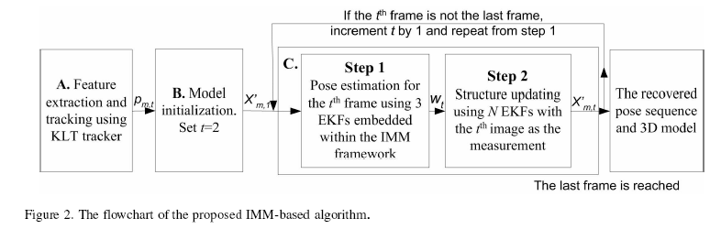
Steps

Slide 75
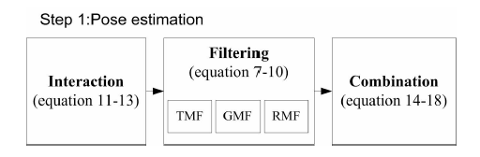
Pose

Slide 76
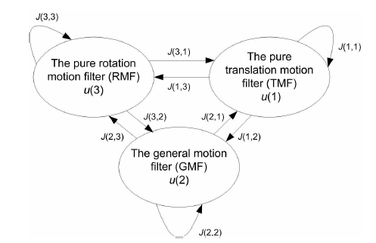
IMM switching

Slide 77
Part C
USE Trifocal tensor (TRI-KSFM) structure and pose estimation
Major reference [Yu Feb.2005]

Slide 78
Example : USE Trifocal tensor (TRI-KSFM)
Always use first second (I₁, I₂) frames as reference
Use I_{t} as the third frame to form a trifocal tensor at time t
If only pose output required, use one Kalman filter
If structure is needed use N Kalman filters for N features, similar to IV-KSFM.
Reference
  Ying Kin YU, Kin Hong Wong and Michael Ming Yuen Chang, "Recursive 3D Model Reconstruction Based on Kalman Filtering", IEEE Transactions on Systems, Man and Cybernetics B, Vol.35, No.3, June 2005.

Slide 79
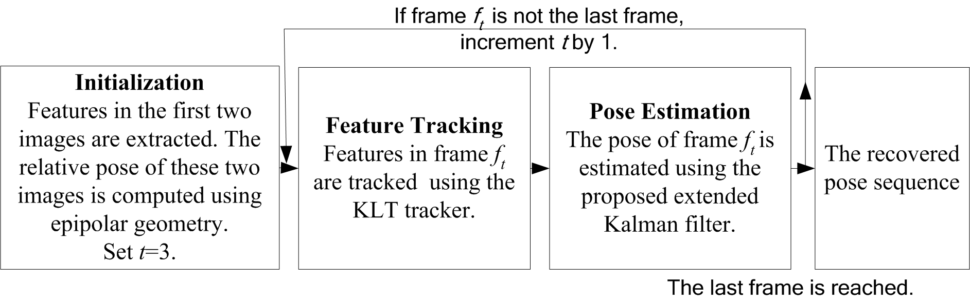
TRI-KSFM flow diagram

Slide 80
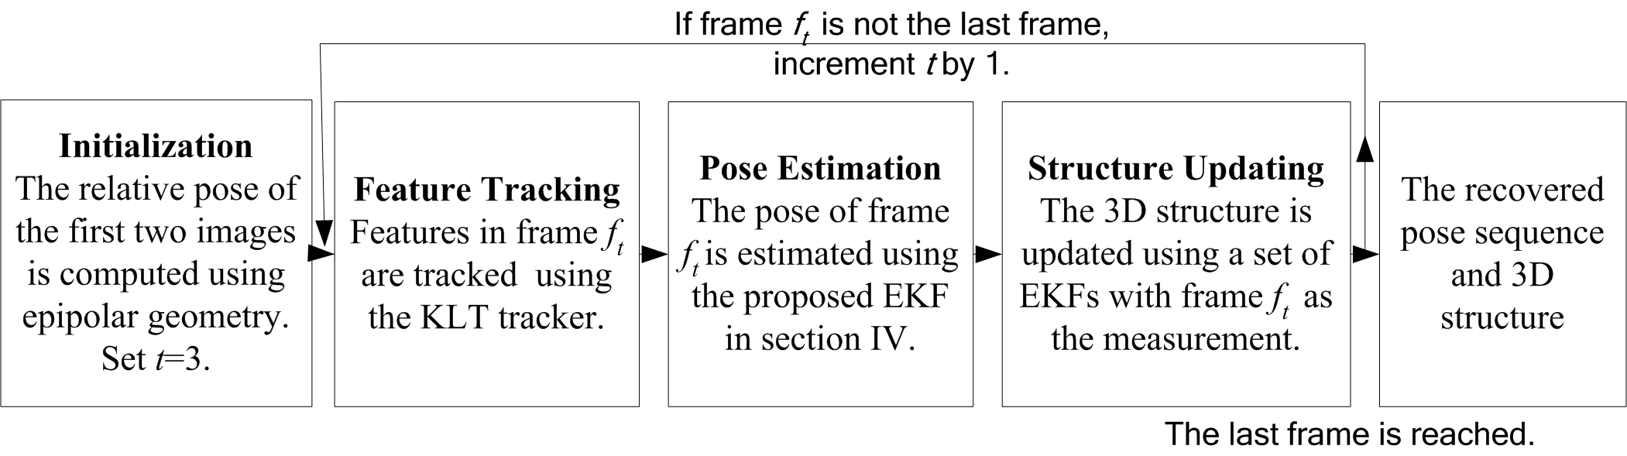
The flow of the recursive algorithm with the structure recovery extension.

Slide 81
Condensation
Reference
  Kin-Hong Wong and Michael Ming-Yuen Chang, "Pose tracking for virtual walk-through environment construction", Proceedings of the Recent Development in Theories and Numerics, Editor: Y.C. Hon , World Scientific Publishing Co. Pte. Ltd. 2003. ISBN 981-238-266-2

Slide 82
Conclusion
Studied various techniques for model and pose tracking in 3D computer vision.

Slide 83
References on Kalman filter
[Azarbayejani 1995] A.Azarbayejani and A.P.Pentland, “Recursive estimation of motion, structure, and focal length”, IEEE Trans. on PAMI, vol. 17, no 6, June 1995.
[Azarbayejani 1993] A. Azarbayejani, T. Starner, B. Horowitz, A. Pentland,“, Visually Controlled Graphics“, IEEE Transactions on Pattern Analysis and Machine Intelligence, vol.15, no. 6, pages 602-605,1993.
[Yu, June 2005] Ying Kin YU, Kin Hong Wong and Michael Ming Yuen Chang, "Recursive 3D Model Reconstruction Based on Kalman Filtering", IEEE Transactions on Systems, Man and Cybernetics B, Vol.35, No.3, June 2005.
Ying Kin YU, Kin Hong Wong and Michael Ming Yuen Chang, "A Fast and Robust Simultaneous Pose Tracking and Structure Recovery Algorithm for Augmented Reality Applications", International Conference on Image Processing (ICPR04), Singapore, Oct. 2004.
Ying Kin YU, Kin Hong Wong and Michael Ming Yuen Chang,"A Fast Recursive 3D Model Reconstruction Algorithm for Multimedia Applications", International Conference on Pattern Recognition ICPR2004, Cambridge, August 2004.
Ying Kin Yu, Kin Hong Wong and Michael Ming Yuen Chang, "Merging Artificial Objects with Marker-less Video Sequences Based on the Interacting Multiple Model Method", IEEE Transactions on Multimedia, Volume 8, Issue 3, June 2006 Page(s):521 - 528.
Ying Kin YU, Kin Hong Wong and Michael Ming Yuen Chang, "Recursive 3D Model Reconstruction Based on Kalman Filtering", IEEE Transactions on Systems, Man and Cybernetics B, Vol.35, No.3, June 2005.
Kin-Hong Wong and Michael Ming-Yuen Chang, "Pose tracking for virtual walk-through environment construction", Proceedings of the Recent Development in Theories and Numerics, Editor: Y.C. Hon , World Scientific Publishing Co. Pte. Ltd. 2003. ISBN 981
Greg Welch and Gary Bishop, "An Introduction to the Kalman Filter, "TR 95-041 Department of Computer Science University of North Carolina at Chapel Hill Chapel Hill, NC 27599-3175 www.cs.unc.edu/~welch/media/pdf/kalman_intro.pdf (excellent tutorial)
T.J.Broida, S.Chandrasiiekhar and R.Chellappa, “Recursive 3-D motion estimation from monocular image sequence”, IEEE Trans. on Aerospace and Electronic Systems, vol 26, no. 4, July 1990. (The first paper of Kalman on pose estimation)
http://mathworld.wolfram.com/Quaternion.html
http://www.euclideanspace.com/maths/algebra/realNormedAlgebra/quaternions/index.htm
A.W. Rihaczek, “Recursive methods for the estimation of rotation quaternions”, IEEE transactions on aerospace and electronic systems, Vol. 32, No. 2, April 1996.
[Yu, Feb 2005]Ying Kin Yu, Kin Hong Wong, Michael Ming Yuen Chang and Siu Hang Or, "Recursive Camera Motion Estimation with Trifocal Tensor:, Submitted to a journal.

Slide 84
Appendix
Some math background
Mean
Variance/ standard deviation
Covariance
Covariance matrix

Slide 85
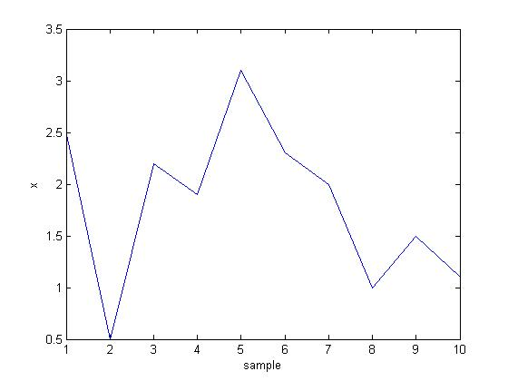
Mean, variance (var) and standard_deviation (std)
x =
2.5000
0.5000
2.2000
1.9000
3.1000
2.3000
2.0000
1.0000
1.5000
1.1000
mean_x = 1.8100
var_x = 0.6166
std_x = 0.7852
%matlab code
x=[2.5 0.5 2.2 1.9 3.1 2.3 2 1 1.5 1.1]'
mean_x=mean(x)
var_x=var(x)
std_x=std(x)
%%%%%%%%Answer:
mean_x = 1.8100
var_x = 0.6166
std_x = 0.7852
x
sample

Slide 86
N or N-1 as denominator?? see http://stackoverflow.com/questions/3256798/why-does-matlab-native-function-cov-covariance-matrix-computation-use-a-differe
“n-1 is the correct denominator to use in computation of variance. It is what's known as Bessel's correction” (http://en.wikipedia.org/wiki/Bessel%27s_correction) Simply put, 1/(n-1) produces a more accurate expected estimate of the variance than 1/n

Slide 87
Class exercise 1
By computer (Matlab)
By and
x=[1 3 5 10 12]'
mean(x)
var(x)
std(x)
Mean(x)
= 6.2000
Variance(x)= 21.7000
Stand deviation = 4.6583
x=[1 3 5 10 12]'
mean=
Variance=
Standard deviation=

Slide 88
Answer1:
By computer (Matlab)
By hand
x=[1 3 5 10 12]'
mean(x)
var(x)
std(x)
Mean(x)
= 6.2000
Variance(x)= 21.7000
Stand deviation = 4.6583
x=[1 3 5 10 12]'
mean=(1+3+5+10+12)/5
=6.2
Variance=((1-6.2)^2+(3-6.2)^2+(5-6.2)^2+(10-6.2)^2+(12-6.2)^2)/(5-1)=21.7
Standard deviation= sqrt(21.7)= 4.6583

Slide 89
What do mean, variance, standard deviation tell you
Mean: the average value of a set of numbers
Variance: the sum of the square of the difference between the numbers and the mean.
Stand deviation : the square root of the mean , a measurement of how the numbers are deviated from the mean. Give you intuition than the Variance.

Slide 90
Variance/Covariance matrix (or called Covariance matrix) of a vector of random variables
See
http://www.biostat.jhsph.edu/~fdominic/teaching/bio655/extras/matrixnotes2.pdf

Slide 91
Variance -covariance matrix
Videos
Co-variance matrix and correlation
  https://www.youtube.com/watch?v=ZfJW3ol2FbA
Co-variance matrix
  https://www.youtube.com/watch?v=locZabK4Als

Slide 92
Particle filter
Video
  https://www.youtube.com/watch?v=O-lAJVra1PU
  With matlab code:
    https://www.youtube.com/watch?v=HZvF8KlFoWk

Slide 93
Derivation the noise co-variance matrix Q in Kalman filter

Slide 94
Extend to include acceleration , change of acceleration is process noise
[*] Proceedings of SPIE Conference on Signal and Data Processing
of Small Targets, Orlando, FL, USA, April 2000. (4048-22)
A Survey of Maneuvering Target Tracking: Dynamic Models
X. Rong Li and Vesselin P. Jilkov
Equ. 23

Slide 95
Singer acceleration model
Equ. (28) of [*]
syms a T real
F=[ 0 1 0 ;
0 0 1;
0 0 -a];
G=expm(F*T)
% result
% G =
%
% [ 1, T, (exp(-T*a) + T*a - 1)/a^2]
% [ 0, 1, -(exp(-T*a) - 1)/a]
% [ 0, 0, exp(-T*a)]
See http://control.ucsd.edu/mauricio/courses/mae280a/lecture6.pdf
For matrix exponential
[*] A Survey of Maneuvering Target Tracking: Dynamic Models, Proceedings of SPIE Conference on Signal and Data Processing of Small Targets, Orlando, FL, USA, April 2000. (4048-22) Section 4.4

