Slide 1
3D pose by Kinect --Reading the work “Point-Plane Slam for Handheld 3D” (a beta version)
A tutorial
By KH Wong

Slide 2
Overview
Based on the paper [1] and discuss various problems and techniques.
[1] Yuichi Taguchi∗ , Yong-Dian Jian† , Srikumar Ramalingam∗ , and Chen Feng‡ , “Point-Plane SLAM for Hand-Held 3D Sensors”, Robotics and Automation (ICRA), 2013 IEEE International Conference on http://www.cc.gatech.edu/~yjian6/publication/taguchi2013icra.pdf

Slide 3
Introduction
The work is to use 3-D points and planes obtained by arrange sensor (Kinect) as features for 3D pose estimation and reconstruction to achieve (SLAM) Simultaneous Localization and mapping.

Slide 4
Problem definition
To be written later, can be found in the paper

Slide 5
Derivation
I have problem in understanding eq. (13) , however, I can derive the result from eq.(12) to (15) directly, the steps are shown below.
Problem and notation
There are i=1,..,N, 3D points, first at landmark position then moved to measured position.
In eq.(12)
P^{l}_{i} = i-th landmark 3-D point (=model point) position
P^{k}_{m}= i-th measured 3-D point at time k,
We want to find the pose (R=rotation, t=translation) of the point at time k, that P^{i}_{l} =R*P^{k}_{m}+t^{k}
Same as to find R,t , so||P^{i}_{l} –(R*P^{k}_{m}+t^{k}) ||²=0------(12)

Slide 6
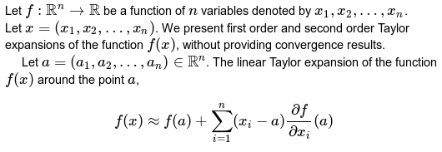
Continue
http://www.fepress.org/files/math_primer_fe_taylor.pdf

Slide 10
Iterative formula using Newton's method

Slide 11
Newton’s method Algorithm

Slide 12
Known problem
I don’t understand when [x,y,z]’ are needed to be guessed and calculated, because they should be given. Landmark_[x,y,z]’ is given the Kinect measured at k=1. And measured_at_k_[x,y,z]’ should also be given by the Kinect sensor at time k.
So I think the system is not j=1,..,9 but j=1,,6.
Meaning the parameters to be guessed are (tx,ty,ty,θx,θy,θz) excluding (x,y,z)
We should test this idea.

