Slide 1
Generative adversarial networks (GANs)
Kh wong

Slide 2
Overview
Introduction
Theory
Example
Case study: GAN for edge detection

Slide 3
1) Introduction
Non-supervised learning
Require 2 Convolution neural networks: Generator (G) and discriminator (D)
Training of GANs
  Use Generator (G) to generate noise
  Use the noise to generate data
  A discriminator (D) to determine it is true or false
  Update the neural networks until the discriminator cannot tell whether the generator is producing true or false data
  After trained G, G can generate many more training samples for training of other neural network algorithms

Slide 4
2) Theory of Generative adversarial networks (GANs)
Idea and math

Slide 5

Theory of Generative adversarial networks (GAN)
GAN
Discriminator (D)is a CNN (Convolution neural network)
Generator(G) is a CNN

Slide 6
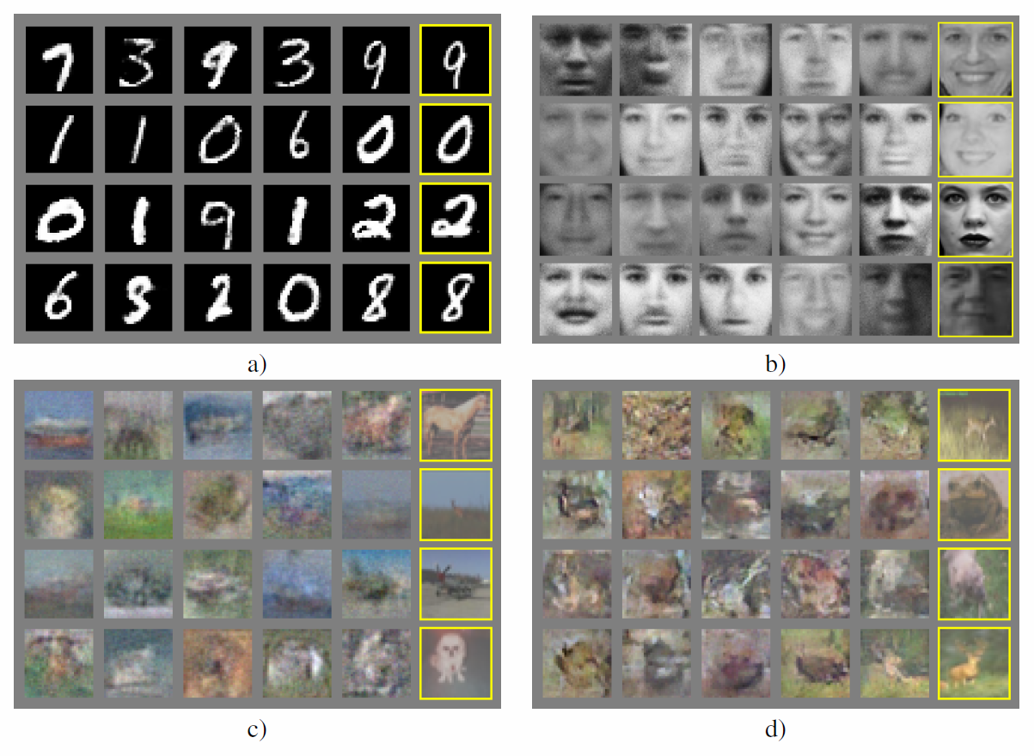
Application of GAN
Generate data with the same distribution of training samples
Application :Enrich data sets, e.g. use some data in MINST dataset to train G, so G can generate more training samples.
Good for face datasets etc.
Can be used in Arts; generate new paintings of a certain style
MINST dataset: http://yann.lecun.com/exdb/mnist/

Slide 7
The idea, from : Goodfellow, Ian, et al. "Generative adversarial nets." Advances in neural information processing systems. 2014. https://arxiv.org/abs/1406.2661
The proposed adversarial nets framework, the generative model is pitted against an adversary:
a discriminative model (D) that learns to determine whether a sample is from the model distribution or the data distribution. The generative model (G) can be thought of as analogous to a team of counterfeiters, trying to produce fake currency and use it without detection, while the discriminative model is analogous to the police, trying to detect the counterfeit currency. Competition in this game drives both teams to improve their methods until the counterfeits are indistinguishable from the genuine articles.

Slide 8
GAN algorithm
Part 1: The Discriminator is trained while the Generator is idle. In this phase, the (Generator) network is only forward propagated and no back-propagation is done. The Discriminator is trained (with back-progataion) on real data for n epochs, and see if it can correctly predict them as real. Also, in this phase, the Discriminator is also trained on the fake generated data from the Generator and see if it can correctly predict them as fake.
Part 2: The Generator (with backpropagation) is trained while the Discriminator is idle. After the Discriminator is trained by the generated fake data of the Generator, we can get its predictions and use the results for training the Generator and get better from the previous state to try and fool the Discriminator.
https://www.geeksforgeeks.org/generative-adversarial-network-gan/

Slide 9
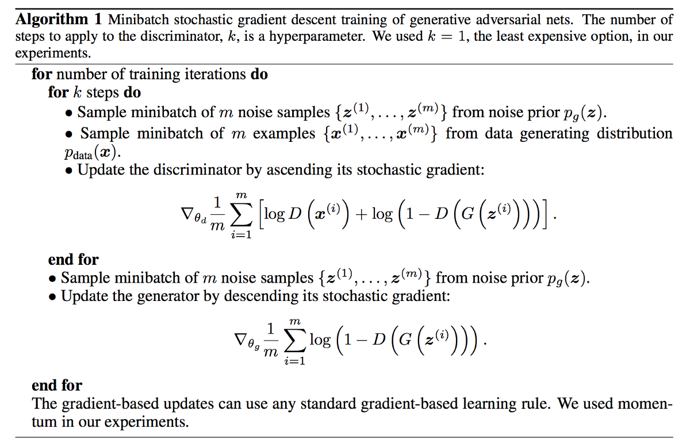
The GAN algorithm by Ian J. Goodfellow https://arxiv.org/pdf/1406.2661.pdf
The equation to update D,G (neural nets) can be implemented by Algorithm 1
Keep G and
maximize D
Keep D and
minimize G
https://medium.com/@jonathan_hui/gan-whats-generative-adversarial-networks-and-its-application-f39ed278ef09

Slide 10
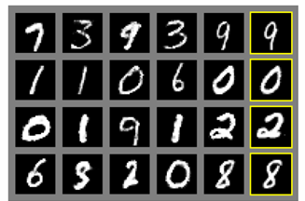
The generator (G) network
Input noise z (with distribution p_{g}) to a generator G which can produce output data
Application example: You train G using many samples of handwritten character images (from MINST dataset), after training you input a noise z (with distribution p_{g} ), then G will give you an image of a handwritten character.
Usage: create more training data for machine leaning systems
Z (distribution p_{g}): a vector
G can generate data according to Z
Output is a picture of a hand written character
MINST dataset: http://yann.lecun.com/exdb/mnist/

Slide 11
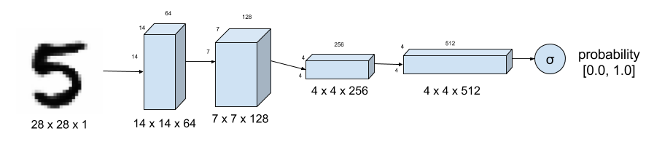
3) Example (i)
https://towardsdatascience.com/gan-by-example-using-keras-on-tensorflow-backend-1a6d515a60d0
Numerical example: Use GAN to generate hand written characters.
Figure 1. Discriminator of DCGAN tells how real an input image of a digit is. MNIST Dataset is used as ground truth for real images. Strided convolution instead of max-pooling down samples the image

Slide 12
Listing 1. Keras code for the Discriminator in Figure 1.
self.D = Sequential()
depth = 64
dropout = 0.4
# In: 28 x 28 x 1, depth = 1
# Out: 14 x 14 x 1, depth=64
input_shape = (self.img_rows, self.img_cols, self.channel)
self.D.add(Conv2D(depth*1, 5, strides=2, input_shape=input_shape,\
padding='same', activation=LeakyReLU(alpha=0.2)))
self.D.add(Dropout(dropout))
self.D.add(Conv2D(depth*2, 5, strides=2, padding='same',\
activation=LeakyReLU(alpha=0.2)))
self.D.add(Dropout(dropout))
self.D.add(Conv2D(depth*4, 5, strides=2, padding='same',\
activation=LeakyReLU(alpha=0.2)))
self.D.add(Dropout(dropout))
self.D.add(Conv2D(depth*8, 5, strides=1, padding='same',\
activation=LeakyReLU(alpha=0.2)))
self.D.add(Dropout(dropout))
# Out: 1-dim probability
self.D.add(Flatten())
self.D.add(Dense(1))
self.D.add(Activation('sigmoid'))
self.D.summary()

Slide 13
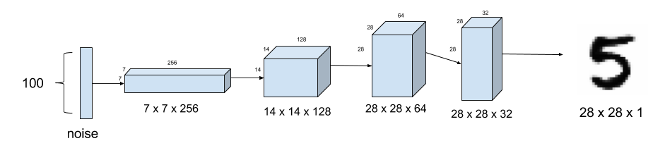
Generator model
Generator
Figure 2. Generator model synthesizes fake MNIST images from noise. Upsampling is used instead of fractionally-strided transposed convolution.

Slide 14
Listing 2. Keras code for the generator in Figure 2.
self.G = Sequential()
dropout = 0.4
depth = 64+64+64+64
dim = 7
# In: 100
# Out: dim x dim x depth
self.G.add(Dense(dim*dim*depth, input_dim=100))
self.G.add(BatchNormalization(momentum=0.9))
self.G.add(Activation('relu'))
self.G.add(Reshape((dim, dim, depth)))
self.G.add(Dropout(dropout))
# In: dim x dim x depth
# Out: 2*dim x 2*dim x depth/2
self.G.add(UpSampling2D())
self.G.add(Conv2DTranspose(int(depth/2), 5, padding='same'))
self.G.add(BatchNormalization(momentum=0.9))
self.G.add(Activation('relu'))
self.G.add(UpSampling2D())
self.G.add(Conv2DTranspose(int(depth/4), 5, padding='same'))
self.G.add(BatchNormalization(momentum=0.9))
self.G.add(Activation('relu'))
self.G.add(Conv2DTranspose(int(depth/8), 5, padding='same'))
self.G.add(BatchNormalization(momentum=0.9))
self.G.add(Activation('relu'))
# Out: 28 x 28 x 1 grayscale image [0.0,1.0] per pix
self.G.add(Conv2DTranspose(1, 5, padding='same'))
self.G.add(Activation('sigmoid'))
self.G.summary()
return self.G
#Listing 2. Keras code for the generator in Figure 2.

Slide 15
#Listing 3. Discriminator Model implemented in Keras.
optimizer = RMSprop(lr=0.0008, clipvalue=1.0, decay=6e-8)
self.DM = Sequential()
self.DM.add(self.discriminator())
self.DM.compile(loss='binary_crossentropy', optimizer=optimizer,\
metrics=['accuracy'])
#Listing 3. Discriminator Model implemented in Keras.

Slide 16
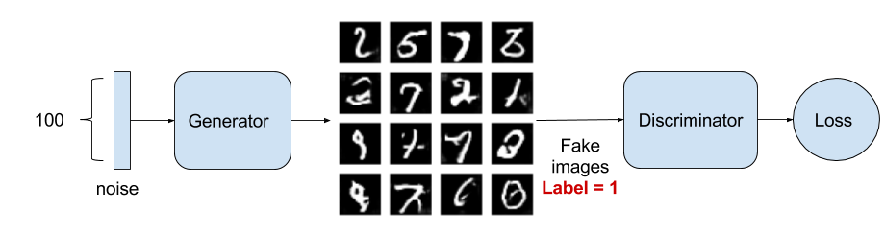
Adversarial Model
Figure 3. The Adversarial model is simply generator with its output connected to the input of the discriminator. Also shown is the training process wherein the Generator labels its fake image output with 1.0 trying to fool the Discriminator.

Slide 17
Listing 4. Adversarial Model as shown in Figure 3 implemented in Keras.
optimizer = RMSprop(lr=0.0004, clipvalue=1.0, decay=3e-8)
self.AM = Sequential()
self.AM.add(self.generator())
self.AM.add(self.discriminator())
self.AM.compile(loss='binary_crossentropy', optimizer=optimizer,\
metrics=['accuracy'])
#Listing 4. Adversarial Model as shown in Figure 3 implemented in Keras.

Slide 18
Figure 4. Discriminator model is trained to distinguish real from fake handwritten images.

Slide 19
Training
images_train = self.x_train[np.random.randint(0,
self.x_train.shape[0], size=batch_size), :, :, :]
noise = np.random.uniform(-1.0, 1.0, size=[batch_size, 100])
images_fake = self.generator.predict(noise)
x = np.concatenate((images_train, images_fake))
y = np.ones([2*batch_size, 1])
y[batch_size:, :] = 0
d_loss = self.discriminator.train_on_batch(x, y)
y = np.ones([batch_size, 1])
noise = np.random.uniform(-1.0, 1.0, size=[batch_size, 100])
a_loss = self.adversarial.train_on_batch(noise, y)
#Listing 5. Sequential training of Discriminator Model and Adversarial Model. Training steps above 1000 generates respectable outputs.

Slide 20
Training GAN models requires a lot of patience due to its depth. Here are some pointers:
Problem: generated images look like noise. Solution: use dropout on both Discriminator and Generator. Low dropout values (0.3 to 0.6) generate more realistic images.
Problem: Discriminator loss converges rapidly to zero thus preventing the Generator from learning. Solution: Do not pre-train the Discriminator. Instead make its learning rate bigger than the Adversarial model learning rate. Use a different training noise sample for the Generator.
Problem: generator images still look like noise. Solution: check if the activation, batch normalization and dropout are applied in the correct sequence.
Problem: figuring out the correct training/model parameters. Solution: start with some known working values from published papers and codes and adjust one parameter at a time. Before training for 2000 or more steps, observe the effect of parameter value adjustment at about 500 or 1000 steps.

Slide 21
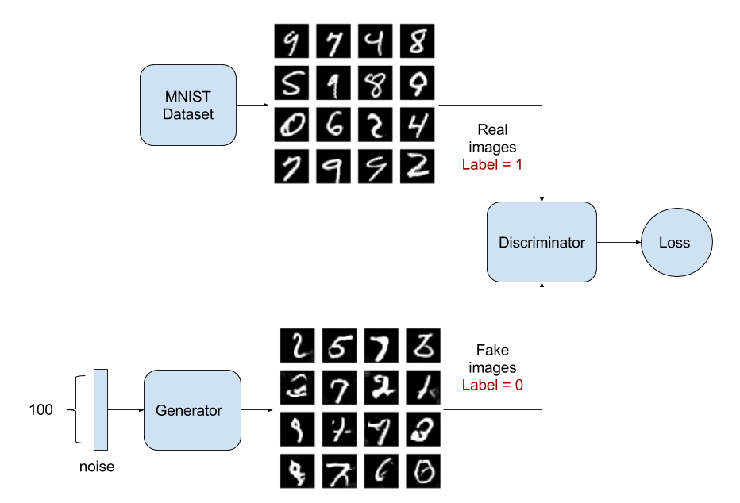
Training

Slide 22
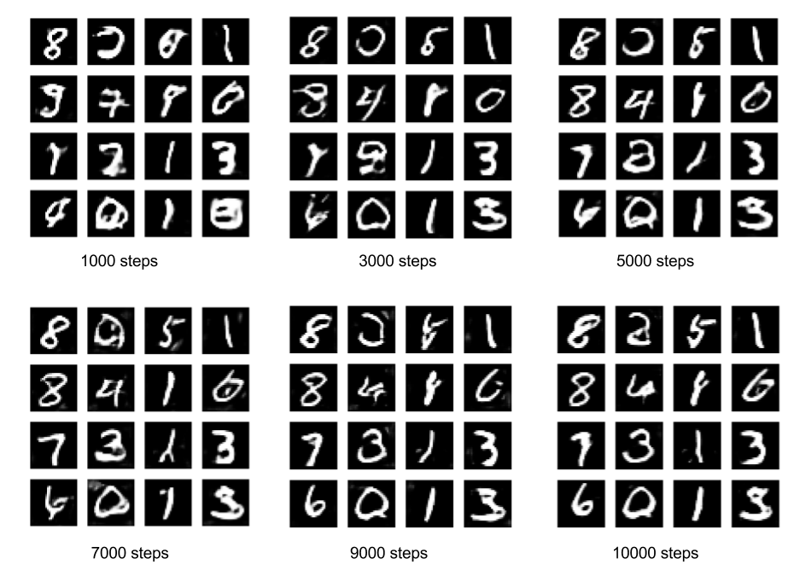
Sample Outputs
The GAN is learning how to write handwritten digits on its own!

Slide 23
Reference
https://github.com/roatienza/Deep-Learning-Experiments/blob/master/Experiments/Tensorflow/GAN/dcgan_mnist.py

Slide 24
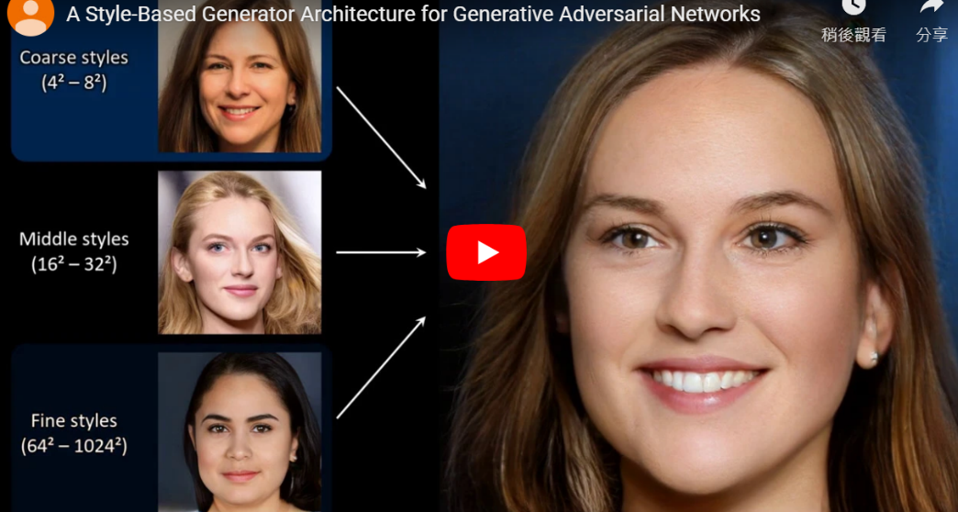
Example (ii) Generate faces
Generated (not real) faces
https://www.bleepingcomputer.com/news/technology/ai-powered-website-generates-realistic-human-faces-on-the-spot/

Slide 25
4) Case study
Edge detection using GAN

Slide 26
Generative adversarial networks (GANs) for edge detection
Z. Zeng Y.K. Yu, K.H. Wong
In
IEEE iciev2018, International Conference on Informatics, Electronics & Vision 'June,kitakyushu exhibition center, japan, 25~29, 2018. (http://cennser.org/ICIEV/scope-topics.html)

Slide 27
Overview
Introduction
Background
Theory
Experiment
Discussions / Future work
Conclusion

Slide 28
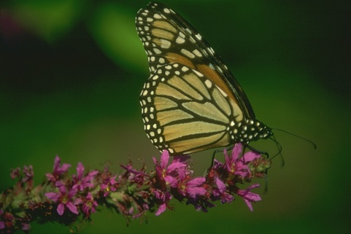
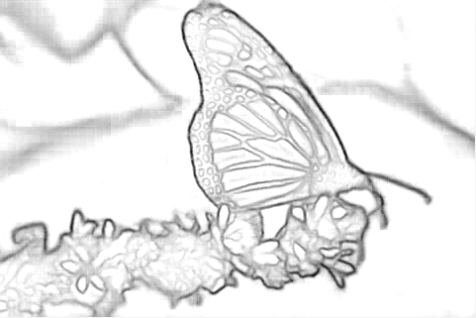
Introduction
What is edge detection?
Why edge detection?
What are the problems?
  Single pixel width requirement, non-maximum suppression
How to solve the problem: Machine learning approach
Our results.

Slide 29
Background of edge detection
Traditional methods
  Sobel, etc.
  Canny
Machine learning methods
  CNN methods
  RCF (state of the art)
  Generative adversarial networks (GANs)
  Conditional GAN (cGANs)
  cGAN with U-NET (=our approach, first team to apply cGAN for edge detection)
https://lmb.informatik.uni-freiburg.de/people/ronneber/u-net/

Slide 30
Theory of Generative adversarial networks (GAN)
GAN
Discriminator (D)
Generator(G)

Slide 31
Application of GAN
Generate data with the same distribution of training samples
Application :Enrich data sets, e.g. use some data in MINST dataset to train G, so G can generate more training samples.
Good for face datasets etc.
MINST dataset: http://yann.lecun.com/exdb/mnist/

Slide 32
The idea, from : Goodfellow, Ian, et al. "Generative adversarial nets." Advances in neural information processing systems. 2014. https://arxiv.org/abs/1406.2661
The proposed adversarial nets framework, the generative model is pitted against an adversary:
a discriminative model (D) that learns to determine whether a sample is from the model distribution or the data distribution. The generative model (G) can be thought of as analogous to a team of counterfeiters, trying to produce fake currency and use it without detection, while the discriminative model is analogous to the police, trying to detect the counterfeit currency. Competition in this game drives both teams to improve their methods until the counterfeits are indistinguishable from the genuine articles.

Slide 33
The concept of a generator G
Input noise z (with distribution p_{g}) to a generator G which can produce output data
Application example: You train G using many samples of handwritten character images (from MINST dataset), after training you input a noise z (with distribution p_{g} ), then G will give you an image of a handwritten character.
Usage: create more training data for machine leaning systems
Z (distribution p_{g}): a vector
G can generate data according to Z
Output is a picture of a hand written character
MINST dataset: http://yann.lecun.com/exdb/mnist/

Slide 34
GAN training procedure https://arxiv.org/abs/1406.2661
Step1
Training images with distribution p_{data}
The training Algorithm
x
Train parameters θ_{d} of discriminator D: CNN
First train D (discriminator)
  Send a new batch of training data to D, with label 1=‘real images’
  Can loop (1) many times , e.g. from 1 to 10 times.
Keep D and train G (generator)
  sending noise to G so that the output should be labeled as ‘0 =‘fake image’
  Can loop (2) many times , e.g. from 1 to 10 times.
Go to 1, until D output is 0.5
One scalar: Label=‘1’ when training
Train D to maximize the probability of assigning the correct label to training examples, (and samples from G, in step2)
Step2
Noise (z) with distribution P_{z}(a vector)
Train parameters θ_{g} of generator G: CNN
Image generated
Both D (parameters θ_{d} ) and G (parameters θ_{g} ) are CNN Convolution neural networks.
Keep D: CNN
One scalar: Label=‘0’ when training
Train G to minimize log(1-D(G(z))

Slide 35
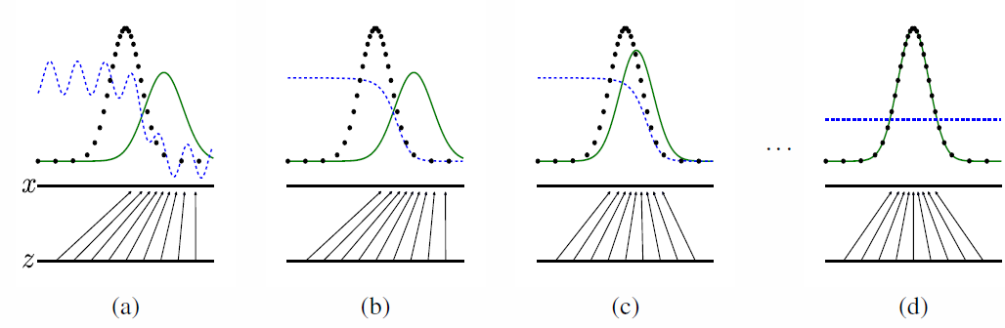
The idea
Blue dashed error (D)
Green solid Pg (move closer to Px)
Black dotted P_{x=data} (from x true data)
Blue dashed (D)=1/2
Green solid Pg (G generated fake)
x=real samples
z=noise with a known distribution (uniform this this case)
Figure 1: Generative adversarial nets are trained by simultaneously updating the discriminative distribution (D, blue, dashed line) so that it discriminates between samples from the data generating distribution (black, dotted line) Px from those of the generative distribution Pg (G) (green, solid line). The lower horizontal line is the domain from which z is sampled, in this case uniformly. The horizontal line above is part of the domain of x. The upward arrows show how the mapping x = G(z) imposes the non-uniform distribution Pg on transformed samples. G contracts in regions of high density and expands in regions of low density of Pg. (a) Consider an adversarial pair near convergence: Pg is similar to pdata and D is a partially accurate classifier. (b) In the inner loop of the algorithm D is trained to discriminate samples from data, converging to D(x) = pdata(x) pdata(x)+pg(x) . (c) After an update to G, gradient of D has guided G(z) to flow to regions that are more likely to be classified as data. (d) After several steps of training, if G and D have enough capacity, they will reach a point at which both cannot improve because pg = pdata. The discriminator is unable to differentiate between the two distributions, i.e. D(x) = 1/2 .

Slide 36
cGAN (conditional GAN )
GAN is difficult to train when the search space is too large. Use cGAN

Slide 37
Theory of conditional GAN (cGAN)
GAN is difficult to train because the search space is too large.
Add condition (prior y) to GAN
Compare formulas
  GAN
  cGAN
https://arxiv.org/pdf/1411.1784.pdf Conditional Generative Adversarial Nets by Mehdi Mirza

Slide 38
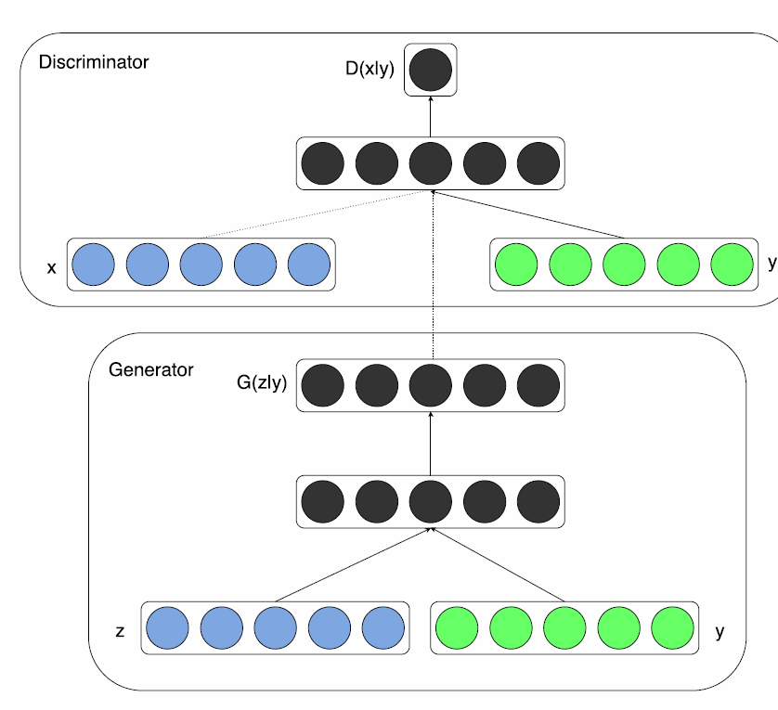
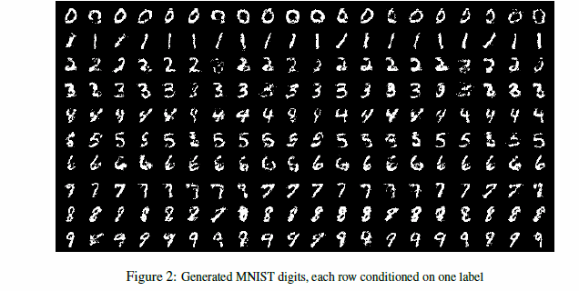
Theory of conditional GAN (cGAN)
GAN is difficult to train because the search space is too large.
Add condition (prior y, usually a label) to GAN
D(x|y)
Conditions added: so can generate different testing sets
Condition y
0
1
2
3
4
5
6
7
8
9
G(z|y)
https://arxiv.org/pdf/1411.1784.pdf Conditional Generative Adversarial Nets by Mehdi Mirza

Slide 39
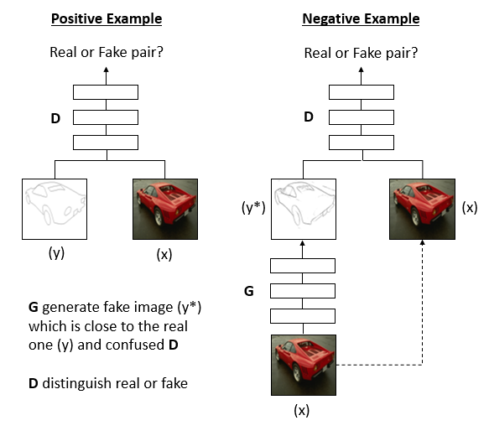

Our approach: Theory of conditional Generative adversarial networks(cGAN)
Real example
Fake example
x=real image sample
Y=real edge of x
y*=false (generated) edge
To optimize
Real = label ‘1’
Fake = label ‘0’
Fake
Real edges
Real image
Real image

Slide 40
Our implementation procedures
The training data set has 1440 batches
1 batch has 20 edge-image pairs.
Each image =256x256x3 integers(color) edge image =256x256x1 binary
G (CNN 3x3 kernel network):
  Input:256x256x3 integers
  Output 256x256x1 binary (real or fake)
  G has 5 stages
    Stage 1: 2 layers →(256x256xdim)
    Stage 2: 2 layers→(128x128xdim)
    Stage 3: 3 layers
    Stage 4: 3 layers
    Stage 5: 3 layers
    Plus 2 predict layer
D (CNN network):
  Input:256x256x4 (image + edge) concatenation
  Output: 1 binary (represents real or fake)
  same as VGG:16 layers
Training procedures
  Step1: Get a new batch of 20 Paris (real + edge)
  Step2: Positive example side: feed 1 batch to train D with target output label real (1)
  Step1: Negative example side: Keep D, train G with target output label fake (0)
  Repeat Step1,2,3 until output on Negative example side of D is 0.5. That means D cannot tell if the generated edge image is rea l or fake
  Usually 9000 iterations will get D produce 0.5 to complete the training
Real example
Fake example
Real = label ‘1’
Fake = label ‘0’
Fake
256x256x1 binary
256x256x1 binary
Real edges
Real image
256x256x3 integer
Real image
40

Slide 41
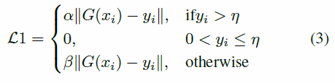
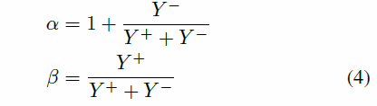
Positive/negative sample balancing problem
Real example
Fake example
Real = label ‘1’
Fake = label ‘0’
Fake
Real edges
Real image
Real image
41

Slide 42
Overall objective function
Real example
Fake example
Real = label ‘1’
Fake = label ‘0’
Fake
Real edges
Real image
Real image
42
42

Slide 43
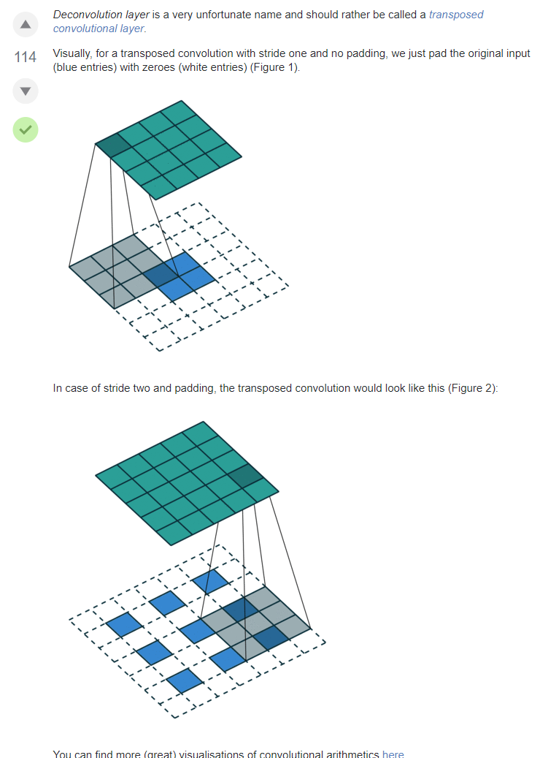
De-Convolution layer https://datascience.stackexchange.com/questions/6107/what-are-deconvolutional-layers

Slide 44
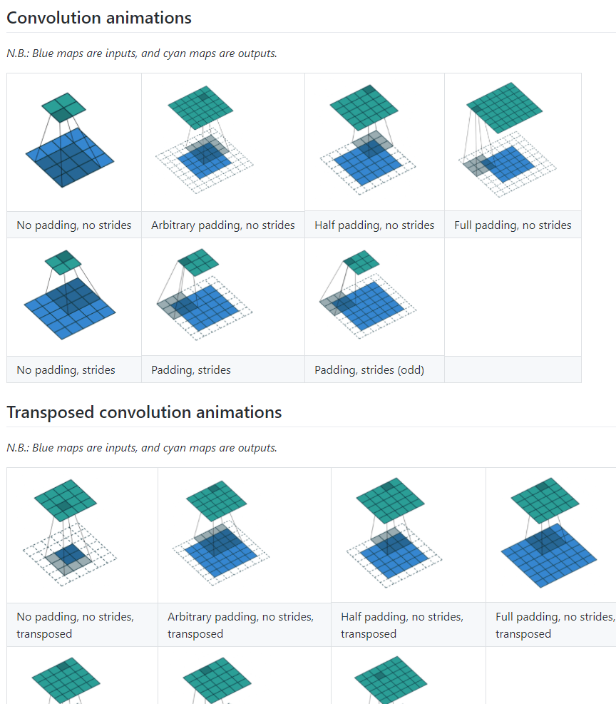
More de-convolution demo https://github.com/vdumoulin/conv_arithmetic
Convolution:
No padding
No strides
Input=4x4 image
Kernel=3x3
Output =2x2
De-convolution:
No padding
No strides
Input=2x2 image
Kernel=3x3
Output =4x4

Slide 45
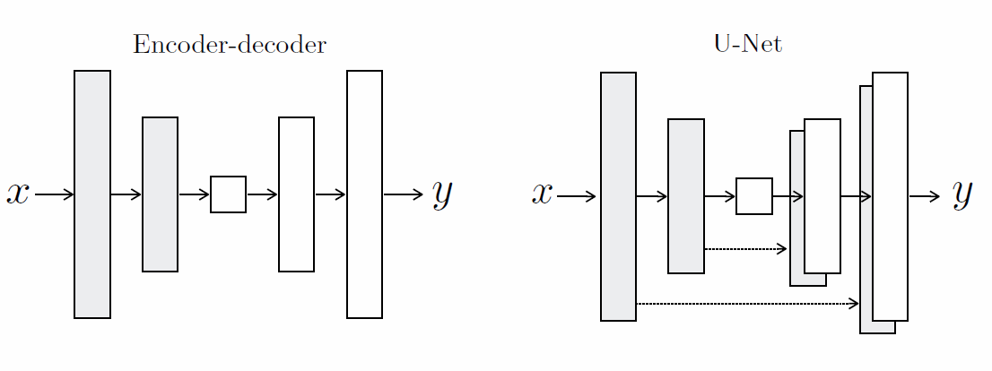
U-Net
From: Image-to-Image Translation with Conditional Adversarial Networks Phillip Isola Jun-Yan Zhu Tinghui Zhou Alexei A. Efros https://arxiv.org/pdf/1611.07004.pdf
Figure 3: Two choices for the architecture of the generator. The “U-Net” [49] is an encoder-decoder with skip connections between mirrored layers in the encoder and decoder stacks.
convolution
De-convolution (transpose convolution)

Slide 46
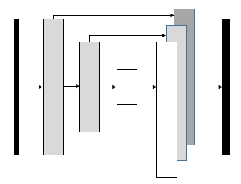
Modified U-net

Slide 47
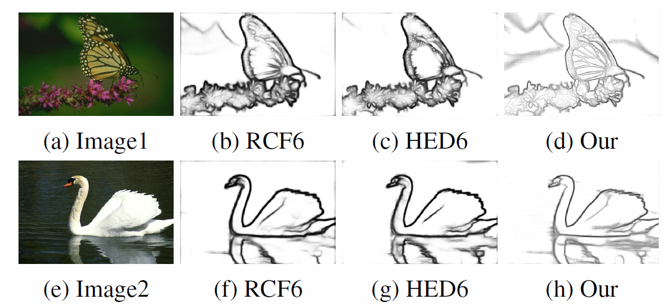
Result
Figure 1
Figure 1. We build a simple generator network based on UNET [25] to produce the edge map. Since RCF [23] and HED [28] contains multiple output, we only compare the final output of both network, which denote as RCF6 and HED6. We show two image examples here. One can clearly see that our result contains more detail information, and produce thinner edge even without apply the non-maximum suppression method.

Slide 48
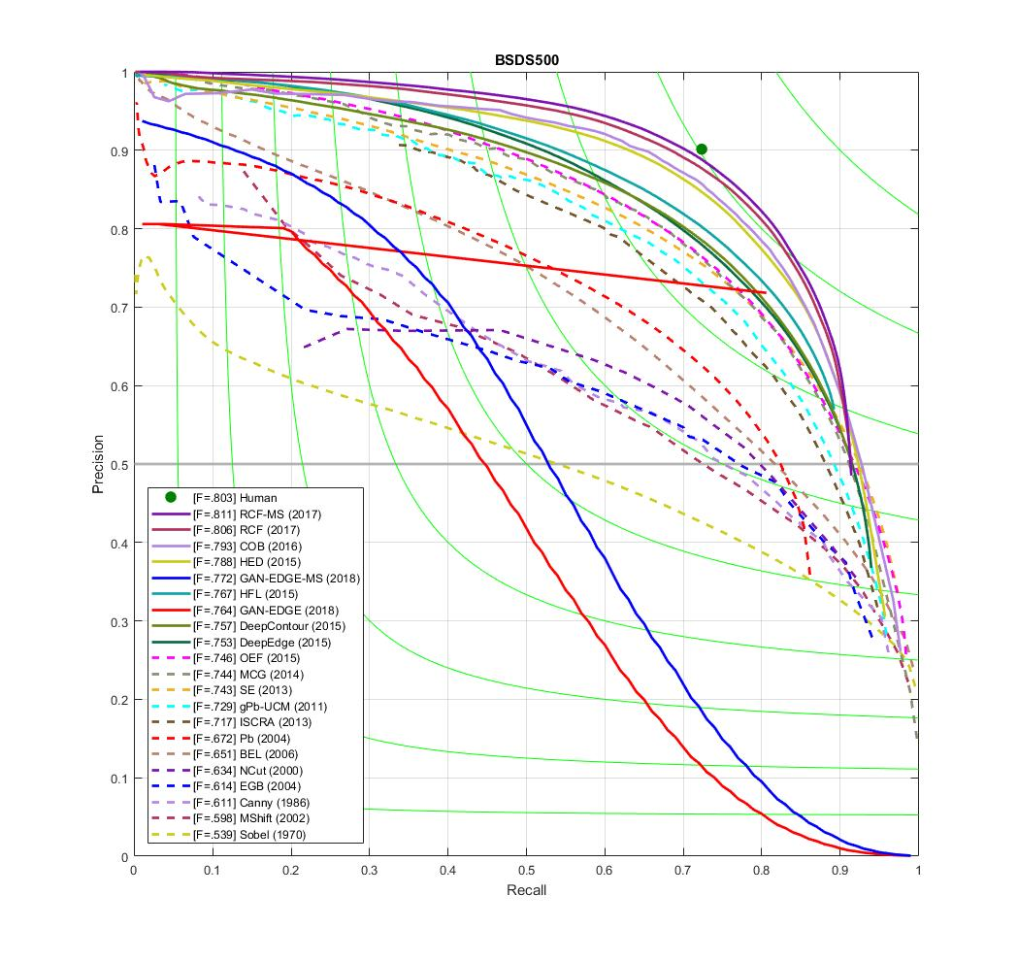
Result

Slide 49
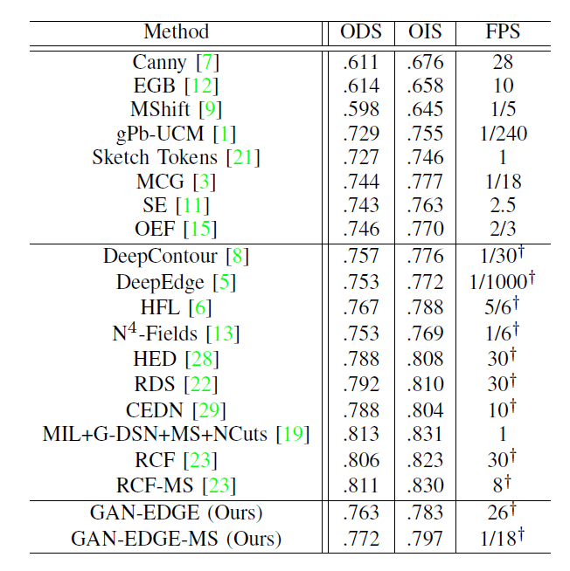
Results
To compare with other edge detection methods, we used the same evaluation metric to illustrate our edge detection results.
Normally, a threshold is necessary to produce the final edge map when an edge probability map is given.
There are various methods to determine the threshold, out of which two well-known evaluation metrics can be used. The first one is called the optimal dataset scale (ODS), which applies a fixed threshold for all edge probability maps. The second one is known as the optimal image scale (OIS), which tries to apply different thresholds to the images and then selects the optimal one from the trial values. For both ODS and OIS, we used Fmeasure to compare the algorithm performances. The formula
can be expressed as ( 2PrecisionRecall
Precision+Recall ).
Ours

Slide 50
Discussions/ Future work

Slide 51
Conclusions
we have devised an innovative edge detection algorithm based on generative adversarial network.
Our approach achieved ODS and OIS scores on natural images that are comparable to the state-of-the-art methods. Our model is computation efficient.
It took 0.016 seconds to compute the edges from an image having a resolution of 224X224X3 with GPU. For a 512X512X image, it took 0.038 seconds. Our algorithm is devised based on the UNET and the conditional generative adversarial neural network (cGAN) architecture.
It is different from the convolutional networks in a way that cGAN can produce an image which is close to the real one.
Therefore, the edges resulting from the cGAN generator is much thinner compared to that from the existing convolutional networks.
Even without using any pre-trained network parameters, the proposed method is still able to produce high quality edge images.

Slide 52
Demo, colab gan
https://colab.research.google.com/github/tomsercu/gan-tutorial-pytorch/blob/master/2019-04-23%20GAN%20Tutorial.ipynb#scrollTo=bipeNVLGmr9U
#working but need to fix that , see below
#xbatch, _ = iter(dataloader).next() # 64 x 1 x 28 x 28: minibatch of 64 samplesx
batch, _ = next(iter(dataloader)) # 64 x 1 x 28 x 28: minibatch of 64 samples

Slide 53
reference

