Slide 1
Tensorflow and Keras (draft)
KH Wong

Slide 2
Introduction
Why Tensor flow
Why Keras
How to install Tensorflow, Keras
How to use Keras

Slide 3
Keras usage
Models
: the Sequential model, and
: the Model class used with the functional API.
model.layers is a flattened list of the layers comprising the model.
model.inputs is the list of input tensors of the model.
model.outputs is the list of output tensors of the model.
model.summary() prints a summary representation of your model. Shortcut for utils.print_summary
model.get_config() returns a dictionary containing the configuration of the model. The model can be reinstantiated from its config via:

Slide 4
Important
If you use new tensorflow (from june2019, Keras is inside tensorflow)
keras→ tensorflow.keras
I.e.
from keras.layers import Activation, Dense, Input
#Should be replaced by
from tensorflow.keras.layers import Activation, Dense, Input
#E.g. typical use
import tensorflow.keras as keras
from tensorflow.keras.layers import Activation, Dense, Input
from tensorflow.keras.layers import Conv2D, Flatten
from tensorflow.keras.layers import Reshape, Conv2DTranspose
from tensorflow.keras.models import Model
from tensorflow.keras import backend as K
from tensorflow.keras.datasets import mnist

Slide 5
Sequential vs functional https://machinelearningmastery.com/keras-functional-api-deep-learning/
The sequential API allows you to create models layer-by-layer for most problems. It is limited in that it does not allow you to create models that share layers or have multiple inputs or outputs.
The functional API in Keras is an alternate way of creating models that offers a lot more flexibility, including creating more complex models.

Slide 6
Sequential model https://machinelearningmastery.com/keras-functional-api-deep-learning/
..the Sequential class is created and model layers are created and added to it.
from keras.models import Sequential
from keras.layers import Dense
model = Sequential([Dense(2, input_dim=1), Dense(1)])
Layers can also be added piecewise:
from keras.models import Sequential
from keras.layers import Dense
model = Sequential()
model.add(Dense(2, input_dim=1))
model.add(Dense(1))
Limitations: it is not straightforward to define models that may have multiple different input sources, produce multiple output destinations or models that re-use layers.

Slide 7
Keras Functional Models
Defining Input
from keras.layers import Input
visible = Input(shape=(2,))
Connecting Layers
from keras.layers import Input
from keras.layers import Dense
visible = Input(shape=(2,))
hidden = Dense(2)(visible)
Creating the Model
from keras.models import Model
from keras.layers import Input
from keras.layers import Dense
visible = Input(shape=(2,))
hidden = Dense(2)(visible)
model = Model(inputs=visible, outputs=hidden)

Slide 8
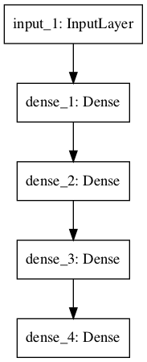
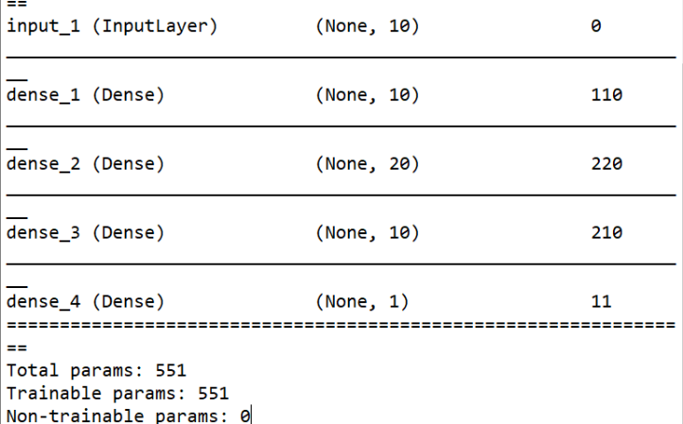
Standard Network Models
Multilayer Perceptron
# Multilayer Perceptron
from keras.utils import plot_model
from keras.models import Model
from keras.layers import Input
from keras.layers import Dense
visible = Input(shape=(10,))
hidden1 = Dense(10, activation='relu')(visible)
hidden2 = Dense(20, activation='relu')(hidden1)
hidden3 = Dense(10, activation='relu')(hidden2)
output = Dense(1, activation='sigmoid')(hidden3)
model = Model(inputs=visible, outputs=output)
# summarize layers
print(model.summary())
# plot graph
plot_model(model, to_file='multilayer_perceptron_graph.png')

Slide 9
Stand Multilayer Perceptron structure produced
_________________________________________________________________
Layer (type) Output Shape Param #
=================================================================
input_1 (InputLayer) (None, 10) 0
_________________________________________________________________
dense_1 (Dense) (None, 10) 110
_________________________________________________________________
dense_2 (Dense) (None, 20) 220
_________________________________________________________________
dense_3 (Dense) (None, 10) 210
_________________________________________________________________
dense_4 (Dense) (None, 1) 11
=================================================================
Total params: 551
Trainable params: 551
Non-trainable params: 0

Slide 10
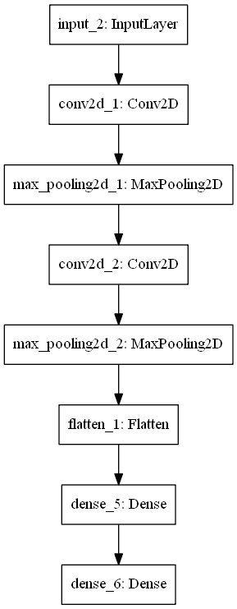
Convolutional Neural Network (CNN)
# Convolutional Neural Network
from keras.utils import plot_model
from keras.models import Model
from keras.layers import Input
from keras.layers import Dense
from keras.layers import Flatten
from keras.layers.convolutional import Conv2D
from keras.layers.pooling import MaxPooling2D
visible = Input(shape=(64,64,1))
conv1 = Conv2D(32, kernel_size=4, activation='relu')(visible)
pool1 = MaxPooling2D(pool_size=(2, 2))(conv1)
conv2 = Conv2D(16, kernel_size=4, activation='relu')(pool1)
pool2 = MaxPooling2D(pool_size=(2, 2))(conv2)
flat = Flatten()(pool2)
hidden1 = Dense(10, activation='relu')(flat)
output = Dense(1, activation='sigmoid')(hidden1)
model = Model(inputs=visible, outputs=output)
# summarize layers
print(model.summary())
# plot graph
plot_model(model, to_file='convolutional_neural_network.png')

Slide 11
The CNN network structure produced
_________________________________________________________________
Layer (type) Output Shape Param #
=================================================================
input_1 (InputLayer) (None, 64, 64, 1) 0
_________________________________________________________________
conv2d_1 (Conv2D) (None, 61, 61, 32) 544
_________________________________________________________________
max_pooling2d_1 (MaxPooling2 (None, 30, 30, 32) 0
_________________________________________________________________
conv2d_2 (Conv2D) (None, 27, 27, 16) 8208
_________________________________________________________________
max_pooling2d_2 (MaxPooling2 (None, 13, 13, 16) 0
_________________________________________________________________
flatten_1 (Flatten) (None, 2704) 0
_________________________________________________________________
dense_1 (Dense) (None, 10) 27050
_________________________________________________________________
dense_2 (Dense) (None, 1) 11
=================================================================
Total params: 35,813
Trainable params: 35,813
Non-trainable params: 0

Slide 12
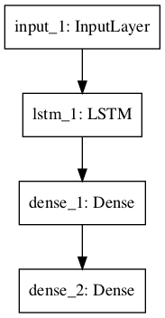
Recurrent Neural Network
# Recurrent Neural Network
from keras.utils import plot_model
from keras.models import Model
from keras.layers import Input
from keras.layers import Dense
from keras.layers.recurrent import LSTM
visible = Input(shape=(100,1))
hidden1 = LSTM(10)(visible)
hidden2 = Dense(10, activation='relu')(hidden1)
output = Dense(1, activation='sigmoid')(hidden2)
model = Model(inputs=visible, outputs=output)
# summarize layers
print(model.summary())
# plot graph
plot_model(model, to_file='recurrent_neural_network.png')

Slide 13
RNN network produced
_________________________________________________________________
Layer (type) Output Shape Param #
=================================================================
input_1 (InputLayer) (None, 100, 1) 0
_________________________________________________________________
lstm_1 (LSTM) (None, 10) 480
_________________________________________________________________
dense_1 (Dense) (None, 10) 110
_________________________________________________________________
dense_2 (Dense) (None, 1) 11
=================================================================
Total params: 601
Trainable params: 601
Non-trainable params: 0
_________________________________________________________________

Slide 14
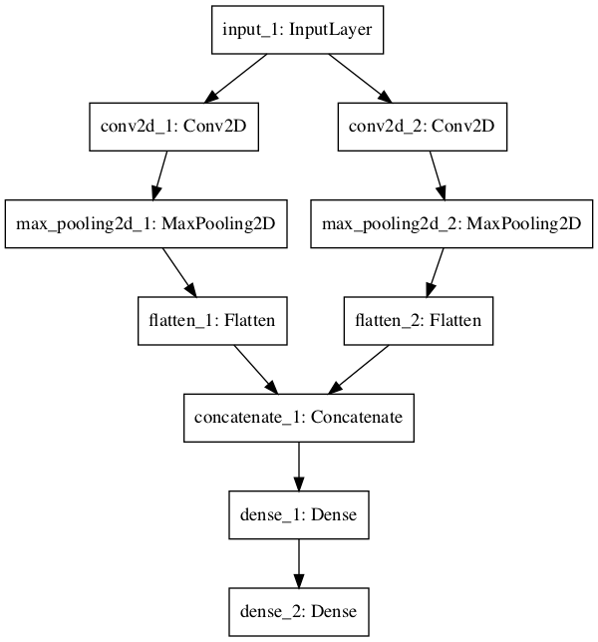
Shared Layers Model
# Shared Input Layer
from keras.utils import plot_model
from keras.models import Model
from keras.layers import Input
from keras.layers import Dense
from keras.layers import Flatten
from keras.layers.convolutional import Conv2D
from keras.layers.pooling import MaxPooling2D
from keras.layers.merge import concatenate
# input layer
visible = Input(shape=(64,64,1))
# first feature extractor
conv1 = Conv2D(32, kernel_size=4, activation='relu')(visible)
pool1 = MaxPooling2D(pool_size=(2, 2))(conv1)
flat1 = Flatten()(pool1)
# second feature extractor
conv2 = Conv2D(16, kernel_size=8, activation='relu')(visible)
pool2 = MaxPooling2D(pool_size=(2, 2))(conv2)
flat2 = Flatten()(pool2)
# merge feature extractors
merge = concatenate([flat1, flat2])
# interpretation layer
hidden1 = Dense(10, activation='relu')(merge)
# prediction output
output = Dense(1, activation='sigmoid')(hidden1)
model = Model(inputs=visible, outputs=output)
# summarize layers
print(model.summary())
# plot graph
plot_model(model, to_file='shared_input_layer.png')

Slide 15
Shared Input Layer structure
____________________________________________________________________________________________________
Layer (type) Output Shape Param # Connected to
====================================================================================================
input_1 (InputLayer) (None, 64, 64, 1) 0
____________________________________________________________________________________________________
conv2d_1 (Conv2D) (None, 61, 61, 32) 544 input_1[0][0]
____________________________________________________________________________________________________
conv2d_2 (Conv2D) (None, 57, 57, 16) 1040 input_1[0][0]
____________________________________________________________________________________________________
max_pooling2d_1 (MaxPooling2D) (None, 30, 30, 32) 0 conv2d_1[0][0]
____________________________________________________________________________________________________
max_pooling2d_2 (MaxPooling2D) (None, 28, 28, 16) 0 conv2d_2[0][0]
____________________________________________________________________________________________________
flatten_1 (Flatten) (None, 28800) 0 max_pooling2d_1[0][0]
____________________________________________________________________________________________________
flatten_2 (Flatten) (None, 12544) 0 max_pooling2d_2[0][0]
____________________________________________________________________________________________________
concatenate_1 (Concatenate) (None, 41344) 0 flatten_1[0][0]
flatten_2[0][0]
____________________________________________________________________________________________________
dense_1 (Dense) (None, 10) 413450 concatenate_1[0][0]
____________________________________________________________________________________________________
dense_2 (Dense) (None, 1) 11 dense_1[0][0]
====================================================================================================
Total params: 415,045
Trainable params: 415,045
Non-trainable params: 0

Slide 16
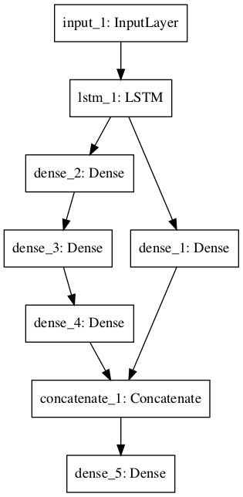
Shared Feature Extraction Layer
# Shared Feature Extraction Layer
from keras.utils import plot_model
from keras.models import Model
from keras.layers import Input
from keras.layers import Dense
from keras.layers.recurrent import LSTM
from keras.layers.merge import concatenate
# define input
visible = Input(shape=(100,1))
# feature extraction
extract1 = LSTM(10)(visible)
# first interpretation model
interp1 = Dense(10, activation='relu')(extract1)
# second interpretation model
interp11 = Dense(10, activation='relu')(extract1)
interp12 = Dense(20, activation='relu')(interp11)
interp13 = Dense(10, activation='relu')(interp12)
# merge interpretation
merge = concatenate([interp1, interp13])
# output
output = Dense(1, activation='sigmoid')(merge)
model = Model(inputs=visible, outputs=output)
# summarize layers
print(model.summary())
# plot graph
plot_model(model, to_file='shared_feature_extractor.png')

Slide 17
Shared Feature Extraction Layer structure
____________________________________________________________________________________________________
Layer (type) Output Shape Param # Connected to
===================================================================================
input_1 (InputLayer) (None, 100, 1) 0
____________________________________________________________________________________________________
lstm_1 (LSTM) (None, 10) 480 input_1[0][0]
____________________________________________________________________________________________________
dense_2 (Dense) (None, 10) 110 lstm_1[0][0]
____________________________________________________________________________________________________
dense_3 (Dense) (None, 20) 220 dense_2[0][0]
____________________________________________________________________________________________________
dense_1 (Dense) (None, 10) 110 lstm_1[0][0]
____________________________________________________________________________________________________
dense_4 (Dense) (None, 10) 210 dense_3[0][0]
____________________________________________________________________________________________________
concatenate_1 (Concatenate) (None, 20) 0 dense_1[0][0]
dense_4[0][0]
____________________________________________________________________________________________________
dense_5 (Dense) (None, 1) 21 concatenate_1[0][0]
====================================================================================================
Total params: 1,151
Trainable params: 1,151
Non-trainable params: 0
____________________________________________________________________________________________________

Slide 18
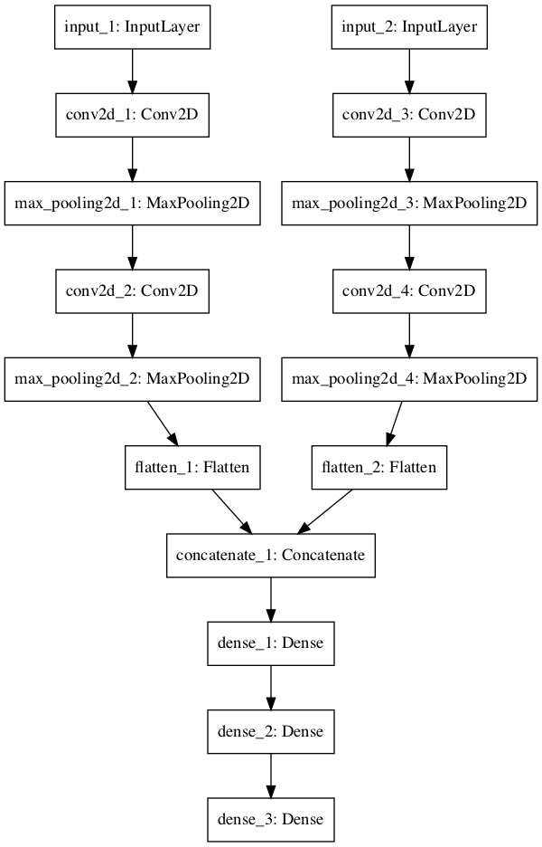
Multiple Input and Output Models
model = Model(inputs=[visible1, visible2], outputs=output)
# Multiple Inputs
from keras.utils import plot_model
from keras.models import Model
from keras.layers import Input
from keras.layers import Dense
from keras.layers import Flatten
from keras.layers.convolutional import Conv2D
from keras.layers.pooling import MaxPooling2D
from keras.layers.merge import concatenate
# first input model
visible1 = Input(shape=(64,64,1))
conv11 = Conv2D(32, kernel_size=4, activation='relu')(visible1)
pool11 = MaxPooling2D(pool_size=(2, 2))(conv11)
conv12 = Conv2D(16, kernel_size=4, activation='relu')(pool11)
pool12 = MaxPooling2D(pool_size=(2, 2))(conv12)
flat1 = Flatten()(pool12)
# second input model
visible2 = Input(shape=(32,32,3))
conv21 = Conv2D(32, kernel_size=4, activation='relu')(visible2)
pool21 = MaxPooling2D(pool_size=(2, 2))(conv21)
conv22 = Conv2D(16, kernel_size=4, activation='relu')(pool21)
pool22 = MaxPooling2D(pool_size=(2, 2))(conv22)
flat2 = Flatten()(pool22)
# merge input models
merge = concatenate([flat1, flat2])
# interpretation model
hidden1 = Dense(10, activation='relu')(merge)
hidden2 = Dense(10, activation='relu')(hidden1)
output = Dense(1, activation='sigmoid')(hidden2)
model = Model(inputs=[visible1, visible2], outputs=output)
# summarize layers
print(model.summary())
# plot graph
plot_model(model, to_file='multiple_inputs.png')

Slide 19
Multiple Input and Output Models structure
____________________________________________________________________________________________________
Layer (type) Output Shape Param # Connected to
====================================================================================================
input_1 (InputLayer) (None, 64, 64, 1) 0
____________________________________________________________________________________________________
input_2 (InputLayer) (None, 32, 32, 3) 0
____________________________________________________________________________________________________
conv2d_1 (Conv2D) (None, 61, 61, 32) 544 input_1[0][0]
____________________________________________________________________________________________________
conv2d_3 (Conv2D) (None, 29, 29, 32) 1568 input_2[0][0]
____________________________________________________________________________________________________
max_pooling2d_1 (MaxPooling2D) (None, 30, 30, 32) 0 conv2d_1[0][0]
____________________________________________________________________________________________________
max_pooling2d_3 (MaxPooling2D) (None, 14, 14, 32) 0 conv2d_3[0][0]
____________________________________________________________________________________________________
conv2d_2 (Conv2D) (None, 27, 27, 16) 8208 max_pooling2d_1[0][0]
____________________________________________________________________________________________________
conv2d_4 (Conv2D) (None, 11, 11, 16) 8208 max_pooling2d_3[0][0]
____________________________________________________________________________________________________
max_pooling2d_2 (MaxPooling2D) (None, 13, 13, 16) 0 conv2d_2[0][0]
____________________________________________________________________________________________________
max_pooling2d_4 (MaxPooling2D) (None, 5, 5, 16) 0 conv2d_4[0][0]
____________________________________________________________________________________________________
flatten_1 (Flatten) (None, 2704) 0 max_pooling2d_2[0][0]
____________________________________________________________________________________________________
flatten_2 (Flatten) (None, 400) 0 max_pooling2d_4[0][0]
____________________________________________________________________________________________________
concatenate_1 (Concatenate) (None, 3104) 0 flatten_1[0][0]
flatten_2[0][0]
____________________________________________________________________________________________________
dense_1 (Dense) (None, 10) 31050 concatenate_1[0][0]
____________________________________________________________________________________________________
dense_2 (Dense) (None, 10) 110 dense_1[0][0]
____________________________________________________________________________________________________
dense_3 (Dense) (None, 1) 11 dense_2[0][0]
====================================================================================================
Total params: 49,699
Trainable params: 49,699
Non-trainable params: 0
____________________________________________________________________________________________________

Slide 20
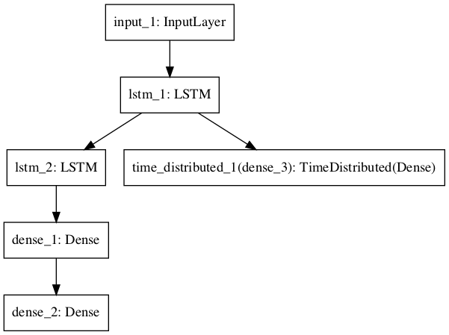
Multiple Output Model
# Multiple Outputs
from keras.utils import plot_model
from keras.models import Model
from keras.layers import Input
from keras.layers import Dense
from keras.layers.recurrent import LSTM
from keras.layers.wrappers import TimeDistributed
# input layer
visible = Input(shape=(100,1))
# feature extraction
extract = LSTM(10, return_sequences=True)(visible)
# classification output
class11 = LSTM(10)(extract)
class12 = Dense(10, activation='relu')(class11)
output1 = Dense(1, activation='sigmoid')(class12)
# sequence output
output2 = TimeDistributed(Dense(1, activation='linear'))(extract)
# output
model = Model(inputs=visible, outputs=[output1, output2])
# summarize layers
print(model.summary())
# plot graph
plot_model(model, to_file='multiple_outputs.png')

Slide 21
Multiple Output Model structure
____________________________________________________________________________________________________
Layer (type) Output Shape Param # Connected to
====================================================================================================
input_1 (InputLayer) (None, 100, 1) 0
____________________________________________________________________________________________________
lstm_1 (LSTM) (None, 100, 10) 480 input_1[0][0]
____________________________________________________________________________________________________
lstm_2 (LSTM) (None, 10) 840 lstm_1[0][0]
____________________________________________________________________________________________________
dense_1 (Dense) (None, 10) 110 lstm_2[0][0]
____________________________________________________________________________________________________
dense_2 (Dense) (None, 1) 11 dense_1[0][0]
____________________________________________________________________________________________________
time_distributed_1 (TimeDistribu (None, 100, 1) 11 lstm_1[0][0]
====================================================================================================
Total params: 1,452
Trainable params: 1,452
Non-trainable params: 0
____________________________________________________________________________________________________

Slide 22
Best Practices
Consistent Variable Names. Use the same variable name for the input (visible) and output layers (output) and perhaps even the hidden layers (hidden1, hidden2). It will help to connect things together correctly.
Review Layer Summary. Always print the model summary and review the layer outputs to ensure that the model was connected together as you expected.
Review Graph Plots. Always create a plot of the model graph and review it to ensure that everything was put together as you intended.
Name the layers. You can assign names to layers that are used when reviewing summaries and plots of the model graph. For example: Dense(1, name=’hidden1′).
Separate Submodels. Consider separating out the development of submodels and combine the submodels together at the end.

Slide 23
Example https://machinelearningmastery.com/tutorial-first-neural-network-python-keras/
# Create your first MLP in Keras
from keras.models import Sequential
from keras.layers import Dense
import numpy
# fix random seed for reproducibility
numpy.random.seed(7)
# load pima indians dataset
dataset = numpy.loadtxt("c:\\data\\pima-indians-diabetes.csv", delimiter=",")
# split into input (X) and output (Y) variables
X = dataset[:,0:8]
Y = dataset[:,8]
# create model
model = Sequential()
model.add(Dense(12, input_dim=8, activation='relu'))
model.add(Dense(8, activation='relu'))
model.add(Dense(8, activation='relu'))
model.add(Dense(1, activation='sigmoid'))
# Compile model
model.compile(loss='binary_crossentropy', optimizer='adam', metrics=['accuracy'])
# Fit the model
model.fit(X, Y, epochs=150, batch_size=10)
# evaluate the model
scores = model.evaluate(X, Y)
print("\n%s: %.2f%%" % (model.metrics_names[1], scores[1]*100))

Slide 24
References
https://machinelearningmastery.com/tutorial-first-neural-network-python-keras/
https://keras.io/models/about-keras-models/

