Slide 1
Ch15. Expectation Maximization for Gaussian mixture
KH Wong

Slide 2
Overview
Introduction,
Problem definition
Basic Theory: (i) Probability, likelihood and log-likelihood functions, (ii) Gaussian mixture
EM algorithm and example
Further theory
Summary

Slide 3
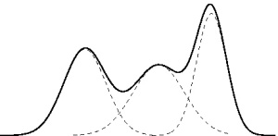
Problem definition
You only have the overall envelop measurement
Find latent (hidden) variables: standard deviations (σ_{1,2,3}) and means (µ_{1,2,3}) of the three Gaussian distributions.
The envelope is the measurement of the Gaussian mixture
The overall probability is a combination of three unknown Gaussian distributions
σ_{1,2,3},µ_{1,2,3}
One of the Gaussian distribution functions : standard deviation (σ₂) and mean (µ₂)
https://prateekvjoshi.com/2013/06/29/gaussian-mixture-models/

Slide 4
Basic theory
of EM

Slide 5
Theory –part (i) Probability, likelihood and log-likelihood functions of a single Gaussian function
https://www.statlect.com/fundamentals-of-statistics/normal-distribution-maximum-likelihood

Slide 6
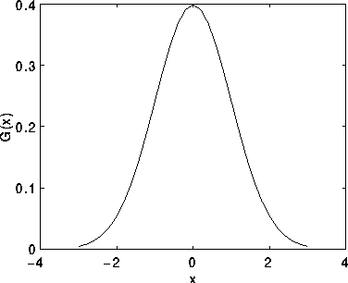
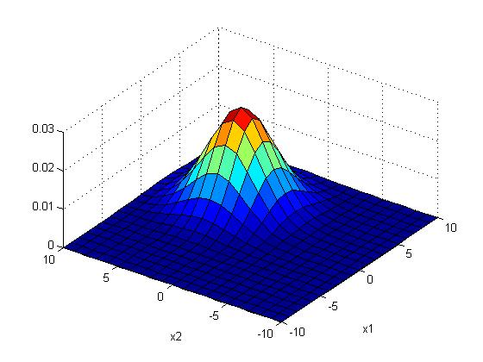
Gaussian distribution
%2-D Gaussian distribution P(x_{j})
%matlab code----------
clear, N=10
[X1,X2]=meshgrid(-N:N,-N:N);
sigma =2.5;mean=[3 3]'
G=1/(2*pi*sigma^2)*exp(-((X1-mean(1)).^2+(X2-mean(2)).^2)/(2*sigma^2));
G=G./sum(G(:)) %normalise it
'sigma is ', sigma
'sum(G(:)) is ',sum(G(:))
'max(max(G(:))) is',max(max(G(:)))
figure(1), clf
surf(X1,X2,G);
xlabel('x1'),ylabel('x2')

Slide 7
Worksheet 1 (Given : σ=2, (mean_x,mean_y)=(4,4))
x=m_{x}
y=m_{y}
x=1+m_{x}
y=m_{y}
Fill in the blanks of this Gaussian function of size 9x9 , sigma (σ)=2, (mean_x, mean_y)=(4,4)
Sketch the function
Position
(0,0)
G(x,y)=
0.0007 0.0017 0.0033 0.0048 0.0054 0.0048 0.0033 0.0017 0.0007
0.0017 0.0042 0.0078 0.0114 0.0129 0.0114 0.0078 0.0042 0.0017
0.0033 0.0078 0.0146 0.0213 0.0241 0.0213 0.0146 0.0078 0.0033
0.0048 0.0114 0.0213 0.0310 0.0351 0.0310 0.0213 0.0114 0.0048
0.0054 0.0129 0.0241 0.0351 ____? ____? 0.0241 0.0129 0.0054
0.0048 0.0114 0.0213 0.0310 0.0351 ____? 0.0213 0.0114 0.0048
0.0033 0.0078 0.0146 0.0213 0.0241 0.0213 0.0146 0.0078 0.0033
0.0017 0.0042 0.0078 0.0114 0.0129 0.0114 0.0078 0.0042 0.0017
0.0007 0.0017 0.0033 0.0048 0.0054 0.0048 0.0033 0.0017 0.0007

Slide 8
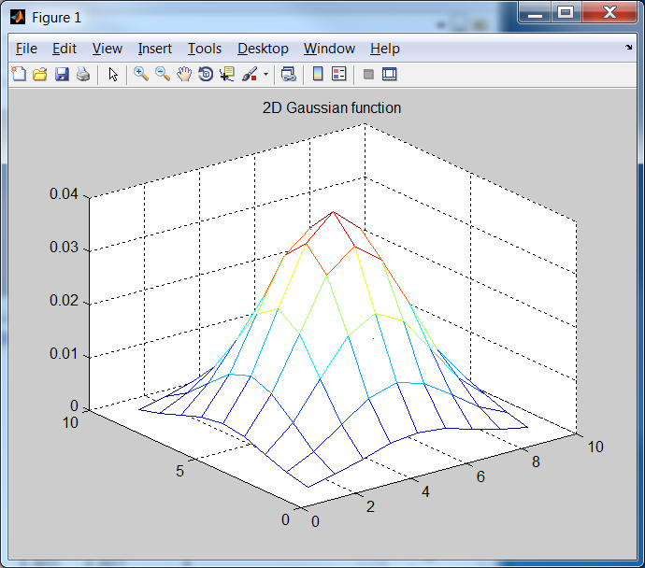
Answer1 (Given : σ=2, (mean_x,mean_y)=(4,4))
1/(2*pi*2^2)
1/(2*pi*2^2)*exp(-1/8)
Fill in the blanks of this Gaussian function of size 9x9 , sigma (σ)=2, (mean_x, mean_y)=(4,4)
Sketch the function
x=1+m_{x}
y=m_{y}
Position
(0,0)
x=m_{x}
y=m_{y}
1/(2*pi*2^2)*exp(-2/8)
0.0007 0.0017 0.0033 0.0048 0.0054 0.0048 0.0033 0.0017 0.0007
0.0017 0.0042 0.0078 0.0114 0.0129 0.0114 0.0078 0.0042 0.0017
0.0033 0.0078 0.0146 0.0213 0.0241 0.0213 0.0146 0.0078 0.0033
0.0048 0.0114 0.0213 0.0310 0.0351 0.0310 0.0213 0.0114 0.0048
0.0054 0.0129 0.0241 0.0351 0.0398 0.0351 0.0241 0.0129 0.0054
0.0048 0.0114 0.0213 0.0310 0.0351 0.0310 0.0213 0.0114 0.0048
0.0033 0.0078 0.0146 0.0213 0.0241 0.0213 0.0146 0.0078 0.0033
0.0017 0.0042 0.0078 0.0114 0.0129 0.0114 0.0078 0.0042 0.0017
0.0007 0.0017 0.0033 0.0048 0.0054 0.0048 0.0033 0.0017 0.0007
clear %matlab
sigma=2 % in matlab , no -ve index for looping, so shift center to (5,5)
mean_x=5 , mean_y=5
for y=1:9
for x=1:9
g(x,y)=(1/(2*pi*sigma^2))*exp(-((x-mean_x)^2+(y-mean_y)^2) /(2*sigma^2))
end
end
mesh(g)
title('2D Gaussian function')

Slide 9
Worksheet 2 (Given : σ=2, (mean_x,mean_y)=(4,4))
1/(2*pi*2^2)
1/(2*pi*2^2)*exp(-1/8)
x=m_{x}
y=m_{y}
x=1+m_{x}
y=m_{y}
Position
(0,0)
1/(2*pi*2^2)*exp(-2/8)
What is the peak probability value and (x,y) position of the peak?
0.0007 0.0017 0.0033 0.0048 0.0054 0.0048 0.0033 0.0017 0.0007
0.0017 0.0042 0.0078 0.0114 0.0129 0.0114 0.0078 0.0042 0.0017
0.0033 0.0078 0.0146 0.0213 0.0241 0.0213 0.0146 0.0078 0.0033
0.0048 0.0114 0.0213 0.0310 0.0351 0.0310 0.0213 0.0114 0.0048
0.0054 0.0129 0.0241 0.0351 0.0398 0.0351 0.0241 0.0129 0.0054
0.0048 0.0114 0.0213 0.0310 0.0351 0.0310 0.0213 0.0114 0.0048
0.0033 0.0078 0.0146 0.0213 0.0241 0.0213 0.0146 0.0078 0.0033
0.0017 0.0042 0.0078 0.0114 0.0129 0.0114 0.0078 0.0042 0.0017
0.0007 0.0017 0.0033 0.0048 0.0054 0.0048 0.0033 0.0017 0.0007
clear %matlab
sigma=2 % in matlab , no -ve index for looping, so shift center to (5,5)
mean_x=5 , mean_y=5
for y=1:9
for x=1:9
g(x,y)=(1/(2*pi*sigma^2))*exp(-((x-mean_x)^2+(y-mean_y)^2) /(2*sigma^2))
end
end
mesh(g)
title('2D Gaussian function')

Slide 10
Answer 2 (Given : σ=2, mean_x,mean_y=(4,4))
1/(2*pi*2^2)
1/(2*pi*2^2)*exp(-1/8)
What is the peak probability value and (x,y) position of the peak? Answer: peak probability value= 0.0398 at (x,y)=(4,4)
x=m_{x}
y=m_{y}
x=1+m_{x}
y=m_{y}
Position
(0,0)
1/(2*pi*2^2)*exp(-2/8)
0.0007 0.0017 0.0033 0.0048 0.0054 0.0048 0.0033 0.0017 0.0007
0.0017 0.0042 0.0078 0.0114 0.0129 0.0114 0.0078 0.0042 0.0017
0.0033 0.0078 0.0146 0.0213 0.0241 0.0213 0.0146 0.0078 0.0033
0.0048 0.0114 0.0213 0.0310 0.0351 0.0310 0.0213 0.0114 0.0048
0.0054 0.0129 0.0241 0.0351 0.0398 0.0351 0.0241 0.0129 0.0054
0.0048 0.0114 0.0213 0.0310 0.0351 0.0310 0.0213 0.0114 0.0048
0.0033 0.0078 0.0146 0.0213 0.0241 0.0213 0.0146 0.0078 0.0033
0.0017 0.0042 0.0078 0.0114 0.0129 0.0114 0.0078 0.0042 0.0017
0.0007 0.0017 0.0033 0.0048 0.0054 0.0048 0.0033 0.0017 0.0007
clear %matlab
sigma=2 % in matlab , no -ve index for looping, so shift center to (5,5)
mean_x=5 , mean_y=5
for y=1:9
for x=1:9
g(x,y)=(1/(2*pi*sigma^2))*exp(-((x-mean_x)^2+(y-mean_y)^2) /(2*sigma^2))
end
end
mesh(g)
title('2D Gaussian function')

Slide 11
Theory –part (ii) Gaussian mixture function (not single Gaussian)
https://www.statlect.com/fundamentals-of-statistics/normal-distribution-maximum-likelihood
http://melodi.ee.washington.edu/people/bilmes/mypapers/em.pdf
https://scikit-learn.org/stable/modules/mixture.html

Slide 12
A tutorial
See probibilty.pptx (http://www.cse.cuhk.edu.hk/~khwong/www2/cmsc5707/probability.pptx )
http://web.iitd.ac.in/~sumeet/GMM_said_crv10_tutorial.pdf

Slide 13
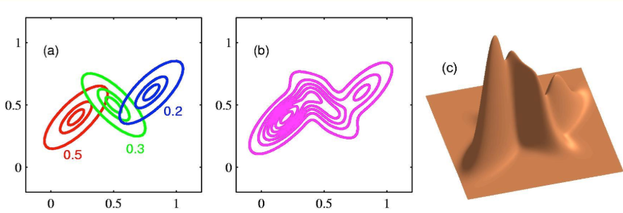
Gaussian mixture : The data is generated by 3 single Gaussian functions
For a Gaussian mixture of K single-Gaussians, the probability of x_{n} being generated by the k^{th} single Gaussian N( ) is a_{k}
For a latent data model problem, You may not know which single Gaussian generates that data x_{n}. But you can use the prob. a_{k} to describe the data
E.g. for k=1, a_{k=1} =Probability that x_{n} is by
this Single Gaussian (µ_{k=1},σ_{k=1}), etc
https://ermongroup.github.io/cs228-notes/learning/latent/
2-D Gaussian, K=3 example

Slide 14
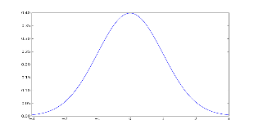
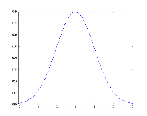
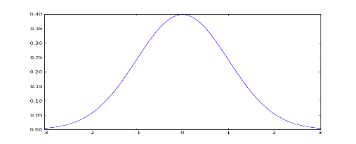
You may use Z_{k} (discrete variable) or a_{k} (continues variable) to describe the Gaussian mixture.
For each sample x_{n}
has an one-hot Z_{k}
k=1, a_{k=1} =Probability that x_{n} is by
this Single Gaussian (µ_{k=1},σ_{k=1})
Z_{k}∈ {1 or 0} is a one-hot variable telling which single Gaussian generates x_{n}
You may describe the same structure by using the probability a_{k} ,where 0≤ a_{k} ≤1.
a_{k} is the soft version of Z_{k} describing the same thing.
Z_{k=1}=0
Z_{k=2}=1
k=2, a_{k=2}
Z_{k=K}=0
k=K, a_{k=K}

Slide 15
Exercise 4
Two views: discrete view(Z_{n,k}), analog view (a_{k})
For each X_{n},
Table TAB1 for z_{n,k}
Show 2 samples x_{n=1},x_{n=2}
Z_{n=1,k=1} =?
k=1, a_{k=1}
TAB1 | k=1 | k=2 | k=3
n=1 | z_{1,1}=0 | z_{1,2}=0 | z_{1,3}=1
n=2 | z_{2,1}=1 | z_{2,2}=0 | z_{2,3}=0
n=3 | z_{3,1}=0 | z_{3,2}=1 | z_{3,3}=0
n=4 | z_{4,1}=0 | z_{4,2}=1 | z_{4,3}=0
n=5 | z_{5,1}=1 | z_{5,2}=0 | z_{5,3}=0
n=6 | z_{6,1}=0 | z_{6,2}=1 | z_{6,3}=0
n=7 | z_{7,1}=1 | z_{7,2}=0 | z_{7,3}=0
n=8 | z_{8,1}=0 | z_{8,2}=1 | z_{8,3}=0
n=9 | z_{9,1}=0 | z_{9,2}=0 | z_{9,3}=1
x_{n=1}
Z_{n=1},_{k=2} =?
Z_{n=1},_{k=3}=?
k=2, a_{k=2}
Z_{n=2,k=1}=?
For the whole data set
a_{k=1}=3/9
a_{k=2}=4/9
a_{k=3}=2/9
x_{n=2}
Z_{n=2,k=2}=??
Z_{n=2} ,_{k=3}=?
k=3, a_{k=3}
The set
Z_{k=1}
Z_{k=2}
Z_{k=3}

Slide 16
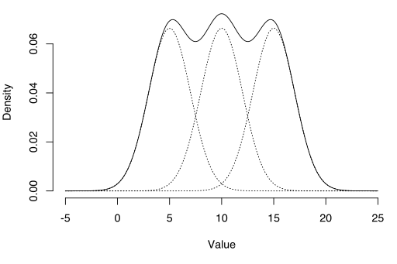
Why EM is used to find the latent Gaussian mixture model (GMM) ?
1-D Gaussian
https://ermongroup.github.io/cs228-notes/learning/latent/

Slide 17
The EM algorithm
We first describe the algorithm, and will derive the theory later

Slide 18
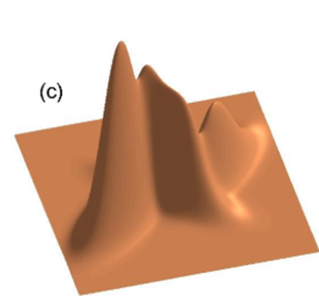
An overview of the EM algorithm
For example for a 3-Gaussian mixture problem. Given input data x, find
a_{K=1,2,3} , σ_{K=1,2,3} , µ_{K=1,2,3}
An initial guess of model parameters, e.g. a 3-Gaussian
a_{K=1,2,3} , σ_{K=1,2,3} , µ_{K=1,2,3}
E-step
M-step
Execute 2 through 4 repeated until parameters are stable

Slide 19
The EM algo. for K-mixture of Gaussians
=Conditional expectation
E-Step: For each x∈Dx∈D,
compute the posterior p(z∣x;θt)p(z∣x;θt).
The E-step (expectation): Compute Q(θ; θ (n) )
Will prove them later
http://www.cse.psu.edu/~rtc12/CSE586/lectures/EMLectureFeb3.pdf

Slide 20
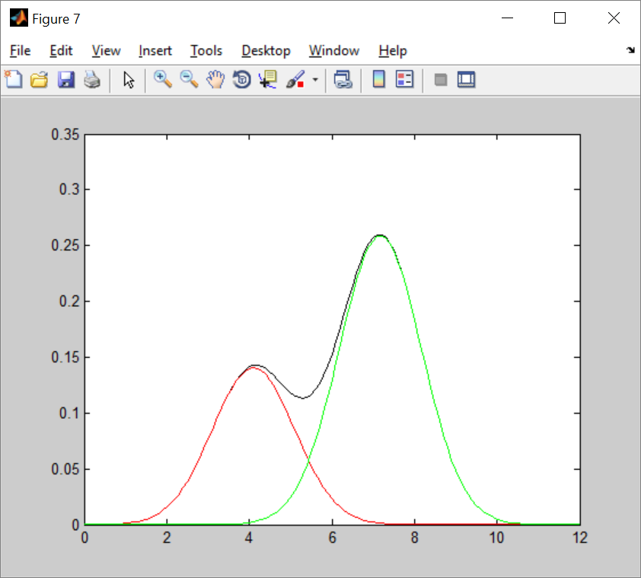
Exercise 5
Estimate means and variances

Slide 21
Example 1: Test code for 2-Gaussian mixture, em9a.m
function em() %em 1d test demo
%known problem, guess sig needs to be close to ground truth k=2
%clc clean window commands
clear
close all
clf
thresold=0.01
N_gt=1000; %total number of samples in total
%sig=[1/sqrt(2), 1/sqrt(2)]';
old_mean=[0 0 ]'
mean_gt=[4.5 7.8]' %ground truth
%mean=mean_gt+[ -1.25 1.25]'; %initial guess
mean=mean_gt+[ -2 2]'; %initial guess
sig_gt=[1 1]';%ground truth
%sig=sig_gt+[0.1 -0.1]';%initial guess
sig=sig_gt+[0.01 -0.01]';%initial guess
a_gt=[0.4 0.6]'; %sum must be 1
a=a_gt+[ 0.05 -0.05]';%initial guess
%Generate values from a normal distribution with mean 1 and standard deviation 2:
r1 = (mean_gt(1) + sig_gt(1)*randn(N_gt*a_gt(1),1)); %mean =1, sd =2
r2 = (mean_gt(2) + sig_gt(2)*randn(N_gt*a_gt(2),1));%mean =3, sd =2.5
x=[r1;r2];
max_x=max(x);
min_x=min(x);
figure(3)
clf
subplot(3,1,1);
hist([x;max_x;min_x],50,'FaceColor', 'r')%add max_x;min_x to align 3 plots
ylabel('x')
subplot(3,1,2);
hist([r1;max_x;min_x],50,'FaceColor', 'g')%add max_x;min_x to align 3 plots
ylabel('r1')
subplot(3,1,3);
hist([r2;max_x;min_x],50,'FaceColor', 'b')%add max_x;min_x to align 3 plots
ylabel('r2')
%x=[2,4,7 ]' %overwrite
N=length(x)
for t=1:10
%%%%%%%%%%% E-step %%%%%%%%%%%%%%%%%%%%%
for n=1:N %
for k=1:2
g(n,k)=gauss(x(n),sig(k),mean(k));
end
end
%%%%%%%%%%%%%%%%%%
for n=1:N %
for k=1:2
raw_w(k,n)=a(k)*g(n,k);
end
end
for n=1:N
denon(1,n)=raw_w(1,n)+raw_w(2,n);
denon(2,n)=raw_w(1,n)+raw_w(2,n);
end
%%%%%%%%%%%%%%%%%%%%%%%%%%%%%%%%%%
%normalize w
for n=1:N
for k=1:2
w(k,n)=raw_w(k,n)/denon(k,n);
end
end
%%%%%%%%%% M-step %%%%%%%%%%%%%%%%%%%%%%%%
for k=1:2 %find mean
mean(k)=0;
for n=1:N
mean(k)=mean(k)+w(k,n)*(x(n)) ;%new mean, max step
end
mean(k)=mean(k)/sum(w(k,:));
%%%%%%%%%%%%%%%%%%%%%%%%%%%%%%%%%
sig(k)=0;
for n=1:N
sig(k)=sig(k)+w(k,n)*(x(n)-mean(k))^2 ;%new mean, max step
end
sig(k)=sig(k)/sum(w(k,:));
a(k)=sum(w(k,:))/N;
end
dd=(old_mean-mean)'*(old_mean-mean)
old_mean=mean;
t
mean
sig
a
dd
'press key to continue'
pause
if dd<thresold
'quit, because dd is small enough'
dd
break;
end
end
%plot the Gaussian mixture %%%%%%%%%%
xx=[0:0.1:12];
%xx=x;
for n=1:length(xx)
temp=0;
for k=1:2
temp=temp+a(k)*gauss(xx(n),sig(k), mean(k));
end
gmm_b(n)=temp;
end
%%%%%%%%%%%%%%%%%%%%%%%%%%%%%%%%%
%plot the G1 %%%%%%%%%%
for n=1:length(xx)
temp=0;
k=1;
temp=temp+a(k)*gauss(xx(n),sig(k), mean(k));
g1_b(n)=temp;
end
%%%%%%%%%%%%%%%%%%%%%%%%%%%%%%%%%
%plot the G1 %%%%%%%%%%
for n=1:length(xx)
temp=0;
k=2;
temp=temp+a(k)*gauss(xx(n),sig(k), mean(k));
g2_b(n)=temp;
end
%%%%%%%%%%%%%%%%%%%%%%%%%%%%%%%%%
sum(gmm_b)/length(xx)
figure(7)
clf
plot(xx,gmm_b,'k');
hold on
plot(xx,g1_b,'r');
hold on
plot(xx,g2_b,'g');
% 'area'
% area(xx,gmm)
% trapz(xx,gmm)
%%%%%%%%%%%%%%%%%%%%%%%%%%%%%%%%%%%%%%%%%%%%%%%%%%%
function g=gauss(x,sig, mean)
g=(1/sqrt(2*pi*sig^2))*exp(-(x-mean)^2/(2*sig^2));
return

Slide 22
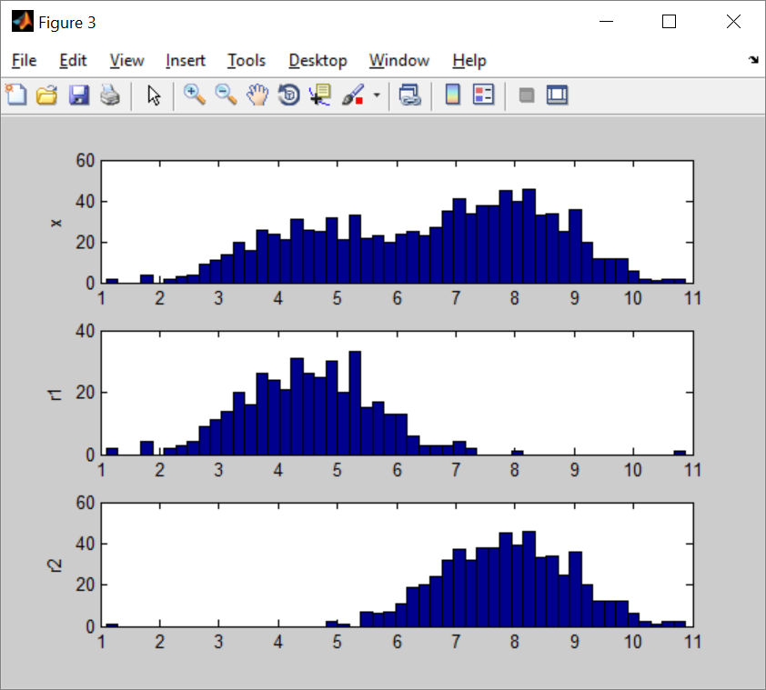
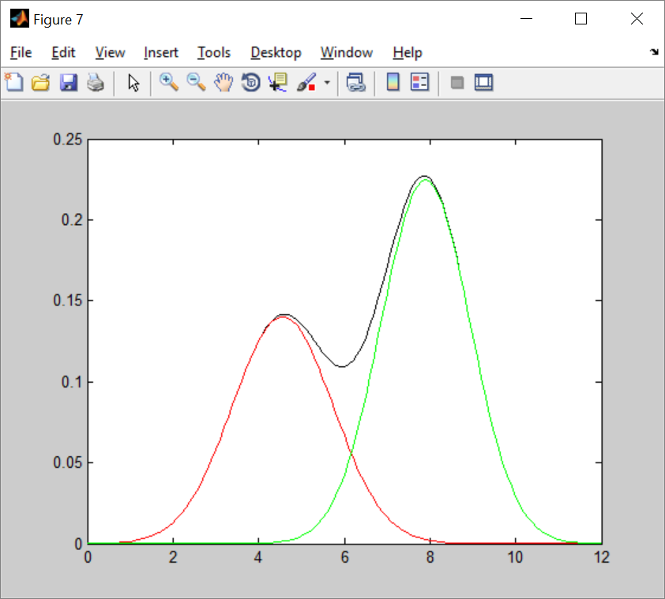
Result of the code em8d.m
Input Output

Slide 23
Example2: Test code:em10a.m
function em() %em 1d test demo
%known problem, guess sig needs to be close to ground truth
%clc clean window commands
clear, close all, clf
thresold=0.0001;
N_gt=10; %total number of samples in total
old_mean=[0 0]';
mean_gt=[4 7]' ;%ground truth
%mean=mean_gt+[ -1.25 1.25]'; %initial guess
mean=mean_gt+[ -0.2 0.2]'; %initial guess
sig_gt=[1 1]';%ground truth
%sig=sig_gt+[0.1 -0.1]';%initial guess
sig=sig_gt+[0 0]';%fixed sig=stdev , assume there is no need to find sig
a_gt=[0.4 0.6]'; %sum must be 1,prob.that is generated by gaussian [1 or 2]
a=a_gt+[ 0.05 -0.05]';%initial guess
%%%%%gen data if needed
% r1 = (mean_gt(1) + sig_gt(1)*randn(N_gt*a_gt(1),1)); %mean, sd
% r2 = (mean_gt(2) + sig_gt(2)*randn(N_gt*a_gt(2),1));%mean, sd
% x=[r1;r2];
% x'
%input data,generated by 2Gaussians,G1=(mean=4,stdev=1),G2=(mean=8,stdev=1)
x=[ 5.5344 4.1756 3.5239 3.7203 7.7026 8.2082 6.7524 8.5127 6.2751 6.5347]';
N=length(x);
'x='
x'
for t=1:10 %loop at most 10 times
mean
a
%%%%%%%%%%% E-step %%%%%%%%%%%%%%%%%%%%%
for n=1:N %
for k=1:2
g(n,k)=gauss(x(n),sig(k),mean(k));
end
end
%%%%%%%%%%%%%%%%%%
for n=1:N %
for k=1:2
raw_w(k,n)=a(k)*g(n,k);
end
end
for n=1:N
denon(1,n)=raw_w(1,n)+raw_w(2,n);
denon(2,n)=raw_w(1,n)+raw_w(2,n);
end
%%%%%%%%%%%%%%%%%%%%%%%%%%%%%%%%%%
%normalize w
for n=1:N
for k=1:2
w(k,n)=raw_w(k,n)/denon(k,n);
end
end
%%%%%%%%%% M-step %%%%%%%%%%%%%%%%%%%%%%%%
for k=1:2 %find mean
%%%%%% mean %%%%%%%%%%%%%%%%%%%%%%%%%%
mean(k)=0;
for n=1:N
mean(k)=mean(k)+w(k,n)*(x(n)) ;%new mean, max step
end
mean(k)=mean(k)/sum(w(k,:));
% % sig,comment the followings if there is no need to find sig
% sig(k)=0;
% for n=1:N
% sig(k)=sig(k)+w(k,n)*(x(n)-mean(k))^2 ;%new mean, max step
% end
% sig(k)=sig(k)/sum(w(k,:));
%%%% a %%%%%%%%%%%%%%%%%%%%%%%
a(k)=sum(w(k,:))/N;
end
dd=(old_mean-mean)'*(old_mean-mean);
old_mean=mean;
%sig
t
gg=g';
gg
w
mean
a
'press key to continue'
pause
if dd<thresold
'quit, because dd is small enough'
dd
break;
end
end
%plot the Gaussian mixture %%%%%%%%%%
xx=[0:0.1:12];
%xx=x;
for n=1:length(xx)
temp=0;
for k=1:2
temp=temp+a(k)*gauss(xx(n),sig(k), mean(k));
end
gmm_b(n)=temp;
end
%%%%%%%%%%%%%%%%%%%%%%%%%%%%%%%%%
%plot the G1 %%%%%%%%%%
for n=1:length(xx)
temp=0;
k=1;
temp=temp+a(k)*gauss(xx(n),sig(k), mean(k));
g1_b(n)=temp;
end
%%%%%%%%%%%%%%%%%%%%%%%%%%%%%%%%%
%plot the G1 %%%%%%%%%%
for n=1:length(xx)
temp=0;
k=2;
temp=temp+a(k)*gauss(xx(n),sig(k), mean(k));
g2_b(n)=temp;
end
%%%%%%%%%%%%%%%%%%%%%%%%%%%%%%%%%
sum(gmm_b)/length(xx)
figure(7)
clf
plot(xx,gmm_b,'k');
hold on
plot(xx,g1_b,'r');
hold on
plot(xx,g2_b,'g');
% 'area'
% area(xx,gmm)
% trapz(xx,gmm)
%%%%%%%%%%%%%%%%%%%%%%%%%%%%%%%%%%%%%%%%%%%%%%%%%%%
function g=gauss(x,sig, mean)
g=(1/sqrt(2*pi*sig^2)) * exp(-(x-mean)^2/(2*sig^2) );
return
Result obtained by EM:
Given ground truth ( 2 Single Gaussian functions, known σ=[1,1]’):
mean_gt(µ_gt)=[4 ,7]; a_gt=[0.4 ,0.6]‘
First guess:
mean’ (µ’)=[3.8000, 7.2000]’;a’ =[0.4500, 0.5500]’
Result obtained by EM:
mean(µ)=[4.1035,7.1737]’; a =[0.3517,0.6483]’

Slide 24
Result
t = 2
gg =
0.1389 0.3972 0.3415 0.3737 0.0006 0.0001 0.0113 0.0000 0.0360 0.0197
0.1038 0.0044 0.0005 0.0010 0.3471 0.2340 0.3649 0.1631 0.2661 0.3250
w =
0.4180 0.9796 0.9972 0.9949 0.0009 0.0002 0.0163 0.0001 0.0677 0.0315
0.5820 0.0204 0.0028 0.0051 0.9991 0.9998 0.9837 0.9999 0.9323 0.9685
mean =
4.0980
7.1718
a =
0.3507
0.6493
press key to continue
mean =
4.0980
7.1718
a =
0.3507
0.6493
t = 3
gg =
0.1422 0.3977 0.3383 0.3715 0.0006 0.0001 0.0118 0.0000 0.0373 0.0205
0.1044 0.0045 0.0005 0.0010 0.3465 0.2332 0.3653 0.1624 0.2669 0.3257
w =
0.4238 0.9796 0.9972 0.9949 0.0009 0.0002 0.0171 0.0001 0.0702 0.0329
0.5762 0.0204 0.0028 0.0051 0.9991 0.9998 0.9829 0.9999 0.9298 0.9671
mean =
4.1035
7.1737
a =
0.3517
0.6483
press key to continue
ans =
quit, because dd is small enough
dd = 3.3746e-05
ans = 0.0826
>> em10a
x=
5.5344 4.1756 3.5239 3.7203 7.7026 8.2082 6.7524 8.5127 6.2751 6.5347
mean =
3.8000
7.2000
a =
0.4500
0.5500
t = 1
gg =
0.0887 0.3718 0.3840 0.3977 0.0002 0.0000 0.0051 0.0000 0.0186 0.0095
0.0997 0.0041 0.0005 0.0009 0.3516 0.2400 0.3609 0.1685 0.2601 0.3197
w =
0.4213 0.9866 0.9985 0.9971 0.0005 0.0001 0.0114 0.0000 0.0554 0.0237
0.5787 0.0134 0.0015 0.0029 0.9995 0.9999 0.9886 1.0000 0.9446 0.9763
mean =
4.0816
7.1751
a =
0.3495
0.6505
press key to continue
mean =
4.0816
7.1751
a =
0.3495
0.6505

Slide 25
Example first iteration : E-step
%Given ground truth
% ( 2 Single Gaussian functions, known σ=[1,1]’):
mean_gt(µ_gt)=[4 ,7]; a_gt=[0.4 ,0.6]‘
>> em10a
x= 5.5344 4.1756 3.5239 3.7203 7.7026 8.2082 6.7524 8.5127 6.2751 6.5347
mean = 3.8000 7.2000
a = 0.4500 0.5500
t = 1
gg (row=k, column=n)=
0.0887 0.3718 0.3840 0.3977 0.0002 0.0000 0.0051 0.0000 0.0186 0.0095
0.0997 0.0041 0.0005 0.0009 0.3516 0.2400 0.3609 0.1685 0.2601 0.3197
w (row=k, column=n)=
0.4213 0.9866 0.9985 0.9971 0.0005 0.0001 0.0114 0.0000 0.0554 0.0237
0.5787 0.0134 0.0015 0.0029 0.9995 0.9999 0.9886 1.0000 0.9446 0.9763
mean = 4.0816 7.1751
a = 0.3495 0.6505
----------------
W(k=1,n=1)=a_{1*}N(x1| µ_{k=1}, σ _{k=1})/(a_{1*}N(x1| µ_{k=1}, σ _{k=1})+a_{2*}N(x1| µ_{k=2}, σ _{k=2}))
a₁*N(x₁| µ_{k=1}, σ _{k=1} )=0.45 *(1/sqrt(2*pi*1^2)) * exp(-(5.5344-3.8)^2/(2*1^2) ) = 0.0398944561
a₂*N(x₁| µ_{k=2}, σ _{k=2} )=0.55* *(1/sqrt(2*pi*1^2)) * exp(-(5.5344-7.2)^2/(2*1^2) )= 0.0548097482
W(k=1,n=1)= 0.0398944561 /( 0.0398944561 + 0.0548097482 )=0.42125327375
--------------------
W(k=2,n=1)=a_{1*}N(x1| µ_{k=2}, σ _{k=2})/(a_{1*}N(x1| µ_{k=1}, σ _{k=1})+a_{2*}N(x1| µ_{k=2}, σ _{k=2}))
W(k=2,n=1)= 0.0548097482 /( 0.0398944561 + 0.0548097482 )=0.57874672624
--------------------
W(k=1,n=2)=a_{1*}N(x1| µ_{k=1}, σ _{k=1})/(a_{1*}N(x1| µ_{k=1}, σ _{k=1})+a_{2*}N(x1| µ_{k=2}, σ _{k=2}))
a₁*N(x₁| µ_{k=1}, σ _{k=1} )=0.45 *(1/sqrt(2*pi*1^2)) * exp(-(4.1756 -3.8)^2/(2*1^2) ) = 0.16729711603
a₂*N(x₁| µ_{k=2}, σ _{k=2} )=0.55* (1/sqrt(2*pi*1^2)) * exp(-(4.1756 -7.2)^2/(2*1^2) )= 0.00226479005
W(k=1,n=1)= 0.16729711603 /(0.16729711603 + 0.00226479005 )=0.98664328502
-------------------
W(k=1,n=2)= 0.00226479005 /(0.16729711603 + 0.00226479005 )=0.01335671497

Slide 26
Example: first iteration M-step
%input data x, generated by 2Gaussians,G1=(mean=4,stdev=1),G2=(mean=8,stdev=1)
>> em10a
x= 5.5344 4.1756 3.5239 3.7203 7.7026 8.2082 6.7524 8.5127 6.2751 6.5347
mean = 3.8000 7.2000
a = 0.4500 0.5500
t = 1
w (row=k, column=n)
0.4213 0.9866 0.9985 0.9971 0.0005 0.0001 0.0114 0.0000 0.0554 0.0237
0.5787 0.0134 0.0015 0.0029 0.9995 0.9999 0.9886 1.0000 0.9446 0.9763
mean = 4.0816 7.1751
a = 0.3495 0.6505
Mean(k)=sum_alln(w(k,n)*x(n)/sum_alln(w(k,n))
Mean(k=1):::::::1111::::::::::::::::
num1=(5.5344*0.4213+4.1756*0.9866+3.5239*0.9985+3.7203*0.9971+7.7026*0.0005+8.2082* 0.0001+6.7524*0.0114+8.5127*0.0000+6.2751*0.0554+6.5347*0.0237)= 14.26357737
Den1=(0.4213+0.9866+0.9985+0.9971+0.0005+0.0001+0.0114+0.0000+0.0554+0.0237)=3.4946
Mean(k=1) =Num1/Den=14.26357737/3.4946=4.08160515367
Mean(k=2)::::::222:::::::::::::::
num2=5.5344*0.5787+4.1756*0.0134+3.5239*0.0015+3.7203*0.0029+7.7026*0.9995+8.2082*0.9999+6.7524*0.9886+8.5127*1.0000+6.2751*0.9446+6.5347*0.9763=46.67632263
den2=0.5787+0.0134+0.0015+0.0029+0.9995+0.9999+0.9886+1.0000+0.9446+0.9763=6.5054
Mean(k=2)=num2/den2=46.67632263/6.5054=7.17501193316
a(k=1)=den1/N=3.4946/10=0.34946;;;;;;;111;;;;;;;;;;;;;;
a(k=2)=den2/N=6.5054/10=0.65054;;;;;;222;;;;;;;;;;;;;;

Slide 27
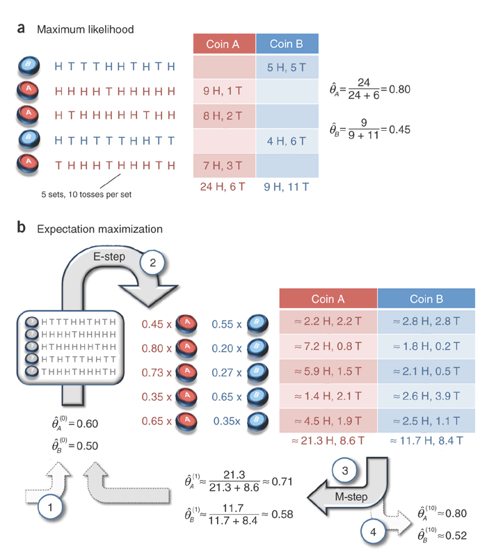
Example 3: an EM small numerical example (not Gaussian mixture)
http://ai.stanford.edu/~chuongdo/papers/em_tutorial.pdf
If you know which coin is used, you may find . θ_{A}=0.8, θ_{B}=0.45
(Part b of right hand side) First row
Init. θ_{A}=0.6, θ_{B}=0.5
We perform an exp. 5Heads, 5Tails
θ’_{A} =(θ_{A})⁵(1-θ_{B})⁵
=(0.6)^5*(1-0.6) ^5
=0.000796
θ’_{B} =(θ_{B})⁵(1-θ_{A})⁵
=(0.5)^5*(1-0.5) ^5
=0.0009766
θ’’_{A} = θ’_{A} /(θ’_{A} + θ’_{B})
=0.000796/(0.000796+0.0009766)
=0.4491=0.45
Similarly, θ’’_{B}= =0.0009766/(0.000796+0.0009766)
=0.55
https://math.stackexchange.com/questions/25111/how-does-expectation-maximization-work

Slide 28
EM small numerical example (continue)
http://ai.stanford.edu/~chuongdo/papers/em_tutorial.pdf
If you know which coin is used, you may find . θ_{A}=0.8, θ_{B}=0.45
(Part b of right hand side) second row
Init. θ_{A}=0.6, θ_{B}=0.5
We perform an exp. 9Heads, 1Tail
θ’_{A} =(θ_{A})⁵(1-θ_{A})⁵
=(0.6)^9*(1-0.6) ^1
= 0.00403
θ’_{B} =(θ_{B})⁵(1-θ_{B})⁵
=(0.5)^9*(1-0.5) ^1
=0.000976
θ’’_{A} = θ’_{A} /(θ’_{A} + θ’_{B})
=0.00403 /(0.00403 + 0.000976)
=0.8
Similarly, θ’’_{B}=
= 0.000976 /(0.00403 + 0.000976 )
=0.2
https://math.stackexchange.com/questions/25111/how-does-expectation-maximization-work

Slide 29
Exercise 6
Follow up the calculation for the next step

Slide 30
Derivation
of EM

Slide 31
Math rules
P(B|A)=P(A|B)P(B)/P(A)
P(A and B)=P(A,B)=P(A|B) P(B)
P(A,B|C)=P(A|B,C) P(B|C)
Prove the above as exercises
In each cell, the joint probability p(r, c) is re-expressed by the equivalent form
p(r | c) p(c) from the definition of conditional probability in Equation 5.3. The marginal probability p(r) =Σ_{c*}p(r | c*) p(c*),
https://www.sciencedirect.com/topics/mathematics/marginal-probability

Slide 32
The Gaussian mixture model
Two views: discrete view(Z_{n,k}), analog view (a_{k})
For each sample x_{n}
Discrete View: Z_{n,k}∈ {1 or 0} is a one-hot variable telling which single Gaussian generates x_{n}.
Analog view: You may describe the same structure by using the mixing coefficient a_{k} ,0≤ a_{k} ≤1.
a_{k} is the soft version of Z_{n,k} describing the same thing.
Each sample x_{n’}
has an one-hot Z_{k,n’}
k=1, a_{k=1} =Prob. that x_{n’} is generated by the
single Gaussian (µ_{k=1},σ_{k=1})
Z_{n’, k=1} =0
X_{n’}
Z_{n’,k=2}=1
k=2, a_{k=2}
Z_{n’, k=K,}=0
k=K, a_{k=K}

Slide 33
Example:
Two views: discrete view(Z_{n,k}), analog view (a_{k})
For each X_{n},
Table TAB1 for z_{n,k}
Show 2 samples x_{n=1},x_{n=2}
Z_{n=1,k=1} =0
k=1, a_{k=1}
TAB1 | k=1 | k=2 | k=3
n=1 | z_{1,1}=0 | z_{1,2}=0 | z_{1,3}=1
n=2 | z_{2,1}=1 | z_{2,2}=0 | z_{2,3}=0
n=3 | z_{3,1}=0 | z_{3,2}=1 | z_{3,3}=0
n=4 | z_{4,1}=0 | z_{4,2}=1 | z_{4,3}=0
n=5 | z_{5,1}=1 | z_{5,2}=0 | z_{5,3}=0
n=6 | z_{6,1}=0 | z_{6,2}=1 | z_{6,3}=0
n=7 | z_{7,1}=1 | z_{7,2}=0 | z_{7,3}=0
n=8 | z_{8,1}=0 | z_{8,2}=1 | z_{8,3}=0
n=9 | z_{9,1}=0 | z_{9,2}=0 | z_{9,3}=1
x_{n=1}
Z_{n=1},_{k=2} =0
Z_{n=1},_{k=3}=1
k=2, a_{k=2}
Z_{n=2,k=1}=1
For the whole data set
a_{k=1}=3/9
a_{k=2}=4/9
a_{k=3}=2/9
x_{n=2}
Z_{n=2,k=2}=0
Z_{n=2} ,_{k=3}=0
k=3, a_{k=3}
The set
Z_{k=1}
Z_{k=2}
Z_{k=3}

Slide 34
Graphical view
Data generated by 3 Gaussians k=1,2,3
Cluster
K=2
Cluster
K=1
Cluster
K=3

Slide 35
EM Algo.: Gaussian mixture
https://www.cs.toronto.edu/~urtasun/courses/CSC411/13_mog.pdf

Slide 36
EM Algo.: derivation of the ownership weight w()
https://www.cs.toronto.edu/~urtasun/courses/CSC411/13_mog.pdf

Slide 37
Continue
Because P(A|B)=
P(B|A)*P(A)/P(B)

Slide 38
Exercise 7: Example using TAB1
X= the set of 9 samples,
Z_{k}={z_{n=1,k} , z_{n=2,k} ,…., z_{n=N,k}}= {z_{1,k} , z_{2,k} , z_{3,k} ,…, z_{9,k}}
from TAB1
P(Z_{k=2})=(4/9)^{z1,2}*(4/9)^{z2,2}* *(4/9)^{z3,2}*...*(4/9)^{z9,2}
E.g. P(Z_{k=2}=1)=(4/9)⁰*(4/9)⁰*(4/9)¹*….*(4/9)⁰
P(Z_{k=2}=1)=(4/9)
E.g. if all elements in Z are known , use equation (v)
Mixing coefficients=a_{k=1}=3/9, a_{k=2}=4/9, a_{k=3}=2/9
P(X)=(3/9)*N(X|µ_{k=1},σ_{k=1})+(4/9)*N(X|µ_{k=2},σ_{k=2})
+(2/9)*N(X|µ_{k=3},σ_{k=3})
Z_{n,k}
TAB1 | k=1 | k=2 | k=3
n=1 | z_{1,1}=0 | z_{1,2}=0 | z_{1,3}=1
n=2 | z_{2,1}=1 | z_{2,2}=0 | z_{2,3}=0
n=3 | z_{3,1}=0 | z_{3,2}=1 | z_{3,3}=0
n=4 | z_{4,1}=0 | z_{4,2}=1 | z_{4,3}=0
n=5 | z_{5,1}=1 | z_{5,2}=0 | z_{5,3}=0
n=6 | z_{6,1}=0 | z_{6,2}=1 | z_{6,3}=0
n=7 | z_{7,1}=1 | z_{7,2}=0 | z_{7,3}=0
n=8 | z_{8,1}=0 | z_{8,2}=1 | z_{8,3}=0
n=9 | z_{9,1}=0 | z_{9,2}=0 | z_{9,3}=1
Mixing coefficients=
a_{k=1}=3/9, a_{k=2}=4/9, a_{k=3}=2/9

Slide 39
Continue
W_{n,k} is an estimation of the probability of the number of elements generated by the k-th Gaussian, it will be used later for derivation

Slide 40
Continue
Maximum likelihood maximizes

Slide 41
Maximum log_likehood of Gaussian

Slide 42
Maximum Log-likelihood of mixture parameters
Assume a_{k} is the guessed solution, so they are known and constant here
Only k is considered so the summation is gone
Read the tutorial: http://www.cse.cuhk.edu.hk/~khwong/www2/cmsc5707/5707_probability.pptx
https://stephens999.github.io/fiveMinuteStats/intro_to_em.html

Slide 43
M-step: variance & mixing coefficients
We can get similarity expression for the variance
http://jrmeyer.github.io/machinelearning/2017/08/18/mle.html

Slide 44
Exercise 8
Derivate : We can get similarity expression for the variance
https://stephens999.github.io/fiveMinuteStats/intro_to_em.html

Slide 45
Answer 8: Maximum Log-likelihood of mixture parameters
Assume a_{k} is the guessed solution, so they are known and constant here
Only k is considered so the summation is gone
Read the tutorial: http://www.cse.cuhk.edu.hk/~khwong/www2/cmsc5707/5707_probability.pptx
Note x_{n} is a single element
https://stephens999.github.io/fiveMinuteStats/intro_to_em.html

Slide 46
Maximum Log-likelihood of mixture parameters
Assume a_{k} is the guessed solution, so they are known and constant here
Only k is considered so the summation is gone
Read the tutorial: http://www.cse.cuhk.edu.hk/~khwong/www2/cmsc5707/5707_probability.pptx
https://stephens999.github.io/fiveMinuteStats/intro_to_em.html

Slide 47
M-step: variance & mixing coefficients
We can get similarity expression for the variance
http://jrmeyer.github.io/machinelearning/2017/08/18/mle.html

Slide 48
Exercise 8
Derivate : We can get similarity expression for the variance
https://stephens999.github.io/fiveMinuteStats/intro_to_em.html

Slide 49
d
d

Slide 50
Applications with examples
of EM

Slide 51
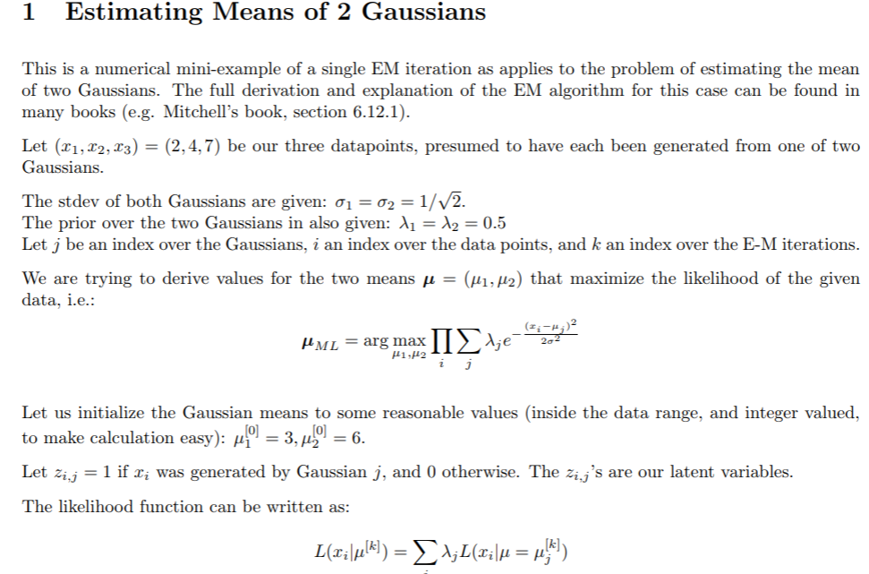
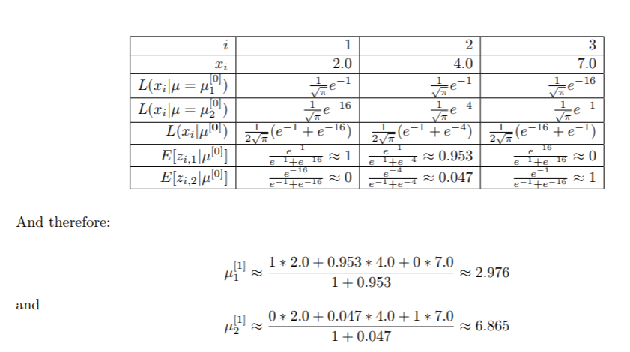
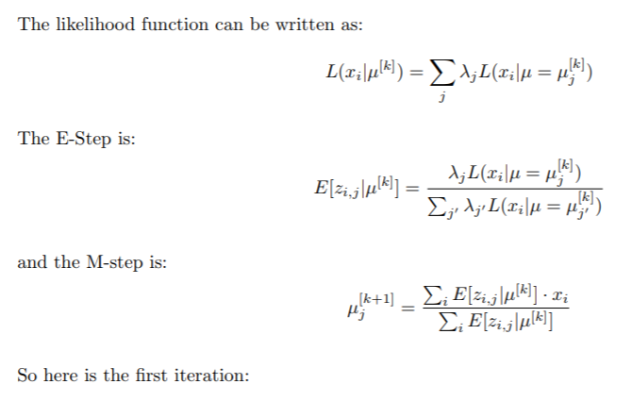
x
x
https://www.cs.cmu.edu/~roni/10601-slides/EM%20GaussianMixture%20Example.pdf

Slide 52
x
x

Slide 53
x
x

Slide 54
Summary

Slide 55
Alternative proof of EM

Slide 56
Using d(Log_likelihood [log(L(θ))]/dθ =0 to find maximum likelihood for k-Gaussian mixture is not working , so use an iteration method. Parameters θ_{all_k} = [mean =µ, stdev =σ] _{all_k} Derivation 1

Slide 57
Derivation 2

Slide 58
Derivation 3

Slide 59
Conditional expectation
https://www.math.arizona.edu/~tgk/464_07/cond_exp.pdf

Slide 60
Some useful differentiation results

Slide 61
Maximum log_likehood of Gaussian

Slide 62
Maximum Log-likelihood of mixture parameters
Assume a_{k} is the guessed solution, so they are known and constant here
Only k is considered so the summation is gone
Read the tutorial: http://www.cse.cuhk.edu.hk/~khwong/www2/cmsc5707/5707_probability.pptx
https://stephens999.github.io/fiveMinuteStats/intro_to_em.html

Slide 63
M-step: variance & mixing coefficients
We can get similarity expression for the variance
http://jrmeyer.github.io/machinelearning/2017/08/18/mle.html

Slide 64
Exercise 8
Derivate : We can get similarity expression for the variance
https://stephens999.github.io/fiveMinuteStats/intro_to_em.html

Slide 65
Answer 8: Maximum Log-likelihood of mixture parameters
Assume a_{k} is the guessed solution, so they are known and constant here
Only k is considered so the summation is gone
Read the tutorial: http://www.cse.cuhk.edu.hk/~khwong/www2/cmsc5707/5707_probability.pptx
Note x_{n} is a single element
https://stephens999.github.io/fiveMinuteStats/intro_to_em.html

