Slide 1
Regression techniques
KH Wong

Slide 2
Introduction
Simple linear regression and normal equation
Multiple linear regression

Slide 3
(1) Simple Linear regression and normal equation
Simple Linear equation has one input and one output

Slide 4

Simple linear equation to find the solution
https://nic.schraudolph.org/teach/NNcourse/linear1.html
https://www.statlect.com/glossary/normal-equations
$$y=β_{0}x_{0}+β_{1}x_{1}$$
$$Set x_{0}=1, so β_{0} is the bias.$$
In a Simple linear equation there is one input (x1) and one output (y).
$$β=\left[β_{0},β_{1}\right]T$$
$$x=\left[x_{0}=1,x_{1}\right]T$$
$y =β^{T}$⋅$x$
Given $several samples of pairs of y^{′}and x^{′}, i.e.$
$$y^{′}and x′=\left[1,x_{1}′ \right]T$$
$y^{′′}and x′′=\left[1,x_{1}′′\right]T$… etc.
We would like to find $β$ by the normal equation, see next slide

Slide 5

Derivation of the normal equation
https://eli.thegreenplace.net/2014/derivation-of-the-normal-equation-for-linear-regression/
$$h_{β}(x)=β_{0}x_{0}+β_{1}x_{1}$$
$$Set cost function$$
$J(β)$=$J(β_{0,1,..,n})$ $=\frac{1}{2m}\sum_{1}^{m}{({h_{β}\left(x^{\left(i\right)}\right)− h}_{β}(x))}A=πr^{2}$
$$J(β)\text{=}\frac{1}{2m}\sum_{i=1}^{m}{{\left(h_{θ}\left(x^{\left(i\right)}\right)−y^{(i)}\right)}^{2}}$$
$$β=\left[β_{0},β_{1},β_{2},…β_{n}\right]T$$
$$x=\left[x_{0}=1,x_{1},x_{2},…x_{n}\right]T$$
$h_{β}(x)=β^{T}$⋅$x$
$J(β)$= $\frac{1}{2m}{(Xβ−y)}^{T}\left(Xβ−y\right)$
= $\frac{1}{2m}\left({(Xβ)}^{T}−y^{T}\right)\left(Xβ−y\right)$
${= \frac{1}{2m}(Xβ)}^{T}Xβ$- ${(Xβ)}^{T}y−{y^{T}\left(Xβ\right)}^{T}+y^{T}y$
$${= \frac{1}{2m}β}^{T}X^{T}Xβ−2{\left(Xβ\right)}^{T}y+y^{T}y$$
The solution is at
$\frac{∂J}{∂β}=2X^{T}Xβ$-2 $X^{T}$y=0
$X^{T}Xβ$= $X^{T}$y, hence$β={\left(X^{T}\text{⋅}X\right)}^{−1}$⋅$X^{T}\text{⋅}y$
This called the normal Equation $β={\left(X^{T}\text{⋅}X\right)}^{−1}$⋅$X^{T}\text{⋅}y$

Slide 6
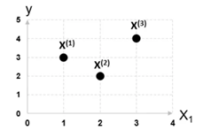
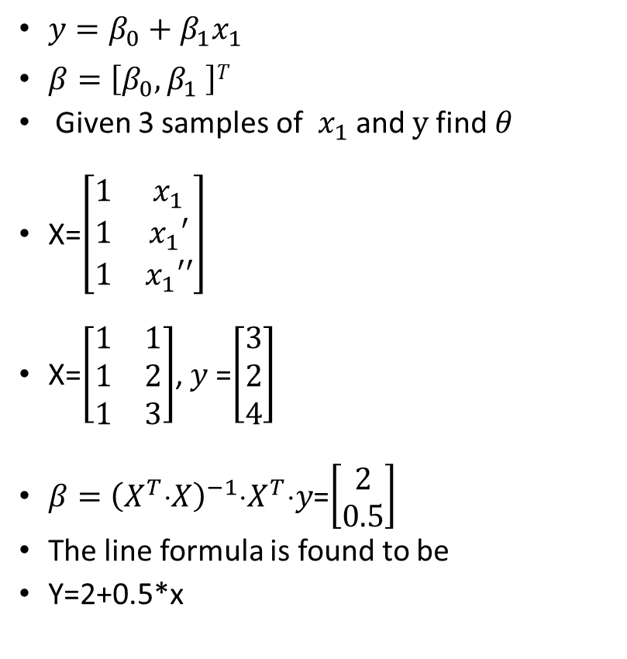
A small example to find the line equation using linear regression
$y=β_{0}+β_{1}x_{1}$
$β=\left[β_{0},β_{1} \right]T$
Given 3 samples of $x_{1}$ and $y$find $θ$
X=$\left[\begin{matrix}1 & x_{1} \\ 1 & x_{1}′ \\ 1 & x_{1}′′\end{matrix}\right]$
X=$\left[\begin{matrix}1 & 1 \\ 1 & 2 \\ 1 & 3\end{matrix}\right]$, $y$=$\left[\begin{matrix}3 \\ 2 \\ 4\end{matrix}\right]$
$β={\left(X^{T}\text{⋅}X\right)}^{−1}$⋅$X^{T}\text{⋅}y$=$\left[\begin{matrix}2 \\ 0.5\end{matrix}\right]$
The line formula is found to be
Y=2+0.5*x

Slide 7
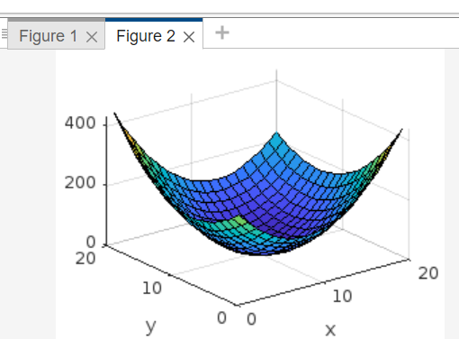
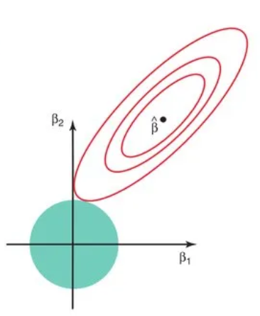
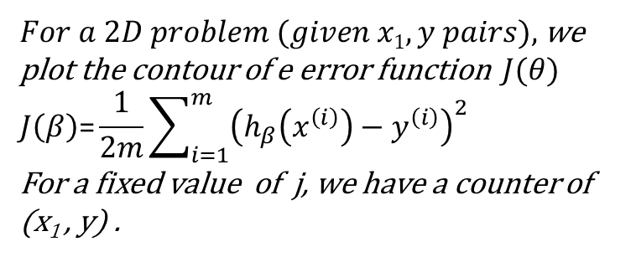
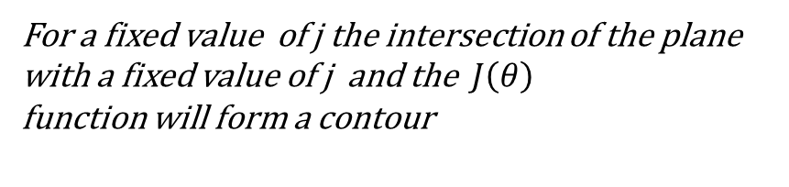

code
$For a 2D problem (given x1,y pairs),$ we plot the contour of e error function $J(θ)$
$$J\left(β\right)\text{=}\frac{1}{2m}\sum_{i=1}^{m}{{\left(h_{β}\left(x^{\left(i\right)}\right)−y^{\left(i\right)}\right)}^{2}}$$
For a fixed value of j, we have a counter of (x₁ , y) .
clear %https://nic.schraudolph.org/teach/NNcourse/linear1.html
close all
xp=[ -1 -0.8 -0.6 -0.4 -0.1 0 1.1 1.3 1.4 1.6 ]'
yp=[ 1.6 1.3 1.2 0.4 0.3 0.1 0.3 -0.1 -0.4 -0.7 ]'
%%%%%%%%%%%%%%%%%%%%%%%%%%%%
figure(1)
clf
plot([-3,3],[-3,3],'o')
hold on
plot(xp,yp,'+')
hold on
X=[ones(length(xp),1),xp]
%solution using closed form , normal equ.
theta=inv(X'*X)*X'*yp
%plot the line found
yp_found=theta'*X';
%plot(yp_found,xp,'b-')
plot(xp,yp_found,'b-')
M=20
%now find the countour of error
w0=([1:1:M]-(M/2))*theta(1)
w1=([1:1:M]-(M/2))*theta(2)
N_samples=length(xp)
%%%
for i=1:M
for j=1:M
w0(i)
w1(j)
temp=0;
for k=1:N_samples
tp_y=w0(i)+w1(j)*xp(k);
temp=temp+0.5*(tp_y-yp(k))^2;
end
E(i,j)=temp;
end
end
figure(2)
clf
ii=[1:M]'
jj=[1:M]'
%the contour of error are rings of
% which each has a fixed error
surf(ii,jj,E)
grid on
xlabel('x')
ylabel('y')
Contours of error or
Cost. Each contour has a different j.
$$J\left(θ\right)$$
y
j’
x₁
x₁
For a fixed value of j the intersection of the plane with a fixed value of j and the $J\left(θ\right)$
function will form a contour

Slide 8
(2) Multiple linear equation and the normal equation
A multiple linear equation has multiple inputs and outputs
https://en.wikipedia.org/wiki/Linear_regression

Slide 9

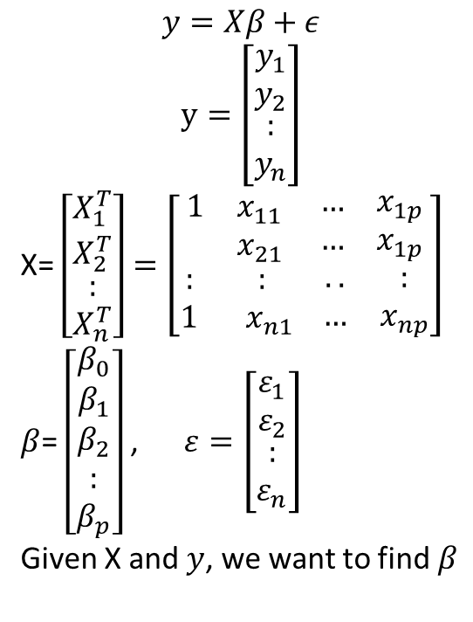
Multiple linear question and the solution -- normal matrix equation
$$y=Xβ+ε$$
$$y=\left[\begin{aligned}\begin{matrix}y_{1} \\ y_{2}\end{matrix} \\ : \\ y_{n}\end{aligned}\right]$$
X= $\left[\begin{aligned}\begin{matrix}X_{1}^{T} \\ X_{2}^{T}\end{matrix} \\ : \\ X_{n}^{T}\end{aligned}\right]=\left[\begin{aligned}\begin{matrix}1 & x_{11} \\ & x_{21}\end{matrix} \begin{matrix}… & x_{1p} \\ … & x_{1p}\end{matrix} \\ \begin{matrix}: & : \\ 1 & x_{n1}\end{matrix} \begin{matrix}.. & : \\ … & x_{np}\end{matrix}\end{aligned}\right]$
$β$= $\left[\begin{aligned}\begin{matrix}β_{0} \\ β_{1}\end{matrix} \\ β_{2} \\ : \\ β_{p}\end{aligned}\right]$ , $ε=\left[\begin{aligned}\begin{matrix}ε_{1} \\ ε_{2}\end{matrix} \\ : \\ ε_{n}\end{aligned}\right]$
Given X and $y$, we want to find $β$
$$The error (or cost) function$$
$J(β)≈$ $\frac{1}{2n}{(Xβ−y)}^{T}\left(Xβ−y\right)$
= $\frac{1}{2n}\left({(Xβ)}^{T}−y^{T}\right)\left(Xβ−y\right)$
${= \frac{1}{2n}(Xβ)}^{T}Xβ$- ${(Xβ)}^{T}y−{y^{T}\left(Xβ\right)}^{T}+y^{T}y$
$${= \frac{1}{2n}β}^{T}X^{T}Xβ−2{\left(Xβ\right)}^{T}y+y^{T}y$$
The solution is at
$\frac{∂J}{∂β}=2X^{T}Xβ$-2 $X^{T}$y=0
$X^{T}Xβ$= $X^{T}$y, hence$β={\left(X^{T}\text{⋅}X\right)}^{−1}$⋅$X^{T}\text{⋅}y$
This called the normal matrix Equation
$β={\left(X^{T}\text{⋅}X\right)}^{−1}$⋅$X^{T}\text{⋅}y$

Slide 10
Calculation example2: linear regression, multiple valuables
https://www.statology.org/multiple-linear-regression-by-hand/
clear, clc
y_raw=[140 155 159 179 192 200 212 215]'
x1_raw=[60 62 67 70 71 72 75 78]'
x2_raw=[22 25 24 20 15 14 14 11]'
x1=x1_raw-mean(x1_raw)
x2=x2_raw-mean(x2_raw)
x=[x1,x2]
y=y_raw-mean(y_raw)
b=inv(x'*x)*(x’*y) % linear least square method
b0=mean(y_raw)-b'*[mean(x1_raw); mean(x2_raw)] %offset
' found b = [ 3.1479, -1.6561]'
' b0 = -6.8675'
b
b0

Slide 11
MATLAB demo code
clear
clc
x=rand(5,3)
x'*x
xx=x*x'
inv(xx)
'is ok because data is random'
y=rand(5,1)
yy=[y,2*y,3*y]
yy'*yy
'but inv(transpose(yy)*yy) fails.’
‘Because columns are correlated, hit key'
pause
inv(yy'*yy)

Slide 12
(3a) Advanced topic: Regularization : ridge regression
https://online.stat.psu.edu/stat857/node/155/
If input data streams are correlated. E.g., you put 2 temperature sensors together, they give you similar measurements and not useful. So, the related βs (regression coefficients) should be suppressed (shrunk).
Mathematically: If x=input data has many intercorrelated columns, so, if x’*x is singular (cannot be inverted), regression fails. Note: x’*x is a necessary step in regression.
Solution: ridge regression

Slide 13



Ridge Regularization for linear regression.
It suppresses linear parameters $β$_{i} that are too large https://medium.com/@msoczi/ridge-regression-step-by-step-introduction-with-example-0d22dddb7d54
$$The error \left(or cost\right)function$$
$$with ridge regulatzaion$$
$J(β)≈$ $\frac{1}{2n}{(Xβ−y)}^{T}\left(Xβ−y\right)$+$λβ^{T}β$
= $\frac{1}{2n}\left({(Xβ)}^{T}−y^{T}\right)\left(Xβ−y\right)\text{+}λβ^{T}β$
${= \frac{1}{2n}(Xβ)}^{T}Xβ$- ${(Xβ)}^{T}y−{y^{T}\left(Xβ\right)}^{T}+y^{T}y$ +$λβ^{T}β$
$${= \frac{1}{2n}β}^{T}X^{T}Xβ−2{\left(Xβ\right)}^{T}y+y^{T}y\text{+}λβ^{T}β$$
The solution is at
$\frac{∂J}{∂β}=2X^{T}Xβ$-2 $X^{T}$y+2 $λ I$ $β$=0
$X^{T}Xβ$+ $λ I$ $β$= $X^{T}$y,
hence$β={\left(X^{T}\text{⋅}X+λI\right)}^{−1}$⋅$X^{T}\text{⋅}y$
This called the normal matrix Equation
$β={\left(X^{T}\text{⋅}X+λI\right)}^{−1}$⋅$X^{T}\text{⋅}y$
$λ$ can be set by the user
A simple case with $β$₀ and $β$₁
https://medium.com/@adipusk/power-of-regularization-l1-l2-ridge-and-lasso-regression-caccc36e2dbb

Slide 14
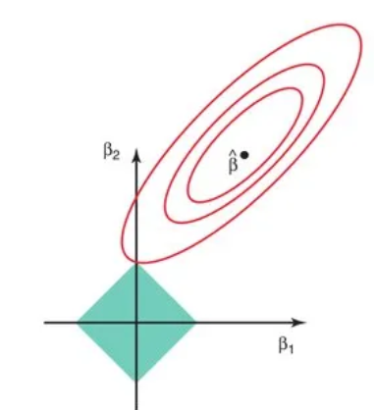
(3b)Advanced topic: Regularization
: Lasso regression
https://www.mygreatlearning.com/blog/understanding-of-lasso-regression/

Slide 15
(3c)Advanced topic: Bayesian_linear_regression
https://en.wikipedia.org/wiki/Bayesian_linear_regression

Slide 16
(3)Nonlinear regression as an optimization process
Newton's method (or Newton-Raphson) for optimization

Slide 17
Basic math : Taylor series
https://www.mathportal.org/formulas/pdf/taylor-series-formulas.pdf

Slide 18
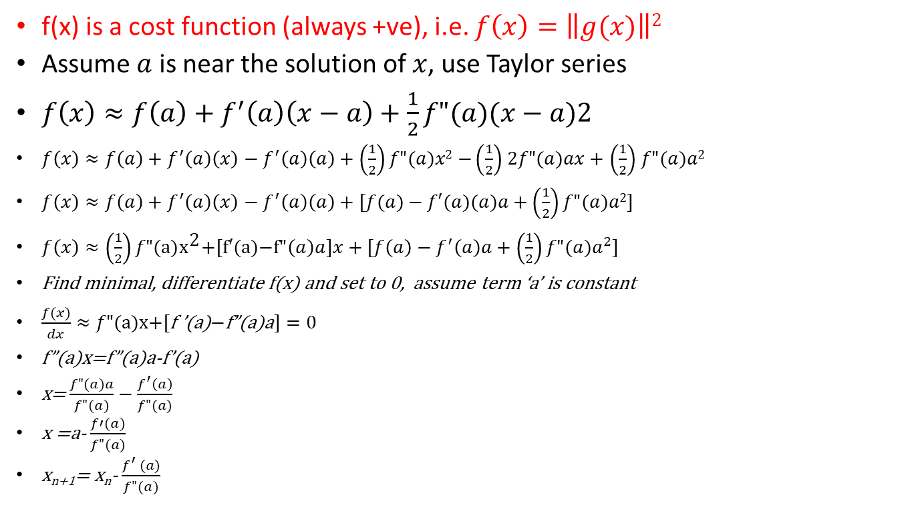

jton’s (second order) optimization method https://ardianumam.wordpress.com/2017/09/27/jtons-method-optimization-derivation-and-how-it-works/#:~:text=We%20can%20say%20that%20jton%E2%80%99s%20method%20for%20finding,method%20for%20optimization%2C%20it%20use%20second%20order%20method.
f(x) is a cost function (always +ve), i.e. $f\left(x\right)=\left\|g(x)\right\|2$
Assume $a$ is near the solution of $x$, use Taylor series
$f\left(x\right)≈f\left(a\right)+f^{′}\left(a\right)\left(x−a\right)+\frac{1}{2}f"(a)(x−a)2$
$f\left(x\right)≈f\left(a\right)+f^{′}\left(a\right)\left(x\right)−f^{′}\left(a\right)\left(a\right)+\left(\frac{1}{2}\right)f"(a)x2$ $−\left(\frac{1}{2}\right)$ $2f"(a)ax+$ $\left(\frac{1}{2}\right)$ $f"(a)a2$
$f\left(x\right)≈f\left(a\right)+f^{′}\left(a\right)\left(x\right)−f^{′}\left(a\right)\left(a\right)+[f(a)−f′(a)(a)a+\left(\frac{1}{2}\right)f"(a)a2]$
$f\left(x\right)≈\left(\frac{1}{2}\right)f\text{"(}\text{a}\text{)}{\text{x}}^{\text{2}}\text{+[}\text{f}\text{′(}\text{a}\text{)−}\text{f}\text{"}\left(a\right)a]x+[f\left(a\right)−f^{′}\left(a\right)a+\left(\frac{1}{2}\right)f"(a)a^{2}]$
Find minimal, differentiate f(x) and set to 0, assume term ‘a’ is constant
$\frac{f(x)}{dx}≈f"\text{(}\text{a}\text{)}\text{x}\text{+[}\text{f} \text{’}\text{(}\text{a}\text{)}\text{−}\text{f}\text{”(}\text{a}\text{)}\text{a}]=0$
f”(a)x=f”(a)a-f’(a)
x= $\frac{f"(a)a}{f"(a)}−\frac{f^{′}\left(a\right)}{f"(a)}$
x =a- $\frac{f′(a)}{f"(a)}$
x_{n+1}= x_{n}- $\frac{f^{′} (a)}{f"(a)}$
To optimize (maximum or minimum), we need to differentiate and equal to 0.
** Jacobian f’() and Hessian f”() are needed. The iterative formula is
x_{n+1}= x_{n} - $\frac{f^{′} (a)}{f"(a)}, or$
$$∆x=x_{n+1}−x_{n}=−\frac{f^{′} (a)}{f"(a)}$$

Slide 19
Implementation of optimization: Gradient Descent methods
Normal Gradient Descent
Newton’ s Gradient Descent
Stochastic Gradient Descent Algorithm (SGD)

Slide 20
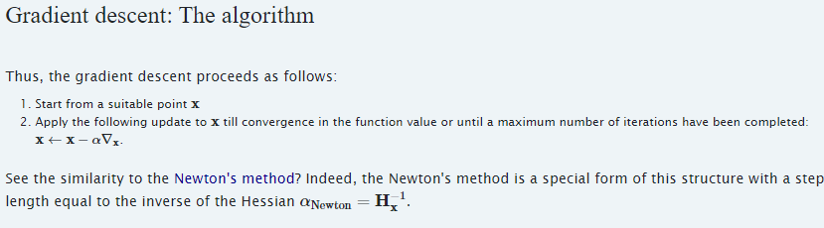
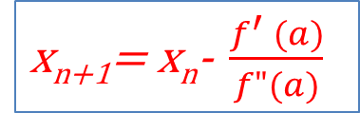
Compare Gradient Descent vs. jton’s Gradient Descent https://the-learning-machine.com/article/optimization/gradient-descent#:~:text=Well%2C%20note%20that%20gradient%20descent%20is%20not%20that,or%20learning%20rate%20%CE%B1%20%CE%B1%20on%20the%20performance.
x_{n+1}= x_{n}- $\frac{f^{′} (a)}{f"(a)}$
Newton optimization method
Gradient descent : x_{n+1}=x_{n} - αf’(x), α=learning _rate
By comparing the above 2 methods, we see that α=1/f”(x) , leaning rate = approx. of the inverse of Hessian matrix

Slide 21
Calculation example 4: non-linear regression
d

Slide 22
(4)Logistic Regression

Slide 23
Introduction
Logistic Regression is a “Supervised machine learning” algorithm that can be used to model the probability of a certain class or event. ... That means Logistic regression is usually used for Binary classification problems.
https://www.analyticsvidhya.com/blog/2021/07/an-introduction-to-logistic-regression/
Math background : https://towardsdatascience.com/cross-entropy-negative-log-likelihood-and-all-that-jazz-47a95bd2e81

Slide 24
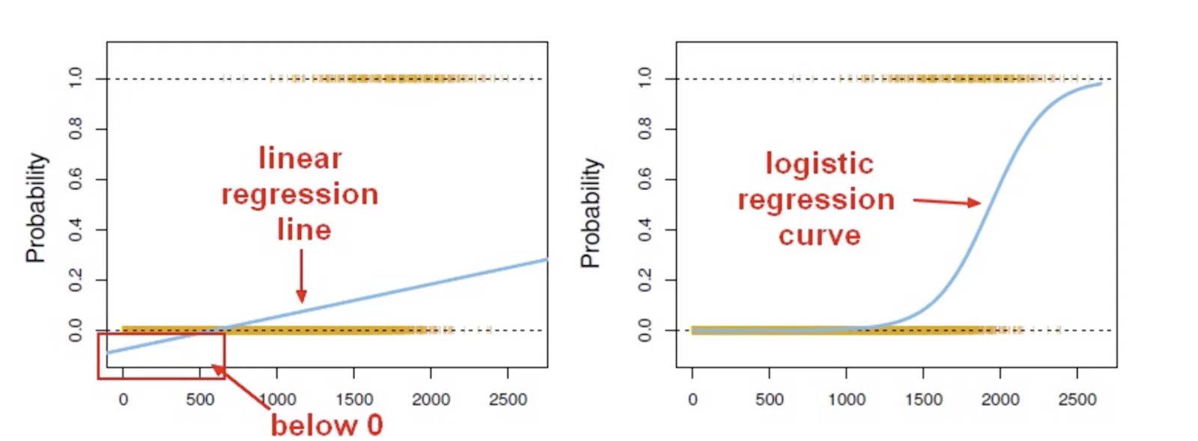
Problems that can be solved by logistic regression
https://www.vebuso.com/2020/02/linear-to-logistic-regression-explained-step-by-step/
Linear regress does not work
Use logistic regression should work
Input
Input

Slide 25
Odds
Odds is the ratio of winning /losing.
If you play a game 8 times, 3 wins, 5 losses:
  There are 8 events, 3 win_events, 5 loss_events,
  The odds for wining is win_events/loss_events=3/5=0.6,
  The odds of losing is loss_events/win_events =5/3= 1.667,
  The probability of wining is P=3/(6+2)=0.375,
  Odds_of_wining=p/(1-p). To verify, in above odds=0.6. And p=0.376, hence p/(1-p)=0.375/(1-0.375)=0.6=odds
If you play a game 10 times, 5 wins, 5 losses,
  the odds for wining is 5/5=1, we call it even odds.
Using log(odds), we have a symmetric relation with probability , see https://yury-zablotski.netlify.app/post/from-odds-to-probability/

Slide 26
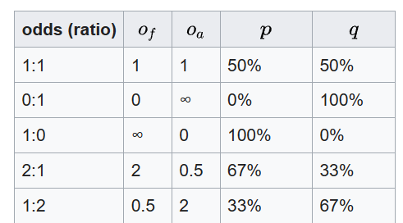
Background : Probability & Log-odds
Example
Define: Odds (Odds – Wikipedia)
If Probability = p, then odds=p/(1-p)
E.g. P=0.1, odds=0.1/(1-0.1)=0.1111
Log-odds : ln(0.1111)= -2.197
Relation between log-odd and probabilityAssume a linear relationship between predictor variables x=[x1,x2,x3,.. Xn] and the log-odds (L , also called logit) of the event that Y=1.
  L= log_{b}[p(x)/(1-p(x))] =β₀+β₁*x1+ β₂*x2 + ε(small terms of β₃*x3+ β₄*x4+…). Assume , the other variables has little effect. This is to simplify the situation, assume n=2, i.e. a 2 predictors x1,x2 case:
  L≈ log_{b}[p(x)/(1-p(x))] =β₀+β₁*x1+ β₂*x2
  Hence, take exp() of both sides
  exp(L)=p(x)/(1-p(x), exp(L)-exp(L) *(p(x))=p(x)
  exp(L)=p(x)+exp(L) *(p(x)) =p(x)(1+exp(L))
  P(x)=exp(L)/(1+exp(L)) %the logistic function, or
  P(x)=exp(β₀+β₁*x1+ β₂*x2)/(1+ exp( β₀+β₁*x1+ β₂*x2)), this is called a sigmoid function, https://en.wikipedia.org/wiki/Sigmoid_function
P
Range
0-1
P/(1-P)
Range
0-large
Log(P/(1-P))
Range
-ve to +ve
https://www.statisticshowto.com/log-odds/

Slide 27
Assume a linear relationship between predictor variables x=[x1,x2,x3,.. Xn] assume (n dimensional data), and the log-odds (L , also called logit) of the event that Y=1.
Assume n=2 dimension.
After some manipulation shown in the last page. P(x)=Sigmoid(β₀+β₁*x1+ β₂*x2).
The Sigmoid function is defined by β_{0,}β₁,β₂
If we have β₀,β₁,β₂ , the sigmoid function is found.
After the sigmoid func. is found, given a set of x1,x2 (observation), we can find p.
We can use gradient descent method to find β_{0,}β₁,β₂ from training data.
Summary: {Training data} → find β_{0,}β₁,β_{2,} then probability (p) having this result=Sigmoid(β₀+β₁*x1+ β₂*x2)

Slide 28
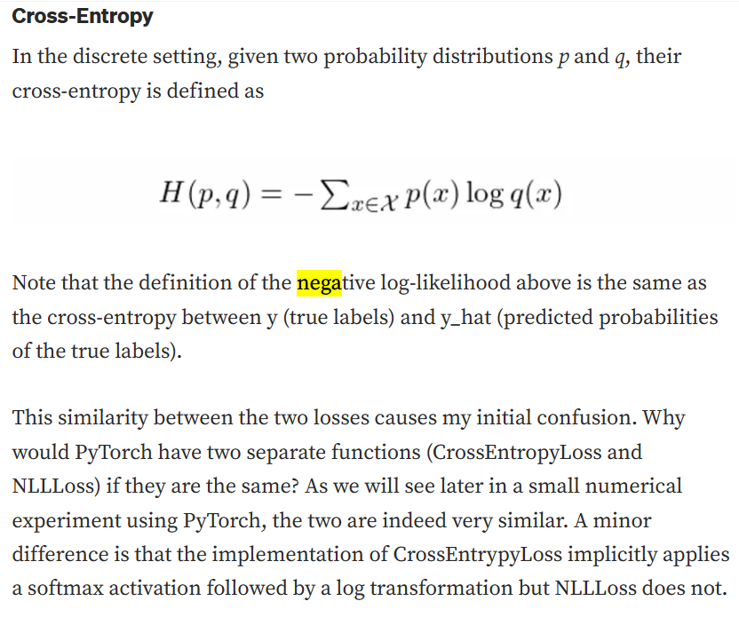
r
Math background : https://towardsdatascience.com/cross-entropy-negative-log-likelihood-and-all-that-jazz-47a95bd2e81
In discrete setting use
Cost measurement 2 (neg cross-entroy)
r

Slide 29
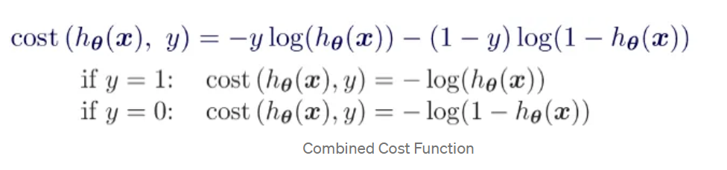
Cost function for binary data
https://medium.com/@jacknayeem/derivative-the-gradient-descent-of-linear-and-logistic-regression-6162685cb333

Slide 30
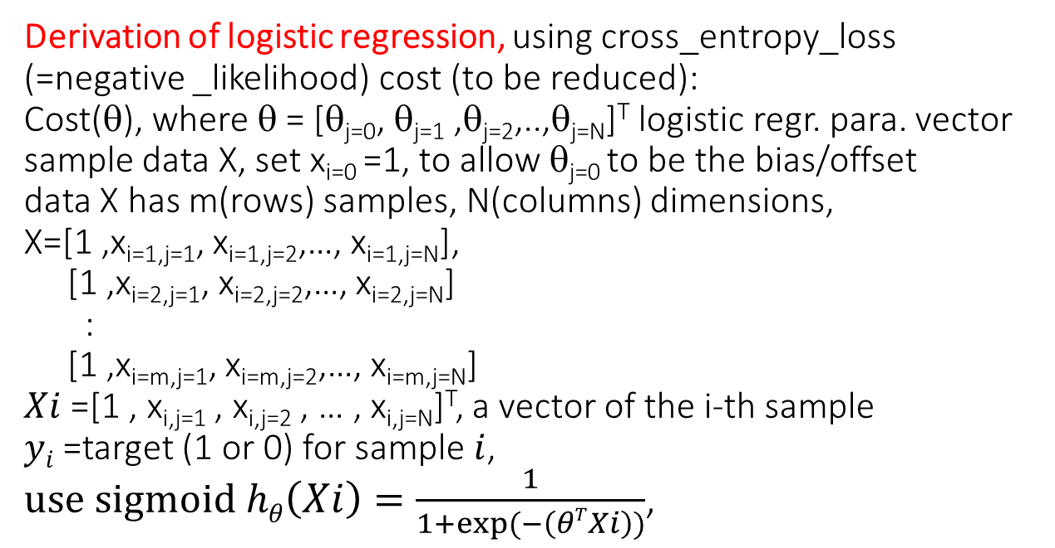
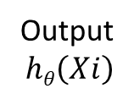

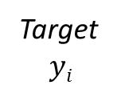



Derivation of logistic regression, using cross_entropy_loss (=negative _likelihood) cost (to be reduced):
Cost(θ), where θ = [θ_{j=0}, θ_{j=1} ,θ_{j=2},..,θ_{j=N}]^{T} logistic regr. para. vector sample data X, set x_{i=0} =1, to allow θ_{j=0} to be the bias/offset data X has m(rows) samples, N(columns) dimensions,
X=[1 ,x_{i=1,j=1}, x_{i=1,j=2},…, x_{i=1,j=N}],
[1 ,x_{i=2,j=1}, x_{i=2,j=2},…, x_{i=2,j=N}]
:
[1 ,x_{i=m,j=1}, x_{i=m,j=2},…, x_{i=m,j=N}]
$Xi$=[1 , x_{i,j=1} , x_{i,j=2} , … , x_{i,j=N}]^{T}, a vector of the i-th sample
$yi$=target (1 or 0) for sample $i$,
$use sigmoid hθ\left(Xi\right)=\frac{1}{1+exp⁡(−\left(θTXi\right))}$,
For the j-th sample
1
θ₀
Output
$$hθ\left(Xi\right)$$
$$Xi=1,j$$
$$Xi=2,j$$
:
$$Xi=N,j$$
θ¹
θ²
$hθ$()
Target
$$yi$$
θ^{n}
Note:
Data has
m training samples
N dimensions
$Xi$ =a vector of N+1
= a vector of N+1
$yi$ = a scalar (0 or 1)
Cost Function for logistic regression is cross entropy loss
cost$\left(θ\right)=\frac{1}{2m}\sum_{i=0}^{m}{\left[−yi∗\left(log⁡(hθ(Xi)\right)−(1−yi\text{)}\text{∗}\text{log}\text{(1−} hθ(Xi))\right]}$
Dealing with the j-th dimension. Note: we still use $\left(hθ(Xi\right) not \left(hθj(Xi\right)$ here
$θj$= $θj$ - $α\frac{∂}{∂θj}$ $cost\left(θ\right)$, summing all i-th samples for ($Xi$) and target ($yi$), α=learning rate
$θj$= $θj$ - $α\frac{∂}{∂θj}\left\{\frac{1}{m}\sum_{i=0}^{m}{\left[−yi\left(hθ(Xi\right)−(1−yi\text{)}\text{log}\text{(1−} hθ(Xi))\right]}\right\}$
Cross entropy loss
for y=0
Cross entropy loss
for y=1
Derivation: https://medium.com/@jacknayeem/derivative-the-gradient-descent-of-linear-and-logistic-regression-6162685cb333

Slide 31
Example, h, X, y etc

Slide 32
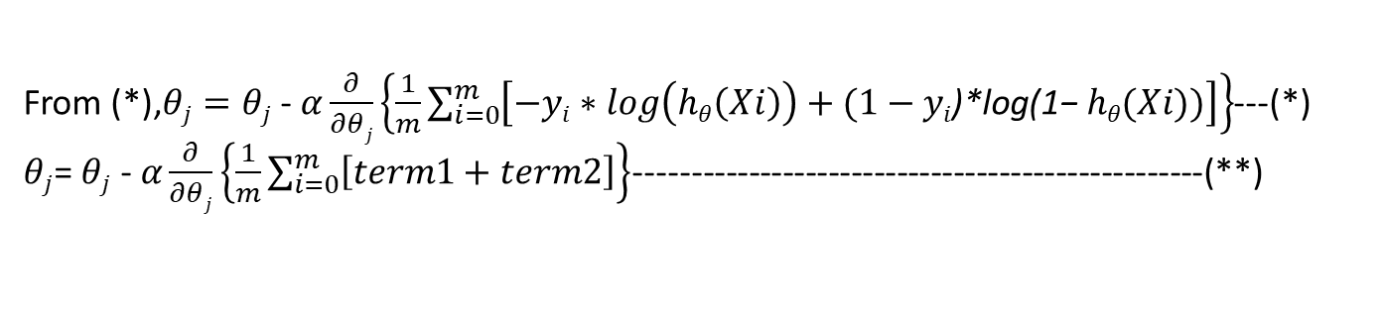
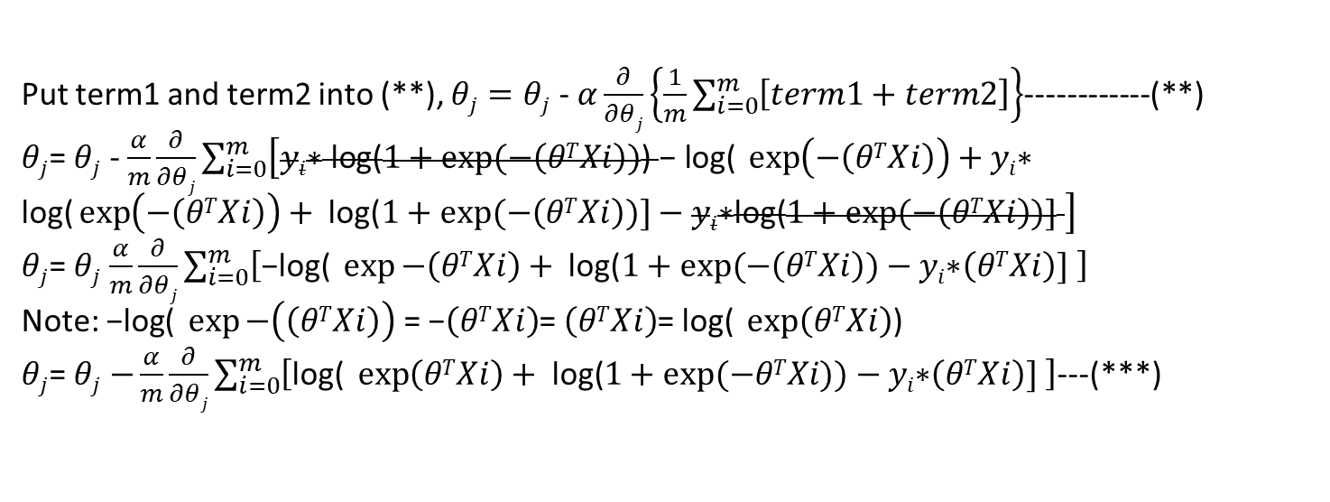
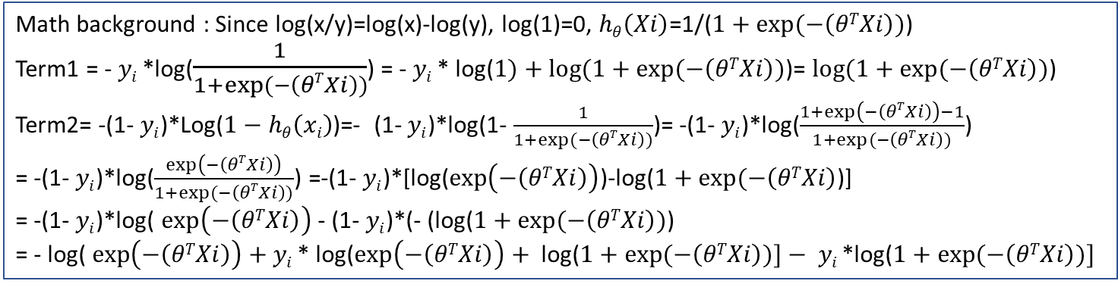
From (*),$θj=θj$ - $α\frac{∂}{∂θj}\left\{\frac{1}{m}\sum_{i=0}^{m}{\left[−yi∗log\left(hθ\left(Xi\right)\right)+(1−yi\text{)}\text{∗}\text{log}\text{(1−} hθ(Xi))\right]}\right\}$---(*)
$θj$= $θj$ - $α\frac{∂}{∂θj}\left\{\frac{1}{m}\sum_{i=0}^{m}{\left[term1+term2\right]}\right\}$--------------------------------------------------(**)
Math background : Since log(x/y)=log(x)-log(y), log(1)=0, $hθ\left(Xi\right)$=1/($1+exp⁡(−\left(θTXi\right))$)
Term1 = - $yi$*log($\frac{1}{1+exp⁡(−\left(θTXi\right))}$) = - $yi$* log($1)+log⁡(1+exp⁡(−\left(θTXi\right))$)= $log⁡(1+exp⁡(−\left(θTXi\right))$)
Term2= -(1- $yi$)*Log($1−hθ\left(xi\right)$)=- (1- $yi$)*log(1- $\frac{1}{1+exp⁡(−\left(θTXi\right))}$)= -(1- $yi$)*log($\frac{1+\exp\left(−\left(θTXi\right)\right)−1}{1+exp⁡(−\left(θTXi\right))}$)
= -(1- $yi$)*log($\frac{\exp\left(−\left(θTXi\right)\right)}{1+exp⁡(−\left(θTXi\right))}$) =-(1- $yi$)*[log($\exp\left(−\left(θTXi\right)\right)$)-log($1+exp⁡(−\left(θTXi\right)$)]
= -(1- $yi$)*log( $\exp\left(−\left(θTXi\right)\right)$ - (1- $yi$)*(- (log($1+exp⁡(−\left(θTXi\right))$)
= - log( $\exp\left(−\left(θTXi\right)\right)+$ $yi$* log($\exp\left(−\left(θTXi\right)\right)+ \text{log}\text{(}1+exp⁡(−\left(θTXi\right))]− yi$*log($1+exp⁡(−\left(θTXi\right))]$
Put term1 and term2 into (**), $θj=θj$ - $α\frac{∂}{∂θj}\left\{\frac{1}{m}\sum_{i=0}^{m}{\left[term1+term2\right]}\right\}$------------(**)
$θj$= $θj$ - $\frac{α}{m}\frac{∂}{∂θj}\sum_{i=0}^{m}{\left[yi\text{∗ }\text{log}\text{(}1+exp⁡(−\left(θTXi\right))\text{)} \text{− }\text{log}\text{( }\exp\left(−\left(θTXi\right)\right)+yi\text{∗ }\text{log}\text{(}\exp\left(−\left(θTXi\right)\right)+ \text{log}\text{(}1+exp⁡(−\left(θTXi\right))]−yi\text{∗}\text{log}\text{(}1+exp⁡(−\left(θTXi\right))] \right]}$
$θj$= $θj$ $\frac{α}{m}\frac{∂}{∂θj}\sum_{i=0}^{m}{\left[\text{−}\text{log}\text{( }\exp{−\left(θTXi\right)}+ \text{log}\text{(}1+exp⁡(−\left(θTXi\right))−yi\text{∗}\left(θTXi\right)] \right]}$
Note: $\text{−}\text{log}\text{( }\exp{−\left(\left(θTXi\right)\right)}$ = $\text{−}\left(θTXi\right)$= $\left(θTXi\right)$= $\text{log}\text{( }\exp\left(θTXi\right)$)
$θj$= $θj$ $−\frac{α}{m}\frac{∂}{∂θj}\sum_{i=0}^{m}{\left[\text{log}\text{( }\exp\left(θTXi\right)+ \text{log}\text{(}1+exp⁡(−θTXi))−yi\text{∗}\left(θTXi\right)] \right]}$---(***)

Slide 33

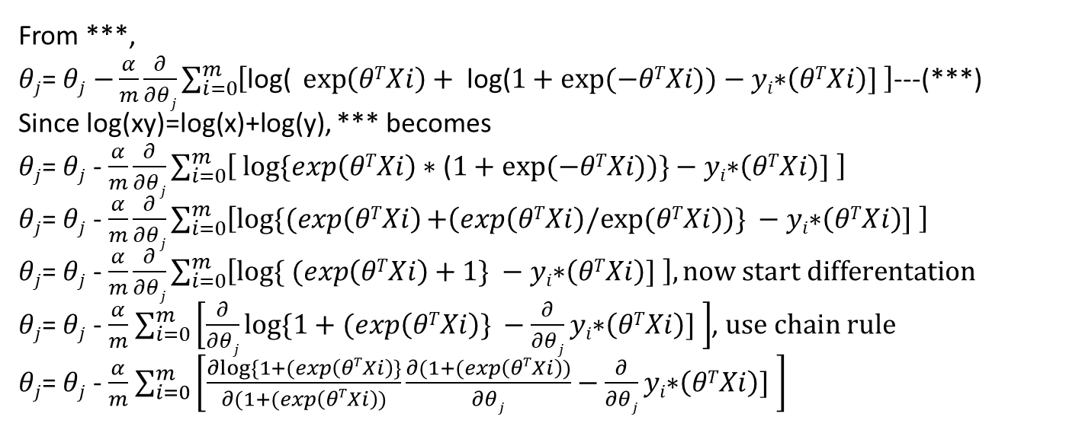
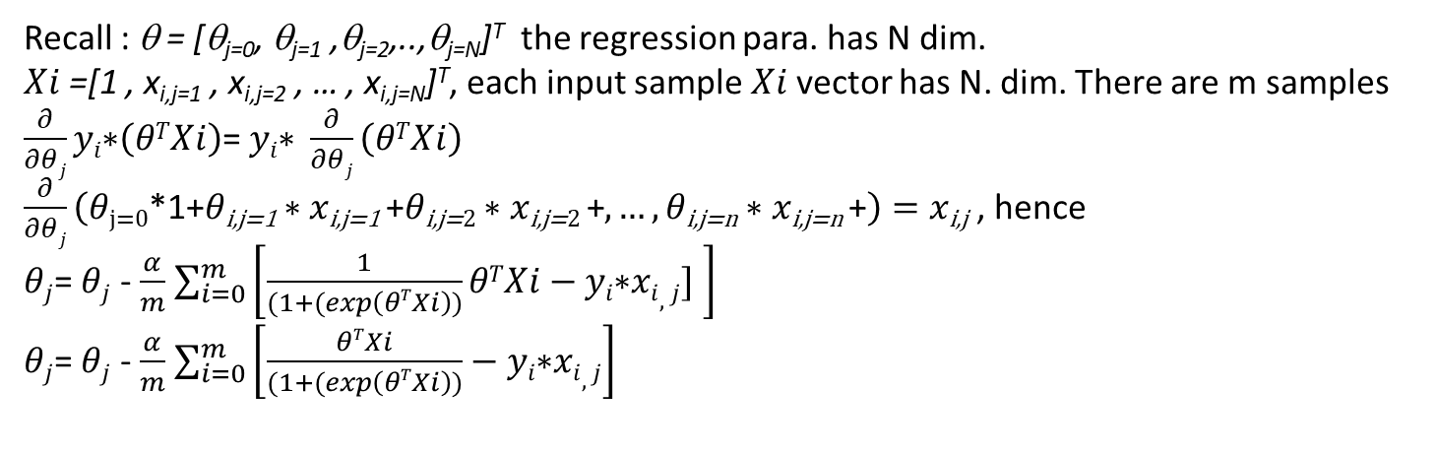

From ***,
$θj$= $θj$ $−\frac{α}{m}\frac{∂}{∂θj}\sum_{i=0}^{m}{\left[\text{log}\text{( }\exp\left(θTXi\right)+ \text{log}\text{(}1+exp⁡(−θTXi))−yi\text{∗}\left(θTXi\right)] \right]}$---(***)
Since log(xy)=log(x)+log(y), *** becomes
$θj$= $θj$ - $\frac{α}{m}\frac{∂}{∂θj}\sum_{i=0}^{m}{\left[ log⁡\{exp\left(θTXi\right)∗\text{(}1+exp⁡(−θTXi))\}−yi\text{∗}\left(θTXi\right)] \right]}$
$θj$= $θj$ - $\frac{α}{m}\frac{∂}{∂θj}\sum_{i=0}^{m}{\left[log⁡\{(exp\left(θTXi\right)+\left(exp\left(θTXi\right)/exp⁡(θTXi\right))\} −yi\text{∗}\left(θTXi\right)] \right]}$
$θj$= $θj$ - $\frac{α}{m}\frac{∂}{∂θj}\sum_{i=0}^{m}{\left[log⁡\{ (exp\left(θTXi\right)+1\} −yi\text{∗}\left(θTXi\right)] \right], \text{now} \text{start} \text{differentation}}$
$θj$= $θj$ - $\frac{α}{m}$ $\sum_{i=0}^{m}{\left[\frac{∂}{∂θj}log⁡\{1+(exp\left(θTXi\right)\} −\frac{∂}{∂θj}yi\text{∗}\left(θTXi\right)] \right]}$, $use chain ru\text{le}$
$θj$= $θj$ - $\frac{α}{m}$ $\sum_{i=0}^{m}{\left[\frac{∂log⁡\{1+(exp\left(θTXi\right)\}}{∂(1+(exp\left(θTXi\right))}\frac{∂(1+(exp\left(θTXi\right))}{∂θj}−\frac{∂}{∂θj}yi\text{∗}\left(θTXi\right)] \right]}$
Note:
$$\frac{∂\exp\left(z\right)}{∂z}=$$
$$\exp\left(z\right)$$
$$\frac{∂\log\left(f(z)\right)}{∂z}= \frac{1}{f(z)}$$
Recall : θ = [θ_{j=0}, θ_{j=1} ,θ_{j=2},..,θ_{j=N}]^{T} the regression para. has N dim.
$Xi$=[1 , x_{i,j=1} , x_{i,j=2} , … , x_{i,j=N}]^{T}, each input sample $Xi$ vector has N. dim. There are m samples
$\frac{∂}{∂θj}yi\text{∗}\left(θTXi\right)$= $yi\text{∗} \frac{∂}{∂θj}\left(θTXi\right)$
$\frac{∂}{∂θj}\left(θ\text{j}\text{=0}\text{∗1+}θ\text{i}\text{,}\text{j}\text{=1}∗x\text{i}\text{,}\text{j}\text{=1} \text{+}θ\text{i}\text{,}\text{j}\text{=}2∗x\text{i}\text{,}\text{j}\text{=}\text{2} \text{+},…,θ\text{i}\text{,}\text{j}\text{=}\text{n}∗x\text{i}\text{,}\text{j}\text{=}\text{n} \text{+}\right)=x\text{i}\text{,}\text{j}$ , hence
$θj$= $θj$ - $\frac{α}{m}$ $\sum_{i=0}^{m}{\left[\frac{1}{(1+(exp\left(θTXi\right))}θTXi−yi\text{∗}xi,j] \right]}$
$θj$= $θj$ - $\frac{α}{m}$ $\sum_{i=0}^{m}{\left[\frac{θTXi}{(1+(exp\left(θTXi\right))}−yi\text{∗}xi,j\right] }$

Slide 34
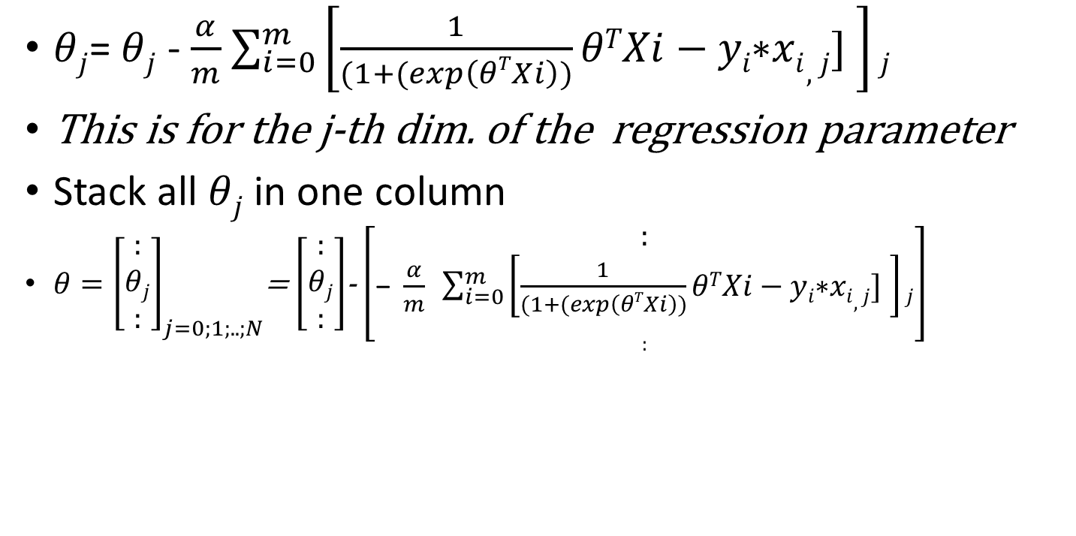
The matrix form
$θj$= $θj$ - $\frac{α}{m}$ $\sum_{i=0}^{m}{\left[\frac{1}{(1+(exp\left(θTXi\right))}θTXi−yi\text{∗}xi,j] \right]j}$
This is for the j-th dim. of the regression parameter
Stack all $θj$ in one column
$θ={\left[\begin{matrix}: \\ θj \\ :\end{matrix}\right]}_{j=0;1;..;N}$= $\left[\begin{matrix}: \\ θj \\ :\end{matrix}\right]$- $\left[\begin{matrix}: \\ \text{− }\frac{α}{m} \sum_{i=0}^{m}{\left[\frac{1}{(1+(exp\left(θTXi\right))}θTXi−yi\text{∗}xi,j] \right]j} \\ :\end{matrix}\right]$

Slide 35
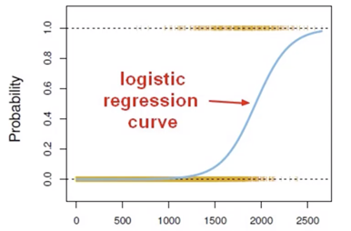

In practice:
Add a column of 1 to the training data
Assume D dimensional problem, num. of samples=N
Sigmoid function, D=2,
X_{train}=$\left[\begin{aligned}\begin{matrix}1 & x_{1,1} & x_{2,1} \\ 1 & x_{1,2} & x_{2,2} \\ 1 & : & :\end{matrix} \\ \begin{matrix}1 & x_{1,k} & x_{2,k} \\ 1 & : & : \\ 1 & x_{1,N} & x_{2,N}\end{matrix}\end{aligned}\right]$
${(X}_{k})T=\left[1,x_{1,k},x_{2,k}\right]$_{(1x3)} % K^{th} row of X_{train}
$θ^{T}$ has D+1 parameters, ${because θ}_{0}$ is the bias:
$θ=\left[θ_{0},θ_{1},θ_{D=2}\right]$^{T}=$\left[β_{0},β_{1}, β_{D=2}\right]$^{T} % assume D=2
$h_{k}$($x$) = $\frac{1}{1+e^{−}\left({(X}_{k})T\left[θ_{0},θ_{1},θ_{D=2}\right]T\right)}=\frac{1}{1+e^{−}\left({(X}_{k})Tθ\right)}$

Slide 36
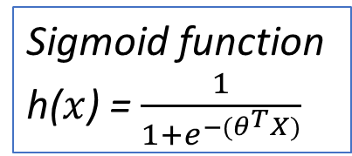
Iterative code
Sigmoid function
h($x$) = $\frac{1}{1+e^{−(θ^{T}X)}}$
h
is
13x1
Xtrain = 1.0000 -0.9200 -0.3378
1.0000 -0.3505 0.3822
1.0000 0.7886 -0.3378
:
1.0000 1.1303 -0.5539
13x3
First column ‘1’ is bias
for j=1:iter
h=sigmoid(xtrain*th);%h is13x1
%xtrain' is 3x13, (ytrain-h) is 13x1, this 3x1, khw
%length(xtrain) and alpha(learning rate=0.1) are scaler
% update rule:d(J(theta))/d(theta)=(1/m)*X'(h_theta(x)-y)
%th=th-alpha*d(J(theta))/d(theta)=
% th = th+(alpha/m)*X’(yh_theta(x)) %update equation
th=th+(alpha/length(xtrain))*xtrain'*(ytrain-h)
%ytrain, h are 13x1
end
3x1
3x13
13x1
This matrix multiplication is to create a summation effect
θ₀ =bias
Ref code from: https://www.mathworks.com/matlabcentral/fileexchange/66161-logistic-regression

Slide 37
Calculation example
https://en.wikipedia.org/wiki/Logistic_regression

Slide 38
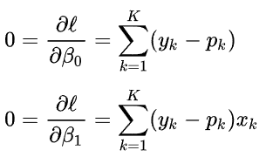
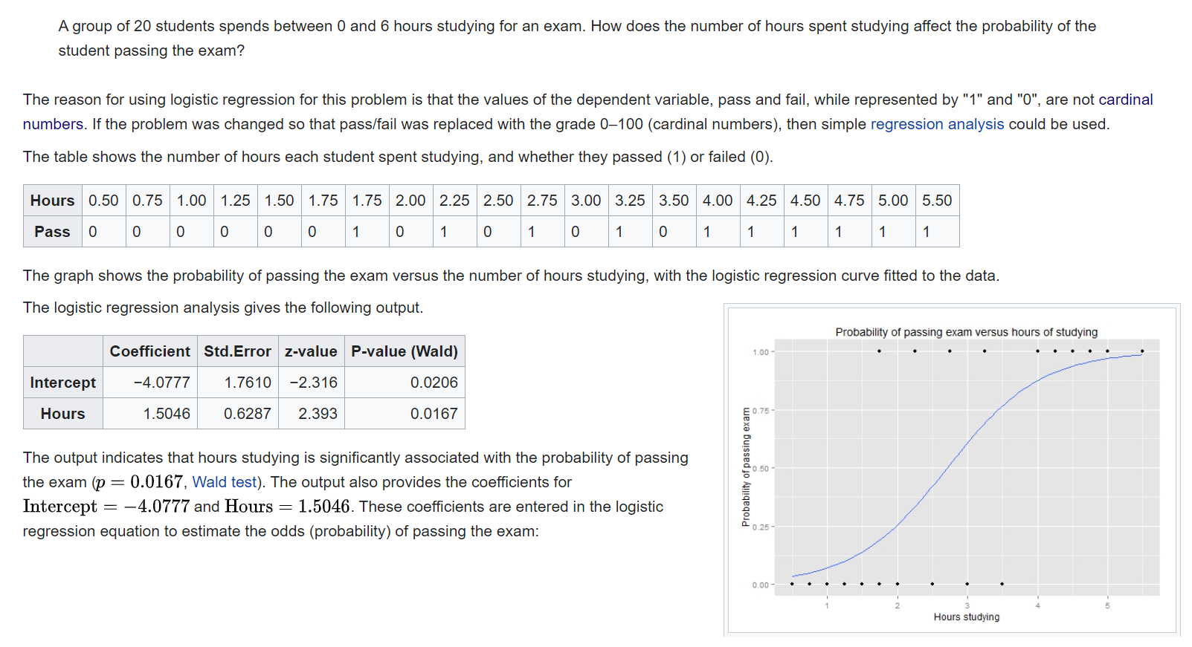
Our main task is to find the sigmoid function β_{0,}β₁
Here: Given some training data, find Sigmoid
X is input
Y is class
We will show later the logistic regression analysis algo. That is how to get the sigmoid function from the training data
We wish to fit a logistic function to the data consisting of the hours studied (x_{i}) and the outcome of the test (y_{i} =1 for pass, 0 for fail). The x variable is called the "explanatory variable", and the y variable is called the "categorical variable" consisting of two categories: "pass" or "fail" corresponding to the categorical values 1 and 0 respectively.

Slide 39
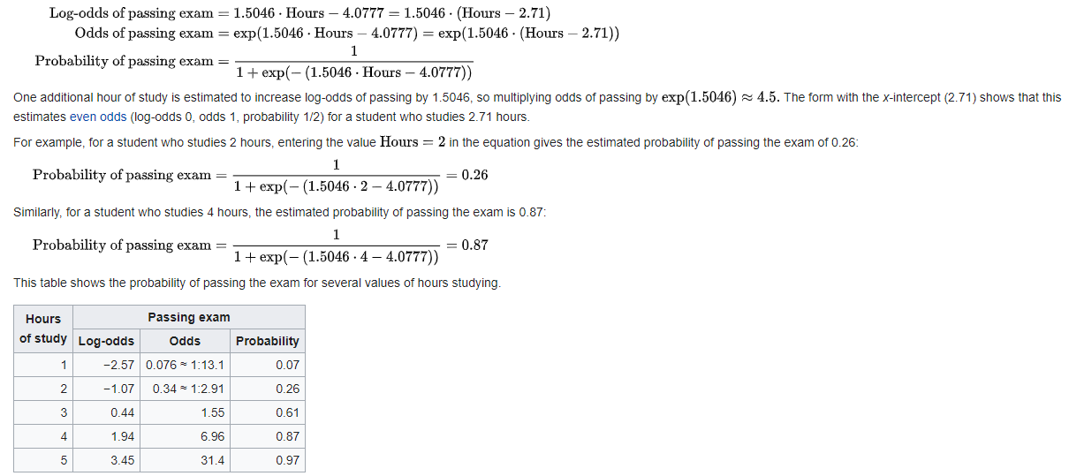
Continue
Plot P vs 1-p
Log(odds) line gradient is -1.5, vertical cutting -4.07
xz
The output from the logistic regression analysis gives a p-value of p=0.0167, which is based on the Wald z-score. Rather than the Wald method, the recommended method[citation needed] to calculate the p-value for logistic regression is the likelihood-ratio test (LRT), which for this data gives p=0.0006.

Slide 40
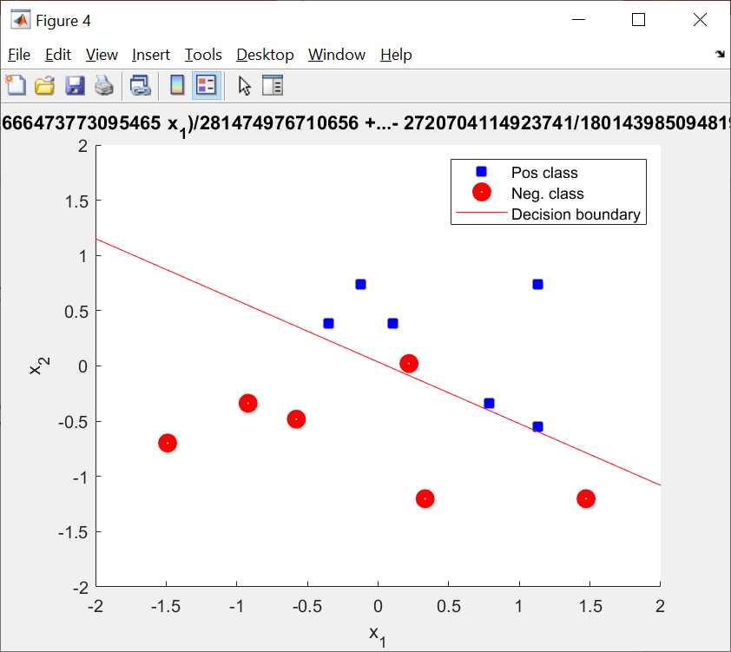
Matlab regression example (2 variables with data normalization) reference: https://www.mathworks.com/matlabcentral/fileexchange/66161-logistic-regression
clc;
clear all;
% Data File for marks of students in two subject
% to determine whether a student is pass or fail
% x=xlsread('marks.xlsx');
x_2var=[ 15 20 0
20 30 1
30 20 1
25 25 0
26 8 0
36 8 0
22 35 1
24 30 1
10 15 0
8 60 1
33 35 1
18 18 0
33 17 1];
x=x_2var;
ytrain=x(:,end); % Target variable
xtrain=zscore(x(:,1:end-1));% Normalized Predictors
p=length(x);
xtrain=[ones(length(xtrain),1) xtrain]; % one is added for calculation of biases.
xtest=xtrain;
ytest=ytrain;
%compute cost and gradient
iter=1000; % No. of iterations for weight updation
theta=zeros(size(xtrain,2),1); % Initial weights
alpha=0.1 % Learning parameter
[J grad h th]=cost(theta,xtrain,ytrain,alpha,iter) % Cost funtion
ypred=xtest*th; %target prediction
% probability calculation
[hp]=sigmoid(ypred); % Hypothesis Function
ypred(hp>=0.5)=1;
ypred(hp<0.5)=0;
% Decision Boundary
syms x1 x2
fnn=th(1)+th(2)*x1+th(3)*x2-0.5
figure
hold on
scatter(xtest(ytest==1,2),xtest(ytest==1,3),'b+','lijidth',5.0)
scatter(xtest(ytest==0,2),xtest(ytest==0,3),'r','lijidth',5.0)
h1=ezplot(fnn)
set(h1,'color','r')
legend('Pos class','Neg. class','Decision boundary')
xlim([-2 2])
ylim([-2 2])
% //// functions ///////////////////////
%/////////////////////////////////////////////////////////////////
function [J grad h th] = cost(theta, xtrain,ytrain,alpha,iter)
%Cost Summary of this function goes here
% Detailed explanation goes here
th=theta
m=size(xtrain,1);
for j=1:iter
h=sigmoid(xtrain*th);
J=-(1/m)*sum(ytrain.*log(h)+(1-ytrain).*log(1-h));
th=th+(alpha/length(xtrain))*xtrain'*(ytrain-h)
end
grad=zeros(size(theta,1),1);
for i=1:size(grad)
grad(i)=(1/m)*sum((h-ytrain)'*xtrain(:,i));
end
end
%///////////////////////////////////////////////////////
function g = sigmoid( z )
%SIGMOID Summary of this function goes here
% Detailed explanation goes here
g=1./(1+exp(-z));
end
th =
0.3490
2.3678
4.2416

Slide 41
Matlab example in wiki (one variable, without data normalization)
%th = -4.0777
% 1.5046
clc;
clear all;
% Data File for marks of students in two subject
% to determine whether a student is pass or fail
x=xlsread('marks_wiki.xlsx');
%Example demonstarted in wiki https://en.wikipedia.org/wiki/Logistic_regression
x_wiki=[0.50 0.75 1.00 1.25 1.50 1.75 1.75 2.00 2.25 2.50 2.75 3.00 3.25 3.50 4.00 4.25 4.50 4.75 5.00 5.50
0 0 0 0 0 0 1 0 1 0 1 0 1 0 1 1 1 1 1 1]
x=x_wiki';
% https://en.wikipedia.org/wiki/Logistic_regression
%https://rpubs.com/johnakwei/167443
ytrain=x(:,end); % Target variable
%xtrain=zscore(x(:,1:end-1));% Normalized Predictors,can remove wiki example
xtrain=(x(:,1:end-1));% Normalized Predictors %no normalization for wiki example
p=length(x);
xtrain=[ones(length(xtrain),1) xtrain]; % one is added for calculation of biases.
xtest=xtrain;
ytest=ytrain;
%compute cost and gradient
iter=10000%000; % No. of iter. will give same answer as in wiki
theta=zeros(size(xtrain,2),1); % Initial weights
alpha=0.1 % Learning parameter
[J grad h th]=cost(theta,xtrain,ytrain,alpha,iter) % Cost funtion
ypred=xtest*th; %target prediction
% probability calculation
[hp]=sigmoid(ypred); % Hypothesis Function
ypred(hp>=0.5)=1;
ypred(hp<0.5)=0;
% Decision Boundary
%for wiki examplel , need rewrite
% for https://en.wikipedia.org/wiki/Logistic_regression
% and https://rpubs.com/johnakwei/167443
% syms x1 x2
% fnn=th(1)+th(2)*x1+th(3)*x2-0.5
%
% figure
% hold on
% scatter(xtest(ytest==1,2),xtest(ytest==1,3),'b+','lijidth',5.0)
% scatter(xtest(ytest==0,2),xtest(ytest==0,3),'r','lijidth',5.0)
% h1=ezplot(fnn)
% set(h1,'color','r')
% legend('Pos class','Neg. class','Decision boundary')
% xlim([-2 2])
% ylim([-2 2])
%th = -4.0777
% 1.5046

Slide 42
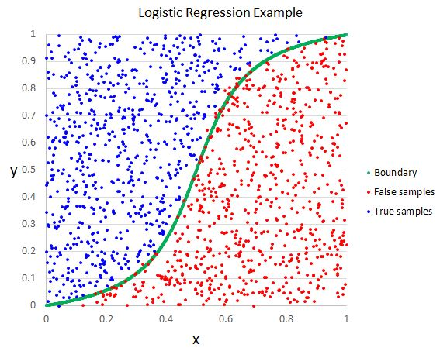
Why it works?
Example 1 to determine exam, pass or fail (mark >0.5)
  X=Hour studying
  Y=Exam result mark
Example 2
  X=pollution pm2.5 rate
  Y=age
Method
  Using the training data to determine the curve
https://helloacm.com/a-short-introduction-logistic-regression-algorithm/

Slide 43
References on logistic regression
https://win-vector.com/2011/09/14/the-simpler-derivation-of-logistic-regression/
Derivation
  https://www.analyticsvidhya.com/blog/2021/07/an-introduction-to-logistic-regression/
  Math background : https://towardsdatascience.com/cross-entropy-negative-log-likelihood-and-all-that-jazz-47a95bd2e81
  https://medium.com/analytics-vidhya/derivative-of-log-loss-function-for-logistic-regression-9b832f025c2d
  http://deeplearning.stanford.edu/tutorial/supervised/SoftmaxRegression/
  The Simpler Derivation of Logistic Regression https://win-vector.com/2011/09/14/the-simpler-derivation-of-logistic-regression/
Logistic regression Numerical calculation example
  https://www.vebuso.com/2020/02/linear-to-logistic-regression-explained-step-by-step/
  https://www.kdnuggets.com/2018/02/logistic-regression-concise-technical-overview.html
  https://www.saedsayad.com/logistic_regression.htm
  https://stats.stackexchange.com/questions/327274/how-to-calculate-logistic-regression-coefficients-manually
  https://www.geeksforgeeks.org/role-of-log-odds-in-logistic-regression/ log(odds) lines
  https://www.graphpad.com/guides/prism/latest/curve-fitting/reg_simple_logistic_coefficients.htm https://www.youtube.com/watch?v=S-piV4ixfAc Video

Slide 44
References on softmax
https://stats.stackexchange.com/questions/265905/derivative-of-softmax-with-respect-to-weights
https://alexcpn.medium.com/yet-another-backpropagation-article-20ae57aabd1e
https://www.mldawn.com/back-propagation-with-cross-entropy-and-softmax/
https://math.stackexchange.com/questions/945871/derivative-of-softmax-loss-function
https://stats.stackexchange.com/questions/298977/why-is-softmax-regression-often-written-without-the-bias-term
https://developers.google.com/machine-learning/crash-course/multi-class-neural-networks/softmax
https://stats.stackexchange.com/questions/308307/matrix-backpropagation-with-softmax-and-cross-entropy
https://stats.stackexchange.com/questions/235528/backpropagation-with-softmax-cross-entropy
https://stats.stackexchange.com/questions/235528/backpropagation-with-softmax-cross-entropy (good, related weights of hidden layer)
https://towardsdatascience.com/derivative-of-the-softmax-function-and-the-categorical-cross-entropy-loss-ffceefc081d1
https://towardsdatascience.com/cross-entropy-negative-log-likelihood-and-all-that-jazz-47a95bd2e81
https://medium.com/analytics-vidhya/derivative-of-log-loss-function-for-logistic-regression-9b832f025c2d
Bias in softmax
  https://stats.stackexchange.com/questions/291730/differentiating-cross-entropy-w-r-t-the-bias-term
  negative log-likelihood_loss is like the cross-entropy_loss: definition
  https://machinelearningmastery.com/cross-entropy-for-machine-learning/
  https://gombru.github.io/2018/05/23/cross_entropy_loss/
  https://sebastianraschka.com/blog/2022/losses-learned-part1.html

Slide 45
Appendix

Slide 46
1-D , simple case square error not working
Given i=1,2,3,4,,m examples
Each sample has a pair
of x^{(i)} : input and y^{(i)} : class label
Each input x^{(i)} has 0,1,2,,,n features,
Total n+1 features

Slide 47
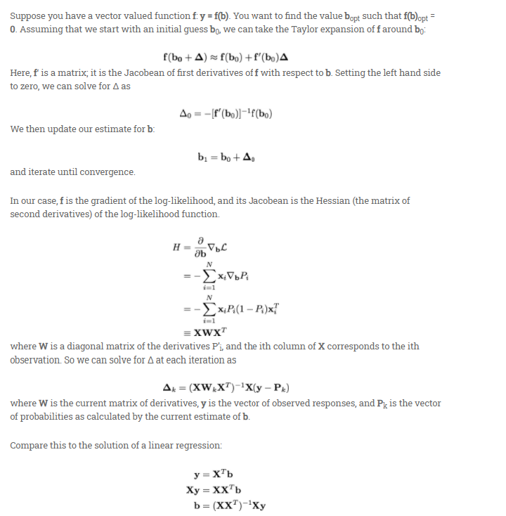

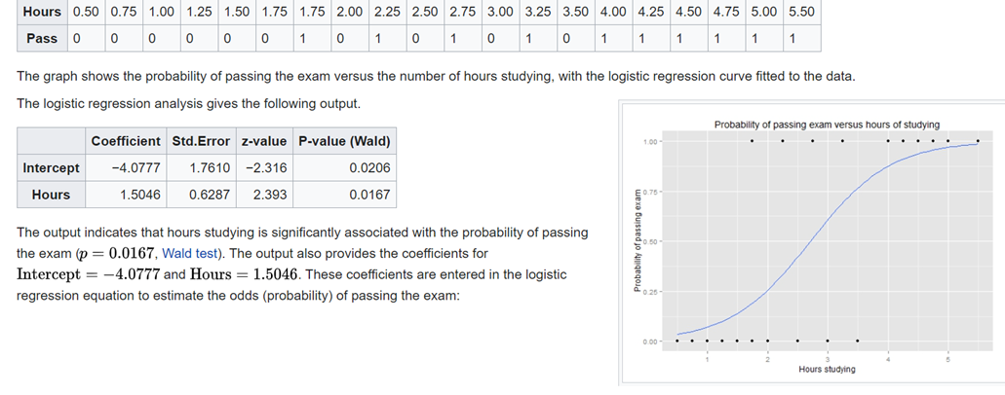
Hessian is introduced for second order approach
Gradient decent method
Given X,Y pairs (training data)
Find b iteratively
j_b=old_b+Δb
Our earlier derivation with
first order term (Jacobian) only
Δb
X is input
Y is class
With second order Hessian term
https://win-vector.com/2011/09/14/the-simpler-derivation-of-logistic-regression/
Note: {Training data} → find β_{0,}β₁,β_{2,} then probability (p) having this result=Sigmoid(β₀+β₁*x1+ β₂*x2)

Slide 48
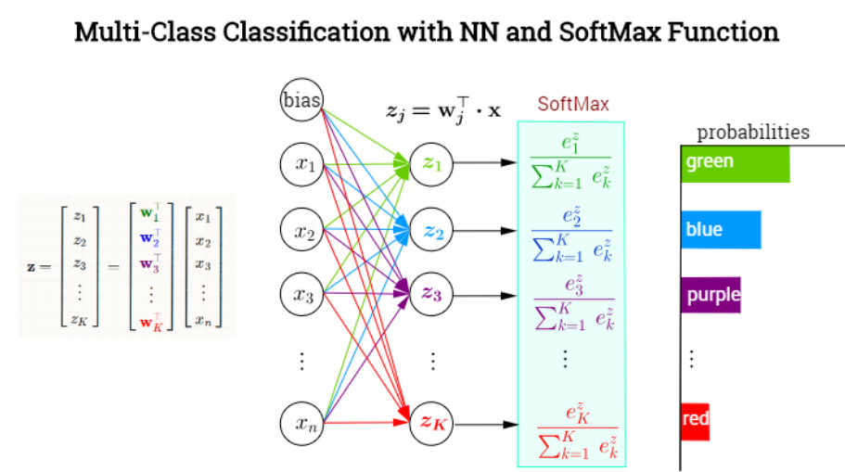
https://stats.stackexchange.com/questions/265905/derivative-of-softmax-with-respect-to-weights

Slide 49
https://stats.stackexchange.com/questions/298977/why-is-softmax-regression-often-written-without-the-bias-term
s
Meaning that each neuron got a bias and is already included in the formula

Slide 50
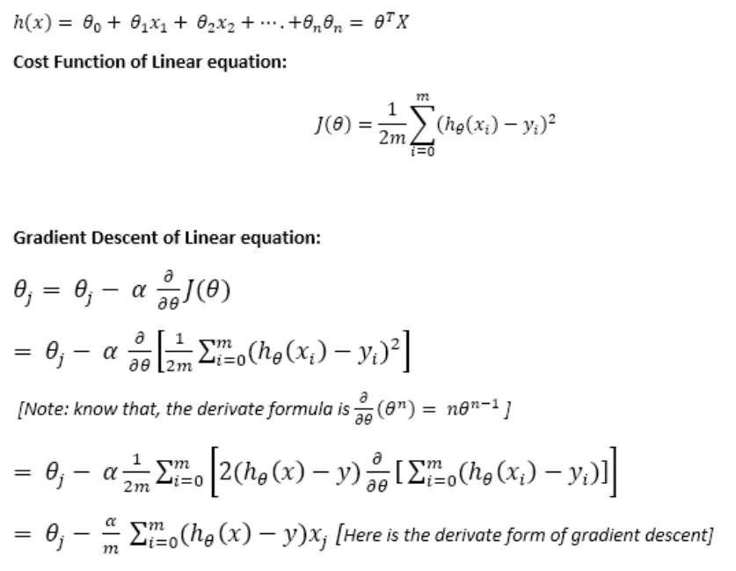
Derivations of Linear regression, using square error cost (to reduce). here we use θ₀, =β_{0,} θ₁₌β₁ (used previously)
J(θ), where θ = [θ₀, θ₁]’ linear parameter vector
https://win-vector.com/2011/09/14/the-simpler-derivation-of-logistic-regression/
Cost=square_Error, so, we need to reduce cost or error

Slide 51
r
Math background : https://towardsdatascience.com/cross-entropy-negative-log-likelihood-and-all-that-jazz-47a95bd2e81
r

Slide 52
Derivations of logistic regression, using cross_entropy_loss (=negative _likelihood) cost (to reduce): here we use θ₀, =β_{0,} θ₁₌β₁ (used previously)
J(θ), where θ = [θ₀, θ₁]’ logistic parameter vector
https://medium.com/analytics-vidhya/derivative-of-log-loss-function-for-logistic-regression-9b832f025c2d
Simplified
Cost
function
negative log-likelihood_loss is like the cross-entropy_loss: definition
https://machinelearningmastery.com/cross-entropy-for-machine-learning/
https://gombru.github.io/2018/05/23/cross_entropy_loss/
https://sebastianraschka.com/blog/2022/losses-learned-part1.html
https://medium.com/@jacknayeem/derivative-the-gradient-descent-of-linear-and-logistic-regression-6162685cb333
https://towardsdatascience.com/cross-entropy-negative-log-likelihood-and-all-that-jazz-47a95bd2e81
Cross entropy loss for y=1
Cross entropy loss for y=0
α=learning rate
m=number of training samples

Slide 53
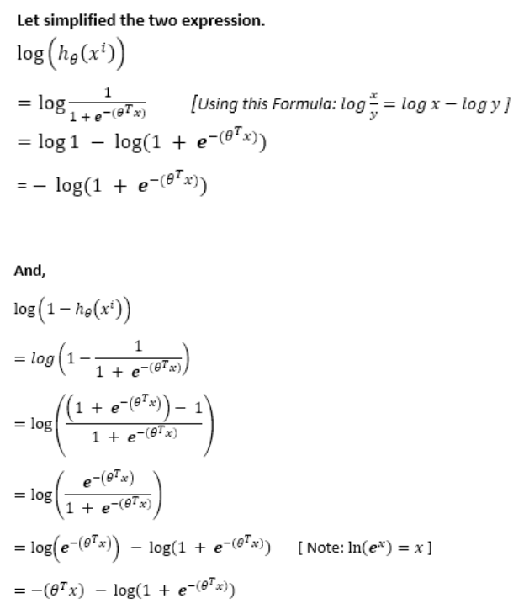
c
c
P(x)=Sigmoid(β₀+β₁*x1+ β₂*x2)

Slide 54
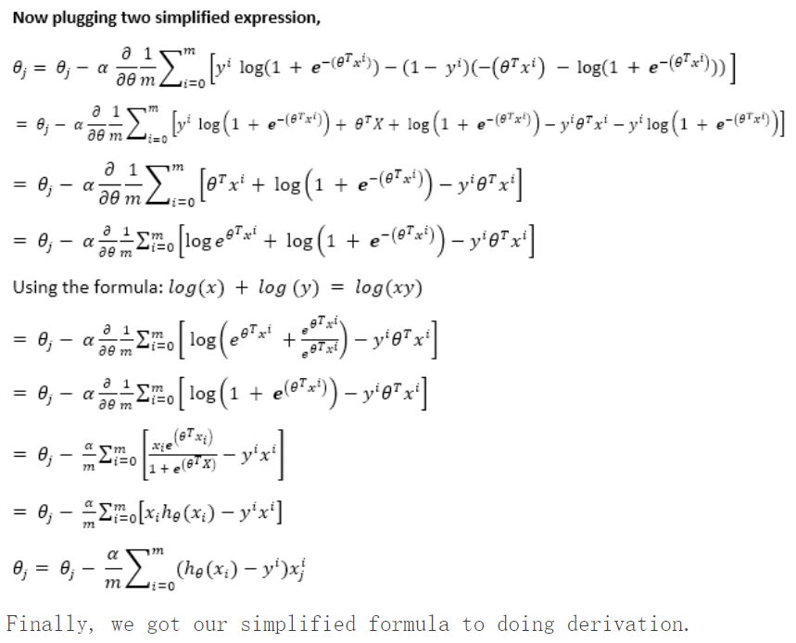
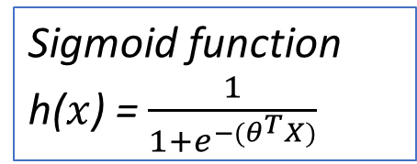
d
d
Sigmoid function
h($x$) = $\frac{1}{1+e^{−(θ^{T}X)}}$
Differentiation step d log(x)/dx =1/log(x), and d(exp(x))/dx=exp(x)
Note: we use cross_entropy_loss (=negative _likelihood) cost (so our goal is to reduce the cost) that’s why we need next_θj= θj-learning_rate*∂ (cross_entropy_loss) / ∂θ

Slide 55
Regression techniques
(draft)
KH Wong

Slide 56
Regression techniques
(1)Linear Regression (direct method)
  (a)Simple linear regression (1 input variable)
  (b)Multiple linear regression (multiple input variable)
(2)Polynomial Regression (non-linear input-output relation) (direct method)
(3)Nonlinear regression as an optimization process (iterative methods)
  jton's method and gradient descent methods
  Regularization schemes to improve results
    (a)Ridge Regression
    (b)Lasso Regression
    (c)Bayesian Linear Regression
(4)Logistic Regression (input output relation is logistic) (iterative methods)

Slide 57
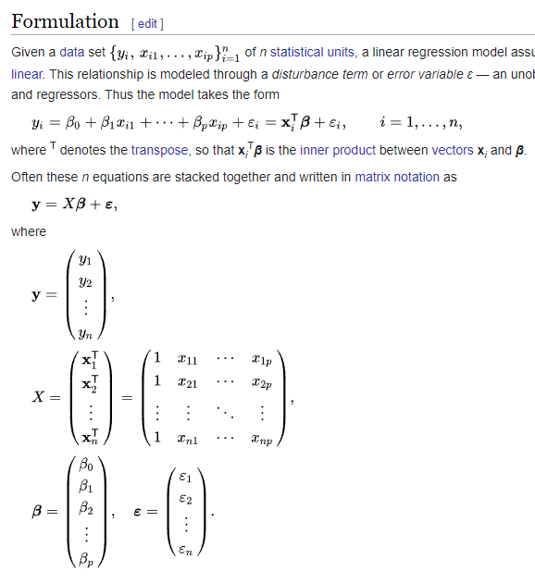
(1)
Defining terms
y is a vector of observed values
X a row vector of independent variables ,or regressors
β0, β1, ..,βm are regression coefficients
https://en.wikipedia.org/wiki/Linear_regression

Slide 58
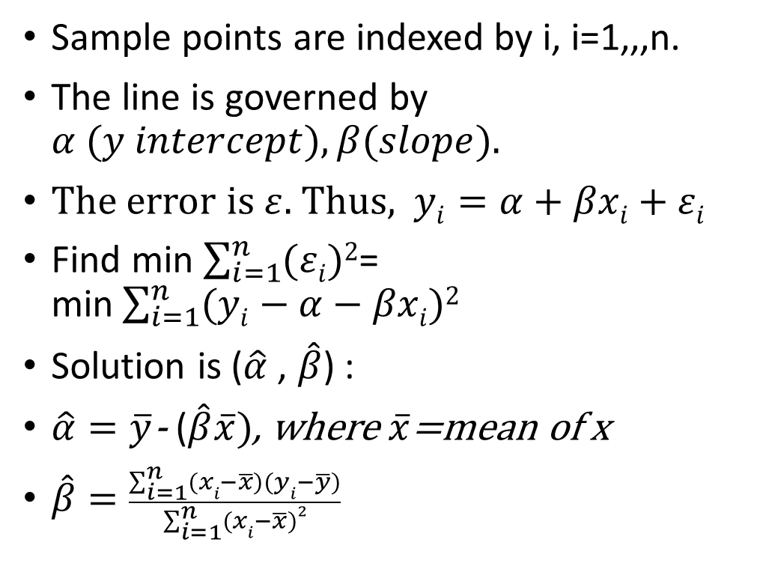

Simple linear regression
(one input variable)
y
Sample points are indexed by i, i=1,,,n.
The line is governed by $α (y intercept),β(slope).$
The error $is ε$. Thus, $yi=α+βxi+εi$
Find min $\sum_{i=1}^{n}{(εi})2$= min$\sum_{i=1}^{n}{(yi−α−βxi})2$
Solution is ($\hat{α}$, $\hat{β}$) :
$\hat{α}=\overline{y}$- ($\hat{β}\overline{x})$, where $\overline{x}$=mean of x
$\hat{β}=\frac{\sum_{i=1}^{n}{(xi−\overline{x})(yi−\overline{y})}}{\sum_{i=1}^{n}{(xi−\overline{x}})2}$
$$εi$$
Sample point (x_{i} ,y_{i})
x
https://www.analyticsvidhya.com/blog/2021/08/understanding-linear-regression-with-mathematical-insights/
https://en.wikipedia.org/wiki/Simple_linear_regression

Slide 59
Proof https://math.stackexchange.com/questions/716826/derivation-of-simple-linear-regression-parameters
d

Slide 60
e
d

Slide 61

%Calculation example1:linear regression,1 valuable. Using matlab
%https://vrcacademy.com/tutorials/simple-linear-regression-raw-data/
clc, clear
%x=DailyRainfall(0.01cm):
%y=Particulate Removed :
x=[4.3 4.5 5.9 5.6 6.1 5.2 3.8 2.1 7.5]'
y=[126 121 116 118 114 118 132 141 108]'
n=length(x)
temp1=n*sum(x.*y)-sum(x)*sum(y)
temp2=n*sum(x.^2)-(sum(x))^2
b1=temp1/temp2
b0=mean(y)-b1*mean(x)
'results'
b1,b0,%b1 = -6.3240;%b0 = 153.1755
'given x=4.8,y=b0+b1*x+e %e=small, y='
'y_estimate=b0 + b1*4.8='
y_estimate=b0 + b1*4.8
%'result' 122.8203
%%plotting : https://www.mathworks.com/matlabcentral/answers/27600-linear-fit
figure(1), clf, scatter(x,y,25,'b','*'), P = polyfit(x,y,1);
yfit = polyval(P,x); hold on; plot(x,yfit,'r-.');
eqn = string(" Linear: y = " + P(1)) + "x + " + string(P(2));
text(min(x),max(y),eqn,"HorizontalAlignment","left","VerticalAlignment","top")
xlabel('x=DailyRainfall(0.01cm)'),ylabel('y Particulate Removed')
Y=122.8
x=4.8

Slide 62

(2)
Multiple linear regression.
(More than one input variables, xi1,xi2,…xip)
https://en.wikipedia.org/wiki/Linear_regression

Slide 63

(2)Polynomial regression (non-linear because of the square and cubic etc. operators ) https://en.wikipedia.org/wiki/Polynomial_regression
y is a vector of observed values
X row vectors of independent variables ,or regressors
We need to find β0, β1, ..,βm regression coefficients
Proof :Ordinary least squares - Wikipedia

Slide 64

proof
Ordinary least squares - Wikipedia
d

Slide 65
Calculation example3: non-linear regression, multiple variables
%data=seq, temperature, yield
%https://online.stat.psu.edu/stat501/lesson/9/9.8
%https://online.stat.psu.edu/stat501/lesson/9/9.8
clear,clc % data=[seq, temperature, yield data]
data=...
[1 50 3.3
2 50 2.8
3 50 2.9
4 70 2.3
5 70 2.6
6 70 2.1
7 80 2.5
8 80 2.9
9 80 2.4
10 90 3.0
11 90 3.1
12 90 2.8
13 100 3.3
14 100 3.5
15 100 3.0];
y=data(:,3);
x1=data(:,2);
x1_sq=x1.*x1; %make sqaure data
x=[ones(length(x1),1) , x1,x1_sq]; %fill 1 at column 1
b=inv(x'*x)*(x'*y)
%b = 7.9605, -0.1537, 0.0011
% The Regression equation is , t=temperature
%y=7.9605-0.1537*t+0.0011*t*t

Slide 66


Derivation of the normal equation
https://eli.thegreenplace.net/2014/derivation-of-the-normal-equation-for-linear-regression/
$h_{β}(x)=β_{0}x_{0}+β_{1}x_{1}$ $+β_{2}x_{2}$ $+…+β_{n}x_{n}$
$$Set cost function$$
$J(β)$=$J(β_{0,1,..,n})$ $=\frac{1}{2m}\sum_{1}^{m}{({h_{β}\left(x^{\left(i\right)}\right)− h}_{β}(x))}A=πr^{2}$
$$J(β)\text{=}\frac{1}{2m}\sum_{i=1}^{m}{{\left(h_{θ}\left(x^{\left(i\right)}\right)−y^{(i)}\right)}^{2}}$$
$$β=\left[β_{0},β_{1},β_{2},…β_{n}\right]T$$
$$x=\left[x_{0}=1,x_{1},x_{2},…x_{n}\right]T$$
$h_{β}(x)=β^{T}$⋅$x$
$J(β)$= $\frac{1}{2m}{(Xβ−y)}^{T}\left(Xβ−y\right)$
= $\frac{1}{2m}\left({(Xβ)}^{T}−y^{T}\right)\left(Xβ−y\right)$
${= \frac{1}{2m}(Xβ)}^{T}Xβ$- ${(Xβ)}^{T}y−{y^{T}\left(Xβ\right)}^{T}+y^{T}y$
$${= \frac{1}{2m}β}^{T}X^{T}Xβ−2{\left(Xβ\right)}^{T}y+y^{T}y$$
The solution is at
$\frac{∂J}{∂β}=2X^{T}Xβ$-2 $X^{T}$y=0
$X^{T}Xβ$= $X^{T}$y, hence$β={\left(X^{T}\text{⋅}X\right)}^{−1}$⋅$X^{T}\text{⋅}y$
This called the normal Equation $β={\left(X^{T}\text{⋅}X\right)}^{−1}$⋅$X^{T}\text{⋅}y$

Slide 67

Normal equation to find the solution
https://nic.schraudolph.org/teach/NNcourse/linear1.html
$y=β_{0}x_{0}+β_{1}x_{1}$ $+β_{2}x_{2}$ $+…+β_{n}x_{n}$
$$Set x_{0}=1, so β_{0} is the bias.$$
$$β=\left[β_{0},β_{1},β_{2},…β_{n}\right]T$$
$$x_{n}^{T}=\left[{1,x}_{11},x_{12},…x_{np}\right]T$$
$$y=\left[y_{1},y_{2},…y_{n}\right]T$$
$y =β^{T}$⋅$x$
Given $several samples of pairs of y^{′}and x^{′}, i.e.$
$$y^{′}and x′=\left[1,x_{1}′,x_{2}′,…x_{n}′\right]T$$
$$y^{′′}and x′′=\left[1,x_{1}′′,x_{2}′′,…x_{n}′′\right]T$$
^{… etc}
we would like to find y using the
Normal Equation $β={\left(X^{T}\text{⋅}X\right)}^{−1}$⋅$X^{T}\text{⋅}y$
Will give you the proof of this equation later.

Slide 68
Derivation of the normal equation
https://eli.thegreenplace.net/2014/derivation-of-the-normal-equation-for-linear-regression/
$h_{β}(x)=β_{0}x_{0}+β_{1}x_{1}$ $+β_{2}x_{2}$ $+…+β_{n}x_{n}$
$$Set cost function$$
$J(β)$=$J(β_{0,1,..,n})$ $=\frac{1}{2m}\sum_{1}^{m}{({h_{β}\left(x^{\left(i\right)}\right)− h}_{β}(x))}A=πr^{2}$
$$J(β)\text{=}\frac{1}{2m}\sum_{i=1}^{m}{{\left(h_{θ}\left(x^{\left(i\right)}\right)−y^{(i)}\right)}^{2}}$$
$$β=\left[β_{0},β_{1},β_{2},…β_{n}\right]T$$
$$x=\left[x_{0}=1,x_{1},x_{2},…x_{n}\right]T$$
$h_{β}(x)=β^{T}$⋅$x$
$J(β)$= $\frac{1}{2m}{(Xβ−y)}^{T}\left(Xβ−y\right)$
= $\frac{1}{2m}\left({(Xβ)}^{T}−y^{T}\right)\left(Xβ−y\right)$
${= \frac{1}{2m}(Xβ)}^{T}Xβ$- ${(Xβ)}^{T}y−{y^{T}\left(Xβ\right)}^{T}+y^{T}y$
$${= \frac{1}{2m}β}^{T}X^{T}Xβ−2{\left(Xβ\right)}^{T}y+y^{T}y$$
The solution is at
$\frac{∂J}{∂β}=2X^{T}Xβ$-2 $X^{T}$y=0
$X^{T}Xβ$= $X^{T}$y, hence$β={\left(X^{T}\text{⋅}X\right)}^{−1}$⋅$X^{T}\text{⋅}y$
This called the normal Equation $β={\left(X^{T}\text{⋅}X\right)}^{−1}$⋅$X^{T}\text{⋅}y$

Slide 69
Alternative proof
Ordinary least squares - Wikipedia
d

