Slide 1
Reinforcement learning
KH Wong
References: https://en.wikipedia.org/wiki/Reinforcement_learning
https://people.engr.tamu.edu/robin.r.murphy/IAIR2/Ch16bQ-LearningExample.pptx

Slide 2
Introduction
3 types of machine learning methods
  Supervised learning: e.g. Convolution Neural Net CNN
  Unsupervised learning: e.g. K-means
  Reinforcement learning, e.g. Q-learning, Deep-Q-Learning DQN
Reinforcement learning is similar to human learning: obtain reward if correct, otherwise no-reward or penalty.
Applications: robot navigation, natural language processing – ChatGPT, etc.
Famous reinforcement learning applications: AlphaGo –plays GO, Netflix – for its recommendation system, Google – for page ranking etc.

Slide 3
Q learning is a reinforcement method
Q-learning learns by taking actions and review rewards. It does not involve a model so it is model free.
Assume the environment involves a a Markov decision process (the future state only depends on the present state)
Q-learning finds an optimal policy to maximizing the expected total reward.
A policy (π) is the rule that how the agent acts (execute action ‘a’) given a state (s).
a_{t}←π_{θ}(s_{t}). π can be random(π_{θ=random}), or optimal (π_{θ=optimal}) which gives the highest reward.
Q leaning is a way to find π_{θ=optimal}

Slide 4



Basic concept of reinforcement learning
Environment
(Gymnasium game simulator)
Action (a)
Agent
State(s)
An agent takes actions (a) in an environment to learn an optimal scheme to achieve the highest rewards.
E.g. : an agent is a game player.
The environment (Env) is the video game or simulator.
Action (a) is how he moves the keyboard/mouse.
Reward (R) is point scored.
At state (s_{t}) if action ‘a_{t}’ is taken, the environment will enter a new state (s_{t+1})
https://www.datacamp.com/tutorial/introduction-q-learning-beginner-tutorial
Reward(R)
This Photo by Unknown Author is licensed under CC BY-NC
This Photo by Unknown Author is licensed under CC BY
This Photo by Unknown Author is licensed under CC BY-SA

Slide 5
Different Q learning algorithms
Part 1a :Vanilla Q learning (greedy approach)
Part 1b: Q leaning with Epsilon(ε)-greedy algo.
Part 2a: Vanilla Q Deep Learning.
Part 2b: Double Q Deep Learning.

Slide 6
Part 1a
Vanilla Q learning (greedy approach)
Demo how it works by an example

Slide 7
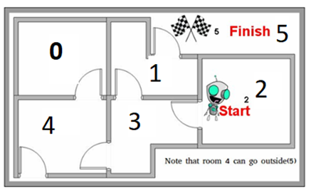
Problem definition, learn through as example. Teach a robot to escape from the maze
https://leonardoaraujosantos.gitbook.io/artificial-inteligence/artificial_intelligence/reinforcement_learning/qlearning_simple

Slide 8

Meaning of action and reward
At a certain state s_{t}, a robot can take action from a list (a1,a2,a3,a4).
For each action chosen it gets a reward. i.e.
Action Reward
a1, 10
a2, -1
a3, 10
a4, 100
Reasons: Takes a1,a2,a3 gain less reward/score. Take a4 will go to the exit.
a1
State s_{t}
a2
a3
a4
Exit

Slide 9
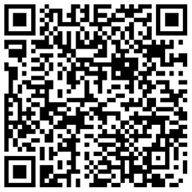
How about multiple steps?
Example from s_{t-1} to s_{t} :
If the robot is at state s_{t-1,} the action reward are as follows:
Exercise 1 : Which action will the robot choose?
Action reward
1) a1, 10
2) a2, 75
3) a3, 5
4) a4, 0
The idea is to ask the robot to learn the best move at every step to maximize total rewards.
a1
a1
State s_{t}
State s_{t-1}
a2
a3
a2
a3
a4
a4
Exit

Slide 10
Temporal difference learning (TD)
Answer to Exercise 1: (2) is true, because reward is the highest
Temporal Difference Learning estimates the value of states in a Markov Decision Process (MDP). A prediction method that updates estimates based on the difference, or “temporal difference”, between the estimated values of two successive states. This difference is then used to update the value of the initial state.
V(S_{t})^{update}= V(S_{t}) + αlpha * [R_{t+1} + γ * V(S_{t+1}) - V(S_{t})]
V(S_{t}) is the current estimate of the state’s value
alpha=a is the learning rate (alpha, e.g. α = 0.95 or 1)
R_{t+1} is the reward observed after taking the action
γ is the discount rate (gamma, e.g. γ = 0.85)
V(S_{t+1}) is the estimated value of the next state
https://saturncloud.io/glossary/temporal-difference-learning/

Slide 11
The idea of Q learning
An agent (e.g. a robot game player) is at a certain state ‘s’ in an environment (i.e. PAC-MAN game), it performs an action ‘a’ (move the cursor left ) and see how much reward (swallowing a Pac-dot) will be obtained and the experience is store in a Q-table with entries of Q(state, action) . After many exploration cycles, the Q table is constructed and will be used to give advice to the system to perform well in playing the same game.
You need two matrix tables
R-table
  In our example, it is given, it is always be the same and cannot be changed. Another example is for a game engine, it is already designed by the game-designer.
Q-table
  To be learned by the Q-learning algorithm

Slide 12
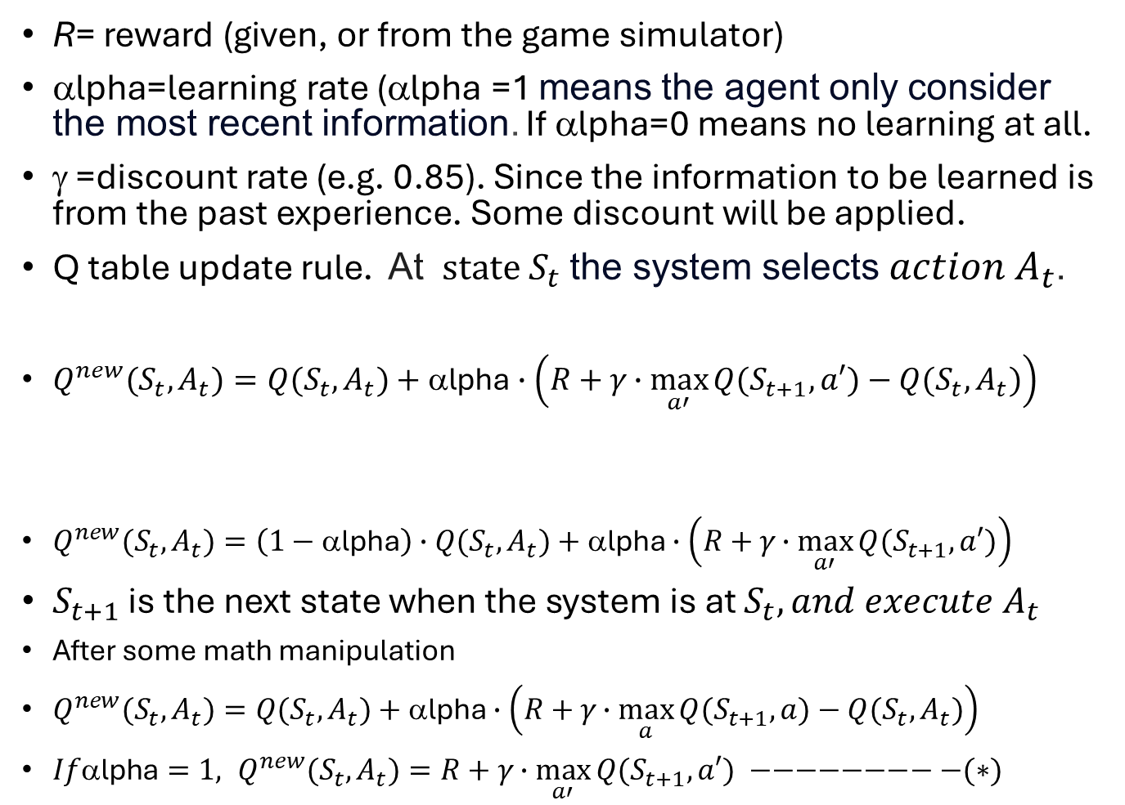
Q learning is a Temporal difference learning (TD) method
R= reward (given, or from the game simulator)
αlpha=learning rate (αlpha =1 means the agent only consider the most recent information. If αlpha=0 means no learning at all.
γ =discount rate (e.g. 0.85). Since the information to be learned is from the past experience. Some discount will be applied.
Q table update rule. At $state S_{t}$the system selects ${action A}_{t}$.
$Q^{new}{(S}_{t},A_{t})=Q{(S}_{t},A_{t})+\text{α}\text{lpha}∙\left(R+γ∙\max_{a′}{Q{(S}_{t+1},a′)}−Q{(S}_{t},A_{t})\right)$
$Q^{new}{(S}_{t},A_{t})=\left(1−\text{α}\text{lpha}\right)∙Q{(S}_{t},A_{t})+\text{α}\text{lpha}∙\left(R+γ∙\max_{a′}{Q{(S}_{t+1},a′)}\right)$
$S_{t+1}$ is the next state when the system is at $S_{t},{and execute A}_{t}$
After some math manipulation
$Q^{new}{(S}_{t},A_{t})=Q{(S}_{t},A_{t})+\text{α}\text{lpha}∙\left(R+γ∙\max_{a}{Q{(S}_{t+1},a)−Q{(S}_{t},A_{t})}\right)$
${If\text{α}\text{lpha}=1, Q}^{new}{(S}_{t},A_{t})=R+γ∙\max_{a′}{Q{(S}_{t+1},a′) −−−−−−−−−(∗)}$
Estimate of best future value (Bellman’s equation)
Original Q value
New value: Temporal difference target

Slide 13
General terms used in Q-learning
Model-free: Q-learning is model free because it doesn’t require one. It learns by maximizing rewards when taking actions.
Behaviorial Policy: is the policy the Agent uses to find its action in a given state, so behavior policy is in charge of selecting actions for the Agent.
Target Policy: is the policy the Agent uses to learn from the rewards received for its actions which are used to update the Q-value.
On-policy: An agent uses the same approach for selecting action and updating Q value (i.e. epsilon greedy algorithm). E.g. The SARSA (State-Action-Reward-State-Action ) method is on-policy.
  For the Behavior Policy: uses Epsilon(ε)-greedy_algo() to select action
  For the Target Policy: uses Epsilon(ε)-greedy_algo() to update Q-value
Off-policy: An agent uses different approaches for selecting action and updating Q value. E.g. the Q learning method is Off-policy.
  For the Behaviorial Policy: uses Epsilon(ε)-greedy_algo() to select action
  For the Target Policy: uses max() (pure greedy) to update the Q value
Epsilon(ε)-greedy algorithm : to be discussed later
https://arshren.medium.com/reinforcement-learning-on-policy-and-off-policy-5587dd5417e1
https://en.wikipedia.org/wiki/Q-learning

Slide 14
Differences between Q-learning -- off policy approach and SARSA (State-Action-Reward-State-Action) – on policy approach
It is about Exploration vs. Exploitation
Q-learning : is an off-policy method, Q-learning updates its Q-values using the maximum possible future reward, regardless of the action taken. This can lead to more aggressive exploration of the environment.
SARSA : is an on-policy method, SARSA updates its Q-values based on the actions actually taken by the policy. This typically results in a more cautious approach, balancing exploration and exploitation more conservatively.
No definite answer to which approach is better, depends on application.
https://www.geeksforgeeks.org/differences-between-q-learning-and-sarsa/

Slide 15
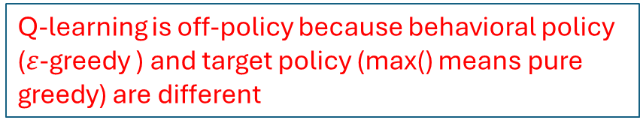
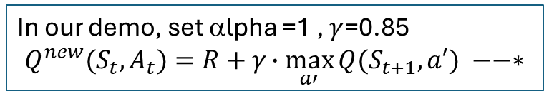
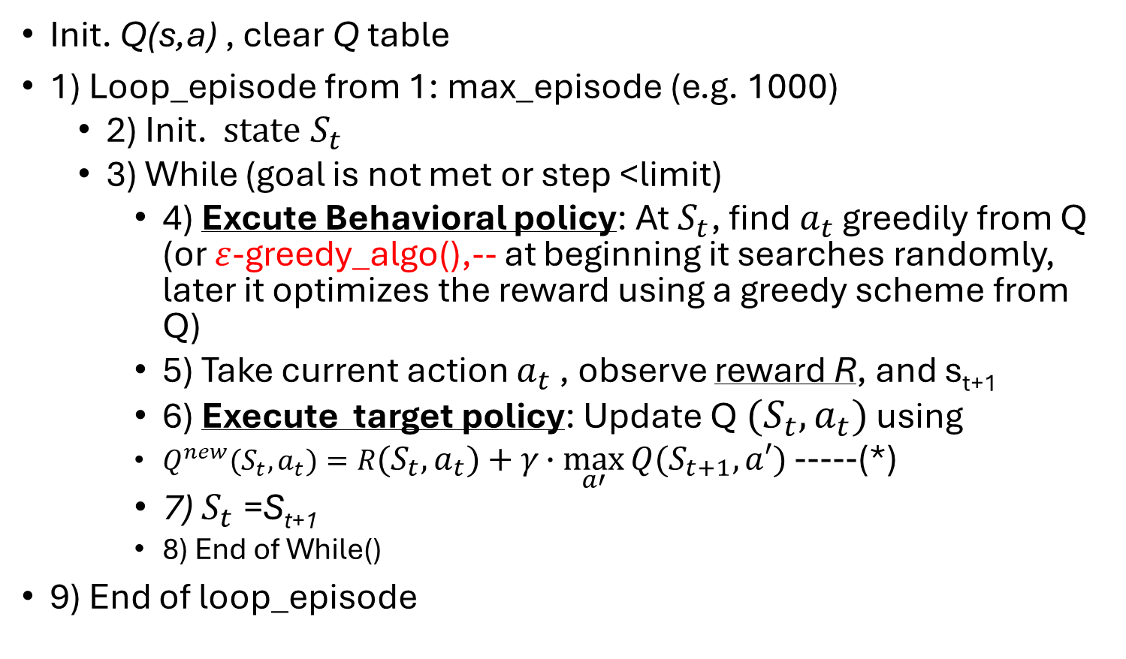
Simple vanilla Q learning algorithm1 (greedy approach) pseudo code https://www.researchgate.net/figure/The-Q-Learning-Algorithm-6_fig1_220776448 https://web.stanford.edu/class/psych209/Readings/SuttonBartoIPRLBook2ndEd.pdf
In our demo, set αlpha =1 , $γ$=0.85
$$Q^{new}{(S}_{t},A_{t})=R+γ∙\max_{a′}{Q{(S}_{t+1},a′) −−∗}$$
Init. Q(s,a) , clear Q table
1) Loop_episode from 1: max_episode (e.g. 1000)
  2) Init. $state S_{t}$
  3) While (goal is not met or step <limit)
    4) Excute Behavioral policy: At $S_{t}$, find$a_{t}$ greedily from Q (or $ε$-greedy_algo(),-- at beginning it searches randomly, later it optimizes the reward using a greedy scheme from Q)
    5) Take current action $a_{t}$ , observe reward R, and s_{t+1}
    6) Execute target policy: Update Q ${(S}_{t},a_{t})$ using
    $Q^{new}{(S}_{t},a_{t})=R{(S}_{t},a_{t})+γ∙\max_{a′}{Q{(S}_{t+1},a′) }$-----(*)
    7) $S_{t}$=S_{t+1}
    8) End of While()
9) End of loop_episode
Q-learning is off-policy because behavioral policy ($ε$-greedy ) and target policy (max() means pure greedy) are different
Q-Learning By Examples: Numerical Example

Slide 16
Vanilla Q-Learning Example1
References:
http://mnemstudio.org/path-finding-q-learning-tutorial.htm
https://people.engr.tamu.edu/robin.r.murphy/IAIR2/Ch16bQ-LearningExample.pptx
Note: In our discussion:
S=S_{t} , S’=S_{t+1} , a=a_{t} , a’=a_{t+1}

Slide 17
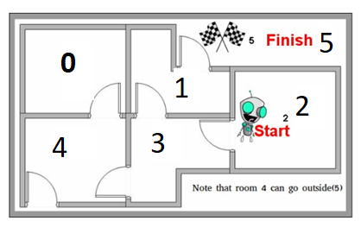
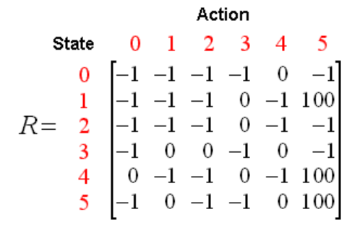
Reward R-table
From state and take an action
If you are in room (state) “1” take action (go to) “5” reward is 100 (Finished).
If you are in state “4” take action ”0”, then reward is 0 (just another room). Also, you may take action “3 (just another room)
Reward = -1 represents there is a wall you cannot get across. Say you are in state 4 you cannot take action 1,2,4. However, go to 5 is possible, thru. The narrow corridor.
The reward table (fixed) is available for the user at anytime.
Ex2. If it is at room 4 and takes action to 5, find the reward in the R-table.
1) -1 ; 2) 0 ; (3) 100 ; (4) 1
R=Reward table, R is given and always the same

Slide 18
State/action R, Q table
Room = state. R=Reward table, R is given and always the same
Answer to Exercise 2: (choice 3) is true, reward=100
 |  | Action
R | State | 0 | 1 | 2 | 3 | 4 | 5
 | 0 | -1 | -1 | -1 | -1 | 0 | -1
 | 1 | -1 | -1 | -1 | 0 | -1 | 100
 | 2 | -1 | -1 | -1 | 0 | -1 | -1
 | 3 | -1 | 0 | 0 | -1 | 0 | -1
 | 4 | 0 | -1 | -1 | 0 | -1 | 100
 | 5 | -1 | 0 | -1 | -1 | 0 | 100
Example 1: How to read the R table:
If the robot is at state 1 (at room1), perform action 5 (go to room5), the reward is 100.
If the robot is at state 2(at room2), perform action 3 (go to room3), the reward is 0.
If the robot is at state 2(at room2) , perform action 4(go to room4), the reward is -1 (not possible).
Similar approach for Q-matrix.
Exercise 3: If the robot is at room1 , according to the Q table, which room the robot should go next according to the Q table?
(1) or (2) or (3) or (4) or (5)
Q_table is
to be learned
 |  | Action
Q | State | 0 | 1 | 2 | 3 | 4 | 5
 | 0 | 0 | 0 | 0 | 0 | 0 | 0
 | 1 | 0 | 0 | 0 | 0 | 0 | 100
 | 2 | 0 | 0 | 0 | 0 | 0 | 0
 | 3 | 0 | 0 | 0 | 0 | 0 | 0
 | 4 | 0 | 0 | 0 | 0 | 0 | 0
 | 5 | 0 | 0 | 0 | 0 | 0 | 0

Slide 19
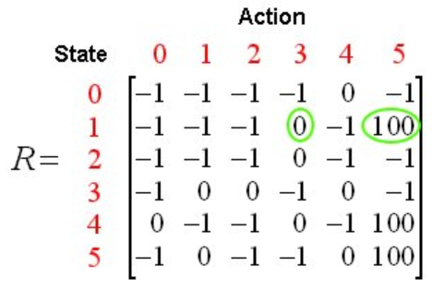
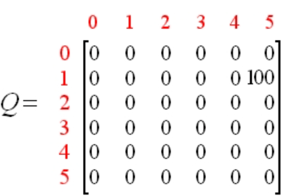
How to read the Q table:
Ans. to Ex.3: (choice 5 is true) because Q(1,5)=100 is the highest.
Before learning, you should have the R-table (fixed, no change afterwards)
Set discount rate (γ) =0.8, learning_rate α =1
Starting from episode 1. Then episode 2, 3 etc. until the Q_matrix is stable or 1000 times
Find the best reward for this episode.
See next slide for episode1.
R=Reward table, R is given and always the same
Action
state
Result of episode 1
Q_matrix
To be learned

Slide 20
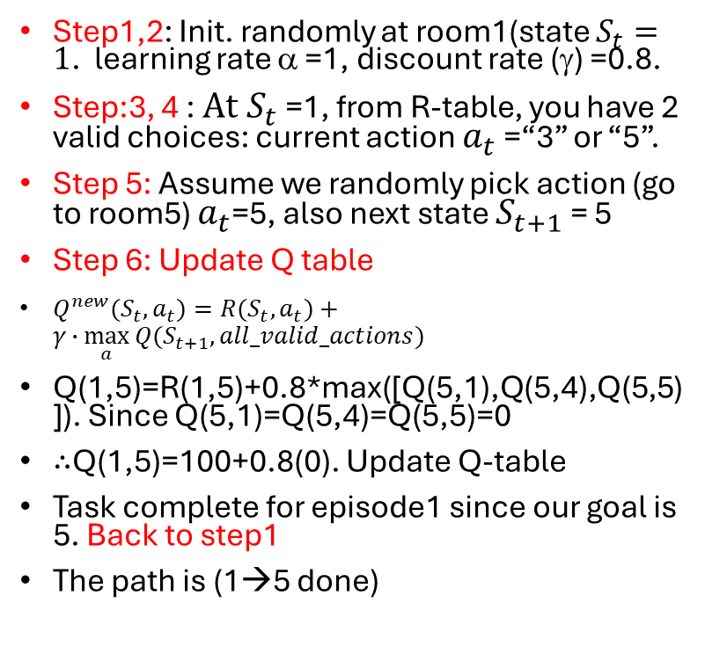
Example 1
Learning Q-table (Q-matrix)
Episode 1
Refer to Algorithm 1 for the steps
Step1,2: Init. randomly at room1(state $S_{t}=1$. learning rate α =1, discount rate (γ) =0.8.
Step:3, 4 : $At S_{t}$=1, from R-table, you have 2 valid choices: current action $a_{t}$ =“3” or “5”.
Step 5: Assume we randomly pick action (go to room5) $a_{t}$=5, also next state $S_{t+1}$= 5
Step 6: Update Q table
$Q^{new}{(S}_{t},a_{t})=R{(S}_{t},a_{t})+γ∙\max_{a}{Q{(S}_{t+1},all_valid_actions) }$
Q(1,5)=R(1,5)+0.8*max([Q(5,1),Q(5,4),Q(5,5)]). Since Q(5,1)=Q(5,4)=Q(5,5)=0
∴Q(1,5)=100+0.8(0). Update Q-table
Task complete for episode1 since our goal is 5. Back to step1
The path is (1→5 done)
R=Reward table, R is given and always the same
-1 = not valid
Action
state
Q_matrix
To be learned
Result of episode 1
From**:Q(state,action)=R(state,action)+ γ Max[Q(nextState,allActionsnextState​)]

Slide 21
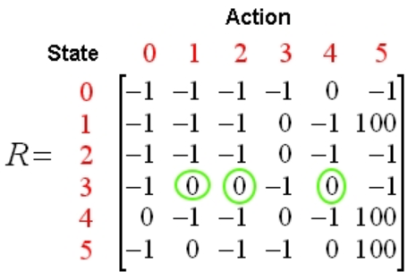
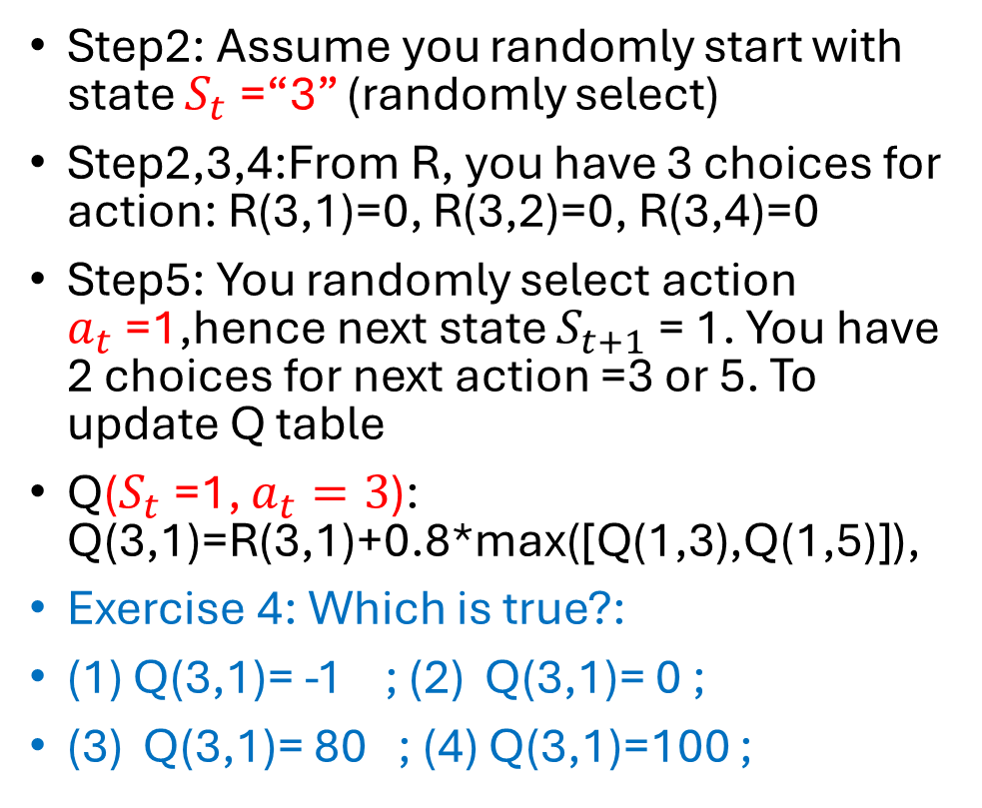
Learning Q-table
Now, try Episode 2
Based on episode 1, we will continue to train the system by randomly select the initial position
Step2: Assume you randomly start with state $S_{t}$=“3” (randomly select)
Step2,3,4:From R, you have 3 choices for action: R(3,1)=0, R(3,2)=0, R(3,4)=0
Step5: You randomly select action $a_{t}$=1,hence next state $S_{t+1}$= 1. You have 2 choices for next action =3 or 5. To update Q table
Q($S_{t}$=1, $a_{t}=3$): Q(3,1)=R(3,1)+0.8*max([Q(1,3),Q(1,5)]),
Exercise 4: Which is true?:
(1) Q(3,1)= -1 ; (2) Q(3,1)= 0 ;
(3) Q(3,1)= 80 ; (4) Q(3,1)=100 ;
Q before update
Q(state,action)=R(state,action)+Gamma∗Max[Q(nextState,allActions_nextState​)]

Slide 22
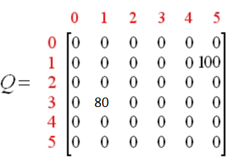
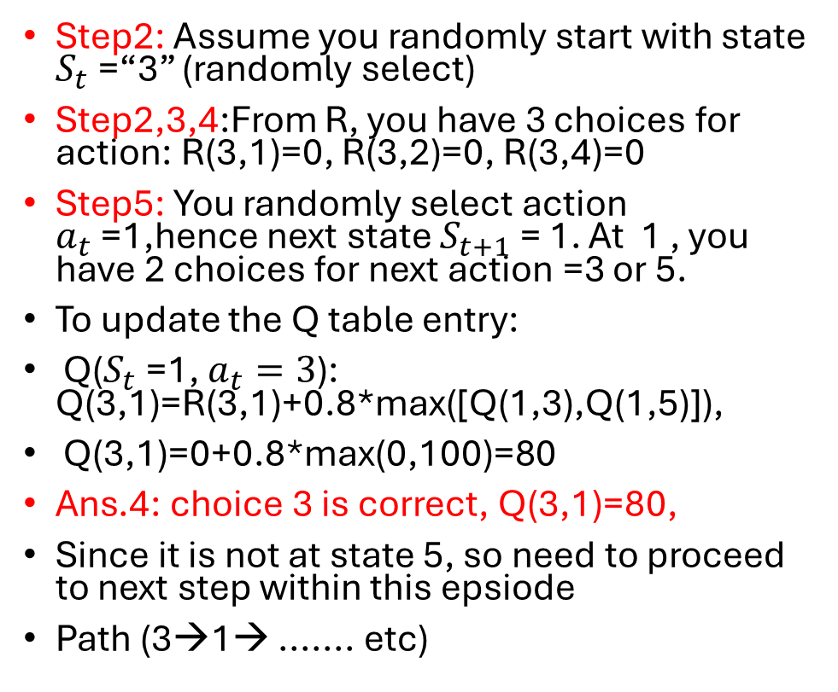
Answer to Ex.4
At Episode 2
Based on episode 1, we will continue to train the system by randomly select the initial position
Step2: Assume you randomly start with state $S_{t}$=“3” (randomly select)
Step2,3,4:From R, you have 3 choices for action: R(3,1)=0, R(3,2)=0, R(3,4)=0
Step5: You randomly select action $a_{t}$=1,hence next state $S_{t+1}$= 1. At 1 , you have 2 choices for next action =3 or 5.
To update the Q table entry:
Q($S_{t}$=1, $a_{t}=3$): Q(3,1)=R(3,1)+0.8*max([Q(1,3),Q(1,5)]),
Q(3,1)=0+0.8*max(0,100)=80
Ans.4: choice 3 is correct, Q(3,1)=80,
Since it is not at state 5, so need to proceed to next step within this epsiode
Path (3→1→ ....... etc)
Updated Q
Q(state,action)=R(state,action)+Gamma∗Max[Q(nextState,allActions_nextState​)]

Slide 23
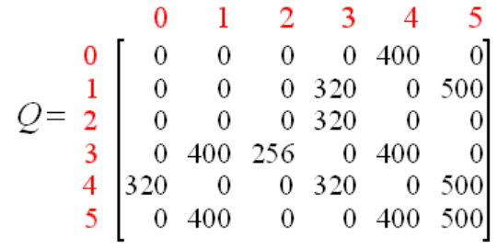
Learning Q-table (or Q-matrix)
After many episodes till episode=10000, our Q table is complete and can be used for prediction
Updated Q after episode 100000
Q(state,action)=R(state,action)+Gamma∗Max[Q(nextState,allActionsnextState​)]

Slide 24
Execution: After the Q-table (or called Q-matrix) is learned (after 1000 episodes) how to use it.
Execution: After we have a good Q table (after learning), we just need to follow it:
  Set current state = initial state.
  From current state, find the action with the highest Q value
  Set current state = next state(state from action chosen on 2).
  Repeat Steps 2 and 3 until current state = goal state

Slide 25
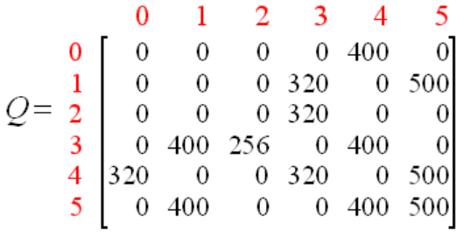
Execution example: After learning , the Q table is ready to be used.
Case1 :
  assume initialize. at state “3”
  The highest is “1” score 400 or “4” score 400. We can select “1 or “4”, assume “1” is selected.
  In “1” the highest is 5, so we complete the task.
Case2 :
  Assume Initialize at state “2”
  The highest is state “3” with score 320.
  At state3, we pick 4 (because 400 is one of the highest). Then at 4, we select state 5 (highest).We now reach the goal of 5. Done!
Exercise 5: If it in state 0, how many steps it will take to reach state 5 (exit)
Choices: 1,2,3,4
Updated Q after episode 100000
action
state

Slide 26
Example 2
Exercise 5: If it in state 0, how many steps it will take to reach state 5 (exit)
Choices: 1,2,3,4
Answer: it will go to 4 first and then 5, so take 2 steps to reach 5, ( choice 2 is correct)
Revisit the example again

Slide 27
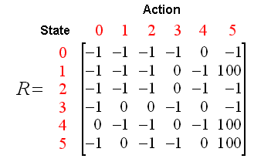
Step1: Start With A Rewards Matrix and a Random Exploration
Discount rate γ=0.8
Learning rate α=1
Let -1 represent actions that can’t be taken
Let 0 represent the initial unknown discounting of the reward
Notes:
Room 0 can I go to room 0, not allowed; room 1, no door, room 2, no door; … room 4, yes, room 5 no?

Slide 28
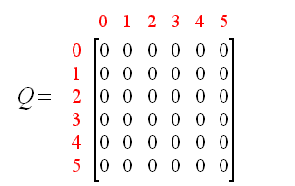
2. Initialize the Q Matrix

Slide 29
3. Episode 1
Robot randomly starts at State 1 initially
Note: In our discussion:
S=S_{t} , S’=S_{t+1} , a=a_{t} , a’=a_{t+1}
Reward
R-table is
Given
S=1
You have 2 choices:
Go to state 3
Go to state 5
Since Q is filled zeros at init. at episode 1, so, we randomly choose state 5
a=5
So, we need to update Q(1,5), now next state s’=5
Q(s, a) = R(s,a) + γ *max_{all_a’} (Q(s’,a’))
Q(1, 5) = R(1,5) + 0.8 *max_{all_a’} (Q(s’,a’))
Notes:
Room 0 can I go to room 0, not allowed; room 1, no door, room 2, no door; … room 4, yes, room 5 no?

Slide 30
Note: In our discussion:
S=S_{t} , S’=S_{t+1} , a=a_{t} , a’=a_{t+1}
Initially at t=0, Q-table are filled with zeros,
Reward
R-table is
Given
Q(1, 5) = R(1,5) + 0.8 *max_{all_a’} (Q(s’,a’))
Q(1, 5) = R(1,5) + 0.8 *max_{all_a’} (Q(5,1), Q(5,4), Q(5,5))
Q(1, 5) = 100+ 0.8 max_{all_a’} (0, 0, 0)
Q(1, 5) = 100
End of Episode (because state 5 is reached)
Conclusion:
in episode1, the path is (1→5)
100
After this step , Q is updated
Notes:
Room 0 can I go to room 0, not allowed; room 1, no door, room 2, no door; … room 4, yes, room 5 no?

Slide 31
3. Episode 2a
Robot randomly starts at State 3 initially
Randomly state at S=3
There are 3 choices:
Go to state 1
Go to state 2
Go to state 4
It randomly chooses state 1
a=1, so Q(3,1), Q(3,1) will be updated.
Also, next state s’=1, so we next max_{all_a’}(Q(s’=1,a’))
Q(3, 1) = R(3,1) + 0.8 *max_{all_a’}(Q(s’,a’))
Notes:
Room 0 can I go to room 0, not allowed; room 1, no door, room 2, no door; … room 4, yes, room 5 no?

Slide 32
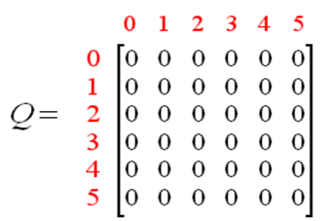
100
S’=1
Q(3, 1) = R(3,1) + 0.8 * max_{all_a’}((Q(s’,a’))
There are two choices a’= 3 or 5, hence
Q(3, 1) = R(3,1) + 0.8 * max_{all_a’}((Q(1,a’=3), Q(1,a’=5))
Q(3, 1) = 0+ 0.8 *max(0, 100)
Q(3, 1) = 80 (because a’=1 not 5)
Next state is 1, not our goal 5,
So, we need further calculations.
This is from epsiode1
100
80
Notes:
Room 0 can I go to room 0, not allowed; room 1, no door, room 2, no door; … room 4, yes, room 5 no?

Slide 33
Continuing episode 2a. Now at State 1
Now at state 1, we have 2 choices, 3 and 5., We see that Q(1,3)=0, Q(1,5)=100, so we choose 5 using a greedy scheme. Thus s_{t}=1, a_{t}=5. Then s_{t+1}=5
100
80
33
Q(s_{t} =1,a_{t} =5)=Q(1, 5) = R(1,5) + 0.8 * max_{all_a’}((Q(s’,a’))
s_{t} =1, selected a_{t} =5 using a greedy scheme ,then s’= s_{t+1} =5
Notes:
Room 0 can I go to room 0, not allowed; room 1, no door, room 2, no door; … room 4, yes, room 5 no?

Slide 34
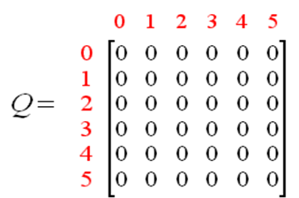
Now at 5
Before
update
100
80
Q(1, 5) = R(1,5) + 0.8 * max_{all_a’} (Q(s’,a’))
Q(1, 5) = R(1,5) + 0.8 *max_{all_a’} (Q(5,1),Q(5,4),Q(5,5))
Q(1, 5) = 100+ 0.8 *max_{all_a’} (0,0,0)
Q(1, 5) = 100
Done ,
end of episode2
because goal (5) is reached, done!
Conclusion:
in episode2a, the path is (3→1→5) Done!
After
update
100
80
Notes:
Room 0 can I go to room 0, not allowed; room 1, no door, room 2, no door; … room 4, yes, room 5 no?

Slide 35
Do-While Loop
Robot is at State 3
Now the robot is at state 3.
Exercise 6 : If the robot is at state 3, using the reward table what are the possible choices for next move?
0,1,2
1,2,3
2,3,5
1,2,4
0,2,5

Slide 36
What if we had randomly chosen state 3 not 5 at the last step of episode 2 (in the previous example). This may help the system to explore for more choices to improve performance. This random approach will be discussed later in the epsilon-greedy algo.
At episode 2b (alternative path for episode 2), if you are curious to know what happened if the randomly selected result is different:
At discussed previously, when s_{t} =1 , there are two actions:
Go to state 3
Go to state 5
Using a greedy scheme it should choose 5 as discussed . But in order to explore more options, it randomly choses state 3 in stead of 5
Q(1, 5) = R(1,5) + 0.8 *max(Q(s’,a’))
Q(1, 3) = R(1,3) + 0.8 *max(Q(s’,a’))
Hence next state s’=3
Answer to Exercise6, Inner Do-While Loop, the Robot is at State 3. the choices are 1,2,4 , because the others are -1. So, (choice 4) is correct.
Notes:
Room 0 can I go to room 0, not allowed; room 1, no door, room 2, no door; … room 4, yes, room 5 no?

Slide 37
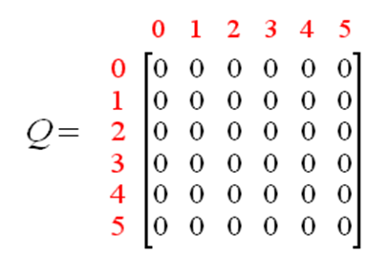
Before
update
100
80
S’=3
Q(1, 3) = R(1,3) + 0.8 *max_a’(Q(s’,a’))
Q(1, 3) = R(1,3) + 0.8 *max(Q(3,1), Q(3,2), Q(3,4))
Q(1, 3) = 0+ 0.8 argmax(80, 0, 0)
The others selection (Q(3,0), Q(3,3),Q(3,5) are not allowed because in the R table the entries are -1.
Q(1, 3) =0+0.8*80=64
Next state is s’=3,
Episode not done yet
still need more work.
See next slide.
After
update
64
100
80
Notes:
Room 0 can I go to room 0, not allowed; room 1, no door, room 2, no door; … room 4, yes, room 5 no?

Slide 38
at state s=3, there are 3 choices :
Go to state 1 (with Q(3,1)=80)
Go to state 2 (with Q(3,2)=0)
Go to state 4 (with Q(3,4)=0)
Using a greedy-scheme it should choose 3, because Q(3,1) =80 is the max. However, it uses a random scheme and choses state 4 instead. Hence S’=4
Q(3, 4) = R(3,4) + 0.8 * max_{all_a’} (Q(s’,a’))
Q(3, 4) = R(3,4) + 0.8 * max_{all_a’}(Q(4,0), Q(4,3), Q(4,5))
Q(3, 4) =0+0.8*0=0
So, no change to Q-table for this round
64
100
No
change
80

Slide 39
Class Exercise, Inner Do While Loop
Robot is at State s=4
Now the robot is at 4.
Says robot has choice of two actions:
Go to state 0 (with Q(4,0)=0)
Go to state 3 (with Q(4,3)=0)
Go to state 5 (with Q(4,3)=0) Q(4,5)=10)
It randomly choses state 5
S’=5
After update
Q(4,5)
will becomes 100
It randomly choses state 5
Q(4, 5) = R(4,5) + 0.8 *max_a’(Q(s’,a’))
Q(4, 5) = R(4,5) + 0.8 *max(Q(4,0),Q(4,3),Q(4,5))
Q(4, 5) = 100 + 0.8 *max(0,0,0)
Q(4, 5)=100
Now at state 5, it is complete for this episode
in episode2b, the path is (3→1→3→4→5)
64
100
80
100

Slide 40
End of the current episode 2b
64
100
80
100
But still need more episodes (say 10000) to learn the complete stable Q table.

Slide 41
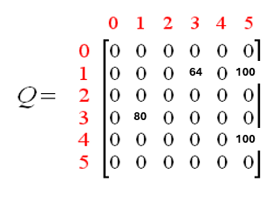
Take home Exercise, no answer is given.
Given learning rate =1, discount rate=0.85, if the R and the current Q tables are given as shown.
The random choice for state S=2 and action a=4. The next action should be a’ and Q(S’,a’). Find the new Q’ . (answer: This is impossible because S=2,a=4 has -1 in the R table.)
The random choice for state S=3 and action a=4. The next action should be a’ and Q(S’,a’). Find the new Q’ using a greedy scheme. Student will work out the answer, it is not given.

Slide 42
Part 1b:
Q learning
With the Epsilon(ε)-greedy algorithm

Slide 43
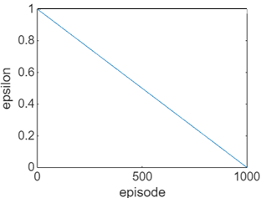
Epsilon(ε)-greedy algorithm
random_num(0,1)=randomly generate a number range 0 to 1
For ep=1: max_episode
ε = 1-(ep/max_episode)) # ε =1 random find action (a)
if random_num(0,1) < ε
choose a random possible action
else
use action suggested by the Q table
construct the Q table as in algorithm1
//// The effect is /////////////////////
At the beginning the system (ε≈1) explores actions randomly, at the end (ε≈0) it trusts the Q table completely.
Example: if ε=0.3
30% of the chance the agent uses a random possible action, 70% uses an action suggested by the Q table
Exercise 7: If max_episode=1000, ep is 150, what is the chance of choosing the Q table to select the next action? Choices:
(1) 0.15 ; (2) 0.25 ;
(3) 0.55 ; (3) 0.85
ε
Episode
Epsilon drops from 1 to 0
For the episode 1 to max_episode(1000)

Slide 44
Epsilon(ε)-greedy algorithm
random_num(0,1)=randomly generate a number range 0 to 1
For ep=1: max_episode
ε = 1-(ep/max_episode)) # ε =1 random find action (a)
if random_num(0,1) < ε
choose a random possible action
else
use action suggested by the Q table
construct the Q table as in algorithm1
//// The effect is /////////////////////
At the beginning the system (ε≈1) explores actions randomly, at the end (ε≈0) it trusts the Q table completely.
Example: if ε=0.3
30% of the chance the agent uses a random possible action, 70% uses an action suggested by the Q table
Answer to Exercise 7: If max_episode=1000, ep is 150, what is the chance of choosing the Q table to select the next action?
ε=1-(150/1000)=0.85, the chance of choosing a random action (a) is 0.85, hence the chance of choosing a by the Q table is 1-0.85=0.15
Choices:
(1) 0.15 (correct) ; (2) 0.25 ;
(3) 0.55 ; (3) 0.85
ε
Episode
Epsilon drops from 1 to 0
For the episode 1 to max_episode(1000)

Slide 45

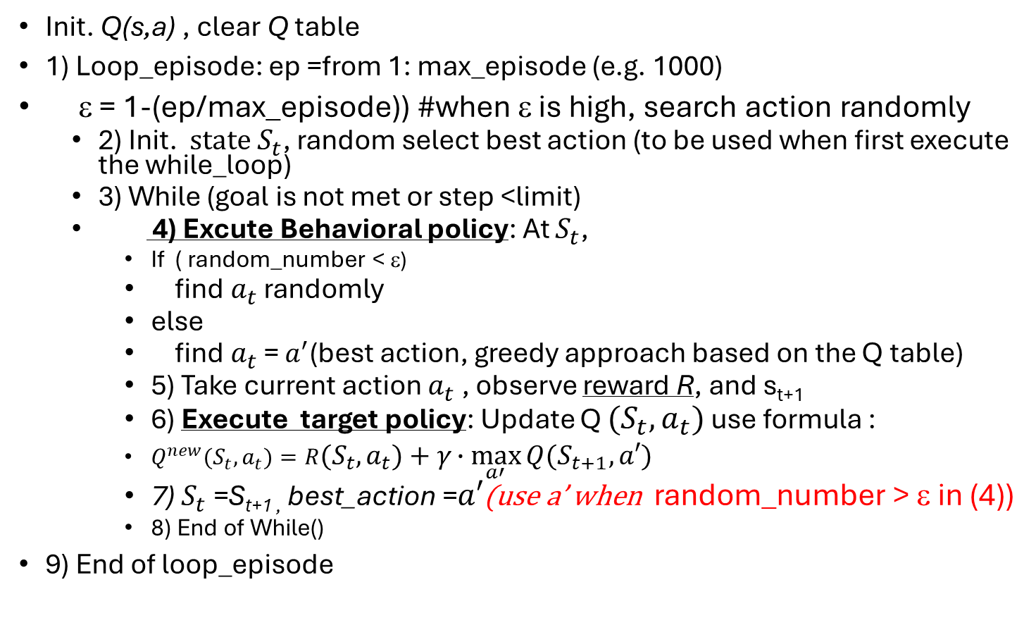
ε-greedy_algo() Q learning algorithm2
See Code_ε-greedy_algo(), next slide https://www.researchgate.net/figure/The-Q-Learning-Algorithm-6_fig1_220776448 https://web.stanford.edu/class/psych209/Readings/SuttonBartoIPRLBook2ndEd.pdf
In our demo, set αlpha =1 , $γ$=0.85
$$Q^{new}{(S}_{t},A_{t})=R+γ∙\max_{a′}{Q{(S}_{t+1},a′) −−∗}$$
Init. Q(s,a) , clear Q table
1) Loop_episode: ep =from 1: max_episode (e.g. 1000)
ε = 1-(ep/max_episode)) #when ε is high, search action randomly
  2) Init. $state S_{t}$, random select best action (to be used when first execute the while_loop)
  3) While (goal is not met or step <limit)
  4) Excute Behavioral policy: At $S_{t}$,
    If ( random_number < ε)
    find$a_{t}$ randomly
    else
    find$a_{t}$ = $a^{′}$(best action, greedy approach based on the Q table)
    5) Take current action $a_{t}$ , observe reward R, and s_{t+1}
    6) Execute target policy: Update Q ${(S}_{t},a_{t})$ use formula :
    $Q^{new}{(S}_{t},a_{t})=R{(S}_{t},a_{t})+γ∙\max_{a′}{Q{(S}_{t+1},a′) }$
    7) $S_{t}$=S_{t+1 ,} best_action =$a′$(use a’ when random_number > ε in (4))
    8) End of While()
9) End of loop_episode
Q-Learning By Examples: Numerical Example

Slide 46
Study the Code: RL_demo1.m
RL_demo1.m: Q learning algorithm With epsilon_greedy, Q and sarsa, 2024.11.3
% Reinforcement Learning demo: Q learning/SARSA with epsilon_greedy
% %demo for lecture notes, by KH Wong, 2024.11.3
% note: matlab matrix matrices starts from 1 not 0, so in the lecture note
% the Q matrix index 0 is actually 1 in code.
%result automode agrees with that in
%https://people.revoledu.com/kardi/tutorial/ReinforcementLearning/Q-Learning-Example.htm
%clf
function RL() %Reinforcement Learning , Q_learning and SARSA
%clear
%close all
%initialization
R=[ -1 -1 -1 -1 0 -1
-1 -1 -1 0 -1 100
-1 -1 -1 0 -1 -1
-1 0 0 -1 0 -1
0 -1 -1 0 -1 100
-1 0 -1 -1 0 100]
Q=[0 0 0 0 0 0
0 0 0 0 0 0
0 0 0 0 0 0
0 0 0 0 0 0
0 0 0 0 0 0
0 0 0 0 0 0
]
need_to_work=1;
gamma=0.8
ep_max=1000
step_max=200
Loop=100
%method="Q_learning" % or "SARSA"
method= "SARSA"
%step1: Loop episode ----------------------------
for ep=1:ep_max %for each episode ep
ep
epsilon=1-(ep/ep_max);%from 1 to 0.e=1 is randon select,e=0 trust Q_table()
%step 2:--------------------------------
current_state=randi(length([1 2 3 4 5 6]));%random select a current state
best_action=current_state; %this is used at the beginning, later find_action will find it
need_to_work =1; %set before while loop
%step3:---------------------------------
step=0;
while need_to_work ==1 && step <step_max %set limit for steps
step=step+1;
%step4: Execute behavioral policy:use Q learning or SARSA from R table
%find valid action (in column)
[current_action,next_state,Qmax_value, best_action]=find_action_Q(epsilon,R,Q,current_state,best_action);
% [current_action,next_state,Qmax_value, best_action]=find_action_SARSA(epsilon,R,Q,current_state,best_action);
%step 6: Execute Target policy ---------------------------------------
Q(current_state,current_action)=R(current_state,current_action)+gamma*Qmax_value;
if (next_state==6)
% 'Goal state=6 reached, done for this episode', 'next episode, episode = '
need_to_work=0;
else
%step 7: %'inside an espisode but not complete'
if method == "Q_learning“ % Q_learning is off-policy, SARSA is on-policy
current_state=next_state; %for next search within this episode
else
current_state=best_action; %for SARSA(off policy) only, (not for Qlearn)
end
end
%step 8 ---------------------------------------
end
end
max(max(Q))
%Q_normalized=100*Q./(max(max(Q))),%normalize Q, can add a small num to avoid div-by-zero
Q % the raw Q, similar to that shown in
% https://people.revoledu.com/kardi/tutorial/ReinforcementLearning/Q-Learning-Example.htm
return %end of main
%//////QQQQQQQQQQQQQQQQQQQQQQQQQQQQQQQQQQQQQQQQQQQQQQQQQQQ
function [current_action,next_state,Qmax_value,best_action]=...
find_action_Q(epsilon,R,Q,current_state,best_action)
[foo,valid_action_list_from_R] = find(R(current_state,:)>=0);
%use Q table to select the best reward action
[foo,i_index]=find(Q(current_state,valid_action_list_from_R) >=0);
valid_action_list_from_Q=Q(current_state,i_index); %
if rand < epsilon %epsilon=1 random, 0= greedy. episoln_greedy_part. Ignor best_action choose again
ii_index=randi(length([valid_action_list_from_Q])); %pick one action randomly
current_action=valid_action_list_from_R(ii_index);
else
current_action=best_action; % greedy, the best action
end
[foo,valid_next_state_list_from_R] = find(R(current_action,:)>=0);
[Qmax_value,i]=max(Q(current_state,valid_next_state_list_from_R));
%use only the index not max value
next_state=valid_next_state_list_from_R(i);
best_action=valid_next_state_list_from_R(i);%for SARSA only,not Q-learning
return

Slide 47
Another interesting example “the Frozen lake”.
The format of the Q-table for the State/action relation is not the same as we used in the previous slides, but the content is similar. Think about it!
Reward : R=1 at state s=15, otherwise R=0 (as defined in the Gymnasium toolbox Gym)
Q table
Q-table
State | Action : Left a=0 | Action : Down a=1 | Action : Right a=2 | Action : Up a=3
0 (begin) | Q(s=0,a=0) | Q(s=0,1) | Q(s=0,a=2) | Q(s=0,a=3)
1 | Q(s=1,a=0) | Q(s=1,1) | Q(s=1,a=2) | Q(s=1,a=3)
:
14 | Q(s=14,a=0) | Q(s=14,0) | Q(s=14,a=0) | Q(s=14,a=0)
15 (G=goal) | Q(s=15,a=0) | Q(s=15,1) | Q(s=15,a=2) | Q(s=15,a=3)
https://towardsdatascience.com/q-learning-for-beginners-2837b777741

Slide 48

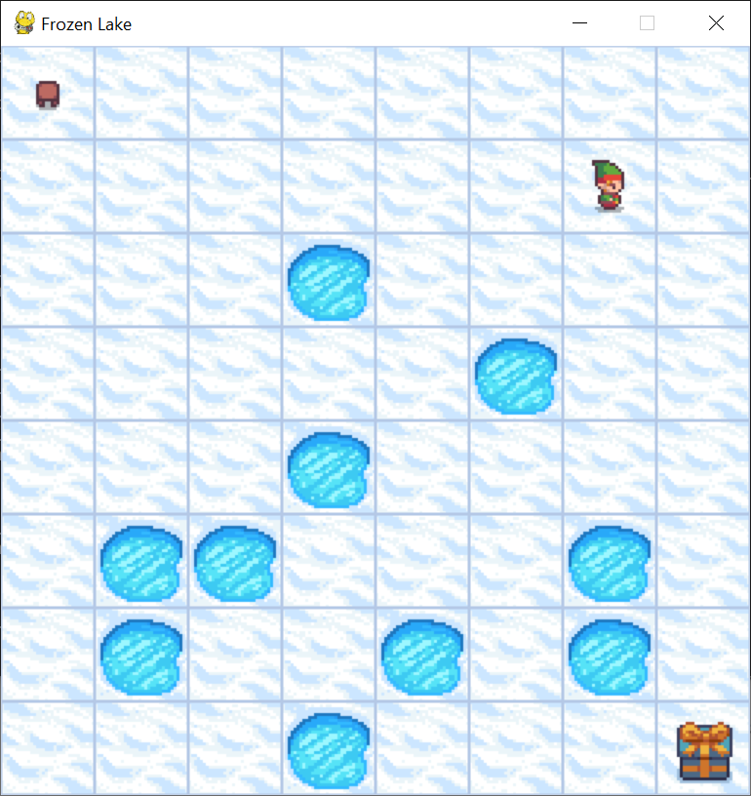

Python pytorch example for frozen lake, classical Q learning demo tutorial video https://www.youtube.com/watch?v=ZhoIgo3qqLU&t=61s
The man
The man is searching for the path to the treasure box.
It makes an action every time (left/right/up/down) and obtains a reward.
Train many episodes using the Q learning method.
The environment (gym) with display is supported by https://github.com/openai/gym
Rewards: Rewards
Reward schedule:
Reach goal(G): +1
Reach hole(H): 0
Reach frozen(F): 0
Starting position
Goal: treasure box

Slide 49
Study the classic Q network python code : https://github.com/johnnycode8/gym_solutions frozen_lake_q.py
import gymnasium as gym
import numpy as np
import matplotlib.pyplot as plt
import pickle
def run(episodes, is_training=True, render=False):
env = gym.make('FrozenLake-v1', map_name="8x8", is_slippery=True, render_mode='human' if render else None)
if(is_training):
q = np.zeros((env.observation_space.n, env.action_space.n)) # init a 64 x 4 array
else:
f = open('frozen_lake8x8.pkl', 'rb')
q = pickle.load(f)
f.close()
learning_rate_a = 0.9 # alpha or learning rate
discount_factor_g = 0.9 # gamma or discount rate. Near 0: more weight/reward placed on immediate state. Near 1: more on future state.
epsilon = 1 # 1 = 100% random actions
epsilon_decay_rate = 0.0001 # epsilon decay rate. 1/0.0001 = 10,000
rng = np.random.default_rng() # random number generator
rewards_per_episode = np.zeros(episodes)
for i in range(episodes):
state = env.reset()[0] # states: 0 to 63, 0=top left corner,63=bottom right corner
terminated = False # True when fall in hole or reached goal
truncated = False # True when actions > 200
while(not terminated and not truncated):
if is_training and rng.random() < epsilon:
action = env.action_space.sample() # actions: 0=left,1=down,2=right,3=up
else:
action = np.argmax(q[state,:])
new_state,reward,terminated,truncated,_ = env.step(action)
if is_training:
q[state,action] = q[state,action] + learning_rate_a * (
reward + discount_factor_g * np.max(q[new_state,:]) - q[state,action]
)
state = new_state
epsilon = max(epsilon - epsilon_decay_rate, 0)
if(epsilon==0):
learning_rate_a = 0.0001
if reward == 1:
rewards_per_episode[i] = 1
env.close()
sum_rewards = np.zeros(episodes)
for t in range(episodes):
sum_rewards[t] = np.sum(rewards_per_episode[max(0, t-100):(t+1)])
plt.plot(sum_rewards)
plt.savefig('frozen_lake8x8.png')
if is_training:
f = open("frozen_lake8x8.pkl","wb")
pickle.dump(q, f)
f.close()
if __name__ == '__main__':
# run(15000)
run(1000, is_training=True, render=True)
Tutorial video https://www.youtube.com/watch?v=ZhoIgo3qqLU&t=52s

Slide 50
Main loop in python code,
Q table update
if is_training:
q[state,action] = q[state,action] + learning_rate_a * (
reward + discount_factor_g * np.max(q[new_state,:]) -q[state,action])
This is to implement the Q-table update formula
Q(state,action)=R(state,action)+Gamma∗Max[Q(nextState,allActionsnextState​)]

Slide 51
Part 2a
Vanila Q Deep Network.
Reinforcement learning using neural net

Slide 52
Why do we need Deep Q Network (DQN)?
The R/Q-table can be very large for complex problems. Imagine 1000 states, 1000 possible actions, then you need a table of 1000*1000
Using a neural network to learn the knowledge make the process more efficient and flexible for further development.
In practice: Need an environment for the learning process (I.e. game simulator , e.g. https://github.com/openai/gym )

Slide 53
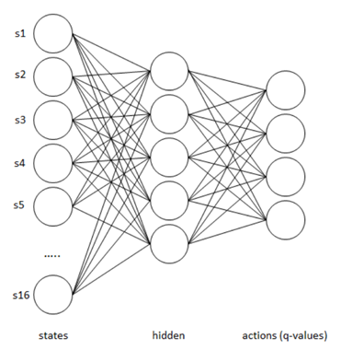
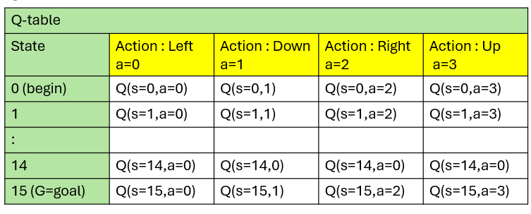
Use a fully connected neural network to implement the Q table, it is called deep-Q-network (DQN) for the frozen lake example
Qtable → Deep-Q-Net (DQN)
16 states: s=0→15
4 action outputs a=0, left
a=1,down
a=2, right
a=3, up
Hidden neurons
=s
Note: This is for a 4x4x frozen lake (16 states). If it is for an 8x8 frozen lake, the number of state-neurons should be 8x8=64 states.
Output =4, (left, down, right, up)
https://sebastianappelt.com/refactoring-frozenlake-to-deep-reinforcement-learning/

Slide 54
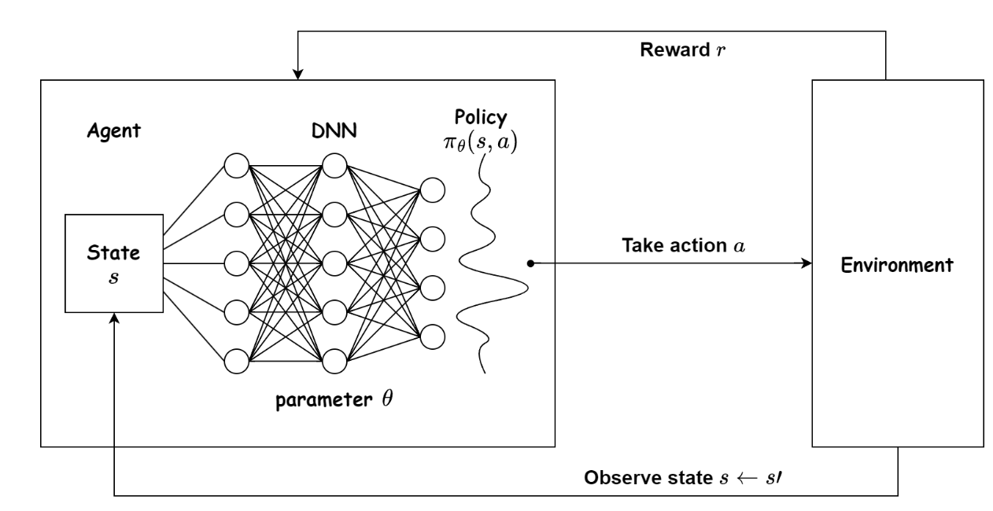
Vanilla Deep Q Network
The main idea is , if it is not time for random actions (using epsilon-greedy algo), choose the best action.
Choose the best action when reward is the highest.
Then use that action as the target for the neural network backpropagate during training.
Reward
Deep neural net
Environment (game gym)
State
Action
https://wikidocs.net/174548
https://medium.com/@vishnuvijayanpv/deep-reinforcement-learning-value-functions-dqn-actor-critic-method-backpropagation-through-83a277d8c38d

Slide 55
Training methods
On-line training method, feed samples to the system one by one when encountered.
Off-line training method, collect data first and train from the stored data.
Training using experience replay memory
  In between on-line/off-line. Collect a fixed amount of data for processing (reply memory size), also replace old data in replay memory by new data when available.
Reference: https://ai.stackexchange.com/questions/10474/what-is-the-relation-between-online-or-offline-learning-and-on-policy-or-off

Slide 56
Part 2b
Double Q Deep Learning.
Reinforcement learning using neural net

Slide 57
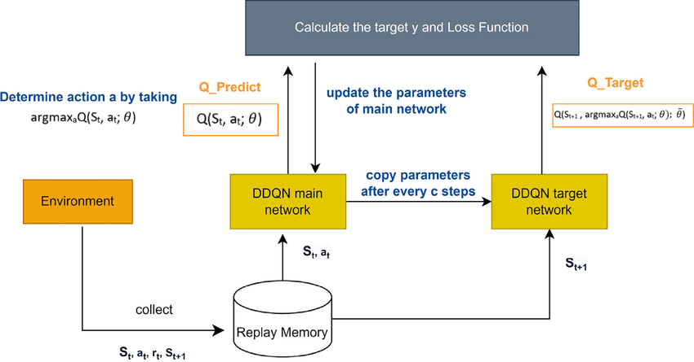
Double DQN (DDNQ) uses 2 networks
(i) Q_Policy (or called Q_Main or Q_online)
(ii) Q_Target
Calculate the target y and loss function
(i)Q_Current
(ii) Q_target
Backprop to improve θp
Environment (Gym game simulator)
Q_Policy
Qp with weights
θp
Q_Target
Qt with weights θt
Copy θp to θt every C (=10) steps
Replay memory (e.g. 1000 tuples, each tuple has 5 elements)
https://www.researchgate.net/figure/Double-Deep-Q-Network-architecture_fig2_373652868

Slide 58
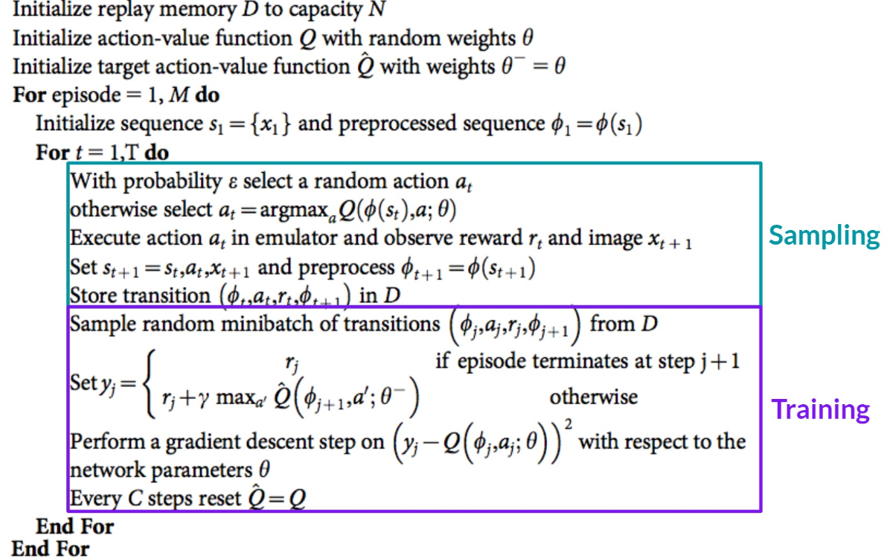

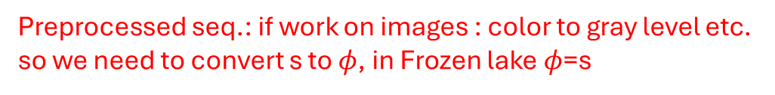
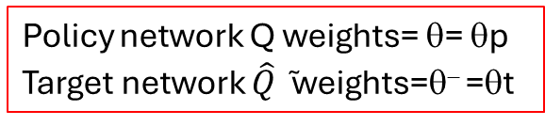
Double Deep-Q (DDQN) learning with experience replay memory/buffer (D)
Policy network Q weights= θ= θp
Target network $\hat{Q}$̃ weights=θ⁻ =θt
Preprocessed seq.: if work on images : color to gray level etc. so we need to convert s to $φ$, in Frozen lake $φ$=s
Sampling is to fill up replay memory D
Epsilon-greedy applied
Frozen lake image x_{t+1}
Action a_{t} will bring it to a new state st, so set s_{t+1}=s_{t}
All are greedy moves in D
Training is for training Qp, Qt
In frozen lake :$φ$=s
https://huggingface.co/learn/deep-rl-course/unit3/deep-q-algorithm
https://ieeexplore.ieee.org/stamp/stamp.jsp?tp=&arnumber=9036763

Slide 59
Experience replay (memory buffer D)
The size can be 1000 tuples (e.g. deque in python)
In step 3 we collect state-action-reward experiences , each experience is
  [current state s_{t}, current action a_{t}, current reward r_{t}, next state s_{t+1 ,} Eflag]
  =[s_{t}, a_{t}, r_{t+1}, s_{t+1},Eflag]
  Eflag= reached exit=1 else 0
  We use a min-batch (e.g. randomly select 32 tuples from D) of experiences to train/update the weights and biases of the policy Q network (Qp)
This make training more efficient and stable
(s₁,a₁,r₁,s₂,E1), 1
(s₂,a₂,r₂,s₃,E2), 2
: : : :
(s_{T},a_{T},r_{T+1},s_{T+1},ET), T : : ( , , , , ,),P
Replay memory, e.g. 1000 units
https://paperswithcode.com/method/experience-replay

Slide 60
DDQN (Simplified) mini-batch size=32,learn_rate=1, discount = γ
Step 1: create Qp,Qt
Step2: Copy Qp to Qt
For each episode (from 1 to Max_ep)
Sampling : Step3: Run Gym and fill D with the 1000 tuples (s_{t},a_{t},r_{t+1},s_{t+1},E_{t}) using Bellman’s scheme, E =1 means exit, done!
Training :
Step4: Pick from D a batch (e.g. 32), send each s_{j} (one-hot vector) to Qp and Qt.
Step5: Loop C=10 steps
  Randomly pick mini-batch j from D
  Now based on the tuples (s_{j},a_{j},r_{j},s_{j},E_{j})
  If Ej=1, y_{j}= r_{j} else
  Send next state s_{j+1} to Qt and find max reward r for possible a’ from env. Gym
  y_{j}=r +γ*max_a’(Qt(s_{j+1} ,a’))
  Use y_{j} as target to update Qp, i.e.
  Use loss (y_{j} -Qp(s_{j} , a_{j}))², to update Qp. (Qt is fixed for this 10 steps)
Step6: Copy Qp to Qt, repeat Sampling/training for all episodes
Qp_out:4 action outputs
Qt_out:
4 action outputs
Current s_{t}
Qp (policy Q)
Qt (target Q)
Copy Qp to Qt for every 10 steps
(s₁,a₁,r₁,s₂,E1), 1
(s₂,a₂,r₂,s₃,E2), 2
: : : :
(s_{T},a_{T},r_{T},s_{T+1},ET), T :: ( , , , , ,),P
Replay memory D

Slide 61
Study the Q network python code : https://github.com/johnnycode8/gym_solutions frozen_lake_dql.py
import gymnasium as gym
import numpy as np
import matplotlib.pyplot as plt
from collections import deque
import random
import torch
from torch import nn
import torch.nn.functional as F
# Define model
class DQN(nn.Module):
def __init__(self, in_states, h1_nodes, out_actions):
super().__init__()
# Define network layers
self.fc1 = nn.Linear(in_states, h1_nodes) # first fully connected layer
self.out = nn.Linear(h1_nodes, out_actions) # ouptut layer w
def forward(self, x):
x = F.relu(self.fc1(x)) # Apply rectified linear unit (ReLU) activation
x = self.out(x) # Calculate output
return x
# Define memory for Experience Replay
class ReplayMemory():
def __init__(self, maxlen):
self.memory = deque([], maxlen=maxlen)
def append(self, transition):
self.memory.append(transition)
def sample(self, sample_size):
return random.sample(self.memory, sample_size)
def __len__(self):
return len(self.memory)
# FrozeLake Deep Q-Learning
class FrozenLakeDQL():
# Hyperparameters (adjustable)
learning_rate_a = 0.001 # learning rate (alpha)
discount_factor_g = 0.9 # discount rate (gamma)
network_sync_rate = 10 # number of steps the agent takes before syncing the policy and target network
replay_memory_size = 1000 # size of replay memory
mini_batch_size = 32 # size of the training data set sampled from the replay memory
# Neural Network
loss_fn = nn.MSELoss() # NN Loss function. MSE=Mean Squared Error can be swapped to something else.
optimizer = None # NN Optimizer. Initialize later.
ACTIONS = ['L','D','R','U'] # for printing 0,1,2,3 => L(eft),D(own),R(ight),U(p)
# Train the FrozeLake environment
def train(self, episodes, render=False, is_slippery=False):
# Create FrozenLake instance
env = gym.make('FrozenLake-v1', map_name="4x4", is_slippery=is_slippery, render_mode='human' if render else None)
num_states = env.observation_space.n
num_actions = env.action_space.n
epsilon = 1 # 1 = 100% random actions
memory = ReplayMemory(self.replay_memory_size)
# Create policy and target network. Number of nodes in the hidden layer can be adjusted.
policy_dqn = DQN(in_states=num_states, h1_nodes=num_states, out_actions=num_actions)
target_dqn = DQN(in_states=num_states, h1_nodes=num_states, out_actions=num_actions)
# Make the target and policy networks the same (copy weights/biases from one network to the other)
target_dqn.load_state_dict(policy_dqn.state_dict())
print('Policy (random, before training):')
self.print_dqn(policy_dqn)
# Policy network optimizer. "Adam" optimizer can be swapped to something else.
self.optimizer = torch.optim.Adam(policy_dqn.parameters(), lr=self.learning_rate_a)
# List to keep track of rewards collected per episode. Initialize list to 0's.
rewards_per_episode = np.zeros(episodes)
# List to keep track of epsilon decay
epsilon_history = []
# Track number of steps taken. Used for syncing policy => target network.
step_count=0
for i in range(episodes):
state = env.reset()[0] # Initialize to state 0
terminated = False # True when agent falls in hole or reached goal
truncated = False # True when agent takes more than 200 actions
# Agent navigates map until it falls into hole/reaches goal (terminated), or has taken 200 actions (truncated).
while(not terminated and not truncated):
# Select action based on epsilon-greedy
if random.random() < epsilon:
# select random action
action = env.action_space.sample() # actions: 0=left,1=down,2=right,3=up
else:
# select best action
with torch.no_grad():
action = policy_dqn(self.state_to_dqn_input(state, num_states)).argmax().item()
# Execute action
new_state,reward,terminated,truncated,_ = env.step(action)
# Save experience into memory
memory.append((state, action, new_state, reward, terminated))
# Move to the next state
state = new_state
# Increment step counter
step_count+=1
# Keep track of the rewards collected per episode.
if reward == 1:
rewards_per_episode[i] = 1
# Check if enough experience has been collected and if at least 1 reward has been collected
if len(memory)>self.mini_batch_size and np.sum(rewards_per_episode)>0:
mini_batch = memory.sample(self.mini_batch_size)
self.optimize(mini_batch, policy_dqn, target_dqn)
# Decay epsilon
epsilon = max(epsilon - 1/episodes, 0)
epsilon_history.append(epsilon)
# Copy policy network to target network after a certain number of steps
if step_count > self.network_sync_rate:
target_dqn.load_state_dict(policy_dqn.state_dict())
step_count=0
# Close environment
env.close()
# Save policy
torch.save(policy_dqn.state_dict(), "frozen_lake_dql.pt")
# Create new graph
plt.figure(1)
# Plot average rewards (Y-axis) vs episodes (X-axis)
sum_rewards = np.zeros(episodes)
for x in range(episodes):
sum_rewards[x] = np.sum(rewards_per_episode[max(0, x-100):(x+1)])
plt.subplot(121) # plot on a 1 row x 2 col grid, at cell 1
plt.plot(sum_rewards)
# Plot epsilon decay (Y-axis) vs episodes (X-axis)
plt.subplot(122) # plot on a 1 row x 2 col grid, at cell 2
plt.plot(epsilon_history)
# Save plots
plt.savefig('frozen_lake_dql.png')
# Optimize policy network
def optimize(self, mini_batch, policy_dqn, target_dqn):
# Get number of input nodes
num_states = policy_dqn.fc1.in_features
current_q_list = []
target_q_list = []
for state, action, new_state, reward, terminated in mini_batch:
if terminated:
# Agent either reached goal (reward=1) or fell into hole (reward=0)
# When in a terminated state, target q value should be set to the reward.
target = torch.FloatTensor([reward])
else:
# Calculate target q value
with torch.no_grad():
target = torch.FloatTensor(
reward + self.discount_factor_g * target_dqn(self.state_to_dqn_input(new_state, num_states)).max()
)
# Get the current set of Q values
current_q = policy_dqn(self.state_to_dqn_input(state, num_states))
current_q_list.append(current_q)
# Get the target set of Q values
target_q = target_dqn(self.state_to_dqn_input(state, num_states))
# Adjust the specific action to the target that was just calculated
target_q[action] = target
target_q_list.append(target_q)
# Compute loss for the whole minibatch
loss = self.loss_fn(torch.stack(current_q_list), torch.stack(target_q_list))
# Optimize the model
self.optimizer.zero_grad()
loss.backward()
self.optimizer.step()
'''
Converts an state (int) to a tensor representation.
For example, the FrozenLake 4x4 map has 4x4=16 states numbered from 0 to 15.
Parameters: state=1, num_states=16
Return: tensor([0., 1., 0., 0., 0., 0., 0., 0., 0., 0., 0., 0., 0., 0., 0., 0.])
'''
def state_to_dqn_input(self, state:int, num_states:int)->torch.Tensor:
input_tensor = torch.zeros(num_states)
input_tensor[state] = 1
return input_tensor
# Run the FrozeLake environment with the learned policy
def test(self, episodes, is_slippery=False):
# Create FrozenLake instance
env = gym.make('FrozenLake-v1', map_name="4x4", is_slippery=is_slippery, render_mode='human')
num_states = env.observation_space.n
num_actions = env.action_space.n
# Load learned policy
policy_dqn = DQN(in_states=num_states, h1_nodes=num_states, out_actions=num_actions)
policy_dqn.load_state_dict(torch.load("frozen_lake_dql.pt"))
policy_dqn.eval() # switch model to evaluation mode
print('Policy (trained):')
self.print_dqn(policy_dqn)
for i in range(episodes):
state = env.reset()[0] # Initialize to state 0
terminated = False # True when agent falls in hole or reached goal
truncated = False # True when agent takes more than 200 actions
# Agent navigates map until it falls into a hole (terminated), reaches goal (terminated), or has taken 200 actions (truncated).
while(not terminated and not truncated):
# Select best action
with torch.no_grad():
action = policy_dqn(self.state_to_dqn_input(state, num_states)).argmax().item()
# Execute action
state,reward,terminated,truncated,_ = env.step(action)
env.close()
# Print DQN: state, best action, q values
def print_dqn(self, dqn):
# Get number of input nodes
num_states = dqn.fc1.in_features
# Loop each state and print policy to console
for s in range(num_states):
# Format q values for printing
q_values = ''
for q in dqn(self.state_to_dqn_input(s, num_states)).tolist():
q_values += "{:+.2f}".format(q)+' ' # Concatenate q values, format to 2 decimals
q_values=q_values.rstrip() # Remove space at the end
# Map the best action to L D R U
best_action = self.ACTIONS[dqn(self.state_to_dqn_input(s, num_states)).argmax()]
# Print policy in the format of: state, action, q values
# The printed layout matches the FrozenLake map.
print(f'{s:02},{best_action},[{q_values}]', end=' ')
if (s+1)%4==0:
print() # Print a newline every 4 states
if __name__ == '__main__':
frozen_lake = FrozenLakeDQL()
is_slippery = False
frozen_lake.train(1000, is_slippery=is_slippery)
frozen_lake.test(10, is_slippery=is_slippery)

Slide 62
Conclusions
Studied the concept of reinforcement learning
Studied the Q learning algorithm which is a type of reinforcement learning
Studied the method of deep Q learning that uses neural networks to achieve reinforcement learning

Slide 63
Appendix

Slide 64
References/Code
https://github.com/johnnycode8/gym_solutions
frozen_lake_dql.py
Or implement using a convolution neural network
frozen_lake_dql_cnn.py
Tutorial video https://www.youtube.com/watch?v=EUrWGTCGzlA

Slide 65
DDQN step 1-4
Replay memory D
(s₁,a₁,r₂,s₂), 1
(s₂,a₂,r₃,s₃), 2
: : : :
(s_{T},a_{T},r_{T+1},s_{T+1}), P=1000
Step6: From GYM , the next action should be [0,0,1,0] to maximize the reward.
Step7: Set target [0,0,1,0] for Qt.
Step8: Us the target of Qt as target of Qp, train the network.
Step6: Repeat step 3 to 8 many times (e.g. 10 times)
Step6: Syn the two networks, copy Qp to Qt.
Step6: Repeat step 9 and 10 again until training is done (e.g. 1000 times)

Slide 66
Overview of Double deep Q (DDQN)network implementation
Update rule: Q[state,action]=reward if new state is terminal else reward+discount_factor *max(q[new_state,:)])
Input neuron size=16, each represent a state in the map.
Output is action, there are 4 actions [left, up, right, down]
Create Qp(policy Q network) randomly,
Copy Qp to Qt (target Q network)
Agent navigate the map from a state s (e.g. state 14) in the simulator Gymnasium (GYM). Append this experience to replay memory D
Send one-hot representation of 14 [0,0,0,0,0,0,0,0,0,0,0,0,0,1,0] to input of Qp. Since Qp is randomly generated, Qp_out (e.g 0.001, -0.001, -0.001, -0.002) may be generated.
Send same input to Qt, so Qt_out has the same output as Qp_out.
From GYM , the next action should be [0,0,1,0] to maximize the reward.
Set target [0,0,1,0] for Qt. Use the target of Qt as target of Qp, train the network.
Repeat step 3 to 8 many times (e.g. 10 times)
Syn the two networks, copy Qp to Qt.
Repeat step 9 and 10 again until training is done (e.g. 1000 times)
Tutorial video: https://www.youtube.com/watch?v=EUrWGTCGzlA
https://github.com/johnnycode8/gym_solutions frozen_lake_dql.py

Slide 67
Other reinforcement learning approaches
MC (Monte Carlo reinforcement learning)
TD (Temporal difference learning)
  Q-learning (“Q” stands for quality)
  SARSA (State–Action–Reward–State–Action)
Note: All above methods may involve the use of a Q-table. So, Q-table is only a data collection scheme.
https://www.analyticsvidhya.com/blog/2018/11/reinforcement-learning-introduction-monte-carlo-learning-openai-gym/
https://en.wikipedia.org/wiki/Temporal_difference_learning

Slide 68
Double Deep Q learning to reduce overestimations by decomposing the maximization operation in the target into action evaluation
tutorial video : https://www.youtube.com/watch?v=EUrWGTCGzlA

Slide 69
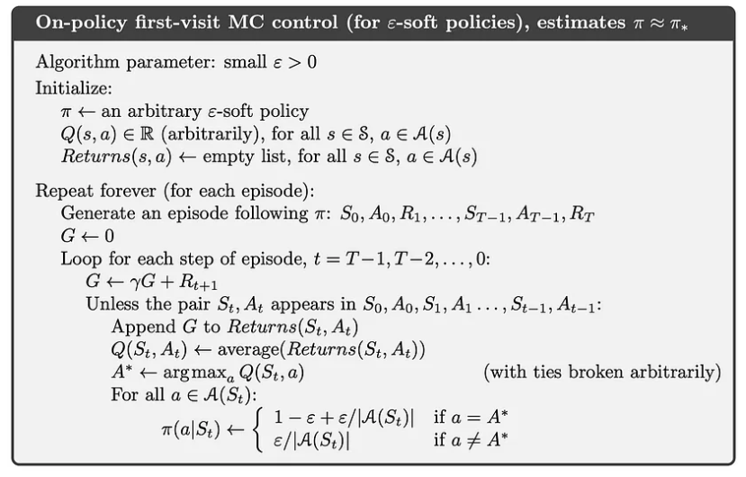
MC (Monte Carlo reinforcement learning)
Demo code
https://github.com/devidduma/intro-reinforcement-learning/tree/master
https://towardsdatascience.com/introduction-to-reinforcement-learning-rl-part-5-monte-carlo-methods-25067003bb0f
https://www.analyticsvidhya.com/blog/2018/11/reinforcement-learning-introduction-monte-carlo-learning-openai-gym/

Slide 70
GYM for reinforcement learning
https://gymnasium.farama.org/
An API standard for reinforcement learning with a diverse collection of reference environment

Slide 71
minDQN (demo)
Deep Q-Learning Tutorial: minDQN
A Practical Guide to Deep Q-Networks
https://towardsdatascience.com/deep-q-learning-tutorial-mindqn-2a4c855abffc
https://github.com/mswang12/minDQN/blob/main/minDQN.py
** minDQN.py runs ok but need to use the latest gym by installation it, i.e.
pip install gym==0.26.2

Slide 72
Example of Q learning
https://colab.research.google.com/github/simoninithomas/Deep_reinforcement_learning_Course/blob/master/Q_Learning_with_FrozenLakev2.ipynb#scrollTo=5Dqqo_8LA5De
Use
env = gym.make("FrozenLake-v1")
Instead of
env = gym.make("FrozenLake-v0")

Slide 73
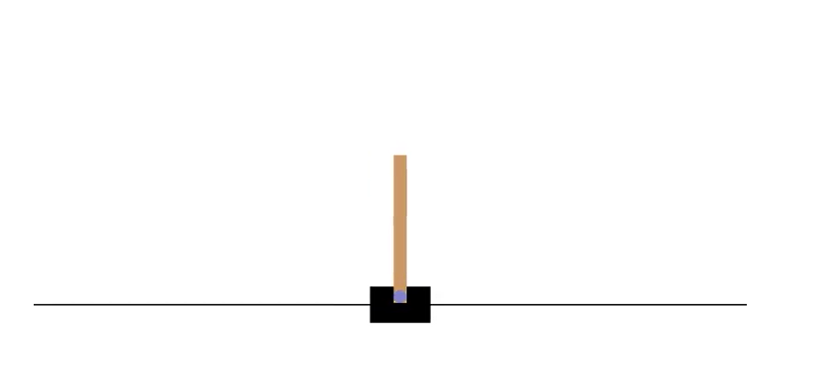
Example DQN
https://colab.research.google.com/github/tensorflow/agents/blob/master/docs/tutorials/1_dqn_tutorial.ipynb#scrollTo=KEHR2Ui-lo8O
Introduction to RL and Deep Q Networks
https://colab.research.google.com/github/tensorflow/agents/blob/master/docs/tutorials/0_intro_rl.ipynb#scrollTo=iuYYBJUWtvnP
Can produce video successfully

Slide 74
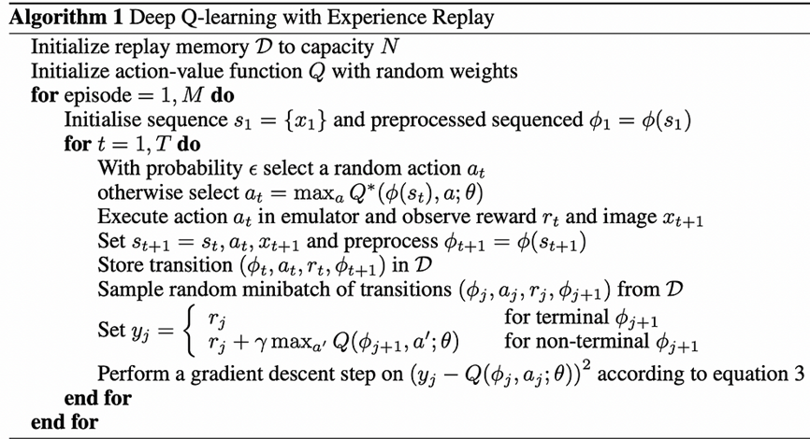
Deep-Q learning using experience replay memory/buffer (D)
Policy network weights= θ= θp
Target network weights=θ⁻ =θt
Sampling is to fill up replay memory D
Training is for training
https://medium.com/@cedric.vandelaer/reinforcement-learning-dqn-part-1-2-aac5f1e6e3be
https://huggingface.co/learn/deep-rl-course/unit3/deep-q-algorithm
https://ieeexplore.ieee.org/stamp/stamp.jsp?tp=&arnumber=9036763

