Slide 1
Auto-encoders
KH Wong

Slide 2
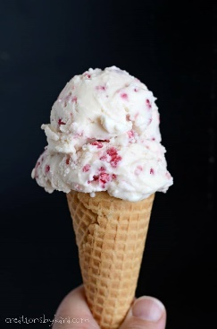
Two types of autoencoders
Part1 : Vanilla (means traditional or classical) Autoencoder
  or simply called Autoencoder
Part 2: Variational Autoencoder
This Photo by Unknown Author is licensed under CC BY-NC-ND

Slide 3
Part 1:
Overview of Vanilla (traditional/classical) Autoencoder
Introduction
Theory
Architecture
Application
Examples

Slide 4
Introduction
What is auto-decoder?
  An unsupervised method
Application
  For noise removal
  Dimensional reduction
Method
  Use noise-free ground truth data (e.g. MNIST)+ self generative noise to train the network
  The final network can remove noise of in the input (e.g. hand written characters), the output will be similar to the ground truth data

Slide 5
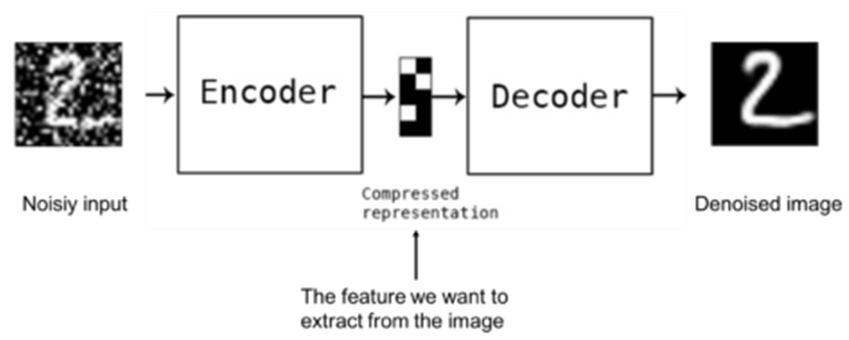

Noise removal
https://www.slideshare.net/billlangjun/simple-introduction-to-autoencoder
Perfect input + noise
Result:
plt.title('Original images: top rows,'
'Corrupted Input: middle rows, '
'Denoised Input: third rows')

Slide 6
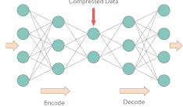
Auto encoder Structure
De-noised
Output
x‘
An autoencoder is a feedforward neural network that learns to predict the input (corrupted by noise) itself in the output.
The input-to-hidden part corresponds to an encoder
The hidden-to-output part corresponds to a decoder.
Input and output are of the same dimension and size.
Noisy
Input
x
Z (code)
x
x‘
encoder
decoder
Neural network after training
https://towardsdatascience.com/deep-autoencoders-using-tensorflow-c68f075fd1a3

Slide 7
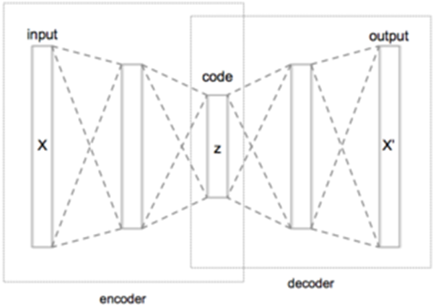
Theory
(W=weight, b=bias)
Input code output
X W
b
σ
Z W’
b’
σ’ x’
Autoencoders are trained to minimize reconstruction errors (such as squared errors), often referred to as the "loss (L)":
By combining (*) and (**)
Encoder decoder
Notes:
\subsection{Theory}
%%eeeeeeeeeeeeeeeeeeeeeeeeeeeeeeeeeeeeeeee
$x \rightarrow F \rightarrow x'$\\
$z=\sigma (Wx+b)------(*)$\\
$x'=\sigma'(W'z+b')---(**)$\\
Autoencoders are trained to minimize reconstruction errors (such as squared errors), often referred to as the "loss (L)":\\
By combining (*) and (**)\\
$Loss=L(x,x')=\| x-x' \|^2$\\
$\| x-\sigma' ( W' \sigma (W x+b)+b' \|^2$\\

Slide 8
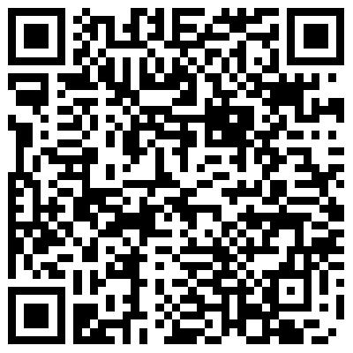
Exercise 1a,b,c
How many input layers, hidden layers, output layers in the figure shown? MC choices: How many
(a) input layer(s)?
(b) hidden layer(s)?
(c) Output layer(s)?
How many neurons in these layers? MC choices: How many neurons in these layers?
(d) input layer?
(e) hidden layers: choices:
  1) 3
  2) 6
  3) 8
  4) 10
(f) output layer?
(g) Which is true on the number of neurons?
  1) input neurons more than output neurons 2) input neurons same as output neurons
  3) input neurons less than output neurons
Input
Output

Slide 9
Answer : Exercise 1
Input
Output
How many input layers, hidden layers, output layers in the figure shown?
  Answer: input=1, hidden=3, output layer=1
How many neurons in these layers?
  Answer: input(=4), hidden(3,2,3),total=8 (choice 3), output (=4)
What is the relation between the number of input and output neurons?
  Answer: same (choice 2)

Slide 10
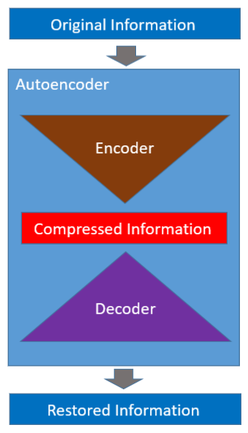
Architecture
Encoder and decoder
Training can use typical backpropagation methods
https://towardsdatascience.com/how-to-reduce-image-noises-by-autoencoder-65d5e6de543

Slide 11
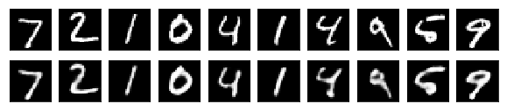
Training
Apply clean MNIST data set + added noise to be used as input,
Use clean MNIST data set as output
Train the autoencoder using backpropagation
Added noise
Clean MNIST samples
+
same
Autoencoder training by backpropagation
Clean MINST
samples

Slide 12
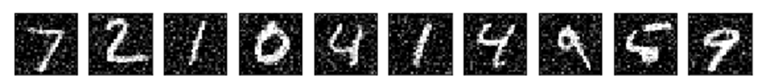
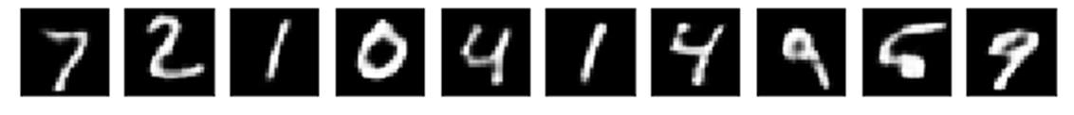
Recall
After training, autoencoders can be used to remove noise
Noisy
Input
Trained
autoencoder
De-noised
Output

Slide 13

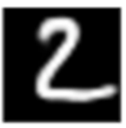
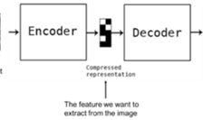
Exercise 2a,b: Auto-encoder training
(Q.2a) For (epoch=1;epoch <=max_epoch ; epoch++)
  {For all 10,000 images{
    Core code:
    Use backpropagation to train the whole autoencoder network (encoder + decoder)}
    Break if Loss is too small }
MC question: In core code, choices:
  Feed each clean image to the input, and Present the clean image to the output
  Feed each clean image+noise to the output, and Present the clean image to the input
  Feed each clean image+noise to the input, and Present the clean image to the output
(Q.2b) If the trained encoder receives a noisy image of a handwritten numeral, what do you expect at the output?
  MC choice: 1) a denoised image; 2) input + noise
  3) same as input ; 4) pure random noise
Noise
clean image for numeral “2”
Input
output
auto-encoder

Slide 14

Answer: Exercise 2a,b
Answer 2(a): Auto-encoder training
For (epoch=1;epoch <=max_epoch ; epoch++)
  {For all 10,000 images{
    Feed each clean image plus noise to the (encoder) input
    Present the clean image of the numerical to the output (of the decoder),
    Use backpropagation to train the whole autoencoder network (encoder + decoder)
    }
    Break if Loss is too small
  }
Ex.2(b) Autoencoder usage: If the trained encoder receives a noisy image of a handwritten numeral, what do you expect at the output?
  Answer 2(b): a denoised image of the realinput numeral image (choice 1 is correct)
Noise
clean image for numeral “2”
Core code
Choice 3 is correct
+
Input
Output
auto-encoder

Slide 15
Sample Code:
Part(i): obtain dataset and add noise https://towardsdatascience.com/how-to-reduce-image-noises-by-autoencoder-65d5e6de543
#part1 ---------------------------------------------------
np.random.seed(1337)
# MNIST dataset
(x_train, _), (x_test, _) = mnist.load_data()
image_size = x_train.shape[1]
x_train = np.reshape(x_train, [-1, image_size, image_size, 1])
x_test = np.reshape(x_test, [-1, image_size, image_size, 1])
x_train = x_train.astype('float32') / 255
x_test = x_test.astype('float32') / 255
# Generate corrupted MNIST images by adding noise with normal dist
# centered at 0.5 and std=0.5
noise = np.random.normal(loc=0.5, scale=0.5, size=x_train.shape)
x_train_noisy = x_train + noise
noise = np.random.normal(loc=0.5, scale=0.5, size=x_test.shape)
x_test_noisy = x_test + noise
x_train_noisy = np.clip(x_train_noisy, 0., 1.)
x_test_noisy = np.clip(x_test_noisy, 0., 1.)

Slide 16
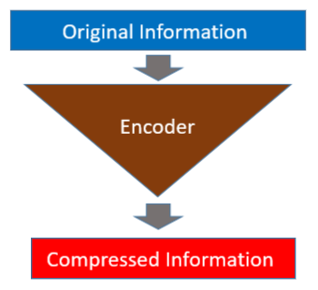
Part (ii):First build the Encoder Model
#part2 ---------------------------------------------------
# Network parameters
input_shape = (image_size, image_size, 1)
batch_size = 128
kernel_size = 3
latent_dim = 16
# Encoder/Decoder number of CNN layers and filters per layer
layer_filters = [32, 64]
# Build the Autoencoder Model
# First build the Encoder Model
inputs = Input(shape=input_shape, name='encoder_input')
x = inputs
# Stack of Conv2D blocks
# Notes:
# 1) Use Batch Normalization before ReLU on deep networks
# 2) Use MaxPooling2D as alternative to strides>1
# - faster but not as good as strides>1
for filters in layer_filters:
x = Conv2D(filters=filters,
kernel_size=kernel_size,
strides=2,
activation='relu',
padding='same')(x)
# Shape info needed to build Decoder Model
shape = K.int_shape(x)
# Generate the latent vector
x = Flatten()(x)
latent = Dense(latent_dim, name='latent_vector')(x)
# Instantiate Encoder Model
encoder = Model(inputs, latent, name='encoder')
encoder.summary()

Slide 17
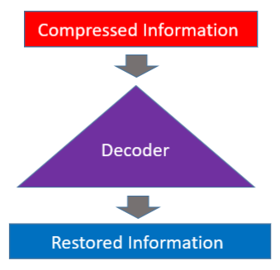
Part (iii):Build the Decoder Model
#part3 ---------------------------------------------------
# Build the Decoder Model
latent_inputs = Input(shape=(latent_dim,), name='decoder_input')
x = Dense(shape[1] * shape[2] * shape[3])(latent_inputs)
x = Reshape((shape[1], shape[2], shape[3]))(x)
# Stack of Transposed Conv2D blocks
# Notes:
# 1) Use Batch Normalization before ReLU on deep networks
# 2) Use UpSampling2D as alternative to strides>1
# - faster but not as good as strides>1
for filters in layer_filters[::-1]:
x = Conv2DTranspose(filters=filters,
kernel_size=kernel_size,
strides=2,
activation='relu',
padding='same')(x)
x = Conv2DTranspose(filters=1,
kernel_size=kernel_size,
padding='same')(x)
outputs = Activation('sigmoid', name='decoder_output')(x)
# Instantiate Decoder Model
decoder = Model(latent_inputs, outputs, name='decoder')
decoder.summary()
# Autoencoder = Encoder + Decoder
# Instantiate Autoencoder Model
autoencoder = Model(inputs, decoder(encoder(inputs)), name='autoencoder')
autoencoder.summary()
autoencoder.compile(loss='mse', optimizer='adam')

Slide 18
Part (iv): Train the autoencoder, decode images display result
#part4 ---------------------------------------------------
# Train the autoencoder
autoencoder.fit(x_train_noisy,
x_train,
validation_data=(x_test_noisy, x_test),
epochs=30,
batch_size=batch_size)
# Predict the Autoencoder output from corrupted test images
x_decoded = autoencoder.predict(x_test_noisy)
# Display the 1st 8 corrupted and denoised images
rows, cols = 10, 30
num = rows * cols
imgs = np.concatenate([x_test[:num], x_test_noisy[:num], x_decoded[:num]])
imgs = imgs.reshape((rows * 3, cols, image_size, image_size))
imgs = np.vstack(np.split(imgs, rows, axis=1))
imgs = imgs.reshape((rows * 3, -1, image_size, image_size))
imgs = np.vstack([np.hstack(i) for i in imgs])
imgs = (imgs * 255).astype(np.uint8)
plt.figure()
plt.axis('off')
plt.title('Original images: top rows, '
'Corrupted Input: middle rows, '
'Denoised Input: third rows')
plt.imshow(imgs, interpolation='none', cmap='gray')
Image.fromarray(imgs).save('corrupted_and_denoised.png')
plt.show()

Slide 19
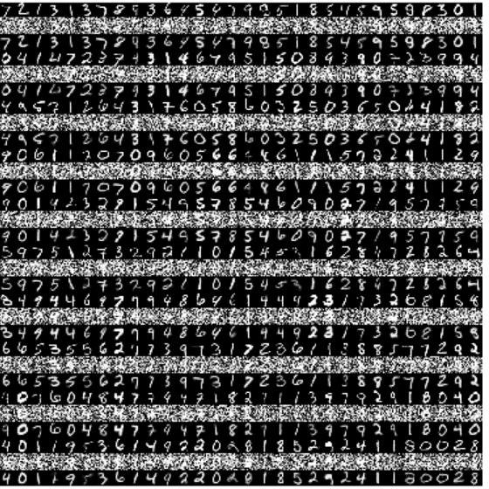
Code https://towardsdatascience.com/how-to-reduce-image-noises-by-autoencoder-65d5e6de543
Result: plt.title('Original images: top rows, '
'Corrupted Input: middle rows, '
'Denoised Image: third rows')
'''Trains a denoising autoencoder on MNIST dataset.
https://towardsdatascience.com/how-to-reduce-image-noises-by-autoencoder-65d5e6de543
Denoising is one of the classic applications of autoencoders.
The denoising process removes unwanted noise that corrupted the
true signal.
Noise + Data ---> Denoising Autoencoder ---> Data
Given a training dataset of corrupted data as input and
true signal as output, a denoising autoencoder can recover the
hidden structure to generate clean data.
This example has modular design. The encoder, decoder and autoencoder
are 3 models that share weights. For example, after training the
autoencoder, the encoder can be used to generate latent vectors
of input data for low-dim visualization like PCA or TSNE.
'''
#keras>> tensorflow.keras, modification by khw
from __future__ import absolute_import
from __future__ import division
from __future__ import print_function
import tensorflow.keras as keras
from tensorflow.keras.layers import Activation, Dense, Input
from tensorflow.keras.layers import Conv2D, Flatten
from tensorflow.keras.layers import Reshape, Conv2DTranspose
from tensorflow.keras.models import Model
from tensorflow.keras import backend as K
from tensorflow.keras.datasets import mnist
import numpy as np
import matplotlib.pyplot as plt
from PIL import Image
np.random.seed(1337)
# MNIST dataset
(x_train, _), (x_test, _) = mnist.load_data()
image_size = x_train.shape[1]
x_train = np.reshape(x_train, [-1, image_size, image_size, 1])
x_test = np.reshape(x_test, [-1, image_size, image_size, 1])
x_train = x_train.astype('float32') / 255
x_test = x_test.astype('float32') / 255
# Generate corrupted MNIST images by adding noise with normal dist
# centered at 0.5 and std=0.5
noise = np.random.normal(loc=0.5, scale=0.5, size=x_train.shape)
x_train_noisy = x_train + noise
noise = np.random.normal(loc=0.5, scale=0.5, size=x_test.shape)
x_test_noisy = x_test + noise
x_train_noisy = np.clip(x_train_noisy, 0., 1.)
x_test_noisy = np.clip(x_test_noisy, 0., 1.)
# Network parameters
input_shape = (image_size, image_size, 1)
batch_size = 128
kernel_size = 3
latent_dim = 16
# Encoder/Decoder number of CNN layers and filters per layer
layer_filters = [32, 64]
# Build the Autoencoder Model
# First build the Encoder Model
inputs = Input(shape=input_shape, name='encoder_input')
x = inputs
# Stack of Conv2D blocks
# Notes:
# 1) Use Batch Normalization before ReLU on deep networks
# 2) Use MaxPooling2D as alternative to strides>1
# - faster but not as good as strides>1
for filters in layer_filters:
x = Conv2D(filters=filters,
kernel_size=kernel_size,
strides=2,
activation='relu',
padding='same')(x)
# Shape info needed to build Decoder Model
shape = K.int_shape(x)
# Generate the latent vector
x = Flatten()(x)
latent = Dense(latent_dim, name='latent_vector')(x)
# Instantiate Encoder Model
encoder = Model(inputs, latent, name='encoder')
encoder.summary()
# Build the Decoder Model
latent_inputs = Input(shape=(latent_dim,), name='decoder_input')
x = Dense(shape[1] * shape[2] * shape[3])(latent_inputs)
x = Reshape((shape[1], shape[2], shape[3]))(x)
# Stack of Transposed Conv2D blocks
# Notes:
# 1) Use Batch Normalization before ReLU on deep networks
# 2) Use UpSampling2D as alternative to strides>1
# - faster but not as good as strides>1
for filters in layer_filters[::-1]:
x = Conv2DTranspose(filters=filters,
kernel_size=kernel_size,
strides=2,
activation='relu',
padding='same')(x)
x = Conv2DTranspose(filters=1,
kernel_size=kernel_size,
padding='same')(x)
outputs = Activation('sigmoid', name='decoder_output')(x)
# Instantiate Decoder Model
decoder = Model(latent_inputs, outputs, name='decoder')
decoder.summary()
# Autoencoder = Encoder + Decoder
# Instantiate Autoencoder Model
autoencoder = Model(inputs, decoder(encoder(inputs)), name='autoencoder')
autoencoder.summary()
autoencoder.compile(loss='mse', optimizer='adam')
# Train the autoencoder
autoencoder.fit(x_train_noisy,
x_train,
validation_data=(x_test_noisy, x_test),
epochs=30,
batch_size=batch_size)
# Predict the Autoencoder output from corrupted test images
x_decoded = autoencoder.predict(x_test_noisy)
# Display the 1st 8 corrupted and denoised images
rows, cols = 10, 30
num = rows * cols
imgs = np.concatenate([x_test[:num], x_test_noisy[:num], x_decoded[:num]])
imgs = imgs.reshape((rows * 3, cols, image_size, image_size))
imgs = np.vstack(np.split(imgs, rows, axis=1))
imgs = imgs.reshape((rows * 3, -1, image_size, image_size))
imgs = np.vstack([np.hstack(i) for i in imgs])
imgs = (imgs * 255).astype(np.uint8)
plt.figure()
plt.axis('off')
plt.title('Original images: top rows, '
'Corrupted Input: middle rows, '
'Denoised Input: third rows')
plt.imshow(imgs, interpolation='none', cmap='gray')
Image.fromarray(imgs).save('corrupted_and_denoised.png')
plt.show()

Slide 20
Exercise 3
Discuss applications of a Vanilla (traditional) autoencoder.
Which of the following is true? MC choices:
  Image recognition
  Denoise input images + Image recognition
  Denoise input images +Dimensionality Reduction
  Denoise input images only

Slide 21
Answer: Exercise 3
Discuss applications of a Vanilla (traditional) autoencoder.
Which of the following is true? MC choices:
  Image recognition
  Denoise input images + Image recognition
  Denoise input images +Dimensionality Reduction (correct)
  Denoise input images only
More information, see https://en.wikipedia.org/wiki/Autoencoder
  Dimensionality Reduction
  Relationship with principal component analysis (PCA)
  Information Retrieval
  Anomaly Detection
  Image Processing
  Drug discovery

Slide 22
Part 2: Variational autoencoder
Will learn
  Learn what is Variational autoencoder
  How to train it?
  How to use it?

Slide 23
Some math background is needed:
https://ljvmiranda921.github.io/notebook/2017/08/13/softmax-and-the-negative-log-likelihood/
See appendix2: The expected negative log likelihood
Conditional expectation etc.

Slide 24
Variational Autoencoder (VAE) v.s. Traditional Autoencoder
Autoencoders (vanilla or traditional)
  During training you present a pattern with artificial added noise to the encoder, and feed the same input pattern (as target, or teacher) to the output. Then, use backpropagation to train the Autoencoder network.
  So, it is unsupervised learning (no label data is needed).
  It can be used for data compression and noise removal.
  During recall, when a noisy pattern is presented to the input, a de-noise image will appear at the output.
Variational autoencoders
  Instead of learning from an input pattern, Variational autoencoders learn the parameters of a probability distribution function from the input patterns. We then use the parameters learned to generate new data. So, it is a generative model like GAN (Generative Adversarial Network) in functionality.

Slide 25
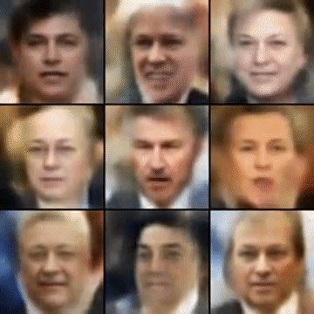
Variational autoencoder https://jaan.io/what-is-variational-autoencoder-vae-tutorial/
Variational autoencoders are cool. They let us design complex generative models of data and fit them to large datasets. They can generate images of fictional celebrity faces and high-resolution digital artwork.
VAE faces
VAE faces demo
VAE MNIST
VAE street addresses
https://jaan.io/what-is-variational-autoencoder-vae-tutorial/
May be or similar to that used in software such as Deepfake (https://en.wikipedia.org/wiki/Deepfake)
FICTIONAL CELEBRITY FACES GENERATED BY A VARIATIONAL AUTOENCODER (BY ALEC RADFORD).

Slide 26
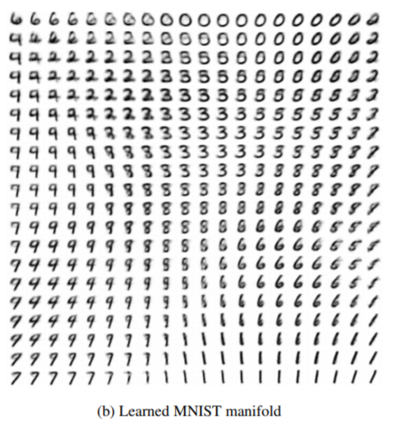
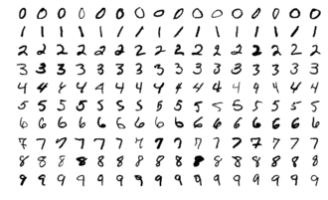
Example: Applying VAE for MNIST data set extension
Input: original image data set
Output: generated image
Dataset (images extended)
https://arxiv.org/pdf/1312.6114.pdf

Slide 27
Some background:
Univariate and Multivariate Gaussian
https://ttic.uchicago.edu/~shubhendu/Slides/Estimation.pdf
Notes:
subsection{Uni-variate and Multivariate Gaussian}
%https://ttic.uchicago.edu/~shubhendu/Slides/Estimation.pdf
$N_{univariate}(x)=\frac{1}{(2\pi \sigma^2)^{(1/2)}}
exp\big( -\frac{1}{2}\frac{(x-\mu)^2}{\sigma^2}
\big)$\\
Multivariate Gaussian, $x$=data sample, %$\mu$=mean, $\sum$=covariance \\
d-dimension\\
$N_{univariate}(x)=
\frac{1}{(2\pi)^{(d/2)} | \Sigma |^{(1/2)}}
exp\big( -\frac{1}{2}(x-\mu)^T \Sigma^{-1}(x-\mu)
\big)$

Slide 28
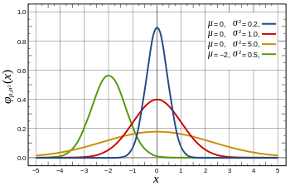

Properties of Gaussian (Normal) distribution
Standard Normal distribution (1-dimension):
Red line, when mean(μ)=0, Sigma (σ)=1
  At (x-μ)=0, σ =1
  G(x) =1/sqrt(2*pi)=0.3989
At x=1*σ, drops off to
  (1/sqrt(2*pi))*exp(-1^1/2)=0.2420
  Area covered 68.2%
At x=2*σ, drops off to
  (1/sqrt(2*pi))*exp(-2^2/2)= 0.0540
  Area covered 95.44%
At x=3*σ, drops off to
  (1/sqrt(2*pi))*exp(-2^2/2)= ?? (exercise)
  Area covered 99.73%
Probability density function
G
sets the horizontal shift
Controls the shape
G
Standard Normal distribution
Area covered
(total=
100%)
http://en.wikipedia.org/wiki/Normal_distribution
So called 95% confident value µ(+/-)2σ

Slide 29
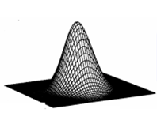
Gaussian (Normal) functions 1D,2D
G(x)
1-D Gaussian
x
μ
2-D Gaussian
y
x
μ_{y}
μ_{x}
Notes:
%%%%%%%%%%%% slide 54 %%%%%%%%%%%%%%%%%%%%
%%% eeeeee eq:filtering_01A eeeeeeeeeeeeeeeeeeeeeeeeeeeeeeeeee
%%%
1st order (A) Gaussian
\begin{flalign}
\label{eq:filtering_01a}
\begin{aligned}
G(x) = \frac{1}
{\sqrt{2\pi{\sigma^2 }}}
e^{-
\frac{(x-\mu)^2}
{2\sigma^2}
}
\end{aligned}
\end{flalign}
%%% eeeeee eq:filtering_01B eeeeeeeeeeeeeeeeeeeeeeeeeeeeeeeeee
1st order (B) Gaussian\\
\begin{flalign}
\label{eq:filtering_01b}
\begin{aligned}
G(x) = \frac{1}
{\sqrt{2\pi{\sigma^2 }}}
exp\left({-
\frac{(x-\mu)^2}
{2\sigma^2}
}\right)
\end{aligned}
\end{flalign}
%%%%%%%%%%%%%%%%%%%%%%%%%%%%%%%%%
%%% eeeeee eq:filtering_02A eeeeeeeeeeeeeeeeeeeeeeeeeeeeeeeeee
%%%%%%%%%%%%%%%%%%%%%%%%%%%%%%%%%
2nd order (A) Gaussian\\
\begin{flalign}
\label{eq:filtering_02A}
\begin{aligned}
G(x,y) =G(x)G(y)= \frac{1}
{{2\pi{\sigma^2 }}}
e^{-
\frac{(x-\mu_x)^2+(y-\mu_y)^2}
{2\sigma^2}
}
\end{aligned}
\end{flalign}
%%%
2nd order (B) Gaussian
%%% eeeeee eq:filtering_02B eeeeeeeeeeeeeeeeeeeeeeeeeeeeeeeeee
\begin{flalign}
\label{eq:filtering_02B}
\begin{aligned}
G(x,y) =G(x)G(y)= \frac{1}
{{2\pi{\sigma^2 }}}
exp\left({-
\frac{(x-\mu_x)^2+(y-\mu_y)^2}
{2\sigma^2}
}\right)
\end{aligned}
\end{flalign}

Slide 30
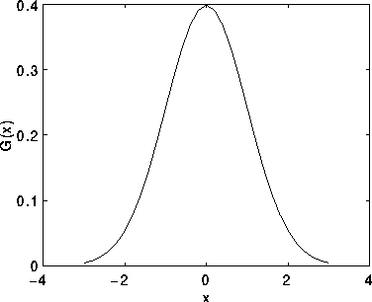
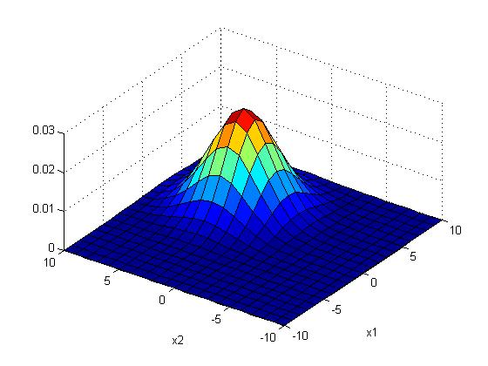
Example : A 1-D and 2-D Gaussian distribution
%2-D Gaussian distribution P(x_{j})
%matlab code----------
clear, N=10
[X1,X2]=meshgrid(-N:N,-N:N);
sigma =2.5;mean=[3 3]'
G=1/(2*pi*sigma^2)*
(exp(-((X1-mean(1)).^2+(X2-mean(2)).^2)) /(2*sigma^2));
G=G./sum(G(:)) %normalise it
'sigma is ', sigma
'sum(G(:)) is ',sum(G(:))
'max(max(G(:))) is',max(max(G(:)))
figure(1), clf
surf(X1,X2,G);
xlabel('x1'),ylabel('x2')
Notes:
%%%%%%%%%%%%%slide 28 %%%%%%%%%%%%%%%%%
1-D Gaussian $x_j$= a sample,\\
$\mu_0=mean, \sigma_0=variance$\\
$N(x_j)=\frac{1}{(2 \pi \sigma_0^2)^{1/2}}
exp \big (-\frac{1}{2}\frac{(x_j - \mu_0)^2}{\sigma_0^2} \big)$\\
%%%%%%%%%%%%%%%%%%%%%%%%%%%%%%
2-D an isotropic (circular symmetric) Gaussian \\
assume mean is 0\\
$N(x_1,x_2)=\frac{1}{(2 \pi \sigma_0^2)}
exp \big (-\frac{1}{2}\frac{(x_1^2+x_2^2 )^2}{\sigma_0^2} \big)$\\

Slide 31
Exercise 4
In Box 1, sigma (σ)=2
x=m_{x} y=m_{y}
Mc choices:
G(x,y)=1/(2*pi*2+2)
G(x,y)=1/(2*pi*2)
G(x,y)=1/(2*pi*2^4)
G(x,y)=1/(2*pi*2^2).
Student exercise:
Fill in the blanks of this Gaussian mask of size 9x9 , sigma (σ)=2
Sketch the function
Box1
x=m_{x}
y=m_{y}
x=1+m_{x}
y=m_{y}
G(x,y)=
0.0007 0.0017 0.0033 0.0048 0.0054 0.0048 0.0033 0.0017 0.0007
0.0017 0.0042 0.0078 0.0114 0.0129 0.0114 0.0078 0.0042 0.0017
0.0033 0.0078 0.0146 0.0213 0.0241 0.0213 0.0146 0.0078 0.0033
0.0048 0.0114 0.0213 0.0310 0.0351 0.0310 0.0213 0.0114 0.0048
0.0054 0.0129 0.0241 0.0351 BOX1 ? ____? 0.0241 0.0129 0.0054
0.0048 0.0114 0.0213 0.0310 0.0351 ____? 0.0213 0.0114 0.0048
0.0033 0.0078 0.0146 0.0213 0.0241 0.0213 0.0146 0.0078 0.0033
0.0017 0.0042 0.0078 0.0114 0.0129 0.0114 0.0078 0.0042 0.0017
0.0007 0.0017 0.0033 0.0048 0.0054 0.0048 0.0033 0.0017 0.0007
Notes:
%%%%%%%%%%slide 29 , 30%%%%%%%%%%%%%%%%%%%%
---------------slide 29,30 \\
2-D an isotropic (circular symmetric) Gaussian for variable $(x,y)$ \\
assume 2-D mean is $(m_x,m_y)$\\
$G(x,y)=G(x)G(y)$\\
$N(x_1,x_2)=\frac{1}{(2 \pi \sigma_0^2)}
exp \big (-\frac{1}{2}\frac{((x-m_x)^2+(y-m_y)^2 )^2}{\sigma_0^2} \big)$\\

Slide 32
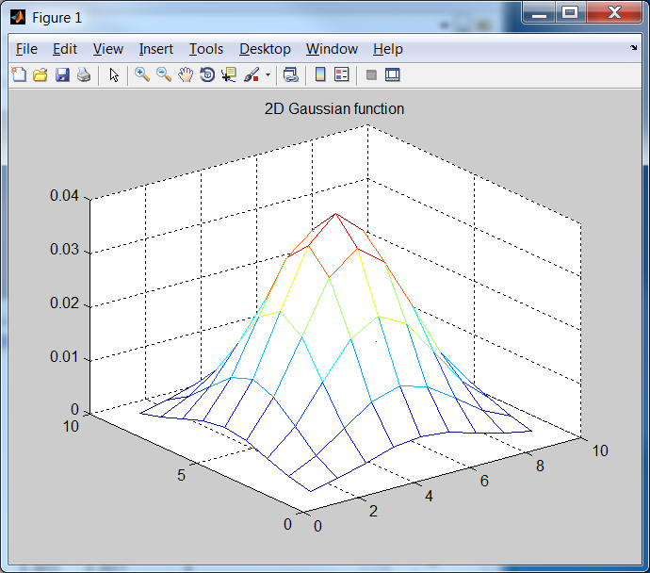

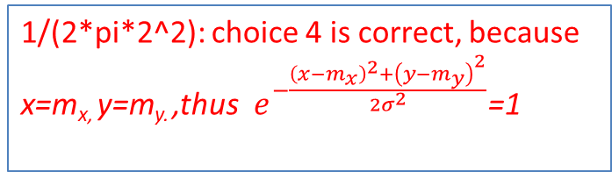
Answer: Exercise 4
1/(2*pi*2^2): choice 4 is correct, because x=m_{x,} y=m_{y.} ,thus $e^{−\frac{{\left(x−m_{x}\right)}^{2}+{\left(y−m_{y}\right)}^{2}}{2σ^{2}}}$=1
Box 1
x=m_{x}
y=m_{y}
1/(2*pi*2^2)*exp(-1/8)
x=1+m_{x}
y=m_{y}
1/(2*pi*2^2)*exp(-2/8)
0.0007 0.0017 0.0033 0.0048 0.0054 0.0048 0.0033 0.0017 0.0007
0.0017 0.0042 0.0078 0.0114 0.0129 0.0114 0.0078 0.0042 0.0017
0.0033 0.0078 0.0146 0.0213 0.0241 0.0213 0.0146 0.0078 0.0033
0.0048 0.0114 0.0213 0.0310 0.0351 0.0310 0.0213 0.0114 0.0048
0.0054 0.0129 0.0241 0.0351 0.0398 0.0351 0.0241 0.0129 0.0054
0.0048 0.0114 0.0213 0.0310 0.0351 0.0310 0.0213 0.0114 0.0048
0.0033 0.0078 0.0146 0.0213 0.0241 0.0213 0.0146 0.0078 0.0033
0.0017 0.0042 0.0078 0.0114 0.0129 0.0114 0.0078 0.0042 0.0017
0.0007 0.0017 0.0033 0.0048 0.0054 0.0048 0.0033 0.0017 0.0007
Fill in the blanks Gaussian mask of size the 9x9 , sigma (σ)=2
clear %matlab
sigma=2 % in matlab , no -ve index for looping, so shift center to (5,5)
mean_x=5 , mean_y=5
for y=1:9
for x=1:9
g(x,y)=(1/(2*pi*sigma^2))*exp(-((x-mean_x)^2+(y-mean_y)^2) /(2*sigma^2))
end
end
mesh(g)
title('2D Gaussian function')
$$2−\text{D} \text{Gaussian}\text{, }\text{mean} \\ (m_{x},m_{y}) \\ G(\text{x}\text{,}\text{y})=G(x)G(y) \\ =\frac{1}{2πσ^{2}}e^{−\frac{{\left(x−m_{x}\right)}^{2}+{\left(y−m_{y}\right)}^{2}}{2σ^{2}}}$$
Notes:
%%%%%%%%%%slide 29 , 30%%%%%%%%%%%%%%%%%%%%
---------------slide 29,30 \\
2-D an isotropic (circular symmetric) Gaussian for variable $(x,y)$ \\
assume 2-D mean is $(m_x,m_y)$\\
$G(x,y)=G(x)G(y)$\\
$N(x_1,x_2)=\frac{1}{(2 \pi \sigma_0^2)}
exp \big (-\frac{1}{2}\frac{((x-m_x)^2+(y-m_y)^2 )^2}{\sigma_0^2} \big)$\\

Slide 33
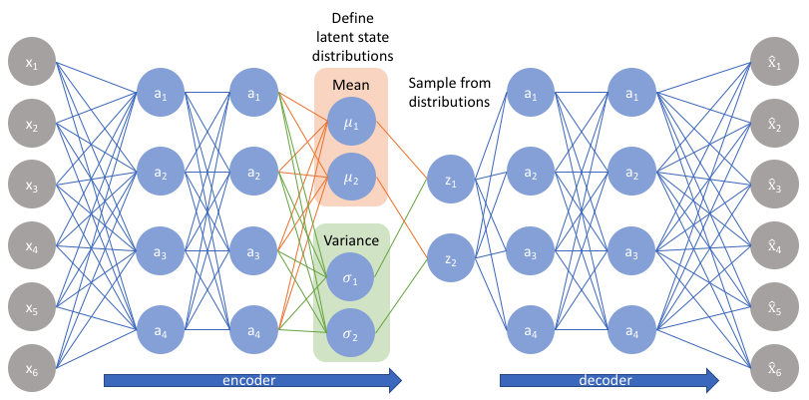
A VAE neural network with 2 latent dimensions
Each neuron has 1 bias except the input neuron . Also, calculation of mean and variance do not need weight and bias.
2 means
2 variances
This system has 2 latent dimensions, hence 2 Zs
mean = µ, variance = σ²
Can use convolution layers here
Can use transposed convolution layers here
4 neurons
1 bias
1 bias
https://www.jeremyjordan.me/variational-autoencoders/

Slide 34
Generative Models concept
It is an unsupervised learning method that generates new samples by using training data from the same distribution
E.g., You have limited number of samples but want to create more samples of the same probability distributions to be used in machine learning purposes. Others include:
  Creating new cartoon figures
  Generating faces from images of celebrities.
  Creating new fashions.
  Creating new written characters for training optical character recognition systems of some languages
Generative model algorithms
  Variational autoencoder (discussed here)
  Generative adversarial network (GAN) not discussed here

Slide 35

Variational autoencoder for generative models
Use training samples to train hidden data (parameters of multi-variate Gaussian standard deviations=σ_{s}, means = µ_{s} ). After training you may create new output from some input and weighted σ_{s} and µ_{s} . You may change the weights of σ_{s} and µ_{s} for a variety of related different outputs.
(Z are Gaussian generated values, using σ_{s}², µ_{s} )
E.g. latent dimension =2. Then two µ_{s}, two σ_{s}
Z
https://www.quora.com/Whats-the-difference-between-a-Variational-Autoencoder-VAE-and-an-Autoencoder
Standard deviation is the square root of variance

Slide 36
Application example: Use Generative Models for MNIST data extension http://yann.lecun.com/exdb/mnist/
MNIST original data set
During training , patterns are fed into input and output one by one, learn µ,σ by minimize loss
After training, data generation phase
Apply a training sample to both input and output at the same time
Gaussian generated values, using σ_{s}², µ_{s} )
neurons,
Generated extended data set
z
Random generator layer using 2µ_{s}, 2σ_{s}

Slide 37
Exercise 5:What is the architectural difference between Vanilla (traditional) autoencoder and Variational autoencoder?
MC: Which is incorrect?
In Vanilla (traditional) autoencoder: input to output are directly connected by neurons and weights.
In Variational autoencoder: The encoder turns input (x) into means (µ_{s}) and standard deviations (σ_{s}) of a multivariate Gaussian distribution, then use a random sampling method to create the output.
In Variational autoencoder : input to output are directly connected by neurons and weights .
In Variational autoencoder: The number of mean (µ_{s}) and standard deviations (σ_{s}) neurons are the same.
Vanilla autoencoder
z
E.g. 2µ_{s}, 2σ_{s}

Slide 38
Answer Exercise 5:What is the architectural difference between Vanilla (traditional) autoencoder and Variational autoencoder?
MC: Which is incorrect?
In Vanilla (traditional) autoencoder: input to output are directly connected by neurons and weights.
In Variational autoencoder: The encoder turns input (x) into means (µ_{s}) and standard deviations (σ_{s}) of a multivariate Gaussian distribution, then use a random sampling method to create the output.
In Variational autoencoder : input to output are directly connected by neurons and weights . (This is incorrect)
In Variational autoencoder: The number of mean (µ_{s}) and standard deviations (σ_{s}) neurons are the same.
Vanilla autoencoder
Vanilla autoencoder
z
E.g. 2µ_{s}, 2σ_{s}

Slide 39
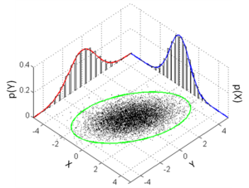
Exercise 6a,b for Variational autoencoder VAE
Which statement is incorrect for VAE?: MC choices:
Because the search space is large, there are too many combinations of means (µ_{s}) and standard deviations (σ_{s}) for generating the same output.
There are multiple solutions for means (µ_{s}) and standard deviations (σ_{s}).
There is a deterministic linear solution for the original VAE
Neural network provides a solution for VAE.
(b) Discuss exercise for students: what is a multivariate-Gaussian distribution.
form
https://en.wikipedia.org/wiki/Multivariate_normal_distribution
of 2 dimensions

Slide 40
Answer: Exercise 6a,b for Variational autoencoder VAE
Which statement is incorrect for VAE?: MC choices:
(choice3)There is a deterministic linear solution for the original VAE (this is incorrect It has a probability random process inside and is not derministic
(b) Discuss exercise for students: what is a multivariate-Gaussian distribution.
Answer: Multivariate-dimensional Gaussian:
In probability theory and statistics, the multivariate normal distribution, multivariate Gaussian distribution, or joint normal distribution is a generalization of the one-dimensional (univariate) normal distribution to higher dimensions. One definition is that a random vector is said to be k-variate normally distributed if every linear combination of its k components has a univariate normal distribution.
form
https://en.wikipedia.org/wiki/Multivariate_normal_distribution
of 2 dimensions

Slide 41
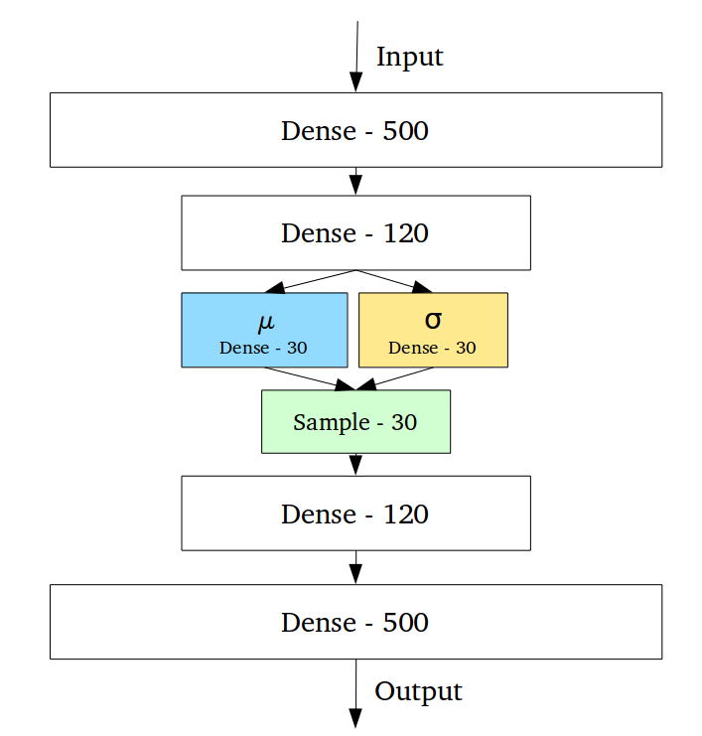
Latent dimensions of variational autoencoder
E.g. In some applications, latent dimension =30 .
30 σ values
30 μ values
Hence Z has 30 neurons.
Note: Most MNIST (character dataset generation) demos, Z has only 2 neurons for latent_dimension=2. But some can have 3 (or even 30 in this example) latent dimensions, see
http://www.cs.unibo.it/~asperti/variational.html
Face generation and VAE with different latent dimension examples: https://diposit.ub.edu/dspace/bitstream/2445/171974/3/171974.pdf
30 σ values
30 μ values
Random generator layer
generated by σ_{s}² and μ
Z
https://towardsdatascience.com/intuitively-understanding-variational-autoencoders-1bfe67eb5daf

Slide 42
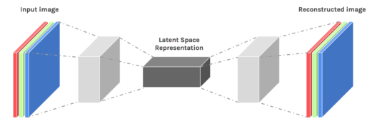
Training of Vanilla and Variational Autoencoders
Training of variational autoencoders is like training the vanilla autoencoders. E.g., for the de-noised application, presents noisy images to the input and clean image versions to the output. Use backpropagation to train the network. Read our previous discussion on vanilla autoencoder
http://www.math.purdue.edu/~buzzard/MA598-Spring2019/Lectures/Lec18%20-%20VAE.pptx
https://www.edureka.co/blog/autoencoders-tutorial/

Slide 43
Another example of Variational Autoencoder (VAE)
E.g. for hidden dimension=30
https://jaan.io/what-is-variational-autoencoder-vae-tutorial/
In this example: the latent variables, Z, are drawn from a probability distribution depending on the input, X, and the reconstruction is chosen probabilistically from z.
That means after you obtained mean=µ,variance σ², sample from X (n=500 neurons) to get Z (k=30 samples). Latent dimension=30.
Input : X=(x₁,x₂,…………,x_{n})
Latent variables :Z=(z₁,z₂,…,z_{k})
→
Dense connection to the next layer : input to decoder 120 neurons.
Note: in another example, such as MNIST (character dataset generation) demos, Z has only 2 neurons for latent-dimension=2
http://www.cs.unibo.it/~asperti/variational.html (from2 to 3 dimensions)
Encoder
Q_{θ} (z|X)
Decoder
P_{φ} (X|z)
Z
Z=Sample from
a distribution
N(µ,σ)
https://jaan.io/what-is-variational-autoencoder-vae-tutorial/

Slide 44
VAE example https://colab.research.google.com/github/keras-team/keras-io/blob/master/examples/generative/ipynb/vae.ipynb
Encoder: Layer (type) Output Shape Param # Connected to
=========================================================
input_1 (InputLayer) [(None, 28, 28, 1)] 0 [], padding == “SAME”,
layer1:conv2d (Conv2D) (None, 14, 14, 32) 320 ['input_1[0][0]’]
layer2 :conv2d_1 (Conv2D) (None, 7, 7, 64) 18496 ['conv2d[0][0]’]
layer3: flatten (Flatten) (None, 3136) 0 ['conv2d_1[0][0]’]
layer4: dense (Dense) (None, 16) 50192 ['flatten[0][0]’]
layet5a: z_mean (Dense) (None, 2) 34 ['dense[0][0]']
layer5b: z_log_var (Dense) (None, 2) 34 ['dense[0][0]’]
layer 6: sampling (Sampling)(None, 2) 0 ['z_mean[0][0]’, 'z_log_var[0][0]']
=========================================================
Total params: 69076 (269.83 KB), strides=s=2 for all conv2D used.
Kernel size=mxm=3x3, D=(((N-m)/s)+1), (28-3)/2+1≈14, using p=Zero-padding =1
﻿ When padding == “SAME”, the output size is half of that of input
Explanation for encoder:
Layer1 : W1=input*(kernel_size)*output_filter=1*(3*3)*32=288, B1=32, W1+B1= 320
Layer2 : W2=input_filters*(kernel_size)*output_filter=32*(3*3)*64=18432, B2=64, W1+B1=18496
Layer3 : W3=0, B3=0, W4+B4=0, x=layers.Flatten()(x)has 0 weight/bias, output=(7*7)*64=3136,
Layer4 : W4=3136*16=50176, B4=16. W4+B4=50176+16=50192
Layer5a: W5a=16*2=32,B5a=2. W5a+ B5a=34.
Since 16 inputs,2 outputs(latent dimension=2),2 biases for Z_mean
Layer5b: W5b=16*2=32,B5b=2.W5b+B5b=34
Since 16 inputs,2 outputs(latent dimension=2),2 biases for z_log_var
layer 6: sampling has no weight, W6=B6=0

Slide 45
VAE example https://colab.research.google.com/github/keras-team/keras-io/blob/master/examples/generative/ipynb/vae.ipynb
_________________________________________________________________
Decoder: Layer (type) Output Shape Param #
=================================================================
layer 7: input_2 (InputLayer) [(None, 2)] 0
layer 8: dense_1 (Dense) (None, 3136) 9408
layer 9: reshape (Reshape) (None, 7, 7, 64) 0
layer 10: conv2d_transpose(Conv2DTr (None, 14, 14, 64) 36928 transpose)
layer 11: conv2d_transpose_1 (Conv2D (None, 28, 28, 32)18464 transpose)
layer 12: conv2d_transpose_2 (Conv2D (None, 28, 28, 1) 289 Transpose)
=================================================================
Total params: 65089 (254.25 KB)
Trainable params: 65089 (254.25 KB)
Non-trainable params: 0 (0.00 Byte)
Explanation for decoder
Layer7 : generated by resampling no weight/bias, w7=B7=0
Layer8 : dense layer has 2 inputs,3136 outputs, W8=2*3136=6272,B8=3136, W8+B7=6272+3136=9408
Layer9 : reshape has no weights/bias. W9=9, B9=0
Layer10: W10=input*(kernel_size)*output_filter=64*(3*3)*64=36864, B10=64. W10+B10=36928
Layer11: W11=input*(kernel_size)*output_filter=64*(3*3)*32=18432, B11=32,W11+B11=18464
Layer12: W12=(kernel_size)*32=(3x3)*32=288, B12=1,W12+B12=289 (down sampling, transpose conv.)

Slide 46
Matlab code
%///////////////////////
clear %encode: matlab code to verify the results
W1=288, B1=32,
W2=18432, B2=64
W3=0, B3=0,
W4=50176, B4=16,
W5a=32, B5a=2,
W5b=32,B5b=2,
W6=0,B6=0,
W_all_encoder=W1+W2+W3+W4+W5a+W5b+W6
B_all_encoder= B1+B2+B3+B4+B5a+B5b+B6
W_all_encoder+B_all_encoder %= 69076 % ( same as that shown in the program, see above)
%/////////////////////////////////////////////////////////////////
W7=0, B7=0,
W8=6272,B8=3136,
W9=0, B9=0,
W10=36864, B10=64,
W11=18432, B11=32,
W12=288,B12=1,
W_all_decoder=W7+W8+W9+W10+W11+W12
B_all_decoder=B7+B8+B9+B10+B11+B12
W_all_decoder+B_all_decoder % =65089 % (same as that shown in the program, see above)

Slide 47
Three concepts in VAE
Train the neural network to maximize input/output likelihood
Use of Divergence (D_{KL})
Reparameterization

Slide 48
Variational Autoencoders
VAE Concept 1
Train the neural network to maximize input/output likelihood
Tutorial on Variational Autoencoders
Carl Doersch
https://arxiv.org/abs/1606.05908

Slide 49
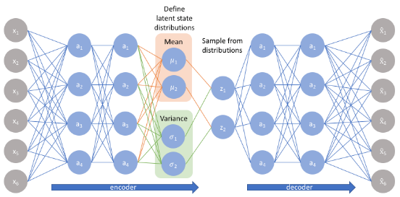
VAE Encoder
X-> encoder –>Z->decoder x^
https://jaan.io/what-is-variational-autoencoder-vae-tutorial/
θ
φ
The Encoder q_{θ(en)}(z|x) takes input x and returns Hidden (latent) parameters Z (random generated from µ,σ). (θ=encoder parameters, such as weights/biases)
From Z, use sampling to create input to the decoder
Encoders and Decoders are neural networks (NN)
Parameters in the NN are needed to be learned – so we have to set up a loss function.
Input
Data
Hidden variable
Z
Encoder(X→Z)
q_{θ(en)}(z|x)
Decoder(Z→ )
https://jaan.io/what-is-variational-autoencoder-vae-tutorial/
http://gregorygundersen.com/blog/2018/04/29/reparameterization/

Slide 50
VAE Decoder
https://jaan.io/what-is-variational-autoencoder-vae-tutorial/
The decoder takes hidden (latent) variable Z (gen. from means and standard deviations) as input, and reconstructs the image using random sampling methods.
( φ=decoder parameters weights/biases)
Encoders and Decoders are Neural Networks (NN)
Parameters (θ ,φ) in the NN are needed to be learned – so we have to set up a loss function.
Hidden
(latent)
variable
Z
Input
Data
Encoder(X→Z)
q_{θ(en)}(z|x)
Decoder(Z→ )
https://jaan.io/what-is-variational-autoencoder-vae-tutorial/

Slide 51
Define the reconstruction loss =(l ^{(rec)} )= “expected negative log-likelihood” of VAE
Given x_{i} ∈X, z∈Q, E() is expected value
The idea is to train the Encoder/Decoder (Neural Network) to maximum the likelihood (or minimize error) between x and reconstructed.
To maximize likelihood, same as minimize the reconstruction loss
Hidden
Z (µ,σ)
Encoder
q_{θ(en)}(z|x_{i})
Decoder
Error
Notes:
%%%%%%%%%%slide 46%%%%%%%%%%%%%%%%%%%%
---------------slide 46 \\
\subsection{slide 46:The reconstruction loss $l()$}
Given $x_i \epsilon X, z \epsilon Q, \text { and } E()$ is the expected value
The idea is to train the Encoder/Decoder (Neural Network) to maximum the likelihood of the Mean squared error (MSE) between x and reconstructed $\hat x_i \epsilon \hat X$\\
%
To maximize likelihood, we can minimize the “expected negative log-likelihood” $(l_i)$ of the $ i^{th}$ datapoint $x_i$. \\
%
$ l_i(\theta, \phi | x_i)=-E_{x_i \epsilon X} \big[
E_{z \epsilon Q}[log P_{\phi (de)}(\hat x_i | z)]
\big]$\\
$q_{\theta(en)}(z|x_i)$\\
$P_{\phi(de)}(\hat x_i |z)$\\
%
$l_i(\theta,\phi)$\\

Slide 52
Variational Autoencoders
VAE Concept 2
Use of Divergence (D_{KL}):
Similar training images should produce similar hidden data (means and standard deviations)
http://mi.eng.cam.ac.uk/~mjfg/local/4F10/lect4.pdf
https://en.wikipedia.org/wiki/Kullback%E2%80%93Leibler_divergence
https://jhui.github.io/2017/03/06/Variational-autoencoders/ (for relating covariance and standard deviations, with good example)

Slide 53
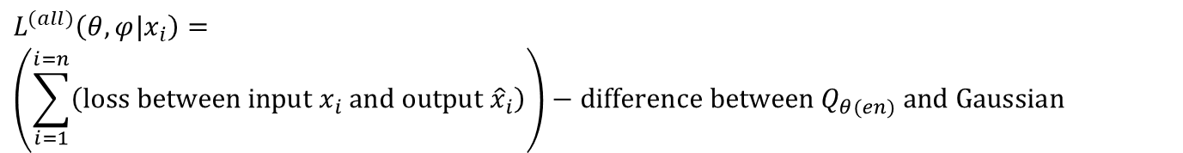

How to make sure the neural networks produce similar hidden data (means & standard deviations) from similar training images
Problem: Input that we regard as similar may end up very different in z space (hidden, means and standard deviations). That means some solutions may give small loss l_{i} ^{(all)}(θ, φ ), even q_{θ(en)} and p_{φ(de)} are of very different prob. distributions.
Solution: Use p(z)=N(0,1), try to force q_{θ(en)}(z|x_{i}) (a neural network) to act similarly to a standard normal probability density function. We can use Kullback-Leibler divergence (difference) (D_{KL}) to do the checking.
$$L^{(all)}\left(θ,φ|x_{i}\right)= \\ \left(\sum_{i=1}^{i=n}{\left(\text{loss} \text{between} \text{input} x_{i} \text{and} \text{output} {\hat{x}}_{i}\right)}\right)−\text{difference} \text{between} Q_{θ(en)} \text{and} \text{Gaussian}$$
We will minimize (L^{(all)} )
For encoder and decoder
We discussed this in concept 1:
This is for concept 2:
$$−D_{KL}\left[q_{θ(en)}\left(z|x_{i}\right)||N\left(0,I\right)\right]$$
https://jaan.io/what-is-variational-autoencoder-vae-tutorial/
https://en.wikipedia.org/wiki/Kullback%E2%80%93Leibler_divergence
http://gregorygundersen.com/blog/2018/04/29/reparameterization/
Notes:
%%%%%%%%%%%%%%%%%%%%%%%%
\subsection{slide 48: How to make sure the neural networks produce similar hidden data (means and standard deviations) from similar training images}
Problem: Input that we regard as similar may end up very different in z space (hidden, means and standard deviations). That means some solutions may give small loss $l_i{(\theta, \phi)}$, even $q_{\theta(en)}$ and $p_{\phi(de)}$ are of very different distributions.\\
Solution: Use $p(z)=N(0,1)$, try to force $q_{\theta(en)}(z|x_i)$ (a neural network) to act similar to a standard normal probability density function. We can use Kullback-Leibler divergence $(D_{KL})$ to do the checking.
%
$l_i(\theta,\phi|x_i)$\\
$l_i()$

Slide 54

Math background: Kullback–Leibler (KL) divergence D_{KL}, (also known as relative entropy) measures how one probability distribution is different from another one -- reference probability distribution over the same variable X.
Difference of two distributions
For equation (I) See https://arxiv.org/pdf/1907.08956.pdf
https://en.wikipedia.org/wiki/Kullback%E2%80%93Leibler_divergence
Tutorial on Variational Autoencoders by Carl Doersch & https://arxiv.org/abs/1606.05908
$$D_{KL}\left[N\left(μ_{1},σ_{1}^{2}\right)||N\left(μ_{2},σ_{2}^{2}\right)\right]= \\ \frac{1}{2}\left(tr\left({\left[σ_{2}^{2}\right]}^{T}∗σ_{1}^{2}−I\right)+{\left(μ_{1}−μ_{2}\right)}^{T}{\left[σ_{2}^{2}\right]}^{−1}\left(μ_{1}−μ_{2}\right)+\log\left(\frac{\det\left(σ_{2}^{2}\right)}{\det\left(σ_{1}^{2}\right)}\right)\right)−−−−−(I) \\ \text{If} N\left(μ_{1},σ_{1}^{2}\right)=N\left(μ\left(X\right),σ^{2}\left(X\right)\right); \text{also} N\left(μ_{2},σ_{2}^{2}\right)=N\left(0,I\right),i.e., µ2=0, σ\text{2}\text{2}\text{=1 (}\text{Normal} \text{dist}\text{.)}$$
$$Then D_{KL}\left[N\left(μ\left(X\right),σ^{2}\left(X\right)\right)||N\left(0,I\right)\right]=\frac{1}{2}\left[tr\left(σ^{2}\left(X\right)−I\right)+{\left(μ\left(X\right)\right)}^{T}\left(μ\left(X\right)\right)−\log\left(\det{σ^{2}}\left(X\right)\right)\right]$$
That means, by $setting µ2=0,σ_{2}^{2}\text{=1 (}\text{Normal} \text{dist}\text{.)}$, and
Setting $σ=σ1 \text{and} \text{N}\text{(0,}\text{I}\text{)}\text{=}\text{Zero}\text{_}\text{mean}\text{, }\text{variance}\text{=1 }$.
If $Q\left(z|x_{i}\right)=N\left(μ\left(X\right),σ^{2}\left(X\right)\right)$,so $DKL\left[Q\left(z|x_{i}\right)||N\left(0,I\right)\right]=D_{KL}\left[N\left(μ\left(X\right),σ^{2}\left(X\right)\right)||N\left(0,I\right)\right]$
$is the loss function we need to minimize$:
To minimize this:
$$D_{KL}\left[N\left(μ\left(X\right),σ^{2}\left(X\right)\right)||N\left(0,I\right)\right]=\frac{1}{2}\left[tr\left(σ^{2}\left(X\right)−I\right)+{\left(μ\left(X\right)\right)}^{T}\left(μ\left(X\right)\right)−\log\left(\det{σ^{2}}\left(X\right)\right)\right]$$
1
0
1
0
Note: If KL divergence D_{KL} (D1|| D2)=0, it indicates the two distributions D1,D2 are identical.
The above is to see if $Q\left(z|x_{i}\right)=N\left(μ\left(X\right),σ^{2}\left(X\right)\right)$ is closed to a normal distrib. of mean=0, std=1 or not.
Notes:
\subsection{Slide 49: Math background: Kullback–Leibler divergence}
%https://ttic.uchicago.edu/~shubhendu/Slides/Estimation.pdf
Math background: Kullback–Leibler divergence (also known as relative entropy) measures how one probability distribution is different from a second, reference probability distribution over the same variable X.
%1
Define:\\
$D_{KL}\big[
N(\mu_1,\sigma_1^2) || ( \mu_2,\sigma_2^2)
\big]=
\frac{1}{2} \Big[
tr \big ([\sigma_2^2]^T \cdot \sigma_1^2-I \big)
+(\mu_1-\mu_2)^T[\sigma^2]^{-1}(\mu_1 - \mu_2)
+log \big( \frac{det(\sigma_2^2)}{det(\sigma_1^2)} \big)
\Big]$-----(I)\\
If $N(\mu_1,\sigma_1^2)=N(\mu(X),\sigma^2(X))$;
\\Also $N(\mu_2,\sigma^2_2)=N(0,I)$\\
%2
%
$D_{KL}\big[
N(\mu(X),\sigma^2(X)) || ( N(0,I)
\big]=
\frac{1}{2} \Big[
tr \big ([\sigma^2]^T \cdot \sigma^2-I \big)
+(\mu(X))^T(\mu(X)))
-log (det(\sigma^2(X)))
\Big]$\\
%3
For $D[Q(z|x_i) || N(0,I)] \text{, where }
Q(z|x_i) =N(\mu(X),\sigma^2(X))$\\
$D_{KL}\big[
N(\mu(X),\sigma^2(X)) || ( N(0,I)
\big]=
\frac{1}{2} \Big[
tr \big ([\sigma^2]^T \cdot \sigma^2-I \big)
+(\mu(X))^T(\mu(X)))
-log (det(\sigma^2(X)))
\Big]$\\
Kullback–Leibler divergence $D_{KL} (D_1 || D_2)=0$ indicates the two distributions ${D_1,D_2}$ are identical
%Tutorial on Variational Autoencoders by Carl Doersch & https://arxiv.org/abs/1606.05908

Slide 55
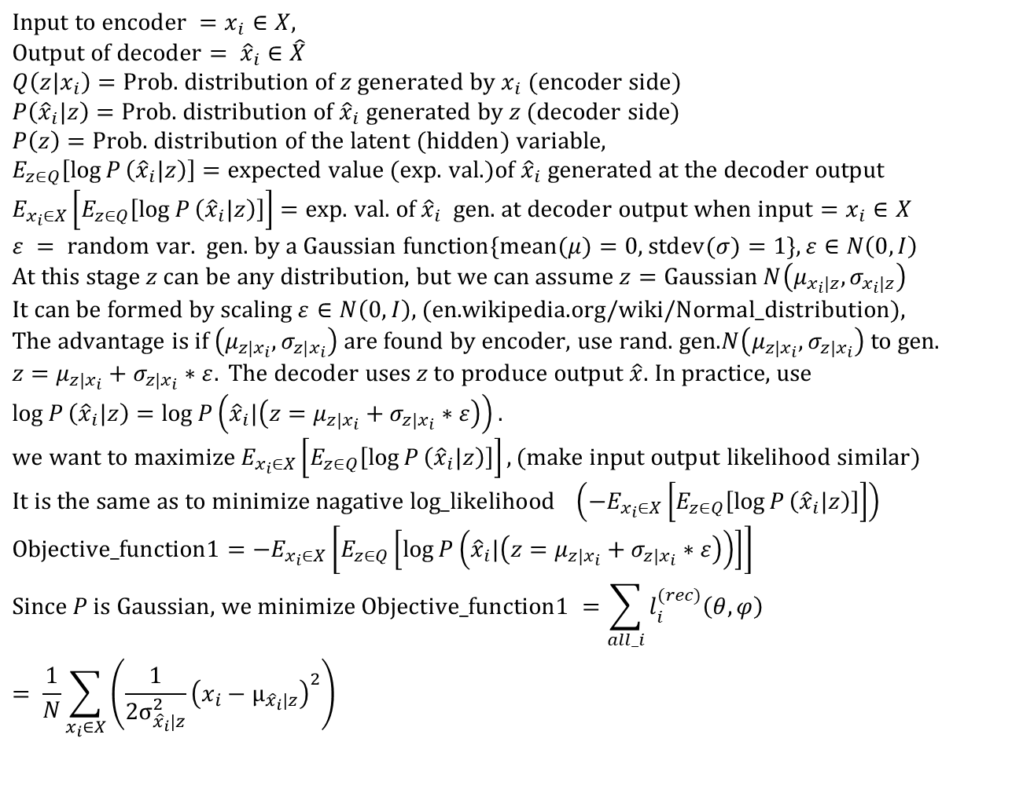
Training: Combining concept 1 and 2 to minimize Loss l_{i} (X), of X= {x₁,x_{2,}..,x_{N}} , E()=expected value . For the whole X, the average loss is
See http://bjlkeng.github.io/posts/variational-autoencoders/ & https://arxiv.org/abs/1312.6114
$$\text{Input} \text{to} \text{encoder} =x_{i}∈X, \\ \text{Output} \text{of} \text{decoder}= {\hat{x}}_{i}∈\hat{X} \\ Q\left(z|x_{i}\right)=\text{Prob}\text{. }\text{distribution} \text{of} z \text{generated} \text{by} x_{i} (\text{encoder} \text{side}) \\ P\left({\hat{x}}_{i}|z\right)=\text{Prob}\text{. }\text{distribution} \text{of} {\hat{x}}_{i} \text{generated} \text{by} z (\text{decoder} \text{side}) \\ P\left(z\right)=\text{Prob}\text{. }\text{distribution} \text{of} \text{the} \text{latent} (\text{hidden}) \text{variable}\text{, } \\ E_{z∈Q}\left[\log{P}\left({\hat{x}}_{i}|z\right)\right]=\text{expected} \text{value} (\text{exp}\text{. }\text{val}\text{.})\text{of} {\hat{x}}_{i} \text{generated} \text{at} \text{the} \text{decoder} \text{output} \\ E_{x_{i}∈X}\left[E_{z∈Q}\left[\log{P}\left({\hat{x}}_{i}|z\right)\right]\right]=\text{exp}\text{. }\text{val}\text{. }\text{of} {\hat{x}}_{i} \text{gen}\text{. }\text{at} \text{decoder} \text{output} \text{when} \text{input}=x_{i}∈X \\ ε = \text{random} \text{var}\text{. }\text{gen}\text{. }\text{by} \text{a} \text{Gaussian} \text{function}\{\text{mean}(μ)=\text{0, }\text{stdev}(σ)=1\},ε∈N\left(0,I\right) \\ \text{At} \text{this} \text{stage} z \text{can} \text{be} \text{any} \text{distribution}\text{, }\text{but} \text{we} \text{can} \text{assume} z=\text{Gaussian} N\left(μ_{x_{i}|z},σ_{x_{i}|z}\right) \\ \text{It} \text{can} \text{be} \text{formed} \text{by} \text{scaling} ε∈N\left(0,I\right)\text{, }(\text{en}\text{.}\text{wikipedia}\text{.}\text{org}\text{/}\text{wiki}\text{/}\text{Normal}\text{_}\text{distribution})\text{, } \\ \text{The} \text{advantage} \text{is} \text{if} \left(μ_{z|x_{i}},σ_{z|x_{i}}\right) \text{are} \text{found} \text{by} \text{encoder}\text{, }\text{use} \text{rand}\text{. }\text{gen}\text{.}N\left(μ_{z|x_{i}},σ_{z|x_{i}}\right) \text{to} \text{gen}\text{. } \\ z=μ_{z|x_{i}}+σ_{z|x_{i}}∗ε. \text{The} \text{decoder} \text{uses} z \text{to} \text{produce} \text{output} \hat{x}\text{. }\text{In} \text{practice}\text{, }\text{use} \\ \log{P}\left({\hat{x}}_{i}|z\right)=\log{P}\left({\hat{x}}_{i}|\left(z=μ_{z|x_{i}}+σ_{z|x_{i}}∗ε\right)\right). \\ \text{we} \text{want} \text{to} \text{maximize} E_{x_{i}∈X}\left[E_{z∈Q}\left[\log{P}\left({\hat{x}}_{i}|z\right)\right]\right], (\text{make} \text{input} \text{output} \text{likelihood} \text{similar}) \\ \text{It} \text{is} \text{the} \text{same} \text{as} \text{to} \text{minimize} \text{nagative} \text{log}\text{_}\text{likelihood} \left(−E_{x_{i}∈X}\left[E_{z∈Q}\left[\log{P}\left({\hat{x}}_{i}|z\right)\right]\right]\right) \\ \text{Objective}\text{_}\text{function}\text{1}=−E_{x_{i}∈X}\left[E_{z∈Q}\left[\log{P}\left({\hat{x}}_{i}|\left(z=μ_{z|x_{i}}+σ_{z|x_{i}}∗ε\right)\right)\right]\right] \\ \text{Since} P \text{is} \text{Gaussian}\text{, }\text{we} \text{minimize} \text{Objective}\text{_}\text{function}\text{1 }=\sum_{all_i}{l_{i}^{(rec)}\left(θ,φ\right)}= \frac{1}{N}\sum_{x_{i}∈X}{\left(\frac{1}{2σ_{{\hat{x}}_{i}|z}^{2}}{\left(x_{i}−μ_{{\hat{x}}_{i}|z}\right)}^{2}\right)}$$
Input, reconstructed output mean
,Max. likelihood
Concept 1
Notes:
\subsection{Slide50:Training (concept 1)}
%See http://bjlkeng.github.io/posts/variational-autoencoders/ & https://arxiv.org/abs/1312.6114
Combining concept 1 and 2 to minimize Loss $l_i (X), \text{ of } X= {x_1,x_2,..,x_N} , E()$=expected value . For the whole $X$, the average loss is \\
Input to encoder = $x_i \epsilon X$\\
Output to encoder = $\hat{x_i} \epsilon \hat{X}$\\
$P(\hat{x_i} | z)$=Prob. distribution of $x_i$ generated by $z$ (decoder side)\\
%
$P(z | x_i)$=Prob. distribution of $x_i$ generated by $z$ (decoder side)\\
%
$P(z)$=Prob. distribution of the latent (hidden) variables,\\
%
$E_{Z \epsilon Q}[log P(\hat x_i | z)]$=expected value (exp. val) of $\hat x_i$ generated at the decoder output\\
%
$E_{x_i \epsilon X}[E_{Z \epsilon Q}[log(P(\hat {x_i | z)})]]$=
exp. val. of $\hat{x_i}$ gen. at the decoder output when input = $x_i \epsilon X$ \\
%
$\varepsilon = \text { random variable generated by a Gaussian function }\{ mean (\mu)=0, stdev( \sigma)=1\}, \varepsilon N(0,I) $\\
%
At this stage $z$ can be any distribution, but we can assume $z$= Gaussian $N(\mu_{x_i|z}), \sigma_{x_i | z})$\\
%
It can be formed by scaling $\varepsilon \epsilon N(),I)$, (\url{en. https://en.wikipedia.org/wiki/Normal_distribution})\\
The advantage is if $(\mu_{x_i | z}, \sigma_{x_i | z)})$ are found, then use a random gen. $N(\mu_{x_i | z}, \sigma_{x_i | z})$ to gen. $z$.\\
%
Hence $log P(\hat{x_i} | z)=log P \big( \hat {x_i |z}=\mu_{x_i |z}(x_i)+\sigma_{x_i | z}(x_i) \ast \varepsilon \big)$ \\
%
We want to maximize $E_{x_i \epsilon X}[ E_{z_i \epsilon Q}[log P (\hat x_i | z]]$ (to make input output similar)\\
%
It is the same as to minimize $-\big( E_{x_i \epsilon X}[ E_{z_i \epsilon Q}[log P (\hat x_i | z]]
\big)$\\
Objective function1=$-E_{x_i | X}
\Big[ E_{z \epsilon Q}[
log P(\hat{x_i} | z=\mu_{x_i |z}(x_i)+\sigma_{x_i | z}(x_i) \ast \varepsilon )$ ]
\Big]\\
Since P is Gaussian, we minimize Objective$\_$function1=$\frac{1}{N}
\sum\limits_{x_i \epsilon X}
\Big( \frac{1}{2 \sigma^2_{\hat {x_i}} |z}
(x_i - \mu_{\hat{x_i}|z})^2
\Big)$

Slide 56
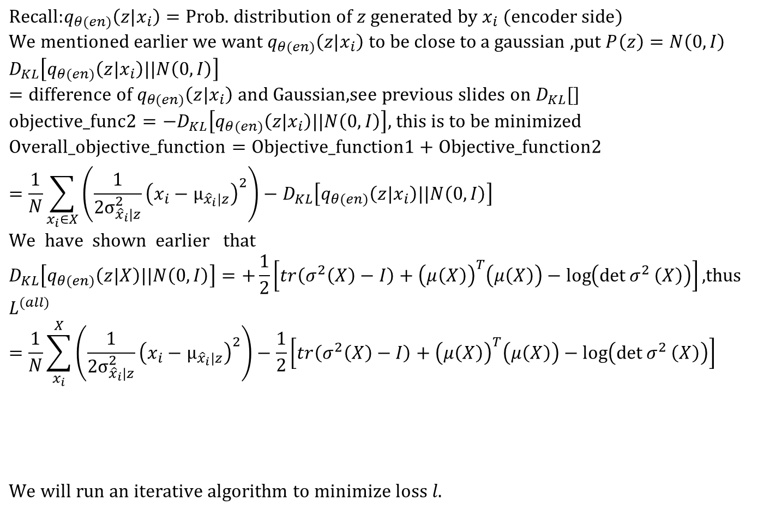

Training: Combining concept 1 and 2 to minimize Loss l_{i} (X), of X= {x₁,x_{2,}..,x_{N}} ,, E()=expected value . For the whole X, the average loss is
$$\text{Recall}\text{:}q_{θ(en)}\left(z|x_{i}\right)=\text{Prob}\text{. }\text{distribution} \text{of} z \text{generated} \text{by} x_{i} (\text{encoder} \text{side}) \\ \text{We} \text{mentioned} \text{earlier} \text{we} \text{want} q_{θ(en)}\left(z|x_{i}\right) \text{to} \text{be} \text{close} \text{to} \text{a} \text{gaussian}\text{ ,}\text{put} P\left(z\right)=N\left(0,I\right) \\ D_{KL}\left[q_{θ(en)}\left(z|x_{i}\right)||N\left(0,I\right)\right]=\text{difference} \text{of} q_{θ(en)}\left(z|x_{i}\right) \text{and} \text{Gaussian}\text{,}\text{see} \text{previous} \text{slides} \text{on} D_{KL}[] \\ \text{objective}\text{_}\text{func}\text{2}=−D_{KL}\left[q_{θ(en)}\left(z|x_{i}\right)||N\left(0,I\right)\right]\text{, }\text{this} \text{is} \text{to} \text{be} \text{minimized} \\ \text{Overall}\text{_}\text{objective}\text{_}\text{function}=\text{Objective}\text{_}\text{function}\text{1}+\text{Objective}\text{_}\text{function}\text{2} \\ =\frac{1}{N}\sum_{x_{i}∈X}{\left(\frac{1}{2σ_{{\hat{x}}_{i}|z}^{2}}{\left(x_{i}−μ_{{\hat{x}}_{i}|z}\right)}^{2}\right)}−D_{KL}\left[q_{θ(en)}\left(z|x_{i}\right)||N\left(0,I\right)\right] \\ \text{We} \text{have} \text{shown} \text{earlier} \text{that} \\ D_{KL}\left[q_{θ(en)}\left(z|X\right)||N\left(0,I\right)\right]=+\frac{1}{2}\left[tr\left(σ^{2}\left(X\right)−I\right)+{\left(μ\left(X\right)\right)}^{T}\left(μ\left(X\right)\right)−\log\left(\det{σ^{2}}\left(X\right)\right)\right]\text{,}\text{thus} \\ L^{(all)}=\frac{1}{N}\sum_{x_{i}}^{X}{\left(\frac{1}{2σ_{{\hat{x}}_{i}|z}^{2}}{\left(x_{i}−μ_{{\hat{x}}_{i}|z}\right)}^{2}\right)}−\frac{1}{2}\left[tr\left(σ^{2}\left(X\right)−I\right)+{\left(μ\left(X\right)\right)}^{T}\left(μ\left(X\right)\right)−\log\left(\det{σ^{2}}\left(X\right)\right)\right]$$
$$\text{We} \text{will} \text{run} \text{an} \text{iterative} \text{algorithm} \text{to} \text{minimize} \text{loss} l.$$
Concept 2 (will make Zs generated correspond to a Gaussian distribution)
Concept 1:(reconstruction loss to be minimized):
$$−D_{KL}\left[q_{θ(en)}\left(z|x_{i}\right)||N\left(0,I\right)\right]$$
See http://bjlkeng.github.io/posts/variational-autoencoders/ & https://arxiv.org/abs/1312.6114
Notes:
%%%%%%%%%%%%%%%%%%%%%%%%
\subsection{slide 51, concept2}
Training: Combining concept 1 and 2 to minimize Loss $l_i (X), of X= {x_1,x_2,..,x_N} , E()$=expected value . For the whole $X$, the average loss is
Recall $q_{\theta(en)(z|x_i)}$=prob.distribution of $z$ generated by $x_i$ (encoder side)\\
%
We mentioned earlier we want $q_{\theta(en)(z|x_i)}$ to be close to Gaussian, put $P(z)=N(0,I)$\\
%
$D_{KL}\big[
q_{\theta(en)}(z|x_i) || ( N(0,I)
\big]$=difference of $q_{\theta(en)(z|x_i)}$ and Gaussian, see previous discussion on $D_KL[]$\\
%
objective$\_$func2= $D_{KL}\big[
q_{\theta(en)(z|x_i)} || ( N(0,I)
\big]$, this is to be minimized\\
%
Overall$\_$objective$\_$function =objective$\_$funct1+objective$\_$func2\\
$=\frac{1}{N}
\sum\limits_{x_i \epsilon X}
\Big( \frac{1}{2 \sigma^2_{\hat {x_i}} |z}
(x_i - \mu_{\hat{x_i}|z})^2
\Big)
+D_{KL}\big[
q_{\theta(en)(z|x_i)} || ( N(0,I)
\big]$\\
We have shown earlier that\\
$D_{KL}\big[
q_{\theta(en)}(z|x_i) || ( N(0,I)
\big]=
%
+\frac{1}{2} \big\{
tr (\sigma^2(X)-I)
+\mu(X)^T \mu(X)-log(det(\sigma^2(X)))
\big\}$
%
%
%%
$l=\frac{1}{N}
\sum\limits_{x_i \epsilon X}
\Big( \frac{1}{2 \sigma^2_{\hat {x_i}} |z}
(x_i - \mu_{\hat{x_i}|z})^2
\Big)
+\frac{1}{2} \big\{
tr (\sigma^2(X)-I)
+\mu(X)^T \mu(X)-log(det(\sigma^2(X)))
\big\}$\\
The first term is for concept 1 and the second term is for concept 2\\
We will run an iterative algorithm to minimize $l$
See \url{ http://bjlkeng.github.io/posts/variational-autoencoders/ & https://arxiv.org/abs/1312.6114}

Slide 57
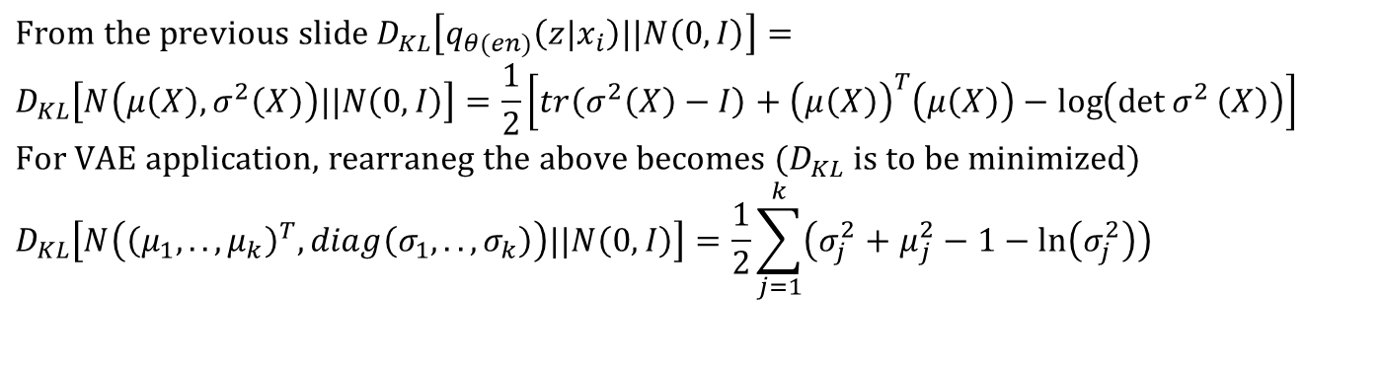
For VAE implementation
Input X=(x₁,x₂,…,x_{n}) , hidden dimensions=k
Using the encoder, from X we obtain k different Gaussian distributions: N(mean_{j} , StdDev_{j} ),
each z_{j}=generated by N(µ _{j} ,σ_{j}),where j =1,.,K,then we have Z=(z₁,z₂,.,z_{k})
$$\text{From} \text{the} \text{previous} \text{slide} D_{KL}\left[q_{θ(en)}\left(z|x_{i}\right)||N\left(0,I\right)\right]= \\ D_{KL}\left[N\left(μ\left(X\right),σ^{2}\left(X\right)\right)||N\left(0,I\right)\right]=\frac{1}{2}\left[tr\left(σ^{2}\left(X\right)−I\right)+{\left(μ\left(X\right)\right)}^{T}\left(μ\left(X\right)\right)−\log\left(\det{σ^{2}}\left(X\right)\right)\right] \\ \text{For} \text{VAE} \text{application}\text{,} \text{rearraneg} \text{the} \text{above} \text{becomes} (D_{KL} \text{is} \text{to} \text{be} \text{minimized}) \\ D_{KL}\left[N\left({\left(μ_{1},..,μ_{k}\right)}^{T},diag\left(σ_{1},..,σ_{k}\right)\right)||N\left(0,I\right)\right]=\frac{1}{2}\sum_{j=1}^{k}{\left(σ_{j}^{2}+μ_{j}^{2}−1−\ln\left(σ_{j}^{2}\right)\right)}$$
Concept 2:
See https://en.wikipedia.org/wiki/Kullback%E2%80%93Leibler_divergence
https://wiseodd.github.io/techblog/2016/12/10/variational-autoencoder/

Slide 58
In practice, use exp(σ²) instead of σ²
we replace σ² with exp(σ²) to enable stability in calculation. And for the minimization of D_{KL}, this replacement gives the same result

Slide 59
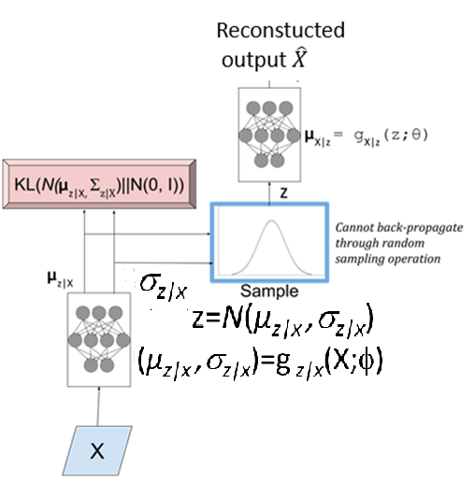


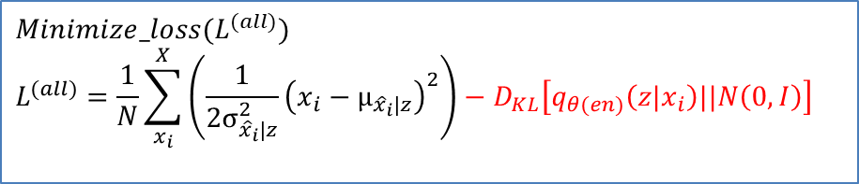
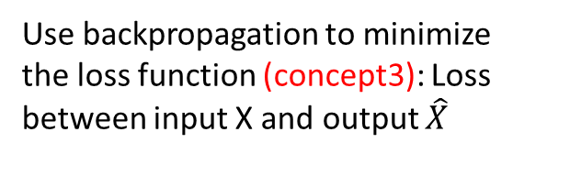
Use neural networks to implement the system
Use backpropagation to minimize
the loss function L^{(all)} of encoder: (concept1 & 2)
Decoder neural network
Use backpropagation to minimize
the loss function (concept3): Loss between input X and output $\hat{X}$
$$−D_{KL}\left[q_{θ(en)}\left(z|x_{i}\right)||N\left(0,I\right)\right]$$
D_{KL}[] below measures the difference between $q_{θ(en)}\left(z|x_{i}\right)$and N(0,1). We want to make $q_{θ(en)}\left(z|x_{i}\right)$ closer to N(0,1), hence we minimize -D_{KL}[]
Encoder neural network
$$Minimize_loss(L^{(all)}) \\ L^{(all)}=\frac{1}{N}\sum_{x_{i}}^{X}{\left(\frac{1}{2σ_{{\hat{x}}_{i}|z}^{2}}{\left(x_{i}−μ_{{\hat{x}}_{i}|z}\right)}^{2}\right)}−D_{KL}\left[q_{θ(en)}\left(z|x_{i}\right)||N\left(0,I\right)\right]$$
Concept 1
Concept 2
Input
Data
Notes:
\subsection{slide 52:Use neural networks to implement system}
$l=\frac{1}{N}
\sum\limits_{x_i \epsilon X}
\Big( \frac{1}{2 \sigma^2_{\hat {x_i}} |z}
(x_i - \mu_{\hat{x_i}|z})^2
\Big)
+\frac{1}{2} \big\{
tr (\sigma^2(X)-I)
+\mu(X)^T \mu(X)-log(det(\sigma^2(X)))
\big\}$\\

Slide 60
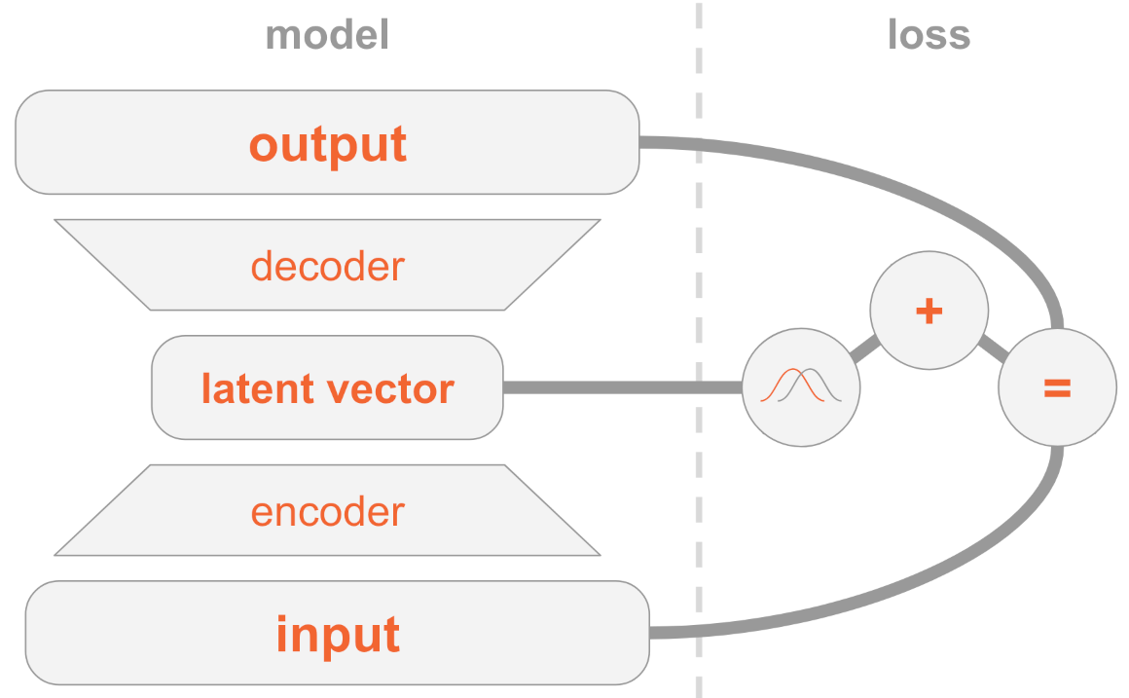
The training method
Minimize loss (L^{(all)})
Using Concept 1 &2
reconstructed
Input and output are similar
The latent vector represents Gaussian distributions
http://anotherdatum.com/vae.html

Slide 61
Variational Autoencoders
VAE Concept 3
Reparameterization: the method to enable backpropagation for training neural network that involves random processes

Slide 62
VAE generative model
In theory, we can sample z_{i} from N(µ_{i} ,σ_{i} ) produced by the encoder. Note: N()=Gaussian Function
Z is the input to the decoder to produce the output. Alternatively,
we find z by sampling ∈ (called epsilon or eps) from N_{normal}(0,1) (Gaussian: mean µ_{normal} = 0, σ_{normal} =1), then find z using
: z_{i} =µ_{i} +∈*σ_{i}
Since µ_{normal} =0, so µ_{i} shift the data to the required z_{i}
Also, σ_{normal} =1, so ∈*σ_{i} scale the data to the required z_{i}
Then z has mean = µ_{i} , StdDev= σ_{I} as required
See gen_data_using_mean0_sigma1.m in appendix
This is called Reparameterization,
Reason: we can back-propagate this function during training because every time you have a real number ∈ and the formula for backpropagation: z_{i} =µ_{i} +∈*σ_{i}
%Use randn() in matlab for N(µ_{i} ,σ_{i} ) .
Clear,clc, x=mean(randn(50000,1)) % if number is large , mean1=mean(x), std1=std(randn(50000,1))
%mean1 = 0.0058 is closed to 0
%std1 = 0.9929 is closed to 1
use matlab randn() to gen. ∈
Notes:
%%%%%%%%%%%%%%%%%%%%
\subsection{slide 55: VAE generative model}
In theory, we use a sample of z from $q_{\theta(en)} (z|x_i)$ as input to sample from $p_{\phi(de)}(\hat X_i| Z) $ to give an approximate reconstruction of $x_i$\\
Alternatively, if we sample any $z$ from $N(0,1)$ and use it as input to sample from $p_{\phi(de)}(\hat X_i | Z) $ then we can approximate the entire data distribution $p( )$. I.e., we can generate new samples that look like the input but aren’t in the input.

Slide 63
Train the variational-encoder
How to train the auto-encoder neural network?
Difficulty
  Since a random process is involved, backpropagation cannot be executed
Solution
  Use of the re-parameterization trick
Generate z by
random sampling

Slide 64
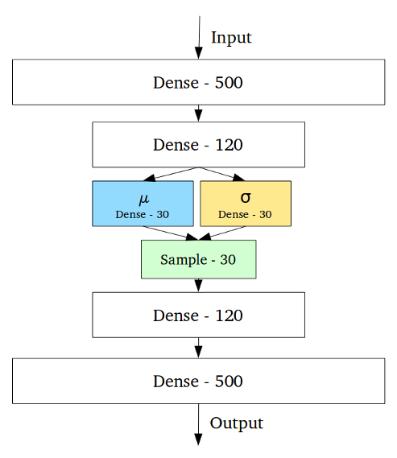
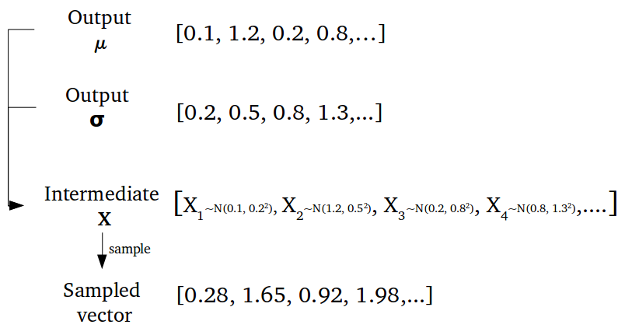
Training : an example
https://towardsdatascience.com/intuitively-understanding-variational-autoencoders-1bfe67eb5daf
example
Can add/use convolution layer here
Random
Generated 30 Zs, each is not a neuron by gen. by a pair of σ, μ
30 σ, 30 μ neurons
Z
Can add/use transposed convolution layer here to reconstruct output

Slide 65
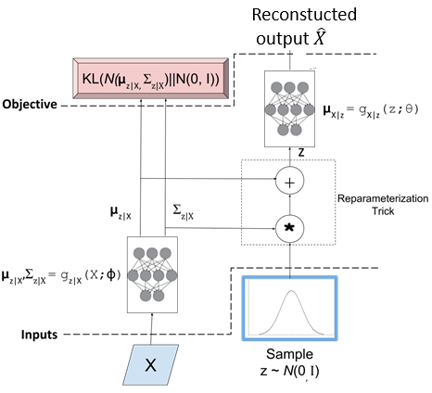
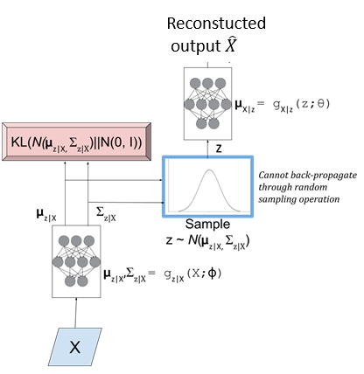
Learning algorithm : The probability function (left side diagram) cannot be back-propagated, therefore Reparameterization trick (right side diagram) should be applied
http://bjlkeng.github.io/posts/variational-autoencoders/
We also want the output to be similar to the input
This Q(z|x)
=N(µ_{z|X},σ_{z|X}) should be close to N(0,I)
P(X|z)
Random generator layer
StdDev=
σ
Solution:
Reparameterization trick
∈
Qq(z|x)
Problem:
Cannot backpropagate
Figure 4: A variational autoencoder with the "Reparameterization trick". Notice that all operations between the inputs and objectives are continuous deterministic functions, allowing back-propagation to occur.
Figure 3: An initial attempt at a variational autoencoder without the "Reparameterization trick". Objective functions shown in red. We cannot back-propagate through the stochastic sampling operation because it is not a continuous deterministic function.

Slide 66
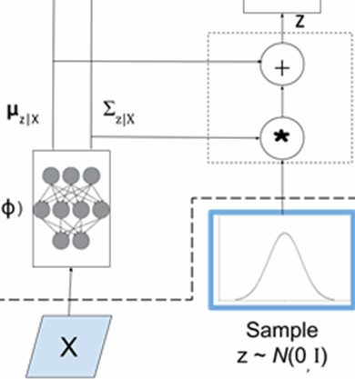
Intuition of the Reparameterization trick
The encoder uses random sampling to generate z
Backpropagation (during training) is not possible for the random sampling process
Parameterization can produce the same effect for the encoder
Backpropagation (during training) is possible because no random process is involved
Backpropagation path
∈
Encoder
Path by random sampling

Slide 67
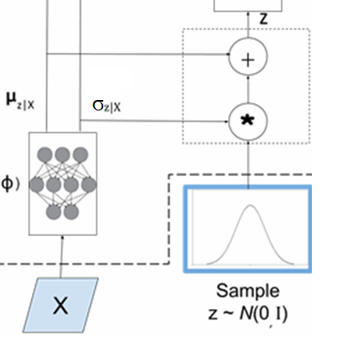
Reparameterization
Z can be produced by a scaled N(0,I)
Reparameterization generates any Gaussian distribution of known mean (µ_{x}), standard-deviation (σ_{x}) by using the equation (Z= µ_{x}+ ∈σ_{x} ) based on the variable ∈ generated by N(0,1) .
After the forward pass, ∈ is generated, so ∈ is not random. It is a data to be used in backpropagation during training.
N(0,1) =Gaussian with mean=0 and standard deviation=1
∈ = the generated variable of N(0,1)
µ_{x} =mean
σ_{x} = standard-deviation
Z= µ_{x}+ ∈σ_{x}
mean
Standard deviation
∈
Input data
To produce the random variable ∈ N(0,1): mean =0, std=1
Notes:
%%%%%%%%%%%%%%%%%%%%
\subsection{slide 55: VAE generative model}
In theory, we use a sample of z from $q_{\theta(en)} (z|x_i)$ as input to sample from $p_{\phi(de)}(\hat X_i| Z) $ to give an approximate reconstruction of $x_i$\\
Alternatively, if we sample any $z$ from $N(0,1)$ and use it as input to sample from $p_{\phi(de)}(\hat X_i | Z) $ then we can approximate the entire data distribution $p( )$. I.e., we can generate new samples that look like the input but aren’t in the input.

Slide 68
Summary for reparameterization
∈ = the generated variable by sampling N(0,1)
µ_{x} = mean
σ_{x} = standard deviation
z= µ_{x} +∈ σ_{x} ; This equation is deterministic, so we can formulate the backpropagate equation
See code in
https://learnopencv.com/variational-autoencoder-in-tensorflow/
Notes:
\subsection{slide 67: Summary: Forward pass}
$\epsilon$= the generated variable\\
$\mu$ = mean\\
$\sigma$= variance\\
$Z= \epsilon \sigma_x +\mu_x$

Slide 69
https://learnopencv.com/variational-autoencoder-in-tensorflow/
Probability cannot backpropagate
Reparameterization can backpropagate

Slide 70
Exercise 7
In reparameterization of the variational autoencoder method shown below, ∈ = 0.35 which is a randomly sampled value by sampling the normal distribution of mean=0 and standard deviation =1. If the output of the encoder network has µ _{z|x} = mean =0.3, σ_{z|x} = standard deviation=0.8, find the value z .
MC choices:
0.50
0.54
0.56
0.58

Slide 71
Answer: Exercise 7
In reparameterization of the variational autoencoder method shown below, ∈ = 0.35 which is a randomly sampled value by sampling the normal distribution of mean=0 and standard deviation =1. If the output of the encoder network has µ _{z|x} = mean =0.3, σ_{z|x} = standard deviation=0.8, find the value z .
MC choices:
0.50
0.54
0.56
0.58 (correct)
Answer:
z =µ +∈* σ_{z|x} , here ∈=0.35, µ=0.3, standard deviation= σ_{z|x} =0.8
=0.3+0.35*0.8=0.58

Slide 72
Exercise 8
Discuss exercise
why Reparameterization is needed?

Slide 73
Answer: Exercise 8
Discuss why Reparameterization is needed.
Answer: Z is generated by a random process if you have mean=µ_{x} , standardDev= σ_{x}. Since the VAE system is implemented using neural networks, they need backpropagation for training the weights/parameters, and the random process of generating Z cannot be backpropagated.
Solution: The reparameterization trick converts the random process into a determinization process (z= µ_{x} +∈ σ_{x} ) with the help of a random variable ∈ generated by a normal distributed random generated normal distribution with mean=0 and standardDev=1: N(0,1), hence this deterministic process can be backpropagated.
Reparameterization trick

Slide 74
Demo Matlab code: gen_data_using_mean0_sigma1.m to show the idea: X= µx+ σx * eps is the formula for generating X by eps (generated by normal distortion of mean=0, std=1) https://nbviewer.jupyter.org/github/gokererdogan/Notebooks/blob/master/Reparameterization%20Trick.ipynb
%gen_data_using_mean0_sigma1.m
clear
%%large number of samples %%
eps=randn(10000,1);
mu_x=2 %this is your mean
sigma_x=1 %this is your std
x=mu_x+(eps*sigma_x);
grad2_of_mean= sum(2*(mu_x+eps))/length(x);
'grad2 of mean='
grad2_of_mean
'mean(x)='
mean(x)
'std(x)='
std(x)
Result:grad2_of_mean = 3.9933
mean(x)= 1.9960 (approximate 2)
std(x)= 0.9984 (approximate 1)
σ_{x}= standard deviation of x
µ_{x} =mean of x
eps= N(mean=0,std=1), normal dist.
X= µ_{x}+ σ_{x} * eps
And gradient of mean is expected_val_of (2(eps+mu_x)), assume σ_{x}=1 for simplicity
The above is not random, because eps has been generated and µ_{x} is the current mean. We can use this in our backpropagation formula to find the updated mean.
Using X= µx+ σx * eps , we can find its gradient bypassing the random process. Because eps is generated by a random process during the neural net forward pass, during backpropagation this is the data (now available deterministically) to be used. Note:grad2_of_mean = expected_value_of (2(eps+mu_x))

Slide 75
Implementation
Using Keras
https://github.com/keras-team/keras/tree/master/

Slide 76
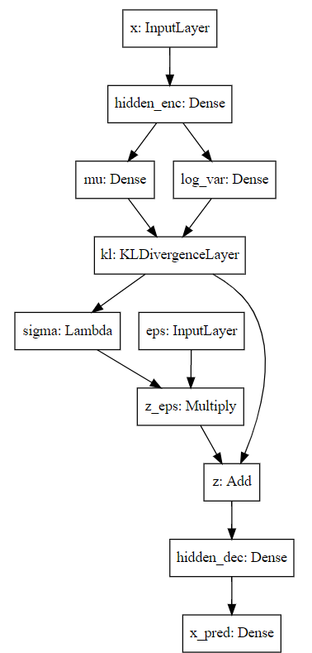
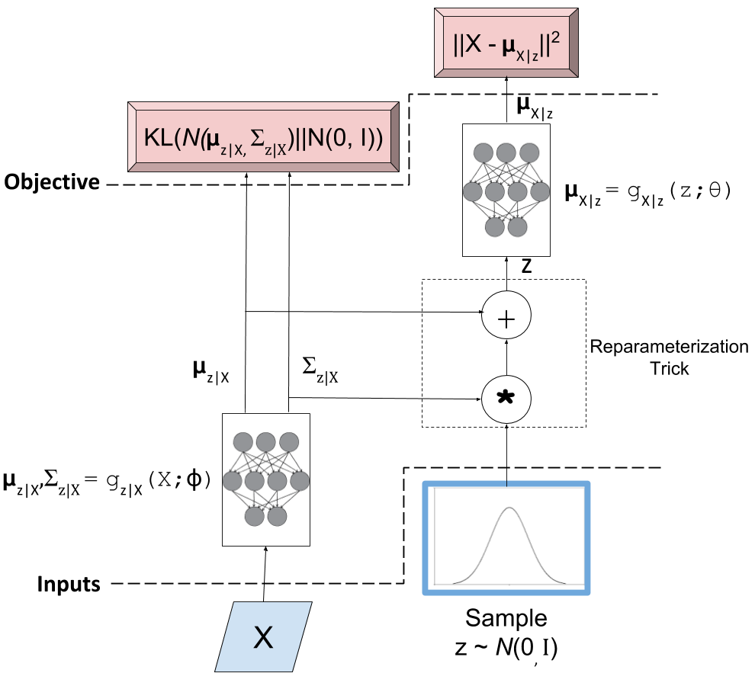
Keras
StdDev=
σ

Slide 77

Keras implementation of VAE
original_dim = 784
intermediate_dim = 256
latent_dim = 2
batch_size = 100
epochs = 50
epsilon_std = 1.0
x = Input(shape=(original_dim,))
h = Dense(intermediate_dim, activation='relu')(x)
z_mu = Dense(latent_dim)(h)
z_log_var = Dense(latent_dim)(h)
z_mu, z_log_var = KLDivergenceLayer()([z_mu, z_log_var])
# Use of lambda: normalize log variance to std dev
z_sigma = Lambda(lambda t: K.exp(.5*t))(z_log_var)
eps = Input(tensor=K.random_normal(shape=(K.shape(x)[0],
latent_dim)))
z_eps = Multiply()([z_sigma, eps])
z = Add()([z_mu, z_eps])
decoder = Sequential([
Dense(intermediate_dim, input_dim=latent_dim, activation='relu'),
Dense(original_dim, activation='sigmoid')
])
x_pred = decoder(z)
StdDev=σ
Note: latent_dim = 2
Predicted output
http://louistiao.me/posts/implementing-variational-autoencoders-in-keras-beyond-the-quickstart-tutorial/

Slide 78
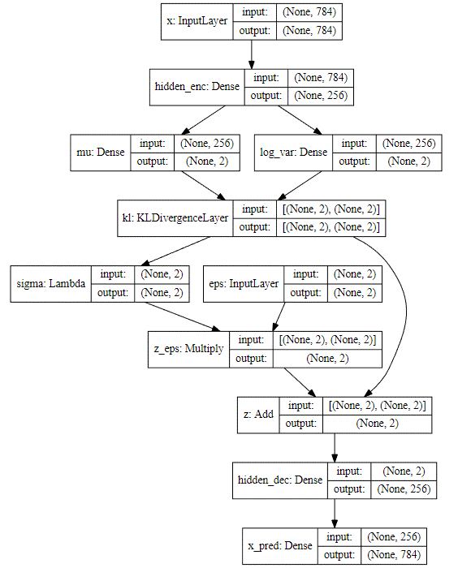
df
StdDev=
σ σ_{z|x}
Note: latent_dim = 2

Slide 79
variational_autoencoder_deconv .py from https://github.com/keras-team/keras/tree/master/
'''Example of VAE on MNIST dataset using CNN
The VAE has a modular design. The encoder, decoder and VAE
are 3 models that share weights. After training the VAE model,
the encoder can be used to generate latent vectors.
The decoder can be used to generate MNIST digits by sampling the
latent vector from a Gaussian distribution with mean=0 and std=1.
# Reference
[1] Kingma, Diederik P., and Max Welling.
"Auto-encoding variational bayes."
https://arxiv.org/abs/1312.6114
'''
from __future__ import absolute_import
from __future__ import division
from __future__ import print_function
from tensorflow.keras.layers import Dense, Input
from tensorflow.keras.layers import Conv2D, Flatten, Lambda
from tensorflow.keras.layers import Reshape, Conv2DTranspose
from tensorflow.keras.models import Model
from tensorflow.keras.datasets import mnist
from tensorflow.keras.losses import mse, binary_crossentropy
from tensorflow.keras.utils import plot_model
from tensorflow.keras import backend as K
import numpy as np
import matplotlib.pyplot as plt
import argparse
import os
# reparameterization trick
# instead of sampling from Q(z|X), sample eps = N(0,I)
# then z = z_mean + sqrt(var)*eps
def sampling(args):
"""Reparameterization trick by sampling fr an isotropic unit Gaussian.
# Arguments
args (tensor): mean and log of variance of Q(z|X)
# Returns
z (tensor): sampled latent vector
"""
z_mean, z_log_var = args
batch = K.shape(z_mean)[0]
dim = K.int_shape(z_mean)[1]
# by default, random_normal has mean=0 and std=1.0
epsilon = K.random_normal(shape=(batch, dim))
return z_mean + K.exp(0.5 * z_log_var) * epsilon
def plot_results(models,
data,
batch_size=128,
model_name="vae_mnist"):
"""Plots labels and MNIST digits as function of 2-dim latent vector
# Arguments
models (tuple): encoder and decoder models
data (tuple): test data and label
batch_size (int): prediction batch size
model_name (string): which model is using this function
"""
encoder, decoder = models
x_test, y_test = data
os.makedirs(model_name, exist_ok=True)
filename = os.path.join(model_name, "vae_mean.png")
# display a 2D plot of the digit classes in the latent space
z_mean, _, _ = encoder.predict(x_test,
batch_size=batch_size)
plt.figure(figsize=(12, 10))
plt.scatter(z_mean[:, 0], z_mean[:, 1], c=y_test)
plt.colorbar()
plt.xlabel("z[0]")
plt.ylabel("z[1]")
plt.savefig(filename)
plt.show()
filename = os.path.join(model_name, "digits_over_latent.png")
# display a 30x30 2D manifold of digits
n = 30
digit_size = 28
figure = np.zeros((digit_size * n, digit_size * n))
# linearly spaced coordinates corresponding to the 2D plot
# of digit classes in the latent space
grid_x = np.linspace(-4, 4, n)
grid_y = np.linspace(-4, 4, n)[::-1]
for i, yi in enumerate(grid_y):
for j, xi in enumerate(grid_x):
z_sample = np.array([[xi, yi]])
x_decoded = decoder.predict(z_sample)
digit = x_decoded[0].reshape(digit_size, digit_size)
figure[i * digit_size: (i + 1) * digit_size,
j * digit_size: (j + 1) * digit_size] = digit
plt.figure(figsize=(10, 10))
start_range = digit_size // 2
end_range = n * digit_size + start_range + 1
pixel_range = np.arange(start_range, end_range, digit_size)
sample_range_x = np.round(grid_x, 1)
sample_range_y = np.round(grid_y, 1)
plt.xticks(pixel_range, sample_range_x)
plt.yticks(pixel_range, sample_range_y)
plt.xlabel("z[0]")
plt.ylabel("z[1]")
plt.imshow(figure, cmap='Greys_r')
plt.savefig(filename)
plt.show()
# MNIST dataset
(x_train, y_train), (x_test, y_test) = mnist.load_data()
image_size = x_train.shape[1]
x_train = np.reshape(x_train, [-1, image_size, image_size, 1])
x_test = np.reshape(x_test, [-1, image_size, image_size, 1])
x_train = x_train.astype('float32') / 255
x_test = x_test.astype('float32') / 255
# network parameters
input_shape = (image_size, image_size, 1)
batch_size = 128
kernel_size = 3
filters = 16
latent_dim = 2
epochs = 30#30
# VAE model = encoder + decoder
# build encoder model
inputs = Input(shape=input_shape, name='encoder_input')
x = inputs
for i in range(2):
filters *= 2
x = Conv2D(filters=filters,
kernel_size=kernel_size,
activation='relu',
strides=2,
padding='same')(x)
# shape info needed to build decoder model
shape = K.int_shape(x)
# generate latent vector Q(z|X)
x = Flatten()(x)
x = Dense(16, activation='relu')(x)
z_mean = Dense(latent_dim, name='z_mean')(x)
z_log_var = Dense(latent_dim, name='z_log_var')(x)
# use reparameterization trick to push the sampling out as input
# note that "output_shape" isn't necessary with the TensorFlow backend
z = Lambda(sampling, output_shape=(latent_dim,), name='z')([z_mean, z_log_var])
# instantiate encoder model
encoder = Model(inputs, [z_mean, z_log_var, z], name='encoder')
encoder.summary()
plot_model(encoder, to_file='vae_cnn_encoder.png', show_shapes=True)
# build decoder model
latent_inputs = Input(shape=(latent_dim,), name='z_sampling')
x = Dense(shape[1] * shape[2] * shape[3], activation='relu')(latent_inputs)
x = Reshape((shape[1], shape[2], shape[3]))(x)
for i in range(2):
x = Conv2DTranspose(filters=filters,
kernel_size=kernel_size,
activation='relu',
strides=2,
padding='same')(x)
filters //= 2
outputs = Conv2DTranspose(filters=1,
kernel_size=kernel_size,
activation='sigmoid',
padding='same',
name='decoder_output')(x)
# instantiate decoder model
decoder = Model(latent_inputs, outputs, name='decoder')
decoder.summary()
plot_model(decoder, to_file='vae_cnn_decoder.png', show_shapes=True)
# instantiate VAE model
outputs = decoder(encoder(inputs)[2])
vae = Model(inputs, outputs, name='vae')
if __name__ == '__main__':
parser = argparse.ArgumentParser()
help_ = "Load h5 model trained weights"
parser.add_argument("-w", "--weights", help=help_)
help_ = "Use mse loss instead of binary cross entropy (default)"
parser.add_argument("-m", "--mse", help=help_, action='store_true')
args = parser.parse_args()
models = (encoder, decoder)
data = (x_test, y_test)
# VAE loss = mse_loss or xent_loss + kl_loss
if args.mse:
reconstruction_loss = mse(K.flatten(inputs), K.flatten(outputs))
else:
reconstruction_loss = binary_crossentropy(K.flatten(inputs),
K.flatten(outputs))
reconstruction_loss *= image_size * image_size
kl_loss = 1 + z_log_var - K.square(z_mean) - K.exp(z_log_var)
kl_loss = K.sum(kl_loss, axis=-1)
kl_loss *= -0.5
vae_loss = K.mean(reconstruction_loss + kl_loss)
vae.add_loss(vae_loss)
vae.compile(optimizer='rmsprop')
vae.summary()
plot_model(vae, to_file='vae_cnn.png', show_shapes=True)
if args.weights:
vae.load_weights(args.weights)
else:
# train the autoencoder
vae.fit(x_train,
epochs=epochs,
batch_size=batch_size,
validation_data=(x_test, None))
#vae.save_weights('vae_cnn_mnist.h5')
vae.save_weights('vae_cnn_mnist.tf') #vae.save_weights('vae_cnn_mnist.h5')
plot_results(models, data, batch_size=batch_size, model_name="vae_cnn")
To run this, you need to install:
>>conda install graphviz
>>conda install pydot
n variational_autoencoder_deconv : use: vae.save_weights('vae_cnn_mnist.tf') #instead of vae.save_weights('vae_cnn_mnist.h5')
Resulst
Epoch 30/30
60000/60000 [==============================] - 91s 2ms/sample - loss: 145.7313 - val_loss: 146.8615

Slide 80
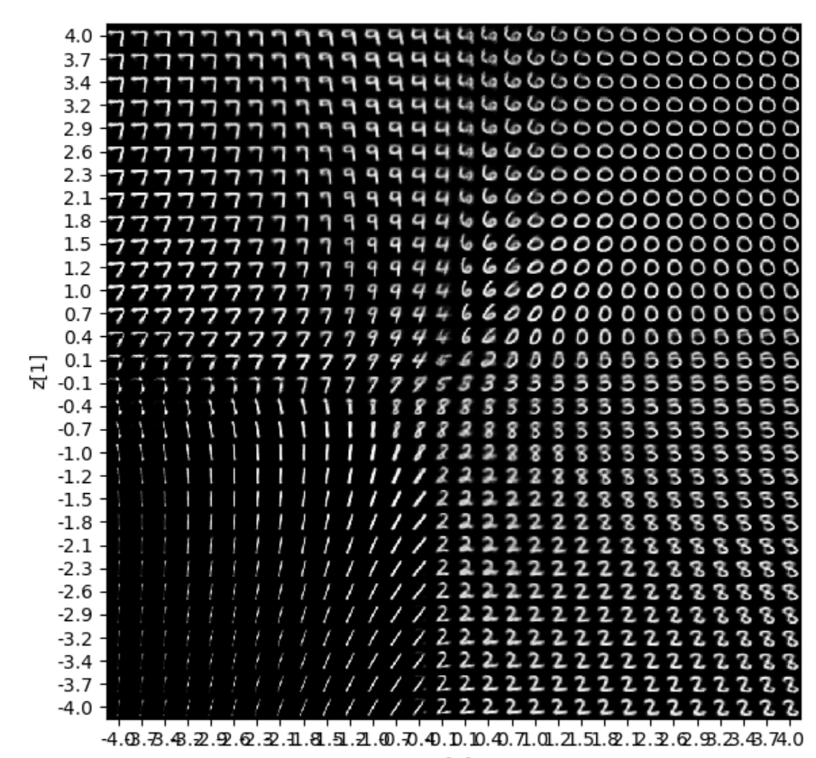
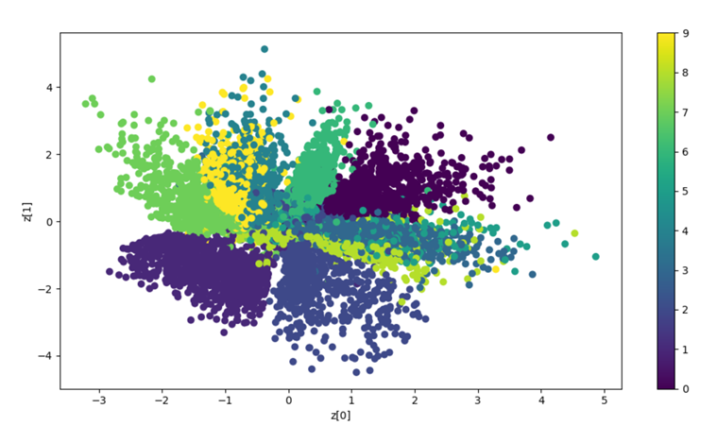
variational_autoencoder_deconv.py from https://github.com/keras-team/keras/tree/master/
Note: latent_dim = 2
Display to see how the 2 latent variables (Z:z1,z2) perform for each numerals(0,1,2,…9). They form 10 clusters
.
latent variable (z2)
latent variable (z1)

Slide 81
Summary
Learned vanilla autoencoder
Learned variational autoencoder
Learned the Reparameterization trick to enable learning in variational autoencoder

Slide 82
Reference
https://nbviewer.jupyter.org/github/gokererdogan/Notebooks/blob/master/Reparameterization%20Trick.ipynb

Slide 83
Appendices

Slide 84
Appendix 1: Training: Combining concept 1 and 2 to minimize Loss L. X={x₁,x_{2,}..,x_{N}} , E()=expected value . For the whole X, the average loss is
See http://bjlkeng.github.io/posts/variational-autoencoders/ & https://arxiv.org/abs/1312.6114
Concept 1
Concept 2

Slide 85
Appendix 2
Probability likelihood
A tutorial
KH Wong

Slide 86
Overview
Bayesian rules
Gaussian distribution
Probability vs likelihood
Log-likelihood and maximum likelihood
Negative log-likelihood

Slide 87
Bayesian rules

Slide 88
Bayesian rules
P(B|A)=P(A|B)P(B)/P(A)
P(A and B)=P(A,B)=P(A|B) P(B)
P(A,B|C)=P(A|B,C) P(B|C)
Prove the above as exercises
In each cell, the joint probability p(r, c) is re-expressed by the equivalent form
p(r | c) p(c) from the definition of conditional probability in Equation 5.3. The marginal probability p(r) =Σ_{c*}p(r | c*) p(c*),
https://www.sciencedirect.com/topics/mathematics/marginal-probability

Slide 89
Gaussian distribution
%2-D Gaussian distribution P(x_{j})
%matlab code----------
clear, N=10
[X1,X2]=meshgrid(-N:N,-N:N);
sigma =2.5;mean=[3 3]'
G=1/(2*pi*sigma^2)*exp(-((X1-mean(1)).^2+(X2-mean(2)).^2)/(2*sigma^2));
G=G./sum(G(:)) %normalise it
'sigma is ', sigma
'sum(G(:)) is ',sum(G(:))
'max(max(G(:))) is',max(max(G(:)))
figure(1), clf
surf(X1,X2,G);
xlabel('x1'),ylabel('x2')

Slide 90
Probability vs likelihood
It is two sides of a coin.
P() Probability function :
  Given a Gaussian model (with mean µ_{o} and variance σ_{o}), the probability function P(X| µ_{o,}σ_{o}) measures the probability that the observation X is generated by the model.
L() likelihood function:
  Given data X, the Likelihood function L(µ_{o,}σ_{o}| X) measures the probability that X fits the Gaussian model with mean µ_{o} and variance σ_{o}.
  Major application: Given data X, we can maximize the Likelihood function L(µ_{o,}σ_{o}| X) to find the model (µ_{o,}σ_{o}) that fits the data. This is called the maximum likelihood method.
  Log-likelihood rather than likelihood is more convenient for finding the maximum, hence it is often used.

Slide 91
Likelihood function
L( ) of n-dimension
Likelihood function
Intuition: Likelihood function
L(µ,σ|X)) means: given a Gaussian model N(mean, variance) how much the multivariate data X =[x₁,x₂,x₃,..,x_{n}] fits the model with parameter (µ,σ).

Slide 92
A more useful representation is Log-Likelihood function= Log(L( ))=l ()
Intuition:
The peak of Likelihood and Log-Likelihood functions should be the same.
The two are one to one mapping hence no data loss.
Log based method is easier to be handled by math, so log-Likelihood function is often used
For computers, log numbers are smaller hence may save memory. Using log, we can use addition rather than multiplication which makes computation easier.

Slide 93
Maximum Likelihood V.S. Log-Likelihood
$$\text{Since} \text{both} \text{likelihood} L\left(\right) \text{and} \text{Log}\text{−}\text{likelihood} l\left(\right) \text{are} \text{monotonic} \text{functions}\text{, }\text{hence} \\ \text{arg}\text{_}\text{ma}{\text{x}}_{θ}\left(L(θ|X)\right)==\text{arg}\text{_}\text{ma}{\text{x}}_{θ}\left(l(θ|X)\right) \\ \text{The} \text{maximum} \text{happens} \text{at} θ=\left\{μ,σ^{2}\right\}\text{, }\text{where} μ=\frac{1}{n}\sum_{j=1}^{n}{\left(x_{j}\right)},\text{\& }\text{variance} σ^{2}=\frac{1}{n}\sum_{j=1}^{n}{\left[{\left(x_{j}−μ\right)}^{2}\right]}$$
Important
http://jrmeyer.github.io/machinelearning/2017/08/18/mle.html
https://towardsdatascience.com/probability-concepts-explained-maximum-likelihood-estimation-c7b4342fdbb1

Slide 94
Proof 1 :Maximum Log-Likelihood function of a Multivariate Gaussian distribution
http://jrmeyer.github.io/machinelearning/2017/08/18/mle.html
https://towardsdatascience.com/probability-concepts-explained-maximum-likelihood-estimation-c7b4342fdbb1

Slide 95
Proof 2 : Maximum Log-Likelihood function of a Multivariate Gaussian distribution
http://people.stat.sfu.ca/~raltman/stat402/402L4.pdf
https://towardsdatascience.com/probability-concepts-explained-maximum-likelihood-estimation-c7b4342fdbb1

Slide 96
Alternative proof: Maximum Log_likelihood
Find the most suitable variance σ²
Maximum likelihood is at

Slide 97
Negative Log-Likelihood (NLL)
And its application in softmax
To maximize log-likelihood, we can minimize its negative log-likelihood (NLL) function

Slide 98
Softmax function
https://medium.com/data-science-bootcamp/understand-the-softmax-function-in-minutes-f3a59641e86d
y=[2 , 1, 0.1]’
Softmax(y)=[0.6590, 0.242,0.0986]’
exp(2)/((exp(2)+exp(1)+exp(0.1))=0.6590
exp(1)/((exp(2)+exp(1)+exp(0.1))= 0.2424
exp(0.1)/((exp(2)+exp(1)+exp(0.1))= 0.0986

Slide 99
Softmax Activation Function
https://ljvmiranda921.github.io/notebook/2017/08/13/softmax-and-the-negative-log-likelihood/#nll
exp(4)/((exp(5)+exp(4)+exp(2))=0.25949
exp(5)/((exp(5)+exp(4)+exp(2))=0.705
=5/(5+4+2)=

Slide 100

Negative Log-Likelihood (NLL)
=-ln(likelihood)
=-ln(0.02)=3.91
=-ln(0)=infinity
=-ln(0.98)=0.02
Minimum negative log-likelihood (NLL) is picked, so 0.02 is selected
To maximize likelihood, minimum negative log-likelihood (NLL) is picked
Softmax output as the
likelihood
https://ljvmiranda921.github.io/notebook/2017/08/13/softmax-and-the-negative-log-likelihood/#nll

Slide 101

Continue

Slide 102
FAQ on VAE
FAQ Assign3, 2020 Nov 17
Question 3.1:
Hi, sorry for interrupting, i got a question for assignment 3 auto-encoder part. in question one, encoder hidden layer and decoder hidden layer are in different size(15 and 18), and the neurons for (means, variance) and samples are different as well, does it mean in variational auto-encoder, encoder hidden layer size and decoder hidden layer size can be different, and neuron numbers for means, variance and samples don't have to match? if so, is there some random drop-out functions when means, variance and samples size don't match? Thanks.
Answer 3.1:
This is a very good question, in my notes, (mean, variance, sample_z are of the same sizes, but I have found some implementations that show it may not be the only case. Yes, it is a kind of dropout as described by the papers shown below. I think the rule is mean and variance should have the sample number because they go into pairs, but the randomly generated sample_z can be of different sizes. It is done by randomly (via Monte carlo method) select the pair of mean and variance for generating the value of sample_z. Neural computing is a trial-and-error method, you may try different approaches and the preferred method is the one which gives you the good result. You may explore more papers and see if my interpretation is correct or not.
See section3.4 of
https://arxiv.org/pdf/1706.03643.pdf
Also
https://deeplearn.org/arxiv/92996/generating-data-using-monte-carlo-dropout
////////////////////////////////////////////////////////
Question 3.2 on VAE (variational Auto-encoder)
Question 3.2a:
In your notes, variational auto encoder turns input x into means and deviations of a multivariate Gaussian distribution, then use a random sampling method to create output. The output is Z and Z is generating random sample to the next layer of neuron.
(i) How do we train the neuron network if the input is from random sampling? (ii) And How do we force a multivariate Gaussian distribution Z to uni-variate Gaussian distribution N(0,1)?
Answer 3.2a : I will answer part (ii) of the above question first. It is not to avoid over-fitting. Since from input to the latent (hidden) representation z, there is a random process. A random process can have many different forms, it can be Gaussian, Laplace or Cauchy etc. or some unknown forms. If there is no control you may not be able to repeat the process hence training becomes useless. In the VAE paper (https://arxiv.org/abs/1312.6114 ) , the authors propose to force the random probability distribution to be Gaussian (I guess you may force them to be Laplace etc. and still can work, but you have to be consistent on using one model). How? The method is using D_KL ( Kullback–Leibler divergence ). It the concept 2 in my notes, to make sure the random process is Gaussian.
////--------------------------------------------------------------------------------------------------------------------
Question 3.2b : Why do we still need re-parameterization to do back propagation?
Answer 3.2b: It is known that random process cannot be back-propagate. But re-parameterization provides a means to back-propagate. First, z_{i} is not generated by a random generator of mean=µ_{i} ,Stad_dev=σ_{i} , but rather using an indirect method of finding z_{i} (using z_{i} =µ_{i} +∈*σ_{i} ) through ∈ which is generated by N(0,1)=N_{Gaussian}(mean=0,std_dev=1). If you have doubt run my Matlab program on p.71 of 5707_10_auto-encoder (1).pptx . It short, it is found that if we use z_{i} =µ_{i} +∈*σ_{i} to generate z_{i.} then z_{i} will have the characteristic of (mean= µ_{i},std_dev=σ_{i}).
Then, why do we use that indirect method? Because during forward pass of neural computing, ∈ is already calculated by N(0,), it is a real number not a random variable (same for mean=µ_{i} ,Stad_dev=σ_{i} neuron outputs) , so during back-propagation we can use z_{i} =µ_{i} +∈*σ_{i} to find out how much we can back-propagate to change the weights of the neurons. In the lecture note p.67 of 5707_10_auto-encoder.pptx, the gradient is calculated (please recall that for neural back-propagation computing, gradient is needed to find the de/dw), we can form our weight updating program based on this formulation. The idea is with this gradient, we know how to change µ_{i} ,σ_{i} if we know the change of z_{i}. (if it is random process , we simply do not know how). However, you don’t need to enter this gradient to the VAE program because it is already in the Tensorflow-keras library, it is done automatically by Tensorflow-keras as long as you provide the z_{i} =µ_{i} +∈*σ_{I} formulation of the forward pass.
////--------------------------------------------------------------------------------------------------------------------
Question 3.2c :If we put N(0.15, 2,3) does that mean the input mean is 0.15 and std is 2.3. Then it goes through KL to compute the error with the expected.
Answer3.2c: The use of N(0,1) (using Gaussian mean=0, Std_dev=1) is to make the formulation easier to program or calculate , see P.51 , D_KL ( the loss function is based on that ) formulation becomes simpler. I guess you may assume all distributions to be N(0.15, 2,3), then your loss function becomes more complex. The idea is to make sure z_{i} is generated by a Gaussian process, z_{i} can be generated by a different mean and std_dev, but needed to be Gaussian. It is done by reducing D_KL( random process that generate z_{i}, || N(0,1) ). So by comparing the process of generating z_{i} to a typical Gaussian like N(0,1) to form the loss function is reasonable.

Slide 103

To prove ∇_{θ}E_{q} [x²]=E_{p} [2(θ +∈)],
https://stats.stackexchange.com/questions/199605/how-does-the-reparameterization-trick-for-vaes-work-and-why-is-it-important

Slide 104

Alternative Derivation : To prove ∇_{θ}E_{q} [x²]=E_{p} [2(θ +∈)]
–
Note:
Notes:
%%%%%%%%%%%%%%%%%%%%%%%%%%%%%%
\subsection{slide 64 :Derivation}
We want to find $\min_\theta(E_q[X^2])$, thus we need to find
$\nabla_\theta E_q[x^2]$\\
Since $\nabla_\theta q_\theta (x)=q_\theta(x)$, and $\frac{d(log(y))}{dx}=\frac{1}{log(y)}\frac{dy}{dx}$\\
Thus, $\nabla_\theta log(q_\theta (x)) =\frac{1}{q_\theta (x)} \nabla (q_\theta(x))$ -----(i)\\
%
$\nabla\theta E_q[x^2]=\nabla_\theta
\int q_\theta(x) x^2 dx$, by definition of exception\\
%
$\nabla\theta E_q[x^2]=
\int \nabla_\theta q_\theta(x) \frac{q_\theta(x)}{q_\theta(x)}
\Big)
x^2 dx$,\\
$=\int \Big(
\frac{1}{q_\theta(x)} \nabla_\theta
q_\theta(x)
\Big)
q_\theta(x)
x^2 dx$---(ii), put (i) in (ii)\\
%%%
$\nabla _\theta E_q[x^2]=
\int q_\theta(x) \nabla_\theta log (q_\theta(x)) x^2 dx$\\
$=E_q[\nabla_\theta log(q_\theta(x))x^2]$, also by definition of expectation\\
%
If $q_\theta = N(\theta, I) $ is a normal distribution of mean =$\theta$, variance =1\\
hence $\nabla_\theta log (q_\theta(x))=x-\theta$ (see appendix 1), therefore\\
$\nabla_\theta E_q[x^2]=E_q[x^2(x-\theta)]$, since $X=\theta + \epsilon, \epsilon \approx N(0,1)$\\
%
then $E_q[x^2]=E_p[(\theta+\epsilon)^2]$, where p is the distribution of $\epsilon$,\\
i.e. $\epsilon \approx N(0,1)$, therefore derivative of $E_q[x^2]$ is \\
$\nabla_\theta E_q[x^2]=\nabla_\theta E_p [(\theta+\epsilon)^2]=E_p[(2\theta+\epsilon)]$\\
%%%%%%%%%%%%%%%%%%%%%%%%%
%%%%%%%%%%%
Note by definition: $\frac{d}{dx}ln(x)=\frac{1}{x}, \text{ and also }
\frac{log_b(x)}{dx}=\frac{1}{ln(b) \cdot x}$\\

Slide 105

Reparameterization:
Backpropagation needs derivative of a function (process)
Derivative of a random process
is not possible
Derivative of the Reparameterization process
(no random node is involved) is possible
https://stats.stackexchange.com/questions/199605/how-does-the-reparameterization-trick-for-vaes-work-and-why-is-it-important

Slide 106

ssa
Explanation:
https://stats.stackexchange.com/questions/199605/how-does-the-reparameterization-trick-for-vaes-work-and-why-is-it-important

Slide 107
Summary: Backpropagation
The gradient during backpropagation is
This gradient is required for the neural network learning (back-propagation) process
∈ the generated variable of N(0,1) during the forward pass
µ_{x} is the current mean and is given at forward pass
So, the gradient (see formula * above) can be found and used in backpropagation
$∇θEq[z2]$=$∇θ$E$p$ [(µ_{x} +ε)²]=E_{p}[2(µ_{x} + ε)]------(*)
Notes:
%%%%%%%%%%%%%%%%%%%%%%%%%%%
\subsection{slide 68:Summary: Backpropagation}
%
The gradient during backpropagation is\\
$\nabla E_q[x^2]=\nabla_\theta E_p [(\theta+\epsilon)^2]=E_p[2(\theta+\epsilon)]$\\
%
$\epsilon$ is found the generated variable\\
$\theta$ is given\\
So the gradient can be found and used in backpropagation

Slide 108
Gradient for backpropagation
E_{q}()=expectation,
µ=mean, σ=standard deviation
z=µ+σ∈, ∈ ≈ sampled from N(0,I)
The above is deterministic, we can find µ and thus, derivative of E_{q} [z²]
E_{q} [z²]= E_{p} [(µ +σ∈)²]
Assume σ=1 for simplicity, (µ,σ are independent)
Derivative of E_{q} [z²] = ∂ E_{q} [z²] / ∂ µ =∇_{µ} E_{q} [z²] = E_{p} [2(µ +∈)]
(The proof is in the appendix: To prove ∇_{µ} E_{q} [z²]=E_{p} [2(µ +∈)])
If we have enough samples of ∈, we can find ∇_{µ} E_{q} [z²] . This gradient is required for the neural network learning (back-propagation) process
µ=current mean, ∈ = randomly generated by N(0,I) during forward pass
For σ, we can apply the same treatment for updating
Notes:
%%%%%%%%%%%%%%%%%%%%%%%%%%%%%%
\subsection{slid 63:Gradient for back propagation}
Derivation of $\nabla_{\theta}E_q[x^2]$\\
$X=\theta+\epsilon,\epsilon \approx N(0,I) $\\
Then $E_q [x^2]=E_p[(\theta+\epsilon)^2]$\\
$P= \text { distribution of } \epsilon \approx N(0,I)$\\
Thus, derivative of $E_q[x^2]$
$=\nabla_\theta E_q[x^2]=\nabla_\theta E_p[(\theta + \epsilon)^2]$
$=E_p[2(\theta+\epsilon)]$

Slide 109

https://nbviewer.jupyter.org/github/gokererdogan/Notebooks/blob/master/Reparameterization%20Trick.ipynb
Demo gen_data_using_mean0_sigma1.py Reparameterization trick
import numpy as np
N = 1000
theta = 2.0
eps = np.random.randn(N)
x = theta + eps
grad1 = lambda x: np.sum(np.square(x)*(x-theta)) / x.size
grad2 = lambda eps: np.sum(2*(theta + eps)) / x.size
print grad1(x)
print grad2(eps)
3.86872102149
4.03506045463
Let us plot the variance for different sample sizes.
Ns = [10, 100, 1000, 10000, 100000]
reps = 100
means1 = np.zeros(len(Ns))
vars1 = np.zeros(len(Ns))
means2 = np.zeros(len(Ns))
vars2 = np.zeros(len(Ns))
est1 = np.zeros(reps)
est2 = np.zeros(reps)
for i, N in enumerate(Ns):
for r in range(reps):
x = np.random.randn(N) + theta
est1[r] = grad1(x)
eps = np.random.randn(N)
est2[r] = grad2(eps)
means1[i] = np.mean(est1)
means2[i] = np.mean(est2)
vars1[i] = np.var(est1)
vars2[i] = np.var(est2)
print means1
print means2
print
print vars1
print vars2
[ 4.10377908 4.07894165 3.97133622 4.00847457 3.99620013]
[ 3.95374031 4.0025519 3.99285189 4.00065614 4.00154934]
[ 8.63411090e+00 8.90650401e-01 8.94014392e-02 8.95798809e-03
1.09726802e-03]
[ 3.70336929e-01 4.60841910e-02 3.59508788e-03 3.94404543e-04
3.97245142e-05]
%matplotlib inline
import matplotlib.pyplot as plt
plt.plot(vars1)
plt.plot(vars2)
plt.legend(['no rt', 'rt'])
/usr/local/lib/python2.7/dist-packages/matplotlib/__init__.py:872: UserWarning: axes.color_cycle is deprecated and replaced with axes.prop_cycle; please use the latter.
warnings.warn(self.msg_depr % (key, alt_key))
Variance of the estimates using reparameterization trick is one order of magnitude smaller than the estimates from the first method!

