Slide 1
Convolution Neural Networks
(CNN) and systems
KH Wong

Slide 2
Overview
Part A: Introduction to CNN
Part B: SoftMax activation function
Part C: CNN Architectures/systems

Slide 3
Part A: Introduction to CNN
Very Popular:
  Toolboxes: tensorflow, keras library , cuda-convnet and caffe (user friendlier)
A high-performance Classifier (multi-class)
Successful in object recognition, handwritten optical character OCR recognition, image noise removal etc.
Easy to implementation
  Slow in learning
  Fast in classification

Slide 4
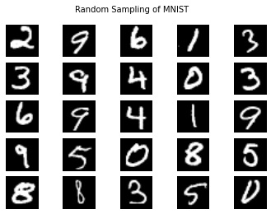
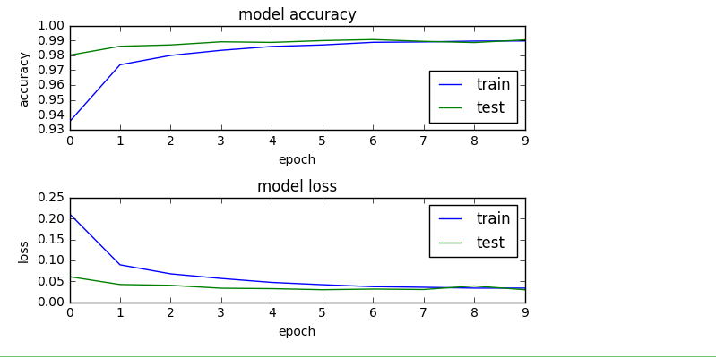
An example optical character recognition (OCR)
Example test_example_CNN.m in http://www.mathworks.com/matlabcentral/fileexchange/38310-deep-learning-toolbox
Based on a data base (mnist_uint8, from http://yann.lecun.com/exdb/mnist/)
60,000 training examples (e.g. 28x28 pixels each)
10,000 testing samples (a different dataset)
  After training , given an unknown image, it will tell whether it is 0, or 1 ,..,9 etc.
https://towardsdatascience.com/a-simple-2d-cnn-for-mnist-digit-recognition-a998dbc1e79a

Slide 5
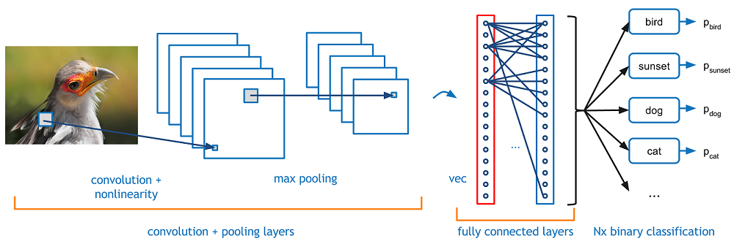
The basic idea of Convolution Neural Networks CNN
Same idea as Back-propagation-neural networks (BPNN) but different implementation
After vectorized (vec), the 2D arranged inputs become 1D vectors. Then the network is just like a BPNN
(Back propagation neural networks )
https://adeshpande3.github.io/adeshpande3.github.io/A-Beginner%27s-Guide-To-Understanding-Convolutional-Neural-Networks/

Slide 6
Basic structure of CNN
The convolution layer: see how to use convolution for feature identifier

Slide 7
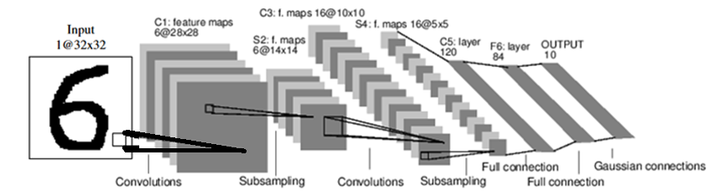
The basic structure
Input conv. subs. conv subs fully fully output
Alternating Convolution (conv) and subsampling layer (subs)
  But some architectures skip some of the subsampling layers (subs), it is up to the designer to decide
Subsampling allows the features to be flexibly positioned

Slide 8
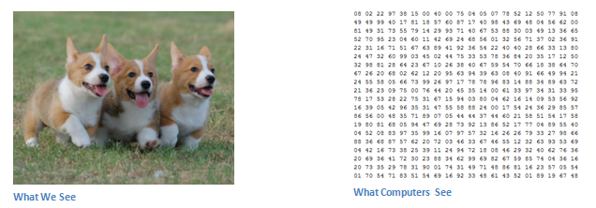
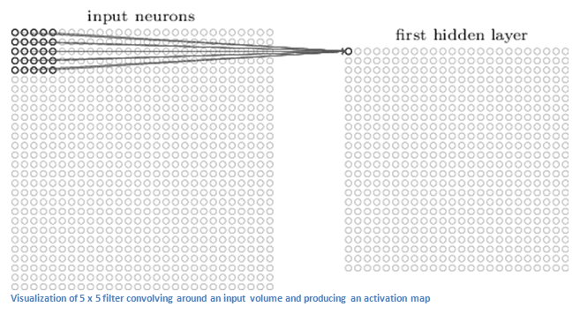
Convolution (conv) layer:
Example: From the input layer to the first hidden layer
The first hidden layer represents the filter outputs of a certain feature
So, what is a feature?
Answer is in the next slide

Slide 9
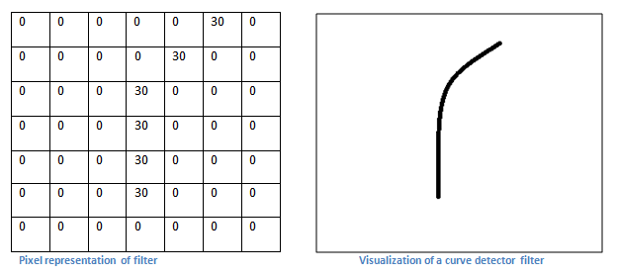
Convolution (conv) layer
Idea of a feature identifier
We would like to extract a curve (feature) from the image
Input picture

Slide 10
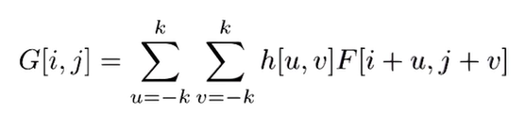
We first learn discrete (cross) correlation
h=[1 3 4
2 7 1
0 5 2]
F=[4 1
2 7]
G =
convulve(h*F)
7 23 34 8
15 60 37 18
2 50 53 8
0 5 22 8
4 | 1
2 | 7
1 | 3 | 4
2 | 7 | 1
0 | 5 | 2
4 | 1
2 | 7
4 | 1
2 | 7
4 | 1
2 | 7
4*5+2*1=22
1*4+2*2+3*1+7*7=60
0*1=0
4*0+5*1=5
https://www.youtube.com/watch?app=desktop&v=C3EEy8adxvc

Slide 11
Discrete convolution: Correlation is more intuitive
So, we use correlation of the flipped version of h to implement convolution[1]
$$I=\left[\begin{matrix}1 & 4 & 1 \\ 2 & 5 & 3\end{matrix}\right],h=\left[\begin{matrix}1 & 3 \\ 2 & −4\end{matrix}\right],\text{find} I∗h$$
convolution
$$C(m,n)=\sum_{j=−∞}^{j=∞}{\sum_{k=−∞}^{k=∞}{h(m−j,n−k)×I(j,k)}} \\ =\sum_{j=−∞}^{j=∞}{\sum_{k=−∞}^{k=∞}{h^{(flip)}(−m+j,−n+k)×I(j,k)}}$$
Flipped h
correlation

Slide 12
Matlab (octave) code for convolution convolution= 2D-flipped correlation
I=[1 4 1;
2 5 3]
h=[1 3 ;
2 -4]
conv2(I,h)
pause
disp('It is the same as the following');
conv2(h,I)
pause
disp('It is the same as the following');
xcorr2(I,fliplr(flipud(h)))
Flipped h=
-4 | 2
3 | 1

Slide 13
Steps to find C(m,n)
Step1:
C(0,0)
=2x2=4
Step 2:
C(1,0)
= -4*2+2*5=2
Step 3:
C(2,0)
= -4*5+2*3
=-14
Step 4:
C(3,0)
= -4*3
=-12
1 | 4 | 1
2 | 5 | 3
1 | 4 | 1
2 | 5 | 3
-4 | 2
3 | 1
-4 | 2
3 | 1
Flipped h
1 | 4 | 1
2 | 5 | 3
1 | 4 | 1
2 | 5 | 3
-4 | 2
3 | 1
-4 | 2
3 | 1
C(0,0) | C(1,0) | C(2,0) | C(3,0)
C(0,0) | C(1,0) | C(2,0) | C(3,0)
C(0,0)=4 | C(1,0)=2 | C(2,0)=-14 | C(3,0)=-12
C(m,n)=

Slide 14
Steps continue
1 | 4 | 1
2 | 5 | 3
Step 5:
C(0,1)
=1*2+2*1
=4
Step 6:
C(1,1)
= 1*-4+2*3+4*2+5*1
=15
Step 7:
C(2,1)
= -4*4+5*3+1*2+3*1
=4
Step 8:
C(3,1)
= -4*1+3*3
=5
1 | 4 | 1
2 | 5 | 3
-4 | 2
3 | 1
-4 | 2
3 | 1
1 | 4 | 1
2 | 5 | 3
-4 | 2
3 | 1
1 | 4 | 1
2 | 5 | 3
-4 | 2
3 | 1
C(0,2) | C(1,2) | C(2,2) | C(3,2)
C(0,1)=4 | C(1,1)=15 | C(2,1)=4 | C(3,1)=5
C(0,0)=4 | C(1,0)=2 | C(2,0)=-14 | C(3,0)=-1
C(m,n)=

Slide 15
Find all elements
-4 | 2
3 | 1
-4 | 2
3 | 1
-4 | 2
3 | 1
-4 | 2
3 | 1
1 | 4 | 1
2 | 5 | 3
1 | 4 | 1
2 | 5 | 3
1 | 4 | 1
2 | 5 | 3
1 | 4 | 1
2 | 5 | 3
n
$$=\left[\begin{matrix}1 & 7 & 13 & 3 \\ 4 & 15 & 4 & 5 \\ 4 & 2 & −14 & −12\end{matrix}\right]$$
C(m,n)
n
m
m

Slide 16
Example
I=[1 4 1;
2 5 3
3 5 1]
h2=[-1 2
3 4]
Find convolution of I and h2.

Slide 17
Answer of the example
%
I=[1 4 1;
2 5 3
3 5 1]
h2=[-1 2
3 4]
%Find convolution of I and h2.
conv2(I,h2)
ans =
-1 -2 7 2
1 15 26 10
3 24 38 14
9 27 23 4

Slide 18
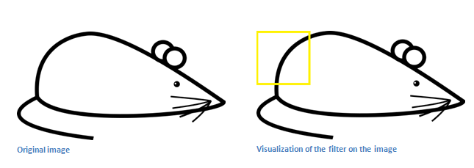
Convolution (conv) layer
The curve feature in an image
So, for this part of the image, there is such as a curve feature to be found.
Example of a curve feature map: If that cell is high , that means there is such a curve feature in the box of the input image

Slide 19
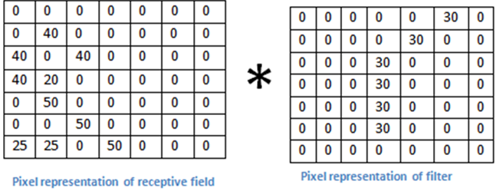

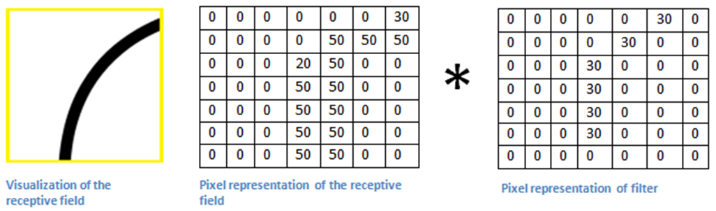
Convolution (conv) layer: What does it do?
Convolution is implemented by correlation
Correlation(X,B)=multiplication and summation of image X and B= 0 (or small).
Image X has no curve feature B
Input image=X
A curve feature=B
Correlation(A,B)=Multi_and_Sum= 3*(30*50)+(20*30)+50*30=6600 is large . That means image A has curve feature B
Input image=A
A curve feature=B

Slide 20
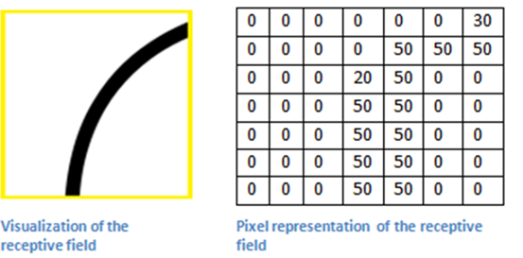

Exercises on CNN
Exercise 1: Convolution (conv) layer. How to find the curve feature
Exercise on convolution (implemented by correlation).
Question 1a: Find Y=correlation( A,C).
MC question. Which choice is correct?
Y=(20*30)+(50*30)+(50*20)
Y=(20*30)+ (50*30) +(20*30)
Y=(20*50)+(50*30)+(50*30)
Y=(20*30)+(50*30)+(50*30)
Image A
Matrix data of A
=C (empty cell = 0)
 | 30
 |  | 30
 |  |  | 30
 |  | 30
 |  | 30
 |  |  | 30
 |  |  |  | 30
*
Question 1b:
If Y>5000 image A has feature C.
Does image A have feature C?
Ans:_______?

Slide 21
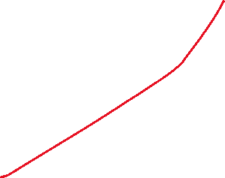
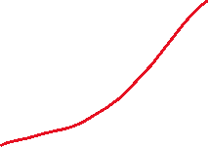
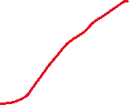

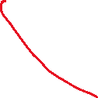
Answer :Exercises on CNN
Exercise 1: Convolution (conv) layer How to find the curve feature
Exercise on convolution (implemented by correlation, see appendix).
Answer:_________?=(20*30)+(50*30)+(50*30)=3600 (a bit small)
MC question. Y=correlation( A,C). (choice 4 is correct) Y=(20*30)+(50*30)+(50*30)
Question 1b: If Y>5000 image A has feature C. Does image A have feature C?
Answer : No. Because Y<5000. It has no feature C
Image A
Matrix data of A
Kernel feature C (empty cell = 0)
 | 30
 |  | 30
 |  |  | 30
 |  | 30
 |  | 30
 |  |  | 30
 |  |  |  | 30
*

Slide 22

To complete the convolution layer
After convolution (multiplication and summation) the output is passed on to a non-linear activation function (Sigmoid or Tanh or Relu), same as Back –Propagation NN.
We can use a neuron to simulate correlation, such as
u is generated by: u=correlation(x,w)
$$y=f(u)\text{with} u=\sum_{i=1}^{i=I}{\left[w(i)x(i)\right]+b}, \\ b=\text{bias}\text{, }x=\text{input}\text{,}w=\text{weight}\text{, }u=\text{internal} \text{signal} \\ Typically, f() \text{is} \text{an} \text{activation} \text{function}\text{,} \\ \text{e}\text{.}\text{g}\text{. }\text{logistic} (\text{sigmoid})\text{, }\text{i}\text{.}\text{e}\text{.} \\ f(u)=\frac{1}{1+e^{−u}},\text{(}\text{typical} \text{sigmoid}\text{)} \\ \text{therefore} y=f(u)=\frac{1}{1+e^{−\left(\sum_{i=1}^{i=I}{\left[ω(i)x(i)\right]+b}\right)}}$$

Slide 23
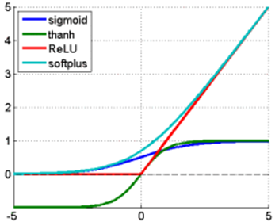

Activation function/gradient choices
https://imiloainf.wordpress.com/2013/11/06/rectifier-nonlinearities/
https://www.simonwenkel.com/2018/05/15/activation-functions-for-neural-networks.html#softplus
$$\text{Sigmoid} (output \text{from}\text{ 0 }\text{to}\text{ 1}): \\ g\left(x\right)=\frac{1}{1+e^{−x}},$$
$$gradient=\frac{dg(x)}{dx}=g(x)⋅(1−g(x))$$
$$\text{Tanh} (output \text{from}\text{ −1 }\text{to}\text{ 1}): \\ g\left(x\right)=\frac{\sinh{(}x)}{\cosh{(}x)},$$
$$gradient=\frac{dg(x)}{dx}=\frac{4}{{\left(e^{−x}+e^{x}\right)}^{2}}$$
$$\text{Rectified} \text{Linear} \text{Unit} \left(Relu\right)\left(\text{output} \text{from}\text{ 0 }\text{to} ∞\text{,}\text{hard} \text{change}\right):$$
$$g(x)=\max{(}0,x),$$
$$gradient=\frac{dg(x)}{dx} =\left\{\begin{matrix}1, \text{if} \text{x}≥0 \\ 0, \text{if} \text{x}<0\end{matrix}\right.$$
$$\text{Softplus} (\text{from}\text{ 0 }\text{to} ∞\text{,}\text{soft} \text{change})\text{: } \\ g(x)=\ln{(}1+e^{x}),gradient=\frac{dg(x)}{dx}=\frac{1}{1+e^{−x}}$$
Max. gradient of Signmoid is 0.25, it will cause the vanishing gradient problem
Relu is now very popular and shown to be working better other methods

Slide 24
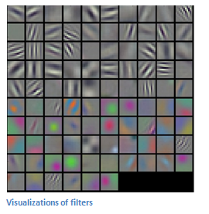
Example (LeNet)
An implementation example http://yann.lecun.com/exdb/lenet/
Filters
Filters
Input C1:conv. S2:subs. C3:conv S4:subs C5:fully F6:fully output
(use Softmax)
Each feature filter uses one kernel (e.g. 5x5) to generate a feature map
Each feature map represents the output of a particular feature filter output.
Alternating Convolution (conv) and subsampling layer (subs) (optional, some systems skip subs)
Subsampling allows the features to be flexibly positioned
(array of feature maps

Slide 25
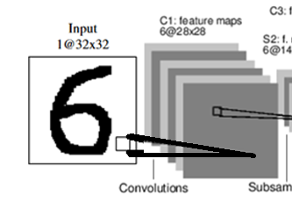
Input → C1: Input to convolution
For each 5x5 kernel (or called kernel) you need 5x5 weights (per convolution layer NN) . Unlike a fully connected Neural Net, the weights are shared. Meaning that, when you convolve the kernel with the input , only one set of 5x5 kernel (weights) is used for the convolution.
Convolution layer
  Input →one feature map (filter), you only need 5x5 weights , one bias
  For 6 feature maps you need 6x5x5 weights. (very efficient)
(To compare with a fully connected NN) If this is to be implemented by a fully connected layer without convolution
  You need 32x32x28x28 weights.
  For 6 feature maps need 6x 32x32x28x28 (not efficient)
Training by backpropagation is the same as a common back propagation neural network BPNN.
The filter (kernel) is like a feature extractor
Each filter has one bias
Filters
6x28x28
32x32
Convolution layer
5x5 kernel
From input to one of the 6 convolution maps
https://stanford.edu/~shervine/teaching/cs-230/cheatsheet-convolutional-neural-networks
One bias per kernel (or called filter)
No bias for max pooling

Slide 26






Example of how one feature map is formed
If you need 6 feature maps, you need 6 kernels maps (K_{j=1.,,,6}) and perform 6 sets of correlations(K_{j},i), for feature index j=1,,6
The kernel (flipped) 5x5 K_{j=1} is
The 5x5 image window (i) is
K₁11 | K₁12 | K₁13 | K₁14 | K₁15
K₁21 | K₁22 | . | . | .
. | . | .
 |  |  |  | K₁55
Convolution layer
5x5 kernel
Conv2() is 2D convolution
Sigmoid
$$i11$$
$$k_{1}11$$
Output
Of the
kernel
$$i12$$
$$k112$$
i11 | i12 | i13 | i14 | i15
i21 | i22 | . | . | .
. | . | .
 |  |  |  | i55
$$i55$$
$$k155$$
correlation(K_{j=1},i)
This process (correlation) is the same as convolution depends on how you index the kernel.

Slide 27
Example (w7)
%A 2X2 WINDOW FROM THE INPUT IMAGE IS I
i=[0.21 0.13
0.24 0.42]
%KERNEL IS 2X2, BIAS B= 0.6
K=[0.1 0.31
0.23 0.12]
B=0.6
C=0.21*0.1+0.24*0.23+0.13*0.31+0.42*0.12 %=use correlation (assume K is already up_down and left_right flipped.)
U=sum(sum(C))+ B
Output=1/(1+exp(-(U)))
%ANS: 0.6828
See https://towardsdatascience.com/convolution-vs-correlation-af868b6b4fb5
$$f(u)=\frac{1}{1+e^{−u}}$$

Slide 28
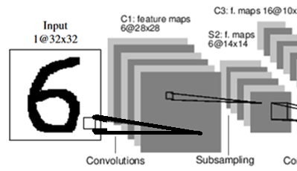

C1→ S2: From convolution map (C1) to subsampling to map (S2)
Filters
No weights involved, just by calculation
  Sample s=( )
One layer to the next corresponding layer, no cross layer connections.
It can be achieved by one of two methods:
  Average pooling : s=(a+b+c+d)/4, or
  Max pooling : s= max(a,b,c,d)
From convolution maps to subsampling to maps
Normally a convolution layer is followed by a subsample layer, but it is also possible to connect a convolution layer directly to another convolution layer without a subsample layer, it is up to the designer to choose.
No bias for max pooling or averaging
https://www.mathworks.com/matlabcentral/answers/350254-why-there-is-no-bias-and-coefficient-trainable-parameters-in-the-max-and-average-pooling-layers

Slide 29
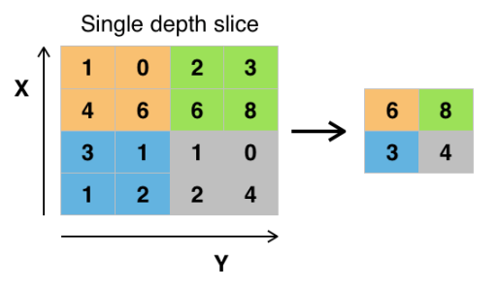
Subsampling (subs)
Subsampling allows features to be flexibly positioned around a specific area, example:
  Subsample an output (a matrix of 2x2)
  Sample s=( )
It can be achieved by two methods:
  Average pooling: s=(a+b+c+d)/4, or
  Max pooling : s= max(a,b,c,d)
a | b
c | d
Max pooling
https://en.wikipedia.org/wiki/Convolutional_neural_network#/media/File:Max_pooling.png

Slide 30
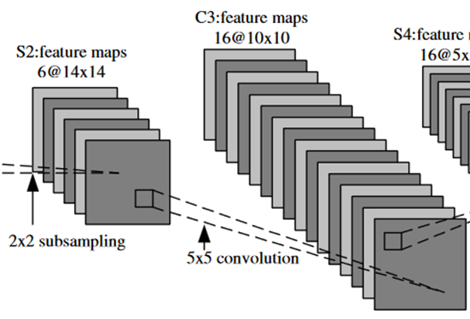
S2→C3: From subsampling map (S2) to the next convolution layer (C3)
For each element in the C3 (feature) map, it is connected to all 6 feature maps from S2.
You need 5x5 weights for each input from each S2 map, so altogether you need 6x(5x5) weights to generate a C3 feature map from all 6 S2 feature maps.
How to add up the input to become the output depends on your design. Will show later
For all 16 feature maps of C3, you need 16x(6x(5x5)) weights.
Filters
Num of weights=n_feature_map*(kernel_size)*n_output_feature_map
=6*(5x5)*16 weights.
Num_of biases= n_output_feature_map=16

Slide 31
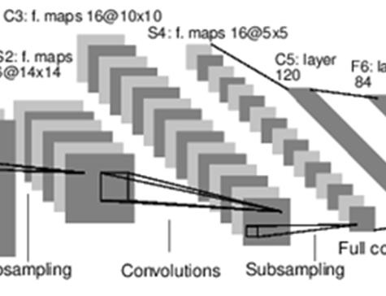
C3→S4:From subsampling map (C3) to the next convolution layer (S4)
No weights involved, just by calculation
  Sample s=( )
One layer to the next corresponding layer, no cross layer connections.
It can be achieved by two methods:
  Average pooling: s=(a+b+c+d)/4, or
  Max pooling : s= max(a,b,c,d)
From C3→S4

Slide 32
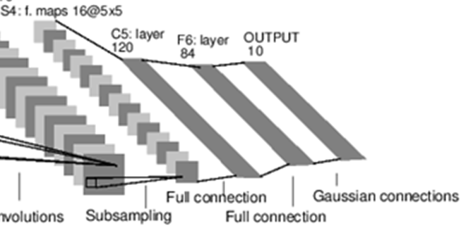
S4→C5: From fully connection layer (S4) to a fully connection vector (C5), and so on
F6→output
C5→F6
(use SoftMax for multi-class output)
S4→C5
Fully connection vector
Each element in the fully connection vector (C5) connects to all elements in S4 (S4 has 16x5x5 neurons). Therefore, we need 120x(16x5x5) weights
Likewise, from C5 to F6, you need 120x84 weights
From F6 to output , you need 84x10 weights.

Slide 33
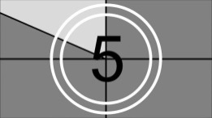
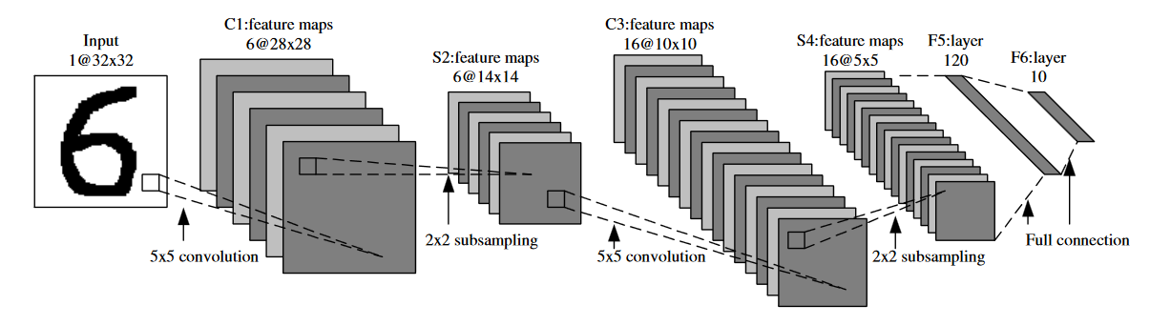
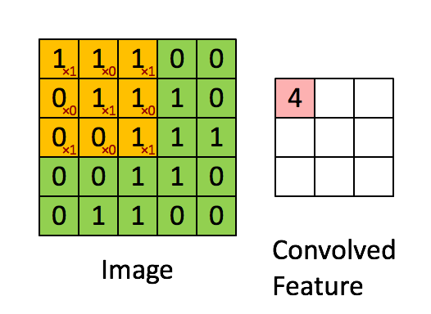
Exercise2 and Demo (click image to see demo)
http://deeplearning.stanford.edu/wiki/images/6/6c/Convolution_schematic.gif , https://link.springer.com/content/pdf/10.1007%2F978-3-642-25191-7.pdf
Filters
Filters
(Softmax)
1 | 0 | 1
0 | 1 | 0
1 | 0 | 1
This is a 3x3 mask(kernel) for illustration purpose,
but noted that the above application uses a 5x5 mask (kernel).
Input image
A different kernel generates a different feature map.
Use softmax to generate the output (see next slide)
A feature map
X
Correlation mask (kernel) .
Exercise 2a: Find X. Answer :X=_______?
MC question: (1) X=2; (2) X= 4; (3) X= 6; (4) X= 8
(Ex2b.) Find X again if the correlation mask (or kernel) is [0 2 0;
2 0 2;
0 2 0].

Slide 34
Answer2: and Demo (click image to see demo)
http://deeplearning.stanford.edu/wiki/images/6/6c/Convolution_schematic.gif , https://link.springer.com/content/pdf/10.1007%2F978-3-642-25191-7.pdf
1 | 0 | 1
0 | 1 | 0
1 | 0 | 1
This is a 3x3 mask for illustration purpose,
but noted that the above application uses a 5x5 mask.
Input image
A different kernel generates a different feature map
A feature map
X
Convolution mask
Exercise (2a) Find X. Answer X= 4(choice 2)
(2b) Find X again if the correlation mask is [0 2 0;
2 0 2;
0 2 0].
Answer:X_{new}=2*1+2*1+2*1=6

Slide 35
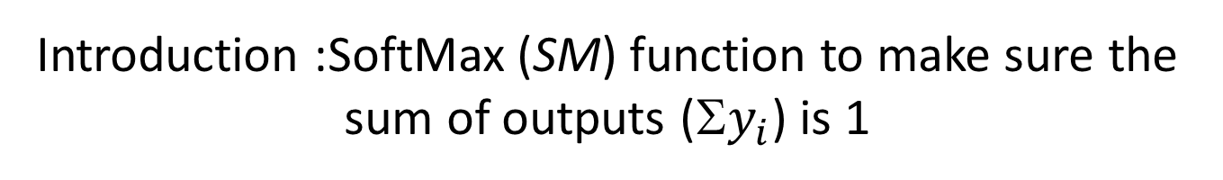

Introduction :SoftMax (SM) function to make sure the sum of outputs (${y}_{i}$) is 1
https://medium.com/data-science-bootcamp/understand-the-softmax-function-in-minutes-f3a59641e86d
See http://www.cse.cuhk.edu.hk/~khwong/www2/cmsc5707/5707_probability.pptx
Output (Z)= [$z_{i=1},z_{i=2}$, $z_{i=3}$]=[2 , 1, 0.1]’
Softmax(Y)= ${[y}_{i=1},y_{i=2},y_{i=3}$]=[0.6590, 0.242,0.0986]’
$y_{i}\text{=}\frac{\exp{(}z_{i})}{\exp\left(z_{j=1}\right)+\exp\left(z_{j=2}\right)+\exp\left(z_{j=3}\right)}$
y_{i=1}=exp(2)/((exp(2)+exp(1)+exp(0.1))=0.6590
y_{i=2}= exp(1)/((exp(2)+exp(1)+exp(0.1))= 0.24243
y_{i=3}= exp(0.1)/((exp(2)+exp(1)+exp(0.1))=0.098566
Question: I$s{ y}_{i}$ =1 ?
Answer : sum([0.6590, 0.24243, 0.098566])=1
$$y_{i}\text{=}\text{softmax}(z_{i})=\frac{\exp{(}z_{i})}{\sum_{j=1}^{K}{\exp{(}z_{j})}},\text{for} j=1,2,..,K$$
0.6590, 0.24243, 0.098566
$y_{i=1}$ $y_{i=2}$ ${ y}_{i=3}$
SoftMax
$z_{j=1} z_{j=2}$ $z_{j=3}$
2 1 0.1

Slide 36
Exercise 3: A small example of how the feature map is calculated
Input image 7x7
Filter
Figure 1
Kernel 3x3
output feature map 5x5
Correlation
with
For each dimension, N=image_width, m=kernel (mask) width, s=step size, output_feature_map_width D={ [(N-m)/s]+1}
If step size of correlation=1 pixel (horizontally and vertically), output=5x5 pixels
(Ex.3a) If input is 32x32, mask is 5x5, what is the size of the output feature map if step size is 1? MC Question3a : (1) 24x24; (2) 26x26; (3) 28x28; (4) 30x30;
(Ex.3b) If input is 28x28, what is the size of the subsample layer?
MC Question3b: (1) 10x10; (2) 12x12; (3) 14x14; (4) 16x16.
(Ex.3c) If input is 14x14, kernel=5x5, what is the size of the output feature map if step size is 1? MC Question3c: (1) 10x10; (2) 12x12; (3) 14x14; (4) 16x16.
(Ex.3d) In the figure above (Image=7x7, kernel=3x3), if the step size is 2 pixels, What is the size of the output feature map? MC Question3d: (1) 2x2; (2) 3x3; (3) 4x4; (4) 5x5
(Ex.3e) In Ex.3a, if step size= 2 pixels, D=((32-5)/2]+1)=14.5 which is not an integer, what should we do? MC Question3e:(1) change kernel; (2) crop output; (3) crop input; (4) use zero padding

Slide 37
Answer 3: A small example of how the feature map is calculated
output feature map 5x5
Input image 7x7
Filter
Kernel 3x3
correlation
with
For each dimension, N=image_width, m=kernel (mask) width, s=step size, output_feature_map_width={ [(N-m)/s]+1}
(Ex.3a) If input is 32x32, mask is 5x5, what is the size of the output feature map if step size is 1? MC. Ans3a: Choice3 is correct : { [(N-m)/s]+1}=28x28, for each dimension, image_width, m=kernel (mask) width, s=step size, output_feature_map_width={ [(N-m)/s]+1}
(Ex.3b) Input =28x28, what is the size of the subsample layer? Ans:choice 3 is correct=14x14
(Ex.3c) If input is 14x14, kernel=5x5, what is the size of the output feature map if step size is 1? Ans3c : choice 1 is correct= 10x10
(Ex.3d) In the figure above (Image=7x7, kernel=3x3), if the step size is 2 pixels, What is the size of the output feature map?Ans 3d. choice 2 is correct { [(N-m)/s]+1}={ [(7-3)/2] +1) =3, so 3x3.
(Ex.3e) In Ex.3a, if step size= 2 pixels, D=((32-5)/2]+1)=14.5 which is not an integer, what should we do? MC Question3e:(1) change kernel; (2) crop output; (3) crop input; (4) use zero padding > Answer: choice 4 , use zero padding is correct, see next slide 3x3

Slide 38
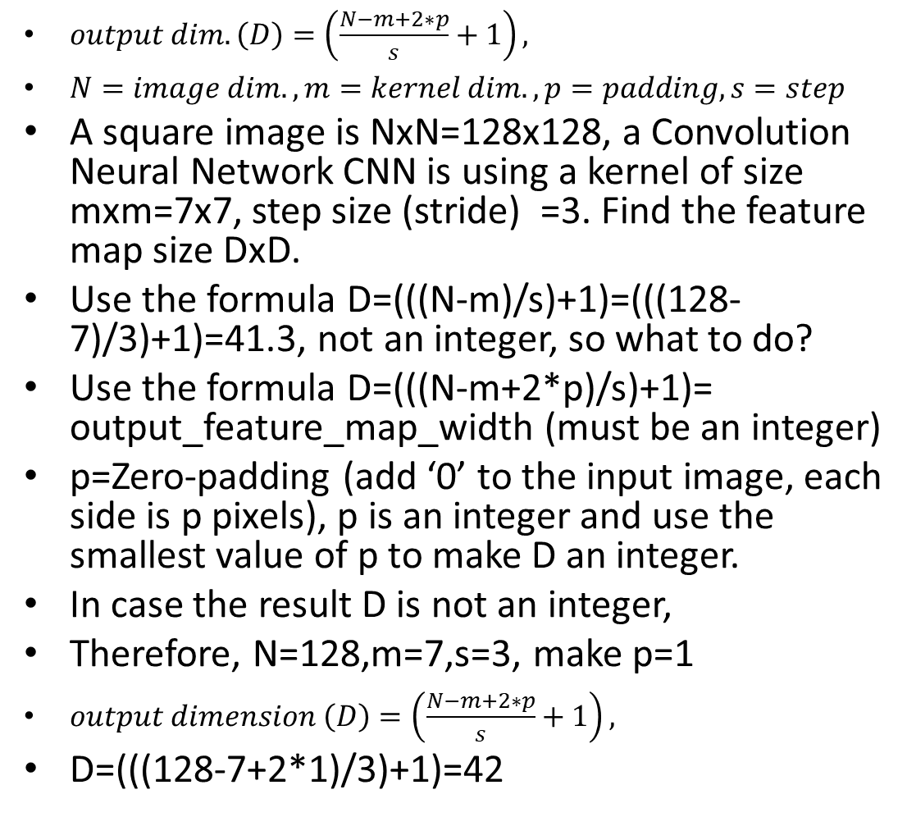
Zero padding (p) in CNN
$output dim. \left(D\right)=\left(\frac{N−m+2∗p}{s}+1\right),$
$N=image dim.,m=kernel dim.,p=padding,s=step$
A square image is NxN=128x128, a Convolution Neural Network CNN is using a kernel of size mxm=7x7, step size (stride) =3. Find the feature map size DxD.
Use the formula D=(((N-m)/s)+1)=(((128-7)/3)+1)=41.3, not an integer, so what to do?
Use the formula D=(((N-m+2*p)/s)+1)= output_feature_map_width (must be an integer)
p=Zero-padding (add ‘0’ to the input image, each side is p pixels), p is an integer and use the smallest value of p to make D an integer.
In case the result D is not an integer,
Therefore, N=128,m=7,s=3, make p=1
$output dimension \left(D\right)=\left(\frac{N−m+2∗p}{s}+1\right),$
D=(((128-7+2*1)/3)+1)=42
Image after zero padding
p
Original image
p
p
White areas: Zeros are added to the image
Ref : https://datahacker.rs/what-is-padding-cnn/

Slide 39
To create a layer from multiple feature layers
Layer to layer

Slide 40
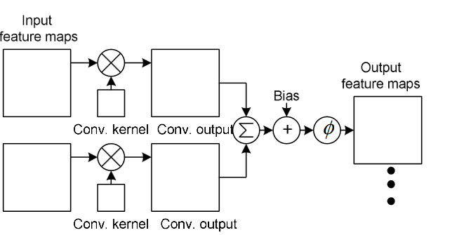
How to feed one feature layer to multiple feature layers
Layer 1 Layer 2 Layer 3 Layer 4 Layer 5 Layer 6
Filters
Filters
6 feature maps
require 6 kernels
You can combine multiple feature maps of one layer into one feature map in the next layer
See next slide for details
Bias (one for each output_feature_map)
https://link.springer.com/content/pdf/10.1007%2F978-3-642-25191-7.pdf

Slide 41
Calculation of number of weights and biases used
Layer 1 Layer 2 Layer 3 Layer 4 Layer 5 Layer 6
6 feature maps
Weights:W1=6*(5*5)
Biases: B1=6
W3=6*(5*5)*16
B3=16
Flatten=
W5=16*(5*5)*120
B5=120 (one for each output)
W2=0
B2=0
W4=0
B4=0
No weight and bias for subsampling layer
Num_of_Weights=num_of_input_maps*(kernel_size)*num_of_output_maps
Num_of_biases=num_of_output_maps (one_for_each_output_feature_map)
A feature maps is also called a filter
Fully connected
W6=120*10
B6=10 (one for each output)
https://link.springer.com/content/pdf/10.1007%2F978-3-642-25191-7.pdf

Slide 42
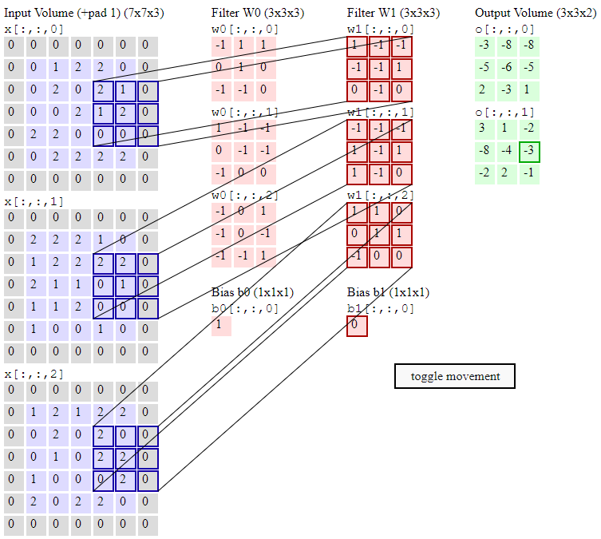
Example:
This is to show how to use 3 input features maps (e.g. RGB color) to become 2 output maps

Slide 43
A demo
2*1+1*-1+1*-1+2*-1
+
2*-1+2*-1+1*-1
+
2*1+2*1= -3
By adding 3 correlation results
Input is three 7x7 images (e.g. RGB)
Shift step size is 2 pixels rather than 1, therefore the output is 3x3 for each feature map
Generate 2 output feature maps
  0[:,:,0]
  0[:,:,1]
https://youtu.be/vAh_ZHtyJ0k demo video
http://cs231n.github.io/convolutional-networks/

Slide 44
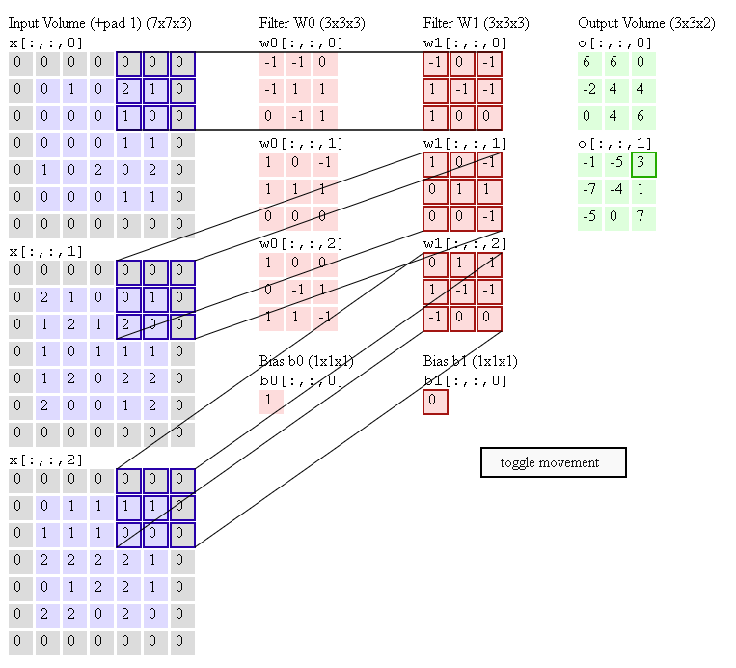
Example and demo
2*1+1*(-1)+1*1+
1*1+
1*1+1*(-1)=3
Input is a 3 7x7 image (e.g. RGB)
Shift step size is 2 pixels rather than 1, therefore the output is 3x3 for each feature map
Generate 2 output feature maps
  0[:,:,0]
  0[:,:,1]
Exercise : verify the results in outputs:
  0[:,:,0] and 0[:,:,1]
Input (In)
In ⊗ w0
In ⊗ w1
⊗=convolution
1*(-1)+
2*1+1*(1)+2*(-1)+
1*(-1)=-1
http://cs231n.github.io/convolutional-networks/

Slide 45
Example
Using a program

Slide 46
Example: Overview of
Test_example_CNN.m
Read data base
Part I:
cnnsetup.m
  Layer 1: input layer (do nothing)
  Layer 2→ convolution(conv.) Layer, output maps=6, kernel size=5x5
  Layer 3→ sub-sample (subs.) Layer, scale=2
  Layer 4→ conv. Layer, output maps =12, kernel size=5x5
  Layer 5→ subs. Layer (output layer), scale =2
Part 2:
cnntrain.m % train weights using 60,000 samples
  cnnff( ) % CNN feed forward
  cnndb( ) % CNN feed back to train weighted in kernels
  cnnapplygrads( ) % update weights
cnntest.m % test the system using 10000 samples and show error rate
Matlab example based on
http://www.mathworks.com/matlabcentral/fileexchange/38310-deep-learning-toolbox

Slide 47
Architecture example
Layer 3→4:
12 conv.
Maps (C)
InputMaps=6
OutputMaps=12
Fan_in=
6x5²=150
Fan_out=
12x5²=300
Layer 1→2:
6 conv.Maps (C)
InputMaps=6
OutputMaps=6
Fan_in=5²=25
Fan_out=6x5²=150
Layer 2→3:
6 sub-sample
Map (S)
InputMaps=6
OutputMaps=12
Layer 4→5:
12 sub-sample
Map (S)
InputMaps=12
OutputMaps=12
Each output neuron corresponds to a character (0,1,2,..,9 etc.)
Layer 1:
One input (I)
Layer 1:
Image
Input
1x28x28
Layer 5
(subsample):
12x4x4
Layer 2
(hidden):
6x24x24
Layer 3
(subsample):
6x12x12
Layer 4
(hidden):
12x8x8
Can use sigmoid or softmax
10
outputs
Conv.
Kernel
=5x5
Subs
Kernel
=5x5
Conv.
2x2
Subs
I=input
C=Conv.=convolution
S=Subs=sub sampling or mean or max pooling
2x2

Slide 48
Data used in training of a neural networks
  Training set
    Around ≈ 60-70 % of the total data
    Used to train the system
  Validation set (optional)
    Around ≈ 10-20 % of the total data
    Used to tune the parameters of the model of the system
  Test set
    Around ≈ 10-20 % of the total data
    Used to test the system
  Data in the above sets cannot be overlapped, the exact % depends on applications and your choice.

Slide 49
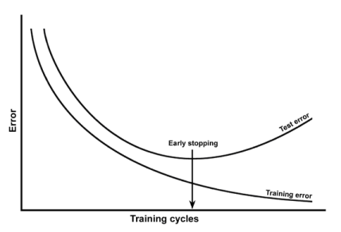
Warning: How to train a neural network to avoid data over fitting
Over-fitting: the system works well for training data but not testing data, so extensive training may not help.
What should we do? Use validation data to tune the system to reduce the test error. Stop training at early stop.
Test error curve using testing data: rising or rise slowly or fluctuationing around a narrow range
Error from loss function
Early stopping
test error at early stop
Training cycles (epoch)
Training error using training data (keep falling)
https://stats.stackexchange.com/questions/131233/neural-network-over-fitting

Slide 50
How to compare systems using k-fold Cross-Validation, usually K=10
Idea: divide the data in K equal portions and perform tests on each portion using different models -- maybe a different model (method) or same model (method) with different parameters: Here is the procedure.
Shuffle the data randomly.
Split the dataset into k groups (e.g., K=10) , keep the grouping
For m=1:M [Collect the accuracy_of_model(m)]{
  For i=1:K , (for each unique group){
    Take a group as a test data set
    Take the remaining groups (k-1 groups) as training data
    Fit the model on training set & evaluate it on test set, record accuracy(i)}
  The accuracy_of_model_m =mean {1:K (accuracy(i)} of that model (m)}
List all accuracy_of_model_m(s) and compare which is better.
** It is to make sure each sample will be used as a testing data.

Slide 51
Transfer learning
Practical machine learning implementation method,
speedup the development cycle

Slide 52
Transfer learning for deep net (e.g. over 50 layers): leaning using pre-trained weights
Slow: Take long tine to train and require a lot of data.
Fast: Can be very efficient to tarin
Use
Pre-trained-CNN NEW TASK
https://neptune.ai/blog/transfer-learning-guide-examples-for-images-and-text-in-keras
https://medium.datadriveninvestor.com/introducing-transfer-learning-as-your-next-engine-to-drive-future-innovations-5e81a15bb56 7

Slide 53
How to implement transfer learning
1) Obtain the pre-trained model
2) Create a base model
3) Freeze layers
4) Add new trainable layers
5) Train the new layers on the dataset
6)Improve the model via fine-tuning
Obtain the pre-trained model
Create a base model
Freeze layers
Add new trainable layers
Train the new layers on the dataset
Improve the model via fine-tuning
Idea: In transfer learning, a downstream task uses the output of a previous task. It applies the knowledge of the pretrained model to a new problem.
https://neptune.ai/blog/transfer-learning-guide-examples-for-images-and-text-in-keras
https://www.baeldung.com/cs/downstream-tasks

Slide 54
Step1 : Obtain the pre-trained model
The first step is to get the pre-trained model that you would like to use for your problem. The various sources of pre-trained models are covered in a separate section
There are more than two dozen pre-trained models available from Keras. They’re served via Keras applications.

Slide 55
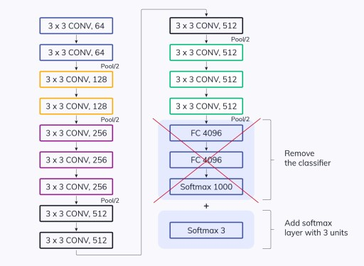
Step2 : Create a base model
Usually, the first step is to instantiate the base model using one of the architectures such as ResNet or Xception. You can also optionally download the pre-trained weights. ….

Slide 56
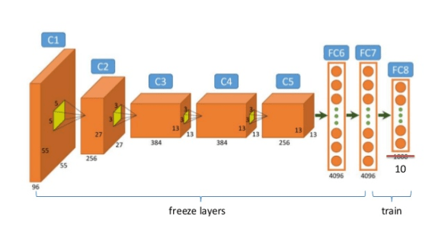
Step3 : Freeze layers
So, Freeze layer don’t change during training
Freeze layers
Train

Slide 57
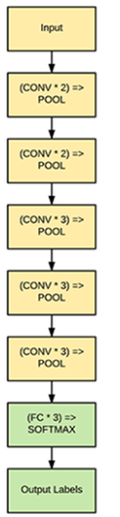
Step4 : Add new trainable layers
Input
Freeze
Earlier
Layers
Add new trainable layers
FC=fully
connected

Slide 58
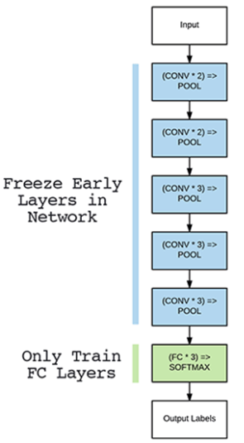
Step 5: Train the new layers on the dataset
Remember that the pre-trained model’s final output will most likely be different from the output that you want for your model. For example, pre-trained models trained on the ImageNet dataset will output 1000 classes, but you may only need 50 classes.
Freeze early layers in the network
Only train the fully connected layer

Slide 59
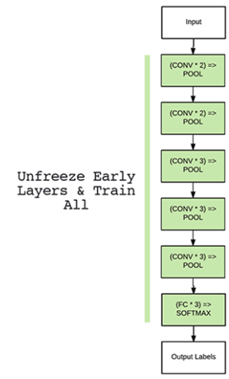
Step 6: Improve the model via fine-tuning
Unfreeze early layers and train the whole network again
After that,
DONE!

Slide 60
Exercise 4
Why do we use transfer learning? The reasons:
  More accurate
  More efficient
  Less programming work
  MC question, which are true?
(1) a,b (2) b,c; (3) a,c (4)a,b,c

Slide 61
Exercise 4
Why do we use transfer learning? The reasons:
  More accurate
  More efficient
  Less programming work
  MC question, which are true?
(1) a,b (2) b,c is correct; (3) a,c (4)a,b,c

Slide 62
Part B: SoftMax activation function and how to Backpropagate
KH Wong

Slide 63
Overview of SoftMax
Introduction
Backpropagation: Derivation of SoftMax weight update
SoftMax and Bias
Summary

Slide 64
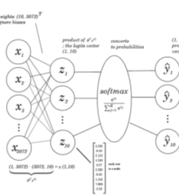
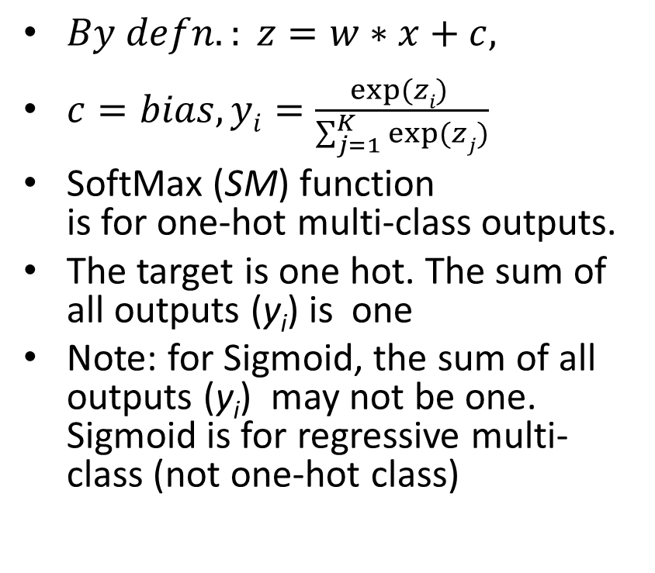
Introduction
Target T=[ti,t2,..] is one hot
$By defn.: z=w∗x+c,$
$c=bias, yi=\frac{exp⁡(zi) }{\sum_{j=1}^{K}{exp⁡(zj)}}$
SoftMax (SM) function
is for one-hot multi-class outputs.
The target is one hot. The sum of all outputs (y_{i}) is one
Note: for Sigmoid, the sum of all outputs (y_{i}) may not be one. Sigmoid is for regressive multi-class (not one-hot class)
t1
t1
t2
t10

Slide 65
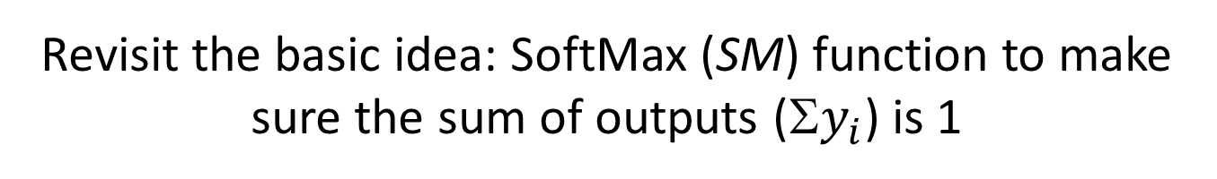
Revisit the basic idea: SoftMax (SM) function to make sure the sum of outputs (${y}_{i}$) is 1
https://medium.com/data-science-bootcamp/understand-the-softmax-function-in-minutes-f3a59641e86d
See http://www.cse.cuhk.edu.hk/~khwong/www2/cmsc5707/5707_probability.pptx
Output (Z)= [$z_{i=1},z_{i=2}$, $z_{i=3}$]=[2 , 1, 0.1]’
Softmax(Y)= ${[y}_{i=1},y_{i=2},y_{i=3}$]=[0.6590, 0.242,0.0986]’
$y_{i}\text{=}\frac{\exp{(}z_{i})}{\exp\left(z_{j=1}\right)+\exp\left(z_{j=2}\right)+\exp\left(z_{j=3}\right)}$
y_{i=1}=exp(2)/((exp(2)+exp(1)+exp(0.1))=0.6590
y_{i=2}= exp(1)/((exp(2)+exp(1)+exp(0.1))= 0.24243
y_{i=3}= exp(0.1)/((exp(2)+exp(1)+exp(0.1))=0.098566
Question: I$s{ y}_{i}$ =1 ?
Answer : sum([0.6590, 0.24243, 0.098566])=1
$$y_{i}\text{=}\text{softmax}(z_{i})=\frac{\exp{(}z_{i})}{\sum_{j=1}^{K}{\exp{(}z_{j})}},\text{for} j=1,2,..,K$$
0.6590, 0.24243, 0.098566
$y_{i=1}$ $y_{i=2}$ ${ y}_{i=3}$
SoftMax
$z_{j=1} z_{j=2}$ $z_{j=3}$
2 1 0.1

Slide 66




Loss function(E) for SoftMax
SoftMax is used as the output layer for multi-class classification.
SoftMax is considered as one activation function with multiple inputs and outputs. (Note: a sigmoid active function has multiple inputs but 1 output)
Each output (y_{j})can range from 0 to 1 and the sum of all outputs is 1.
Loss function (E) used is categorical Cross entropy loss (or Softmax Loss)
  If T=True (target) probability, y= predicted probability
  E = -$\sum_{i}{t_{i}∗log⁡(y_{i})}$, (Note: for sigmoid it is square loss: E=0.5*(T-y)^2
T=target
Vector (one-hot)
weights
SoftMax
Input
E=-$\sum_{i}^{K}{t_{i}∗\log\left(y_{i}\right)}$
Y=output vector
Y=[$y_{i=1}$, $y_{2}$, $…$,$t_{i=K}$]^{T}
T=[$t_{i=1}$, $t_{2}$, $…$, $t_{i=K}$]^{T}
i class
$$\left(yi\right)$$
$$\left(zi\right)$$
n features
Gradient Descent Update rule for Multiclass Logistic Regression _ by adam dhalla _ Artificial Intelligence in Plain English.pdf

Slide 67
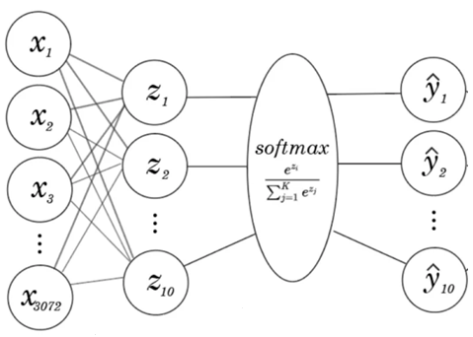

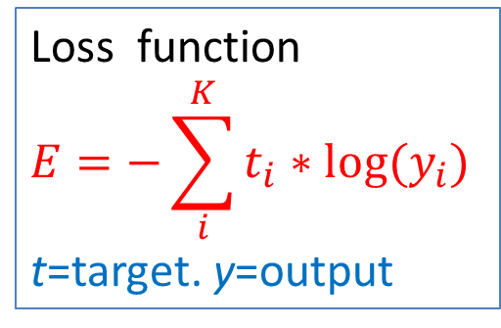


Derivation of SoftMax weight update
X has N features (x1,x2,….,xN), Z (Z1,Z2,..,ZK). has K classes. Hence, we have y1,y2,,,yK. E.g. N=3072,K=10 for an optical character recognition example/problem.
For Backpropagation , we need
$$\frac{∂E}{∂w_{n,i}}=\frac{∂E}{∂y}\frac{∂y}{∂z}\frac{∂z}{∂w_{n,i}}=term1∗term2∗term3$$
(chain rule)
$$w_{n,i}$$
y_{i=1}
X_{n=1}
Z_{i=1}
X_{n=2}
Loss function
$$E=−\sum_{i}^{K}{t_{i}∗log⁡(y_{i})}$$
t=target. y=output
y_{i=2}
X_{n=3}
X_{n=N}
$$softmax$$
$$\frac{eZi}{\sum_{j=1}^{K}{eZj}}=yi$$
z_{i=K=10}
y_{i=K=10}
Example
N=3072, K=10

Slide 68





Use Gradient descent method to find the weights of SoftMax
Gradient descent method:
W_{new} = W_{old} +ΔW
ΔW= -η$\frac{∂E}{∂w_{n,i}}$
Loss function
$$E=−\sum_{i}^{K}{t_{i}∗log⁡(y_{i})}$$
Input
$$w_{n,j}$$
weights
SoftMax
η (Ita) =0.1 =learning rate
y_{i}
X_{n}
z_{i}
Y=output vector
=[$y_{i=1}$, $y_{2}$, $…$,$t_{j=K}$]^{T}
T=target Vector (one-hot)
=[$t_{i=1}$, $t_{2}$, $…$, $t_{j=K}$]^{T}

Slide 69

We need 3 steps.
Here is Step 1 (find term2)
For Backpropagation , we need
$\frac{∂E}{∂w_{n,i}}=\frac{∂E}{∂y}\frac{∂y}{∂z}\frac{∂z}{∂w_{n,i}}=term1∗term2∗term3$
(chain rule)
To derive SoftMax weight update
we will find term2 = $\frac{∂y}{∂z}$ first

Slide 70






Derivation of SoftMax update, term2 =$\frac{∂y}{∂z}$
2 cases: (i) Indexes are same; (ii) indexes not the same
Example
(i) Indexes are same (h=i)
$$by defn. yi=\frac{exp⁡(z_{i=1})}{\sum_{j=1}^{j=K}{exp⁡(z_{j})}}$$
Z₁
Y₁
(i) Indexes are same, we need this
$$\frac{∂y}{∂z}=\frac{∂\left(\frac{exp⁡(z_{i=1})}{\sum_{j=1}^{j=K}{exp⁡(z_{j})}}\right)}{∂Z_{1}}\text{−−−(}\text{∗)}$$
Index 1,1(same)
(i) Indexes are not the same
(ii) indexes not the same (h≠i)
$\frac{∂y}{∂z}= \frac{∂\left(\frac{exp⁡(z_{i=1})}{\sum_{j=1}^{j=K}{exp⁡(z_{j})}}\right)}{∂Z_{2}}$ --(**)
Y₁
z₂
Index 2,1 (not the same)
https://ai.plainenglish.io/gradient-descent-update-rule-for-multiclass-logistic-regression-4bf3033cac10

Slide 71



j is only an index for summing. Now use h for input index, i for output index
$$Softmax\left(Zh\right)=yh=σ\left(Zh\right)=\frac{exp⁡(z_{h})}{\sum_{j=1}^{j=K}{exp⁡(z_{j})}}$$
From(*), partial derivation
$\frac{∂\left(σ\left(Z\right)\right)}{∂Z_{i}}$ =$\frac{∂\left(\frac{exp⁡(z_{h})}{\sum_{j=1}^{j=K}{exp⁡(z_{j})}}\right)}{∂Z_{i}}$
=$\frac{\left(\frac{∂\left(exp⁡(Z_{h=i})\right)}{∂ Z_{i} }\right)\left(\sum_{j=1}^{j=K}{exp⁡(z_{j})}\right)−\left(exp⁡(Z_{h=i}\right)\frac{∂\left(\sum_{j=1}^{j=K}{exp⁡(z_{j})}\right)}{∂\left(Z_{i}\right)}}{{\left(\sum_{j=1}^{j=K}{exp⁡(z_{j})}\right)}^{2}}$
=$\left(\frac{exp⁡(Z_{i})}{\sum_{j=1}^{j=K}{exp⁡(z_{j})}}\right)−\left(\frac{\left(exp⁡(Z_{i})\right)\left(exp⁡(Z_{i})\right)}{{\left(\sum_{j=1}^{j=K}{exp⁡(z_{j})}\right)}^{2}}\right)$
= $\left(\frac{exp⁡(Z_{i})}{\sum_{j=1}^{j=K}{exp⁡(z_{j})}}\right)−{\left(\frac{\left(exp⁡(Z_{i})\right)}{\sum_{j=1}^{j=K}{exp⁡(z_{j})}}\right)}^{2}$
=$σ\left(Z_{i}\right)−{\left(σ\left(Z_{i}\right)\right)}^{2}$ =$σ\left(Z_{i}\right)\left(1−σ\left(Z_{i}\right)\right)$
hence
$\frac{∂\left(y_{h}∙σ\left(Zi\right)\right)}{∂Z_{i}}$ = $y_{i}\left(1−y_{i}\right)$
Case (i), h=i
Note: For indexes are not the same derivative is 0
Case(i)
Indexes (h,i) are same
Note:$\frac{d\left(\frac{u}{v}\right)}{dx}=$
$$\frac{v∗(\frac{du}{dx})−u∗(\frac{dv}{dx})}{v^{2}}$$
h for input index, i for output index
Remember this for later use

Slide 72



$$Softmax\left(Zh\right)=yh=σ\left(Zh\right)=\frac{exp⁡(z_{h})}{\sum_{j=1}^{j=K}{exp⁡(z_{j})}}$$
From(**)
$\frac{∂\left(σ\left(Z\right)\right)}{∂Z_{i}}$ =$\frac{∂\left(\frac{exp⁡(z_{h≠i})}{\sum_{j=1}^{j=K}{exp⁡(z_{j})}}\right)}{∂Z_{i}}$
=$\frac{\left(\frac{∂\left(exp⁡(Z_{h≠i})\right)}{∂ Z_{i} }\right)\left(\sum_{j=1}^{j=K}{exp⁡(z_{j})}\right)−\left(exp⁡(Z_{h≠i})\right)\frac{∂\left(\sum_{j=1}^{j=K}{exp⁡(z_{j})}\right)}{∂\left(Z_{i}\right)}}{{\left(\sum_{j=1}^{j=K}{exp⁡(z_{j})}\right)}^{2}}$
=$\left(\frac{0}{{\left(\sum_{j=1}^{j=K}{exp⁡(z_{j})}\right)}^{2}}\right)−\left(\frac{\left(exp⁡(Z_{h})\right)\left(exp⁡(Z_{i})\right)}{{\left(\sum_{j=1}^{j=K}{exp⁡(z_{j})}\right)}^{2}}\right)$
= $−\left(\frac{\left(exp⁡(Z_{h})\right)\left(exp⁡(Z_{i})\right)}{{\left(\sum_{j=1}^{j=K}{exp⁡(z_{j})}\right)}^{2}}\right)$, hence
=- $\frac{exp⁡(z_{h})}{\sum_{j=1}^{j=K}{exp⁡(z_{j})}}$ $\frac{exp⁡(z_{i})}{\sum_{j=1}^{j=K}{exp⁡(z_{j})}}$
= -$σ\left(z_{h}\right)σ\left(z_{i}\right)$ = -$y_{h}$ $y_{i}$
Case (ii), h≠i
Note: For indexes are not the same, $\frac{∂\left(exp⁡(Z_{h≠i})\right)}{∂ Z_{i} }=$ 0
Case(ii)
Indexes (h,i) are not the same
$$0$$
Remember this for later use

Slide 73




Summary for step1 (find term2)
Partial derivation$\frac{∂\left(y_{h}\right)}{∂Z_{i}}=\frac{∂\left(σ\left(Z\right)\right)}{∂Z_{i}}$
$\frac{∂\left(y_{h}\right)}{∂Z_{i}}=\frac{∂\left(\frac{exp⁡(z_{h})}{\sum_{j=1}^{j=K}{exp⁡(z_{j})}}\right)}{∂Z_{i}}\left\{\begin{matrix}{=y}_{i}\left(1−y_{i}\right), if indexes (h=i) are the same \left(case i\right) \\ \text{=} \text{−} y_{h} y_{i},if indexes (h≠i)are not the same (case ii)\end{matrix}\right.$
Summary of the 2 cases:
$\frac{∂\left(y_{h=i}\right)}{∂Z_{i}}=\frac{∂\left(\frac{exp⁡(z_{h=i})}{\sum_{j=1}^{j=K}{exp⁡(z_{j})}}\right)}{∂Z_{i}}$=y_{i}*(1-y_{i})
$\frac{∂\left(y_{h\text{≠}i}\right)}{∂Z_{i}}$= $\frac{∂\left(\frac{exp⁡(z_{h≠i})}{\sum_{j=1}^{j=K}{exp⁡(z_{j})}}\right)}{∂Z_{i}}$=-y_{h}*y_{i}
$$h=i$$
$$h≠i$$

Slide 74


Step 2, find $\frac{∂E}{∂y}\frac{∂y}{∂z}$= $\frac{∂E}{∂z} ( to find term1∗term2)$
For Backpropagation , we need
$\frac{∂E}{∂w_{n,i}}=\frac{∂E}{∂y}\frac{∂y}{∂z}\frac{∂z}{∂w_{n,i}}=term1∗term2∗term3$
(chain rule)
To derive SoftMax weight backpropagation, we will find (term1*term2) = $\frac{∂E}{∂z}$

Slide 75




Recall
$\frac{∂E}{∂w_{n,i}}=(\frac{∂E}{∂y}\frac{∂y}{∂z})\frac{∂z}{∂w_{n,i}}=(term1∗term2)∗term3$= $\frac{∂E}{∂z}$*term3
Use categorical Cross entropy loss (E)= $−Truth_prob∙log⁡(preicted_prob)$
Categorical Cross entropy loss (E)= L(T_{h},y_{h}) $=\sum_{h}{{(−T}_{h}log\left(y_{h}\right)), h=1,2,..K}$
Now we find Partial derivation of cross entropy loss (term1*term2)= $\frac{∂E}{∂Z_{i}}$
$\frac{∂E}{∂Z_{i}}=\frac{∂}{∂Z_{i}}$L(T_{h},y_{h}) $=−\sum_{h}{Th}\left(\frac{∂log⁡(yh)}{∂yh} \frac{∂yh}{∂Zi}\right)$,
Since by definition $\frac{∂log⁡(yh)}{∂yh}$= $\frac{1}{yh}\text{, }\text{hence}$
$\frac{∂E}{∂Z_{i}}=\frac{∂}{∂Z_{i}}$L(T_{h},y_{h}) = $−\sum_{h}{\left(\frac{Th}{yh} \frac{∂yh}{∂Zi}\right)}$ ----(1)
y_{h} is SoftMax output.
Target vector is
[T₁
T₂
T_{k} ]
Target T_{h} for each output
E=$\sum_{h}{{(−T}_{h}log\left(y_{h}\right)), h=1,2,..K}$

Slide 76





Recall T=target, y=SoftMax output, h=index (1,2,..,N)
From (1)
$\frac{∂E}{∂Z_{i}}=\frac{∂}{∂Z_{i}}$L(T_{h},y_{h}) = $−\sum_{h}{\left(\frac{Th}{yh}\frac{∂yh}{∂Zi}\right)}$ -------------------(1) ,
concentrate on 2nd term of (eq.1) $\frac{∂yh}{∂Zi}$
$since yh=\frac{exp⁡(z_{h})}{\sum_{j=1}^{j=K}{exp⁡(z_{j})}}$,
Recall Partial derivation in step1
$\frac{∂\left(yh\right)}{∂Z_{i}}$ =$\frac{∂\left(\frac{exp⁡(z_{h})}{\sum_{j=1}^{j=K}{exp⁡(z_{j})}}\right)}{∂Z_{i}}\left\{\begin{matrix}{=y}_{i}\left(1−y_{i}\right), if indexes are the same,i=h \\ =\text{−} y_{h} y_{i},if indexes are not the same,i≠h \end{matrix}\right.$
We split up all h cases of eq(1) into $i≠$h and i=h
$\frac{∂}{∂Z_{i}}$L(T_{h},y_{h})=$−[\sum_{i≠h}{(\frac{Th}{yh}∙}$ $(\text{−} y_{h} y_{i}))+$ $\sum_{i=h}{\frac{Th}{yh}∙}y_{i}\left(1−y_{i}\right)$]----(2)
Because the target vector T is one hot
thus, only one term exists for i=h,
$\frac{∂}{∂Z_{i}}$L(T_{h},y_{h})= $−\sum_{i≠h}{(\frac{Th}{yh}∙}$ $(\text{−} y_{h} y_{i}))−$ $\frac{Ti}{yi}$ $y_{i}\left(1−y_{i}\right)$--(3)
$\frac{∂}{∂Z_{i}}$L(T_{h},y_{h})= $\sum_{i≠h}{Thy_{i}}−$ $Ti\left(1−y_{i}\right)$--------------------(4)
$$i≠h$$
$$i=h$$
h=1,2,..,N=10
$$i=h, only one term exists$$

Slide 77


From (4)
$\frac{∂}{∂Z_{i}}$L(T_{h},y_{h})= $\sum_{i≠h}{Thy_{i}}−$ $Ti\left(1−y_{i}\right)$----------------(4)
Since $\sum_{i≠h}{Thy_{i}}$ = $y_{i}$ $\sum_{i≠h}{Th}$ , ($y_{i}$ is not inside the summation calculation)
$\frac{∂}{∂Z_{i}}$L(T_{h},y_{h})= $y_{i} \sum_{i≠h}{Th}−Ti\left(1−y_{i}\right)$
$\frac{∂}{∂Z_{i}}$L(T_{h},y_{h})= $y_{i} \sum_{i≠h}{Th}−Ti$+ $y_{i}$ $Ti$ (group all $y_{i}$ $Ti$ )
$\frac{∂}{∂Z_{i}}$L(T_{h},y_{h})= $y_{i} \sum_{all i}{Th}−Ti$
Since $\sum_{all h}{Th}$ =1 (because T is one hot),
$\frac{∂}{∂Z_{i}}$L(T_{h},y_{h})= $y_{i} −Ti$
(DONE! for finding $term1∗term2$)
[y1
y2
:
:
yK]
[T1
T2
:
:
TK]
Target
vector one-hot)
Output
Vector
(sum=1)
Summary: recall , for Backpropagation , we need
$$\frac{∂E}{∂w_{n,i}}=(\frac{∂E}{∂y}\frac{∂y}{∂z})\frac{∂z}{∂w_{n,i}}=(term1∗term2)∗term3$$
Result to be used later
$(term1∗term2)=\frac{∂E}{∂z}$=$\frac{∂}{∂Z_{i}}$L(T_{h},y_{h}) = $y_{i} −Ti$

Slide 78


Step3:Back propagation of weights for SoftMax
$$Recall: By defn.: z=w∗x+c, c=bias, yi=\frac{eZi}{\sum_{j=1}^{K}{eZj}}$$
For Backpropagation , we need
$\frac{∂E}{∂w_{n,i}}=\frac{∂E}{∂y}\frac{∂y}{∂z}\frac{∂z}{∂w_{n,i}}=term1∗term2∗term3$
Term3=$\frac{∂z}{∂w_{n,i}}$= x_{n,} And term1*term2=$\frac{∂E}{∂z}$=$\frac{∂}{∂Z_{i}}$L(T_{h},y_{h}) = $y_{i} −Ti$,
hence using gradient descent rule
$\frac{∂E}{∂w_{n,j}}=\frac{∂E}{∂y}\frac{∂y}{∂z}\frac{∂z}{∂w_{n,i}}=term1∗term2∗term3$= x_{n}($y_{i} −Ti$)
Back propagation of weights for SoftMax, $\text{w}=−η\frac{∂E}{∂w_{n,j}}$
$\text{w}\text{h}\text{,}\text{n}\text{(}\text{new}\text{)}=\text{w}\text{h}\text{,}\text{n}\text{(}\text{old}\text{)}\text{+}Δ\text{w}$
$\text{w}\text{h}\text{,}\text{n}\text{(}\text{new}\text{)}=\text{w}\text{h}\text{,}\text{n}\text{(}\text{old}\text{)}$ -$η∙$x_{n} ($y_{i} −Ti$)
T=target, y=output$,η$=leaning rate (ita) ≈ 0.1

Slide 79


Back propagation of weights, find $\frac{∂E}{∂w}$
$${\vec{Z}=\text{W}∙\text{X}=\left[\begin{matrix}w11 & w12 & .. \\ w21 & w22 & .. \\ : & : & .. \\ wn1 & wn2 & ..\end{matrix} \begin{matrix}w1N \\ w2N \\ .. \\ wKN\end{matrix}\right]}_{(k×(N))}{ \left[\begin{matrix}x1 \\ x2 \\ \begin{aligned}: \\ xn\end{aligned}\end{matrix}\right]}_{((N)×1)}$$
Z1=w11*x1+w12*x2+…+w1N*xn
Z2=w21*x1+w22*x2+…+w2N*xn
:
ZK=wK1*x1+wK2*x2+…+wKN*xn
$\text{w}\text{k}\text{,}\text{n}\text{(}\text{new}\text{)}=\text{w}\text{k}\text{,}\text{n}\text{(}\text{old}\text{)}$ -$η∙$ $\frac{∂E}{∂w},$
$Use chain rule \frac{∂E}{∂w}$= $\frac{∂E}{∂y} \frac{∂y}{∂z} \frac{∂z}{∂w}$=term1*term2*tem3,
for particular w_{k,n,}$, since z\text{=}\text{w}\text{∗}\text{xn}\text{+}\text{b}$
Term3=$\frac{∂z}{∂w}$= $\frac{∂\text{(}\text{w}\text{∗}\text{xn}\text{+}\text{b}\text{)}}{∂w}$=x_{n ,}
and term1*term2=$\frac{∂E}{∂y} \frac{∂y}{∂z}=\frac{∂E}{∂z}=\text{(}\text{y}\text{−}\text{T}\text{)}$, derived earlier
Hence $\frac{∂E}{∂w}$=x_{n}*(y-T), the weight update rule
$\text{w}\text{k}\text{,}\text{n}\text{(}\text{new}\text{)}=\text{w}\text{k}\text{,}\text{n}\text{(}\text{old}\text{)}$ -$η∙$x_{n}*(y-T), $η$=leaning rate (ita)=0.1
d
T=target, y=output

Slide 80

Exercise 5 : Numerical example
S=sum_all j(exp(zj))
SoftMax
output
One hot
Target
0.5
1.0
1.5
W_{n=1,j=1}
z_{j=1}
x_{n=1}
y_{j=1}
T_{j=1}
0
1
0
W_{n=2,i=1}
z_{j=2}
Softmax:
y_{j}=
exp(z_{j})/S
x_{n=2}
y_{j=2}
T_{j=2}
W_{n=3,i=1}
z_{j=3}
x_{n=3}
y_{j=3}
T_{j=3}
x_{n=1}=0.5, x_{n=2}=1.0, x_{n=3}=1.5. Targets: [T_{j=1},T_{j=2},T_{j=3}]=[0,1,0]
W_{n=1,i=1}=0.2, w_{n=2,i=1}= -0.5, w_{n=3,i=3}=0.3, bias=1 (will talk about bias later)
z_{j=1}=x_{n=1}*w_{n=1,i=1}+ x_{n=2} *w_{n=2 ,i=1 +} x_{n=3}*w_{n=3 ,i=1} +bias=0.5*0.2+1*(-0.5)+1.5*0.3+1=1.05
z_{j=2} =2.0 , z_{j=3} =3.0 (the other weights are not shown, assume z_{j=2}, z_{j=3} are correct)
S=exp(1.05)+ exp(2.0)+ exp(3.0)=30.33.
Predicted Probability at SoftMax outputs are
y_{j=1} =exp(1.05)/30.33= 0.0942, y_{j=2} =exp(2.0)/30.33= 0.2436, y_{j=3} =exp(3.0)/30.33= 0.6622
$\text{w}\text{n} \text{(}\text{new}\text{)}=\text{w}\text{n} \text{(}\text{old}\text{)}$ - $η∙\frac{∂E}{∂W}=$ $\text{w}\text{n}\text{=1}\text{o}\text{ld}\text{)}$ - $η∙\text{x}\text{n}$(y_{j}-T_{j}), $assume η$=0.1
w1(new)= W1(old)- $η$( 0.2−0.1*0.5* (0.0942−0)= 0.19529
w2(new)= -0.5 −0.1*1*(0.2436 −1)= -0.42436
Exercise 5: w3(new)= 0.3−0.1*1.5* (0.6622 −0)= 0.20067
Choice: (1)0.10067, (2)-0.5993, (3)0.2337, (4) 0.20067

Slide 81
SoftMax and bias
Answer5: w3(new)= 0.3−0.1*1.5* (0.6622 −0)= 0.20067
Do we need bias?

Slide 82




SoftMax with bias
Compared to Sigmoid which has only 1 output
B$y defn.: z=w∗x+c, c=bias, yi=\frac{eZi}{\sum_{j=1}^{K}{eZj}}$
Softmax has multiple outputs
X has N features, Z (or y) has K classes, bias is c
$${\left[\begin{matrix}Z1 \\ Z2 \\ \begin{aligned}: \\ ZK\end{aligned}\end{matrix}\right]}_{(K×1)}$$
$${=\left[\begin{matrix}c w11 & w12 & .. \\ c w21 & w22 & .. \\ : : & : & .. \\ c wK1 & wK2 & ..\end{matrix} \begin{matrix}w1N \\ w2N \\ .. \\ wKN\end{matrix}\right]}_{(k×(N+1))}{ \left[\begin{matrix}1 \\ x1 \\ \begin{aligned}x2 \\ : \\ xN\end{aligned}\end{matrix}\right]}_{((N+1)×1)}$$
Hence,
Z1=c+w11*x1+w12*x2+…+w1n*xN
Z2=c+w21*x1+w22*x2+…+w2N*xN
:
ZK=c+wK1*x1+wK2*x2+…+wKN*xN
This c is added hence the
vector has N+1 rows
The whole SoftMax output system is considered as one activation function with multiple inputs and outputs.
While a sigmoid active function has multiple inputs but one output

Slide 83


Can Softmax have bias? Ans: Yes, set bias=1 can increases stability (avoid divided by 0 problem). https://chrisyeh96.github.io/2018/06/11/logistic-regression.html
The following formula shows the bias (c ) has no effect but can improve stability. I.e., when all x terms are small , the denominator is not 0 hence no divided_by_0 problem. In practice, add one column of 1 in the weight matrix will do the job. X has N features, Z (or y) has K classes, bias is c
$${\vec{Z}=\left[\begin{matrix}Z1 \\ Z2 \\ \begin{aligned}: \\ ZK\end{aligned}\end{matrix}\right]}_{(K×1)}$$
$${=\left[\begin{matrix}c w11 & w12 & .. \\ c w21 & w22 & .. \\ : : & : & .. \\ c wK1 & wK2 & ..\end{matrix} \begin{matrix}w1N \\ w2N \\ .. \\ wKN\end{matrix}\right]}_{(k×(N+1))}{ \left[\begin{matrix}1 \\ x1 \\ \begin{aligned}x2 \\ : \\ xN\end{aligned}\end{matrix}\right]}_{((N+1)×1)}$$
From the left, we see that the SoftMax result remains unchanged for any value of c for each yi. But put c=a constant will increase data stability (no divided_by_0 problem).
$${\vec{Z}=\left[\begin{matrix}w11 & w12 & .. \\ w21 & w22 & .. \\ : & : & .. \\ wK1 & wK2 & ..\end{matrix} \begin{matrix}w1N \\ w2N \\ .. \\ wKN\end{matrix}\right]}_{(k×(N))}{ \left[\begin{matrix}x1 \\ x2 \\ \begin{aligned}: \\ xN\end{aligned}\end{matrix}\right]}_{((N)×1)}$$
Z1=w11*x1+w12*x2+…+w1n*xn
Z2=w21*x1+w22*x2+…+w2N*xn
:
ZK=wK1*x1+wK2*x2+…+wKN*xn
This c is added hence the
vector has N+1 rows
yi=softmax(zi)=

Slide 84
SoftMax bias discussion:
This code shows that the SoftMax output will not be changed for any value of bias (c ). We can make it 0 to ignore it. But when SoftMax inputs are small, the output is easily altered by noise (the denominator is approaching to 0, hence there is the divided by zero problem), so many programmers make bias=1, and that can stabilize the SoftMax outputs without affecting their values.
clear
clc
z1=1.9138
z2=1.1217
z3=0.9243
z4=1.0636
tot=exp(z1)+exp(z2)+exp(z3)+exp(z4)
y1=exp(z1)/tot
y2=exp(z2)/tot
y3=exp(z3)/tot
y4=exp(z4)/tot
(y1+y2+y3+y4)
%%%%%%%%%%%%%%%%%%
c=rand %any random number
z1=1.9138+c
z2=1.1217 +c
z3=0.9243 +c
z4=1.0636 +c
tot=exp(z1)+exp(z2)+exp(z3)+exp(z4)
bias_y1=exp(z1)/tot
bias_y2=exp(z2)/tot
bias_y3=exp(z3)/tot
bias_y4=exp(z4)/tot
(bias_y1+bias_y2+bias_y3+bias_y4)
bias_y1-y1
bias_y2-y2
bias_y3-y3
bias_y4-y4
'bias_yi and yi are same , done'

Slide 85


Note: In most derivations, for simplicity, bias is not shown, c is 0.
$z=w∗x+c,c=bias$,$yj=\frac{eZi}{\sum_{j=1}^{K}{eZj}}$
X has N features (x1,x2,….,xN), Z (Z1,Z2,..,Z10) has K classes, bias c=0
$${\vec{Z}=\left[\begin{matrix}w11 & w12 & .. \\ w21 & w22 & .. \\ : & : & .. \\ wK1 & wK2 & ..\end{matrix} \begin{matrix}w1N \\ w2N \\ .. \\ wKN\end{matrix}\right]}_{(k×(N))}{ \left[\begin{matrix}x1 \\ x2 \\ \begin{aligned}: \\ xN\end{aligned}\end{matrix}\right]}_{((N)×1)}$$
Z1=w11*x1+w12*x2+…+w1n*xn
Z2=w21*x1+w22*x2+…+w2N*xn
:
ZK=wK1*x1+wK2*x2+…+wKN*xn

Slide 86
Summary of part B
Learn how SoftMax function works
Derived and learned the weight-update-rule when SoftMax is used as the output circuit of a neural network
Relation of SoftMax and bias is studied: set bias=1 for a SoftMax function can increase stability

Slide 87
Part C: CNN Architectures
A little history and descriptions

Slide 88
Popular CNN Architectures:
  LeNet
  Alexnet,
  VGGnet, Visual Geometry Group
  Inception (GoogLeNet)
  FCN, ResNet ,R-CNN, Faster-CNN
  From 2015-2023, YOLO1,2,3 SSD multibox, VOLO etc
  Tools: See: [1] https://medium.com/雞雞與兔兔的工程世界/機器學習-ml-note-cnn演化史-alexnet-vgg-inception-resnet-keras-coding-668f74879306

Slide 89

(i) LeNet
The classical CNN architecture
http://deeplearning.net/tutorial/lenet.html
You may use tensorflow “layers” or “keras” for the implementation

Slide 90

LeNet using layers
model = keras.Sequential() model.add(layers.Conv2D(filters=6, kernel_size=(3, 3), activation='relu', input_shape=(32,32,1))) model.add(layers.AveragePooling2D()) model.add(layers.Conv2D(filters=16, kernel_size=(3, 3), activation='relu')) model.add(layers.AveragePooling2D()) model.add(layers.Flatten()) model.add(layers.Dense(units=120, activation='relu')) model.add(layers.Dense(units=84, activation='relu')) model.add(layers.Dense(units=10, activation = 'softmax'))
https://medium.com/@mgazar/lenet-5-in-9-lines-of-code-using-keras-ac99294c8086
https://github.com/ianlewis/tensorflow-examples/blob/master/notebooks/TensorFlow%20MNIST%20tutorial.ipynb

Slide 91
LeNet using keras (Test accuracy: 0.992)
#modified from https://github.com/keras-team/keras/blob/master/examples/mnist_cnn.py
'''Trains a simple convnet on the MNIST dataset.
#khwong 2019 june 8
Gets to 99.25% test accuracy after 12 epochs
(there is still a lot of margin for parameter tuning).
16 seconds per epoch on a GRID K520 GPU.
'''
from __future__ import print_function
import tensorflow.keras as keras
from tensorflow.keras.datasets import mnist
from tensorflow.keras.models import Sequential
from tensorflow.keras.layers import Dense, Dropout, Flatten
from tensorflow.keras.layers import Conv2D, MaxPooling2D
from tensorflow.keras import backend as K
batch_size = 128
num_classes = 10
epochs = 12
# input image dimensions
img_rows, img_cols = 28, 28
# the data, split between train and test sets
(x_train, y_train), (x_test, y_test) = mnist.load_data()
if K.image_data_format() == 'channels_first':
x_train = x_train.reshape(x_train.shape[0], 1, img_rows, img_cols)
x_test = x_test.reshape(x_test.shape[0], 1, img_rows, img_cols)
input_shape = (1, img_rows, img_cols)
else:
x_train = x_train.reshape(x_train.shape[0], img_rows, img_cols, 1)
x_test = x_test.reshape(x_test.shape[0], img_rows, img_cols, 1)
input_shape = (img_rows, img_cols, 1)
x_train = x_train.astype('float32')
x_test = x_test.astype('float32')
x_train /= 255
x_test /= 255
print('x_train shape:', x_train.shape)
print(x_train.shape[0], 'train samples')
print(x_test.shape[0], 'test samples')
# convert class vectors to binary class matrices
y_train = keras.utils.to_categorical(y_train, num_classes)
y_test = keras.utils.to_categorical(y_test, num_classes)
model = Sequential()
model.add(Conv2D(32, kernel_size=(3, 3),
activation='relu',
input_shape=input_shape))
model.add(Conv2D(64, (3, 3), activation='relu'))
model.add(MaxPooling2D(pool_size=(2, 2)))
model.add(Dropout(0.25))
model.add(Flatten())
model.add(Dense(128, activation='relu'))
model.add(Dropout(0.5))
model.add(Dense(num_classes, activation='softmax'))
model.compile(loss=keras.losses.categorical_crossentropy,
optimizer=keras.optimizers.Adadelta(),
metrics=['accuracy'])
model.fit(x_train, y_train,
batch_size=batch_size,
epochs=epochs,
verbose=1,
validation_data=(x_test, y_test))
score = model.evaluate(x_test, y_test, verbose=0)
print('Test loss:', score[0])
print('Test accuracy:', score[1])

Slide 92
(ii) AlexNet
https://engmrk.com/alexnet-implementation-using-keras/
https://www.learnopencv.com/understanding-alexnet/
AlexNet
  consists of 5 Convolutional Layers and 3 Fully Connected Layers
  Overlapping Max Pooling
  ReLU Nonlinearity
  Reducing Overfitting
  Data Augmentation
  Dropout
Paper : https://papers.nips.cc/paper/4824-imagenet-classification-with-deep-convolutional-neural-networks.pdf

Slide 93

AlexNet
From the paper
https://papers.nips.cc/paper/4824-imagenet-classification-with-deep-convolutional-neural-networks.pdf

Slide 94

AlexNet
https://cv-tricks.com/tensorflow-tutorial/understanding-alexnet-resnet-squeezenetand-running-on-tensorflow/
Alex Krizhevsky first won Imagenet challenged in 2012 using a convolutional neural network for image classification task. Alexnet achieved top-5 accuracy of 84.6%

Slide 95

AlexNet
Architecture
https://engmrk.com/alexnet-implementation-using-keras/

Slide 96
AlexNet using keras
https://engmrk.com/alexnet-implementation-using-keras/
import keras
from keras.models import Sequential
from keras.layers import Dense, Activation, Dropout, Flatten, Conv2D, MaxPooling2D
from keras.layers.normalization import BatchNormalization
import numpy as np
np.random.seed(1000)
#Instantiate an empty model
model = Sequential()
# 1st Convolutional Layer
model.add(Conv2D(filters=96, input_shape=(224,224,3), kernel_size=(11,11), strides=(4,4), padding=’valid’))
model.add(Activation(‘relu’))
# Max Pooling
model.add(MaxPooling2D(pool_size=(2,2), strides=(2,2), padding=’valid’))
# 2nd Convolutional Layer
model.add(Conv2D(filters=256, kernel_size=(11,11), strides=(1,1), padding=’valid’))
model.add(Activation(‘relu’))
# Max Pooling
model.add(MaxPooling2D(pool_size=(2,2), strides=(2,2), padding=’valid’))
# 3rd Convolutional Layer
model.add(Conv2D(filters=384, kernel_size=(3,3), strides=(1,1), padding=’valid’))
model.add(Activation(‘relu’))
# 4th Convolutional Layer
model.add(Conv2D(filters=384, kernel_size=(3,3), strides=(1,1), padding=’valid’))
model.add(Activation(‘relu’))
# 5th Convolutional Layer
model.add(Conv2D(filters=256, kernel_size=(3,3), strides=(1,1), padding=’valid’))
model.add(Activation(‘relu’))
# Max Pooling
model.add(MaxPooling2D(pool_size=(2,2), strides=(2,2), padding=’valid’))
# Passing it to a Fully Connected layer
model.add(Flatten())
# 1st Fully Connected Layer
model.add(Dense(4096, input_shape=(224*224*3,)))
model.add(Activation(‘relu’))
# Add Dropout to prevent overfitting
model.add(Dropout(0.4))
# 2nd Fully Connected Layer
model.add(Dense(4096))
model.add(Activation(‘relu’))
# Add Dropout
model.add(Dropout(0.4))
# 3rd Fully Connected Layer
model.add(Dense(1000))
model.add(Activation(‘relu’))
# Add Dropout
model.add(Dropout(0.4))
# Output Layer
model.add(Dense(17))
model.add(Activation(‘softmax’))
model.summary()
# Compile the model
model.compile(loss=keras.losses.categorical_crossentropy, optimizer=’adam’, metrics=[“accuracy”])

Slide 97

An implementation of AlexNet
May need to install the following version
pip install numpy==1.16.2
to make it work, i.e. 1.16.4 or higher may fail
https://github.com/felzek/AlexNet-A-Practical-Implementation
https://medium.com/coinmonks/understand-alexnet-in-just-3-minutes-with-hands-on-code-using-tensorflow-925d1e2e2f82
inputs
recognized results
Expresso Tank, army tank Electric Guitar Brambling,
Fringilla montifringilla 燕雀

Slide 98
(iii) VGG Net
VGGNet, in 2014 ILSVRC rank number2 (first prize is InceptionNet)，VGGNet and AlexNet are similar , just difference in depth but can generate better result on the dataset oxflower17
However , training time is longer

Slide 99
VGGNet
http://www.robots.ox.ac.uk/~vgg/practicals/cnn/
Forward pass: Convolve C_{i} with W_{i} (kernel) to generate the next layer C_{i+1}
Backpropagation: Use gradient decent method [d(error)/dW_{i}] to update W_{i}

Slide 100

Comparison
AlexNet and VGG16

Slide 101
(iv) Inception (GoogLeNet)
GoogLeNet, in 2014 ILSVRC ranks number 1
The network structure is different from VGG or AlexNet
Use of Inception layer as shown below
Inception becomes InceptionV4 later
Auxiliary classifier

Slide 102

(v) ResNet
https://medium.com/@apiltamang/yet-another-resnet-tutorial-or-not-f6dd9515fcd7

Slide 103
(vi) Tools
Tensorflow , the current version includes Keras: The Python Deep Learning library
Microsoft CNTK
Caffé
Theano
Amazon Machine Learning
Torch
Brainstorm
http://www.it4nextgen.com/best-artificial-intelligence-frameworks/

Slide 104
Introduction-A study of popular neural network systems
CNN based
  CNN (convolution neural network) (or LeNet ) 1998 https://en.wikipedia.org/wiki/Convolutional_neural_network
  GoogleNet/Inception(2014) https://www.cs.unc.edu/~wliu/papers/GoogLeNet.pdf
  FCN (Fully Convolution neural networks) 2015
    https://people.eecs.berkeley.edu/~jonlong/long_shelhamer_fcn.pdf
      VGG VERY DEEP CONVOLUTIONAL NETWORKS 2014
        https://arxiv.org/pdf/1409.1556.pdf
      ResNet https://en.wikipedia.org/wiki/Residual_neural_network 2015
      Alexnet https://en.wikipedia.org/wiki/AlexNet 2012
      (R-CNN) Region-based Convolutional Network by J.R.R. Uijlings and al. (2012)
    RNN based
  LSTM(-RNN) (long short term memory-RNN) 1997
    https://en.wikipedia.org/wiki/Long_short-term_memory
  Sequence to sequence approach
    https://papers.nips.cc/paper/5346-sequence-to-sequence-learning-with-neural-networks.pdf

Slide 105
Problems
Object detection and recognition
  Dataset
    PASCAL Visual Object Classification (PASCAL VOC)
    Common Objects in COntext (COCO)
  Systems
    Region-based Convolutional Network (R-CNN) by J.R.R. Uijlings and al. (2012)
    Fast Region-based Convolutional Network (Fast R-CNN), developed by R. Girshick (2015)
    Faster Region-based Convolutional Network (Faster R-CNN),. S. Ren and al. (2016)
    Region-based Fully Convolutional Network (R-FCN), J. Dai and al. (2016)
    You Only Look Once (YOLO) model (J. Redmon et al., 2016))
    Single-Shot Detector (SSD),, W. Liu et al. (2016)
    YOLO9000 and YOLOv2,. Redmon and A. Farhadi (2016)
    Ahitecture Search Net (NASNet), The Neural Architecture Search (B. Zoph and Q.V. Le, 2017)
    Another extension of the Faster R-CNN model has been released by K. He and al. (2017)
Object tracking
Speech recognition
Machine translation
https://medium.com/comet-app/review-of-deep-learning-algorithms-for-object-detection-c1f3d437b852

Slide 106
Summary of part c
Studied the basic operation of Convolutional Neural networks (CNN)
Demonstrate how a simple CNN can be implemented

Slide 107
Conclusion
Studied the operation of Convolution of Neural Networks (CNN)
Studied the theory of SoftMax and how to backpropagate
Studied various CNN systems

Slide 108
References
Wiki
  http://en.wikipedia.org/wiki/Convolutional_neural_network
  http://en.wikipedia.org/wiki/Backpropagation
Matlab programs
  Neural Network for pattern recognition- Tutorial http://www.mathworks.com/matlabcentral/fileexchange/19997-neural-network-for-pattern-recognition-tutorial
  CNN Matlab example http://www.mathworks.com/matlabcentral/fileexchange/38310-deep-learning-toolbox
CNN tutorial
  http://cogprints.org/5869/1/cnn_tutorial.pdf

