Slide 1
Ch.1: Introduction to audio signal processing
KH WONG,
CSE Dept. CUHK,
Email: khwong@cse.cuhk.edu.hk
http://www.cse.cuhk.edu.hk/~khwong

Slide 2
Overview of Audio signal processing
Part 1: Introduction
Part 2: Preprocessing
Part 3: Feature extraction
Part 4: Speech compression : Vector quantization, K-means
Part 5: Recognition Procedures

Slide 3
Part. 1
Signals in time & frequency domain

Slide 4
Content
  Components of a speech recognition systems
  Types of speech recognition systems
  Speech recognition Hardware
  A speech production model
  Phonetics: English and Cantonese

Slide 5
Overview of a speech recognition system
Pre-processor
Feature extraction
Training of the system
Recognition model

Slide 6
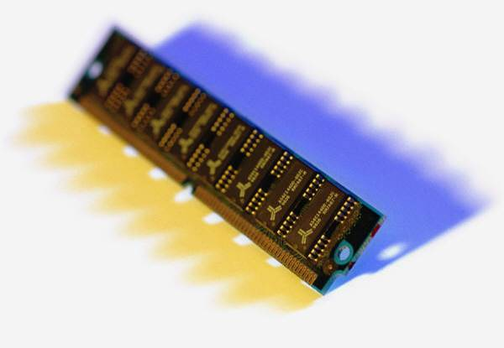

Speech recognition hardware
DAC
(Digital to Analog Converter)
ADC
(analog-to-digital conversion system)
Speech
Recording
System
Or

Slide 7
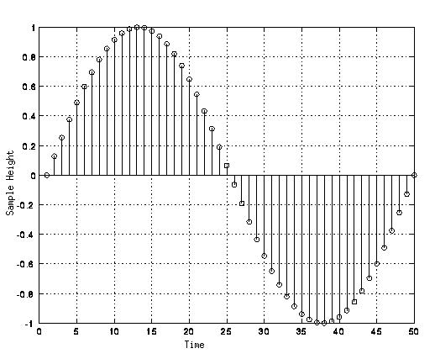
Sampling example
16-bit
Voltage or pressure range
  0->(2¹⁶-1)=65535) digitized levels
Time in ms
Sampling is at 1KHz
Voltage
or pressure
65535
0
Time in ms
www.webkinesia.com/games/images/quant.gif

Slide 8

Conversion time and sampling time
  Human listening range (frequency) from 20Hz to 20KHz,
  Sampling frequency (freq.) must double or higher than the highest freq. (sampling theory). So, sampling for Hi-Fi music > 40KHz.
  74 minutes CD music, 44.1KHz sampling 16-bit sound=44.1KHz*2bytes*2channels*60seconds*70min.=783,216,000 bytes (747~ MB). (see http://en.wikipedia.org/wiki/CD-ROM)
  Compromise: telephone quality sound is 8KHz 8-bit sampling – still ok for human speech.

Slide 9
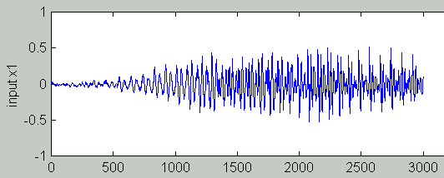
A speech wave
Time samples

Slide 10
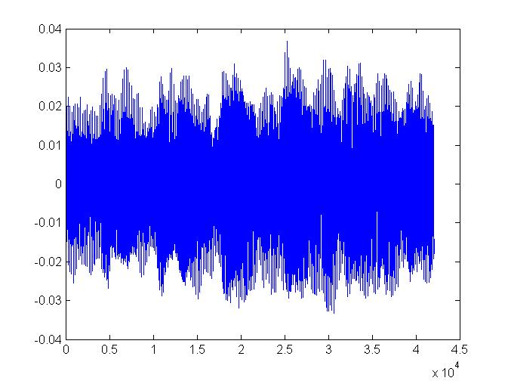
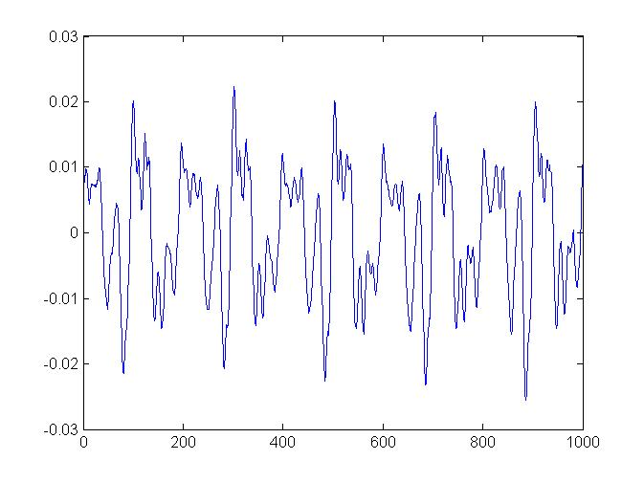
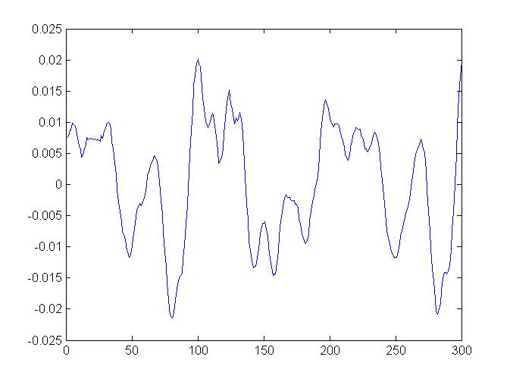
Music wave: violin3.wav (repeated 6 times for demo purposes)
(http://www.youtube.com/watch?v=xdMX5D99xgU&feature=youtu.be)
Sampling Frequency=FS=44100 Hz ( 42070 samples)
How long is the play time?
Answer:(1/44100)*42070
=0.954 seconds
All 42070 samples
Zoom in to see 1000 samples
Zoom in to see 300 samples

Slide 11

Class exercise 1.1
For a single channel 20KHz, 16-bit sampling signal, how many bytes are used in 5 seconds?
Use your phone to can this code and give your answer
Multiple choices:
1) 100Kbytes
2) 150Kbytes
3) 200Kbytes
4) 250Kbytes

Slide 12
Answer: Class exercise 1.1
For a single channel 20KHz, 16-bit sampling signal, how many bytes are used in 5 seconds?
Answer: 20KHz*2bytes*5 seconds=200Kbytes.
Multiple choices:
1) 100Kbytes
2) 150Kbytes
3) 200Kbytes (correct choice is 3)
4) 250Kbytes

Slide 13
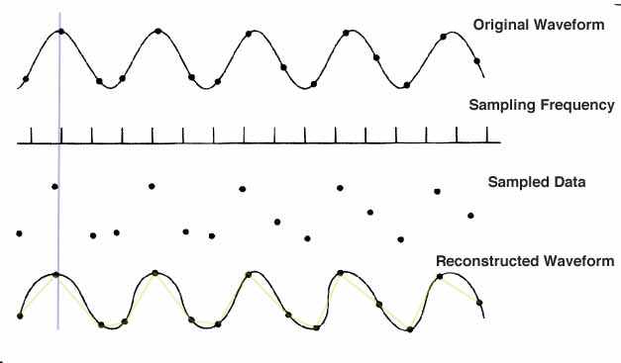
Sampling and reconstruction
https://edocs.uis.edu/jduva1/www/courses/455/sampling.jpg
(2¹⁶-)-1= 65535
0
time
After sampling you only have the data points
You may reconstruct the signal by joining the data points

Slide 14
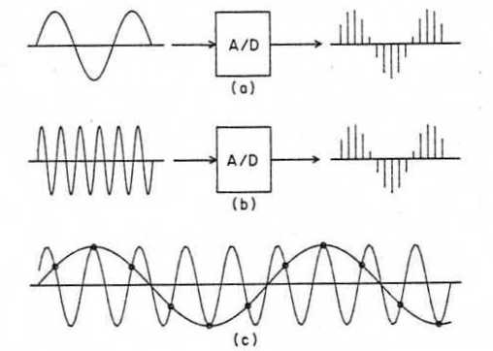
Hardware for speech recognition setup
Speech is captured by a microphone , e.g.
Sampled periodically ( 16KHz) by an analogue-to-digital converter (ADC)
Each sample converted is a 16-bit data.
Tutorial: For a 16KHz/16-bit sampling signal, how many bytes are used in 1 second. (=32Kbytes)
If sampling is too slow, sampling may fail , see
http://www.ras.ucalgary.ca/grad_project_2005/asph_sampling.jpg
Sampling theorem for a signal X: The sampling frequency must be higher or equal to double the highest frequency in the signal X.
E.g.
If the highest frequency in a signal is 16K Hz, sampling frequency is 32 KHz or higher.
If the highest frequency in a signal is 20K Hz, sampling frequency is 40 KHz or higher.

Slide 15
Exercise 1.2a,b
(Q1.2a) If the sampling rate of the analog-to-digital conversion system is 20KHz , how large is the frequency of the sound that that can be sampled? MC choices:
1) 5KHz
2) 10KHz
3) 15KHz
4) 20KHz
(Q1.2b) If the sound is 20KHz, what is the minimum sampling rate of the analog-to-digital conversion system? ? MC choices:
1) 20KHz
2) 30KHz
3) 40KHz
4) 50KHz

Slide 16
Answer: Exercise 1.2 a,b
If the sampling rate of the analog-to-digital conversion system is 20KHz , how large is the frequency of the sound that that can be sampled?
Answer: 20/2=10KH
1) 5KHz
2) 10KHz (correct choice is 2)
3) 15KHz
4) 20KHz
If the sound is 20KHz, what is the minimum sampling rate of the analog-to-digital conversion system?
Answer: 20x2=40KHz
1) 20KHz
2) 30KHz
3) 40KHz (correct choice is 3)
4) 50KHz

Slide 17
Discussion: Conversion resolution
Music
  44.1KHz , 16-bit is very good.
  Higher specifications may be used : e.g., 96 KHz sampling 24-bit
  Compression: MP3,etc can compress data
Speech
  20KHz sampling 16-bit is good enough.

Slide 18
Class exercise 1.3a, b
(Q 1.3) A sound is sampled at 22-KHz and resolution is 16 bit.
(a) How many bytes are needed to store the sound wave for 10 seconds? MC choices:
1) 110 KHz
2) 220 KHz
3) 330 KHz
4) 440 KHz
(b) What is the highest frequency allowed in the sound signal?
1) 11 KHz
2) 22 KHz
3) 33 KHz
4) 44 KHz

Slide 19
Answer: Class exercise 1.3a,b
(Q1.3) A sound is sampled at 22-KHz and resolution is 16 bit.
(a) How many bytes are needed to store the sound wave for 10 seconds?
Answer:
  One second has 22K samples , so for 10 seconds: 22K x 2bytes x 10 seconds =440K bytes
  *note: 2 bytes are used because 16-bit = 2 bytes
1) 110 KHz
2) 220 KHz
3) 330 KHz
4) 440 KHz (correct choice is 4)
(b) What is the highest frequency allowed in the sound signal?
  ANS: 11KHz because the sampling frequency is 22KHz, so the signal cannot be higher than 22KHz/2=11KHz.
1) 11 KHz (correct choice is 1)
2) 22 KHz
3) 33 KHz
4) 44 KHz

Slide 20
Signal analysis
spectrum

Slide 21
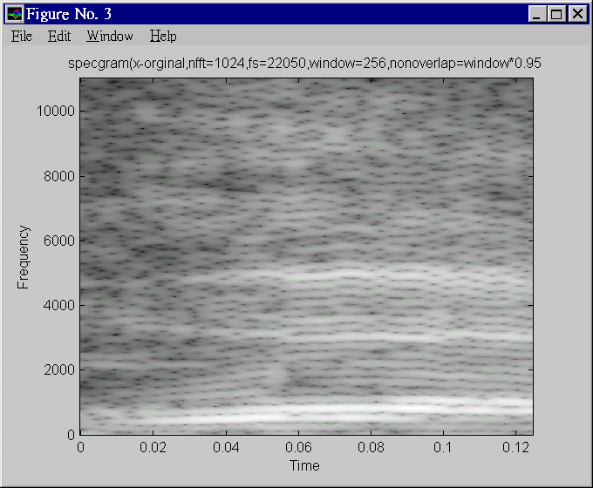
Can we see speech?
Pressure
/output
of mic
Time domain signal
Yes, using spectrogram.
The “time domain signal” shows the amplitude of air-pressure against time.
The “spectrogram” shows the energies of the frequency contents against time.
time
Freq.
Spectrogram
Spectrogram
(matlab function
spectrogram.m)
Time

Slide 22
Basic Phonetics
Phonemes are symbols to show how a word is pronounced.
Phonemes
Consonants
-Nasals /M/
-stops /B/,/P/
-fricative /V/,/S/
-whisper /H/
-affricates /JH/,/CH/
Vowel
/AA/,/I/,/UH/
Diphthongs
/AY/,/AW/

Slide 23
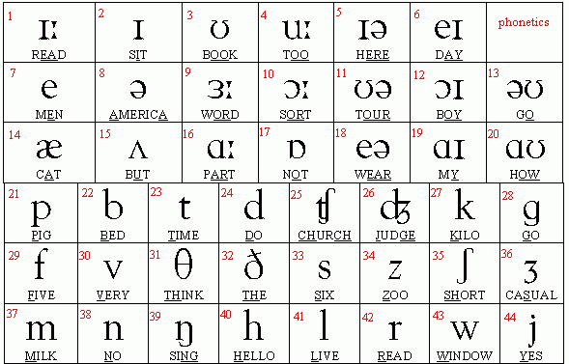
Phonetic table
http://www.telefonica.net/web2/eseducativa/phonetics/tablea.gif

Slide 24
Special features for Cantonese phonetics 廣東話
Each word is combined by an Initial (consonant 聲母) and a final (vowel 韵母); entering tone (入聲) are ended by /p/, /t/ or /k/
Nine tones(九聲):
  lower-flat(陽平),lower-rising(陽上),lower-go(陽去)
  higher-flat(陰平),higher-rising(陰上),higher-go (陰上)
  Entering (入聲) : ended by /p/, /t/ or /k/

Slide 25
Summary of part1
Studied
  Basic digital audio recording systems
  Speech recognition system applications and classifications

Slide 26
Part. 2 : Preprocessing of audio signals in time and frequency domain
Time framing (frame blocking)
Frequency model
Fourier transform
Spectrogram

Slide 27
Revision: Raw data and PCM
Human listening range 20Hz → 20K Hz
CD Hi-Fi quality music: 44.1KHz (sampling) 16bit
People can understand human speech sampled at 5KHz, e.g., Telephone quality speech can be sampled at 8KHz using 8-bit data.
Speech recognition systems normally use: 10→16KHz,12→16 bit.

Slide 28
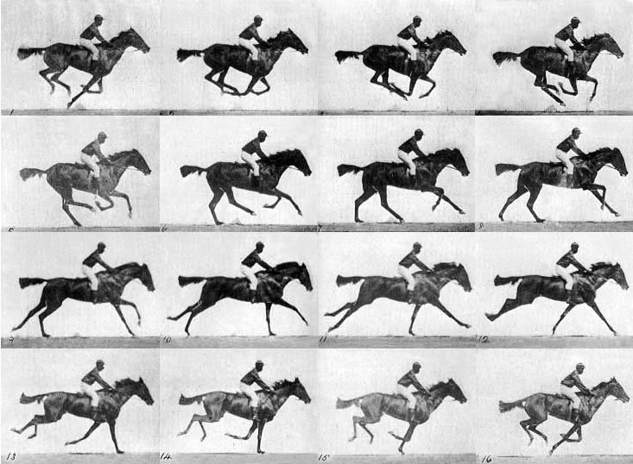
Concept: Human perceives data in blocks
We see 24 still pictures in one second, then
we can build up the motion perception in our brain.
It is likewise for speech.
Source: http://antoniopo.files.wordpress.com/2011/03/eadweard_muybridge_horse.jpg?w=733&h=538

Slide 29

Time framing ( or frame blocking)
Since our ear cannot response to very fast change of speech data content, we normally cut the speech data into frames before analysis. (similar to watch fast changing still pictures to perceive motion )
Frame size is 10~30ms (1ms=10⁻³ seconds)
Frames can be overlapped, normally the overlapping region ranges from 0 to 75% of the frame size .
Time framing Video demo: https://youtu.be/lOu-c2UHU00

Slide 30
Time framing (or Frame blocking) and Windowing
To choose the frame size (N samples )and adjacent frames separated by m samples (non-overlap samples).
I.e. a 16KHz sampling signal, a 10ms window has N=160 samples, (non-overlap samples, or hop_length , or hop_size= m=40 samples)
l=2 (second window), length = N
s_{k}
N
k
m
time
N
l=1 (first window), length = N

Slide 31
Tutorial for frame blocking
A signal is sampled at 12KHz, the frame size is chosen to be 20ms and adjacent frames are separated by m=5ms. Calculate N (Frame size) and m (hop_length) and draw the frame blocking diagram.(ans: N=duration/time between 2 samples=
20ms/(1/12K)=(20*10^-3)
---------------
(1/12*10^3)
N=20*12=240, similarly we can find m=60.
Repeat above when adjacent frames do not overlap.(ans: N=240, m=240.)

Slide 32
Class exercise 2.1
For a 22-KHz/16 bit sampling speech wave, frame size is 15 ms and frame overlapping period is 40 % of the frame size. Find the number of samples (N) in one frame. MC choices:
1) 110
2) 220
3) 330
4) 440
Draw the frame blocking diagram (student exercise).

Slide 33
Answer: Class exercise 2.1
For a 22-KHz/16 bit sampling speech wave, frame size is 15 ms and frame overlapping period is 40 % of the frame size. Find the number of samples (N) in one frame. Draw the frame block diagram.
Answer: Number of samples in one frame (N)= 15 ms / (1/22K)
= 15*(10^-3) /(1/(22000))=330
1) 110; 2) 220; 3) 330 (correct choice is 3); 4) 440, (answer N=33)
Overlapping samples = 330*40%=132, m=N - overlap samples=330-132=198.
Overlapping time = 132 * (1/22k)= 132 * (1/22000) =6ms;
Time in one frame= 330* (1/22k)= 330* (1/22000)=15ms.
The frame block diagram.
l=2 (second window), length = N=330
s_{k}
N
k
m=132
time
N
l=1 (first window), length = N

Slide 34
The frequency model
For a frame we can calculate its frequency content by Fourier Transform (FT)
Computationally, you may use Discrete-FT (DFT) or Fast-FT (FFT) algorithms. FFT is popular because it is more efficient.
FFT algorithms can be found in most numerical method textbooks/web pages.
E.g. http://en.wikipedia.org/wiki/Fast_Fourier_transform

Slide 35
A time domain signal of N samples
s=
Signal
level
s_{k=2}
s_{k=1}
s_{k=0}
k=0 1 2….
Time k
N-1
End of the signal
Beginning of the signal

Slide 36
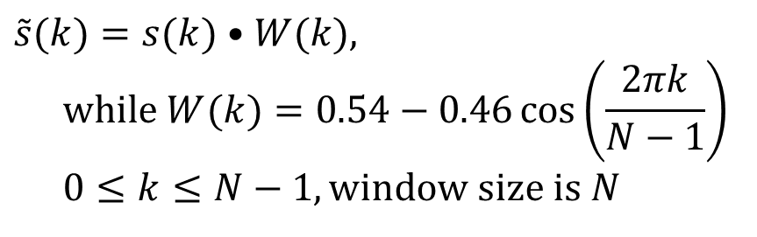
Windowing
This is to smooth out the discontinuities at the beginning and end. Otherwise, sudden change of signal level will result into high frequency noise at the frequency domain after Fourier transform
Hamming or Hanning windows can be used.
Hamming window
Tutorial: write a program segment to find the result of passing a speech frame, stored in an array int s[1000] into the Hamming window.
$$\tilde{s}(k)=s(k)•W(k), \\ \text{while} W(k)=0.54−0.46\cos\left(\frac{2πk}{N−1}\right) \\ 0≤k≤N−1,\text{window} \text{size} \text{is} N$$

Slide 37
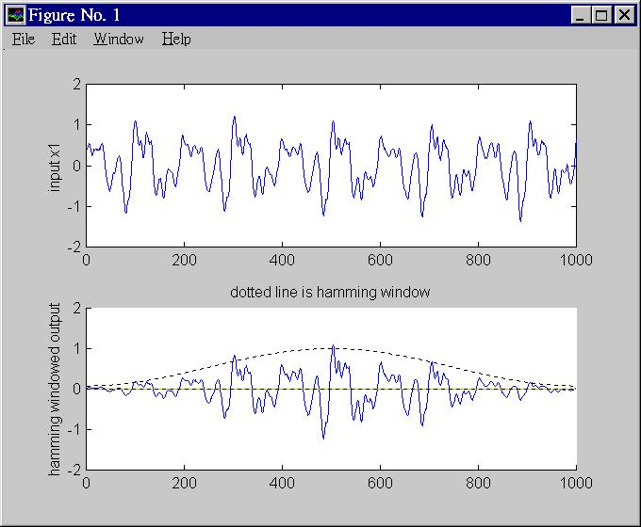
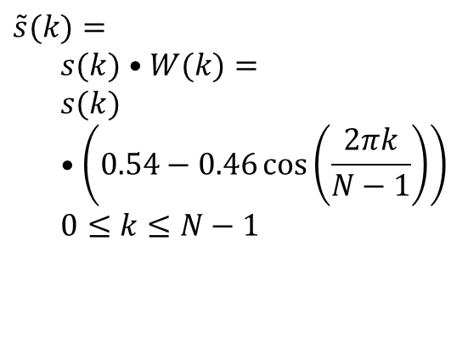
Effect of Hamming window
(For Hanning window See http://en.wikipedia.org/wiki/Window_function )
Original signal s(k)
$$\tilde{s}(k)= \\ s(k)•W(k)= \\ s(k)•\left(0.54−0.46\cos\left(\frac{2πk}{N−1}\right)\right) \\ 0≤k≤N−1$$
Signal after hamming window operation
Beginning of the signal frame
End of the signal frame

Slide 38
Matlab code segment
s1=wavread('violin3.wav');
for k=1:N
hamming_window(k)=
abs(0.54-0.46*cos(k*(2*pi/N)));
s_hat1(k)=hamming_window(k)*s1(k);
end

Slide 39
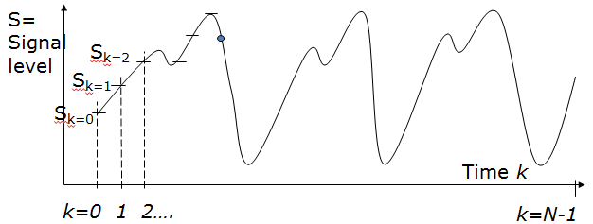


The Fourier Transform FT method
(Assume Signal S_{k} is already smoothed by a hamming window to simplify the discussion)
Forward Transform (FT) of N samples: $X_{m}$ =$FT$($s_{k}$)
$X_{m=0,1.,N−1}(\text{com}\text{plex} numbers)= FT \{ s_{k=0,1,2..,N−1}(\text{real} \text{numbers})\}$, the equation is
$$X_{m}=\sum_{k=0}^{N−1}{s_{k}e^{−j\left(\frac{2πkm}{N}\right)}},m=0,1,2,3,...,N−1,\text{and} e^{jθ}=\cos{(}θ)+j\sin{(}θ),j=\sqrt{−1} \\ \text{Input} (\text{is} \text{in} \text{time} \text{domain}) =s_{k=0,1,2,..N−1}=s_{0,}s_{1,}s_{2,}...,s_{N−1,}( \text{total} \text{N} \text{samples}) \\ \text{Output} (is in \text{Frequency} \text{domain}) \text{after} FT=X_{m=0,}X_{m=1,}X_{m=2,},..,X_{m=N−1,} \text{which} \\ \text{are} (N) \text{complex} \text{numbers}$$
$X_{m}={\left\|X_{m}\right\|}_{2}e^{jθ_{m}}\text{,}\text{so} X_{m} \text{is} \text{complex}$. ${\left\|\right\|}_{2}=$Euclidean norm, or 2-norm, i.e.
$$\text{If} Z=(z_{1},z_{2},..,x_{n}),\text{then} {\left\|Z\right\|}_{2}=\sqrt{z_{1}^{2}+z_{2}^{2}+...+z_{n}^{2}}$$
Demo Matlab code:
demo_dft_tutorial.rar
https://ww2.mathworks.cn/matlabcentral/fileexchange/77789-discrete-fourier-transform

Slide 40

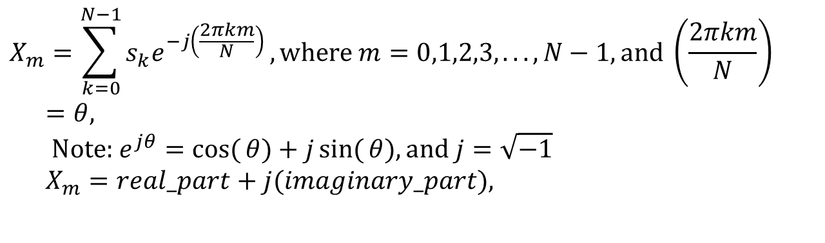
Fourier Transform
From time domain to frequency domain
$$X_{m}=\sum_{k=0}^{N−1}{s_{k}e^{−j\left(\frac{2πkm}{N}\right)}},\text{where} m=0,1,2,3,...,N−1,\text{and} \left(\frac{2πkm}{N}\right)=θ, \\ \text{Note}\text{: }e^{jθ}=\cos{(}θ)+j\sin{(}θ),\text{and} j=\sqrt{−1} \\ X_{m}=real_part+j(imaginary_part),$$
Power=||X_{m}||₂²= (real²+imginary²)
Signal
voltage/
pressure
level
single freq..
Fourier Transform
Time
S₀,S₁,S₂,S_{3.} … S_{N-1}
freq. (m)
This curve is called spectral envelop
Demo Matlab code: demo_dft_tutorial.rar
Demo Video

Slide 41

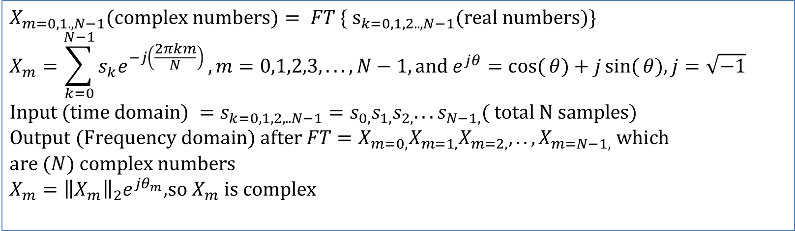
Example
$$X_{m}=\sum_{k=0}^{N−1}{s_{k}e^{−j\left(\frac{2πkm}{N}\right)}}$$
[s0,s1,s2,…]=[1 ,3 ,4,…], N=128, m=0,…,127
X_{m=0}=1*e^{-j(2*pi*0*0/128)}+3*e^{-j(2*pi*1*0/128)}+4*e^{-j(2*pi*2*0/128)} +..
X_{m=1}=1*e^{-j(2*pi*0*1/128)}+3*e^{-j(2*pi*1*1/128)}+4*e^{-j(2*pi*2*1/128)} +..
X_{m=2}=1*e^{-j(2*pi*0*2/128)}+3*e^{-j(2*pi*1*2/128)}+4*e^{-j(2*pi*2*2/128)} +..
$$X_{m=0,1.,N−1}(\text{complex} \text{numbers})= FT \{ {\text{s}}_{k=0,1,2..,N−1}(\text{real} \text{numbers})\} \\ X_{m}=\sum_{k=0}^{N−1}{s_{k}e^{−j\left(\frac{2πkm}{N}\right)}},m=0,1,2,3,...,N−1,\text{and} e^{jθ}=\cos{(}θ)+j\sin{(}θ),j=\sqrt{−1} \\ \text{Input} (\text{time} \text{domain}) =s_{k=0,1,2,..N−1}=s_{0,}s_{1,}s_{2,}...s_{N−1,}( \text{total} \text{N} \text{samples}) \\ \text{Output} (\text{Frequency} \text{domain}) \text{after} FT=X_{m=0,}X_{m=1,}X_{m=2,},..,X_{m=N−1,} \text{which} \\ \text{are} (N) \text{complex} \text{numbers} \\ X_{m}={\left\|X_{m}\right\|}_{2}e^{jθ_{m}}\text{,}\text{so} X_{m} \text{is} \text{complex}$$

Slide 42

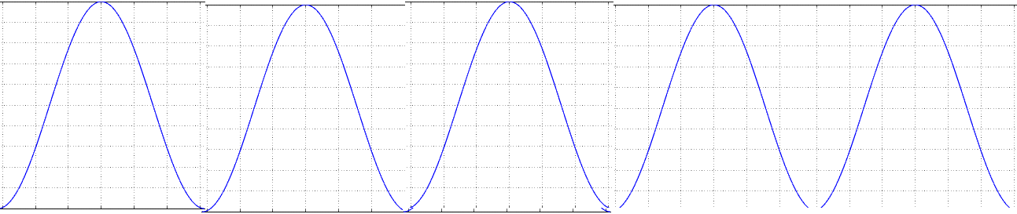

Examples of FT (Pure wave vs. speech wave)
s_{k}
$${{\left\|X_{m}\right\|}_{2}}^{2}$$
pure cosine has one frequency band
FT
single freq..
time(k)
freq.. (m)
complex speech wave
has many different frequency bands
$${{\left\|X_{m}\right\|}_{2}}^{2}$$
s_{k}
single freq..
time(k)
In time domain
freq. (m)
Spectral envelop
In frequency domain
http://math.stackexchange.com/questions/1002/fourier-transform-for-dummies
DFT and Inverse: DFT https://www.mathworks.com/matlabcentral/fileexchange/41228-dft-and-idft/content/Untitled3.m

Slide 43


Discrete Fourier transform DFT and
Inverse Discrete Fourier transform IDFT
https://en.wikipedia.org/wiki/Discrete_Fourier_transform
Matlab code:
https://www.mathworks.com/matlabcentral/fileexchange/41228-dft-and-idft/content/Untitled3.m
$$\text{Fourier} \text{Transform} \\ X_{m}=\sum_{k=0}^{N−1}{s_{k}⋅e^{−i\frac{2πkm}{N}}}=\sum_{k=0}^{N−1}{s_{k}⋅\left(\cos\left(\frac{2πkm}{N}\right)−i\sin\left(\frac{2πkm}{N}\right)\right)} \\ \text{Inverse} \text{Fourier} \text{Transform} \\ s_{k}=\frac{1}{N}\sum_{m=0}^{N−1}{X_{m}⋅e^{i\frac{2πkm}{N}}}=\frac{1}{N}\sum_{m=0}^{N−1}{X_{m}⋅\left(\cos\left(\frac{2πkm}{N}\right)+i\sin\left(\frac{2πkm}{N}\right)\right)}$$
$$\text{Note}\text{: } \\ e^{jθ}=\cos{(}θ)+j\sin{(}θ), \\ \sin{(}−θ)=−\sin{(}θ), \\ \cos{(}−θ)=\cos{(}θ)$$
N=number of time samples
k=time index of the current sample , it is from 0 to N-1
s_{k}=value of the signal sample at time k
m=frequency index (from 0 Hz to N-1 Hz)
X_{m}= amount of frequency m in the signal of all s_{k}
Notes:
\begin{equation}\label{eq3_FOURIER}
\begin{split}
&X_m=\sum_{k=0}^{N-1}s_k \cdot e^{-i \frac{s\pi k m}{N}}=\sum_{k=0}^{N-1} s_k \cdot
\left( cos \left(- \frac {2 \pi k m} {N} \right)
+i \cdot sin \left(- \frac {2 \pi k m} {N} \right)
\right) \\
%
&s_m=\frac{1}{N} \sum_{k=0}^{N-1}X_m \cdot e^{-i \frac{s\pi k m}{N}}=\frac{1}{N} \sum_{k=0}^{N-1} X_m \cdot
\left( cos \left( \frac {2 \pi k m} {N} \right)
+i \cdot sin \left( \frac {2 \pi k m} {N} \right)
\right)
\end{split}
\end{equation}Where,\\
$N$=number of time samples\\
$k$=time index of the current sample , it is from 0 to $N-1$\\
$s_k$=value of the signal sample at time $k$\\
$m$=frequency index (from 0 Hz to $N-1$ Hz)\\
$X_m$= amount of frequency m in the signal of all s$_k$

Slide 44

Use of short term Fourier Transform
(Fourier Transform of a frame)
Power spectrum envelope is a plot of the energy Vs frequency.
FFT video demo: https://youtu.be/EuX2uKZSd40
Time domain signal
of a frame
DFT or FFT
Frequency
domain output
Amplitude x_{k}
time domain signal
of a frame
Energy=||X_{m}||₂²
Spectral envelop
0
Fourier
Transform
First formant
Second formant
N-1
Time index k
freq.index m.
1KHz
2KHz

Slide 45
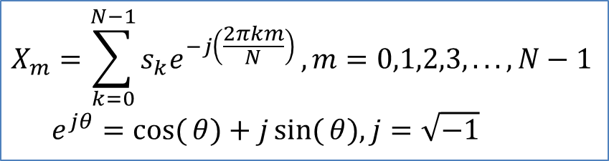
Exercise 2.2a,b: Fourier Transform
For (m=0;m<=Unknown1;m++)
{
  tmp_real=0; tmp_img=0;
  For(k=0;k<= Unknown2;k++)
  { tmp_real=tmp_real+S_{k}*cos(2*pi*k*m/N);
  tmp_img=tmp_img-S_{k}*sin(2*pi*k*m/N);
  }
  X_real(m)=tmp_real;
  X_img(m)=tmp_img;
}
%E.g. s_{k}=s₀,s₁,..,s₅₁₁ → X_real₀,X_real₁,..,X_real_{511,} X_imgl₀,X_img₁,..,X_img_{511,}
%Note that:
X_magnitude(m)= sqrt[(X_real(m))²+ (X_img(m))²]
The pseudo code for Fourier transform from S to X(real) IX (imaginary) is shown.
Int s[256] input in frequency domain
Output :float X[256] (real) , and float IX[256] (imaginary).
Student exercise: How to generate a spectrogram?
(a) MC choices: Unknown1=
1) N-1
2) N
3) N+1
(b) MC choices: Unknown2=
1) N-1
2) N
3) N+1
$$X_{m}=\sum_{k=0}^{N−1}{s_{k}e^{−j\left(\frac{2πkm}{N}\right)}},m=0,1,2,3,...,N−1 \\ e^{jθ}=\cos{(}θ)+j\sin{(}θ),j=\sqrt{−1}$$

Slide 46
Answer exercise 2.2: Fourier Transform
http://en.wikipedia.org/wiki/List_of_trigonometric_identities
For (m=0;m<=N-1;m++)
{
  tmp_real=0; tmp_img=0;
  For(k=0;k<=N-1;k++)
  {
    tmp_real=tmp_real+S_{k}*cos(2*pi*k*m/N);
    tmp_img=tmp_img-S_{k}*sin(2*pi*k*m/N);
  }
  X_real(m)=tmp_real;
  X_img(m)=tmp_img;
}
E.g. s_{k}=s₀,s₁,..,s₅₁₁ → X_real₀,X_real₁,..,X_real_{511,} X_imgl₀,X_img₁,..,X_img_{511,}
Note that X_magnitude(m)= sqrt[(X_real(m))²+ (X_img(m))²]
(a) MC choices: Unknown1=
1) N-1 (correct choice is 1)
2) N
3) N+1
(b) MC choices: Unknown2=
1) N-1 (correct choice is 1)
2) N
3) N+1

Slide 47
Appendix
%demo_ch2_dft_using_exp_sin_cos.m
%Matlab program for DFT/IDFT without using the inbuilt functions
%demo_ch2_dft_using_exp_sin_cos.m
%Matlab program for DFT/IDFT without using the inbuilt functions
%http://newlinecode.blogspot.com/2013/02/dft-idft-without-using-function-matlab.html
%this to show how to code discrete Fourier forward/inverse (2020 Sept 10)
% It shows using exp() and cos()+sin() functions generate the same result
%program to find the DFT/IDFT of a sequence without using the inbuilt functions
close all;
clear all;
%xn=input('Enter the sequence x(n)'); %Get the sequence from user
xn=[8,16,24,32,40,48,56,64]
ln=length(xn); %find the length of the sequence
xk=zeros(1,ln); %initialize an array of same size as that of input sequence
xk2=zeros(1,ln); %initialize an array of same size as that of input sequence
ixk=zeros(1,ln); %initialize an array of same size as that of input sequence
ixk2=zeros(1,ln); %initialize an array of same size as that of input sequence
%code block to find the DFT of the sequence
i=sqrt(-1);
%-----------------------------------------------------------
for k=0:ln-1
for n=0:ln-1
xk(k+1)=xk(k+1)+(xn(n+1)*exp((-i)*2*pi*k*n/ln));
xk2(k+1)=xk2(k+1)+(xn(n+1)*( cos(2*pi*k*n/ln) - i*sin(2*pi*k*n/ln) ) );
%this is to show xk and xk2 are exactly teh same, see result at the
%end of this code
end
end
%------------------------------------------------------------
%code block to plot the input sequence
%------------------------------------------------------------
t=0:ln-1;
subplot(221);
stem(t,xn);
ylabel ('Amplitude');
xlabel ('Time Index');
%---------------------------------------------------------------
magnitude=abs(xk) % Find the magnitudes of individual DFT points
%code block to plot the magnitude response
%------------------------------------------------------------
t=0:ln-1;
subplot(222);
stem(t,magnitude);
ylabel ('Amplitude');
xlabel ('K');
%------------------------------------------------------------
phase=angle(xk); % Find the phases of individual DFT points
%code block to plot the magnitude sequence
%------------------------------------------------------------
t=0:ln-1;
subplot(223);
stem(t,phase);
ylabel ('Phase');
xlabel ('K');
%------------------------------------------------------------
% Code block to find the IDFT of the sequence
%-------------------------inverse transform -----------------------------------
for n=0:ln-1
for k=0:ln-1
ixk(n+1)=ixk(n+1)+(xk(k+1)*exp(i*2*pi*k*n/ln));
ixk2(n+1)=ixk2(n+1)+(xk2(k+1)*(cos((2*pi*k*n/ln)) + i* sin(2*pi*k*n/ln)));
end
end
ixk=ixk./ln;
ixk2=ixk2./ln;
%----------------------------------------------------------
%code block to plot the input sequence
%------------------------------------------------------------
t=0:ln-1;
subplot(224);
stem(t,ixk);
ylabel ('Amplitude');
xlabel ('Time Index');
%%%%%%%%%%%%%%%%%%%%%%%
'number of samples'
ln
'results'
'source input ='
xn
'xk frequency is calculated by exp(), xk2 frequency is calculated by sin()_cos(),'
'It shows they are the same'
xk
xk2
xk-xk2
'hit key to continue'
pause
%
ixk %recovered xn by using exp() function
ixk2%recovered xn by using sin(),cos() functions
%magnitude=abs(ixk)
magnitude=abs(ixk)
magnitude2=abs(ixk2)
ixk-ixk2
disp('the result shows ixk and ixk2 are the same: ')
disp('magnitude=abs(ixk) , ixk :recovered xn by using exp() function')
disp('magnitude2=abs(ixk2) , ixk2: recovered xn by using sin(),cos() functions')

Slide 48
The spectrogram: to see the spectral envelope as time moves forward
It is a visualization method (tool) to look at the frequency content of a signal.
Parameter setting: (1)Window size = N=(e.g. 512)= number of time samples for each Fourier Transform processing. (2) non-overlapping sample size D . (3) frame index is j.
t is an integer, initialize t=0, j=0. X-axis = time, Y-axis = freq.
Step1: FT samples s_{t+j*D} to s_{t+512+j*D}
Step2: plot FT result (freq v.s. energy) spectral envelope vertically using different gray scale.
Step3: j=j+1
Repeat Step1,2,3 until j*D+t+512 >length of the input signal.

Slide 49
A specgram
Specgram: The white bands are the formants which represent high energy frequency contents of the speech signal

Slide 50
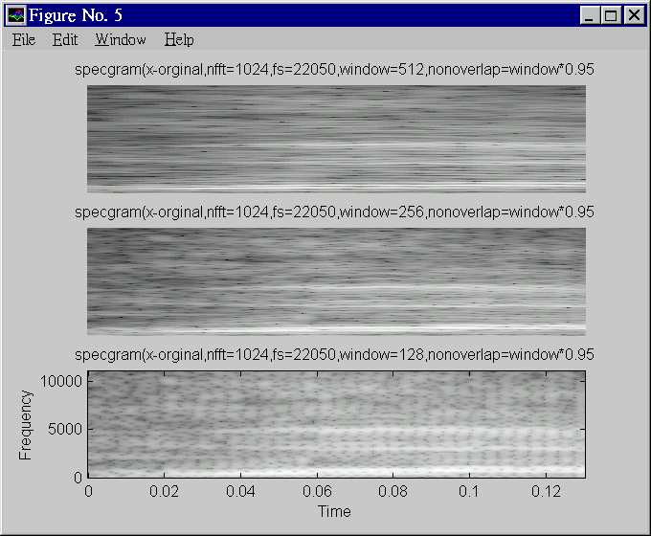
Freq.
Better frequency resolution
Freq.
Better time. resolution

Slide 51
How to generate a spectrogram?

Slide 52
Procedures to generate a spectrogram (Specgram1)
Window=256-> each frame has 256 samples
Sampling is fs=22050, so maximum frequency is 22050/2=11025 Hz
Nonverlap =window*0.95=256*.95=243 , overlap is small (overlapping =256-243=13 samples)
|X(128)|
For each frame (256 samples)
Find the magnitude of Fourier
X_magnitude(m), m=0,1,2, 128
Plot X_magnitude(m)=
Vertically,
-m is the vertical axis
-|X(m)|=X_magnitude(m) is
represented by intensity
Repeat above for all frames
q=1,2,..Q
|X(i)|
|X(0)|
Frame q=Q
Frame q=1
frame q=2

Slide 53
Class exercise 2.3a,b,c,d.
In specgram1 , calculate the first sample location and last sample location of the frames q=3 and 7. Note: N=256, m=243 (non-overlapped samples).
  q=1, frame starts at sample index =? MC:(1) 0; (2)1; (3); (4)3
  q=1, frame ends at sample index =? MC:(1) 252; (2)253 (3)254; (4)255
  q=2, frame starts at sample index =? MC:(1) 241; (2)242; (3)243; (4)244
  q=2, frame ends at sample index =? MC:(1) 496; (2)497; (3)498; (4)499.
  Student exercises:
  q=3, frame starts at sample index =? q=3, frame ends at sample index =?
  q=7, frame starts at sample index =?
  q=7, frame ends at sample index =?

Slide 54
Answer: Class exercise 2.3: In specgram1 (updated)
In specgram1 , calculate the first sample location and last sample location of the frames q=3 and 7. Note: N=256, m=243 (non-overlapped samples).
  q=1, frame starts at sample index =? MC:(1) 0; (2)1; (3); (4)3 .(correct choice is 1)
  q=1, frame ends at sample index =? MC:(1) 252; (2)253 (3)254; (4)255. (correct choice is 4)
  q=2, frame starts at sample index =? MC:(1) 241; (2)242; (3)243; (4)244. (correct choice is 3)
  q=2, frame ends at sample index =? MC:(1) 496; (2)497; (3)498; (4)499. (correct choice is 3)
  Calculation details
    q=1, frame starts at sample index =0
    q=1, frame ends at sample index =255
    q=2, frame starts at sample index =0+243=243 (so the gap between the q=1 frame and q=2 frame is 243)
    q=2, frame ends at sample index =243+(N-1)=243+255=498 (so q=2 frame has 256 samples)
    q=3, frame starts at sample index =0+243+243=486
    q=3, frame ends at sample index =486+(N-1)=486+255=741
    q=7, frame starts at sample index =243*6=1458
    q=7, frame ends at sample index =1458+(N-1)=1458+255=1713

Slide 55
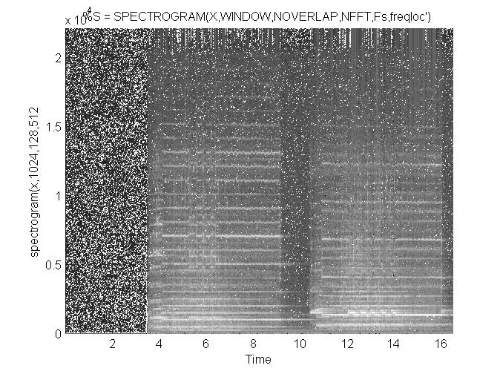
Spectrogram plots of some music sounds sound file is tz1.wav
Matlab Code:
demo_spectrogram_release16.rar
High
energy
Bands:
Formants
seconds

Slide 56
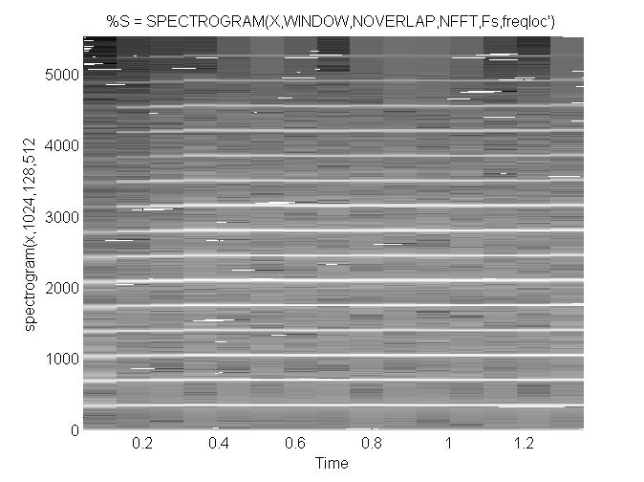
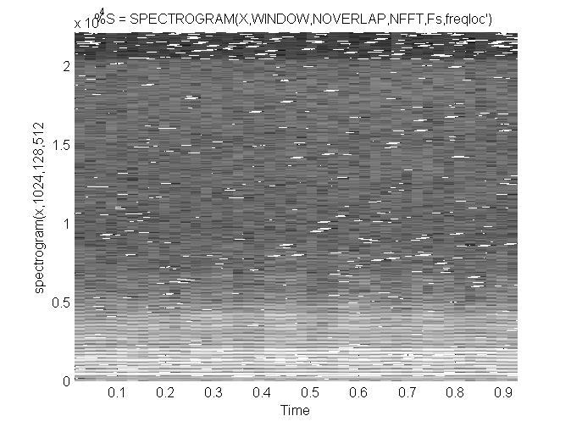
spectrogram plots of some music sounds
http://www.cse.cuhk.edu.hk/%7Ekhwong/www2/cmsc5707/tz1.wav
http://www.cse.cuhk.edu.hk/~khwong/www2/cmsc5707/trumpet.wav
http://www.cse.cuhk.edu.hk/%7Ekhwong/www2/cmsc5707/violin3.wav
Spectrogram of
Trumpet.wav
Spectrogram of
Violin3.wav
High
energy
Bands:
Formants
Violin has
complex
spectrum
seconds

Slide 57
Student exercise 2.4
Write the procedures for generating a spectrogram from a source signal X.

Slide 58
Answer: Exercise 2.4
Write the procedures for generating a spectrogram from a source signal X.
Answer: to be completed by students. No standard answer is given.

Slide 59
Summary of part2
Studied
  Basic digital audio recording systems
  Speech recognition system applications and classifications
  Fourier analysis and spectrogram

Slide 60
Appendix: Why in practical Discrete Fourier transform, the summation is from k=0 to k=N-1 , and m is ranging from 0 to N/2 but not N?
Since , Fourier frequency real-value outputs are mirrored around the vertical axis at 0, so using half are fine for calculating the energy during the calculation of the spectrum. It is only an engineering approach to save time. In fact, the real definition is using N sample for forward and inverse Fourier transform where all complex numbers are used.
The problem is actual very deep mathematically, i.e., how many samples should we use in forward and reverse transform. To get the best result, one should add more zeros to the original sequence (zero padding at the end of the sequence) to increase frequency resolution.
x = 1 2 4 6 5 4 3
>> fft(x), Columns 1 through 4
25.0000 + 0.0000i -7.5734 + 0.3479i -0.4620 + 1.7568i -0.9647 - 0.5410i
-0.9647 + 0.5410i -0.4620 - 1.7568i -7.5734 - 0.3479i
Antilasing Demo: https://www.youtube.com/watch?v=ByTsISFXUoY
https://www.youtube.com/watch?v=Fy9dJgGCWZI

Slide 61
Part. 3: Feature extraction from audio signals
We will study
Filtering
Mel scale
Linear predictive coding LPC
Cepstrum

Slide 62
(A) Filtering
Ways to find the spectral envelope
  Filter banks: uniform
  Filter banks can also be non-uniform
  LPC and Cepstral LPC parameters
Use Vector quantization method to represent data more efficiently
Spectral
envelop
energy
spectral
envelop
filter2
output
filter1
output
filter3
output
filter4
output
freq..

Slide 63
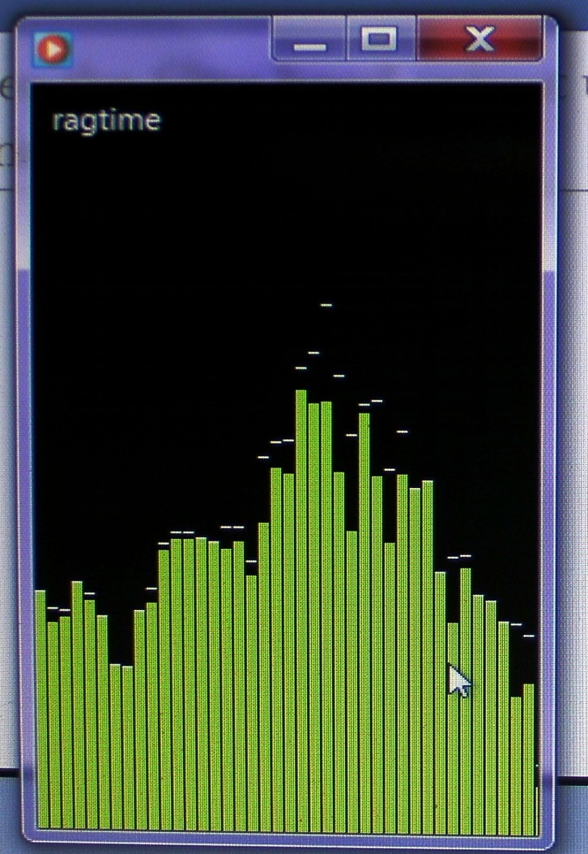
You can see the filter band output using windows-media-player for a frame
Try to look at it
Run
  windows-media-player
  To play music
  Right-click, select
    Visualization / bar and waves
    Video Demo
energy
Spectral envelop
Frequency

Slide 64
Speech recognition idea using 4 linear filters, each bandwidth is 2.5KHz
Two sounds with two Spectral Envelopes SE_{ar},SE_{ei} ,E.g. Spectral Envelop (SE) “ar”, Spectral envelop “ei”
Spectral envelope SE_{ar}=“ar”
Spectral envelope SE_{ei}=“ei”
energy
energy
Spectrum A
Spectrum B
Freq.
Freq.
0
0
10KHz
10KHz
filter 1 2 3 4
filter 1 2 3 4
Filter
out
Filter
out
v1 v2 v3 v4
w1 w2 w3 w4

Slide 65
Difference between two sounds (or spectral envelopes SE_{ar} , SE_{ei})

Slide 66
Filtering method
Example: For each frame (N=30 ms), a set of filter outputs will be calculated. (frame overlap 5ms), that is non-overlapping samples=hop_length=hop_size=N-5ms.
There are many different methods for setting the filter bandwidths -- uniform or non-uniform
Input waveform
Time frame i
Filter outputs (v1,v2,…)
30ms
Time frame i+1
Filter outputs (v’1,v’2,…)
30ms
Time frame i+2
Filter outputs (v’’1,v’’2,…)
30ms
5ms

Slide 67
How to determine filter band ranges
W2
The pervious example of using 4 linear filters is too simple and primitive.
We will discuss
  Uniform filter banks
  Non-uniform filter banks: Log frequency
  Mel filter bands

Slide 68
Uniform Filter Banks
Uniform filter banks
  bandwidth B= Sampling Freq... (Fs)/no. of banks (N)
  For example, Fs=10Kz, N=20 then B=500Hz
  Simple to implement. Experimental results show it is not too effective as features for speech recognition
V
Filter
output
v3
v1
v2
1
2
3
4
5
....
Q
...
freq..
500
1K
1.5K
2K
2.5K
3K
...
(Hz)

Slide 69
Non-uniform filter banks: Log frequency
Log. Freq... scale : close to human ear
Experimental results show it is also not too effective as features for speech recognition
V
Filter
output
v1
v2
v3
200
400
800
1600
3200
freq.. (Hz)

Slide 70
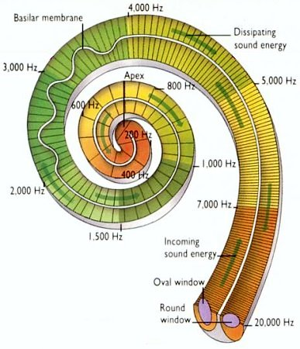
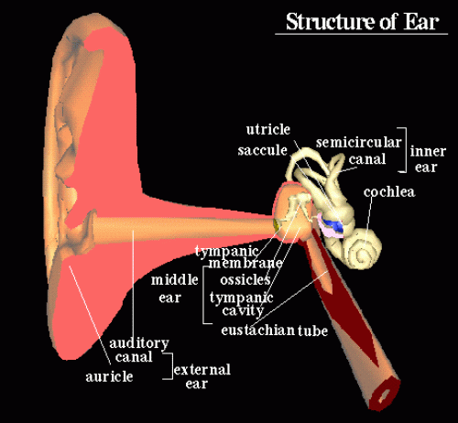
(B) Mel Scale:
Inner ear and the cochlea
(human also has filter bands)
Ear and cochlea
http://universe-review.ca/I10-85-cochlea2.jpg
http://www.edu.ipa.go.jp/chiyo/HuBEd/HTML1/en/3D/ear.html

Slide 71
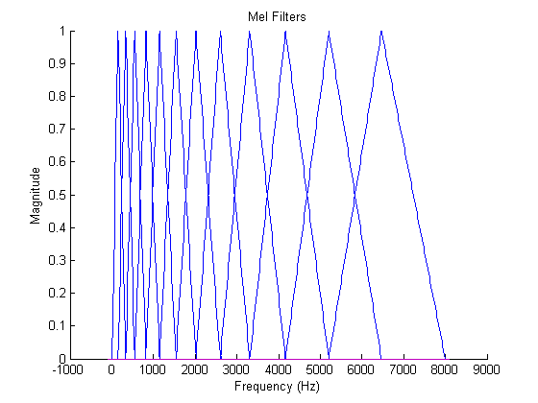
Mel filter bands (found by psychological and instrumentation experiments)
Freq. lower than 1 KHz has narrower bands (and in linear scale)
Higher frequencies have larger bands (and in log scale)
More filter below 1KHz
Less filters above 1KHz
Filter
output
Gain
Ear test:
https://www.youtube.com/watch?v=H-iCZElJ8m0&t=3s
Freq.
http://instruct1.cit.cornell.edu/courses/ece576/FinalProjects/f2008/pae26_jsc59/pae26_jsc59/images/melfilt.png

Slide 72
Mel scale (Melody scale)
From https://en.wikipedia.org/wiki/Mel_scale
Measure relative strength in perception of different frequencies.
The mel scale, named by Stevens, Volkmann, and Newman in 1937,[1] is a perceptual scale of pitches judged by listeners to be equal in distance from one another. The reference point between this scale and normal frequency measurement is defined by assigning a perceptual pitch of 1000 mels to a 1000 Hz tone, 40 dB above the listener's threshold. Above about 500 Hz, increasingly large intervals are judged by listeners to produce equal pitch increments. As a result, four octaves on the hertz scale above 500 Hz are judged to comprise about two octaves on the mel scale. The name mel comes from the word melody to indicate that the scale is based on pitch comparisons.
Note: Mel scale is not science, it is rather a result of empirical measurement done by psychologists. And engineers turn it into a formula. So, for practical use, apply the formula always for all range of frequencies, it is by all means an approximation, so, in the diagram , the freq. below 1KHz approximates a linear scale.).

Slide 73
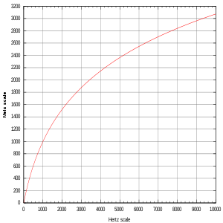
Critical band scale: Mel scale
Mel
Scale
(m)
Based on perceptual studies
  Log. scale when freq. is above 1KHz
  Approximate Linear scale when freq. is below 1KHz (this part of the line created by the following formula approximates a linear relation)
Popular scales are the “Mel” (stands for melody) or “Bark” scales
Δm=150
(f) Freq in hz
Δf=7000-6000
Below 1KHz, Δf≈Δm,approx. linear
Above 1KHz, Δf>Δm, log scale
http://en.wikipedia.org/wiki/Mel_scale

Slide 74
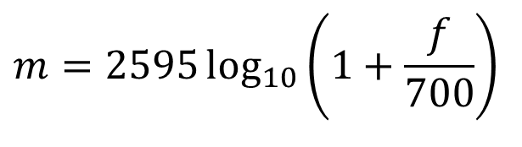
Exercise 3.1:
Mel
Scale
(m)
Note for students: For assignment and exam, use the formula shown on the right.
(a): When the input frequency f ranges from 200 to 800 Hz (Δf=600Hz), what is the delta Mel (Δm) in the Mel scale?
(b): When the input frequency ranges from 6000 to 7000 Hz (Δf=1000Hz), what is the delta Mel (Δm) in the Mel scale?
MC choices for (a) and (b):
1) 575.7
2) 570.7
3) 156.8
4) 150.8
Below 1KHz, Δf≈Δm, approx. Linear
Above 1KHz, Δf>Δm, log scale
$$m=2595\log_{10}\left(1+\frac{f}{700}\right)$$
m= Mel scale,
f = frequency in Hz
.

Slide 75
ANSWER 3.1
MC choices for (a) and (b):
1) 575.7; 2) 570.7;3) 156.8;4) 150.8
Answer(a):, f from 200 to 800 Hz, Δf =600 Hz
Δm =(2595* log_10(1+800/700))-(2595* log_10(1+200/700))
Δm =575.7 choice 1 is correct. , compared to Δf =600.
They are not the same but of the similar order because the input frequency is less than 1 KHz. Note: Mel scale is not science but a result of psychological measurement of human perception, but for engineers it is more convenient to use the formulas as described.
Answer (b): Δf is 1000 Hz from 6000 Hz to 7000 Hz. For Mel scale
Δm =(2595* log_10(1+7000/700))-(2595* log_10(1+6000/700))
Δm =156.8. Choice 3 is correct.
We see when Δf =1000 Hz, Δm is only 150, it is a log scale change, because the frequency is already over 1KHz
Note for students: For assignment and exam, use the given formula rather than observations.
Ref: %http://www.homepages.ucl.ac.uk/~sslyjjt/speech/Mel2Hz.html

Slide 76
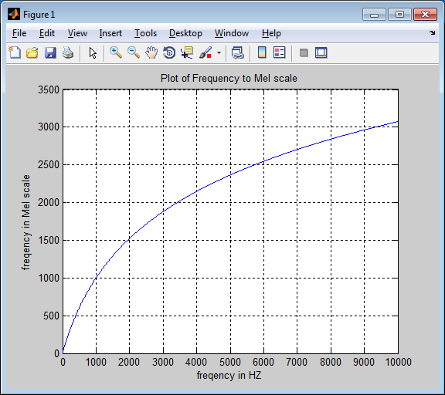
Use Matlab to plot the Mel scale
%plot mel scale, matlab
f=1:10000 %input frequency range
mel=(2595* log10(1+f/700));
figure(1)
clf
plot(f,mel)
grid on
xlabel('freqeuncy in HZ')
ylabel('freqeuncy Mel scale')
title('Plot of Frequency to Mel scale')
Plot
%Note: Someone uses log (natural log)
format shortG
f=1200 %1200 Hz
mel_1=1127.01048 * log((f/700) +1) %mel scale, using ln (natural log)
mel_2=2595.01048 * log10((f/700) +1) %mel scale , using log10, (base10)
> %got similar result
mel_1 = 1125.4
mel_2 = 1125.3
Notes:
import numpy as np #converted from matlab (shown above) to python using copilot on 250523
import matplotlib.pyplot as plt
# Define input frequency range
f = np.arange(1, 10001) # Equivalent to MATLAB's 1:10000
# Compute Mel scale values
mel = 2595 * np.log10(1 + f / 700)
# Plot the Mel scale
plt.figure(figsize=(8, 6))
plt.plot(f, mel)
plt.grid(True)
plt.xlabel('Frequency in Hz')
plt.ylabel('Frequency in Mel scale')
plt.title('Plot of Frequency to Mel Scale')
# Show the plot

Slide 77
(C) Use Linear Predictive coding LPC to implement filters
Linear Predictive coding LPC methods

Slide 78
Motivation
Fourier transform is a frequency method for finding the parameters of an audio signal, it is the formal method to implement filters. However, there is an alternative, which is a time domain method, and it works faster. It is called Linear Predicted Coding LPC coding method. The next slide shows the procedure for finding the filter output.
The procedures are: (i) windowing (Hamming) (ii) Pre-emphasis, (iii) autocorrelation, (iv) LPC calculation, (v) (optional) Cepstral coefficient calculation to find the representations the filter output.

Slide 79
Feature extraction data flow
- The LPC (Liner predictive coding) method based method
Signal
windowing,
pre-emphasis -> autocorrelation-> LPC -->cepstral coef
(pre-emphasis) r₀,r₁,.., r_{p} a₁,.., a_{p} c₁,.., c_{p}
windowing is discussed in the previous chapter (Durbin alog.)

Slide 80
Pre-emphasis
“ The high concentration of energy in the low frequency range observed for most speech spectra is considered a nuisance because it makes less relevant the energy of the signal at middle and high frequencies in many speech analysis algorithms.”
From Vergin, R. etal. ,“"Compensated mel frequency cepstrum coefficients ", IEEE, ICASSP-96. 1996 .

Slide 81

Pre-emphasis -- high pass filtering
(the effect is to suppress low frequency)
To reduce noise, average transmission conditions and to average signal spectrum.
$$S^{′}(k)=S(k)−\tilde{a}S(k−1) \\ 0.9≤\tilde{a}≤1.0,\text{typically} \tilde{a}=0.9−0.98, \\ \operatorname{For}{ }S(0),S(1),S(2),.., \\ \text{the} \text{value} S^{′}(0) \text{does} \text{not} \text{exist} \text{and} \text{is} \text{not} \text{used}\text{.} \\ \text{Assume} S′(0)=S′(1) \\ \tilde{a}=\text{pre}_\text{emphasis} \text{constant}$$
Notes:
\begin{equation}\label{eq3_preamp}
\begin{split}
&S^{'}(k)=S(k)-\tilde{a}S(k-1)\\
&0.9<a<1.0, \text{typically } \tilde{a}=0.95\\
&For S(0),S(1),S(2),...\\
&\text{the value } S^{'}(0) \text{does not exist and is not used. Assume } S^{'}(0)=S^{'}(1)\\
&\tilde{a} = \text{pre\_emphasis constant }
\end{split}
\end{equation}

Slide 82

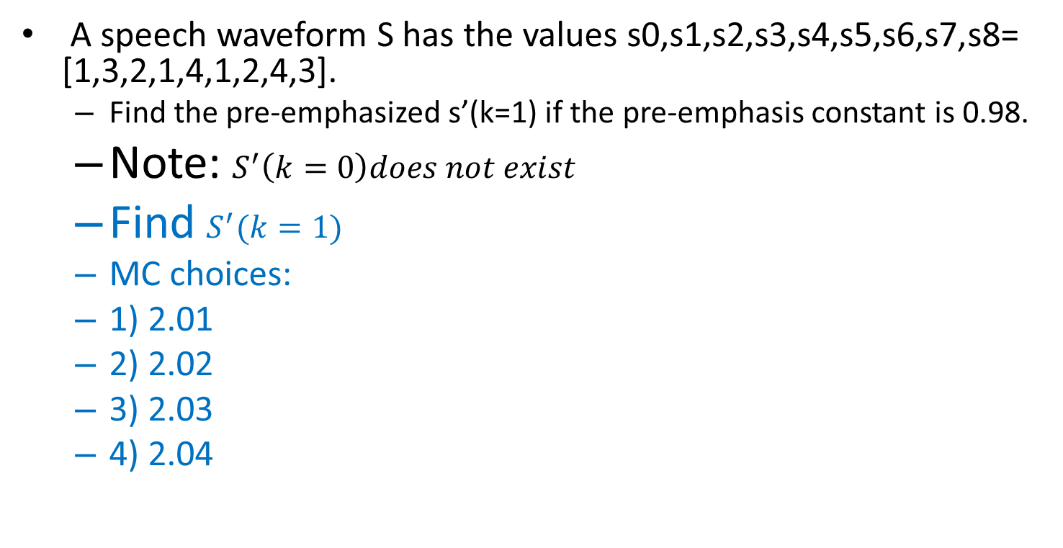
Class exercise 3.2
A speech waveform S has the values s0,s1,s2,s3,s4,s5,s6,s7,s8= [1,3,2,1,4,1,2,4,3].
  Find the pre-emphasized s’(k=1) if the pre-emphasis constant is 0.98.
  Note: $S^{′}\left(k=0\right)does not exist$
  Find $S^{′}(k=1)$
  MC choices:
  1) 2.01
  2) 2.02
  3) 2.03
  4) 2.04
$$S^{′}(k)=S(k)−\tilde{a}S(k−1) \\ 0.9≤\tilde{a}≤1.0,\text{typically} \tilde{a}=0.9−0.98$$
$$\operatorname{For}{ }S(0),S(1),S(2),.., \\ \text{the} \text{value} S^{′}(0) \text{does} \text{not} \text{exist} \text{and} \text{is} \text{not} \text{used}\text{.} \\ \text{Assume} S′(0)=S′(1) \\ \tilde{a}=\text{pre}_\text{emphasis} \text{constant}$$

Slide 83

Answer: Class exercise 3.2
A speech waveform S has the values s0,s1,s2,s3,s4,s5,s6,s7,s8= [1,3,2,1,4,1,2,4,3].
  Find the pre-emphasized s’(k=1) if the pre-emphasis constant is 0.98.
  Note: $S^{′}\left(k=0\right)does not exist$
  Find $S^{′}(k=1)$
  MC choices:
  1) 2.01
  2) 2.02 (correct)
  3) 2.03
  4) 2.04
  Find the pre-emphasized
  wave if is 0.98.
  Answer:
  s’1=s1- (0.98*s0)=3-1*0.98= 2.02
  s’2=s2- (0.98*s1)=2-3*0.98= -0.94
  s’3=s3- (0.98*s2)=1-2*0.98= -0.96
  s’4=s4- (0.98*s3)=4-1*0.98= 3.02
  s’5=s5- (0.98*s4)=1-4*0.98= -2.92
  s’6=s6- (0.98*s5)=2-1*0.98= 1.02
  s’7=s7- (0.98*s6)=4-2*0.98= 2.04
  s’8=s8- (0.98*s7)=3-4*0.98= -0.92

Slide 84
The Linear Predictive Coding
LPC method
Linear Predictive Coding LPC method
  Time domain
  Easy to implement
  Achieve data compression

Slide 85
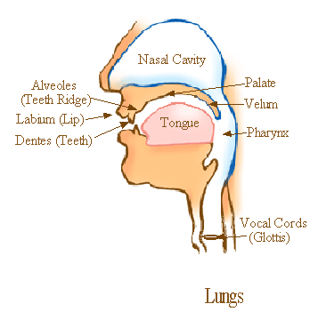
The LPC speech production model
Speech synthesis model:
  Impulse train generator governed by pitch period-- glottis
  Random noise generator for consonant.
  Vocal tract parameters = LPC parameters
http://home.hib.no/al/engelsk/seksjon/SOFF-MASTER/ill061.gif
Glottal excitation
for vowel
LPC parameters
Voice/unvoiced
switch
Impulse train
Generator
Time varying
digital filter
Time-varying
X
output
digital filter
Noise
Generator
(Consonant)
Gain

Slide 86
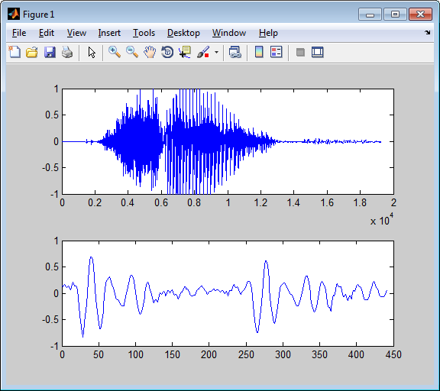
Example of a Consonant and Vowel
Sound file : http://www.cse.cuhk.edu.hk/~khwong/www2/cmsc5707/sar1.wav
The sound of ‘sar’ (沙) in Cantonese
The sampling frequency is 22050 Hz, so the duration is 2x10⁴x(1/22050)=0.9070 seconds.
By inspection, the consonant ‘s’ is roughly from 0.2x10⁴ samples to 0.6 x10⁴samples.
The vowel ‘ar’ is from 0.62 x10⁴ samples to 1.2 2x10⁴ samples.
The lower diagram shows a 20ms (which is (20/1000)/(1/22050)=441=samples) segment (vowel sound ‘ar’) taken from the middle (from the location at the 1x10⁴ ^{th} sample) of the sound.
%Sound source is from http://www.cse.cuhk.edu.hk/~khwong/www2/cmsc5707/sar1.wav
[x,fs]=wavread('sar1.wav'); %Matlab source to produce plots
fs % so period =1/fs, during of 20ms is 20/1000
%for 20ms you need to have n20ms=(20/1000)/(1/fs)
n20ms=(20/1000)/(1/fs) %20 ms samples
len=length(x)
figure(1),clf, subplot(2,1,1),plot(x)
subplot(2,1,2),T1=round(len/2); %starting point
plot(x(T1:T1+n20ms))
Consonant (s), Vowel(ar)
The vowel
wave is periodic

Slide 87
For vowels (voiced sound), use LPC to represent the signal
The concept is to find a set of parameters ie. α₁, α₂, α₃, α₄,.. α_{p=8} to represent the same waveform (typical values of p=8->13)
For example
Input waveform
Can reconstruct the waveform from
these LPC codes
Time frame y
α1, α2, α3, α4,.. α8
30ms
Time frame y+1
α’1, α’2, α’3, α’4,.. α’8
30ms
α’’1, α’’2, α’’3, α’’4,.. α’’8
:
Time frame y+2
30ms
Non_overlapping ≈ 20ms
Each time frame y=512 samples
(S₀,S₁,S₂,…,S_{n},S_{N-1=511})
512 integer numbers (16-bit each)
Each set has 8 floating point numbers (data compressed)

Slide 88
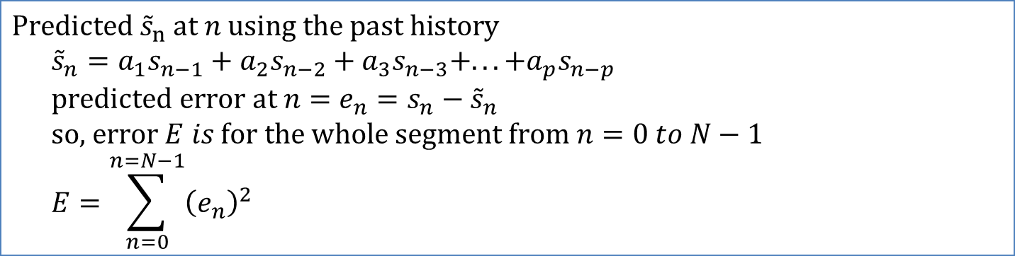
Linear predicted Coding LPC concept we want to find a set of a1,a2,..,a8, so when applied to all Sn in this frame (n=0,1,..N-1), the total error E (n=0→N-1)is minimum
$$\text{Predicted} {\tilde{s}}_{n} \text{at} n \text{using} \text{the} \text{past} \text{history} \\ {\tilde{s}}_{n}=a_{1}s_{n−1}+a_{2}s_{n−2}+a_{3}s_{n−3}+...+a_{p}s_{n−p} \\ \text{predicted} \text{error} \text{at} n=e_{n}=s_{n}−{\tilde{s}}_{n} \\ \text{so}\text{,} \text{error} E is \text{for} \text{the} \text{whole} \text{segment} \text{from} n=0 to N−1 \\ E=\sum_{n=0}^{n=N−1}{{\left(e_{n}\right)}^{2}}$$
S
Signal
level
Predicted S
Note: It is possible to make prediction if the signal S is a periodical wave. If S is random, LPC won’t work.
S_{n-1}
S_{n}
S_{n-2}
S_{n-4}
S_{n-3}
Time n
0
n
N-1=511
Notes:
\begin{equation}\label{eq3_LPC0}
\begin{split}
&\text{Predicted } \tilde{s}_n \text{ at $n$ using the past history }\\
&\tilde{s}_n=a_1s_{n-1}+a_2s_{n-2}+...+a_ps_{n-p}\\
&\text{predicted error at $n$ }=e_n=s_n-\tilde{s_n} \\
&\text{So the error $E$ for the whole segment from } n=0 \text{ to } N-1 \text { is }\\
&R=\sum_{n=0}^{n=N-1}\left( e_n \right)^2
\end{split}

Slide 89

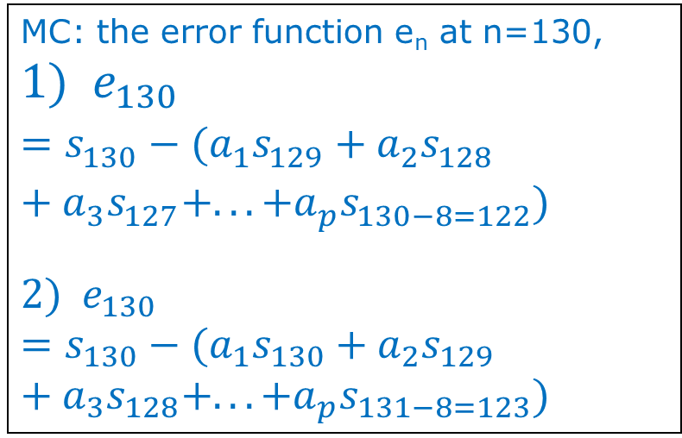
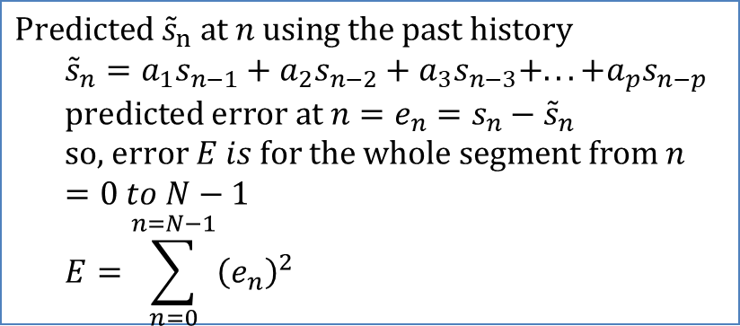
Class Exercise 3.3
Concept: we want to find a set of a1,a2,..,a8, so when applied to all Sn in this frame (n=0,1,..N-1), the total error E (n=0→N-1)is minimum
MC: the error function e_{n} at n=130,
$${1) e}_{130}=s_{130}−(a_{1}s_{129}+a_{2}s_{128}+a_{3}s_{127}+...+a_{p}s_{130−8=122})$$
$${2) e}_{130}=s_{130}−(a_{1}s_{130}+a_{2}s_{129}+a_{3}s_{128}+...+a_{p}s_{131−8=123})$$
$$\text{Predicted} {\tilde{s}}_{n} \text{at} n \text{using} \text{the} \text{past} \text{history} \\ {\tilde{s}}_{n}=a_{1}s_{n−1}+a_{2}s_{n−2}+a_{3}s_{n−3}+...+a_{p}s_{n−p} \\ \text{predicted} \text{error} \text{at} n=e_{n}=s_{n}−{\tilde{s}}_{n} \\ \text{so}\text{,} \text{error} E is \text{for} \text{the} \text{whole} \text{segment} \text{from} n=0 to N−1 \\ E=\sum_{n=0}^{n=N−1}{{\left(e_{n}\right)}^{2}}$$
(student exercise) . Draw it on the graph
Write the error function at n=288
Why e₀= s₀?
Write E for n=1,..N-1, (showing n=1, 8, 130,288,511)
S
Signal
level
Predicted S
S_{n-1}
S_{n}
S_{n-2}
S_{n-4}
S_{n-3}
Time n
0
n
N-1=511
Notes:
\begin{equation}\label{eq3_LPC0}
\begin{split}
&\text{Predicted } \tilde{s}_n \text{ at $n$ using the past history }\\
&\tilde{s}_n=a_1s_{n-1}+a_2s_{n-2}+...+a_ps_{n-p}\\
&\text{predicted error at $n$ }=e_n=s_n-\tilde{s_n} \\
&\text{So the error $E$ for the whole segment from } n=0 \text{ to } N-1 \text { is }\\
&R=\sum_{n=0}^{n=N-1}\left( e_n \right)^2
\end{split}

Slide 90
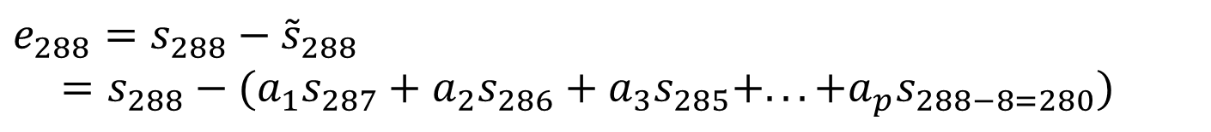
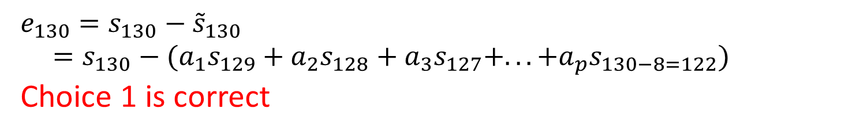
Answers:
Exercise 3.2
Prediction error
measured
predicted
Write error function at N=130,draw e_{n} on the graph
Write the error function at N=288
Why e₁= 0?
  Answer: Because s₋₁, s₋₂,.., s₋₈ are outside the frame and they are considered as 0. The effect to the overall solution is very small.
Write E for n=1,..N-1, (showing n=1, 8, 130,288,511)
$$e_{130}=s_{130}−{\tilde{s}}_{130}=s_{130}−(a_{1}s_{129}+a_{2}s_{128}+a_{3}s_{127}+...+a_{p}s_{130−8=122})$$
Choice 1 is correct
$$e_{288}=s_{288}−{\tilde{s}}_{288}=s_{288}−(a_{1}s_{287}+a_{2}s_{286}+a_{3}s_{285}+...+a_{p}s_{288−8=280})$$
$$E={\left[s_{0}−{\tilde{s}}_{0}\right]}^{2}+{\left[s_{1}−{\tilde{s}}_{1}\right]}^{2}+..+{\left[s_{8}−{\tilde{s}}_{8}\right]}^{2}+..+{\left[s_{130}−{\tilde{s}}_{130}\right]}^{2}+..+{\left[s_{288}−{\tilde{s}}_{288}\right]}^{2}+..{\left[s_{511}−{\tilde{s}}_{511}\right]}^{2}$$

Slide 91
LPC idea and procedure
W3
The idea: from all samples s₀,s₁,s₂,s_{N-1=511}, we want to find a_{p}(p=1,2,..,8), so that E is a minimum. The periodicity of the input signal provides information for finding the result.
Procedures
  For a speech signal, we first get the signal frame of size N=512 by windowing(will discuss later).
  Sampling at 25.6KHz, it is equal to a period of 20ms.
  The signal frame is (S₀,S₁,S₂,…,S_{N-1=511}) total 512 samples.
  Ignore the effect of outside elements by setting them to zero, I.e. S_{-∞} ..=S₋₂ = S₋₁ =S₅₁₂ =S₅₁₃=…= S∞=0 etc.
  We want to calculate LPC parameters of order p=8, i.e. α₁, α₂, α₃, α₄,.. α_{p=8}.
  P=8 is the minimal choice , using higher P, say up to 13 will get better sound quality. But experiments show that p>13 has no significant impact on the sound quality.

Slide 92
For each 30ms time frame
Input waveform
Time frame y
α1, α2, α3, α4,.. α8
30ms
$$\text{The} \text{predicted} \text{value} s_{n} \text{is} \text{denoted} \text{by} {\tilde{s}}_{n} \\ {\tilde{s}}_{n}=a_{1}s_{n−1}+a_{2}s_{n−2}+a_{3}s_{n−3}+...+a_{p}s_{n−p}−−−(1) \\ \text{prediction} \text{error} \\ e_{n}=s_{n}−{\tilde{s}}_{n},\text{from} (1) \\ e_{n}=s_{n}−(a_{1}s_{n−1}+a_{2}s_{n−2}+a_{3}s_{n−3}+...+a_{p}s_{n−p}) \\ e_{n}=s_{n}−\sum_{i=1}^{i=p}{a_{i}s_{n−i}}, \\ \text{so}\text{, }\text{for} \text{the} \text{whole} \text{frame} \text{from} n=0 to N−1 \\ E=\sum_{n=0}^{n=N−1}{{\left(e_{n}\right)}^{2}}=\sum_{n=0}^{n=N−1}{{\left(s_{n}−\sum_{i=1}^{i=p}{a_{i}s_{n−i}}\right)}^{2}} \\ \text{To} \text{find} a_{i=1,2,..p} \text{that} \text{generates} Emin\text{, }\text{need} \text{to} \text{solve} \text{for} \frac{∂E}{∂a_{i}}\text{=0, }\text{for} \text{all} \text{i}\text{=1,2,}…p$$
Notes:
\begin{equation}\label{eq3_LPC1}
\begin{split}
&\text{The predicted value } s_n \text{ is denoted by }\tilde{s}_n\\
&\tilde{s}_n=a_1s_{n-1}+a_2s_{n-2}+...+a_ps_{n-p}---(*)\\
&\text{predicted error }\\
&e_n=s_n-\tilde{s}, \text{from} (*)\\
&e_n=s_n-(a_1s_{n-1}+a_2s_{n-2}+...+a_ps_{n-p})\\
&e_n=s_n-\sum_{i=1}^{i=p}a_is_{n-i},\\
&\text{So the whole frame from n=0 to N-1}\\
&E=\sum_{n=1}^{n=N-1}{(e_n)}^2=\sum_{n=1}^{n=N-1}{\left( s_n-\sum_{i=1}^{i=p}a_is_{n-i} \right) }^2\\
&\text{To find } a_{i=1,2,...p} \text{ that generate } E_{min}, \text{solve }\frac{\partial E}{\partial a_i}=0 \text{ for all i=1,2,...,p}
\end{split}
\end{equation}

Slide 93
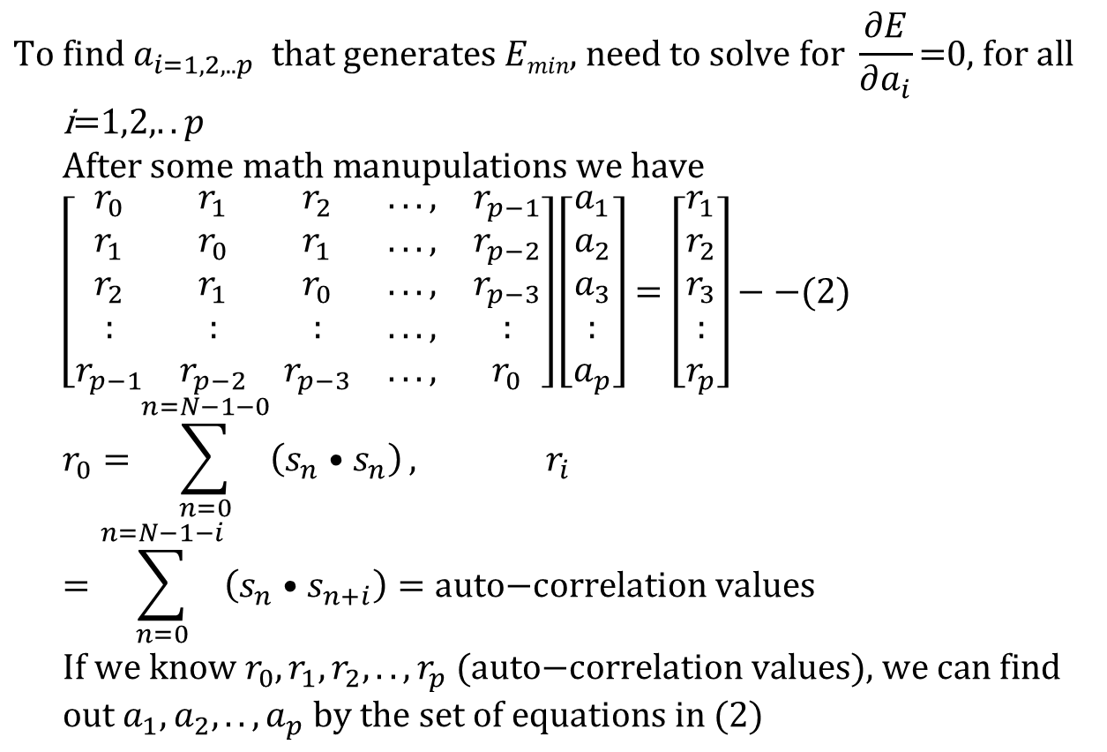
Solve for a_{1,2,…,p}
Input waveform
Time frame y
α1, α2, α3, α4,.. α8
30ms
$$\text{To} \text{find} a_{i=1,2,..p} \text{that} \text{generates} Emin\text{, }\text{need} \text{to} \text{solve} \text{for} \frac{∂E}{∂a_{i}}\text{=0, }\text{for} \text{all} \text{i}\text{=1,2,}..p \\ \text{After} \text{some} \text{math} \text{manupulations} \text{we} \text{have} \\ \left[\begin{matrix}r_{0} & r_{1} & r_{2} & ..., & r_{p−1} \\ r_{1} & r_{0} & r_{1} & ..., & r_{p−2} \\ r_{2} & r_{1} & r_{0} & ..., & r_{p−3} \\ : & : & : & ..., & : \\ r_{p−1} & r_{p−2} & r_{p−3} & ..., & r_{0}\end{matrix}\right]\left[\begin{matrix}a_{1} \\ a_{2} \\ a_{3} \\ : \\ a_{p}\end{matrix}\right]=\left[\begin{matrix}r_{1} \\ r_{2} \\ r_{3} \\ : \\ r_{p}\end{matrix}\right]−−(2) \\ r_{0}=\sum_{n=0}^{n=N−1−0}{\left(s_{n}•s_{n}\right)}, r_{i}=\sum_{n=0}^{n=N−1−i}{\left(s_{n}•s_{n+i}\right)=\text{auto}\text{−}\text{correlation} \text{values}} \\ \text{If} \text{we} \text{know} r_{0},r_{1},r_{2},..,r_{p}\text{ (}\text{auto}\text{−}\text{correlation} \text{values}\text{)}\text{, }\text{we} \text{can} \text{find} \text{out} a_{1},a_{2},..,a_{p} \text{by} \text{the} \text{set} \text{of} \text{equations} \text{in} (2)$$
Derivations can be found at
http://www.cslu.ogi.edu/people/hosom/cs552/lecture07_features.ppt
See (https://en.wikipedia.org/wiki/Linear_prediction)
Use Durbin’s equation
to solve this
Notes:
\begin{equation}\label{eq3_LPC2}
\begin{split}
%
&\begin{bmatrix}
r_0 & r_1 & r_2 & ..., & r_{p-1} \\
r_1 & r_0 & r_1 & ..., & r_{p-2} \\
r_2 & r_1 & r_0 & ..., & r_{p-3} \\
: & : & : & ..., & : \\
r_{p-1} & r_{p-2} & r_{p-3} & ..., & r_0
\end{bmatrix}
%
\begin{bmatrix}
a_1\\
a_2\\
a_3\\
:\\
a_{p}
\end{bmatrix}=
%
\begin{bmatrix}
r_1\\
r_2\\
r_3\\
:\\
r_{p}
\end{bmatrix}-----(**)\\
&\text{where } r_0=\sum_{n=0}^{n=N-1-0}(s_n \cdot s_n), r_i=\sum_{n=0}^{n=N-1-i}(s_n \cdot s_{n+i})=\text{ auto-correlation function } \\
\end{split}
\end{equation}\\
If we know $r_0,r_1,r_2,...,r_p$, we can find out $a_1,a_2,a_3,...,a_p$ by the set of equation in (**). See \cite{LPC_wiki} for more information.

Slide 94
The example
For each time frame (25 ms), data is valid only inside the window.
20.48 KHZ sampling, a window frame (25ms) has 512 samples (N)
Require 8-order LPC, i=1,2,3,..,8
Calculate using r₀, r₁, r₂,..,r₈, using the above formulas, then get LPC parameters a₁, a₂,.. a₈ by the Durbin recursive Procedure.

Slide 95
Steps for each time frame to find a set of LPC
(step1) N=WINDOW=512, the speech signal is s₀,s₁,..,s₅₁₁
(step2) Order of LPC is 8, so r₀, r₁,..,r₈ required are:
(step3) Solve the set of linear equations (see previous slides)
$r_{0}=s_{0}s_{0}+s_{1}s_{1}+s_{2}s_{2}+s_{3}s_{3}+s_{4}s_{4}+...+s_{511}s_{511}$
$$r_{1}=s_{0}s_{1}+s_{1}s_{2}+s_{2}s_{3}+s_{3}s_{4}+s_{4}s_{5}+...+s_{510}s_{511} \\ r_{2}=s_{0}s_{2}+s_{1}s_{3}+s_{2}s_{4}+s_{3}s_{5}+s_{4}s_{6}+...+s_{509}s_{511} \\ r_{3}=s_{0}s_{3}+s_{1}s_{4}+s_{2}s_{5}+s_{3}s_{6}+s_{4}s_{7}+...+s_{508}s_{511} \\ ⇓ \\ r_{7}=s_{0}s_{7}+s_{1}s_{8}+s_{2}s_{9}+s_{3}s_{10}+s_{4}s_{11}+...+s_{504}s_{511} \\ r_{8}=s_{0}s_{8}+s_{1}s_{9}+s_{2}s_{10}+s_{3}s_{11}+s_{4}s_{12}+...+s_{503}s_{511}$$
Notes:
\begin{equation}\label{eq3_LPC3}
\begin{split}
&r_0=s_0 s_0 + s_1 s_1 +s_2 s_2 +s_3 s_3 +s_4 s_4 +...+s_{511} s_{511}\\
&r_1=s_0 s_1 + s_1 s_2 +s_2 s_3 +s_3 s_4 +s_4 s_5 +...+s_{510} s_{511}\\
&r_2=s_0 s_2 + s_1 s_3 +s_2 s_4 +s_3 s_5 +s_4 s_6 +...+s_{509} s_{511}\\
&r_3=s_0 s_3 + s_1 s_4 +s_2 s_5 +s_3 s_6 +s_4 s_7 +...+s_{508} s_{511}\\
:\\
&r_7=s_0 s_7 + s_1 s_8 +s_2 s_9 +s_3 s_{10} +s_4 s_{11} +...+s_{504} s_{511}\\
&r_8=s_0 s_8 + s_1 s_9 +s_2 s_{10} +s_3 s_{11} +s_4 s_{12} +...+s_{503} s_{511}\\
\end{split}
\end{equation}

Slide 96
Program segmentation algorithm for auto-correlation
WINDOW=size of the frame; auto_coeff = autocorrelation matrix; sig = input, ORDER = lpc order
void autocorrelation(float *sig, float *auto_coeff)
{int i,j;
for (i=0;i<=ORDER;i++)
{
auto_coeff[i]=0.0;
for (j=i;j<WINDOW;j++)
auto_coeff[i]+= sig[j]*sig[j-i];
}
}
Notes:
%%MMMMMMMMMMMMMMMMMMMMMMMMMMMMMMMMMMMMMMMM
\section*{program segment for auto-correlation}
\begin{lstlisting}
WINDOW=size of the frame; auto\_coeff=autocorrelation matrix; sig =input
ORDER=lpc\_order
void autocorrelation(float *sig, float *auto\_coeff}
{int i,j;
for (i=0;i<=ORDER;i++)
auto\_coeff[i]=0.0;
for(j=i;j<WINDOW;j++)
auto_coeff[i]+=sig[j]*sig[j-i];
}
}
\end{lstlisting}
%%MMMMMMMMMMMMMMMMMMMMMMMMMMMMMMMMMMMMMMMM

Slide 97
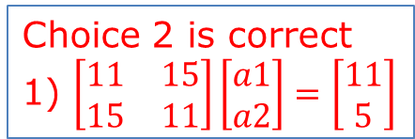
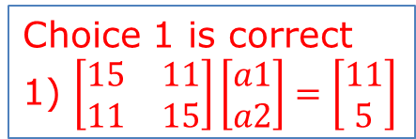
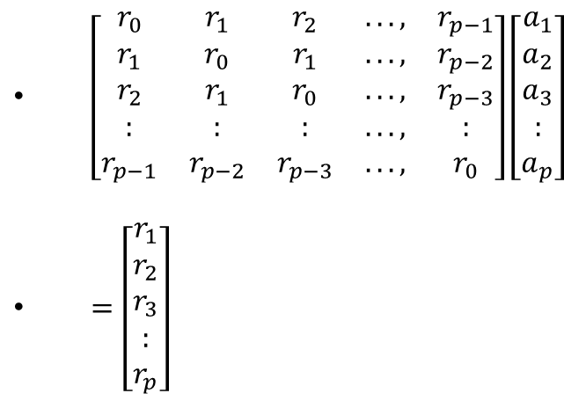


Class exercise 3.3
A speech waveform S has the values s0,s1,s2,s3,s4,s5,s6,s7,s8= [1,3,2,1,4,1,2,4,3]. The frame size is 4.
  For this exercise , for simplicity no pre-emphasis is used (or assume pre-emphasis constant is 0)
  First, find auto-correlation parameter r0, r1, r2 for the first frame.
  If we use LPC order 2 for our feature extraction system, find LPC coefficients a1, a2.
  If the number of overlapping samples for two frames is 2, find the LPC coefficients of the second frame.
  Mc choices
$\left[\begin{matrix}r_{0} & r_{1} & r_{2} & ..., & r_{p−1} \\ r_{1} & r_{0} & r_{1} & ..., & r_{p−2} \\ r_{2} & r_{1} & r_{0} & ..., & r_{p−3} \\ : & : & : & ..., & : \\ r_{p−1} & r_{p−2} & r_{p−3} & ..., & r_{0}\end{matrix}\right]\left[\begin{matrix}a_{1} \\ a_{2} \\ a_{3} \\ : \\ a_{p}\end{matrix}\right]$
$=\left[\begin{matrix}r_{1} \\ r_{2} \\ r_{3} \\ : \\ r_{p}\end{matrix}\right]$
Choice 1 is correct
1) $\left[\begin{matrix}15 & 11 \\ 11 & 15\end{matrix}\right]\left[\begin{matrix}a1 \\ a2\end{matrix}\right]=\left[\begin{matrix}11 \\ 5\end{matrix}\right]$
Choice 2 is correct
1) $\left[\begin{matrix}11 & 15 \\ 15 & 11\end{matrix}\right]\left[\begin{matrix}a1 \\ a2\end{matrix}\right]=\left[\begin{matrix}11 \\ 5\end{matrix}\right]$
Choice 3 is correct
1) $\left[\begin{matrix}15 & 11 \\ 11 & 15\end{matrix}\right]\left[\begin{matrix}a2 \\ a1\end{matrix}\right]=\left[\begin{matrix}11 \\ 5\end{matrix}\right]$
Choice 4 is correct
1) $\left[\begin{matrix}15 & 11 \\ 11 & 15\end{matrix}\right]\left[\begin{matrix}a2 \\ a1\end{matrix}\right]=\left[\begin{matrix}\begin{aligned}5 \\ 11\end{aligned} \\ \end{matrix}\right]$
Student exercise:Repeat the question if pre-emphasis constant is 0.98.

Slide 98



Answer: Class exercise 3.3
$\left[\begin{matrix}r_{0} & r_{1} & r_{2} & ..., & r_{p−1} \\ r_{1} & r_{0} & r_{1} & ..., & r_{p−2} \\ r_{2} & r_{1} & r_{0} & ..., & r_{p−3} \\ : & : & : & ..., & : \\ r_{p−1} & r_{p−2} & r_{p−3} & ..., & r_{0}\end{matrix}\right]\left[\begin{matrix}a_{1} \\ a_{2} \\ a_{3} \\ : \\ a_{p}\end{matrix}\right]$
$=\left[\begin{matrix}r_{1} \\ r_{2} \\ r_{3} \\ : \\ r_{p}\end{matrix}\right]$
Frame size=4, first frame is [1,3,2,1]
  r0=1x1+ 3x3 +2x2 +1x1=15
  r1= 3x1 +2x3 +1x2=11
  r2= 2x1 +1x3=5
$$\left[\begin{matrix}r0 & r1 \\ r1 & r0\end{matrix}\right]\left[\begin{matrix}a1 \\ a2\end{matrix}\right]=\left[\begin{matrix}r1 \\ r2\end{matrix}\right] \\ \left[\begin{matrix}15 & 11 \\ 11 & 15\end{matrix}\right]\left[\begin{matrix}a1 \\ a2\end{matrix}\right]=\left[\begin{matrix}11 \\ 5\end{matrix}\right] \\ \left[\begin{matrix}a1 \\ a2\end{matrix}\right]=inverse\left(\left[\begin{matrix}15 & 11 \\ 11 & 15\end{matrix}\right]\right)\left[\begin{matrix}11 \\ 5\end{matrix}\right] \\ \left[\begin{matrix}a1 \\ a2\end{matrix}\right]= \left[\begin{matrix}\text{1.0577} \\ \text{−0.4423}\end{matrix}\right]$$
Choice 1 is correct
1) $\left[\begin{matrix}15 & 11 \\ 11 & 15\end{matrix}\right]\left[\begin{matrix}a1 \\ a2\end{matrix}\right]=\left[\begin{matrix}11 \\ 5\end{matrix}\right]$

Slide 99
Application of LPC for speech data compression
Example code in Matlab
https://www.mathworks.com/matlabcentral/fileexchange/13529-speech-compression-using-linear-predictive-coding/content/LPC_fin
Demo video: Sound recorder and reconstructed using LPC https://youtu.be/KpmvGju_WcM
Pulse train simulates
Glottal Pluses
e.g (50Hz)
LPC parameters (order 10)
Voice/unvoiced
switch
Impulse train
Generator
Time varying
digital filter
Time-varying
X
output
digital filter
Gain
99

Slide 100
1 2 3 4 5 6 7 8 9 10
Sound
Source
In time
samples
1=Voice
or
0=unvoiced
Pitch
Frequency
In Hz
Energy
Demo video: Sound recorder and reconstructed using LPC https://youtu.be/KpmvGju_WcM

Slide 101
(D) Cepstrum
A new word by reversing the first 4 letters of spectrum → cepstrum.
It is the spectrum of a spectrum of a signal
MFCC (Mel-frequency cepstrum) is the most popular audio signal representation method nowadays

Slide 102
Glottis and cepstrum
Speech wave (X(m))= Excitation (E(m)) . Filter (H(m))
[X(m)]
[H(m)]
(Vocal tract filter)
Output
So voice has a
strong glottis
Excitation,
X(m) is in Frequency domain content
In Ceptsrum
We can easily identify and
remove the glottal excitation
[E(m)]
Glottal excitation
From
Vocal cords
(Glottis)
http://home.hib.no/al/engelsk/seksjon/SOFF-MASTER/ill061.gif

Slide 103
Recall: Discrete Fourier transform DFT and
Inverse Discrete Fourier transform IDFT
https://en.wikipedia.org/wiki/Discrete_Fourier_transform
Matlab code:
https://www.mathworks.com/matlabcentral/fileexchange/41228-dft-and-idft/content/Untitled3.m
$$\text{Fourier} \text{Transform} \\ X_{m}=\sum_{k=0}^{N−1}{s_{k}⋅e^{−i\frac{2πkm}{N}}}=\sum_{k=0}^{N−1}{s_{k}⋅\left(\cos\left(\frac{2πkm}{N}\right)−i\sin\left(\frac{2πkm}{N}\right)\right)} \\ \text{Inverse} \text{Fourier} \text{Transform} \\ s_{k}=\frac{1}{N}\sum_{m=0}^{N−1}{X_{m}⋅e^{i\frac{2πkm}{N}}}=\frac{1}{N}\sum_{m=0}^{N−1}{X_{m}⋅\left(\cos\left(\frac{2πkm}{N}\right)+i\sin\left(\frac{2πkm}{N}\right)\right)}$$
$$\text{Note}\text{: } \\ e^{jθ}=\cos{(}θ)+j\sin{(}θ), \\ \sin{(}−θ)=−\sin{(}θ), \\ \cos{(}−θ)=\cos{(}θ)$$
N=number of time samples
k=time index of the current sample , it is from 0 to N-1
s_{k}=value of the signal sample at time k
m=frequency index (from 0 Hz to N-1 Hz)
X_{m}= amount of frequency m in the signal of all s_{k}
Notes:
\begin{equation}\label{eq3_FOURIER}
\begin{split}
&X_m=\sum_{k=0}^{N-1}s_k \cdot e^{-i \frac{s\pi k m}{N}}=\sum_{k=0}^{N-1} s_k \cdot
\left( cos \left(- \frac {2 \pi k m} {N} \right)
+i \cdot sin \left(- \frac {2 \pi k m} {N} \right)
\right) \\
%
&s_m=\frac{1}{N} \sum_{k=0}^{N-1}X_m \cdot e^{-i \frac{s\pi k m}{N}}=\frac{1}{N} \sum_{k=0}^{N-1} X_m \cdot
\left( cos \left( \frac {2 \pi k m} {N} \right)
+i \cdot sin \left( \frac {2 \pi k m} {N} \right)
\right)
\end{split}
\end{equation}Where,\\
$N$=number of time samples\\
$k$=time index of the current sample , it is from 0 to $N-1$\\
$s_k$=value of the signal sample at time $k$\\
$m$=frequency index (from 0 Hz to $N-1$ Hz)\\
$X_m$= amount of frequency m in the signal of all s$_k$

Slide 104
Cepstral analysis
Ref: http://iitg.vlab.co.in/?sub=59&brch=164&sim=615&cnt=1
Signal(s)=convolution(*) of
  glottal excitation (e) and vocal_tract_filter (h)
  s(k)=e(k)*h(k), k is time index
After Fourier transform FT: FT{s(k)}=FT{e(k)*h(k)}
  Convolution(*) becomes multiplication (.)
  n(time index)→ m(frequency index),
S(m) = E(m).H(m)
Find the magnitude of the spectrum
|S(m)| = |E(m)|.|H(m)|
log₁₀ |S(m)|= log₁₀{|E(m)|}+ log₁₀{|H(m)|}
Cepstrum C(n)=IDFT(log₁₀ |S(m)|)=IDFT( log₁₀{|E(m)|}+ log₁₀{|H(m)|} )
Note: Fourier transform has Linearity property:
  DFT{ax(t)+b(y(t)}=a∙DFT{x(t)}+b∙DFT{y(t)}
  See http://fourier.eng.hmc.edu/e101/lectures/handout3/node2.html

Slide 105
Cepstrum
In MFCC (Mel scale cepstral coefficients) implementation
IDCT (Inverse Discrete Cosine Transform) is used to reduce dimension from filter bands (e.g. 20) to MFCC (e.g. 13).see appendix
C(n)=IDFT[log₁₀ |X(m)|]=
IDFT[ log₁₀{|E(m)|} + log₁₀{|H(m)|} ]
Why do we prefer to use Cepstrum? Because in C(n), you can see E(n) and H(n) are at two different positions along the n axis (index for Cepstrum).
Therefore, you can use it for
  (i) glottal excitation removal
  (ii) vocal tract filter analysis
X(m)
Log|X(w)|
S(k)
windowing
DFT
Log|X(m)|
IDFT
/IDCT
C(n)
k=time index
m=frequency
I-DFT=Inverse-discrete Fourier transform
n=index for Cepstrum

Slide 106

Example of cepstrum http://www.cse.cuhk.edu.hk/%7Ekhwong/www2/cmsc5707/demo_for_ch4_cepstrum.zip
Run spCepstrumDemo in matlab
'sor1.wav‘=sampling frequency 22.05KHz
S(k)
Cepstral
transform
K time index
Cepstrum
n axis

Slide 107

s(n) time
domain signal
x(n)=windowed(s(n))
Suppress two sides
|x(w)|=dft(x(n))
= frequency signal
(dft=discrete Fourier transform)
Log (|x(w)|)
C(n)=
iDft(Log (|x(w)|))
gives Cepstrum
Glottal excitation cepstrum
Vocal track
cepstrum
http://iitg.vlab.co.in/?sub=59&brch=164&sim=615&cnt=1
http://www.engineeringproductivitytools.com/stuff/T0001/PT01.HTM

Slide 108

Liftering (to remove glottal excitation)
Low time liftering:
  Magnify (or Inspect) the low time to find the vocal tract filter cepstrum
High time liftering:
  Magnify (or Inspect) the high time to find the glottal excitation cepstrum (remove this part for speech recognition.
Vocal tract
Cepstrum
Used for
Speech
recognition
Glottal excitation
Cepstrum, useless for
speech recognition,
Actual Cut-off is found
by experiment
Frequency =FS/ quefrency
FS=sample frequency
=22050

Slide 109



Liftering method: Select the high time and low time liftering
Signal X
Cepstrum
(quefrency)
Select low time
C_low (show vocal track characteristic)
Select high time, C_high (show glottal excitation characteristic)
Low time liftering:
High time liftering:

Slide 110

Recover Glottal excitation and vocal track spectrum
Spectrum of glottal excitation
No use for speech recognition
Cepstrum of glottal excitation
C_high
For
Glottal
excitation
C_low
For
Vocal track
characteristic
Frequency
Spectrum of vocal track filter
Cepstrum of vocal track
Frequency
quefrency (sample index)
This peak may be the pitch period:
This smoothed vocal track spectrum can be used to find pitch
For more information see :
http://isdl.ee.washington.edu/people/stevenschimmel/sphsc503/files/notes10.pdf

Slide 111
Exercise 3.4a, b, c
Given X(m) is the spectrum , C(n) is the cepstrum , E(m) is the glottal excitation and H(w) is the vocal track response and
  |X(m)| = |E(m)|.|H(m)|,
  log₁₀ |X(m)|= log₁₀{|E(m)|}+ log₁₀{|H(m)|}
  Cepstrum C(n)=IDFT(log₁₀ |X(m)|)=IDFT(log₁₀{|E(m)|}+ log₁₀{|H(m)|})
MC questions: For the procedure for finding the cepstral coefficients of a speech signal S(k).
(a) Why do we need low time liftering? Mc choices:
  1) remove glottal excitation, so that vocal track responses can be found.
  2) remove vocal track responses , so that glottal excitation can be found.
(b) Why do we need high time liftering? MC choices:
  1) remove glottal excitation, so that vocal track responses can be found.
  2) Remove vocal track information , so that glottal excitation can be found.
(c) Which of the following statement is true? MC choices:
  1) : In spectrum, E and H are mixed by multiplication, While in Cepstrum , Glottal excitation E and vocal track characteristic H are appearing separately on the quefrency axis indexed by n. So, it can easily be separated easily.
  2) : In Cepstrum , and H are mixed by multiplication, While in Spectrum, Glottal excitation E and vocal track characteristic H are appearing separately on the frequncy axis indexed by n. So, it can easily be separated easily.
Student exercise: Write the procedure for finding the cepstral coefficients of a speech signal S(k).

Slide 112
Answer: Exercise 3.4
MC questions: For the procedure for finding the cepstral coefficients of a speech signal S(k).
(a) Why do we need low time liftering? Mc choices:
  1) remove glottal excitation, so that vocal track responses can be found (correct)
  2) remove vocal track responses , so that glottal excitation can be found
(b) Why do we need high time liftering? MC choices:
  1) remove glottal excitation, so that vocal track responses can be found
  2) Remove vocal track information , so that glottal excitation can be found (correct)
(c) Which of the following statement is true? MC choices:
  1) : In spectrum, E and H are mixed by multiplication, While in Cepstrum , Glottal excitation E and vocal track characteristic H are appearing separately on the quefrency axis indexed by n. So, it can easily be separated easily. (correct)
  2) : In Cepstraum , and H are mixed by multiplication, While in Spectrum, Glottal excitation E and vocal track characteristic H are appearing separately on the frequncy axis indexed by n. So, it can easily be separated easily.
Student exercise : Write the procedure for finding the cepstral coefficients of a speech signal S(k).
s(n) time
domain signal
s’(k)=windowed(s(k)) Suppress two sides
→|X(m)|=dft(s’(k)) = frequency signal
→(dft=discrete Fourier transform)
→Log (|X(m)|)
→C(n)=iDft(Log (|X(m)|))
C(n) =Cepstrum coefficients

Slide 113
Summary of part3
Learned
  Audio feature types
  Signal filtering
  How to extract audio features
  Mel scale signal processing
  Cepstrum and cepstral coefficients

Slide 114
Appendix 3.1: Discrete Cosine Transform DCT demo_ch3_dct_vs_fft.m see also https://en.wikipedia.org/wiki/Discrete_cosine_transform
% demo_ch3_dct_vs_fft.m
%MATLAB program to show difference between dct and fft
%this is to sow exp () and sin, cos generate the same result
%program to find the DFT/IDFT of a sequence without using the inbuilt functions
close all;
clear all;
%xn=input('Enter the sequence x(n)'); %Get the sequence from user
xn=[8,16,24,32,40,48,56,64]
xk_fft=fft(xn);
xn_recovered_full_magnitude=abs(ifft(xk_fft));
'if we remove the last 4 fft parameters, we can still recover the sequence xn'
xk_fft(5)=0;
xk_fft(6)=0;
xk_fft(7)=0;
xk_fft(8)=0;
xn_recovered_truncated4_magnitude=abs(ifft(xk_fft));
'show all rsulst'
'orginal xn'
xn
'xn_recovered_full_magnitude'
xn_recovered_full_magnitude
'xn_recovered_truncated4_magnitude'
xn_recovered_truncated4_magnitude
'press key to continue, will test dct'
'it shows the xn_recovered_truncated4_magnitude is not the same as xn'
pause
%%%%%%%%%%%%%%%%%%%%%%%%%%%%%%%%%%%%%%%%%%%%%%%%%%%%%%%%%%%%%%%%%%%%%%%%%%
'if we remove the last 4 dct parameters, we can still recover the sequence xn'
xn_recovered_by_idct_full=idct(dct(xn))
'xn_recovered_by_idct_full'
xn_recovered_by_idct_full
%%% now truncate some dct parameters
xk3_dct=dct(xn)
xk3_dct(5)=0;
xk3_dct(6)=0;
xk3_dct(7)=0;
xk3_dct(8)=0;
xn_recovered_by_idct_truncated4=idct(xk3_dct);
'compare results'
'original input xn'
xn
'xn_recovered_by_idct_full'
xn_recovered_by_idct_full
'xn_recovered_by_idct_truncated4'
xn_recovered_by_idct_truncated4
disp('the whole program shows for dct even you truncate 4 high frequency parameters')
disp('you can still recovered most of the original data xn')
disp('but it is not true for fft , so dct is suitable for data compression, it is used in mp3 and jpeg')

Slide 115
FAQ 3.1 frequently asked equations
Question1
Question1: But I want to know the purpose of LPC is to find the value of a that minimizes the prediction error E, and MFCC aims to find the audio envelope ( H(k)- glottal excitation ?
Answer1:
For MFCC(Mel scale cepstral coefficient), we starts to discuss the term “Cepstral”. After cepstral analysis you can split the sound into (1) vocal_track_filter_part (2) glottal excitation part, along the cepstral axis, then you can remove the (2) glottal excitation part (by liftering) because it has little use for speech recognition.
LPC is completely different, it is a method to compress/represent data into LPC features .LPC data (e.g., a vector of 8x1 if using lpc-8) is much smaller than the source data. So, it is a method of compression. It represents the sound because two different sounds may have different LPC data. It was an old representation method until people invented MFCC. We can represent the sound using LPC, in particular but perform badly in speech recognition. However, you can reconstruct the original sound (with distortion) from the LPC vector. So, it is used for mobile phone data compression, because it can run faster and computationally inexpensive.
//////////////////////////////////////////////////////////////////////////////////////////////////////////

Slide 116
FAQ 3.2 frequently asked equations
Question2: Is the A obtained through Durbin's equation (auto-correlation) the feature of audio frequency?
Answer2: It is not audio frequency, but the LPC data is related to the frequency spectrum of the source sound. Therefore, you may reconstruct the original sound from LPC data.
////////////////////////////////////////////////////////////////////////////////////////////////////////////////
Question3: LPC is much less computational than MFCC, so what are the disadvantages of LPC?
Answer3: It is fast in terms of calculation, but not accurate. It is good for data compression, because our ear can tolerate poor quality sounds (e.g. it can be used in mobile phones) but not good for speech recognition.
/////////////////////////////////////////////////////////////////////////////////////////////
Question4: what makes MFCC (MFCC(Mel scale cepstral coefficient), so popular?
Answer4: It is accurate in representing and preserving the essential features in speech signals that human uses for recognizing different sounds, I.e. Mel scale is implemented using different filters in the program code. Glottal excitation is also removed using liftering. You may see these features in the typical mfcc-program-code implementation, matlab or python

Slide 117
Part. 4: Feature representation
Using Vector Quantization (VQ) and K-means

Slide 118
Representing features using Vector Quantization (VQ)
Speech data is not random, human voices have limited forms.
Vector quantization is a data compression method
  raw speech 10KHz/8-bit data for a 30ms frame is 300 bytes
  10th order LPC =10 floating numbers=40 bytes
  after VQ it can be as small as one byte.
Used in tele-communication systems.
Enhance recognition systems since less data is involved.

Slide 119
8-bit Linear Quantization
Analog–to-digital conversion
Note: 1/(2^8)=1/256= 0.00390625x1
Input analog voltage Vin
Quantized 8-bit value representation
if Vin falls into this range
1 Volt
1111 1111B=FF Hex
1- 0.00390625x1 Volts
1- 0.00390625x2 Volts
1111 1110B=FE Hex
:
:
E.g.
34H,38H,76H ….
E.g.
0.00390625x2 Volts
0.00390625x1 Volts
0000 0001B=01 Hex
0000 0000B=00 Hex
0 Volt

Slide 120
Use of Vector quantization for Further compression
If the order of LPC is 10, it is a data in a 10-dimensional space
after VQ it can be as small as one byte.
Example, the order of LPC is 2 (2 D space, it is simplified for illustrating the idea)
LPC coefficient a2
e:
e.g. same voices (i:) spoken by the same person at different times
i:
u:
LPC coefficient a1

Slide 121
Vector Quantization (VQ) (weeek3)
A simple example, 2nd order LPC, LPC2
 | Sound | Mean values of samples
code |  | Lpc code: a1 | Lpc code:a2
1 | e: | 0.5 | 1.5
2 | i: | 2 | 1.3
3 | u: | 0.7 | 0.8
We can classify speech sound segments by Vector quantization
Make a table
The standard sound is
the centroid of all
samples of I (a1,a2)=(2,1.3)
The standard sound is
the centroid of all
samples of e: (a1,a2)=(0.5,1.5)
a2
2
e:
i:
1
Using this table, 2 bits are
enough to encode each sound
u:
Feature space and sounds are
classified into three different types
e:, i: , u:
2
a1
The standard sound is the centroid of all samples of u:, (a1,a2)=(0.7,0.8)

Slide 122
Another example LPC8
(used in telecommunication data-compression systems)
256 different sounds encoded by the table (one segment which has 512 samples is represented by one byte)
Use many samples to find the centroid of that sound, “i”,“e:”, or “i:”
Each row is the centroid of that sound in LPC8.
In telecomm sys., the transmitter only transmits the code (1 segment using 1 byte), the receiver reconstructs the sound using that code and the table. The table is only transmitted once at the beginning.
One segment (512 samples ) compressed into 1 byte
transmitter
receiver
Code (1 byte) | a1 | a2 | a3 | a4 | a5 | a6 | a7 | a8
0=(e:) | 1.2 | 8.4 | 3.3 | 0.2 | .. | .. | .. | ..
1=(i:) | .. | .. | .. | .. | .. | .. | .. | ..
2=(u:)
:
255 | .. | .. | .. | .. | .. | .. | .. | ..

Slide 123
VQ techniques, M code-book vectors from L training vectors
Method 1: standard K-means clustering algorithm(slower, more accurate)
  Arbitrarily choose M vectors
  Nearest Neighbor search
  Centroid update and reassignment, back to above statement until error is minimum.
Method 2: Binary split K-means (faster) clustering algorithm, this method is more efficient.
Video Demo:
https://www.youtube.com/watch?v=BVFG7fd1H30
Matlab Demo
  http://www.mathworks.com/matlabcentral/fileexchange/16762-k-means-algorithm-demo

Slide 124
Method 1: Standard K-means
(K-means is considered as an unsupervised machine learning method)
Example: the goal is to partition these sample data into 3 clusters (groups).

Slide 125
The Standard K-means algorithm

Slide 126
Method 1: Standard K-means example for 3 clusters
Step1: Randomly select 3 samples among the candidates as centroids. Each centroid represents a cluster (a group): see in the diagram.
Step2: For each sample, find the nearest centroid and that sample becomes a member of that cluster.
After step2, three
clusters are formed
= randomly selected
as centroid at the beginning

Slide 127
Method 1: Standard K-means
Step3: Find the new centroid within a cluster for all clusters.
Step4: Regroup all samples based on the new centroids.
Step5: Repeat step 2-4 until no change of grouping. Each final centroid is the presentative of that cluster. Done!
=New centroid
=Old centroid

Slide 128
Method 2(more efficient):Binary split K-means:(assume you use all available samples in building the centroids at all stages of calculations)
Split function:
new_centroid=
old_centriod(1+/-e),
for 0.01≤e ≤ 0.05
1 centroid
2 centroids
4 centroids
8 centroids
splitting
m is the counter of how many clusters are current using.
M is the number of clusters you want
A simplified model of the Binary split K-means VQ algorithm

Slide 129


Example: VQ : 240 samples use VQ-binary-split to split to 4 classes
Steps
Step1: all data find centroid C
C1=C(1+e)
C2=C(1-e)
Step2:
Split the centroid into two C1,C2
Regroup data into two classes according to the two new centroids C1,C2

Slide 130


continue
Stage3:
Update the 2 centroids according to the two spitted groups
Each group find a new centroid.
Stage 4: split the 2 centroids again to become 4 centroids

Slide 131



Final result
demo041_kmeans_demo_3D
video
Video Demo: 3D , 3 clusters
Stage 5: regroup and update the 4 new centroids, done.

Slide 132
Exercise 4.1: VQ
Given 4 speech frames, each is described by a 2-D vector (x,y) as below.
P1=(1.2,8.8); P2=(1.8,6.9); P3=(7.2,1.5); P4=(9.1,0.3).
  Use K-means method to find the two centroids.
  Use Binary split K-means method to find the two centroids. Assume you use all available samples in building the centroids at all stages of calculations
  A raw speech signal is sampled at 10KHz/8-bit. Estimate compression ratio (=raw data storage/compressed data storage) if LPC-order is 10 and frame size is 25ms with no overlapping samples.

Slide 133
Answer 4.1 : Class exercise 4.1 :
K-means method to find the two centroids
P₁=(1.2,8.8);P₂=(1.8,6.9);P₃=(7.2,1.5);P₄=(9.1,0.3)
Arbitrarily choose P₁ and P₄ as the 2 centroids. So C₁=(1.2,8.8); C₂=(9.1,0.3).
Nearest neighbor search; find closest centroid
  P₁-->C₁ ; P₂-->C₁ ; P₃-->C₂ ; P₄-->C₂
Update centroids
  C’₁=Mean(P₁,P₂)=(1.5,7.85); C’₂=Mean(P₃,P₄)=(8.15,0.9).
Nearest neighbor search again. No further changes, so VQ vectors =(1.5,7.85) and (8.15,0.9)
Draw the diagrams to show the steps.

Slide 134
Answer for exercise 4.1
  A raw speech signal is sampled at 10KHz/8-bit. Estimate compression ratio (=raw data storage/compressed data storage) if LPC-order is 10 and frame size is 25ms with no overlapping samples.
Answer:
Raw data for a frame is 25ms/(1/10KHz)=25*10^-3/(1/(10*10^3)) bytes=250 bytes
LPC order is 10, assume each code is a floating point of 4 bytes, so totally 40 bytes
Compression ratio is 250/40=6.25

Slide 135
Exercise 4.2: Binary split K-means method for the number of required centroids is fixed (assume you use all available samples in building the centroids at all stages of calculations) .Find the 4 centroids
P₁=(1.2,8.8);P₂=(1.8,6.9);P₃=(7.2,1.5);P₄=(9.1,0.3),P₅=(8.5,6.0),P₆=(9.3,6.9)
first centroid C₁=((1.2+1.8+7.2+9.1+8.5+9.3)/6, 8.8+6.9+1.5+0.3+6.0+6.9)/6) = (6.183,5.067)
Use e=0.02 find the two new centroids
Step1: CC_{a}= C₁(1+e)=(6.183x1.02, 5.067x1.02)=(6.3067,5.1683)
CC_{b}= C₁(1-e)=(6.183x0.98,5.067x0.98)=(6.0593,4.9657) CCa=(6.3067,5.1683) ; CCb=(6.0593,4.9657)
The function dist(Pi,CCx )=Euclidean distance between Pi and CCx
Group to the side
(a or b) if |diff| for that side is smaller
Points | A=Dist. To CC_{a} | B=Dist. To CC_{b} | Diff=A-B | If Diff is +ve assign to CCb, otherwise to CCa
P1 | 6.2664 | 6.1899 | 0.0765 | CC_{b}
P2 | 4.8280 | 4.6779 | 0.1500 | CC_{b}
P3 | 3.7755 | 3.6486 | 0.1269 | CC_{b}
P4 | 5.6127 | 5.5691 | 0.0437 | CC_{b}
P5 | 2.3457 | 2.6508 | -0.3051 | Cc_{a}
P6 | 3.4581 | 3.7741 | -0.3160 | CC_{a}

Slide 136
Answer 4.2: Binary split K-means method for the number of required contriods is fixed (assume you use all available samples in building the centroids at all stages of calculations)
P₁=(1.2,8.8);P₂=(1.8,6.9);P₃=(7.2,1.5);P₄=(9.1,0.3)
first centroid C₁=((1.2+1.8+7.2+9.1)/4, 8.8+6.9+1.5+0.3)/4) = (4.825,4.375)
Use e=0.02 find the two new centroids
Step1: CC_{a}= C₁(1+e)=(4.825x1.02,4.375x1.02)=(4.9215,4.4625)
CC_{b}= C₁(1-e)=(4.825x0.98,4.375x0.98)=(4.7285,4.2875) CCa=(4.9215,4.4625)
CCb=(4.7285,4.2875)
The function dist(Pi,CCx )=Euclidean distance between Pi and CCx
points dist to CCa -1*dist to CCb =diff Group to
P1 5.7152 -5.7283 = -0.0131 CCa
P2 3.9605 -3.9244 = 0.036 CCb
P3 3.7374 -3.7254 = 0.012 CCb
P4 5.8980 -5.9169 = -0.019 CCa

Slide 137
Answer 4.2: Nearest neighbor search to form two groups. Find the centroid for each group using K-means method. Then split again and find new 2 centroids. P1,P4 -> CCa group; P2,P3 -> CCb group
Step2: CCCa=mean(P1,P4),CCCb =mean(P3,P2);
CCCa=(5.15,4.55)
CCCb=(4.50,4.20)
Run K-means again based on two centroids CCCa,CCCb for the whole pool -- P1,P2,P3,P4.
points dist to CCCa -dist to CCCb=diff2 Group to
P1 5.8022 -5.6613 = 0.1409 CCCb
P2 4.0921 -3.8148 = 0.2737 CCCb
P3 3.6749 -3.8184 = -0.1435 CCCa
P4 5.8022 -6.0308 = -0.2286 CCCa
Regrouping we get the final result
CCCCa =(P3+P4)/2=(8.15, 0.9); CCCCb =(P1+P2)/2=(1.5,7.85)

Slide 138

Answer 4.2
P₁=(1.2,8.8);
Step1:
Binary split K-means method
for the number of required
contriods is fixed, say 2, here.
CC_{a},CC_{b}= formed
P₂=(1.8,6.9)
CC_{a}= C₁(1+e)=(4.9215,4.4625)
C1=(4.825,4.375)
CC_{b}= C₁(1-e)=(4.7285,4.2875)
P₃=(7.2,1.5);
P₄=(9.1,0.3)

Slide 139

Answer 4.2
Direction
of the split
P₁=(1.2,8.8);
Step2:
Binary split K-means method
for the number of required
contriods is fixed, say 2, here.
CCC_{a},CCC_{b}= formed
CCCCb=(1.5,7.85)
P₂=(1.8,6.9)
CCCa=(5.15,4.55)
CCCb=(4.50,4.20)
P₃=(7.2,1.5);
CCC_{b} =(8.15,0.9)
CCCCa=(8.15,0.9)
P₄=(9.1,0.3)

Slide 140
Recall: Application of K-means to build the vector quantization (VQ) table
Record many sound samples, each sound sample should belong to one of the 256 clusters (sound group) such as a “i”,“e:”, “i:”.. etc. Construct the VQ table as follows.
Use K-means to find 256 centroids , each is an representation of that sound group.
Each row is a centroid which has 8-columns, each column is an LPC code (a1,..,a8 etc.)
Use one byte to index each row, enough for a table of 256 rows.
In telecomm sys., the transmitter only transmits the code (1 sound segment of 20ms using 1 byte), the receiver reconstructs the sound using that code and the table. The table is only transmitted once at the beginning. This table can also be used for speech recognition.
One segment (512 samples ) compressed into 1 byte
transmitter
receiver
Code (1 byte) | a1 | a2 | a3 | a4 | a5 | a6 | a7 | a8
0=(e:) | 1.2 | 8.4 | 3.3 | 0.2 | .. | .. | .. | ..
1=(i:) | .. | .. | .. | .. | .. | .. | .. | ..
2=(u:)
:
255 | .. | .. | .. | .. | .. | .. | .. | ..

Slide 141
4.3 Exercise
X =[1.5 5.9
0.6 4.2
4.9 8.5
9.5 10
7.0 9.5
6.9 0.3
11.2 4.2
4.8 2.1]
e=0.1
Use Binary Split K-means to find centroids of 4 cluster 4
Answer:

Slide 142
4.3 Exercise
% Answer:
%matlab code
X =[ 1.5 5.9
0.6 4.2
4.9 8.5
9.5 10
7.0 9.5
6.9 0.3
11.2 4.2
4.8 2.1]
[cts,c]=kmeans(X,4)
cts
c
%run the above to check the result
%warning https://www.mathworks.com/matlabcentral/answers/367432-k-means-clustering-giving-different-results
%K-means clustering giving different results
%So, the results depend on the initial guess which is random. But if you have large number of sample data, the result is more stable and acceptable.
X =[1.5 5.9
0.6 4.2
4.9 8.5
9.5 10
7.0 9.5
6.9 0.3
11.2 4.2
4.8 2.1]
e=0.1
Use Binary Split K-means to find centroids of 4 cluster 4
Answer:

Slide 143

How to determine the number of clusters when using K-means?
One suggested method is: The elbow method looks at the percentage of explained variance as a function of the number of clusters: One should choose a number of clusters so that adding another cluster does not give much better modeling of the data.
Many other methods can be found at Determining the number of clusters in a data set – Wikipedia
The choice is subjective, depends on applciation and no definite answer.

Slide 144

K-NN (k-nearest neighbours algorithm) is a supervised machine learning method (a type of lazy learning) for classification https://en.wikipedia.org/wiki/K-nearest_neighbors_algorithm
K-NN (a supervised machine learning method) is not the same as K-means which is unsupervised clustering (because when training K-means, there is no need to specify the location and number of clusters). However, K-NN may use the clustered classes generated by K-means for classification.
When a training dataset is given, classification depends on the average distances between the input point and its nearest K points in the dataset.
E.g. K=3, classes=2 (A or B). for an input x, k=3 points (p1_classA, p2_classB, p3_classB) nearest to x are selected. Using the formula di=sqrt(x^2-pi^2) . Say, we obtain, d1=0.3, d2=0.7, d3=0.9. Vote for classA=0.3. Vote for class B=(0.7+0.9)/2=0.8, thus, x is class B by majority voting.
Normally, the training data set is fixed and will not be changed by the input data seeking classification.
The K-NN algorithm can also be generalized for regression. …known as nearest neighbor interpolation.
Larger values of k reduces effect of the noise, but make boundaries between classes less distinct……
Application of k-NN (k=3): Left - Given the test point "?", the algorithm seeks the 3 closest points in the training set (all blue and red), and adopts the majority vote to classify it as "class red". Right - By iteratively repeating the prediction over the whole feature space (X1, X2), one can depict the "decision surface".

Slide 145

K-means vs K-NN
https://medium.com/@amit25173/k-means-clustering-vs-k-nearest-neighbor-1e73bbdfbbea

Slide 146
Summary of part4
Learned
  Audio feature types
  How to extract audio features
  How to represent these features
  How to use K-means to find the presentations (centroids) of the features
  Learn K-NN and its difference between K-means

Slide 147
FAQ 4.1 : Question and answer:
Why binary split k-means can run faster than classical k-means
Answer:
step1: one centroid for all data, no k-means. Just split the centorid into 2.
step2: now your have 2 centroids, run 2 k-means starting from the 2 centroids. After that , you split the 2 new centroids into 4 centroids.
step3: starting from the 4 centroids in step2, you need to run 4 k-means etc.
The advantage of using binary split k-means is : you don't need to handle the full set of data for the required clusters(groups), say 32 clusters, for every stage.
Because the complexity (run time) of k-means is directly related to the number clusters required. Rather than you need to handle 32-clusters in every iteration in the classical k-means, in Binary k-means you starts with 2 clusters , than 4, 8 till 32 etc. It then runs faster.

Slide 148
Part 5 : Speech Recognition
An example of a speech recognition system using dynamic programming

Slide 149
Speech recognition using Dynamic programming
(A) Recognition procedures
(B) Dynamic programming

Slide 150
(A) Recognition Procedures
Preprocessing for recognition
  endpoint detection
  Pre-emphasis
  Frame blocking and windowing
  distortion measure methods
Comparison methods
  Vector quantization
  Dynamic programming
  Hidden Markov Model

Slide 151
LPC processor for a 10-word isolated speech recognition system
Steps
End-point detection
Pre-emphasis -- high pass filtering
(3a) Frame blocking and (3b) Windowing
Feature extraction
  Find Cepstral coefficients by LPC
    Auto-correlation analysis
    LPC analysis,
    Find Cepstral coefficients,
  or find Cepstral coefficients directly
Distortion measure calculations

Slide 152
Example of speech signal analysis
Frame size is 20ms, separated by 10 ms, S is sampled at 44.1 KHz
Calculate: N(frame size in samples) and m(non-overlapping size in samples).
E.g. whole duration about is 1 second
Speech signal S
1st frame
(one set of LPC -> code word)
One frame
=N samples
2nd frame
(one set of LPC -> code word)
3rd frame
(one set of LPC -> code word)
4th frame
(one set of LPC -> code word)
5th frame
Separated
by m samples
Answer:
N=20ms/(1/44100)=882,
m=10ms/(1/44100)=441

Slide 153
Step1: Get one frame and execute end point detection
Determine the start and end frames of the speech sound
  Not easy since the energy of the starting energy is always low.
  Determined by energy & zero crossing rate
In our example it is about 1 second
s(k)
end-point
detected
k
Start
Frame
F_start
End
Frame
F_end
recorded

Slide 154
A simple End point detection method
At the beginning the energy level is always low.
If the energy level and zero-crossing rate of successive several frames are high, it is a starting frame.
After the starting point if the energy and zero-crossing rate for several successive frames are low, it is the end-frame.
More accurate approaches use neural networks.
Ref: https://www.sciencedirect.com/science/article/pii/S0003682X19309521

Slide 155
Energy calculation from time signal s(k)
E= [s₀^2+s₁^2+,…,+s_{n-1}^2]
E=Energy(k) = s(k).s(k)
For a frame of size N,
Calculate the energy :
for(k=0;k<N;k++)
{
Energy(k)=s(k) s(k);
}
Problem:
When the energy is high it may just be a flat top high signal with no oscillation (no frequency content). Therefore, we need zero crossing measurements to identify the start and end frames.
Signal
Time

Slide 156
Zero crossing calculation
A zero-crossing point is obtained when
  |(S(k))| > small threshold % 0.01 make sure S(k) not noise
  sign[s(k)] != sign[s(k-1)] (=at change of sign)
The zero-crossing points of s(k)= 6 (may exclude k=0 & k=N-1)
Zero crossing is the number of times that the signal changing from +ve to -ve , or -ve to +ve. That is the time the signal is crossing the zero level. Hence it is called zero crossing.
When zero-crossing is high , the signal is oscillating (with frequency content).
But small signal fluctuation is moise , so also need to be removed hence apply |(S(k))| > small threshold
1
s(k)
Assume S(k) is ranging from -1 to +1
5
k
4
6
2
-1
1
3
k=0
k=N-1
A signal

Slide 157
A simple End-point detection algorithm using energy and zero-crossing
Assume one frame has n samples.
A frame is a start-frame F_start =[s₀,s₁,…,s_{n-1}] of an isolated word if
  the zero-crossing rate of F_start ≥ α1
  the energy of that frame E=K* [s₀^2+s₁^2+,…,+s_{n-1}^2]≥ β1.
    Energy is propagation to [s₀^2+s₁^2+,…,+s_{n-1}^2]. K=1/2 is a common choice.
  Satisfy the above rules (i) and (ii) for θ1 successive frames.
After F_start of a word is found, the end-frame of that word is F_end.
  Optional , no need for clean signal : the zero-crossing rate of F_end < α2 )
  the energy of that frame < β2.
  Satisfy the above rules (i)--optional and (ii) for θ2 successive frames.
Typical threshold values : α1=50; α2=50, β1=10; β2=10; θ1=3; θ2=5.
The actual values of these thresholds depend on the actual noise level and condition of the recording. (They should be found by trial-and-error)

Slide 158

Energy plot

Slide 159
Question and answer
Question1: Is zero-crossing a time unit? How zero_crossing is measured?
Answer1: No, zero crossing is the counting of the signal crossing zero inside a frame, not in terms of seconds. Usually, we count the number of times that the signal changing from +ve to -ve , or -ve to +ve, so, at those times, the signal must have been passing the zero level. Hence it is called zero crossing
./////////////////////////////////////////////////////////////////////////////////////////////////////////
Question2 :How to find energy E(i) of a signal ?
Answer2: it is half of the sum of the squares of the sample points. I.e. E=0.5* [s₀^2+s₁^2+,…,+s_{n-1}^2] is a common choice E.g. If E=K*s(t)^2. set K=1/2, E=(1/2)*s(t)^2. In fact, you may choose a suitable value for K, However, K= 1/2 is convenient constant, because after differentiation , the result will be one unit. I.e. dE/dt=s(t). You may adjust the threshold value for energy calculation after choosing K.
//////////////////////////////////////////////////////////////////////////////////////////////////
Question3: How to find the starting point of an audio signal?
Answer3: set the time frame length say 20 ms, and non-overlapping =10 ms. So, we partition the signal into frames. We now search for the search point, starting form the first frame (i=1) to the last frame.
Then , find in energy E(i) and zero crossing ZC(if) of frame i. If E(i) > e_threshold and ZC(i)> zc_threshold for 3 successive frames, it is the starting point. What it means is , e.g. i=32,
if (
E(i=32)> e_threshold and ZC(i=32) > zc_threshold ) and
and (E(i=33)> e_threshold and ZC(i=33) > zc_threshold) and
and (E(i=34)> e_threshold and ZC(i=34) > zc_threshold)
) then it is the starting point.
After the starting point is found, you now have to search for the ending point.
////////////////////////////////////////
Question4, is the starting point in terms of time or frame?
Answer4: In the above example , the starting frame is 32 if the rules are satisfied. You may call the starting point the starting frame. But you may use the starting time (in seconds) of the starting frame as the starting point.

Slide 160
Step2: Pre-emphasis -- high pass filtering
To reduce noise, average transmission conditions and to average signal spectrum.
Tutorial: write a program segment to perform pre-emphasis to a speech frame stored in an array int s[1000].

Slide 161
Pre_emphasis program segment
input=sig1, output=sig2
void pre_emphasize(char far *sig1, float *sig2)
{
int k;
sig2[0]=(float)sig1[0];
for (k=1;k<WINDOW;k++)
sig2[k]=(float)sig1[k] - 0.95*(float)sig1[k-1];
}

Slide 162

Pre-emphasis

Slide 163
Step3(a): Frame blocking and Windowing
To choose the frame size (N samples )and adjacent frames separated by m samples.
I.e.. a 16KHz sampling signal, a 10ms window has N=160 samples, m=40 samples.
l=2 window, length = N
s_{k}
N
n
m
N
l=1 window, length = N

Slide 164

Step3(b): Windowing
To smooth out the discontinuities at the beginning and end.
Hamming or Hanning windows can be used.
Hamming window →
Tutorial: write a program segment to find the result of passing a speech frame, stored in an array int s[1024], into the Hamming window.
Hamming window
$$\tilde{S}(k)=S(k)•W(k), \\ \text{while} W(k)=0.54−0.46\cos\left(\frac{2πk}{N−1}\right) \\ 0≤k≤N−1,\text{window} \text{size} \text{is} N$$

Slide 165

Effect of Hamming window
(For Hanning window See http://en.wikipedia.org/wiki/Window_function )
$$\tilde{S}(k)= \\ S(k)•W(k)= \\ S(k)•\left(0.54−0.46\cos\left(\frac{2πk}{N−1}\right)\right) \\ 0≤k≤N−1$$

Slide 166

Windowing of a signal source
clear
close all
clc
%capture voiced sound
fname="num1.wav";
%fname="num5.wav";
[y,fs]=audioread(fname);%x=data,fs=sampling_rate,nbits=num_bits
x=y(:,1);
start=13470; %starting place for voiced sound (vowel sound)
frame_size=1024; % one frame
x1=x(start:start+frame_size-1);
figure(1)
clf
subplot(3,1,1);
plot(x1)
ylabel("signal frame")
xlabel("time 1024 samples")
subplot(3,1,2);
hamming=hamming(frame_size);
plot(hamming)
ylabel("hamming")
xlabel("time 1024 samples")
subplot(3,1,3);
x1_hamming=hamming.*x1;
plot(x1_hamming)
ylabel("hamming windowed")
xlabel("time 1024 samples")
Test files: num1.wav or num5.wav
http://www.cse.cuhk.edu.hk/~khwong/www2/cmsc5707/num1.wav
From https://pixabay.com/sound-effects/female-voice-counting-0-9-137293/

Slide 167
Matlab code segment
x1=wavread('violin3.wav');
for i=1:N
hamming_window(i)=
abs(0.54-0.46*cos(i*(2*pi/N)));
y1(i)=hamming_window(i)*x1(i);
end

Slide 168
Cepstrum Vs spectrum
The spectrum is sensitive to glottal excitation (E). But we only interested in the filter H
In frequency domain
  Speech wave (X)= Excitation (E) . Filter (H)
  Log (X) = Log (E) + Log (H)
Cepstrum =Fourier transform of log of the signal’s power spectrum
In Cepstrum, the Log(E) term can easily be isolated and removed.

Slide 169
Step 4 : Cepstral coefficients calculation (more accurate)
If Cepstral coefficients are weight by the Mel scale, it is called MFCC (Mel scale Cepstral coefficients)
In MFCC (Mel scale cepstral coefficients) implementation
IDCT (inverse cosine transform) is used to reduce dimension from filter bands (e.g. 20) to MFCC (e.g. 13).
C(n)=IDFT[log₁₀ |S(m)|]=
IDFT[ log₁₀{|E(m)|} + log₁₀{|H(m)|} ]
In C(n), you can see E(n) and H(n) at two different positions
Application: useful for (i) glottal excitation removal (ii) vocal tract filter analysis
X(k)
X(m)
Log|x(m)|
S(k)
windowing
DFT
Freq. to
MFCC
filters
Log|x(m)|
IDCT
C(n)
N=time index
w=frequency
I-DFT=Inverse-discrete Fourier transform

Slide 170


MFCC (Mel scale Cepstral coefficients) implementation
  Implementation of using filter banks and Fourier transform to obtain the MFCC parameters (use triangular shape filters to simplify implementation):
Signal s(k)→ (each filter band m)→ power ceptrum → c(n)
Magnitude of band
filters
Mel scale filters. Each peak
is the center frequency in the band
Mel / frequency relation
Ref: https://haythamfayek.com/2016/04/21/speech-processing-for-machine-learning.html
https://ww2.mathworks.cn/help/audio/ref/mfcc.html

Slide 171


Matlab implementation https://ww2.mathworks.cn/help/audio/ref/mfcc.html
Mel filter banks
Inverse
transform
MFCC
Windowing
Fourier
transform
log
Input
Mel filter banks
Frequency to Me scale
conversion

Slide 172

Step 5: Distortion measure - difference between two signals
  Measure the difference between two frames
  Mel scale Cepstral distances (dist_mfcc) is the distance between a frame (described by MFCC (c₁,c₂…c_{p} )) and another frame (described by c’₁,c’₂…c’_{p}).
  MFCC (Mel scale Cepstral coefficients) is used because it gives better result in speech recognition)
dist_mfcc=Mel scale cepstral coefficient difference
$$=\sum_{n=2}^{p}{{\left(c_{n}−c_{n}^{′}\right)}^{2}}$$
Note:
c_{1,} c’₁ are not used because they represent the energy terms and not very useful in speech recognition.

Slide 173
Matching method: Dynamic programming DP
Correlation is a simple method for pattern matching BUT:
The most difficult problem in speech recognition is time alignment. No two speech sounds are exactly the same even produced by the same person.
Align the speech features by an elastic matching method -- DP.

Slide 174
Example: A 10 words speech recognizer
Small Vocabulary (10 words) DP speech recognition system
Store 10 templates of standard sounds : such as sounds of one , two, three ,…
Unknown input –>Compare (using DP) with each sound. Each comparison generates an error
The one with the smallest error is result.

Slide 175

(B) Dynamic programming algo.
Step 1: calculate Distortion score matrix: Dist(i,j)
Step 2: calculate Accumulated distortion score matrix for D(i,j)
  Based on the formula
$$D(i,j)=Dist(i,j)+\min\left\{\begin{aligned}&D(i−1,j−1), \\ &D(i−1,j), \\ &D(i,j−1)\end{aligned}\right\}$$
D( i-1, j)
D( i, j)
D( i-1, j-1)
D( i, j-1)

Slide 176

Example
Distortion score matrix: Dist(i,j)
j-axis, j=5
Step 1 : find
Distortion score matrix
Dist(I,j)
Step 2: Find
Reference
j=1
i=1 2 3 4
$$Fill up the cells starting from the lowest−left cell using$$
$$D(i,j)=Dist(i,j)+\min\left\{\begin{aligned}&D(i−1,j−1), \\ &D(i−1,j), \\ &D(i,j−1)\end{aligned}\right\}$$
unknown input
i-axis
Optimal path is (1,3,4,5,7)
Accumulated distortion score matrix D(i,j)
j-axis, j=5
Accumulated
distortion score matrix
D(i,j)
j=1
Reference
DP(LEA ,
Trends in speech recognition.)
i=1 2 3 4
unknown input
i-axis

Slide 177
How to produce the distortion score matrix
From the previous slide, the distortion score matrix shows the differences between two sequences. For example (1) you record the reference-speech of "FFOOR", you may assume the numbers are LPC code a1 in LPC8 (but only a1 is shown, this is to simplify the problem). (2) And you record the input-speech "FORR" . It is shorter, but it doesn't matter. Dynamic Programming can handle it.
The distortion matrix is found by comparing the two sequences , here, the first element in the reference sequence is F, it compares with the first element in the input sequence which is also F. The distortion between them is 1 (small distortion due to noise), because they are supposed to be F so they are similar.
The second element in reference is F, it compares to the first in the input which is F, they are similar too, so the score is 2 (small). But the third element in the reference is O , when compared to the first element of the input which is F, they are not the same, so the distortion is 8 (large),etc.

Slide 178

Find optimal path in the accumulated distortion
(or distance) score (or cost) matrix
Building the Accumulated distortion score matrix (or called Accumulated matrix ) D(i,j) by using Distortion score matrix: Dist(i,j) and D(I,j). Procedure: f$ill up the cells starting from the lowest−left D(i,j) cell using$
$D\left(i,j\right)=Dist\left(i,j\right)+\min\left\{\begin{aligned}&D(i−1,j−1), \\ &D(i−1,j), \\ &D(i,j−1)\end{aligned}\right\},$
$cells outside the\text{Accumulated} \text{distortion} \text{score} \text{matrix} are not considered$
Find optimal path: after the Accumulated distortion score matrix (D(i,j)) is found .
Starting from the top row and right most column of the Accumulated distortion score matrix , find the lowest cost D (i,j)_{t} : it is found to be the cell at (i,j)=(3,5), D(3,5)=7 in the top row. *(this cost is called the “minimum accumulated distortion” , or “minimum accumulated distance”)

Slide 179
Example
E.g. From the lowest cost position p(i=3,j=5) (the cell is D(3,5)_{t}),find the next position (i,j)_{t-1}
=argument_min_i,j{D(i-1,j), D(i-1,j-1), D(i,j-1)}.
E.g. p(i,j)_{t-1} =argument_min_{i,j}{11,5,12)} = 5 (i=2,j=4)is selected.
Repeat above until the path reaches the left most column or the lowest row. This path is called the “optimal path”. For equal score cases, you can randomly choose one.
Note:
  argument_min_i,j{cell1, cell2, cell3} means the argument i,j of the cell with the lowest value is selected.
  The above procedure is : tracking from the last element of the optimal path back to the beginning of the path.
  Diagonal path is preferred: When tracing the optimal path from the last element (the smallest value at the top_row or right_column) to the first element (the smallest value at the bottom_row or left column), the diagonal path is preferred, that means for the selection of the next element of the optimal path, if horizontal or vertical or diagonal movements are of the same value select the diagonal path.
  In this example, part of the Accumulated distortion score matrix is shown. If the current position is at (I,j) with value 35 ,the next element should be at (i-1,j-1) because all (i-1,j) , (i,j-1), (i-1,j-1) have the same value of 33.
j
j-1
.. | 33 | 35
.. | 33 | 33
.. | .. | ..
i-1 i

Slide 180
More discussions on the Optimal path
The path should be from any element in the ‘top-row’ or ‘right-most-column’ to any element in the ‘bottom-row’ or ‘left-most-column’.
The reason is noise may be corrupting elements at the beginning or the end of the input sequence.
However, in fact, in actual processing the path should be restrained near the 45-degree diagonal (from bottom-left to top-right), see the diagram in the next slide, the path cannot pass over the restricted regions. The user can set a reasonable range for this region.
If the optimal path (score) is inside the restricted region, that means the reference and input sequence lengths are very different, that is not a good solution even the optimal distortion score is low. So, avoid the optimal score goes inside the restriction region, it also makes the algorithm runs faster because less data-cells are considered.
In the accumulated matrix example shown earlier, since we only pick the smallest value (optimal distortion score -- Op_{dist_core} ) in the top row, OR the right column, therefore, the optimal path is (1,3,4,5,7), 9 is formally not included in the optimal path. There are three cases for the optimal path:
  The optimal path ends at (where Op_{dist_core} is located) the top-row, in this case, it means the input sequence is shorter than the reference sequence.
  The optimal path ends at (where Op_{dist_core} is located) the top-right corner cell, in this case, it means the input sequence may be the same length as reference sequence.
  The optimal path ends at (where Op_{dist_core} is located) the right-column, in this case, it means the input sequence is longer than the reference sequence.

Slide 181

Optimal path and restricted regions
E.g. we pick this as the Op_{dist_core}
The optimal distortion score (Op_{dist_core}) is the minimum score located either at the top-row or the right-most-column of the accumulated matrix table . Also, the
Op_{dist_core} (and optimal path) should not be inside the restricted regions because if it is true, the input and reference sequence lengths are would be very different and is not a good (or possible) solution
Top row which is not in the restricted region
Right-most-column which is not in the restricted region
Reference
The accumulated
matrix
Optimal path
Input

Slide 182
Example
A speech signal is 0.8 seconds in duration. A frame blocking method is applied to obtain the frames, the frame size is 20ms and non-overlapping region is 5ms. Estimate how many frames (+/-1 accuracy allowed) will you obtain for this signal.
Answer:
(Duration - frame_size)/non-overlapping_region
(800-20)/5=156 frames

Slide 183
Example of an isolated 10-word recognition system
A word (with duration 1 second) is recorded 5 times to train the system, so there are 5x10 templates.
Sampling freq.. = 16KHz, 16-bit, so each sample has 16,000 integers.
Each frame is 20ms, overlapping 50%, so there are about =(duration-frame_size)/overlapping=(1000-20)/10= 98 frames.
For 12-ordered LPC, each frame generates 12 LPC floating point numbers,, hence 12 cepstral coefficients C₁,C₂,..,C₁₂.

Slide 184
So, there are 5x10samples=5x10x98 frames
Each frame is described by a vector of 12-th dimensions (12 cepstral coefficients = 12 floating point numbers)
Put all frames to train a code-book of size 64. So, each frame can be represented by an index ranged from 1 to 64 (See ** below)
Use dynamic programming (DP) to compare an input with each of the templates based on the index (See ** below) to obtain the optimal result of minimum distortion.
**Q&A
Question: How to convert a frame to an index?
Answer: Assume each word is 1 second, you choose 20 ms as the frame size, and if the non-overlapping time (hop time ) between 2 frames is 50% of 20ms (=10ms), you have =(duration-frame_size)/overlapping =(1000-20)/10=98 frames.
For a frame i, you can obtain cepstral coefficients (such as MFCC) for that frame, i.e. 13 MFCC parameters: [C0,C1,C2, ... C12]_frame_i
Because you have 5 recordings for each word (your target 10 words are 'one' to 'ten') , and each word has 98 frames , so altogether there are 5*10 *98= 4900 frames.
Imagine you have an MFCC-space of 13 dimensions, and each frame( [C0,C1,C2, ... C12]_frame_i) is a point in that space.
So, you have 4900 points (each point represent a frame) in that space, run a K-means algo. and assume there are 64 clusters, you will get 64 centroids. Then, you index the centroids from 1 to 64.
However, it is not very accurate to use the index directly in the Dynamic Programming DP algorithm in the next slide, because the distortion(distance or difference) between two indexes is not the squared difference as in the note: (index_i - index_j)^2. To be more precise, it is the distortion (Euclidean distance ) between the 2 points of index_i, index_j in the 13-dimensional MFCC space. The example used in the next slide is just to illustrate the idea of Dynamic program, so a very crude description of the distortion function (index_i - index_j)^2 is given in that slide.

Slide 185
Exercise 5.1: for DP
The VQ-LPC codes of the speech sounds of ‘YES’and ‘NO’ and an unknown ‘input’ are shown.
Find Op__{score}(reference=‘yes’, input) and Op__{score}(reference=‘No’, input) , which is smaller?
Is the ‘input’ = ‘Yes’ or ‘NO’? {ans: is ‘Yes’, because Op__{score}(reference=‘yes’, input) is smaller}

Slide 187

Answer for ex. 5.1
Starting from the top row and right most column, find the lowest cost D (i,j)t : it is found to be the cell at (i,j)=(9,9), D(9,9)=13.
From the lowest cost position (i,j)t, find the next position (i,j)t-1
=argument_mini,j{D(i-1,j), D(i-1,j-1), D(i,j-1)}. E.g. position (i,j)t-1 =argument_mini,j{48,12,47)} =(9-1,9-1)=(8,8) that contains “12” is selected.
Repeat above until the path reaches the right most column or the lowest row.
Note: argument_min_i,j{cell1, cell2, cell3} means the argument i,j of the cell with the lowest value is selected.
Q&A
Question: During the process of getting the optimal path which is indicated by the red line: (13,12,11,7,6,.....), there are equal values (11 and 11) when picking the 3th element. Is it OK to pick another 11 instead? Or, is the diagonal movement has higher priority?
Answer : In this case, either one is correct. And it does not affect the final optimal score (at the top right corner). There are two optimal paths, and according to the data, they are equally correct. Choose either one as the answer is your personal own choice.
Op__{score}(reference=‘yes’, input) =13
Op__{score}(reference=‘No’, input)=37

Slide 188
Interpret dynamic programming (DP) speech recognition results using the Confusion matrix table https://en.wikipedia.org/wiki/Confusion_matrix
Example: A speech recognition system for 5 words of different types of fruits
The confusion table contains optimal distortion scores between entries in the reference class and unknown input.
For every reference/input pair , find the distortion and accumulated score, then Op_{score}.
As shown in the table, if the type matched (e.g. reference class =Pear, input =Pear), then Op_{score}( Pear,Pear) the accumulated distortion score is low. Therefore, the diagonal of the table should contain the lower scores.
Recall: The optimal distortion score (Op_{score})should be located at the top row or right-column (outside the restricted regions) of the accumulated table, see previous slides.
 |  | Actual class (reference class)
 |  | Apple | Lemon | Pear | Peach | Banana
Predicted class (unknown input) | Apple | 2 | 10 | 14 | 7 | 11
 | Lemon | 21 | 3 | 9 | 9 | 8
 | Pear | 9 | 13 | 1 | 23 | 13
 | peach | 21 | 22 | 14 | 0 | 10
 | Banana | 13 | 14 | 20 | 14 | 1

Slide 189
Summary of Part 5
We studied the data processing pathway for a simple speech recognition system.
We studied a speech recognition example using dynamic programming.

Slide 190
Appendix 5.1 : Cepstrum Vs spectrum
the spectrum is sensitive to glottal excitation (E). But we only interested in the filter H
In frequency domain
  Speech wave (X)= Excitation (E) . Filter (H)
  Log (X) = Log (E) + Log (H)
Cepstrum =Fourier transform of log of the signal’s power spectrum
In Cepstrum, the Log(E) term can easily be isolated and removed.

Slide 191
Appendix 5.2 : LPC analysis for a frame based on the auto-correlation values r(0),…,r(p), and use the Durbin’s method (See P.115 [Rabiner 93])
LPC parameters a₁, a₂,..a_{p} can be obtained by setting for i=0 to i=p to the formulas

Slide 192
Appendix 5.3 Program to Convert LPC coeffs. to Cepstral coeffs.
void cepstrum_coeff(float *coeff)
{int i,n,k; float sum,h[ORDER+1];
h[0]=coeff[0],h[1]=coeff[1];
for (n=2;n<=ORDER;n++){ sum=0.0;
for (k=1;k<n;k++)
sum+= (float)k/(float)n*h[k]*coeff[n-k];
h[n]=coeff[n]+sum;}
for (i=1;i<=ORDER;i++)
coeff[i-1]=h[i]*(1+ORDER/2*sin(PI_10*i));}

Slide 193
Appendix 5.4 Define Cepstrum: also called the spectrum of a spectrum
“The power cepstrum (of a signal) is the squared magnitude of the Fourier transform (FT) of the logarithm of the squared magnitude of the Fourier transform of a signal” From Norton, Michael; Karczub, Denis (2003). Fundamentals of Noise and Vibration Analysis for Engineers. Cambridge University Press
Algorithm: signal → FT → abs() → square → log₁₀ → FT → abs() → square → power cepstrum
http://mi.eng.cam.ac.uk/~ajr/SA95/node33.html
http://en.wikipedia.org/wiki/Cepstrum

Slide 194
Appendix 5.5:
LPC to Cepstral coefficients conversion (an alternative method for Cepstral coefficient valuation. This is more efficient as compared to the Fourier-FFT-IFFT method discussed earlier)
Cepstral coefficient is more accurate in describing the characteristics of speech signal
Normally cepstral coefficients of order 1<=m<=p are enough to describe the speech signal.
Calculate c₁, c₂, c₃,.. c_{p} from LPC a₁, a₂, a₃,.. a_{p}
Note:
c1=a1 and
a0=-1 (see chapter 3)
Ref:http://www.mathworks.com/help/dsp/ref/lpctofromcepstralcoefficients.html
http://www.clear.rice.edu/elec532/PROJECTS98/speech/cepstrum/cepstrum.html

Slide 195
Overall Conclusion
In this chapter we studied various signal methods of processing methods for audio signals.
We studied the popular Mel Scale Cepstral Coefficient MFCC audio feature representation.
We learned signal classification and recognition methods such as K-means and dynamic programing .
We showed how to build a dynamic programming speech recognition system based on the MFCC features.

Slide 196
References
  Audio signals processing
    Theory and Applications of Digital Speech Processing, Lawrence Rabiner , Ronald Schafer , Pearson 2011
    DAFX: Digital Audio Effects by Udo Zölzer (2nd Edition 2011) , JohnWiley & Sons, Ltd. First edition can be found at http://books.google.com.hk
    The Audio Programming Book by Richard Boulanger, Victor Lazzarini 2010, The MIT press, can be found at CUHK e-library
    Digital Audio Signal Processing by Udo Zölzer, Wiley 2008.
    Real sound synthesis for interactive applications : by Perry Cook, AK Peters

