Slide 1
Exam Rules
KH Wong

Slide 2
Exam schedule
See classroom_info and cuhk-campus-map.
The exam will start from 6:45pm (please come to the classroom at 6:30pm).
Put ser.num (serial number ) at the right-top corner of your question sheet and answer book
The clock will be shown during the exam https://www.hko.gov.hk/en/gts/time/clock_e.html

Slide 3
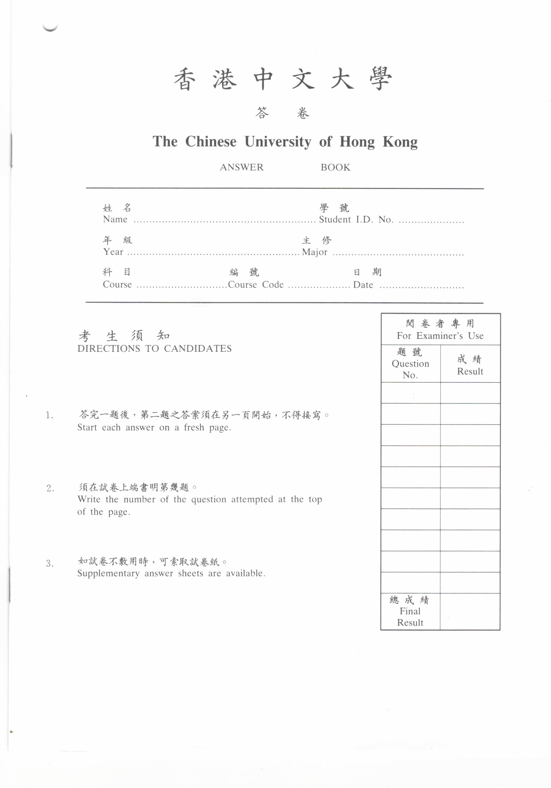
Insert your serial number (Ser.Num.) here
Answer Book
Serial
Number:
Question paper
Long questions: Write your answers in the answer book.
Short questions: Fill in the blanks provided in the question paper

Slide 4
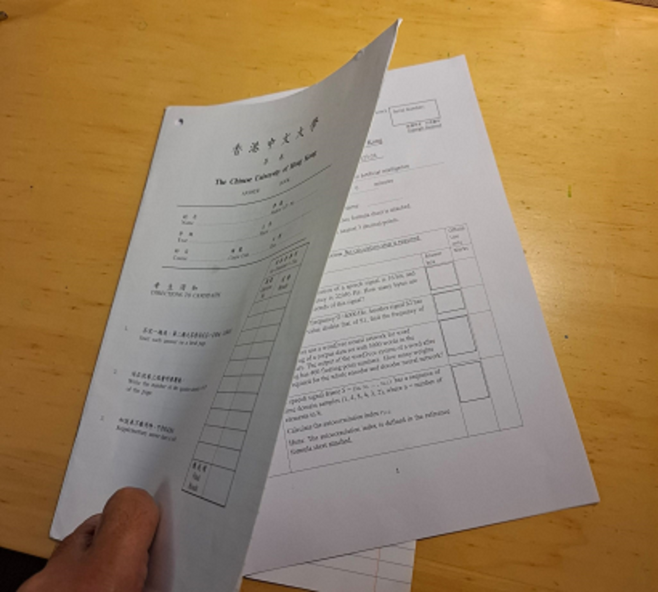
After completed the exam paper, insert your question paper into the answer book before submission. Return both to the invigilator.
answer book
question paper

