Slide 1
Classification Decision Tree and Regression Decision Tree
KH Wong

Slide 2
We will learn : the Classification and Regression decision Tree ( CART) ( or Decision Tree)
Classification decision tree
  uses Gini Index as metric.
  ID3 (Iterative Dichotomiser 3) or C4.5 and C5.0 : uses Information gain (based on Entropy function ) as metrics.
Regression decisions tree
  Using Variance
Regression vs classification algorithms
  Regression predicts a continuous quantity (a real number),
  Classification predicts discrete class labels ( 1 or -1; yes or no).
  There are areas of overlap of the two algorithms.
References:
https://medium.com/deep-math-machine-learning-ai/chapter-4-decision-trees-algorithms-b93975f7a1f1
https://machinelearningmastery.com/classification-and-regression-trees-for-machine-learning/

Slide 3
To build the tree you need training data
You should have enough data for training. It is a supervised learning algorithm
Divide the whole training data (100%) into:
  Training set (≈60-70%): for training your classifier
  Validation set (≈10-15%): for tuning the parameters
  Test set (≈10-30%): for testing the performance of your classifier

Slide 4
CART can preform classification or regression functions
When to use classification or regression?
Classification tree : Outputs are class (discrete) symbols not real numbers. E.g. high, medium, low etc.
  A good example can be found at https://sefiks.com/2018/08/28/a-step-by-step-regression-decision-tree-example/
Regression tree : Outputs are target variables (real numbers): E.g. 1.234, 5.678 etc. (In appendix)

Slide 5
Decision trees
Classification (decision) tree
Regression (decision) tree (Appendix)

Slide 6
Classification decision tree
Can also be called
Classification tree, or
Decision tree

Slide 7
Classification decision tree approaches
Famous classification tree models/software are CART and ID3.
  CART using Gini index
    https://en.wikipedia.org/wiki/Decision_tree_learning
  ID3 using information gain
    https://en.wikipedia.org/wiki/ID3_algorithm
Information gain & Gini index will be discussed

Slide 8
How to read Classification tree diagram
Leaf is not called Leaf node here to avoid confusion. However, some literature call it a leaf node.
Root node
Interior node
Interior node
Leaf
Leaf
Interior node
Interior node
Leaf
Leaf
Leaf
Leaf

Slide 9
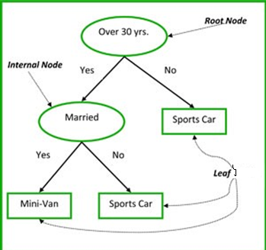
Common terms used with Classification Decision trees
Root Node: It represents entire population or sample and this further gets divided into two or more homogeneous sets.
Splitting: It is a process of dividing a node into two or more sub-nodes.
Decision Node: When a sub-node splits into further sub-nodes, then it is called decision node.
Leaf: Nodes do not split is called Leaf (but don’t call it leaf node, call it leaf)
Pruning: When we remove sub-nodes of a decision node, this process is called pruning. You can say opposite process of splitting.
Branch / Sub-Tree: A sub section of entire tree is called branch or sub-tree.
Parent and Child Node: A node, which is divided into sub-nodes is called parent node of sub-nodes whereas sub-nodes are the children of parent node.
https://medium.com/greyatom/decision-trees-a-simple-way-to-visualize-a-decision-dc506a403aeb

Slide 10
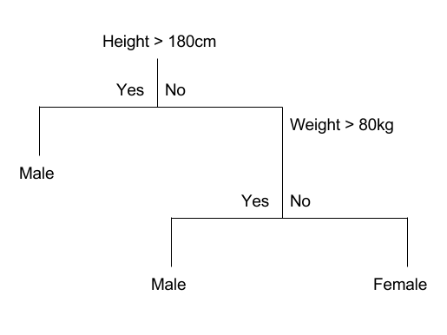
CART Model Representation
Root
node
Attribute
(variables)
CART can be a binary tree.
Each root node represents a single input variable (x) and a split point on that variable (assuming the variable is numeric).
The leaf of the tree contains an output variable (y) which is used to make a prediction.
Given a dataset with two inputs (x) of height in centimeters and weight in kilograms the output of sex as male or female, here is an example of a binary decision tree (completely fictitious for demonstration purposes only).
Leaf (class variable prediction)
In our naming system , we do not call a leaf a leaf-node or terminal-node (which are used in other literature) to avoid confusion.
https://machinelearningmastery.com/classification-and-regression-trees-for-machine-learning/

Slide 11
A simple example of a classification decision tree
Use height and weight to guess the sex of a person.
code
1 2 3 4 | If Height > 180 cm Then Male If Height <= 180 cm AND Weight > 80 kg Then Male If Height <= 180 cm AND Weight <= 80 kg Then Female Make Predictions With CART Models
The decision tree split this up into rectangles (when p=2 input variables) or some kind of hyper-rectangles with more inputs.
Testing to see if a person a male or not
Height > 180 cm: No
Weight > 80 kg: No
Therefore: Female

Slide 12
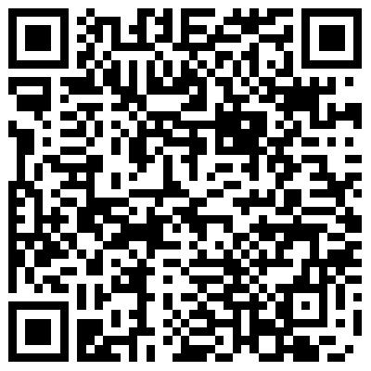
Exercise 1 : Classification Decision Tree
(Ex1a) Why the diagram Tree 1 is a binary tree?
  MC question, choices:
  at each node it has 1 leave
  at each node it has 2 leaves
  at each node it has 3 leaves
  at each node it has 4 leaves
(Ex1b) Number of nodes=N, number of leaves=L? Calculate N+L
  MC question, choices:
  N+L=4
  N+L= 5
  N+L=6
  N+L=7
(Ex1c) Person A is 173 cm , 79 Kg
Person B is 183 cm , 77 Kg
Which choice is correct?
  A=male, B=female
  A=male, B=male
  A=female, B=female
  A= female, B= male
Tree 1

Slide 13
Answer 1: Classification Decision Tree
(Ex1a) Why the diagram Tree 1 is a binary tree?
  MC question, choices:
  at each node it has 1 leave
  at each node it has 2 leaves (correct: at each node it has 2 leaves (choice 2 is correct)
  at each node it has 3 leaves
  at each node it has 4 leaves
(Ex1b) Number of nodes=N, number of leaves=L? Calculate N+L
  MC question, choices:
  N+L=4
  N+L=5 (correct) Nodes:2, leaves 3
  N+L=6
  N+L=7
(Ex1c) Person A is 173 cm , 79 Kg
Person B is 183 cm , 77 Kg
Which choice is correct?
  A=male, B=female
  A=male, B=male
  A=female, B=female
  A= female, B=male (correct)
Nodes
Tree 1
leaves

Slide 14
How to create a classification decision tree
Greedy Splitting : Grow the tree
Stopping Criterion: when the number of samples in a leaf is small enough.
Pruning the tree: remove unnecessary leaves to
  make it more efficient and
  solve the overfitting problem.

Slide 15
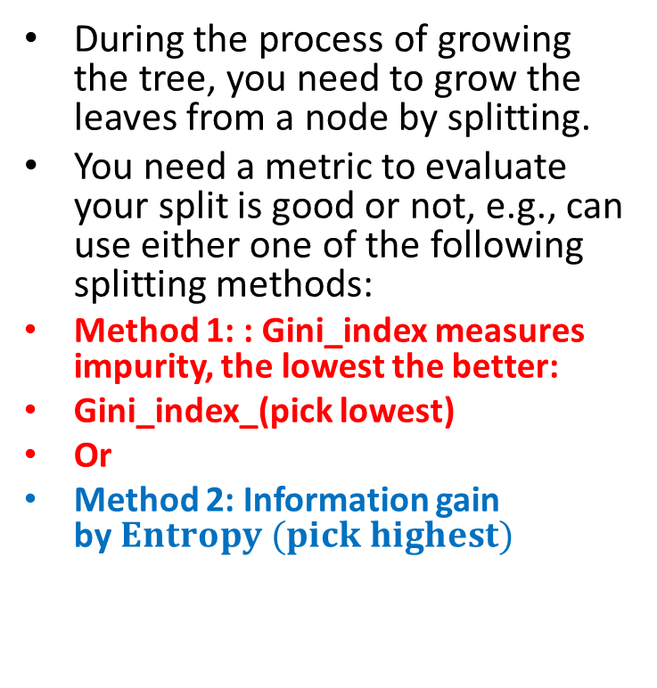
Greedy Splitting
During the process of growing the tree, you need to grow the leaves from a node by splitting.
You need a metric to evaluate your split is good or not, e.g., can use either one of the following splitting methods:
Method 1: : Gini_index measures impurity, the lowest the better:
Gini_index_(pick lowest)
Or
Method 2: Information gain by$Entropy (pick highest)$
Some math tools you may need:
By definition
If log_y(x) is logorithm(x) with base y, then
log_b (x)= log_a(x)/log_a (b)
E.g. log_2(1.8)=0.84799690655, or
=log_10(1.8)/log_10(2)= 0.84799690655
or
=ln(1.8)/ln(2)=0.84799690655, where ln() is “natural log” or log with base =2.718281828459.
Also
Note log(0) will give -ve infinity or NaN( Not a number) message, use log_2(0)≈log_2(0.00000001) = -26.5
in writing software code

Slide 16
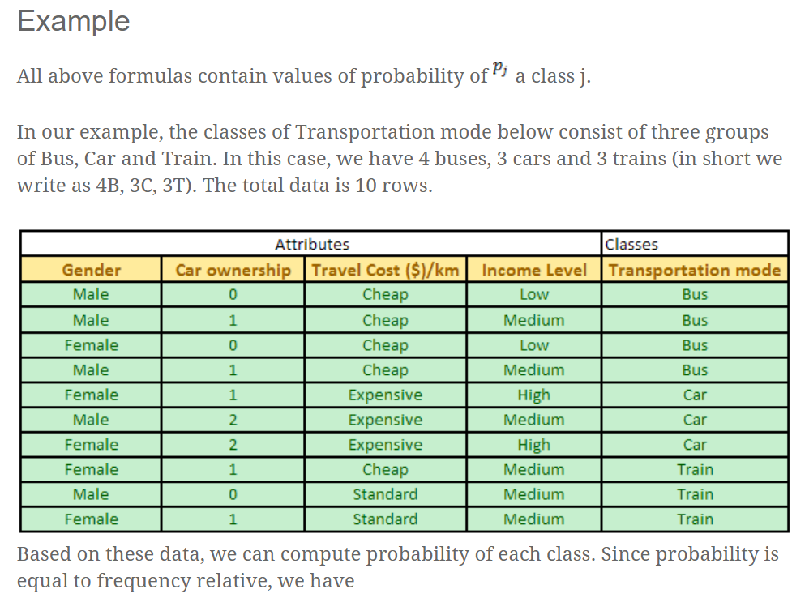
Example: data input
Male, female, etc. are Categorical variables
(or features)
(or outcome)
4 buses
3 cars
3 trains
Total 10 samples
https://www.saedsayad.com/decision_tree.htm

Slide 17
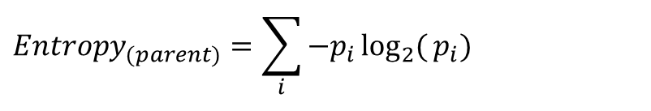
Method 1) Split metric : Entropy_{(Parent)} =Entropy at the top level
$$Entropy_{(parent)}=\sum_{i}{−p_{i}\log_{2}{(}p_{i})}$$
Prob(bus) =4/10=0.4
Prob(car) =3/10=0.3
Prob(train)=3/10=0.3
  Entropy_{(parent)}= -0.4*log_2(0.4)- 0.3*log_2(0.3)-0.3*log_2(0.3)
  =1.571 (measure how complex it is!)
  note:log_2 is log base 2. and log_b (x)= log_a(x)/log_a (b)
  Note log(0) will give -ve infinity or NaN( Not a number) message, use log_2(0)≈log_2(0.00000001) = -26.5 in writing code
Another example: if P(bus)=1, P(car)=0, P(train)=0
  Entropy = -1*log_2(1)-0*log_2(0.00001)- 0*log_2(0.000001)=0
  Entropy = 0, it is very pure, Impurity is 0
0=pure
Higher value=complex

Slide 18
Exercise 2
Method 2) Split metric: Gini index, or called Gini (impurity) index
(Ex.2a) : MC question,
Prob(bus) =4/10=0.4
Prob(car) =3/10=0.3
Prob(train)=3/10=0.3
Gini (impurity) index = ____?, choices:
  =1-(0.4+0.3+0.3)^2
  = 1-(0.4*0.4+0.3*0.3+0.3*0.3 )
  =1-(0.4*0.4+0.3*0.3)
  =1-(0.4*0.4-0.3*0.3-0.3*0.3)
(Ex.2b) If P(bus)=1, P(car)=0, P(train)=0, Gini (impurity) index =_?
  Gini (impurity) index = 0
  Gini (impurity) index= 1
  Gini (impurity) index= unknown
  Gini (impurity) index= -1

Slide 19
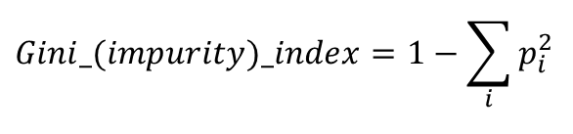
Answer2
Method 2) Split metric: Gini index, or called Gini (impurity) index
(Ex.2a) : MC question,
Prob(bus) =4/10=0.4
Prob(car) =3/10=0.3
Prob(train)=3/10=0.3
Gini (impurity) index = ____?, choices:
Gini index =1-(0.4*0.4+0.3*0.3+0.3*0.3)= 0.66
  =1-(0.4+0.3+0.3)^2
  =1-(0.4*0.4+0.3*0.3+0.3*0.3 ) (correct)
  =1-(0.4*0.4+0.3*0.3)
  =1-(0.4*0.4-0.3*0.3-0.3*0.3)
(Ex.2b) If P(bus)=1, P(car)=0, P(train)=0, Gini (impurity) index = ____?
  Gini (impurity) index = 0 (correct)
  Gini (impurity) index= 1
  Gini (impurity) index= unknown
  Gini (impurity) index= -1
  Because: Gini index= 1-1*1-0*0-0*0=0. Data probability is pure
  Impurity means the condition of being impure
$$Gini_(impurity)_index=1−\sum_{i}{p_{i}^{2}}$$

Slide 20
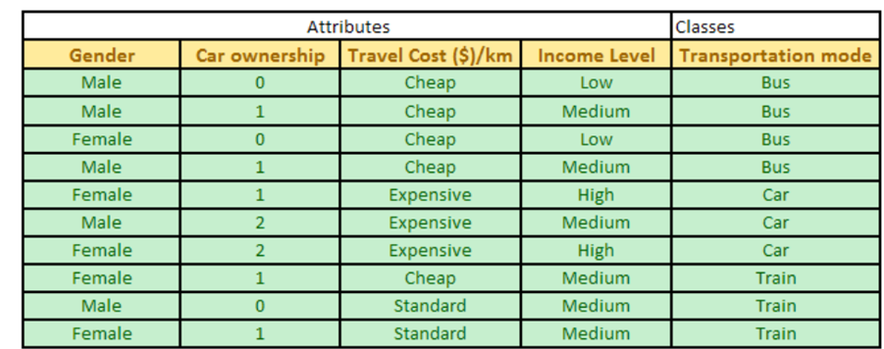
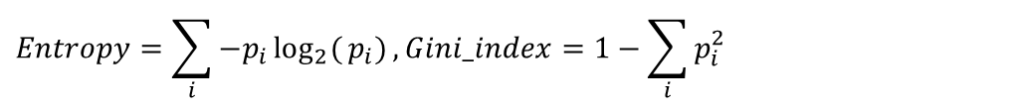
Exercise 3.
$$Entropy=\sum_{i}{−p_{i}\log_{2}{(}p_{i})},Gini_index=1−\sum_{i}{p_{i}^{2}}$$
Male, female, etc. are Categorical variables
(or features)
(or outcome)
Train
Train
Prob(bus) =2/10=0.2, Prob(car)=3/10=0.3, Prob(train)=5/10=0.5,
(Ex3a) : Which choice is correct? Parent Entropy =
-0.2*log_10(0.2)- 0.3*log_10(0.3)- 0.5*log_10(0.5)
-0.2*log_2(0.2)- 0.3*log_2(0.3)- 0.5*log_2(0.5)
-log_2(0.2)- log_2(0.3)- log_2(0.5)
-0.2* 0.2- 0.3*0.3- 0.5*0.5
(Ex3b) : Which choice is correct? Parent Gini index=
1-(0.2*0.2+0.3*0.3+0.5*0.5)
1+(0.2*0.2+0.3*0.3+0.5*0.5)
1-(0.2*0.2-0.3*0.3-0.5*0.5)
1+(0.2*0.2-0.3*0.3-0.5*0.5)

Slide 21
Answer3.
$$Entropy=\sum_{i}{−p_{i}\log_{2}{(}p_{i})},Gini_index=1−\sum_{i}{p_{i}^{2}}$$
Male, female, etc. are Categorical variables
(or features)
(or outcome)
Train
Train
Prob(bus) =2/10=0.2, Prob(car)=3/10=0.3, Prob(train)=5/10=0.5,
(Ex3a) : Which choice is correct? Parent Entropy =
-0.2*log_10(0.2)- 0.3*log_10(0.3)- 0.5*log_10(0.5)
-0.2*log_2(0.2)- 0.3*log_2(0.3)- 0.5*log_2(0.5)
-log_2(0.2)- log_2(0.3)- log_2(0.5)
-0.2* 0.2- 0.3*0.3- 0.5*0.5
Choice 2 is correct
(Ex3b) :Parent Gini index=
1-(0.2*0.2+0.3*0.3+0.5*0.5)
1+(0.2*0.2+0.3*0.3+0.5*0.5)
1-(0.2*0.2-0.3*0.3-0.5*0.5)
1+(0.2*0.2-0.3*0.3-0.5*0.5)
Choice 1 is correct
Ans: Entropy =-0.2*log_2(0.2)- 0.3*log_2(0.3)- 0.5*log_2(0.5)= 1.485
Ans: Gini index =1-(0.2*0.2+0.3*0.3+0.5*0.5)= 0.62

Slide 22
Method 3) Split metrics : Variance reduction
Introduced in CART (Classification And Regression Trees is a general name),^{[3]} variance reduction is often employed in cases where the target variable is continuous (regression tree), meaning that use of many other metrics would first require discretization before being applied. The variance reduction of a node N is defined as the total reduction of the variance of the target variable x due to the split at this node:
Details will be discussed in regression tree (appendix).
https://en.wikipedia.org/wiki/Decision_tree_learning

Slide 23
Splitting procedure: Recursive Partitioning Algorithm for CART
Take all of your training data.
Consider all possible values of all variables.
Select the variable/value (X=t₁) (e.g. X1=Height) that produces the greatest “separation” (or maximum homogeneity - - less impurity within each of the new part, meaning lowest Gini index) in the target.
(X=t₁) is called a “split”.
If X< t₁ (e.g. Height <180cm) then send the data to the “left”; otherwise, send data point to the “right”.
Now repeat same process on these two “nodes”. You get a “tree”
Better
to be pure for this branch
Better
to be pure for this branch
Better
to be pure for this branch
https://www.casact.org/education/specsem/f2005/handouts/cart.ppt

Slide 24
Example1: Design a decision tree (table1)
Day | Outlook (feature) | Temp. (feature) | Humidity (feature) | Wind (feature) | Decision (outcome)
1 | Sunny | Hot | High | Weak | No
2 | Sunny | Hot | High | Strong | No
3 | Overcast | Hot | High | Weak | Yes
4 | Rain | Mild | High | Weak | Yes
5 | Rain | Cool | Normal | Weak | Yes
6 | Rain | Cool | Normal | Strong | No
7 | Overcast | Cool | Normal | Strong | Yes
8 | Sunny | Mild | High | Weak | No
9 | Sunny | Cool | Normal | Weak | Yes
10 | Rain | Mild | Normal | Weak | Yes
11 | Sunny | Mild | Normal | Strong | Yes
12 | Overcast | Mild | High | Strong | Yes
13 | Overcast | Hot | Normal | Weak | Yes
14 | Rain | Mild | High | Strong | No
https://sefiks.com/2018/08/27/a-step-by-step-cart-decision-tree-example/

Slide 25
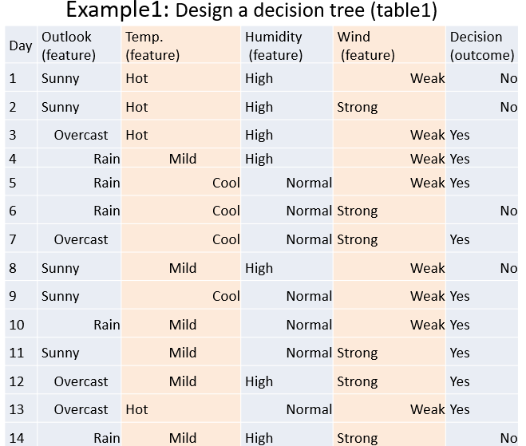
Image of the example

Slide 26
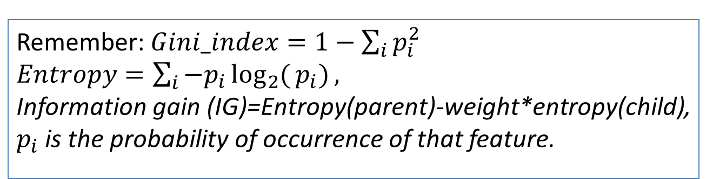
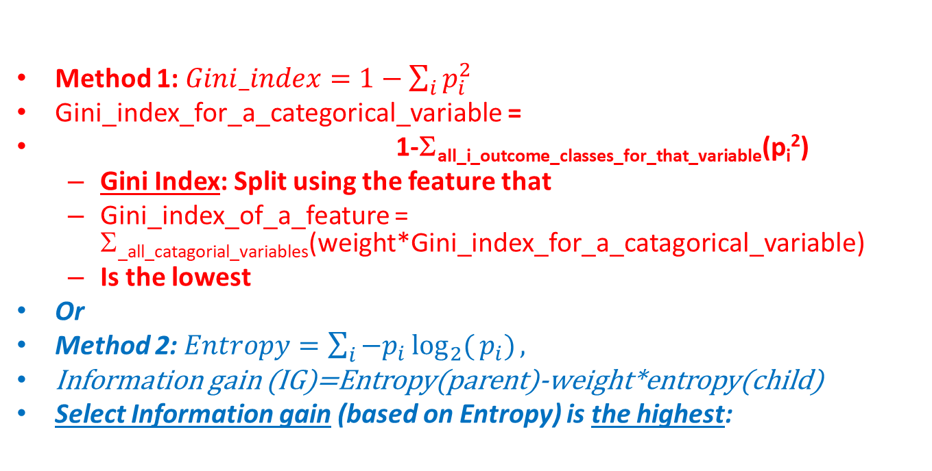
(1)Gini index or (2)Information gain approach
Method 1:$Gini_index=1−\sum_{i}{p_{i}^{2}}$
Gini_index_for_a_categorical_variable =
1-Σall_i_outcome_classes_for_that_variable(p_{i}²)
  Gini Index: Split using the feature that
  Gini_index_of_a_feature = Σ_{_all_catagorial_variables}(weight*Gini_index_for_a_catagorical_variable)
  Is the lowest
Or
Method 2:$Entropy=\sum_{i}{−p_{i}\log_{2}{(}p_{i})},$
Information gain (IG)=Entropy(parent)-weight*entropy(child)
Select Information gain (based on Entropy) is the highest:
Remember:$Gini_index=1−\sum_{i}{p_{i}^{2}}$
$Entropy=\sum_{i}{−p_{i}\log_{2}{(}p_{i})},$
Information gain (IG)=Entropy(parent)-weight*entropy(child), $p_{i}$ is the probability of occurrence of that feature.

Slide 27
Outlook( should it be at the top of the tree?)
GINI index approach
Outlook is a nominal feature. It can be sunny, overcast or rain (categorical variables). I will summarize the final decisions for the outlook feature.
Gini(Outlook=Sunny) = 1 – (2/5)^2– (3/5)^2 = 0.48
Gini(Outlook=Overcast) = 1 – (4/4)^2– (0/4)^2 = 0
Gini(Outlook=Rain) = 1 – (3/5)^2 – (2/5)^2 = 0.48
Then, we will calculate weighted sum of Gini indexes for the outlook feature.
Gini(Outlook) = (5/14) * 0.48 + (4/14) * 0 + (5/14) * 0.48 = 0.343
Information gain by entropy approach: Overall decision: yes=9, no=5
Parent entropy= -(9/14)*log_2(9/14)-(5/14)*log_2(5/14)=0.94
Outlook is a nominal feature. It can be sunny, overcast or rain. I will summarize the final decisions for outlook feature.
Weighted_entropy(Outlook=Sunny) =(5/14)*( -(2/5)*log_2(2/5)-(3/5)*log_2(3/5))=0.347
Weighted_entropy(Outlook=Overcast) = (4/14)*( -(4/4)*log_2(4/4)-(0/4)*log_2(0.000001/4))=0
Weighted_entropy(Outlook=Rain) = (5/14)*( -(3/5)*log_2(3/5)-(2/5)*log_2(2/5))=0.347
Information_gain_for_outlook= Parent entropy- Weighted_entropy(Outlook=Sunny)- Weighted_entropy(Outlook=Overcast) - Weighted_entropy(Outlook=Rain)=0.94
-0.347-0-0.347= 0.246
Weighted_entropy =weight*entropy
Outlook | Yes | No | Number of instances
Sunny | 2 (P_{yes}=2/5) | 3 (P_{no}=3/5) | 5
Overcast | 4 (P_{yes}=4/4) | 0 (P_{no}=0/4) | 4
Rain | 3 (P_{yes}=3/5) | 2(P_{no}=2/5) | 5
From table1 of example1

Slide 28
Exercise 4:Temperature
GINI index approach (MC question)
Similarly, temperature is a nominal feature, and it can have 3 different values: Cool, Hot and Mild. Let’s summarize decisions for the temperature feature.
(Ex4a) : Gini(Temp=Hot) =________________________________?
(Ex4b) Gini(Temp=Mild) =________________________________?
(Ex4c) Gini(Temp=Cool) =________________________________?
We’ll calculate weighted sum of Gini index for temperature feature
(Ex4d) Gini(Temp) =_____________________________________?
Choices:
0.375
0.5
0.439
0.445
Information gain by entropy approach: Overall decision: yes=9, no=5
Parent entropy= -(9/14)*log_2(9/14)-(5/14)*log_2(5/14)=0.94 (same as last page)
Humidity is a feature. It can be High or Normal
Weighted_entropy(Temp=Hot) =(4/14)*( -(2/4)*log_2(2/4)- (2/4)*log_2(2/4))=0.2857
Weighted_entropy(Temp=Mild) =(6/14)*( -(4/6)*log_2(4/6)- (2/6)*log_2(2/6))=0.39355
Weighted_entropy(Temp=Cool) =(4/14)*( -(3/4)*log_2(3/4)- (1/4)*log_2(1/4))= 0.23179
Information_gain_for_humidity= Parent entropy- Weighted_entropy(Temp=Hot) - Weighted_entropy(Temp=Cool) – Weighted_entropy(Temp=Mild) =0.94- 0.2857
- 0.39355 - 0.23179 = 0.029
Weighted_entropy =weight*entropy
Temperature | Yes | No | Number of instances
Hot | 2 | 2 | 4
Mild | 4 | 2 | 6
Cool | 3 | 1 | 4
Gi
From table1 of example1

Slide 29
ANSWER 4:Temperature
GINI index approach
Similarly, temperature is a nominal feature, and it can have 3 different values: Cool, Hot and Mild (Categorical variables). Let’s summarize decisions for the temperature feature.
(Ex4a) : Gini(Temp=Hot) = 1-(2/4)^2- (2/4)^2 = 0.5 (choice 2 is correct)
(Ex4b) : Gini(Temp=Mild) = 1-(4/6)^2-(2/6)^2 = 0.445 (choice 4 is correct)
(Ex4c) : Gini(Temp=Cool) = 1-(3/4)^2-(1/4)^2 = 0.375 (choice 1 is correct)
We’ll calculate weighted sum of Gini index for temperature feature
(Ex4d) : Gini(Temp) =(4/14) *0.5 +(6/14)*0.445 +(4/14)*0.375 = 0.439 (choice 3)
Choices:
0.375
0.5
0.439
0.445
Information gain by entropy approach: Overall decision: yes=9, no=5
Parent entropy= -(9/14)*log_2(9/14)-(5/14)*log_2(5/14)=0.94 (same as last page)
Humidity is a feature. It can be High or Normal
Weighted_entropy(Temp=Hot) =(4/14)*( -(2/4)*log_2(2/4)- (2/4)*log_2(2/4))=0.2857
Weighted_entropy(Temp=Mild) =(6/14)*( -(4/6)*log_2(4/6)- (2/6)*log_2(2/6))=0.39355
Weighted_entropy(Temp=Cool) =(4/14)*( -(3/4)*log_2(3/4)- (1/4)*log_2(1/4))= 0.23179
Information_gain_for_humidity= Parent entropy- Weighted_entropy(Temp=Hot) - Weighted_entropy(Temp=Cool) – Weighted_entropy(Temp=Mild) =0.94- 0.2857
- 0.39355 - 0.23179 = 0.029
Weighted_entropy =weight*entropy
Temperature | Yes | No | Number of instances
Hot | 2 | 2 | 4
Mild | 4 | 2 | 6
Cool | 3 | 1 | 4
Gi
From table1 of example1

Slide 30
Humidity (choose as top of tree?)
GINI index approach
Humidity is a binary class feature. It can be high or normal (categorical variables).
Gini(Humidity=High) = 1 – (3/7)^2 – (4/7)^2 = 1 – 0.183 – 0.326 = 0.489
Gini(Humidity=Normal) = 1 – (6/7)^2 – (1/7)^2 = 1 – 0.734 – 0.02 = 0.244
Weighted sum for humidity feature will be calculated next
Gini(Humidity) = (7/14) x 0.489 + (7/14) x 0.244 = 0.367
Information gain by entropy approach: Overall decision: yes=9, no=5
Parent entropy= -(9/14)*log_2(9/14)-(5/14)*log_2(5/14)=0.94 (same as last page)
Humidity is a feature. It can be High or Normal
Weighted_entropy(Humidity=high) =(7/14)*( -(3/7)*log_2(3/7)- (4/7)*log_2(4/7))=0.492
Weighted_entropy(Humidity=Normal) =(7/14)*( -(6/7)*log_2(6/7)- (1/7)*log_2(1/7))=0.296
Information_gain_for_humidity= Parent entropy- Weighted_entropy(Humidity=high) - Weighted_entropy(Humidity=Normal) =0.94- 0.492- 0.296= 0.152
Weighted_entropy =weight*entropy
From table1 of example1
Humidity | Yes | No | Number of instances
High | 3 | 4 | 7
Normal | 6 | 1 | 7

Slide 31
Exercise 5: Wind (choose as top?)
GINI index approach
Wind is a binary class similar to humidity. It can be weak and strong (as categorical variables).
Gini(Wind=Weak) = 1-(6/8)^2- (2/8)^2 =0.375
Gini(Wind=Strong) = 1-(3/6)^2-(3/6)^2 = 0.5
Gini(Wind) = (8/14) * 0.375 + (6/14) * 0.5 = 0.428
Information gain by entropy approach: Overall decision: yes=9, no=5
Parent entropy= ________________________?
Weighted_entropy(wind=weak) =__________?
Weighted_entropy(wind=strong) =_________?
Information_gain_for_wind =
Information_gain_for_wind = Parent entropy- Weighted_entropy(wind=weak) - Weighted_entropy(wind=strong) =_________?
Choices:
0.464
0.94
0.048
0.428
Wind | Yes | No | Number of instances
Weak | 6 | 2 | 8
Strong | 3 | 3 | 6
From table1 of example1

Slide 32
Answer 5: Wind (choose as top?)
GINI index approach
Wind is a binary class similar to humidity. It can be weak and strong.
Gini(Wind=Weak) = 1-(6/8)^2- (2/8)^2 =0.375
Gini(Wind=Strong) = 1-(3/6)^2-(3/6)^2 = 0.5
Gini(Wind) = (8/14) * 0.375 + (6/14) * 0.5 = 0.428
Information gain by entropy approach: Overall decision: yes=9, no=5
Parent entropy= -(9/14)*log_2(9/14)-(5/14)*log_2(5/14)=0.94 (choice 2, same as before)
Weighted_entropy(wind=weak) =(8/14)*( -(6/8)*log_2(6/8)- (2/8)*log_2(2/8))=0.464 (choice 1 is correct)
Weighted_entropy(wind=strong) =(6/14)*( -(3/6)*log_2(3/6)- (3/6)*log_2(3/6))=0.428 (choice 4 is correct)
Information_gain_for_wind = Parent entropy- Weighted_entropy(wind=weak) - Weighted_entropy(wind=strong) =____________________?
=0.94- 0.464 - 0.428 = 0.048 (choice 3 is correct)
Choices:
0.464
0.94
0.048
0.428
From table1 of example1
Wind | Yes | No | Number of instances
Weak | 6 | 2 | 8
Strong | 3 | 3 | 6

Slide 33
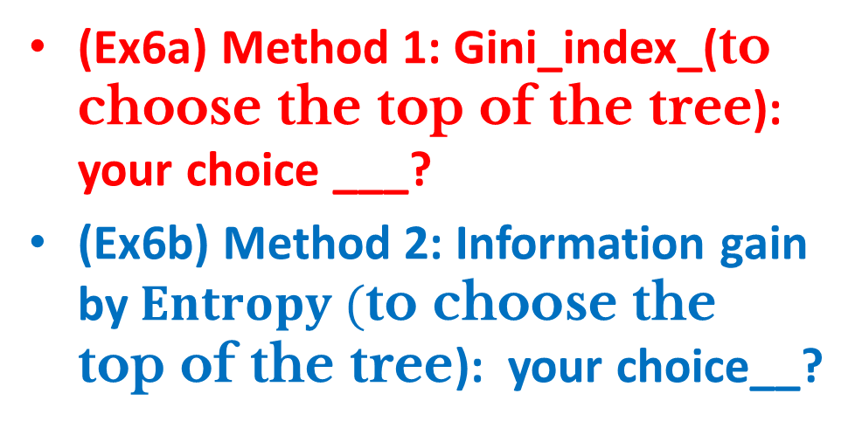
Question 6 : Time to decide: Use either Gini or information gain to choose the top of the tree
(Ex6a) Method 1: Gini_index_(to choose the top of the tree): your choice ___?
(Ex6b) Method 2: Information gain by$Entropy (\text{to} \text{choose} \text{the} \text{top} \text{of} \text{the} \text{tree}$): your choice__?
Question: Choose which one is used as the top node
Feature | Method 1 : Gini index | Method 2 : Information gain by entropy
Outlook (Choice 1) | 0.342 | 0.246
Temperature (Choice 2) | 0.439 | 0.029
Humidity (Choice 3) | 0.367 | 0.152
Wind (Choice 4) | 0.428 | 0.048

Slide 34

Answer 6 : Time to decide: Use either Gini or information gain to choose the top of the tree
(Ex6a) Method 1: Gini_index_(to choose the top of the tree): your choice ___? (answer: pick lowest, choice 1 is correct)
(Ex6b) Method 2: Information gain by$Entropy (\text{to} \text{choose} \text{the} \text{top} \text{of} \text{the} \text{tree}$): your choice__? (answer: pick highest, choice 1 is correct)
Answer: Both methods agrees with each other
Feature | Method 1 : Gini index | Method 2 : Information gain by entropy
Outlook ( picked as top node) (Choice 1) | 0.342 (lowest) | 0.246 (highest)
Temperature (Choice 2) | 0.439 | 0.029
Humidity (Choice 3) | 0.367 | 0.152
Wind (Choice 4) | 0.428 | 0.048

Slide 35
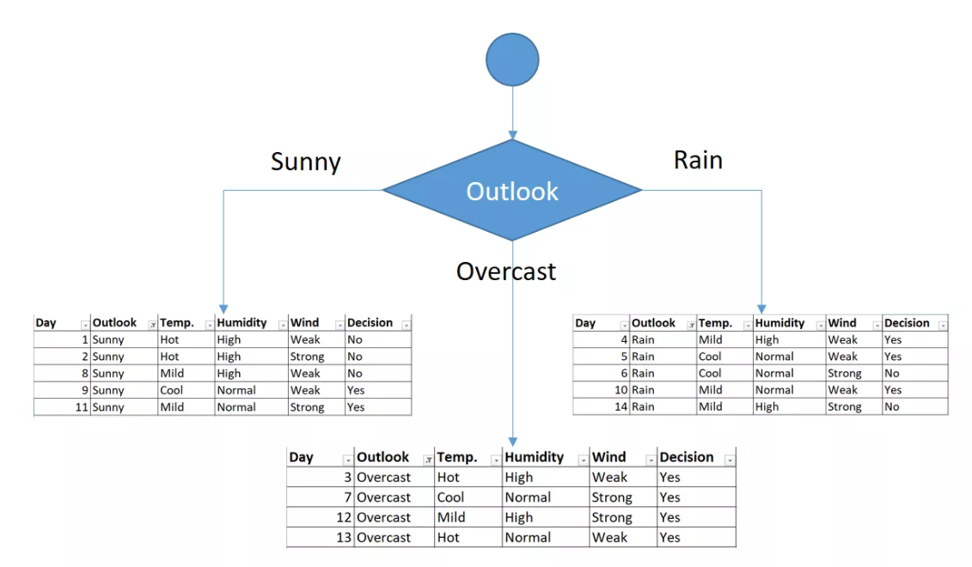
Now we decided : outlook decision is at the top of the tree. Then, here we concentrate on leaves under : sunny, overcast, rain (Categorical variables).
Top of the tree
All “Decision=yes”, so the branch for “Overcast” is over

Slide 36
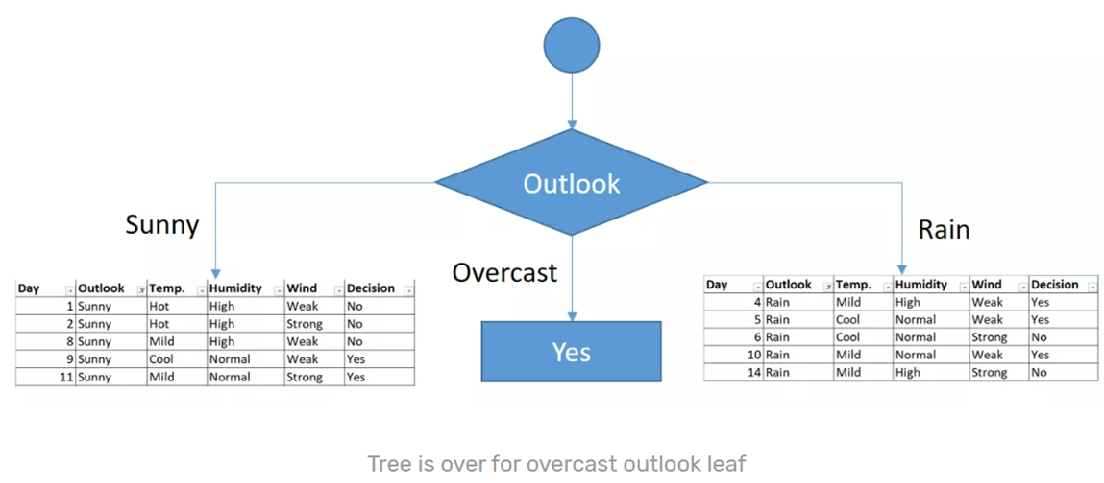
You might realize that sub dataset in the overcast leaf has only yes decisions. This means that overcast leaf is done.
Top of the tree

Slide 37
We will apply same principles to those sub datasets in the following steps. Focus on the sub dataset for sunny/outlook. We need to find the Gini index scores for temperature, humidity and wind features, respectively.
Total population total under Outlook_sunny=5, yes=2,no=3
Day | Outlook | Temp. | Humidity | Wind | Decision
1 | Sunny | Hot | High | Weak | No
2 | Sunny | Hot | High | Strong | No
8 | Sunny | Mild | High | Weak | No
9 | Sunny | Cool | Normal | Weak | Yes
11 | Sunny | Mild | Normal | Strong | Yes

Slide 38
Gini of temperature for sunny outlook
Gini approach
Gini(Outlook=Sunny & Temp=Hot) = 1-(0/2)^2-(2/2)^2 = 0
Gini(Outlook=Sunny & Temp=Cool) =1-(1/1)^2-(0/1)^2 = 0
Gini(Outlook=Sunny & Temp=Mild) = 1-(1/2)^2-(1/2)^2 = 0.5
Gini(Outlook=Sunny & Temp)=(2/5)*0+(1/5)*0+(2/5)*0.5 = 0.2
Information gain by entropy : Total population under Outlook_sunny=5, yes=2,no=3
Parent entropy_Outlook_sunny= -(2/5)*log_2(2/5)-(3/5)*log_2(3/5) = 0.97
Weighted_entropy(outlook_sunny=hot) =(2/5)*( -(0/2)*log_2(0/2)- (2/2)*log_2(2/2))=0
Weighted_entropy(outlook_sunny=cool) =(1/5)*( -(0/1)*log_2(0.0001/1)- (0/1)*log_2(0.0001/1))=0
Weighted_entropy(outlook_sunny=Mild) =(2/5)*( -(1/2)*log_2(1/2)- (1/2)*log_2(1/2))=0.4
Information_gain_for_outlook_sunny= Parent entropy_Outlook_sunny - Weighted_entropy(outlook_sunny=hot) – Weighted_entropy(outlook_sunny=cool)- Weighted_entropy(outlook_sunny=Mild)= 0.97 -0-0-0.4= 0.57
Temperature | Yes | No | Number of instances
Hot | 0 | 2 | 2
Cool | 1 | 0 | 1
Mild | 1 | 1 | 2

Slide 39
Gini of humidity for sunny outlook
Gini approach
Gini(Outlook=Sunny and Humidity=High) = 1-(0/3)^2-(3/3)^2 = 0
Gini(Outlook=Sunny and Humidity=Normal) = 1-(2/2)^2-(0/2)^2 = 0
Gini(Outlook=Sunny and Humidity) = (3/5)*0 + (2/5)*0 = 0
Weighted_entropy(outlook_humidity=high) =(3/5)*( -(0/3)*log_2(0.00001/3)- (3/3)*log_2(3/3))=0
Weighted_entropy(outlook_humidity=normal) =(2/5)*( -(2/2)*log_2(2/2)- (0.0001/2)*log_2(0.00001/2))=0
Information_gain_for_outlook_humidity= Parent entropy_Outlook_sunny - Weighted_entropy(outlook_humidity=high)- Weighted_entropy(outlook_humidity=normal)= 0.97 -0-0= 0.97
Humidity | Yes | No | Number of instances
High | 0 | 3 | 3
Normal | 2 | 0 | 2

Slide 40
Gini of wind for sunny outlook
Gini Approach
Gini(Outlook=Sunny and Wind=Weak) = 1-(1/3)^2-(2/3)^2 =0.445
Gini(Outlook=Sunny and Wind=Strong) = 1-(1/2)^2-(1/2)^2 = 0.5
Gini(Outlook=Sunny and Wind) = (3/5)*0.445 + (2/5)*0.5 = 0.467
Weighted_entropy(Outlook=Sunny and Wind=Weak) =(3/5)*( -(1/3)*log_2(1/3)- (2/3)*log_2(2/3))=0.551
Weighted_entropy(Outlook=Sunny and Wind=strong) =(2/5)*( -(1/2)*log_2(1/2)- (1/2)*log_2(1/2))=0.4
Information_gain_for_Outlook_Sunny= Parent entropy_Outlook_sunny - Weighted_entropy(Outlook=Sunny and Wind=Weak) - Weighted_entropy(Outlook=Sunny and Wind=strong) =0.97-0.551-0.4=0.019
Wind | Yes | No | Number of instances
Weak | 1 | 2 | 3
Strong | 1 | 1 | 2

Slide 41
Decision for sunny outlook
We’ve calculated Gini index score for feature when outlook is sunny. The winner is humidity because it has the lowest value. We’ll put humidity check at the extension of sunny outlook
Split using the attribute that the Gini (impurity) index is the lowest . Gini_index=1-Σ(p_{i})²
Or splitting using
Information gain (based on Entropy) is the highest:
Both results agree with each other. Humidity is picked as the second level node
Feature | Gini index | Information gain by entropy
Temperature | 0.2 | 0.57
Humidity | 0 is the lowest | 0.97 is the highest
Wind | 0.466 | 0.019

Slide 42
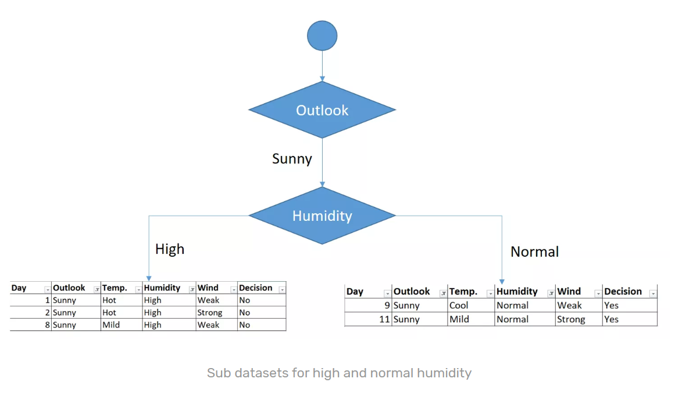
Result
Both results agree with each other. Humidity is picked as the second level node
Pure No
Pure Yes
When humidity is “High”, decision is pure “No”
When humidity is “Normal”, decision is pure “Yes”

Slide 43
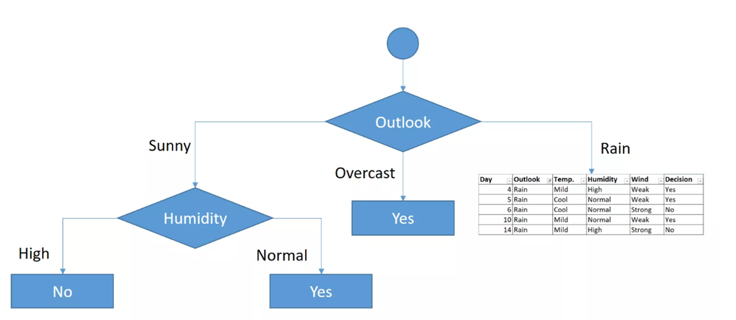
As seen, decision is always “no” for high humidity and sunny outlook. On the other hand, decision will always be “yes” for normal humidity and sunny outlook. This branch is over.

Slide 44
Now we will work on the Rain branch
Now, we need to focus on rain outlook.
We’ll calculate Gini index scores for temperature, humidity and wind features when outlook is rain.
Day | Outlook | Temp. | Humidity | Wind | Decision
4 | Rain | Mild | High | Weak | Yes
5 | Rain | Cool | Normal | Weak | Yes
6 | Rain | Cool | Normal | Strong | No
10 | Rain | Mild | Normal | Weak | Yes
14 | Rain | Mild | High | Strong | No

Slide 45
Gini of temperature for rain outlook
Gini Approach
Gini(Outlook=Rain and Temp.=Cool) = 1-(1/2)^2-(1/2)^2 = 0.5
Gini(Outlook=Rain and Temp.=Mild) = 1-(2/3)^2-(1/3)^2 = 0.444
Gini(Outlook=Rain and Temp.) = (2/5)*0.5 + (3/5)*0.444 = 0.466
Information gain by entropy : Total population under Outlook_rain=5, yes=3,no=2
Parent entropy_Outlook_rain= -(3/5)*log_2(3/5)-(2/5)*log_2(2/5) = 0.97
Weighted_entropy(Outlook_rain=cool) =(2/5)*( -(1/2)*log_2(1/2)- (1/2)*log_2(1/2))=0.4
Weighted_entropy(Outlook_rain=Mild) =(3/5)*( -(2/3)*log_2(2/3)- (1/3)*log_2(1/3))=0.551
Information_gain_for_Outlook_rain= Parent entropy_Outlook_rain - Weighted_entropy(Outlook_rain=cool) - Weighted_entropy(Outlook_rain=Mild) = 0.97
-0.4-0.551= 0.019
Temperature | Yes | No | Number of instances
Cool | 1 | 1 | 2
Mild | 2 | 1 | 3

Slide 46
Gini of Humidity for rain outlook
Gini approach
Gini(Outlook=Rain and humidity=High) = 1-(0/3)^2-(3/3)^2 =0
Gini(Outlook=Rain and humidity=normal) = 1-(2/2)^2-(0/2)^2 = 0
Gini(Outlook=Rain and humidity) = (3/5)*0 + (2/5)*0 = 0
Weighted_entropy(Outlook=rain and humidity=high) =(3/5)*( -(0/3)*log_2(0.00001/3)- (3/3)*log_2(3/3))=0
Weighted_entropy(Outlook=rain and humidity=normal) =(2/5)*( -(2/2)*log_2(2/2)- (0/2)*log_2(0.00001/2))=0
Information_gain_for_outlook_rain= Parent entropy_Outlook_rain - Weighted_entropy(Outlook=rain and humidity=high) - Weighted_entropy(Outlook=rain and humidity=high) =0.97-0-0=0.97
Humidity | Yes | No | Number of instances
High | 0 | 3 | 3
Normal | 2 | 0 | 2

Slide 47
Gini of wind for rain outlook
Gini approach
Gini(Outlook=Rain Gini(Outlook=Rain and Wind=Weak) = 1-(3/3)^2-(0/3)^2 = 0
Gini(Outlook=Rain and Wind=Strong) = 1-(0/2)^2-(2/2)^2 = 0
Gini(Outlook=Rain and Wind) = (3/5)*0 + (2/5)*0 = 0
and Wind=Weak) = 1-(3/3)^2-(0/3)^2 = 0
Gini(Outlook=Rain and Wind=Strong) = 1-(0/2)^2-(2/2)^2 = 0
Gini(Outlook=Rain and Wind) = (3/5)*0 + (2/5)*0 = 0
Weighted_entropy(Outlook=rain and Wind=Weak) =(3/5)*( -(3/3)*log_2(3/3)- (0/3)*log_2(0.00001/3))=0
Weighted_entropy(Outlook=rain and Wind=strong) =(2/5)*( -(0/2)*log_2(0.0001/2)- (2/2)*log_2(2/2))=0
Information_gain_for_outlook_rain= Parent entropy_Outlook_rain - Weighted_entropy(Outlook=rain and Wind=Weak) - Weighted_entropy(Outlook=rain and Wind=strong) = 0.97-0-0=0.97
Wind | Yes | No | Number of instances
Weak | 3 | 0 | 3
Strong | 0 | 2 | 2

Slide 48
Decision for rain outlook
The winner is wind feature for rain outlook because it has the minimum gini index score in features.
Put the wind feature for rain outlook branch and monitor the new sub data sets. Split using the attribute that the Gini (impurity) index is the lowest .
Or
Information gain (based on Entropy) is the highest:
Feature | Gini index | Information gain by entropy
Temperature | 0.466 | 0.019
Humidity | 0 is the lowest | 0.97 is highest
Wind | 0 is the lowest | 0.97 is the highest (pick this arbitrary)

Slide 49
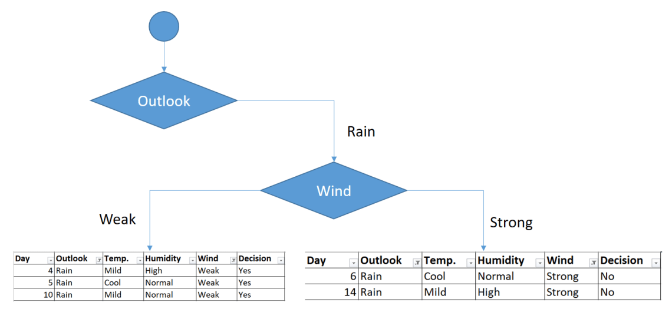
Put the wind feature for rain outlook branch and monitor the new sub data sets. Can repeat the calculation to find the complete solution.
However, you might realize that sub dataset in the overcast leaf has only yes decisions. This means that overcast leaf is over.
Pure :yes
Pure :Nos
Sub data sets for weak and strong wind and rain outlook

Slide 50
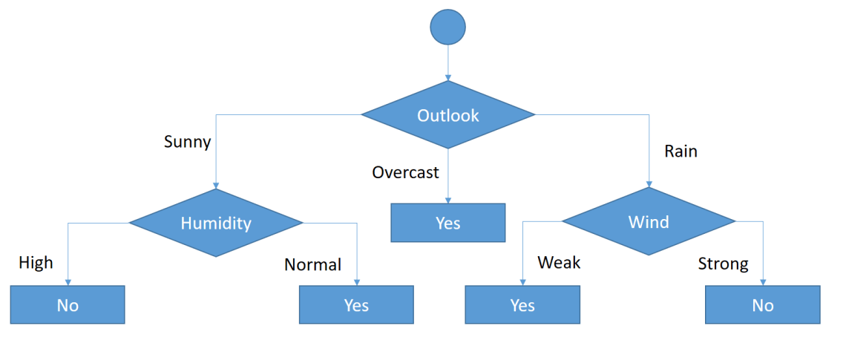
Final result
As seen, decision is always “yes” when “wind” is “weak”. On the other hand, decision is always “no” if “wind” is “strong”. This means that this branch is over.

Slide 51
Example 2
Design a tree to find out whether an umbrella is needed

Slide 52
An example: design a tree to find out whether an umbrella is needed
Weather Driving Class=Umbrella
------- -------- ----------
1 Sunny 1 Yes 1 Yes
2 Cloudy 2 No 2 No
3 Rainy
------- ----- -------
1 1 2
1 2 2
2 1 2
3 1 2
2 2 1
3 1 2
3 2 1
2 2 2
2 2 1
The first question is :
Choose the root attribute:
You have two choices for the root attribute:
1) Weather
2) Driving

Slide 53
How to build the tree
First question: You have 2 choices
1) Root is attribute “Weather”: The braches are
  Sunny or not , find metric M_sunny
  Cloudy or not, find metric M_cloudy
  Rainy or not, find metric M_rainy
  Total weather_split_metric= weight_sunny*M_sunny+ weight_cloudy*M_cloudy+ weight_rainy*M_rainy
  (If this is smaller, pick “weather” as root)
2) Root is attribute “Driving”:
  Yes or n umbrella , find metric M_drive
  Total split_metric_drive= weight_drive* M_drive
  Note weight_drive =1, since it is the only choice
  (If this is smaller, pick “driving” as root)
We will describe the procedure using 7 steps
Root=weather
Sunny
Cloudy
Rainy
OR
Root=driving
Yes
(umbrella)
No
(umbrella)

Slide 54
Steps to develop the tree.
If root is attribute “weather”:
Weather:
Sunny ?
step1
Step1 : if root is attribute “weather”, branch is “Sunny”, find split metric (M_sunny)
Step2 : if root is attribute “weather”, branch is “Cloudy”, find split metric (M_cloudy)
Step3: if root is attribute “weather”, branch is “Rainy”, find split metric (M_rainy)
yes
No
Weather:
Cloudy ?
step2
yes
No
Weather:
Rainy ?
step3
yes
No
54

Slide 55
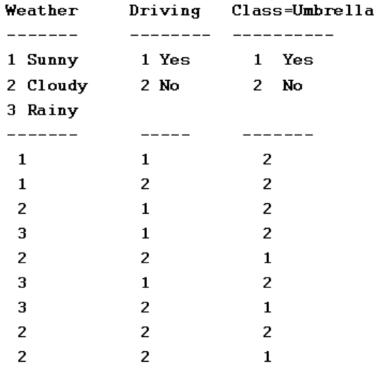
Step1: Find M_sunny, Weight_sunny
Weather:
Sunny ?
step1
N=Number of samples=9
M1=Number of sunny cases=2
W1=Weight_sunny=M1/N=2/9
N1y=Num of Umbrella yes=0
N1n=Num of Umbrella No=2
Nsunny=2
G1=Gini=1- ((N1y/M1)^2+(N1n/M1)^2)
= 1-((0/2)^2+(2/2)^2)=0
Metric_sunny=G1 or E1
yes
No

Slide 56
For step2: Find M_cloudy, Weight_cloudy
Weather:
Cloudy?
step2
yes
No
N=Number of samples=9
M2=Number of cloudy cases=4
W2=Weight_cloudy=M2/N=4/9
N2y=Num of Umbrella Yes, when cloudy=2
N2n=Num of Umbrella No, when cloudy=2
G2=Gini=1- ((N2y/M2)^2+(N2n/M2)^2)
= 1-((2/4)^2+(2/4)^2)=0.5
Metric_cloudy=G2 or E2

Slide 57
For step3: Find M_rainy, Weight_rainy
Weather:
Rainy ?
step3
yes
No
N=Number of samples=9
M3=Number of rainy cases=3
W3=Weight_rainy=M3/N=3/9
N3y=Num of Umbrella Yes, when rainy=1
N3n=Num of Umbrella No, when rainy=2
G3=Gini=1- ((N3y/M3)^2+(N3n/M3)^2)
= 1-((1/3)^2+(2/3)^2)=0.444
Metric_rainy=G3 or E3

Slide 58
Step4: metric for weather
weather_split_metric= weight_sunny*M_sunny+ weight_cloudy*M_cloudy+ weight_rainy*M_rainy
weather_split_metric_Gini= W1*G1+W2*G2+W3*G3
=(2/9)*0+(4/9)*0.5+(3/9)*0.44= 0.3689

Slide 59
Step5a: Find M_driving, Weight_driving_yes
driving ?
step5
yes
No
N=Number of samples=9
M4=Number of driving cases=4
W4=Weight_driving=M4/N=4/9
N4y=Num of Umbrella Yes, when driving=0
N4n=Num of Umbrella No, when driving=4
G4=Gini=1- ((N4y/M4)^2+(N4n/M4)^2)
G4=Gini=1- ((0/4)^2+(4/4)^2)=0
Metric_driving=G4 or E4

Slide 60
Step5b: Find M_driving, Weight_driving_no
driving ?
step5
yes
No
N=Number of samples=9
M5=Number of driving cases=5
W5=Weight_no_driving=M4/N=5/9
N5y=Num of Umbrella Yes, when not driving=3
N5n=Num of Umbrella No, when not driving=2
G4=Gini=1- ((N5y/M5)^2+(N5n/M5)^2)
G4=Gini=1- ((3/5)^2+(2/5)^2)=0.48
Metric_driving=G5 or E5

Slide 61
Step6: metric for driving
driving_split_metric= driving_sunny*M_yes+ driving_cloudy*M_no
driving_split_metric_Gini= W4*G4 +W5*G5= (4/9)*0+ (5/9)* 0.48= 0.2667

Slide 62
Step7 make decision for root
Decide which is suitable to be the root (weather or driving)
Compare
weather_split_metric_Gini= 0.3689
driving_split_metric_Gini= = 0.2667
Choose the lowest score, so driving is selected as the root,
see more example https://sefiks.com/2018/08/27/a-step-by-step-cart-decision-tree-example/

Slide 63
Step8: To continue
Driving yes is pure (all no-umbrella)
Weather Driving Class=Umbrella
------- -------- ----------
1 Sunny 1 Yes 1 Yes
2 Cloudy 2 No 2 No
3 Rainy
------- ----- -------
1 1 2
1 2 2
2 1 2
3 1 2
2 2 1
3 1 2
3 2 1
2 2 2
2 2 1
Root=Driving
yes
No
All no
umbrella
weather
rainy
sunny
cloudy
Note: 1,2,3 (categorical variables) are symbols not numeric values

Slide 64
The final result
Root=Driving
ALL no driving cases
Weather Driving Umbrella
------- -------- --------
1 Sunny 1 Yes 1 Yes
2 Cloudy 2 No 2 No
3 Rainy
------- ----- -------
1 2 2
2 2 1
3 2 1
2 2 2
2 2 1
yes
No
weather
No
umbrella
Sunny
cloudy
Rainy
No
umbrella
Not sure
Yes=2
N=1 for
umbrella
Yes
umbrella
Sample is 3, cannot resolve, but the sample is too small, so
we can ignore it
https://stackoverflow.com/questions/19993139/can-splitting-attribute-appear-many-times-in-decision-tree

Slide 65
Exercise 7:
Information gain using entropy, example: A decision tree to determine a person can complete marathon or not
Total 30 students
Target(complete marathon):yes=16, no=14
Bodymass:
  Heavy (13 in total): 1 yes, 12 no
  Fit (17 in total): 13 yes, 4 no
Exercise(habit)
  Daily (total 8):7 yes, 1 no
  Weekly (total 10): 4 yes, 6 no
  Occasionally (total 12): 5 yes, 7 no
Build a tree, first, we need to select bodymass or habit as the top node, the calculation will follow.
https://towardsdatascience.com/entropy-how-decision-trees-make-decisions-2946b9c18c8

Slide 66
Answer exercise 7: Calculation1
Parent entropy :yes=16, no=14
Test1: Entropy_parent
=-(14/30)*log_2(14/30)-(16/30)*log_2(16/30)
=0.997
Total population =30
Test2: entropy for bodymass
Heavy (1 yes, 12 no) total 13
Fit (13 yes, 4 no) total 17
Entropy_bodymass_heavy= -(1/13)*log_2(1/13) -(12/13)*log_2(12/13)=0.391
Weighted_Entropy_bodymass_heavy= (total_bodymass_heavy_polution/total_population)* Entropy_bodymass_heavy
Weight_Entropy_bodymass_heavy= (13/30)*0.391
Entropy_bodymass_fit= -(13/17)*log_2(13/17) -(4/17)*log_2(4/17)=0.787
Weighted_entropy for bodymass+ Entropy_bodymass_fit = (13/30)*0.391+(17/30)* 0.787 =0.615
Information gain_for bodymass is top node: Entropy_parent- entropy for weight =0.997-0.615=0.382

Slide 67
Calculation2 Exercise(habit)
Habit_Daily (total 8):7 yes, 1 no
Entropy_habit_daily= -(7/8)*log_2(7/8) -(1/8)*log_2(1/8)=0.544
Weighted_Entropy_habit_daily= (total_habit_daily/total_population)* Entropy_habit_daily
Weighted_Entropy_habit_daily = (8/30)*0.543= 0.1448
Habit_Weekly (total 10): 4 yes, 6 no
Entropy_habit_ Weekly = -(4/10)*log_2(4/10) -(6/10)*log_2(6/10)=0.971
Weighted_Entropy_habit_Weekly = (total_habit_Weekly /total_population)* Entropy_habit_daily
Weighted_Entropy_habit_Weekly = (10/30)*0.971= 0.324
Habit_Occasionally (total 12): 5 yes, 7 no
Entropy_habit_ Weekly= -(5/12)*log_2(5/12) -(7/12)*log_2(7/12)=0.98
Weighted_Entropy_habit_Occasionally = (total_habit_Occasionally /total_population)* Entropy_habit_Occasionally
Weighted_Entropy_habit_Occasionally = (12/30)*0.98= 0.392
-
Test3: entropy for habit
Total population =30
Daily (total 8):7 yes, 1 no
Weekly (total 10): 4 yes, 6 no
Occasionally (total 12): 5 yes, 7 no

Slide 68
Selection
Information gain_if_bodymass_is_top_node: Entropy_parent- entropy for weight =0.997-0.615=0.382
Information gain_if_habit_is_top_node =Entropy_parent- Weighted_Entropy_habit_daily- Weighted_Entropy_habit_Weekly - Weighted_Entropy_habit_Occasionally =0.997-( 0.1448+ 0.324+ 0.392)=0.997-0.8608= 0.1362
Conclusion
Bodymass is picked as the top node because its information gain is bigger.

Slide 69
Classification Decision tree
Bodymass
Root node
Interior node
Heavy
Fit
Interior node
Leaf nodes
Exercise daily
Exercise daily
Exercise daily
Exercise daily
Exercise daily
Exercise daily
https://towardsdatascience.com/entropy-how-decision-trees-make-decisions-2946b9c18c8

Slide 70
Exercise 8 (student exercise, no answer given)
Temperature Humidity Weather Drive/walk Class=Umbrella
----------- -------- ------- ---------- ----------
1 Low 1 Low 1 Sunny 1 Drive 1 Yes
2 Medium 2 Medium 2 Cloudy 2 Walk 2 No
3 High 3 High 3 Rain
----------- -------- ------- ---------- ----------
1 1 1 1 2
1 2 1 2 1
2 2 1 1 2
2 1 1 2 1
1 2 1 2 1
1 1 2 1 2
2 2 2 1 2
2 2 3 2 2
3 3 3 2 1
3 3 3 1 2
Note: 1,2,3 are symbols not numeric values
http://dni-institute.in/blogs/cart-algorithm-for-decision-tree/
http://people.revoledu.com/kardi/tutorial/DecisionTree/how-decision-tree-algorithm-work.htm

Slide 71
Overfitting
Problem and solution

Slide 72
Overfitting problem and solution
Problem: Your trained model only works for training data but will fail when handling new or unseen data
Solution: use error estimation to prune (remove some leaves) the decision tree to avoid overfitting.
One approach is Post-pruning using Error estimation
References: https://www.investopedia.com/terms/o/overfitting.asp
https://www.investopedia.com/terms/o/overfitting.asp#ixzz5OJ5hm9Hb

Slide 73
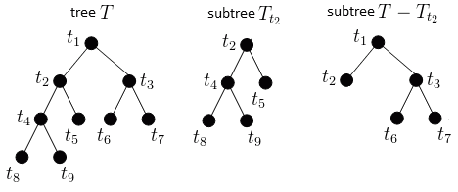
Pruning methods
Idea: Remove leaves that contribute little or cause overfitting.
The original Tree is T, it has a subtree T_{t2}, we prune T_{t2} and the pruned tree is shown below
Tree T subtree T_{t2} Tree after pruned (T- T_{t2})
to be pruned
https://en.wikipedia.org/wiki/Pruning_(decision_trees)
http://mlwiki.org/index.php/Cost-Complexity_Pruning

Slide 74
Pruning methods in practice
Pre-pruning : that stop growing the tree earlier, before it perfectly classifies the training set. It is not easy to precisely estimate when to stop growing the tree
Post-pruning : allows perfectly classify the training set (70 % of all data) first , then prune the tree. Useful, easy to implement. Build the tree by using the training set , then apply a statistical test to estimate whether pruning or expanding a particular node is likely to produce an improvement beyond the training set. There are 3 implementation methods.
    Error estimation scheme (to be described in the next slide), or
    Significance testing scheme method, or
    Minimum Description Length principle (MDL):Use an explicit measure of the complexity for encoding the training set and the decision tree, stopping growth of the tree when this encoding size (size(tree) + size(misclassifications(tree)) is minimized.

Slide 75
Post-pruning using Error estimation scheme, example
Select 2/3 samples from the data to form the training set
Select 1/3 of samples from the data to form the pruning set
Use the training set to construct the decision tree (will be pruned)
f= Error on pruning set (meaning after the tree is developed, you pass on the pruning set to the tree, you will get some error, i.e. 3 wrong decisions, 4 good decisions etc., so the error f =3/(4+3)=0.43
N= number of instances covered by the leaves
z= score of a normal distribution(You select a suitable z). Choose z to be 0.69 which is equal to a confidence level of 51%.
See https://www.omnicalculator.com/statistics/confidence-interval
See https://en.wikipedia.org/wiki/Standard_normal_table
e=Error rate (calculated from f,N,z)
If the error rate (e.g. e=0.46 ) at the parent node is smaller than error rate (e.g. e=5.1) of the child node, we do not want to keep the child node.
References:
http://www.saedsayad.com/decision_tree_overfitting.htm
Data mining : practical machine learning tools and techniques.
Witten, I. H. (Ian H.), CHAPTER 6, Implementations: Real Machine Learning Schemes
https://www.statisticshowto.com/wilson-ci/
https://www.mwsug.org/proceedings/2008/pharma/MWSUG-2008-P08.pdf

Slide 76

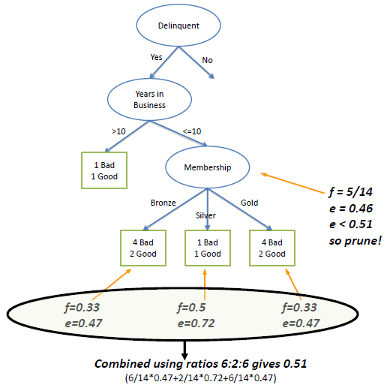
Post-pruning by Error estimation example
http://www.saedsayad.com/decision_tree_overfitting.htm, https://cse.usf.edu/~lohall/ml/Pruning.pdf
pruning by chi square test
For delinquent decision
2 Good , 4 bad, means 2 good guys were classified as not be able to reply, so error is 2/(2+4)
=being unable to pay debt
For f=5/14, it means 5 good out of 14 samples(good+bad) to classify on 14 samples
f=is the error (using pruning data set)
N=no. of instances covered by leaf
Z=from normal distribution
f=2/6,z=0.69,N=4+2 % 4 bad, 2 good
e=(f + z^2/(2*N)+z*sqrt( (f/N) -f^2/N
+z^2/(4*N^2) ))/ (1+(z^2/N)) %=0.4740
f=1/2,z=0.69,N=2 %1 bad, 1 good
e=(f + z^2/(2*N)+z*sqrt( (f/N) -f^2/N +z^2/(4*N^2) ))/...
(1+(z^2/N)) %=0.7192
The error rate (e) at the parent node=0.46 , and since the error rate for its children (0.51) increases with the split, we do not keep the child.
Set z to 0.69 (see normal distribution curve) which is equal to a confidence level of 51%.
https://www.omnicalculator.com/statistics/confidence-interval
=2/(4+2)
=1/(1+1)
Increase in error e
Note: weighted e= (6/14)*0.47 +(2/14)*0.72 + (6/14)*0.47=0.5057
https://www.rapidtables.com/math/probability/normal_distribution.html
https://media.neliti.com/media/publications/239412-study-of-pruning-techniques-to-predict-e-17830149.pdf

Slide 77
Cost complexity pruning
Post pruning techniques
There are several post pruning techniques. Cost complexity pruning is one of the important among them.
Cost Complexity Pruning
  Decision trees can easily overfit. One way to avoid it is to limit the growth of trees by setting constrains. We can limit parameters like max_depth , min_samples etc. But a most effective way is to use post pruning methods like cost complexity pruning. This helps to improve test accuracy and get a better model.
https://www.kaggle.com/code/arunmohan003/pruning-decision-trees-tutorial

Slide 78
Random forest: Extension of decision tree
https://www.analyticsvidhya.com/blog/2020/05/decision-tree-vs-random-forest-algorithm/
The Random Forest Algorithm combines the output of multiple (randomly created) Decision Trees to generate the final output.
Each decision tree selects some input data randomly from the dataset
Combine or select which decision tree gives more reliable result

Slide 79
Conclusion
We studied how to build a classification decision tree
We learned the method of splitting using Gini index
We learned the method of splitting using information gain by entropy
We learn the idea of pruning to improve classification and solve the overfitting problem

Slide 80
Appendix1

Slide 81
Regression Decision trees for continuous variables (a value rather than yes/no)
Rather than using Gini index or information gain by entropy to determine how to split branches, it uses
  stand-deviation (SD) and
  stand-deviation-reduction(SDR) with respect to the parent to determine the split.
The results are continuous variables.
Reference: https://www.saedsayad.com/decision_tree_reg.htm
https://sefiks.com/2018/08/28/a-step-by-step-regression-decision-tree-example/

Slide 82
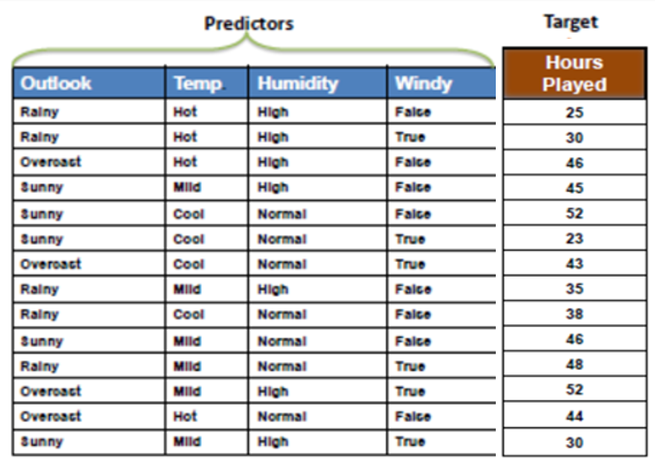
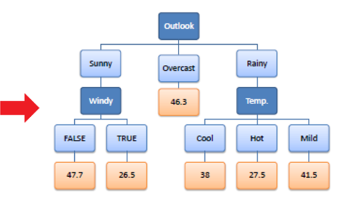
Regression tree using variance
Example: A regression tree, it tells you how many hours ( a value not yes or not) a player will play golf if the attributes (or features) are given .
The result is a value (hours) rather than you should play or not.
(Predictors or features or attributes)
Hours a player will play golf under those conditions : attributes (predictors or features)
Give training samples of how a player plays golf.

Slide 83
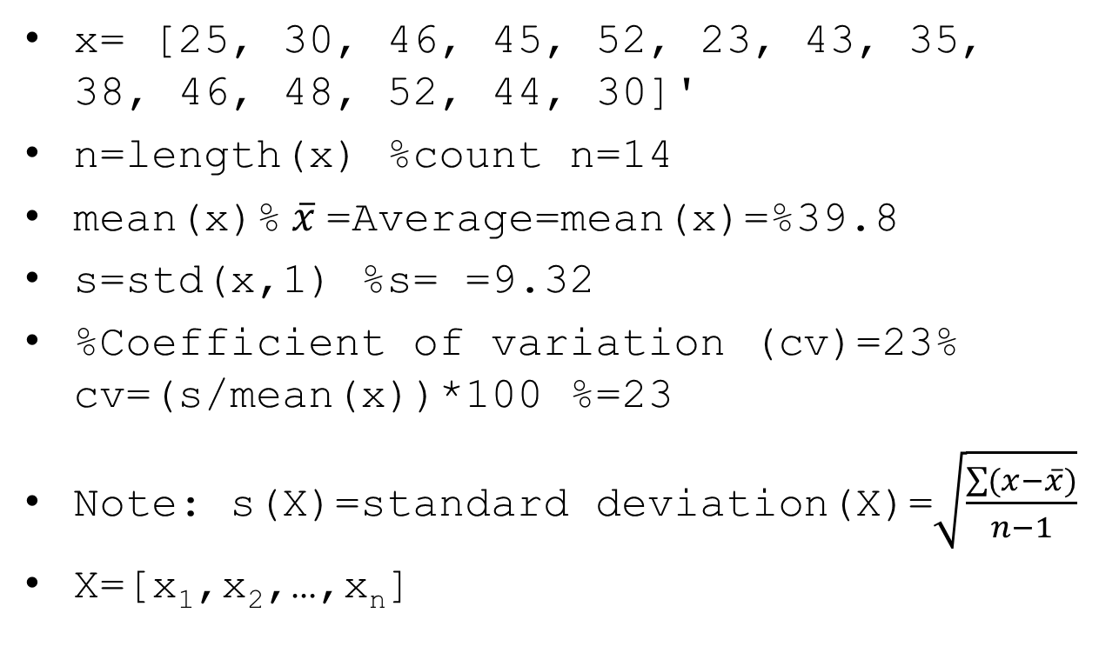
Parameters used for the calculation
Hour played(x)
25
30
46
45
52
23
43
35
38
46
48
52
44
30
x= [25, 30, 46, 45, 52, 23, 43, 35, 38, 46, 48, 52, 44, 30]'
n=length(x) %count n=14
mean(x)% $\overline{x}$=Average=mean(x)=%39.8
s=std(x,1) %s= =9.32
%Coefficient of variation (cv)=23% cv=(s/mean(x))*100 %=23
Note: s(X)=standard deviation(X)=$\sqrt{\frac{\sum{(x−\overline{x})}}{n−1}}$
X=[x₁,x₂,…,x_{n}]
Define: SDR=standard deviation reduction

Slide 84
Standard Deviation Reduction (SDR) method
The standard deviation reduction is based on the decrease in standard deviation after a dataset is split on an attribute. Constructing a decision tree is all about finding attribute that returns the highest standard deviation reduction (i.e., the most homogeneous branches). Given:
T= [25, 30, 46, 45, 52, 23, 43, 35, 38, 46, 48, 52, 44, 30]
S(parent) =std(T,1)=9.3211. This is the parent StDev
(T)
S()=
stand deviation function
Parent StDev
S(parent) =9.32

Slide 85
Chose which attribute is the decision node outlook?, temp(erture)?, Humidify?, windy?
The attribute with the largest standard deviation reduction (SDR) )(i.e., the most homogeneous branch). is chosen for the decision node.
  Check if attribute outlook is suitable to be the root or not
  Check if attribute temp(erture) is suitable to be the root or not
  Check if attribute Humidity is suitable to be the root or not
  Check if windy is suitable to be the root or not

Slide 86
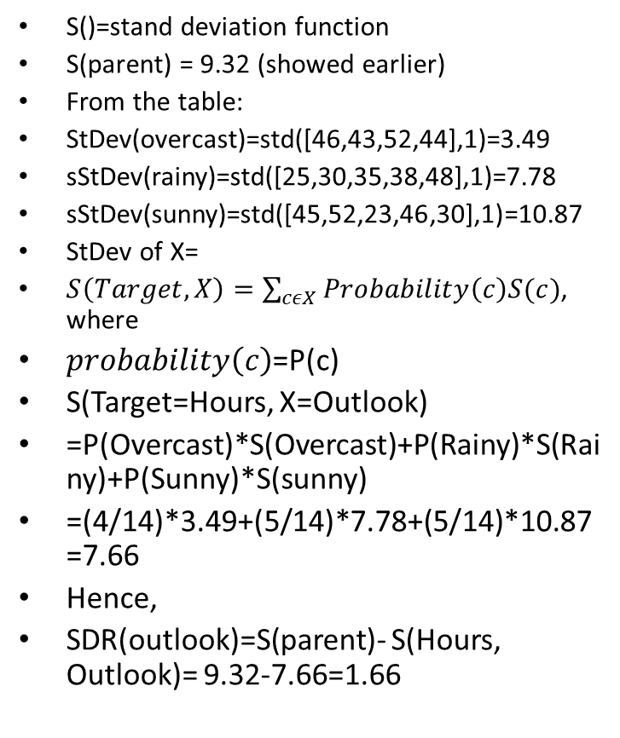
Step 1: Check if outlook is suitable to be the root or not: Find Stand deviation reduction=SDR of outlook
P(overcast)=4/14),P(rainy)=5/14)
P(sunny)=5/14)
1
2
3
4
5
6
7
8
9
10
11
12
13
14
Outlook has total =14 cases:
Overcast=4
Rainy=5
Sunny=5
S()=stand deviation function
S(parent) = 9.32 (showed earlier)
From the table:
StDev(overcast)=std([46,43,52,44],1)=3.49
sStDev(rainy)=std([25,30,35,38,48],1)=7.78
sStDev(sunny)=std([45,52,23,46,30],1)=10.87
StDev of X=
$S\left(Target,X\right)=\sum_{cεX}{Probability\left(c\right)S(c)}$, where
$probability\left(c\right)$=P(c)
S(Target=Hours, X=Outlook)
=P(Overcast)*S(Overcast)+P(Rainy)*S(Rainy)+P(Sunny)*S(sunny)
=(4/14)*3.49+(5/14)*7.78+(5/14)*10.87=7.66
Hence,
SDR(outlook)=S(parent)- S(Hours, Outlook)= 9.32-7.66=1.66
 |  | Hours played (StDev) | count
Outlook | overcast | 3.49 | 4
 | rainy | 7.78 | 5
 | sunny | 10.87 | 5
 |  |  | 14

Slide 87
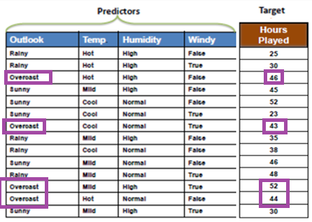

Details (1): find StDev of overcast=
Std(overcast hours)= 3.4911 https://www.calculator.net/standard-deviation-calculator.html
overcast=[46, 43, 52, 44]
std(overcast,1)= 3.4911
Mean(overcast)= 46.3
Probability P(overcast)=4/14
Total =14
Overcast=4
Rainy=5
Sunny=5
Note: s(X)=standard deviation(X)=$\sqrt{\frac{\sum{(x−\overline{x})}}{n−1}}$
X=[x₁,x₂,…,x_{n}]

Slide 88
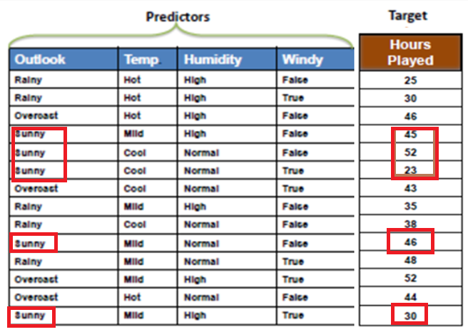
Details (2): find StDev of sunny Std(sunny hours)= 10.8701 https://www.calculator.net/standard-deviation-calculator.html
sunny=[45, 52, 23 ,46, 30]
std(sunny,1)= 10.8701
Mean(sunny)= 39.2
Probability P(sunny)=5/14
Total =14
Overcast=4
Rainy=5
Sunny=5
Note: s(X)=standard deviation(X)=$\sqrt{\frac{\sum{(x−\overline{x})}}{n−1}}$
X=[x₁,x₂,…,x_{n}]

Slide 89
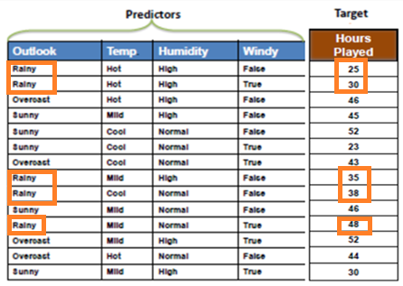

Details (3): find StDev of rainy=
Std(rainy hours)= 7.782
rainy=[25 30 35 38 48]
std(rainy,1)= 7.7820
Mean(rainy)= 35.2
Probability P(rainy)=5/14
Total =14
Overcast=4
Rainy=5
Sunny=5
Note: s(X)=standard deviation(X)=$\sqrt{\frac{\sum{(x−\overline{x})}}{n−1}}$
X=[x₁,x₂,…,x_{n}]

Slide 90
Details (4) : Combining them: SDR(T,X=Outlook)=9.32-7.66=1.66
Left most column : the Standard deviation of outlook
  S(Hour, Outlook) =P(Sunny)*S(sunny)+P(Overcast)*S(Overcast)+P(Rainy)*S(Rainy)
  =(4/14)*3.49+(5/14)*7.78+(5/14)*10.87=7.66
  Hence Stand deviation reduction=SDR=S(Hours, Target)- S(Hour, Outlook)= =9.32-7.66=1.66
Total =14
Overcast=4
Rainy=5
Sunny=5
Found earlier

Slide 91
Continue
Apply the same routine to other attributes
Temp(erture),
Humid,
Windy.
Now find SDR()= Standard Deviation Reduction
The resulting standard deviation is subtracted from the standard deviation (parent) before the split. The result is the standard deviation reduction(SDR).

Slide 92
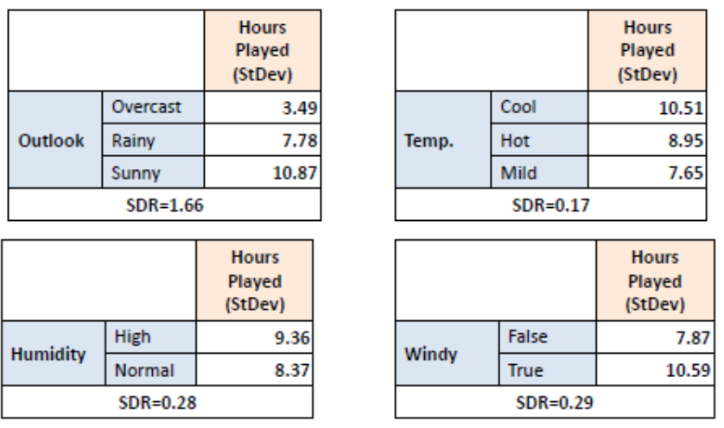
More calculations of StdDev under different features
SDR=standard deviation reduction
Under outlook
Std(overcast)=std([46,43,52,44],1)= 3.4911
Std(rainy)= std([25,30,35,38,48],1)
= 7.7820
Std(sunny)= std([45,52,23,46,30],1)
= 10.8701
------------------------
Under Humidity
Std(High)=std([25,30,46,45,35,52,30],1)
= 9.3634
Std(Normal)=std([52,23,43,38,46,48,44],1)
= 8.7342
Under temp
std(cool)=std([52,23,43,38],1)= 10.5119
Std(Hot)=std([25,30,46,44],1)= 8.9547
Std(Mild)=std([45,35,46,48,52,30],1)
= 7.6522
-----------
Under Windy
std(False)=std([25,46,45,52,35,38,46,44],1)= 7.8730
Std(True)=std([30,23,43,48,52,30],1)= 10.5935
Count
4
5
5
14
Count
4
4
6
14
SDR=0.48
Count
8
6
14
Count
7
7
14

Slide 93
Step 2: The dataset is then split on the different attributes. The standard deviation for each branch is calculated. The resulting standard deviation is subtracted from the standard deviation before the split. The result is the standard deviation reduction(SDR).
Step 2a
S(Hour, Outlook)=P(Sunny)*S(sunny)+P(Overcast)*S(Overcast)+P(Rainy)*S(Rainy)=
=(4/14)*3.49+(5/14)*7.78+(5/14)*10.87
=7.66
SDR(T,X=Outlook)=9.32-7.66=1.66
/////////////////////////////////////////////////////
Step2b
S(Hour, Temp)=P(cool)*S(cool)+P(hot)*S(hot)+P(mild)*S(mild)=
=(4/14)*10.51+(4/14)*8.95+(6/14)*7.65= 8.84
SDR(T,X=Temp)=9.32- 8.84 =0.48
///////////////////////////////////////////////////
Step2c
S(Hour, Humidity)=P(High)*S(High)+P(Normal)*S(Normal) =
=(7/14)*9.36+(7/14)*8.37= 9.04
SDR(T,X= Humidity)=9.32-9.04 = 0.28
//////////////////////////////////////////
Step2d
S(Hour, Temp)=P(False)*S(False)+P(True)*S(True)
=(8/14)*7.87+(6/14)*10.59=9.0357
SDR(T,X=Temp)=9.32-9.0357=0.2843
SDR(T,X=Windy)=0.29
Largest SDR
Count
4
5
5
14
Count
4
4
6
14
SDR=0.48
Count
7
7
14
Count
8
6
14
https://sefiks.com/2018/08/28/a-step-by-step-regression-decision-tree-example/

Slide 94
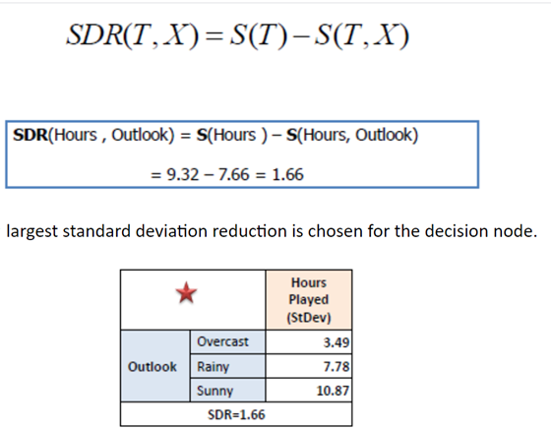
Step 3: The attribute with the largest standard deviation reduction is chosen for the decision node.
For finding the attribute that returns the highest standard deviation reduction(SDR)(i.e., the most homogeneous branch)., where
S(T)=standard deviation (Tree)
S(T,X) =stand deviation of the tree with attribute X
SDR(T,X=outlook)=1.66 won the competition
Thus, the tree top is outlook
SDR(outlook)=1.66
SDR(temp)=0.48
SDR(humidity)=0.28
SDR(windy)=29
SDR(outlook)=1.66
is chosen since it is largest.
Define: CV=Coefficient of Variation
=Std/mean
=S/mean
Use CV to determine when to stop

Slide 95
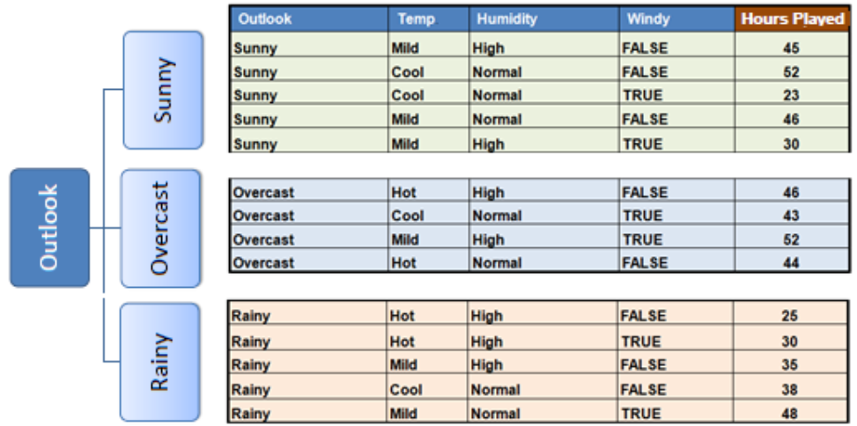
Step 4a: The dataset is divided based on the values of the selected attribute. This process is run recursively on the non-leaf branches, until all data is processed.
In practice, we need some termination criteria. For example, when coefficient of variation (CV=S/mean) for a branch becomes smaller than a certain threshold (e.g., 10%) and/or when too few instances (n) remain in the branch (e.g., 3).
mean([45,52,23,46,30])
= 39.2
mean([46,43,52,44])
= 46.3
mean([25,30,35,38,48])
= 35.2

Slide 96

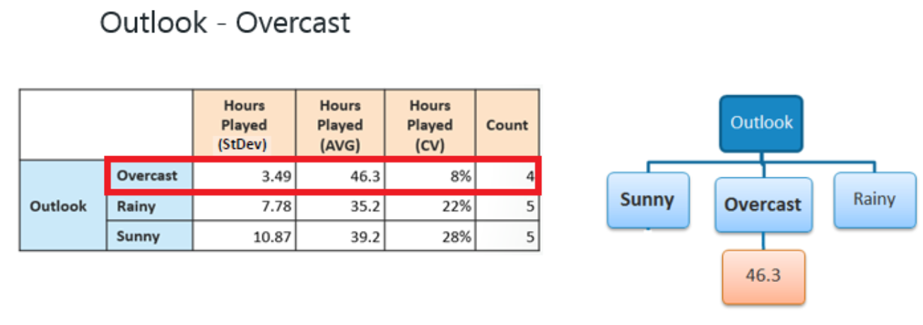
Step 4b (how to stop)
Define: CV=Coef. of Variation =S/mean, use CV to determine when to stop
Step 4b:
"Overcast" subset does not need any further splitting because its CV (8%) is less than the threshold (10%). The related leaf node gets the average of the "Overcast" subset.
CV=s/mean*100%
CV(overcast)=(3.49/46.3)*100%=8%
CV(Rainy)=(7.78/35.2)*100%=22%
CV(overcast)=(10.87/39.2)*100%=28%
Complete (stop) for overcast, because CV (overcast)<10%, from previous slide: the output is mean([46,43,52,44])= 46.3
This is the output

Slide 97
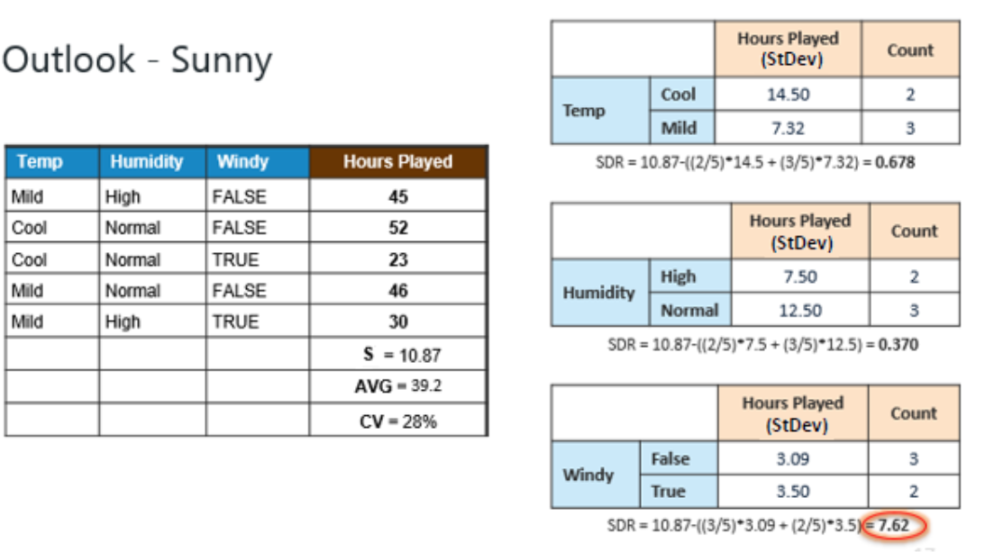
Step 4c: However, the "Sunny" branch has coefficient of variation CV (28%) more than the threshold (10%) which needs further splitting. We select "Windy" as the best node after "Outlook" because it has the largest Standard deviation reduction SDR.

Slide 98
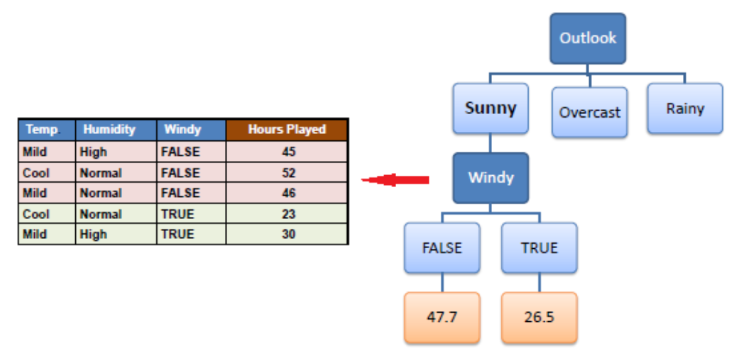
Because the number of data points for both branches (FALSE and TRUE) is equal or less than 3 (too few) we stop further branching and assign the average of each branch to the related leaf node.

Slide 99
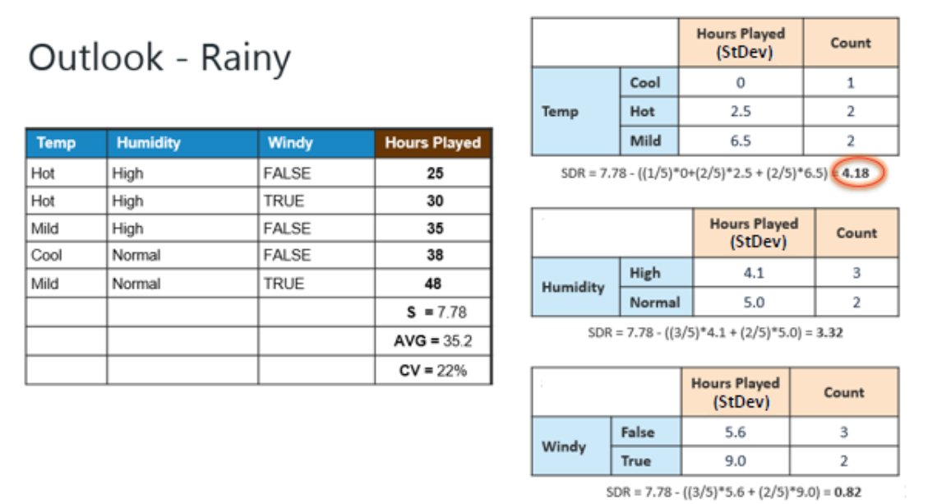
Step 4d: Moreover, the "rainy" branch has an CV (22%) which is more than the threshold (10%). This branch needs further splitting. We select "Windy" as the best best node because it has the largest SDR. d

Slide 100
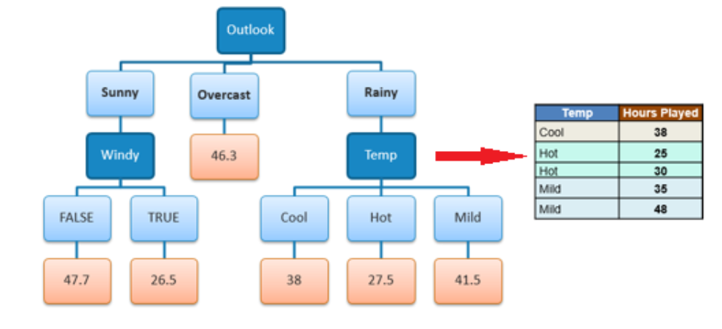
Because the number of data points for all three branches (Cool, Hot and Mild) is equal or less than 3 we stop further branching and assign the average of each branch to the related leaf node.
When the number of instances is more than one at a leaf node we calculate the average as the final value for the target.
d
mean([25,30])
=27.5
mean([35,48])
=41.5
Sunny/windy-true is (23+30)/2=26.5 hours golf playing,
Sunny/windy-false =(45+52+46)/3=47.7 hours golf playing
DONE!

Slide 101
References
http://people.revoledu.com/kardi/tutorial/DecisionTree/how-decision-tree-algorithm-work.htm
https://onlinecourses.science.psu.edu/stat857/node/60/
https://sefiks.com/2018/08/27/a-step-by-step-cart-decision-tree-example/

Slide 102
Appendix2

Slide 103
Example using sklearn
https://github.com/alameenkhader/spam_classifier
Using sklearn
from sklearn import tree
# You may hard code your data as given or to use a .csv file import csv then fetch your data from .csv file
# Assume we have two dimensional feature space with two classes we like distinguish
dataTable = [[2,9],[4,10],[5,7],[8,3],[9,1]]
dataLabels = ["Class A","Class A","Class B","Class B","Class B"]
# Declare our classifier
trained_classifier = tree.DecisionTreeClassifier()
# Train our classifier with data we have
trained_classifier = trained_classifier.fit(dataTable,dataLabels)
# We are done with training, so it is time to test it!
someDataOutOfTrainingSet = [[10,2]]
label = trained_classifier.predict(someDataOutOfTrainingSet)
# Show the prediction of trained classifier for data [11,2]
print(label[0])

Slide 104
Iris test using sklearn, this will generate (decision tree) dt.dot file
import numpy as np
from sklearn import datasets
from sklearn import tree
# Load iris
iris = datasets.load_iris()
X = iris.data
y = iris.target
# Build decision tree classifier
dt = tree.DecisionTreeClassifier(criterion='entropy')
dt.fit(X, y)
dotfile = open("dt.dot", 'w')
tree.export_graphviz(dt, out_file=dotfile, feature_names=iris.feature_names)
dotfile.close()

Slide 105
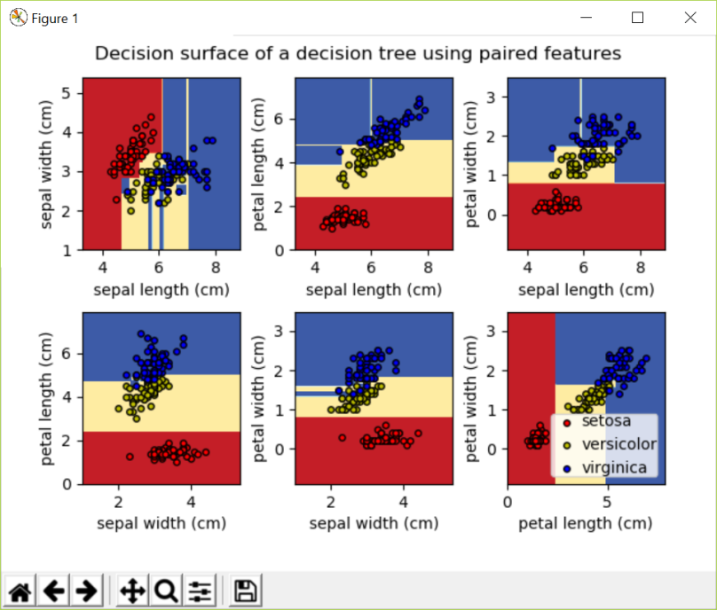
Iris dataset
print(__doc__)
import numpy as np
import matplotlib.pyplot as plt
from sklearn.datasets import load_iris
from sklearn.tree import DecisionTreeClassifier
# Parameters
n_classes = 3
plot_colors = "ryb"
plot_step = 0.02
# Load data
iris = load_iris()
for pairidx, pair in enumerate([[0, 1], [0, 2], [0, 3],
[1, 2], [1, 3], [2, 3]]):
# We only take the two corresponding features
X = iris.data[:, pair]
y = iris.target
# Train
clf = DecisionTreeClassifier().fit(X, y)
# Plot the decision boundary
plt.subplot(2, 3, pairidx + 1)
x_min, x_max = X[:, 0].min() - 1, X[:, 0].max() + 1
y_min, y_max = X[:, 1].min() - 1, X[:, 1].max() + 1
xx, yy = np.meshgrid(np.arange(x_min, x_max, plot_step),
np.arange(y_min, y_max, plot_step))
plt.tight_layout(h_pad=0.5, w_pad=0.5, pad=2.5)
Z = clf.predict(np.c_[xx.ravel(), yy.ravel()])
Z = Z.reshape(xx.shape)
cs = plt.contourf(xx, yy, Z, cmap=plt.cm.RdYlBu)
plt.xlabel(iris.feature_names[pair[0]])
plt.ylabel(iris.feature_names[pair[1]])
# Plot the training points
for i, color in zip(range(n_classes), plot_colors):
idx = np.where(y == i)
plt.scatter(X[idx, 0], X[idx, 1], c=color, label=iris.target_names[i],
cmap=plt.cm.RdYlBu, edgecolor='black', s=15)
plt.suptitle("Decision surface of a decision tree using paired features")
plt.legend(loc='lower right', borderpad=0, handletextpad=0)
plt.axis("tight")
plt.show()
http://scikit-learn.org/stable/auto_examples/tree/plot_iris.html#sphx-glr-auto-examples-tree-plot-iris-py

Slide 106
A working implementation in pure python
https://machinelearningmastery.com/implement-decision-tree-algorithm-scratch-python/

Slide 107
code
function tt4
clear
parent_en=entropy_cal([9,5])
%humidy-------------------
en1=entropy_cal([3,4])
en2=entropy_cal([6,1])
Information_gain(1)=parent_en-(7/14)*en1-(7/14)*en2
clear en1 en2
%outlook------------------
en1=entropy_cal([3,2])
en2=entropy_cal([4,0])
en3=entropy_cal([2,3])
Information_gain(2)=parent_en-(5/14)*en1-(4/14)*en2-(5/14)*en3
clear en1 en2 en3
%wind -------------------------
en1=entropy_cal([6,2])
en2=entropy_cal([3,3])
Information_gain(3)=parent_en-(8/14)*en1-(6/14)*en2
clear en1 en2
%temperature -------------------------
en1=entropy_cal([2,2]) %hot 2 yes , 2 no
en2=entropy_cal([3,1]) %mild 3 yes, 1 no
en3=entropy_cal([4,2]) %cool 4 yes, 2 no
clear en1 en2 en3
Information_gain(4)=parent_en-(4/14)*en1-(4/14)*en2-(6/14)*en3
Information_gain
%%%%%%%%%%%%%%%%%%%%%%%%%%%%%%%%%%%%%%%%%%%%%
function [en]=entropy_cal(e)
n=length(e);
base=sum(e);
%% probabilty of the elements in the input
for i=1:n
p(i)=e(i)/base;
end
%%%%%%%%%%%%%%%%%%%%%%%%%%%%%%%%%%%%%%%%%%%
temp=0;
for i=1:n
if p(i)==0 %to avoid the problem of -inf
temp=0;
else
temp= p(i)*log2(p(i))+temp;
end
end
en=-temp;

Slide 108





A tree showing nodes, branches, leaves , attributes and target classes
Root node
If attribute X=Raining
?
Branch: No
Branch: yes
?
?
Leaf node1
If attribute X=sunny
Leaf node3
If attribute Z=driving
?
Branch: No
Branch: Yes
Yes
No
Leaf node2
If Y=stay outdoor
Target
Class= No umbrella
Target
Class= No umbrella
Target
Class= umbrella
Branch: Yes
Branch: No
Target
Class= umbrella
Target
Class= No umbrella
https://www-users.cs.umn.edu/~kumar001/dmbook/ch4.pdf

Slide 109
MATLAB DEMO
https://www.mathworks.com/help/stats/examples/classification.html

Slide 110
Terms used
From
https://datascience.stackexchange.com/questions/42957/whats-the-difference-between-the-terms-predictor-and-feature
In a nutshell: X columns: features, predictors, independent variables, experimental variables.
y column(s): target, dependent variable, outcome, outcome variable.

Slide 111
Appendix

Slide 112
Experiment:
Decision tree using Colab
+code
Files
Upload
• Copy and paste “Main.py” to Colab “+code” , which is at top part of Colab window
• Run the code in “+code” , you may need these tools before running Main.py
– “pip install p_decision_tree.DecisionTree” #to install the tool
– “pip install graphviz” and “pip install pandas” if neccsary
• Upload the data file "playtennis.csv" to Colab “files”, the file-icon is at the left margin of the Colab window.
– under /content/sample_data, click on the "3 vertical dots"-icon, load playtennis.csv under sample_data
– - change the line in the code Main.py for reading the .csv file to data = pd.read_csv('/content/sample_data/playtennis.csv')
• Un-comment the line display( dot ), run the code.
You will get the result and the diagram of the decision tree. The total number of nodes and leaves should be 8 (see next slide).

Slide 113
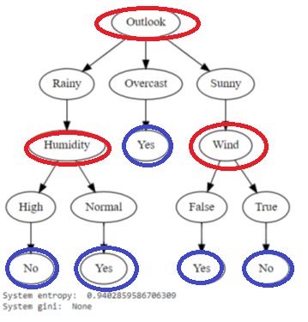
Experiment: Decision tree using Colab
Playtennis.cse (open by excel)
Outlook | Temperature | Humidity | Wind | Play Tennis
Rainy | Hot | High | FALSE | No
Rainy | Hot | High | TRUE | No
Overcast | Hot | High | FALSE | Yes
Sunny | Mild | High | FALSE | Yes
Sunny | Cool | Normal | FALSE | Yes
Sunny | Cool | Normal | TRUE | No
Overcast | Cool | Normal | TRUE | Yes
Rainy | Mild | High | FALSE | No
Rainy | Cool | Normal | FALSE | Yes
Sunny | Mild | Normal | FALSE | Yes
Rainy | Mild | Normal | TRUE | Yes
Overcast | Mild | High | TRUE | Yes
Overcast | Hot | Normal | FALSE | Yes
Sunny | Mild | High | TRUE | No
https://github.com/m4jidRafiei/Decision-Tree-Python-
Main.py
''''
@author: majid
'''
from p_decision_tree.DecisionTree import DecisionTree
import pandas as pd
#Reading CSV file as data set by Pandas
data = pd.read_csv('/content/sample_data/playtennis.csv')
columns = data.columns
#All columns except the last one are descriptive by default
descriptive_features = columns[:-1]
#The last column is considered as label
label = columns[-1]
#Converting all the columns to string
for column in columns:
data[column]= data[column].astype(str)
data_descriptive = data[descriptive_features].values
data_label = data[label].values
#Calling DecisionTree constructor (the last parameter is criterion which can also be "gini")
decisionTree = DecisionTree(data_descriptive.tolist(), descriptive_features.tolist(), data_label.tolist(), "entropy")
#Here you can pass pruning features (gain_threshold and minimum_samples)
decisionTree.id3(0,0)
#Visualizing decision tree by Graphviz
dot = decisionTree.print_visualTree( render=True )
# When using Jupyter
display( dot )
print("System entropy: ", format(decisionTree.entropy))
print("System gini: ", format(decisionTree.gini))
Output:
Tot=nodes + leaves=3 nodes + 5 leaves=8
(updated 2023, Nov22)
Experiment: change the “Play Tennis” decision from “Yes” to “No” for the last Overcast and find the new Tot.

Slide 114
reference
https://github.com/m4jidRafiei/Decision-Tree-Python-
https://www.kaggle.com/code/gabrielaltay/categorical-variables-in-decision-trees
https://github.com/anshul1004/DecisionTree

