Slide 1
Neural Network Models for Object detection
KH Wong

Slide 2
Part 1
Introduction to Object detection and related fields

Slide 3
Introduction
What are the object recognition problems?
How to build the systems and evaluate the results?
Solutions and models
  Object recognition models
  Object localization models
  Segmentation models

Slide 4
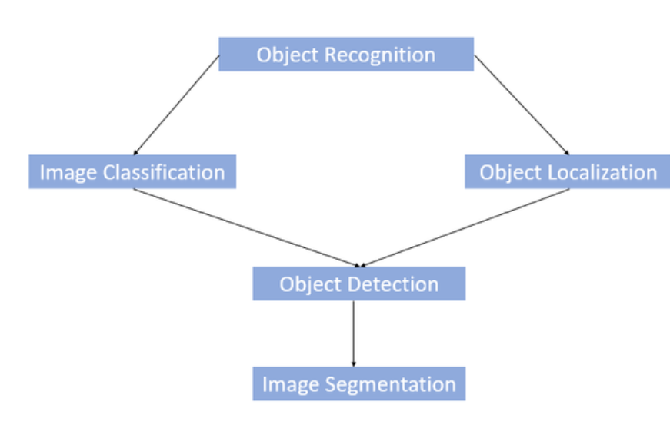
Problems: Object Recognition vs Object Detection vs Image Segmentation
https://www.kaggle.com/getting-started/169984
https://www.geeksforgeeks.org/object-detection-vs-object-recognition-vs-image-segmentation/
What?
Where?

Slide 5
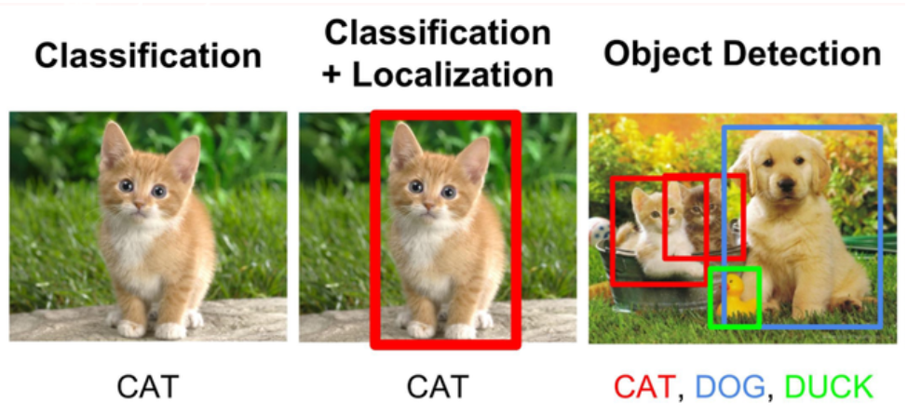
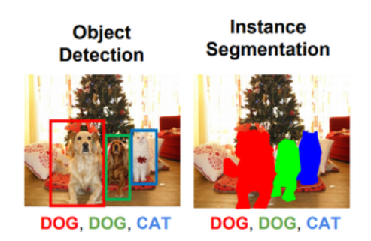
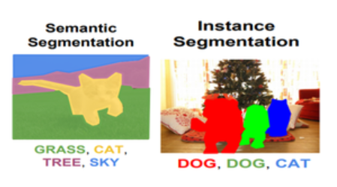
Example
Classification
Segmentation

Slide 6
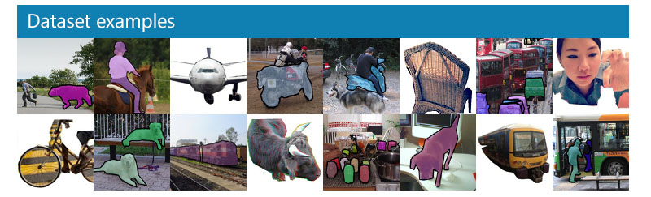
Famous object recognition systems and datasets
2021
COCO - Common Objects in Context (cocodataset.org) and
LVIS 2021 Challenge and Workshop
Classic datasets
  Datasets: Data set VOC2012
  Evaluation: How to evaluate the object recognition system
  System building : ImageNet Large Scale Visual Recognition Challenge (ILSVRC)

Slide 7
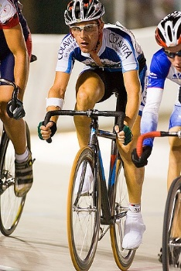
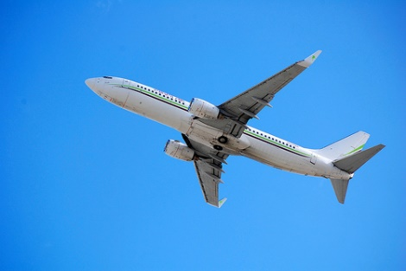
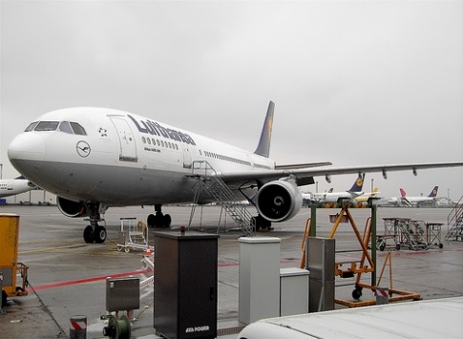
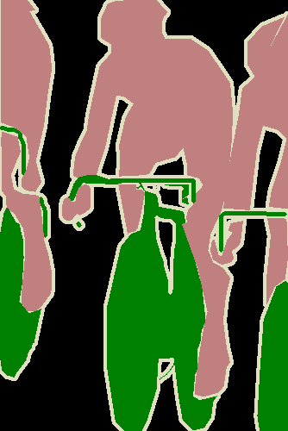


Data set VOC2012 is used in many development systems, images and their Segmentation Classes are given
Download the training/validation data (2GB tar file) http://host.robots.ox.ac.uk/pascal/VOC/voc2012/VOCtrainval_11-May-2012.tar
http://host.robots.ox.ac.uk/pascal/VOC/voc2012/index.html
Source
Images
Group truth Classes and Segmentation Class (pixelwise) are given in dataset
cyclist 2008_000033 airplane
2008_000033
airplane

Slide 8
How to evaluate object detection systems
Using
mean Average Precision
mAP

Slide 9
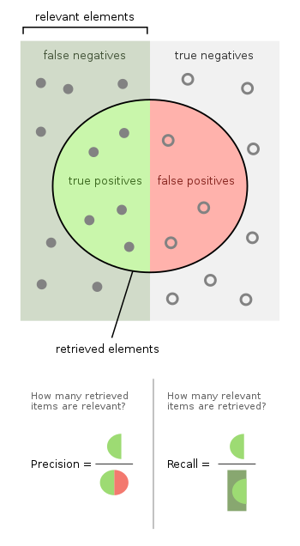
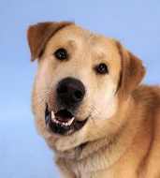
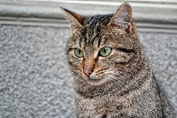
The first word shows the system is correct or not: True is correct, False is not correct.
The second word shows what the system thinks: Positive = the system thinks it is positive. Negative= the system thinks it is negative.
Relevant elements
Program X reads all pics, recognizes dogs & exclude cats. Positive=dogs, Negative=cats.
The truth is there are 12 dogs (relevant elements filled dots) and 10 cat (unfilled dots)
Program X outputs 8 dogs (selected elements inside the circle) and others are cats.
But the truth is : Inside the retrieved elements (circled) only 5 are dogs, 3 are cats. Thus, True positives [TP] =5, False positives [FP]=3
7 dogs missed(false negatives [FN])=7, these dots represent the system is incorrect, and thinks they are not dogs.
7 cats excluded (true negatives [TN])=7, these dots represent the system is correct, and thinks they are not dogs.
Selected elements= TP+FP = 8
X’s Precision = (true positives [TP]/ selected elements)= TP/(TP+FP)=5/8 = 0.625
X’s Recall= (true positives [TP]/ relevant elements)=TP/(FN+TP)=5/12
FN=7
TN=7
TP=5
FP=3
Retrieved elements
12 dogs
10 cats
https://en.wikipedia.org/wiki/Precision_and_recall
https://www.dataschool.io/simple-guide-to-confusion-matrix-terminology/
Dog :This Photo by Unknown Author is licensed under CC BY
Cat: This Photo by Unknown Author is licensed under CC BY
Recall=
Precision=

Slide 10
How to evaluate classifiers
A summary:
  True Positives (TP)
  True Negatives (TN)
  False Positives (FP)
  False Negatives (FN)
function accuracy2(TP,TN,FP,FN)
%demo2: TP=5,TN=7,FP=3,FN=7, accuracy2(TP,TN,FP,FN)
'result======================'
Accuracy = (TP+TN)/(TP+TN+FP+FN);
Precision = TP/(TP+FP);
Recall= TP/(TP+FN);
F1_score = 2*(Recall * Precision) / (Recall + Precision);
F1 =harmonic mean of the precision and recall. Harmonic mean of (A, B)=2*A*B/(A+B)
https://en.wikipedia.org/wiki/Harmonic_mean
In program x, for example,
TP =5
FP=3
FN=7
TN=7
Accuracy=(5+7)/(5+3+7+7)=0.545
Precision=5/(5+3)=0.625
Recall=5/(5+7)=0.4166
F1 score=
2*(0.4166* 0.625)/(0.4166+ 0.625)
=0.49995
'result======================'
Accuracy=0.545
Precision=0.625
Recall=0.417
F1score=0.500

Slide 11
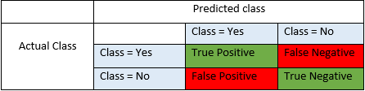
True/False, and Positive/ Negative
Source: https://blog.exsilio.com/all/accuracy-precision-recall-f1-score-interpretation-of-performance-measures/
True positive and true negatives are the observations that are correctly predicted and therefore shown in green. We want to minimize false positives and false negatives so they are shown in red color. These terms are a bit confusing. So let’s take each term one by one and understand it fully.
True Positives (TP) - These are the correctly predicted positive values which means that the value of actual class is yes and the value of predicted class is also yes. E.g. if actual class value indicates that this passenger survived (in an accident) and predicted class tells you the same thing.
True Negatives (TN) - These are the correctly predicted negative values which means that the value of actual class is no and value of predicted class is also no. E.g. if actual class says this passenger did not survive and predicted class tells you the same thing.
False positives and false negatives, these values occur when your actual class contradicts with the predicted class.
False Positives (FP) – When actual class is no and predicted class is yes. E.g. if actual class says this passenger did not survive but predicted class tells you that this passenger will survive.
False Negatives (FN) – When actual class is yes but predicted class in no. E.g. if actual class value indicates that this passenger survived and predicted class tells you that passenger will die.

Slide 12
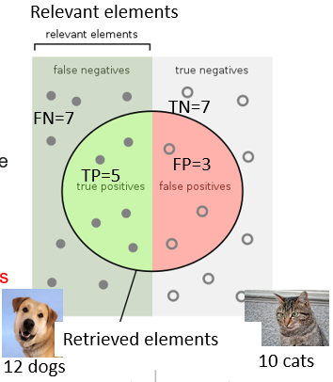
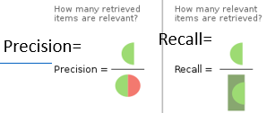
Accuracy, Precision, Recall and F1 score
Accuracy is a ratio of correctly predicted observation to the total observations.
Accuracy = (TP+TN)/(TP+FP+FN+TN)
Precision is the ratio of correctly predicted positive observations to the total predicted positive observations.
Precision = TP/(TP+FP)
Recall (Sensitivity) is the ratio of correctly predicted positive observations to the all observations in actual class - yes. Recall = TP/(TP+FN)
F1 score - F1 Score is the weighted average of Precision and Recall. Therefore, this score takes both false positives and false negatives into account
F1 Score = 2*(Recall * Precision) / (Recall + Precision). Harmonic mean of 2 terms A,B =2/(1/A+1/B)= 2*A*B/(A+B) . Unlike arithmetic mean, harmonic mean punishes extreme values. A classifier with a precision of 1.0 and a recall of 0.0 has a simple average of 0.5 but an F1 score of 0.

Slide 13
F1 Score vs. Accuracy
Accuracy:
  Pro: Easy to interpret. If we say that a model is 90% accurate, we know that it correctly classified 90% of observations.
  Con: Does not take into account how the data is distributed. For example, suppose 90% of all players do not get drafted into the NBA. If we have a model that simply predicts every player to not get drafted, the model would correctly predict the outcome for 90% of the players. This value seems high, but the model is actually unable to correctly predict any player who gets drafted.
F1 Score: (the harmonic mean of the precision and recall.)
  Pro: Takes into account how the data is distributed. For example, if the data is highly imbalanced (e.g., 90% of all players do not get drafted and 10% do get drafted) then F1 score will provide a better assessment of model performance.
  Con: Harder to interpret. The F1 score is a blend of the precision and recall of the model, which makes it a bit harder to interpret.
As a rule of thumb:
  We often use accuracy when the classes are balanced and there is no major downside to predicting false negatives.
  We often use F1 score when the classes are imbalanced and there is a serious downside to predicting false negatives.
https://www.statology.org/f1-score-vs-accuracy/

Slide 14

Exercise 1
Hints: Accuracy = (TP+TN)/(TP+TN+FP+FN)
Calculation exercise
TP=56, %True Positive
TN=19, %True Negative
FP=1, %False Positive
FN=24 %False Negative
Accuracy=_______?
MC Question
(1) 0.65
(2) 0.7
(3) 0.75
(4) 0.80

Slide 15
Answer 1
'======result===========‘
Accuracy = (TP+TN)/(TP+TN+FP+FN)=
=(56+19)/(56+19+1+24)=0.75
Precision = TP/(TP+FP)=56/(56+1)=0.982;
Recall= TP/(TP+FN)=56/56+24)=0.7
F1score= 2*(Recall*Precision)/ (Recall+Precision)=
(2*0.7*0.982)/(0.7+0.982)=0.8174
%%%%%%%%%%
Accuracy=0.750
Precision=0.982
Recall=0.700
F1score=0.818
Calculation exercise
TP=56, %True Positive
TN=19, %True Negative
FP=1, %False Positive
FN=24 %False Negative
Accuracy=_______?
MC Question
(1) 0.65
(2) 0.7
(3) 0.75 (is correct)
(4) 0.80

Slide 16
How to compare systems using k-fold Cross-Validation, usually K=10
Idea: divide the data in K equal portions and perform tests on each portion using different models -- maybe different methods or same method with different parameters: Here is the procedure.
Shuffle the data randomly.
Split the dataset into k groups (e.g., K=10) , keep the grouping
For m=1:M [Collect the accuracy_of_model(m)]{
  For i=1:K , (for each unique group){
    Take a group as a test data set
    Take the remaining groups (k-1 groups) as training data
    Fit the model on training set & evaluate it on test set, record accuracy(i)}
  The accuracy_of_model_m =mean {1:K (accuracy(i)} of that model (m)}
List all accuracy_of_model_m(s) and compare which is better.
** It is to make sure each sample will be used as a testing data.

Slide 17
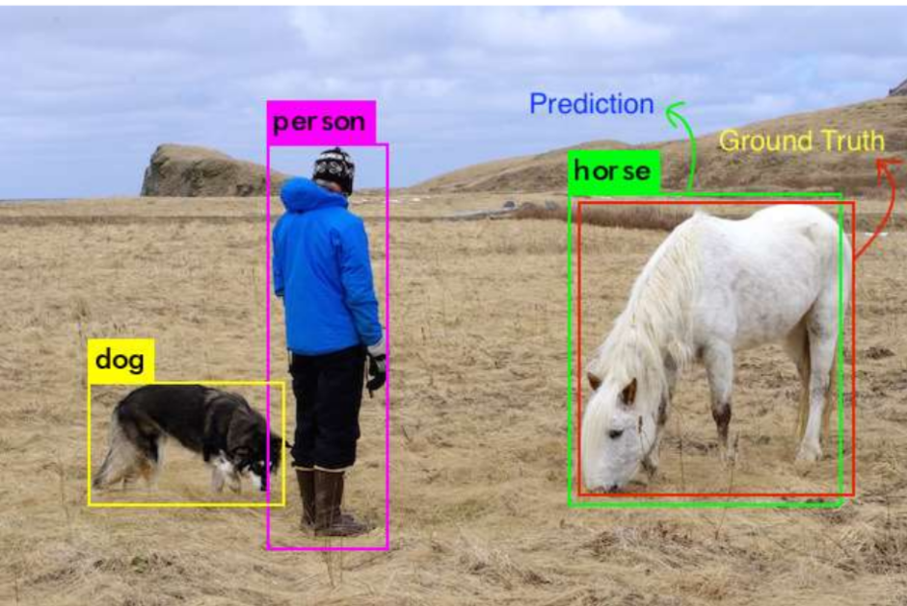
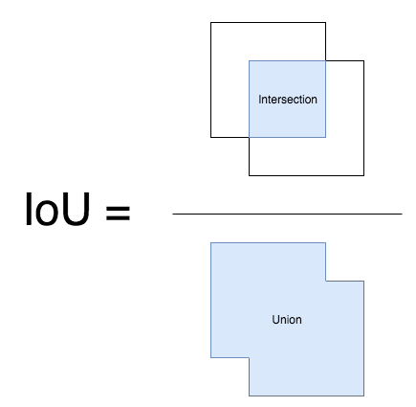
Evaluations: How to measure object detection rate. First find TP(true positive) and FP (false positive) for the result https://towardsdatascience.com/what-is-map-understanding-the-statistic-of-choice-for-comparing-object-detection-models-1ea4f67a9dbd
If the IoU (Intersection Over Union) is > threshold (e.g. 0.5), it is considered a True Positive (TP) else it is considered a False positive(FP).
Intersection over Union (IoU) is a ratio between the intersection and the union of the predicted box and the ground truth box.
Ground truth is given by the data set (i.e. Cifar100)
Prediction is given by the algorithm to be evaluated
object detection demo https://www.youtube.com/watch?v=lVdh571SwOQ

Slide 18
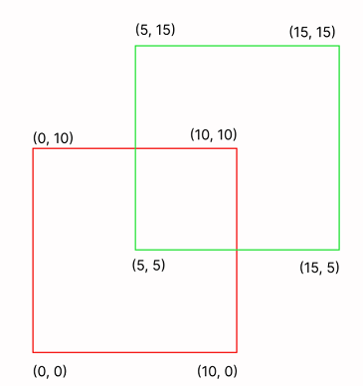
Exercise 2
https://hasty.ai/docs/mp-wiki/metrics/iou-intersection-over-union
Red box = ground truth bounding box
Green box =predicted bounding box
MC questions:
(Ex2a) Area of Overlap:=____?
Choices: (1) 10; (2) 15; (3) 20 ; (4) 25;
(Ex2b) Area of Union:=__?
Choices:(1) 100; (2) 150; (3) 175 ; (4) 200;
(Ex2c) : IoU: Area of Overlap / Area of Union=__?
Your judgment of the IOU using common sense.
(1) excellent: IoU > 0.9
(2) good : 0.9> IoU > 0.7
(3) fair : 0.7> IoU > 0.3
(4) poor : 0.3> IoU

Slide 19
Answer for Exercise 2
https://hasty.ai/docs/mp-wiki/metrics/iou-intersection-over-union
Red box = ground truth bounding box
Green box =predicted bounding box
MC questions:
(Ex2a) Area of Overlap:=___25 _?
Choices: (1) 10; (2) 15; (3) 20 ; (4) 25;
(Ex2b) Area of Union:=_175_?
Choices:(1) 100; (2) 150; (3) 175 ; (4) 200;
(Ex2c) : IoU: Area of Overlap / Area of Union__?
=25/175=0.14
Your judgment of the IOU using common sense.
(1) excellent: IoU > 0.9
(2) good : 0.9> IoU > 0.7
(3) fair : 0.7> IoU > 0.3
(4) poor : 0.3> IoU
Area of Overlap: 5 * 5 = 25;
Area of Union: Area of the Red Bounding Box + Area of the Green Bounding Box - Area of Overlap = 10 10 + 10 10 - 25 = 175
IoU: Area of Overlap / Area of Union = 25 / 175 ~ 0.14 - poor IoU

Slide 20
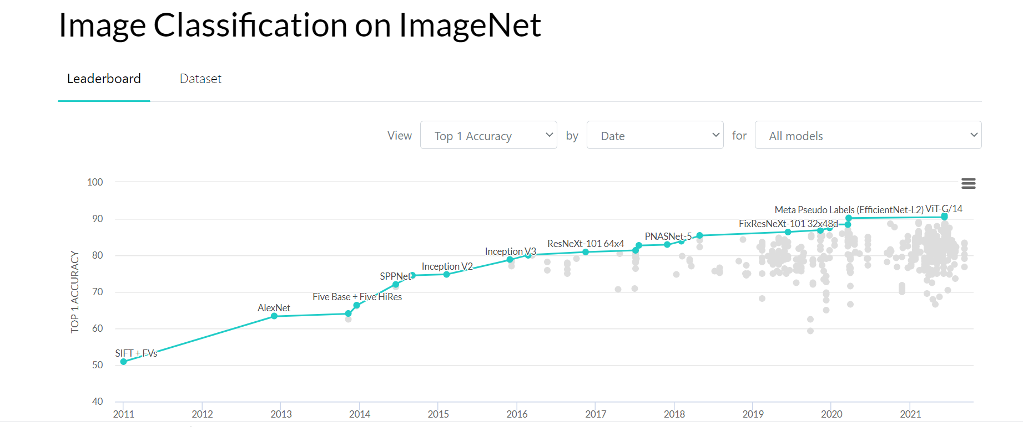
Best Object detection systems and their Recognition rates in Imagenet object recognition challenges https://paperswithcode.com/sota/image-classification-on-imagenet?p=ghostnet-more-features-from-cheap-operations
AlexNet
Recent
winner
2013
progress
2021
The beginning of modern neural computing

Slide 21
Part 2
Segmentation and Object detection systems
Segmentation : FCN Fully convolution network
  Normal convolution
  Transposed convolutions
  Dilated (atrous) convolutions
  1x1 convolutions
Object detection : R-CNN,YOLO (You only look once)

Slide 22
Object and segmentation systems
FCN Fully convolution network for semantic segmentation
Inception net (Googlenet)
R-CNN (Region convolution neural network)
YOLO You only look once models: for object detection
  Reference: See: [1] https://medium.com/雞雞與兔兔的工程世界/機器學習-ml-note-cnn演化史-alexnet-vgg-inception-resnet-keras-coding-668f74879306

Slide 23
Fully Convolutional Networks (FCN) for Semantic Segmentation
https://arxiv.org/pdf/1411.4038.pdf
https://arxiv.org/abs/1612.03144
https://people.eecs.berkeley.edu/~jhoffman/yahooJapan_Mar2016_talks/1-Evan-fcn%20spotlight.pdf
An implementation using Tensorflow
c # encode
conv1_1 = conv(inputs, 32, 3, strides=2, name='conv1_1')
conv1_2 = conv(conv1_1, 32, 3, name='conv1_2')
conv1_3 = conv(conv1_2, 32, 3, name='conv1_3')
conv2_1 = conv(conv1_3, 64, 3, strides=2, name='conv2_1')
conv2_2 = conv(conv2_1, 64, 3, name='conv2_2')
conv2_3 = conv(conv2_2, 64, 3, name='conv2_3')
conv3_1 = conv(conv2_3, 128, 3, strides=2, name='conv3_1')
conv3_2 = conv(conv3_1, 128, 3, name='conv3_2')
conv3_3 = conv(conv3_2, 128, 3, name='conv3_3')
conv4_1 = conv(conv3_3, 256, 3, strides=2, name='conv4_1')
conv4_2 = conv(conv4_1, 256, 3, name='conv4_2')
conv4_3 = conv(conv4_2, 256, 3, name='conv4_3')
conv5_1 = conv(conv4_3, 512, 3, strides=2, name='conv5_1')
conv5_2 = conv(conv5_1, 512, 3, name='conv5_2')
conv5_3 = conv(conv5_2, 512, 3, name='conv5_3')
# decode
upsample2 = deconv(conv5_3, 256, name='upsample2')
upsample2 = dropout(upsample2, rate=0.5, training=is_train, name='dropout1')
upsample4 = deconv(upsample2, 128, name='upsample4')
upsample4 = dropout(upsample4, rate=0.5, training=is_train, name='dropout2')
upsample_concat = tf.concat([upsample4, conv3_3], axis=3, name='concat_8s')
logits = conv(upsample_concat, num_classes, 1, do_act=False, name='logits')
logits = tf.image.resize_images(logits, tf.shape(inputs)[1:3], method=1, align_corners=True)
return logits
Original FCN : For 21 classes of objects
500x500 images
Fully Convolutional Networks for Semantic Segmentation
Jonathan Long∗ Evan Shelhamer∗ Trevor Darrell
UC Berkeley
https://arxiv.org/pdf/1605.06211.pdf

Slide 24
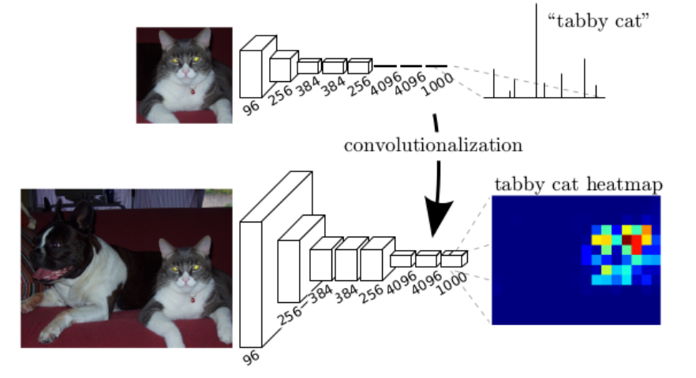
Trained with 1000 object classes, such as tabby cat etc.
The final output neuron shows the probabilities of the input belonging to the 1000 classes.
https://stats.stackexchange.com/questions/419242/how-to-reproduce-the-classification-heatmap-figure-figure-2-from-the-fcn-paper
In classification, conventionally, an input image is downsized and goes through the convolution layers and fully connected (FC) layers.
Conventional CNN: use Fully connected output layer
One output predicted label is for the input image class
Output size =1000x1
Convolution
Fully connected
Fully convolution network (FCN)
Each pixel in the heatmap shows the probability of that belongs to tabby cat
Input Image size=
output image size
(no change)
Down-sample
Up-sample

Slide 25
Different types of convolutions
Normal convolutions –for feature extraction
Transposed convolutions – for up sampling (output dimension bigger than input dimension)
Dilated (atrous) convolutions –for better efficiency
1x1 convolution –for better efficiency & changing dimension

Slide 26

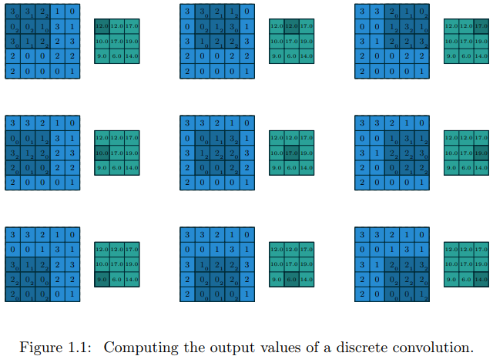
(a)Normal Discrete convolution (same as correlation in this contest)
Input (Blue), kernel(gray) output (green)
kernel
Example
Stride =1, zero-padding=0

Slide 27
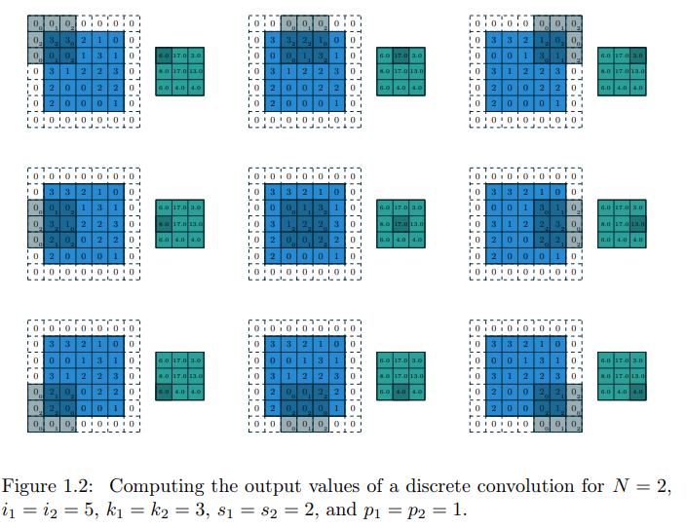
Discrete convolution with stride (s=2)and zero-padding (p=1). Input (Blue), kernel(gray) output (green)
kernel
E.g..

Slide 28
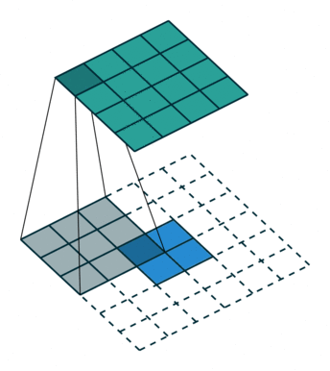
(b) Transposed convolution
Other names: up convolution, fractional stride convolution). Some people call it de-convolution which is not too accurate.
For this example
Output (green)4x4
Kernel (gray)size=3x3
Stride=1
Input pattern (blue) 2x2
Up-sampling Via Deconvolution (Blue: Input, Green: Output)
See https://medium.com/apache-mxnet/transposed-convolutions-explained-with-ms-excel-52d13030c7e8 for more examples. Numerical examples can be found at https://naokishibuya.medium.com/up-sampling-with-transposed-convolution-9ae4f2df52d0
https://towardsdatascience.com/review-fcn-semantic-segmentation-eb8c9b50d2d1
What is up sampling? https://towardsdatascience.com/transposed-convolution-demystified-84ca81b4baba

Slide 29
Deconvolution and transposed convolution( deconvolution)
The name Deconvolution is not correct, but many people are still using this not-so-correct term.
A guide to convolution arithmetic for deep learning Vincent Dumoulin, Francesco Visin
https://arxiv.org/abs/1603.07285
Note : In deep learning , convolution and cross-correlation are the same in practice. (I.e. for convolution, no need to flip one of the images before correlation)

Slide 30
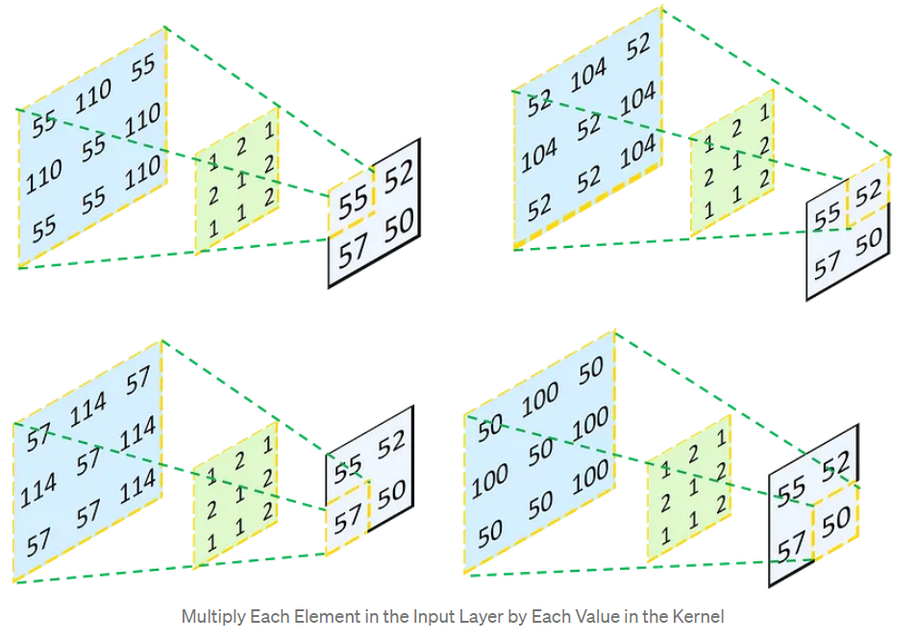
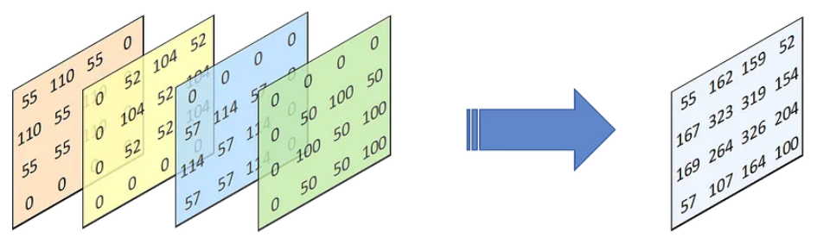
Transposed convolution example stride=1
Step1: multiply input left-top
55 to all elements of Kernel mask
Step2: multiply input right-top
52 to all elements of kernel mask
Output
Output
kernel
kernel
Input
Input
Input 2x2
[55 52
57 50]
Kernel mask
3x3
[1 2 1
2 1 2
1 1 2]
Output is 4x4
Step3: multiply input left-bottom
57 to all elements of kernel mask
Step4: multiply 50 to all elements of kernel mask
Output
Output
Input
Input
kernel
kernel
Place the 4 results with shift here
Step1
result
Step2
result
Step3
result
Step4
result
Combine and add 4 results (with shift) is the final transposed
convolution output
Idea: It is like to use the input pixel as light source to project the kernel to the output plane.
https://towardsdatascience.com/understand-transposed-convolutions-and-build-your-own-transposed-convolution-layer-from-scratch-4f5d97b2967

Slide 31

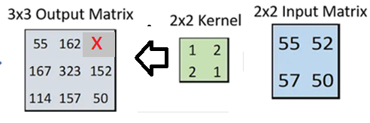
Exercise 3: Transposed convolution with stride (step size)=1
MC question, Find X, __?
(1) 100; (2) 102; (3) 104; (4) 106.

Slide 32
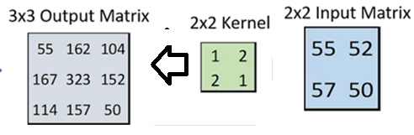
Answer 3 transposed convolution: MC question, Find X, __?
(1) 100 ;(2) 102 ;(3) 104 ;(4) 106: X=104, (choice3 is correct)
step1:top-left element (=1) of the Kernel multiplies the Input
Step3 :bottom-left element (=2) of the Kernel multiplies the Input
1*55 | 2*55
2*55 | 1*55
Step2 : top-right element (=2) of the Kernel multiplies the input
Step4 : bottom-right element (=1) of Kernel multiplies the input
Combine and add shifted results=output
1*52 | 2*52
2*52 | 1*52
1*57 | 2*57
2*57 | 1*57
1*50 | 2*50
2*50 | 1*50
1*55+2*52+2*57+1*50=323
2*55+1*57=167
X
2*55+1*52=162
55 | 2*55+1*52=162 | 2*52=104
2*55+1*57=167 | 1*55+2*52+2*57+1*50=323 | 1*52+2*50 =152
2*57=114 | 1*57+2*50=157 | 1*50=50
1*55 | 2*55
2*55 | 1*55
1*52 | 2*52
2*52 | 1*52
1*52+2*50
=152
1*57 | 2*57
2*57 | 1*57
1*50 | 2*50
2*50 | 1*50
=157
=114

Slide 33
Transposed convolution when Strides=(2,2)
https://d2l.ai/chapter_computer-vision/transposed-conv.html
https://www.researchgate.net/figure/Example-of-Transpose-Convolution-with-Stride-2-2-Kernel-size-2-2_fig3_347534508
Larger strides can enable Bigger output size
input =2x2, kernal=2x2,
Strides=2, meaning (2,2)
Output = 4x4

Slide 34
Transposed convolution when Strides=(2,2)
Strides=(2,2) can be written as stride=2
https://d2l.ai/chapter_computer-vision/transposed-conv.html
https://www.researchgate.net/figure/Example-of-Transpose-Convolution-with-Stride-2-2-Kernel-size-2-2_fig3_347534508
Example:
Given that
input = [0 1 ;
2 3],
Kernel= [ 0 1 ;
2 3]
Find Transposed convolution when strides (step sizes) =(2,2).
Larger strides can enable
bigger output size

Slide 35
Example : Transposed convolution when strides (step sizes)=(2,2)
Strides=(2,2) can be written as stride=2.
Example: input size (i) =2 kernel size (k) =2
Stride (2) =2, padding (p) =0,
Transposed_Conv_output_size=(i-1)*s-(2*p)+(k-1)+1
=(2-1)*2-(2*0)+(2-1)+1=4
C=Transposed convolution of A and K
Size of C is 2x2
Larger strides can enable bigger output size
A= | 1 | 3
 | 5 | 7
K= | 1 | 2
 | 2 | 3
C= | 1*1=1 | 2*1=2 | 1*3=3 | 2*3=6
 | 2*1=2 | 3*1=3 | 2*3=6 | 3*3=9
 | 1*5=5 | 2*5=10 | 1*7=7 | 2*7=14
 | 2*5=10 | 3*5=15 | 2*7=14 | 3*7=21
 | Sum of C = | 128
1+2+2+3+3+6+6+9+5+10+10+15+7+14+14+21=128

Slide 36
Convolution and transposed convolution( deconvolution)
A guide to convolution arithmetic for deep learning Vincent Dumoulin, Francesco Visin
https://arxiv.org/abs/1603.07285
Note : In deep learning , convolution and cross-correlation are the same in practice. (I.e. for convolution, no need to flip one of the images before correlation)

Slide 37
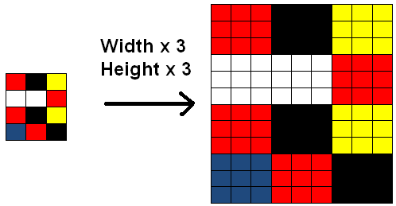
Simple up-sampling method, it makes output size bigger than input
Up sampling from 4x3 to 12x9
Just repeat the pixel values. But this method is not learnable
https://www.giassa.net/?page_id=200

Slide 38
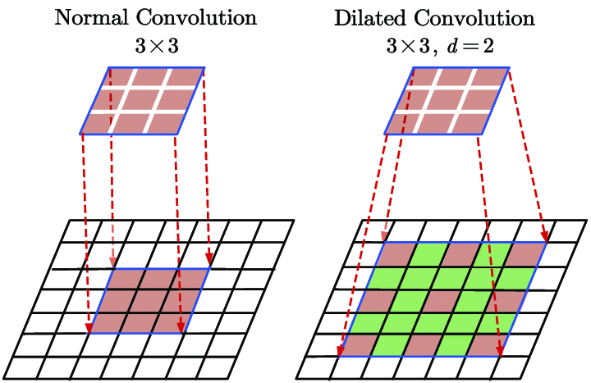
(c) Dilated (atrous) convolutions
Like convolution but with a bigger receptive field
Advantages of Dilated Convolution:
Using this method rather than normal convolution is better as:
Larger receptive field (i.e. no loss of coverage)
Computationally efficient (as it provides a larger coverage on the same computation cost)
Lesser Memory consumption (as it skips the pooling step) implementation
No loss of resolution of the output image (as we dilate instead of performing pooling)
Structure of this convolution helps in maintaining the order of the data.
3x3 kernel
Input
The illustration of the 2D dilated convolution with spatial size of 3×3 and dilation factor of 2. Both the non-dilated (d=1) , and 2-dilated convolutions have the same number of parameters, whereas the dilated convolution has a larger receptive field.
https://www.researchgate.net/figure/The-illustration-of-the-2D-dilated-convolution-with-spatial-size-of-33-and-dilation_fig1_338780378
https://towardsdatascience.com/a-primer-on-atrous-convolutions-and-depth-wise-separable-convolutions-443b106919f5
https://www.geeksforgeeks.org/dilated-convolution/

Slide 39
Application of dilated (atrous) convolution
-- increase efficiency
Using dilated (atrous) convolution , we achieve same effect as :
maxpooling/conv/up-sampling
Max-pooling/conv/up-sampling
https://openaccess.thecvf.com/content_cvpr_2018/papers/Li_CSRNet_Dilated_Convolutional_CVPR_2018_paper.pdf

Slide 40
(d) 1x1 convolution
A very useful tool in Convolution Neural Network
-- for better efficiency and changing convolution dimension

Slide 41
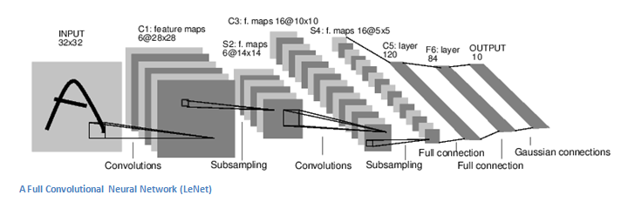
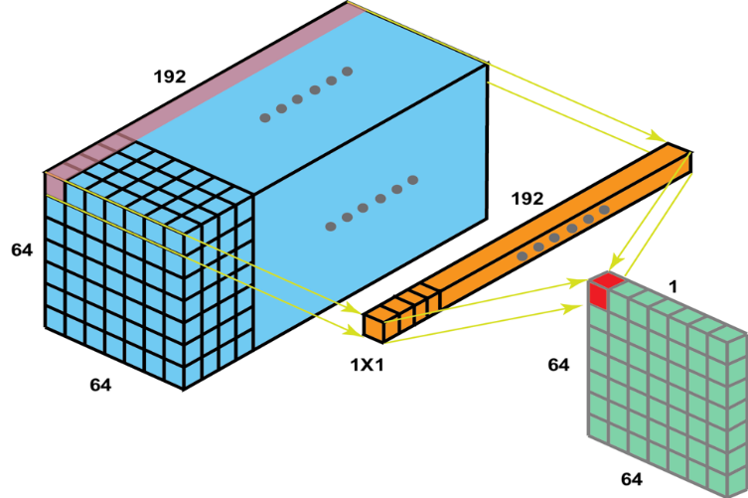
1x1 convolution: Use it to change dimension. Here, we show that a layer in CNN is a 3D structure (tensor)
https://medium.com/analytics-vidhya/talented-mr-1x1-comprehensive-look-at-1x1-convolution-in-deep-learning-f6b355825578
Similar 3D structure
D=6,H=28,
W=28
1x1 convolution
1D input:
1x192(pink)
1D kernel
1x192(orange)
D=192
H=64
In this LeNet CNN example , the circled is a convolution layer C1 , you may treat it as a 3D structure of HxWxD, where,
Height (H)=28
Wide (W) =28
Depth (D)=6
W=64
In this similar example of a convolution layer of a CNN, the 3D structure is HxWxD=64x64x192
The 1x1 convolution result is a scaler (in red)
Apply the 1x1 convolution to the whole 3D structure. You can to a 64x64 image (green)

Slide 42

You can employ a 1x1xD kernel (K) and convolve with the 3D structure
E.g.
The kennel is a vector (1x1x192) for K=[k1,k2,..,k192]’
For an input 3D tensor (blue) the 1D vector along the depth (D) direction is
D(1,1)=[d1,d2,..,d192]’
The output is a scalar value (in red) =Relu(K’*D(1,1)), (assume Rectified Linear Unit Relu is used)
Apply to all 64x64 D vectors and you have a 64x64 output image (Green: 1 plane)
If you have n such Kernel (K) vectors, you may have a 3D tensor structure of 64x64xn (n planes).
So, you may transform a 64x64x192 tensor to a 64x64xn tensor (green), this is dimensional change, which is very useful in many CNN model design.
An excellent video on this topic by Andrew Ng : https://www.youtube.com/watch?v=vcp0XvDAX68
D(1,1 )
[d1,d2,..,d192]’
Input
64x64x192
K=[k1,k2,..,k192]’
Output
64x64x1
--one layer of the 64x64xn tensor

Slide 43

Exercise4a,b : 1x1 convolution H=3,W=3,D=4
Ex4a: MC question
Output= 1x1 convolution between T and K (P is at left-top of T). F()=Relu
Which is correct?
P=F(A1*z4+A2*z3+A3*z2+A4*z1)
P=F(B1*z1+B2*z2+B3*z3+B4*z4)
P=F(A1*z1+A2*z2+A3*z3+A4* z4)
P=F(D1*z1+D2*z2+D3*z3+D4*z4)
Ex4b. If you want the output to be 3x3x10, which choice is correct for the kernels?
4 kernels, size for each kernel = 1x1x10.
10 kernels, size for each kernel = 1x1x10.
4 kernels, size for each kernel = 1x1x4.
10 kernels, size for each kernel = 1x1x4 .
A4 | B4 | C4
D4 | E4 | F4
G4 | H4 | I4
z4
A3 | B3 | C3
D3 | E3 | F3
G3 | H3 | I3
z3
A2 | B2 | C2
D2 | E2 | F2
G2 | H2 | I2
z2
P | Q | R
S | T | U
W | X | Y
A1 | B1 | C1
D1 | E1 | F1
G1 | H1 | I1
z1
K=1x1x4 Kernel
Output 3x3x1
Input Tensor
T=H x W x D = 3 x 3 x 4

Slide 44
Answer a,b : 1x1 convolution H=3,W=3,D=4
Ex4a: MC question
Output= 1x1 convolution between T and K (P is at left-top of T). F()=Relu
Which is correct?
Choice (3) is correct P=F(A1*z1+A2*z2+A3*z3+A4*z4)
Note: You may treat P as the output of a neuron with A1,A2,A3,A3 as inputs and z1,z2,z3,z4 as the corresponding weights. If you need more output layers, you need more neurons.
F() is the activation function Relu.
Ex4b. If you want the output to be 3x3x10, which choice is correct for the kernels?
4 kernels, size for each kernel = 1x1x10
10 kernels, size for each kernel = 1x1x10
4 kernels, size for each kernel = 1x1x4
10 kernels, size for each kernel = 1x1x4 (is correct)
A4 | B4 | C4
D4 | E4 | F4
G4 | H4 | I4
z4
A3 | B3 | C3
D3 | E3 | F3
G3 | H3 | I3
z3
F=Relu()
Neuron
B=bias
A2 | B2 | C2
D2 | E2 | F2
G2 | H2 | I2
Σ=u , F(u+B)
z2
P | Q | R
S | T | U
W | X | Y
A1 | B1 | C1
D1 | E1 | F1
G1 | H1 | I1
z1
K=1x1x4 Kernel
Output 3x3x1
Input Tensor
T=H x W x D = 3 x 3 x 4

Slide 45
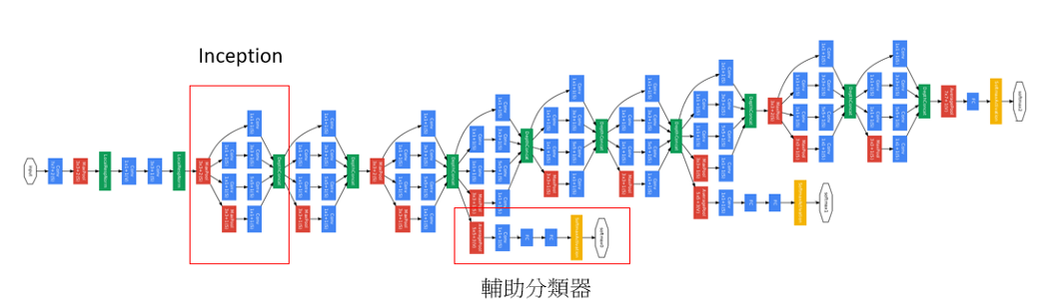
Example of how 1x1 convolutions is used in the famous Inception (GoogLeNet) model
GoogLeNet, in 2014 ILSVRC ranks number 1
It combines 3x3 and 5x5 kernels in the CNN, 1x1 convolutions. See the videos
https://www.youtube.com/watch?v=C86ZXvgpejM https://www.youtube.com/watch?v=KfV8CJh7hE0&t=306s
One Inception module block
Auxiliary classifier

Slide 46
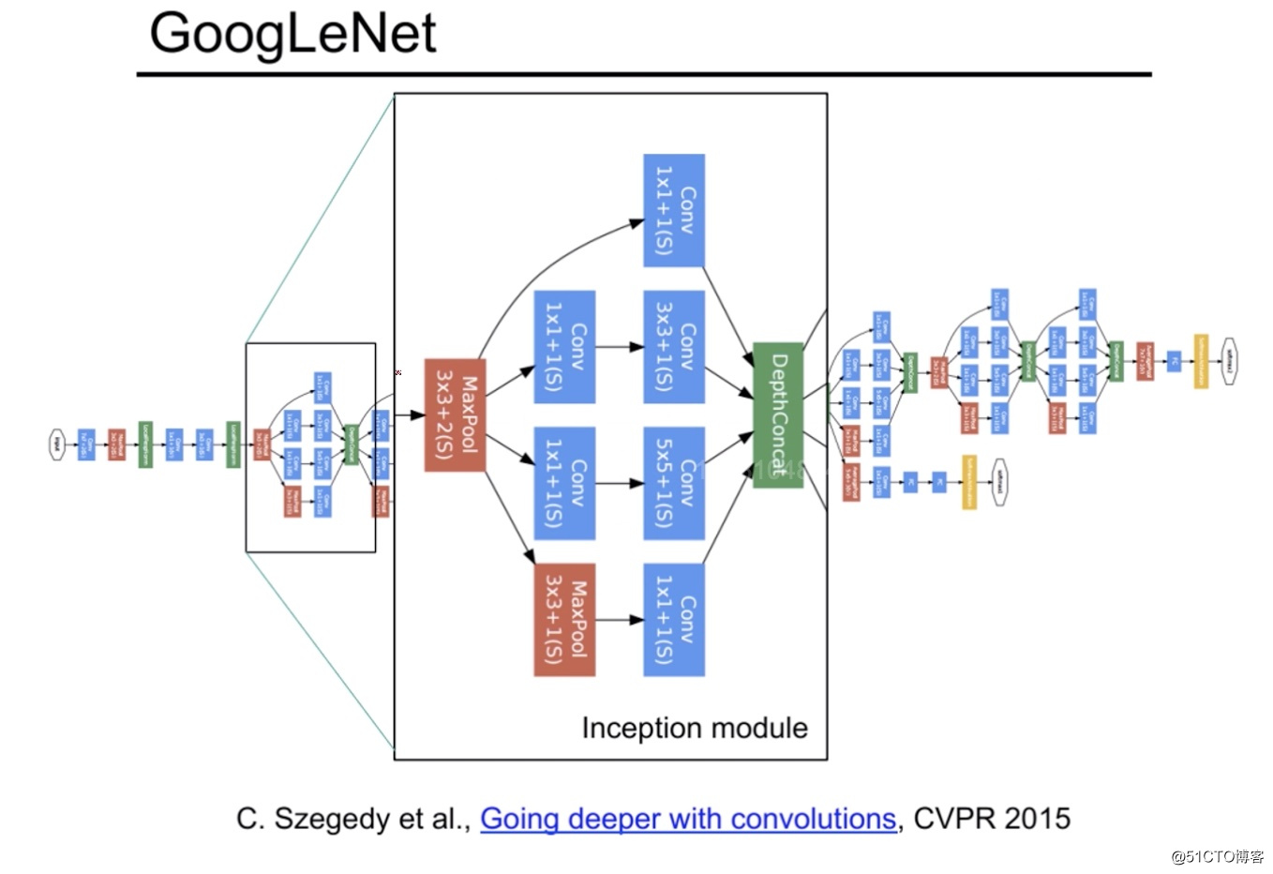
Applications of various convolutions:
Inception (GoogleLeNeT) network
Each output (from conv 3x3, 5x5 etc.) have same H and W, but different depts (Di).
In this network, an Inception module has multiple parallel channels: 1x1, 3x3, 5x5 convolutions & max pooling. Thus, the network can handle different types of input images.
So, how to combine them?
Solution: make sure different channels have the same width(W),height(H) by using padding and different strides.
Use 1x1 convolution to create outputs (say using kernels of 3x3 conv., 5x5 conv. etc.) of different depths(Di).
Concatenate (stack) different outputs (can be done because they have same W and H but different depts Di) to become the desired H x W x D output tensor. D is the total depth of all different outputs. I.e. Sum_all_i(Di)=D
After concatenation you have the HxWxD tensor

Slide 47
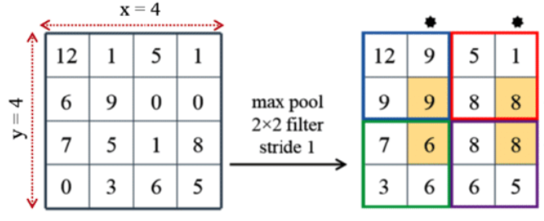
Max pool with stride =1, step size= (1,1)
Normally pooling stride is (2,2), so size (area) is reduced to ¼ (half in both directions). But you may use stride (1,1) to keep the dimension.
Process max pooling as the window moves (1,1) in each step.
https://www.researchgate.net/figure/a-S3Pool-in-this-example-the-size-of-feature-map-is-4x4-where-x-4-and-y-4-In_fig5_335570021
Max-pooling to get 9

Slide 48
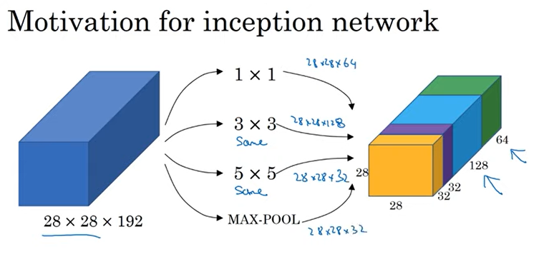
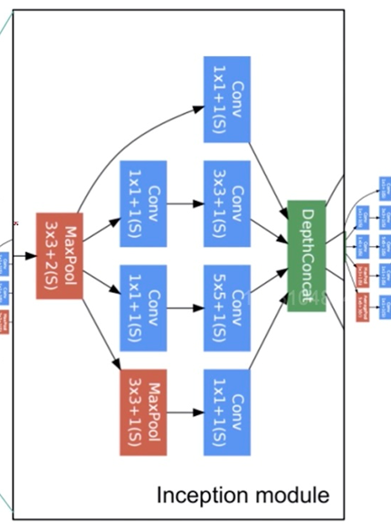
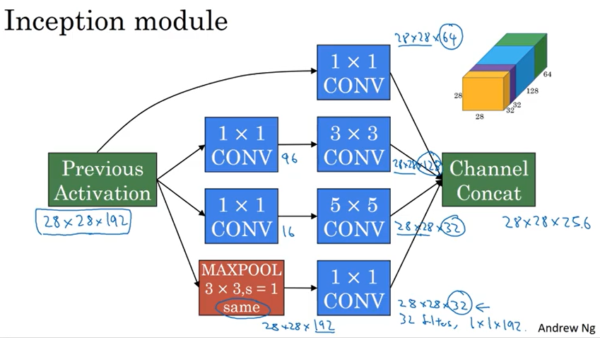
See how to concatenate different filters/channels (padding is used to match all feature map height/width dimensions during convolution). Here: Input is 28x28x192, output is 28x28x256. Same width/height dimension. 1x1 = 1x1 convolutions, 3x3 = use 3x3 kernel convolution etc.
28x28x64
Same W, H but different D
d
28x28x128
28x28x32
28x28x256
The next layer
W x H x D
Stride=1 pad_same
28x28x32
A previous layer
W x H x D
Used in Inception net

Slide 49
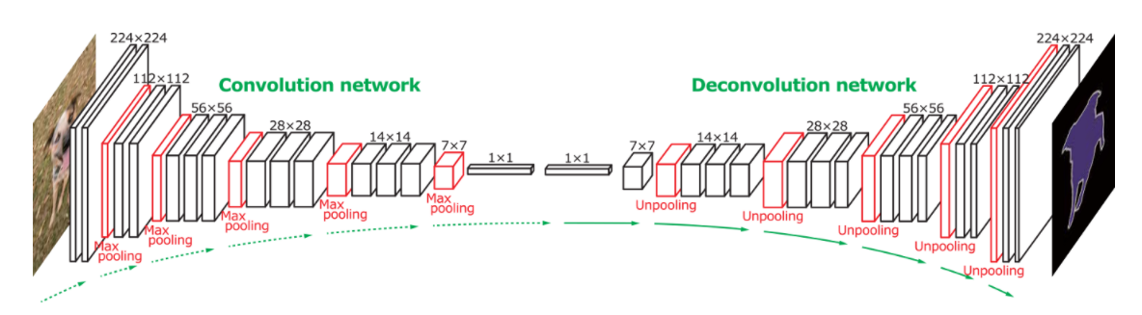
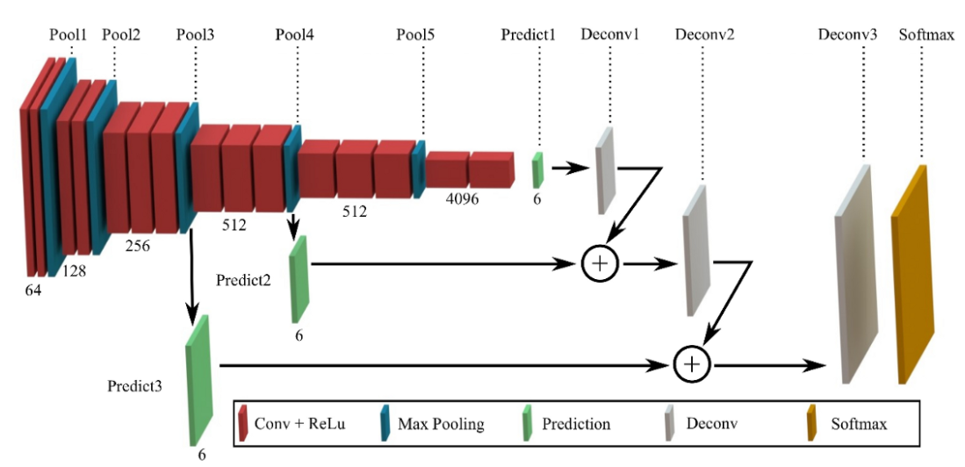
Application of 1x1 and transpose (un-sample) convolution
FCN : An implementation of FCN (Fully Convolution Network), it reuses pre-trained layers 3, 4 and 7 of the VGG model and then generate up sampling layers by transposed convolution (also known as deconvolution)
From the paper http://cvlab.postech.ac.kr/research/deconvnet/
VGG 16, Convolution net
for encoding
for decoding
Another implementation: From
https://medium.com/@wilburdes/semantic-segmentation-using-fully-convolutional-neural-networks-86e45336f99b
Used in U-net

Slide 50
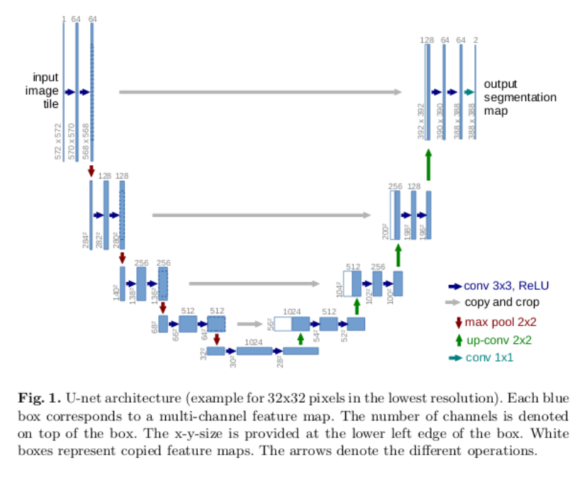
Use 1x1 convolution in U-net segmentation map from input image https://kharshit.github.io/blog/2019/08/09/quick-intro-to-semantic-segmentation
See https://towardsdatascience.com/unet-line-by-line-explanation-9b191c76baf5
For implementation
Input for training
Target for training
Used in U-net
2-class Biomedical Image Segmentation
(Foreground/background)
The pre-trained resnet18 is used as the left part of the model.
Output channels=number of classes required to classify
https://arxiv.org/pdf/1505.04597.pdf 2 classes for medical data (foreground background)
encoder
decoder
See next slide for details.
See also https://www.geeksforgeeks.org/u-net-architecture-explained /

Slide 51
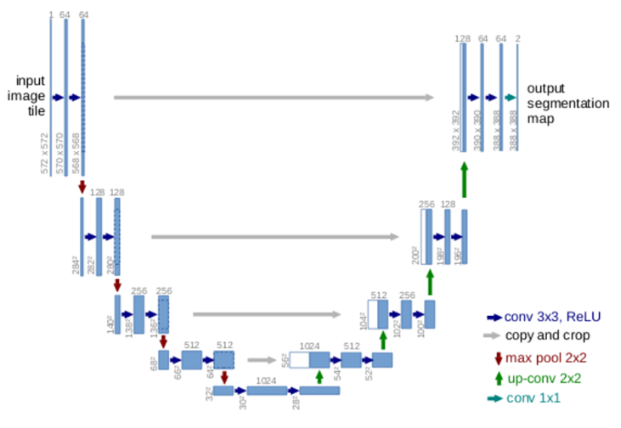
Conv: For each dimension, N=image_width, m=kernel (mask) width, s=strike(or step size), output_feature_map_width={ [(N-m)/s]+1}
Input for training
Kernel size=3x3, (use 64 such kernels)
572-3+1=570
570-3+1=568
Target for training
2-class
Biomedical Image Segmentation
(Foreground/background)
Max pooling
Hence 572/2=284
Kernel size=3x3
284-3+1=282
Up sample
(196)*2=292
You may use dilated (atrous) convolution ) to implement the encoder
Max pooling 2x2, (128 kernels)
Hence 282/2=141
Kernel size=3x3, (256 kernels)
141-3+1=139
Up sample
(100)*2=200
Max pooling
Hence 136/2=68
See next slide
Lowest res is 28x28
1024 kernels each for a class of object
encoder
decoder

Slide 52
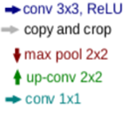
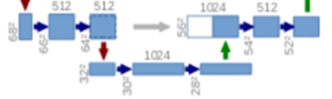
Special treatment for lower resolution in Unet
68^2 to 66^2, 512 feature maps (use 3x3 kernel conv.)
66^2 to 64^2, 512 feature maps (use 3x3 kernel conv.)
64^2 to 32 ^2, (use max pool 2x2)
32^2 to 30^2 (use 3x3 kernel conv.)
30^2,512 feature maps (30x30*512) to 1024
  First use a 512x1 kernel (based on 1x1 conv) to convolve with the input 30x30*512 , then the output is a plane of 30x30.
  Repeat above for 1024 times, stack them, you get a 30x30x1024 tensor ‘T’.
  Average each 30x30 plane of ‘T’ to a data , you have a vector of 1024x1 (this method is called Global Average Pooling (GAP))
1024 to 28^2: reshape 1024 to 32x32, use 3x3 con. To m,ake it 28^28
28^2 to 56^2 (up sampling by transposed conv. Stride 2x2)
56^2 to 54^2 (use 3x3 conv.)
A B C
G
D E F

Slide 53
Implementation example: Image segmentation with a U-Net-like architecture https://keras.io/examples/vision/oxford_pets_image_segmentation/
Input image for training
Test result
test image
Ground truth annotations
Result the U-Net FCN (Fully Convolution Network)
Input image for training
Target annotations
for training
Exercise: Count the number of conv2d, con2d_transposed layers

Slide 54
Region-convolution neural net
Extract region of interest of the object
R-CNN and its variants

Slide 55
R-CNN (Region-convolution neural net)
Family of R-CNN
  R-CNN(ECCV2014),
  Fast R-CNN (ICCV2015),
  Faster R-CNN (NIPS2015),
  Mask-R-CNN (CVPR2017):added Region of Interest (RoI)
  YOLO (CVPR2016) Grid based, achieve 45 frames/sec
  SSD (ECCV2015) Single Shot multibox Detector
  YOLOv1 to YOLOv10 (2024) : A comprehensive review of YOLO https://arxiv.org/html/2406.10139v1
https://blog.csdn.net/v_JULY_v/article/details/80170182

Slide 56
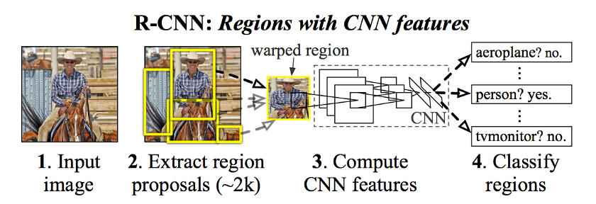
R-CNN (original, slow)
https://towardsdatascience.com/step-by-step-r-cnn-implementation-from-scratch-in-python-e97101ccde55
https://arxiv.org/pdf/1311.2524.pdf
takes an input image,
extracts around 2000 bottom-up region proposals,
computes features for each proposal using a large convolutional neural network (CNN), and then
classifies each region using class-specific linear support vector machine SVMs.

Slide 57
R-CNN relies on the followings for object window searching
Graph cut based segmentation for the first search
  Efficient graph-based image segmentation PF Felzenszwalb, DP Huttenlocher 2004
  To be discussed in the next slide.
Refined by “Selective search for object recognition”
  J. Uijlings, K. van de Sande, T. Gevers, and A. Smeulders. Selective search for object recognition. IJCV, 2013.
Finally, it uses Support vector machine (SVM) for classification. See http://www.cse.cuhk.edu.hk/~khwong/www2/cmsc5707/5707_14_svm.pptx

Slide 58
Segmentation using Graph theory:
First mentioned in Efficient Graph-Based Image Segmentation by Pedro F. Felzenszwalb (the theory is discussed in appendix)
Implemented in opencv: cv.GraphSegmentation();
The Idea is: Cut (separate) neighboring pixels that have high intensity changes
http://people.cs.uchicago.edu/~pff/papers/seg-ijcv.pdf
https://blog.gtwang.org/programming/opencv-graph-based-segmentation-tutorial/
https://cs.gmu.edu/~kosecka/cs482/lect-segmentation-part2.pdf
https://www.analyticsvidhya.com/blog/2021/05/image-segmentation-with-felzenszwalbs-algorithm/

Slide 59
R-CNN: Result
https://bdtechtalks.com/2021/06/21/object-detection-deep-learning/

Slide 60
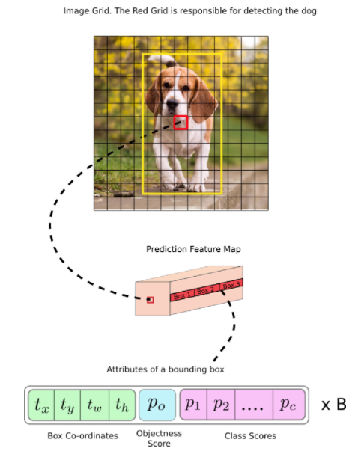
Yolo.v1 : “You only look once” can detect
20 object categories. Yolo.v3 (80 categories) https://medium.com/axinc-ai/yolov3-a-machine-learning-model-to-detect-the-position-and-type-of-an-object-60f1c18f8107
13x13
grid
Divide the input image into a 7x7 grid, (more cells in version3 , e.g. 13x13),
  each grid cell has 2 anchor boxes
    Each anchor box has 5 parameters: tx,ty,tw,th, objectness-confidence score (p0: prob. of is it an object)
    Note: The anchor box (w,h) can be larger than the grid cell but centered at the cell.
    Each grid cell can also predicts C (=20) conditional class probabilities. Each predicts one set of class probabilities per grid cell, regardless of the number of boxes B (typically B=2, meaning 2 anchor boxes).
    [p1,..p_{c=20}]= 20 conditional object class probabilities. E.g. P1=car, P2=cat, P3=truck,… etc. for a 20-object detection system.
An anchor box
Tx,ty (position)
tw,th (box width, height)
p0=objectness-confidence score of the anchor box contains an object
[p1,..p_{c=20}]= 20 conditional object class probabilities

Slide 61
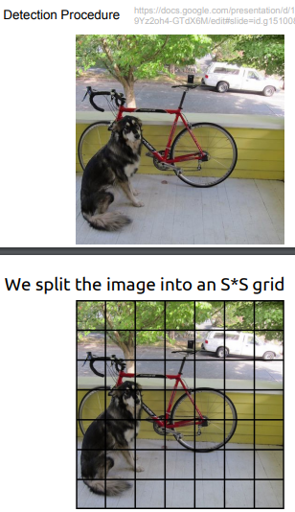
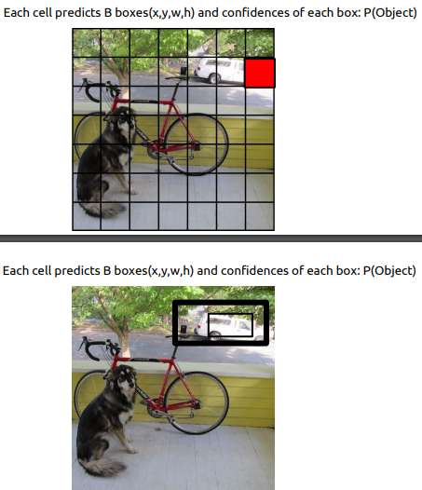
Why Yolo is fast: Rather than searching for 2000 windows in R-CNN, Yolo.v1 divides the input image into SxS grid
S*S=7x7 grid (so, it is faster) https://web.cs.ucdavis.edu/~yjlee/teaching/ecs289g-winter2018/YOLO.pdf
For 20 object classes
Each grid cell predicts 2 anchor boxes, and a set of class probabilities: p1,p2,..,p20 for this cell
7
The two anchor boxes: Each box is defined by 5 parameters: x,y,h,w and P(object)= confidence score which tells how confident that box has an object.
(But not telling you what is that object)
7

Slide 62
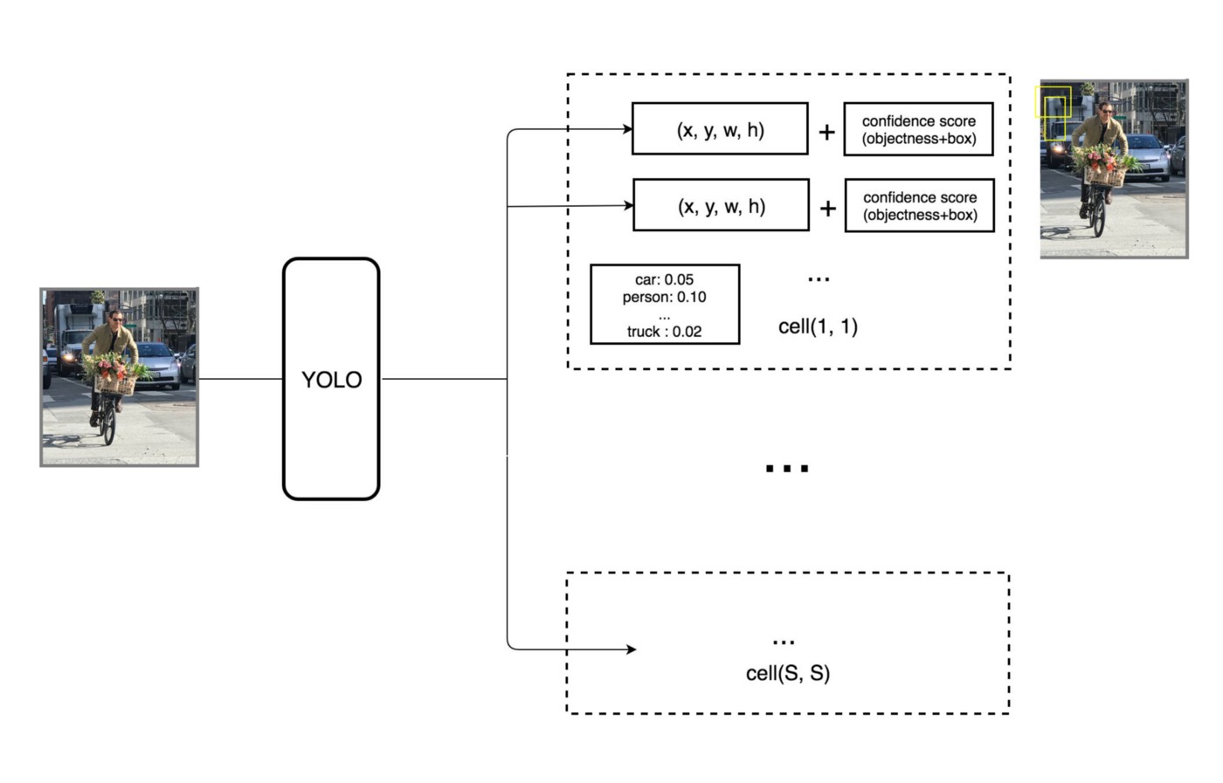
Each grid cell predicts B bounding boxes (2 in YOLO) and confidence scores (2) each for a box.
These confidence scores reflect how confident the model is that the box contains an object and also how accurate it thinks the box is that it predicts
S x S=7x7 grid cells
Each grid cell predicts 2 boxes (B=2) #1, #2 and their score
Each grid cell also predicts C (=20)c conditional class probabilities,
Pr(Classi|Object). These probabilities are conditioned on the grid cell containing an object. We only predict
one set of class probabilities per grid cell, regardless of the
number of boxes B.
S x S=7x7

Slide 63
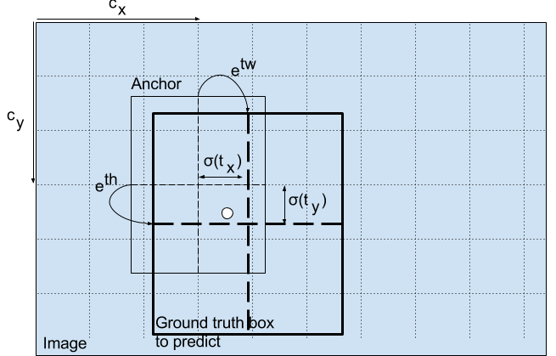
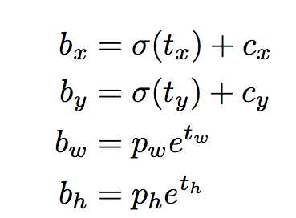
YOLO.v3: 13x13 grid, each cell has B Anchor (bounding) Boxes https://www.kdnuggets.com/2018/05/implement-yolo-v3-object-detector-pytorch-part-1.html
Each grida cell contains n anchor boxes.
Each an
An anchor box B
Parameters inside each anchor box B
p0(confidence score of this box has an object)
p1,..,Pc (score for each in C classes)
e.g. in Pascal dataset C=20. Typically, B=2 anchor boxes.

Slide 64


Yolo: processing steps
Inside each cell of the 7x7 grid, it has B=2 bounding boxes
The anchor (bounding) box B size can be larger that of the grid cell size
d

Slide 65


Yolo: the class probability (Po-P20)processing steps
d
The anchor (bounding) box B size can be larger that of the grid cell size

Slide 66

Yolo
From input to output

Slide 67

YoloV3 (YOLO version 3): Each cell in the output layer’s feature map predicts 3 boxes in the case of Yolo-V3 and 5 boxes in YOLO-V2
d
https://towardsdatascience.com/yolo-v3-explained-ff5b850390f

Slide 68


Yolo7 (in a 2023 tutorial)
https://viso.ai/deep-learning/yolov7-guide/
YOLOv7: Trainable bag-of-freebies sets new state-of-the-art for real-time object detectors
By Chien-Yao Wang1 et.al. https://arxiv.org/pdf/2207.02696.pdf

Slide 69

Yolo versions https://www.datacamp.com/blog/yolo-object-detection-explained
The latest Yolo (from Yolo v5-v12) can detect 80 different objects 2025.march
d

Slide 70
Implementation options
for neural networks

Slide 71
Full batch and min-batch training
Full batch (or batch) training: Neural networks are trained in a series of epochs.
  Each epoch consists of one forward pass and one backpropogation pass over all training samples.
  Naively, we can compute the true gradient by computing the gradient value of each training case independently, then summing together the resultant vectors. This is known as full batch learning,
Mini-batch training: Alternatively, we may choose to update the training weights several times over the course of a single epoch.
  We are computing an approximation of the true gradient, using however many training samples are included in each split of the epoch. This is known as mini-batch learning.
  In the most extreme case we may choose to adjust the gradient after every single forward and backwards pass. This is known as online (stochastic gradient ) learning.
https://www.kaggle.com/residentmario/full-batch-mini-batch-and-online-learning
https://towardsdatascience.com/batch-mini-batch-stochastic-gradient-descent-7a62ecba642a

Slide 72
Example, and iterations https://www.baeldung.com/cs/epoch-vs-batch-vs-mini-batch
On iteration for n number of samples
  In batch gradient descent, 1 epoch corresponds to a single iteration.
  In stochastic gradient (online) descent, one epoch corresponds to n iterations.
  In mini-batch gradient descent, one epoch corresponds to n/b iterations where b is the size of the mini-batch.
  We have already defined the other two terms but let’s re-introduce them more formally.
On number of updates
  Let’s assume that we have a dataset with n=2000 samples, and we want to train a deep learning model using gradient descent for 10 epochs and mini-batch size b=4:
  In (full) batch gradient descent, we’ll update the network’s parameters (using all the data) 10 times which corresponds to 1 time for each epoch.
  In stochastic gradient (online) descent , we’ll update the network’s parameters (using one sample each time) 2000*10=20000 times which corresponds to 2000 times for each epoch.
  In mini-batch gradient descent, we’ll update the network’s parameters (using b=4 samples each time), (2000/4)*10=5000 times, or that corresponds to (2000)/4=500 times for each epoch.

Slide 73

Mini_batch weight update by averaging, a typical method
https://stats.stackexchange.com/questions/266968/how-does-minibatch-gradient-descent-update-the-weights-for-each-example-in-a-bat/266977
If your model has 5 weights and you have a mini-batch size of 2 (2 samples or examples) then you might get this:
Example 1. Loss=2, gradients = (1.5,−2.0,1.1,0.4,−0.9)
Example 2. Loss=3, gradients=(1.2,2.3,−1.1,−0.8,−0.7)
The average of the gradients in this mini-batch are calculated, they are (1.35,0.15,0,−0.2,−0.8), which
will be used to update the weights)
Gradient$=\left({∂e}/{∂w}\right)$,
$$\text{Note} \text{weight} \text{update}\text{: }$$
$$w_{new}\text{=}w_{old}+Δw$$
$where Δ$w= -$η\left({∂e}/{∂w}\right),$
$η$=0.1
a=[1.5,-2.0,1.1,0.4,-0.9],b=[1.2,2.3,-1.1,-0.8,-0.7], (a+b)/2
% 1.3500 0.1500 0 -0.2000 -0.8000

Slide 74

Dropout
Dropout: A Simple Way to Prevent Neural Networks from Overfitting by Nitish Srivastava
http://jmlr.org/papers/volume15/srivastava14a/srivastava14a.pdf
=Randomly choose not to update some weights

Slide 75

Adam Optimization Algorithm (Adaptive Moment estimation) make weight update more efficient and effective
https://www.math.purdue.edu/~nwinovic/deep_learning_optimization.html
https://www.researchgate.net/figure/Adam-optimizer-algorithm_fig2_339075038
m initialized as 0 at the beginning

Slide 76

ADAM optimization algorithm/code https://towardsdatascience.com/adam-latest-trends-in-deep-learning-optimization-6be9a291375c https://www.geeksforgeeks.org/intuition-of-adam-optimizer/
Background:
  w=weights, g=$\frac{ΔE}{Δw}$ is the gradient on current mini-batch , α=learning rate
  Classical learning method we studied is w=w-αg
Adam algo: Using momentum and Root Mean Square Propagation .
Can handle sparse gradients on noisy problems. m initialized as 0 at beginning
for t in range(num_iterations), or w converges:
g = compute_gradient(x, y)
m = beta_1 * m + (1 - beta_1) * g
v = beta_2 * v + (1 - beta_2) * np.power(g, 2)
m_hat = m / (1 - np.power(beta_1, t))
v_hat = v / (1 - np.power(beta_2, t))
w = w - step_size * m_hat / (np.sqrt(v_hat) + epsilon)
Example:
beta_1(β1) ≈ 0.9
beta_2 (β2)≈ 0.001
step_size(α) ≈0.001
epsilon(ε) ≈ 10^-8
Python code with numpy
np.sqrt(x)=x², np.power(a,b)=a^{b}
Ref:
https://www.math.purdue.edu/~nwinovic/deep_learning_optimization.html
https://medium.com/@nishantnikhil/adam-optimizer-notes-ddac4fd7218
https://sefiks.com/2018/06/23/the-insiders-guide-to-adam-optimization-algorithm-for-deep-learning/

Slide 77
Summary
Studied object detection systems and related topics
Studied how to achieve object detection and how to evaluate them.
Studied different kinds of convolutions.
Studied various famous (FCN, R-CNN, YOLO etc.) object detection and segmentation models.
Studied implementation options for neural networks are discussed.

Slide 78
Appendices

Slide 79
Appendix 1: Rf-test3: imagenet
DATA_URL = 'http://download.tensorflow.org/models/image/imagenet/inception-2015-12-05.tgz'
imagenet
D:\tensorflow\models-master\tutorials\image\imagenet
run_inference_on_image('banana.jpg')
: 0000:02:00.0, compute capability: 6.1)
2020-02-21 20:06:22.555089: I tensorflow/stream_executor/dso_loader.cc:152]
successfully opened CUDA library cublas64_100.dll locally
banana (score = 0.99933)
orange (score = 0.00003)
zucchini, courgette (score = 0.00002)
pineapple, ananas (score = 0.00001)
shopping basket (score = 0.00001)
(tf-gpu) PS D:\tensorflow\models-master\tutorials\image\imagenet>

Slide 80

Appendix 2: FCN: How to generate output using 1x1 kernel convolution
In the case of the U-net diagram two 1×1×64 kernels are applied to the input volume (not the images!) to produce two feature maps of size 388×388. They used two 1×1 kernels because there were two classes in their experiments (cell and not-cell)…..
So, in the case we want to apply a 1×1 convolution to an input of shape 388×388×64, where 64 is the depth of the input, then the actual 1×1 kernels that we will need to use have shape 1×1×64 (as I said above for the U-net). The way you reduce the depth of the input with 1×1 is determined by the number of 1×1 kernels that you want to use. This is exactly the same thing as for any 2d convolution operation with different kernels (e.g. 3×3). – One class for one 1x1x64, kernel. You can have more classes by using more kernels
https://ai.stackexchange.com/questions/21810/what-is-a-fully-convolution-network

Slide 81

FCN: Max un-pooling
Accurate method for un-Pooling
Need to remember max positions(indices) during (max) Pooling
Paillassa, Maxime & Bertin, Emmanuel & Bouy, Herve. (2019). MAXIMASK and MAXITRACK: Two new tools for identifying contaminants in astronomical images using convolutional neural networks. Astronomy & Astrophysics. 634. 10.1051/0004-6361/201936345.

Slide 82

Appendix 3: Segmentation
To separate an image into logical parts according to some criteria
Application : foreground object and background separation
https://learnopencv.com/applications-of-foreground-background-separation-with-semantic-segmentation/

Slide 83
Graph theory https://www.cs.yale.edu/homes/aspnes/pinewiki/GraphTheory.html
A graph G(v,e) has vertices (v) and edges (e)
Directed graphs have edges and each edge has a direction
  Simple directed digraph has no loops.
Undirected graphs have edges that do not have a direction
  A simple undirected graph contains no duplicate edges and no loops (an edge from some vertex u back to itself).
Undirected graphs will be used here, examples
vertices
edges
Vertices (V)
Edges (E)

Slide 84
Graph-cut cuts edges of a graph
Examples of graph-cut
A graph-cut separates the graph into 2
A graph-cut separates the graph into 2
The image is a graph
Pixels are vertices
Intensity difference between pixels are edges
Using graph-cut, we separate the foreground and the background
vertices
edges
vertices
Edges

Slide 85


Using graph-cut for segmentation
Normalized Cuts and Image Segmentation Jianbo Shi and Jitendra Malik, https://people.eecs.berkeley.edu/~malik/papers/SM-ncut.pdf
Pixels in gray area are A, pixel positions are u
Pixels in white area are B, pixel positions are v
The value of the cut is$Cut(A,B)=\sum_{uεA,vεB}{w(u,v)}$ ------(1)
We can define the weight
  $w(u,v)$ as exp( $−{\left\|I_{(u)}−I_{(v)}\right\|}^{2}$). I.e. intensity (I( )) difference is high, weight is small
$Cut\left(A,B\right)=$weight between set A and B
Our aim is to cut the graph to minimize the cut value: find Min ($Cut(A,B)$)
A graph-cut $N_{cut}$(A,B) separates the graph into 2
Edges (intensity
difference
between pixels)
Vertices
(Pixels)
A
The vertices are pixels , intensity = I()
B

Slide 86

Appendix 4:
Up sampling by Transposed convolution
It is one of the up-sampling methods.
It makes the output bigger than the input and the kernel. The advantage of using it for up-sampling is that the kernel is learnable.

Slide 87

Transposed convolution with stride (s=2), zero-padding (p=1)
The stride (step size) is applied to the input first.
Output (green)
Kernel (gray)
Input (white/blue)

Slide 88

More examples: transposed convolution with padding (padding is added inside the input )
During convolution
The original cells are spaced 2 apart, and the grid is expanded so that the kernel can cover one of the original values.
Padding (p=1), remove 1 ring from around the grid. This leaves the grid at size 5 by 5. Applying the kernel to this grid gives us an output of size 4 by 4.

