Slide 1
The transformer and large language model
KH Wong

Slide 2
Part 1: Transformer model
KH Wong

Slide 3
Introduction
Basic structure
Processing steps
  Encoder
  Decoder
Applications
  Natural Language Processing (NLP) Question and Answer Demo (English) by Pragnakalp Techlabs
Summary

Slide 4
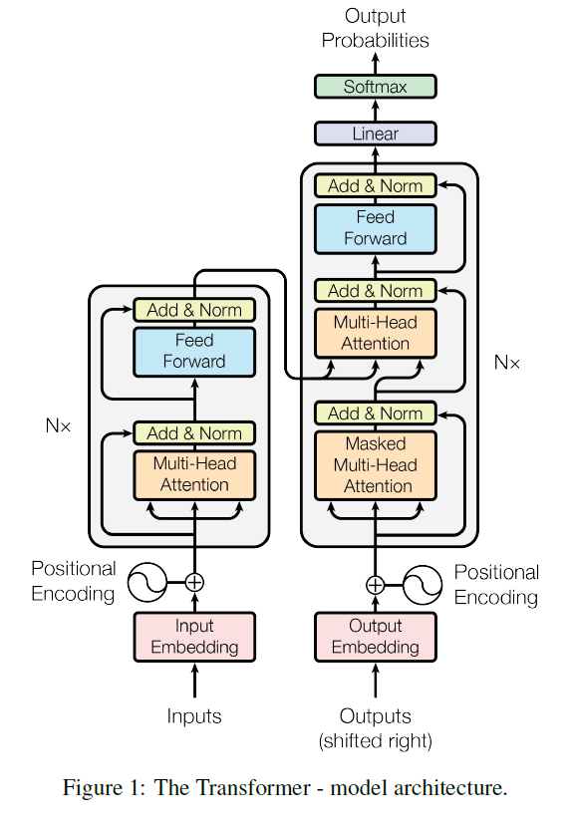
Basic structure encoder + decoder
Basic processing
7)Decoder: feed forward network
Each encoder has encoder 1,2
Encoder1,2 can repeat N times to enhance capability.
4) Encoder2: feed forward network
6) Decoder:
multi-head self-attention for input/target
3) Encoder1 :
multi-head attention
2) Positional encoding
5) Decoder:
multi-head self-attention for target
1) Input embedding
https://pytorch.org/tutorials/beginner/transformer_tutorial.html
https://bbycroft.net/llm (graphical display of transformer models)

Slide 5
Processing steps
1) Input embedding, two methods
  (1a) By learning
  (1b) (subword embedding: wordpiece algo.)
2) Positional encoding
3) Encoder1: multi-head attention
4) Encoder2: feed forward network
5) Decoder: multi-head self-attention for target
6) Decoder: multi-head self-attention for input/target
7) Decoder: feed forward network
https://bbycroft.net/llm (graphical display of transformer models)

Slide 6
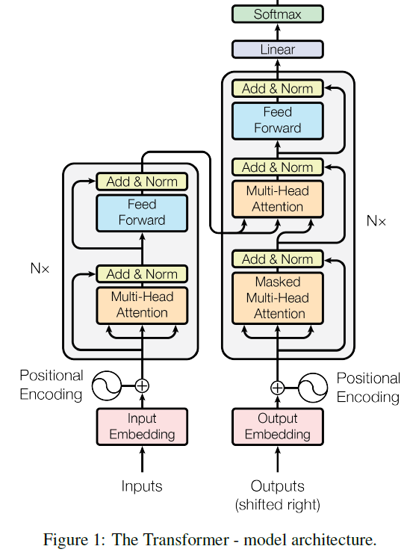
Overview
https://pytorch.org/tutorials/beginner/transformer_tutorial.html
AMMUS : A Survey of Transformer-based Pretrained Models in Natural Language Processing https://arxiv.org/abs/2108.05542
A tutorial: https://jalammar.github.io/illustrated-transformer/
Transformers in Vision: A Survey https://arxiv.org/pdf/2101.01169.pdf

Slide 7
1a) Input embedding using learning
The Transformer (original paper) uses a random initialization of the weight matrix and refines these weights during training – i.e. it learns its own word embeddings.
Reference https://ai.stackexchange.com/questions/26235/what-kind-of-word-embedding-is-used-in-the-original-transformer

Slide 8
1b) Input embedding using subwords
E.g. WordPiece: Subword-based tokenization algorithm (used in BERT, based on 30K words and subwords)
BERT=“Bidirectional Encoder Representations from Transformers” from Google It uses Subwords, examples: ##ge, ##bra
E.g., linear = li + near or li + n + ea + r
algebra = al + ge + bra or al + g + e + bra
E.g. WordPiece, input is a table of 30K
Input embedding: e.g., input using wordpieces, use a trainable neural net (matrix) to convert each subword ( 30000x1 one hot vector) into a vector of 1x768 for each word.
1x768
30000x1
https://mccormickml.com/2019/05/14/BERT-word-embeddings-tutorial/
https://towardsdatascience.com/wordpiece-subword-based-tokenization-algorithm-1fbd14394ed7

Slide 9
Why Sub-word methods?
Using traditional “word2vec, Glove” have the Out-Of-Vocabulary (OOV) problem -- a word is not in the library.
Sub-word embedding is used to overcome the OOV problem. There are several schemes
  Byte Pair Encoding https://en.wikipedia.org/wiki/Byte_pair_encoding
  WordPiece (used by BERT) https://paperswithcode.com/method/wordpiece
  Etc.

Slide 10
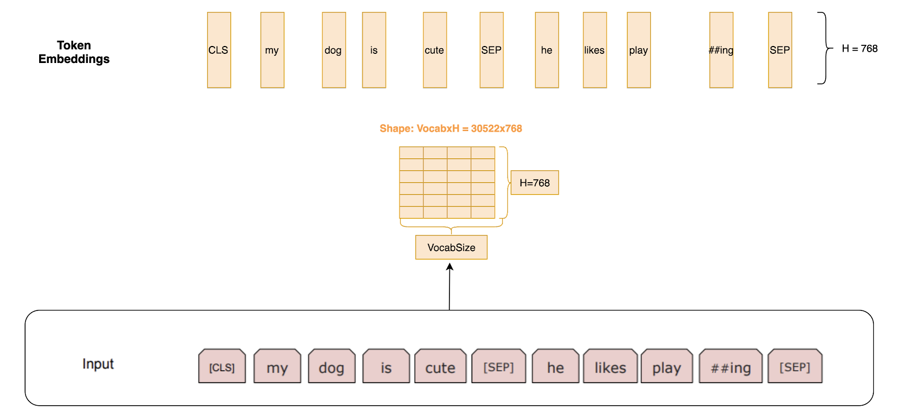
Convert “word” into “token” (for the Transformer) https://www.exxactcorp.com/blog/Deep-Learning/how-do-bert-transformers-work
Example: A dictionary has VocabSize=30500 words (sub-words)
Each word W=30500x1 (one hot; only 1 bit is 1 , other bits are 0)
A token (X) has token embedded size (or token length) H=768.
A learning weight matrix M=(30500x768) is used.
X=M^{T}W
M= VocabSize x H=(30533 x 768)
X=768x1
M=
H=768 (token length or embedded size)
VocabSize=30533
Wordpiece
Subword inputs
each word (subword) is a vector W=(30533 x 1) (onehot)

Slide 11

Exercise 1
The vocabulary of a dictionary (vocab size) is 10000.
1.a) Which of the following can be used to represent the word X?
  One hot vector of size 10000x1 ,
  A matrix of size 10000x10000,
  A matrix of size 100x100.
1.b) If the input token (X) has length 512, what is the size of the weight matrix (M) to convert an input word into the token. Hint: X=M^{T}W
  M is 512x10000,
  M is 10000x 512,
  M is 10000x10000,
  M is 512x512.

Slide 12
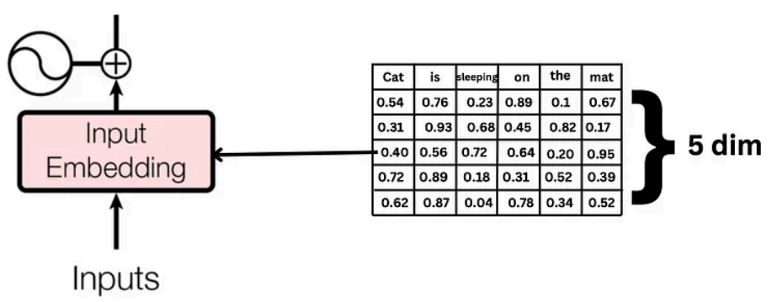
Example: embedding vector length =5 for each word, input sentence length=6 words (Token length)
Answer 1: Q1.a) One hot vector of size 10000x1,(correct). Q1.b) M is 10000x512 (correct)
Positional encoding
6 words in a sentence (=token or context length)
X
Token Embeddingsize is 5
X=[0.54 0.76 0.23 0.89 0.1 0.67
0.31 0.93 0.68 0.45 0.82 0.17
0.40 0.56 0.72 0.64 0.20 0.95
0.72 0.89 0.18 0.31 0.52 0.39
0.62 0.87 0.04 0.78 0.34 0.52]
https://medium.com/@sumith.madupu123/understanding-transformer-architecture-using-simple-math-be6c2e1cdcc7
Notes:
% Cat is sleeping on the mat
%token embedded size or token length=5
X=[0.54 0.76 0.23 0.89 0.1 0.67
0.31 0.93 0.68 0.45 0.82 0.17
0.40 0.56 0.72 0.64 0.20 0.95
0.72 0.89 0.18 0.31 0.52 0.39
0.62 0.87 0.04 0.78 0.34 0.52]

Slide 13
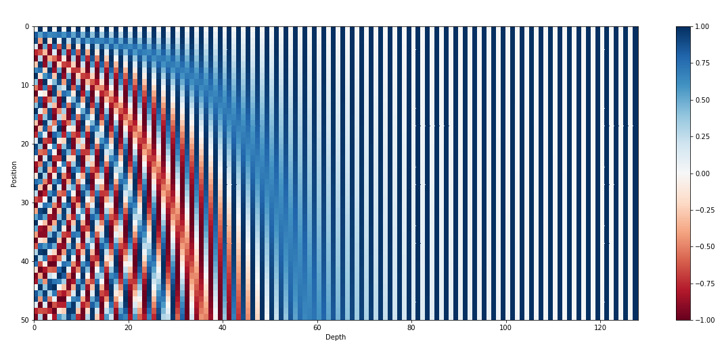
2) Positional encoding
Make sure each position of the input sequence has a different code
https://kazemnejad.com/blog/transformer_architecture_positional_encoding/

Slide 14
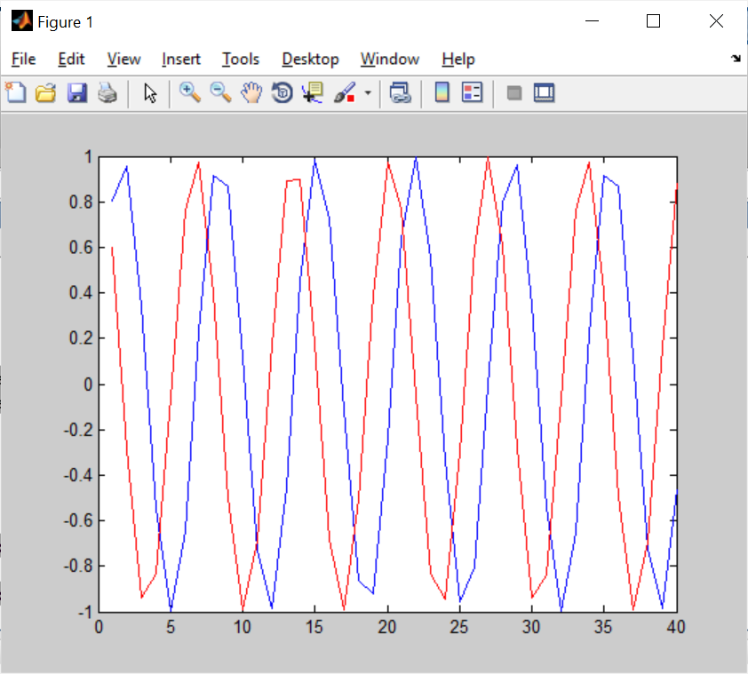
demo
clear
close all
N_pos=40
N_i=512
d_model=512
for pos=1:N_pos
i=2;
PE_pos_2i_sin(pos)=sin(pos/(10000^(2*i/d_model)));
PE_pos_2i_cos(pos)=cos(pos/(10000^(2*i/d_model)));
end
size(PE_pos_2i_sin)
figure(1)
clf
plot(PE_pos_2i_sin(1:N_pos),'b')
hold on
plot(PE_pos_2i_cos(1:N_pos),'r')

Slide 15
Absolute positional encoding (PE)
shttps://www.inovex.de/de/blog/positional-encoding-everything-you-need-to-know/

Slide 16
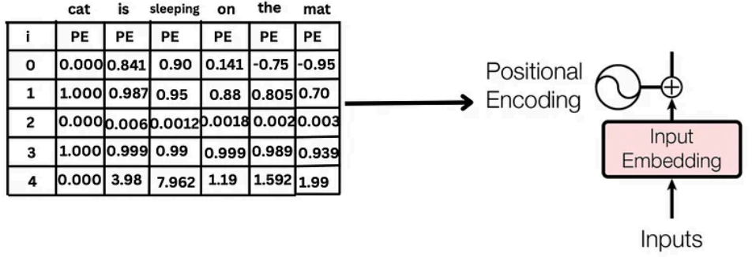
Example: embedding vector length =5 for each word, input sentence length=6 words
Positional encoding and input are of same dimensions, so they can be added
PE=[0.000 0.841 0.900 0.141 -0.75 -0.95
1.000 0.987 0.95 0.88 0.805 0.70
0.000 0.006 0.0012 0.0018 0.002 0.003
1.000 0.999 0.99 0.999 0.989 0.939
0.000 3.98 7.962 1.19 1.592 1.99]
6 words in a sentence (=token or context length)
https://medium.com/@sumith.madupu123/understanding-transformer-architecture-using-simple-math-be6c2e1cdcc7
Notes:
% Cat is sleeping on the mat
%token embedded size or token length
X=[0.54 0.76 0.23 0.89 0.1 0.67
0.31 0.93 0.68 0.45 0.82 0.17
0.40 0.56 0.72 0.64 0.20 0.95
0.72 0.89 0.18 0.31 0.52 0.39
0.62 0.87 0.04 0.78 0.34 0.52]
PE=[0.000 0.0841 0.900 0.141 -0.75 -0.95
1.000 0.987 0.95 0.88 0.805 0.70
0.000 0.006 0.0012 0.0018 0.002 0.003
1.000 0.999 0.99 0.999 0.989 0.939
0.000 0.398 0.7962 1.19 1.592 1.99]

Slide 17
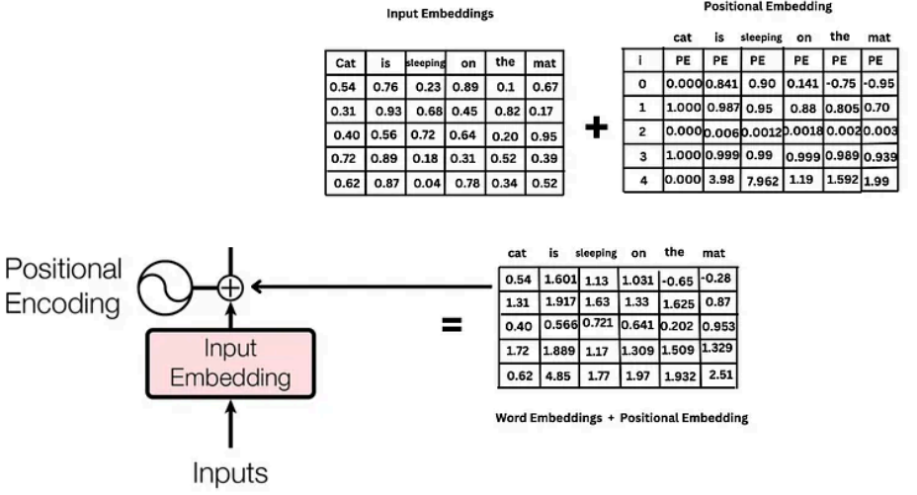
Example: embedding vector length =5 for each word, input sentence length=6 words (after Input embedding and Position embedding are added)
6 words in a sentence (=token or context length)
s
clear
% Cat is sleeping on the mat
%token embedded size or token length
X=[0.54 0.76 0.23 0.89 0.1 0.67
0.31 0.93 0.68 0.45 0.82 0.17
0.40 0.56 0.72 0.64 0.20 0.95
0.72 0.89 0.18 0.31 0.52 0.39
0.62 0.87 0.04 0.78 0.34 0.52]
PE=[0.000 0.841 0.900 0.141 -0.75 -0.95
1.000 0.987 0.95 0.88 0.805 0.70
0.000 0.006 0.0012 0.0018 0.002 0.003
1.000 0.999 0.99 0.999 0.989 0.939
0.000 3.98 7.962 1.19 1.592 1.99]
X+PE
=
0.5400 1.6010 1.1300 1.0310 -0.6500 -0.2800
1.3100 1.9170 1.6300 1.3300 1.6250 0.8700
0.4000 0.5660 0.7212 0.6418 0.2020 0.9530
1.7200 1.8890 1.1700 1.3090 1.5090 1.3290
0.6200 4.8500 8.0020 1.9700 1.9320 2.5100
Notes:
clear
% Cat is slepping on the mat
%token embedded size or token length
X=[0.54 0.76 0.23 0.89 0.1 0.67
0.31 0.93 0.68 0.45 0.82 0.17
0.40 0.56 0.72 0.64 0.20 0.95
0.72 0.89 0.18 0.31 0.52 0.39
0.62 0.87 0.04 0.78 0.34 0.52]
PE=[0.000 0.0841 0.900 0.141 -0.75 -0.95
1.000 0.987 0.95 0.88 0.805 0.70
0.000 0.006 0.0012 0.0018 0.002 0.003
1.000 0.999 0.99 0.999 0.989 0.939
0.000 0.398 0.7962 1.19 1.592 1.99]
X+PE
ns =
0.5400 0.8441 1.1300 1.0310 -0.6500 -0.2800
1.3100 1.9170 1.6300 1.3300 1.6250 0.8700
0.4000 0.5660 0.7212 0.6418 0.2020 0.9530
1.7200 1.8890 1.1700 1.3090 1.5090 1.3290
0.6200 1.2680 0.8362 1.9700 1.9320 2.5100
clear
% Cat is sleeping on the mat
%token embedded size or token length
X=[0.54 0.76 0.23 0.89 0.1 0.67
0.31 0.93 0.68 0.45 0.82 0.17
0.40 0.56 0.72 0.64 0.20 0.95
0.72 0.89 0.18 0.31 0.52 0.39
0.62 0.87 0.04 0.78 0.34 0.52]
PE=[0.000 0.841 0.900 0.141 -0.75 -0.95
1.000 0.987 0.95 0.88 0.805 0.70
0.000 0.006 0.0012 0.0018 0.002 0.003
1.000 0.999 0.99 0.999 0.989 0.939
0.000 3.98 7.962 1.19 1.592 1.99]
X+PE
=
0.5400 1.6010 1.1300 1.0310 -0.6500 -0.2800
1.3100 1.9170 1.6300 1.3300 1.6250 0.8700
0.4000 0.5660 0.7212 0.6418 0.2020 0.9530
1.7200 1.8890 1.1700 1.3090 1.5090 1.3290
0.6200 4.8500 8.0020 1.9700 1.9320 2.5100

Slide 18
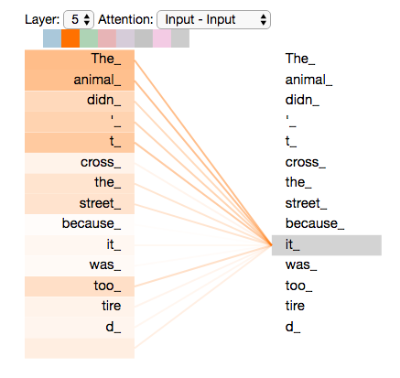
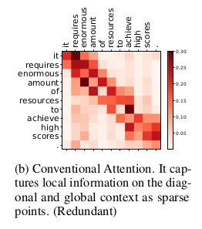
Multi-head attention mechanism Self-attention What is attention (in encoder)?
Words in the same source sentence are related (called self attention)
Darker color represents correlation
https://www.tensorflow.org/text/tutorials/transformer
https://jalammar.github.io/illustrated-transformer/
https://gsarti.com/post/iclr2020-transformers/
https://dmol.pub/dl/attention.html good example

Slide 19
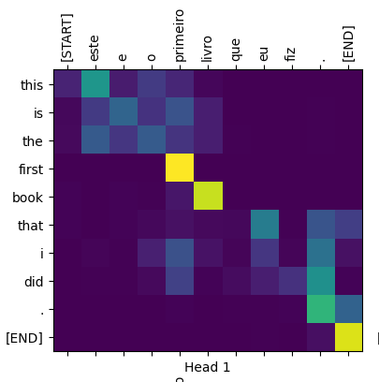
Attention at decoder for machine translation
Words in source/target languages are related (called attention)
Lighter color represents
Higher correlation
French
Entries are cosine score between 2 vectors
English

Slide 20
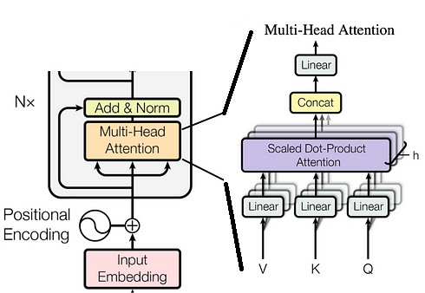
Inside the multiread attention block
Multi-head
attention

Slide 21

Meaning of Query ,Key ,Value
https://www.freepik.com
When you search for movie in a database , e.g. Netflix, Disney+, YouTube,….
Queries (type in the search bar), against a set of Keys (USA movies, types, storyline, etc.), then the results are Values (best matched videos).
If Queries = “Classic movie”,
and Keys = “crime, thriller”
Values= search results,“Psycho , Godfather1.. ”
Search Queries (Q)
“Classic movies”
Use Key (K)
“crime , thriller”
Result: Values (V):
“Pycho, Godfather1”

Slide 22
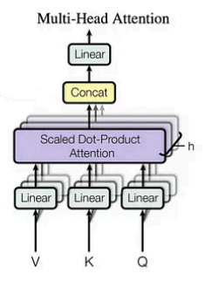
Multi-head structure example
Assume, we have 3 heads
V or K or Q is 5x4
Single head output (Zi) is 5x4
After concatenation of all heads,
Z=concat (z_{i=1},z_{i=2},z_{i=3}), the output Z is 5x(4+4+4)=5x12
Linear weight (W)is 12x6, hence multi-head attention output (Z*W ) is 5x6
Multi-head attention output is d=5x6
Linear weight (W)=12x6
Concat. output (Z) is 5x12
Each single head Z_{i} (5x4)

Slide 23
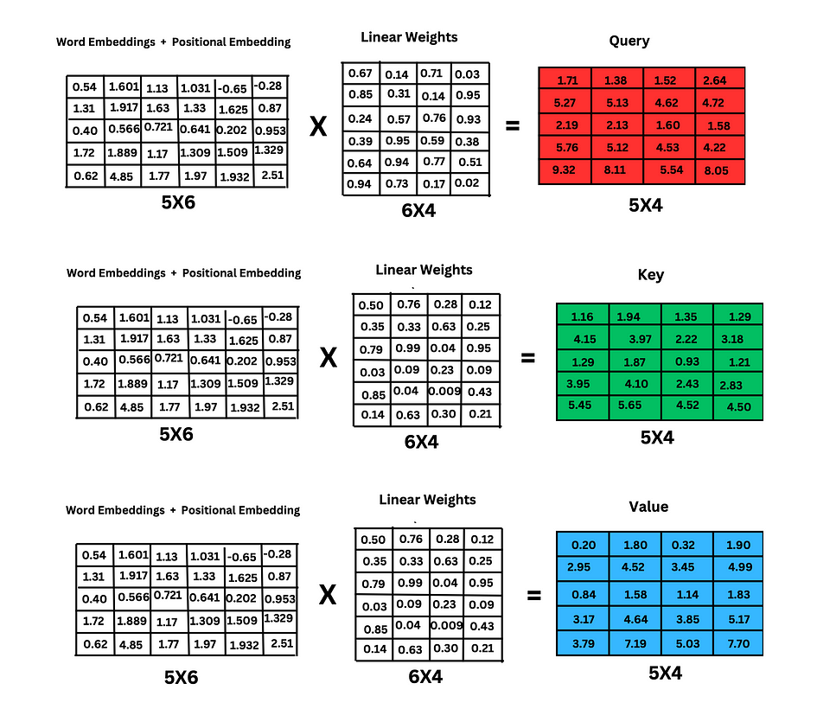
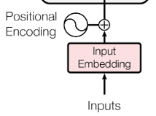
For a single head of a multi-head structure, embedding vector length =5 for each word, input sentence length=6 words.
This is only for a single head
Example:
6 words in sentence (=token/context length)
Q Query:
“Exciting
Movie”
K Key:
crime, or thriller, or
Oscar
V Value:
Psycho , or Godfather1

Slide 24
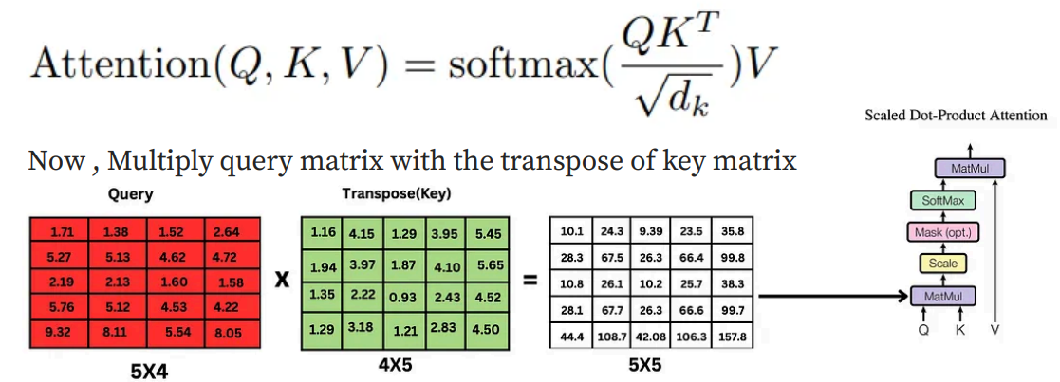
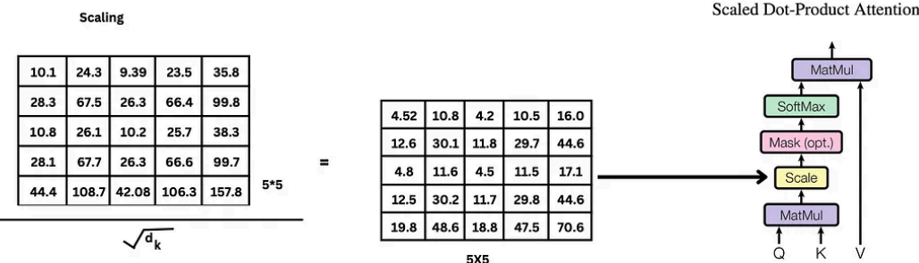
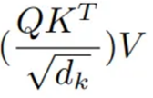
Single head example: Steps to find attention score
Q=Query K’=key’ Q*K’
d_{k}=5, 10.1/sqrt(5)=4.52
=

Slide 25
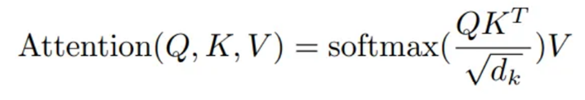
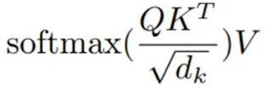
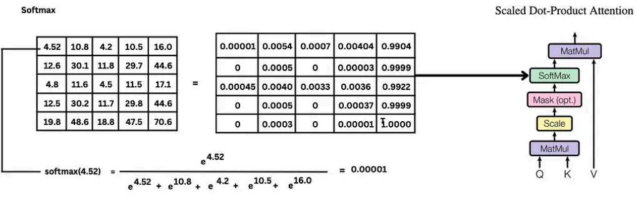
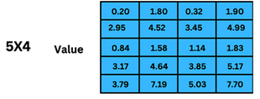
Single head example : SoftMax step
(to implement the scaled dot product attention)
(5x4)
(5x5)
The SoftMax function will enable the output to be a probability
V_{(5x4)}=

Slide 26
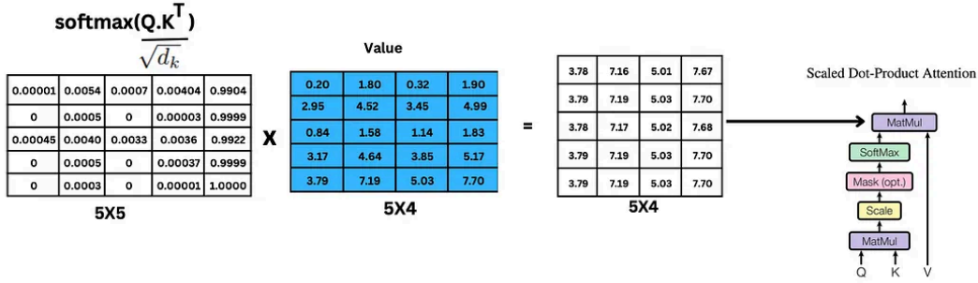
Single head example : Steps to find attention score
Scaled dot-product attention
Scaled dot-product attention for a single head output (Zi) is 5x4
Value (V)

Slide 27
Matlab demo
%Q=Query
Q=[1.71 1.38 1.52 2.64
5.27 5.13 4.62 4.72
2.19 2.13 1.6 1.58
5.76 5.12 4.53 4.22
9.32 8.11 5.54 8.05];
%KT=K'=Transposed key
KT=[1.16 4.15 1.29 3.95 5.45
1.94 3.97 1.87 4.1 5.65
1.35 2.22 0.93 2.43 4.52
1.29 3.18 1.21 2.83 4.5];
%V = value
V=[0.2 1.8 0.32 1.9
2.96 4.52 3.45 4.99
0.84 1.58 1.14 1.83
3.17 4.64 3.85 5.17
3.79 7.19 5.03 7.7];
%Q*KT
U=(Q*KT)/sqrt(5)
%U=
% ans =
% 4.5251 10.8873 4.2013 10.5441 16.0402
% 12.6969 30.1881 11.8061 29.7101 44.6446
% 4.8616 11.6817 4.5652 11.5126 17.1336
% 12.5997 30.2793 11.7724 29.8267 44.6255
% 19.8599 48.6445 18.8193 47.5427 70.6067
softmax(U(1,:)')
softmax(U')'*V
softmax(U')'*V
ans = 3.7827 7.1643 5.0161 7.6741 3.7900 7.1900 5.0300 7.7000 3.7842 7.1694 5.0190 7.6793 3.7900 7.1900 5.0300 7.7000 3.7900 7.1900 5.0300 7.7000

Slide 28
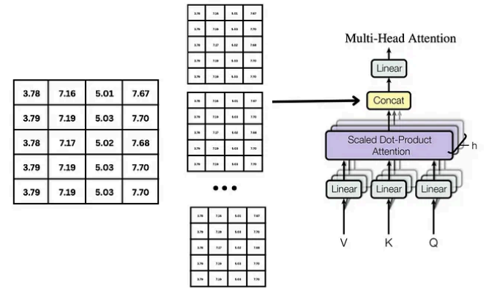
Multi-head concatenation
The previous discussion is for a single head, we concatenate them to become multi-head
Scaled dot-product attention for a single head output , each head is (5x4)
E.g. each head is (5x4. A 3 heads multi-head structure : Concatenate Z=3 heads : Z=concat (z_{i=1},z_{i=2},z_{i=3}), will become
5x*(4+4+4)=
5x12 matrix.
Weight (W) is 12x6, hence multi-head attention output is 5x6
d=5x6
W = 12x6
Z is 5x12
Z_{i} is 5x4
Concatenation of heads (5x12)

Slide 29
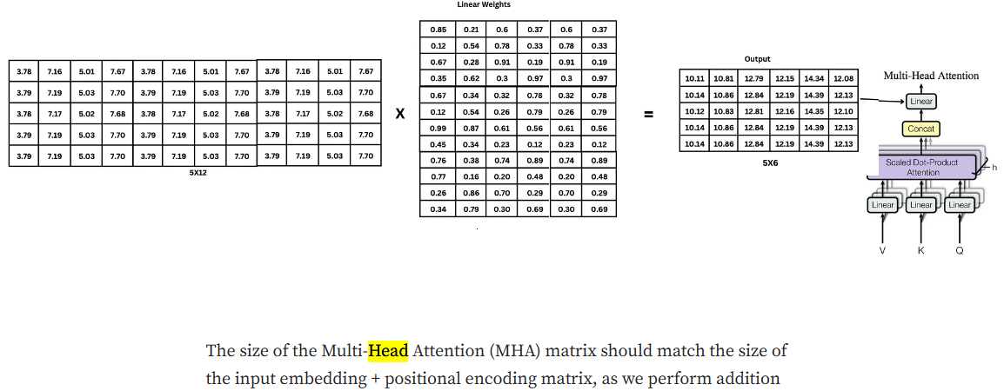
Multi head attention output is 5x6
3 heads , output of each head =4
3 heads
Multi head attention
Output(d) =5x6
Multi-head hidden dimension=4+4+4=12
Linear Weight 5x12
Linear Weight (W) 12 x 6
Multi head attention
output =5x6
Modified from https://medium.com/@sumith.madupu123/understanding-transformer-architecture-using-simple-math-be6c2e1cdcc7

Slide 30
Discussion of Multi-head mechanism
Why “Multi-head mechanism ?”
  Using multi-head does not change the input (X) , attention output dimensions
  Multi-head learns different weights and approaches for the explanations of attention. Experimental results show it performs better. It is same using different kernel sizes in resnet www.cv-foundation.org/openaccess/content_cvpr_2016/papers/He_Deep_Residual_Learning_CVPR_2016_paper.pdf
  Why Multi-head has no activation function?
  https://ai.stackexchange.com/questions/30341/why-does-a-transformer-not-use-an-activation-function-following-the-multi-head-a , https://peterbloem.nl/blog/transformers
  How weights are Wq, Wk, Wv trained?
  https://datascience.stackexchange.com/questions/68220/how-are-q-k-and-v-vectors-trained-in-a-transformer-self-attention
  What are the gradients used in Transformer-attention unit during learning by backpropagation ?
  https://ai.stackexchange.com/questions/25055/what-is-the-gradient-of-an-attention-unit
  https://say-hello2y.github.io/2022-09-07/attention-gradient

Slide 31
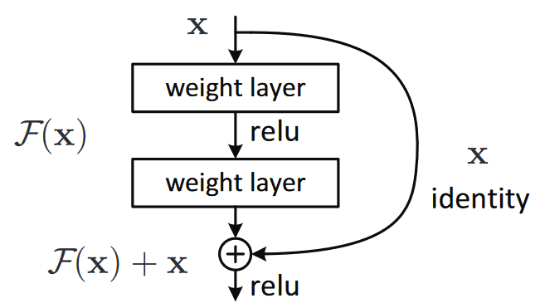
Why “add and normalization” (norm) in the encoder?
Reason for Add X :
  There is a possibility to skip this encoder block if it performs badly. It also reduces the gradient descent problem if this block performs badly.
  https://theaisummer.com/skip-connections/
Normalizing makes data to be on a similar scale. Normally, makes data: mean=0, standard deviation =1
Idea comes from
“Resnet” by He et al. in Deep Residual Learning for Image Recognition
https://paperswithcode.com/method/resnet

Slide 32
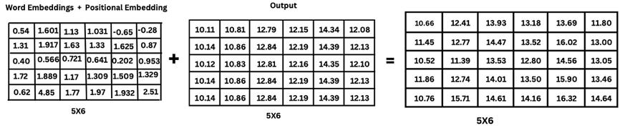
Add and normalization:
Add step
https://medium.com/@sumith.madupu123/understanding-transformer-architecture-using-simple-math-be6c2e1cdcc7
Add step
X=5x6
Input
X=Input(word embeddings positional embedding)
Attention Output
Added Output =5x6

Slide 33

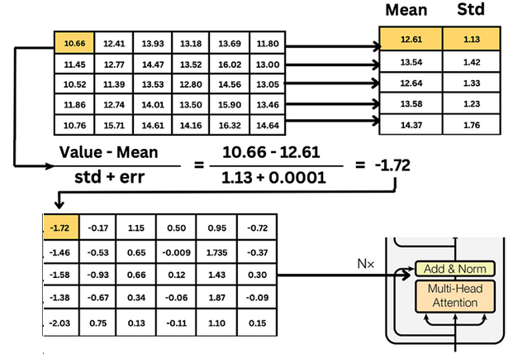
Normalization step: Find mean, standard deviation
Add and normalization result

Slide 34
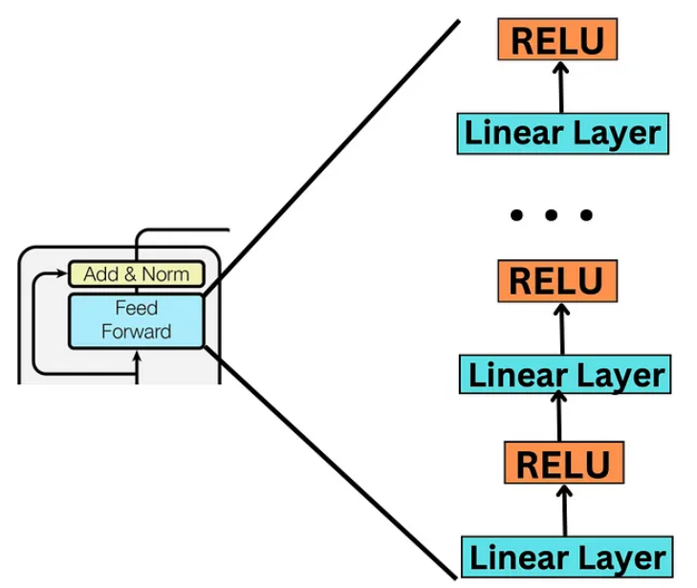
Feed forward step
RELU + linear layer
To simplify the discussion we assume we have only one Linear +RELU layer in the “Feed Forward” block in this example. Real transformers may have more Relu-Linear layers

Slide 35
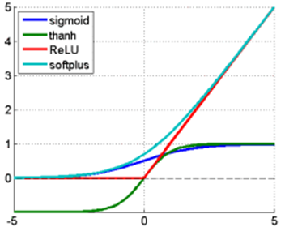
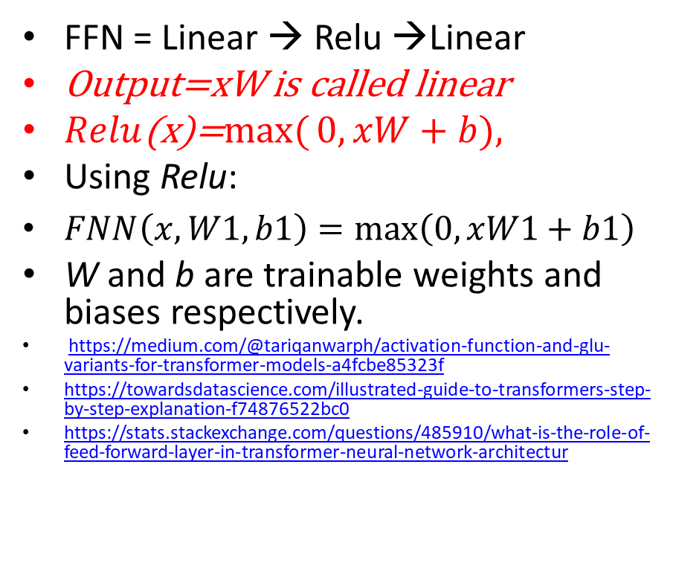
4) Encoder2: Feed forward network (FFN)
FFN = Linear → Relu →Linear
Output=xW is called linear
$Relu$(x)=$\max{(}0,xW+b),$
Using Relu:
$FNN\left(x,W1, b1\right)=\max\left(0,xW1+b1\right)$
W and b are trainable weights and biases respectively.
https://medium.com/@tariqanwarph/activation-function-and-glu-variants-for-transformer-models-a4fcbe85323f
https://towardsdatascience.com/illustrated-guide-to-transformers-step-by-step-explanation-f74876522bc0
https://stats.stackexchange.com/questions/485910/what-is-the-role-of-feed-forward-layer-in-transformer-neural-network-architectur
RELU
Assume we have only one Linear +RELU layer in the “Feed Forward” block in our example
FFN (Feed forward network)

Slide 36
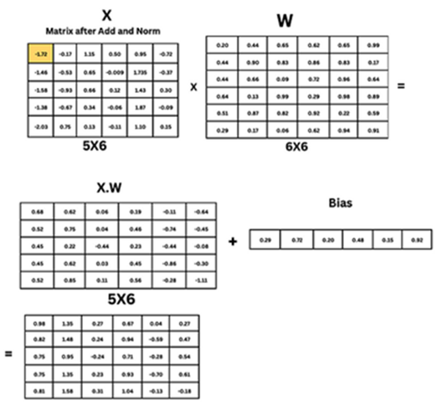
Feed forward step example
Matrix after add and norm=X
Weights

Slide 37
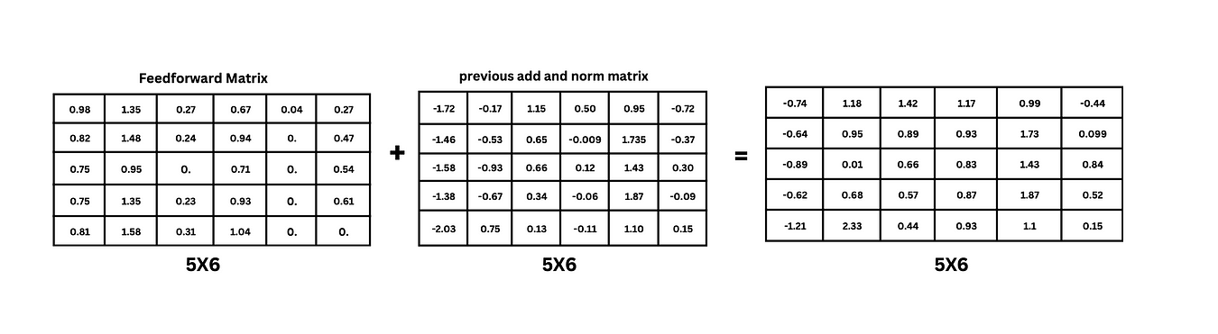
Add and Norm
Add and Norm again
Add step:

Slide 38
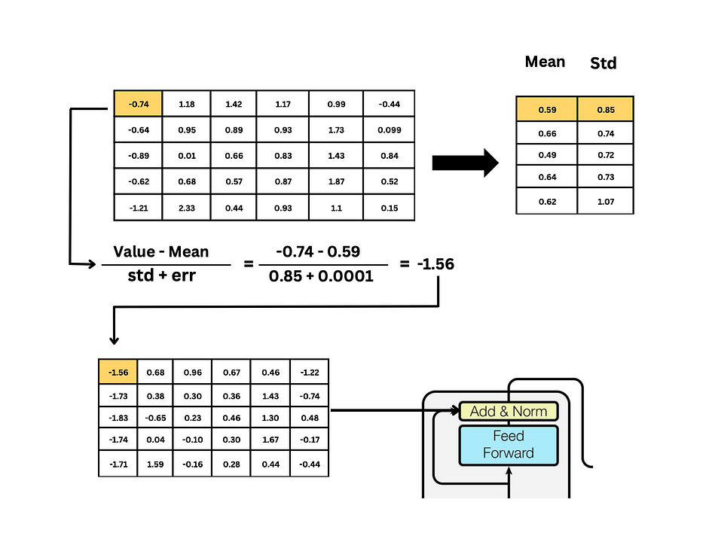
Add and Norm
Add and Norm again
Norm step:

Slide 39
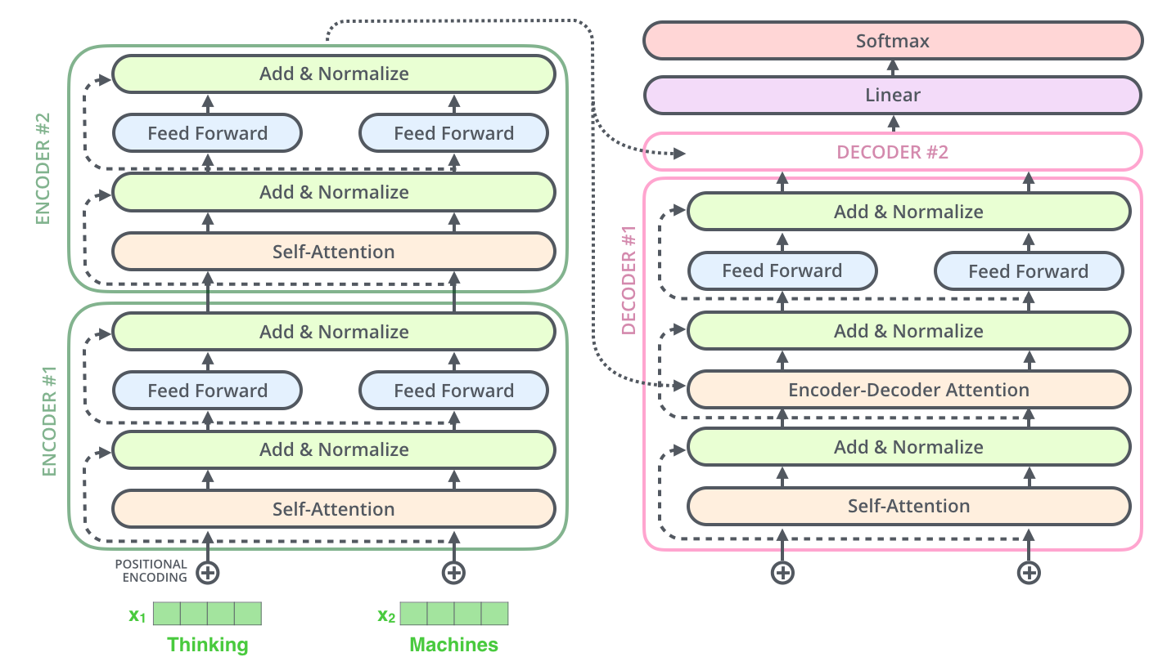
Encoder + decode
Architectures are similar except:
In decoder “Key (K) and Query (Q)” are from the Encoder
“Value (V)” is from the decoder input
decoder input
Encoder input

Slide 40
5) Decoder: multi-head self-attention for input/target
target output
In machine translation: decoder is similar to the encoder except input is from the “outputs shift right” , we call this input “target input” here.
See the usage of this input in application1: machine translation, later in this ppt.
target input

Slide 41
6) Decoder: multi-head self-attention for input/target
Similar to the encoder
except
  K,Q are from encoder output
  V is from encoder below it (target input shifted right)

Slide 42
7)Decoder: feed forward network
The feed-forward layer is weights that is trained during training, and the exact same matrix is applied to each respective token position.
Since it is applied without any communication with or inference by other token positions it is a highly parallelizable part of the model.
The role and purpose is to process the output from one attention layer in a way to better fit the input for the next attention layer.
https://stats.stackexchange.com/questions/485910/what-is-the-role-of-feed-forward-layer-in-transformer-neural-network-architectur

Slide 43
Application1: machine translation
Durring training: enter Target input one by one « I am a student ».
Target output
https://www.youtube.com/watch?v=4Bdc55j80l8
Input: Je suis etudiant (at once)
Every time feed target output to target_input. I.e.
feed « start code » to target input
  Taget output at time 1= I,
feed « I » to target input
  Taget output at time2= am,
feed « am » to target input
  Taget output at time3= a,
feed « a » to target input
  Taget output at time4= student
feed « student » to target input
  Taget output at time5= end_code
END
For machine translation decoder is step-by-step not parallel. Can be made parallel by teacher forcing https://machinelearningmastery.com/teacher-forcing-for-recurrent-neural-networks/
https://zaai.ai/llms-and-transformers-from-scratch-the-decoder/ - - (The sequential input process at the decoder can be achieved by applying a moving mask to select the target input word to the decoder attention mechanism one by one)
Target input
Input : a sentence at one go "Je sui étudiant "

Slide 44
Application 2: Transformer (BERT uses encoder only, no decoder required) can be used for:
Determine positive or negative movie reviews (Sentiment Analysis)
Automatic answering questions. (Question answering)
Predicts next text (Text prediction)
Robotic writer (Text generation)
Summarization of a long article (Summarization)
Determine word meaning (Polysemy resolution)
Using pre-trained BERT for emotion analysis
Ref: https://huggingface.co/blog/bert-101#1-what-is-bert-used-for

Slide 45
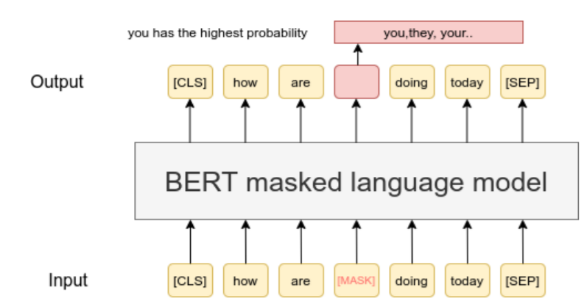
Example of using BERT:
Masked word prediction https://www.exxactcorp.com/blog/Deep-Learning/how-do-bert-transformers-work https://www.sbert.net/examples/unsupervised_learning/MLM/README.html
Input a sentence and masked one word off
Train at the output given the missing word
So, when similar sentence appear it can fill in the missing word
E.g., BERT is trained using known missing words

Slide 46
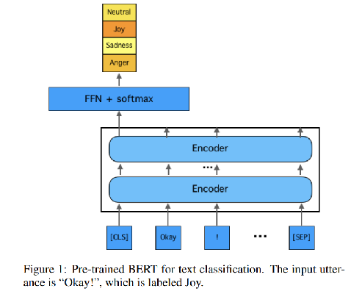
Example of using BERT emotion analysis
Build Down stream task:
FFN = feed forward network
Build a downstream model (using a Transfer learning method ) for emotion classification
Downstream building means built you own application based on some pretrained model like BERT.
EmotionX-HSU: Adopting Pre-trained BERT for Emotion Classification https://arxiv.org/abs/1907.09669
Z
Based on Pre-trained BERT
https://arxiv.org/abs/1810.04805
Pre-trained BERT can be downloaded from
https://huggingface.co/

Slide 47
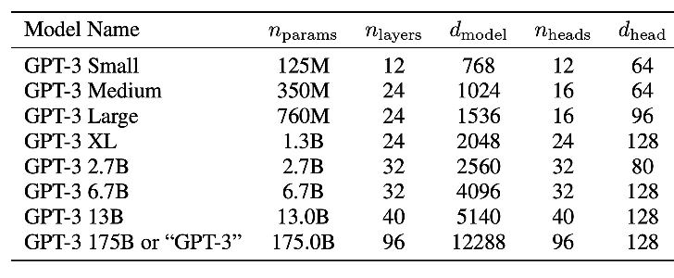
Transformer model parameters
https://www.lesswrong.com/posts/3duR8CrvcHywrnhLo/how-does-gpt-3-spend-its-175b-parameters
d_model = the dimensionality of the representations used as input to the multi-head attention, which is the same as the dimensionality of the output. One word (or token if subword is used) is represented by a vector of d_modle length)
n_heads=number of heads in a multi-head
n_layers = number of layers
d_head=dimension of a single head =d_model / n_heads,
e.g. for GPT3 small: d_head=678/12=64
Also ChatGPT 3.5 has maximum token length around 4096 (a sentence length is about 1000-3000 words, because token are sub words)
https://ai.stackexchange.com/questions/45691/what-should-be-relationship-between-embedding-dimension-and-context-length

Slide 48
Summary on transformer on Natural Language Processing
Basic operation of the transformer model is studied
Applications of transformers are discussed

Slide 49
Extension: Application of transformer models : computer vision
KH Wong

Slide 50
Vision transformer
The Transformer is successful in NLP (Natural Language Processing).
Hence, researchers explore the idea of using it for computer vision -- Vision transformer.
See https://en.wikipedia.org/wiki/Vision_transformer
Transformers are found to overperform classical approaches in object recognition etc.

Slide 51
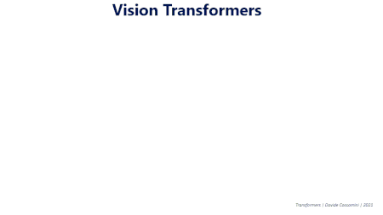
The main idea
The Transformer is designed for sequential data, but image data is parallel. So how to do it? Solution : Divide the picture into patches (in a grid) and the patches are lined up as a sequence for the transformer (SWIN Transformer uses sifted windows) .

Slide 52
The Swin Transformer https://arxiv.org/abs/2103.14030
The Swin Transformer ("Shifted windows")^{[7]} takes inspiration from standard convolutional neural networks:
Instead of performing self-attention over the entire sequence of tokens, one for each patch, it performs "shifted window based" self-attention, which means only performing attention over square-shaped blocks of patches. One block of patches is analogous to the receptive field of one convolution.
After every few attention blocks, there is a "merge layer", which merges neighboring 2x2 tokens into a single token. This is analogous to pooling (by 2x2 convolution kernels, with stride 2). Merging means concatenation followed by multiplication with a matrix.
It is improved by Swin Transformer V2,^{[13]} which modifies upon the ViT by a different attention mechanism (Figure 1):
layernorm immediately after each attention and feedforward layer ("res-post-norm");
scaled cosine attention to replace the original dot product attention;
log-spaced continuous relative position bias, which allows transfer learning across different window resolutions.

Slide 53
Part 2: Large Language Models (LLM)
KH Wong

Slide 54
Induction
Large Language Models (LLM) model can exchange information intelligently with human using text, such as answer questions when asked.
Currently uses Transformer as the work horse
  Use decoder-only transformers
Becoming popular and essential in Artificial intelligence

Slide 55
Overview
Decoder-only transformer
Training of Large Language Models LLM
  Pretraining
Experiments with Opensource model Lamma3

Slide 56
Basic concept
of Large Language Models LLM

Slide 57
The key idea: Next token prediction
Next token prediction (also known as the standard language modeling objective)—the workhorse behind all causal language models.
Language Model Training and Inference: From Concept to Code
Background:
  The Transformer Architecture [link]
  Decoder-Only Transformers [link]
Programming
  Neural Nets in PyTorch [link]
  PyTorch Distributed Overview [link]
  Distributed Data Parallel in PyTorch [link]

Slide 58
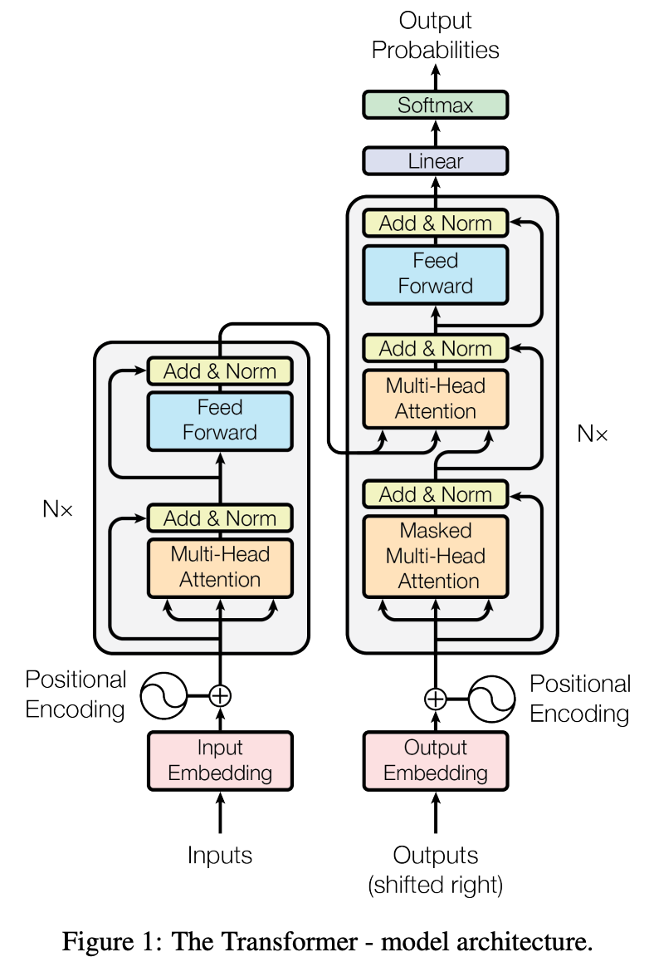
The Transformer model
Language Models: GPT and GPT-2 - by Cameron R. Wolfe, Ph.D.

Slide 59
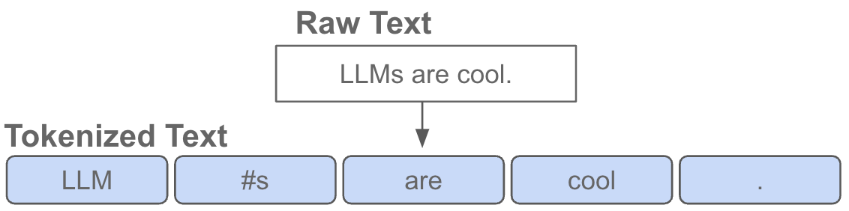
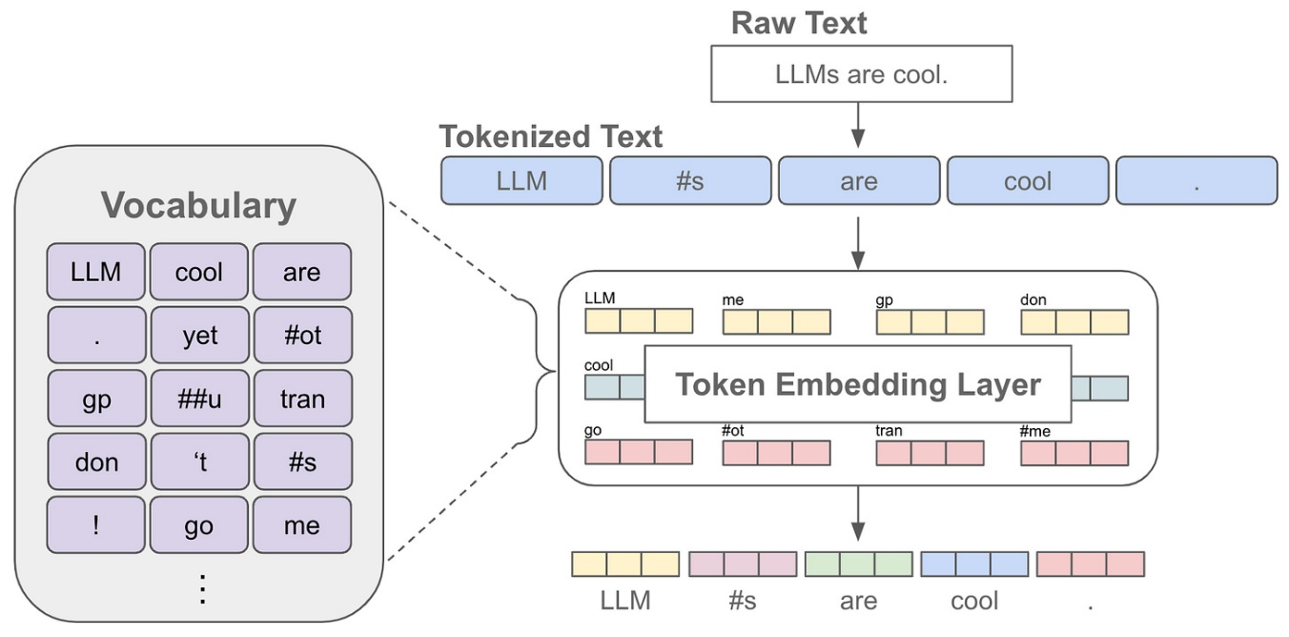
The model : Token embedding
Tokens may contain sub-words : Workpieces Tokenization https://botpenguin.com/glossary/wordpiece-tokenization
Tokenization turns texts into numbers.
According to OpenAI, one token is about four characters and ¾ words in English (100 tokens ≈ 75 words)

Slide 60
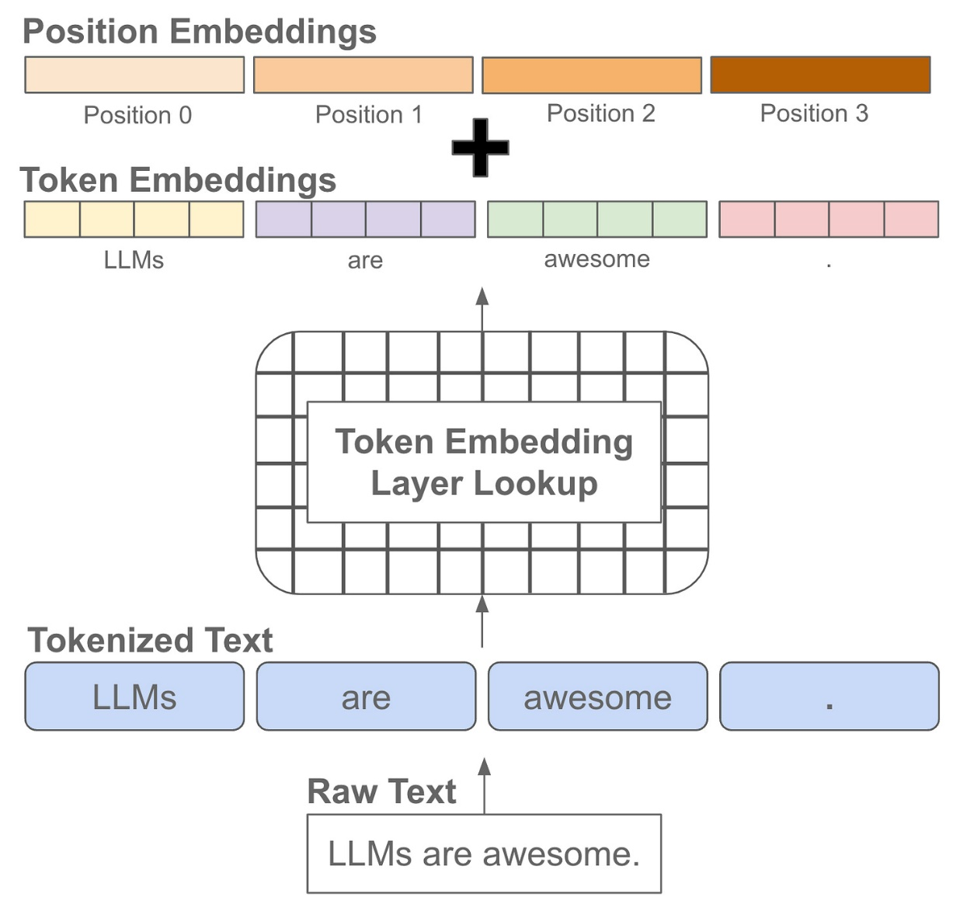
The model: Token embedding-
Positional embedding
Trainable
Context window

Slide 61
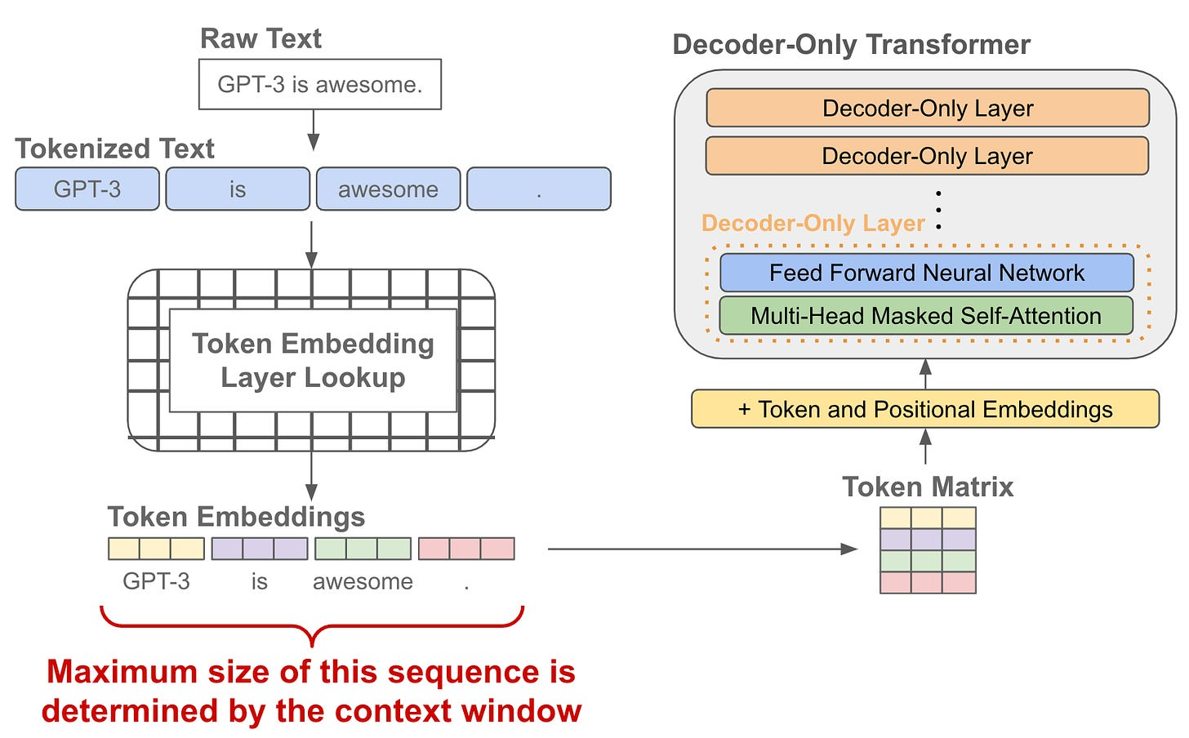
The model: Decoder-only transformer
Trainable
Context window

Slide 62
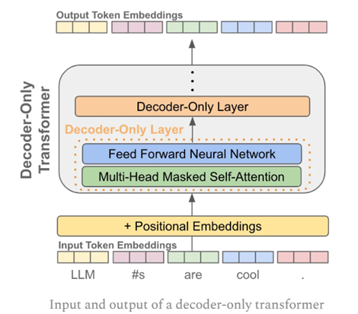
The model
Predicting the next token.
Output: Produces a corresponding output vector for each token embedding
Input: pass these vectors into a decoder-only transformer

Slide 63
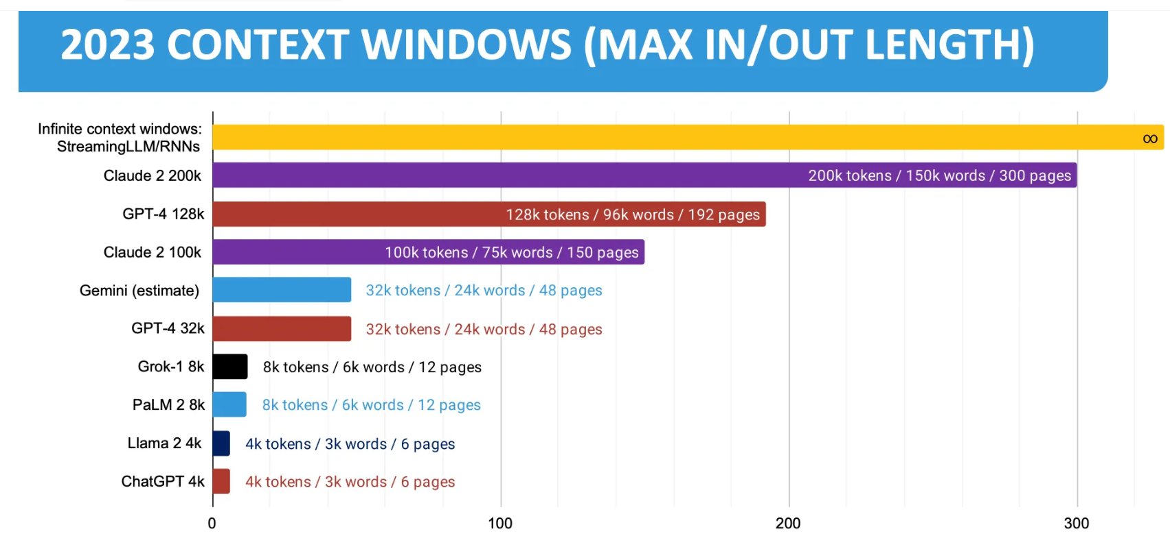
Context window size comparison
https://ogre51.medium.com/context-window-of-language-models-a530ffa49989
Deepseek v3 context window = 128,000
=number tokens that can be handled at the same time
A token is a word or subworld.

Slide 64
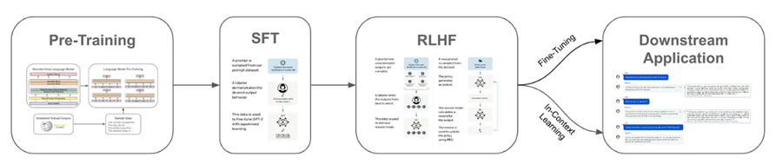
Language model training
https://cameronrwolfe.substack.com/p/language-model-training-and-inference
Pre-training : Use the whole (broad) dataset to train the system to produce the base model. https://www.sapien.io/blog/fine-tuning-vs-pre-training-key-differences-for-language-models
Supervised fine-tuning (SFT) : For a specific application. Use a small set of labeled data (provided by the application engineer) to train the base model for the application.
Reinforcement Learning from Human Feedback (RLHF): Further training by giving reward to correct answers.
https://klu.ai/glossary/supervised-fine-tuning

Slide 65
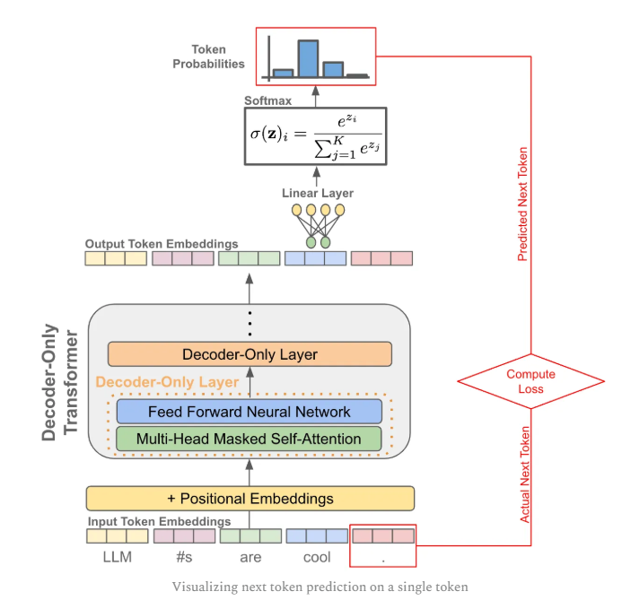
Training
Next token prediction training to minimize Loss

Slide 66
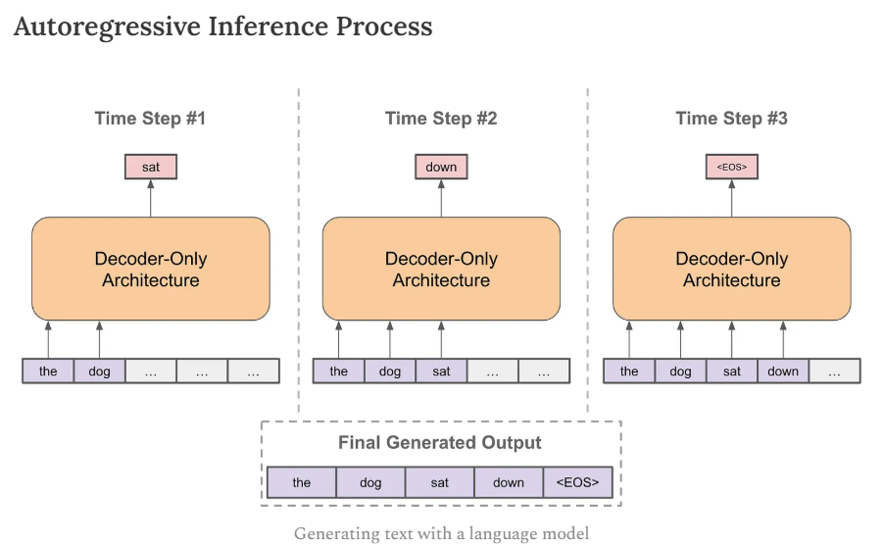
Training by next token prediction: provide the initial sequence, then predict the next token.
Can be used for training and inference
d
https://cameronrwolfe.substack.com/p/language-model-training-and-inference

Slide 67
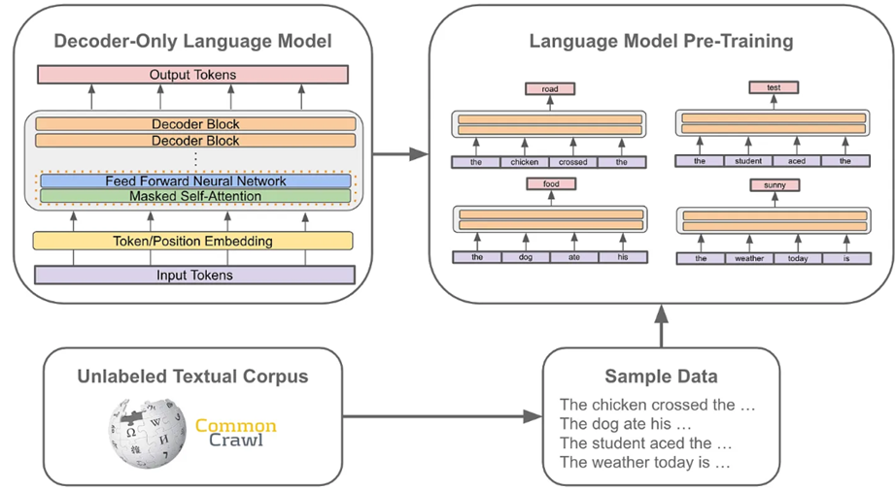
Implementation: Build Pre-train model using Next Token Prediction
Obtain huge data from www:
https://commoncrawl.org/
develop sample sentence data
https://arxiv.org/html/2412.02595v1

Slide 68

Experiments
Llama3.2_(1B_and_3B)-Conversational.ipynb – Colab
MMMLU
HumanEval
GSM8K
ARC challenge
BFCL

Slide 69
How to evaluate a Large Language Model (LLM) : some benchmarks
MMLU:MMLU consists of about 16,000 multiple-choice questions spanning 57 academic subjects including mathematics, philosophy, law, and medicine. It is one of the most commonly used benchmarks for comparing the capabilities of large language models, with over 100 million downloads as of July 2024
  https://en.wikipedia.org/wiki/MMLU
HumanEval: HumanEval is a benchmark dataset developed by OpenAI that evaluates the performance of large language models (LLMs) in code generation tasks. https://www.datacamp.com/tutorial/humaneval-benchmark-for-evaluating-llm-code-generation-capabilities
GSM8K: GSM8K tests an LLM’s mathematical reasoning skills. It has a corpus of 8,500 grade-school math word problems. Solutions are collected in the form of natural language instead of mathematical expressions. AI verifiers are trained to evaluate model solutions. https://www.ibm.com/think/topics/llm-benchmarks
AI2 Reasoning Challenge (ARC): ARC measures an LLM’s question answering and reasoning abilities through a series of more than 7,000 grade-school natural science questions.
BFCL Leaderboard: The Berkeley Function Calling Leaderboard V3 (also called Berkeley Tool Calling Leaderboard V3) evaluates the LLM's ability to call functions (aka tools) accurately. https://gorilla.cs.berkeley.edu/leaderboard.html

Slide 70

After pre-tuning you may use it in 2 ways:
1) Fine tuning training: Fine-tuning refers to taking the weights trained in the general model and then continuing training a bit using your specific data.
2) Prompt engineering : Prompt engineering, on the other hand, modifies the input prompt to guide the model's output without retraining for data—offering a less resource-intensive customization method.
Prompt engineering example:
https://medium.com/@alishafique3/llm-prompt-engineering-techniques-and-best-practices-7cc0f46467e9

Slide 71

Fine tuning
Common crawl
https://commoncrawl.org/
Specific data set In https://discuss.huggingface.co/
e.g.. https://huggingface.co/datasets/tatsu-lab/alpaca
Base model
e.g. GPT4, Lamma
ChatGPT4
e.g. Lamma question/answer

Slide 72
The fine-tuning process steps
Data selection and preparation : Selecting high-quality, relevant data is an important first step. …Preparing this data involves cleaning, labeling (if applicable), and possibly augmenting it to ensure the model has a robust dataset to learn from.
Hyperparameter adjustments : You can alter the model’s hyperparameters or incorporate task-specific layers to better suit particular tasks. Low-Rank Adaptation (LoRA), may also be used. LoRA is a popular and lightweight training technique that significantly reduces the number of trainable parameters. It works by inserting a smaller number of new weights into the model, and only these are trained.
Training and optimization :The crux of fine-tuning involves training the model further on the selected dataset.

Slide 73
Pros and cons of fine-tuning
Pros include:
  Enhanced accuracy and performance on domain-specific tasks.
  Ability to leverage pre-existing knowledge from the base model (also called foundation model), reducing the need for extensive training from scratch.
cons include
  Requires significant computational resources and time for huge models.
  Risk of overfitting, making the model less effective on general tasks or unseen data within the same domain.

Slide 74

Fine-tuning can make a pre-trained LLM to be come a useful chatbot
Fine-tuning is the training continuation of general large model to make the model capable of a specific task. I.e. train the system to be a cardiologist.
E.g. pre-trained LLM
As a transformer-based model, GPT-4 uses a paradigm where pre-training using both public data and "data licensed from third-party providers" is used to predict the next token.
https://en.wikipedia.org/wiki/GPT-4
After fine tuning
ChatGPT is based on particular GPT foundation models, namely GPT-4, GPT-4o and GPT-4o mini, that were fine-tuned to target conversational usage.^{[18]}
https://en.wikipedia.org/wiki/ChatGPT

Slide 75
Another fine-tuning step:
Reinforcement learning human feedback(RLHF)
  It is a trial-and-error interactive method, the system proses a solution ,, it gains reward if correct and lose if fail.
  Just like human learning process: make random decisions and gain reward or penalty for their actions.

Slide 76

Reinforcement learning (RL)

Slide 77
There are four fundamental terms in Reinforcement Learning (RL):
  action,
  state,
  policy, and
  reward. A policy can be thought of as the brain of the agent. At first, there is no policy and the agent takes random actions. And by observing the rewards after certain actions, the policy is being created.

Slide 78

Reinforcement fine tuning LLMs
You can use two methods to update weights
  Human expert
  Use a reward model to classify outputs of the LLM
Everything to learn about Large Language Models(Part 2/3 Pre-training and Fine-tuning) | by Kerem Aydın | Medium

Slide 79


Case study of LLMs:
Llama vs GPT https://zh.wikipedia.org/wiki/Facebook https://openai.com/
Llama 3.2 has 90B parameters, trained from about 200 billion tokens.
GPT-3 has 175B parameters, trained on about 45TB of text data from different sources https://www.springboard.com/blog/data-science/machine-learning-gpt-3-open-ai/
GPT-4 is estimated to have >1 trillion parameters https://cobusgreyling.medium.com/what-are-realistic-gpt-4-size-expectations-73f00c39b832
  1G=2^30=1073741824 (in binary format)
  1 billion(B)=10^9=1000000000 (decimal format) https://cryptosmith.com/2013/10/18/memory-sizes-kilo-mega-giga-tera-peta-exa/

Slide 80

Large language model distillation
Learn from a larger model
It can reduce the storage size of a model which can have similar accuracy as the larger model.
It is less expensive to produce
ref: Model Distillation in the API | OpenAI
Example DeepSeek

Slide 81
Experiment1: Free colab account only have limited use of GPU.
llama (Llama3.1_(8B)-Alpaca.ipynb) tested ok on colab https://colab.research.google.com/github/unslothai/notebooks/blob/main/nb/Llama3.1_(8B)-Alpaca.ipynb#scrollTo=VZ6PSFBnZjnZ
Experiment 1:
# alpaca_prompt = Copied from above
FastLanguageModel.for_inference(model) # Enable native 2x faster inference
inputs = tokenizer(
[
alpaca_prompt.format(
"give the heights ",#instruction
"5 highest mountains on earth", # input
"", # output - leave this blank for generation!
)
], return_tensors = "pt").to("cuda")
outputs = model.generate(**inputs, max_new_tokens = 200, use_cache = True)
tokenizer.batch_decode(outputs)
User can
modify these

Slide 82
Result of experiment 1:
['<|begin_of_text|>Below is an instruction that describes a task, paired with an input that provides further context. Write a response that appropriately completes the request.\n\n### Instruction:\ngive the heights \n\n### Input:\n5 highest mountains on earth\n\n### Response:\nThe 5 highest mountains on earth are:\n\n1. Mount Everest - 8,848 meters (29,029 feet)\n2. K2 (Mount Godwin-Austen) - 8,611 meters (28,251 feet)\n3. Kanchenjunga - 8,586 meters (28,169 feet)\n4. Makalu - 8,485 meters (27,838 feet)\n5. Lhotse - 8,516 meters (27,940 feet)<|end_of_text|>']

Slide 83
Experiment2 with llama (Llama3.1_(8B)-Alpaca.ipynb) tested ok on colab https://colab.research.google.com/github/unslothai/notebooks/blob/main/nb/Llama3.1_(8B)-Alpaca.ipynb#scrollTo=VZ6PSFBnZjnZ
# alpaca_prompt = Copied from above
FastLanguageModel.for_inference(model) # Enable native 2x faster inference
inputs = tokenizer(
[
alpaca_prompt.format(
"write me a story of 500 words starting from the following words", # instruction
"Once upon a time", # input
"", # output - leave this blank for generation!
)
], return_tensors = "pt").to("cuda")
outputs = model.generate(**inputs, max_new_tokens = 500, use_cache = True)
tokenizer.batch_decode(outputs)
modified

Slide 84
Result of experiment 2:
Once upon a time, in a faraway land, there lived a young princess named Arielle. She was known for her kind heart, beautiful voice, and love for adventure. One day, while out exploring the forest, she came across a mysterious crystal that glowed with a bright light. Curious, she picked it up and placed it in her pocket.\n\nThe next day, when she arrived at the castle, she noticed that the crystal had grown brighter and was now glowing with a golden hue. Intrigued, she decided to investigate further. She took the crystal to her father, the king, and he summoned his trusted advisor, the wizard Merlin. Together, they studied the crystal and discovered that it was a powerful artifact that held the key to unlocking a great mystery.\n\nArielle\'s father, the king, decided to send her on a quest to find the answer to the mystery. She set off on her journey, accompanied by her faithful servant, Pippin, and a small band of loyal knights. Along the way, they encountered many dangers and challenges, but Arielle\'s courage and determination never wavered.\n\nAs they traveled, the crystal continued to grow brighter, leading them to the heart of the mystery. They arrived at a hidden valley, where they discovered an ancient temple. Inside, they found a powerful magical force that had been sealed away for centuries. With the help of the crystal, they were able to unlock the force and restore balance to the land.\n\nArielle\'s quest was a success, and she returned to the castle a hero. She was rewarded with a place of honor in the royal court, and her name was remembered for generations to come. The crystal, now known as the "Crystal of Light and Power," was placed in the castle\'s royal treasury, where it remained a source of wonder and inspiration for all who came to see it.<|end_of_text|>']

Slide 85
Experiment 3
Llama 3.2
https://huggingface.co/unsloth/Meta-Llama-3.1-8B
Llama 3.2 Conversational notebook. Free Colab
Llama 3.2 Vision finetuning - Radiography use case. Free Colab
https://colab.research.google.com/github/unslothai/notebooks/blob/main/nb/Llama3.2_(1B_and_3B)-Conversational.ipynb#scrollTo=J-IRbDfRp03Y
Students are encouraged to try it themselves.

Slide 86

Student exercises: Explore more on fine-tuning datasets
You may use these datasets to fine-tune a base LLM model (also called foundation model) for some applications
https://huggingface.co/datasets
10 Datasets for Fine-Tuning Large Language Models
  https://odsc.medium.com/10-datasets-for-fine-tuning-large-language-models-d27f5a9b2a9a
Enter your search key, e.g. Conversation, story, Logic, math, calculus, chemistry….etc.

Slide 87
Conclusions
Introduced how transformer is used for building large language model (LLM)
Major steps of pre-training and fine tuning of LLM are discussed
Prompt engineering is mentioned.
Reinforcement learning method fine tunning are discussed,
Distillation method of building LLM are mentioned.
Experiments on an LLM is described

Slide 88
References
https://cameronrwolfe.substack.com/p/language-model-training-and-inference
https://cameronrwolfe.substack.com/p/decoder-only-transformers-the-workhorse
https://ai.meta.com/blog/meta-llama-3-1/
https://snorkel.ai/blog/large-language-model-training-three-phases-shape-llm-training/
https://colab.research.google.com/github/unslothai/notebooks/blob/main/nb/Llama3.2_(1B_and_3B)-Conversational.ipynb#scrollTo=J-IRbDfRp03Y
https://colab.research.google.com/github/unslothai/notebooks/blob/main/nb/Llama3.2_(1B_and_3B)-Conversational.ipynb#scrollTo=zdN0CpBLtsGQ
[PDF] Attention is all you need , A Vaswani, N Shazeer, N Parmar… - Advances in neural …, 2017 - papers.nips.cc
https://jalammar.github.io/illustrated-transformer/
https://towardsdatascience.com/transformers-explained-visually-part-1-overview-of-functionality-95a6dd460452
https://towardsdatascience.com/transformers-explained-visually-part-2-how-it-works-step-by-step-b49fa4a64f34
https://towardsdatascience.com/transformers-explained-visually-part-3-multi-head-attention-deep-dive-1c1ff1024853
Pre-trained bert can be downloaded from
https://huggingface.co/
https://bbycroft.net/llm (graphical display of transformer models)

