Slide 1
Introduction to RNN, LSTM
  RNN (Recurrent neural network)
  LSTM (Long short-term memory)
KH Wong

Slide 2
Overview
Introduction
Concept of RNN (Recurrent neural network) ?
The Gradient vanishing problem
LSTM Long Short Term Memory
  LSTM theory and concept
  LSTM Numerical example

Slide 3
Introduction
RNN (Recurrent neural network) is a form of neural networks that feed outputs back to the inputs during operation
LSTM (Long short-term memory) is a form of RNN. It fixes the vanishing gradient problem of the original RNN.
  Application: Sequence to sequence model based using LSTM for machine translation
References:
Materials are mainly based on links found in https://www.tensorflow.org/tutorials
https://towardsdatascience.com/illustrated-guide-to-lstms-and-gru-s-a-step-by-step-explanation-44e9eb85bf21

Slide 4
Concept of RNN (Recurrent neural network)
concept

Slide 5
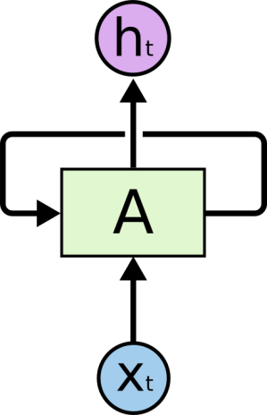
RNN Recurrent neural network
X_{t}= input at time t
h_{t}= output at time t
A=neural network
The loop allows information to pass from t to t+1
reference:
http://colah.github.io/posts/2015-08-Understanding-LSTMs/

Slide 6
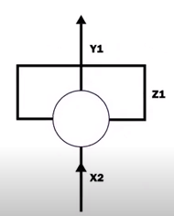
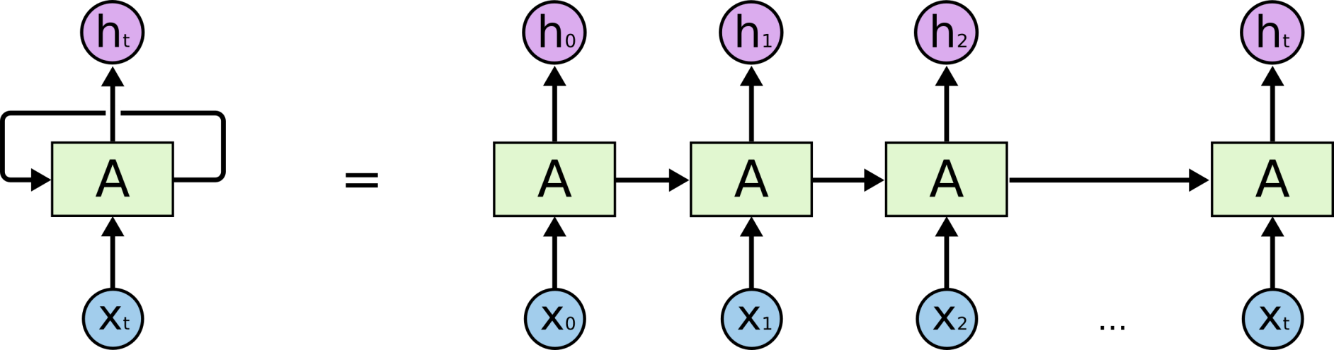
RNN unrolled
But RNN suffers from the vanishing gradient problem to be discussed later
https://www.youtube.com/watch?v=zt18u6BgdK8 RNN Animation
Unroll and treat each time sample as a unit.
An unrolled RNN
Problem:
Learning long-term dependencies with gradient descent is difficult , Bengio, et al. (1994)
LSTM can fix the vanishing gradient problem

Slide 7
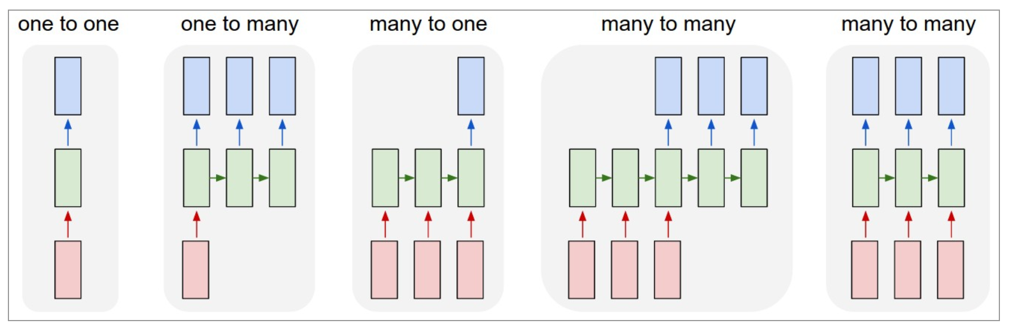
Different types of RNN
(1) Vanilla (classical) mode of processing without RNN, from fixed-sized input to fixed-sized output (e.g., image classification). Feedforward NN
(2) Sequence output (e.g., image captioning takes an image and outputs a sentence of words).
(3) Sequence input (e.g., sentiment analysis where a given sentence is classified as expressing positive or negative sentiment).
(4) Sequence input and sequence output (e.g. Machine Translation: an RNN reads a sentence in English and then outputs a sentence in French).
(5) Synced sequence input and output (e.g. video classification where we wish to label each frame of the video).
http://karpathy.github.io/2015/05/21/rnn-effectiveness/
Output layer
Hidden layer
(recurrent layer)
Input
layer
(1) (2) (3) (4) (5)

Slide 8
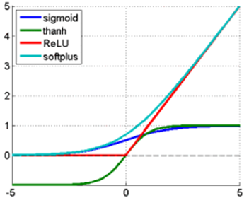

Activation function choices
https://imiloainf.wordpress.com/2013/11/06/rectifier-nonlinearities/
https://www.simonwenkel.com/2018/05/15/activation-functions-for-neural-networks.html#softplus
Max. gradient of Signmoid is 0.25, it will cause the vanishing gradient problem
$$\text{Sigmoid} (\text{from}\text{ 0 }\text{to}\text{ 1}): \\ g\left(x\right)=\frac{1}{1+e^{−x}},$$
$$gradient=\frac{dg(x)}{dx}=g(x)⋅(1−g(x))$$
$$\text{Tanh} (\text{from}\text{ −1 }\text{to}\text{ 1}): \\ g\left(x\right)=\frac{\sinh{(}x)}{\cosh{(}x)}=\frac{e^{x}−e^{−x}}{e^{x}+e^{−x}},$$
$$gradient of g(x)=\frac{dg(x)}{dx}=\frac{4}{{\left(e^{−x}+e^{x}\right)}^{2}}$$
$$\text{Rectified} \text{Linear} \text{Unit} \left(Relu\right)\left(\text{from}\text{ 0 }\text{to} ∞\text{,}\text{hard} \text{change}\right):$$
$$g(x)=\max{(}0,x),$$
$$gradient=\frac{dg(x)}{dx} =\left\{\begin{matrix}1, \text{if} \text{x}≥0 \\ 0, \text{if} \text{x}<0\end{matrix}\right.$$
$$\text{Softplus} (\text{from}\text{ 0 }\text{to} ∞\text{,}\text{soft} \text{change})\text{: } \\ g(x)=\ln{(}1+e^{x}),gradient=\frac{dg(x)}{dx}=\frac{1}{1+e^{−x}}$$
Relu is now very popular and shown to be working better other methods
Tanh: Output is in between -1 to +1 for all input values
(green line)

Slide 9
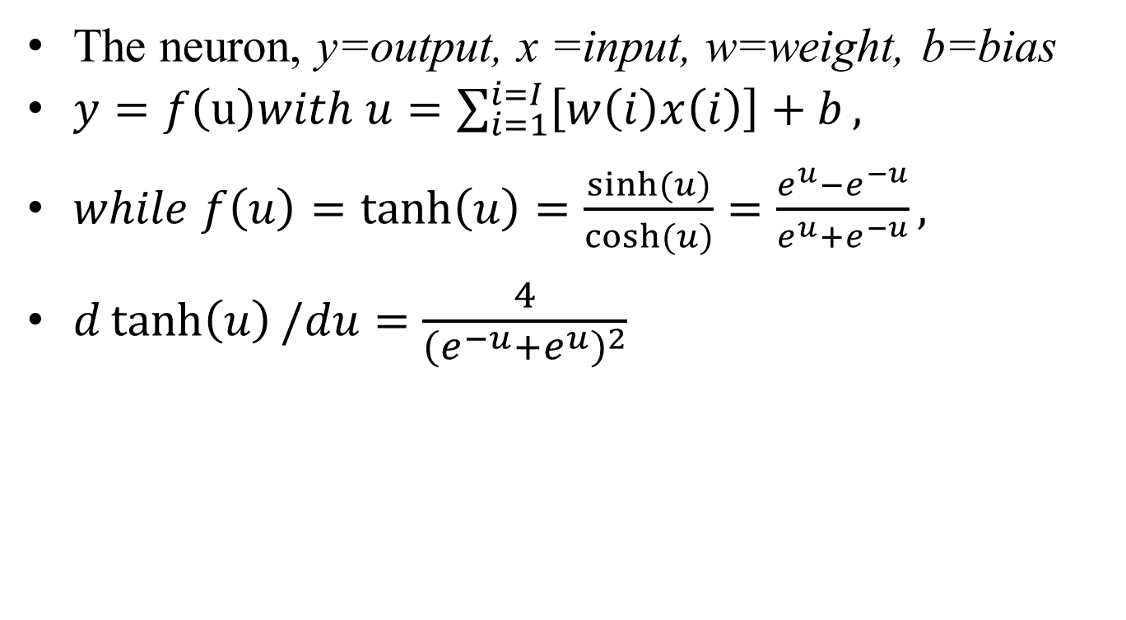
Tanh neuron
The neuron, y=output, x =input, w=weight, b=bias
$y=f\left(u\right)with u=\sum_{i=1}^{i=I}{\left[w\left(i\right)x\left(i\right)\right]+b},$
$while f\left(u\right)=\tanh\left(u\right)=\frac{\sinh{(}u)}{\cosh{(}u)}=\frac{e^{u}−e^{−u}}{e^{u}+e^{−u}},$
$d\tanh\left(u\right)/du=\frac{4}{{\left(e^{−u}+e^{u}\right)}^{2}}$

Slide 10
A simple RNN (recurrent Neural network) for weather (sequence) prediction (type4: many-to-many)
S=Sunny; C=Cloudy; R=Rainy; T=Thundery (weather in a day)
First: define the characters. The dictionary has 4 types, one-hot representation
X=Use 4-bit code (one hot) to represent the weather, it means
  at any time, only one output is 1, others are 0.
  X _{t} can be one of those {X1,X2,X3,X4}_{t}
  E.g. when the input X=X1=“1000”, it is sunny
Assume the training input sequence is S,C,R,T,S,C,R,T….etc. After training, predict the weather tomorrow.
This mechanism (type4: many-to-many) can be extended to other applications such as machine translation
One hot Encoding (X) | S | C | R | T
X1 | 1 | 0 | 0 | 0
X2 | 0 | 1 | 0 | 0
X3 | 0 | 0 | 1 | 0
X4 | 0 | 0 | 0 | 1

Slide 11
The architecture: 4 inputs(x_{i}), 3 hidden neurons(h_{j}), 4 outputs (sy)
Only partial weights are shown to avoid crowdedness
smy= softmax_out_y
smy1(t)
smy1(t)
smy2(t)
smy3(t)
smy4(t)
softmax
softmax
softmax
softmax
softmax
y= output
Weights
=why
Why
A
A
Whh, size 3x3
Weights types
Whh=h(t) to h(t+1)
Whx=x to h
Why=h to y
Assume all fully connected
h_{t+1}
h(j=1,t)
h(j=1,t+1)
Hidden
(recurrent)
layer
A
=
h(j=2,t)
h(j=2,t+1)
Input layer
X_{t}
h(j=3,t)
h(j=3,t+1)
h_{t}
Whx, size 3x4
X(i=1,t)
X(i=2,t)
X(i=3,t)
X(i=4,t), X is of size 4x1
Hidden neurons at time t
Hidden neurons at time t,
which depend on x_{t} and h_{t}

Slide 12
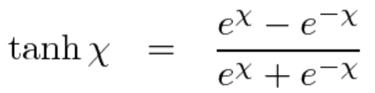
A simple RNN (recurrent Neural network) for sequence prediction
From t to t+1
Unroll an RNN: If ‘S’,’C’,’R’→ are received, the prediction is ‘T’
Tanh(Whx(1,:)*X_{t} + Whh(1,:)*h_{t} + bias(1) )=h_{t+1}(1)
Tanh(Whx(2,:)*X_{t} + Whh(2,:)*h_{t} + bias(2) )=h_{t+1}(2)
Tanh(Whx(3,:)*X_{t} + Whh(3,:)*h_{t} + bias(3) )=h_{t+1}(3)
A is an RNN with 3 neurons : After training, if you enter ‘S’,’C’,’R’ step by step to X_{t} at each time t , the system will output T after you input X_{t=3}
Note:
For softmax, see
http://www.cse.cuhk.edu.hk/~khwong/www2/cmsc5707/5707_likelihood.pptx
External output
‘C’
‘R’
‘T’
Output layer
(Softmax)
Output layer
(Softmax)
Output layer
(Softmax)
Output layer
(Softmax)
h_{t+1}
h_{t=2}
Time-unrolled diagram of the RNN
h_{t=3}
h_{t=4}
Hidden
(recurrent)
layer
A
=
tanh
tanh
tanh
Whx
Whh
Inside A,
3 neurons
Input layer
X_{t}
h_{t}
X_{t=1}=
‘S’
X_{t=2}=
‘C’
X_{t=3}=
‘R’
https://www.analyticsvidhya.com/blog/2017/12/introduction-to-recurrent-neural-networks/

Slide 13
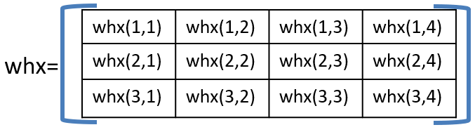
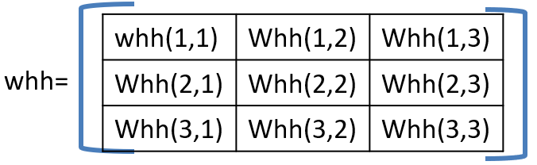
Inside A : 3 neurons at time from t to t+1, X=[X(1), X(2), X(3), X(4)]’,
Bias=[bias(1),
bias(2),
bias(3)]
h=[h1,h2,h3]’
h_{t}(1)
h_{t+1}(1)
Output, also
feedback to neurons’
inputs
Whh(1,1)
h_{t}(2)
Tanh(Whx(1,:)*X_{t}+Whh(1,:)*h_{t}+bias(1))=h_{t+1}(1)
Whh(1,2)
h_{t}(3)
Whh(1,3)
Whx(1,1)
Whx(1,2)
Whx(1,3)
Whx(1,4)
neuron1
X(1)
X(2)
X(3)
X(4)
h_{t}(1)
h_{t+1}(2)
Output, also
feedback to neurons’
inputs
Whh(2,1)
h_{t}(2)
Tanh(Whx(2,:)* X_{t} +Whh(2,:)*h_{t}+bias(2))=h_{t+1}(2)
Whh(2,2)
h_{t}(3)
Whh(2,3)
Whx(2,2)
Whx(2,1)
Whx(2,3)
Whx(2,4)
neuron2
X(1)
X(2)
X(3)
X(4)
h_{t}(1)
h_{t+1}(3)
Output, also
feedback to neurons’
inputs
Whh(3,1)
Tanh(Whx(3,:)* X_{t} +Whh(3,:)*h_{t1}+bias(3))=h_{t+1}(3)
h_{t}(2)
Whh(3,2)
Whx(3,1)
Whx(3,2)
Whx(3,3)
Whx(3,4)
neuron3
h_{t}(3)
Whh(3,3)
X(1)
X(2)
X(3)
X(4)

Slide 14
Define weights whx, whh, why
whx(1,1) | whx(1,2) | whx(1,3) | whx(1,4)
whx(2,1) | whx(2,2) | whx(2,3) | whx(2,4)
whx(3,1) | whx(3,2) | whx(3,3) | whx(3,4)
whx=
Input X to h output weights
(not recurrent)
whh(1,1) | Whh(1,2) | Whh(1,3)
Whh(2,1) | Whh(2,2) | Whh(2,3)
Whh(3,1) | Whh(3,2) | Whh(3,3)
whh=
Current h_{t} to next h_{t+1} weights
(recurrent)
why=
why(1,1) | why(1,2) | why(1,3)
why(2,1) | why(2,2) | why(2,3)
why(3,1) | why(3,2) | why(3,3)
why(4,1) | why(4,2) | why(4,3)
Output h_{t} to y_output_{t} weights
(Not recurrent)

Slide 15
Zoom inside to see the connections of neuron 1
whx(1,1) | whx(1,2) | whx(1,3) | whx(1,4)
whx(2,1) | whx(2,2) | whx(2,3) | whx(2,4)
whx(3,1) | whx(3,2) | whx(3,3) | whx(3,4)
whh(1,1) | Whh(1,2) | Whh(1,3)
Whh(2,1) | Whh(2,2) | Whh(2,3)
Whh(3,1) | Whh(3,2) | Whh(3,3)
whx=
whh=
From h_{t}(3) of neuron3
From h_{t}(2) of neuron2
h_{t}(1)
h_{t+1}(1)
whh(1,1)
h_{t}(2)
neuron1
whh(1,2)
Output, also
feedback to neurons’
inputs
h_{t-}3)
whh(1,3)
whx(1,1)
whx(1,2)
whx(1,3)
whx(1,4)
X(1)
X(2)
X(3)
X(4)
h_{t}(1) from neuron1 previous output
Inside view of neuron1 with connections
h_{t+1}(1)
h_{t+1}(1) =Tanh(
whx(1,1)*X_{t}(1)+whx(1,2)*X_{t} (2)+whx(1,3)*X_{t} (3)+whx(1,4)*X_{t} (4)
+whh(1,1)*h_{t}(1)+whh(1,2)*h_{t}(2)+whh(1,3)*h_{t}(3) + Bias)
neuron1
Output, also
feedback to neurons’
inputs
h_{t}(2)
From neuron2 previous output
whx(1,1)
whx(1,2)
whx(1,3)
whx(1,4)
X(1)
X(2)
X(4)
h_{t}(3) from neuron3 previous output
X(3)

Slide 16
Zoom inside to see the connections of neuron 2
whx(1,1) | whx(1,2) | whx(1,3) | whx(1,4)
whx(2,1) | whx(2,2) | whx(2,3) | whx(2,4)
whx(3,1) | whx(3,2) | whx(3,3) | whx(3,4)
whh(1,1) | Whh(1,2) | Whh(1,3)
Whh(2,1) | Whh(2,2) | Whh(2,3)
Whh(3,1) | Whh(3,2) | Whh(3,3)
whx=
whh=
From h_{t}(3) of neuron3
From h_{t}(2) of neuron2
h_{t}(1)
h_{t+1}(2)
whh(2,1)
h_{t}(2)
neuron2
whh(2,2)
Output, also
feedback to neurons’
inputs
h_{t}(3)
whh(2,3)
whx(2,1)
whx(2,2)
whx(2,3)
whx(2,4)
X(1)
X(2)
X(3)
X(4)
h_{t}(1) from neuron1 previous output
Inside view of neuron1 with connections
h_{t+1}(1) =Tanh(
whx(2,1)*X_{t}(1)+whx(2,2)*X_{t} (2)+whx(2,3)*X_{t} (3)+whx(2,4)*X_{t} (4)
+whh(2,1)*h_{t}(1)+whh(2,2)*h_{t}(2)+whh(2,3)*h_{t}(3) + Bias)
h_{t+1}(2)
Output, also
feedback to neurons’
inputs
neuron2
h_{t}(2)
From neuron2 previous output
whx(2,1)
whx(2,2)
whx(2,3)
whx(2,4)
X(1)
X(2)
X(4)
h_{t}(3) from neuron3 previous output
X(3)

Slide 17
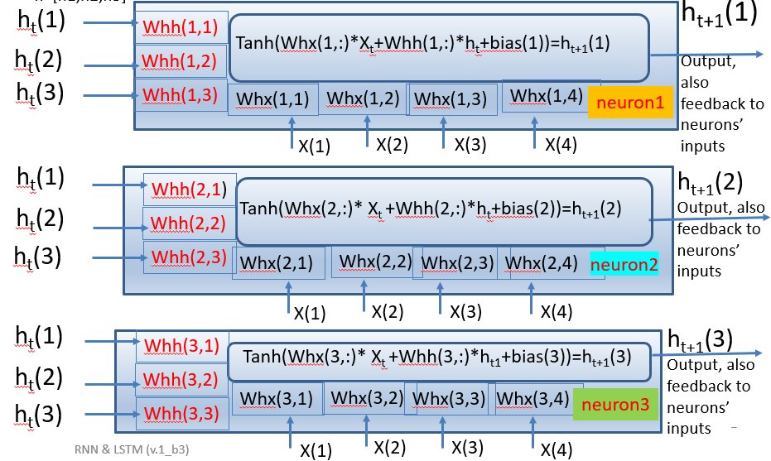

demo_rnn4b.m: Numerical examples, give at t=0, weight/bias are initialized as:
whx=[0.28 0.84 0.57 0.48
0.90 0.87 0.69 0.18
0.53 0.09 0.55 0.49];
whh =[0.41 0.12 0.13
0.51 0.24 0.26
0.61 0.34 0.36];
ht(:,1)=[0.11 0.21 0.31]'; %assume ht initially at t=1
bias=[0.51, 0.62, 0.73]';%bias initialized
why=[0.37 0.97 0.83
0.39 0.28 0.65
0.64 0.19 0.33
0.91 0.32 0.14];
ht(:,t+1)=tanh(whx*in(:,t)+whh*ht(:,t)+bias)
% //// eqn.for h(t+1) ///////////////////
Exercise 1a, if X=[1,0,0,0]
MC question: choices: find h_{t=2}(1)=_____?
(1) tanh(0.28*1+0.84*0+ 0.57*0+ 0.48*0+ 0.41*0.11+0.12*0.21+0.13*0.31+ 0.51)
(2) tanh(0.28*0+0.84*1+ 0.57*0+ 0.48*0+ 0.41*0.11+0.12*0.21+0.13*0.31+ 0.51)
(3) tanh(0.28*0+0.84*0+ 0.57*1+ 0.48*0+ 0.41*0.11+0.12*0.21+0.13*0.31+ 0.51)
(4) tanh(0.28*0+0.84*0+ 0.57*0+ 0.48*1 0.41*0.11+0.12*0.21+0.13*0.31+ 0.51)
Exercise 1b : find h_{t=2}(2)=___? , Exercise 1c : find h_{t=2}(3)= ___?
whx(1,1) | whx(1,2) | whx(1,3) | whx(1,4)
whx(2,1) | whx(2,2) | whx(2,3) | whx(2,4)
whx(3,1) | whx(3,2) | whx(3,3) | whx(3,4)
whx=
whh(1,1) | Whh(1,2) | Whh(1,3)
Whh(2,1) | Whh(2,2) | Whh(2,3)
Whh(3,1) | Whh(3,2) | Whh(3,3)
whh=

Slide 18
Step1 find initialized h_{t=1}
%Explanation of how to find answer of Ex.1a, h_{t=2}(1), h_{t=2}(2), h_{t=2}(3)
%To find output at t=2,
%Equation:X=[1,0,0,0]
ht(1,t+1)= Tanh(
Whx(1,1)*X_{t}(1)+Whx(1,2)*X_{t}(2)+Whx(1,3)*X_{t}(3)+Whx(1,4)*X_{t} (4)
+Whh(1,1)*(h1)+Whh(1,2)*(h2)+Whh(1,3)*(h3) + bias(1))
Exercise 1a,
MC question: choices: find h_{t=2}(1)=_____?
(1) tanh(0.28*1+ 0+0+0+ 0.41*0.11+0.12*0.21+0.13*0.31+ 0.51)
= 0.7166
(2) tanh(0+0.84*1+0+0+ 0.41*0.11+0.12*0.21+0.13*0.31+ 0.51)
(3) tanh(0+0+0.57*1+0+ 0.41*0.11+0.12*0.21+0.13*0.31+ 0.51)
(4) tanh(0+0+0+0.48*1+ 0.41*0.11+0.12*0.21+0.13*0.31+ 0.51)
(choice 1 is correct) h_{t=2}(1)= 0.7166
h_{t=2}(2)=
tanh(0.90*1+ 0+0+0+ 0.51*0.11+0.24*0.21+0.26*0.31+ 0.62) =0.9363
h_{t=2}(3)=
tanh(0.53*1+ 0+0+0+ 0.61*0.11+0.34*0.21+0.36*0.31+ 0.73)=0.9070
h_2=[0.7166,0.9363,0.9070]’
Ans. For Exercise0.1a,b,c
At time t=1 ,X= 1 0 0 0
whx=[0.28 0.84 0.57 0.48
0.90 0.87 0.69 0.18
0.53 0.09 0.55 0.49];
whh =[0.41 0.12 0.13
0.51 0.24 0.26
0.61 0.34 0.36];
ht(:,1)=[0.11
0.21
0.31]; %assume ht initially at t=1
bias=[0.51, 0.62, 0.73]';%bias initialized
time t=1 ,X= [1,0,0,0]’

Slide 19
Exercise 2 : After ht(:,2) is found , find y_out
Look at the output network, it finds y_out() from h()
Recall ht(:,2)=[0.7002, 0.9321, 0.9009]’
why=
why(1,1) | why(1,2) | why(1,3)
why(2,1) | why(2,2) | why(2,3)
why(3,1) | why(3,2) | why(3,3)
why(4,1) | why(4,2) | why(4,3)
y_out(1)=why(1,1)*ht(1)+why(1,2)*ht(2)+ why(1,3)*ht(3)
y_out(2)=why(2,1)*ht(1)+why(2,2)*ht(2)+ why(2,3)*ht(3)
y_out(3)=why(3,1)*ht(1)+why(3,2)*ht(2)+ why(3,3)*ht(3)
y_out(4)=why(4,1)*ht(1)+why(4,2)*ht(2)+ why(4,3)*ht(3)
h , y_out are fully connected so
Weights(the “why” variable)=(4x3)
why=[0.37 0.97 0.83
0.39 0.28 0.65
0.64 0.19 0.33
0.91 0.32 0.14];
%h_2=[0.7166,0.9363,0.9070]
ht=[0.7166,0.9363,0.9070]’
Y_out=why*ht=
1.9262
1.1312
0.9358
1.0787
y_out(1) (2) (3) (4)
(This SoftMax output network requires
no bias, but can add bias =1 to make resulst stable. See the chapter on cnn for details)
h_{t}(1)
h_{t}(2)
h_{t}(3)

Slide 20
Answer for Ex2
Softmax is to make sum_all_i{softmax[y_out(i)]}=1
,each softmax[y_out(i)] is a probability
A=exp(1.9262)
B=exp(1.1312)
C=exp(0.9358)
D=exp(1.0787)
tot=A+B+C+D
soft_max_y_out(1)=A/tot;
soft_max_y_out(2)=B/tot;
soft_max_y_out(3)=C/tot;
soft_max_y_out(4)=D/tot;
soft_max_y_out
0.4441 0.2006 0.1650 0.1903
This is to make Softmax is a probability (sum of the above vector is 1)
[ 0.4441 0.2006 0.1650 0.1903]
Softmax_y_out(1) (2) (3) (4)
The
output
layer
1.9262 1.1312 0.9358 1.0787
y_out_{i=1,2,3,4}
h , Y_out are fully connected so
Weights(the “why” variable)=(4x3)
(This output network requires
no bias)
h_{t}(1)=
0.7002
h_{t}(2)=
0.9321
h_{t}(3)=
0.9009

Slide 21
After y_out is is found , find softmax_y_out
Look at the softmax output module it transforms y_out() to softmax_y_out()
A1=exp(y_out(1))
A2=exp(y_out(2))
A3=exp(y_out(3))
A4=exp(y_out(4))
Tot=A1+A2+A3+A4
Softmax_y_out(1)=A1/Tot
Softmax_y_out(2)=A2/Tot
Softmax_y_out(3)=A3/Tot
Softmax_y_out(4)=A4/Tot
Exercise 3
MC question: This stage is to make sure
each softmax_y_out is positive,
each softmax_y_out is negative,
each softmax_y_out is a probability
each softmax_y_out is smaller than 2.
Softmax_y_out(1) (2) (3) (4)
y_out(1) (2) (3) (4)
(This output network requires
no bias)
h_{t}(1)
h_{t}(2)
h_{t}(3)

Slide 22
Calculate recurrently for t=1,2,3,4
Answer of ex3 is choice 3:each softmax_y_out is a probability
Assume the training input sequence is S,C,R,T,S,C,R,T….etc.
When t=1, input is ‘S’, so x(1)=1,x(2)=0,x(3)=0,x(4)=0 [i.e.X=1000]
Find h_{t=1}(1), h_{t=1}(2), h_{t=1}(3), (shown before)
Then for t=2, input is ‘C’, use X=0100] and also the current weights and h values
Find h_{t=2}(1), h_{t=2}(2), h_{t=2}(3), and so on
After h_{t=2}(1), h_{t=2}(2), h_{t=2}(3) are found calculate softmax_y_out at time t=3 ,
is [ 0.4441 0.2006 0.1650 0.1903]
Calculate recurrently until you find all h and softmax output values. They will be used for training
See the program in the next slide
One hot Encoding (X) | S | C | R | T
X1 | 1 | 0 | 0 | 0
X2 | 0 | 1 | 0 | 0
X3 | 0 | 0 | 1 | 0
X4 | 0 | 0 | 0 | 1

Slide 23
Ans. 1,2,3(overall result)
%MatlabDemo rnn4b.m modified f2023 Dec30a
%https://stackoverflow.com/questions/50050056/simple-rnn-example-showing-numerics
%https://www.analyticsvidhya.com/blog/2017/12/introduction-to-recurrent-neural-networks/
clear, %clc
in_S=[1 0 0 0]';
in_C=[0 1 0 0]';
in_R=[0 0 1 0]';
in_T=[0 0 0 1]';
X=[in_S,in_C,in_R, in_T];
%assume whx,whh,why are initialised at t=1 as
whx=[ 0.28 0.84 0.57 0.48
0.90 0.87 0.69 0.18
0.53 0.09 0.55 0.49];
whh =[0.41 0.12 0.13
0.51 0.24 0.26
0.61 0.34 0.36];
why=[ 0.37 0.97 0.83
0.39 0.28 0.65
0.64 0.19 0.33
0.91 0.32 0.14];
bias=[0.51, 0.62, 0.73]';%bias initialised
ht(:,1)=[0.11 0.21 0.31]'; %assume ht has value initally at t=1
%Forward pass only, %for t = 1:length(in)-1 %
%(y_out not feedback to network, only h feeback to network)
y_out(:,1)=why*ht(:,1);%the outputs at t=1 (inital value)
softmax_y_out(:,1)=softmax(y_out(:,1)); %outputs at t=1(init)
for t = 1:3 % assume we want to see 3 steps
ht(:,t+1)=tanh( whx*X(:,t)+whh*ht(:,t)+bias); %recurrent layer
y_out(:,t+1)=why*ht(:,t+1) ;
softmax_y_out(:,t+1)=softmax(y_out(:,t+1)); %output layer
end
%'print result ===================‘
X, ht, y_out, softmax_y_out
print result ===================
X =
1 0 0 0
0 1 0 0
0 0 1 0
0 0 0 1
ht =
0.1100 0.7166 0.9540 0.9370
0.2100 0.9363 0.9807 0.9793
0.3100 0.9070 0.9564 0.9876
y_out =
0.5017 1.9261 2.0981 2.1164
0.3032 1.1312 1.2683 1.2816
0.2126 0.9358 1.1125 1.1117
0.2107 1.0787 1.3158 1.3043
softmax_y_out =
0.3015 0.4441 0.4412 0.4456
0.2472 0.2006 0.1924 0.1934
0.2258 0.1650 0.1646 0.1632
0.2254 0.1903 0.2018 0.1978
T = 1 2 3 4
Time

Slide 24
Discussion: Output layer: softmax
Assume you train this network using SCRTSCRT,… SCRT,.. etc
Prediction is achieved by seeing which y_out is biggest after the softmax processing of the output layer
softmax_y_out =
Time= 1 2 3 4
0.3015 0.4441 0.4412 0.4456
0.2472 0.2006 0.1924 0.1934
0.2258 0.1650 0.1646 0.1632
0.2254 0.1903 0.2018 0.1978
From the above result, at t=3 prediction is ‘S’=[high,low,low,low]=[1,0,0,0] which is not correct, it should be ‘T’.
Why? Because at t=1, predicted output should be ‘C’, then at t=2, output should be ‘R’, at t=3 output should be ‘T’. Here weights are just randomly initialized in this example, so currently predict is wrong. After training, the prediction should be fine.
One hot Encoding (X) | S | C | R | T
X1 | 1 | 0 | 0 | 0
X2 | 0 | 1 | 0 | 0
X3 | 0 | 0 | 1 | 0
X4 | 0 | 0 | 0 | 1
y
For softmax, see
http://www.cse.cuhk.edu.hk/~khwong/www2/cmsc5707/5707_likelihood.pptx

Slide 25
How to train a recurrent Neural net RNN
S=Sunny; C=Cloudy; R=Rainy; T=Thundery (average weather in a day)
After unrolled the RNN, it becomes a Feedforward neural network
Give sequence samples, say 3 years=(365*3) days samples
E.g. S,C,R,T,S,C,R,T,S,C,R,T…… SSCRT……(mostly the sequence of SCRT,SCRT)
Train by backpropagation, the rule: If X_{t=1} is the INPUT then X_{t=2} is the TARGET
  e.g. input =‘S’ (X_{t=1} =1000), output is at the softmax output, and target is ‘C’ (X_{t=2} =0100), or, in another example case, if
  input =‘R’ (X_{t=1} =0010), output is at the softmax output, and target is ‘T’(X_{t=2} =0001)
  After unroll the RNN, we will use : (1) input, (2) output(softmax output) and (3) target, to train weights/biases as if it is a feedforward network (discuss before)
Ideally, after successfully trained the RNN, if “SCR” for 3 consecutive days are observed, the weather prediction for the next day is ‘T’
h_{t+1}
Target
target=‘C’
target=‘R’
target=‘T’
h = O_{t}= encoder hidden vector is generated after a sequence is entered. You will see that it will be used for machine translation
Softmax
Softmax
Softmax
h_{t=2}
h_{t=3}
h_{t=4}
A
=
tanh
tanh
tanh
X_{t}
h_{t}
X_{t=2}=
‘C’
X_{t=1}=
‘S’
X_{t=3}=
‘R’
X_{t=1} is the input, X_{t=2} is the target,
Time-unrolled diagram of the RNN

Slide 26
Problem with RNN:
The vanishing gradient problem
Ref: https://hackernoon.com/exploding-and-vanishing-gradient-problem-math-behind-the-truth-6bd008df6e25

Slide 27
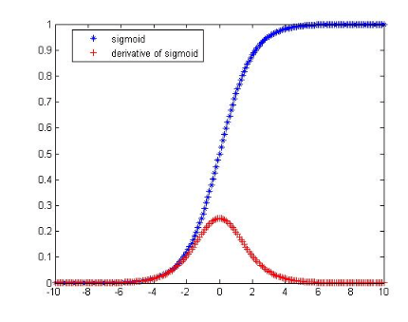
Problem with RNN:
The vanishing gradient problem
The maximum of derivative of sigmoid is 0.25, Hence feedback will vanish when the number of layers is large.
sigmoid
0.25
During backpropagation, signals are fed backward from output to input using gradient-based learning methods
In each iteration, a network weight receives an update proportional to the gradient of the error function with respect to the current weight.
In theory, the maximum gradient is less than 1 (max derivative of sigmoid is 0.25). So, the learning signal is reduced from layer to layer.
In RNN, after unrolled the network, the difference between the target and the output of the last element of the sequence has to back-propagate to update the weights/biases of all the previous neurons. The backpropagation signal will be reduced to zero if the training sequence is long.
It also happens to a feedforward neural network with many hidden layers (deep net).

Slide 28
Recall the weight updating process by gradient decent in Back-propagation (see previous lecture notes)
Case1: Δw in Back-propagation from output layer (L) to hidden layer
Δw=(output-target)*dsigmoid(f)*input to w
Δw= sensitivity δ^{L} *input to w
Case 2: Δw in Back-propagation a hidden layer to the previous hidden layer
Δw= δ^{L-1} *input to w
sensitivity δ^{L-1} will be used for the layer in front of layer L-1, .. etc
Input to w
Gradient of sigmoid
(disgmoid)
Cause of the vanishing gradient problem : Gradient of the activation function (sigmoid here) is less then 1, so the back-propagated values may diminish if more layers are involved

Slide 29

Popular neuron activation functions
https://imiloainf.wordpress.com/2013/11/06/rectifier-nonlinearities/
https://www.simonwenkel.com/2018/05/15/activation-functions-for-neural-networks.html#softplus
Max. gradient of Signmoid is 0.25, it can cause the vanishing gradient problem
$$\text{Sigmoid} (\text{from}\text{ 0 }\text{to}\text{ 1}): \\ g\left(x\right)=\frac{1}{1+e^{−x}},$$
$$gradient=\frac{dg(x)}{dx}=g(x)⋅(1−g(x))$$
$$\text{Tanh} (\text{from}\text{ −1 }\text{to}\text{ 1}): \\ g\left(x\right)=\frac{\sinh{(}x)}{\cosh{(}x)}=\frac{e^{x}−e^{−x}}{e^{x}+e^{−x}},$$
$$gradient of g(x)=\frac{dg(x)}{dx}=\frac{4}{{\left(e^{−x}+e^{x}\right)}^{2}}$$
$$\text{Rectified} \text{Linear} \text{Unit} \left(Relu\right)\left(\text{from}\text{ 0 }\text{to} ∞\text{,}\text{hard} \text{change}\right):$$
$$g(x)=\max{(}0,x),$$
$$gradient=\frac{dg(x)}{dx} =\left\{\begin{matrix}1, \text{if} \text{x}≥0 \\ 0, \text{if} \text{x}<0\end{matrix}\right.$$

Slide 30
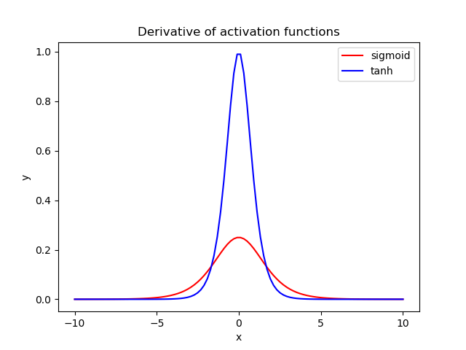
Advantages of these activation functions
Sigmoid :output range from 0 to 1, good to model probability.
Tanh: Max. gradient is 4 times greater than that of sigmoid. Using Tanh can help to reduce the gradient vanishing problem. Popular for building RNN.
Relu: The gradient is 1 which can reduce the gradient vanishing problem. It is computationally efficient, and popular for building hidden layers.
1
Tanh gradient
Sigmoid gradient
0.25
https://www.baeldung.com/cs/sigmoid-vs-tanh-functions

Slide 31
To solve the vanishing gradient problem, LSTM adds C (cell state)
RNN has x_{i} (input) and h_{t} (output) only
In LSTM (Long Short Term Memory), add
  Cell state (C_{t}) to solve gradient vanishing problem
  In each time (t), updates
    C_{t}=cell state (ranges from -1 to 1)
    h_{t}= output (ranges from 0 to 1)
    The system learns C_{t} and h_{t} together

Slide 32
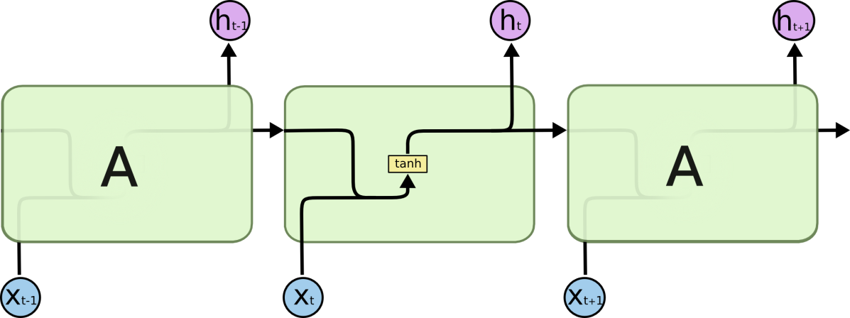
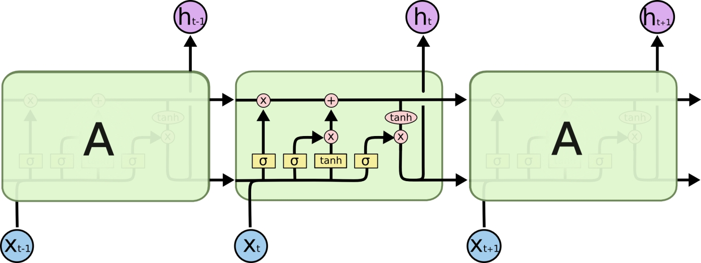
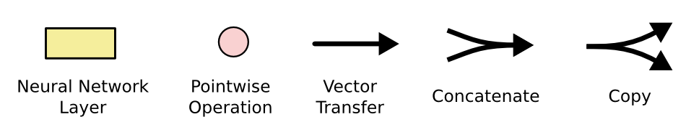
LSTM (Long short-term memory)
Standard RNN
Input concatenate with output then feed to input again
LSTM
The repeating structure is more complicated
(the complexity is 4 times of the standard RNN)

Slide 33
Conclusion
We studied the basic structure of Recurrent Neural Networks (RNN) and its applications
The neural network vanishing problem is discussed.
The solution of the vanishing gradient problem using LSTM (Long short-term memory) is discussed.

Slide 34
References
Deep Learning Book.
http://www.deeplearningbook.org/
Papers:
Fully convolutional networks for semantic segmentation by J Long, E Shelhamer, T Darrell
Sequence to sequence learning with neural networks by I Sutskever, O Vinyals, QV Le -
tutorials
http://colah.github.io/posts/2015-08-Understanding-LSTMs/
https://github.com/terryum/awesome-deep-learning-papers
turtorial:
https://theneuralperspective.com/tag/tutorials/
RNN encoder-decoder
https://theneuralperspective.com/2016/11/20/recurrent-neural-networks-rnn-part-3-encoder-decoder/
sequence to sequence model
  https://arxiv.org/pdf/1703.01619.pdf
  https://indico.io/blog/sequence-modeling-neuralnets-part1/
  https://medium.com/towards-data-science/lstm-by-example-using-tensorflow-feb0c1968537
  https://google.github.io/seq2seq/nmt/
  https://chunml.github.io/ChunML.github.io/project/Sequence-To-Sequence/
  parameters of lstm
    https://stackoverflow.com/questions/38080035/how-to-calculate-the-number-of-parameters-of-an-lstm-network
    https://datascience.stackexchange.com/questions/10615/number-of-parameters-in-an-lstm-model
    https://stackoverflow.com/questions/38080035/how-to-calculate-the-number-of-parameters-of-an-lstm-network
    https://www.quora.com/What-is-the-meaning-of-%E2%80%9CThe-number-of-units-in-the-LSTM-cell
    https://www.quora.com/In-LSTM-how-do-you-figure-out-what-size-the-weights-are-supposed-to-be
    http://kbullaughey.github.io/lstm-play/lstm/ (batch size example)
  feedback
    https://medium.com/@aidangomez/let-s-do-this-f9b699de31d9
  Numerical examples
    https://blog.aidangomez.ca/2016/04/17/Backpropogating-an-LSTM-A-Numerical-Example/
    https://karanalytics.wordpress.com/2017/06/06/sequence-modelling-using-deep-learning/
    http://monik.in/a-noobs-guide-to-implementing-rnn-lstm-using-tensorflow/

