Slide 1
Artificial Neural networks
Introduction to Back Propagation of Neural Networks BPNN
By KH Wong

Slide 2
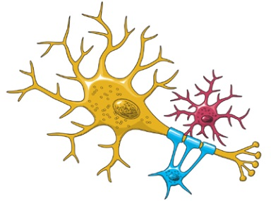
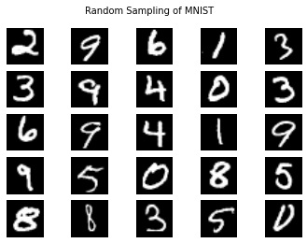
Introduction
Neural Network research is very popular
A high performance Classifier (multi-class)
Successful in handwritten optical character OCR recognition, speech recognition, image noise removal etc.
Easy to implement
  Slow in learning
  Fast in classification
Example and dataset:
http://yann.lecun.com/exdb/mnist/

Slide 3
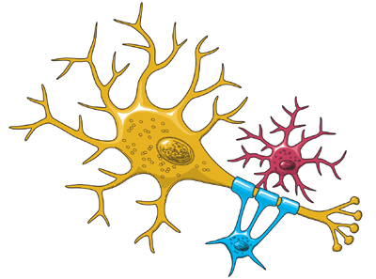
Motivation
Biological findings inspire the development of Neural Net
  Input →weights →Logic function→ output
Biological relation
  Input
  Dendrites
  Output
  Human computes using a net
Neuron(Logic function)
X=inputs
W=weights
Output
https://www.ninds.nih.gov/Disorders/Patient-Caregiver-Education/Life-and-Death-Neuron

Slide 4

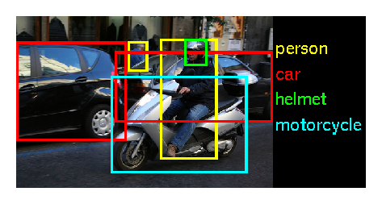
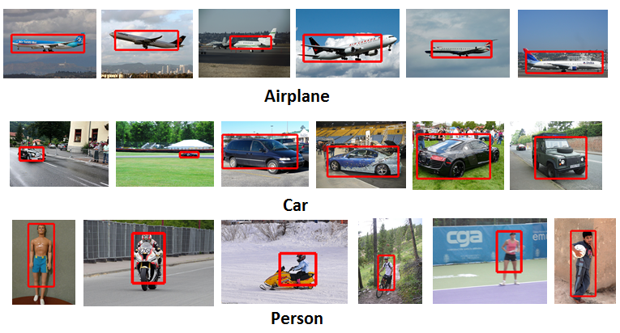
Applications
Microsoft: XiaoIce. AI
http://image-net.org/challenges/LSVRC/2015/
  200 categories: accordion, airplane ,ant ,antelope ….dishwasher ,dog ,domestic cat ,dragonfly ,drum ,dumbbell , etc.
Tensor flow
 |  | ILSVRC 2015
Number of object classes |  | 200
Training | Num images | 456567
 | Num objects | 478807
Validation | Num images | 20121
 | Num objects | 55502
Testing | Num images | 40152
 | Num objects | ---

Slide 5
Different types of artificial neural networks
Autoencoder
DNN Deep neural network & Deep learning
MLP Multilayer perceptron
RNN (Recurrent Neural Networks), LSTM (Long Short-term memory)
RBM Restricted Boltzmann machine
SOM (Self-organizing map)
Convolutional neural network CNN
Transformer model
From https://en.wikipedia.org/wiki/Artificial_neural_network
The method discussed in this power point can be applied to many of the above nets.

Slide 6
Theory of
Back Propagation Neural Net (BPNN)
Use many samples to train the weights (W) & Biases (b), so it can be used to classify an unknown input into different classes
Will explain
  How to use it after training: forward pass (classify /or the recognition of the input )
  How to train it: how to train the weights and biases (using forward and backward passes)

Slide 7
Back propagation is an essential step in many artificial network designs
Used to train an artificial neural network
For each training example x_{i}, a supervised (teacher) output t_{i} is given.
For each i^{th} training sample x: x_{i}
  Feed forward propagation: feed x_{i} to the neural net, obtain output y_{i}. Error e_{i} ∝|t_{i}-y_{i}|²
  Back propagation: feed e_{i} back to net from the output side and adjust weight w (by finding ∆w) to minimize e.
Repeat 1) and 2) for all samples until E is 0 or very small.

Slide 8
Example :Optical character recognition OCR
Training: Train the system first by presenting a lot of samples with known classes to the network
Recognition: When an image is input to the system, it will tell what character it is
Training up the network:
weights (W) and bias (b)
Neural Net
Neural Net
Output3=‘1’, other outputs=‘0’

Slide 9


Overview of what we will learn
Back Propagation Neural Networks (BPNN)
  Part 1: Feed forward processing (classification or Recognition)
  Part 2: Back propagation (Training the network), also include forward processing, backward processing and update weights
  Appendix:
    A MATLAB example is explained
    %source : http://www.mathworks.com/matlabcentral/fileexchange/19997-neural-network-for-pattern-recognition-tutorial

Slide 10
Part 1 (classification in action /or the Recognition process)
Forward pass of Back Propagation Neural Net (BPNN)
Assume weights (W) and bias (b) are found by training already (to be discussed in part2)

Slide 11
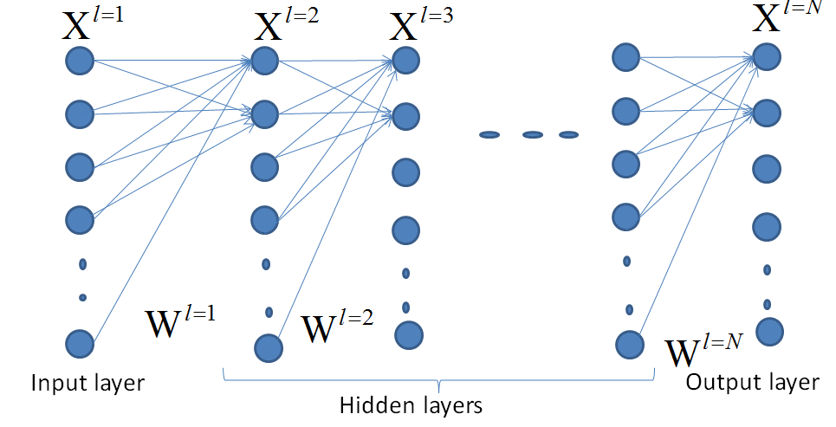
Recognition: assume weight (W) bias (b) are found earlier
Output
Output(0)=0
Output(1)=0
Output(2)=0
Output(3)=1
:
Output(9)=0
Assume you
have classes(0-9)
Each pixel is X(u,v)
Correct recognition

Slide 12
A neural network
Input layer
Output layer
Hidden layers
Blue circles are neurons (X), they form layers.
The links (lines) are weights (W).
There are : Input layer, hidden layers, and output layer.

Slide 13

Exercise 1a,b,c,d
(1a) How many inputs neurons, and output neurons?
MC question: choices:
(1) 4 inputs,2 outputs; (2) 3 inputs,2 outputs
(3) 3 inputs, 2 outputs; (4) 1 input, 2 outputs
(1b) How many hidden layers that this network have?
MC question: choices : 1,2,3,4
(1c) How many weights in total?
MC question: choices: (1) 20; (2) 40; (3) 43; (4) 48;
(1d) How do you call this layer (L) of neurons X ?
MC choice, L=: 1,2,3,4 __?
Input
neurons

Slide 14
ANSWER: Exercise 1a,b,c,d
(1a) How many input neurons and output neurons?
Ans: 4 input and 2 output neurons (choice1 is correct)
(1b) How many hidden layers that this network have?
Ans: 3 (choice3 is correct)
(1c) How many weights in total?
Ans: First hidden layer has 4x4, second layer has 3x4, third hidden layer has 3x3, fourth hidden layer to output layer has 2x3 weights. total=16+12+9+6=43
Choice 3 is correct
(1d) How do you call this layer of neurons X ?
Ans: choice 4 is correct L=4
Inputs
neurons

Slide 15
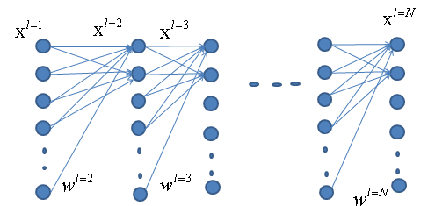
Multi-layer structure of a BP neural network
Input
layer
Other
hidden
layers

Slide 16
Inside each neuron there is a bias (b)
In between any 2 neighboring neuron layers, a set of weights are found

Slide 17
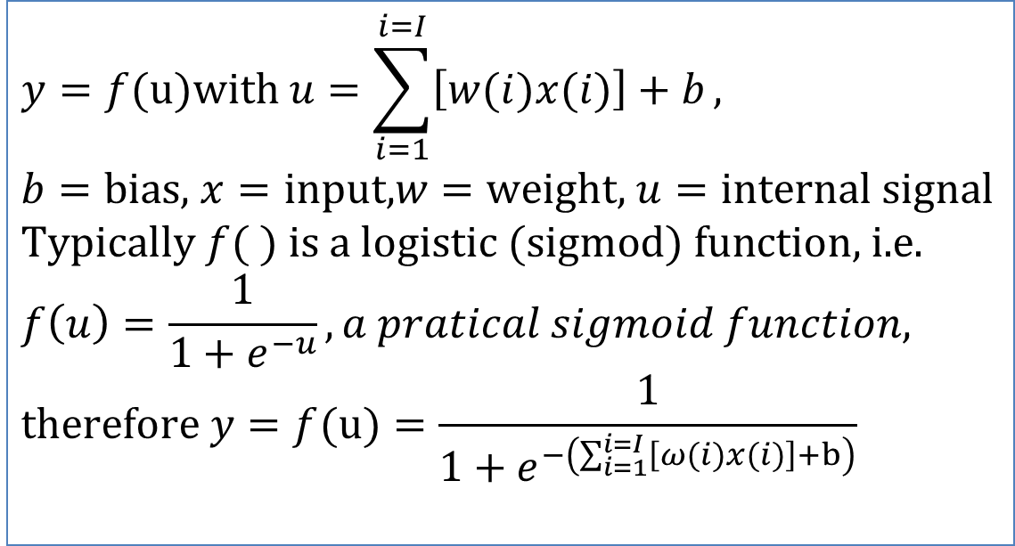
Inside each neuron x=input, y=output
$$y=f(u)\text{with} u=\sum_{i=1}^{i=I}{\left[w(i)x(i)\right]+b}, \\ b=\text{bias}\text{, }x=\text{input}\text{,}w=\text{weight}\text{, }u=\text{internal} \text{signal} \\ \text{Typically} f( ) \text{is} \text{a} \text{logistic} (\text{sigmod}) \text{function}\text{, }\text{i}\text{.}\text{e}\text{.} \\ f\left(u\right)=\frac{1}{1+e^{−u}},a pratical sigmoid function, \\ \text{therefore} y=f(u)=\frac{1}{1+e^{−\left(\sum_{i=1}^{i=I}{\left[ω(i)x(i)\right]+b}\right)}}$$
Notes:
%%%%%%%%%%%%%%%%%%%%%%%%%%%%%%%%%%%%
\subsection{slide 17: model: Inside each neuron x=input, y=output}
$y=f(u) with u=\sum\limits_{i=1}^{i=I}[w(i)x(i)]+b,$\\
$b$=bias, $x$=input, $w$=weight, $u$=internal signal\\
Typically $f()$ is a logistic (Sigmod) function,i.e.\\
%
$f(u)=\frac{1}{1+exp{(-\beta u)}}$, assume $\beta=1$ for simplicity,\\
%
therefore $f(u)=\frac{1}{1+exp{
\big(- \sum\limits_{i=1}^{i=I}[w(i)x(i)]+b)
\big)}}$

Slide 18
Some good math videos on the web
https://www.youtube.com/watch?v=MzI1sppnqqY differentiation https://www.youtube.com/watch?v=BcOPKQAZcn0 Simple differentiation
https://www.youtube.com/watch?v=WjJ-kpgps1c Understand Calculus in 10 Minutes
https://www.youtube.com/watch?v=oo1ZZlvT2LQ On Exponential function
https://www.youtube.com/watch?v=rnoToCoEK48 Partial Differentiation

Slide 19
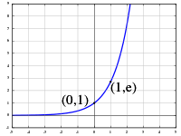



Essential result you must remember
The gradient of the exponential function $exp\left(x\right)=e^{x}$ is itself $e^{x} if e2.71828$
$f^{′}\left(x\right)=\frac{df\left(x\right)}{dx}=\frac{d\left(exp⁡(x)\right)}{dx}=\frac{d\left(e^{x}\right)}{dx}=e^{x}$
Note: Example If $y=f(x)$
Gradient= $f′\left(x\right)=$ $\frac{dy}{dx}=\frac{2}{1}=2$
$$e^{x}$$
x
$$e^{x}=\exp\left(x\right)={\text{2.71828}}^{x}$$
You may use the google browser for calculation
E.g. if you want to find exp(2)
:just type ‘=exp(2)’ in the search bar of the browser.
$$dy=2 meters$$
$$dx=1 meter$$

Slide 20
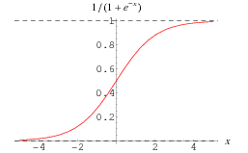
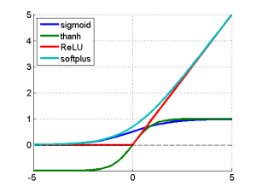
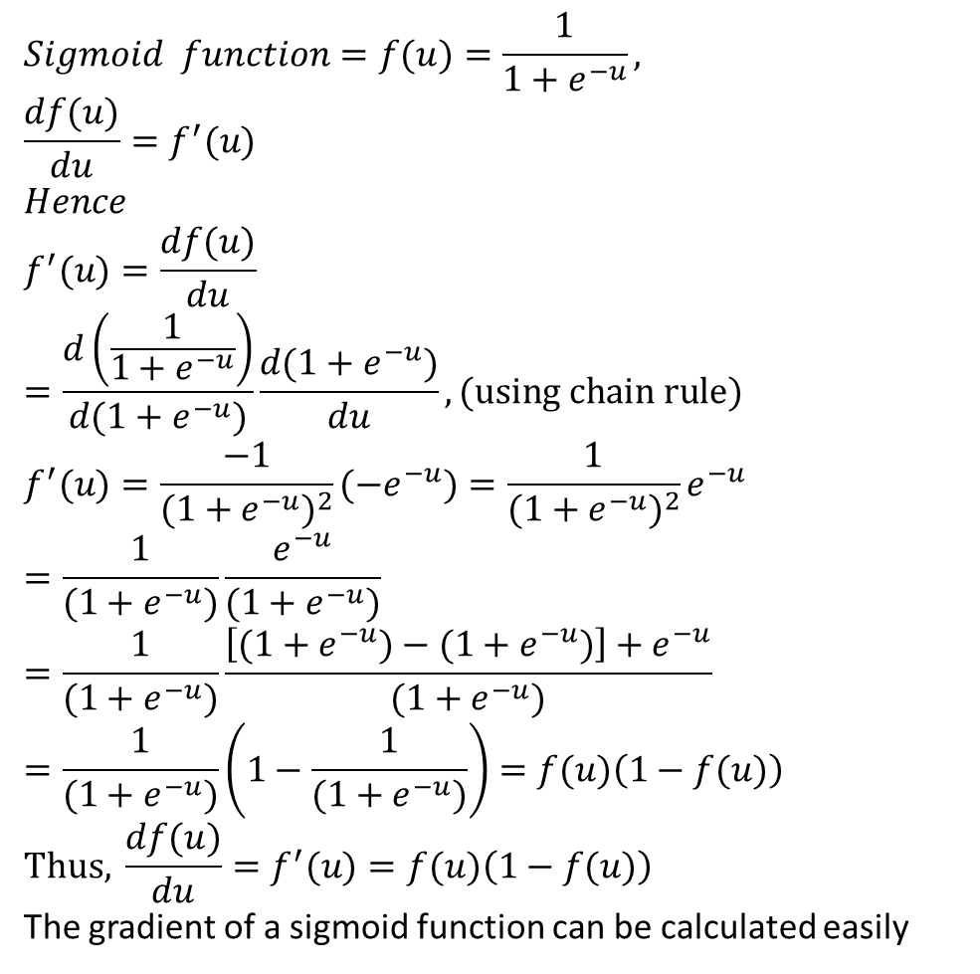
MATH STUFF: Sigmoid function f(u)= logsig(u) and its derivative f’(u)=dlogsig(u)
$$Sigmoid function=f(u)=\frac{1}{1+e^{−u}}, \\ \frac{df(u)}{du}=f^{′}(u) \\ Hence \\ f^{′}(u)=\frac{df(u)}{du}=\frac{d\left(\frac{1}{1+e^{−u}}\right)}{d(1+e^{−u})}\frac{d(1+e^{−u})}{du},(\text{using} \text{chain} \text{rule}) \\ f^{′}(u)=\frac{−1}{(1+e^{−u})^{2}}(−e^{−u})=\frac{1}{(1+e^{−u})^{2}}e^{−u} \\ =\frac{1}{(1+e^{−u})}\frac{e^{−u}}{(1+e^{−u})}=\frac{1}{(1+e^{−u})}\frac{\left[(1+e^{−u})−(1+e^{−u})\right]+e^{−u}}{(1+e^{−u})} \\ =\frac{1}{(1+e^{−u})}\left(1−\frac{1}{(1+e^{−u})}\right)=f(u)\left(1−f(u)\right) \\ \text{Thus}\text{, }\frac{df(u)}{du}=f^{′}(u)=f(u)\left(1−f(u)\right)$$
The gradient of a sigmoid function can be calculated easily
http://mathworld.wolfram.com/SigmoidFunction.html
Logistic sigmoid (logsig)
https://kawahara.ca/how-to-compute-the-derivative-of-a-sigmoid-function-fully-worked-example/
http://link.springer.com/chapter/10.1007%2F3-540-59497-3_175#page-1 , https://imiloainf.wordpress.com/2013/11/06/rectifier-nonlinearities/
Notes:
%%%%%%%%%%%%%%%%%%%%%%%%%%%%%%%%%%%%
\subsection{slide 18: Sigmoid function $f(u)= logsig(u)$ and its derivative $f’(u)=dlogsig(u)$}
$f(u)=\frac{1}{1+e^{-\beta u}}=\frac{1}{1+e^{- u}}$, for simplicity set $\beta =1$\\
%
$d \frac{ f(u)}{du}=f(u)$\\
Note $\frac{de^x}{dx}=e^x$\\
$f'(u)=\frac{d f(u)}{du}=
\frac{
d(\frac{1}{1+e^{-u}})
}
{d(1+e^{-u})}
%
\frac{d(1+e^{-u})}{du}
$, (using chain rule)\\
%%%%%%%
$f'(u)=\frac{-1}{(1+e^{-u})}
(-e^{-u})$
%
$=\frac{1}{(1+d^{-u})^2}
e^{-u}$\\
%%%%%%%%%%%%%
$=\frac{1}{(1+e^{-u})}
\frac{e^{-u}}{(1+e^{-u})}
%%
=\frac{1}{(1+e^{-u})}
\frac{[(1+e^{-u})-(1+e^{-u})]+e^{-u}}
{(1+e^{-u})}
$\\
%%%%%%%%%%%%%%
$=\frac{1}{(1+e^{-u})}
(1-\frac{1}{(1+e^{-u})})
=f(u)(1-f(u))
$\\
This, $\frac{ d f(u)}{du}=f'(u)=f(u)(1-f(u))$

Slide 21
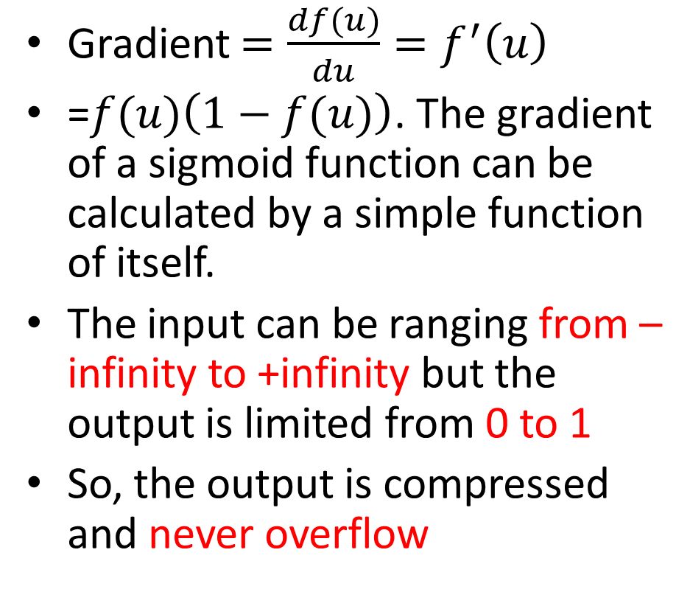

Why use sigmoid function
$$f(u)=\frac{1}{1+e^{−u}}$$
Gradient $=\frac{df(u)}{du}=f^{′}\left(u\right)$
=$f(u)\left(1−f(u)\right)$. The gradient of a sigmoid function can be calculated by a simple function of itself.
The input can be ranging from –infinity to +infinity but the output is limited from 0 to 1
So, the output is compressed and never overflow
The idea:
Th input (excitement) range be large
(–infinity to +infinity )
Output
(0->1)
Never overflow
A neuron

Slide 22
Back Propagation Neural Net (BPNN) Forward pass
Forward pass is to find the output when an input is given. E.g.
MNIST dataset has N=60,000 images for training, the dataset also has 10,000 for testing. Each sample image belongs to one of the 10 classes(c) , c=0,1,2,..9 numerals.
When an unknown image is given to the input, the output neuron corresponds to the correct answer will give the highest output level.
0
0
0
1
0
0
Input
image
10 output neurons for 0,1,2,..,9

Slide 23
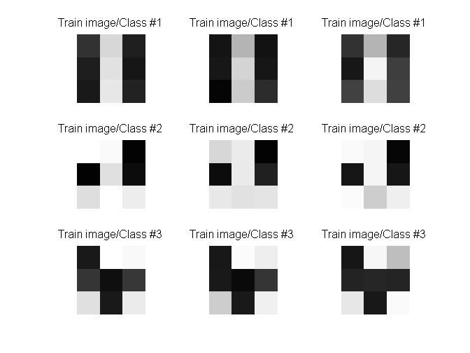

Our simple demo program
Training pattern
  3 classes (in 3 rows)
  Each class has 3 training samples (items in each row)
After training , an input (assume it is test-image #2) is presented to the network, the network should tell you it is class 2, etc.
class1
class2
class3
Result
:image (class 2)
Unknown
input

Slide 24
Numerical Example : Architecture of our example (see code in appendix)
Input
Layer
9x1 pixels
output
Layer 3x1

Slide 25
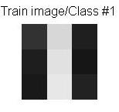
The input x
P2=[50 30 25 215 225 231 31 22 34; ... %class1: 1st training sample. Gray level 0->255
P1=50
P2=30
P3=25
P4=215
P5=225
P6=235
P7=31
P8=22
P9=34
9 neurons
In input layer
5 neurons
In hidden layer
3 neurons
In output layer

Slide 26
Exercise 2: Feed forward
Input =P1,..P9, output =Y1,Y2,Y3 teacher(target) =T1,T2,T3
Class1 :
T1,T2,T3=1,0,0
P(i=1)
P(i=2)
P(i=3)
:
:
P(i=9)
ω (i=1,j=1)
A1(j=1)
ω (j=1,k=1)
Y1=0.5101
T1=1
ω (i=2,j=1)
A1(j=2)
ω (j=2,k=1)
Y2=0.4322
T2=0
ω ^{l=2}(j=2,k=2)
Y3=0.3241
T3=0
A1(j=4)
A1(j=5)
A1: Hidden layer1 =5 neurons, indexed by j
W^{l=1}=9x5
b^{l=1}=5x1
Output layer
Layer l=1
Layer l=2
Input layer
Exercise 2: What is the target (teacher) code for T1,T2,T3 if it is for class 3?
MC question, choice:(1) 1,0,0 ; (2) 1,1,0 ; (3) 0,1,0 ; (4) 0,0,1 ;
Answer:________________________

Slide 27
Answer: Exercise 2: Feed forward
Input =P1,..P9, output =Y1,Y2,Y3 teacher(target) =T1,T2,T3
Class1 :
T1,T2,T3=1,0,0
P(i=1)
P(i=2)
P(i=3)
:
:
P(i=9)
ω (i=1,j=1)
A1(j=1)
ω (j=1,k=1)
Y1=0.5101
T1=1
ω (i=2,j=1)
A1(j=2)
ω (j=2,k=1)
Y2=0.4322
T2=0
ω ^{l=2}(j=2,k=2)
Y3=0.3241
T3=0
A1(j=4)
A1(j=5)
A1: Hidden layer1 =5 neurons, indexed by j
W^{l=1}=9x5
b^{l=1}=5x1
Output layer
Layer l=1
Layer l=2
Input layer
Exercise 2: What is the target(teacher) code for T1,T2,T3 if it is for class 3?
MC question, choice:(1) 1,0,0 ; (2) 1,1,0 ; (3) 0,1,0 ; (4) 0,0,1 ;
Ans: 0,0,1 (choice 4 is correct)

Slide 28


Architecture : Example, write the formula for A1(j=1)
$$A_{1}(j=1)=\frac{1}{1+e^{−\left[ω^{l=1}(i=1,j=1)P_{1}+ω^{l=1}(i=2,j=1)P_{2}+...+b_{1}(j=1)\right]}}$$
$$A_{2}(k=1)=\frac{1}{1+e^{−[ω^{l=2}(j=1,k=1)A_{1}(k=1)+ω^{l=2}(j=2,k=1)A_{2}(k=1)+...+b_{2}(k=1)]}}$$
P(i=1)
ω^{l=1}(i=1,j=1)
A1
ω ^{l=2}(i=1,k=1)
ω^{l=1}(i=2,j=1)
Neuron i=1
Bias=b1(i=1)
A₁(i=1)
ω ^{l=2}(i=2,k=1)
Neuron k=1
Bias=b2(k=1)
P(i=2)
A2
P(i=9)
ω^{l=1}(i=9,j=1)
A5
ω ^{l=2}(i=5,k=1)
A_{2(k=2)}
P(i=1)
P(i=2)
P(i=3)
:
:
P(i=9)
ω ^{l=1}(i=1,j=1)
A1(j=1)
ω ^{l=2}(j=1,k=1)
ω ^{l=1}(i=2,j=1)
A1(j=2)
ω ^{l=2}(j=2,k=1)
ω ^{l=2}(j=2,k=2)
ω^{l=1}(i=3,j=4)
A1(j=4)
ω ^{l=2}(j=5,k=3)
A2:layer2, 3 Output neurons
indexed by k
W^{l=2}=5x3
b^{l=2}=3x1
A1(j=5)
ω ^{l=1}(i=9,j=5)
A1: Hidden layer1 =5 neurons, indexed by j
W^{l=1}=9x5
b^{l=1}=5x1
Input:
P=9x1
Indexed by i
Layer l=1
Layer l=2
←S2 generated
←S1 generated

Slide 29
Architecture : Example (continue, left hand side first) write the formula for A1(j=1)
$$A_{1}(j=1)=\frac{1}{1+e^{−\left[ω^{l=1}(i=1,j=1)P_{1}+ω^{l=1}(i=2,j=1)P_{2}+...+b_{1}(j=1)\right]}}$$
$$A_{2}(k=1)=\frac{1}{1+e^{−[ω^{l=2}(j=1,k=1)A_{1}(k=1)+ω^{l=2}(j=2,k=1)A_{2}(k=1)+...+b_{2}(k=1)]}}$$
P(i=1)
ω^{l=1}(i=1,j=1)
A1
ω ^{l=2}(i=1,k=1)
ω^{l=1}(i=2,j=1)
Neuron i=1
Bias=b1(i=1)
A₁(i=1)
ω ^{l=2}(i=2,k=1)
Neuron k=1
Bias=b2(k=1)
P(i=2)
A2
P(i=9)
ω^{l=1}(i=9,j=1)
A5
ω ^{l=2}(i=5,k=1)
A_{2(k=2)}
P(i=1)
P(i=2)
P(i=3)
:
:
P(i=9)
ω ^{l=1}(i=1,j=1)
A1(j=1)
ω ^{l=2}(j=1,k=1)
ω ^{l=1}(i=2,j=1)
A1(j=2)
ω ^{l=2}(j=2,k=1)
ω ^{l=2}(i=2,k=2)
ω^{l=1}(i=3,j=4)
A1(j=4)
ω ^{l=2}(j=5,k=3)
A2:layer2, 3 Output neurons
indexed by k
W^{l=2}=5x3
b^{l=2}=3x1
A1(j=5)
ω ^{l=1}(i=9,j=5)
A1: Hidden layer1 =5 neurons, indexed by j
W^{l=1}=9x5
b^{l=1}=5x1
Input:
P=9x1
Indexed by i
Layer l=1
Layer l=2
←S2 generated
←S1 generated

Slide 30
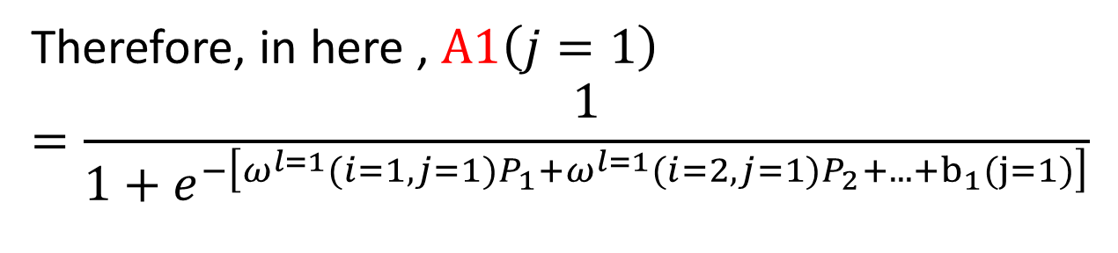
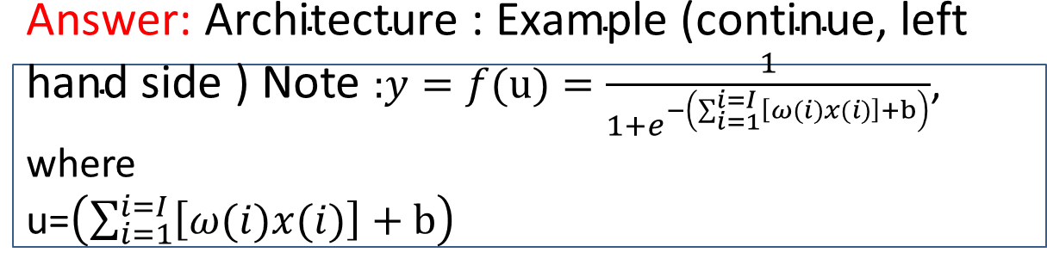
$\text{Answer}\text{: }\text{Architecture}\text{ : }\text{Example}\text{ (}\text{continue}\text{, }\text{left} \text{hand} \text{side}\text{ )}$ Note $\text{:}y=f(u)=\frac{1}{1+e^{−\left(\sum_{i=1}^{i=I}{\left[ω(i)x(i)\right]+b}\right)}}$, where u=$\left(\sum_{i=1}^{i=I}{\left[ω(i)x(i)\right]+b}\right)$
Therefore, in here , $A1\left(j=1\right)$
$$=\frac{1}{1+e^{−\left[ω^{l=1}(i=1,j=1)P_{1}+ω^{l=1}(i=2,j=1)P_{2}+...+b_{1}(j=1)\right]}}$$
P(i=1)
ω^{l=1}(i=1,j=1)
P(i=2)
ω^{l=1}(i=2,j=1)
Neuron (j=1)
Bias=b1(j=1)
A1(j=1)
P(i=9)
ω^{l=1}(i=9,j=1)

Slide 31

Architecture : write the formula for A2(k=1)
$$A_{1}(j=1=\frac{1}{1+e^{−\left[ω^{l=1}(i=1,j=1)P_{1}+ω^{l=1}(i=2,j=1)P_{2}+...+b_{1}(j=1)\right]}}$$
$$A_{2}(k=1)=\frac{1}{1+e^{−[ω^{l=2}(j=1,k=1)A_{1}(k=1)+ω^{l=2}(j=2,k=1)A_{2}(k=1)+...+b_{2}(k=1)]}}$$
P(i=1)
ω^{l=1}(i=1,j=1)
A1
ω ^{l=2}(j=1,k=1)
ω^{l=1}(i=2,j=1)
Neuron i=1
Bias=b1(i=1)
A₁(i=1)
ω ^{l=2}(j=2,k=1)
Neuron k=1
Bias=b2(k=1)
P(i=2)
A2
P(i=9)
ω^{l=1}(i=9,j=1)
A5
ω ^{l=2}(j=5,k=1)
A_{2(k=2)}
P(i=1)
P(i=2)
P(i=3)
:
:
P(i=9)
ω ^{l=1}(i=1,j=1)
A1(j=1)
ω ^{l=2}(j=1,k=1)
ω ^{l=1}(i=2,j=1)
A1(j=2)
ω ^{l=2}(j=2,k=1)
ω ^{l=2}(i=2,k=2)
ω^{l=1}(i=3,j=4)
A1(j=4)
ω ^{l=2}(j=5,k=3)
A2:layer2, 3 Output neurons
indexed by k
W^{l=2}=5x3
b^{l=2}=3x1
A1(j=5)
ω ^{l=1}(i=9,j=5)
A1: Hidden layer1 =5 neurons, indexed by j
W^{l=1}=9x5
b^{l=1}=5x1
Input:
P=9x1
Indexed by j
Layer l=1
Layer l=2
←S2 generated
←S1 generated

Slide 32
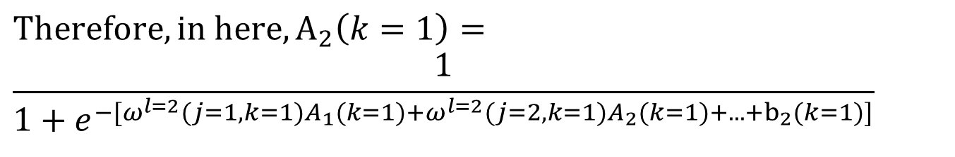
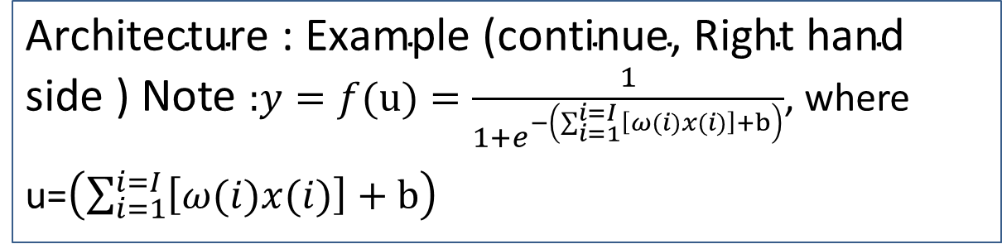
Answer: write the formula for A2(k=1)
$\text{Architecture}\text{ : }\text{Example}\text{ (}\text{continue}\text{, }\text{Right} \text{hand} \text{side}\text{ )}$ Note $\text{:}y=f(u)=\frac{1}{1+e^{−\left(\sum_{i=1}^{i=I}{\left[ω(i)x(i)\right]+b}\right)}}$, where
u=$\left(\sum_{i=1}^{i=I}{\left[ω(i)x(i)\right]+b}\right)$
$$Therefore, in here, A_{2}\left(k=1\right)=$$
$$\frac{1}{1+e^{−[ω^{l=2}(j=1,k=1)A_{1}(k=1)+ω^{l=2}(j=2,k=1)A_{2}(k=1)+...+b_{2}(k=1)]}}$$
A1(k=1)
ω ^{l=2}(i=1,k=1)
A1(k=2)
ω ^{l=2}(i=2,k=1)
Neuron k=1
Bias=b2(k=1)
A_{2(k=2)}
ω ^{l=2}(i=5,k=1)
A1(k=5)

Slide 33
Exercise 3a,b
$$A_{1}(j=1)=\frac{1}{1+e^{−\left[ω^{l=1}(i=1,j=1)P_{1}+ω^{l=1}(i=2,j=1)P_{2}+...+b_{1}(j=1)\right]}}$$
$$A_{2}(k=1)=\frac{1}{1+e^{−[ω^{l=2}(j=1,k=1)A_{1}(k=1)+ω^{l=2}(j=2,k=1)A_{2}(k=1)+...+b_{2}(k=1)]}}$$
P(i=1)
ω^{l=1}(i=1,j=1)
A1
ω ^{l=2}(j=1,k=1)
ω^{l=1}(i=2,j=1)
Neuron i=1
Bias=b1(i=1)
A₁(i=1)
ω ^{l=2}(j=2,k=1)
Neuron k=1
Bias=b2(k=1)
P(i=2)
A2
P(i=9)
ω^{l=1}(i=9,j=1)
A5
ω ^{l=2}(j=5,k=1)
A_{2(k=2)}
P(i=1)
P(i=2)
P(i=3)
:
:
P(i=9)
ω ^{l=1}(i=1,j=1)
A1(j=1)
ω ^{l=2}(j=1,k=1)
ω ^{l=1}(i=2,j=1)
A1(j=2)
ω ^{l=2}(j=2,k=1)
ω ^{l=2}(i=2,k=2)
Exercise3a:
I=number of inputs
H=number of hidden neurons,
O=number of outputs
MC question: I+H+O=__?
Choices: (1) 10 ; (2)15; (3)17 ;(4)23
Exercise3b: W=number of weights, B=num of biases. MC choices: W+B=
20 ; (2) 35; (3)89 ; (4) 68
A1(j=4)
ω^{l=1}(i=3,j=4)
A1(j=5)
ω ^{l=1}(i=9,j=5)

Slide 34
Answer: Exercise 3a,b
$$A_{1}(j=1)=\frac{1}{1+e^{−\left[ω^{l=1}(i=1,j=1)P_{1}+ω^{l=1}(i=2,j=1)P_{2}+...+b_{1}(j=1)\right]}}$$
$$A_{2}(k=1)=\frac{1}{1+e^{−[ω^{l=2}(j=1,k=1)A_{1}(k=1)+ω^{l=2}(j=2,k=1)A_{2}(k=1)+...+b_{2}(k=1)]}}$$
P(i=1)
ω^{l=1}(i=1,j=1)
A1
ω ^{l=2}(j=1,k=1)
ω^{l=1}(i=2,j=1)
Neuron i=1
Bias=b1(i=1)
A₁(i=1)
ω ^{l=2}(j=2,k=1)
Neuron k=1
Bias=b2(k=1)
P(i=2)
A2
P(i=9)
ω^{l=1}(i=9,j=1)
A5
ω ^{l=2}(j=5,k=1)
A_{2(k=2)}
P(i=1)
P(i=2)
P(i=3)
:
:
P(i=9)
ω ^{l=1}(i=1,j=1)
A1(j=1)
ω ^{l=2}(j=1,k=1)
ω ^{l=1}(i=2,j=1)
A1(j=2)
ω ^{l=2}(j=2,k=1)
ω ^{l=2}(i=2,k=2)
Exercise3a:
I=number of inputs
H=number of hidden neurons,
O=number of outputs
MC question: I+H+O=__?
Choices: (1) 10 ; (2)15; (3)17 ;(4)23
Ans: I=9, H=5, O=3, total=17 (choice3 correct)
Exercise3b: W=number of weights, B=num of biases. MC choices: W+B=
20 ; (2) 35; (3)89 ; (4) 68
W=9*5+5*3=60. B=5+3=8, input neuron has no bias. W+B=68 (choice (4) is correct
A1(j=4)
ω^{l=1}(i=3,j=4)
A1(j=5)
ω ^{l=1}(i=9,j=5)

Slide 35
Exercise3c: write formula for A1 (j=4)
$$A_{1}(j=1)=\frac{1}{1+e^{−\left[ω^{l=1}(i=1,j=1)P_{1}+ω^{l=1}(i=2,j=1)P_{2}+...+b_{1}(j=1)\right]}}$$
$$A_{2}(k=1)=\frac{1}{1+e^{−[ω^{l=2}(j=1,k=1)A_{1}(k=1)+ω^{l=2}(j=2,k=1)A_{2}(k=1)+...+b_{2}(k=1)]}}$$
P(i=1)
ω^{l=1}(i=1,j=1)
A1
ω ^{l=2}(j=1,k=1)
ω^{l=1}(i=2,j=1)
Neuron i=1
Bias=b1(i=1)
A₁(i=1)
ω ^{l=2}(j=2,k=1)
Neuron k=1
Bias=b2(k=1)
P(i=2)
A2
P(i=9)
ω^{l=1}(i=9,j=1)
A5
ω ^{l=2}(j=5,k=1)
A_{2(k=2)}
P(i=1)
P(i=2)
P(i=3)
:
:
P(i=9)
ω ^{l=1}(i=1,j=1)
A1(j=1)
ω ^{l=2}(j=1,k=1)
ω ^{l=1}(i=2,j=1)
A1(j=2)
ω ^{l=2}(j=2,k=1)
ω ^{l=2}(i=2,k=2)
ω^{l=1}(i=3,j=4)
A1(j=4)
ω ^{l=2}(j=5,k=3)
A2:layer2, 3 Output neurons
indexed by k
W^{l=2}=5x3
b^{l=2}=3x1
A1(j=5)
ω ^{l=1}(i=9,j=5)
A1: Hidden layer1 =5 neurons, indexed by j
W^{l=1}=9x5
b^{l=1}=5x1
Input:
P=9x1
Indexed by j
Layer l=1
Layer l=2
←S2 generated
←S1 generated

Slide 36
Exercise 3c: Find A1 (j=4), the output of the 4th neuron in the hidden layer. write output value for A1(j=4)
P(i=1)
ω^{l=1}(i=1,j=4)
P(i=2)
ω^{l=1}(i=2,j=4)
Neuron Bias=b
A1_j_is_4
P(i=9)
ω^{l=1}(i=9,j=4)
Example: if P=[ 0.7656 0.7344 0.9609 0.9961 0.9141 0.9063 0.0977 0.0938 0.0859]
ω^{l =1}=[ 0.2112 0.1540 -0.0687 -0.0289 0.0720 -0.1666 0.2938 -0.0169 -0.1127]
b^{l=1}= 0.1441 %for neuron i
%Find A1(j=4)
Answer:
U1=0.7656*0.2112 + 0.7344*0.1540 + 0.9609* -0.0687 + 0.9961 *-0.0289 0.9141 *0.0720 + 0.9063 *-0.1666 + 0.0977* 0.2938 + 0.0938*-0.0169 + 0.0859 *-0.1127
=0.1123
U=u1+b= 0.1123+ 0.1441= 0.2564
A1_j_is_4=1/(1+exp(- 0.2564))=0.564
A1_j_is_4=1/(1+exp[-(ω^{l=1}*P+b^{l=1}))]
=0.564
%Matlab Code:
P=[ 0.7656 0.7344 0.9609 0.9961 0.9141 0.9063 0.0977 0.0938 0.0859];
W=[ 0.2112 0.1540 -0.0687 -0.0289 0.0720 -0.1666 0.2938 -0.0169 -0.1127];
bias=0.1441;
1/(1+exp(-1*(sum(P.*W)+bias)) ) %correct 0.5637

Slide 37
Exercise 4: find Y1
Layers are indexed by l
Neurons are indexed by i
Weights are indexed by j
b=bias
l=1
i=1
X=1
NA1
l=3
i=1
b=0.7
0.1
l=2
i=1
b=0.5
0.6
0.35
Y1
=?
l=1
i=2
0.4
0.35
X=0.3
0.27
0.73
0.25
NA2
l=3
i=2
b=0.6
0.15
0.8
y2
l=2
i=2
b=0.3
l=1
i=3
X=0.5
W^{l =1}(j=3,i=2)
Hidden layer
ouput layer
Input layer

Slide 38
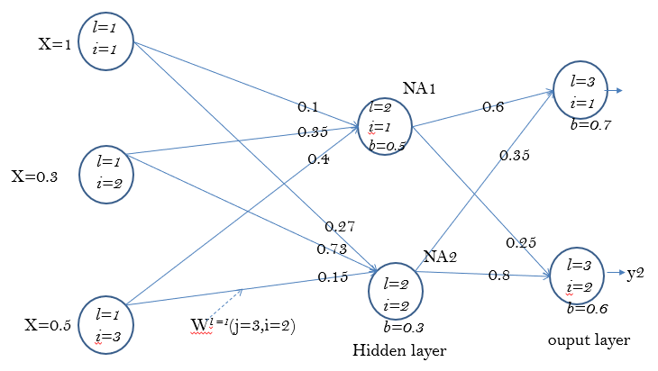
Answer 4
clear
clc
%
u1=1*0.1+0.3*0.35+0.5*0.4+0.5
NA1=1/(1+exp(-1*u1))
%NA1=0.7120
u2=1*0.27+0.3*0.73+0.5*0.15+0.3
NA2=1/(1+exp(-1*u2))
%NA2=0.7035
u_Y1=NA1*0.6+NA2*0.35+0.7
Y1=1/(1+exp(-1*u_Y1))
%Y1=0.798
Y1=

Slide 39

Part 2: Back propagation processing
(Training the network)
Back Propagation Neural Net (BPNN)
Assume using it for regression
Ref:http://en.wikipedia.org/wiki/Backpropagation

Slide 40

Back propagation stage
Part1:Feed
Forward (studied before)
Part2: Back propagation
sensitivity
For training we need to find , why?
We will explain why and prove the necessary equations in the following slides

Slide 41
The criteria to train a network
Based on the overall error function, there are ‘N’ samples and ‘c’ classes to be learned (Assume N=60,000 in MNIST dataset)
In our simple example
the n^{th} training sample
Example: The k-th output neuron y_{k}^{n}
the teacher says
it is class t_{k}^{n}=1
y^{n}_{K=1} ← t^{n}_{k=1}
y^{n}_{K=2} ← t^{n}_{k=2}
y^{n}_{K=3} ← t^{n}_{k=3}
MSE Regression
loss function
C Output neurons

Slide 42
Before we back propagate data , we have to find the feed forward error signals e(n)– regression loss function first for the training sample x(n). Recall: Feed forward processing, Input =P1,..P9, output =Y1,Y2,Y3, teacher =T1,T2,T3
I.e. e(n)=
(1/2)|Y1-T1|²
=0.5*(0.5101-1)^2
=0.12
Input=
P(i=1)
P(i=2)
P(i=3)
:
:
P(i=9)
ω (i=1,j=1)
A1(j=1)
ω (j=1,k=1)
Y1=0.5101
T1=1
ω (i=2,i=1)
A1(j=2)
ω (j=2,k=1)
Y2=0.4322
T2=0
ω (j=2,k=2)
Y3=0.3241
T3=0
A1(j=5)
Output layer
W^{l=1}=9x5
b^{l=1}=5x1
A1: Hidden layer,
5 neurons,
indexed by j
Layer l=2
W^{l=2}=5x3
b^{l=2}=3x1
Input layer
Layer l=1
e

Slide 43
Exercise 5a,b : The training idea
Assume it is for the n^{th} training sample, and belong to class C.
In the previous exercise we calculated that in this network Y1=0.798
During training target t is
(5a)MC question.
e=__?
e=(1/2)|Y1-t|²
e=(1/2)|Y1-t|
e= |Y1-t|²
e=(1/4)|Y1-t|²
(5b) How do you use this e?
t=1
Y1=
0.798
.
e
Assume it is for the n^{th} training sample
Assume it is for the n^{th} training sample

Slide 44
Answer 5a,b : The training idea
Assume it is for the n^{th} training sample, and belong to class C.
In the previous exercise we calculated that in this network Y1=0.798
During training target t is
(5a) MC question.
e=__?
e=(1/2)|Y1-t|²
e=(1/2)|Y1-t|
e= |Y1-t|²
e=(1/4)|Y1-t|²
____
t=1
Y1=
0.798
e
Assume it is for the n^{th} training sample
Answer 5a: e=(1/2)|Y1-t|²=0.5*(1-0.798)^2= 0.0204
Choice (1) is correct. Answer 5b: We feed e back to the network to find Δw to minimize the overall E (E =sum_all_n [t-e]). It is because we know that w_new=w_old+ Δ w (will prove this later) will give a new w that decreases E. hence by applying this formula recursively, we can achieve a set of W to minimum E.

Slide 45
How to back propagate?
Neuron j
45
i=1,2,..,I
I inputs to neuron j
Output of neuron j is y_{j}

Slide 46

Because: ∂E/ ∂ w_{i,j} tells you how to change w to minimize e∈E
The method is called Learning by gradient descent
$$\text{In} \text{each} \text{learning} \text{cycle} (\text{epoch})\text{, }\text{a} \text{new} w \text{is} \text{calculated}\text{,} \\ \text{using} w_{\text{new}}= w_{\text{old}}+Δw, \text{if} \text{we} \text{want} \text{to} \text{decrease} \\ E(e \text{is} \text{an} \text{element} \text{of} \text{E}) \text{for} \text{every} \text{learning} \text{cycle} \\ \text{make} Δw=−η\frac{∂E}{∂w} (\text{learning} \text{by} \text{gradient} \text{descent}) \\ T\text{o} \text{do} \text{it} \text{slowly} \text{use} \text{a} \text{small} +\text{ve} η \left( \text{learning} \text{factor} η≈\text{0.1 }\right),$$
$η$ pronounced as eta
$$(\text{The} \text{theory} \text{of} \text{gradient} \text{descent} \text{will} \text{be} \text{explained} \text{in} \text{the} \text{next} \text{slide}), \\ w_{\text{new}}= w_{\text{old}}+Δw= w_{\text{old}}−η\frac{∂E}{∂w} \\ \text{That}\text{′}\text{s} \text{why} \text{we} \text{need} \frac{∂E}{∂w} \\ \text{For} \text{the} \text{same} \text{argument}\text{, }b_{new}=b_{old}−η\frac{∂E}{∂b}$$
Important result

Slide 47
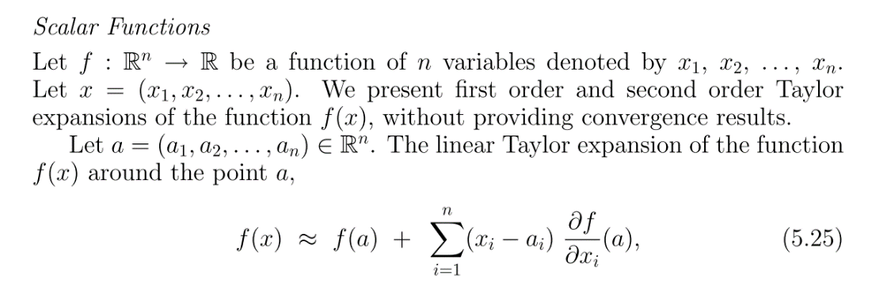
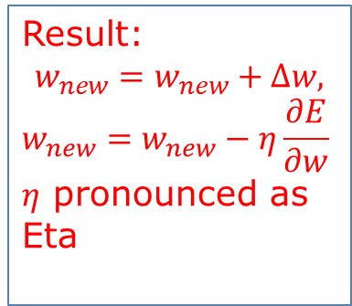
ANS for : We need to find , why?
Using Taylor series
http://www.fepress.org/files/math_primer_fe_taylor.pdf
http://en.wikipedia.org/wiki/Taylor's_theorem
Result:
$$w_{new}=w_{new}+∆w,$$
$$w_{new}=w_{new}−η\frac{∂E}{∂w}$$
$η$ pronounced as Eta
Always +ve

Slide 48
Back propagation idea
Input =P1,..P9, output =Y(k=1),Y(k=2),Y3(k=3) teachers =T(k=1),T(k=3),T(k=3)
I.e. e(n)=
(1/2)|Y1-T1|²
=0.5*(0.5101-1)^2
=0.12
Input=
P(i=1)
P(i=2)
P(i=3)
:
:
P(i=9)
ω (i=1,j=1)
A1(j=1)
ω (j=1,k=1)
Y1=0.5101
T1=1
ω (i=2,i=1)
A1(j=2)
ω (j=2,k=1)
Y2=0.4322
T2=0
ω (j=2,k=2)
Y3=0.3241
T3=0
A1(j=5)
Output layer
W^{l=1}=9x5
b^{l=1}=5x1
A1: Hidden layer,
5 neurons,
indexed by j
Layer l=2
W^{l=2}=5x3
b^{l=2}=3x1
Input layer
Layer l=1
e
Neural Networks Ch9. , ver. 6.2f
48

Slide 49

The training algorithm
Write the data structures required for each step of the training algorithm
Initialize all weights w randomly
Iteration=1: all_epochs (or break when E is very small)
{ For n=1:N_all_training_samples and classes
{ feed forward x(n) to network to get y(n)
e(n)=0.5*[y(n)-t(n)]^2 ; //t(n)=teacher of sample x(n)
back propagate e(n) to the network,
//showed earlier if Δw=-η*∂E/∂w , and w_{new}=w_{old}+ Δw
//output y(n) will be closer to t(n) hence e(n) will decrease
find Δw=-η*(∂E/∂w); //E will decrease. η≈0.1=learning rate
update w_{new}=w_{old}+ Δw =w_{old}-η*∂E/∂w ; //for weight update
Similarity update b_{new}=b_{old}+ Δb =w_{old}-η*∂e/∂b ; //for bias
}
E=sum_all_n (e(n))
}
η. /'i:tə/. eta

Slide 50
How to calculate Δw, Δb of all neurons during training
Formulas and code

Slide 51
Now use this indexing scheme (k,j,i) now
http://cogprints.org/5869/1/cnn_tutorial.pdf
K_{layer}
j_{layer}
i_{layer}
Output teacher
t_{i=1}
t_{i}
Hidden layer l-2
Indexed by k
Hidden layer l-1
Indexed by j
Output layer (l)
indexed by i

Slide 52
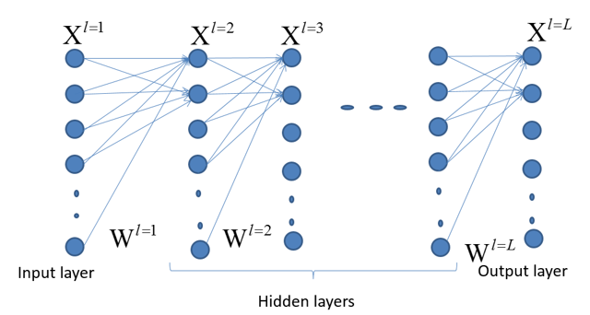
Case 1 of weight updating
if the neuron in between the hidden layer and the output layer

Slide 53
Case 1 of weight updating
(i): if the neuron in between the hidden layer and the output layer
Definition
Output
t_{i}
Overall picture
Neuron n as an output neuron
Output
Sensitivity (S2)
s2 = 1*diag(df2) * e(:,i); %e=A2-T;
df2=f’=f(1-f) of layer2, in bnppx.m
Notes:
%%%%%%%%%%%%%%%%%%%%%%%%%%%%%%%%%%%%%%
%%%%%%%%% slide 43 %%%%%%%%%
\subsection{slide 43 Case 1(i): if the neuron in between the output and the hidden layer}
By definition:
$x_i=f(u_i)=
f \Big( \sum\limits_{j=1}^{j=J}(w_{j,i}x_j+b_j)
\Big)
=\frac{1}{
1+exp
\Big(- \sum\limits_{j=1}^{j=J} (w_{j,i}x_j+b_j) \Big)
}$\\
%%%%%%%%%%%%%%%%%%%%%%%%%%%%%%%%%%%%
$\frac{\partial \varepsilon}{\partial w_{i,j}}=
\frac{\partial \varepsilon}{\partial x_j}
\frac{\partial x_j}{\partial u_j}
\frac{\partial u_j}{\partial w_{i,j}}$
%%%%%%%%%%%%%%%%%%%
update $w_{j,i}$ factor,
=term1 $\cdot$ term2 $\cdot$ term3\\
$term1:\frac{\partial \varepsilon }{x_i}=\frac {\partial (0.5)*(x_i - t_i)^2}{\partial x_i}=(x_i - t_i)$\\
$x_i=f(u_i)$ , by definition\\
%%
$term2: \frac{\partial x_i}{\partial u_i}=\frac{\partial f (u_i)}{\partial u_i}=f(u_i)(1-f(u_i))$, proved earlier\\
since $u_i= \sum\limits_{j=1}^{j=J} w_{j,i} x_j+b_j =w_{j,i} x_j+b_j$, for a particular $(j,i)$ pair\\
%%
$term3=\frac{u_j}{w_{j,i}}=\frac{\partial (w_{j,i} \cdot x_j + b_j ) }{\partial w_{j,i}}$, since $b_j$=constant\\
Note : term1 $\cdot term2=\frac{\partial \varepsilon }{\partial u_i }
=\frac{\partial \varepsilon }{\partial x_i }
\frac{\partial x_i }{\partial u_i }=s_i$ is called the sensitivity\\
$s_i=(x_i-t_i) \cdot f(u)(1-f(u))$---(2)\\
since $\frac{\partial \varepsilon}{\partial w_{j,i}}=term1 \cdot term2 \cdot term3$\\
%
$\frac{\partial \varepsilon}{\partial w_{j,i}}=s_ix_j=[(x_i-t_i) \cdot f(u_i)(1-f(u))] \cdot x_j$\\
Note:$ f(u_i)(1-f(u))] \cdot x_j$ is sensitivity (s2)
\begin{verbatim}
%The code:
s2 = 1*diag(df2) * e(:,i); %e=A2-T;
df2=f’=f(1-f) of layer2, in bnppx.m
\end{verbatim}

Slide 54
Case 1 of weight updating : (ii) if the neuron in between the hidden layer and the output layer
More Explanation for term1
Definition
Output
t_{i}
Neuron n as an output neuron
Output
Notes:
\subsection{slide 44 Case 1(ii): if the neuron in between the output and the hidden layer}
%%%%%%%%%%%%%%%%%%%%%%%%%%%%%%%%%%%%
$\frac{\partial \varepsilon}{\partial w_{i,j}}=
\frac{\partial \varepsilon}{\partial x_j}
\frac{\partial x_j}{\partial u_j}
\frac{\partial u_j}{\partial w_{i,j}}$
%%%%%%%%%%%%%%%%%%%
update $w_{j,i}$ factor,
=term1 $\cdot$ term2 $\cdot$ term3\\
=update $w_{j,i}$ factor\\
i.e. $w_{j,i(new)}+w_{j,i(old)}+\Delta w_{j,i}$\\
by definition $\varepsilon =\frac {\partial (0.5)*(x_i - t_i)^2}{\partial x_i}$, therefore \\
$term1:\frac{\partial \varepsilon }{x_i}=\frac {\partial (0.5)*(x_i - t_i)^2}{\partial x_i}=(x_i - t_i)$\\

Slide 55
Case 1 of weight updating(iii): if the neuron in between the output and the hidden layer
More Explanation for term2
Output
t_{i}
Neuron n as an output neuron
Output

Slide 56
Case 1(iv): if the neuron in between the output and the hidden layer
More Explanation for term3
Definition
Output
t_{i}
Neuron n as an output neuron
Output

Slide 57
Case 1(v): if the neuron in between the output and the hidden layer
More Explanation
term1*term2*term3
Definition
Output
t_{i}
Neuron n as an output neuron
term1
term2
Output

Slide 58
Case2 of weight updating
if neuron in between a hidden and hidden layer

Slide 59
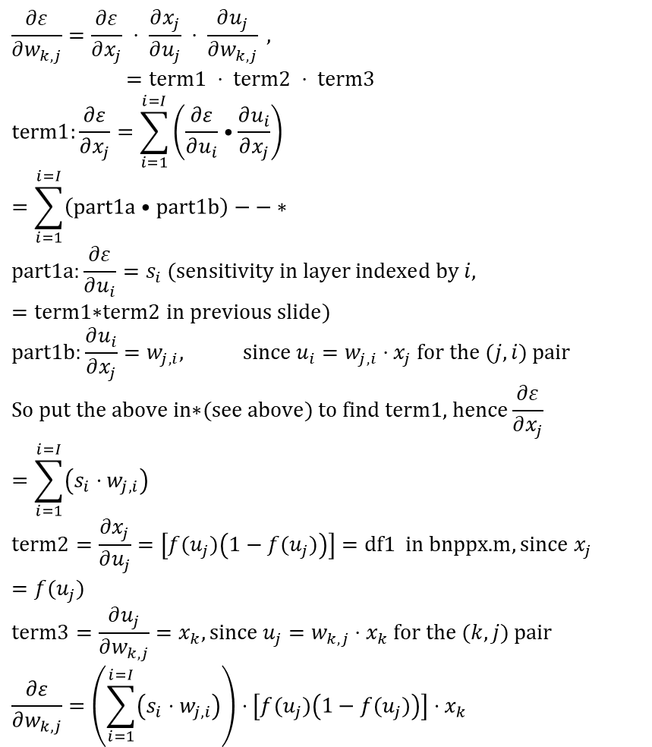
Case2 of weight updating
(i) : if neuron in between a hidden and hidden layer. We want to find
$$\frac{∂ε}{∂w_{k,j}}=\frac{∂ε}{∂x_{j}} ⋅ \frac{∂x_{j}}{∂u_{j}} ⋅ \frac{∂u_{j}}{∂w_{k,j}}\text{ , } \\ =\text{term}\text{1 }⋅ \text{term}\text{2 }⋅ \text{term}\text{3} \\ \text{term}\text{1}:\frac{∂ε}{∂x_{j}}=\sum_{i=1}^{i=I}{\left(\frac{∂ε}{∂u_{i}}•\frac{∂u_{i}}{∂x_{j}}\right)}=\sum_{i=1}^{i=I}{\left(\text{part}\text{1}\text{a}•\text{part}\text{1}\text{b}\right)}−−∗_{} \\ \text{part}\text{1}\text{a}\text{:}\frac{∂ε}{∂u_{i}}=s_{i} (\text{sensitivity} \text{in} \text{layer} \text{indexed} \text{by} i, \\ =\text{term}\text{1∗}\text{term}\text{2 }\text{in} \text{previous} \text{slide}) \\ \text{part}\text{1}\text{b}\text{:}\frac{∂u_{i}}{∂x_{j}}=w_{j,i}, \text{since} u_{i}=w_{j,i}⋅x_{j} \text{for} \text{the} (j,i) \text{pair} \\ \text{So} \text{put} \text{the} \text{above} \text{in}\text{∗}(\text{see} \text{above}) \text{to} \text{find} \text{term}\text{1, }\text{hence}\frac{∂ε}{∂x_{j}}=\sum_{i=1}^{i=I}{\left(s_{i}⋅w_{j,i}\right)} \\ \text{term}\text{2}=\frac{∂x_{j}}{∂u_{j}}=\left[f(u_{j})\left(1−f(u_{j})\right)\right]=\text{df}\text{1 }\text{in} \text{bnppx}\text{.}\text{m},\text{since} x_{j}=f(u_{j}) \\ \text{term}\text{3}=\frac{∂u_{j}}{∂w_{k,j}}=x_{k},\text{since} u_{j}=w_{k,j}⋅x_{k} \text{for} \text{the} (k,j) \text{pair} \\ \frac{∂ε}{∂w_{k,j}}=\left(\sum_{i=1}^{i=I}{\left(s_{i}⋅w_{j,i}\right)}\right)⋅\left[f(u_{j})\left(1−f(u_{j})\right)\right]⋅x_{k}$$
A1
Weight
Layer L
Indexed by i
sensitivity of layer indexed by i
Overall picture
Output
layer
S_{j}: sensitivity for layer j to i
Notes:
%%%%%%%%%%%%%%%%%%%%%%%%%%%%%%%%%%%%%%%%
\subsection{Slide 48: Case2 : if neuron in between a hidden to hidden layer. We want to find}
$\frac{\partial \varepsilon }{\partial w_{i,j}}=
\frac{\partial \varepsilon }{\partial x_j}
\frac{\partial x_j}{\partial u_j}
\frac{\partial u_j}{\partial w_{k,j}}$
%
%update $w_{j,i}$ factor,
$=term1 \cdot term2 \cdot term3$\\
$term1=\frac{\partial \varepsilon}{\partial x_j}
=\sum\limits_{i=1}^{i=I}
\Big(
\frac{\partial \varepsilon }{\partial u_i}
\frac{\partial u_i}{\partial x_j }
\Big)
=\sum\limits_{i=1}^{i=I}(part1a \cdot part1b)$
---(*)\\
%
Part1a: $\frac{\partial \varepsilon }{\partial u_i}=s_i $ (sensitivity in layer $i$)\\
%
=$term1 \cdot term2$ in case 1 discussed earlier\\
part1b: $\frac{\partial u_i }{\partial x_j}=w_{j,i} , $ since $u_i=w_{j,i} \cdot x_j $ for the (j,i) pair\\
So put in (*)
to find term1, hence $\frac{\partial \varepsilon }{\partial x_j}=
\sum\limits_{i=1}^{i=I}(s_i \cdot w_{j,i})$\\
%
$term2= \frac{\partial x_j}{\partial u_j}=[f(u_j)(1-f(u_j)]=$df1 in bnppx.m, since $x_j=f(u_j)$\\
%
$term3=\frac{\partial u_j}{\partial w_{k,j}}=x_k,$ since $u_j=w_{k,j} \cdot x_k$ for the $(k,j)$ pair\\
%
$\frac{\partial \varepsilon }{\partial w_{k,j}}= \Big(
\sum\limits_{i=1}^{i=I}(s_i \cdot \cdot w_{j,i})
\Big)
\cdot [f(u_j)(1-f(u_j)] \cdot x_k$\\
Note: $s_i$ is called the ``sensitivity'' for layer $j$ to $i$

Slide 60
Case2 of weight updating (ii) : if neuron in between a hidden and hidden layer. We want to find
A1
Weight
Layer L
Indexed by i
Note: back-propagate to w_{k,j} depends on all w_{j,i=1,,.I}
Output
layer

Slide 61
Case2(iii) : if neuron in between a hidden and hidden layer. We want to find
A1
Weight
Layer L
Indexed by i
Output
layer

Slide 62
Case2(iv) : if neuron in between a hidden and hidden layer. We want to find
A1
Weight
Layer L
Indexed by i
Output
layer

Slide 63
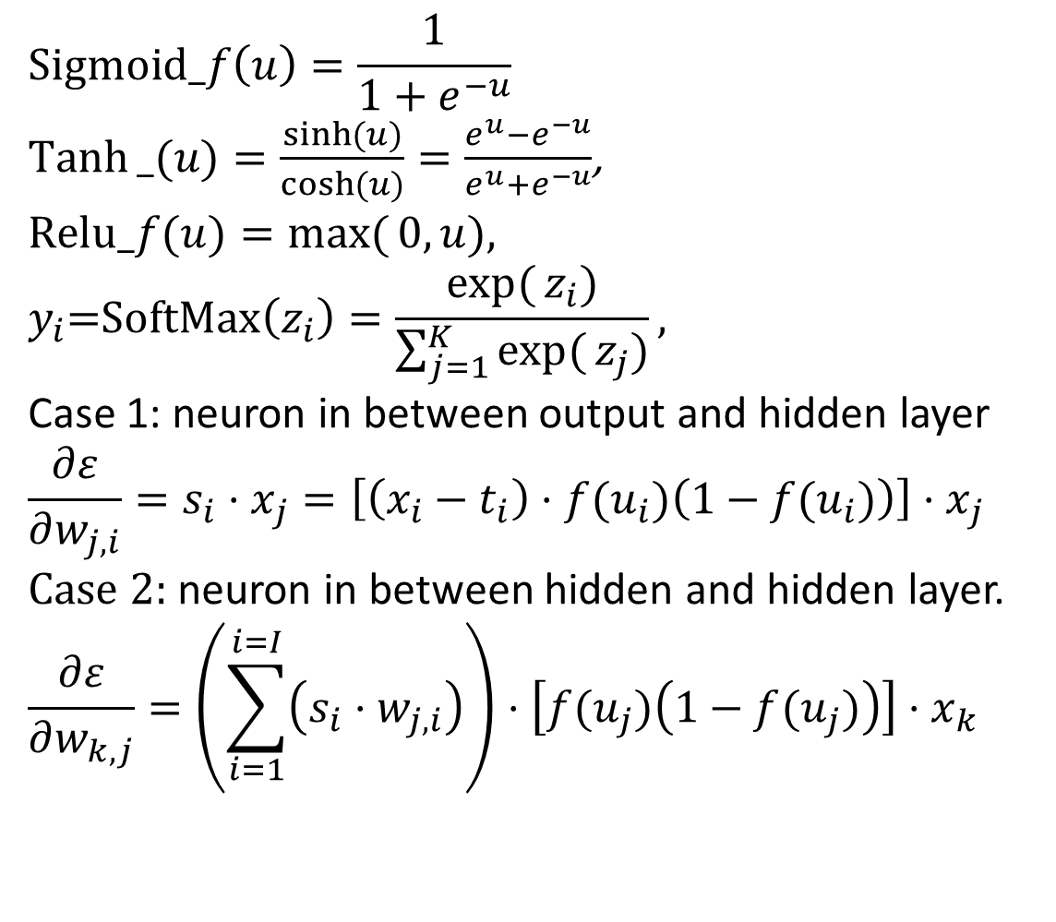
Neural networks: useful formulas
$$\text{Sigmoid}_f\left(u\right)=\frac{1}{1+e^{−u}}$$
$Tanh⁡_(u)=\frac{\sinh{(u})}{\cosh{(}u)}=\frac{e^{u}−e^{−u}}{e^{u}+e^{−u}}$,
$$\text{Relu}\text{_}f(u)=\max{(}0,u),$$
$$y_{i}\text{=}\text{SoftMax}\left(z_{i}\right)=\frac{\exp{(}z_{i})}{\sum_{j=1}^{K}{\exp{(}z_{j})}},$$
Case 1: neuron in between output and hidden layer
$$\frac{∂ε}{∂w_{j,i}}=s_{i}⋅x_{j}=\left[\left(x_{i}−t_{i}\right)⋅f(u_{i})\left(1−f(u_{i})\right)\right]⋅x_{j}$$
Case 2: neuron in between hidden and hidden layer.
$$\frac{∂ε}{∂w_{k,j}}=\left(\sum_{i=1}^{i=I}{\left(s_{i}⋅w_{j,i}\right)}\right)⋅\left[f(u_{j})\left(1−f(u_{j})\right)\right]⋅x_{k}$$
A1
Weight
Layer L
Indexed by i
Output
layer

Slide 64
Essential MATLAB code in bpnn(versionx).m see appendix for source listing
%back propagation pass
df1=A1(:,i).*(1-A1(:,i)); % derivative of A1
df2=A2(:,i).*(1-A2(:,i)); % derivative of A2
s2 = 1*diag(df2) * e(:,i); %e=A2-T; df2=f’=f(1-f) of layer2
s1 = diag(df1)* W2'* s2; % eq(3),feedback, from s2 to S1
W2 = W2-0.1*s2*A1(:,i)'; %learning rate=0.1, equ(2) output case
b2 = b2-0.1*s2; %threshold
W1 = W1-0.1*s1*P(:,i)';% update W1 in layer 1, see equ(3) hidden case
b1 = b1-0.1*s1;%threshold
%forward pass again
A1(:,i)=logsig(W1*P(:,i)+b1);%forward again
A2(:,i)=logsig(W2*A1(:,i)+b2);%forward again

Slide 65

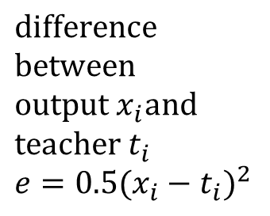
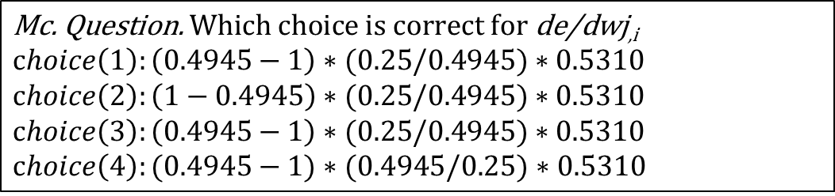
Exercise 6: question on output layer see reference code in appendix
Case 1 of weight updating as discuses earlier
$\text{de}\text{/}\text{dwj}\text{,}\text{i}$=(x_{i}-t_{i})*f(u_{i})*(1-f(u_{i}))*x_{j}= s_{i} * x_{j} , s_{i}=sensitivity
term1, term2 term3
s_{i}=term1*term2=(x_{i}-t_{i})*f(u_{i})*(1-f(u_{i}))=0.25
Input =x_{j}=0.4945
t_{i}=1=target
Output =x_{i}=0.5310
$(6a).$
$\left(6b\right) \text{Find} \text{de}\text{/}\text{dw}j,i$.
(6c)$\text{Why} \text{do} \text{we} \text{need} \text{to} \text{find} \text{de}\text{/}\text{dw} j,i?$
Output=x_{i}=0.5310
Output
t_{i}
Input x_{j}=0.4945
$$\text{difference} \text{between} \\ \text{output} x_{i}\text{and} \text{teacher} t_{i} \\ e=0.5(x_{i}−t_{i})^{2}$$
Output layer i
$$\text{Mc}\text{. }\text{Question}\text{.} \text{Which} \text{choice} \text{is} \text{correct} \text{for} \text{de}\text{/}\text{dwj}\text{,}\text{i}$$
$$choice\left(1\right):\left(0.4945−1\right)∗(0.25/0.4945)∗0.5310$$
$$choice\left(2\right):\left(1−0.4945\right)∗(0.25/0.4945)∗0.5310$$
$$choice\left(3\right):\left(0.4945−1\right)∗(0.25/0.4945)∗0.5310$$
$choice\left(4\right):(0.4945−1)∗(0.4945/0.25)$ $∗0.5310$

Slide 66

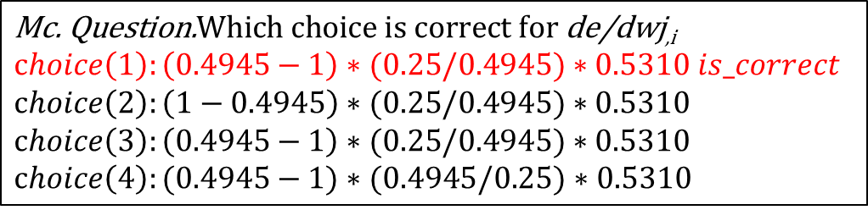
Answer 6 a,b: question on output layer see reference code in appendix
Case 1 of weight updating as discuses earlier
$\text{de}\text{/}\text{dwj}\text{,}\text{i}$=(x_{i}-t_{i})*f(u_{i})*(1-f(u_{i}))*x_{j}= s_{i} * x_{j} , s_{i}=sensitivity
term1, term2 term3
s_{i}=term1*term2=(x_{i}-t_{i})*f(u_{i})*(1-f(u_{i}))=0.25
Term2= 0.25/ x_{j}= 0.25/ 0.4945
Input =x_{j}=0.4945
t_{i}=1=target
Output =x_{i}=0.5310
$(6a).$
$\left(6b\right) \text{Find} \text{de}\text{/}\text{dw}j,i$. Ans=$\left(0.4945−1\right)∗0.25∗0.5310$= -0.0671
(6c)$\text{Why} \text{do} \text{we} \text{need} \text{to} \text{find} \text{de}\text{/}\text{dwj}\text{,}\text{i} ?$
Output=x_{i}=0.5310
Output
t_{i}
Input x_{j}=0.4945
$$\text{difference} \text{between} \\ \text{output} x_{i}\text{and} \text{teacher} t_{i} \\ e=0.5(x_{i}−t_{i})^{2}$$
Output layer i
$$\text{Mc}\text{. }\text{Question}\text{.}\text{Which} \text{choice} \text{is} \text{correct} \text{for} \text{de}\text{/}\text{dwj}\text{,}\text{i}$$
$$choice\left(1\right):\left(0.4945−1\right)∗(0.25/0.4945)∗0.5310 is_correct$$
$$choice\left(2\right):\left(1−0.4945\right)∗(0.25/0.4945)∗0.5310$$
$$choice\left(3\right):\left(0.4945−1\right)∗(0.25/0.4945)∗0.5310$$
$choice\left(4\right):(0.4945−1)∗(0.4945/0.25)$ $∗0.5310$

Slide 67
Answer
(6c) on output layer

Slide 68

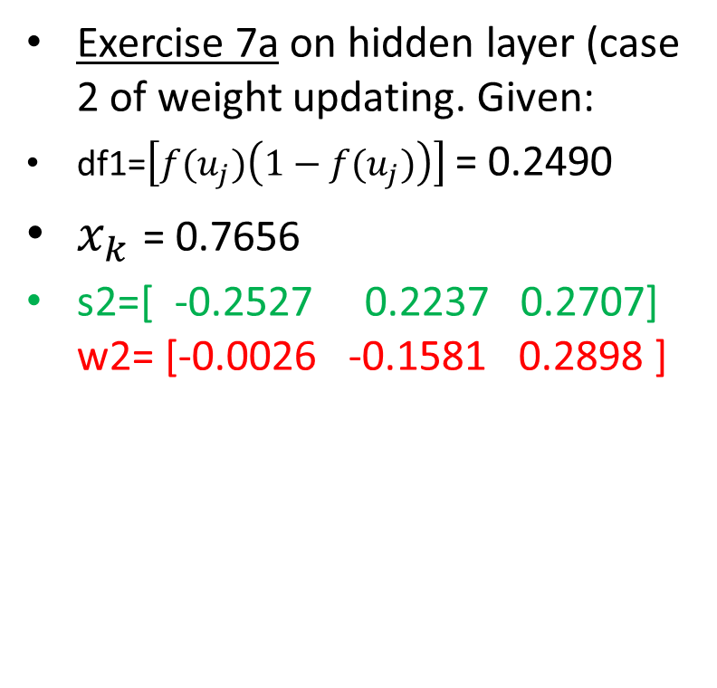


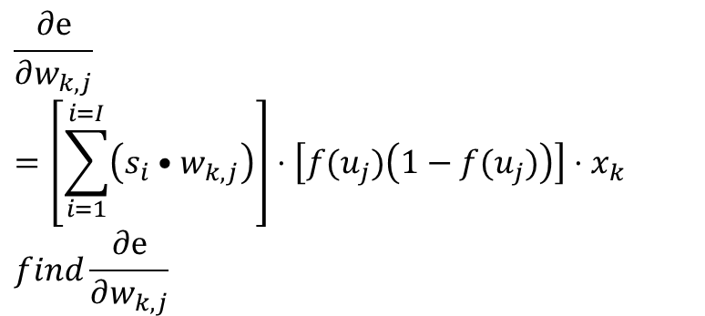
$\text{Exercise}\text{7}:$ Example of Case 2 of weight updating
$$\frac{∂e}{∂w_{k,j}}=\left[\sum_{i=1}^{i=I}{\left(s_{i}•w_{k,j}\right)}\right]⋅\left[f(u_{j})\left(1−f(u_{j})\right)\right]⋅x_{k} \\ find\frac{∂e}{∂w_{k,j}}$$
Indexed by j
Weight
Layer j
Indexed by i
$$w_{k,j}$$
$$w_{k,j}$$
=-0.0026
= -0.2527
=-0.1581
Exercise 7a on hidden layer (case 2 of weight updating. Given:
df1=$\left[f(u_{j})\left(1−f(u_{j})\right)\right]$= 0.2490
$x_{k}$= 0.7656
s2=[ -0.2527 0.2237 0.2707] w2= [-0.0026 -0.1581 0.2898 ]
=0.2237
=0.2898
=0.2707]
%Question (7a): Find de/dw_{k,j}=__? Mc question, choices
(1) =[ (-0.2527*-0.0026) * (0.2237* 0.2707) * (-0.1581 * 0.2898 )]*0.2490*0.7656
(2) = [(-0.2527* 0.2898) + (0.2237* -0.1581) + (0.2707* -0.0026 ) ]*0.2490*0.7656
(3) = [ (-0.2527*-0.0026) + (0.2237* -0.1581) + (0.2707 * 0.2898 ))] *0.2490*0.7656 .
(4) =[ (-0.2527* 0.2898) * (0.2237* -0.1581) * (0.2707* -0.0026 )] *0.2490*0.7656
%Question (7b): Draw the diagram of the related neurons

Slide 69

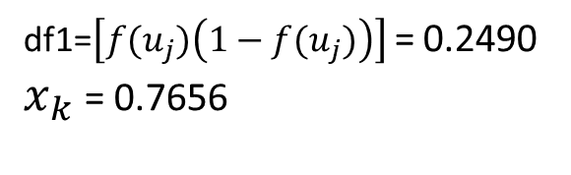


Answer (7a,7b) on hidden to hidden layer
Case 2
Weight
Layer L
Indexed by i
$$w_{k,j}$$
df1=$\left[f(u_{j})\left(1−f(u_{j})\right)\right]$= 0.2490
$x_{k}$= 0.7656
=-0.0026
= -0.2527
$$\left[\sum_{i=1}^{i=I}{\left(s_{i}•w_{j,i}\right)}\right]⋅$$
=-0.1581
=0.2237
$\frac{∂e}{∂w_{k,j}}$=ss*transpose(w2)*df1* x$\text{k}$
=[ (-0.2527*-0.0026) + (0.2237* -0.1581) + (0.2707 * 0.2898 ))] *0.2490*0.7656 . (choice 3 is correct)
$\frac{∂e}{∂w_{k,j}}$= 0.0083
=0.2898
=0.2707]
Case2:Term*term2=sensitivity 1 (ss1 for later use)
Output
layer
69

Slide 70
Finally, all (∂e/∂w) terms are found after you solved case1 and case2

Slide 71
Exercise 8: The training algorithm
Iter=1: all_epochs (or break when E is very small)
{ For n=1:N_all_training_samples
{ feed forward x(n) to network to get y(n)
e(n)=0.5*[y(n)-t(n)]^2 ;//t(n)=teacher of sample x(n)
back propagate e(n) to the network,
//showed earlier if Δw=-η*∂E/∂w , and w_{new}=w_{old}+ Δw
//output y(n) will be closer to t(n) hence e(n) will decrease
find Δw=-η*∂E/∂w //E will decrease. η≈0.1=learning rate
Update_Statement
Similarity update b_{new}=b_{old}+ Δb =b_{old}-η*∂E/∂b ;//for bias
}
E=sum_all_n (e(n))
} MC question: Update_statement =
Choice (1): update w_{new}=w_{old}+(η*∂E/∂w);
Choice (2): update w_{new}=w_{old} -(η*∂E/∂w);
Choice (3): update w_{new}=w_{old}+(η*∂w/ ∂E);
Choice (4): update w_{new}=w_{old} -(η *∂w/ ∂E);
η. /'i:tə/. eta

Slide 72
Answer 8: The training algorithm
Iter=1: all_epochs (or break when E is very small)
{ For n=1:N_all_training_samples
{ feed forward x(n) to network to get y(n)
e(n)=0.5*[y(n)-t(n)]^2 ;//t(n)=teacher of sample x(n)
back propagate e(n) to the network,
//showed earlier if Δw=-η*∂E/∂w , and w_{new}=w_{old}+ Δw
//output y(n) will be closer to t(n) hence e(n) will decrease
find Δw=-η*∂E/∂w //E will decrease. η≈0.1=learning rate
Update_Statement
Similarity update b_{new}=b_{old}+ Δb =b_{old}-η*∂E/∂b ;//for bias
}
E=sum_all_n (e(n))
} MC question: Update_statement =
Choice (1): update w_{new}=w_{old}+(η*∂E/∂w);
Choice (2): update w_{new}=w_{old} -(η*∂E/∂w); is correct
Choice (3): update w_{new}=w_{old}+(η*∂w/ ∂E);
Choice (4): update w_{new}=w_{old} -(η *∂w/ ∂E);
η. /'i:tə/. eta

Slide 73
Answer 8: The training algorithm
Data structures used can be found in the program at appendix
Write the data structures required for each step of the training algorithm
Iter=1: all_epochs (or break when E is very small)
{ For n=1:N_all_training_samples and classes
{ feed forward x(n) to network to get y(n)
e(n)=0.5*[y(n)-t(n)]^2 ;//t(n)=teacher of sample x(n)
back propagate e(n) to the network,
//showed earlier if Δw=-η*∂E/∂w , and w_{new}=w_{old}+ Δw
//output y(n) will be closer to t(n) hence e(n) will decrease
find Δw=-η*∂E/∂w //E will decrease. η≈0.1=learning rate
update w_{new}=w_{old}+ Δw =w_{old}-η*∂E/∂w ; //for weight
Similarity update b_{new}=b_{old}+ Δb =b_{old}-η*∂e/∂b ; //for bias
}
E=sum_all_n (e(n))
}

Slide 74
(self study question)

Slide 75
Ex10. (self study question)
Case 1: when the neuron in between the output and the hidden layer
Definition
Output
t_{i}
Neuron n as an output neuron
Output
http://cogprints.org/5869/1/cnn_tutorial.pdf

Slide 76
Ex.11 (self study question): Case2 : when neuron in between a hidden and hidden layer. We want to find
A1
Weight
Layer L
Indexed by k
S2= sensitivity of layer 2 neurons
Output
layer

Slide 77
Ex12a (self study question)
Answer can be found in appendix
Give the following diagram (in next slide) showing the parameters of part of a neural network at time k. Other neurons and weights exist but not shown.
The activation function of the neurons is sigmoid.
  Find the output [y1,y2]’ at time k.
  If the target code is [t1, t2]’=[1,0]’, when training the neural network, find the new w11,w12,w13,w21,w22,w23 at time k+1.
  Find the new wh1 at time k+1. Assume all the weights will be updated together only after all delta weights (Δw) have been calculated for each epoch k.

Slide 78
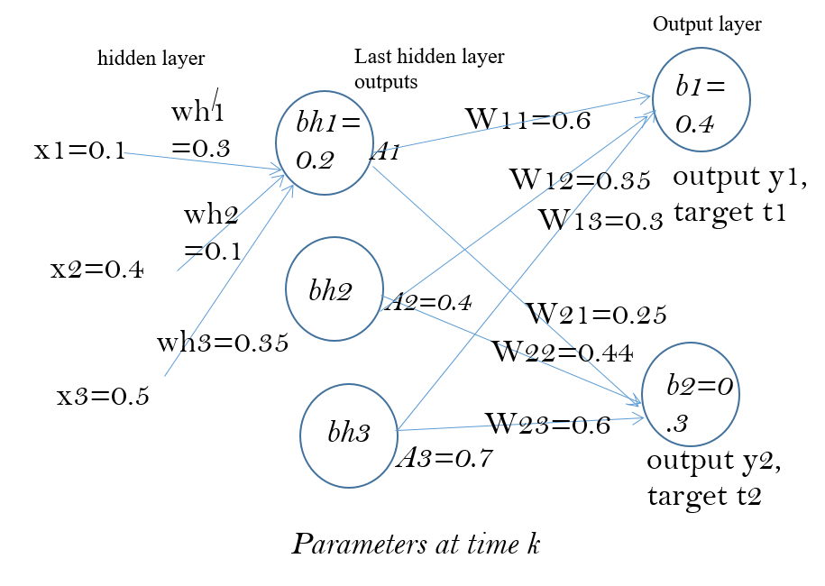
d
EX12b (self study question)
d

Slide 79
Implementation issues
Speed up weight update training :
  Full Batch
  Mini-batch and
  Stochastic Gradient Descent Algorithm SGD
A Simple Way to Prevent Neural Networks from Overfitting : Dropout
Popular optimization algorithm: ADAM

Slide 80
Full batch and min-batch
Full batch: Neural networks are trained in a series of epochs. Each epoch consists of one forward pass and one backpropogation pass over all of the provided training samples. Naively, we can compute the true gradient by computing the gradient value of each training case independently, then summing together the resultant vectors. This is known as full batch learning, and it provides an exact answer to the question of which stepping direction is optimal, as far as gradient descent is concerned.
Mini-batch: Alternatively, we may choose to update the training weights several times over the course of a single epoch. In this case, we are no longer computing the true gradient; instead we are computing an approximation of the true gradient, using however many training samples (randomly select) are included in each split of the epoch. This is known as mini-batch learning. (see example in next slide)
Online learning: In the most extreme case we may choose to adjust the gradient after every single forward and backwards pass. This is known as online learning. An online batch size would be just 1.
The amount of data included in each sub-epoch weight change is known as the batch size. For example, with a training dataset of 1000 samples, a full batch size would be 1000, a mini-batch size would be 500 or 200 or 100 (randomly select from the full set), and an online batch size would be just 1.
https://www.kaggle.com/residentmario/full-batch-mini-batch-and-online-learning
https://www.geeksforgeeks.org/ml-stochastic-gradient-descent-sgd/#stochastic-gradient-descent-sgd

Slide 81
Epoch, batch size and iterations
Epoch: One Epoch is when an ENTIRE dataset is passed forward and backward through the neural network only ONCE.
Batch size is the total number of training examples present in a single batch. I.e., the number of batches is equal to number of iterations for one epoch.
Iterations is the number of batches needed to complete one epoch.
Example: The training set has 2000 examples. We can divide the dataset of 2000 examples into batches of 500 then it will take 4 iterations to complete 1 epoch.
From https://towardsdatascience.com/epoch-vs-iterations-vs-batch-size-4dfb9c7ce9c9

Slide 82
Mini_batch weight update by averaging, a typical method
If your model has 5 weights and you have a mini-batch size of 2 (2 samples or examples) then you might get this:
sample 1. Loss=2, gradients = (1.5,−2.0,1.1,0.4,−0.9)
sample 2. Loss=3, gradients=(1.2,2.3,−1.1,−0.8,−0.7)
The average of the gradients in this mini-batch are calculated, they are (1.35,0.15,0,−0.2,−0.8), which will be used to update the weights) Note: a=[1.5,-2.0,1.1,0.4,-0.9],b=[1.2,2.3,-1.1,-0.8,-0.7], (a+b)/2
% 1.3500 0.1500 0 -0.2000 -0.8000
Alternative, you may use sum (not average) for the update. Sum or average may produce similar result if you adjust the learning rate accordingly.
  See https://stackoverflow.com/questions/45160691/batch-training-uses-sum-of-updates-or-average-of-updates
  https://stats.stackexchange.com/questions/183840/sum-or-average-of-gradients-in-mini-batch-gradient-decent
https://stats.stackexchange.com/questions/266968/how-does-minibatch-gradient-descent-update-the-weights-for-each-example-in-a-bat/266977

Slide 83
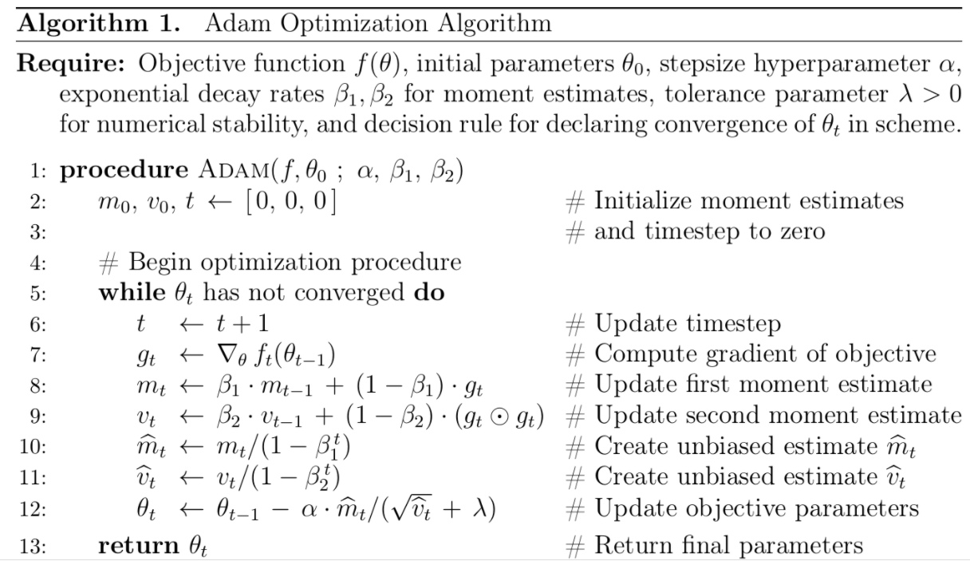
Adam Optimization Algorithm
(Adaptive Moment estimation)
https://www.math.purdue.edu/~nwinovic/deep_learning_optimization.html
https://www.researchgate.net/figure/Adam-optimizer-algorithm_fig2_339075038
m initialized as 0 at the beginning

Slide 84

ADAM optimization algorithm/code https://towardsdatascience.com/adam-latest-trends-in-deep-learning-optimization-6be9a291375c https://www.geeksforgeeks.org/intuition-of-adam-optimizer/
Background:
  w=weights, g=$\frac{ΔE}{Δw}$ is the gradient on current mini-batch , α=learning rate=step size
  Classical learning method we studied is w=w-αg
Adam algo: Using momentum and Root Mean Square Propagation .
Can handle sparse gradients on noisy problems. m initialized as 0 at beginning
for t in range(num_iterations), or w converges:
g = compute_gradient(x, y)
m = beta_1 * m + (1 - beta_1) * g
v = beta_2 * v + (1 - beta_2) * np.power(g, 2)
m_hat = m / (1 - np.power(beta_1, t))
v_hat = v / (1 - np.power(beta_2, t))
w = w - step_size * m_hat / (np.sqrt(v_hat) + epsilon)
Adam takes consideration of past history of g
Example:
beta_1(β1) ≈ 0.9
beta_2 (β2)≈ 0.999
step_size(α) ≈0.001
epsilon(ε) ≈ 10^-8
compare
Python code with numpy
np.sqrt(x)=x², np.power(a,b)=a^{b}
Ref:
https://www.quora.com/What-is-an-intuitive-explanation-of-the-Adam-deep-learning-optimization-algorithm
https://medium.com/@nishantnikhil/adam-optimizer-notes-ddac4fd7218
https://sefiks.com/2018/06/23/the-insiders-guide-to-adam-optimization-algorithm-for-deep-learning/

Slide 85
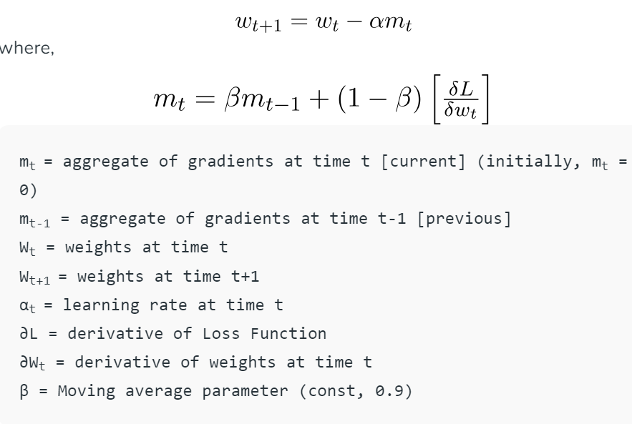

ADAM: Idea of Momentum
https://www.geeksforgeeks.org/intuition-of-adam-optimizer/
is used to accelerate the gradient descent algorithm by taking into consideration the ‘exponentially weighted average’ of the gradients. Using averages makes the algorithm converge towards the minima in a faster pace.
Gradient g= $\frac{ΔE}{Δw}$

Slide 86
Summary
Studied what is Back Propagation Neural Networks (BPNN)
Studied the forward pass
Studied how to back propagate data during training of the BPNN network
Studied implementation issues of neural BPNN networks

Slide 87
References
Wiki
  http://en.wikipedia.org/wiki/Backpropagation
  http://en.wikipedia.org/wiki/Convolutional_neural_network
Matlab programs
  Neural Network for pattern recognition- Tutorial http://www.mathworks.com/matlabcentral/fileexchange/19997-neural-network-for-pattern-recognition-tutorial
  CNN Matlab example http://www.mathworks.com/matlabcentral/fileexchange/38310-deep-learning-toolbox
Open source library
  Tensor flow: http://www.geekwire.com/2015/google-open-sources-tensorflow-machine-learning-system-offering-its-neural-network-to-outside-developers/

Slide 88
Appendices

Slide 89
Appendix1a:
These 3 variants of Gradient Descent
  Batch Gradient Descent (BGD)
  Stochastic Gradient Descent (SGD)
  Mini-Batch Gradient Descent (mBGD)
References
  https://towardsdatascience.com/batch-mini-batch-and-stochastic-gradient-descent-for-linear-regression-9fe4eefa637c
  https://optimization.cbe.cornell.edu/index.php?title=Stochastic_gradient_descent

Slide 90
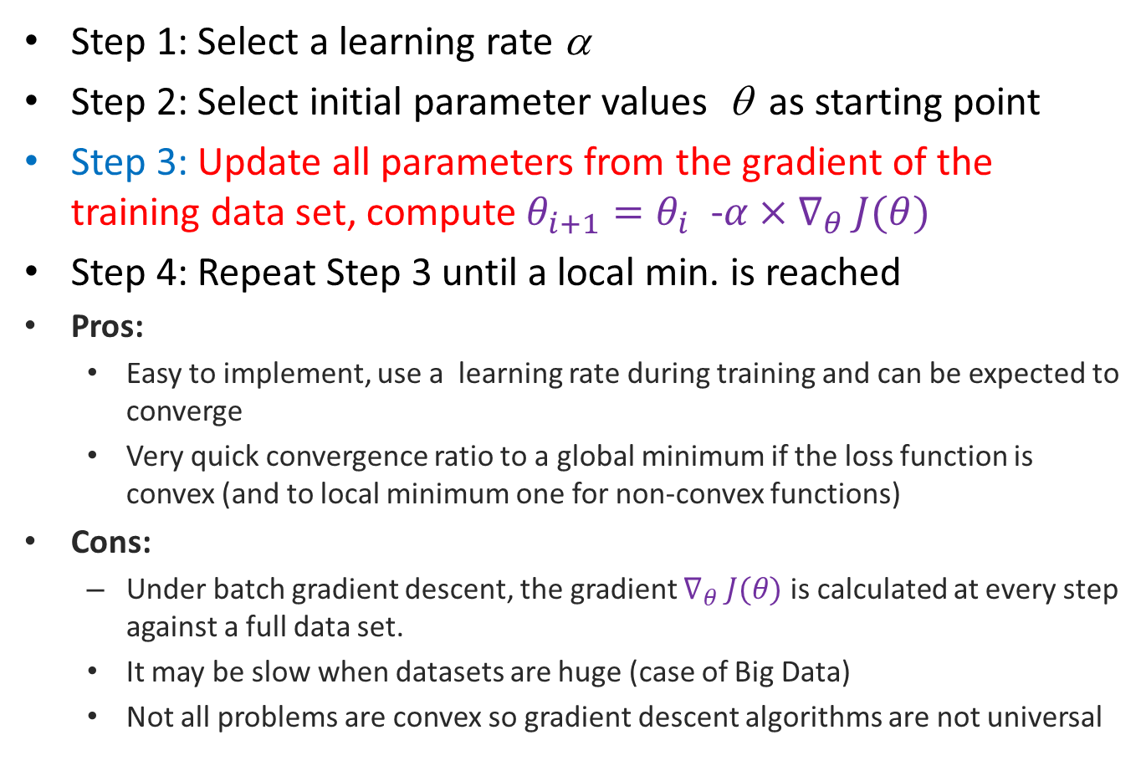
(i) Batched Gradient descent (BGD)
Step 1: Select a learning rate α
Step 2: Select initial parameter values θ as starting point
Step 3: Update all parameters from the gradient of the training data set, compute$θ_{i+1}=θ_{i}$ -$α×∇_{θ} J(θ)$
Step 4: Repeat Step 3 until a local min. is reached
Pros:
  Easy to implement, use a learning rate during training and can be expected to converge
  Very quick convergence ratio to a global minimum if the loss function is convex (and to local minimum one for non-convex functions)
Cons:
  Under batch gradient descent, the gradient $∇_{θ} J(θ)$ is calculated at every step against a full data set.
  It may be slow when datasets are huge (case of Big Data)
  Not all problems are convex so gradient descent algorithms are not universal

Slide 91
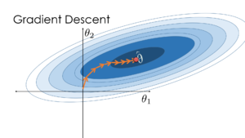
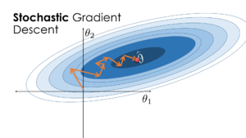
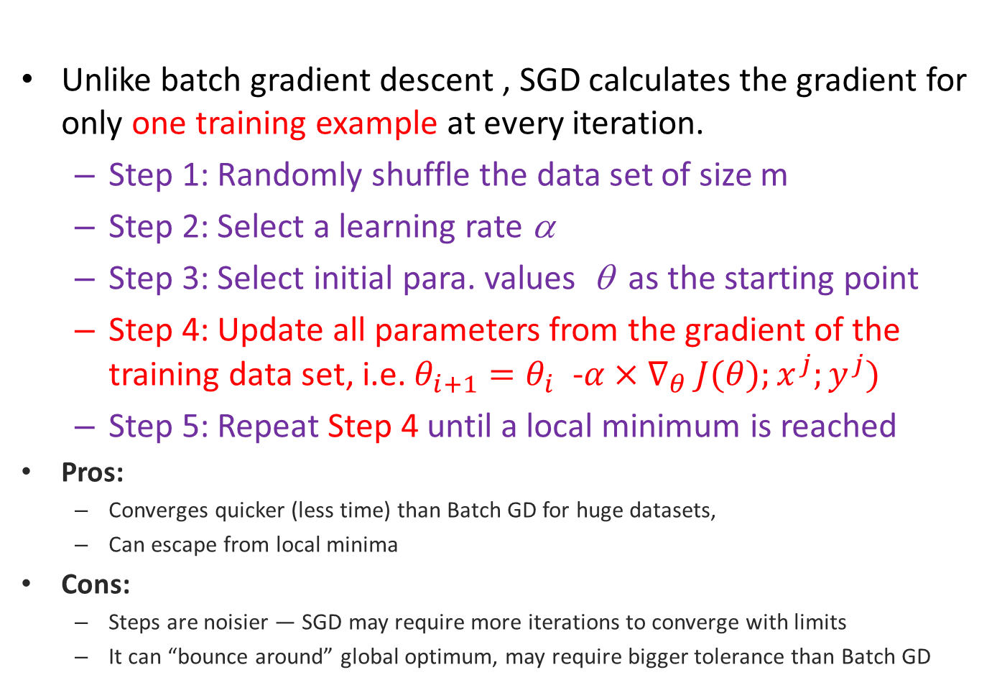
(ii) Stochastic Gradient Descent (SGD)
v.s.
Unlike batch gradient descent , SGD calculates the gradient for only one training example at every iteration.
  Step 1: Randomly shuffle the data set of size m
  Step 2: Select a learning rate α
  Step 3: Select initial para. values θ as the starting point
  Step 4: Update all parameters from the gradient of the training data set, i.e. $θ_{i+1}=θ_{i}$ -$α×∇_{θ} J(θ);x^{j};y^{j})$
  Step 5: Repeat Step 4 until a local minimum is reached
Pros:
  Converges quicker (less time) than Batch GD for huge datasets,
  Can escape from local minima
Cons:
  Steps are noisier — SGD may require more iterations to converge with limits
  It can “bounce around” global optimum, may require bigger tolerance than Batch GD
(Classical GD)
(Stochastic GD)

Slide 92
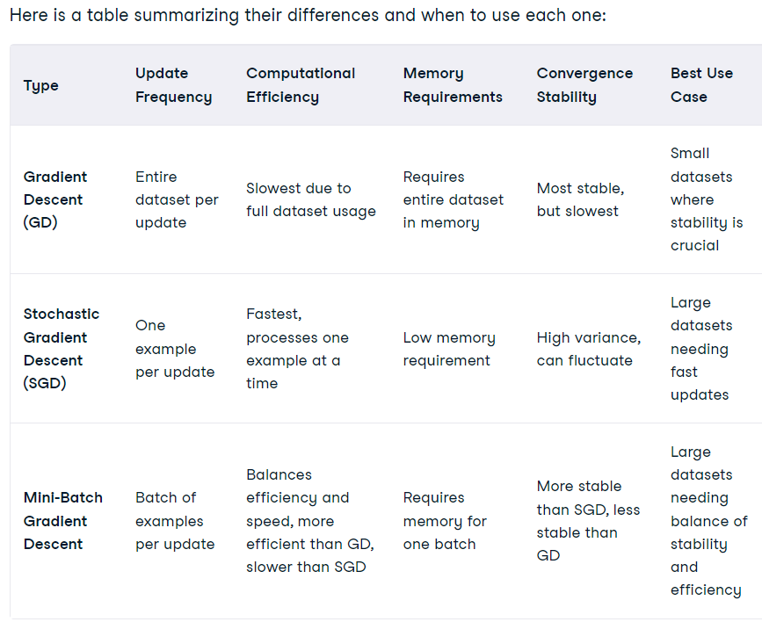
https://www.datacamp.com/tutorial/stochastic-gradient-descent

Slide 93
(iii) Mini-Batch Gradient Descent mBGD
(in between BGD and SDG)
The steps for performing mini-batch gradient descent are identical to SGD with one exception - when updating the parameters from the gradient, rather than calculating the gradient of a single training example, the gradient is calculated against a batch size of n (n < full data set) training examples, i.e. compute
Pros:
  A good balance between BGD and SGD in terms of efficiency
  Easily fits into computer memory
  Can escape from local minimums
Cons:
  It can still “bounce around” global optimum — it may require bigger tolerance than Batch GD but smaller than SGD
  One more hyper-parameter to optimize — a batch size
$θ_{i+1}=θ_{i}$ -$α×∇_{θ} J(θ;x^{j};y^{j})$

Slide 94
Appendix 1b
Using softmax with cross-entropy_loss
for a 2-class classifier (single output neuron)
https://www.ics.uci.edu/~pjsadows/notes.pdf

Slide 95


Slide 96


Slide 97
Appendix 2:
Recurrent-dropout in LSTM https://medium.com/@bingobee01/a-review-of-dropout-as-applied-to-rnns-72e79ecd5b7b
Like Moon et al., (2015) and Gal and Ghahramani (2015), Semeniuta et al., (2016) proposed applying dropout to the recurrent connections of RNN’s so that recurrent weights could be regularized to improve performance.
Apply dropout out in Dotted lines

Slide 98
Appendix 3: Return sequences in tensorflow-keras
Return sequences refer to return the hidden state a^{<t>}. By default, the return_sequences is set to False in Keras RNN layers, and this means the RNN layer will only return the last hidden state output a^{<T>}. The last hidden state output captures an abstract representation of the input sequence. In some case, it is all we need, such as a classification or regression model where the RNN is followed by the Dense layer(s) to generate logits for news topic classification or score for sentiment analysis, or in a generative model to produce the softmax probabilities for the next possible char.
In other cases, we need the full sequence as the output. Setting return_sequences to True is necessary.
https://www.dlology.com/blog/how-to-use-return_state-or-return_sequences-in-keras/

Slide 99
Appendix 4:
BNPP example in matlab
  Based on Neural Network for pattern recognition- Tutorial http://www.mathworks.com/matlabcentral/fileexchange/19997-neural-network-for-pattern-recognition-tutorial

Slide 100
Example: a simple BPNN
Number of classes (no. of output neurons)=3
Input 9 pixels: each input is a 3x3 image
Training samples =3 for each class
Number of hidden layers =1
Number of neurons in the hidden layer =5

Slide 101
Display of testing patterns
Testing patterns , recognition rate = 8/9=88.8889

Slide 102
Architecture
P(i=1)
ω^{l=1}(i=1,j=1)
A1
ω 2(j=1,k=1)
A_{2(k=2)}
ω^{l=1}(i=2,j=1)
Neuron j=1
Bias=b1(j=1)
A₁(j=1)
ω 2(j=2,k=1)
Neuron k=1
Bias=b2(k=1)
P(i=2)
A2
P(i=9)
ω^{l=1}(i=9,j=1)
A5
ω 2(j=5,k=1)
P(i=1)
P(i=2)
P(i=3)
:
:
P(i=9)
ω ^{l=1}(i=i,j=1)
A1(j=1)
ω ^{l=2}(j=1,k=1)
ω ^{l=1}(i=2,j=1)
A1(j=2)
ω ^{l=2}(j=2,k=1)
ω ^{l=2}(j=2,k=2)
ω^{l=1}i(j=3,j=4)
ω ^{l=2}(j=5,k=3)
A2:layer2, 3 Output neurons
indexed by k
W^{l=2}=5x3
b^{l=2}=3x1
A1(j=5)
ω ^{l=1}(i=9,j=5)
A1: Hidden layer1 =5 neurons, indexed by j
W^{l=1}=9x5
b^{l=1}=5x1
Input:
P=9x1
Indexed by j
Layer l=1
Layer l=2
←S2 generated
←S1 generated

Slide 103
bnpp(version).m program listing
%source : http://www.mathworks.com/matlabcentral/fileexchange/19997-neural-network-for-pattern-recognition-tutorial
%khw bpnn_v201004.m 2020 oct 4,
function ann()
clear memory %comments added by kh wong
clear all
clc
nump=3; % number of classes
n=3; % number of images per class
% training images reshaped into columns in P
% image size (3x3) reshaped to (1x9)
% training images set A
%sample , data set A, you may create another testing set
% <--class 1--> <--class 2--> <--class 3---->
% 1, 2, 3, 4, 5, 6, 7, 8, 9 <= sample index
PA=[196 188 246 255 234 232 25 24 22
35 15 48 223 255 255 53 25 35
234 236 222 224 205 231 224 205 231
232 244 225 255 251 247 255 251 247
59 44 40 10 12 38 15 10 38
244 228 226 255 251 246 25 25 24
243 251 208 249 238 190 249 238 190
57 48 35 255 253 236 55 53 36
226 230 234 235 240 250 235 240 250];
34 44 64 237 228 239 235 240 250];
P=PA;
N=P+round(rand(9,9)*50); %add noise to create the testing samples
% Normalization, to make each pixel value 0->1
P=(P/256);
N=(N/256);
Training patterns

Slide 104
% display the training images
figure(1),
for i=1:n*nump
im=reshape(P(:,i), [3 3]);
%remove theline below to reflect the truth data input
% im=imresize(im,20); % resize the image to make it clear
subplot(nump,n,i),imshow(im);…
title(strcat('Train image/Class #', int2str(ceil(i/n))))
end
% display the testing images
figure,
for i=1:n*nump
im=reshape(N(:,i), [3 3]);
% remove theline below to reflect the truth data input
% im=imresize(im,20); % resize the image to make it clear
subplot(nump,n,i),imshow(im);title(strcat('test image #', int2str(i)))
end

Slide 105
% targets
T=[ 1 1 1 0 0 0 0 0 0
0 0 0 1 1 1 0 0 0
0 0 0 0 0 0 1 1 1 ];
S1=5; % numbe of hidden layers
S2=3; % number of output layers (= number of classes)
[R,Q]=size(P);
epochs = 10000; % number of iterations
goal_err = 10e-5; % goal error
a=0.3; % define the range of random variables
b=-0.3;
W1=a + (b-a) *rand(S1,R); % Weights between Input and Hidden Neurons
W2=a + (b-a) *rand(S2,S1); % Weights between Hidden and Output Neurons
b1=a + (b-a) *rand(S1,1); % Weights between Input and Hidden Neurons
b2=a + (b-a) *rand(S2,1); % Weights between Hidden and Output Neurons
n1=W1*P;
A1=logsig(n1); %feedforward the first time
n2=W2*A1;
A2=logsig(n2);%feedforward the first time
e=A2-T; %actually e=T-A2 in main loop
error =0.5* mean(mean(e.*e)); % better say e=T-A2 , but no harm to error here
nntwarn off

Slide 106


A1 A2 e T
S2 deals with output neurons (case1)
A2=x_{j}
S2= 1*diag(df2)*e
for itr =1:epochs
if error <= goal_err
break
else
for i=1:Q %i is index to a column in P(9x9), for each column of P ( P:,i)
%df1=dlogsig(n1,A1(:,i)); % derivative of A1
df1=A1(:,i).*(1-A1(:,i)); % derivative of A1
%df2=dlogsig(n2,A2(:,i));% derivative of A1
df2=A2(:,i).*(1-A2(:,i)); % derivative of A1
s2 = 1*diag(df2) * e(:,i); %e=A2-T; df2=f’=f(1-f) of layer2
s1 = diag(df1)* W2'* s2; % eq(3),feedback, from s2 to S1
W2 = W2-0.1*s2*A1(:,i)'; %learning rate=0.1, equ(2) output case
b2 = b2-0.1*s2; %threshold
W1 = W1-0.1*s1*P(:,i)';% update W1 in layer 1, see equ(3) hidden case
b1 = b1-0.1*s1;%threshold
A1(:,i)=logsig(W1*P(:,i)+b1);%forward again
A2(:,i)=logsig(W2*A1(:,i)+b2);%forward again
end
e = A2-T ; % for this e, put -ve sign for finding s2
error =0.5*mean(mean(e.*e));
disp(sprintf('Iteration :%5d mse :%12.6f%',itr,error));
mse(itr)=error;
end
end
P W1 W2 A2
s_{i}x_{j}=S2 A2
e=(A2-T)
A2=output neurons, T=target
S1 deals with hidden neurons (case2)
S1=
s2
A1
diag(df1)*W2’

Slide 107
threshold=0.9; % threshold of the system (higher threshold = more accuracy)
% training images result
%TrnOutput=real(A2)
TrnOutput=real(A2>threshold)
% applying test images to NN , TESTING BEGINS HERE
n1=W1*N;
A1=logsig(n1);
n2=W2*A1;
A2test=logsig(n2);
% testing images result
%TstOutput=real(A2test)
TstOutput=real(A2test>threshold)
% recognition rate
wrong=size(find(TstOutput-T),1);
recognition_rate=100*(size(N,2)-wrong)/size(N,2)
% end of code

Slide 108

Result of the program mse error vs. itr (epoch iteration)

Slide 109
Bnpp_v201004.m
Can display weight (see line 118)
%source : http://www.mathworks.com/matlabcentral/fileexchange/19997-neural-network-for-pattern-recognition-tutorial
%khw bpnn_v201004.m 2020 oct 4,
function ann()
clear memory %comments added by kh wong
clear all
clc
nump=3; % number of classes
n=3; % number of images per class
% training images reshaped into columns in P
% image size (3x3) reshaped to (1x9)
% training images set A
%sample , data set A, you may create another testing set
% <--class 1--> <--class 2--> <--class 3---->
% 1, 2, 3, 4, 5, 6, 7, 8, 9 <= sample index
PA=[196 188 246 255 234 232 25 24 22
35 15 48 223 255 255 53 25 35
234 236 222 224 205 231 224 205 231
232 244 225 255 251 247 255 251 247
59 44 40 10 12 38 15 10 38
244 228 226 255 251 246 25 25 24
243 251 208 249 238 190 249 238 190
57 48 35 255 253 236 55 53 36
226 230 234 235 240 250 235 240 250];
% training images set 2
%sample , data set A, you may create another testing set
% <--class 1--> <--class 2--> <--class 3---->
% 1, 2, 3, 4, 5, 6, 7, 8, 9 <= sample index
PB=[50 20 50 255 215 250 25 24 22
30 23 23 2 12 22 53 25 35
25 5 65 222 232 251 224 205 231
215 180 180 250 235 245 255 251 247
225 212 244 224 234 245 15 10 38
231 203 221 264 225 205 25 25 24
31 18 38 3 3 6 249 238 190
22 22 62 12 32 22 55 53 36
34 44 64 237 228 239 235 240 250];
P=PA;
N=P+round(rand(9,9)*50); %add noise to create the testing samples
% Normalization, to make each pixel value 0->1
P=(P/256);
N=(N/256);
% targets
% <-class 1-> <-class 2-> <-class 3->
% 1, 2, 3, 4, 5, 6, 7, 8, 9 <= sample index
T=[ 1 1 1 0 0 0 0 0 0 %<=target at output neuron 1
0 0 0 1 1 1 0 0 0 %<=target at output neuron 2
0 0 0 0 0 0 1 1 1 ]; %<=target at output neuron 3
S1=5; % number of neurons in the hidden layer
S2=3; % number of neurons in the output layer (= number of classes)
[R,Q]=size(P);
epochs = 10000; % number of iterations
goal_err = 10e-5; % goal error
a=0.3; % define the range of random variables
b=-0.3;
W1=a + (b-a) *rand(S1,R); % Weights between Input and Hidden Neurons
W2=a + (b-a) *rand(S2,S1); % Weights between Hidden and Output Neurons
b1=a + (b-a) *rand(S1,1); % Weights between Input and Hidden Neurons
b2=a + (b-a) *rand(S2,1); % Weights between Hidden and Output Neurons
n1=W1*P;
A1=logsig(n1); %feedforward the first time
n2=W2*A1;
A2=logsig(n2);%feedforward the first time
e=A2-T; %actually e=T-A2 in main loop
error =0.5* mean(mean(e.*e)); % better say e=T-A2 , but no harm to error here
nntwarn off
%%%%%%%%%%%%%%%%%%%%%%----------------%%%%%%%%%%%%%%%%%%%%%%%%%%
save data1; %save data for ananlysis
load data1; %load data for analysis to avoid random data, remove if needed
% display the training and testing images
%DDDDDDDDDDDDDDDDDDDDDDDDDDDDDDDDDDDDDDDDDDDDDDDDDD
figure(1)
clf
for i=1:n*nump
im=reshape(P(:,i), [3 3]);
%remove theline below to reflect the truth data input
% im=imresize(im,20); % resize the image to make it clear
subplot(nump,n,i),imshow(im);
%title(strcat('Train image/Class #,', int2str(ceil(i/n)),num2str(T(:,i))));
title({
[strcat('Train image # ',num2str(i) )]
['class=[', num2str( T(:,i)'),']']
});
% title(strcat('Train image ',num2str(i),'class=', num2str( T(:,i)')));
end
%%%%%%%%%%%%%%%%%% start training ////////////////
for itr =1:epochs
if error <= goal_err
break
else
for i=1:Q % for each column of P ( P:,i), i =input sample index
%weights/biases updated every sample=mini-batch size1=online_training
%df1=dlogsig(n1,A1(:,i)); % derivative of A1,5x1
df1=A1(:,i).*(1-A1(:,i)); % derivative of A1,5x1
%df2=dlogsig(n2,A2(:,i));% derivative of A1,3x1
df2=A2(:,i).*(1-A2(:,i)); % derivative of A1,3x1
s2 = 1*diag(df2) * e(:,i); %e=A2-T; df2=f’=f(1-f) of layer2, 5x1
s1 = diag(df1)* W2'* s2; % eq(3),feedback, from s2 to S1
W2 = W2-0.1*s2*A1(:,i)'; %learnRate=0.1,equ(2) output case, 3x9
b2 = b2-0.1*s2; %threshold , 3x1
W1 = W1-0.1*s1*P(:,i)';%update W1, hidden-to-hidden case2, 5x9
b1 = b1-0.1*s1;%threshold , 3x1
A1(:,i)=logsig(W1*P(:,i)+b1);%forward again, 5x1
A2(:,i)=logsig(W2*A1(:,i)+b2);%forward again, 3x1
% i is sample index, P(:,i) is 9x1 input pixels
% P(:,i)=9x1, df1=5x1, df2=3x1, s1=5x1, s2=3x1, W1=5x9 , W2=3x5,
% b1=5x1, b2=3x1, A1(:,i)=5x1, A2(:,i)=3x1
% show_table1(i,P(:,i),df1,df2,s1,s2,W1,W2,b1,b2,A1(:,i),A2(:,i),T(:,i));
end
e = A2-T ; % for this e, put -ve sign for finding s2
error =0.5*mean(mean(e.*e));
disp(sprintf('Iteration :%5d mse :%12.6f%',itr,error));
mse(itr)=error;
end
%disp('just finished one sample of training, hit key to continue');
% pause
end
threshold=0.9; % threshold of the system (higher threshold = more accuracy)
% training images result
%TrnOutput=real(A2)
TrnOutput=real(A2>threshold)
% applying test images to NN , TESTING BEGINS HERE
n1=W1*N;
A1=logsig(n1);
n2=W2*A1;
A2test=logsig(n2);
% testing images result
%TstOutput=real(A2test)
TstOutput=real(A2test>threshold)
%DDDDDDDDDDDDDDDDDDDDDD2222222222222222222
% display the testing images
figure(2)
clf
for i=1:n*nump
im=reshape(N(:,i), [3 3]);
% remove theline below to reflect the truth data input
% im=imresize(im,20); % resize the image to make it clear
subplot(nump,n,i),imshow(im);
%title(strcat('test image #', int2str(i)))
title({
[strcat('Test image # ',num2str(i) )]
['class found=[', num2str( TstOutput(:,i)'),']']
});
end
% recognition rate
wrong=size(find(TstOutput-T),1);
recognition_rate=100*(size(N,2)-wrong)/size(N,2)
% end of code
figure(4)
clf
plot(mse)
ylabel('error mse')
xlabel('epoch')
title('back propagation demo')
% i is sample index, P(:,i) is 9x1 input pixels
% P(:,i)=9x1, df1=5x1, df2=3x1, s1=5x1, s2=3x1, W1=5x9 , W2=3x5,
% b1=5x1, b2=3x1, A1(:,i)=5x1, A2(:,i)=3x1
function show_table1(i,P_val,df1,df2,s1,s2,W1,W2,b1,b2,A1_vec,A2_vec,T_i)
InputIndex = {'1';'2';'3';'4';'5';'6';'7';'8';'9'};
InputP=P_val;
T_val=[T_i;nan;nan;nan;nan;nan;nan];
W1_1=W1(1,:)';
W1_2=W1(2,:)';
W1_3=W1(3,:)';
W1_4=W1(4,:)';
W1_5=W1(5,:)';
W2_1=[W2(1,:)';nan;nan;nan;nan];
W2_2=[W2(2,:)';nan;nan;nan;nan];
W2_3=[W2(3,:)';nan;nan;nan;nan];
df1_val=[df1;nan;nan;nan;nan];
df2_val=[df2;nan;nan;nan;nan;nan;nan];
s1_val=[s1;nan;nan;nan;nan];
s2_val=[s2;nan;nan;nan;nan;nan;nan];
Bias1_val=[b1;nan;nan;nan;nan];
Bias2_val=[b2;nan;nan;nan;nan;nan;nan];
A1_val=[A1_vec;nan;nan;nan;nan];
A2_val=[A2_vec;nan;nan;nan;nan;nan;nan];
Err=[ norm(A2_vec - T_i) ;nan;nan;nan;nan;nan;nan;nan;nan];
figure(2)
clf
%Weight = [71;69;64;67;64;nan;nan;nan;nan];
%T = table(InputP,W1_1,W1_2,W1_1,W1_3,W1_4,W1_5,Bias1_val,Bias2_val,A1_1,A2_1,'RowNames',InputIndex);
T1 = table(InputP,W1_1,W1_2,W1_3,W1_4,W1_5,df1_val,s1_val,Bias1_val,A1_val,'RowNames',InputIndex);
uitable('Data',T1{:,:},'ColumnName',T1.Properties.VariableNames,...
'RowName',T1.Properties.RowNames,'Units', 'Normalized', ...
'Position',[0, 0, 1, 1]);
title('forward pass A1');
figure(3)
clf
%T2 = table(W2_1,W2_2,W2_3,W2_4,W2_5,df2_val,s2_val,Bias2_val,A2_val,T_val,'RowNames',InputIndex);
T2 = table(W2_1,W2_2,W2_3,df2_val,s2_val,Bias2_val,A2_val,Err,T_val,'RowNames',InputIndex);
uitable('Data',T2{:,:},'ColumnName',T2.Properties.VariableNames,...
'RowName',T2.Properties.RowNames,'Units', 'Normalized', ...
'Position',[0, 0, 1, 1]);
% 'hit key'
% pause

Slide 110
Matlab code,bnpp2c1.m (old version)
%source : http://www.mathworks.com/matlabcentral/fileexchange/19997-neural-network-for-pattern-recognition-tutorial
%khw 2017 aug 23
clear memory %comments added by kh wong
clear all
clc
nump=3; % number of classes
n=3; % number of images per class
% training images reshaped into columns in P
% image size (3x3) reshaped to (1x9)
% training images set 1
% P1=[196 35 234 232 59 244 243 57 226; ...
% 188 15 236 244 44 228 251 48 230; ... % class 1
% 246 48 222 225 40 226 208 35 234; ...
%
% 255 223 224 255 0 255 249 255 235; ...
% 234 255 205 251 0 251 238 253 240; ... % class 2
% 232 255 231 247 38 246 190 236 250; ...
%
% 25 53 224 255 15 25 249 55 235; ...
% 24 25 205 251 10 25 238 53 240; ... % class 3
% 22 35 231 247 38 24 190 36 250]';
% training images set 2
P2=[50 30 25 215 225 231 31 22 34; ... %class1: 1st tranining sample
20 23 5 180 212 203 18 22 44; ... %class1, 2nd tranining sample
50 23 65 180 244 221 38 62 64; ... %class1, 2nd tranining sample
255 2 222 250 224 264 3 12 237; ...
215 12 232 235 234 225 3 32 228; ...
250 22 251 245 245 205 6 22 239; ...
25 53 224 255 15 25 249 55 235; ...
24 25 205 251 10 25 238 53 240; ... % class 3
22 35 231 247 38 24 190 36 250]';
P=P2; %select which set you want to use for traning, khw v15
% testing images
% N=[208 16 235 255 44 229 236 34 247; ...
% 245 21 213 254 55 252 215 51 249; ... % class 1
% 248 22 225 252 30 240 242 27 244; ...
%
% 255 241 208 255 28 255 194 234 188; ...
% 237 243 237 237 19 251 227 225 237; ... % class 2
% 224 251 215 245 31 222 233 255 254; ...
%
% 25 21 208 255 28 25 194 34 188; ...
% 27 23 237 237 19 21 227 25 237; ... % class 3
% 24 49 215 245 31 22 233 55 254]';
N2=P2+round(rand(9,9)*50); %add noise
N=N2;
%'press any key to continue'
%pause
% Normalization
P=P/256;
N=N/256;
% display the training images
figure(1),
clf
for i=1:n*nump
im=reshape(P(:,i), [3 3]);
%remove theline below to reflect the truth data input
% im=imresize(im,20); % resize the image to make it clear
subplot(nump,n,i),imshow(im);
title(strcat('Train image/Class #', int2str(ceil(i/n))))
end
% display the testing images
figure(2)
clf
for i=1:n*nump
im=reshape(N(:,i), [3 3]);
% remove theline below to reflect the truth data input
% im=imresize(im,20); % resize the image to make it clear
subplot(nump,n,i),imshow(im);title(strcat('test image #', int2str(i)))
end
% targets
T=[ 1 1 1 0 0 0 0 0 0
0 0 0 1 1 1 0 0 0
0 0 0 0 0 0 1 1 1 ];
S1=5; % number of neurons in the hidden layer
S2=3; % number of neurons in the output layer (= number of classes)
[R,Q]=size(P);
epochs = 10000; % number of iterations
goal_err = 10e-5; % goal error
a=0.3; % define the range of random variables
b=-0.3;
W1=a + (b-a) *rand(S1,R); % Weights between Input and Hidden Neurons
W2=a + (b-a) *rand(S2,S1); % Weights between Hidden and Output Neurons
b1=a + (b-a) *rand(S1,1); % Weights between Input and Hidden Neurons
b2=a + (b-a) *rand(S2,1); % Weights between Hidden and Output Neurons
n1=W1*P;
A1=logsig(n1); %feedforward the first time
n2=W2*A1;
A2=logsig(n2);%feedforward the first time
e=A2-T; %actually e=T-A2 in main loop
error =0.5* mean(mean(e.*e)); % better say e=T-A2 , but no harm to error here
nntwarn off
for itr =1:epochs
if error <= goal_err
break
else
for i=1:Q %i is index to a column in P(9x9), for each column of P ( P:,i)
%df1=dlogsig(n1,A1(:,i)); % derivative of A1
df1=A1(:,i).*(1-A1(:,i)); % derivative of A1
%df2=dlogsig(n2,A2(:,i));% derivative of A1
df2=A2(:,i).*(1-A2(:,i)); % derivative of A1
s2 = 1*diag(df2) * e(:,i); %e=A2-T; df2=f’=f(1-f) of layer2
s1 = diag(df1)* W2'* s2; % eq(3),feedback, from s2 to S1
W2 = W2-0.1*s2*A1(:,i)'; %learning rate=0.1, equ(2) output case
b2 = b2-0.1*s2; %threshold
W1 = W1-0.1*s1*P(:,i)';% update W1 in layer 1, see equ(3) hidden case
b1 = b1-0.1*s1;%threshold
A1(:,i)=logsig(W1*P(:,i)+b1);%forward again
A2(:,i)=logsig(W2*A1(:,i)+b2);%forward again
end
e = A2-T ; % for this e, put -ve sign for finding s2
error =0.5*mean(mean(e.*e));
disp(sprintf('Iteration :%5d mse :%12.6f%',itr,error));
mse(itr)=error;
end
end
threshold=0.9; % threshold of the system (higher threshold = more accuracy)
% training images result
%TrnOutput=real(A2)
TrnOutput=real(A2>threshold)
% applying test images to NN , TESTING BEGINS HERE
n1=W1*N;
A1=logsig(n1);
n2=W2*A1;
A2test=logsig(n2);
% testing images result
%TstOutput=real(A2test)
TstOutput=real(A2test>threshold)
% recognition rate
wrong=size(find(TstOutput-T),1);
recognition_rate=100*(size(N,2)-wrong)/size(N,2)
% end of code
figure(1)
clf
plot(mse)
ylabel('error mse')
xlabel('epoch')
title('back propagation demo')
%source : http://www.mathworks.com/matlabcentral/fileexchange/19997-neural-network-for-pattern-recognition-tutorial
%khw 2020.Aug.9
clear memory %comments added by kh wong
clear all
clc
nump=3; % number of classes
n=3; % number of images per class
% training images reshaped into columns in P
% image size (3x3) reshaped to (1x9)
% training images set 1
% P1=[196 35 234 232 59 244 243 57 226; ...
% 188 15 236 244 44 228 251 48 230; ... % class 1
% 246 48 222 225 40 226 208 35 234; ...
%
% 255 223 224 255 0 255 249 255 235; ...
% 234 255 205 251 0 251 238 253 240; ... % class 2
% 232 255 231 247 38 246 190 236 250; ...
%
% 25 53 224 255 15 25 249 55 235; ...
% 24 25 205 251 10 25 238 53 240; ... % class 3
% 22 35 231 247 38 24 190 36 250]';
% training images set 2
P2=[50 30 25 215 225 231 31 22 34; ... %class1: 1st tranining sample
20 23 5 180 212 203 18 22 44; ... %class1, 2nd tranining sample
50 23 65 180 244 221 38 62 64; ... %class1, 2nd tranining sample
255 2 222 250 224 264 3 12 237; ...
215 12 232 235 234 225 3 32 228; ...
250 22 251 245 245 205 6 22 239; ...
25 53 224 255 15 25 249 55 235; ...
24 25 205 251 10 25 238 53 240; ... % class 3
22 35 231 247 38 24 190 36 250]';
P=P2; %select which set you want to use for traning, khw v15
% testing images
% N=[208 16 235 255 44 229 236 34 247; ...
% 245 21 213 254 55 252 215 51 249; ... % class 1
% 248 22 225 252 30 240 242 27 244; ...
%
% 255 241 208 255 28 255 194 234 188; ...
% 237 243 237 237 19 251 227 225 237; ... % class 2
% 224 251 215 245 31 222 233 255 254; ...
%
% 25 21 208 255 28 25 194 34 188; ...
% 27 23 237 237 19 21 227 25 237; ... % class 3
% 24 49 215 245 31 22 233 55 254]';
%N2=P2+round(rand(9,9)*50); %add noise
N2=P2; %no random noise, make very run the same.
N=N2;
%'press any key to continue'
%pause
% Normalization
P=P/256;
N=N/256;
% display the training images
figure(1),
clf
for i=1:n*nump
im=reshape(P(:,i), [3 3]);
%remove theline below to reflect the truth data input
% im=imresize(im,20); % resize the image to make it clear
subplot(nump,n,i),imshow(im);
title(strcat('Train image/Class #', int2str(ceil(i/n))))
end
% display the testing images
figure(2)
clf
for i=1:n*nump
im=reshape(N(:,i), [3 3]);
% remove theline below to reflect the truth data input
% im=imresize(im,20); % resize the image to make it clear
subplot(nump,n,i),imshow(im);title(strcat('test image #', int2str(i)))
end
% targets
T=[ 1 1 1 0 0 0 0 0 0
0 0 0 1 1 1 0 0 0
0 0 0 0 0 0 1 1 1 ];
S1=5; % number of neurons in the hidden layer
S2=3; % number of neurons in the output layer (= number of classes)
[R,Q]=size(P);
epochs = 10000; % number of iterations
goal_err = 10e-5; % goal error
a=0.3; % define the range of random variables
b=-0.3;
% W1=a + (b-a) *rand(S1,R); % Weights between Input and Hidden Neurons
% W2=a + (b-a) *rand(S2,S1); % Weights between Hidden and Output Neurons
% b1=a + (b-a) *rand(S1,1); % Weights between Input and Hidden Neurons
% b2=a + (b-a) *rand(S2,1); % Weights between Hidden and Output Neurons
%save('var1.mat','W1','W2','b1','b2');
load 'var1.mat';
n1=W1*P;
A1=logsig(n1); %feedforward the first time
n2=W2*A1;
A2=logsig(n2);%feedforward the first time
e=A2-T; %actually e=T-A2 in main loop
error =0.5* mean(mean(e.*e)); % better say e=T-A2 , but no harm to error here
nntwarn off
for itr =1:epochs
if error <= goal_err
break
else
for i=1:Q %i is index to a column in P(9x9), for each column of P ( P:,i)
%df1=dlogsig(n1,A1(:,i)); % derivative of A1
df1=A1(:,i).*(1-A1(:,i)); % derivative of A1
%df2=dlogsig(n2,A2(:,i));% derivative of A1
df2=A2(:,i).*(1-A2(:,i)); % derivative of A1
s2 = 1*diag(df2) * e(:,i); %e=A2-T; df2=fâ€™=f(1-f) of layer2
s1 = diag(df1)* W2'* s2; % eq(3),feedback, from s2 to S1
W2 = W2-0.1*s2*A1(:,i)'; %learning rate=0.1, equ(2) output case
b2 = b2-0.1*s2; %threshold
W1 = W1-0.1*s1*P(:,i)';% update W1 in layer 1, see equ(3) hidden case
b1 = b1-0.1*s1;%threshold
A1(:,i)=logsig(W1*P(:,i)+b1);%forward again
A2(:,i)=logsig(W2*A1(:,i)+b2);%forward again
end
e = A2-T ; % for this e, put -ve sign for finding s2
error =0.5*mean(mean(e.*e));
disp(sprintf('Iteration :%5d mse :%12.6f%',itr,error));
mse(itr)=error;
end
end
threshold=0.9; % threshold of the system (higher threshold = more accuracy)
% training images result
%TrnOutput=real(A2)
TrnOutput=real(A2>threshold)
% applying test images to NN , TESTING BEGINS HERE
n1=W1*N;
A1=logsig(n1);
n2=W2*A1;
A2test=logsig(n2);
% testing images result
%TstOutput=real(A2test)
TstOutput=real(A2test>threshold)
% recognition rate
wrong=size(find(TstOutput-T),1);
recognition_rate=100*(size(N,2)-wrong)/size(N,2)
% end of code
figure(1)
clf
plot(mse)
ylabel('error mse')
xlabel('epoch')
title('back propagation demo')

Slide 111
Linking up all layers
The previous discussion concentrates on output and one hidden later before the output layer. How to generalize it.
Let do this again using some higher level formulations, in general for two layers, the weight adjustment should be

Slide 112
X^{L-2}, X^{L-1} , X^{L}
W^{L-1} W^{L}
So during training after you initialized the weights and bias, and x,t are given, the rest can be calculated, Δw^{output_layer} can be found
:
:
:
Layer L-2, L-1, L
0.1
given
Can be calculated

Slide 113

$$\text{(}\text{revised} \text{on} \text{Feb}\text{5, 2021)}$$
$$l=L−1,(hidden_layer), \\ \text{For} \text{the} \text{hidden} \text{layer} l=L−1 \\ Δw^{l}=Δw^{L−1}=−η⋅x^{L−2}(δ^{L−1})^{T} \\ =−η⋅x^{L−2}(δ^{L−1})^{T},\text{from} (4) \text{of} [\text{Bouvrie}]^{} \\ δ^{L−1}=\left[{\left(w^{L−1+1}\right)}^{T}\right](δ^{L−1+1})^{T}∘f′(u^{L−1}),hence \\ Δw^{L−1}=−η⋅x^{L−2}{\left[{\left(w^{L−1+1}\right)}^{T}(δ^{L−1+1})^{T}∘f′(u^{L−1})\right]}^{T} \\ Δw^{L−1}=−η⋅x^{L−2}{\left[{\left(w^{L}\right)}^{T}(δ^{L})^{T}∘f′(u^{L−1})\right]}^{T} \\ \text{since} δ^{L}=f′(u^{L})∘(y^{n}−t^{n})−−(\text{see} \text{previous} \text{slide}), \\ Δw^{L−1}=−η⋅x^{L−2}{\left[{\left(w^{L}\right)}^{T}(f′(u^{L})∘(y^{n}−t^{n}))^{T}∘f′(u^{L−1})\right]}^{T} \\ \text{Can} \text{continue} \text{like} \text{this} \text{for} \text{all} \text{layers} \text{till} \text{layer} l=1$$

Slide 114
Appendix 5
Loss functions for different applications https://machinelearningmastery.com/loss-and-loss-functions-for-training-deep-learning-neural-networks/
Regression: to you predict a real-value quantity.
  Output Layer Configuration: One node with a linear activation unit.
  Loss Function: Mean Squared Error (MSE).(to be used here)
Binary Classification: to predict one of two classes.
    Output Layer Configuration: 1 node with sigmoid activation unit.
    Loss Function: Cross-Entropy, also referred to as Logarithmic loss.
Multi-Class Classification: to predict more than 2 classes
    Output Layer Configuration: One node for each class using the softmax activation function.
    Loss Function: Cross-Entropy, also referred to as Logarithmic loss.

Slide 115
Appendix 6
Further tutorial examples

Slide 116

Answer Ex9: Sigmoid function f(u)= logsig(u) and its derivative f’(u)=dlogsig(u)
http://mathworld.wolfram.com/SigmoidFunction.html
Logistic sigmoid (logsig)
https://kawahara.ca/how-to-compute-the-derivative-of-a-sigmoid-function-fully-worked-example/
http://link.springer.com/chapter/10.1007%2F3-540-59497-3_175#page-1

Slide 117
Answer Ex10.Case 1: if the neuron in between the output and the hidden layer
Definition
Output
t_{i}
Neuron n as an output neuron
Output
Sensitivity (S2)
s2 = 1*diag(df2) * e(:,i); %e=A2-T;
df2=f’=f(1-f) of layer2, in bnppx.m
http://cogprints.org/5869/1/cnn_tutorial.pdf

Slide 118
Answer: Ex11: Case2 : if neuron in between a hidden to hidden layer. We want to find
A1
Weight
Layer L
Indexed by k
S2= sensitivity of layer 2 neurons
df1
Output
layer
S1: sensitivity for layer 1 neurons
s1 = diag(df1)* W2'* s2; % eq(3),feedback, from s2 to S1 in bnppx.m

Slide 119
Exercise 12
Give the following diagram (in next slide) showing the parameters of part of a neural network at time k. Other neurons and weights exist but not shown.
The activation function of the neurons is sigmoid.
  Exercise 12a: Find the output [y1,y2]’ at time k.
  Exercise 12b: If the target code is [t1, t2]’=[1,0]’, and learning_rate=0.1 when training the neural network, find the new w11,w12,w13,w21,w22,w23 at time k+1.
  Exercise 12c: Find the new wh1 at time k+1. Assume all the weights will be updated together only after all delta weights (Δw) have been calculated for each epoch k.

Slide 120

Exercise 12:
y1 t1=1
y2 t2=0

Slide 121
Answer Ex12 (ver.2.1) by program
ANSWER:
First find A1=0.609
Answer 12a: all: [y1, y2]=[0.75318,0.740460]
Answer 12b: [new_w21,new_w22,new_w23,new_w21,new_w22,new_w23]=
...[0.602796, 0.351835, 0.303212,0.241327, 0.434308, 0.590039]
Answer 12c: in detail :d_wh1=-0.000192, new_wh1=0.299981
Answer 12c: Answer new_wh1=0.299981
clear
clc
% exercise 12 of lecture note
x=[0.1, 0.4,0.5];
wh=[0.3,0.1,0.35];
bh1=0.2;
learning_rate=0.1;
uh1=x*wh'+bh1;
A1=1/(1+exp(-uh1));
fprintf('First find A1=%3.3f\n',A1);
%A1 = 0.6094
%%%%%%%%%%%%%%%%%%%%%%%%%%%%%%%%%%%%%%%%
wh1=0.3;
A=[A1, 0.4,0.7];
w1=[0.6,0.35,0.3];
w2=[0.25,0.44,0.6];
b1=0.4;
b2=0.3;
%%%%%%%%%%%%%%%%%%%%%%%%%%%%%%%%%%%%%%%
% Q2.1a
u1=A*w1(1:3)'+b1;
%'y1= ';
fu1=1/(1+exp(-u1));
y1=fu1;
%%%%%%%%%%%%%%%%%%%%%%%
% Q2.1b
u2=A*w2(1:3)'+b2;
%'y2= '
fu2=1/(1+exp(-u2));
y2=fu2;
fprintf('Answer 12a: all: [y1, y2]=[%f,%f]\n\n',y1,y2);
%%%%%%%%%%%%%%%%%%%%%%%%%%%%%%%%%%%%%%%
%'now calculate back-propagation parameters'
%Q2.2.a
%dw1=(y-t)*f(u)*(1-f(u))*x
t1=1; %target for y1 output
for i=1:3
s1=(y1-t1)*fu1*(1-fu1);
dw1(i)= -s1*A(i);
new_w1(i)=w1(i)+learning_rate*dw1(i);
end
%%%%%%%%%%%%%%%%%%%
%Q2.2.b
t2= 0;%target for y2 output
for i=1:3
s2=(y2-t2)*fu2*(1-fu2);
dw2(i)= -s2*A(i);
new_w2(i)=w2(i)+learning_rate*dw2(i);
end
fprintf('Answer 12b: [new_w11,new_w12,new_w13,new_w21,new_w22,new_w23]=\n...[%f, %f, %f,%f, %f, %f]\n\n',new_w1(1),new_w1(2),new_w1(3),new_w2(1),new_w2(2),new_w2(3));
%part Q2.3
%d_wh1=-[s1 s2]*[w1(1),w2(1)]'*(uh1*(1-uh1))*x(1);%bug,wrong code,
d_wh1=-[s1 s2]*[w1(1),w2(1)]'*(A1*(1-A1))*x(1);
new_wh1=wh(1)+learning_rate*d_wh1;
fprintf('Answer 12c: in detail :d_wh1=%f, new_wh1=%f\n',d_wh1, new_wh1);
fprintf('Answer 12c: Answer new_wh1=%f\n', new_wh1);
%%
% First find A1=0.609
% Answer 12a: all: [y1, y2]=[0.753185,0.740460]
%
% Answer 12b: [new_w11,new_w12,new_w13,new_w21,new_w22,new_w23]=
% ...[0.602796, 0.351835, 0.303212,0.241327, 0.434308, 0.590039]
%
% Answer 12c: in detail :d_wh1=-0.000192, new_wh1=0.299981
% Answer 12c: Answer new_wh1=0.299981
%

Slide 122


Calculation by hand
Step1: find A1 (using equation in case(i))
x=[0.1, 0.4,0.5];
wh=[0.3,0.1,0.35];
bh1=0.2;
learning_rate=0.1;
uh1=x*wh'+bh1;
A1=1/(1+exp(-uh1));
fprintf('First find A1=%3.3f\n',A1);
By hand
Uh1=(0.1*0.3+0.4*0.1+0.5*0.35)+bh1
Uh1=0.245+0.2=0.4450
A1=1/(1+exp(-0.4450))
A1=0.6094
A1
$$Sigmoid fucntion$$
$$f\left(u\right)=\frac{1}{1+e^{−u}}$$

Slide 123

Step2: (forward pass)
wh1=0.3;A=[A1, 0.4,0.7];
w1=[0.6,0.35,0.3];
w2=[0.25,0.44,0.6];
b1=0.4;b2=0.3;
% Q2.1a%%%%%%%%%
u1=A*w1(1:3)'+b1;
%'y1= ';
fu1=1/(1+exp(-u1));
y1=fu1;
% Q2.1b %%%%%%%%%%
u2=A*w2(1:3)'+b2;
%'y2= '
fu2=1/(1+exp(-u2));
y2=fu2;
fprintf('Answer 12a: all: [y1, y2]=[%f,%f]\n\n',y1,y2);
%%%%%%% by hand %%%%
u1=(0.6094*0.6+0.4*0.35+0.7*0.3)+0.4=1.11564
fu1=y1=1/(1+exp(-u1))=y1=1/(1+exp(-1.11564))=0.75318
u2=(0.6094*0.25+0.4*0.44+0.7*0.6)+0.3=1.04835
fu2=y2=1/(1+exp(-u2))=y2=1/(1+exp(- 1.04835))=0.74046
y1=0.75318
y1 t1=1
A1=0.6094
y2=0.74046
y2 t2=0

Slide 124
Step3:
for i=1:3
s1=(y1-t1)*fu1*(1-fu1);
dw1(i)= -s1*A(i);
new_w1(i)=w1(i)+learning_rate*dw1(i);
%case (i) equation
end
%%%% by hand %%%%
% learning_rate =0.1
s1=(y1-t1)*fu1*(1-fu1)
s1=(0.75318-1)*0.75318*(1-0.75318)
=-0.0458838
Similarly (to be used later),
S2=(y2-t2)*fu2*(1-fu2)
S2=(0.740460-0)*0.740460(1-0.740460)=0.1423
dw11= -learning_rate *(s1*A(i));
dw11 =
-learning_rate *(-0.0458838 *0.6094)
New_w11=old_w11+dw11
=0.6+-(0.1*(- 0.04588 *0.6094))
=0.602795
Similarly, for dw12.dw13,dw21,dw22,dw23
The calculation is left for students’ exercises
y1 t1=1
A1=0.6094
s1
y2 t2=0
s2

Slide 125
Step4 (using equation in casew(ii)): weights update for hidden-to-hidden layers
Find wh1
d_wh1=(learning rate)*-[s1 s2]*[w1(1),w2(1)]'*(A1*(1-A1))*x(1); %case (ii) equation
S1=-0.0458838
S2=0.1423
W11=0.6
W21=0.25
Wh1=0.3
A1=0.6094
X1=0.1
Learning_rate=0.1
d_wh1=
-(0.1)*(s1*w11+s2*w12)*A1*(A1-A1)*x1
= -0.1*(-0.0458838
*0.6+0.1423*0.25)*0.6094*(1-0.6094)*0.1
= -0.00001914897
New_Wh1=old_wh1+ d_wh1
Wh1=0.3+ (-0.00001914897)=0.29998
y1 t1=1
Wh1=0.3
X1=0.1
s1
y2 t2=0
s2

Slide 126

Neural networks: formulas
$\text{Sigmoid} f\left(u\right)=\frac{1}{1+e^{−u}}$
$Tanh f\left(u\right)=\frac{\sinh{(}u)}{\cosh{(}u)},$
$\text{Relu} f(u)=\max{(}0,u),$
f=activation function, x=input, t=target, w=weights
Case1 (between hidden and output layers)
$\frac{∂ε}{∂w_{j,i}}=s_{i}⋅x_{j}=\left[\left(x_{i}−t_{i}\right)⋅f(u_{i})\left(1−f(u_{i})\right)\right]⋅x_{j}$
$s_{i} =\left(x_{i}−t_{i}\right)⋅f(u_{i})\left(1−f(u_{i})\right)$
Case 2 (Between hidden and hidden layers)
$\frac{∂ε}{∂w_{k,j}}=\left(\sum_{i=1}^{i=I}{\left(s_{i}⋅w_{j,i}\right)}\right)⋅\left[f(u_{j})\left(1−f(u_{j})\right)\right]⋅x_{k}$

Slide 127


Demo Overfit
import numpy as np
from tensorflow import keras
from tensorflow.keras import layers
import matplotlib.pyplot as plt
# Model / data parameters
num_classes = 10
input_shape = (28, 28, 1)
# Load the data and split it between train and test sets
(x_train, y_train), (x_test, y_test) = keras.datasets.mnist.load_data()
# Scale images to the [0, 1] range
x_train = x_train.astype("float32") / 255
x_test = x_test.astype("float32") / 255
# Make sure images have shape (28, 28, 1)
x_train = np.expand_dims(x_train, -1)
x_test = np.expand_dims(x_test, -1)
print("x_train shape:", x_train.shape)
print(x_train.shape[0], "train samples")
print(x_test.shape[0], "test samples")
# convert class vectors to binary class matrices
y_train = keras.utils.to_categorical(y_train, num_classes)
y_test = keras.utils.to_categorical(y_test, num_classes)
batch_size = 128
epochs = 30
model = keras.Sequential(
[
keras.Input(shape=input_shape),
layers.Conv2D(32, kernel_size=(3, 3), activation="relu"),
layers.MaxPooling2D(pool_size=(2, 2)),
layers.Conv2D(64, kernel_size=(3, 3), activation="relu"),
layers.MaxPooling2D(pool_size=(2, 2)),
layers.Flatten(),
layers.Dropout(0.2),
layers.Dense(num_classes, activation="softmax"),
]
)
model.summary()
model.compile(loss="categorical_crossentropy", optimizer="adam", metrics=["accuracy"])
history=model.fit(x_train, y_train, batch_size=batch_size, epochs=epochs, validation_split=0.1)
score = model.evaluate(x_test, y_test, verbose=0)
print("Test loss:", score[0])
print("Test accuracy:", score[1])
# plot_hist(hist)
# summarize history for accuracy
plt.plot(history.history['accuracy'])
plt.plot(history.history['val_accuracy'])
plt.title('model accuracy')
plt.ylabel('accuracy')
plt.xlabel('epoch')
plt.legend(['train', 'test'], loc='upper left')
plt.show()
# summarize history for loss
plt.plot(history.history['loss'])
plt.plot(history.history['val_loss'])
plt.title('model loss')
plt.ylabel('loss')
plt.xlabel('epoch')
plt.legend(['train', 'test'], loc='upper left')
plt.show()

