Slide 1
Image Processing and
Computer Vision
for smart cities
By KH Wong

Slide 2
Overview
Hardware and software
Camera model
Edge detection
  Convolution/correlation with applications
Color model, RGB to HSV
Stereo vision
Object recognition
Appendix
  Histogram of Gradient feature (HOG)
  Color space
  3D reconstruction

Slide 3
Hardware and software
Hardware
  Camera CCD, CMOS
  Smart pole http://www.marketing.fondalighting.com/smart-pole_0029
  Nvidia Graphic processing unit GPU
Software
  OPENCV opencv.org
  Neural networks (TensorFlow, Colab from Google)

Slide 4
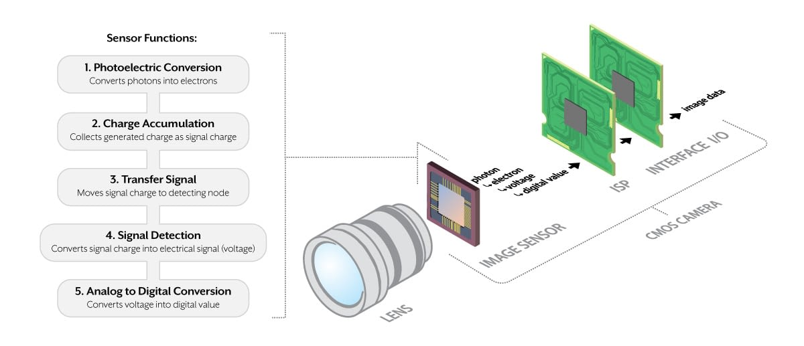
Camera structure
Lens and sensor (CCD-- Charge-Coupled Devices or CMOS -- Complementary Metal Oxide Semiconductor))
https://thinklucid.com/tech-briefs/understanding-digital-image-sensors/

Slide 5
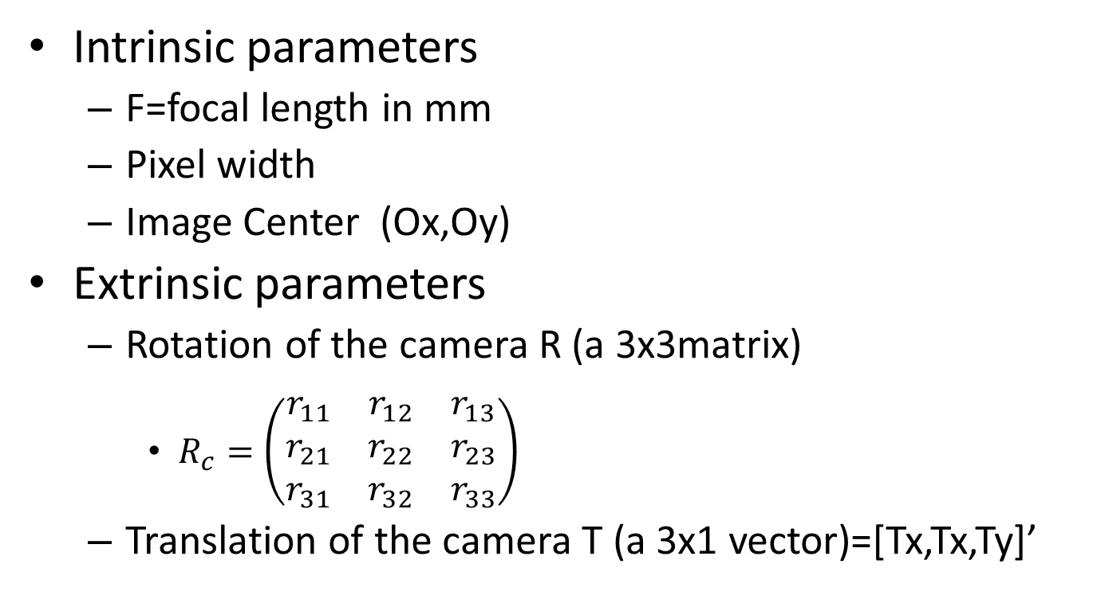
Camera model
Intrinsic parameters
  F=focal length in mm
  Pixel width
  Image Center (Ox,Oy)
Extrinsic parameters
  Rotation of the camera R (a 3x3matrix)
    $R_{c}=\left(\begin{matrix}r_{11} & r_{12} & r_{13} \\ r_{21} & r_{22} & r_{23} \\ r_{31} & r_{32} & r_{33}\end{matrix}\right)$
  Translation of the camera T (a 3x1 vector)=[Tx,Tx,Ty]’

Slide 6
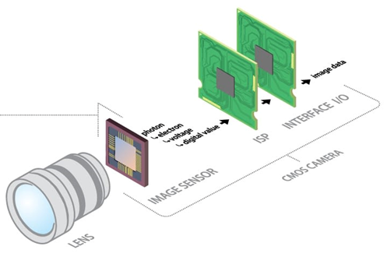
Camera Intrinsic parameters
Parameters inside a camera

Slide 7
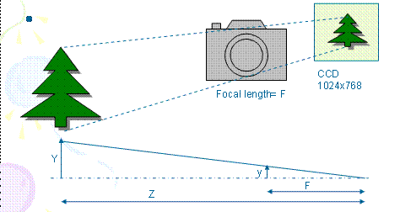
Step2: Camera coordinates to image plane
(Perspective projection of camera in meters)
x=F*X_{c} /Z_{c}---(1)
y=F*Y_{c} /Z_{c}---(2)
F=focal length in meters
A Point in 3D space (camera reference space) is [X_{c},Y_{c},Z_{c}]^{T} in meters
The 2D image point is [x,y]^{T} in meters
Notes:
Step2 is about projection.

Slide 8

Worksheet 1
F=5mm
Z=1 meter
A tree is 2 meters high,0.5 meters wide. What is the value of the height (y) of the tree appearing in the image?
MC question, choices:
(1) y=5mm; (2) y=10mm ; (3) y=15mm, (4) y=20mm,
Sketch the diagram.

Slide 9
Answer: Worksheet 1
F=5mm
Z=1 meter
A tree is 2 meters high,0.5 meters wide. What is the value of the height of the tree appearing in the image?
Answer: using y=F*Y_{c} /Z_{c}
height=y=F*Y/Z=5x10⁻³x2 meters/1 meter=10mm
  or 5*2*10^-3/1 =10mm
MC question, choices:
(1) y=5mm; (2) y=10mm; (3) y=15mm, (4) y=20mm.
Answer (2) y=10mm is correct
also
Width=x=F*X/Z=5x10⁻³x0.5 meters/1 meter=0.0025 meter=2.5mm,
  or =5*0.5*10^-3*1 =2.5mm

Slide 10
Picture element (Pixel) based image
[x,y]^{T} is in meters, []^{T} is transposition in matrix
[u,v]^{T} in pixels which is easy to be measured by the camera
Each pixel is Sx wide and Sy high
Example, Sx = Sy =5.46um (1um=1x10^-6m=1 micron)
Image=
1024x768
pixels
1 pixel
Sx =5.46um
Sy=5.46um
CCD Charge-coupled device
Sensor: http://en.wikipedia.org/wiki/Charge-coupled_device
Notes:
Of course we can measure everything in meters, but it would be easier if we measure them in picture elements (pixels), because pictures are turned into pixels in picture files.
I.e. a jpg file is 1024x768 , meaning 1024 pixels horizontally and 768 pixels vertically.
Each pixel is a point on the image CCD sensor, it responses to the light received at that picture element pixel position.

Slide 11
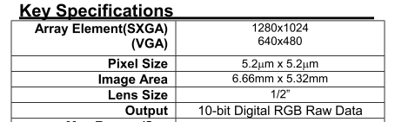
Worksheet 2
For an image of 1280x1024 Sx = Sy =5.2um.
What is the size of the image (CMOS or CCD sensor)?
Find the pixel size of your favorite camera.
MC choices:
(1) Dx= 4.66mm; (2) Dx= 5.66mm;
(3) Dx= 6.66mm; (4) Dx= 7.66mm;
Answer:________________
Dx
Image
(CMOS sensor)
Dy
Hint:
Image
(CMOS
sensor)
www.ovt.com
OVT CameraChip OV9620/9120 webcam camera chip
Notes:
You can check with www.ovt.com
To see the specifications of various cameras.

Slide 12
Answer: Worksheet 2
For an image of 1280x1024, Sx = Sy =5.2um.
What is the size of the image (CMOS or CCD sensor)?
1280*5.2um =1280*5.2*10^-6 = 0.00666m=6.66mm
1024X5.2um =1024*5.2*10^-6 = 0.00532m=5.32mm
MC choices: Choices:
(1) Dx= 4.66mm; (2) Dx= 5.66mm;
(3) Dx= 6.66mm; (4) Dx= 7.66mm;
Answer (3) is correct
Dx
Image
(CMOS sensor)
Dy
www.ovt.com
OVT CameraChip OV9620/9120 webcam camera chip

Slide 13
Image center
In picture files, usually no negative pixel is used because the origin is at one of the corners (e.g. the right bottom (1,1))
Center of CCD is placed at C= (Ox,Oy)
v (pixels)
CCD
768
Vertical
direction
(O_{x},O_{y})=
(512,384) in pixels
x
u (pixels)
1024
1,1
Horizontal direction
Notes:
The image center is at the mid-point of the CCD, so if the CCD is 1024x768, image center is (1024/2,768/2)=(512,384)
But it is not always true because, placing the center of the CCD at the center of the projected image precisely is difficult if the cameras are mass produced. We will deal with this problem later in this chapter.

Slide 14
Worksheet 3
The camera CCD has 1024 x 768 pixels, and the size of the CCD is 5mm x 3.75mm
(Horizontal(x), vertical(y)) pixel size=(Sx,Sy)
MC choices: Which one is true?
(1) Sx= 4.66mm; (2) Sx= 4.77m;
(3) Sx= 4.88mm; (4) Sx= 4.99mm;
Ans:____________

Slide 15
Answer Worksheet 3
The camera CCD has 1024x768 pixels and is 5mmx3.75mm
(Horizontal(x), vertical(y)) pixel size=(Sx,Sy)
Ans: Sx=5mm/1024=4.88um
  Sy=3.75mm/768=4.88um
MC choices: Which one is true?
(1) Sx= 4.66mm; (2) Sx= 4.77m;
(3) Sx= 4.88mm; (4) Sx= 4.99mm
Answer: Choice (3) Sx= 4.88mm is correct
  Why Sx=Sy? Calculate the Sx , Sy of your favorite digital camera.

Slide 16
Edge detection
Very useful features in computer vision

Slide 17
Edge detection, an introduction
Edge detection by differentiation and threshold
The Convolution math tool
Edge mask : edge detection by convolution
Image Filtering: smoothing, high pass etc.
Laplacian method : 2nd order derivative method.
  Laplacian of Gaussian :LOG smoothing and edge detection together
Canny Edge Detection: Most popular method

Slide 18
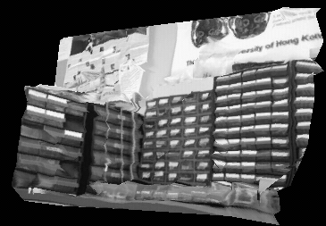
Edge detection, how to achieve?
Edge detection
  First order derivative G(I)
  Second order derivative ∇²I
A gray level image I
has many sharp edges

Slide 19
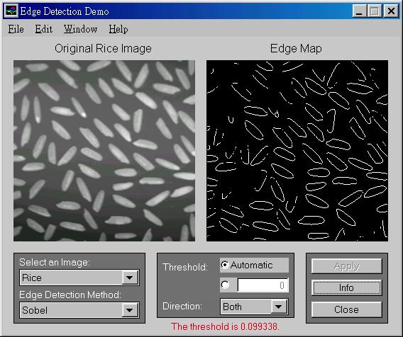
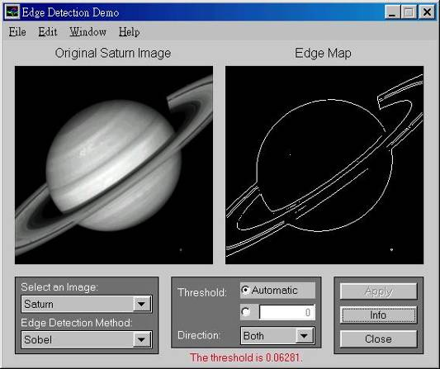
What are edges and why we need them?
Features have many applications: recognition, tracking etc.
The most common are
  Point edges
    Shape intensity change positions
  Boundary edges
    Shape intensity changing lines

Slide 20
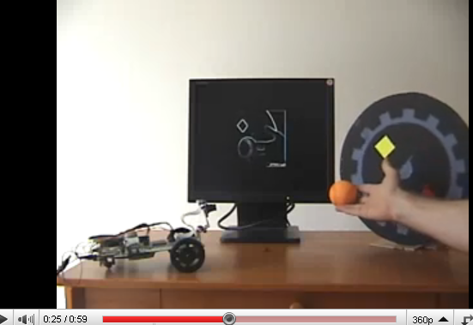
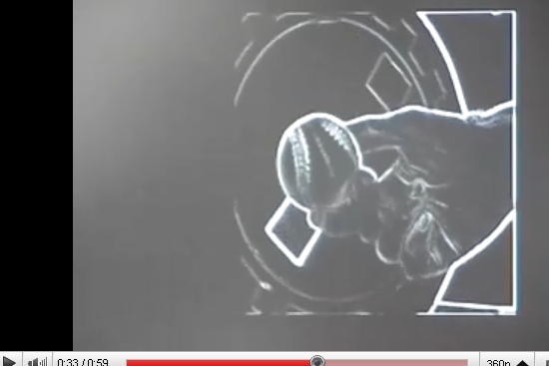
Sobel Demo
http://www.youtube.com/watch?v=z_a6e30aOXo

Slide 21
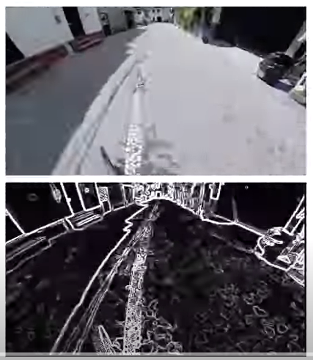
Edge detection
Demo
https://www.youtube.com/watch?v=UMsJNC3dCIA

Slide 22
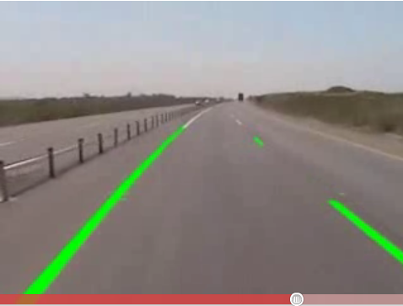
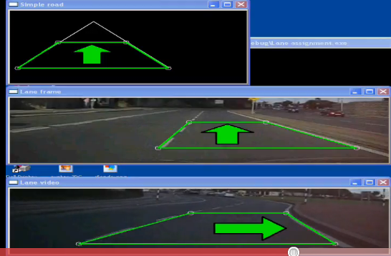
Application of edges
Lane detection
http://www.youtube.com/watch?v=Al4DnNkZUeA&feature=related
http://www.youtube.com/watch?v=9F3_6xL8hEY&feature=related

Slide 23
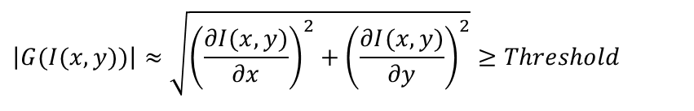
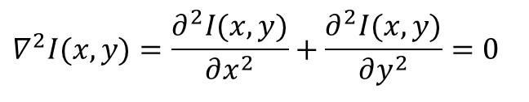
How to obtained edges?
I(x,y+1) I(x+1,y+1)
I(x,y) I(x+1,y)
Use gradient G of intensity [I(x,y)] change, two methods
First order gradient
  I(x,y) is an edge if
Second order gradient (Laplacian operator)
  I(x,y) is an edge if
I(x,y)
$$\left|G(I(x,y))\right|≈\sqrt{{\left(\frac{∂I(x,y)}{∂x}\right)}^{2}+{\left(\frac{∂I(x,y)}{∂y}\right)}^{2}}≥Threshold$$
y
x
$$∇^{2}I(x,y)=\frac{∂^{2}I(x,y)}{∂x^{2}}+\frac{∂^{2}I(x,y)}{∂y^{2}}=0$$
Notes:
\begin{document}
edge, Slide 8\\
\begin{flalign}
\label{eq4}
\begin{aligned}
\sqrt{nm}\\
|G(x,y)|&= \sqrt{ \frac{\partial I(x,y)}{\partial x} + \frac{\partial I(x,y)}{\partial x} }
\geq \text{Threshold}\\
\nabla^2I(x,y)&= \frac{\partial I(x,y)}{\partial x} + \frac{\partial I(x,y)}{\partial x}=0
%%%%%%%%%%%%
%|G(I(x,y)|=\sqrt(\left( \frac{\partial I(x,y)}{\partial x} = \frac{\partia I(x,y)}{\partial y} \right) ))
%|G(I(x,y)|=\sqrt(\left( \frac{\partial I(x,y)}{\partial x} = \frac{\partia I(x,y)}{\partial y} \right) ))
%G(I(x,y)=\sqrt((Z\right) )
\end{aligned}
\end{flalign}

Slide 24
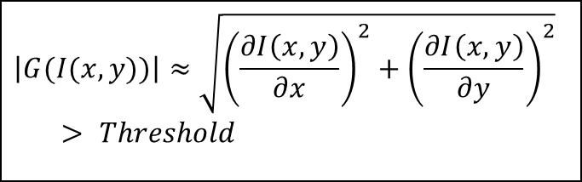
Edge detection using First order gradient G > threshold
Edges are at positions of rapid change of intensity levels
If (intensity gradient G(I(x,y))> threshold)
{
pixel(x,y) is an edge point;
}
$$\left|G(I(x,y))\right|≈\sqrt{{\left(\frac{∂I\left(x,y\right)}{∂x}\right)}^{2}+{\left(\frac{∂I\left(x,y\right)}{∂y}\right)}^{2}}> Threshold$$
I(x,y)
G[I(x,y)] > threshold, Pixel position (x,y) has an edge
First order derivative

Slide 25

Edge detection using second order gradient ∇²I=0
Edges are at ∇²I =0
If (intensity gradient ∇²I =0)
{
pixel(x,y) is an edge point;
}
$$∇^{2}I(x,y)=\frac{∂^{2}I(x,y)}{∂x^{2}}+\frac{∂^{2}I(x,y)}{∂y^{2}}=0$$
I(x,y)
I(x,y)
G[I(x,y)]> threshold is an edge
∇²I(x,y)= 0 is an edge
x
First order derivative
(gradient of I(x,y))
Second order derivative
(gradient of gradient of I(x,y))
x
x

Slide 26
Practical computational methods (discrete method for finding first order gradient)
First order gradient operators
  Roberts operator
  Prewiit operator
  Sobel operator

Slide 27
Convolution method
Convolution is an important and popular technique in signal processing
Edges can found by convoluting an image with a mask

Slide 28
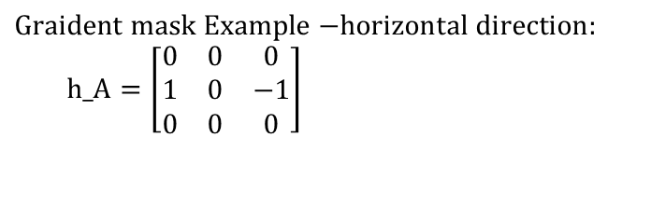
Gradient calculation by convolution*
Differentiate an image I w.r.t x
G(I)=gradient of I= dI/dx
It is the same as
dI/dx ≈ (d/dx)*I
Gradient mask
Or filter mask
*=Convolution operator
$$\text{Graident} \text{mask} \text{Example}\text{ −}\text{horizontal} \text{direction}\text{:} \\ \text{h}\text{_}\text{A}=\left[\begin{matrix}0 & 0 & 0 \\ \text{1} & 0 & −1 \\ 0 & 0 & 0\end{matrix}\right]$$

Slide 29
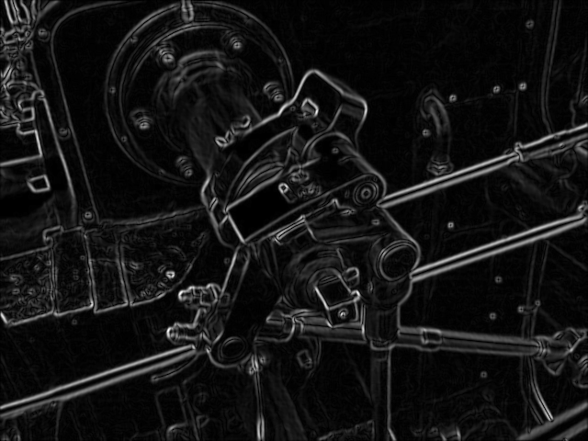
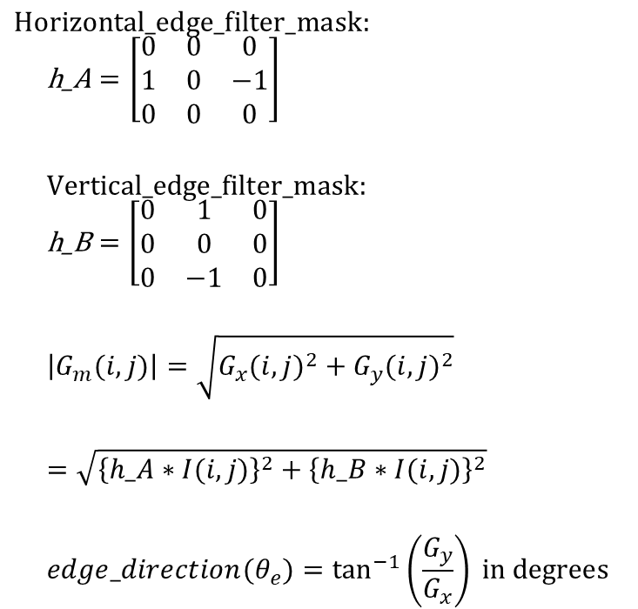
Assume Gx,Gy are separable, the total gradient Gm becomes
Horizontal
direction
Horizontal gradient =G_{x}(i,j)= h_A * I(i,j)
vertical gradient= G_{y}(i,j)= h_B * I(i,j),
vertical
direction
$$\text{Horizontal}\text{_}\text{edge}\text{_}\text{filter}\text{_}\text{mask}\text{: }$$
$$\text{h}\text{_}\text{A}=\left[\begin{matrix}0 & 0 & 0 \\ \text{1} & 0 & −1 \\ 0 & 0 & 0\end{matrix}\right]$$
$$\text{Vertical}\text{_}\text{edge}\text{_}\text{filter}\text{_}\text{mask}\text{:}$$
$$\text{h}\text{_}\text{B}=\left[\begin{matrix}0 & 1 & 0 \\ 0 & 0 & 0 \\ 0 & \text{−1} & 0\end{matrix}\right]$$
$$\left|G_{m}(i,j)\right|=\sqrt{G_{x}(i,j)^{2}+G_{y}(i,j)^{2}}$$
$$=\sqrt{{\left\{h_A∗I(i,j)\right\}}^{2}+{\left\{h_B∗I(i,j)\right\}}^{2}}$$
$$edge_direction(θ_{e})=\tan^{−1}\left(\frac{G_{y}}{G_{x}}\right) \text{in} \text{degrees}$$
* is the
convolution operator
θ_{e}
An edge is found
and direction is tan⁻¹(Gy/Gx)=θ_{e}

Slide 30
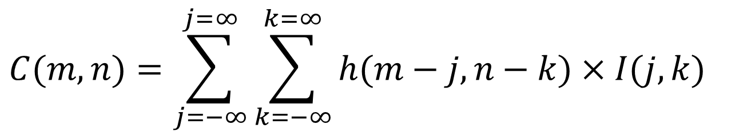
What is convolution ?
Discrete convolution C=I*h
By definition (http://en.wikipedia.org/wiki/Convolution)
$$C(m,n)=\sum_{j=−∞}^{j=∞}{\sum_{k=−∞}^{k=∞}{h(m−j,n−k)×I(j,k)}}$$
X=multiplication
*=convolution
Notes:
\begin{flalign}
\label{eq:convolution_01}
\begin{aligned}
C(m,n)=
\sum_{j=-\infty}^{j=\infty}
\sum_{k=-\infty}^{j=\infty}
h(m-j,n-k) \times I(j,k)
%%%%%%%%%%%%
\end{aligned}
\end{flalign}\\

Slide 31
Convolution is
Commutative : g(n)*h(n)=h(n)*g(n)
associative: {x(n)*g(n)}*h(n)=x(n)*{h(n)*g(n)}
Distributive
x(n)*{g(n)+h(n)}=x(n)*g(n)+x(n)*h(n)
Application: edge finding
In practice : only accept convoluted values obtained when edge mask and image are fully overlapped.

Slide 32
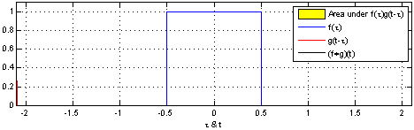
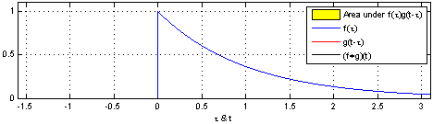
1-D convolution examples
http://en.wikipedia.org/wiki/Convolution
Example 1
Example 2

Slide 33
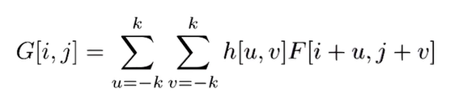
We first learn discrete (cross) correlation
h=[1 3 4
2 7 1
0 5 2]
F=[4 1
2 7]
G =
convolution(h*F)
7 23 34 8
15 60 37 18
2 50 53 8
0 5 22 8
4 | 1
2 | 7
1 | 3 | 4
2 | 7 | 1
0 | 5 | 2
4 | 1
2 | 7
4 | 1
2 | 7
4 | 1
2 | 7
4*5+2*1=22
1*4+2*2+3*1+7*7=60
0*1=0
4*0+5*1=5
https://www.youtube.com/watch?app=desktop&v=C3EEy8adxvc

Slide 34
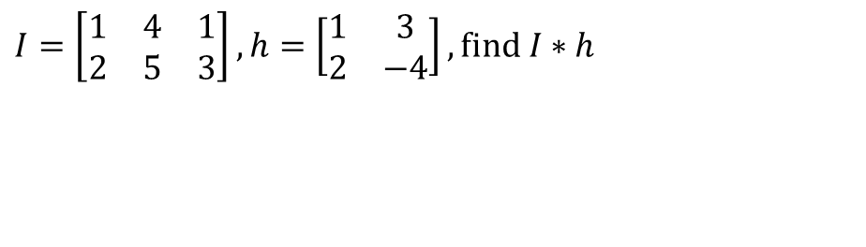

Discrete convolution: Correlation is more intuitive
so we use correlation of the flipped version of h to implement convolution[1]
$$I=\left[\begin{matrix}1 & 4 & 1 \\ 2 & 5 & 3\end{matrix}\right],h=\left[\begin{matrix}1 & 3 \\ 2 & −4\end{matrix}\right],\text{find} I∗h$$
convolution
$$C(m,n)=\sum_{j=−∞}^{j=∞}{\sum_{k=−∞}^{k=∞}{h(m−j,n−k)×I(j,k)}} \\ =\sum_{j=−∞}^{j=∞}{\sum_{k=−∞}^{k=∞}{h^{(flip)}(−m+j,−n+k)×I(j,k)}}$$
Flipped h
correlation

Slide 35
Matlab (octave) code for convolution
I=[1 4 1;
2 5 3]
h=[1 3 ;
2 -4]
conv2(I,h)
pause
disp('It is the same as the following');
conv2(h,I)
pause
disp('It is the same as the following');
xcorr2(I,fliplr(flipud(h)))
Flipped h=h(flip)=
-4 | 2
3 | 1

Slide 36
Steps to find C(m,n)
Step1:
C(0,0)
=2x2=4
Step 2:
C(1,0)
= -4*2+2*5=2
Step 3:
C(2,0)
= -4*5+2*3
=-14
Step 4:
C(3,0)
= -4*3
=-12
1 | 4 | 1
2 | 5 | 3
1 | 4 | 1
2 | 5 | 3
-4 | 2
3 | 1
-4 | 2
3 | 1
Flipped h
1 | 4 | 1
2 | 5 | 3
1 | 4 | 1
2 | 5 | 3
-4 | 2
3 | 1
-4 | 2
3 | 1
C(0,0) | C(1,0) | C(2,0) | C(3,0)
C(0,0) | C(1,0) | C(2,0) | C(3,0)
C(0,0)=4 | C(1,0)=2 | C(2,0)=-14 | C(3,0)=-12
C(m,n)=

Slide 37
Steps continue
1 | 4 | 1
2 | 5 | 3
Step 5:
C(0,1)
=1*2+2*1
=4
Step 6:
C(1,1)
= 1*-4+2*3+4*2+5*1
=15
Step 7:
C(2,1)
= -4*4+5*3+1*2+3*1
=4
Step 8:
C(3,1)
= -4*1+3*3
=5
1 | 4 | 1
2 | 5 | 3
-4 | 2
3 | 1
-4 | 2
3 | 1
1 | 4 | 1
2 | 5 | 3
-4 | 2
3 | 1
1 | 4 | 1
2 | 5 | 3
-4 | 2
3 | 1
C(0,2) | C(1,2) | C(2,2) | C(3,2)
C(0,1)=4 | C(1,1)=15 | C(2,1)=4 | C(3,1)=5
C(0,0)=4 | C(1,0)=2 | C(2,0)=-14 | C(3,0)=-1
C(m,n)=

Slide 38

Find all elements
-4 | 2
3 | 1
-4 | 2
3 | 1
-4 | 2
3 | 1
-4 | 2
3 | 1
1 | 4 | 1
2 | 5 | 3
1 | 4 | 1
2 | 5 | 3
1 | 4 | 1
2 | 5 | 3
1 | 4 | 1
2 | 5 | 3
n
$$=\left[\begin{matrix}1 & 7 & 13 & 3 \\ 4 & 15 & 4 & 5 \\ 4 & 2 & −14 & −12\end{matrix}\right]$$
C(m,n)
n
m
m

Slide 39
Worksheet 4
I=[1 4 1;
2 5 3
3 5 1]
h2=[-1 2
3 4]
Find convolution of I and h2.

Slide 40
Answer worksheet 4
%ws3.1 edge
I=[1 4 1;
2 5 3
3 5 1]
h2=[-1 2
3 4]
%Find convolution of I and h2.
conv2(I,h2)
ans =
-1 -2 7 2
1 15 26 10
3 24 38 14
9 27 23 4

Slide 41
Cmsc5711, Worksheet 5
Which answer is correct?
x=[2 6 7;
4 6 9
1 3 2]
h=[1 -2
-3 4]
Z=x*h ; % * is the convolution operator
Find z. (Fully overlapping and half overlapping of x and h are considered, this is the formal definition of convolution)
What is the size of Z?
What is the value of h*x?
Multiple choice question
Answer 1: Z=
1 2 -5 -14
-2 -12 0 10
-11 -1 -7 32
-3 -5 6 8
Answer 2: Z=
2 2 -5 -14
-2 -12 0 10
-11 -1 -7 32
-3 -5 6 8
Hints:
h after 2D flip is
flipud(fliplr(h))=
4 -3
-2 1
Answer 3: Z=
3 5 -5 -14
-2 -12 0 10
-11 -1 -7 32
-3 -5 6 8

Slide 42
Answer WS5
Hints:
h after 2D flip is
flipud(fliplr(h))=
4 -3
-2 1
Z=x*h
Find z. (Fully overlapping and half overlapping of x and h are considered, this is the formal definition of convolution):
ANSWER 2 is correct: Z=
2 2 -5 -14
-2 -12 0 10
-11 -1 -7 32
-3 -5 6 8
What is the size of Z? : answer: 4x4
What is the value of h*x (reversed order of h,x)?
Same as z
%Matlab
x=[2 6 7;
4 6 9
1 3 2]
h=[1 -2
-3 4]
flipud(fliplr(h))
conv2(x,h)
conv2(h,x)
Answer 2 is correct:
ans =
2 2 -5 -14
-2 -12 0 10
-11 -1 -7 32
-3 -5 6 8

Slide 43

Worksheet 6:
Find edge image using filter masks h_A and h_B
$$I=\left[\begin{matrix}0 & 0 & 0 & 0 \\ 0 & 0 & 0 & 0 \\ 0 & 0 & 1 & 1 \\ 0 & 0 & 1 & 1\end{matrix}\right] \\ h_x=\left[\begin{matrix}0 & 0 & 0 \\ −1 & 0 & 1 \\ 0 & 0 & 0\end{matrix}\right] \\ h_y=\left[\begin{matrix}0 & 1 & 0 \\ 0 & 0 & 0 \\ 0 & −1 & 0\end{matrix}\right]$$
Horizontal edge mask
Vertical edge mask

Slide 44
Answer worksheet 6 (can use matLab or octave)
J=[0 0 0 0
0 0 0 0
0 0 1 1
0 0 1 1]
h_x=[0 0 0
-1 0 1
0 0 0]
h_y=[0 1 0
0 0 0
0 -1 0]
conv2(J,h_x)
conv2(J,h_y)
Try to run this in matlab or octave
Gx=conv2(J,h_A) %horizonatal edge image
ans =
0 0 0 0 0 0
0 0 0 0 0 0
0 0 0 0 0 0
0 0 -1 -1 1 1
0 0 -1 -1 1 1
0 0 0 0 0 0
Gy=conv2(J,h_B) %vertical edge image
ans =
0 0 0 0 0 0
0 0 0 0 0 0
0 0 0 1 1 0
0 0 0 1 1 0
0 0 0 -1 -1 0

Slide 45
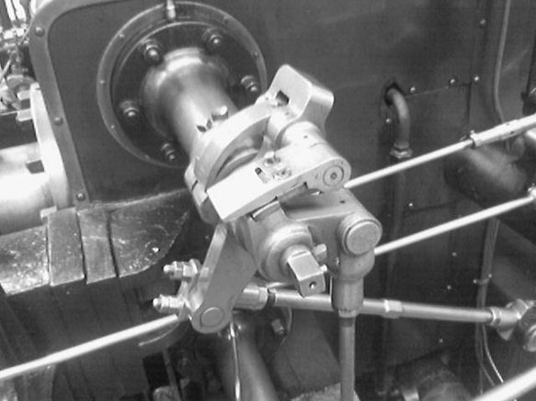
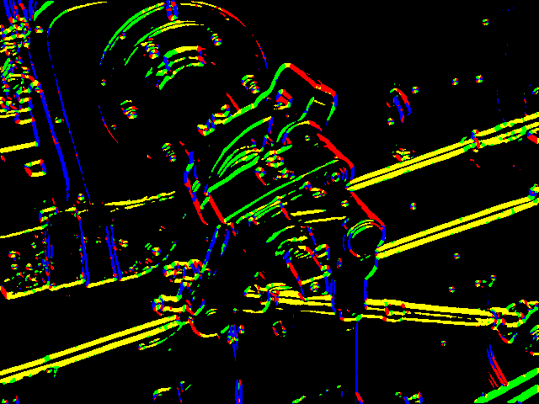
Edge direction
Original
image
Θ(x,y) = tan⁻¹(Gy(x,y) / Gx(x,y))
Find the magnitude G and direction Θ of the gradient by:
That is: G = |Gx| + |Gy| Θ = tan⁻¹(Gy / Gx)
G
90
Θ (4 different colors)
135
45
In some applications (Canny edge detector), we round Θ into 4 directions!!
0°, 45°, 90° and 135°!!!
0
0
45
135
90

Slide 46
Edge mask
Convolution is useful in many image processing applications
For each application what you need is to design a mask for that task
You can use different masks for various applications
  E.g. Edge detection masks
    Prewitt, Sobel etc.
  Image smoothing
  High pass: Edge highlighting

Slide 47
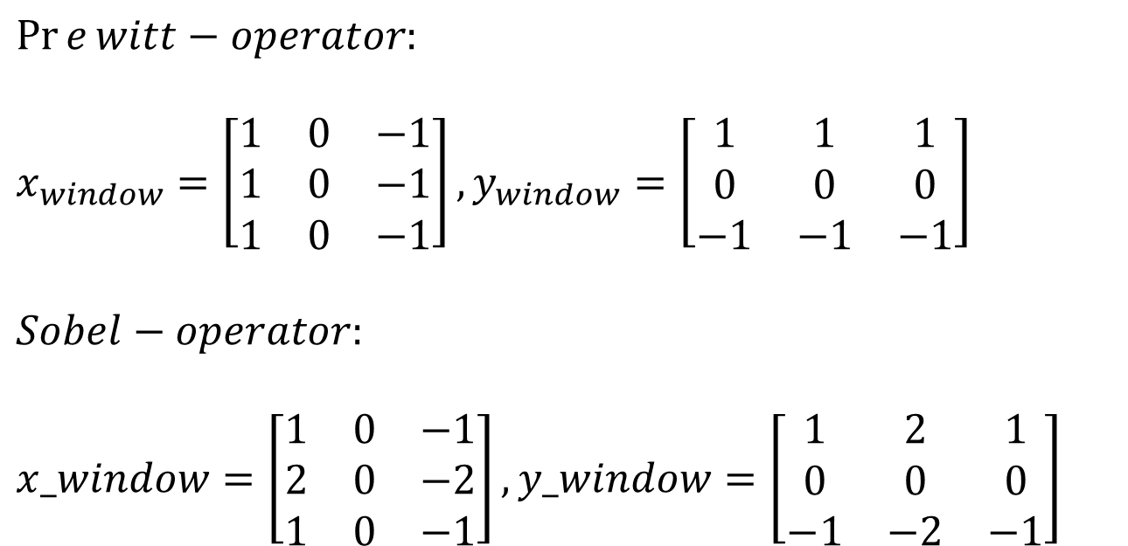
Other simple 3x3 gradient operators
(In practice : only accept convoluted values obtained when edge mask and image are fully overlapped. The size of the image is usually much bigger than the masks)
Two popular operators
$$\operatorname{Pr}{e}witt−operator:$$
$$x_{window}=\left[\begin{matrix}1 & 0 & −1 \\ 1 & 0 & −1 \\ 1 & 0 & −1\end{matrix}\right],y_{window}=\left[\begin{matrix}1 & 1 & 1 \\ 0 & 0 & 0 \\ −1 & −1 & −1\end{matrix}\right]$$
$$Sobel−operator:$$
$$x_window=\left[\begin{matrix}1 & 0 & −1 \\ 2 & 0 & −2 \\ 1 & 0 & −1\end{matrix}\right],y_window=\left[\begin{matrix}1 & 2 & 1 \\ 0 & 0 & 0 \\ −1 & −2 & −1\end{matrix}\right]$$

Slide 48
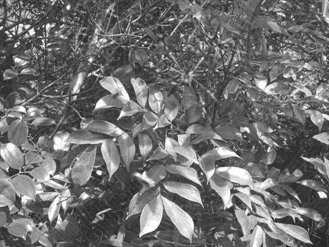
Convolution of a mask to a picture
In theory all overlapped and non-overlapped areas are considered.
But in practice: Non-fully-overlapped areas are usually ignored. Only fully overlapped mask and Image I is considered.
  The effect of this is small
  Size of the convolution result of a 3x3 mask and I_{1024x768} is (1024-2)x(768-2)
* I
Mask=3x3
I_{1024x768} =a 1024x768 image

Slide 49
Edge detection procedure
Input: Image I() , h_A, h_B
Output: edge_image edge()
For m=1,..,M
For n=1,…,N
  Find Horizontal gradient =G_{x}(m,n)= h_A * I(m,n)
  Find vertical gradient =G_{y}(m,n)= h_B * I(m,n)
  Find overall_edge(m,n)=Gt(m,n)=sqrt{G_{x}(m,n)²+G_{y} (m,n)²}
  If ( overall_edge(m,n)>threshold )
edge(m,n) is an edge
  Else
    edge(m,n) is not an edge.
End
End

Slide 50
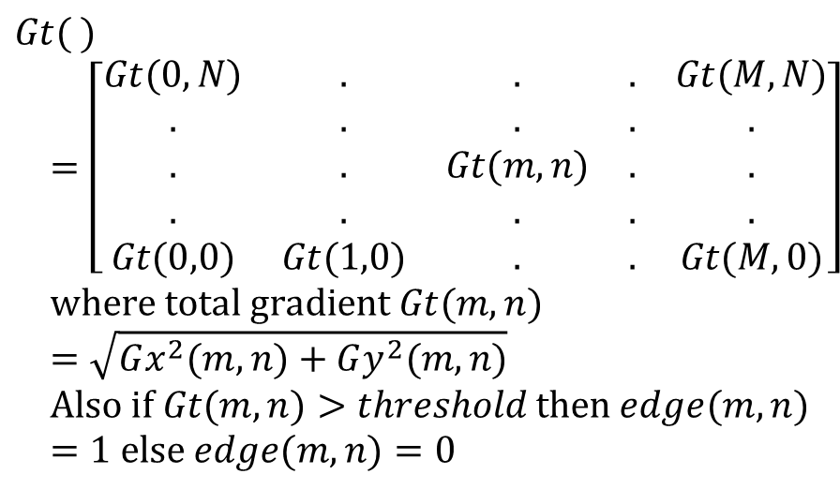
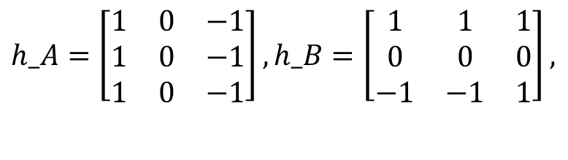
Example to find edges, e.g. use Prewitt edge filter on image I
In practice outside or at m=1 and m=M-1 are not considered, because it is where image/mask are not fully overlapped. Same for n.
For m=2..,M-2
For n=2..,N-2
  Gx(m,n)=h_A*I(m,n)
  Gy(m,n)=h_B*I(m,n)
  Gt(m,n)=sqrt{Gx(m,n)²+Gy(m,n)²}
  If Gt(m,n)>Threshold
  Edge(m,n)=1, else =0
End
End
done
$$h_A=\left[\begin{matrix}1 & 0 & −1 \\ 1 & 0 & −1 \\ 1 & 0 & −1\end{matrix}\right],h_B=\left[\begin{matrix}1 & 1 & 1 \\ 0 & 0 & 0 \\ −1 & −1 & 1\end{matrix}\right],$$
$$Gt( )=\left[\begin{matrix}Gt(0,N) & . & . & . & Gt(M,N) \\ . & . & . & . & . \\ . & . & Gt(m,n) & . & . \\ . & . & . & . & . \\ Gt(0,0) & Gt(1,0) & . & . & Gt(M,0)\end{matrix}\right] \\ \text{where} \text{total} \text{gradient} Gt(m,n)=\sqrt{Gx^{2}(m,n)+Gy^{2}(m,n)} \\ \text{Also} \text{if} Gt(m,n)>threshold \text{then} edge(m,n)=1 \text{else} edge(m,n)=0$$

Slide 51

Sobel masks
$$sobel_masks \\ h_{A}=\left[\begin{matrix}1 & 0 & −1 \\ 2 & 0 & −2 \\ 1 & 0 & −1\end{matrix}\right],$$
$$h_B=\left[\begin{matrix}1 & 2 & 1 \\ 0 & 0 & 0 \\ −1 & −2 & −1\end{matrix}\right],$$
Sobel mask approximation
of a horizontal edge
Sobel mask approximation
of a vertical edge

Slide 52
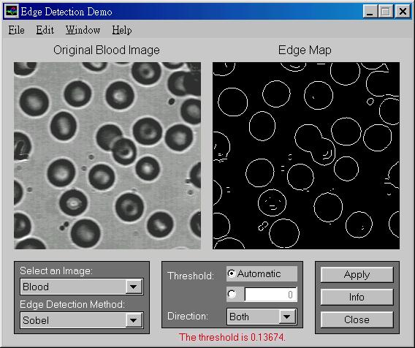
Using Sobel edge masks
Example

Slide 53
Another example

Slide 54
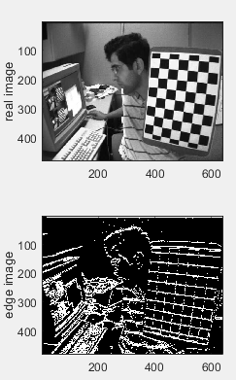
Find edge of real images
(tested on octave https://octave.org/ )
%ws3_3b.m find edge image of a real image, (2022.1.19)
%put test.jpg in c:\images\ ,tested ok on octave
clear
ii=imread('c:\\images\\test.jpg');
prew_x=[1 1 1; 0 0 0; -1 -1 -1]
ex=conv2(ii, prew_x);
prew_y=[1 1 1; 0 0 0; -1 -1 -1]
ey=conv2(ii, prew_y);
%If edge image is required:
etemp=sqrt(ex.*ex+ey.*ey);
e=etemp;
threshold=mean(mean(etemp))% set threshold
e(e<=threshold)=0; %< threshold, set to 0
e(e>threshold)=255;%> threshold, set to 255
figure(1),clf
subplot(2,2,1)
colormap(gray(256))
image(ii)
ylabel('real image')
subplot(2,2,3)
colormap(gray(256))
image(e)
ylabel('edge image')

Slide 55
%Worksheet 7: Intensity gradient of an image
ii=[ 0 0 50 10
0 0 128 255
0 0 128 255
0 0 128 255]
prewitt_x =[1 1 1
0 0 0
-1 -1 -1]
prewitt_y =[1 0 -1
1 0 -1
1 0 -1]
ex=conv2(ii, prewitt_x )
ey=conv2(ii, prewitt_y )
ex =
0 0 50 60 60 10
0 0 128 383 383 255
0 0 78 323 323 245
0 0 0 0 0 0
0 0 -128 -383 -383 -255
0 0 -128 -383 -383 -255
ey =
0 0 50 10 -50 -10
0 0 178 265 -178 -265
0 0 306 520 -306 -520
0 0 384 765 -384 -765
0 0 256 510 -256 -510
0 0 128 255 -128 -255
G(x,y)
GI(x,y) =
0 0 70.7107 60.8276 78.1025 14.1421
0 0 219.2442 465.7403 422.3423 367.7635
0 0 315.7847 612.1511 444.9326 574.8261
0 0 384.0000 765.0000 384.0000 765.0000
0 0 286.2167 637.8001 460.6788 570.1973
0 0 181.0193 460.1239 403.8230 360.6245 Find a formula to relate G(x,y) and ex and ey using the results as shown above
Answer:__________________________?
MC question
G(x,y)=sqrt(|ex|+|ey|)
G(x,y)=sqrt(ex^2+ey^2)
G(x,y)=sqrt(ex^0.5+ey^0.5)
Question 3.3a)MC question
Write the edge image (255= edge, 0=no edge) if the threshold is 500.
Answer (1) e=
0 0 0 0 0 0
0 0 0 0 0 0
0 0 0 255 0 255
0 0 0 255 0 255
0 0 0 255 0 255
0 0 0 0 0 0
Answer (2) e=
0 0 0 0 0 0
0 0 0 0 0 0
0 0 0 255 255 255
0 0 0 255 255 255
0 0 0 255 255 255
0 0 0 0 0 0

Slide 56
%Answer: Worksheet 7: Intensity gradient of an image
ii=[ 0 0 50 10
0 0 128 255
0 0 128 255
0 0 128 255]
prewitt_x =[1 1 1
0 0 0
-1 -1 -1]
prewitt_y =[1 1 -1
1 0 -1
1 0 -1]
ex=conv2(ii, prewitt_x )
ey=conv2(ii, prewitt_y )
ex =
0 0 50 60 60 10
0 0 128 383 383 255
0 0 78 323 323 245
0 0 0 0 0 0
0 0 -128 -383 -383 -255
0 0 -128 -383 -383 -255
ey =
0 0 50 10 -50 -10
0 0 178 265 -178 -265
0 0 306 520 -306 -520
0 0 384 765 -384 -765
0 0 256 510 -256 -510
0 0 128 255 -128 -255
G(x,y)
GI(x,y) =
0 0 70.7107 84.8528 84.8528 14.1421
0 0 181.0193 541.6438 541.6438 360.6245
0 0 110.3087 456.7910 456.7910 346.4823
0 0 0 0 0 0
0 0 181.0193 541.6438 541.6438 360.6245
0 0 181.0193 541.6438 541.6438 360.6245
Find a formula to relate G(x,y) and ex and ey using the results as shown above
Q3.3a ,anwer2 is correct:_G(x,y)=sqrt(ex^2+ey^2)
Write the edge image (255 =edge, 0= no edge) if the threshold is 500.
Answer:? __
Answer:? __
etemp=sqrt(ex.*ex+ey.*ey);
e=etemp;
threshold=500
e
%threshold=mean(mean(etemp))% set threshold
e(e<=threshold)=0; %< threshold, set to 0
e(e>threshold)=255;%> threshold, set to 255
e=
Q3.3a ,
Answer1 is correct, e=
0 0 0 0 0 0
0 0 0 0 0 0
0 0 0 255 0 255
0 0 0 255 0 255
0 0 0 255 0 255
0 0 0 0 0 0

Slide 57
Image smoothing
Using low pass filtering
By convolution

Slide 58
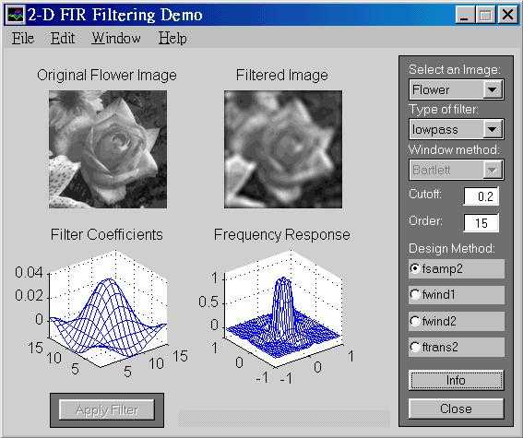
Low pass filtering result

Slide 59
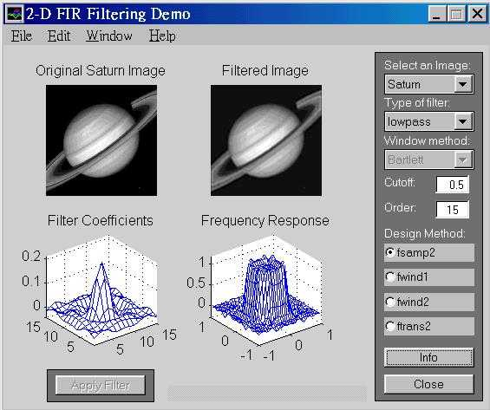
Low pass filtering result

Slide 60
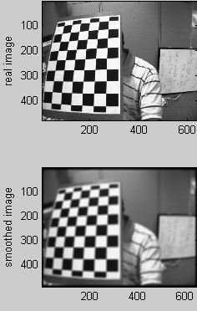
Smooth an image kernal size is 11x11
%smooth an image ws3_5.m,
%put test.jpg in c:\images\
clear
ii=imread('c:\\images\\test.jpg');
%smooth_kernal=[1 1 1 ; 1 2 1; 1 1 1];
%smooth_kernal=[0.1 0.1 0.1 ; 0.1 0.1 0.1; 0.1 0.1 0.1 ]
smooth_kernal=ones(11,11)
%optional:trust middle element more
%smooth_kernal(5,5)=11*11;
%this is to normalize the pixels
smooth_kernal=smooth_kernal/sum(sum(smooth_kernal))
smooth_ii=conv2(ii, smooth_kernal);
figure(1),clf
colormap(gray(256))
subplot(2,2,1)%----------------------
image(ii)
ylabel('real image')
subplot(2,2,3)%--------------------
image(smooth_ii)
ylabel('smoothed image')

Slide 61

Worksheet 8:Can you comment on what is the function of this convolution?
$$I=\left[\begin{matrix}0 & 0 & 100 & 100 \\ 0 & 0 & 120 & 120 \\ 0 & 0 & 200 & 200 \\ 0 & 0 & 255 & 255\end{matrix}\right],h_{lp}=\left(\frac{1}{10}\right)\left[\begin{matrix}1 & 1 & 1 \\ 1 & 2 & 1 \\ 1 & 1 & 1\end{matrix}\right]$$
I*h_{lp}=
0 0 10.0000 20.0000 20.0000 10.0000
0 0 22.0000 54.0000 54.0000 22.0000
0 0 42.0000 96.0000 96.0000 42.0000
0 0 57.5000 135.0000 135.0000 57.5000
0 0 45.5000 116.5000 116.5000 45.5000
0 0 25.5000 51.0000 51.0000 25.5000
MC question:
Find the edge
Smooth the image
Extract features

Slide 62
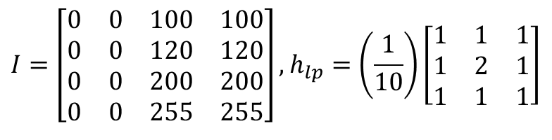
Answer 8:Can you comment on what is the function of this convolution?
%Matlab
I=[ 0 0 100 100
0 0 120 120
0 0 200 200
0 0 255 255]
h_low_pass=0.1*[1 1 1
1 2 1
1 1 1]
conv2(I,h_low_pass)
$$I=\left[\begin{matrix}0 & 0 & 100 & 100 \\ 0 & 0 & 120 & 120 \\ 0 & 0 & 200 & 200 \\ 0 & 0 & 255 & 255\end{matrix}\right],h_{lp}=\left(\frac{1}{10}\right)\left[\begin{matrix}1 & 1 & 1 \\ 1 & 2 & 1 \\ 1 & 1 & 1\end{matrix}\right]$$
I*h_{lp}=
0 0 10.0000 20.0000 20.0000 10.0000
0 0 22.0000 54.0000 54.0000 22.0000
0 0 42.0000 96.0000 96.0000 42.0000
0 0 57.5000 135.0000 135.0000 57.5000
0 0 45.5000 116.5000 116.5000 45.5000
0 0 25.5000 51.0000 51.0000 25.5000
ANSWER2 s correct : It is low pass filtering; the function is to smooth (or blur) the image.

Slide 63
Worksheet 9: Example for intensity gradient calculation
%Given
ii=[ 0 0 50 10
0 0 128 255
0 0 128 255
0 0 128 255]
prewitt_x =[1 1 1
0 0 0
-1 -1 -1]
prewitt_y =[1 0 -1
1 0 -1
1 0 -1]
ex=conv2(ii, prew_x)
ey=conv2(ii, prew_y)
a) Write a formula to find the direction of the edge image at pixel (x,y).
////// Question 3.5a , MC question /////
Answer1:Θ(x,y) = tan⁻¹(ex(x,y) / ey(x,y))
Answer2 :Θ(x,y) = tan⁻¹(ey(x,y) / ex(x,y))
Qb: Find the edge direction at (x1,y1)
/////// Question 3.5b , MC question ////
Answer1 :Θ(x,y) = atan(265/383)
Answer2 :Θ(x,y) = acos(265/383)
At (x1,y1)
Underlined
cell
ex=ii*prewitt_x= (note: * is convolution)
0 0 50 60 60 10
0 0 128 383 383 255
0 0 78 323 323 245
0 0 0 0 0 0
0 0 -128 -383 -383 -255
0 0 -128 -383 -383 -255
ey=ii*prewitt_y = (note: * is convolution)
0 0 50 10 -50 -10
0 0 178 265 -178 -265
0 0 306 520 -306 -520
0 0 384 765 -384 -765
0 0 256 510 -256 -510
0 0 128 255 -128 -255

Slide 64
Answer :Worksheet 9. Example for intensity gradient calculation
%Given
ii=[ 0 0 50 10
0 0 128 255
0 0 128 255
0 0 128 255]
prewitt_x =[1 1 1
0 0 0
-1 -1 -1]
prewitt_y =[1 0 -1
1 0 -1
1 0 -1]
ex=conv2(ii, prewitt_x)
ey=conv2(ii, prewitt_y )
Q3.5a: Write a formula to find the direction of the edge image at pixel (x,y).
////// Question 3.5a , MC question /////
Answer2 :Θ(x,y) = tan⁻¹(ey(x,y) / ex(x,y))
Is correct
Q3.5b: Find the edge direction at (x1,y1)
/////// Question 3.5b , MC //////////////
Answer1 :Θ(x,y) = atan(265/383)= 0.605 rad
Is correct
At (x1,y1)
Underlined
cell
ex=ii*prewitt_x= (note: * is convolution)
0 0 50 60 60 10
0 0 128 383 383 255
0 0 78 323 323 245
0 0 0 0 0 0
0 0 -128 -383 -383 -255
0 0 -128 -383 -383 -255
ey=ii*prewitt_y = (note: * is convolution)
0 0 50 10 -50 -10
0 0 178 265 -178 -265
0 0 306 520 -306 -520
0 0 384 765 -384 -765
0 0 256 510 -256 -510
0 0 128 255 -128 -255

Slide 65
Correlation
Find finding similarity between 2 picture windows

Slide 66
Tracking by Cross correlation
Find how a corner has moved between two image frames
Evaluate the likelihood between 2 image windows
A mathematical technical to track features

Slide 67
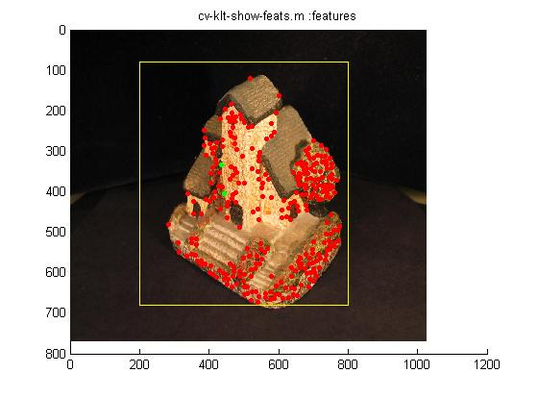
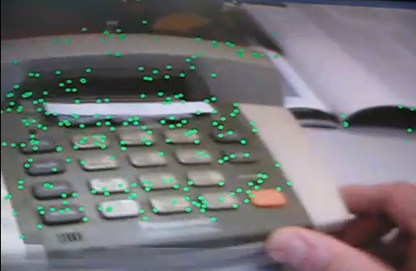
Demo: A more advanced version is feature tracking by the KLT (Kanade-Lucas-Tomasi) method
It is more accurate by simple the cross-correlation method http://www.ces.clemson.edu/~stb/klt/
(Click picture to see movie)
Demo
http://www.youtube.com/watch?v=RXpX9TJlpd0
http://www.youtube.com/watch?v=9XknYOHKv-g

Slide 68

2D-2D Correspondence method using normalized cross-correlation
Normalized Correlation or Normalized Cross correlation coefficient (r_{f,f’}) for 2 windows f and f’ in image frame t and frame t’, respectively. f and f’ have the same size s.
It is a measure of similarity(from -1 to +1): 1 = very similar, -1= very dissimilar.
$$r_{f,f′}=\frac{\sum_{x,y∈s}{\left(f_{x,y}−\overline{f}\right)\left(f_{x,y}^{′}−\overline{f^{′}}\right)}}{\sqrt{\sum_{x,y∈s}{{\left(f_{x,y}−\overline{f}\right)}^{2}}\sum_{x,y∈s}{{\left(f_{x,y}^{′}−\overline{f^{′}}\right)}^{2}}}} \\ s=all_range, \\ \overline{f}=mean(f),\overline{f′}=mean(f′)$$

Slide 69
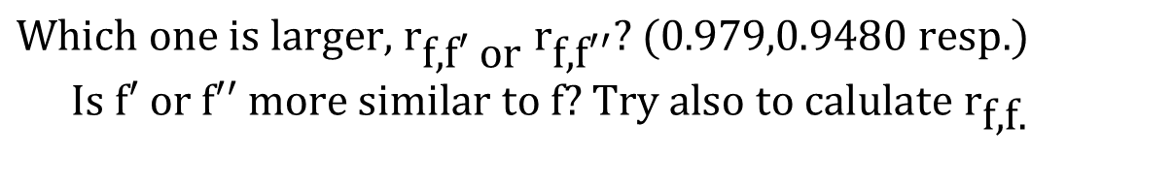
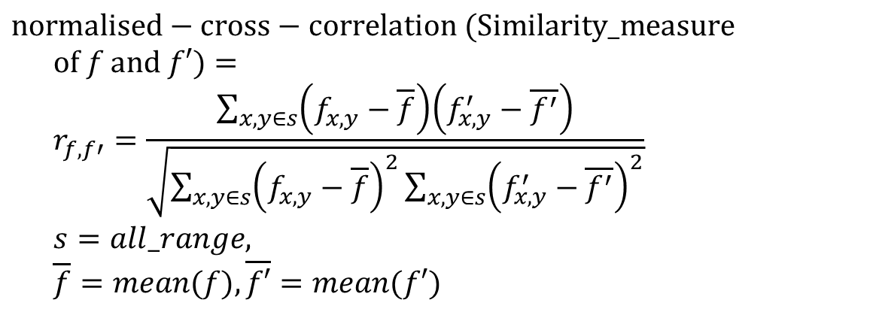
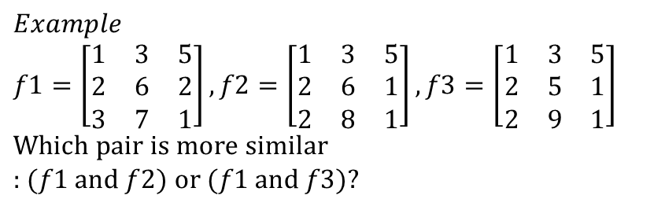
$$\text{Which} \text{one} \text{is} \text{larger}\text{, }{\text{r}}_{\text{f}\text{,}\text{f}\text{′ }\text{or} }r_{\text{f}\text{,}\text{f}\text{′′}}\text{? }(\text{0.979,0.9480 }\text{resp}\text{.}) \\ \text{Is} \text{f}\text{′ }\text{or} \text{f}\text{′′ }\text{more} \text{similar} \text{to} \text{f}\text{? }\text{Try} \text{also} \text{to} \text{calulate} {\text{r}}_{\text{f}\text{,}\text{f}\text{.}}$$
$$\text{normalised}−\text{cross}−\text{correlation} (\text{Similarity}\text{_}\text{measure} \text{of} f \text{and} f′)= \\ r_{f,f′}=\frac{\sum_{x,y∈s}{\left(f_{x,y}−\overline{f}\right)\left(f_{x,y}^{′}−\overline{f^{′}}\right)}}{\sqrt{\sum_{x,y∈s}{{\left(f_{x,y}−\overline{f}\right)}^{2}}\sum_{x,y∈s}{{\left(f_{x,y}^{′}−\overline{f^{′}}\right)}^{2}}}} \\ s=all_range, \\ \overline{f}=mean(f),\overline{f′}=mean(f′)$$
$$Example \\ f1=\left[\begin{matrix}1 & 3 & 5 \\ 2 & 6 & 2 \\ 3 & 7 & 1\end{matrix}\right],f2=\left[\begin{matrix}1 & 3 & 5 \\ 2 & 6 & 1 \\ 2 & 8 & 1\end{matrix}\right],f3=\left[\begin{matrix}1 & 3 & 5 \\ 2 & 5 & 1 \\ 2 & 9 & 1\end{matrix}\right] \\ \text{Which} \text{pair} \text{is} \text{more} \text{similar}\text{ : }(f1 \text{and} f2) \text{or} (f1 \text{and} f3)?$$

Slide 70
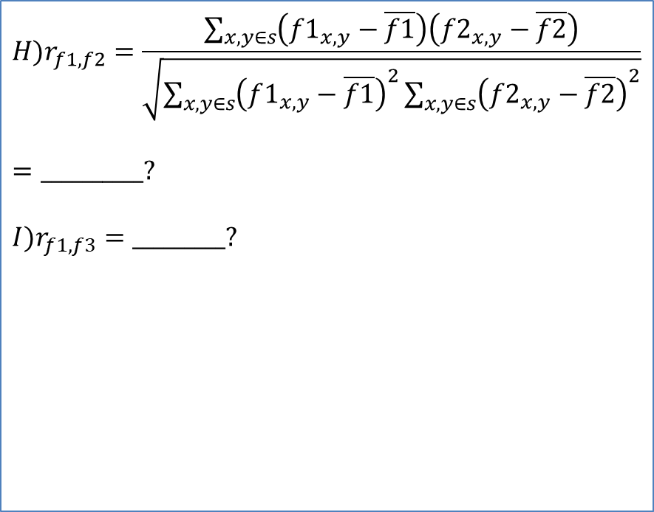
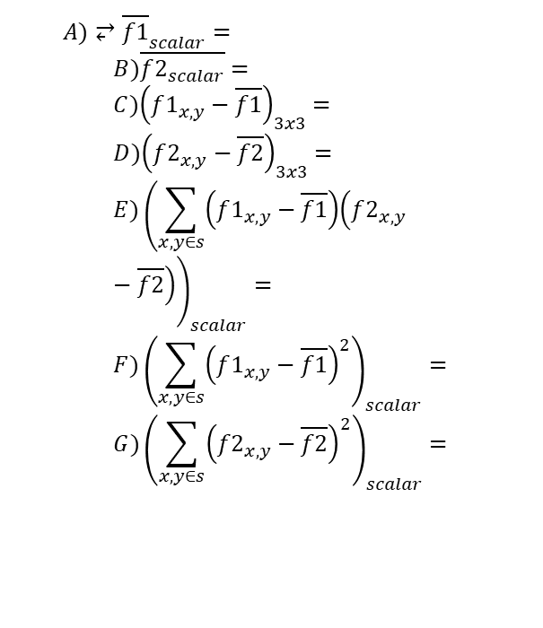

Worksheet 10
Use “Normalized cross correlation r (value from -1 to 1)” to measure similarity. S=all range
$$f1=\left[\begin{matrix}1 & 3 & 5 \\ 2 & 6 & 2 \\ 3 & 7 & 1\end{matrix}\right],f2=\left[\begin{matrix}1 & 3 & 5 \\ 2 & 6 & 1 \\ 2 & 8 & 1\end{matrix}\right],f3=\left[\begin{matrix}1 & 3 & 5 \\ 2 & 5 & 1 \\ 2 & 9 & 1\end{matrix}\right]$$
$$H)r_{f1,f2}=\frac{\sum_{x,y∈s}{\left(f1_{x,y}−\overline{f1}\right)\left(f2_{x,y}−\overline{f2}\right)}}{\sqrt{\sum_{x,y∈s}{{\left(f1_{x,y}−\overline{f1}\right)}^{2}}\sum_{x,y∈s}{{\left(f2_{x,y}−\overline{f2}\right)}^{2}}}}$$
$$=__________?$$
$$I)r_{f1,f3}=_________?$$
$$A)⥂{\overline{f1}}_{scalar}= \\ B)\overline{f2_{scalar}}= \\ C){\left(f1_{x,y}−\overline{f1}\right)}_{3x3}= \\ D){\left(f2_{x,y}−\overline{f2}\right)}_{3x3}= \\ E){\left(\sum_{x,y∈s}{\left(f1_{x,y}−\overline{f1}\right)\left(f2_{x,y}−\overline{f2}\right)}\right)}_{scalar}= \\ F){\left(\sum_{x,y∈s}{{\left(f1_{x,y}−\overline{f1}\right)}^{2}}\right)}_{scalar}= \\ G){\left(\sum_{x,y∈s}{{\left(f2_{x,y}−\overline{f2}\right)}^{2}}\right)}_{scalar}=$$

Slide 71
ANS:worksheet 10 steps A-G —
Note: sum(sum(x)))=sum all elements in matrix x
E)sum(sum((f1-mean_f1).*(f2-mean_f2)))
=sum(sum(df1.*df2)) %sum all elements
=sum(sum([-2.3333 -0.3333 1.6667
-1.3333 2.6667 -1.3333
-0.3333 3.6667 -2.3333].* [
-2.2222 -0.2222 1.7778
-1.2222 2.7778 -2.2222
-1.2222 4.7778 -2.2222]))
=
-2.3333*-2.2222 + -0.3333*-0.2222 + 1.6667*1.7778 + -1.3333*-1.2222 + 2.6667*2.7778 + -1.3333*-2.2222 + -0.3333*-1.2222 + 3.6667*4.7778 + -2.3333*-2.2222
= 43.3333
A)mean_f1=mean2(f1) is
mean_f1 = 3.3333
B)mean_f2=mean2(f2) is
mean_f2 = 3.2222
C) df1= f1-mean_f1 =
[1 3 5]
[2 6 2]- 3.33
[3 7 1]
df1=[ -2.3333 -0.3333 1.6667
-1.3333 2.6667 -1.3333
-0.3333 3.6667 -2.3333]
D) df2= f2-mean_f2 =
[ 1 3 5]
[ 2 6 1]-3.2222=sf2
[ 2 8 1]
df2= [-2.2222 -0.2222 1.7778
-1.2222 2.7778 -2.2222
-1.2222 4.7778 -2.2222]

Slide 72
ANS:ws10 steps A-G (continue)— note: sum(sum(x)))=sum all elements in matrix x
num=sum(sum((f1-mean_f1).*(f2-mean_f2)))
=43.3333
And
den=sqrt(sf1*sf2)
=sqrt(38 * 51.5556) =44.2619
Normalized_correlation_result=
num/den
= 43.3333/44.2619=0.9790
answer by Matlab function using
corr2(f1,f2)\\ (for verification)
corr2(f1,f2) = 0.9790 \\correct
'try corr2(f1,f3)'
corr2(f1,f3)=0.9480
Conclusion: by comparing correlation results, (f1 and f2) are more similar then (f1 and f3)
F)sf1=sum(sum((f1-mean_f1).^2))
sf1=sum(sum((sf1.*sf1))=
sum(sum([
(-2.3333)^2 -(0.3333)^2 (1.6667)^2
(-1.3333)^2 (2.6667)^2 (-1.3333)^2
(-0.3333)^2 (3.6667^2) (-2.3333)^2]))
sf1 = 37.7778 ≈38
G)sf2=sum(sum((f2-mean_f2).^2)) =
sum(sum([
(-2.2222)^2 (-0.2222)^2 (1.7778)^2
(-1.2222)^2 (2.7778)^2 (-2.2222)^2
(-1.2222)^2 (4.7778)^2 (-2.2222)^2]))
=51.5556

Slide 73
Matlab for 2D cross correlation
'answer by direct calculation'
'E)num=sum(sum((f1-mean_f1).*(f2-mean_f2))) is '
num=sum(sum((f1-mean_f1).*(f2-mean_f2)))
'F)sf1=sum(sum((f1-mean_f1).^2)) is'
sf1=sum(sum((f1-mean_f1).^2))
'G)sf2=sum(sum((f2-mean_f2).^2)) is'
sf2=sum(sum((f2-mean_f2).^2))
den=sqrt((sf1.*sf2))
‘result of the 2D correlation formula: num/den is'
num/den
'answer by Matlab function corr2, (for verification)’
corr2(f1,f2)
clear
f1=[1 3 5; 2 6 2; 3 7 1 ]
f2=[1 3 5; 2 6 1; 2 8 1 ]
%f3=[1 3 5; 2 5 1; 2 9 1 ]
'A)mean_f1=mean2(f1) is '
mean_f1=mean2(f1)
'B)mean_f2=mean2(f2) is '
mean_f2=mean2(f2)
'C) f1-mean_f1 is '
f1-mean_f1
'D)f2-mean_f2 is '
f2-mean_f2
sf2=sum(sum((f2-mean_f2).^2))

Slide 74
Demo Code
clear
f1=[1 3 5; 2 6 2; 3 7 1 ]
f2=[1 3 5; 2 6 1; 2 8 1 ]
f3=[1 3 5; 2 5 1; 2 9 1 ]
'A)mean_f1=mean2(f1) is '
mean_f1=mean2(f1)
'B)mean_f2=mean2(f2) is '
mean_f2=mean2(f2)
'C) f1-mean_f1 is '
f1-mean_f1
'D)f2-mean_f2 is '
f2-mean_f2
sf2=sum(sum((f2-mean_f2).^2))
'answer by direct calculation'
'E)num=sum(sum((f1-mean_f1).*(f2-mean_f2))) is '
num=sum(sum((f1-mean_f1).*(f2-mean_f2)))
'F)sf1=sum(sum((f1-mean_f1).^2)) is'
sf1=sum(sum((f1-mean_f1).^2))
'G)sf2=sum(sum((f2-mean_f2).^2)) is'
sf2=sum(sum((f2-mean_f2).^2))
den=sqrt((sf1*sf2))
'result of the 2D correlation formula: num/den is'
num/den
'answer by Matlab function corr2, (for verification)'
corr2(f1,f2)
'try corr2(f1,f3)'
corr2(f1,f3)
'end'

Slide 75
Demo Code
clear
f1=[1 3 5; 2 6 2; 3 7 1 ]
f2=[1 3 5; 2 6 1; 2 8 1 ]
f3=[1 3 5; 2 5 1; 2 9 1 ]
'A)mean_f1=mean2(f1) is '
mean_f1=mean2(f1)
'B)mean_f2=mean2(f2) is '
mean_f2=mean2(f2)
'C) f1-mean_f1 is '
f1-mean_f1
'D)f2-mean_f2 is '
f2-mean_f2
sf2=sum(sum((f2-mean_f2).^2))
'answer by direct calculation'
'E)num=sum(sum((f1-mean_f1).*(f2-mean_f2))) is '
num=sum(sum((f1-mean_f1).*(f2-mean_f2)))
'F)sf1=sum(sum((f1-mean_f1).^2)) is'
sf1=sum(sum((f1-mean_f1).^2))
'G)sf2=sum(sum((f2-mean_f2).^2)) is'
sf2=sum(sum((f2-mean_f2).^2))
den=sqrt((sf1*sf2))
'result of the 2D correlation formula: num/den is'
num/den
'answer by Matlab function corr2, (for verification)'
corr2(f1,f2)
'try corr2(f1,f3)'
corr2(f1,f3)
'end'

Slide 76
Worksheet 11
Please verify the following results
f1=[1 3 5;
2 6 2;
3 7 1 ]
f2=[1 3 5;
2 6 1;
2 8 1 ]
f3=[1 3 5;
2 5 1;
2 9 1 ]
corr2(f1,f2) % normalized correlate f1 and f2, result =0.9790
corr2(f1,f3) % normalized correlate f1 and f2 , result =0.9480
MC question
Which pair is more similar:
(f1,f2); or
(f1,f3)?

Slide 77
Answer: Worksheet 11
Please verify the following results
f1=[1 3 5;
2 6 2;
3 7 1 ]
f2=[1 3 5;
2 6 1;
2 8 1 ]
f3=[1 3 5;
2 5 1;
2 9 1 ]
corr2(f1,f2) % normalized correlate f1 and f2, result =0.9790
corr2(f1,f3) % normalized correlate f1 and f2 , result =0.9480
MC question
Which pair is more similar:
(f1,f2); or
(f1,f3)?
answer by Matlab function using
(ans1) corr2(f1,f2)\\ (for verification)
corr2(f1,f2) = 0.9790 \\correct
(ans2) 'try corr2(f1,f3)'
corr2(f1,f3)=0.9480. Ans1 is correct because 0.9790> 0.9480

Slide 78

Worksheet 12
(student revision exercise)
$$f=\left[\begin{matrix}1 & 4 & 6 \\ 3 & 2 & 3 \\ 1 & 1 & 2\end{matrix}\right],$$
$$f^{′}=\left[\begin{matrix}2 & 4 & 6 \\ 3 & 7 & 3 \\ 6 & 1 & 2\end{matrix}\right],$$
$$f"=\left[\begin{matrix}1 & 5 & 5 \\ 2 & 4 & 2 \\ 2 & 2 & 3\end{matrix}\right] \\ compare \\ correlate(f,f′) \\ and \\ correlate(f,f")$$
Compare
Which pair is more similar
(1) (f,f’)
Or
(2) (f,f”)?

Slide 79


Answer: 12
%Answer by matab
clear
F=[
1 4 6
3 2 3
1 1 2]
F_pi=[
2 4 6
3 7 3
6 1 2]
F_pipi=[1 5 5
2 4 2
2 2 3]
corr2(F,F_pi)
corr2(F,F_pipi)
%ans $(f,f′)$ =
% $(f,f′)$=corr2(F,F_pi)=0.3597
%ans $(f,f")$=
%$(f,f")$=corr2(F,F_pipi)=0.7513
$$f=\left[\begin{matrix}1 & 4 & 6 \\ 3 & 2 & 3 \\ 1 & 1 & 2\end{matrix}\right],$$
$$f^{′}=\left[\begin{matrix}2 & 4 & 6 \\ 3 & 7 & 3 \\ 6 & 1 & 2\end{matrix}\right],$$
$$f"=\left[\begin{matrix}1 & 5 & 5 \\ 2 & 4 & 2 \\ 2 & 2 & 3\end{matrix}\right] \\ compare \\ correlate(f,f′) \\ and \\ correlate(f,f")$$
Answer: the pair (f,f”) is more similar because normalized correlation is larger

Slide 80


Use of cross-correlation
Feature extraction and tracking: for image 1(f) and image 2(g) find windows of corner features
Image1(f) (at Time=1) Image2(g) (at time=2)
Corner Features are shown by overlaid markers on images

Slide 81
Procedure
For( i=1;i<=enough features; i++)
{In image 1 search for corner features f_{i} and record its position (xi,yi)
In image 2 search around position (xi,yi) for possible corner windows: g_{i}(j), j=1…J. E.g. there are g_{i}(j=1), g_{i}(j=2), g_{i}(j=3),...
Use correlation to determine correspondence
  r_{i}(j=1)=Correlation (f_{i},g_{i}(j=1))
  r_{i}(j=2)=Correlation (f_{i}, g_{i}(j=2))
  r_{i}(j=3)=Correlation (f_{i}, g_{i}(j=3))…
  …j=4,j=5..………………..
  Select j’ with the highest r, so f_{i} corresponds to g_{i}(j’)
}
i pairs of correspondences are found

Slide 82



In image 1, f_{i} is a window with a corner feature.
In image 2, g_{i}(j=1),g_{i}(j=2),....are windows with corner features.
Find correspondence between f₁ in Image2: choose between
“f_{i} correspondence to g_{i}(j=1)”, or “f_{i} correspondence to g_{i}(j=2)”
Example
Image1 (at Time=1) Image2 (at time=2)
f_{i}:a small window
g_{i}(j=1)
g_{i}(j=2)
r_{i,j=1}= correlation(f_{i},g_{i}(j=1))
r_{i,j=2}= correlation(f_{i,}g_{i}(j=2))
Pick the window with a bigger ri(j)

Slide 83
Color models and space
To find out what is color

Slide 84
Color models and space
A color model is a system used to describe a color. For example, with Red, Green and Blue (RGB) elements or Cyan, Magenta, Yellow and Black (CMYK).
A color space is a way of mapping real colors to the color model's particular values.
https://www.pantone.com/articles/color-fundamentals/color-models-explained

Slide 85


Color models
Cartesian-coordinate representation
  RGB (Red , Green , Blue)
Cylindrical-coordinate representation
  HSV (Hue, saturation, value)
  HSL (Hue, saturation, Light)
  etc
RGB
HSV
  http://en.wikipedia.org/wiki/HSL_and_HSV#From_HSV

Slide 86
Color models
Cartesian-coordinate representation
  RGB (Red , Green , Blue)
Cylindrical-coordinate representation
  HSV (Hue, saturation, value)
  HSL (Hue, saturation, Light)
  Etc
CMYK (C=CYAN, M=MAGENTA, Y=YELLOW, AND K=BLACK) model for printing
RGB
HSV
  http://en.wikipedia.org/wiki/HSL_and_HSV#From_HSV

Slide 87

(1) Hue色調
http://en.wikipedia.org/wiki/Hue
“the degree to which a stimulus can be described as similar to or different from stimuli that are described as red, green, blue, and yellow,”
The same numerical value for ‘Hue’ in HSV and HSL representations of the same picture
Encoded in degree
max=max_value(R,G,B)
min=min_value(R,G,B)
if R = max, H1 = (G-B)/(max-min)
if G = max, H1 = 2 + (B-R)/(max-min)
if B = max, H1 = 4 + (R-G)/(max-min)
H = H1 * 60
Hue

Slide 88

Cylindrical geometry of Hue (0-360º)
Mixing
Red/Green
Mixing
Green/Blue
Mixing
Blue/Red
0º
Red
Primary
120º
Green
Primary
240º
Blue
Primary
Wrap round
http://en.wikipedia.org/wiki/File:Hsv-hexagons-to-circles.svg

Slide 89

(2) Lightness亮度:
3 different methods to encode brightness:
Intensity (I), Value (V), Light (L)
Given an RGB_{raw} (each channel 0-255 levels) pixel of a picture.
Normalize it first , e.g. each channel is 8-bit.
R=R_{raw}/255; G=G_{raw}/255; B=B_{raw}/255;
$$M=Max(R,G,B) \\ m=Min(R,G,B) \\ C=M−m \\ \text{Method}\text{ 1− }\text{HSI}\text{ :}I=\left(1/3\right)\left(R+G+B\right) \\ \text{Method}\text{ 2−}\text{HSV}\text{: }V=M \\ \text{Method}\text{ 3−}\text{HSL}\text{: }L=\left(1/2\right)\left(M+m\right)$$

Slide 90

(3) Saturation色彩飽和度
Saturation: “Saturation is the colorfulness of a color relative to its own brightness” from http://en.wikipedia.org/wiki/Colorfulness
Not the same numerical values for HSV and HSL representations of the same picture
HSV
HSL

Slide 91




Different saturation (s) values (range 0-1)
The effect of S
S=1 =0.75 =0.5 =0.25
Less water
More water

Slide 92




Saturation Calculation
$$M=Max(R,G,B) \\ m=Min(R,G,B) \\ C=M−m \\ I=\left(1/3\right)\left(R+G+B\right) \\ V=M \\ L=\left(1/2\right)\left(M+m\right)$$
If R=G=B,it is white or gray (no color, S=0)
H is from 0 to 36$0^{∘}$.S,V are from 0 to 1
$$S_{HSV}=\left\{\begin{matrix}0, if M=0 \\ C/V, otherwise\end{matrix}\right. \\ S_{HSL}=\left\{\begin{matrix}0, if C=0 \\ C/2L, if L≤1/2 \\ C/(2−2L), if L⟩1/2\end{matrix}\right. \\ S_{HSI}=\left\{\begin{matrix}0, if I=0 \\ 1−\frac{m}{I}, otherwise\end{matrix}\right.$$
HSV
https://vocal.com/video/rgb-and-hsvhsihsl-color-space-conversion/
http://en.wikipedia.org/wiki/HSL_and_HSV

Slide 93




Exercise 13: From RGB (3x8-bit) to HSV
H is from 0 to 36$0^{∘}$.S,V are from 0 to 1
max= max_value(R,G,B) ------------------(1)
min=min_value(R,G,B) --------------------(2)
if R = max, H1 = (G-B)/(max-min) -------(3)
Note: if R =max, G,B <max, hence -1< (G-B)/(max-min) <1
if G = max, H1 = 2 + (B-R)/(max-min)---(4)
if B = max, H1 = 4 + (R-G)/(max-min) --(5)
H = H1 * 60----------------------------------(6)
V=max/255------------(normalized V)--(7)
if H < 0, H = H + 360
s=(max-min)/max---------------------------(8)
Note
$$a)\text{When} V=0.5,H=0^{∘}\text{,}\text{S}=\text{1,}$$
$\text{what} \text{is} \text{the} \text{color}\text{ ?___}$. MC question:
(1) red ; (2) blue ; (3) green; (4) white
$$b)\text{When} V=0.2,H=120^{∘}\text{,}\text{S}=0.8\text{,} \text{find} \text{RGB} \text{values}\text{:?}\text{__} \\ c)\text{When} V=0.6,H=2\text{60}\text{,} \text{S}=\text{0.5,}\text{find} \text{RGB} \text{values}\text{:?}\text{__} \\ d)\text{When} V=0,H=0^{∘}\text{,}\text{S}=\text{1,}\text{find} \text{RGB} \text{values}\text{:?}\text{__} \\ e)\text{When} V=1,H=0^{∘}\text{,}\text{S}=\text{1,}\text{find} \text{RGB} \text{values}\text{:?}\text{__}$$
Hue (0->
360º)
H1=5 to 1
H=300→60º
H1=5 to 1
H=300→60º
H1=1 to 3
H=60→180º
H1=3 to 5
H=180→300º

Slide 94
Answer a,b: From RGB (3x8-bit) to HSV
a) when V=0.5,H=0,S=1, the color is :
From (7) max=0.5*255=127.5
From (8) S=(max-min)/max=1,
max-min=max, hence min=0, Since H=0,
the only formula for H1 is (3), because
the other formulas will make H more than 0
From (3) H1 = (G-B)/(max-min)
(G-B)/127.5=0 , so G=B=0, hence R=127.5
(MC choice 1 is correct ) The color is pure red.
----------------------------------------
b) V=0.2,H=120,S=0.8
H=120 hence H1=2 by formula (6)
From (7) max=M=0.2*255=51. Put m=Min
From (8) S=(M-m)/M=0.8, hence m=0.2*M=10.2
Since H1=2, eq(4) is the choice and G= max.
Because B,R are smaller than max. Hence -1< (B-R)/(max-min)<1
From (4) H1 =2+ (B-R)/(max-min)
2+(B-R)/(51-10.2)=2 , so B=R , and min is B (or R) =10.2 is the solution
The color RGB is (10.2,51,10.2). It is green.
max=max_value(R,G,B) ------------------(1)
min=min_value(R,G,B) --------------------(2)
if R = max, H1 = (G-B)/(max-min) -------(3)
if G = max, H1 = 2 + (B-R)/(max-min)---(4)
if B = max, H1 = 4 + (R-G)/(max-min) ---(5)
H = H1 * 60------------------------------------(6)
V=max/255------------------------------------(7)
if H < 0, H = H + 360
s=(max-min)/max---------------------------(8)
H=0-120 120-240 240-260
H1=0-2 2-4 4-6

Slide 95
Answer c: From RGB (3x8-bit) to HSV
c) when V=0.6,H=260,S=0.5, the color is :
From (eq7) max=0.6*255=153
From (eq8) S=(max-min)/max=0.5,
max-min=0.5*max, hence min=0.5*max=76.5 Since H=260, from (eq6) H1=260/60=4.333,
the only formula for H1 is (eq5), because
the other formulas will make H1 outside 4 to 6
From (eq5) H1 = 4 + (R-G)/(max-min)
4 + (R-G)/(max-min) =4.333
R-G= 0.333*(153-76.5)=25.47
B=max=153,
R-G=25.47, hence R must be bigger than G, hence G=76.5, so R=G+min=76.5+25.47 =101.97
The color (R,G,B)=(101.97, 153, 76.6)
The color is purple.
----------------------------------------
max=max_value(R,G,B) ------------------(1)
min=min_value(R,G,B) --------------------(2)
if R = max, H1 = (G-B)/(max-min) -------(3)
if G = max, H1 = 2 + (B-R)/(max-min)---(4)
if B = max, H1 = 4 + (R-G)/(max-min) ---(5)
H = H1 * 60------------------------------------(6)
V=max/255---------( it is normalized V)--(7)
if H < 0, H = H + 360
S=(max-min)/max---------------------------(8)
Hue 0->360º)
For eq(5), H=260, H1= 4.33
So B=max, R,G are smaller than max
Hence -1<(R-G)/(max-min)<1
H1 is ranging from 1 to 3
Or 60 to 180 degrees
H=0-120 120-240 240-360
H1=0-2 2-4 4-6

Slide 96
Answer d,e: From RGB (3x8-bit) to HSV
d) when V=0,H=0,S=1,
From (eq7) max=V*255=0*255=0,
So, min must be 0. (R,G,B)=(0,0,0)
The color is black due to no intensity value (V=0)
----------------------------------
e) when V=1,H=0,S=1,
From (eq7) max=V*255=1*255=255,
H=0, from (eq6,eq3) H1=0,
G=B, since S=1, 1=(max-min)/max
V=max/255=1, so max=255.
H1 is 0, so R=max=255.
G-B/max-min=0, G=B.
S=(max-min)/max, max=max-min.
255=255 - min, hence min =0
Therefore R=255, G=0,B=0. Pure red.
----------------------------------------
max=max_value(R,G,B) ------------------(1)
min=min_value(R,G,B) --------------------(2)
if R = max, H1 = (G-B)/(max-min) -------(3)
if G = max, H1 = 2 + (B-R)/(max-min)---(4)
if B = max, H1 = 4 + (R-G)/(max-min) ---(5)
H = H1 * 60------------------------------------(6)
V=max/255------------------------------------(7)
if H < 0, H = H + 360
s=(max-min)/max---------------------------(8)
Hue 0->360º)
H=0-120 120-240 240-260
H1=0-2 2-4 4-6

Slide 97


Exercise 14
$$M=Max(R,G,B) \\ m=Min(R,G,B) \\ C=M−m \\ I=\left(1/3\right)\left(R+G+B\right) \\ V=M \\ L=\left(1/2\right)\left(M+m\right)$$
RGB=(18,200,130)/255 Normalized.
MC question: For HSV, what is the value of V. Choices:
(1) 0.68 (3) 0.72
(3) 0.76 (4) 0.78
What are the values
for HSV,HSL,HSI?
$$S_{HSV}=\left\{\begin{matrix}0, if C=0 \\ C/V, otherwise\end{matrix}\right. \\ S_{HSL}=\left\{\begin{matrix}0, if C=0 \\ C/2L, if L≤1/2 \\ C/(2−2L), if L⟩1/2\end{matrix}\right. \\ S_{HSI}=\left\{\begin{matrix}0, if C=0 \\ 1−\frac{m}{I}, otherwise\end{matrix}\right.$$

Slide 98
Answer 14
RGB=(18,200,130)/255 Normalized
What are the values in HSV?
MC question: RGB=(18,200,130)
MC question: For HSV, what is the value of V. Choices:
V=max/255=200/255=0.78. Answer (4) is correct
(1) 0.68 (3) 0.72
(3) 0.76 (4) 0.78
Answer:
(for HSV on R=18/255, G=200/255, B=130/255)
Normalize them first will make calculation easier.
max=200/255, min=18/255, since green G=max
H1=2+(B-R)/(max-min),
H1=2+(130-18)/(200-18)=2+(112/182)=2.615, need not to show 255 since they cancel each other in numerator and denominator
H=H1*60=156.9°
S=(max-min)/max=(200-18)/200=0.91
V=max/255=200/255=0.78
HSL, HSI , see formulas in note
H=156.9 degrees (green)
H=0-120 120-240 240-260
H1=0-2 2-4 4-6

Slide 99
Use of HSV color model
Change intensity of a color picture
Camera captured images are in RGB (hardware constraint)
Change the RGB representation to HSV
You may change the intensity (V) of the picture.
The other two channels (H,S) remain unchanged.
Put back the changed HSV image back to RGB and display.
The intensity of the picture will be change but the color of the pixels remain the same.
Can use the similar idea for HSI , HSL etc.

Slide 100

CMYK color model
CMYK (C=CYAN, M=MAGENTA, Y=YELLOW, AND K=BLACK): used for printing
R' = R/255,G' = G/255,B' = B/255
C = 1 - R’
M = 1 - G’
Y = 1 - B'
K = 1-max(R', G', B’) %K is used for printing black
Inkjet printer ink :cyan, magenta, yellow and black
https://en.wikipedia.org/wiki/CMYK_color_model
https://www.rapidtables.com/convert/color/rgb-to-cmyk.html
https://www.printer888.com/

Slide 101
Stereo
From 2D images 3D information

Slide 102

3-D computer vision, an overview
Find 3-D structure using 2-D images
One camera:
  Possible but limited results, e.g. by identify vanishing lines
Two cameras:
  Stereo: (This section)
Three cameras:
  Trifocal tensor method (very advanced not discussed here)
N cameras:
  Factorization (Chapter 9), fast method, moderate accuracy
  Bundle adjustment (chapter 11), slow but accurate.

Slide 103
Epipolar geometry (advanced technique, not discussed here)
Stereo camera setup
Essential matrix (E)for describing the geometry between two cameras of known intrinsic parameters
Fundamental matrix (F) for describing the geometry between two cameras of unknown intrinsic parameters
Epipolar geometry: parameters and characteristics
The Correspondent problem
3D Reconstruction using stereo vision

Slide 104
A simple approach 3-D reconstruction from stereo images
Assumption : the cameras are parallel (2 principal axes are parallel) and the camera shift is only in the horizontal direction

Slide 105


Introduction to Stereo Vision
Objectives:
  Basic idea of stereo vision
  Stereo reconstruction by epipolar geometry
    Stereo camera pair calibration (find Fundamental matrix F)
    Construct the 3D (graphic) model from 2 images
Inside a computer
e.g. Graphic
model in a game
3-D object

Slide 106
A simple stereo system
Assume cameras are aligned horizontally
(No vertical disparity)
Left
Camera
Principle
axis
Right
Camera
Principle
axis
Object
Px(x,y,z)
A point in 3D (Px)
z
Left image
plane
Right image
plane
Left
Image
plane
Right
Image
plane
x_{L}
x_{R}
Focal
Length
f
Left
optical
Center
O(left)
(reference
point)
Stereo:
Baseline (B)
Right
optical
Center
O(right)
B (Baseline)
Left camera center
(reference point)
Horizontal
Disparity=x_{L}-x_{R}
Notes:
You may close your left eye and see an object in front of you, then close you right eye and see the same object. The object seems to be moved because both eyes are seeing things at a different angle and it gives us the clues for reconstruction of the 3-D model. The slight motion of the object in the images is called disparity.

Slide 107

Example: Assume cameras are aligned horizontally (No vertical disparity)
Left image Right image
White crosses are
overlaid on images
to show the positions
of features.
They are not
in the original pictures.
Horizontal search range=S and some tolerance for dx (around [x_{L},y_{L}])
for (x’ = XL-dx-S, x’<=XL+dx, x’++) %assume dx=10, S=30
{ W’ = a (11 x 11) window centered at (x’, YL);
c(x’) = correlation(WL, W’);
}
Find index of max {for all c(x’)}= x_{R}”. Hence, the corresponding window is centered at (x_{R}”,y_{L}), and Horizontal disparity = (x_{L}-x_{R}”). Note: Since the features on the Right-image should move left (due to the camera moves right) , so E is added to extend the search for the left side. The actual parameter dx and S are set by the user depending on the camera motion and depth of the object.
WL
A corner feature is found
in a window (WL) (e.g. 11x11 )
centered at the
left image (x_{L},y_{L})
(the blue window
covering a cross).
The inside cross is at (x_{L},y_{L}).

Slide 108

Triangular calculation
Left
Camera
Principle
axis
Right
Camera
Principle
axis
Object
Px(x,y,z)
By similar triangle,
w.r.t left camera lens center
$$\frac{x}{z}=\frac{x_{l}^{′}}{f}\text{, } \\ \frac{(x−b)}{z}= \frac{x_{r}^{′} }{f} \\ \text{elimate} x⇒z=\frac{f•b_{}}{(x_{l}^{′} −x_{r}^{′})}$$
z
x
Left
Image
plane
Right
Image
plane
x’_{l}
x’_{r}
Focal
Length
f
b (Baseline)
By similar triangle,
w.r.t right camera lens center
Left camera center
(reference point)
Horizontal
Disparity=x_{L}-x_{R}
One major problem is to locate x’l and x’r The correspondence problem
Notes:
After the correspondences of corner features are obtained we can use the horizontal shifts (called horizontal disparities of these 2-D features) to find the 3D positions of the 3-D features (find the Z-value of each feature) using the triangulation method.

Slide 109
Stereo vision example: step1:feature extraction (e.g. Harris operator) : for the left and right image find features and locate their windows
Left image right image
Features are shown by overlaid markers on images

Slide 110
Object recognition
techniques

Slide 111
Object recognition problems
What are the object recognition problems?
How to build the systems and evaluate the results?
Solutions and models
  Object recognition models
  Object localization models
  Segmentation models

Slide 112

Problems: Object Recognition vs Object Detection vs Image Segmentation
https://www.kaggle.com/getting-started/169984
https://www.geeksforgeeks.org/object-detection-vs-object-recognition-vs-image-segmentation/
What?
Where?

Slide 113



Example
Classification
Segmentation

Slide 114

What are the object recognition systems?
2021
COCO - Common Objects in Context (cocodataset.org) and
LVIS 2021 Challenge and Workshop
Classic datasets
  Datasets: Data set VOC2012
  Evaluation: How to evaluate the object recognition system
  System building : ImageNet Large Scale Visual Recognition Challenge (ILSVRC)

Slide 115






Data set VOC2012 is used in many development systems, images and their Segmentation Classes are given
Download the training/validation data (2GB tar file) http://host.robots.ox.ac.uk/pascal/VOC/voc2012/VOCtrainval_11-May-2012.tar
http://host.robots.ox.ac.uk/pascal/VOC/voc2012/index.html
Source
Images
Group truth Classes and Segmentation Class (pixelwise) are given in dataset
cyclist 2008_000033 airplane
2008_000033
airplane

Slide 116

YoloV3 (You only look once YOLO version 3): Each cell in the output layer’s feature map predicts 3 boxes in the case of Yolo-V3 and 5 boxes in YOLO-V2
d
Yolo
demo
video : https://www.youtube.com/watch?v=69Ii3HjUiTM&t=17s
https://towardsdatascience.com/yolo-v3-explained-ff5b850390f

Slide 117
Conclusion
Some essential image processing methods such as edge detection, convolution, correlation and color modeling were briefly introduced
Some essential computer vision methods such as camera model, stereo vision were briefly introduced
Ideas of using neural networks for object detection and recognition was discussed.

Slide 118
References
Opencv: https://opencv.org/
Digital image processing https://en.wikipedia.org/wiki/Digital_image_processing
What is computer vision? https://www.ibm.com/topics/computer-vision

Slide 119
Appendix1
Recognition using
Histogram of oriented gradients (HOG) feature
KH Wong

Slide 120

Introduction
Find a way to describe an image for recognition. Very popular in computer vision.
Example
A vector of 34596x1

Slide 121

An example
An image is divided into 8x8 cells
An image is divided into 8x8 cells
Inside each cell
  Gradients for each pixel are quantized in 20 degrees (or 180/20=9 bins). Gradients of the pixels form a histogram, which is represented by a vector of 9x1.
2x2 cells form a block.
  Thus, there are (8-1)*(8-1)=7x7 blocks in the image if the block shift (stride) is 1 cell (or 8 pixels).
  Each block has 2x2x9 features, a vector of 36x1 .
  Then , the 36 features are normalized, So that a cell in different blocks may have different values. See https://datascience.stackexchange.com/questions/123376/histogram-of-oriented-gradients-hog-why-normalize-16x16-blocks-and-not-the-w
Finally, an image will be represented by a vector of (8-1)*(8-1)*36=7*7*36=1764 features (the HOG feature vector is 1764x1)
A block has 2x2 cells
Each cell has 8x8 pixels
8 cells
8
cells
A cell has 8x8 pixels
https://medium.com/@dnemutlu/hog-feature-descriptor-263313c3b40d

Slide 122

HOG histogram calculation for each cell
Bin(j)=
0 | 1 | 2 | 3 | 4 | 5 | 6 | 7 | 8
Center C(j)=
0 | 10 | 20 | 40 | 60 | 80 | 100 | 140 | 160
In
degrees
Or 180
165
Gap=gap between 2 bins =20
Gradient angle=a;
Gradient magnitude=m
If ‘a’ is between centers C(j) ,C(j+1), It will contribute to Bin(j) and Bin(j+1)
E.g. a=165 is in between C(j)=160 (of bin(8)), C(j+1)=180 (next bin is bin(0) ), m=85, gap=20.
Note: the next bin to bin(8) is bin(0)
Contribution to bin(j) : V(j).
V(j=8) =m*(C(j+1)-a)/gap =85*(180-165)/20=63.5
V(j=0) =m-V(j=8)=85-63.5=21.5
8x8 pixels cell
85
Each pixel ,
gradient angle a
Each pixel , gradient
magnitude m
21.5
63.5
Formulas: V(j) = Contribution to bin(j)
V(j)= m*(C(j+1)-a)/gap
V(j+1)= m-V(j)

Slide 123

Gradient histogram calculation for each cell
You may use the 2 previous formulas for calculation, but it is easy to find the answers by intuition.
  When a=80 (blue), the magnitude 2 goes to bin (5) whose center =80
  For a=10 (red) degrees, because it is at the middle between 2 bins: bin(1) centered at 0 degrees, and bin(2) centered at 20 degrees, the magnitude 4 is split equally between the 2 bins.
We have 9 bins , 20 degrees for each bin. Gradient angle bins more than 180 will be the same those between 0-180 because they have same orientations.

Slide 124

Normalization for each block
After obtaining the values inside 9 bins of a cell, we combine 2x2 cells to become a block, so the block has $\left[b_{i=1},b_{i=2},…,b_{i=36}\right]$values.
Normalization:
$k=\sqrt{b_{i=1}^{2}\text{+} b_{i=2}^{2}\text{+} b_{i=3}^{2}\text{+...}\text{+} b_{i=36}^{2}}$
Normalized bin values:$\left[\frac{b_{i=1}}{k},\frac{b_{i=2}}{k},…,\frac{b_{i=36}}{k}\right]$
https://towardsdatascience.com/hog-histogram-of-oriented-gradients-67ecd887675f
https://learnopencv.com/histogram-of-oriented-gradients/

Slide 125
Summary of HOG
Studied the method of the HOG method
Calculation of HOG is introduced.

Slide 126
Appendix2
Camera Extrinsic parameters for image formation
Parameters outside the camera
Study the rotation and translation of the camera relative to the original position

Slide 127
Perspective
Projective
World Coordinates
Z_{w}
Y_{w}
X_{w}
Model M at t=1
O_{W}=(0,0,0)
(World center)
v-axis
image
(X,Y,Z)
R_{c},
T_{c}
Yc-axis
Camera
Coordinates.
(u,v)
Zc-axis
Principal axis
O_{c}=(0,0,0)
(Camera center)
c (Image center, o_{x},o_{y})
u-axis
F=focal length
Xc-axis
Notes:
There are many useful parameters that you need to know.
The most important parameters are:
Focal length
Camera center
Other useful parameters are:
Principal axis
Image center

Slide 128
Inspection exercise
Explain what are these variables.
  F =(focal length)
  C=(ox,oy)
  Zc = principal axis
  Oc =Camera center
  (u,v) image 2-D axes
  (Xc,Yc,Zc) 3-D axes
Focal length is the length between the lens and the image (screen)
Camera center is the origin of the camera coordinate system
Principal axis is the vector perpendicular to the image and intersects with the camera center
Image Center is the center the 2D image , or the point that the principal axis intersects with the image

Slide 129

The most important concept for a camera is the image formation process
3D Object points (X_{w},Y_{w},Z_{w}): world coordinates
Step1:
Motion of camera (R_{cam}=R_{c}⁻¹,T_{cam})
Camera Coordinates(rotated, translated)
result → X_{c},Y_{c},Z_{c}
Step2:
Projection of camera (F)
Result → image (x,y)
Notes:
\documentclass{article} %for testing formulas ppt cam,
\usepackage{amsmath}
\begin{document}
%%%###### slide 7 ################
\begin{flalign}
\begin{aligned}
R_{cam} = R_c^{-1}, T_{cam}
\end{aligned}
\end{flalign}
\end{document}

Slide 130



Step1 of image formation
Motion of camera (R_{cam},T_{cam}) Camera Coordinates
result → Xc,Yc,Zc
Positive rotation angle about an axis: The thumb is pointing to the axis direction; a positive rotation angle is the same direction as the other fingers.
Y_{c}
Camera coordinates
R_{cam}=(R_{c})⁻¹, and T_{cam}=T_{c}
Thumb pointing Axis direction
X_{c}
Y_{w}
Z_{w}
Z_{c}
θ_{y}
θ_{z}
world coordinates using the Right-hand coordinate system
X_{w}
θ_{x}
Notes:
We have two coordinate systems,
(i) Camera coordinate system and (ii) world coordinate system.
The realtion between these two systems is Rc and Tc as shown

Slide 131

Rotation notations: Roll pitch yaw in aviation systems
They are the same systems– (you will see it if you turn the plane up side down). It is called the Right hand coordinate system.
http://www.grc.nasa.gov/WWW/k-12/airplane/rotations.html
http://planning.cs.uiuc.edu/node102.html
Yw (Pitch angle)
Y_{w}
Z_{w}
θ_{y}
Xw (Roll angle)
θ_{z}
Right-hand coordinates
Zw (Yaw angle)
X_{w}
θ_{x}

Slide 132
Extrinsic parameters M_{ext}
External camera parameters
Move the camera to a new position

Slide 133
The camera moves to a new position :
Rotate of the camera Rcam, and translate (T_{C}) to a new position
P_{w}
Z_{w}
Y_{w}
Camera
coordinates
Y_{c}
Z_{c}
R_{c}
X_{c}
T_{Cam}= T_{C} =camera translation
in the world coordinates
Rcam
Rotation
World center
Camera center
X_{w}
Convention used: In this chapter we rotate the camera theta_z (angle around z axis) first, then theta_y and finally theta_x.
World coordinates
(reference)
Notes:
The world coordinate system is always the reference. The camera is first placed at the world center and then translated to Tc (Tc is actual a vector in the world coordinate system).
Then it is rotated using a transformation Rc which can rotate a vector in the world coordinate system to the camera coordinate system.
What we want to know is what is a point Pw (in the world coordinate system) should be described (as Pc) in the camera coordinate system.
The answer is Pc=Rc(Pw-Tc), we are about to show it

Slide 134


Coordinate change calculation
In the following slides, assume the world coordinate sys. does not change
The object Pw does not change
Only the camera coordinate system has changed, therefore Pc will change because it is measure in the camera coordinate system.
Pc is the same point as Pw but measured in the camera coordinates
$$P_{c}=\left[\begin{matrix}X_{c} \\ Y_{c} \\ Z_{c}\end{matrix}\right],$$
P_{w}
$$P_{w}=\left[\begin{matrix}X_{w} \\ Y_{w} \\ Z_{w}\end{matrix}\right]$$
Z_{w}
Y_{w}
Camera
coordinates
Y_{c}
Z_{c}
R_{c}
X_{c}
T_{Cam}= T_{C} =camera translation
in the world coordinates
Rcam
Rotation
World center
Camera center
X_{w}

Slide 135

Advanced idea: the rotation matrix Rc and Translation vector Tc
M_{ext} (3x4)Matrix form
When Tc is not Zero
P_{w}
Y_{w}
Camera
coordinates
Z_{c}
Y_{c}
X_{c}
Z_{w}
T_{C}= camera translation
R_{cam}=(R_{c})⁻¹
Camera center
$$P_{c}=R_{c}(P_{w}−T_{c}) \\ \text{refer} \text{to} \text{slide}\text{16} \\ {\left[\begin{matrix}X_{c} \\ Y_{c} \\ Z_{c} \\ 1\end{matrix}\right]}_{(4×1)}={\left[\begin{matrix}R_{c} & −R_{c}∗T_{c} \\ 0 & 1\end{matrix}\right]}_{(4×4)}{\left[\begin{matrix}X_{w} \\ Y_{w} \\ Z_{w} \\ 1\end{matrix}\right]}_{(4×1)},\text{select} \text{the} \text{first}\text{ 3 }\text{rows} \\ {\left[\begin{matrix}X_{c} \\ Y_{c} \\ Z_{c}\end{matrix}\right]}_{\left(3×1\right)}={R_{c}}_{(3×3)}{\left[I_{3}|−T_{c}\right]}_{(3×4)}{\left[\begin{matrix}X_{w} \\ Y_{w} \\ Z_{w} \\ 1\end{matrix}\right]}_{\left(4×1\right)}=M_{ext_{(3×4)}}{\left[\begin{matrix}X_{w} \\ Y_{w} \\ Z_{w} \\ 1\end{matrix}\right]}_{(4×1)}$$
X_{w}
World center
World coordinates
(reference)
Notes:
After studying the effect of pure camera rotation where Tc=0, we now study the problem when the camera has translation Tc.
From the diagram you should observe that , the vector from the camera (camera center) to the top of the Christmas tree is equal to Pw-Tc.
So now we have a vector (Pw-Tc, from the camera center to the Christmas tree top) in the world coordinates,
we want to know how the vector is described in the camera coordinate system, so Rc is no used.
We learned that a vector P in the world coordinates is described as Pc= Rc*P=Rx*Ry*Rz*P
if the coordinate system is rotated Rz in the z-axis, Ry in the y-axis and Rx-in the x-axis.
Hence the total transformation (combining translation and rotation) becomes Pc=Rc(Pw-Tc)
That means a point Pw in the world coordinates is the same point Pc in the camera coordinates if the camera is translated and rotated.
%%% latext formula
%%%% %%% p 45 %%%%%%%%%%
slide 45
\begin{flalign}
\begin{aligned}
%=================
%...... 1 ......................................
P_x&=R_c(P_w-T_c)\\
%...... 2 ......................................
\begin{bmatrix}
X_c\\
Y_c\\
Z_c\\
1
\end{bmatrix}_{(4 \times 1)}&=
\begin{bmatrix}
R_c &-R_c*T_c\\
0 &1
\end{bmatrix}_{(4 \times 4)}
\begin{bmatrix}
X_w\\
Y_w\\
Z_w\\
1
\end{bmatrix}_{(4 \times 1)}\\
%...... 3 ......................................
\begin{bmatrix}
X_c\\
Y_c\\
Z_c
\end{bmatrix}_{(3 \times 1)}&=R_{c(3 \times 3)}
[I_3 | -T_c]_{(3 \times 4)}
\begin{bmatrix}
X_w\\
Y_w\\
Z_w\\
1
\end{bmatrix}_{(4 \times 1)}=
M_{ext(3x4))}\begin{bmatrix}
X_w\\
Y_w\\
Z_w\\
1
\end{bmatrix}_{(4 \times 1)}
%=================
\end{aligned}
\end{flalign}

Slide 136
Appendix3
Color space : CIE1931 standard
Created by the Commission Internationale de l´Eclairage
(CIE) in 1931.

Slide 137

Overview of Color space
Introduction
What is color space?
Application of color space
Reference:
https://en.wikipedia.org/wiki/CIE_1931_color_space
https://medium.com/hipster-color-science/a-beginners-guide-to-colorimetry-401f1830b65a
https://graphics.stanford.edu/courses/cs148-10-summer/docs/2010--kerr--cie_xyz.pdf
https://medium.com/hipster-color-science/a-beginners-guide-to-colorimetry-401f1830b65a

Slide 138




Light and perception
Spinach reflectance
Reflectance
When sun light (all wavelengths) shine on a spinach leaf, you see green because other wavelength light , expect green – M cones) is absorbed. Also, we are not sensitive to red over 700nm
wavelength
Eye cone cell responses:
Short(S), Medium(M), Long(L) wavelength
Sensitivity
wavelength
Cone cells for color vision
(Short(S), Medium(M), Long(L) wavelengths)
spinach leaf
https://unsplash.com/s/photos/spinach-leaves
https://www.blueconemonochromacy.org/how-the-eye-functions/

Slide 139


The color matching experiment in 1920s by Wright/Guild
Right side: reference light
Left side: 3 Primary lights
  blue: 436 nm (short)
  green: 546 nm (medium)
  red: 700 nm (long)
Change reference light wavelength 380 nm to 780 nm at 1 nm intervals
Short
Medium
Long
Primary light
reference light
Luminosity
Ask human observers to judge the left/right are same
Wavelength
Experimental results: The experiment for CIE1931 https://medium.com/hipster-color-science/a-beginners-guide-to-colorimetry-401f1830b65a

Slide 140

(Mixing 3 colors on the left to match a reference color on the right)
Experimental result with “negative” light
3 Primary light, Reference light
B, blue: 436 nm
(Short)
G, green: 546 nm
(Medium)
R, red: 700 nm
(Long)
(fixed wavelengths)
Positive
zero
Negative
The dots are Luminosity of the 3 primary lights
moving from 380 to 780 nm
Add negative light to reference to enable left/right matches
Human observer
Right side: Ref. light, changes from 380 nm to 780 nm, 1nm intervals
Left side: control luminance of 3 lights (fixed wavelengths 436,546,700nm)
If the left side cannot produce the matched color, add “Negative“ light on the right. See the diagram when the red light is negative.
Because of the “popular” names of its three primaries, this was said to be the CIE RGB color space.
In the tristimulus system, the three primary colors are red(R), green(G), and blue(B) https://www.britannica.com/science/tristimulus-system

Slide 141


How to create the CIE diagram
Make each color a ratio
  r = R/(R+G+B)
  g = G/(R+G+B)
  b = B/(R+G+B)
rgb are chromaticity coordinates and r + g + b = 1. They are ratios.
3D curve (blue) shown below, is the chromaticity of each spectral wavelength of light, called a spectral locus. But 3D data is difficult to understand.
The 3 dots are R,G,B
So, we project the 3D curve (blue) on a 2D plane (red) , it is a tongue-shaped or horseshoe-shaped curve
Since r+g+b = 1, so if you have r,g, you can calculate b by b = 1 –r-g
Plot of 3D chromaticity [r,g,b]
The ground projected plane is [r.g]

Slide 142


The 2D tongue-shaped/horseshoe-shaped curve
Every point on the outer curve is the chromaticity coordinate of a spectral color.
Every point inside the curve is a chromaticity of a non-spectral color. (non-spectral mixing of 2 colors, it is not corresponding to a single wavelength.)
Every point outside the curve is an imaginary chromaticity that is meaningless and has no realizable color.
Our original RGB primaries, are spectral colors, so they fall on the curve.
Every point inside the triangle (R,G,B) formed by the primaries is a chromaticity that can be created with those lights.
Points inside the curve but not the triangle are real chromaticities but you would need different primary lights to create them.
Note: Cg,Cb,Cr are selected to form a triangle covering the whole gamut. Actually these 3 points are outside the visible color range. They are used to map the gamut (r,g) space to a non-negative (x,y) space.
Along the curve , it points to different wavelengths (380-780nm)
g
r can be negative
0
r
g
r

Slide 143


Convert r,g to x,y
Map R,G,B to r,g,b using matrix M
[r] | m11 m12 m13| [R]
[g] = | m21 m22 m23| * [G]
[b] | m31 m32 m33| [B]
x = r / (r + g + b)
y = g / (r + g + b)
The r,g curve is 2D but it represents 3D since r+g+b=1, b can be found.
Since in the original r,g curve (left), r can be –ve and is no good for calculation.
Map Cg to [0,1], Cb to [0,0] and Cr to [1,0], so in x,y space the curve is +ve.
r can be –ve (r, g are chromaticity coord.)
After mapping x,y are all +ve
Cg
y
Green
x,y space
(This is called the CIE1931 gamut色域)
r.g space
g
[0,1]
Cb
[0,0]
[1,0]
Red
Cr
-ve r
0
+ve r
Blue
x
https://medium.com/hipster-color-science/a-beginners-guide-to-colorimetry-401f1830b65a
https://www.cs.rit.edu/~ncs/color/t_convert.html#RGB%20to%20XYZ%20&%20XYZ%20to%20RGB

Slide 144


After mapping
(x y are positive now)
color1
x,y space
(CIE1931 gamut色域)
All points inside the gamut are visible colors
CIE1931 gamut shows human responses to color and independent of certain devices, e.g. computer/phone monitors.
I.e. Color_x can be generated by combining 2 extreme points (color1,color2) along the line
y
Color_x
color2
x
Map x,y space back to X,Y,Z responses,
the curves are all on the +ve side

Slide 145


Real world color space:
Define a color gamut map based CIE1932 gamut (色域)
Companies define triangles (vertexes are their R,G,B) inside the CIE1931 gamut for use in their products.
CIE1931, primaries:
  red: 700 nm
  green: 546 nm
  blue: 436 nm
Adobe RGB, primaries:
  red = 612 nm,
  green = 535 nm,
  blue = 465 nm
sRGB (HP/Microsoft ), primaries:
  red ≈ 610nm,
  green ≈ 555nm,
  blue ≈ 465nm.
Application: provide color standards for monitor, printer, phone to reproduce the same color.
Demo: Test your monitor using color-gamut
https://www.youtube.com/watch?v=S8rmPJpIQaE
CIE1931 gamut色域
D65 as a
white point
The triangle inside is sRGB
https://en.wikipedia.org/wiki/SRGB
https://en.wikipedia.org/wiki/Adobe_RGB_color_space

Slide 146


Companies can design gamut maps for their products
Define R,G,B points inside the CIE1931 gamut
  E.g. Apple-iphone uses P3 (a variant of DCI-P3)
  Standard monitors use sRGB
    E.g., BenQ-PD2705Q 100%sRGB
  Adobe RGB :
The outer shape is CIE1931 gamut, which is human responses to color and is independent of devices/products
https://en.wikipedia.org/wiki/Adobe_RGB_color_space
https://en.wikipedia.org/wiki/DCI-P3

Slide 147


Testing using color gamut
The gamut gives standard color for testing color generating equipment
White point= middle of triangle
Test your monitor using color-gamut https://www.youtube.com/watch?v=S8rmPJpIQaE
Sensor to measure color
https://www.bhphotovideo.com/
https://www.eizoglobal.com/library/basics/lcd_monitor_color_gamut/

Slide 148


Color temperature & application
Defined as the color of a star seen in the sky of a temperature in kevin (k)
For monitor calibration: set white point (color temperature)=
  5000k, white is closed to yellow
  6500k, white is closed to blue
https://en.wikipedia.org/wiki/Color_temperature
https://www.prolighting.com/blog/2020/06/16/choosing-the-right-color-temperature-for-your-home/
Used to define color of light blubs

Slide 149
Summary of the discussion on color
Discussed various color models, HSV,HSI etc.
Discussed the CMYK color scheme for printers
Discussed the use of CIE1931 color space for measuring color
Studied the term color temperature and its applications

