Slide 1
Fuzzy inference systems
Theory and application
By KH Wong

Slide 2
Overview
Introduction
  What is Fuzzy Logic?
  Application of Fuzzy Logic
Classical Control System vs. Fuzzy Control
Theory of Fuzzy Sets
Fuzzy Set Operation
Fuzzy inference process
  Fuzzification
  Fuzzy Inference
  Defuzzification
Case studies of fuzzy logic applications
A design exercise
Conclusion

Slide 3
Introduction
What is Fuzzy Logic?
  Fuzzy means not very certain.
  Therefore, the boundary of division of a set is not clear cut
  In classical theory an element is either in a set or not.
  But for fuzzy set, an element can have partial membership of a fuzzy set.
Examples:
  Cold warm, hot are fuzzy concepts. (linguistic variables)
  For some people, cold means -20°C, but for some t can be 10 °C. Hot for some is 35 °C, some may mean 25 °C.

Slide 4
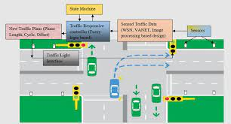
Applications of fuzzy logic
Control of systems
  Rice cocker
  Traffic light control system
  Robotics, under water robot
https://www.amazon.com/Zojirushi-NS-ZCC10-Uncooked-Premium-1-0-Liter/dp/B00007J5U7?th=1
https://ieeexplore.ieee.org/stamp/stamp.jsp?arnumber=8657877
https://www.researchgate.net/figure/Structure-of-fuzzy-traffic-light-control-system-at-intersection_fig1_347221918

Slide 5
Classical vs Fuzzy set
Membership
Membership
Define fuzzy membership functions
1
1
Cold Warm Hot
Cold Warm Hot
0
0
0 18 36
Classical set , or
Crisp set
Temperature in Celsius
0 18 36
Fuzzy set
Temperature in Celsius

Slide 6
Linguistic variables and term set
Linguistic variables are variables whose values are words or sentences in a natural or artificial language – Zadeh (father of fuzzy logic)
For example
  the values of the fuzzy variable height can be {Short, very short, very very short, extremely short} etc.
  the values of the fuzzy variable speed can be {fast, very fast, very very fast, extremely fast} etc.
Short is a linguistic variable or primary term
If “width” is a linguistic variable, then its term set is
T(width) = { narrow, not narrow, very narrow, not
Too narrow,…}.

Slide 7
Example
Let X = {d1, d2, d3, d4, d5} be the reference set of dishes.
X= Linguistic variable, term set={d1, d2, d3, d4, d5}
Let A be the fuzzy set of “spicy” dishes, where “spicy” is a fuzzy description. E.g., Chili is spicy, as well as pepper.
Fuzzy set A = {(d1,0.3)(d2,0.5)(d3,1)(d4,0.7)(d5,0.15)}
Here A shows the spiciness of d1 is 0.3.
(d3,1)= very spicy hot chili
(d5,0.15)= slightly spicy hot pepper

Slide 8
Membership functions
Membership functions can be designed by experience common sense, or machine learning methods
Define fuzzy membership functions of temperature
μ
Fuzzy
member
Degree or
value
(0->1)
1
Linguistic variable=“temperature”
term set T={Cold, Warm, Hot}
In fuzzy logic
Cold, Warm, Hot are fuzzy sets
μ_cold, μ_warm , μ_Hot are the membership degrees
The fuzzy membership to represent the membership degree or value can be triangles or trapeziums as shown
Cold Warm Hot
0
temperature 0 18 36 °C

Slide 9
Example of Degree of membership
Fuzzy membership function (triangles or trapeziums , etc)
prob. (membership degree or value)
A fuzzy set is shown.
Map the input temperature in degree Celsius to the fuzzy membership using the fuzzy membership function (triangles, trapezium, etc.) as shown in the diagram
Example (by inspection)
If Temperature=12
  the membership degree or value of Warm is 0.2.
  the membership degree or value of Cold is 0.45.
  the membership degree or value of Hot is 0
1
Cold Warm Hot
0.45
0.2
0
0 12 18 36
Fuzzy set
Temperature in Celsius

Slide 10

Worksheet 1: Degree of membership
A fuzzy set is shown in the diagram
If Temperature=68°C, find by inspection the membership values of Warm, Cold and Hot.
MC question, choices:
(1) 0; (2) 0.25; (3) 0.55 (4) 1
  the membership value of Warm is: ____.
  the membership value of Cold is: _____.
  the membership value of Hot is:_____.
μA() Fuzzy membership value
1
78
0.55
Cold Warm Hot
0.25
0
68
0 20 40 50 60 80 100
Fuzzy membership functions
Temperature in °C

Slide 11
Answer: Worksheet 1: Degree of membership
A fuzzy set is shown in the diagram
If Temperature=68°C, find by inspection the membership values of Warm, Cold and Hot.
Answer:
  the membership value of Warm is 0.25.
  the membership value of Cold is 0.
  the membership value of Hot is 0.55.
μA() Fuzzy membership value
1
78
0.55
Cold Warm Hot
0.25
0
68
0 20 40 50 60 80 100
Fuzzy membership functions
Temperature in °C

Slide 12
Classical set theory
An object in a set = an element or member of that set.
E.g., A = {a1,a2,a3,……,an}
If the elements ai of a set A are subset of
universal set X, then set A can be represented for all
elements x ϵ X by its characteristics function
μA (x) = 1 if x ϵ X otherwise 0

Slide 13
Operations on classical set theory
Union: the union of two sets A and B is given as
  A U B = { x | x є A or x є B }
Intersection: the intersection of two sets A and B is given as
  A ∩ B = { x | x є A and x є B }
Complement: It is denoted by ∼ A and is defined as
  ∼A = { x | x does not belong to A and x є X }

Slide 14
Fuzzy set theory
Fuzzy Logic uses a range of 0 to 1 (Membership value) to represents its membership to a set
In a Fuzzy Set : the degree of membership, called membership function (μ) has interval [0,1].
Thus, a membership function (triangles or trapeziums, etc.) μA (x) is associated with a fuzzy sets A such that the function maps every element of universe of discourse ( is the range of all possible values ) X to the interval [0,1].
The mapping is : μA(x): X → [0,1].

Slide 15
Fuzzy Sets
Fuzzy set is defined as follows:
If X is a universe of discourse ( the complete range of objects ) and x is a particular element of X, then a fuzzy set A defined on X and can be written as a collection of ordered pairs, i.e. (x, μA(x)), example:
Fuzzy set A = {(x, μA(x)), x є X }
  x is a particular element of X
  The memebrship function on x in the fuzzy set A = μA(x)
  X is a universe of discourse
It can be understood as
Some value x, where x is a value in the range of X.
The memebrship functoin x in the fuzzy set A = μA(x)

Slide 16
Types of membership functions
Triangular,
Trapezoidal,
Gaussian,..

Slide 17
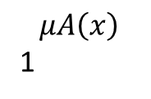

Triangular
$μA\left(x\right)=\left\{\begin{aligned}\begin{aligned}0 if x≤a \\ \frac{x−a}{b−a} if a≤x≤b \\ \frac{c−x}{c−b} if b≤x≤c\end{aligned} \\ 0 if x≥c\end{aligned}\right.$
$$μA\left(x\right)$$
1
0
x
a b c

Slide 18
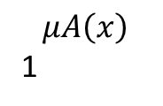

Trapezium
$μA\left(x\right)=\left\{\begin{aligned}0 if x≤a \\ \frac{x−a}{b−a} if a≤x≤b \\ \begin{matrix}1 ifb≤x≤c \\ \frac{d−x}{d−c} if c≤x≤d \\ 0 if d≤x\end{matrix}\end{aligned}\right.$
$$μA\left(x\right)$$
1
0
x
a b c d

Slide 19

Gaussian
C=center
S=width (standard deviation)
$μA\left(x,c,s,m\right)=exp\left(−\frac{1}{2}{\left|\frac{x−c}{s}\right|}^{2}\right)$
$$μA$$
1
S
0
x
C

Slide 20
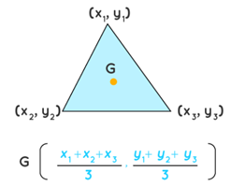
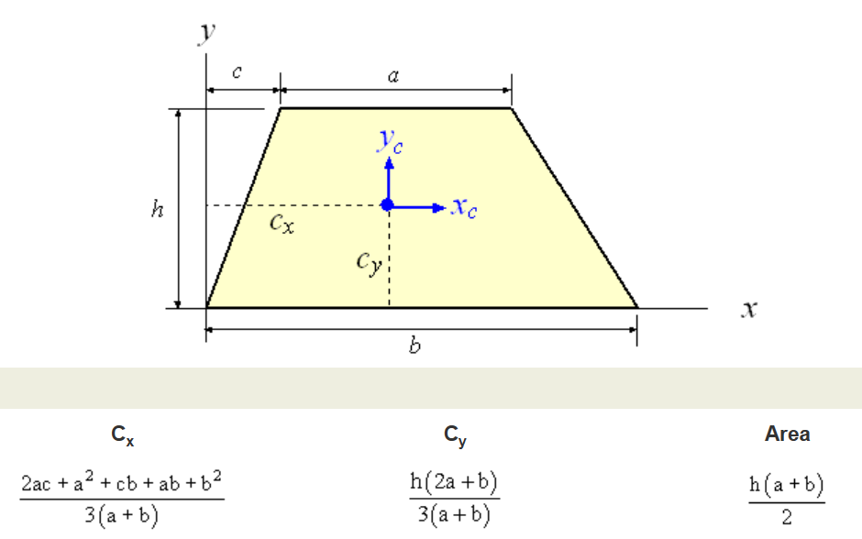
Centroid Calculation for de-fuzzification use
https://www.cuemath.com/centroid-formula/
Centroid of a triangle on x-axis
Cx=(x1+x2+x3)/3
Cy=(y1+y2+y3)/3
https://www.efunda.com/math/areas/trapezoid.cfm
Centroid of a Trapezium on x-axis
Cx=(2*a*c+a^2+c*b+a*b+b^2)/3(a+b)
Cy=h(2a+b)/(3(a+b))
(Cx,Cy)=

Slide 21
Worksheet 2: Degree of membership by calculation
A fuzzy set is shown in the diagram
If Temperature=68°C, find by calculation the membership values of Warm, Cold and Hot.
Show calculation steps
MC question, choices:
(1) 0; (2) 0.25; (3) 0.565 (4) 1
  the membership value of Warm is: ____.
  the membership value of Cold is: _____.
  the membership value of Hot is:_____.
μA(), Fuzzy membership value
1
78
Cold Warm Hot
0
26 50 55 74
68
0 20 40 50 60 80 100
Fuzzy membership functions
Temperature in °C

Slide 22
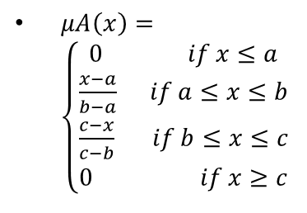
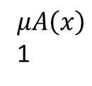
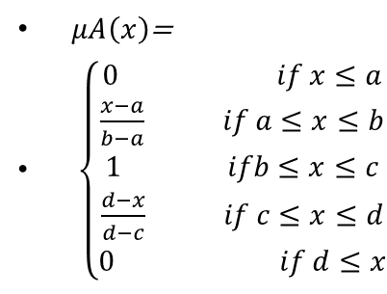
Answer: Worksheet 2: Degree of membership calculation
μA(), Fuzzy membership value
1
78
  (a)Find uWarm(x=68):by triangle calculation, a=26,b=50, c=74
  uwarm(x=68)=(c-x)/(c-b)=(74-68)/(74-50)=0.25
  (b) Find uCold(x=68)=0
  (c) Find uHot(x=68): by Trapezium calculation,
  a=55,b=78, c=100,d=100
  uHot (x=68)=
  (x=68)=(x-a)/b-a)=(68-55)/(78-55)=0.565
0.565
Cold Warm Hot
0.25
0
26 50 55 74
68
0 20 40 50 60 80 100
$μA\left(x\right)$=
$\left\{\begin{aligned}0 if x≤a \\ \frac{x−a}{b−a} if a≤x≤b \\ \begin{matrix}1 ifb≤x≤c \\ \frac{d−x}{d−c} if c≤x≤d \\ 0 if d≤x\end{matrix}\end{aligned}\right.$
$$μA\left(x\right)$$
1
$μA\left(x\right)=\left\{\begin{aligned}\begin{aligned}0 if x≤a \\ \frac{x−a}{b−a} if a≤x≤b \\ \frac{c−x}{c−b} if b≤x≤c\end{aligned} \\ 0 if x≥c\end{aligned}\right.$
$$μA\left(x\right)$$
1
0
x
a b c d
0
x
Triangle calculation
a b c
Trapezium calculation

Slide 23
Fuzzy Set Operation
Given X to be the universe of discourse (the complete range of objects ) and A and B to be fuzzy sets. μA(x) and μB(x) are membership functions respectively, the fuzzy set operations are:
Union:
μ_{A U B}(x) = max (μ_{A}(x), μ_{B}(x))
Intersection:
μ_{A ∩ B}(x) = min (μ_{A}(x), μ_{B}(x))
Complement:
~μ_{A} (x) =1- μ_{A}(x)
A
μ_{A}(x)
B
Intersection
μ_{B}(x)
μ_{A ∩ B}(x)
Union: μ_{A U B}(x)

Slide 24
Example of Fuzzy Union
(max operation)
A = {(x1,0.5),(x2,0.7),(x3,0)}
B = {(x1,0.8),(x2,0.2),(x3,1)}
Union:
  A U B = {(x1,0.8),(x2,0.7),(x3,1)}
  Because
  μ_{A U B}(x1) = max (μA(x1), μB(x1))
  = max(0.5,0.8)
  = 0.8
  μ_{A U B}(x2) = 0.7 and μ _{A U B}(x3) = 1

Slide 25
Example of fuzzy Intersection
(min operation)
A = {(x1,0.5),(x2,0.7),(x3,0)}
B = {(x1,0.8),(x2,0.2),(x3,1)}
Intersection:
  A ∩ B = {(x1,0.5),(x2,0.2),(x3,0)}
  Because
  μ_{A ∩ B}(x1) = min (μA(x1), μB(x1))
  = min(0.5,0.8)
  = 0.5
  μ_{A ∩ B}(x2) = 0.2 and μ_{A ∩ B}(x3) = 0

Slide 26
Example of Complement ‘~’
(One minus operation)
A = {(x1,0.5),(x2,0.7),(x3,0)}
Complement:
  ~A = {(x1,0.5),(x2,0.3),(x3,1)}
  Because
  ~ μA (x1) =1- μA(x1)
  = 1 – 0.5
  = 0.5
  ~ μA (x2) = 0.3 and ~ μA (x3) = 1

Slide 27
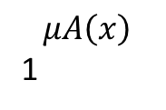
Support and core
Support(A) is set of all points x in X such that {(x∣ μA(x)) > 0 }
core(A) is set of all points x in X such that {(x∣ μA(x)) =1 }
Fuzzy set whose support is a single point in X with μA(x) =1 is called fuzzy singleton
Core
$$μA\left(x\right)$$
1
0
x
Lower
Boundary
Upper
Boundary
Support

Slide 28
Fuzzy rules
Fuzzy rules are useful for modeling the human thinking process.
A fuzzy if-then rule is of the form “If x is A then y is B”.
A and B are linguistic values defined by fuzzy sets on all possible ranges of X and Y, respectively. Here, “If x is A then y is B”.
  “x is A” is called antecedent and
  “y is B” is called consequent.

Slide 29
Examples of Fuzzy rules
If temperature is cold, then wear thick cloths.
Antecedent, consequent.
If it is crowded, then aircon temperature set low
Antecedent , consequent.
If sunlight is strong, then use a darker filter.
Antecedent , consequent.

Slide 30
Fuzzy inference process
E.g., motor speed for the fan inside a car of the train?
Sensor:
Car crisp temperature. Degrees in Celsius
How many people in the car. E.g.,
50 people
Step2
Rule Evaluation
If temperature is hot, many people in the car, fan motor is set to high
If temperature is cold, few people in the car, fan motor is set to low
Step1
Fuzzification
Measure inputs,
turn them to linguistic descriptions : temperature=hot ,or cold
People=few, medium, packed
Step3
Defuzzification
Combine the output of rules to become a real data.
E.g., set motor to 300 rpm.
Inputs

Slide 31
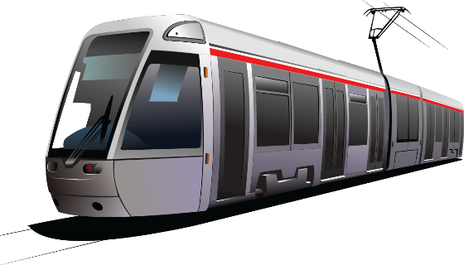
Use an example to illustrate the Fuzzy inference process
In a train, the ventilation fan depends on
  the temperature and
  the number of people in the car.
E.g.,
  Input :Temperature x (e.g., x=19 °C)
  Input :Number of people y (e.g., y=142)
  Output: Fan Motor speed 600 rpms (rotation per minutes)
This Photo by Unknown Author is licensed under CC BY-NC

Slide 32
Step 1 of the Fuzzy inference process
Fuzzification

Slide 33
An example to show how Fuzzy inference works
In a train-car, the temperature is x=19 °C, the number f people is y=142. Find the speed of the fan (z) in rpm
Input x=19 (temperature)
Input y=142 (num. of people in car)
Example: our task
  given: uA_warm(x=19)=0.857, uB_normal(y=142)=0.16, uB_crowded(y=142)=0.53
  Find the speed of the fan z,

Slide 34
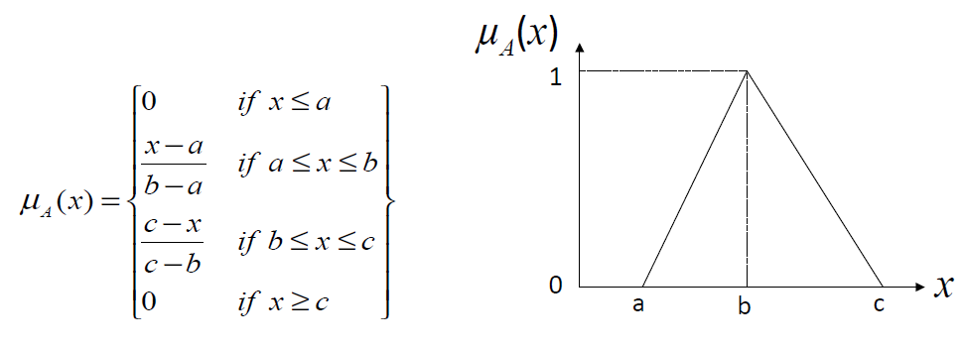
Worksheet 3: Step1: Calculation examples for μA_warm
Fuzzy membership, μA
If x=18 °C , warm a=11, b=18, c=25
  Find μA_warm(x=18)
  uA_warm(x=18)=(x-a)/(b-a)
  =(18-11)/(18-11)
  =1
If x=19, warm a=11, b=18, c=25
  Find uA_warm(x=19)
  MC question, Choices:
  0
  0.862
  0.857
  0.840
  uA_warm(19)= _____?
10 18 26
1
uA_warm(x=19)
Cold Warm Hot
0
11 12 13
23 25
19
x °C

Slide 35
Answer worksheet 3: Step1: Calculation examples for μA_warm
Fuzzy membership value,
μA
If x=18 °C , warm a=11, b=18, c=25
  Find μA_warm(x=18)
  uA_warm(x=18)=(x-a)/(b-a)
  =(18-11)/(18-11)
  =1
If x=19, warm a=11, b=18, c=25
  Find uA_warm(x=19)
  uA_warm(x)=(c-x)/(c-b)
  uA(19)=(25-19)/(25-18)
  =0.857
  When x=19, it only hits the warm fuzzy function, so we can stop here for the temperature fuzzy set calculation. I.e., no need to calculate cases for Cold and hot.
10 18 26
1
uA_warm(x=19)=
0.857
Cold Warm Hot
0
11 12 13
23 25
19
x

Slide 36
Calculation for people number fuzzy function μB_normal
μB
1
When people number y=142, it hits the “normal” and “crowded” fuzzy functions, so we have to calculate each of them.
First, find it membership of “Normal”. Normal fuzzy set is a triangle with (a=50, b=100,c=150)
If y=142
  uB_normal(y)=(c-y)/(c-b)
  =(150-142)/(150-100)
  uB_normal(y=125)=0.16
Few normal crowded
0.16
0
142
y
0.15
0 40 50 90 100 150 170 200
Number of people in the car (y)
Few, normal, crowded are fuzzy variables
For illustration purpose
Note : x=y here

Slide 37
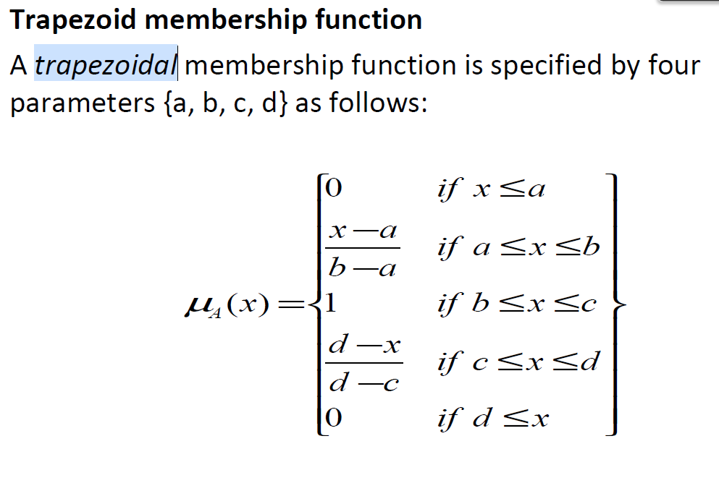
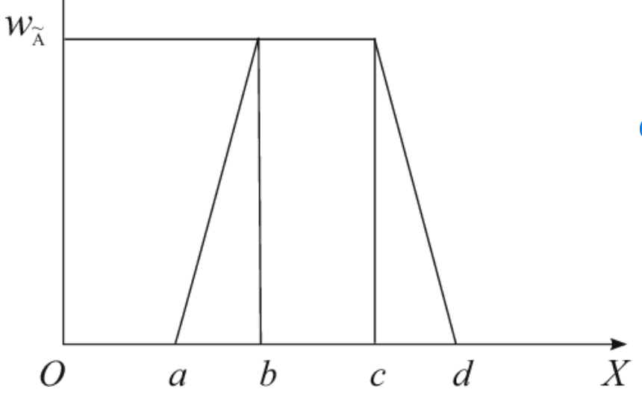
Worksheet 4:
Calculation for μB_crowded
μB
1
Second, crowded fuzzy ,If y=142, find
  Find uB_crowded(y).
  MC question, choices:
  0
  0.50
  0.53
  0.56
  uB_crowded(142)= ANS____?
Few normal crowded
0
110
142
y
0.15
0 40 50 90 100 150 170 200
Number of people in the car (y)
Few, normal, crowded are fuzzy variables

Slide 38
Answer: Worksheet 4:
Calculation for μB_crowded
μB
1
  0.53
Second, crowded fuzzy set is a trapezium with (a=110, b=170,c=200, d=200)
If y=142
  uB_crowded(y)=(y-a)/(b-a)
  =(142-110)/(170-110)
  uB_crowded(y=142)=0.53
Few normal crowded
0
110
142
y
0.15
0 40 50 90 100 150 170 200
Number of people in the car (y)
Few, normal, crowded are fuzzy variables

Slide 39
Step 2 of the Fuzzy inference process
Rule Evaluation

Slide 40
Step2 : Rule Evaluation
Inputs are applied to a set of if/then control rules.
Rule Evaluation
e.g. IF temperature is hot, THEN turn off the heater
Fuzzy rules can be written as
If (input1 is membership function1) and/or
(input2 is membership function2) and/or ….
Then (output is output membership function).
Example:
if temperature is cold and you are is sick turn on the heater

Slide 41
Fuzzy Cartesian product for generating the Fuzzy Association Matrix (FAM)
Suppose
A is a fuzzy set on the universe of discourse X with µA(x)|x ∈ X
B is a fuzzy set on the universe of discourse Y with µB(y)|y ∈ Y
Then R = A × B ⊂ X × Y ; where R has its membership function given by µR(x, y) = µA×B(x, y) = min{µA(x), µB(y)}
Example : A = {(a1, 0.2),(a2, 0.7),(a3, 0.4)} and B = {(b1, 0.5),(b2, 0.6)} , use minimum value, hence min{0.2, 0.5}=0.2
R = A × B =
 | b1(0.5) | b2(0.6)
a1(0.2) | 0.2 | 0.2
a2 (0.7) | 0.5 | 0.6
a3(0.4) | 0.4 | 0.4
Fuzzy interception (AND) operation use min{}
https://cse.iitkgp.ac.in/~dsamanta/courses/sca/resources/slides/FL-02%20Fuzzy%20Rules.pdf

Slide 42
Rule Evaluation --conjunction (intersect) rule
When the conditions are met. Use min{ } function.
Relate input/output using the Fuzzy Association Matrix (FAM)
Input x (temperature): Cold, Warm, Hot
Input y (people in car): Few, Normal, Crowded
Output z (fan motor speed): Slow, medium, fast
In this Fuzzy Association Matrix (FAM), there are 9 If-then rules. E.g., 2 examples are
If temperature = Cold and people = few, then motor = slow (conjunction rule)
If temperature = Warm and people = crowded, then motor = fast (conjunction rule)
Temperature\People in car | Few | Normal | Crowded
Cold | Slow | Slow | Medium
Warm | Slow | Medium | Fast
Hot | Medium | Fast | Fast

Slide 43
Worksheet5: from pervious calculations worksheet 3/4 etc. given: uA_warm(x=19)=0.857, uB_normal(y=125)=0.167, uB_crowded(y=125)=0.53
If temperature x=19°C,
  μA_warm(x) )=0.857
MC question, choices :1,2,3,4
Using the Fuzzy association matrix (FAM) shown below, how many rules are fired (membership value not 0) ANS:__?. And what are these rules:
If people in car y=142,
  uB_normal(y=142)=0.16
  uB_crowded(y=142)=0.53,
Fuzzy Association Matrix (FAM)
Temperature\People in car | Few | Normal | Crowded
Cold | Slow | Slow | Medium
Warm | Slow | Medium | Fast
Hot | Medium | Fast | Fast

Slide 44
Answer: Worksheet5:from pervious calculations worksheet 3/4 etc. given: uA_warm(x=19)=0.857, uB_normal(y=125)=0.167, uB_crowded(y=125)=0.53
If temperature x=19°C,
  μA_warm(x) )=0.857
These data hits 2 rules (2 are fired)
These rules are
If people in car y=142,
  uB_normal(y=142)=0.16
  uB_crowded(y=142)=0.53,
Rule 1) If temperature = warm and people = normal, then motor = Medium
Rule 2) If temperature = Warm and people = crowded, then motor = Fast
Fuzzy association matrix (FAM)
Temperature\People in car | Few | Normal | Crowded
Cold | Slow | Slow | Medium
Warm | Slow | Medium | Fast
Hot | Medium | Fast | Fast

Slide 45
Rule Evaluation result
Given: uA_warm(x=19)=0.857, uB_normal(y=125)=0.16, uB_crowded(y=125)=0.53
Rules
Rule 1) If temperature = warm and people = normal, then motor = Medium
Rule 2) If temperature = Warm and people = crowded, then motor = Fast
In fuzzy formulation
Rule 1, given μA_warm(x)=0.857, μB _normal(y)=0.16 find speed
If μA_warm(x)=0.857 and μB _normal(y)=0.16 then speed_medium
=min{0.857, 0.16}=0.16 (use conjunction rule, i.e., AND operation, apply min{ } )
Speed_medium=0.16
Rule 2, given μA_warm(x)=0.857, μB_crowded(y)=0.53, find speed
If μA_warm(x)= 0.857 and μB_crowded(y)=0.53 then speed_fast
=min{0.857, 0.5}=0.53 (use conjunction rule, i.e., AND operation, apply min{ } )
Speed_fast=0.53
Conclusion for the output (motor speed) membership values
  Speed_medium=0.16 , Speed_fast=0.53

Slide 46
Rule Evaluation– disjunction (union) rules or called aggregation rules,
When one of the conditions is met. Use max{} function.
In case more than one rule fire to have the same output, the simplest method is to find max {membership_values_of_output}.
For example:
Rule1 (Temeprature_Warm, people_crowded) produces u1_motor_speed=0.7,
Rule2 (temperature_Hot,people_crowded) produces u2_ motor_speed =0.6,
output motor_speed=max{u1_motor_speed, u2_motor_speed}=max{0.6,0.7}=0.7
Temperature\People in car | Few | Normal | Crowded
Cold | Slow | Slow | Medium
Warm | Slow | Medium | Fast
Hot | Medium | Fast | Fast

Slide 47
Step 3 of the Fuzzy inference process
Defuzzification

Slide 48
Popular Defuzzification Methods
Center of gravity (COG) / Centroid of Area (COA) Method: Most popular when using modern computers
Maxima Methods (efficient, for small embedded systems)
  First of Maxima Method (FOM)
  Last of Maxima Method (LOM)
  Mean of Maxima Method (MOM)
  Ref:
  https://cse.iitkgp.ac.in/~dsamanta/courses/archive/sca/Archives/Chapter%205%20Defuzzification%20Methods.pdf

Slide 49
(i) Center of gravity (COG) / Centroid of Area (COA) Method
This method provides a crisp value based on the center of gravity of the fuzzy set. The total area of the membership function distribution used to represent the combined control action is divided into a number of sub-areas. The area and the center of gravity or centroid of each sub-area is
calculated and then the summation of all these sub-areas is taken to find the defuzzified value for a discrete fuzzy set.
The Centroid of Area (COA ) is the most accurate and popular method, because integrating an area under a curve can be easily programmed and implemented by modern embedded computers.
See appendix for an example

Slide 50
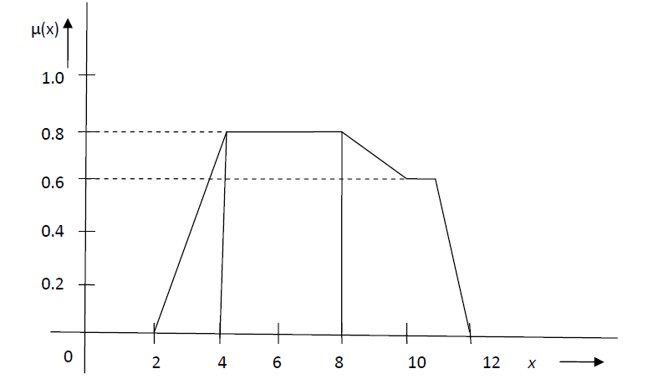
(ii) Min Max method
(v-1) First of Maxima Method (FOM)
This method determines the smallest value of the domain with maximum membership value. Example: The de-fuzzified value x∗ of the given fuzzy set will be x∗=4.
(v-2) Last of Maxima Method (LOM)
Determine the largest value of the domain with maximum membership value.
In the example given for FOM, the de-fuzzified value for LOM method is x∗= 8
mean of Maxima Method (MOM)

Slide 51

(v-3) Mean of Maxima Method (MOM)
Example In the example as shown in Fig. , x = 4, 6, 8 have maximum membership values and hence. |M| = 3
According to MOM method, x∗ =
mean of Maxima Method (MOM)
Fuzzy Logic v3 (230206b)

Slide 52
Defuzzification example
Based on our previous example

Slide 53
Defuzzification example
From speed_medium fuzzy membership value, find the required fan motor speed z
Speed_medium=0.16
μC
Fan motor speed fuzzy membership functions
μC
Fan motor speed fuzzy membership functions
prob.
1
1
Slow medium fast
Slow medium fast
Speed_medium=0.16
0
0
0 300 350 450 500 600 700 800 1000
z
Based on this fuzzy set
Fan motor rpm (z)
0 300 350 450 500 600 700 800 1000
z
Slow, medium, fast are fuzzy variables

Slide 54
Defuzzification
From speed fast fuzzy membership value, find the required fan motor speed z
Speed_fast=0.53
Fan motor speed fuzzy membership functions
Fan motor speed fuzzy membership functions
μC
μC
1
1
Slow medium fast
Slow medium fast
Speed_fast=0.53
5
0
0
0 300 350 450 500 600 700 800 1000
0 300 350 450 500 600 700 800 1000
z
Based on this fuzzy set
Fan motor speed rpm (z)
Slow, medium, fast are fuzzy variables

Slide 55
Worksheet 6: De-fuzzification to find fan speed based on (Speed_medium=0.16 + Speed_fast=0.53)
Fan motor speed fuzzy membership functions
MC question, choices:
(1) 700; (2) 760.6; (3) 850; (4) 900
Find the fuzzy result by de-fuzzification to find the fan speed
using the centroid of area COA/COG method. Ans:___?
using the mean of min-max method, and: Ans:___?
compare their results.
1
fast
0.63
Slow medium fast
0.15
0
0 300 350 450 500 600 700 800 1000
Fuzzy set
Fan motor speed rpm

Slide 56
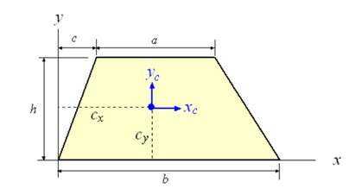

Answer 6a: worksheet 6a, Defuzzification method1: Center of gravity (COG) of A1 and A2
Speed_medium=0.16 + Speed_fast=0.53
Clear %see slide20
format short G
%Center_trapezium1
a=1000-700
b=1000-600
c=700-600
h=0.53 %trapezium centroid C1
C1=600+(2*a*c+a^2+c*b+a*b+b^2)/(3*(a+b)) %see slide 20
A1=(a+b)*h/2 %see slide 20
clear a,b,c,h %///////////////////
%Center_trapezium2
a=630-372.5
b=600-372.5
c=372.5-300
h=0.16%trapezium centroid C2
C2=300+(2*a*c+a^2+c*b+a*b+b^2)/(3*(a+b))
A2=(a+b)*h/2
clear a,b,c,h %..............
C1, A1,C2,A2,
Output=(A1*C1+A2*C2)/(A1+A2)
%%%%%%%%%%%%%%%%%%%%
C1 = 823.81
A1 = 185.5
C2 = 458.4
A2 = 38.8
Output =760.6
To find the real center of gravity, formula in
https://www.efunda.com/math/areas/trapezoid.cfm
z4=700
1
z2
Slow medium fast
Speed_fast=0.53
5
A1
Speed_medium=0.16
A2
0
Input x: temperature x=19 °C,
Input y: Number of people in car =142
fan speed Output z=760.6 rpm
0 300 450 500 600 700 800 1000
z1=372.5
z2= 630
Fan motor speed rpm

Slide 57
Answer: 6b, 6c, Defuzzification method2 (simple approximate ): usingFirst of Maxima Method (FOM)
Speed_medium=0.16 + Speed_fast=0.53
Mean of Maxima Method (MOM), the mean value of the maxima is taken. Using similar triangles
(800-600)/1=(z3-600)/0.53
z3=(800-600)*0.53+600=706
Mean of maxima: min=706, max=1000, hence (1000+706)/2=853 rpm
It is the simplest method, but there is some error compared to the accurate centroid method (760.6)
errror=((853-760.6)/760.6)*100%
= 12.1%
For fuzzy control it is acually an acceptable error, the guess of the fuzzy memebeship functions is fuzzy anyway.
700
1000
850
z3
1
Slow medium fast
Speed_fast=0.53
5
Speed_medium=0.16
A1
A2
0
0 300 350 450 500 600 700 800 1000
z1
z2
Fan motor Speed rpm

Slide 58
Worksheet7: Exercise left for students
Using the previous data,
If temperature x=12 °C,
If people in car y=142,
Calculate the fan motor speed Z.

Slide 59
Hints for worksheet 7 : based on pervious data
(student exercise)
If temperature x=12 °C,
  μA_cold(x) =0.33
  μA_warm(x) =0.143
  μA_hot(x) = 0.
4 rules have fired
If people in car y=142,
  μB_few(y)=0
  μB _normal(y)=0.16
  μB_crowded(y)=0.53
  (found earlier)
Temperature\People in car | Few | Normal | Crowded
Cold | Slow | Slow | Medium
Warm | Slow | Medium | Fast
Hot | Medium | Fast | Fast

Slide 60
Hints: Step1: Calculation examples for μA_warm
Fuzzy membership, μA
Warm fuzzy set is a triangle with (a=11, b=18,c=25)
If x=12
  uA_warm(x)=(x-a)/(b-a)
  uA_warm(12) =(12-11)/(18-11)
  =0.143
10 18 26
1
Cold Warm Hot
μA_warm(x=12)
=0.143
0
11 12 13
23 25
19
x

Slide 61
Hints: Calculation for μA_cold
Fuzzy membership
μA
Cold fuzzy set is a trapezium with (a=0, b=0,c=10,d=13)
If x=12
  uA_cold(x)=(d-x)/(d-c)
  uA_cold(12)
  =(13-12)/(13-10)
  uA_cold(x=19)=0.33
  (this result will be used for student exercise later)
10 18 26
1
Cold Warm Hot
μA_cold(x=12)
0
10 11 12 13
23 25 26
18
x

Slide 62
Worksheet 8:
A calculation example
Determine the seat price (economy) from HK to Berlin by an airline company selling tickets on-line.

Slide 63
Worksheet 8:
A fuzzy inference system
Determine the seat price (economy) from HK to Berlin by an airline company selling tickets on-line
2 Inputs:
  Season index (value 0-100 shows how busy it is)
  Online enquiries (Enquiry: 0 - 1000) per hour
1 Output : Result -- Economy air ticket price

Slide 64
Method
Step1: Fuzzification: Find fuzzy membership values of season_index (Season) and Number of enquires (Enquiry) from inputs.
Step2: Rule Evaluation : From the FAM (fuzzy association matrix) identify the rules.
Step3: Defuzzification: de-fuzzify the output value from the (i) rules, (ii) fuzzy memberships values obtain in step1.

Slide 65
Example: Fuzzification membership functions
Season index (BUSY) : how near to a holiday, the bigger the busier
Low season not busy shoulder busy very busy are fuzzy
variables
membership
16 32 49 66 83
1
0
17 26 34 45 52 64 67 80
0 10 20 30 40 50 60 70 80 90
Season index

Slide 66
Example: Fuzzy membership
Number of enquiries online (Enquiry) per hour
Small average large are
fuzzy
variables
Membership
200 502 780
1
0
260 490 600 744
0 100 200 300 400 500 600 700 800 900 1000
Number of enquires per hour

Slide 67
Example: to be used for de-fuzzification
Output : Result -- Economy air ticket price
(fuzzy variables) Very cheap cheap normal expensive very expensive
Membership
1600 3200 4900 6600 8300
1
0
1800 2900 3500 4600 5200 6300 6900 8000
0 1000 2000 3000 4000 5000 6000 7000 8000
HK dollars per seat

Slide 68
Out target problem: Determine the prices
Season index = 62 (an index to show how busy it is)
Number of enquires is 350 per hour
What is the price given to the customer
How to set the price?

Slide 69
Step1: Fuzzification
Find fuzzy membership values of season_index (Season) and Number of enquires (Enquiry) from inputs.

Slide 70
Answer for worksheet8:
Step1: Fuzzification: Find fuzzy membership values of season_index (Season) and Number of enquires (Enquiry) from inputs.Fuzzification: Determine the seat price (economy) from HK to Berlin by an airline company selling tickets on-line
Season index (BUSY) : how near to a holiday, the bigger the busier
To find Season_busy(62), : Season_shoudler(62)
Low season not busy shoulder busy very busy
Membership
62
16 32 49 66 83
1
Season_busy
Season_shoulder
0
62
17 26 34 45 52 64 67 80
Season index
0 10 20 30 40 50 60 70 80 90

Slide 71
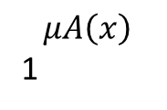
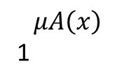
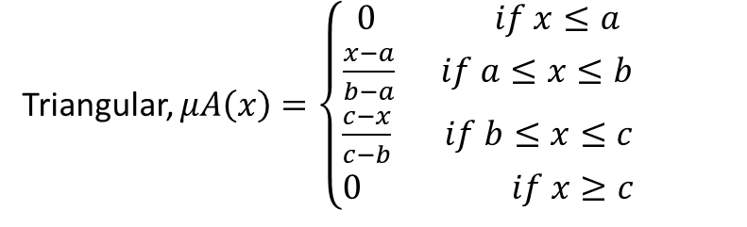
season_busy(x’=62)
=0.714
season_shoulder(x’)
=0.133
season_busy(x=62)=uA_busy(x1)=(x’-a)/(b-a)=(62-52)/(66-52)=0.714
season_shoudler(x=62)=uA_shoulder(x’)=(c-x’/c-b)=(64-62)/(64-49)=0.133
$$μA\left(x\right)$$
1
66
$$μA\left(x\right)$$
1
49
season_busy(x1=62)
season_shoulder(x1=62)
0
x
0
64
x
a b c
a b c
52
X’=62
80
34
X’=62
Triangular, $μA\left(x\right)=\left\{\begin{aligned}\begin{aligned}0 if x≤a \\ \frac{x−a}{b−a} if a≤x≤b \\ \frac{c−x}{c−b} if b≤x≤c\end{aligned} \\ 0 if x≥c\end{aligned}\right.$

Slide 72
Example: Fuzzification
Number of enquiries online (ENQR), Enquiry(350)
Enquiry_Small=, enquiry_ average =
Small average large
Membership
350
200 502 780
1
ENQR_small
ENQR_average
0
260 490 600 744
0 100 200 300 400 500 600 700 800 900 1000
Number of enquires per hour

Slide 73
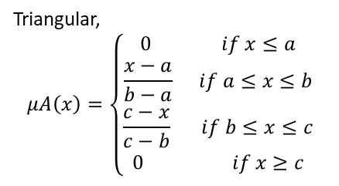
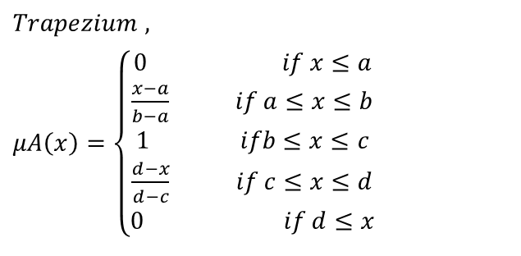
Enquiry_Small(x’=350)
=0.483
Enquiry_average(x’=350)
=0.372
season_busy(x=62)=uA_busy(x1)=(d-x1)/(d-c)=(490-350)/(490-200)=0.483
season_avarage(x=62)=uA_averege(x’)=(x’-a)/(b-a)=(350-260)/(502-260)=0.372
$$μA\left(x\right)$$
1
$$μA\left(x\right)$$
1
502
Enquiry_small (x’=350)
Enquiry_average(x’=350)
0
x
0
x
a b c d
a b c
x’=350
260
x’=350
200 490
$$Trapezium ,$$
$μA\left(x\right)=\left\{\begin{aligned}0 if x≤a \\ \frac{x−a}{b−a} if a≤x≤b \\ \begin{matrix}1 ifb≤x≤c \\ \frac{d−x}{d−c} if c≤x≤d \\ 0 if d≤x\end{matrix}\end{aligned}\right.$
Triangular,
$$μA\left(x\right)=\left\{\begin{aligned}\begin{aligned}0 if x≤a \\ \frac{x−a}{b−a} if a≤x≤b \\ \frac{c−x}{c−b} if b≤x≤c\end{aligned} \\ 0 if x≥c\end{aligned}\right.$$

Slide 74
So far, we collected fuzzy membership values
season_busy(x’=62)=0.714
season_shoulder(x’)=0.133
Enquiry_Small(x’=350)=0.483
Enquiry_average(x’=350)=0.372

Slide 75
Step2: Rule Evaluation
From the FAM (fuzzy association matrix) identify the rules.

Slide 76
Step2:Rules (Fuzzy associate matrix) FAM, season_index=62, Enquiry=350
So far, we have: season_busy(x’=62)=0.714 season_shoulder(x’=62)=0.133,
Enquiry_Small(x’=350)=0.483,Enquiry_average(x’=350)=0.372
Use min{μA, μB}} to calculate the rule output μ_output (filled in the cell)
Rule indexes (row, col): (4,4), (3,4), (4,5) (3,5) rules selected
Row\col | 1 | 2 | 3 | 4 | 5 | 6
1 | Enquiry\Season | Low season | Not busy | Shoulder=0.133 | busy=0.714 | Very busy
2 | Very small | Very cheap | Very cheap | Mid_price | Mid_price | mid_price
3 | Small= 0.483 | Very cheap | Very Cheap | Cheap μ(3,4)=min{0.48,0.133}=0.133 | Mid_price μ(3,5)=min{0.483,0.714}=0.482 | mid_price
4 | Average= 0.372 | cheap | Cheap | Expensive μ(4,4)=min{0.372,0.133}=0.133 | Expensive μ(4,5)=min{0.372,0.714}=0.372 | expensive
5 | large | cheap | Mid_p | expensive | Very expensive | Very exp.
6 | Ver large | Mid_p | Mid_p | Very expensive | Very expensive | Very exp.

Slide 77
Note:
Mid_p = Mid_price
Very exp.=Very expensive
Step2: Output: membership value result:
Cheap=0.133, Mid_price=0.482
For Expensive 2 rules fired, apply disjunction (union) rules:
Expensive=Max{μ(4,4), μ(4,5)}=max{0.133, 0.372}=0.372
Row\col | 1 | 2 | 3 | 4 | 5 | 6
1 | Enquiry\Season | Low season | Not busy | Shoulder | busy | Very busy
2 | Very small | Very cheap | Very cheap | Mid_price | Mid_price | mid_price
3 | small | Very cheap | Very Cheap | Cheap μ(3,4)=min{0.48,0.133}=0.133 | Mid_price μ(3,5)=min{0.483,0.714}=0.482 | mid_price
4 | average | cheap | Cheap | Expensive μ(4,4)=min{0.372,0.133}=0.133 | Expensive μ(4,5)=min{0.372,0.714}=0.372 | expensive
5 | large | cheap | Mid_p | expensive | Very expensive | Very exp.
6 | Ver large | Mid_p | Mid_p | Very expensive | Very expensive | Very exp.

Slide 78
So far, we have price: Cheap=0.133, Mid_price=0.482,Expensive=0.372
To get the actual ticket price: we need Defuzzification
Result: Economy air ticket price
Very cheap cheap mid_price expensive very expensive
Membership
1600 3200 4900 6600 8300
1
Price: Mid_price(0.482)
Centroid of
This around
Price: Expensive(0.372
price=Cheap(0.133)
0
1800 2900 3500 4600 5200 6300 6900 8000
0 1000 2000 3000 4000 5000 6000 7000 8000

Slide 79
Step3: Defuzzification
Defuzzify the output value from the (i) rules, (ii) fuzzy memberships values obtain in step1.

Slide 80
De-Fuzzification
Result: to find air ticket price
price: Cheap=0.133, Mid_price=0.482,Expensive=0.372
Find the de-fuzzification for the result (student exercise)
Very cheap cheap mid_price expensive very expensive
Membership
1600 3200 4900 6600 8300
1
Price: Mid_price(0.482)
Centroid of
This around
Price: Expensive(0.372
price=Cheap(0.133)
0
1800 2900 3500 4600 5200 6300 6900 8000
0 1000 2000 3000 4000 5000 6000 7000 8000

Slide 81
De-Fuzzification
A simple solution is to use the Mean of Maxima Method (MOM)
0.482=(Max1-3500)/(4900-3500), Max1=0.482*(4900-3500)+3500=4174.8
(6300-Max2)/0.482=(6300-4900), Max2=6300-0.482*(6300-4900) =5625.2
Output=Mean(Max1,Max2)=(4174.8+5625.2)/2=4900 dollars
Max1
Max2
Very cheap cheap Mid_price expensive very expensive
Membership
1600 3200 4900 6600 8300
1
Price: Mid_price(0.482)
Output by MOM
= 4900
Price: Expensive(0.372
price=Cheap(0.133)
0
1800 2900 3500 4600 5200 6300 6900 8000
0 1000 2000 3000 4000 5000 6000 7000 8000

Slide 82
De-Fuzzification
Using COA centroid of area.
Left for student exercise

Slide 83
Exercise for students
Recalculate the example in weeksheet8 (http://www.cse.cuhk.edu.hk/~khwong/www2/GISM5033/04_fuzzy.pptx) for another set of input values: Season_index=38, Equires=700.
Step1: find fuzzy membership values of season_index (S), and enquries (Q),
  S=sum of all season fuzzy membership values,
  Q=sum of all enquiry fuzzy membership values, calculate S+Q.
Step2: Rules evaluation, find the rules. Write the rule evaluation indexes in the answer box. See “step2: rule evaluation” in wheetsheet 8 of the definition of rule indexes. E.g (3,5), (4,4) are the 2 rule indexes selected. Answers “(3,5) (4,4)” or “(3,5),(4,4)” are acceptable. (Hint: it can be more than 2 rules)
Step3 Defuzzification: Find the output price value using the mean of maxima (MOM) method.

Slide 84
Conclusion
Theory of fuzzy logic is introduced.
Examples of fuzzy logic control is discussed.
Case studies in various field are studied.
An exercise of using fuzzy control is discussed.

Slide 85
References
https://nitsri.ac.in/Department/Computer%20Science%20&%20Engineering/FuzzyLogic.pdf
https://www.massey.ac.nz/~nhreyes/MASSEY/159741/Lectures/Lec2012-3-159741-FuzzyLogic-v.2.pdf
https://cse.iitkgp.ac.in/~dsamanta/courses/archive/sca/Archives/Chapter%205%20Defuzzification%20Methods.pdf

Slide 86
Appendices

Slide 87
Appendix 1: De-Fuzzification example of the following shape A1 A2
X1, x2, x3, x4
3762 5462 5876 7276
This is an independent example and not related to any examples in the lecture notes
We need to find x1,x2,x3,x4
(0.187/1)=(x1-3500)/(4900-3500)
X1=0.187*(4900-3500)+3500=3761.8
(0.187/1)=(x2-5200)/(6600-5200)
X2=0.187*(6600-5200)+5200=5461.8
(0.483/1)=(x3-5200)/(6600-5200)
X3=0.483*(6600-5200)+5200=5876.2
(0.483/1)=(x4-6600)/(8000-6600)
X4=0.483*(8000-6600)+6600=7276.2
4900 6600
1
(0.483)
Trapezium1
A1
(0.187)
Trapezium2
A2=
3500 5200 8000
Centroid
C2
Centroid
C1
87

Slide 88
De-Fuzzification :X1 ≈ 3762, X2 ≈ 5462,5876 ≈ 5876,X4 ≈ 7276 https://www.efunda.com/math/areas/trapezoid.cfm
clear
format short G
%Center_trapezium1
a=7276-5876
b=8000-5200
c=5876-5200
h=0.483 % find trapezium centroid C1
C1=5200+(2*a*c+a^2+c*b+a*b+b^2)/(3*(a+b))
A1=(a+b)*h/2
clear a,b,c,h %///////////////////
%Center_trapezium2
a=5462-3762
b=5462-3500
c=3762-3500
h=0.187 %find trapezium centroid C2
C2=3500+(2*a*c+a^2+c*b+a*b+b^2)/(3*(a+b))
A2=(a+b)*h/2
clear a,b,c,h %..............
C1, A1,C2,A2,
Output=(A1*C1+A2*C2)/(A1+A2)
%%%%%%%%%%%%%%%%%%%%
C1 = 6589.3
A1 = 1014.3
C2 = 4544.9
A2 = 342.4
Output = 6073.4
X1, x2, x3, x4
3762 5462 5876 7276
4900 6600
1
(0.483)
Trapezium1
A1
(0.187)
Trapezium2
A2=
3500 5200 8000
Input Season_index = 62 (shows how busy it is),
Input No. of enquires is 100 per hour ,
Output price=6073 dollars, done!
Centroid
C2
Centroid
C1
Centroid
C2

Slide 89
Appendix 2: matlab code for fuzzification
%fuzzy trapezium cal.khwong 2023.2.21
%usage trap(x,a,b,c,d) %e.g. trap(1.5,1,2,3,4)
function trap(x,a,b,c,d)
% clear
% clc
% x=4.5, a=1,b=2,c=3,d=4
%x = input('Enter a number: ');
if (x<= a) %%%%%%%%%%%%%%%%%%%%%%%%
u=0
elseif (a<= x && x<=b )%%%%%%%%%%
u=(x-a)/(b-a)
elseif (b<= x && x<=c )%%%%%%%%%%
u=1
elseif (c<= x && x<=d )%%%%%%%%%%
u=(d-x)/(d-c)
elseif (d<= x )%%%%%%%%% %%%%%%%%
u=0
end
disp('trapezium shape fuzzy member function u=‘)
u
%fuzzy triangle calculation, khwong 2023.2.21
%usage tri(x,a,b,c) %e.g. tri(1.3,1,2,3)
function tri(x,a,b,c)
% clear
% clc
% x=1.45, a=1,b=2,c=3
%x = input('Enter a number: ');
if (x<= a) %%%%%%%%%%%%%%%%%%%%%%%%%
u=0
elseif (a<= x && x<=b )%%%%%%%%%%
u=(x-a)/(b-a)
elseif (b<= x && x<=c )%%%%%%%%%%
u=(c-x)/(c-b)
elseif (c <= x )%%%%%%%%%%%%%%%%%
u=0
end
disp('triangular shape fuzzy member function u=')
u

Slide 90
Appendix 3: Other Defuzzification Methods
Center of Sums Method (COS)
Center of gravity (COG) / Centroid of Area (COA) Method
  Most popular when using modern computers
Center of Area / Bisector of Area Method (BOA)
Weighted Average Method
Maxima Methods
  First of Maxima Method (FOM)
  Last of Maxima Method (LOM)
  Mean of Maxima Method (MOM)
  Ref:
  https://cse.iitkgp.ac.in/~dsamanta/courses/archive/sca/Archives/Chapter%205%20Defuzzification%20Methods.pdf

Slide 91
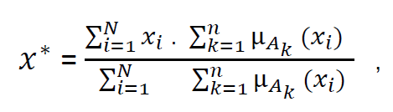
(i) Center of Sums (COS) Method
A common approximate method for defuzzification. In this method, the overlapping area is counted twice.
The defuzzified value x∗ is defined as :
Here, n is the number of fuzzy sets, N is the number of fuzzy variables, μAk(xi) is the
membership function for the k-th fuzzy set.
Details can be found in the appendix

Slide 92
(ii) Center of gravity (COG) / Centroid of Area (COA) Method
This method provides a crisp value based on the center of gravity of the fuzzy set. The total area of the membership function distribution used to represent the combined control action is divided into a number of sub-areas. The area and the center of gravity or centroid of each sub-area is
calculated and then the summation of all these sub-areas is taken to find the defuzzified value for a discrete fuzzy set.
We will show an example later

Slide 93
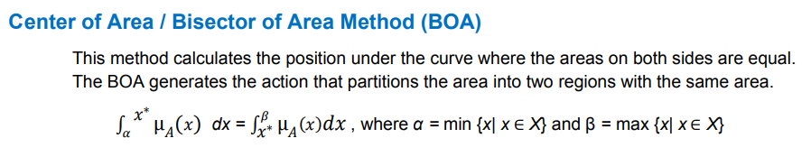
(iii) Center of Area / Bisector of Area Method (BOA)

Slide 94

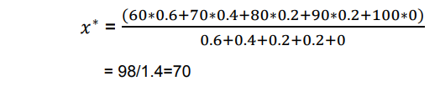
(iv) Weighted Average Method
This method is valid for fuzzy sets with symmetrical output membership functions and produces results very close to the COA method. This method is less computationally intensive. Each membership function is weighted by its maximum membership value. The defuzzified value is defined as:
Example: Let A be a fuzzy set that tells about a student as shown in figure 3 and the elements with corresponding maximum membership values are also given. A = {(P, 0.6), (F, 0.4),(G, 0.2),(VG, 0.2), (E, 0)} Here, the linguistic variable P represents a Pass student, F stands for a Fair student, G represents a Good student, VG represents a Very Good student and E for an Excellent student. Now the defuzzified value x∗for set A will be
98/1.4=70 The defuzzified value for the fuzzy set A with weighted average method represents a Fair student.

Slide 95
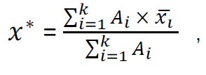
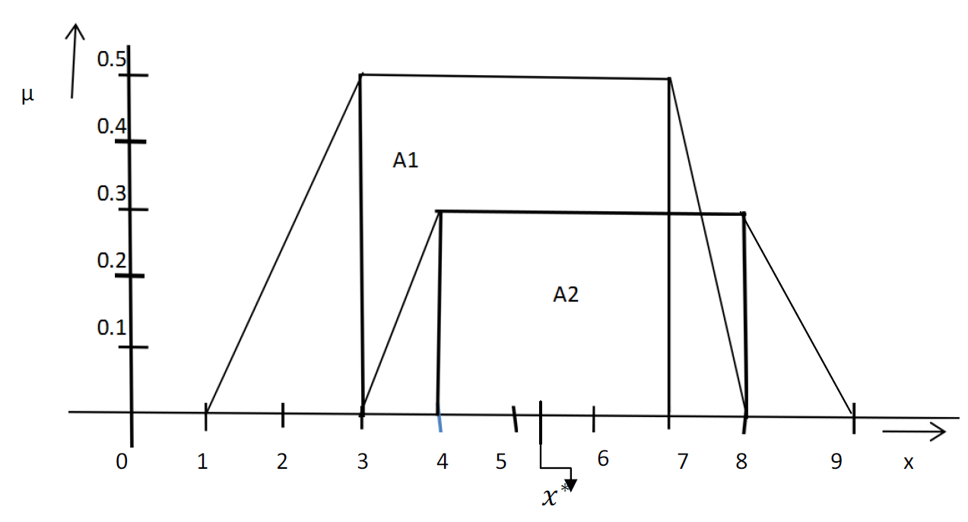

Center of Sums (COS) Method Example
Here, Ai represents the firing area of i-th rules and k is the total number of rules fired and /xi represents the center of area.
The aggregated fuzzy set of two fuzzy sets c1 and c2 is shown in Figure 1. Let the area of this two
fuzzy sets are A1 and A2.
A1 = ½ * [(8-1) + (7-3)] * 0.5 = ½ * 11 * 0.5 = 55/20=2.75
A2 = ½ * [(9-3) + (8-4)] * 0.3 = ½ * 10 * 0.3 = 3/2 =1.5
Now the center of area of the fuzzy set C1 is let say /x1 = (7+3)/2= 5 and
the center of area of the fuzzy set c2 is /x2= (8+4)/2=6.
Now the defuzzified value x∗=
= 22.75/4.25 = 5.35

Slide 96
Appendix 4: Application of fuzzy inference systems
Case studies

Slide 97
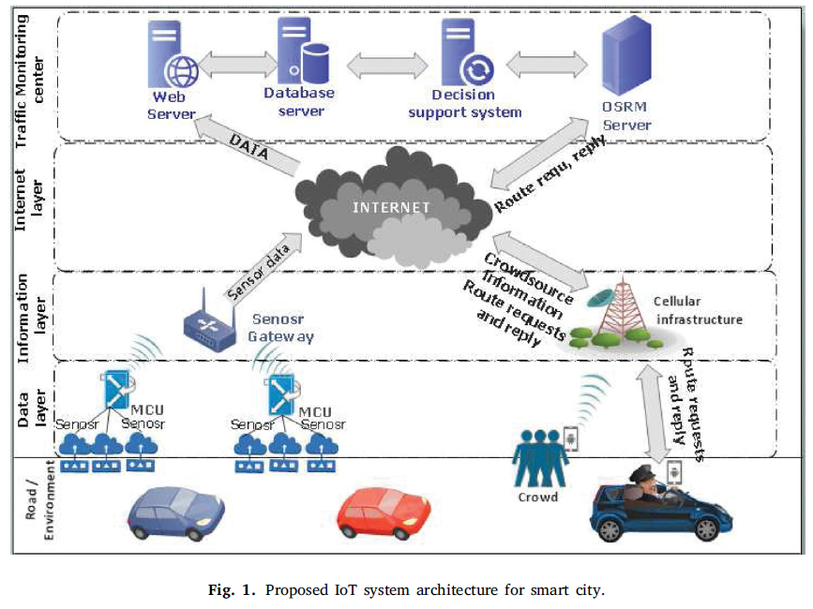
Fuzzy Case study 1
Fuzzy logic-based emergency vehicle routing: An IoT system
development for smart city applications
https://www.sciencedirect.com/science/article/pii/S0045790620306935

Slide 98
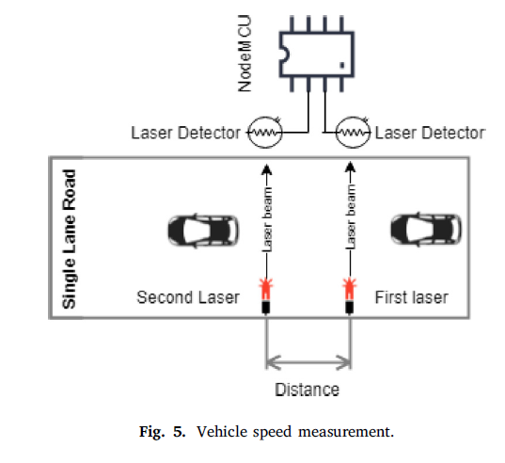
Vehicle Speed measurement
Using laser detection sensors

Slide 99
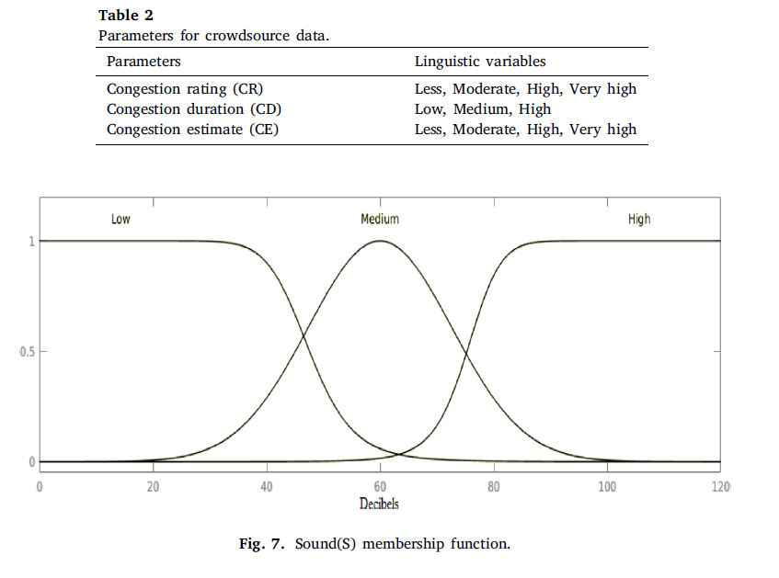
Fuzzy inference engine
Membership functions: Gaussian and Bell membership functions.
Fuzzy rule base: Set of if-then rules which can be built using input and output linguistic variables.
Defuzzification: Process of translating fuzzy output to a crisp value.
Laser laser
2nd
laser detector MQ135 /Co2 DTH11 (humdidty/temperture MQ2/Smoke sound sensor
First laser dector

Slide 100
The hardware
The processor and sensors
Laser laser
2nd laser detector MQ135 /Co2 DTH11 (humidity/temperature) MQ2/Smoke sound sensor
First laser dector

Slide 101
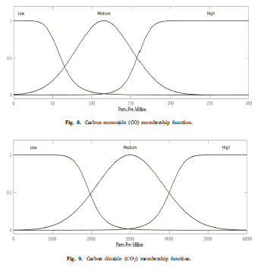
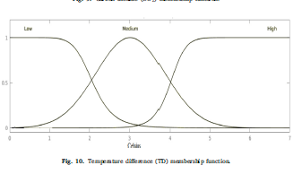
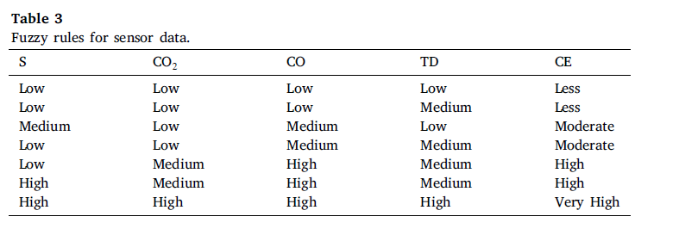
Fuzzy membership functions
d

Slide 102
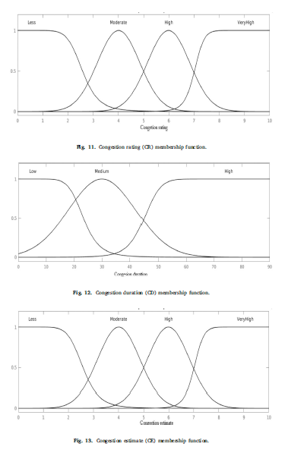
d
More Fuzzy membership functions

Slide 103
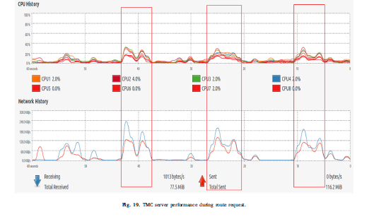
Performance

Slide 104
Fuzzy Case study 2: Fuzzy control of smart transportation
Digital and programmable economy applications: A smart cities congestion case by fuzzy sets1 Ferran Herraiz-Faixo´∗, Francisco-Javier Arroyo-Canada, Mar ˜ ´ıa-Pilar Lopez-Jurado ´ and Ana M. Lauroba-Perez ´ Department of Business and Management, University of Barcelona. Av. Diagonal, Barcelona, Spain
https://www.researchgate.net/publication/338875663_Digital_and_Programmable_Economy_Applications_A_Smart_Cities_Case_by_Fuzzy_Sets

Slide 105
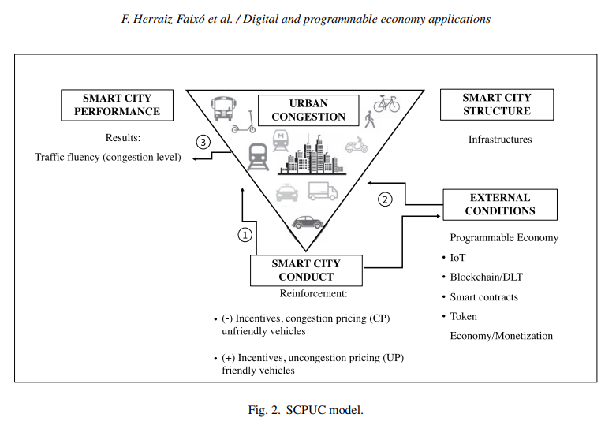
d

Slide 106
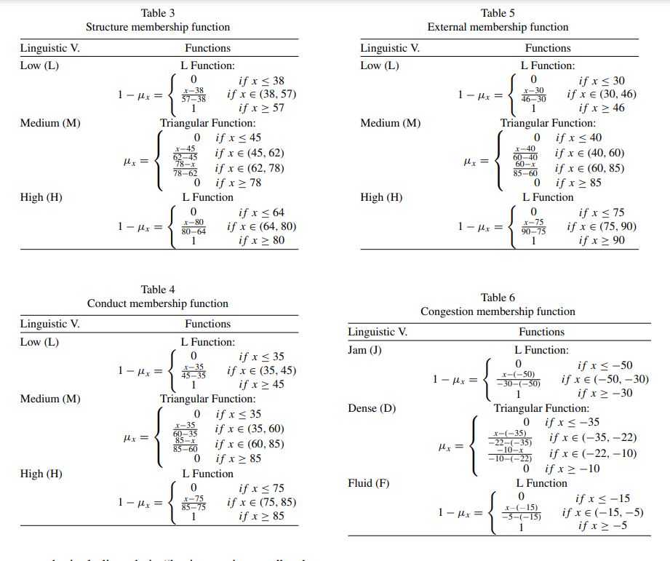
d
d

Slide 107
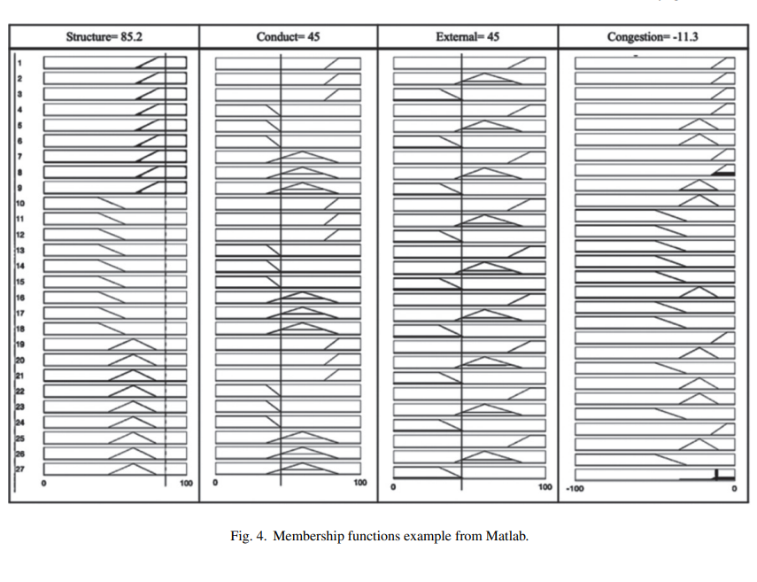
Fuzzy rules
d

Slide 108
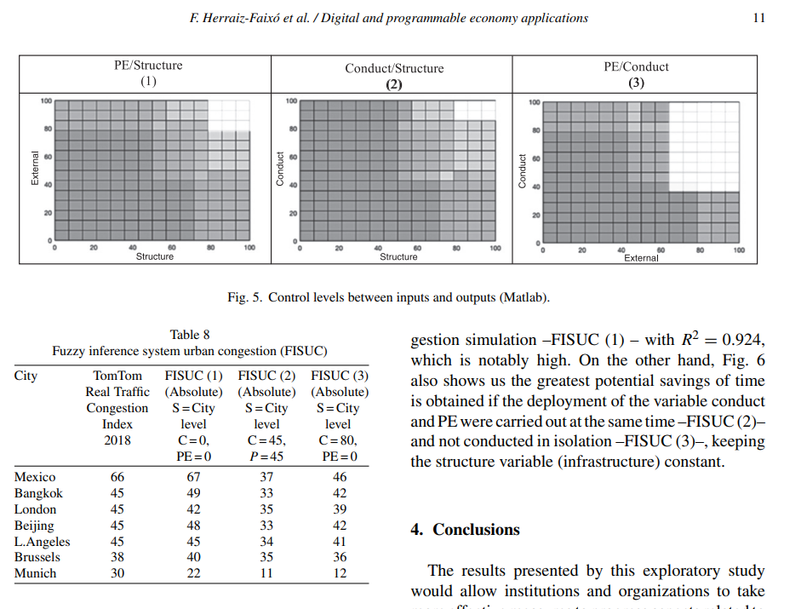
d
dd

Slide 109
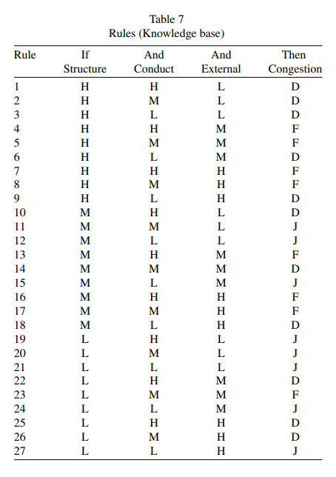
d
Rules

Slide 110
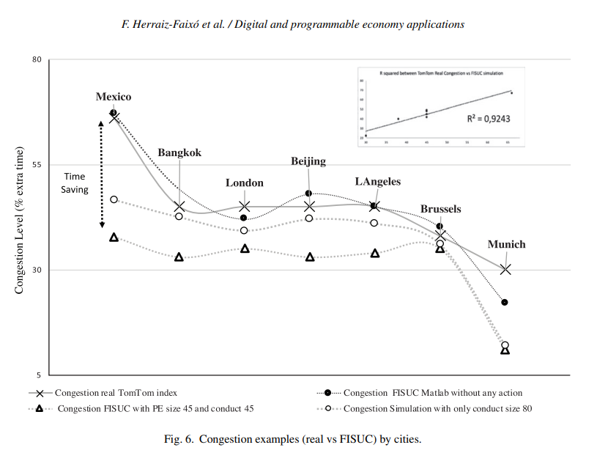
d
d

Slide 111
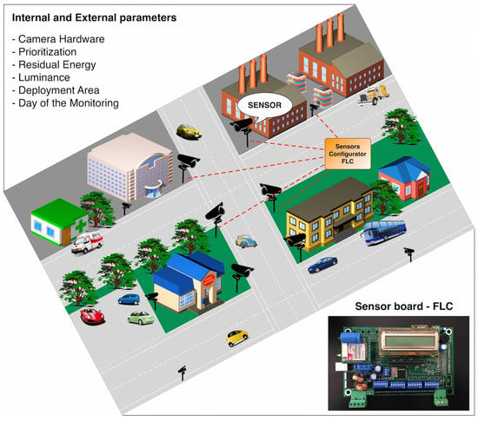
Fuzzy Case study 3
A Fuzzy-Based Approach for Sensing, Coding and
Transmission Configuration of Visual Sensors in
Smart City Applications
Daniel G. Costa 1,*,†, Mario Collotta 2,†, Giovanni Pau 2,† and Cristian Duran-Faundez 3,† https://www.mdpi.com/1424-8220/17/1/93/htm

Slide 112
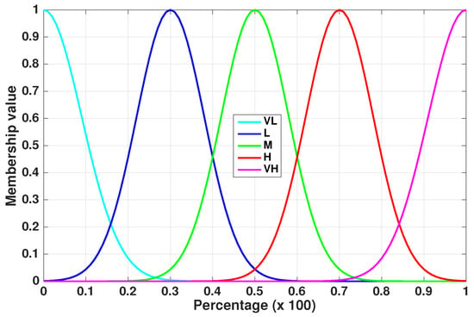
Gaussian Fuzzy Member functions

