Slide 1
GISM 5033 Symbolic Approaches to Spatial Knowledge Representation and Inference
KH Wong

Slide 2
Topics
PROPOSITIONAL LOGIC
PREDICATE LOGIC
FUZZY LOGIC
PRODUCTION SYSTEM
SEMANTIC NETWORK
FRAME⎯ Hierarchical Representation of Knowledge
OBJECT-ORIENTED PROGRAMMING
A REMARK ON SYMBOLIC APPROACHES

Slide 3
SYMBOLIC METHODS
PROPOSITIONAL LOGIC
PREDICATE LOGIC
PRODUCTION SYSTEM
SEMANTIC NETWORK
FRAMES
CONCEPTUAL DEPENDENCE
SCRIPT
OBJECTED-ORIENTED PROGRAMMING
{IF-THEN rules}
entity-relationship e.g., is-a, part-of, has
Slot-and-filler
data encapsulation and inheritance

Slide 4
1. PROPOSITIONAL LOGIC
Propositional logic, or sentential logic, deals with propositions that can be either true or false and uses logical connectives to form complex expressions.
1.1 Examples
Region K is a swamp.
Polygon A has a lake.
Road R is steep and winding.
Pixel B is either a land cover or a fishpond.
Region Q is not densely populated.
Polygon A is connected to polygon B.
If temperature is high, then pressure is low.
https://www.geeksforgeeks.org/

Slide 5
1. PROPOSITIONAL LOGIC (con’t)
1.2 Basic Notions
SYNTAX (NOTATIONAL ASPECT)
A SET OF ATOMIC EXPRESSIONS
well-formed-formula (wff): predicate (object)
pairings
e.g. p, q are terms, p=q is an atomic formula

Slide 6
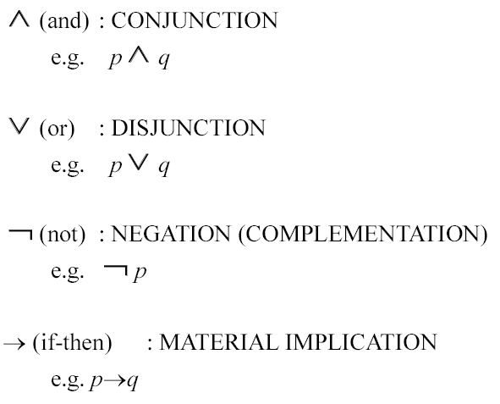
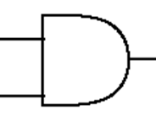
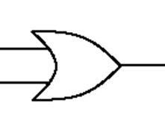
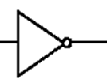
1. PROPOSITIONAL LOGIC (con’t)
CONNECTIVES
Digital logic notation
P
q
p^q
P
q
p v q
p
P
alternatively
not P
or
~p
are the same

Slide 7
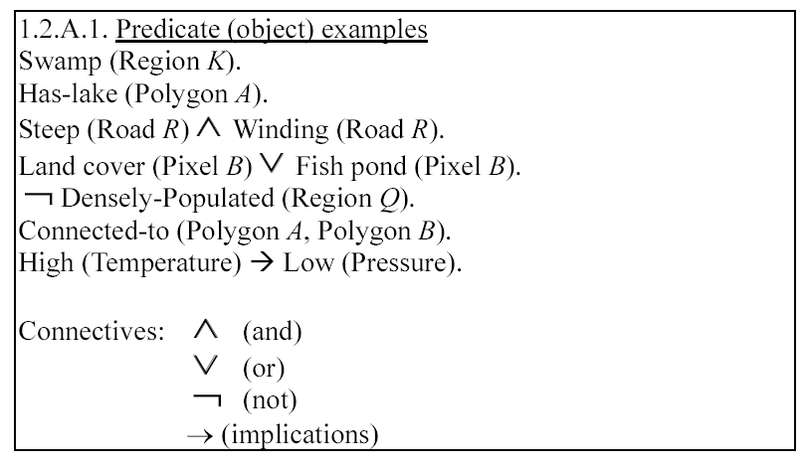
1. PROPOSITIONAL LOGIC (con’t)

Slide 8
1. PROPOSITIONAL LOGIC (con’t)
SEMANTICS (MEANING SPECIFICATION)
for TRUTH DETERMINATION

Slide 9
List of common logical connectives https://en.wikipedia.org/wiki/Logical_connective
List of common logical connectives
Commonly used logical connectives include:^{[2]}
Negation (not): ¬ , other notations: N (prefix), ~
Conjunction (and): ∧ , other notations: K (prefix), & , ∙
Disjunction (or): ∨, other notations: A (prefix)
Material implication (if...then): → , other notations: C (prefix), ⇒ , ⊃
Biconditional (if and only if): ↔ , other notations: E (prefix), ≡ , =
Alternative names for biconditional are iff, xnor, and bi-implication.

Slide 10
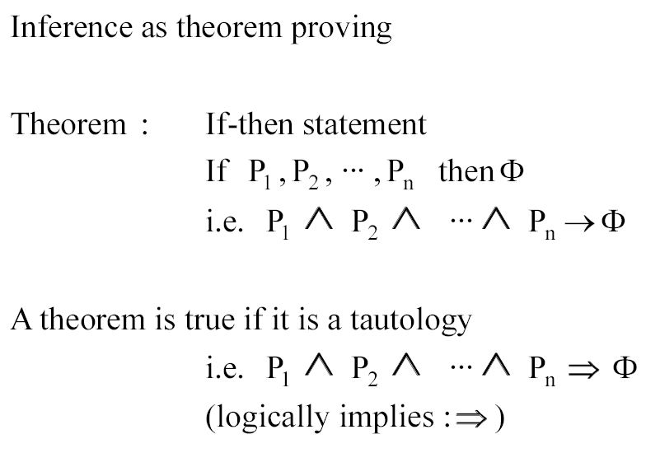
1a. PROPOSITIONAL LOGIC (con’t)
Can be false or true
Differences of → and ⟹
→ is a logic operator, whereas ⟹ is a statement (where you know the outcome must be true).
→ : can have result "false".
⟹ : Always true. Cannot be false.
See appendix for more information.

Slide 11
Examples
For example, P= raining, Q= I am indoors
It is not raining (¬ P)
It is raining and I am indoors ( P ∧ Q)
It is raining or I am indoors (P ∨ Q)
If it is raining, then I am indoors (P → Q)
If I am indoors, then it is raining (Q → P)
I am indoors if and only if it is raining (P ↔ Q)
Always True and False notations:
Truth constants: T, V, or ⊤ for "true"
False constants” F, O, or ⊥ for “false”,
(V and O are from Polish notation).
From https://en.wikipedia.org/wiki/First-order_logic

Slide 12
Worksheet1, Multiple choice MC questions
Let C = Hong Kong (HK) is a city,
M = the city has a Metro system.
B = the city has a bus system
L = the population of a city is large,
S = the population of a city is small.
Convert the sentences into propositional logic
The city has no metro system. Answer: _____? MC question: (1)¬M ; (2 ) M.
HK is a city, and it has a metro system. Ans: _? MC : (1) ¬ C ^ M; (2 ) C ^ M ; (3) C v M.
No matter the city has large or small population, it should have a bus system. Answer:_____? MC question: (1 ) (L ^ S ) → B ; (2) (L ^ S ) → ¬ B; (3) (L v S ) → B.
If the population of a city is large it should have a metro system. Answer: ____________? MC question: (1) L→ ¬ M; (2) ¬ L→M; (3 ) L→M .
Because Hong Kong is a city and has a large population, therefore it has a metro system. Answer: _____? MC : (1) (C v L) →M; (2 ) (C ^ L) →M ; (3) (C ^ L) ↔ M.
Hong Kong is a city, and the population is not small, therefore it has a metro system. Ans: ___? MC : (1) (C ^ S ) →M; (2) (C v ¬S ) →M; (3 ) (C ^ ¬S ) →M ;
If a city has a metro system, if and only if its population is large. Answer: _________? MC : (1 ) M↔L ; (2) M→L; (3) M↔ ¬ L.

Slide 13
Answer: Worksheet1
Let C = Hong Kong is a city, M = the city has a Metro system.
B = the city has a bus system
L = the population of a city is large,
S = the population of a city is small.
Convert the sentences into propositional logic
The city has no metro system. Answer: ___________? ¬M(1)
Hong Kong is a city and has a metro system. Answer: ___________? C ^ M(2)
No matter the city has large or small population, it should have a bus system. Answer: ____________? (L v S ) → B(3)
If the population of a city is large it should have a metro system. Answer: ____________? L→M(3)
Because Hong Kong is a city and has a large population, therefore it has a metro system. Answer: _______________? (C ^ L) →M (2)
Because Hong Kong is a city and the population is not small, therefore it has a metro system. Answer: _______________? (C ^ ¬S ) →M (3)
If a city has a metro system, if and only if its population is large. Answer: _________? M↔L(1)

Slide 14
Tautology 恆真式 或 套套邏輯
A tautology is a statement that is always true, no matter what. If you construct a truth table for a statement and all of the column values for the statement are true (T), then the statement is a tautology because it's always true! The famous saying 'I cannot tell a lie' may come to mind when studying tautologies.
https://study.com/learn/lesson/tautology-in-math.html

Slide 15
1b. PROPOSITIONAL LOGIC (con’t)
Can be false or true
Must be true
Differences of → and ⟹
→ is a logic operator, whereas ⟹ is a statement (where you know the outcome must be true).
→ : can have result "false".
⟹ : Always true. Cannot be false.
See appendix for more information.

Slide 16
Truth table

Slide 17
Truth table : https://sites.millersville.edu/bikenaga/math-proof/truth-tables/truth-tables.html
P | ¬P
T | F
F | T
Negation function
If P is true, ¬ P is false and vice verse
And, “^” function
P ^ Q is true if both P and Q are true
Or, “v” function
P v Q is true if either P is true or Q is true
Inputs output
P | Q | P ^ Q
T | T | T
T | F | F
F | T | F
F | F | F
Inputs output
P | Q | P v Q
T | T | T
T | F | T
F | T | T
F | F | F
Inputs output

Slide 18
Truth table : https://sites.millersville.edu/bikenaga/math-proof/truth-tables/truth-tables.html
P ↔ Q means that P and Q are equivalent.
E.g. P=work hard, Q=Pass exam.
P ↔ Q means you pass the exam only if you work hard. Therefore row 2,3 are false
P → Q means logical implication. If Q follow P, then P → Q is true
E.g. P=work hard, Q=Pass exam
P→Q means if you work hard , you pass exam. This statement is violated only when you work hard, you cannot pass the exam. Therefore, row 2 is the only case (P→Q) is false.
P | Q | P ↔ Q
T | T | T
T | F | F
F | T | F
F | F | T
output
inputs
P | Q | P →Q
T | T | T
T | F | F
F | T | T
F | F | T
output
inputs

Slide 19
Note: If you have more then 2 inputs. E.g., 3 inputs, you need 2^3 rows of different combination of True/False (T/F) for each row
P,Q,R are n=3 inputs (input columns= 2^{n}=2³=8,n=number of inputs)
P | Q | R
T | T | T
T | T | F
T | F | T
T | F | F
F | T | T
F | T | F
F | F | T
F | F | F
inputs

Slide 20
Example of tautology
Output at the
final column:
A tautology
An example.
'I will either get paid or not get paid’,
we can use:
p: I will get paid
¬p: I will not get paid
So, p ∨ ¬p: I will either get paid or not get paid
A truth table for the statement would look like:
Looking at the final column in the truth table, you can see that all the truth values are T (for true). Whenever all of the truth values in the final column are true, the statement is a tautology. So, our statement 'I will either get paid or not get paid' is always a true statement, a tautology
https://study.com/learn/lesson/tautology-in-math.html
2 inputs
p, ¬p
v = or function
Truth Table for p v ¬ p
P | ¬P | p v ¬ p
T | F | T
F | T | T

Slide 21
Example: Use truth table to proof a tautology
Show (P→ Q) V (Q→P) is a tautology.
We need to proof no matter what P, Q are, (P→ Q) V (Q→P) is still true. Here is the proof:
P | Q | P→Q | Q→P | (P→Q) v (Q→P)
T | T | T | T | T
T | F | F | T | T
F | T | T | F | T
F | F | T | T | T
Output:
All true (T) , so (P→Q) v (Q→P)
is a tautology
inputs

Slide 22
Worksheet 2: Use truth table to proof a tautology
MC question
Which of the followings is a tautology?
(a v b)^(~a v c)=>(b ^ c)
(a v b)^(~a ^ c)=>(b v c)
(a v b)^(a ^ c)=>(b ^ c)
Reference:
https://trutabgen.com/

Slide 23
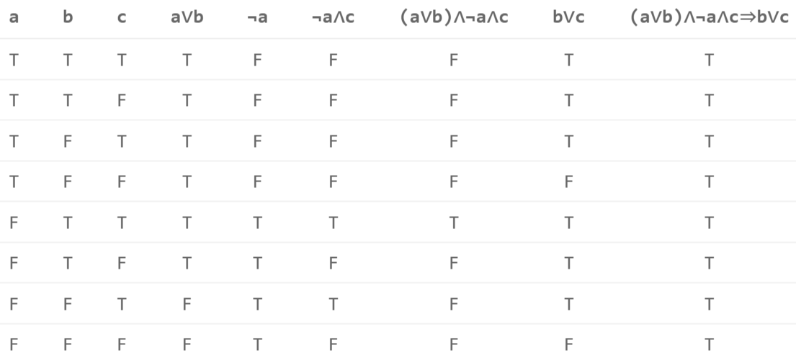
Answer worksheet 2: Use truth table to proof a tautology Note: ‘~’ = ‘¬’
(avb)^(~avc)=>(bvc)
All True here
In this output
column
(a v b)^(~a ^ c)=>(b v c) is a tautology(ans. Num2)

Slide 24
Rules of Inference in propositional logic
In logic, a syllogism is a form of deductive reasoning consisting of a major premise, a minor premise, and a conclusion.
Syllogistic (Adjective). Also known as a categorical argument or a standard categorical syllogism. The term syllogism is from the Greek, "to infer, count, reckon"
Major Premise, Minor Premise, and Conclusion
"The process of deduction has traditionally been illustrated with a syllogism, a three-part set of statements or propositions that includes a major premise, a minor premise, and a conclusion.
Major premise: All books from that store are new. Minor premise: These books are from that store. Conclusion: Therefore, these books are new.
https://www.thoughtco.com/syllogism-logic-and-rhetoric-1692167

Slide 25
Syllogism
The logical process of finding conclusions from given propositions is called syllogism the propositions used to draw conclusion are called the premises.
We can use two methods to draw conclusion
Truth Table Method
Draw a truth table for the premises (matters previously stated) and the conclusion.
We prepare a conditional whose antecedent is the conjunction of all the given premises and consequent is the conclusion to be drawn. If the conditional results in a tautology (i.e., all 1s or True) then the conclusion is established.
Boolean Algebra Method
Propositional Logic Syllogism - Boolean Algebra - DYclassroom | Have fun learning :-)

Slide 26
Propositional Logic Syllogism
Proof by truth table method

Slide 27
Syllogism proof by truth table
Given premises (P AND (P → Q)) infer Q.
So, we have two premises P AND P→ Q. connected by an AND operator and the conclusion to be drawn is Q. So, we have to create a conditional (P^(P→Q))→Q, where ^ is the AND operator, → is the conditional operator
So, we have to prove (P^(P→Q))→Q is a tautology.

Slide 28
Use truth table to prove a tautology
P is a premise. P→Q is a premise. To prove P and P→Q implies Q
Show (P^(P→Q))→Q) is a tautology. We need to proof no matter what P, Q are, (P^(P→Q))→Q) is still true. Here is the proof:
P | Q | P→Q | P^(P→Q) | (P^(P→Q))→Q
F | F | T | F | T
F | T | T | F | T
T | F | F | F | T
T | T | T | T | T
Output:
All true (T)), thus (P^(P→Q))→Q
is a tautology
inputs

Slide 29
Propositional Logic Syllogism
Proof by algebraic method

Slide 30
Direct reasoning Modus ponens - Wikipedia
Modus ponens, a direct reasoning method
In propositional logic, modus ponens is a deductive argument form and rule of inference. It can be summarized as "P implies Q. P is true. Therefore, Q must also be true."
If P, then Q. [means P implies Q, or (P→Q)]
P.
Therefore, Q.
In propositional logic:
((P→Q) ^ P ) →Q
An example of an argument that fits the form modus ponens:
If today is Tuesday, then John will go to work.
Today is Tuesday.
Therefore, John will go to work.

Slide 31
Indirect reasoning Modus ponens - Wikipedia
Modus tollens, indirect reasoning method
In propositional logic, Modus tollens (method of removing by taking away, and denying the consequent). It is inference by contraposition, a form of indirect reasoning
If P, then Q. (means P implies Q)
Not Q.
Therefore, not P.
In propositional logic:
(P→Q)
¬Q
----------------
¬ P
Example: If the dog detects an intruder, the dog will bark.
The dog did not bark.
Therefore, no intruder was detected by the dog.

Slide 32
Basic Logical Laws – Equivalences https://math.libretexts.org/Bookshelves/Combinatorics_and_Discrete_Mathematics/Applied_Discrete_Structures_(Doerr_and_Levasseur)/03%3A_Logic/3.04%3A_The_Laws_of_Logic
Commutative Laws: p∨q⇔q∨p , p∧q⇔q∧p
Associative Laws: (p∨q)∨r⇔p∨(q∨r) , (p∧q)∧r⇔p∧(q∧r)
Distributive Laws: p∧(q∨r)⇔(p∧q)∨(p∧r) ,
p∨(q∧r)⇔(p∨q)∧(p∨r)
Identity Laws: p∨0⇔p , p∧1⇔p
Negation Laws: p∧¬p⇔0 , p∨¬p⇔1
Idempotent Laws: p∨p⇔ p , p∧p⇔p
Null Laws: p∧0⇔0 , p∨1⇔1
Absorption Laws: p∧(p∨q)⇔p, p∨(p∧q)⇔p
DeMorgan's Laws: ¬(p∨q)⇔(¬p)∧(¬q), ¬(p∧q)⇔(¬p)∨(¬q)
Involution Laws: ¬(¬p)⇔p
You may proof these laws by the truth table method

Slide 33
Propositional Logic Syllogism: algebraic method Propositional Logic Syllogism - Boolean Algebra - DYclassroom | Have fun learning :-)
Use conditional elimination to draw conclusion from given premises.
Prepare a conditional whose antecedent is the conjunction of all the given premises and consequent is the conclusion to be drawn. If the conditional results in a tautology (i.e., all 1s or True) then the conclusion is established.
Example: ~ is the NOT operator , + is the OR operator
We substitute the conditional p ⇒ q with ~p + q,
Example:
From the given premises p and p ⇒ q infer q.
So, we have two premises p and p ⇒ q connected by an AND operator and the conclusion to be drawn is q. So, we have to create a conditional ( p . (p ⇒ q) ) ⇒ q where, . is the AND operator, ⇒ is the conditional operator
We now prove ( p . (p ⇒ q) ) ⇒ q is a tautology. See the next slide.

Slide 34
Example, step by step to proof a tautology using algebraic method https://dyclassroom.com/boolean-algebra/propositional-logic-syllogism
We have to prove ( p . (p ⇒ q) ) ⇒ q is a tautology.
// note: ‘.’=and, ‘+’=or, ⇒=imply
We have,
( p . (p ⇒ q) ) ⇒ q
= (p . (~p + q) ) ⇒ q from conditional elimination, a ⇒ b = ~a + b
= (p . ~p) + (p . q) ⇒ q from distributive law, a . (b + c) = (a . b) + (a . c)
= 0 + (p . q) ⇒ q from complementarity law, a . (~a) = 0
= (p . q) ⇒ q from property of 0, 0 + a = a
= ~(p . q) + q from conditional elimination, a ⇒ b = ~a + b
= (~p + ~q) + q from de morgan’s law, ~(a . b) = ~a + ~b
= ~p + (~q + q) from associative law, (a + b) + c = a + (b + c)
= ~p + 1 from complementarity law, (~a + a) = 1
= 1 (true, done) from property of 1, ~a + 1 = 1
So, ( p . (p ⇒ q) ) ⇒ q = 1 i.e., it is a tautology hence conclusion can be drawn.

Slide 35
https://math.libretexts.org/Bookshelves/Combinatorics_and_Discrete_Mathematics/Applied_Discrete_Structures_(Doerr_and_Levasseur)/03%3A_Logic/3.04%3A_The_Laws_of_Logic
Basic Logical Laws - Common Implications and Equivalences
Detachment (AKA Modus Ponens) | (p→q)∧p⇒q(p→q)∧p⇒q
Indirect Reasoning (AKA Modus Tollens) | (p→q)∧¬q⇒¬p(p→q)∧¬q⇒¬p
Disjunctive Addition | p⇒(p∨q)p⇒(p∨q)
Conjunctive Simplification | (p∧q)⇒p(p∧q)⇒p and (p∧q)⇒q(p∧q)⇒q
Disjunctive Simplification | (p∨q)∧¬p⇒q(p∨q)∧¬p⇒q and (p∨q)∧¬q⇒p(p∨q)∧¬q⇒p
Chain Rule | (p→q)∧(q→r)⇒(p→r)(p→q)∧(q→r)⇒(p→r)
Conditional Equivalence | p→q⇔¬p∨qp→q⇔¬p∨q
Biconditional Equivalences | (p↔q)⇔(p→q)∧(q→p)⇔(p∧q)∨(¬p∧¬q)(p↔q)⇔(p→q)∧(q→p)⇔(p∧q)∨(¬p∧¬q)
Contrapositive | (p→q)⇔(¬q→¬p)

Slide 36
2. Predicate Logic
Or called First-order logic

Slide 37
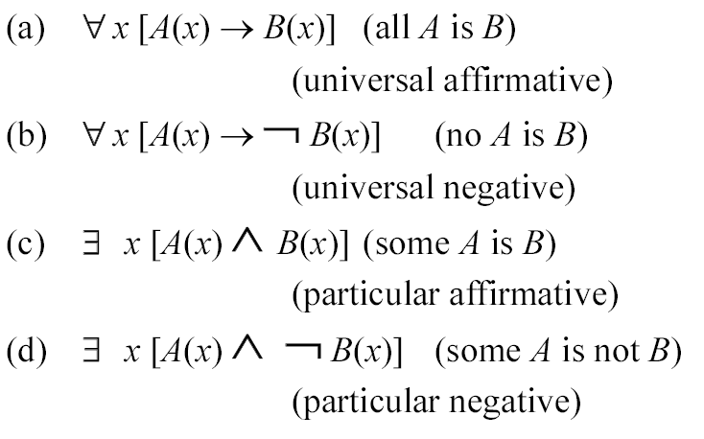
PREDICATE LOGIC (con’t)
Predicate Logic
variables e.g. A(x)
quantifiers
Categorical statements

Slide 38
Propositional vs predicate logic
Propositional Logic : A proposition is a declarative sentence that can be True or False. For example , these are Propositional Logic statements:
An apple is a kind of fruit.
If x is real, then x² > 0
Predicate Logic : Predicates are properties, additional information to better express the subject of the sentence. For example, these are Predicate Logic statements:
In P(x) : x>5, x is the subject or the variable, and ‘>5’ is the predicate.
P(7) : 7>5 is a proposition where we are assigning values to the variable x=7, and it has a truth value, i.e., result is True.
https://www.geeksforgeeks.org/difference-between-propositional-logic-and-predicate-logic/

Slide 39
From Proposition to Predicate
3 + 2 = 5 is a proposition. Because it is True definitely.
3 + 2 = 6 is a proposition. Because it is False definitely.
But is X + 2 = 5 a proposition? Answer: It has a variable X in it, we cannot say it is True or False. So, it is not a proposition. It is called a predicate.
Definition:
A proposition, in contrast, is not a function. It does not have any variable as argument. It is either True or False (but not both).
A predicate is a function. It takes some variable(s) as arguments; it returns either True or False (but not both) for each combination of the argument values.
The variables are always associated with a universe (or domain) of discourse, which tells us what combinations of the argument values are allowed. “Universe of discourse” means “the set of things you want to talk about”

Slide 40
Answer: Worksheet 3: Predicate logic
Suppose F(x,y): “x+y >10”. Where the universe of discourse of x or y is a set of integers.
The colon “ : “ means such that.
Which of the following are proposition? If it is a proposition indicate whether it is true or false.
Which are predicates?
F(20,30), answer: __? (1) Proposition, false; (2 ) Proposition, true ; (3) Predicate.
F(2,3) answer: _____? (1 ) Proposition, false ; (2) Proposition, true; (3) Predicate.
F(x,3), answer: __? (1) Proposition, false; (2) Proposition, true; (3 ) Predicate .
F(4,y) answer: ____? (1) Proposition, false; (2) Proposition, true; (3 ) Predicate .
F(x,y) answer: ____? (1) Proposition, false; (2) Proposition, true; (3 ) Predicate .

Slide 41
Answer: Worksheet 3: Predicate logic
Suppose F(x,y): “x+y >10”. Where the universe of discourse of x and y is as set of integers.
The colon “ : “ means such that.
Which of the following are proposition? If it is a proposition indicate whether it is true or false.
Which are predicates?
F(20,30), answer: __________? Proposition, true (2)
F(2,3), answer: ____________? Proposition, false (1)
F(x,3) answer: _____________? Predicate (3)
F(4,y) answer: _____________? Predicate (3)
F(x,y) answer: _____________? Predicate (3)

Slide 42
The Universal Quantifier example
A sentence ∀xP(x) is true if and only if P(x) is true no matter what value (from the universe of discourse) is substituted for x.
∀x(x^2≥0), i.e., "the square of any number is not negative.‘’ or ∀x(x^2≥0) is the same as ∀x:(x^2≥0) . The colon “ : “ means such that.
∀x∀y(x+y=y+x), i.e., the commutative law of addition.
∀x∀y∀z((x+y)+z=x+(y+z)), i.e., the associative law of addition.
https://www.whitman.edu/mathematics/higher_math_online/section01.02.html

Slide 43
Universal quantification ∀x (it means for all)
Universal quantification is a way of converting a predicate into a proposition.
Definition: Suppose P(x) is a predicate on some universe of discourse. The universal quantification of P(x) is the proposition: “P(x) is true for all x in the universe of discourse”.
We write ∀xP(x), and say ”for all x, P(x)”. ∀xP(x) is TRUE if P(x) is true for every single x. ∀xP(x) is FALSE if there is an x for which P(x) is false
universe of discourse=the complete range of objects, events, attributes, relations, ideas, etc, that are expressed, assumed, or implied in a discussion
https://cse.buffalo.edu/~xinhe/cse191/Classnotes/note02-1x2.pdf

Slide 44
Universal quantification example
P(x) : “x + 2 = 5”, universe of discourse of x is {1, 2, 3}.
It is not a proposition but a predicate, because x is a variable, and whether the statement is true or false depends on x.
“Universe of discourse” means “the set of things you want to talk about”
The colon “ : “ means such that. Note:
P(x) : “x + 2 = 5” is the same P(x) ( x + 2 = 5)
∀ x P(x) means: ”for all x in {1, 2, 3}, x + 2 = 5”.
In other words, it means: ”1+2=5, 2+2=5, and 3+2=5”, which is false. So, it is a proposition, and is false. If a statement is definitely true or false, it is proposition.

Slide 45
Existential quantification ∃ x (it means there exists)
Existential quantification is a way of converting a predicate into a proposition.
Suppose P(x) is a predicate on some universe of discourse.
The existential quantification of P(x) is the proposition:
“P(x) is true for some x in the universe of discourse.”
We write ∃ x P(x), and say “there exists x, P(x)”.
∃ x P(x) is TRUE if P(x) is true for any x.
∃ x P(x) is FALSE if for every x, P(x) is false.

Slide 46
Existential quantification example
P(x) : “x + 2 = 5”, universe of discourse: {1, 2, 3}.
∃ x P(x) means: “for some x in {1, 2, 3}, x + 2 = 5”.
In other words, it means: “1 + 2 = 5, or 2 + 2 = 5, or 3 + 2 = 5”, at least one statement is true. So, it is a proposition.
For the above there exist x=3, x+2=5 is true, therefore P(x) : “x + 2 = 5” is true

Slide 47
The Existential Quantifier example
A sentence ∃xP(x) is true if and only if there is at least one value of x (from the universe of discourse) that makes P(x) true.
Example, the universe of discourse of x and y is all integers including 0
∃x(x≥x^2) is true since x=0 is a solution. There are many others. Note: ∃x(x≥x^2) is the same as ∃x:(x≥x^2)
∃x∃y(x^2+y^2=2xy) is true since x=y=1 is one of many solutions.
https://www.whitman.edu/mathematics/higher_math_online/section01.02.html
The colon “ : “ means such that.

Slide 48
How to convert predicate into a proposition
Universal quantification ∀x or ∃x is a way of converting a predicate into a proposition.
Example: P(x)= “x + 2 ≤ 5”, is a predicate.
“∀x (P(x)) with universe of discourse of x is {1,2,3}” is a proposition and is true. Because when x=1,x2,x=3 P(x) is true.
“∀x (P(x)) with universe of discourse of x is {3,4,5}” is a proposition and is false. Because when x=4,x=5, P(x) is false.
“∃x (P(x)) with universe of discourse of x is {3,4,5}” is a proposition and is true. Because when x=3, P(x) is true.
Therefore adding ∃x , ∀x in front can turn (P(x)) into a proposition.
https://cse.buffalo.edu/~xinhe/cse191/Classnotes/note02-1x2

Slide 49
Worksheet 4:
A proposition is:
A(x) : “x = 1” , B(x) : “x > 2” ,C(x) : “x < 2”, Universe of discourse of x is {1, 2, 3}.
MC question: Are the following propositions (1) true, or (2) false?
∀x (C(x)→A(x)). Answer: (1 ) True or (2) False?
∀x (C(x) v B(x)). Answer: (1) True or (2 ) False?
∃x (C(x) v B(x)). Answer: (1 ) True or (2) False?

Slide 50
Answer:Worksheet 4:
A proposition is:
A(x) : “x = 1” , B(x) : “x > 2” ,C(x) : “x < 2”, Universe of discourse of x is {1, 2, 3}.
Are the following propositions true or false?
∀x (C(x)→A(x)). Answer: ___________? For all x is {1,2,3}, when c(x) is true , that means x=1, hence it can satisfy A(x),hence the answer the predicate (C(x)→A(x)) is true. Answer is true
∀x (C(x) v B(x)). Answer: ___________? Answer is False
For all values of x={1,2,3}:
When x=1, (C(x)=T or B(x)=F) is T
When x=2, (C(x)=F or B(x)=F) is F
When x=3, (C(x)=F or B(x)=T) is T
From the above it is false. Because for all values (∀x ) of x ={1,2,3}, one of the cases is false, so you cannot say for all cases (∀x ) is true.
∃x (C(x) v B(x)). Answer: ___________? Answer: True, because there exits (∃x) a case the predicate (C(x) v B(x)) is true.

Slide 51
Worksheet 5: https://math.stackexchange.com/questions/953727/translate-these-statements-into-english
Translate the following statements into English, where
C(x) means 'x is a comedian’,
F(x) means 'x is funny' and
The domain x (Universe of discourse) consists of all people in the world:
Write the statements for the following propositions:
MC question: (1)=T True; (2) F False
a) ∀x(C(x) → F(x)). Answer: (1) True or (2 ) False?
b) ∀x(C(x) ∧ F(x)). Answer: (1) True or (2 ) False?
c) ∃x(C(x) → F(x)). Answer: (1) True or (2 ) False?
d) ∃x(C(x) ∧ F(x)). Answer: (1 ) True or (2) False?

Slide 52
Answer: Worksheet 5: https://math.stackexchange.com/questions/953727/translate-these-statements-into-english https://www.coursehero.com/file/37745329/iTutorial03-Answerpdf/
Translate the following statements into English, where
C(x) means 'x is a comedian’,
F(x) means 'x is funny' and
the domain (Universe of discourse) consists of all people:
Write the English statements for the following propositions, and comment they are true or false:
a) ∀x(C(x) → F(x)). Answer: (1) True or (2) False? Answer: False
b) ∀x(C(x) ∧ F(x)). Answer: (1) True or (2) False? Answer: False
c) ∃x(C(x) → F(x)). Answer: (1) True or (2) False? Answer: False
d) ∃x(C(x) ∧ F(x)). Answer: (1) True or (2) False? Answer: True
Explanation of the answers:
(a) Every comedian is funny, (False).
(b) Everyone is a funny comedian (False).
(c) There exists a person who is a comedian, then that person is funny. (False)
(d) There is a funny comedian, (True)

Slide 53
3. FUZZY LOGIC
A non-standard logic within which an inference is a deduction of imprecise conclusion from a set of imprecise premises.
MAIN FEATURES OF FUZZY LOGIC
Truth-values are fuzzy
The set of linguistic truth-values is not closed under the logical connectives
Truth-values are subjective and local
Validity can only be characterized semantically
Completeness, consistency, and axiomatisation are peripheral

Slide 54
3. FUZZY LOGIC (con’t)
WHY FUZZY LOGIC?
Information and knowledge representations, inferences, input and output controls, and interfaces all involve the use of daily languages which are intrinsically imprecise
Classification and retrieval can be done in a graded manner
Flexible, natural, and informative systems

Slide 55
4. PRODUCTION SYSTEM (con’t)
A rule is composed of two parts: the condition part, which is optional, and the action part. You use constructs to build your rules.
Condition part
The condition part defines a set of conditions that must be satisfied for the rule's action to be triggered. This part starts with the if keyword and can be preceded by preconditions.
Action part
The action part describes the actions that the rule completes when the conditions are met. This part might start with the then keyword and can contain an else construct.
https://www.ibm.com/docs/en/cloud-paks/cp-biz-automation/20.0.x?topic=reference-rule-structure

Slide 56
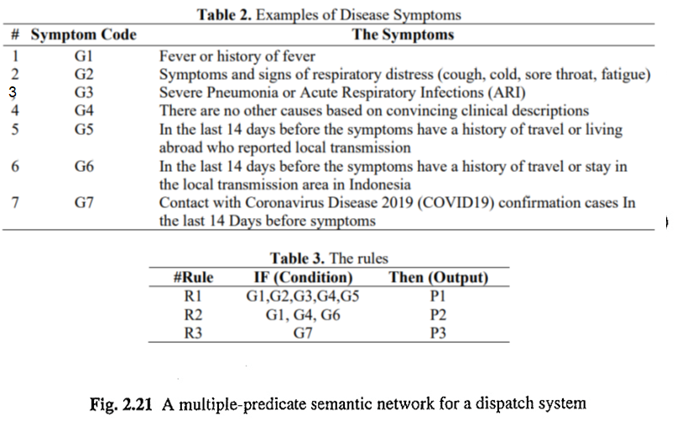
4. PRODUCTION SYSTEM (con’t)
Silahudin, D., and A. Holidin. "Model expert system for diagnosis of covid-19 using naïve Bayes classifier." IOP Conference Series: Materials Science and Engineering. Vol. 1007. No. 1. IOP Publishing, 2020. https://iopscience.iop.org/article/10.1088/1757-899X/1007/1/012067/meta

Slide 57
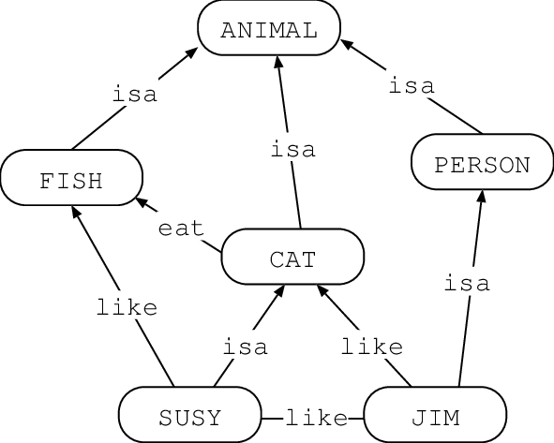
5. Semantic Network
A semantic network is a drawing to depict relations of words. It is a kind of knowledge representation scheme that ideas can be represented to solve problems.
https://www.ibm.com/docs/it/stafs/4.0.1?topic=techniques-semantic-networks
https://medium.com/nerd-for-tech/semantic-network-frame-network-c123b20fdc4c

Slide 58
6. Frame -- Hierarchical Representation of Knowledge
Each piece of information about a particular frame is held in a slot. The information can contain:
Facts or Data
Values (called facets)
Procedures (also called procedural attachments)
IF-NEEDED: deferred evaluation
IF-ADDED: updates linked information
Default Values
For Data
For Procedures
Other Frames or Subframes
https://en.wikipedia.org/wiki/Frame_(artificial_intelligence)

Slide 59
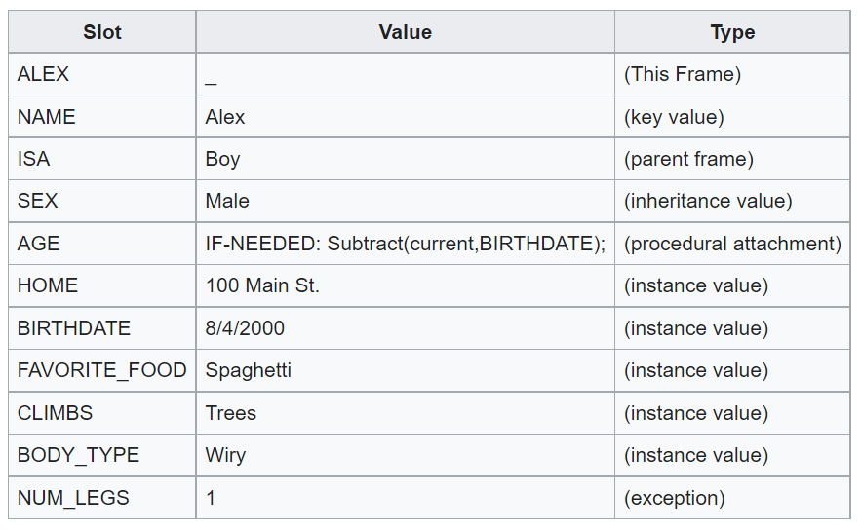
Example of a frame

Slide 60
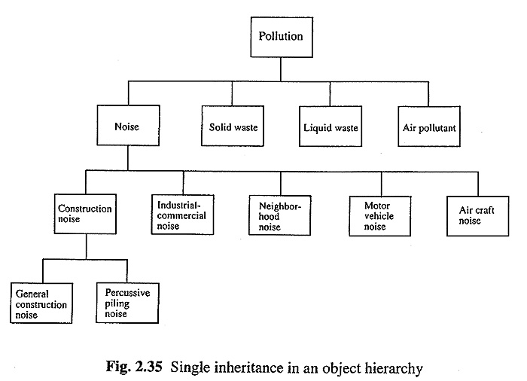
7. Object-Oriented Programming
Data Encapsulation
Inheritance
An environmental example

Slide 61
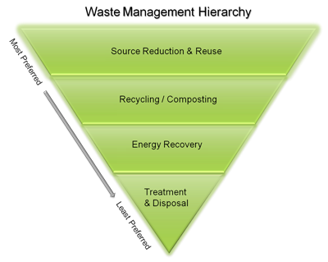
7. Object-Oriented Programming
Data Encapsulation
Inheritance
Example: Non-Hazardous Materials and Waste Management Hierarchy
Sustainable Materials Management:
https://www.epa.gov/smm/sustainable-materials-management-non-hazardous-materials-and-waste-management-hierarchy

Slide 62
8. A REMARK ON SYMBOLIC APPROACHES
Advantages
Processing elements corresponds to meaningful concepts
Complex hierarchical structures can be efficiently represented
Reasoning and explanations are tractable
Disadvantages
Learning (especially automatic) ability is relatively low
Surface relations between atomic concepts are not represented

Slide 63
Reference
Book: Discrete Mathematics by Example by Andrew Simpson
https://trutabgen.com/

Slide 64
Appendix

Slide 65
Other notations: ⊦, →, ⟹
⊦
In metalogic, the study of formal languages; the turnstile represents syntactic consequence (or "derivability"). This is to say, that it shows that one string can be derived from another in a single step, according to the transformation rules (i.e. the syntax) of some given formal system.[3] As such, the expression P ⊦ Q https://en.wikipedia.org/wiki/Turnstile_(symbol)
→ and ⟹
→ is a logic operator, whereas ⟹ is a statement (where you know the outcome must be true).
→ : can have result "false".
⟹ : Always true, by definition cannot be false. Not used as an operator. https://math.stackexchange.com/questions/1015518/in-logic-do-the-longrightarrow-and-rightarrow-signify-different-things

Slide 66
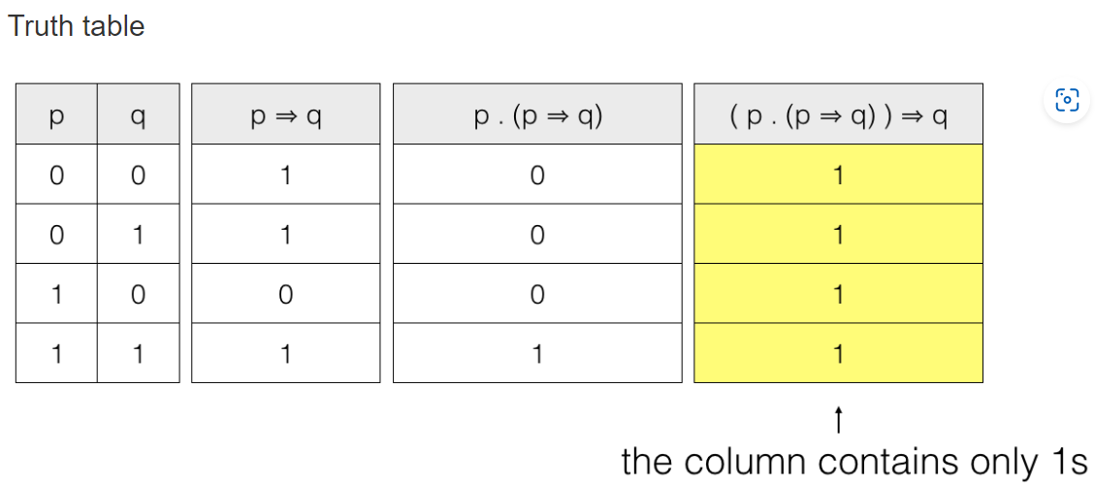
Truth Table Method: From the given premises p and p ⇒ q infer q. “⇒” means logically implies
So, we have two premises p and p ⇒ q. connected by an AND operator and the conclusion to be drawn is q. So we have to create a conditional ( p . (p ⇒ q) ) ⇒ q where, . is the AND operator, ⇒ is the conditional operator
So we have to prove ( p . (p ⇒ q) ) ⇒ q is a tautology. So, ( p . (p ⇒ q) ) ⇒ q is a tautology. Hence the conclusion from the given premises can be drawn.

Slide 67
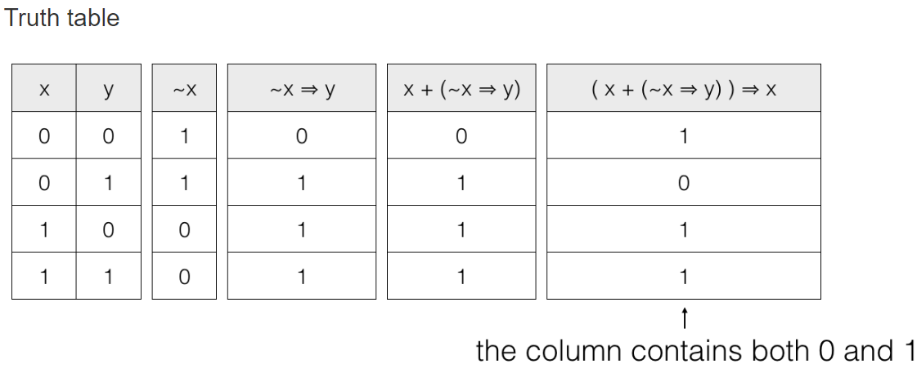
From the given premises x or ~x ⇒ y infer x “⇒” means logically implies
so, we have two premises x and ~x ⇒ y connected by an OR operator and the conclusion to be drawn is x. So, we have to create a conditional ( x + (~x ⇒ y) ) ⇒ x where, . is the AND operator, + is the OR operator, ~ is the NOT operator and ⇒ is the conditional operator
So, we have to prove ( x + (~x ⇒ y) ) ⇒ x is a tautology.
So, ( x + (~x ⇒ y) ) ⇒ x is not a tautology and hence the conclusion from the given premises can’t be drawn.

Slide 68
Truth table calculators
https://trutabgen.com/
https://web.stanford.edu/class/cs103/tools/truth-table-tool/

