Slide 1
GISM5033
Artificial Intelligence for Smart Cities
KH Wong
https://www.cse.cuhk.edu.hk/%7Ekhwong/www2/GISM5033/GISM5033.shtml

Slide 2
Overview
What is AI for smart cities?
  What is AI ?
  Hardware systems
  Sensors
  Internet of Things
  Networking
  Computers
Software systems
  AI techniques and applications

Slide 3
What is AI for smart cities?
Artificial intelligence (AI) is a set of computer methods that enable the machine to
  hear
  see
  understand languages
  summary data
  make recommendation etc.
One approach to achieve the above is to ask the machine to learn by itself. Hence, we need to study machine learning methods.
These are useful methods to be employed to build smart cities.

Slide 4
Different approaches of machine learning
Supervised learning (give labels for samples)
  Ensemble methods
  Neural networks
    Backpropagation – basic idea for most neural network training.
    CNN Convolution neural networks
    RNN Recurrent neural networks
    Autoencoder
    Transformer (for Large Language models)
  KNN K-nearest neighbor classification
Unsupervised learning (no label for samples)
  K-means clustering
Reinforcement learning (give reward if performs well)
  Q learning
  Deep Q learning using neural networks

Slide 5
Hardware systems
For smart cities

Slide 6
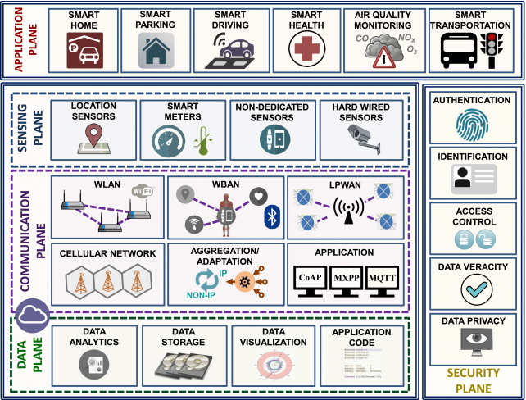
Hardware systems
Sensors
  Location sensors
  Camera
Internet of Things
Networking
  WLAN
  WBAN
  LPWAN
Computers
  CPU/GPU
https://dl.acm.org/doi/fullHtml/10.1145/3309545

Slide 7
Hardware
IoT (Internet of Things)
  Standard – e.g., Zigbee
  For connecting sensors
Internet
  General connections
RFID (Radio-frequency identification)
  Data collection
Mobile network
  5G

Slide 8
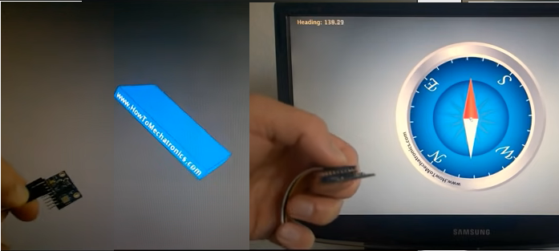
Sensors
Mems Gyroscope for orientation sensing
  https://www.youtube.com/watch?v=eqZgxR6eRjo
Accelerometer for position sensing
Pressure sensor
  https://www.youtube.com/watch?v=E-5g3lJONqs
Magnetic sensor
Camera for machine vision
GPU (graphic processors) for computation
  https://www.nvidia.com/en-us/geforce/graphics-cards/
Satellite for Global monitoring
  https://www.youtube.com/watch?v=DjVXmB6cgEE

Slide 9
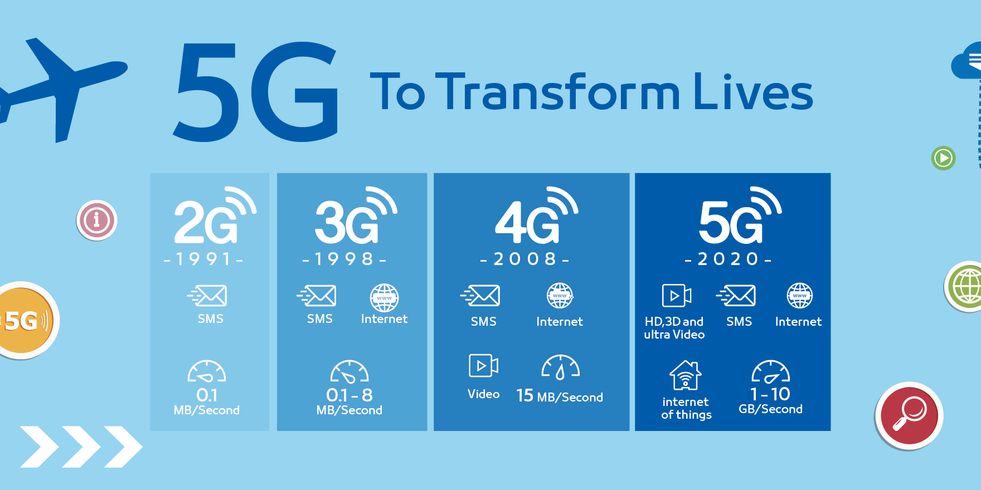
Mobile phone network
https://www.purplepass.com/blog/3g4g-5g-internet-what-is-the-difference/

Slide 10
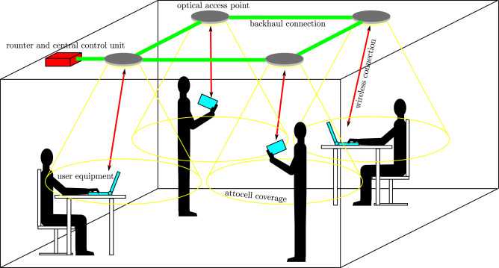
Wi-Fi
Standard Band Maximum data rate
  802.11b 2.4 GHz Up to 11 Mbps
  802.11a 5 GHz Up to 54 Mbps
  802.11g 2.4 GHz Up to 54 Mbps
  802.11n 2.4/5 GHz Up to 450 Mbps
Light network :A guide to wireless networking by light
  https://www.sciencedirect.com/science/article/pii/S0079672717300198

Slide 11
Software systems
For smart cities

Slide 12
Overview of software systems
Those highlighted in red will be studied in this course.
Computer science basic: Symbolic Approaches to Spatial Knowledge Representation and Inference
Machine learning
  Supervised learning
    CNN Convolution Neural networks
    RNN Recurrent Neural networks
    Fuzzy inference system
    K-means
  Unsupervised learning – K-NN K-nearest Neighbor
  Reinforcement learning
    Q learning
Classification using ensemble methods
  Adaboost
  Decision tree
NLP (natural language processing)
  Recurrent neural networks – RNN
  Transformer
  Large Language model (LLM)
Automation and robotics https://www.youtube.com/@BostonDynamics
Machine vision
  Basic computer vision algorithm
  Object recognition (CNN, Unet)
  Automatic driving

Slide 13
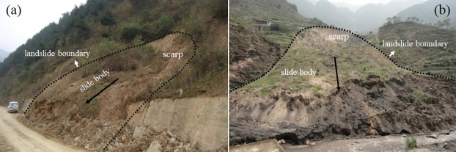
Application of Ada-boost case studies
Wu, Yanli, et al. "Application of alternating decision tree with AdaBoost and bagging ensembles for landslide susceptibility mapping." Catena 187 (2020): 104396.
https://www.sciencedirect.com/science/article/pii/S0341816219305387

Slide 14
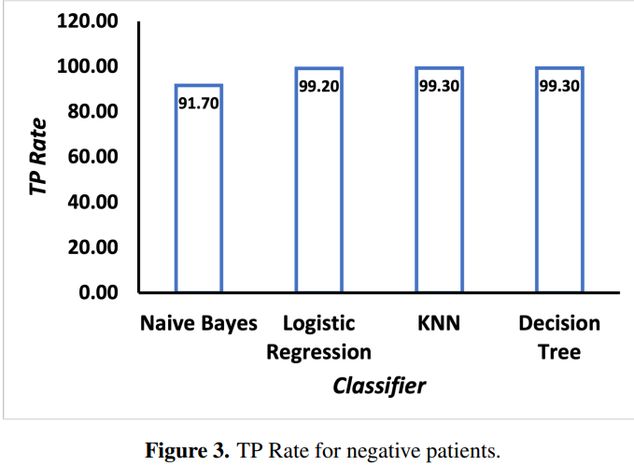
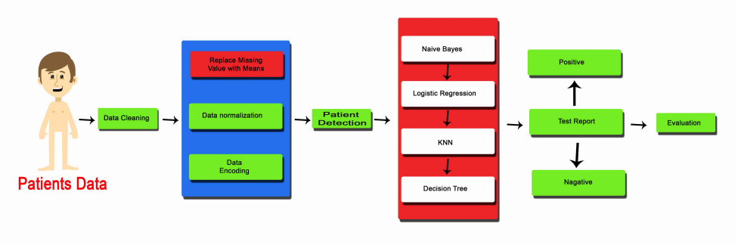
Application of decision tree : Tackling pandemics in smart cities using machine learning https://www.aimspress.com/article/doi/10.3934/mbe.2021418
This paper proposes an artificial intelligence (AI) algorithm that predicts the rate of likely survivals of COVID-19 suspected patients based on good immune system, exercises and age quantiles securely.

Slide 15
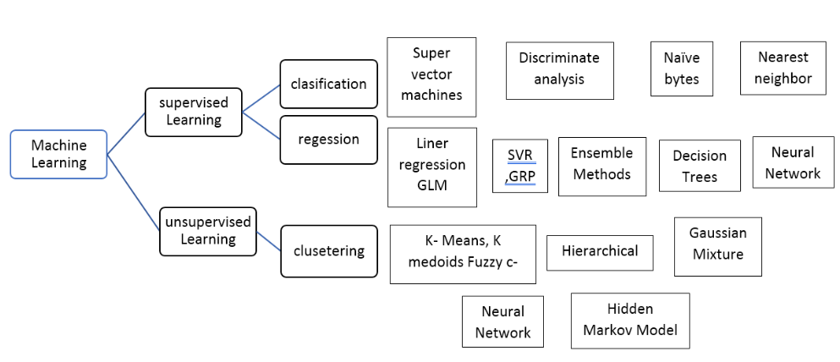
Types of Supervised Machine Learning Algorithm
https://www.educba.com/what-is-supervised-learning/
Reinforcement (Q) learning, learning by rewarding. Application: Robotics, Healthcare. Example: AlphaGo, ChatGPT

Slide 16
NLP (natural language processing)
Recurrent neural networks – RNN
LSTM long-Short-Term-Memory model
Word embedding
Transformer: Doing reading comprehension for you!
  https://www.pragnakalp.com/demos/BERT-NLP-QnA-Demo/
Used for
  Machine translation
  Emotion/Sentiment analysis/classification
  Big data analysis

Slide 17
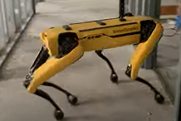
Automation and robotics
Technology
  Proportional Integral Derivative (PID) control
  Fuzzy logic control
  Kalman filter and control
  Neural network approaches
  Reinforcement learning: learn how to walk
Modern robots
  Boston Dynamics
    https://www.youtube.com/watch?v=uhND7Mvp3f4
  Elon Musk reveals a humanoid robot https://www.youtube.com/watch?v=UXHoWNfjJYM

Slide 18
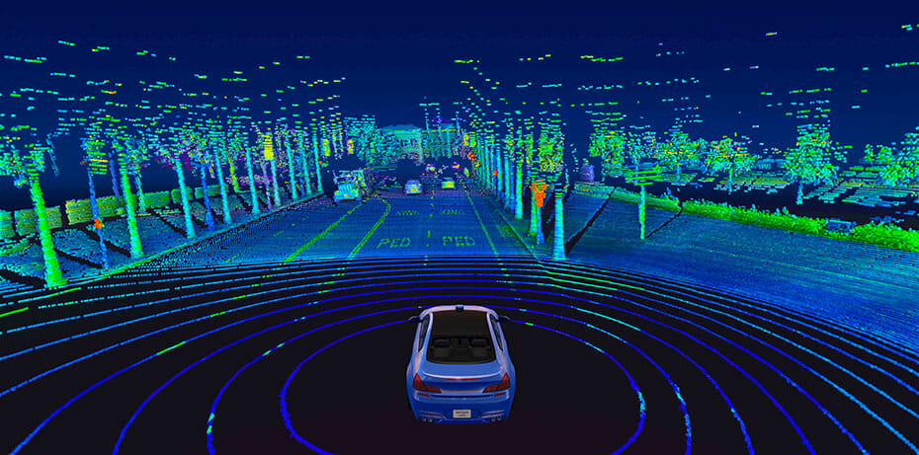
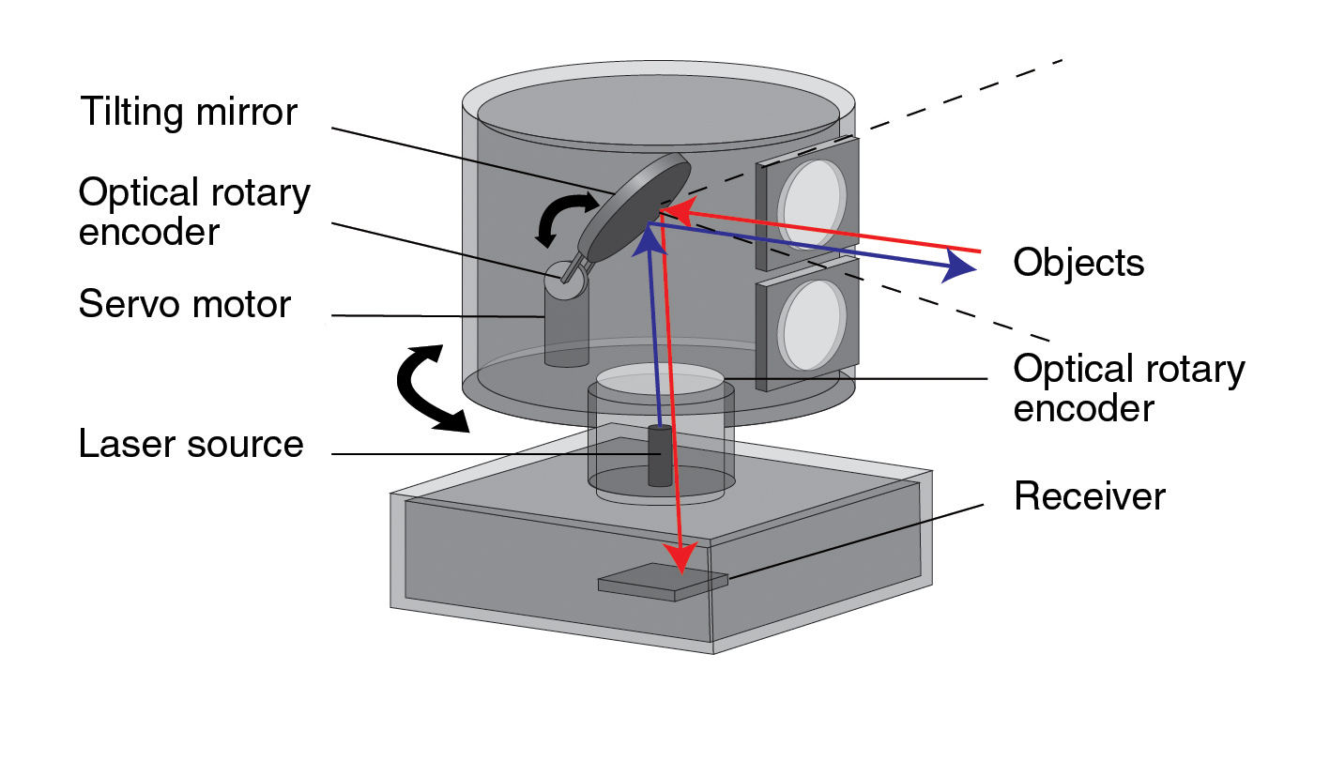
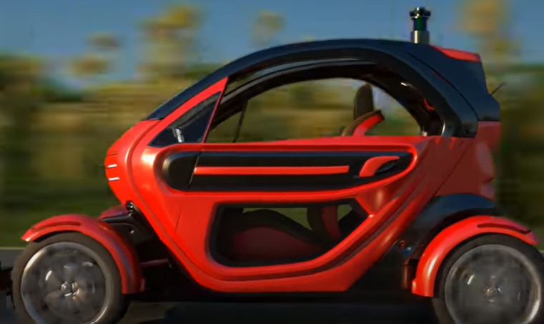
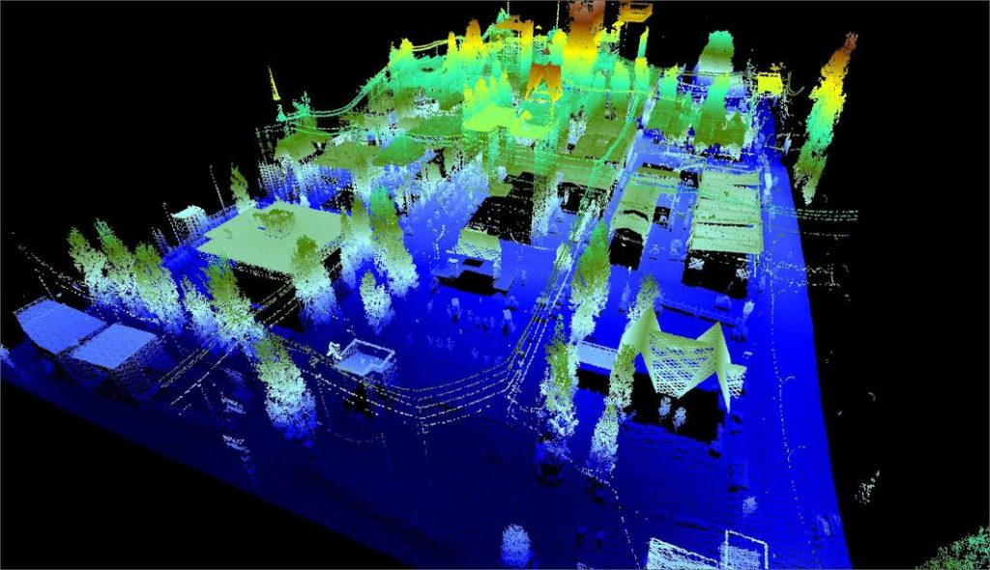
Machine vision and automatic driving
Automatic driving
  Automatic driving using lidar
  https://www.youtube.com/watch?v=gEy91PGGLR0
Should Lidar be used?
  https://insideevs.com/news/488991/tesla-vs-lidar-self-driving-technology/
  https://velodynelidar.com/blog/guide-to-lidar-wavelengths/

Slide 19
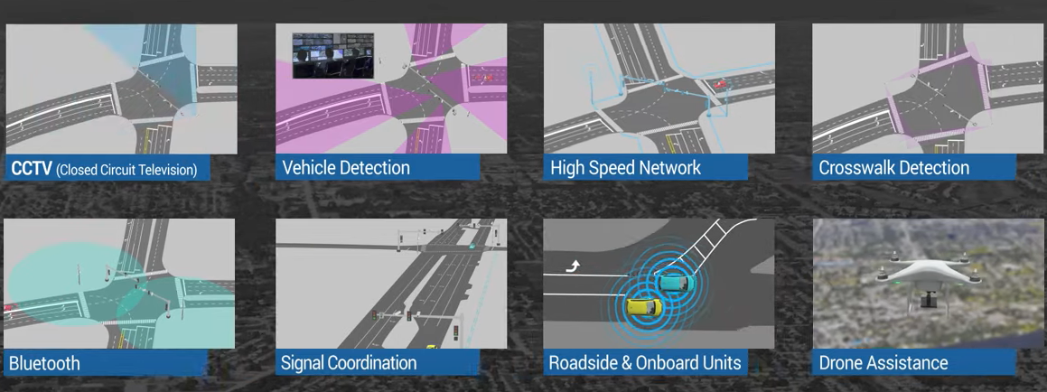
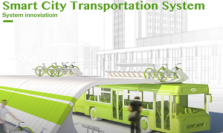
Smart transportation
https://www.youtube.com/watch?v=OnjX0O9dPMc
https://www.youtube.com/watch?v=23iOXeHL4EE
https://www.digi.com/blog/post/introduction-to-smart-transportation-benefits

Slide 20
Application of Fuzzy logic for the automatic braking system
https://www.youtube.com/watch?v=rln_kZbYaWc

Slide 21
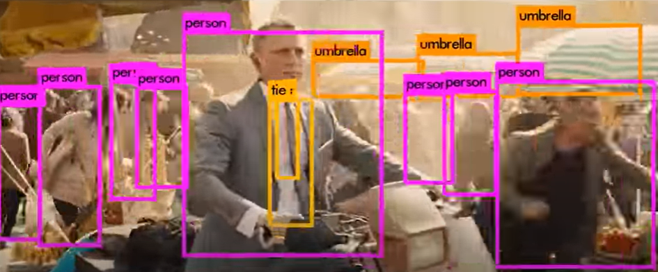
Application of CNN Neural networks for object recognition
Object recognition example: A very successful object recognition system Yolo, You only look once
https://www.nature.com/articles/s41598-021-81216-5
https://www.youtube.com/watch?v=VOC3huqHrss

Slide 22
Application of Natural Networks for Natural language Processing
Chat GPT - Will AI Replace The Human Creator? https://www.youtube.com/watch?v=jt4QANkZVY4
Related fields:
  Seq2seq processing , RNN
  Transformer
  Word embedding
  ChatGPT
  Large language Model LMM

Slide 23
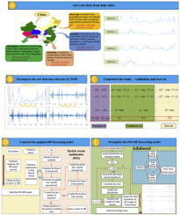
Application of Adaboost on air pollution monitoring
https://www.sciencedirect.com/science/article/pii/S1309104219300546
Air PM_{2.5} concentration multi-step forecasting
Others: Earthquake prediction.

Slide 24
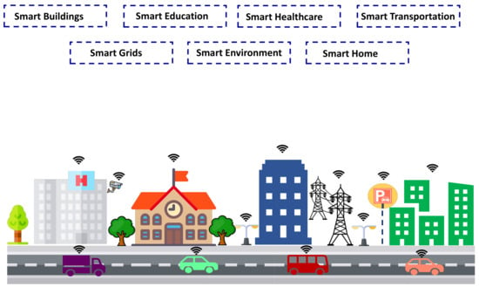
Application of Decision Tree for Smart City Networks
A Comparative Study of Traffic Classification Techniques for Smart City Networks Razan M. AlZoman 1,2 and Mohammed J. F. Alenazi
https://www.mdpi.com/1424-8220/21/14/4677

Slide 25
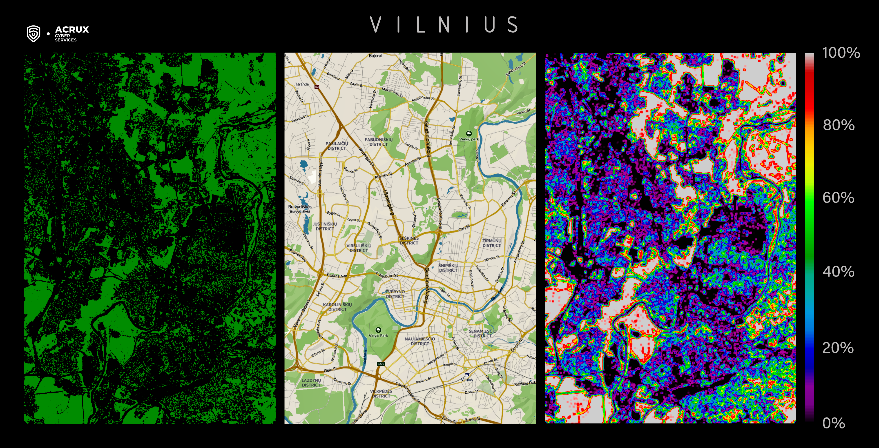
Application of Neural network for Smart Cities
https://acruxcs.com/en/publication/Neural-networks-for-smart-cities

Slide 26
Conclusion
Studied the importance of AI in smart city design
Studied the hardware and software techniques used in smart cities.
Review various artificial Intelligence techniques and their applications in smart cities.

