Slide 1
The use of Artificial Intelligence A.I. tools in GECC3130 or GECC4130
Kh Wong

Slide 2
What you cannot do
Cannot use A.I. to write or rewrite your proposal, report or presentation file (PPT).
Cannot use A.I. to write or rewrite your Reflective Essay
Cannot use A.I. to translate from one language to another (e.g. Chinese to English or the other way around) and insert that in your proposal, report , PPT or reflective essay.
If found it is considered as plagiarism

Slide 3
What you do
Can use A.I. to find references and related work, but need to cite the source, e.g.
https://apastyle.apa.org/blog/how-to-cite-chatgpt
Example in the background of your report:
When prompted with “Is the left brain right brain divide real or a metaphor?” the ChatGPT-generated text indicated that although the two brain hemispheres are somewhat specialized, “the notation that people can be characterized as ‘left-brained’ or ‘right-brained’ is considered to be an oversimplification and a popular myth” (OpenAI, 2023).
Reference
OpenAI. (2023). ChatGPT (Mar 14 version) [Large language model]. https://chat.openai.com/chat
But you must double check the result is correct. If it is not the case, you are the one to be blamed.

Slide 4
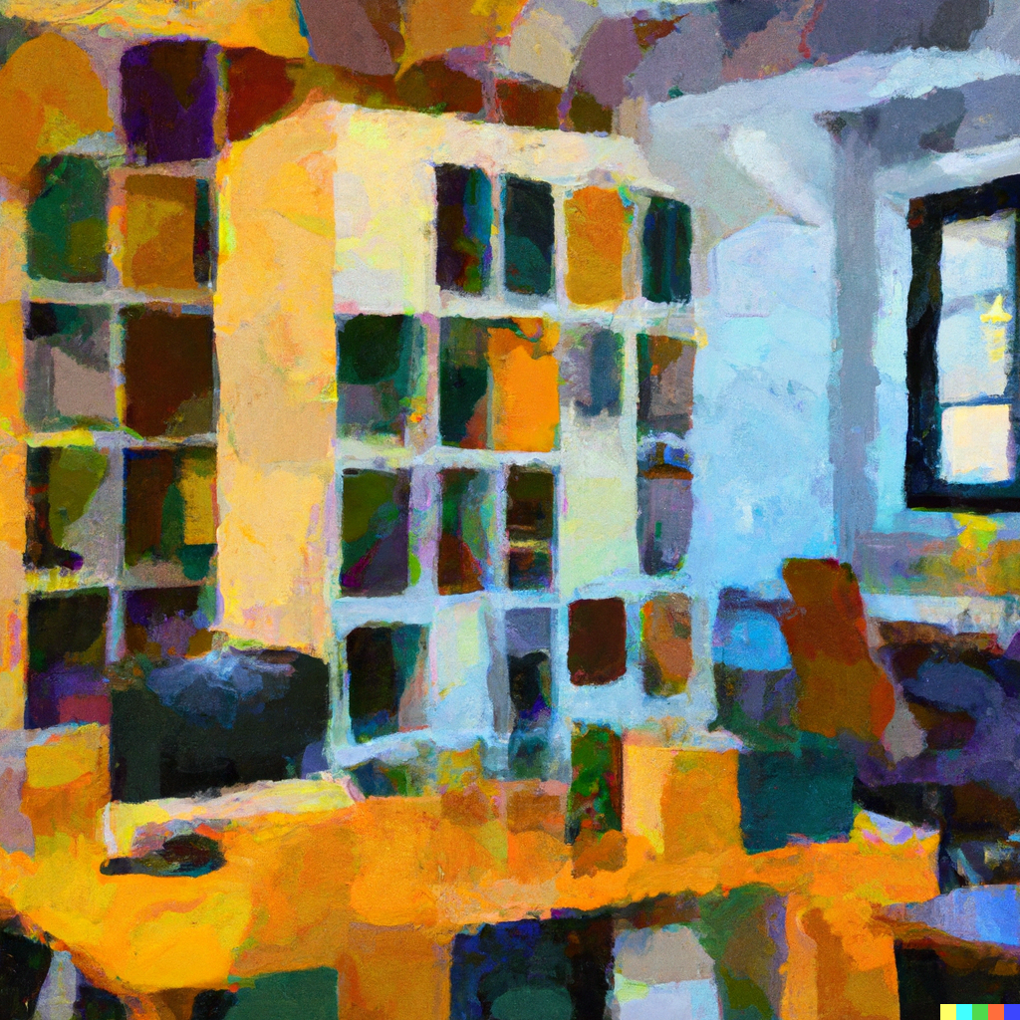
You can use A.I. to generate images and included them in your PPT or report.
But you need to cite the sources such as using the Chicago method as shown below:
https://www.chicagomanualofstyle.org/qanda/data/faq/topics/Documentation/faq0423.html
According to an article on the website of OpenAI, the organization responsible for DALL·E, “If you’d like to cite DALL·E, we’d recommend including wording such as ‘This image was created with the assistance of DALL·E 2’ or ‘This image was generated with the assistance of AI’ ” (see “How Should I Credit DALL·E in My Work?,” accessed March 7, 2023).
In other words, be sure to give credit to the source, as you would for any image (see CMOS 3.29–37). Here’s an image created by DALL·E 2:
https://openai.com/index/dall-e/

