Slide 1
A language assistant system for smart glasses
Shi Fan Zhang, Kin Hong Wong
The Dept. of Computer Science and Engineering
The Chinese University of Hong Kong
Shatin, Hong Kong
Email:khwong.cse.cuhk.edu.hk

Slide 2
Overview
Introduction and the idea
Background
Theory
The algorithm
  Affine transform
  Quadrangle detection
  Affine Transformation
  Optical Character Recognition OCR
  Finger location
  Pose estimation
Results
Conclusions and discussions

Slide 3
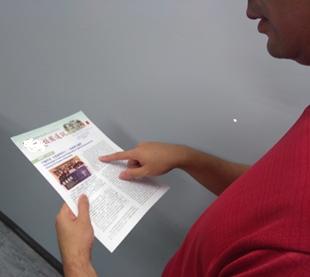
Introduction
Developed a language assistant system
May be used for people using wearable smart glasses.
The user points to a word he needs language translation, our system will recognize the word
And report to the user using sound or images.
Tested with satisfactory results.

Slide 4
Background
Smart cameras are becoming very popular
The Hong Kong Police Force is also running trials on "Body Worn Video Camera" for evidence capturing and recording [2].
Some gadgets even equipped with Global Positioning System (GPS), High Density camera, Head-up-display (HUD) and smartphone connectivity.
Personal communication capabilities are also included in some systems, for example, Golden-i [4] features a wearable computer at work, and allows users to send/receive email, or browse webpages or files.
The Google Glass is also an example. It may also handle face recognition and computer vision tasks. Some people are working in this direction and exploring new ways of using it [5].

Slide 5
Theory and Methodology
Our system will help you in Language translating
First, the rectangular image of the paper with the text should be detected.
The paper may not be perpendicular to the user’s view, the text may be geometrically distorted.
To fix, we recertify the image so the texts will appear normal.
Four corners of the rectangular image are recognized and then affine transformation is applied to rectify the image.
Then OCR will be carried out.

Slide 6
The algorithm
Locate the quadrangle which is the boundary of the paper. Since the 3D geometry of the paper is known (assume A4 size paper), so using a pose estimation technique we can find the pose of the paper. Another approach is to use affine transform to rectify the image to the normal pose.
The next step is to use a finger pointing algorithm to find where the user wants the text to be located on the paper. So we should know which part of the image contains the text to be translated.
Use the rectified image as the input of the OCR system.

Slide 7
  Quadrangle detection
K. K. Lee [6] combines Randomized Hough Transform and Q-corners to facilitate multiple-quadrilateral detection.
A similar idea can be applied to rectangle corner detection.
Our approach is based on the method of Hough transform. First all lines inside the image are selected, our target is to find the four corners that constitute the quadrilateral of the paper.
In our processing cycle, first we pick two detected lines and calculate their intersection point. If the intersection point is not out of the boundary, one score is voted for this point. We repeat the above for all line pairs, and then four points with the highest scores are the four points of the quadrangle.

Slide 8
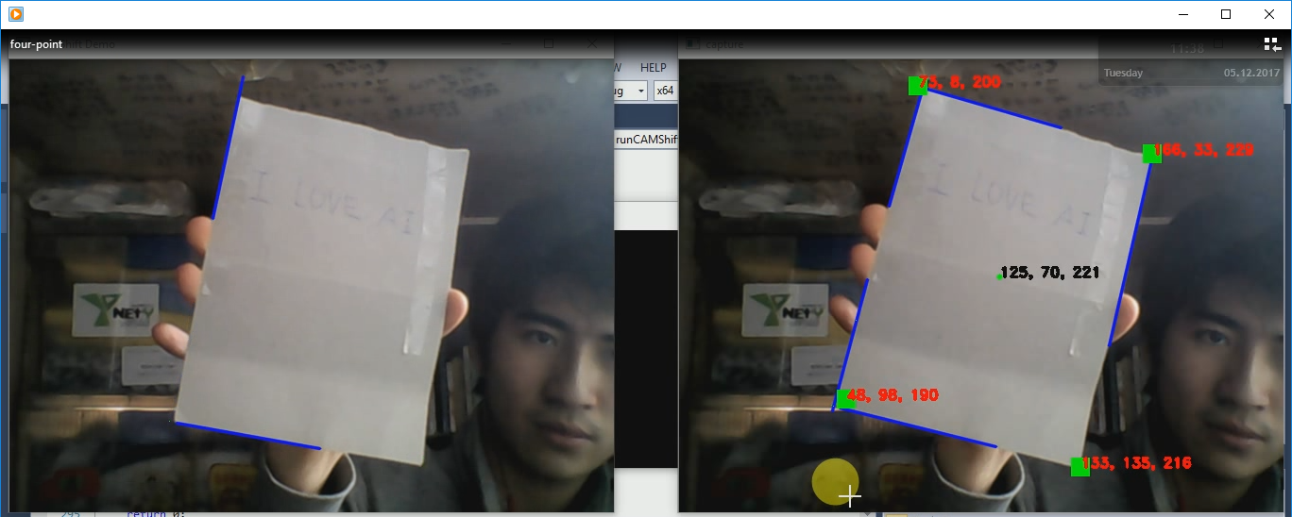
Demo
https://youtu.be/aJd4BenNkTA

Slide 9
Homography transform
Three conditions under which Optical Character Recognition (OCR) has excellent performance:
The text region is normal to the principal axis of the camera lens.
The text is not skewed.
The text is clear and distinct from the background.
Therefore, affine transformation is applied to rectify the frames so that the text lines are not geometrically distorted. OpenCV [7] provides several functions to rotate the input frames and are used in our project.

Slide 10
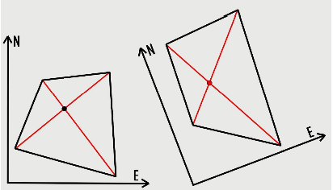

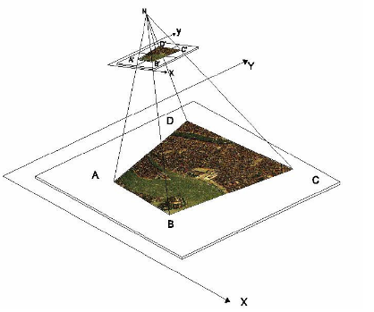
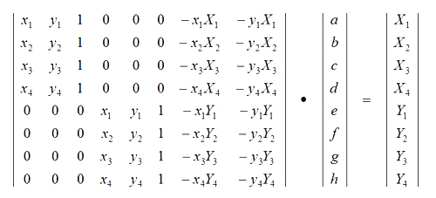
Homography transform
Where X-Y are the coordinates to be calculated in the second reference system, given coordinates x-y in the first reference system in function of 8 transformation parameters a, b, c, d, e, f, g, h.
http://www.corrmap.com/features/homography_transformation.php

Slide 11

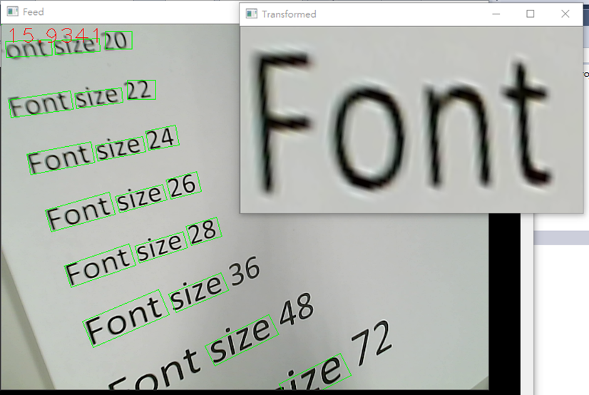
homography transform to rectify the text
Input: Index of the nearest text region
Output: The recognized string of text

Slide 12
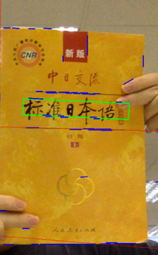
Optical Character Recognition OCR
Use Tesseract for our OCR task. Tesseract [8]
Achieves high accuracy when dealing with printed English characters.
Since our users may be Chinese, and we found that for the Chinese text, Tesseract performs poorly if all parameters are set to be default values.
Often one Chinese character is split into two so it is obvious that Tesseract is difficult to recognize those characters with radicals (parts of a Chinese character).
To fix the problem, some parameters (for instance, set psm=6) are adjusted to inform Tesseract that the targets are of the same shape. An example of successfully Chinese text recognition is shown in Fig. 2.

Slide 13
OCR test
We performed the experiments using (1) default setting and (2) adjusted parameter setting; the results are shown in Table 1 and 2, respectively. From the results, it can be found that Tesseract recognizes Chinese characters precisely with adjusted parameters, regardless whether the characters are printed in standard format or some strokes are eroded to some extent.
It should be mentioned that Tesseract can be trained manually. Although the official dataset contains huge chunks of trained data, it may fail to completely recognize all the characters without mistake. However, related documents declare that official dataset cannot be revised. Manual training the Tesseract needs to start everything from scratch, which can be a hard task. So it may be the next target we will achieve in future.

Slide 14
Test result
Table 1: Tesseract recognizes Chinese characters with default parameters
Table 2: Tesseract recognizes Chinese characters with adjusted parameters
 | Number of all characters | Number of recognized characters | Overall accuracy
High quality characters | 75 | 73 | 97.3%
Low quality characters | 264 | 180 | 68.2%
 | Number of all characters | Number of recognized characters | Overall accuracy
High quality characters | 75 | 74 | 98.7%
Low quality characters | 264 | 262 | 99.2%

Slide 15
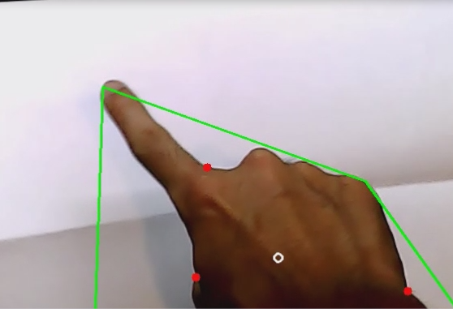
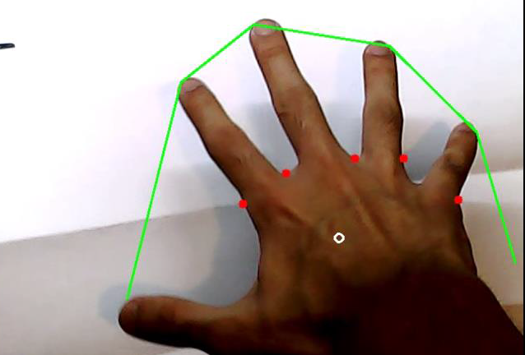
Finger location
The feature of human hand includes:
Five fingers.
Each finger is a convex polygon
The space between two adjacent fingers forms a hollow region.
First, the background is removed,
Our system will perform image thresholding, contour and convex hull finding.
The contour with maximum area (target contour) should form the image of our hand.
If we calculate the distance between points on the contour and the convex hull, several local maxima can be found. They correspond to the hollow region between adjacent fingers.
We can select the top point on the target contour and it is the fingertip of the finger.
A small image area above the fingertip which contains the target word will be selected.
https://youtu.be/qsNmY7OW5_s

Slide 16
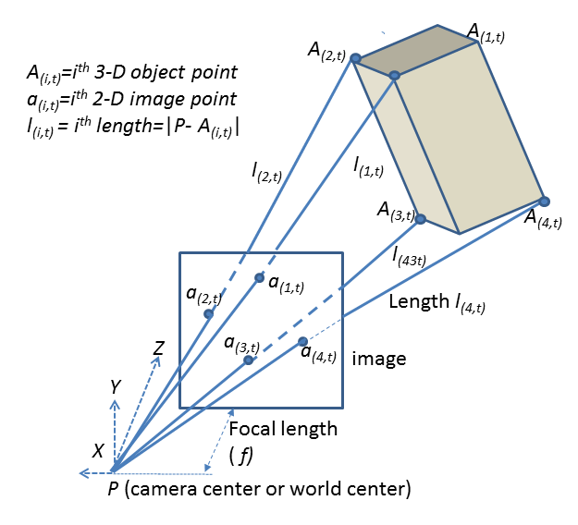
Perspective-Four-Point
Objective
Our proposal
Perspective-Four-Point
Kalman Filter
Experiments & Results
Conclusion
Suppose we have four model points defined as t=0:
Their image projection points can be detected as:

Slide 17
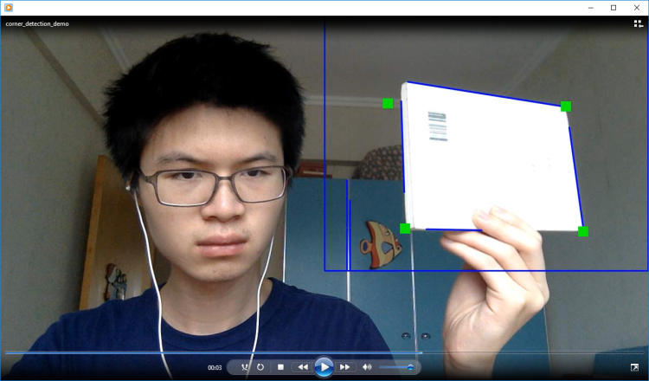
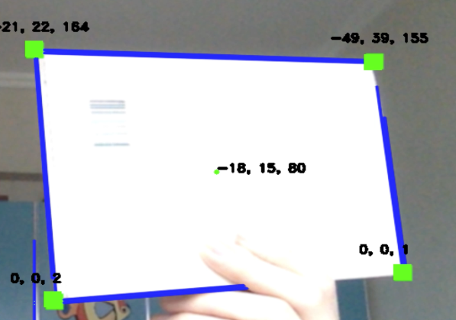
Pose Estimation for future development
Pose estimation using 4 points.
A video demonstration of our implementation can be found at
https://youtu.be/1vMNN4Gbty8
https://www.youtube.com/watch?v=diN565iTPdM

Slide 18
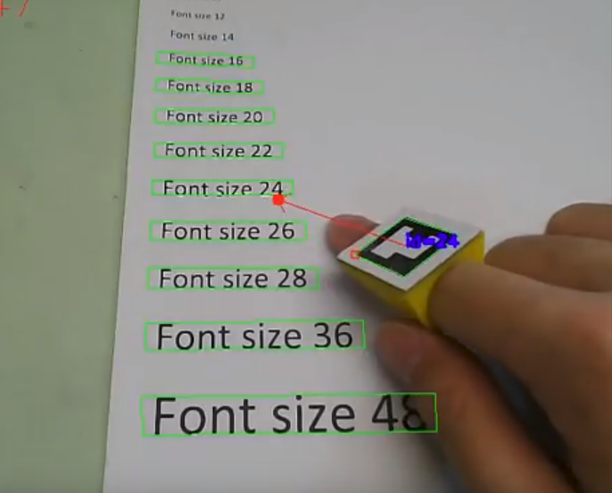
Results and Demonstration
We integrated all modules
The OCR module can look up its meaning in the dictionary and show the result on screen.
As shown in Fig.4, the user points to a word (right window), OCR is ued for recognition.
The result is the text of the target image.
Then, the recognized text is shown on screen (left window). A video demonstration of this process running in real-time can be found at
Our new test
  https://youtu.be/ZVW7IUBM0R8
https://www.youtube.com/watch?v=cepRpxxQbDs

Slide 19
Conclusions and Discussions
From the tests, our idea of building a language assistant for smart glass users is feasible.
The camera can detect the quadrangle of the paper. Affine transform is applied successful to rectify the text of the page.
A finger pointing detection system can be used to find the text to be translated.
An Optical Character Recognition (OCR) system translates the word into text.
The meaning of the text can be then be found by an electronic dictionary.
The whole process is in real-time and can be very useful for students or travelers where instant language translation of foreign words is necessary.

Slide 20
Q&A
Thank you

