Slide 1
Text Detection and Marker Based Finger Tracking in Building a Language Assistant for Wearable Glasses
Ting Kwok Chan, Ying Kin Yu and Kin Hong Wong
Dept. of Computer Science and Engineering
The Chinese University of Hong Kong
Shatin, Hong Kong
khwong@cse.cuhk.edu.hk

Slide 2
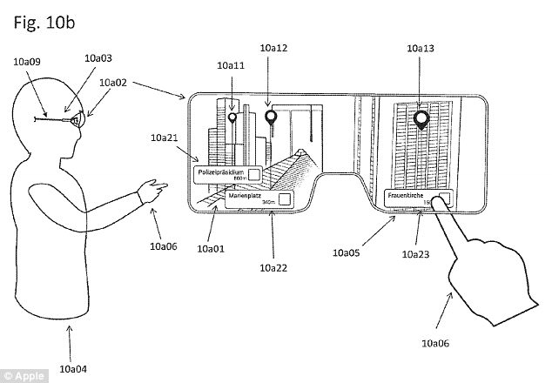
Introduction
Invention of wearable smart glasses makes mobile internet computing easier
Users can see the world with virtual objects augmented into the real space
Figure 1. Apple’s smart glasses patent Patently Apple. (2017). Apple Patent Reveals the Exciting Possibility of Augmented Reality Smartglasses [Online], Accessed: 9th December, 2017,
URL: http://www.patentlyapple.com/patently-apple/2017/07/apple-patent-reveals-the-exciting-possibility-of-augmented-reality-smartglasses.html

Slide 3
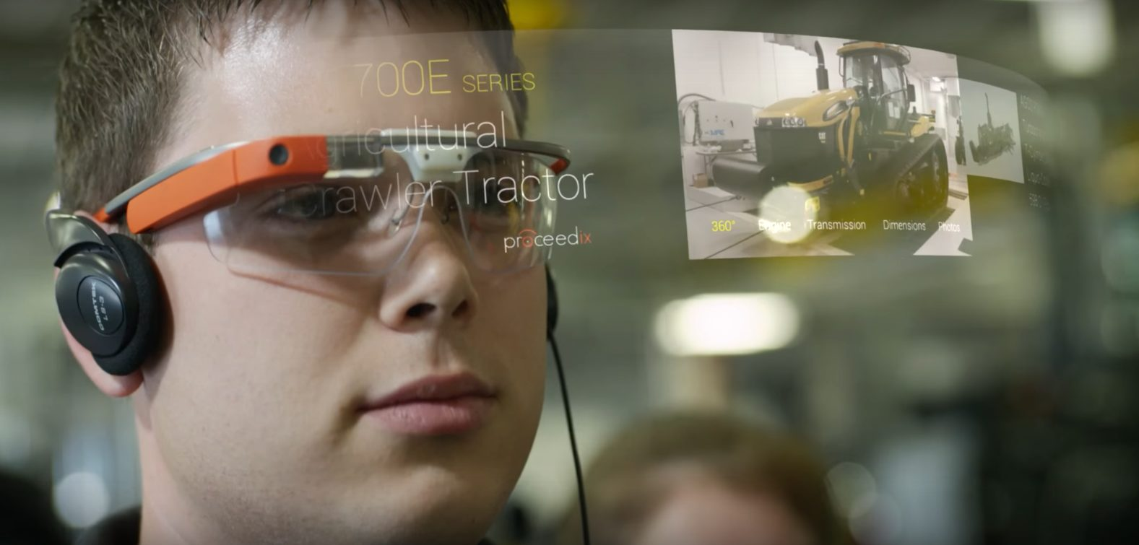
Background
Smart wearable computers are becoming popular because it is easy to use and carry
Wearable cameras are mobile devices that can be taken outdoors for various usages
Figure 2. Google Glasses Edgly Labs. (2017). Look out! Google Glass is Back With Enterprise Edition [Online], Accessed: 27th February, 2018,
URL: https://edgylabs.com/google-glass-back-enterprise-edition

Slide 4
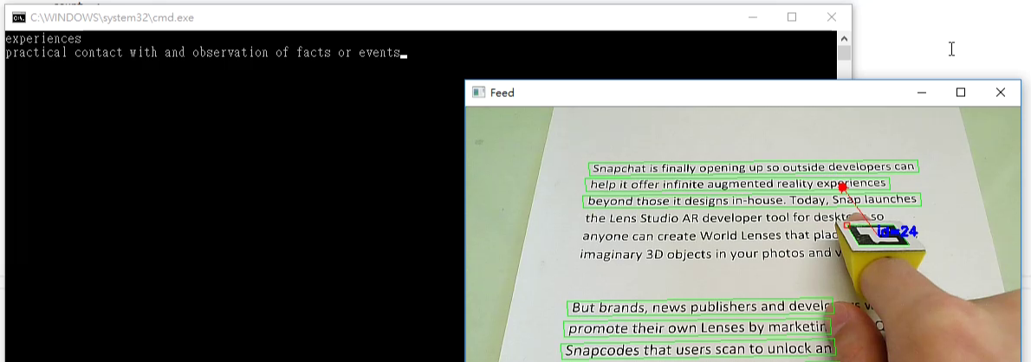
Application Overview
Recognize the word pointed by the user’s finger based on an optical character recognition approach
Lookup the recognized word from dictionary
ArUco markers were introduced to improve fingertip detection performance
Figure 3. Our OCR Dictionary Application

Slide 5
Application Overview
OpenCV was used for image processing and contour and marker detections
Tesseract was used for optical character recognition
Oxford dictionary was used for word definition lookup
SAPI was used for text to speech

Slide 6
Demonstration
https://www.youtube.com/watch?v=I3bowdnqcHM

Slide 7
Overall Design
Figure 4. A flowchart showing the overall design of our system

Slide 8
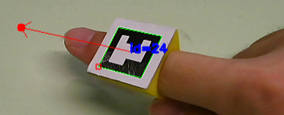
Background
The application can be divided into 3 main modules
Text Detection and Extraction
Finger Detection
Optical Character Recognition

Slide 9
Text Detection and Extraction
Figure 5. The procedure for text detection
Input: Original image from the camera
Output: A list of 4 corners of the detected text regions
Stroke thickening with a series of image processing functions
Nearby characters can be merged together and represented by a block of white pixels in a binary image
Contour detection to group pixel blocks
Simplify contours into rectangles by polygon approximation
Remove small or tall contours

Slide 10
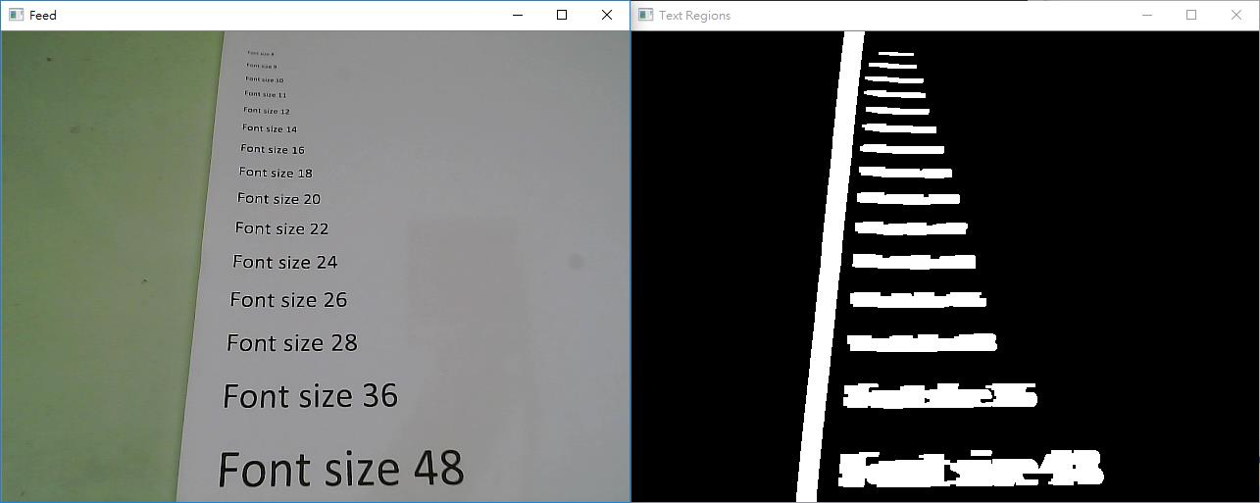
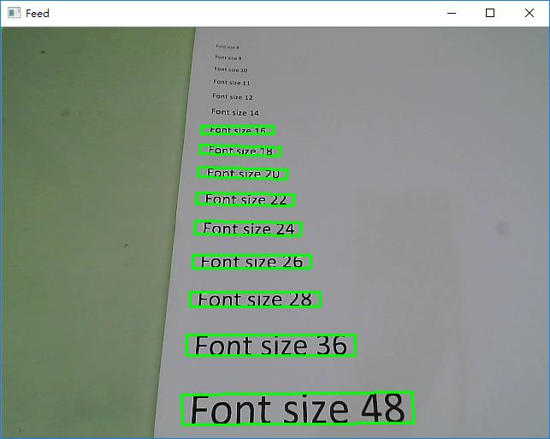
Text Detection and Extraction
Figure 6. The original image from the camera Figure 7. The potential text regions
Figure 8. The finalized detected text regions

Slide 11
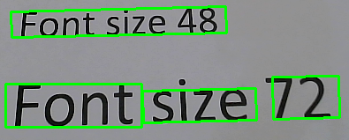
Text Detection
From 20cm away, the algorithm can detect characters of
3mm in height or higher
1.1cm in width or wider
May not be able to separate words from a line for smaller font sizes
Figure 9. The text detection algorithm may not always be able separate words

Slide 12
Finger Detection
Input: Original image from the camera
Output: Coordinates of the fingertip
2 algorithms were developed to tackle this problem

Slide 13
Finger Detection (with color)
Figure 10. The procedure for finger detection based on colors
Convert the original image from the camera into HSV color space
Filter out pixels outside human hand HSV range to obtain a binary image containing the human hand’s shape
Erode and dilate to clean up obtained binary image
Find hand contour from binary image
Select biggest contour
Search fingertip by finding the point with the smallest y-coordinate from hand contour

Slide 14
Finger Detection (with color)
Figure 11. Original image from the camera with an overlaid red dot indicating the fingertip
Figure 12. hand contour with an overlaid red dot indicating the fingertip

Slide 15
Demonstration (Finger Detection with HSV)
https://www.youtube.com/watch?v=j7t7a8maBv0

Slide 16
Finger Detection (with color)
The algorithm has several problems
Color filter is user dependent
Need to tune the filter for different environment
Highest point in the contour may not always mean the fingertip
Accuracy was within 30 pixels in Euclidean distance
There is a better solution for this problem

Slide 17
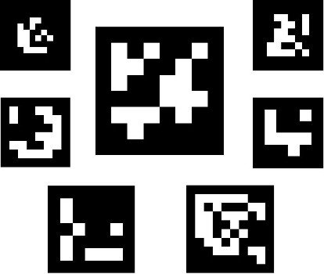
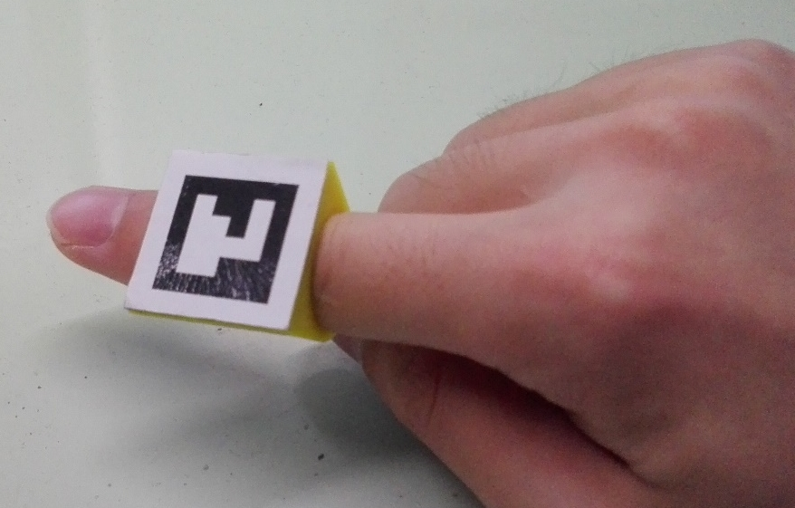
Finger Detection (with marker)
ArUco Marker
Made of black and white squares
Robust detection, identification and pose estimation
The simplest 4x4x50 marker set was used for highest detection speed
Figure 13. Some example ArUco Markers
Figure 14. A custom 3D-printed pointing device for our application

Slide 18
Finger Detection (with marker)
Figure 15. The procedure for finger detection with ArUco Markers
Apply marker detection function by OpenCV
Select the marker with correct pattern (identification)
The coordinates of the fingertip are obtained by extrapolating the line joining the center and the mid-point of the top edge of the marker.
In some circumstances, the markers may be wrongly detected as a text region in the image. To avoid the situation, bitwise operation is applied to the text and the marker region.

Slide 19
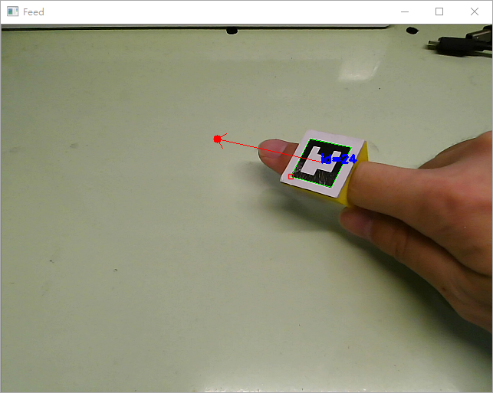
Finger Detection (with marker)
Figure 16. The ArUco cursor that we have implemented.
The red point in the above image is the position where the user is targeted at.

Slide 20
Finger Detection (with marker)
Although user need to wear a custom ring for this implementation
Detection is no longer environment and user dependent and is very robust
Accuracy is within 10 pixels in Euclidean distance

Slide 21
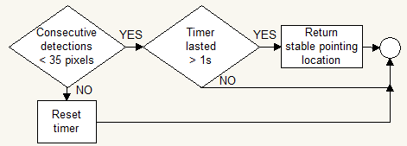
Estimating the Stable Cursor Coordinates
Figure 17. The procedure for finding the stable cursor coordinates
Input: current pointing coordinates
Output: Stable pointing coordinates
The program is required to determine if the finger is moving. If so, the program will not extract the nearest text region for character recognition. If the distance between the previous and the current detected fingertip is less than a threshold within 1 second, the fingertip position retrieved is regarded as stable

Slide 22
Finding Nearest Detected Word Region
Figure 18. The procedure for finding the nearest detected word region
Input: Detected text regions vector, stable pointing coordinates
Output: The index of the nearest text region in the detected text regions vector

Slide 23
Optical Character Recognition
Figure 19. The procedure for character recognition
Input: Index of the nearest text region
Output: The recognized string of text
Perspective transform is applied to the selected text region to warp the image view such that the shapes of the characters are not distorted
A small boundary region with white pixels is added to the extracted image to optimize the recognition performance of Tesseract
The resulting image patches are fed to Tesseract for character recognition

Slide 24
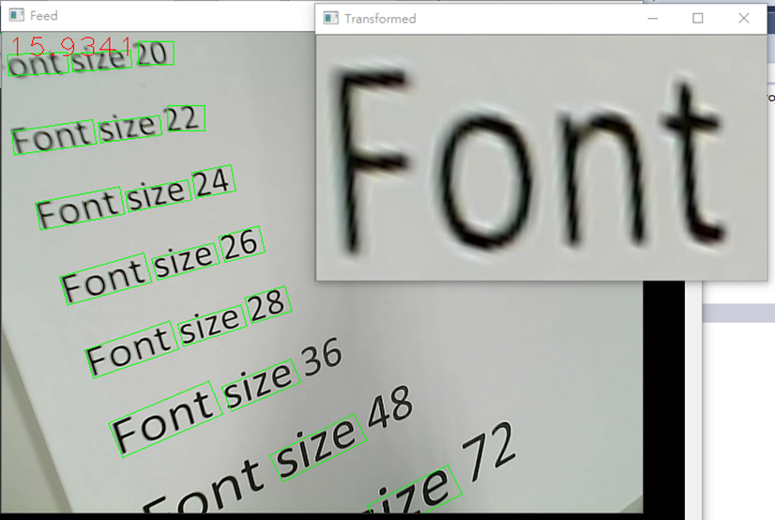
Optical Character Recognition
Figure 20. An example of perspective transformation. The word “Font” is transformed

Slide 25
Result Clean Up
Figure 21. The procedure to tidy up word extraction results
Input: The string of text from Tesseract
Output: The actual word indicated by the user
The text detection procedure described in the previous section may not be able to separate words from a sentence when the words are small or the words are too close together
If the string returned by Tesseract contains one or more spaces, this string is decomposed into individual words
The relative position of the selected word in the extracted area is calculated in terms of the number of characters

Slide 26
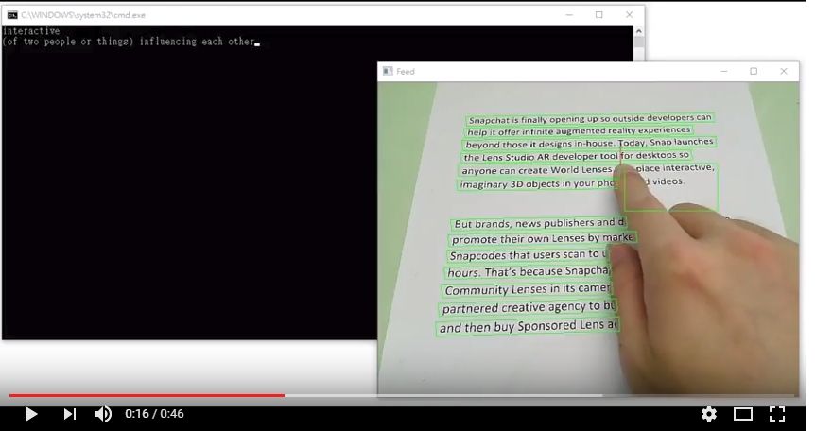
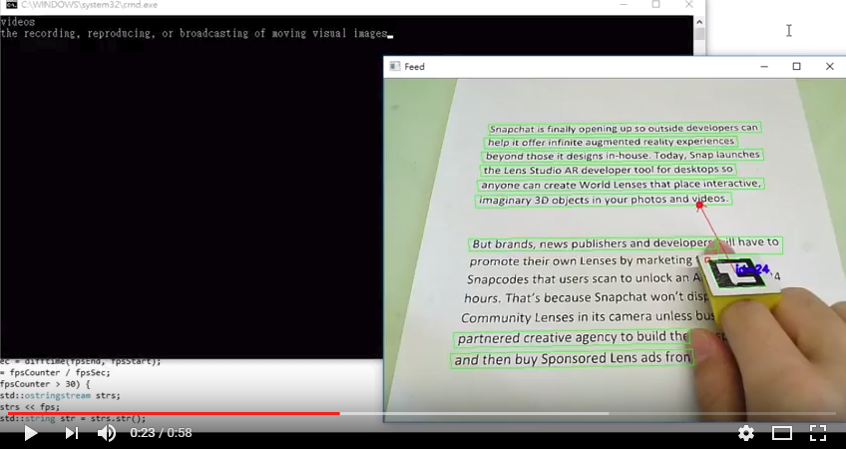
Demo: Finger pointing dictionary
OCR with finger tracking (YouTube)
https://www.youtube.com/watch?v=j7t7a8maBv0
OCR with ARUCO finger tracking (YouTube)
https://youtu.be/I3bowdnqcHM

Slide 27
Discussion
The program could not detect words that are too small and might not be able to separate the words from sentences. The cause of the problem was due to the use of erosion and dilation during image pre-processing.
The current system used a camera of fixed focus. The software had neither mechanism for detecting out of focus camera images nor ways of communicating with the camera to adjust focus, resulting in blurred images when it is aiming at farther texts.
The accuracy and speed of the Tesseract OCR engine were high in general. However, it is worth mentioning that it took noticeably longer time to process long sentences as well as blurred characters. This is because the engine is unable to separate words from sentences and the images captured are out of focus.

Slide 28
Overall Performance
To become a wearable application, it should not be too demanding on the computational power and memory requirement
Our program was tested on a computer with:
2.4GHz Core 2 Duo, 8GB RAM, No graphics card
14-17 fps
Therefore, the program can probably run well on mobile devices with relatively low computation power such as smartphones and the Raspberry Pi board

Slide 29
Conclusion
Described the implementation of a smart wearable glasses application that can recognize a word pointed by the user on a page of text document.
The user wears a ring with a marker printed on it.
The system finds out the position of the ring from the camera images.
From the marker position, the word that the user is pointing at can be determined.
The image region containing the word is then passed to an optical character recognition engine to transform the image pattern into a character string.

Slide 30
Conclusion
Considering the speed performance of the current implementation, the proposed system can be run in an embedded system of a wearable device.
Our solution is useful for a great variety of mobile applications, for example an interactive electronic dictionary.

