Slide 1
Face pose tracking using the four-point algorithm
Objective
Motivation
Our proposal
Perspective-Four-Point
Expr. & Results
Conclusion
Ho Yin Fungª, Kin Hong Wongª, Ying Kin Yu , Kwan Pang Tsui^{b}, and Ho Chuen Kamª
ª Department of Computer Science and Engineering,
The Chinese University of Hong Kong
^{b} Department of Mechanical Engineering,
The Chinese University of Hong Kong
Tuesday, 2 May 2017

Slide 2
Contents
Objective
Motivation
Our proposal
Perspective-Four-Point
Expr. & Results
Conclusion
Objective
Motivation
Our proposal
Perspective-Four-Points
Experiments and Results
Conclusion

Slide 3
Contents
Objective
Motivation
Our proposal
Perspective-Four-Point
Expr. & Results
Conclusion
Objective
Motivation
Our proposal
Perspective-Four-Points
Experiments and Results
Conclusion

Slide 4
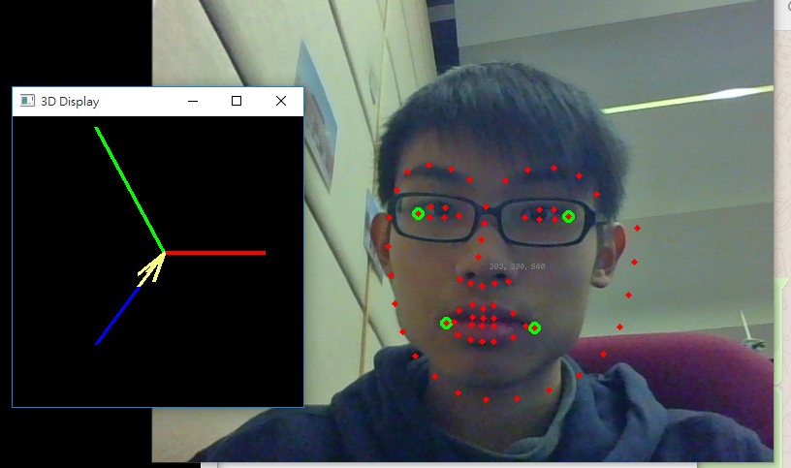
Objective
Objective
Motivation
Our proposal
Perspective-Four-Point
Expr. & Results
Conclusion
We would like to develop a head pose tracking device for virtual reality application.

Slide 5
Objective
Objective
Motivation
Our proposal
Perspective-Four-Point
Exp. & Results
Conclusion
We would like to develop a head pose tracking device for virtual reality applications.
Face tracking system and the four-point algorithm are proposed and developed.
6 DOF of face pose can then be found.

Slide 6
Contents
Objective
Motivation
Our proposal
Perspective-Four-Point
Expr. & Results
Conclusion
Conclusion
Objective
Motivation
Our proposal
Perspective-Four-Points
Experiments and Results
Conclusion

Slide 7
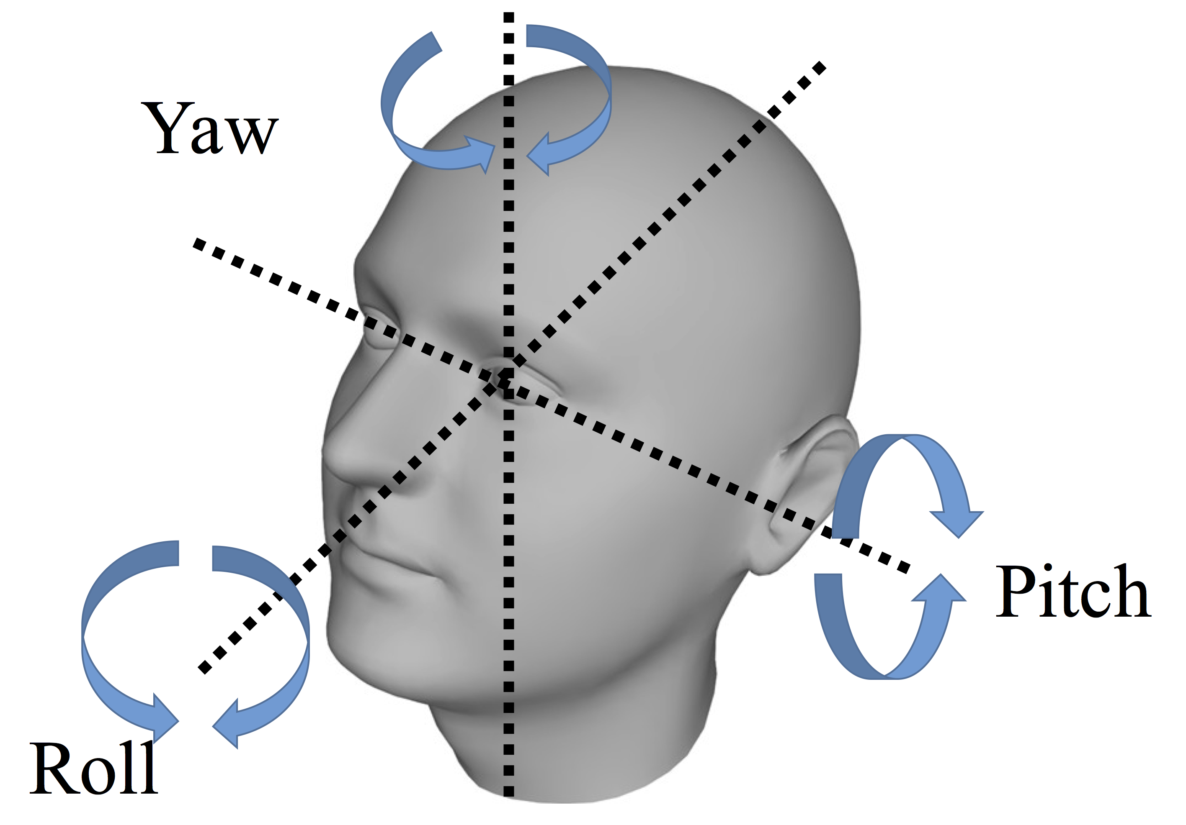
Motivation
Objective
Motivation
Our proposal
Perspective-Four-Point
Expr. & Results
Conclusion
Head pose tracking is useful in various applications.
Can be used as interactive inputs for users, even for the disabled.

Slide 8
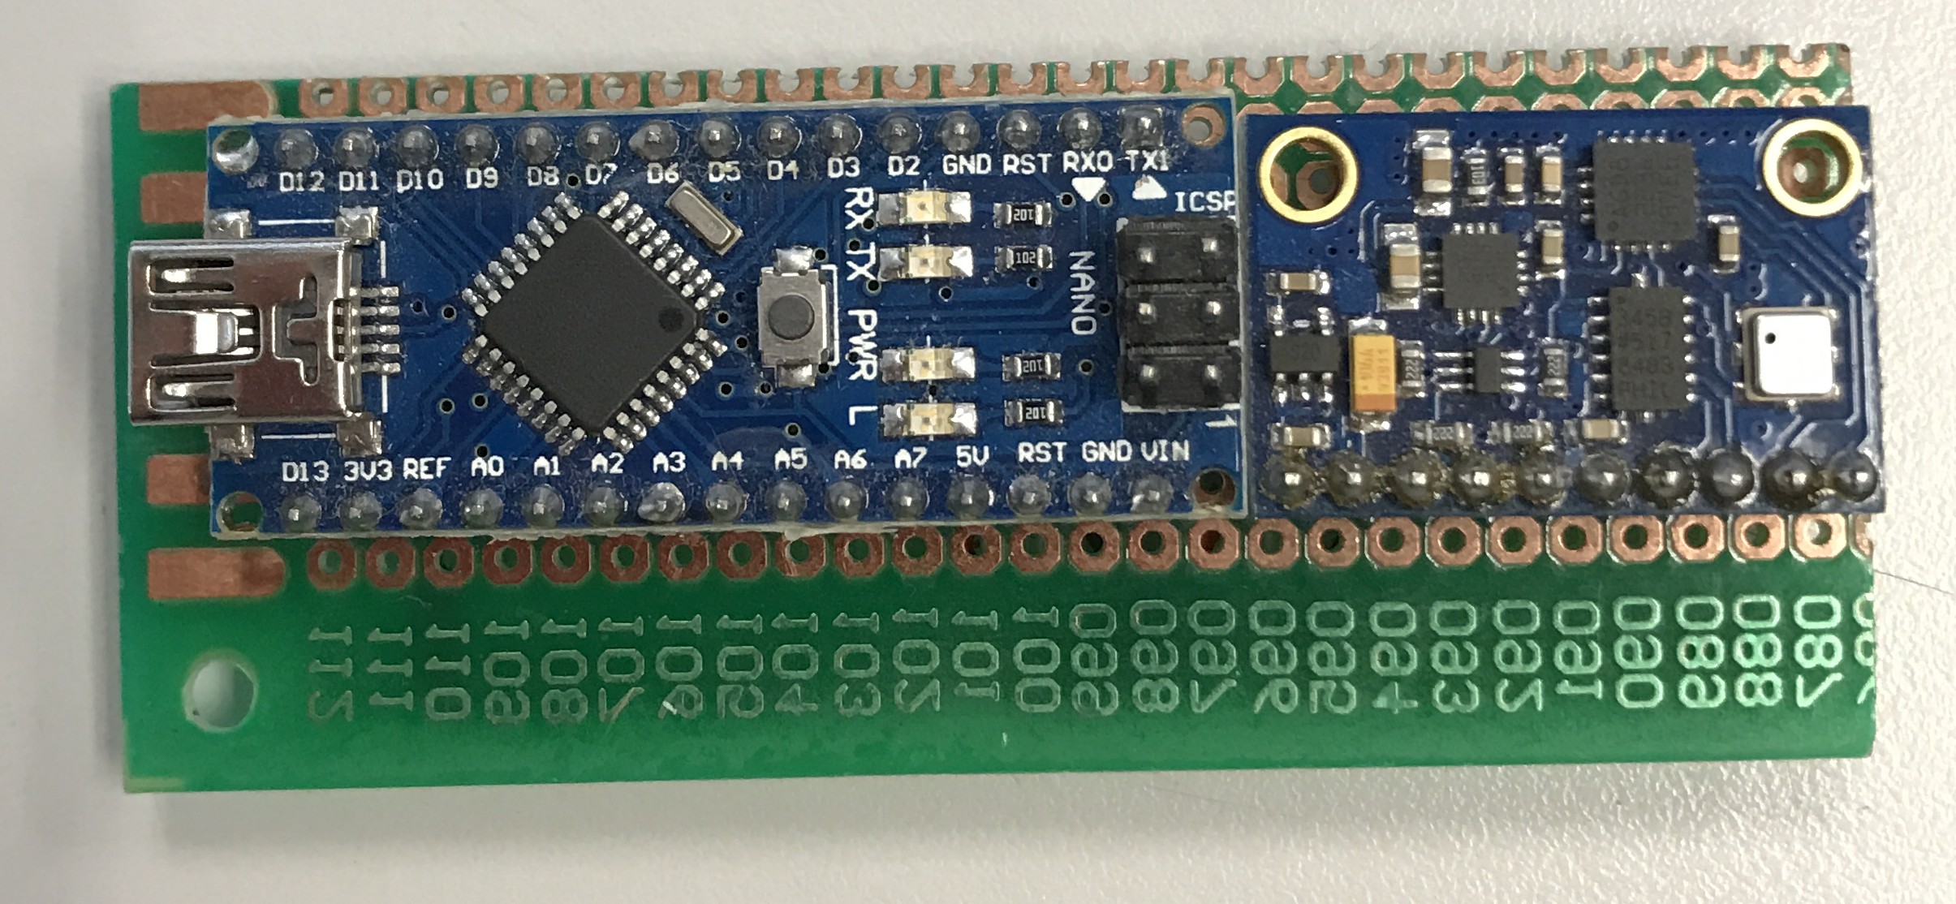
Motivation
Objective
Motivation
Our proposal
Perspective-Four-Point
Expr. & Results
Conclusion
Using Inertial Measurement Unit alone can only output relative positions only.
It also has a drift problem, i.e. accumulated error from integration.

Slide 9
Contents
Objective
Motivation
Our proposal
Perspective-Four-Point
Expr. & Results
Conclusion
Objective
Motivation
Our proposal
Perspective-Four-Points
Experiments and Results
Conclusion

Slide 10
Our proposal
Objective
Motivation
Our proposal
Perspective-Four-Point
Expr. & Results
Conclusion
Our system has two components , namely
Face detection tool
Pose estimation
First a face detection library called “DLib” is used to extract the human face and locate facial features.
Then four of the features are selected, and are passed to the next step for pose estimation.

Slide 11
Face Detection & Feature Extraction
Objective
Motivation
Our proposal
Perspective-Four-Point
Expr. & Results
Conclusion
DLib library can automatically detect and track faces.
By using 68 landmark points we get features
Our proposal only uses 4 of them.

Slide 12
Contents
Objective
Motivation
Our proposal
Perspective-Four-Point
Expr. & Results
Conclusion
Objective
Motivation
Our proposal
Perspective-Four-Points
Experiments and Results
Conclusion

Slide 13
Perspective-Four-Point
Objective
Motivation
Our proposal
Perspective-Four-Point
Expr. & Results
Conclusion
Perspective-Four-Point (four-point) is an iterative algorithm.
If we know the model of four 3-D feature points, and their correspondence image points, pose of the object relative to the camera can be found.

Slide 14
Perspective-Four-Point
Objective
Motivation
Our proposal
Perspective-Four-Point
Expr. & Results
Conclusion
Suppose we have four model points defined as t=0:
Their image projection points can be detected as:

Slide 15
Perspective-Four-Point
Objective
Motivation
Our proposal
Perspective-Four-Point
Expr. & Results
Conclusion
As this is a rigid body, the relative distance among these model points at any time can be known.
D(1,4)=
||A(1,t)-A(4,t)||

Slide 16
Perspective-Four-Point
Objective
Motivation
Our proposal
Perspective-Four-Point
Expr. & Results
Conclusion
With the above information + focal length $f$ ,we can determine the length between the camera center and model points.

Slide 17
Perspective-Four-Point
Objective
Motivation
Our proposal
Perspective-Four-Point
Expr. & Results
Conclusion
Now we can relate the 3-D Model with the length by the following vector:
Where is the unit vector.

Slide 18
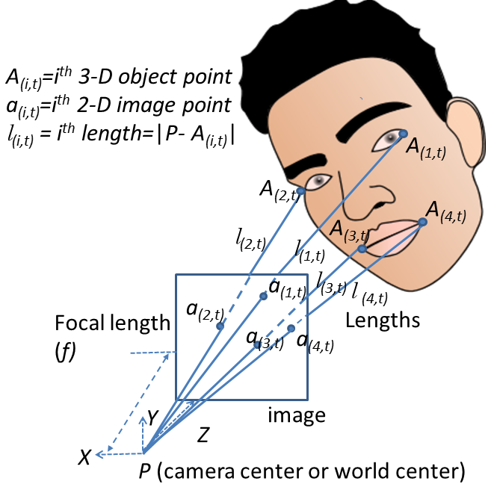
Problem Formulation
Objective
Motivation
Our proposal
Perspective-Four-Point
Expr. & Results
Conclusion
Aim: Find the Length l.
What we have:
Image measurements:
The model ( )_{i=1,2,3,4}
Focal length $f$

Slide 19
Forming Constraints
Objective
Motivation
Our proposal
Perspective-Four-Point
Expr. & Results
Conclusion
By using the distances among four points and using cosine law:
The predicted form is:

Slide 20
Forming Constraints
Objective
Motivation
Our proposal
Perspective-Four-Point
Expr. & Results
Conclusion
From the above formulae, the generalized error function:
With four points, we have 6 combinations of I and J.
True
Predicted

Slide 21
Extra Constraint
Objective
Motivation
Our proposal
Perspective-Four-Point
Expr. & Results
Conclusion
Using the above 6 constraints is not enough. (Liu & Wong 1999).
One more constraint is added to ensure unique solution.
The difference of true and guessed:

Slide 22
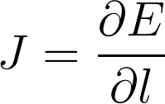
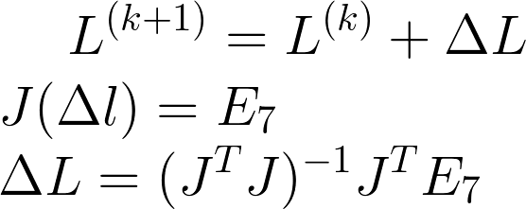
Iterative Processing
Objective
Motivation
Our proposal
Perspective-Four-Point
Expr. & Results
Conclusion
After developing 7 error functions/constraints, now we minimized the error using a Gauss-Newton method.
At Initialization:
Initial Guess:
Iteration from k = 0 to K_{max :until} ΔL is very small
meter
Where J is a Jacobian matrix:

Slide 23
Contents
Objective
Motivation
Our proposal
Perspective-Four-Point
Expr. & Results
Conclusion
Objective
Motivation
Our proposal
Perspective-Four-Points
Experiments and Results
Conclusion

Slide 24
Simulations
Objective
Motivation
Our proposal
Perspective-Four-Point
Expr. & Results
Conclusion
We performed a simulation to prove our proposed method.
4 feature points on 3-D space were created w.r.t features on face.
Points were moved for 50 time-steps with randomness. (Model)
Random image noise with normal distribution was also added (Measurement)
Finally they are fed into the four-point algorithm to recover the pose.

Slide 25
Simulation Results
Objective
Motivation
Our proposal
Perspective-Four-Point
Expr. & Results
Conclusion
Translation
Rotation
Legend:
‘o’: By Four-point algorithm
‘+’: Ground Truth

Slide 26
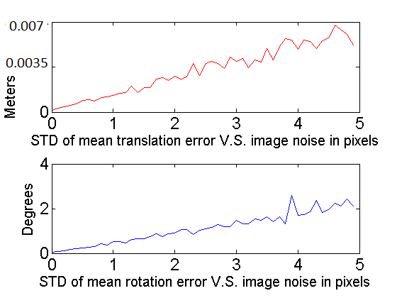
Simulation Result - Error
Objective
Motivation
Our proposal
Perspective-Four-Point
Expr. & Results
Conclusion
For 1000 trials:

Slide 27
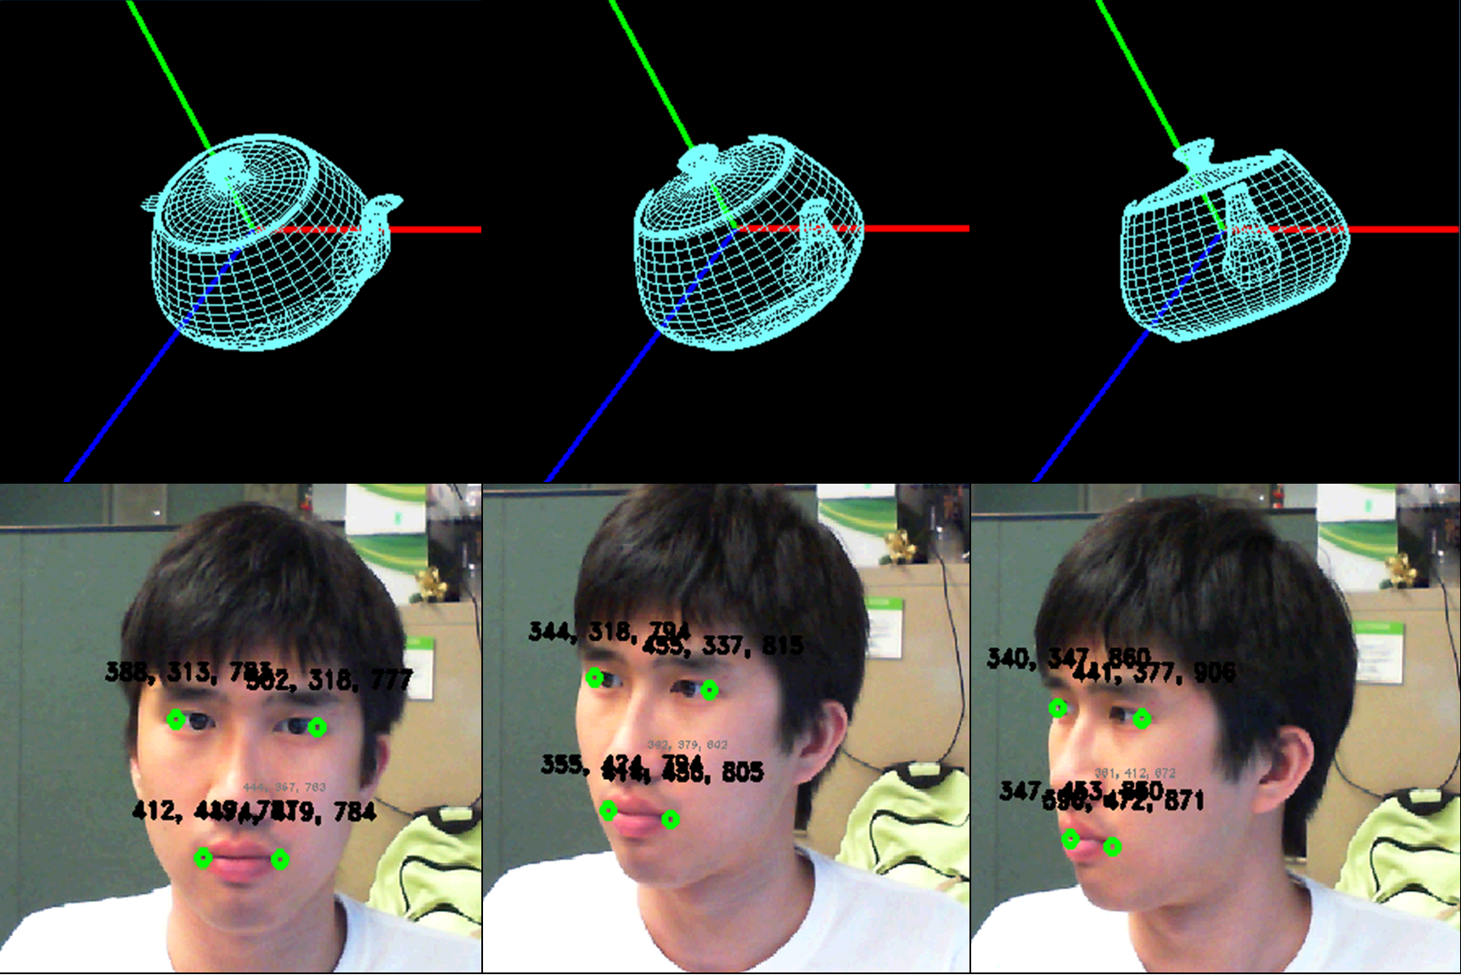
Real Experiments - Video
Objective
Motivation
Our proposal
Perspective-Four-Point
Expr. & Results
Conclusion
https://www.youtube.com/watch?v=XqvpIsX7XRg
Demo video

Slide 28
Contents
Objective
Motivation
Our proposal
Perspective-Four-Point
Expr. & Results
Conclusion
Objective
Motivation
Our proposal
Perspective-Four-Points
Experiments and Results
Conclusion

Slide 29
Discussion & Conclusion
We successfully built a system to integrate face detection algorithm ‘dLib’ to a pose estimation.
10 frames per second.
Effective in tracking the face pose.
Still need to improve “lost-tracking” issues.

Slide 30
References
[1] Davis E. King. Dlib-ml: A machine learning toolkit. Journal of Machine Learning Research, 10:1755{
1758, 2009.
[2] Man Lee Liu and Kin HongWong. Pose estimation using four corresponding points. Pattern Recognition
Letters, 20(1):69{74, 1999.
[3] Pengfei Sun, Changku Sun, Wenqiang Li, and Peng Wang. A new pose estimation algorithm using a
perspective-ray-based scaled orthographic projection with iteration. PloS one, 10(7):e0134029, 2015.
[4] Zimiao Zhang, Shihai Zhang, and Qiu Li. Robust and accurate vision-based pose estimation algorithm
based on four coplanar feature points. Sensors, 16(12):2173, 2016.
[5] Alfredo Liverani, Alessandro Ceruti, and Gianni Caligiana. Tablet-based 3d sketching and curve reverse
modelling. Int. Journ. of Comp. Aided Engineering and Technology 8, 5(2-3):188{215, 2013.
[6] Zimiao Zhang, Bin Liu, and Yongxiang Jiang. A two-step pose estimation method based on four
non-coplanar points. Optik-Int. Journ. for Light and Electron Optics, 126(17):1520{1526, 2015.
[7] Zhe Zhang and Kin HongWong. A novel geometric approach for camera calibration. In Image Processing
(ICIP), 2014 IEEE Int. Conf. on, pages 5806{5810. IEEE, 2014.

Slide 31
Thank You!
Objective
Motivation
Our proposal
Perspective-Four-Point
Experiments & Results
Conclusion
Q & A

