Slide 1
3D Computer Vision and Applications
by Prof. K.H. Wong,
Computer Science and Engineering Dept. CUHK
http://www.cse.cuhk.edu.hk/~khwong/
http://www.cse.cuhk.edu.hk/~khwong/papers.html
khwong@cse.cuhk.edu.hk
Invited talk at :
The Second International Workshop on Pattern Recognition (IWPR2017), Nanyang Executive Centre, Nanyang Technological University, Singapore, May 1-3, 2017

Slide 2
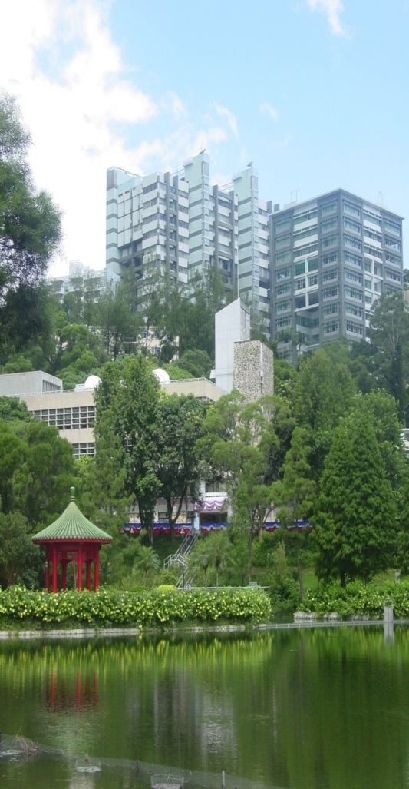
Faculty of Engineering,
The Chinese University of Hong Kong (CUHK)
Electronic Engineering (since 1970)
Computer Science & Engineering (since 1973)
Information Engineering (since 1989)
Systems Engineering & Engineering Management (since 1991)
Electronic Engineering (since 1970)
Computer Science & Engineering (since 1973)
Information Engineering (since 1989)
Systems Engineering & Engineering Management (since 1991)
Mechanical and Automation Engineering (since 1994)
110 faculty members
2,200 undergraduates (15% non-local)
800 postgraduates

Slide 3
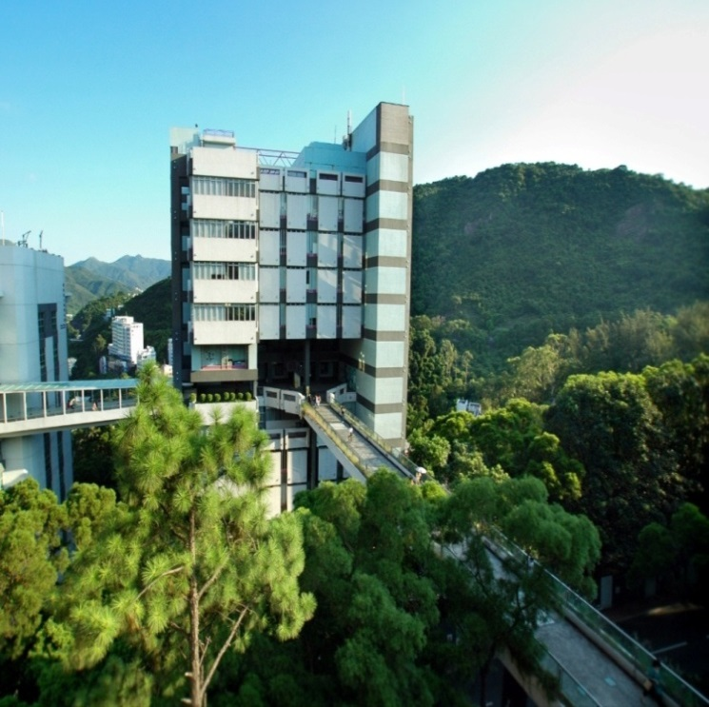
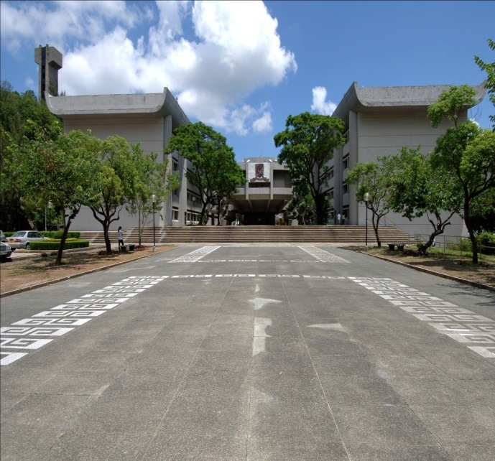
The Chinese University of Hong Kong
Department of Computer Science and Engineering

Slide 4
Abstract
In this seminar, I will talk about various 3-D pose estimation and structure from motion techniques in engineering applications. First, I will discuss the general approaches of feature based pose estimation and structure from motion. Then I will introduce the techniques of Kalman filtering and trifocal tensor for real time pose tracking. Issues of 3-D vision approaches for virtual reality, projector-camera systems and automatically driving will be elaborated. During the talk, I will also give video demonstrations of some interesting vision based systems we developed in recently years. Finally the opportunities and challenges of 3-D computer vison in the modern mobile era will be discussed.

Slide 5
Overview
Motivation
What is 3-D vision?
How it is used?
Some previous approaches
Recent projects

Slide 6
Motivation
3D vision problems
Obtain 3D information from 2D images
Various applications
  Virtual reality
  Augmented reality
  Automatic driving
  Education and entertainment

Slide 7
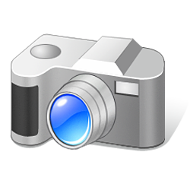
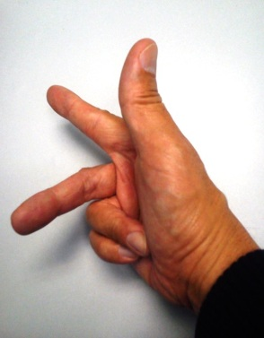
Motion of camera from world to camera coordinates
Camera motion (rotation=R_{c}, translation=T_{c}) will cause change of pixel position (x,y), See p156[1]
Y_{c}
Camera center
Rc,Tc
X_{c}
Y_{w}
Z_{w}
Z_{c}
an_y
an_z
X_{w}
World center
Cameras v.3d
an_x

Slide 8
3D to 2D projection
Perspective model
u=F*X/z
v=F*Y/z
Virtual
Screen
or CCD
sensor
World
center
Y
v
v
F
Z
F
Real
Screen
Or
CCD
sensor
Thin lens
or a pin hole

Slide 9
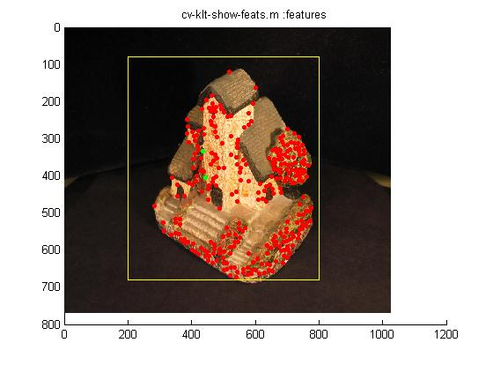
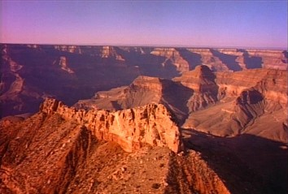
3D computer vision main tasks: SFM structure from motion
Input: only image feature points x_{t=1}, x_{t=2}, x_{t=3},
Output : 3-D structure Model M, Motion (Rotation R_{t}, Translation T_{t} of the object )
3D Model=X_{j} : where j=feature index =1,2…n features
Γ
Time (i)
1 2 3 …
R₁,T₁
R₂,T₂
http://www.youtube.com/watch?v=2KLFRILlOjc
http://www.youtube.com/watch?v=RXpX9TJlpd0

Slide 10
Applications
3D models from images
  Camera projection systems
Some recent work
  Wearable devices
Virtual tourism

Slide 11
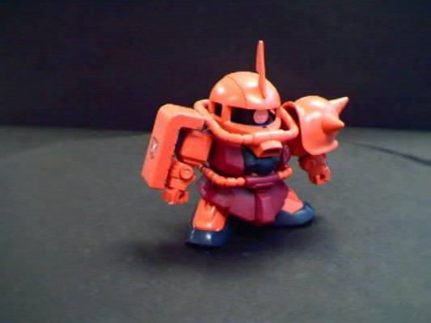
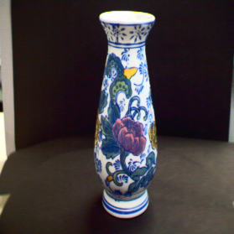
Demo1: 3D reconstruction (see also http://www.cse.cuhk.edu.hk/khwong/demo/index.html)
Grand Canyon Demo
Flask
Robot
http://www.youtube.com/watch?v=2KLFRILlOjc
2-pass bundle adjustment
Algorithm
Loop until converge
{
Find pose based on a guessed model
Find model based on a guessed pose
}
Michael Ming Yuen Chang and Kin Hong Wong, "Model reconstruction and pose acquisition using extended Lowe's method", IEEE Transactions on Multimedia, Volume: 7, Issue: 2, April 2005.

Slide 12
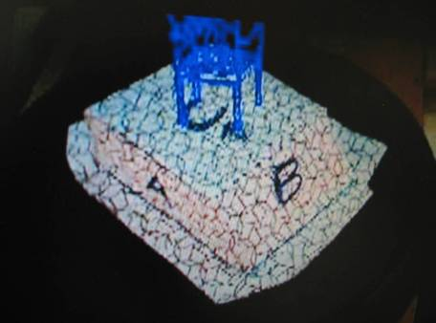
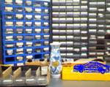
Demo2: augmented reality
(Click picture to see movie)
Augmented reality demo
http://www.youtube.com/watch?v=gnnQ_OEtj-Y
http://www.youtube.com/watch?v=zPbgw-ydB9Y

Slide 13
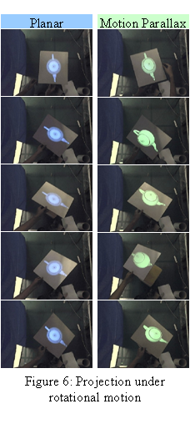
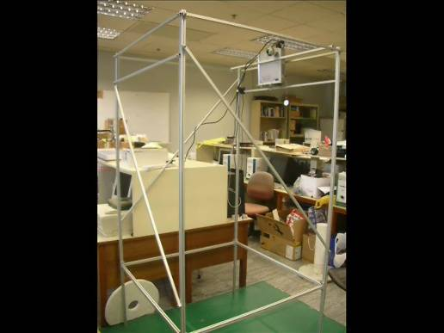
Demo3 Projector camera system (PROCAM) Click pictures to see movies
CVPR
A Projector-based Movable
Hand-held Display System
A Hand-held 3D Display
System that facilities direct
manipulation of 3D virtual
objects
https://www.youtube.com/watch?v=vVW9QXuKfoQ

Slide 14
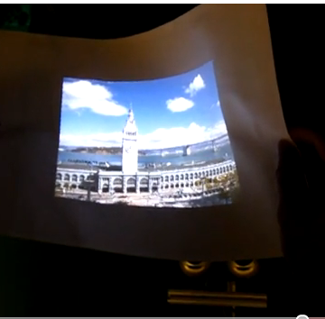
Demo 4
Flexible projected surface
http://www.youtube.com/watch?v=isqg8O9a4LE

Slide 15
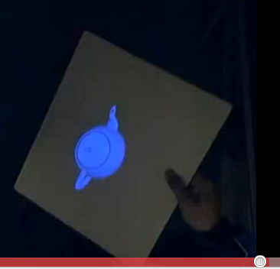
Demo 5
3-D display without the use of spectacles.
http://www.youtube.com/watch?v=oyxR_RT4NNc

Slide 16
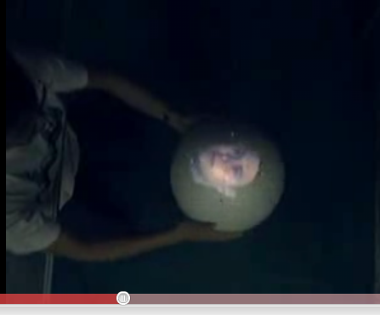
Demo 6
Spherical projected surface for 3D viewing without spectacles.
http://www.youtube.com/watch?v=yVDFcZZ8gDo

Slide 17
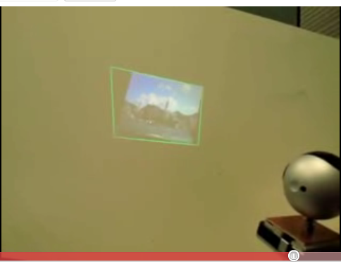
Demo 7
A KEYSTONE-FREE HAND-HELD MOBILE PROJECTION
http://www.youtube.com/watch?v=mbl-BpTnbeA

Slide 18
Some theoretic work
Kalman filter based SFM structure from motion
  Single camera
    Ying Kin YU, Kin Hong Wong and Michael Ming Yuen Chang, "Recursive 3D Model Reconstruction Based on Kalman Filtering", IEEE Transactions on Systems, Man and Cybernetics B, Vol.35, No.3, June 2005
  Stereo camera
    Mohammad Ehab Ragab, Kin Hong Wong, Jun Zhou Chen, Michael Ming-Yuen Chang, "EKF Pose estimation: how many filters and cameras to use?", IEEE International Conference on Image Processing (ICIP08), San Diego, California, U.S.A, October 12–15, 2008
    Ying Kin Yu, Kin Hong Wong, Michael Ming Yuen Chang and Siu Hang Or, "Recursive Camera Motion Estimation with Trifocal Tensor", IEEE Transactions on Systems, Man and Cybernetics B, Volume 36, Issue 5, Oct. 2006 Page(s):1081 - 1090.
  Trifocal tensor based, used in SLAM/Tracking tool box
    For feature points
      Ying Kin Yu, Kin Hong Wong, Siu Hang Or and Junzhou Chen, "Controlling Virtual Cameras Based on a Robust Model-free Pose Acquisition Technique", IEEE Transactions on Multimedia, No. 1, January 2009, pp. 184-190.
    For feature lines
      LEE, Kai Ki; YU Ying Kin; WONG Kin Hong and CHANG Ming Yuen Michael "Tracking 3-D motion from straight lines with trifocal tensors." Multimedia Systems 22.2 (2016): 181-195.
    For feature and point combined
      Kai Ki LEE, Ying Kin YU, Kin Hong WONG, “ Recovering camera motion from points and lines in stereo images:
      A recursive model-less approach using trifocal tensors",17th IEEE/ACIS (SNPD 2017), Japan, 26-26 June 2017

Slide 19
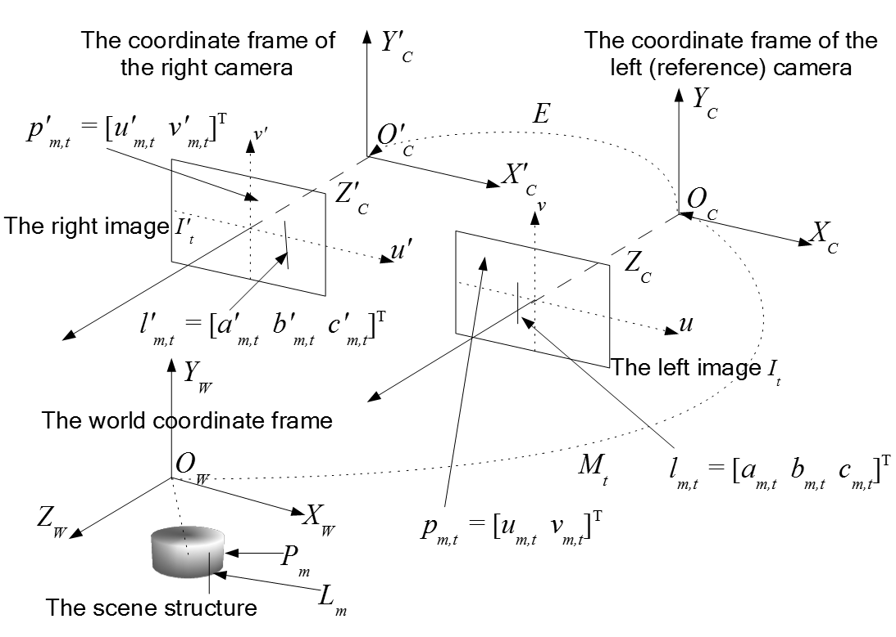
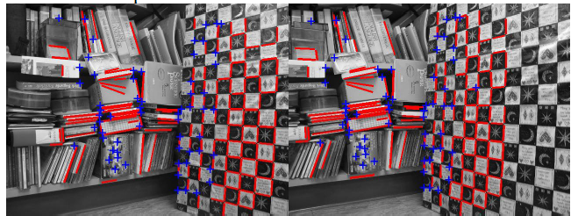
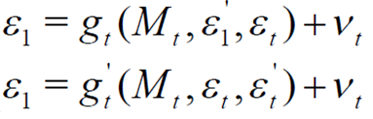
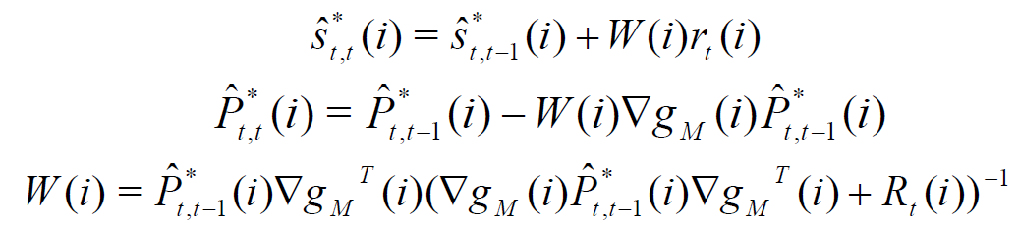
Recent work:
Trifocal tensor Kalman point/line approach
Kai Ki LEE, Ying Kin YU, Kin Hong WONG, “ Recovering camera motion from points and lines in stereo images:
A recursive model-less approach using trifocal tensors",17th IEEE/ACIS International Conference on Software Engineering, Artificial
Intelligence, Networking and Parallel/Distributed Computing, (SNPD 2017), Kanazawa Kinrosha Plaza, Kanazawa, Ishikawa, Japan, 26-26 June 2017.

Slide 20
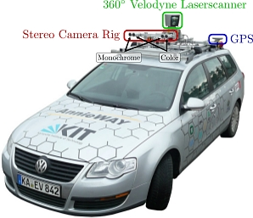
Trifocal tensor vision is used in Automatic driving
Y. K. Yu, K. H. Wong, M. M. Y. Chang, and S. H. Or, "Recursive camera-motion estimation with the trifocal tensor." IEEE Transactions on Systems, Man, and Cybernetics, Part B (Cybernetics) 36.5 (2006): 1081-1090.
Cited by the author of the Kitti dataset and used in the toolbox http://www.cvlibs.net/datasets/kitti/
Kitt, Bernd, Andreas Geiger, and Henning Lategahn. "Visual odometry based on stereo image sequences with ransac-based outlier rejection scheme." Intelligent Vehicles Symposium (IV), 2010 IEEE. IEEE, 2010.

Slide 21
Recent work
Wearable glasses and beyond
  Fro optical character recognition OCR
Virtual tourism
  Calibration of Multiple Kinect Depth Sensors for Full Surface Model Reconstruction
  Robot Avatar: a virtual tourism robot for people with disabilities
  An efficient 3-D environment scanning method

Slide 22
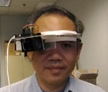
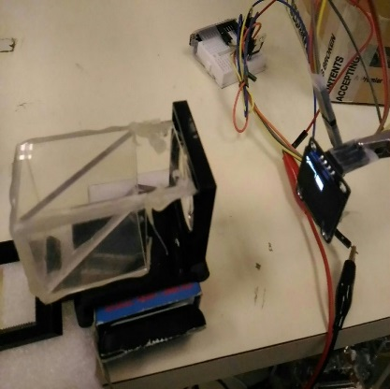
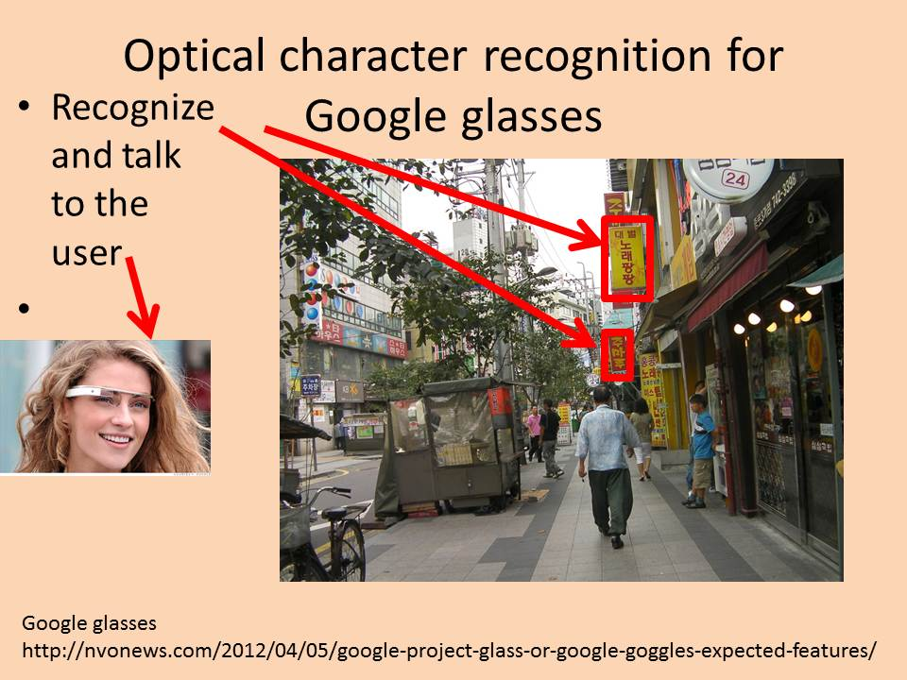
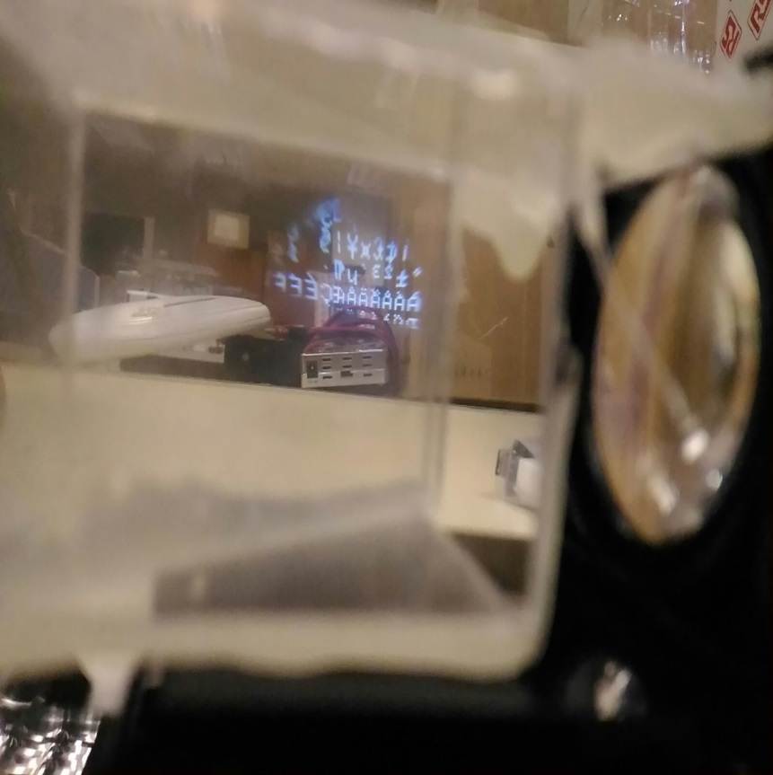
Recent work 1
Wearable glasses
Can see through the display
Overlay text/images with the surroundings

Slide 23
The design of smart glasses for VR applications
The CU-GLASSES
KH Wong

Slide 24
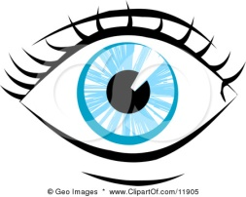
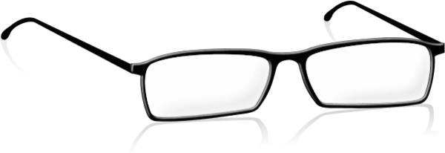

Introduction
Glass frame(no lens)
Be able to overlay images or text to our normal view
Simple, low cost and easy to build
Can duplicate for the 2nd eye
Close up
Lens
See through glass
CCD display
For text or graphics
The CU-GLASSES

Slide 25
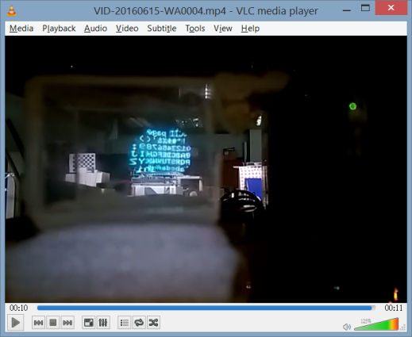
The idea
Top down view
Eye
See through glass
CCD
display
Close up
Lens

Slide 26


Tests
Video link
https://youtu.be/i2lpo0DHaWA

Slide 27
Applications
Translation
  Real time translate what you see into other languages
Education
  Overlay more information to students when reading books

Slide 28
Virtual tourism idea
If you are wearing a head mount device such as the OCULUS (https://www.oculus.com/en-us/), you can feel you are in anywhere you like in the virtual world. To extend it to the real world, we propose to build a robot that carries a set of cameras to capture the images in 3-D at a remote place (e.g. at Tokyo). The 3-D data will be sent back to the user and displayed through the OCULUS (e.g. at Hong Kong). There may be extended features, for example, the system can provide tourist or shopping information to users. This system enables users to visit other countries with little cost. Even disabled people can travel far away without leaving their homes.

Slide 29
Recent work 2
Calibration of Multiple Kinect Depth Sensors for Full Surface Model Reconstruction
2016 the first International Workshop on Pattern Recognition (IWPR 2016)
Tokyo, Japan during May 11-13, 2016
Kwan Pang Tsuiª, Kin Hong Wong^{b}*, Changling Wangª, Ho Chuen Kam^{b}, Hing Tuen Yau^{b}, and Ying Kin Yu
ªDepartment of Mechanical Engineering, The Chinese University of Hong Kong, Hong Kong
^{b}Department of Computer Science and Engineering, The Chinese University of Hong Kong,
Hong Kong

Slide 30
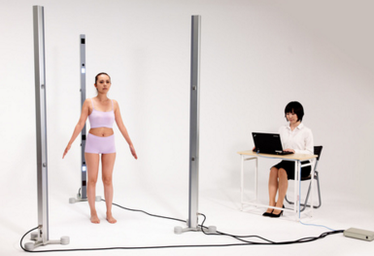
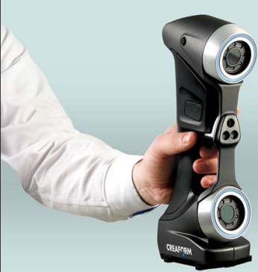
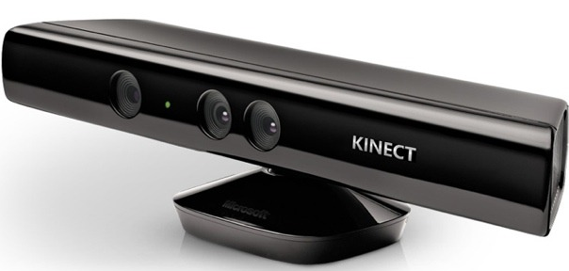
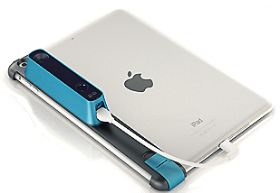
3D Scanning Sensor Types
Laser
  Very Accurate
  Expensive ( up to US$50,000)
  Bulky
LED
  Accurate
  Mid-range price ( > US$ 2000)
Infra-red
  Microsoft Kinect, Structure Sensor
  Cheap ( US$100~200)
  Less accurate

Slide 31
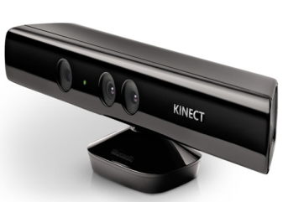
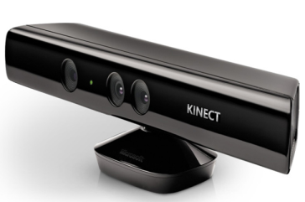

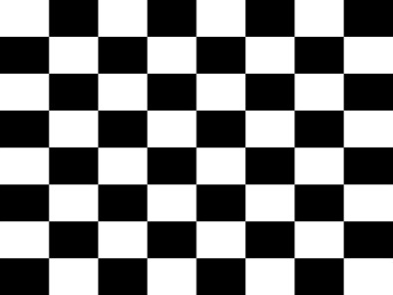
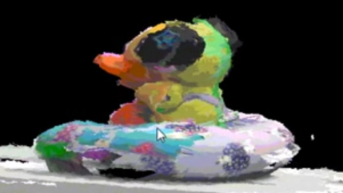
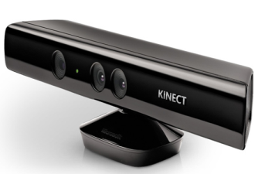
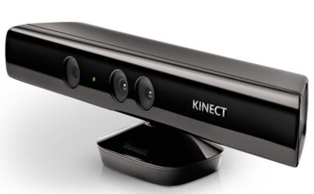
Theory for method 2
Calibrate the pose between Kinect J and K first. Then K and L etc.
Kinect M
Kinect L
Result
Move the checker board and take samples
Kinect J
Kinect K

Slide 32
Recent work 3
Robot Avatar: a virtual tourism robot for people with disabilities
Chong Wing Cheung, Tai Ip Tsang, Kin Hong Wong*
The 2nd International Conference on Virtual Reality ICVR16, May 20-22, 2016, Chengdu, China.
Department of Computer Science and Engineering, The Chinese University of Hong Kong, Hong Kong
*corresponding author (khwong@cse.cuhk.edu.hk)
Download link
https://appsrv.cse.cuhk.edu.hk/~khwong/www2/conference/2016/ICVR2016/ICVR2016.html

Slide 33
Introduction
To create a robot agent aimed to help the disabled person experiencing the physical environment
  Generic Robot that used in Virtual Tourism or Bomb detonation, etc.
Using Cutting Edge Virtual Reality (VR) Technology
  Chose Oculus Rift owing to the features, cost and programmability
Notes:
Story-telling +1

Slide 34
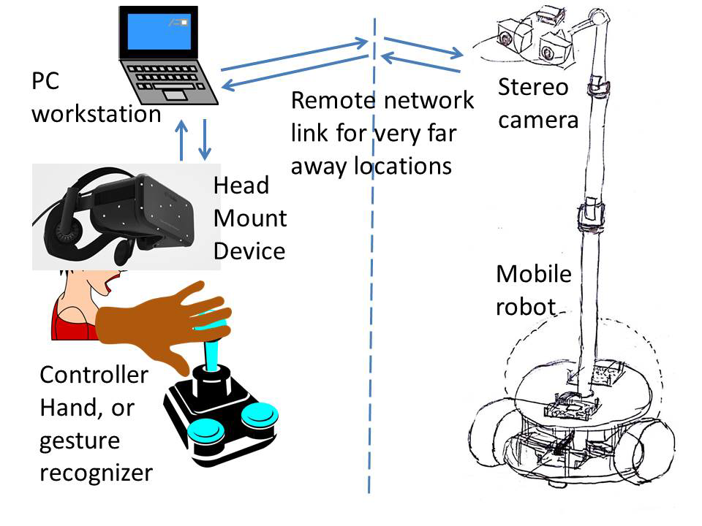
System overview
Notes:
Story-telling +1

Slide 35
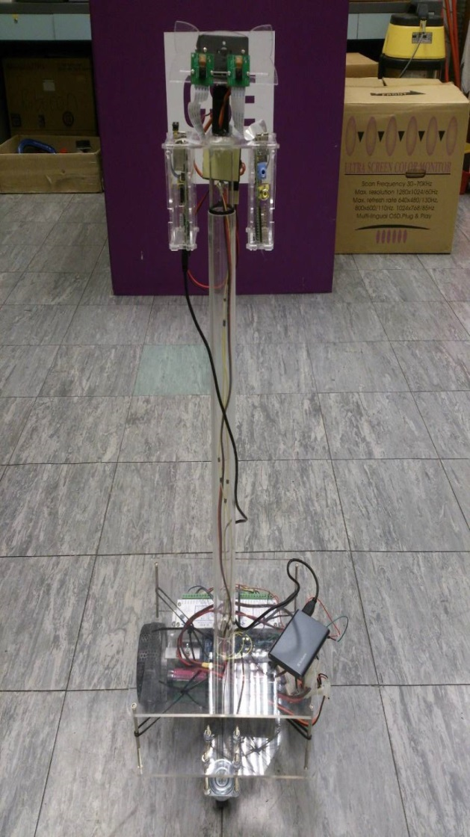
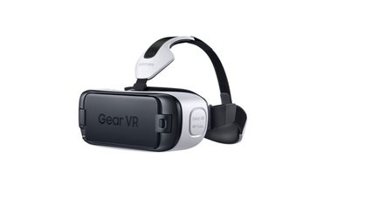
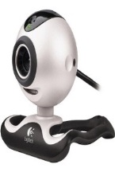
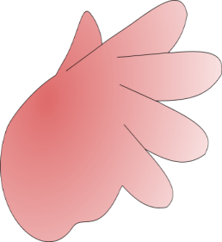
The robot with a stereo camera pair
Head Mount Device
HMD
Hand gesture recognition

Slide 36
Demos
Utube : https://youtu.be/CfkP2Coajpk
icvr16_avatar_video.MP4

Slide 37
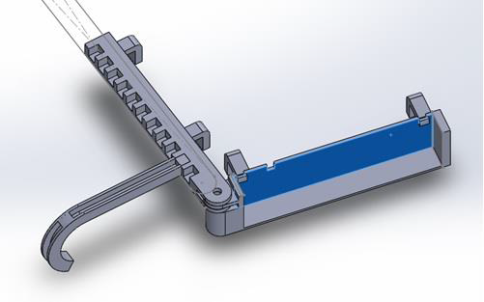
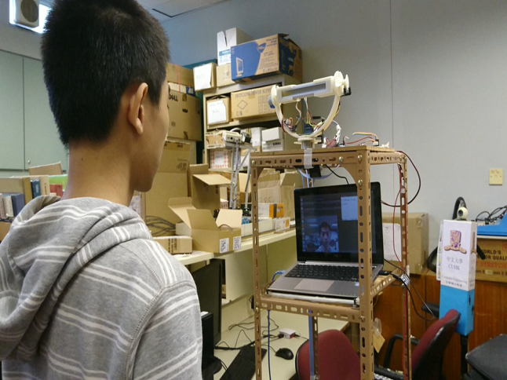
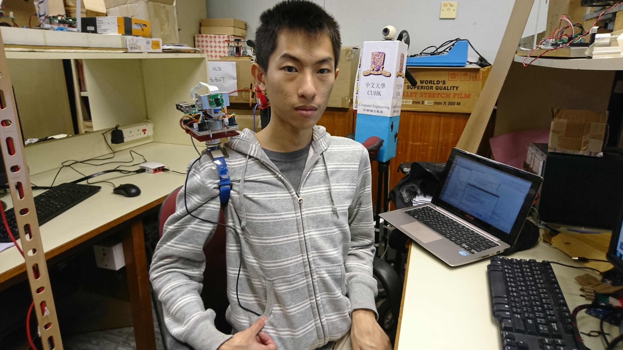
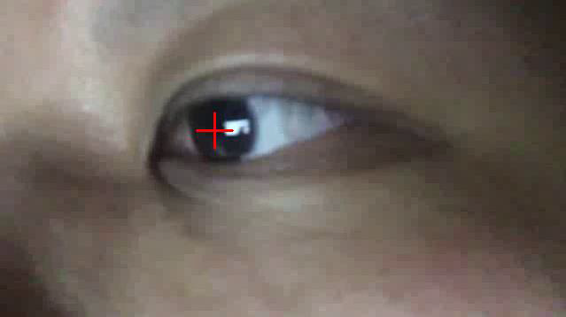
Face tracking/following using a wearable vision systems
Eye ball tracking
Face folllowing robot
Warble extended eye

Slide 38
Recent work 4
An efficient 3-D environment scanning method
24th International Conference in Central Europe on
Computer Graphics, Visualization and Computer Vision 2016
(WSCG 2016)
Venue : May 30 - June 3, 2016
Kin Hong Wongª, Ho Chuen Kamaª, Ying Kin Yuª, Sheung Lai Loª, Kwan Pang Tsui^{b}, and Hing Tuen Yauª
ªDepartment of Computer Science and Engineering, The Chinese University of Hong Kong, Hong Kong
^{b}Department of Mechanical Engineering, The Chinese University of Hong Kong, Hong Kong

Slide 39
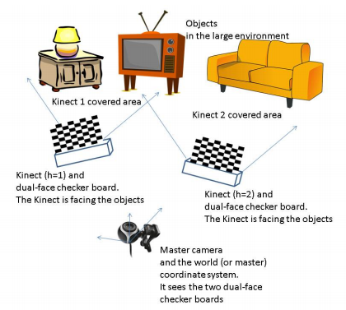
The idea

Slide 40
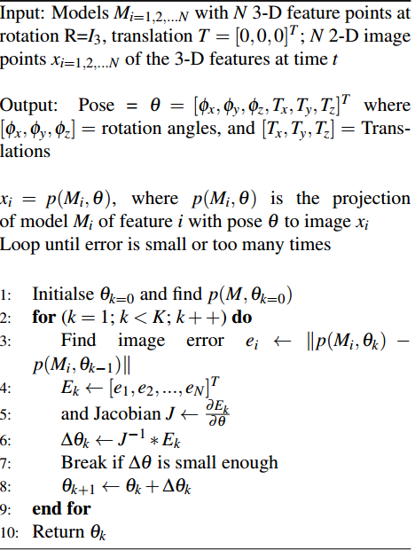
3D reconstruction for each Kinect position (the standard method)

Slide 41



3D environment captured using two rotating back-to-back Kinects and Lidar

Slide 42

Back to Back Kinect calibration –
Overview
Methods
Linear method
Non-linear method: rotation averaging

Slide 43


The mirror technique to solve the problem
Pose computation between the dual-face checkerboard and the Kinect
Need to find out the relative pose (rotation=R_{b}, translation=t_{b}) between the dual-face checkerboard and the Kinect because they cannot be aligned perfectly
Step 1 : Pose estimation through a mirror
Places the mirror at n different positions
Take picture of checkerboard via mirror using Kinect RGB camera
Rotations R_{i=1,2,..n} obtained via the mirrored checkerboard needed to be converted to the corresponding improper rotations Ȓ _{i=1,2,..n} using the formulas (equation 5) found in [LKL+15]

Slide 44


Recent work 5
Ho Yin Fung, Kin Hong Wong, Ying Kin Yu, Kwan Pang Tsui, and Ho Chuen Kam,"Face pose tracking using the four-point pose algorithm", The Second International Workshop on Pattern Recognition (IWPR2017), Nanyang Executive Centre, Nanyang Technological University, Singapore, May 1-3, 2017.

Slide 45

Recent work 6
Kin Hong Wong, Ying Kin Yu, Pang Kwan Tsui, Yin Fung Ho, and Ho Chuen Kam,"Robust and efficient pose tracking using perspective-four-point algorithm and Kalman filter", 2017 International Conference on Mechanical, System and Control Engineering (ICMSC 2017), St. Petersburg, Russia, during May 19-21, 2017

Slide 46


Recent work 8
Zhe Zhang, Kin Hong Wong, Zhiliang Zeng, Lei Zhu,"A neural network approach to visual tracking", The 15th IAPR Conference on Machine Vision Applications (MVA 2017), Nagoya University (Toyoda Auditorium), Nagoya, Japan, 8-12, May 2017,
FCN tracker

Slide 47
End
Q&A

