Slide 1
Improving Postgraduate Learning
LaTeX Advanced –
Thesis Preparation
http://www.cse.cuhk.edu.hk/~yclaw/ipl_latex/
Dr. Yat-chiu LAW* (yclaw@cse.cuhk.edu.hk)
Senior Lecturer, Dept of Comp. Sci. & Engg.
*Acknowledgment to Mr Michael Fung, who allowed me to adopt and adapt his slides for this workshop

Slide 2
Get Course Material
Visit:
http://www.cse.cuhk.edu.hk/~yclaw/ipl_latex/
Download the “Lab Materials”
IPL_LaTeX_Advanced_lab.zip
Extract the content of the zip file

Slide 3
LaTeX
A typesetting system for professional writing and publication
FREE open source software
MiKT_{E}X (www.miktex.org)
MacT_{E}X (www.tug.org/mactex/)
Online
Overleaf (www.overleaf.com)

Slide 4
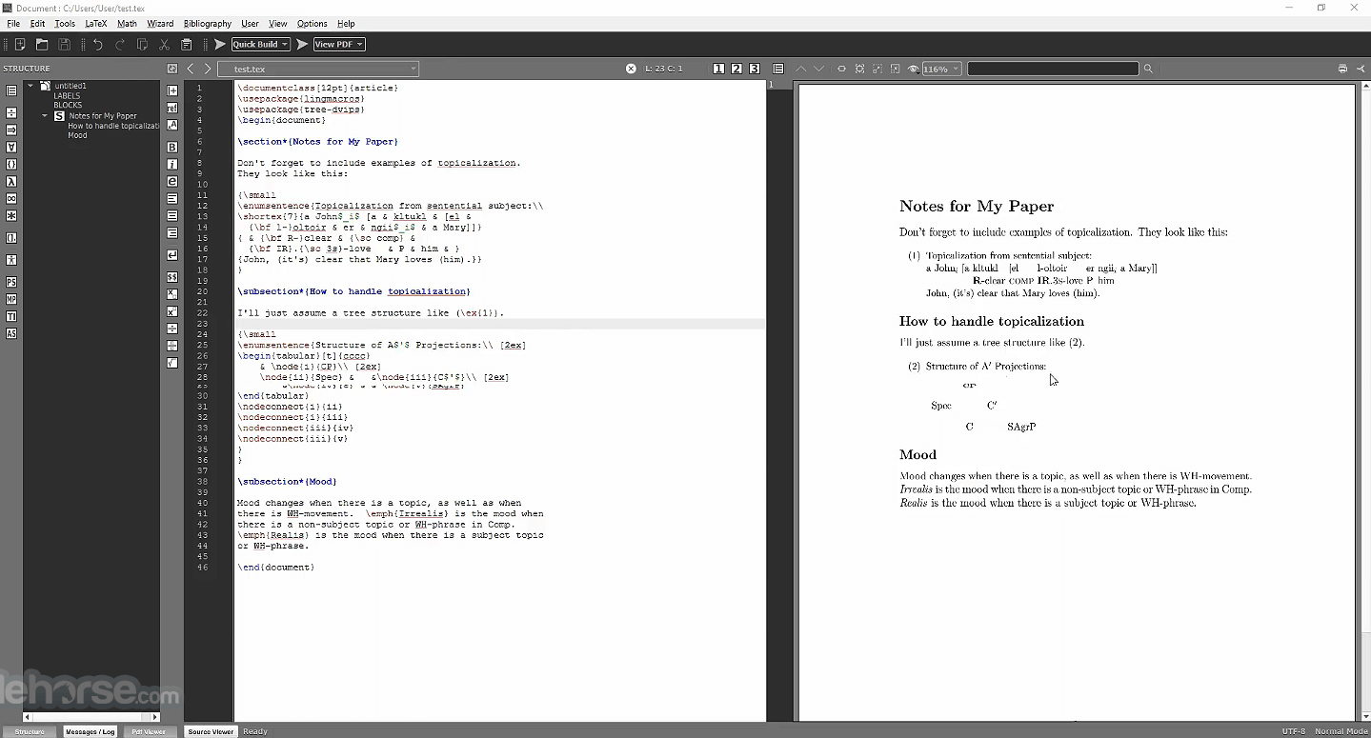
MiKT_{E}X and TeXworks
👍: Free of $ (open source). Extensible
👎: Install and setup yourselves in your own computers

Slide 5
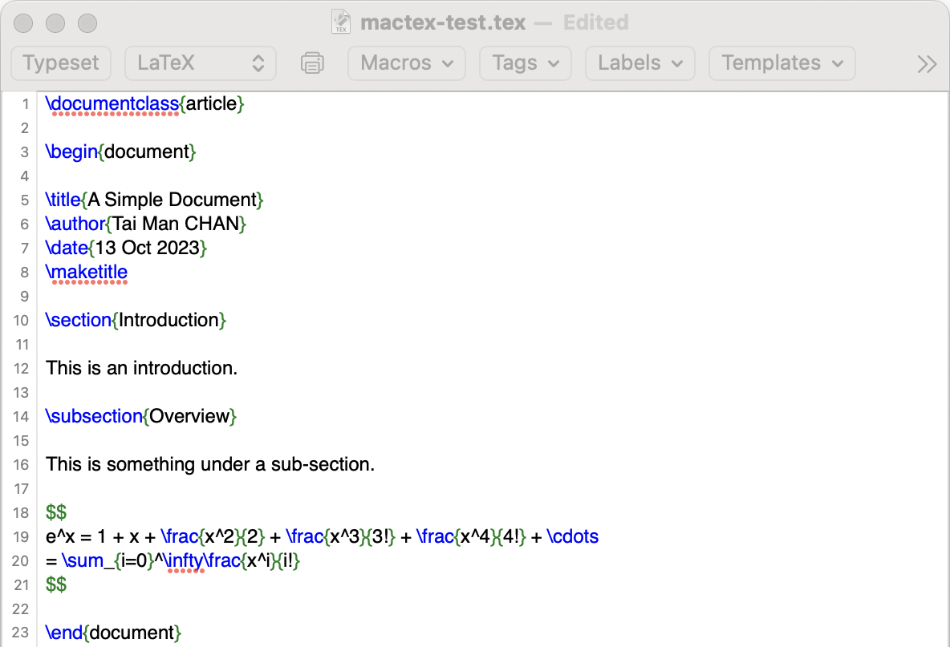
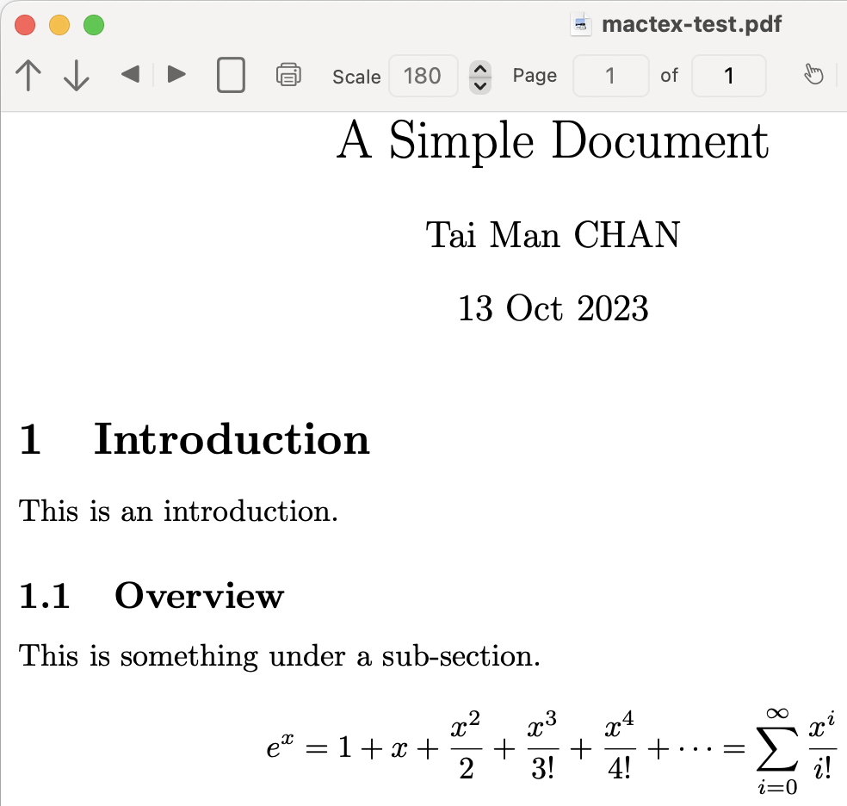
MacTeX
👍: Free of $. Extensible
👎: macOS only. Install and setup yourselves. Less powerful

Slide 6
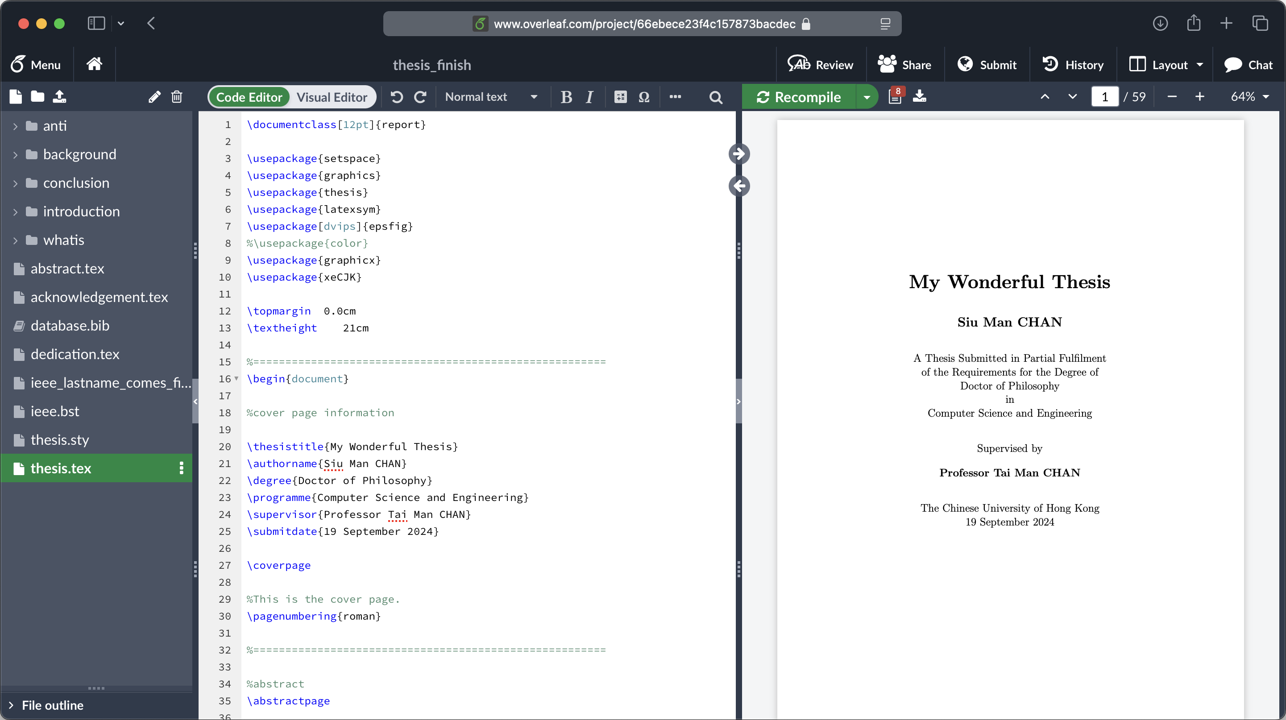
Overleaf (This Workshop)
👍: Cloud-based. No install. Collaborative. CUHK subscription
👎: Security and privacy

Slide 7
Visit CUHK on Overleaf
https://www.overleaf.com/edu/cuhk

Slide 8
CUHK on Overleaf
1155xxxxxx@link.cuhk.edu.hk
with OnePass password…
2FA with Duo Mobile…

Slide 9
CUHK on Overleaf

Slide 10
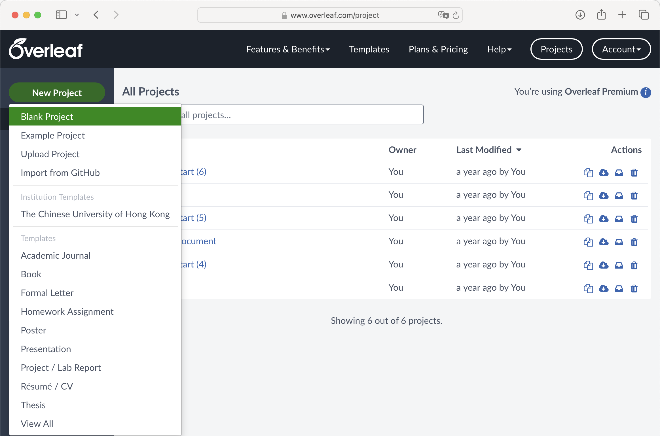
Create a Simple Document
2
1
3

Slide 11
Create a Simple Document
1. Type project name as
“simple” (without quotes)
2. Click

Slide 12
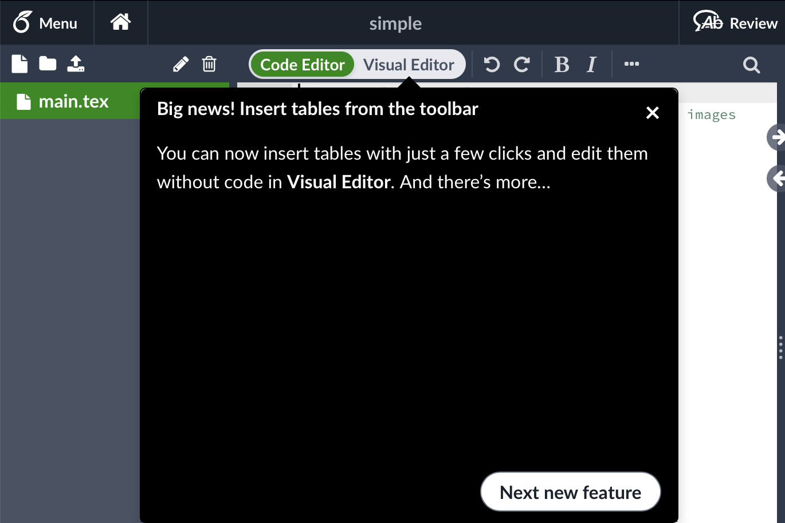
Create a Simple Document
Click here if you see this

Slide 13
Your First Document
A file named main.tex is created for you with some default contents

Slide 14
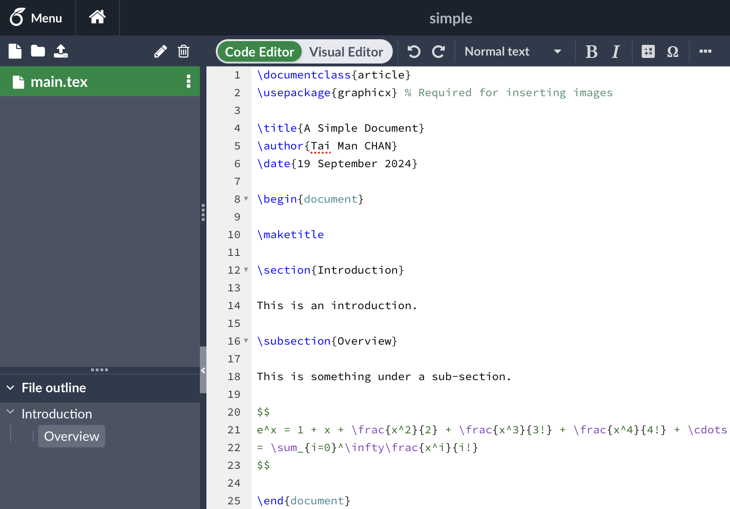
Edit Your Document
Type the following contents exactly:

Slide 15
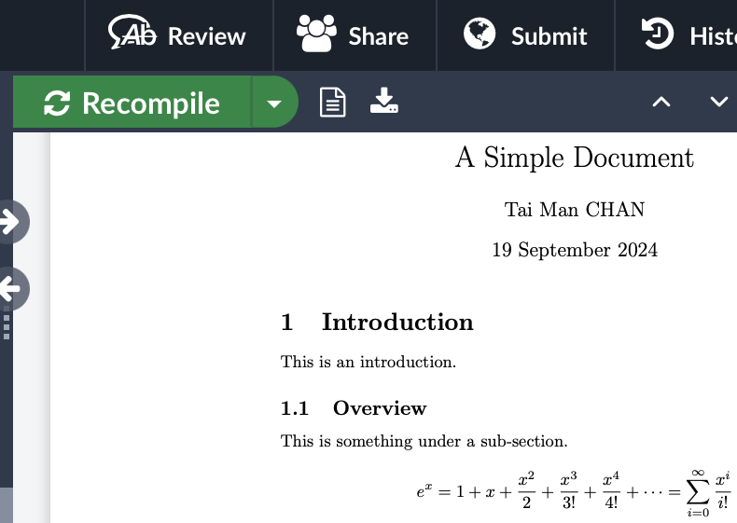
Typeset / Compile
Click “Recompile” to do the first typeset. You should see the following:
Hotkeys to compile:
Windows:
macOS:
Ctrl
+
S
⌘
+
S

Slide 16
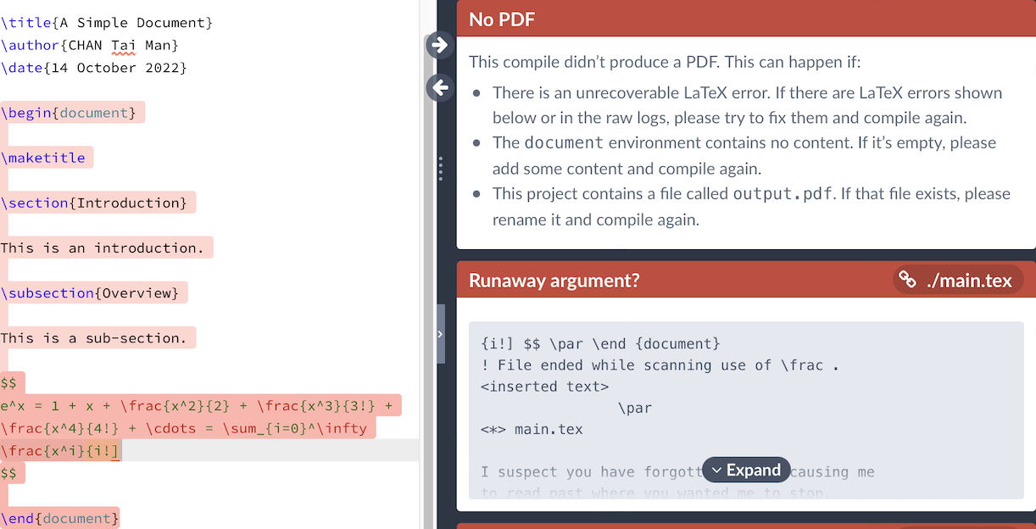
Error Message
If you type wrongly and then compile, you may see some error messages
Fix your error. Then Recompile

Slide 17
Final Document
When you complete your editing, you can download your pdf after compile

Slide 18
Simple LaTeX Editing Cycle
Edit document
Typeset (Compile)
Y
Error? Not finished?
N
Done. Get a pdf

Slide 19
Thesis Preparation
Before we really start…
What should be in a thesis?

Slide 20
Thesis
Title page
Abstract
Table of Contents
List of Figures
List of Tables
Text… (the Beef)
Bibliography

Slide 21
Thesis
Title page
Abstract
[Acknowledgments] (Optional)
Table of Contents
List of Figures
List of Tables
Text… (the Beef)
[Appendices] (Optional)
Bibliography

Slide 22
Course Material
Recall the “Lab Materials” that you downloaded
IPL_LaTeX_Advanced_lab.zip
Extract the zip content, you’ll see two more zip files
thesis_start.zip and thesis_finish.zip
(No need to further extract these two zip files)
The file thesis_start.zip contains a LaTeX template for a thesis

Slide 23
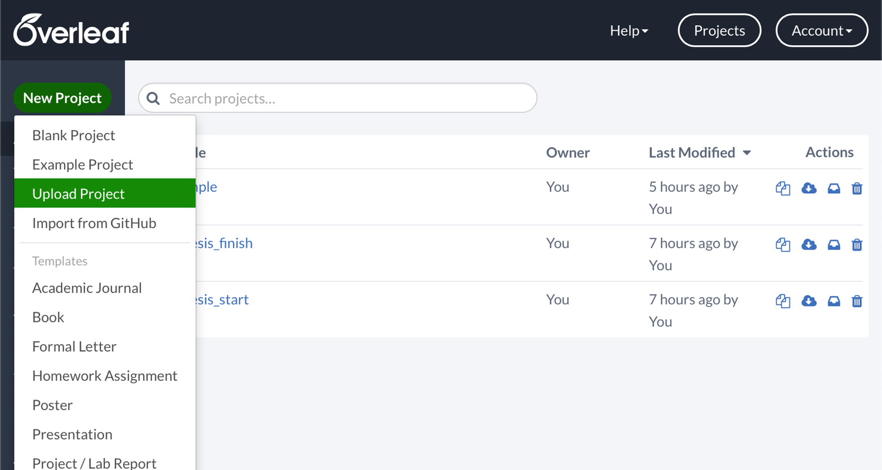
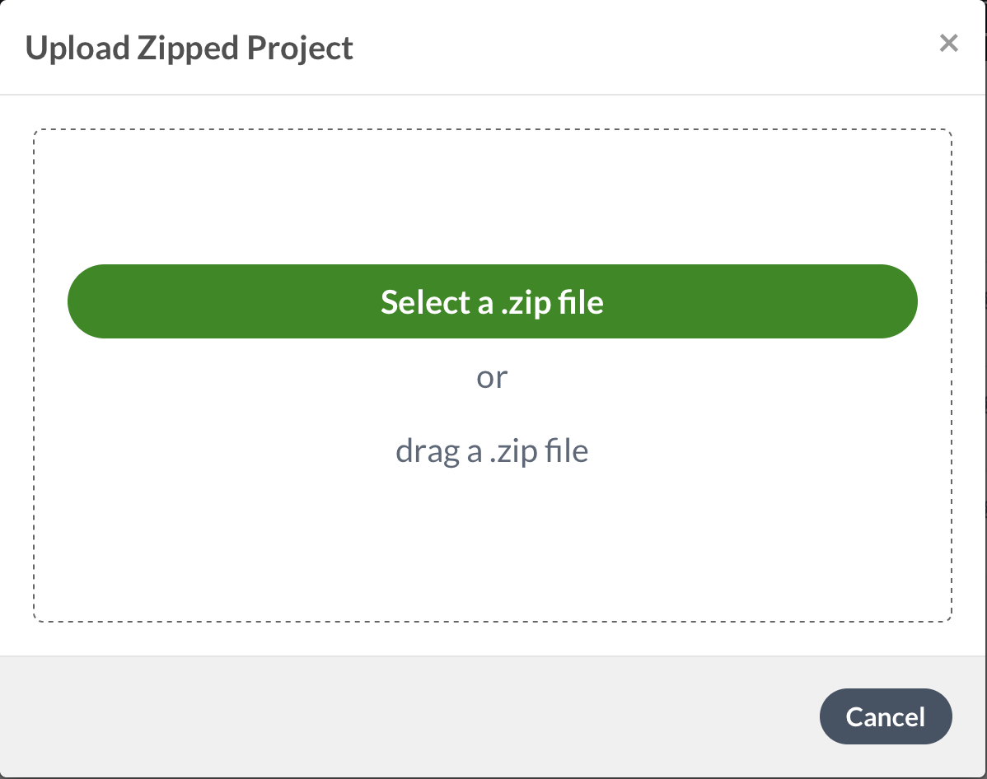
Upload Project
1
2
3. Select thesis_start.zip
The file thesis_start.zip can be uploaded to Overleaf

Slide 24
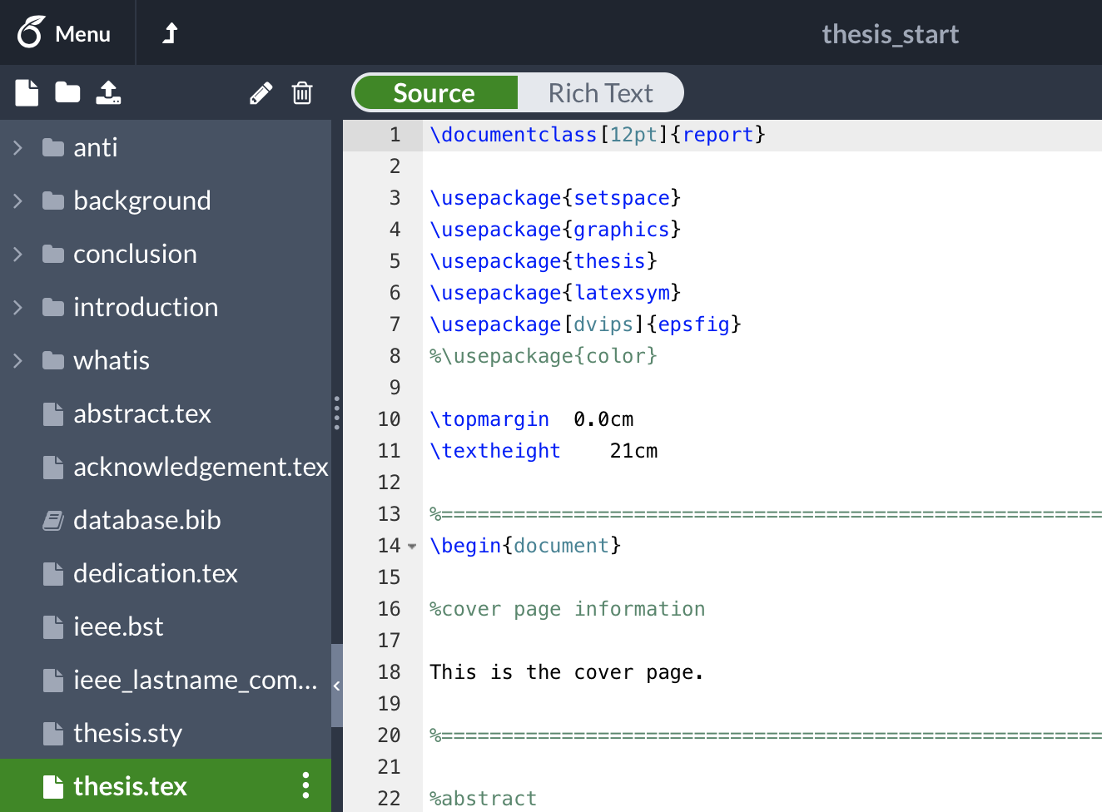
Thesis Template

Slide 25
Thesis Template
When working on big documents (like your thesis), it is a good practice to split the input file into several .tex files for easier management
E.g., put each of your thesis chapters in its own sub-folder

Slide 26
Check Your Files
Each chapter is written in one .tex file
We assume that the thesis text, figures, tables, etc. have been prepared beforehand already
We are now going to bind them together into a thesis
The file thesis.tex will be the port of entry

Slide 27
Look at the Master File
Select thesis.tex
This is our master file
Let's start putting in the ingredients to make our sandwich

Slide 28
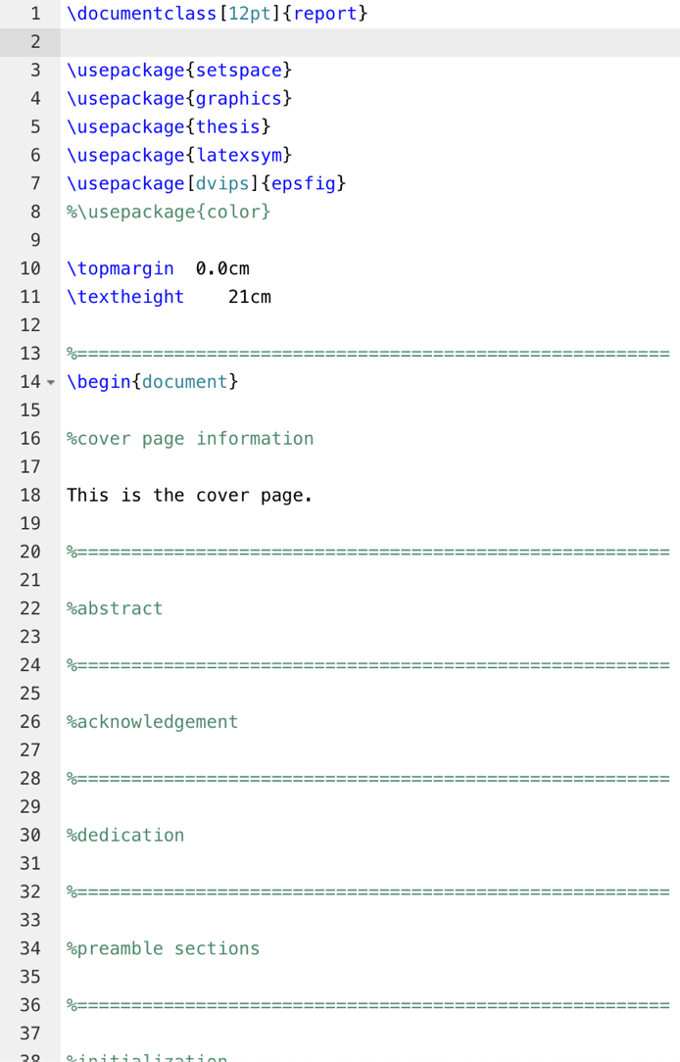
The Meat
The Master file glues other parts together
Check the left pane for other files
Cover Page
Thesis Chapters
\chapter
Preamble
Page Numbering and Style
Appendix
thesis.tex

Slide 29
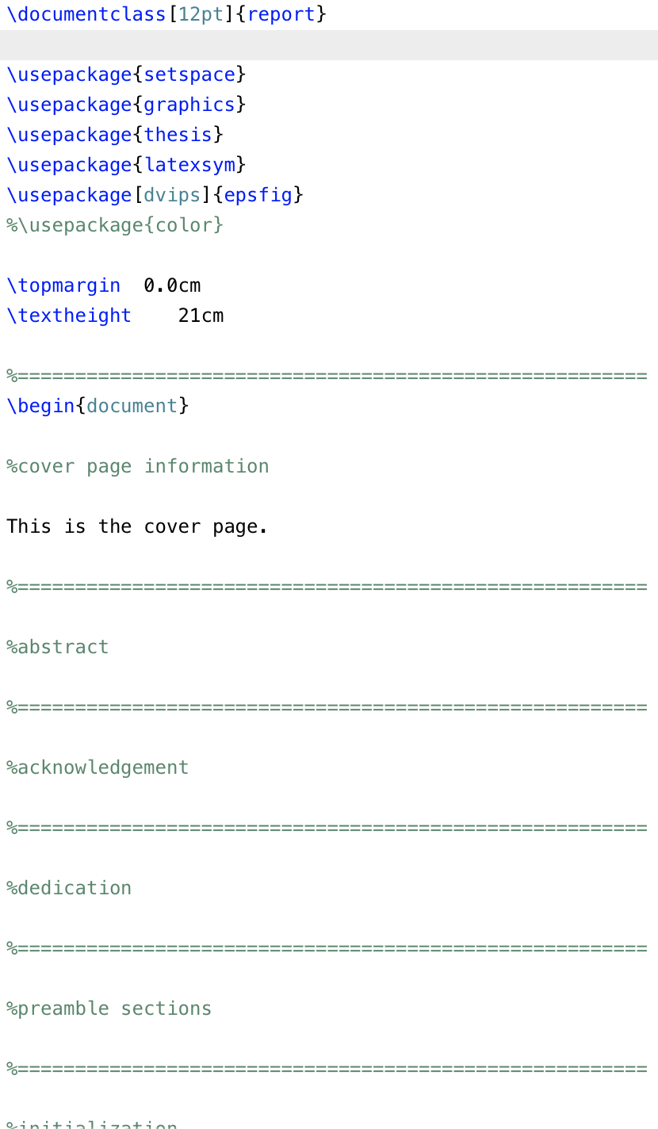
Preamble
\documentclass is now “report” (instead of “article”)
Use the “thesis” package (thesis.sty)
Recall that % means “comments” (i.e., skipped from typesetting)

Slide 30
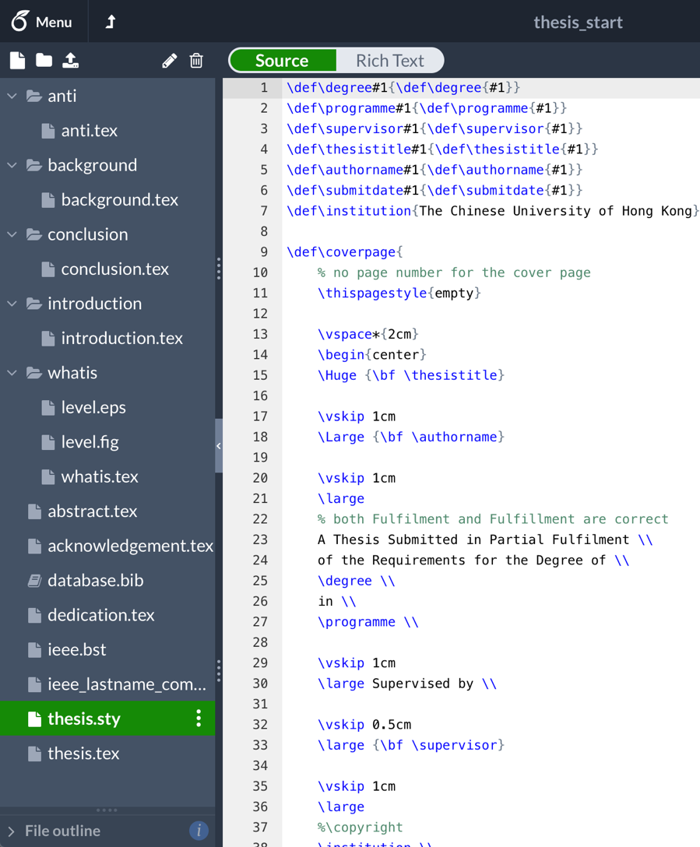
Style File
Going to the style file thesis.sty, you see many commands that help set your thesis layout properly
Do NOT modify this file!

Slide 31
Cover Page
Go back to thesis.tex.
Insert the following under “%cover page information":
Title: \thesistitle{…}
Author: \authorname{…}
Degree: \degree{…}
Programme: \programme{…}
Your boss: \supervisor{…}
Date: \submitdate{…}
\coverpage

Slide 32
Cover Page
Recompile
(Ctrl+S)
(⌘+S)

Slide 33
Style File
The previous commands (\thesistitle, \authorname, etc.), and more coming, are non-standard LaTeX commands, self-defined in the thesis style file (thesis.sty)

Slide 34
Thesis Chapters
Recall our good practice:
Write each chapter in a separate file
Let’s insert the chapters one-by-one
Under “%insert the chapters”, type:
\input{introduction/introduction.tex}
or: \input introduction/introduction.tex

Slide 35
\input
\input{filename.tex}
Inserts the contents of another file named filename.tex to your document
E.g.:
\input{ introduction/introduction.tex }
folder name
path separator
file name

Slide 36
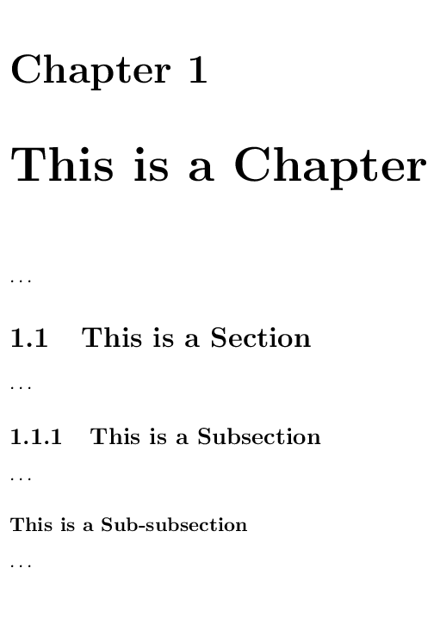
Thesis Chapters
The “report” document class allows an additional top-level sectioning command for chapters:
\chapter{…}
\section{…}
\subsecton{…}
\subsubsection{…}
\paragraph{…}
\chapter*{…} for a chapter without number

Slide 37
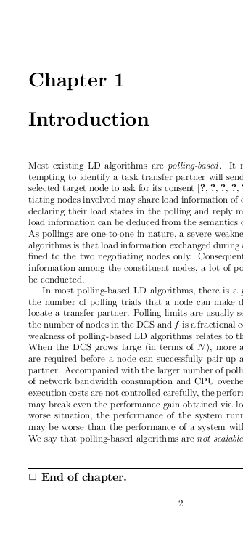
Thesis Chapters
Let’s go to the first chapter (introduction.tex) and start it with:
\chapter{Introduction}
Optionally, end each chapter with:
\chapterend

Slide 38
Thesis Chapters
Go back to thesis.tex
Further insert the chapters in background.tex, anti.tex, and conclusion.tex
Add the chapter sectioning also (\section{…}, \subsection{…}, …)

Slide 39
Cross-References
anti.tex
\subsection{Load State Monitoring}
\label{sec:anti.basic.monitor}
anti.tex
According to the load state definitions given in
Section~\ref{sec:anti.basic.monitor},
the workload of creator node …

Slide 40
\label and \ref
\label{…}: Setting a reference marker
E.g., in anti.tex:
\ref{…}: Referencing to a marker:
E.g., in anti.tex:
\subsection{Load State Monitoring}
\label{sec:anti.basic.monitor}
According to the load state definitions given in
Section~\ref{sec:anti.basic.monitor},
the workload of creator node …

Slide 41
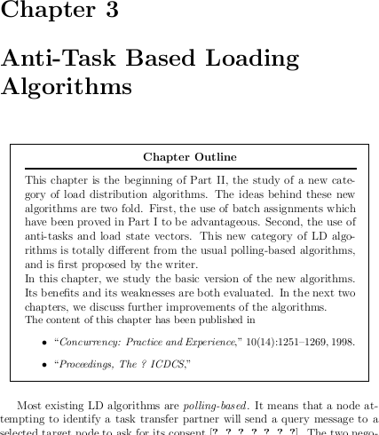
Chapter Outline
Some people would like to add, at the beginning of each chapter, a chapter outline
E.g., in anti.tex, try adding:
\note{Chapter Outline}{…}

Slide 42
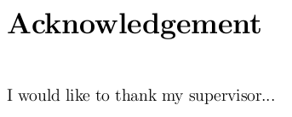
Preamble
Go back to thesis.tex, type:
Abstract: \abstractpage
Acknowledgment: \acknowledgementpage
Dedication: \dedicationpage
Check files: abstract.tex, acknowledgement.tex, and dedication.tex

Slide 43
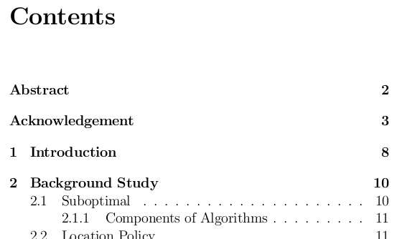
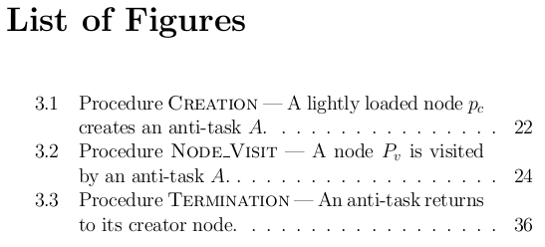
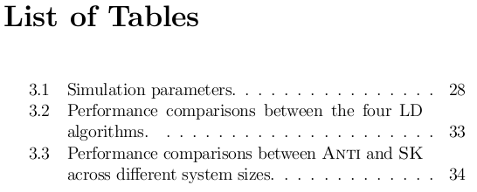
Preamble
Type under %preamble sections:
Table of Contents:
\tableofcontents
List of Figures:
\listoffigures
List of Tables:
\listoftables

Slide 44
Page Numbering
Roman number system, usually for the preamble
\pagenumbering{roman}
Arabic number system, usually for the main text
\newpage
\pagenumbering{arabic}
Put this before Abstract
Put them under Initialization

Slide 45
Page Numbering
If you want to set your own page number, use:
\setcounter{page}{x}
(where x is some number)

Slide 46
Page Style
Control how the headers and footers look like. Try (under %initialization) these one by one:
\pagestyle{headings}
\pagestyle{plain}
\pagestyle{empty}

Slide 47
Line Spacing
Control line spacing. Try (under %initialization):
\singlespacing
\onehalfspacing
\doublespacing

Slide 48
Appendix
To start producing appendixes:
\appendix
Section/chapter numbering will be automatically restarted and changed to alphabetic
E.g., Appendix A, Appendix B, …
Try including whatis.tex to see the effect

Slide 49
Appendix

Slide 50
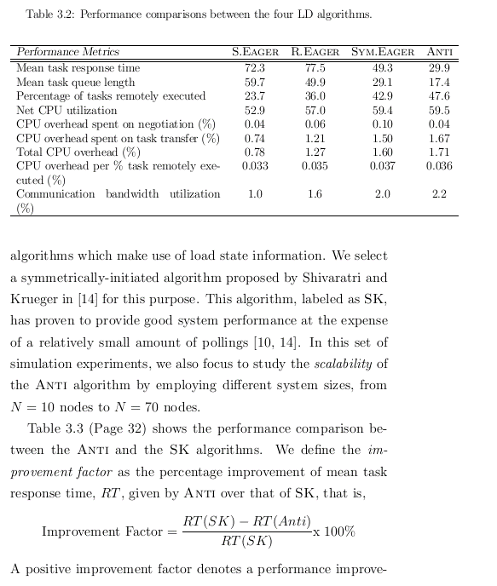
Tables
Table in anti.tex
In LaTeX, tables can easily grow beyond the margins
Tables can be resized using the \resizebox command:
Have to use the “graphicx” package at the preamble:
\usepackage{graphicx}
\resizebox{width}{height}{object}
(add in thesis.tex)

Slide 51
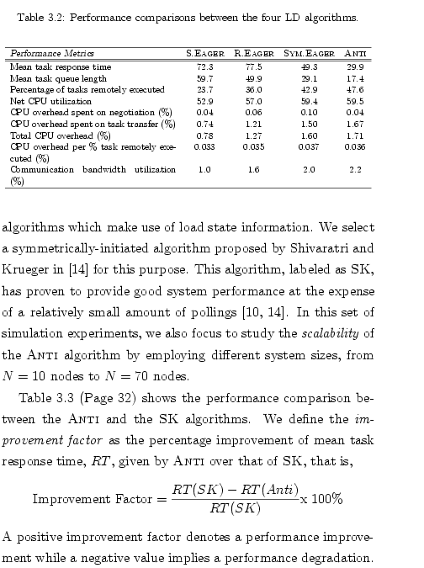
Resizing Tables
Find out the second table ({tabular}) in anti.tex, and type:
“Scale the whole table so that its width is the same as the text width, with the aspect ratio kept (!)”
\resizebox{\textwidth}{!}{
\begin{tabular}{…}
…
\end{tabular}
}

Slide 52
Tables
It is sometimes inconvenient to prepare LaTeX tables
Excel spreadsheets can be exported to LaTeX easily by using the following MS Office add-in:
Excel2LaTeX
http://www.ctan.org/tex-archive/support/excel2latex/

Slide 53
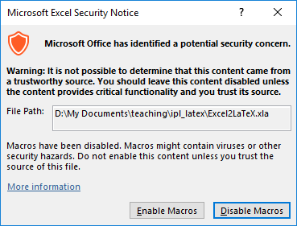
Excel2LaTeX
Download the file Excel2LaTeX.xla and open it in Excel
If prompted, enable the macro

Slide 54
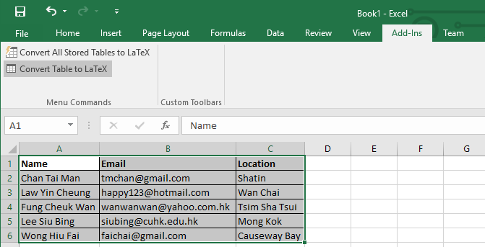
Excel2LaTeX
Create a table in Excel
Switch to the “Add-Ins” menu
3.
2.
1. Select the cells of your table and then click “Convert table to LaTeX”

Slide 55
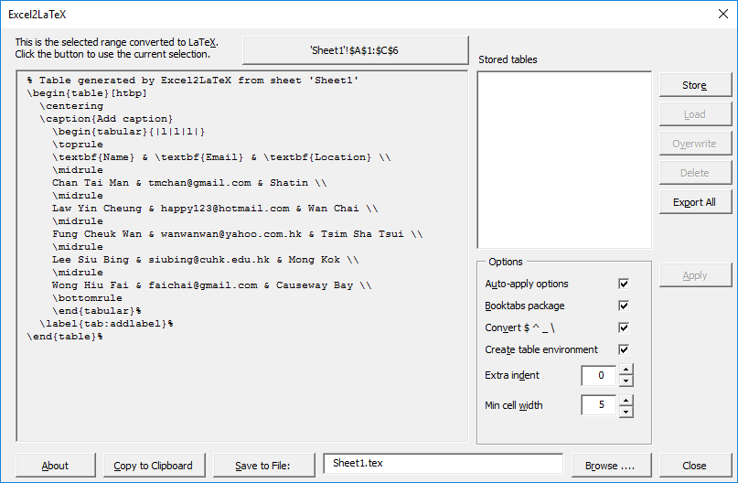
Excel2LaTeX
You can then copy the LaTeX table and paste to your thesis

Slide 56
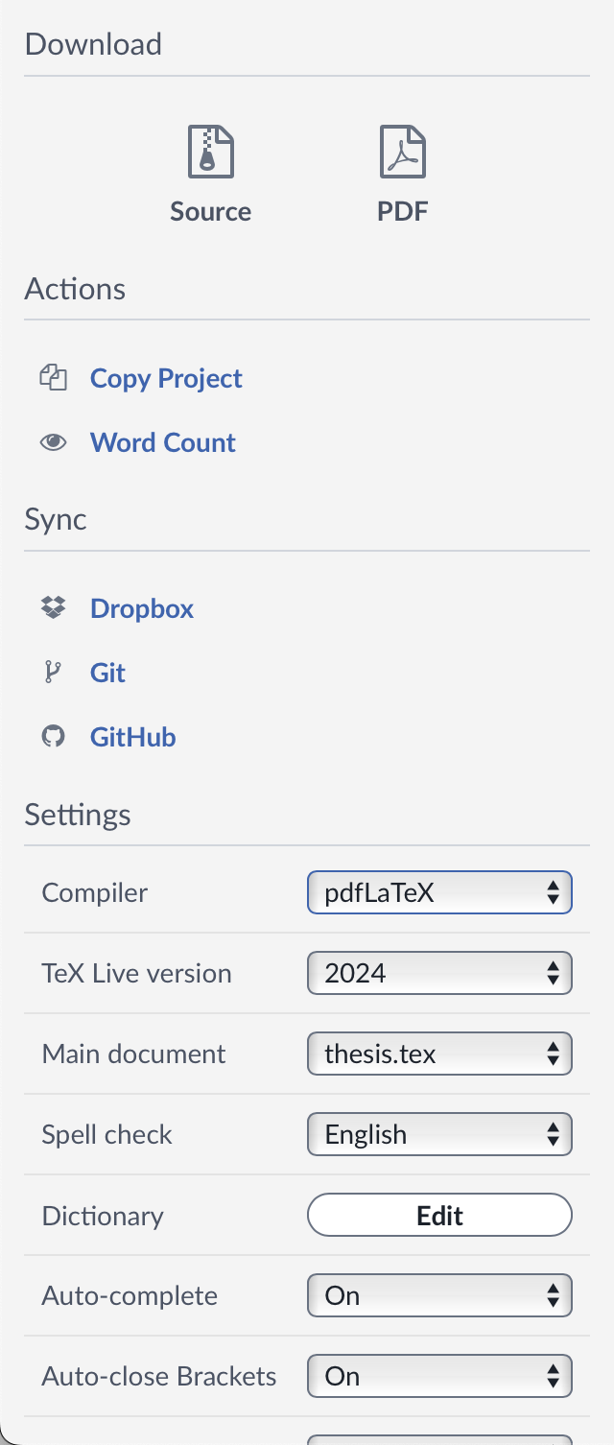
Chinese Editing
1
Sometimes you may need some Chinese text in your document
First, change the typesetting engine to “XeLaTeX”
Menu > Compiler > XeLaTeX
2
3

Slide 57
Chinese Editing
Then, use the “xeCJK” package:
\usepackage{xeCJK} (add in thesis.tex)
Lastly, type Chinese text in your document
abstract.tex

Slide 58
Chinese Editing
Other packages supporting CJK are available…
xeCJK, CJKutf8, …
Learn more on typesetting Chinese documents on Overleaf:
https://www.overleaf.com/learn/latex/Chinese

Slide 59
Bibliography - BibTeX
BibTeX is a popular reference management tool for formatting list of references
You have to prepare a “database” file (.bib) to contain the references you want to include in your document

Slide 60
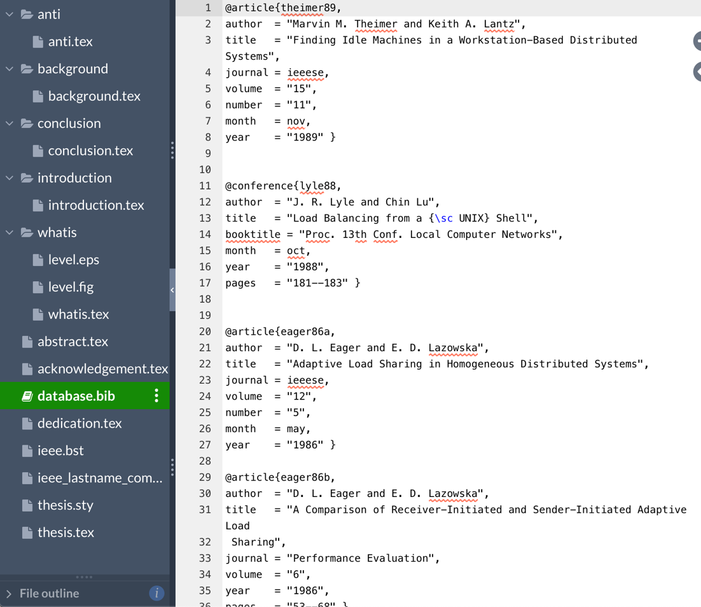
Bibliography - BibTeX
entries

Slide 61
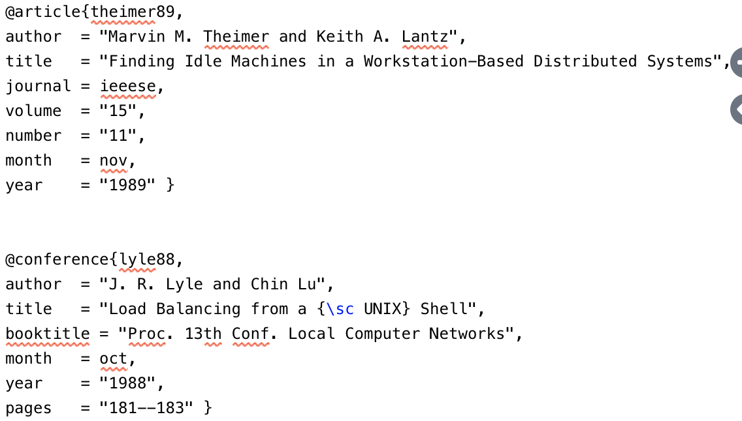
Bibliography - BibTeX
A journal paper entry
An entry in the database does not necessarily appear in your document’s bibliography section
You have to “\cite” it in order to appear
Citation key
A conference
paper entry

Slide 62
BibTeX Entry
Entry type
Each entry type has its own fields
E.g.: article type (for a journal or magazine article)
Required fields: author, title, journal, year
Optional fields: volume, number, pages, month, note, key
Fields

Slide 63
BibTeX Entry
Entry type
Each entry type has its own fields
E.g.: conference type (for a paper in a conference proceedings)
Required fields: author, title, booktitle, year
Optional fields: editor, volume/number, series, pages, address, month, organization, publisher, note, key
Fields

Slide 64
BibTeX Entry Types
Available entry types:
article, book, booklet, conference, incollection, inproceedings, manual, mastersthesis, misc, phdthesis, proceedings, techreport, unpublished
Different entry types have different required and optional fields
See: https://en.wikipedia.org/wiki/BibTeX

Slide 65
Bibliography - BibTeX
To use BibTeX in your thesis, go back to the master file thesis.tex
Type under “%bibliography”:
\newpage
\addcontentsline{toc}{chapter}{Bibliography}
\bibliographystyle{ieee}
\bibliography{database}
Citation style
Database file name
(.bib by default)

Slide 66
Bibliography - BibTeX
Adding a “Bibliography” entry to the Table of Contents (toc)
\addcontentsline{toc}{chapter}{Bibliography}
Bibliography style:
\bibliographystyle{ieee}
Requires the style file ieee.bst
(Try using {ieee_lastname_comes_first})
Database file
\bibliography{database}
Reads the database file database.bib

Slide 67
BibTeX
No space before and after “,”
To cite an entry in the database:
\cite{citation-key} or \cite{key1,key2,…}
(See introduction.tex for examples)

Slide 68
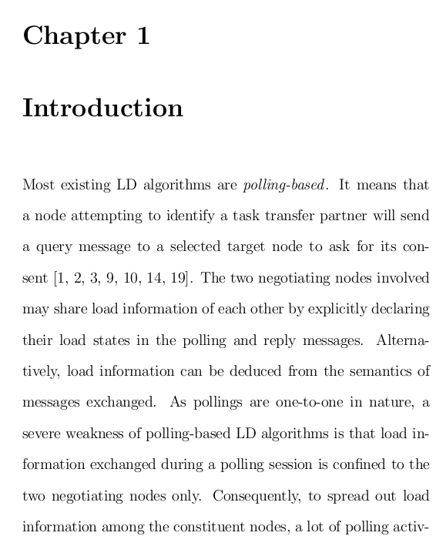
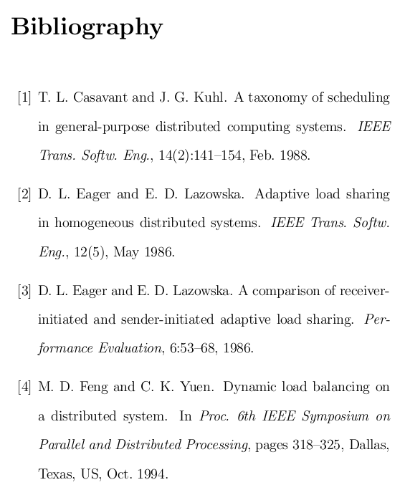
BibTeX

Slide 69
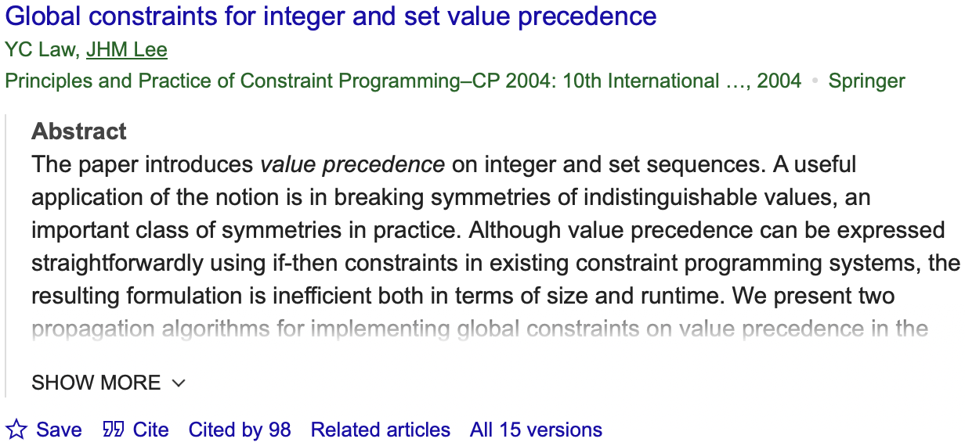
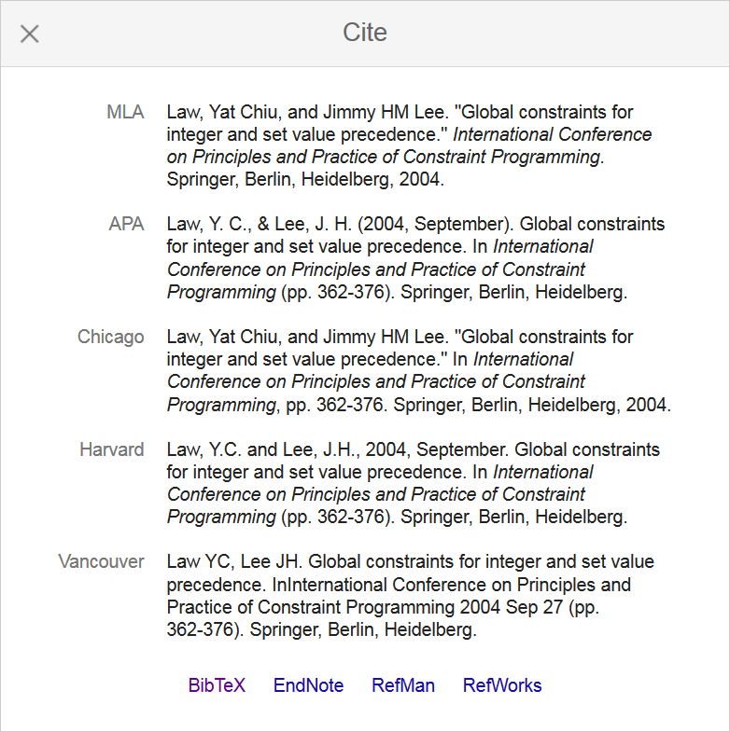
Google Scholar
Google Scholar (https://scholar.google.com) can help prepare the database!
1
2

Slide 70
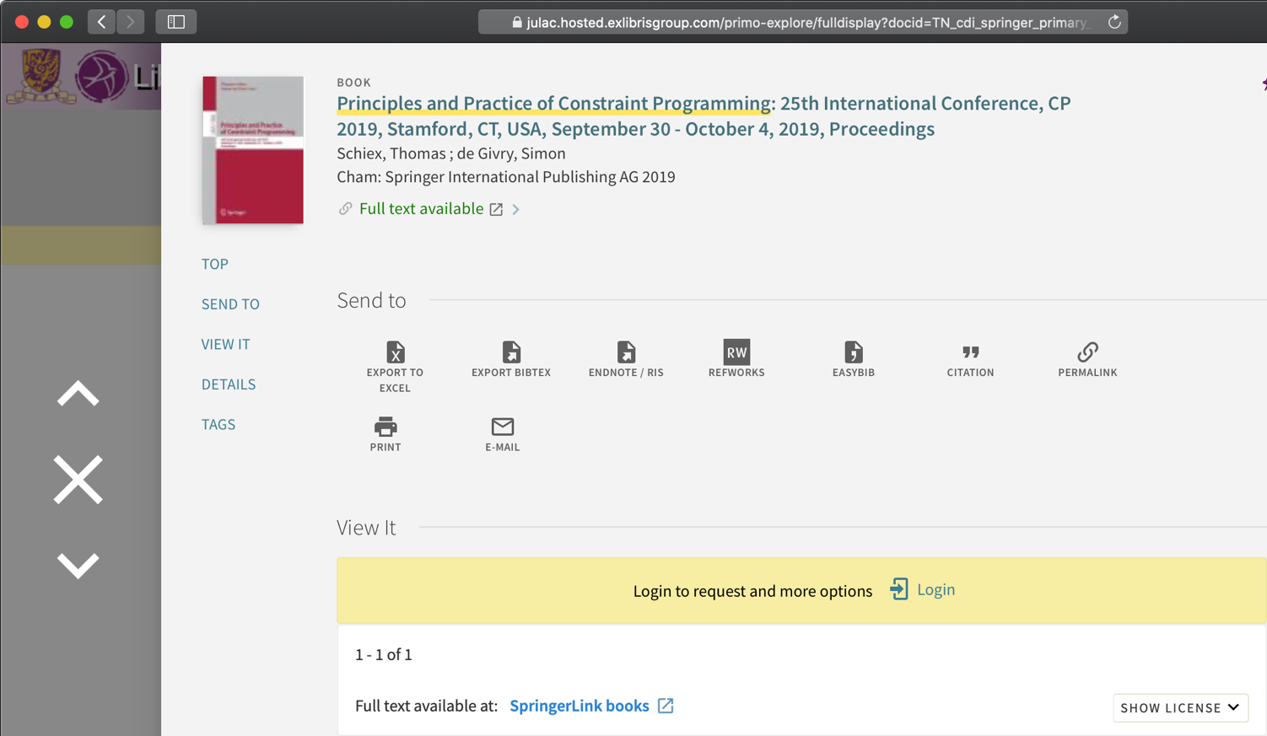
CUHK LibrarySearch

Slide 71
Downloading Your Files
1
2
To download your source files or pdf…
You are ready to publish your work!

Slide 72
Thank You
Wish you a smooth thesis writing!

