Slide 1
Networked Fairness in Cake Cutting
Xiaohui Bei Youming Qiao Shengyu Zhang

Slide 2
Economics
In a nutshell, economics studies how resources are managed and allocated.
One of the most fundamental targets is to achieve certain fairness in the allocation of resources.

Slide 3
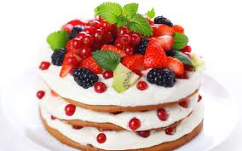
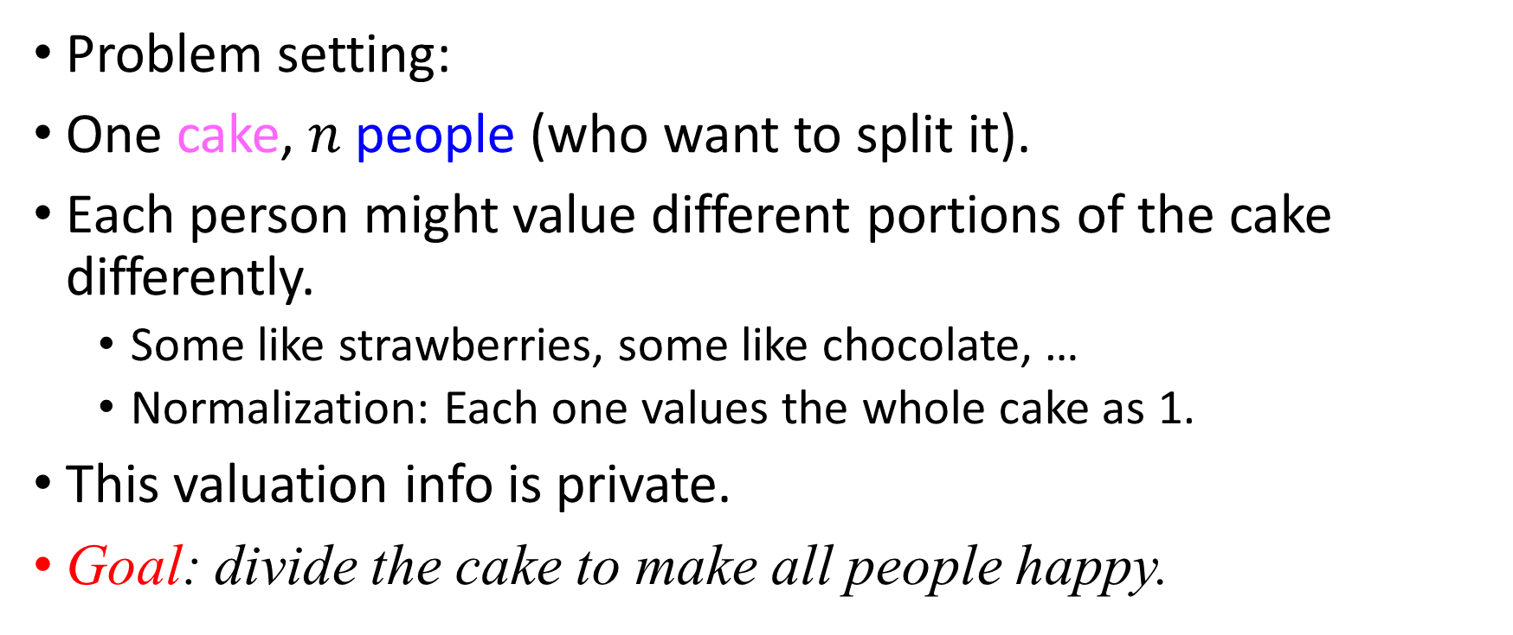
Cake cutting
Problem setting:
One cake, $n$ people (who want to split it).
Each person might value different portions of the cake differently.
  Some like strawberries, some like chocolate, …
  Normalization: Each one values the whole cake as 1.
This valuation info is private.
Goal: divide the cake to make all people happy.

Slide 4
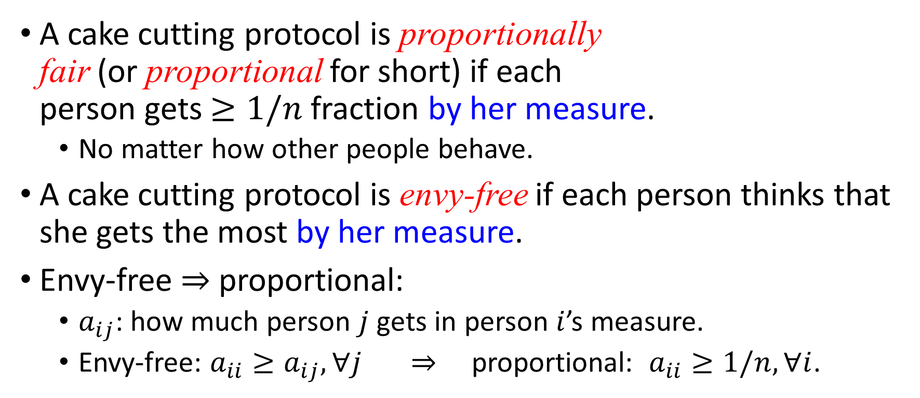
Cake cutting
A cake cutting protocol is proportionally
fair (or proportional for short) if each
person gets $≥1/n$ fraction by her measure.
  No matter how other people behave.
A cake cutting protocol is envy-free if each person thinks that she gets the most by her measure.
Envy-free $⇒$ proportional:
  $a_{ij}$: how much person $j$ gets in person $i$’s measure.
  Envy-free: $a_{ii}≥a_{ij}, ∀j$ $⇒$ proportional: $a_{ii}≥1/n, ∀i$.

Slide 5



Envy-free when $n=2$
Alice cuts the cake into two equal pieces
    by her measure
Bob chooses a larger piece
    by his measure
Alice takes the other piece

Slide 6
Theorem. The outcome is envy-free (and thus proportionally fair).
Proof.
  Alice: gets exactly half
    no matter which piece Bob chooses,
    as the two pieces are equal to her.
  Bob: gets at least half,
    no matter how Alice cuts the cake,
    as Bob takes a piece before Alice.

Slide 7
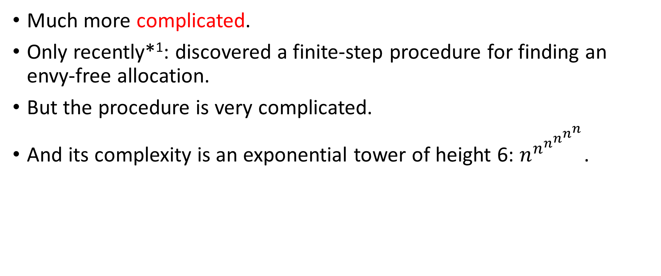
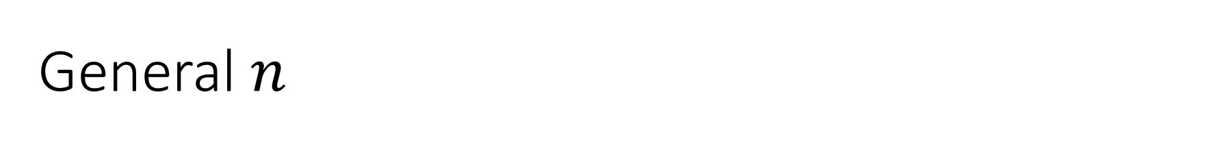
General $n$
Much more complicated.
Only recently*¹: discovered a finite-step procedure for finding an envy-free allocation.
But the procedure is very complicated.
And its complexity is an exponential tower of height 6: $n^{n^{n^{n^{n^{n}}}}}$.
*1. Haris Aziz and Simon Mackenzie. A discrete and bounded envy-free cake cutting protocol for any number of agents. FOCS, 2016.

Slide 8
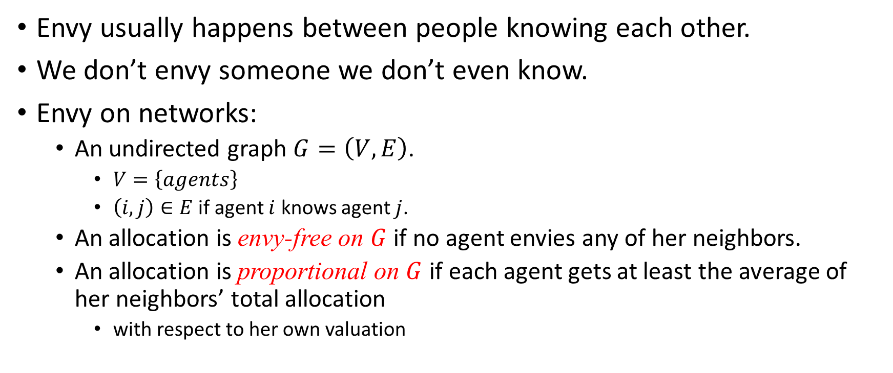
Envy on networks
Envy usually happens between people knowing each other.
We don’t envy someone we don’t even know.
Envy on networks:
  An undirected graph $G=\left(V,E\right)$.
    $V=\left\{agents\right\}$
    $\left(i,j\right)∈E$ if agent $i$ knows agent $j$.
  An allocation is envy-free on $G$ if no agent envies any of her neighbors.
  An allocation is proportional on $G$ if each agent gets at least the average of her neighbors’ total allocation
    with respect to her own valuation

Slide 9
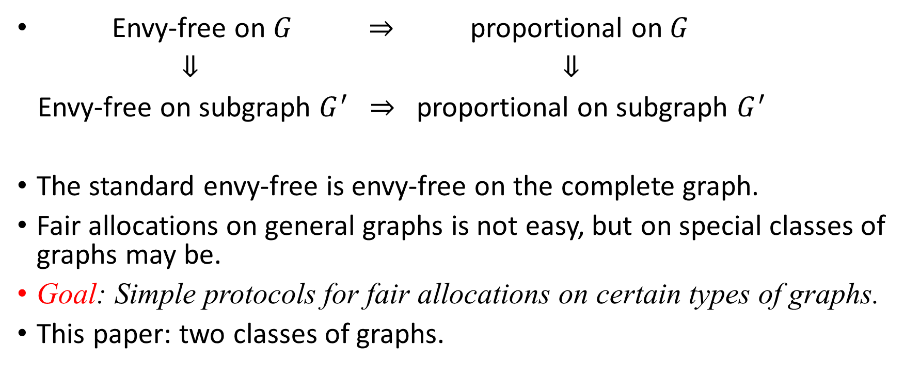
Observations
Envy-free on $G$ $⇒$ proportional on $G$
$⇓$ $⇓$
Envy-free on subgraph $G^{′}$ $⇒$ proportional on subgraph $G^{′}$
The standard envy-free is envy-free on the complete graph.
Fair allocations on general graphs is not easy, but on special classes of graphs may be.
Goal: Simple protocols for fair allocations on certain types of graphs.
This paper: two classes of graphs.

Slide 10
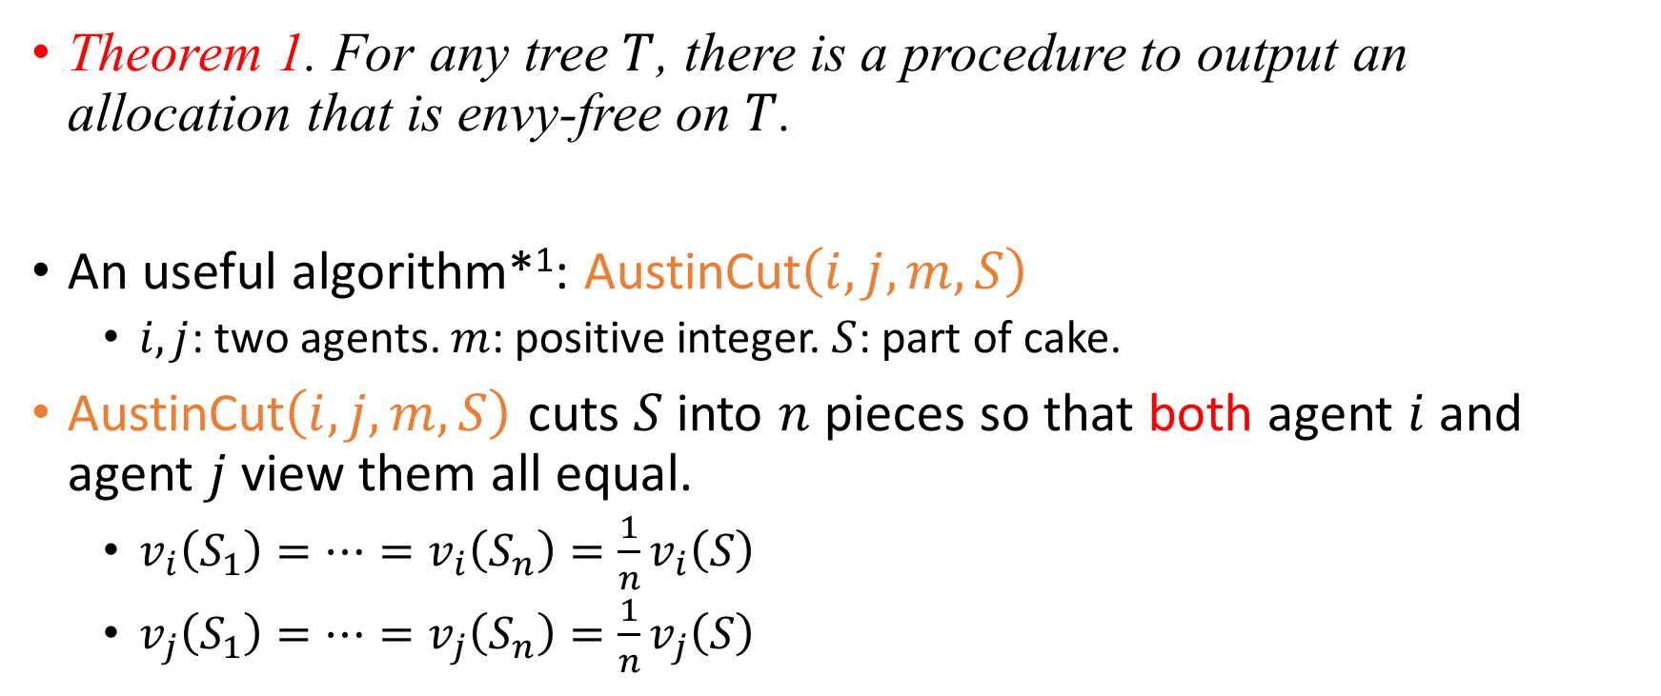
First class: trees
Theorem 1. For any tree $T$, there is a procedure to output an allocation that is envy-free on $T$.
An useful algorithm*¹: AustinCut$\left(i,j,m,S\right)$
  $i,j$: two agents. $m$: positive integer. $S$: part of cake.
AustinCut$\left(i,j,m,S\right)$ cuts $S$ into $n$ pieces so that both agent $i$ and agent $j$ view them all equal.
  $v_{i}\left(S_{1}\right)=…=v_{i}\left(S_{n}\right)=\frac{1}{n}v_{i}\left(S\right)$
  $v_{j}\left(S_{1}\right)=…=v_{j}\left(S_{n}\right)=\frac{1}{n}v_{j}\left(S\right)$
*1. AK Austin. Sharing a cake. The Mathematical Gazette, 66(437):212–215, 1982.

Slide 11








Algorithm
n = 7
Agent $r$ cuts the cake into $n$ equal pieces (in $r$’s measure).
$$r$$
$$a_{1}$$
$$a_{2}$$
$$b_{1}$$
$$b_{2}$$
$$c_{1}$$
$$c_{2}$$

Slide 12

Algorithm
n = 7
Agent $r$ cuts the cake into $n$ equal pieces (in $r$’s measure).
Agent $a_{1}$ takes the largest piece (in $a_{1}$’s measure).
$$r$$
$$a_{1}$$
$$a_{2}$$
$$b_{1}$$
$$b_{2}$$
$$c_{1}$$
$$c_{2}$$

Slide 13

Algorithm
n = 7
Agent $r$ cuts the cake into $n$ equal pieces (in $r$’s measure).
Agent $a_{1}$ takes the largest piece (in $a_{1}$’s measure).
Agent $a_{2}$ takes 5 largest pieces (in $a_{2}$’s measure).
$$r$$
$$a_{1}$$
$$a_{2}$$
$$b_{1}$$
$$b_{2}$$
$$c_{1}$$
$$c_{2}$$

Slide 14
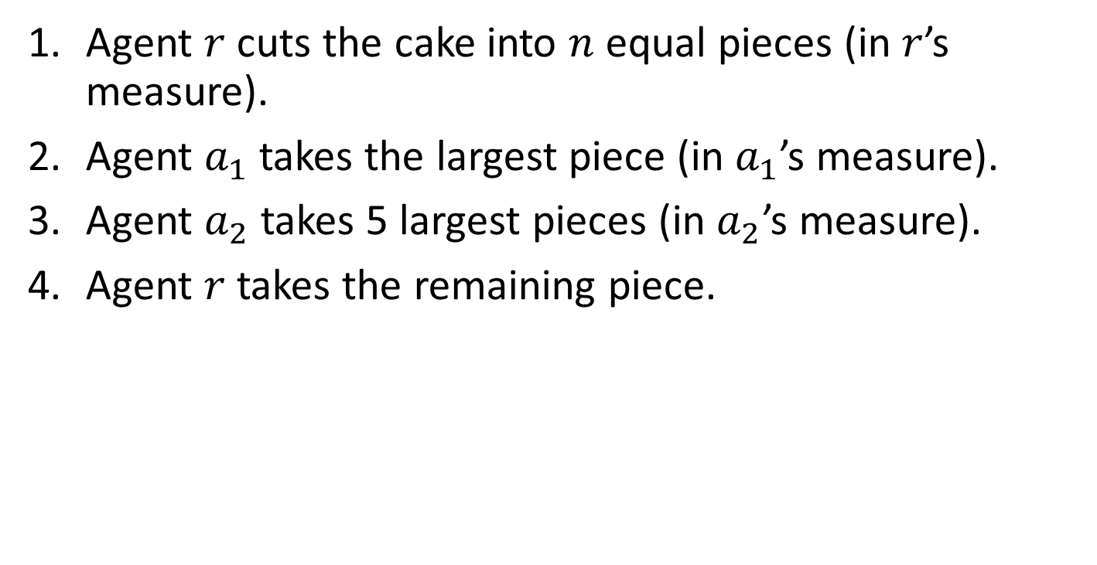
Algorithm
n = 7
Agent $r$ cuts the cake into $n$ equal pieces (in $r$’s measure).
Agent $a_{1}$ takes the largest piece (in $a_{1}$’s measure).
Agent $a_{2}$ takes 5 largest pieces (in $a_{2}$’s measure).
Agent $r$ takes the remaining piece.
$$r$$
$$a_{1}$$
$$a_{2}$$
$$b_{1}$$
$$b_{2}$$
$$c_{1}$$
$$c_{2}$$

Slide 15
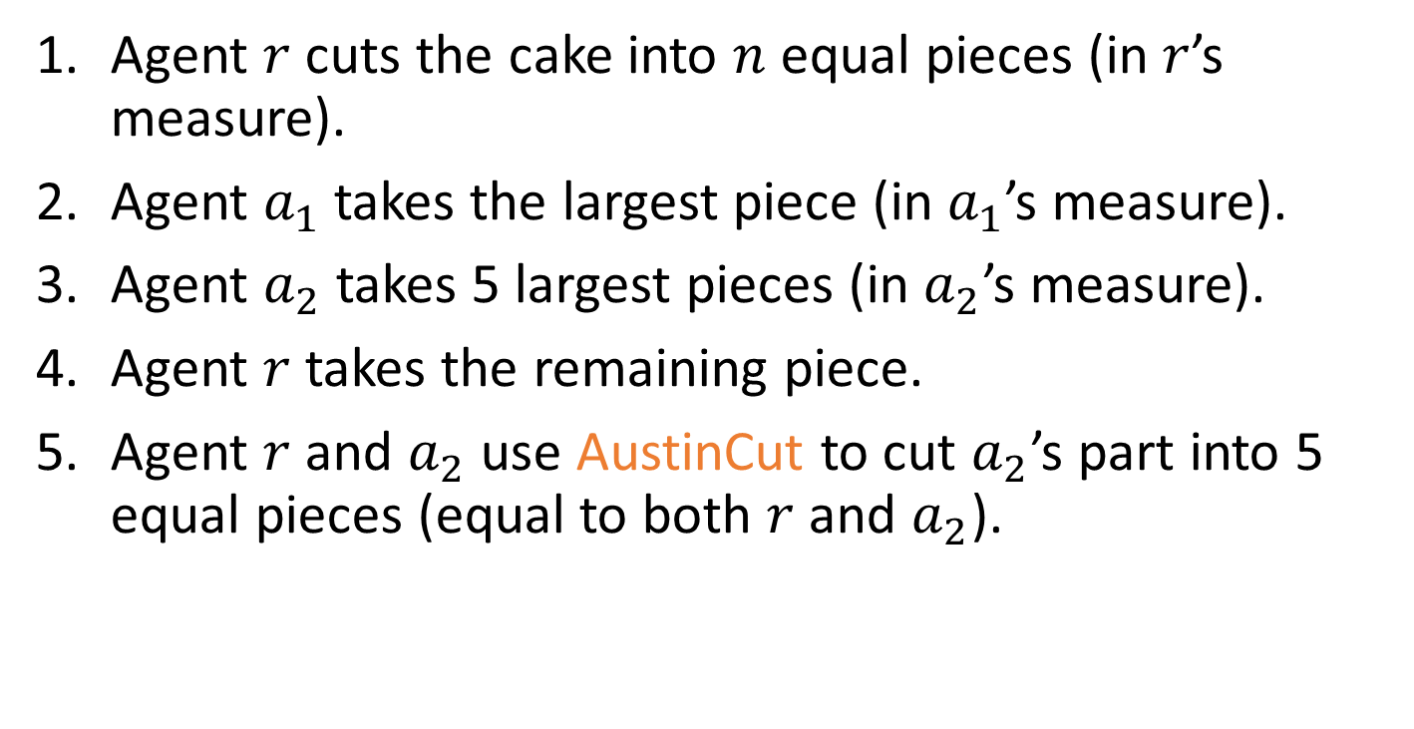
Algorithm
n = 7
Agent $r$ cuts the cake into $n$ equal pieces (in $r$’s measure).
Agent $a_{1}$ takes the largest piece (in $a_{1}$’s measure).
Agent $a_{2}$ takes 5 largest pieces (in $a_{2}$’s measure).
Agent $r$ takes the remaining piece.
Agent $r$ and $a_{2}$ use AustinCut to cut $a_{2}$’s part into 5 equal pieces (equal to both $r$ and $a_{2}$).
$$r$$
$$a_{1}$$
$$a_{2}$$
$$b_{1}$$
$$b_{2}$$
$$c_{1}$$
$$c_{2}$$

Slide 16
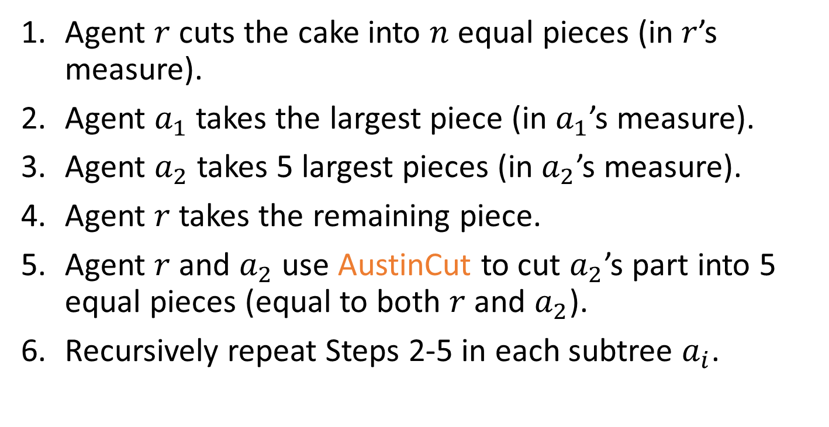
Algorithm
n = 7
Agent $r$ cuts the cake into $n$ equal pieces (in $r$’s measure).
Agent $a_{1}$ takes the largest piece (in $a_{1}$’s measure).
Agent $a_{2}$ takes 5 largest pieces (in $a_{2}$’s measure).
Agent $r$ takes the remaining piece.
Agent $r$ and $a_{2}$ use AustinCut to cut $a_{2}$’s part into 5 equal pieces (equal to both $r$ and $a_{2}$).
Recursively repeat Steps 2-5 in each subtree $a_{i}$.
$$r$$
$$a_{1}$$
$$a_{2}$$
$$b_{1}$$
$$b_{2}$$
$$c_{1}$$
$$c_{2}$$

Slide 17
Algorithm
n = 7
Agent $r$ cuts the cake into $n$ equal pieces (in $r$’s measure).
Agent $a_{1}$ takes the largest piece (in $a_{1}$’s measure).
Agent $a_{2}$ takes 5 largest pieces (in $a_{2}$’s measure).
Agent $r$ takes the remaining piece.
Agent $r$ and $a_{2}$ use AustinCut to cut $a_{2}$’s part into 5 equal pieces (equal to both $r$ and $a_{2}$).
Recursively repeat Steps 2-5 in each subtree $a_{i}$.
$$r$$
$$a_{1}$$
$$a_{2}$$
$$b_{1}$$
$$b_{2}$$
$$c_{1}$$
$$c_{2}$$

Slide 18
Algorithm
n = 7
Agent $r$ cuts the cake into $n$ equal pieces (in $r$’s measure).
Agent $a_{1}$ takes the largest piece (in $a_{1}$’s measure).
Agent $a_{2}$ takes 5 largest pieces (in $a_{2}$’s measure).
Agent $r$ takes the remaining piece.
Agent $r$ and $a_{2}$ use AustinCut to cut $a_{2}$’s part into 5 equal pieces (equal to both $r$ and $a_{2}$).
Recursively repeat Steps 2-5 in each subtree $a_{i}$.
$$r$$
$$a_{1}$$
$$a_{2}$$
$$b_{1}$$
$$b_{2}$$
$$c_{1}$$
$$c_{2}$$

Slide 19
Algorithm
n = 7
Agent $r$ cuts the cake into $n$ equal pieces (in $r$’s measure).
Agent $a_{1}$ takes the largest piece (in $a_{1}$’s measure).
Agent $a_{2}$ takes 5 largest pieces (in $a_{2}$’s measure).
Agent $r$ takes the remaining piece.
Agent $r$ and $a_{2}$ use AustinCut to cut $a_{2}$’s part into 5 equal pieces (equal to both $r$ and $a_{2}$).
Recursively repeat Steps 2-5 in each subtree $a_{i}$.
$$r$$
$$a_{1}$$
$$a_{2}$$
$$b_{1}$$
$$b_{2}$$
$$c_{1}$$
$$c_{2}$$

Slide 20
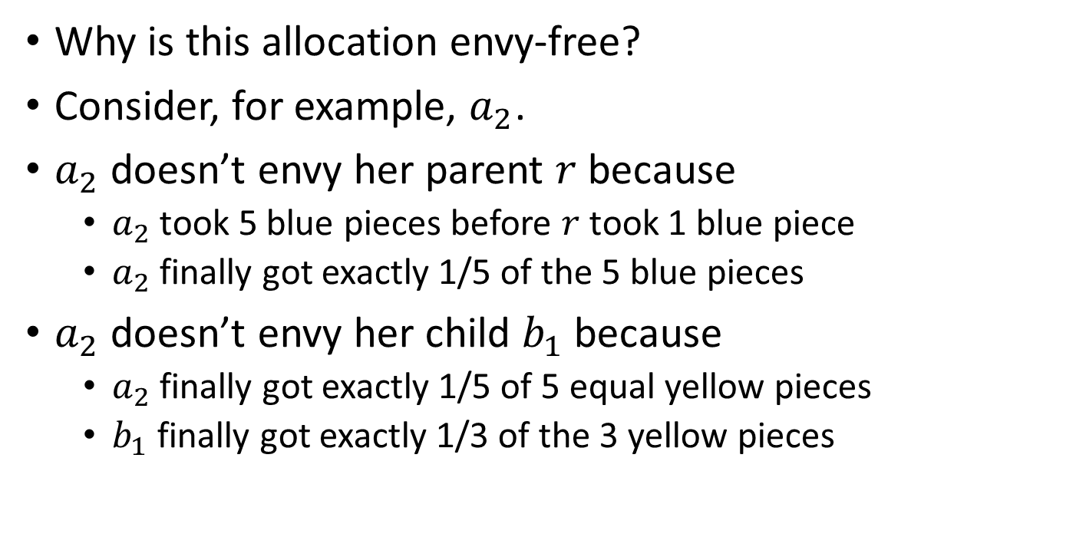
Fairness: Envy-free
n = 7
Why is this allocation envy-free?
Consider, for example, $a_{2}$.
$a_{2}$ doesn’t envy her parent $r$ because
  $a_{2}$ took 5 blue pieces before $r$ took 1 blue piece
  $a_{2}$ finally got exactly 1/5 of the 5 blue pieces
$a_{2}$ doesn’t envy her child $b_{1}$ because
  $a_{2}$ finally got exactly $\text{1/5 }\text{of}$ 5 equal yellow pieces
  $b_{1}$ finally got exactly 1/3 of the 3 yellow pieces
$$r$$
$$a_{1}$$
$$a_{2}$$
$$b_{1}$$
$$b_{2}$$
$$c_{1}$$
$$c_{2}$$

Slide 21
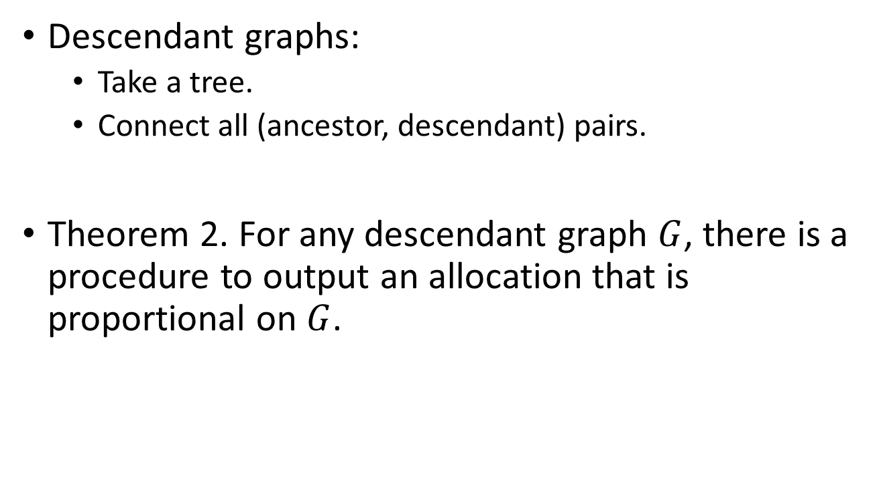
Second class: descendant graphs
Descendant graphs:
  Take a tree.
  Connect all (ancestor, descendant) pairs.
Theorem 2. For any descendant graph $G$, there is a procedure to output an allocation that is proportional on $G$.

Slide 22
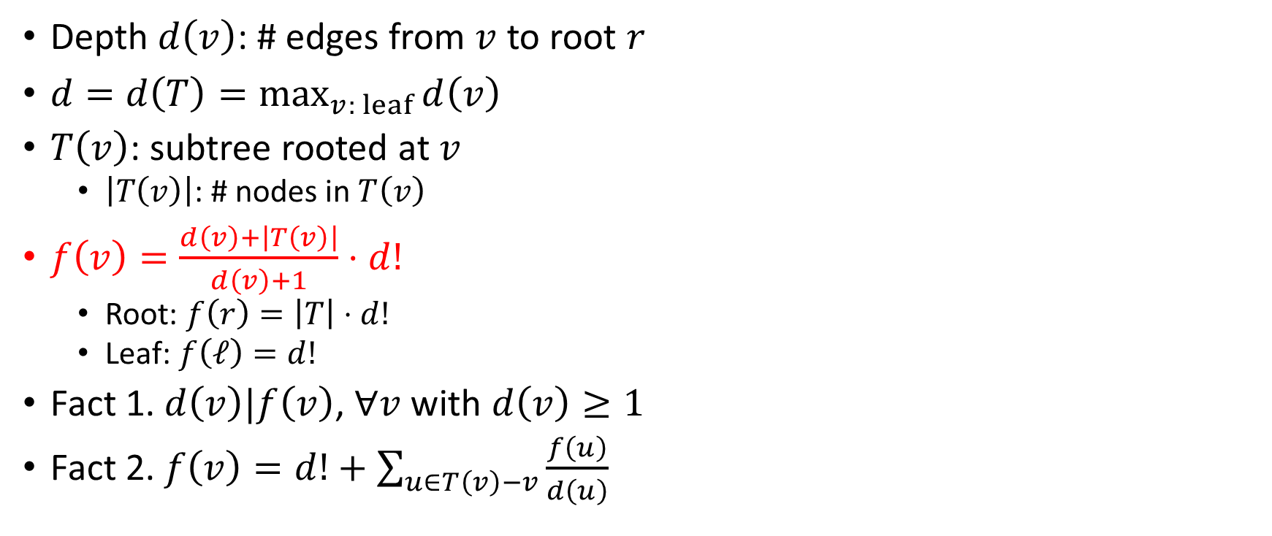
Notation
Depth $d\left(v\right)$: # edges from $v$ to root $r$
$d=d\left(T\right)=\max_{v: leaf}{d\left(v\right)}$
$T\left(v\right)$: subtree rooted at $v$
  $\left|T\left(v\right)\right|$: # nodes in $T\left(v\right)$
$f\left(v\right)=\frac{d\left(v\right)+\left|T\left(v\right)\right|}{d\left(v\right)+1}⋅d!$
  Root: $f\left(r\right)=\left|T\right|⋅d!$
  Leaf: $f\left(ℓ\right)=d!$
Fact 1. $d\left(v\right)|f\left(v\right)$, $∀v$ with $d\left(v\right)≥1$
Fact 2. $f\left(v\right)=d!+\sum_{u∈T\left(v\right)−v}{\frac{f\left(u\right)}{d\left(u\right)}}$

Slide 23


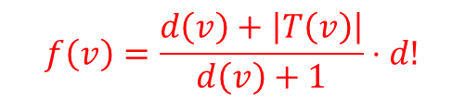



Algorithm
$$f\left(v\right)=\frac{d\left(v\right)+\left|T\left(v\right)\right|}{d\left(v\right)+1}⋅d!$$
$$r$$
$$10$$
$$2$$
$$4$$
$$a_{1}$$
$$a_{2}$$
$$2$$
$$2$$
$$b_{1}$$
$$b_{2}$$

Slide 24

Algorithm
$$f\left(v\right)=\frac{d\left(v\right)+\left|T\left(v\right)\right|}{d\left(v\right)+1}⋅d!$$
Agent $r$ cuts the cake into $f(r)$ equal pieces
(in $r$’s measure).
$$r$$
$$10$$
$$2$$
$$4$$
$$a_{1}$$
$$a_{2}$$
$$2$$
$$2$$
$$b_{1}$$
$$b_{2}$$

Slide 25

Algorithm
$$f\left(v\right)=\frac{d\left(v\right)+\left|T\left(v\right)\right|}{d\left(v\right)+1}⋅d!$$
Agent $r$ cuts the cake into $f(r)$ equal pieces
(in $r$’s measure).
Agent $a_{1}$ takes $\frac{f\left(a_{1}\right)}{d\left(a_{1}\right)}$ largest pieces (in $a_{1}$’s measure).
$$r$$
$$10$$
$$2$$
$$4$$
$$a_{1}$$
$$a_{2}$$
$$2$$
$$2$$
$$b_{1}$$
$$b_{2}$$

Slide 26
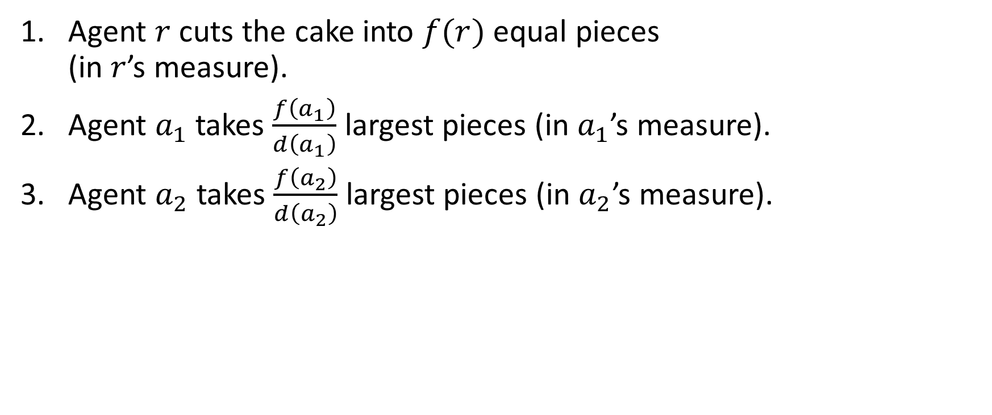
Algorithm
$$f\left(v\right)=\frac{d\left(v\right)+\left|T\left(v\right)\right|}{d\left(v\right)+1}⋅d!$$
Agent $r$ cuts the cake into $f(r)$ equal pieces
(in $r$’s measure).
Agent $a_{1}$ takes $\frac{f\left(a_{1}\right)}{d\left(a_{1}\right)}$ largest pieces (in $a_{1}$’s measure).
Agent $a_{2}$ takes $\frac{f\left(a_{2}\right)}{d\left(a_{2}\right)}$ largest pieces (in $a_{2}$’s measure).
$$r$$
$$10$$
$$2$$
$$4$$
$$a_{1}$$
$$a_{2}$$
$$2$$
$$2$$
$$b_{1}$$
$$b_{2}$$

Slide 27
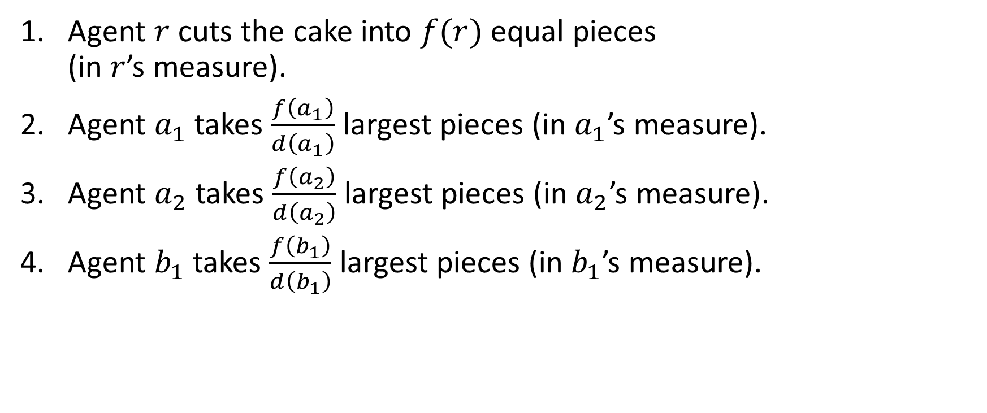
Algorithm
$$f\left(v\right)=\frac{d\left(v\right)+\left|T\left(v\right)\right|}{d\left(v\right)+1}⋅d!$$
Agent $r$ cuts the cake into $f(r)$ equal pieces
(in $r$’s measure).
Agent $a_{1}$ takes $\frac{f\left(a_{1}\right)}{d\left(a_{1}\right)}$ largest pieces (in $a_{1}$’s measure).
Agent $a_{2}$ takes $\frac{f\left(a_{2}\right)}{d\left(a_{2}\right)}$ largest pieces (in $a_{2}$’s measure).
Agent $b_{1}$ takes $\frac{f\left(b_{1}\right)}{d\left(b_{1}\right)}$ largest pieces (in $b_{1}$’s measure).
$$r$$
$$10$$
$$2$$
$$4$$
$$a_{1}$$
$$a_{2}$$
$$2$$
$$2$$
$$b_{1}$$
$$b_{2}$$

Slide 28
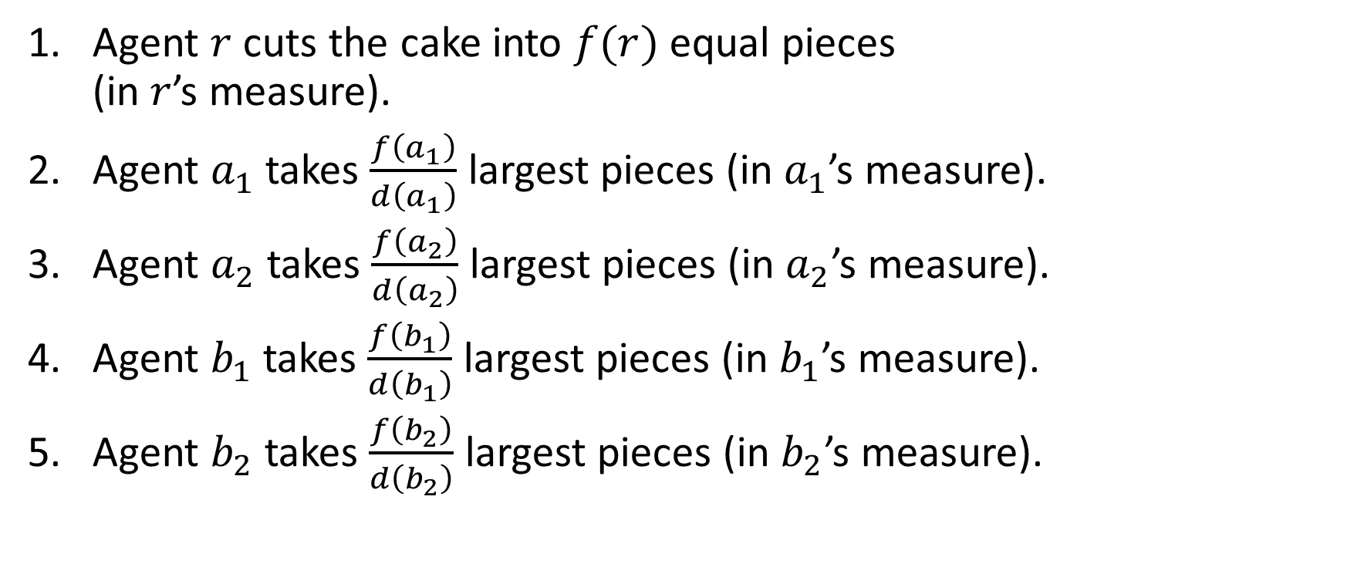
Algorithm
$$f\left(v\right)=\frac{d\left(v\right)+\left|T\left(v\right)\right|}{d\left(v\right)+1}⋅d!$$
Agent $r$ cuts the cake into $f(r)$ equal pieces
(in $r$’s measure).
Agent $a_{1}$ takes $\frac{f\left(a_{1}\right)}{d\left(a_{1}\right)}$ largest pieces (in $a_{1}$’s measure).
Agent $a_{2}$ takes $\frac{f\left(a_{2}\right)}{d\left(a_{2}\right)}$ largest pieces (in $a_{2}$’s measure).
Agent $b_{1}$ takes $\frac{f\left(b_{1}\right)}{d\left(b_{1}\right)}$ largest pieces (in $b_{1}$’s measure).
Agent $b_{2}$ takes $\frac{f\left(b_{2}\right)}{d\left(b_{2}\right)}$ largest pieces (in $b_{2}$’s measure).
$$r$$
$$10$$
$$2$$
$$4$$
$$a_{1}$$
$$a_{2}$$
$$2$$
$$2$$
$$b_{1}$$
$$b_{2}$$

Slide 29
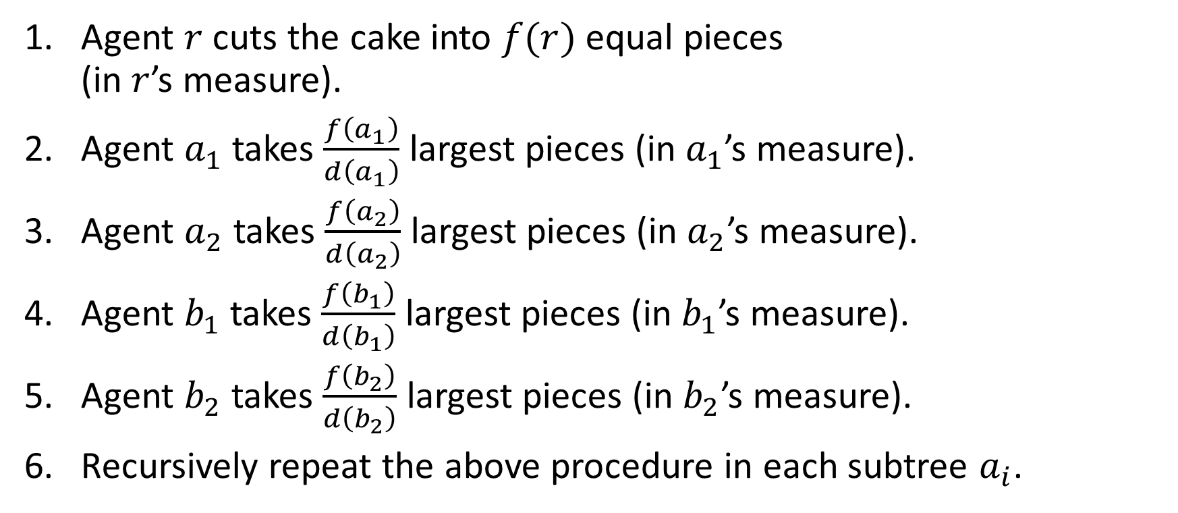
Algorithm
$$f\left(v\right)=\frac{d\left(v\right)+\left|T\left(v\right)\right|}{d\left(v\right)+1}⋅d!$$
Agent $r$ cuts the cake into $f(r)$ equal pieces
(in $r$’s measure).
Agent $a_{1}$ takes $\frac{f\left(a_{1}\right)}{d\left(a_{1}\right)}$ largest pieces (in $a_{1}$’s measure).
Agent $a_{2}$ takes $\frac{f\left(a_{2}\right)}{d\left(a_{2}\right)}$ largest pieces (in $a_{2}$’s measure).
Agent $b_{1}$ takes $\frac{f\left(b_{1}\right)}{d\left(b_{1}\right)}$ largest pieces (in $b_{1}$’s measure).
Agent $b_{2}$ takes $\frac{f\left(b_{2}\right)}{d\left(b_{2}\right)}$ largest pieces (in $b_{2}$’s measure).
Recursively repeat the above procedure in each subtree $a_{i}$.
$$r$$
$$10$$
$$2$$
$$4$$
$$a_{1}$$
$$a_{2}$$
$$2$$
$$2$$
$$b_{1}$$
$$b_{2}$$

Slide 30
Algorithm
$$f\left(v\right)=\frac{d\left(v\right)+\left|T\left(v\right)\right|}{d\left(v\right)+1}⋅d!$$
Agent $r$ cuts the cake into $f(r)$ equal pieces
(in $r$’s measure).
Agent $a_{1}$ takes $\frac{f\left(a_{1}\right)}{d\left(a_{1}\right)}$ largest pieces (in $a_{1}$’s measure).
Agent $a_{2}$ takes $\frac{f\left(a_{2}\right)}{d\left(a_{2}\right)}$ largest pieces (in $a_{2}$’s measure).
Agent $b_{1}$ takes $\frac{f\left(b_{1}\right)}{d\left(b_{1}\right)}$ largest pieces (in $b_{1}$’s measure).
Agent $b_{2}$ takes $\frac{f\left(b_{2}\right)}{d\left(b_{2}\right)}$ largest pieces (in $b_{2}$’s measure).
Recursively repeat the above procedure in each subtree $a_{i}$.
$$r$$
$$10$$
$$2$$
$$4$$
$$a_{1}$$
$$a_{2}$$
$$2$$
$$2$$
$$b_{1}$$
$$b_{2}$$

Slide 31
Algorithm
$$f\left(v\right)=\frac{d\left(v\right)+\left|T\left(v\right)\right|}{d\left(v\right)+1}⋅d!$$
Agent $r$ cuts the cake into $f(r)$ equal pieces
(in $r$’s measure).
Agent $a_{1}$ takes $\frac{f\left(a_{1}\right)}{d\left(a_{1}\right)}$ largest pieces (in $a_{1}$’s measure).
Agent $a_{2}$ takes $\frac{f\left(a_{2}\right)}{d\left(a_{2}\right)}$ largest pieces (in $a_{2}$’s measure).
Agent $b_{1}$ takes $\frac{f\left(b_{1}\right)}{d\left(b_{1}\right)}$ largest pieces (in $b_{1}$’s measure).
Agent $b_{2}$ takes $\frac{f\left(b_{2}\right)}{d\left(b_{2}\right)}$ largest pieces (in $b_{2}$’s measure).
Recursively repeat the above procedure in each subtree $a_{i}$.
$$r$$
$$10$$
$$2$$
$$4$$
$$a_{1}$$
$$a_{2}$$
$$2$$
$$2$$
$$b_{1}$$
$$b_{2}$$

Slide 32

Fairness: Proportional
$$f\left(v\right)=\frac{d\left(v\right)+\left|T\left(v\right)\right|}{d\left(v\right)+1}⋅d!$$
Root:
  Connects all other nodes.
  Cut the cake into $f\left(r\right)=\left|T\right|⋅d!$ equal pieces
  Got $d!$ pieces
  Thus achieves exactly the average of its neighbors
$$r$$
$$10$$
$$2$$
$$4$$
$$a_{1}$$
$$a_{2}$$
$$2$$
$$2$$
$$b_{1}$$
$$b_{2}$$

Slide 33


Fairness: Proportional
Consider an internal node $v$.
$v$ has ancestors: set $N_{a}\left(v\right)$.
$v$ has descendants: set $N_{d}\left(v\right)$.
Consider an ancestor $u$ and a descendant $w$.
$$v$$

Slide 34



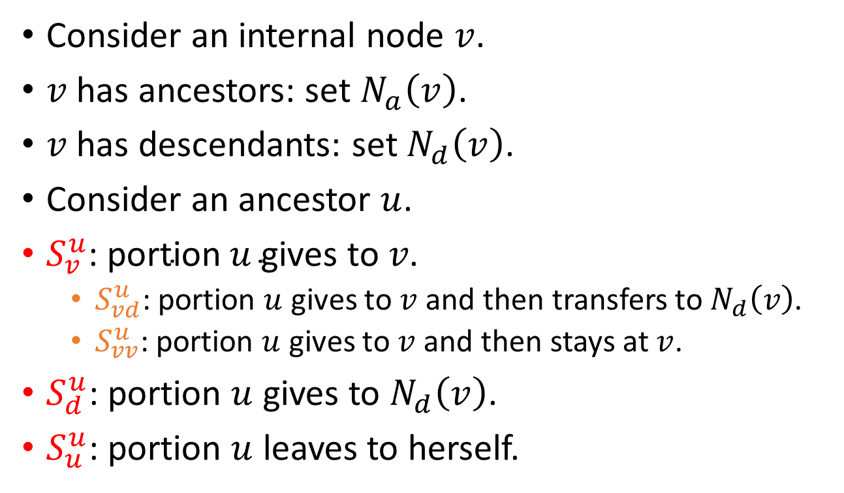



Fairness: Proportional
$$S_{v}^{u}$$
Consider an internal node $v$.
$v$ has ancestors: set $N_{a}\left(v\right)$.
$v$ has descendants: set $N_{d}\left(v\right)$.
Consider an ancestor $u$.
$S_{v}^{u}\text{: }\text{portion} u \text{gives} \text{to} v\text{.}$
  $S_{vd}^{u}$: portion $u$ gives to $v$ and then transfers to $N_{d}\left(v\right)$.
  $S_{vv}^{u}$: portion $u$ gives to $v$ and then stays at $v$.
$S_{d}^{u}$: portion $u$ gives to $N_{d}\left(v\right)$.
$S_{u}^{u}$: portion $u$ leaves to herself.
$$u$$
$$S_{v}^{u}$$
$$S_{d}^{u}$$
$$v$$
$$S_{vv}^{u}$$
$$S_{vd}^{u}$$

Slide 35
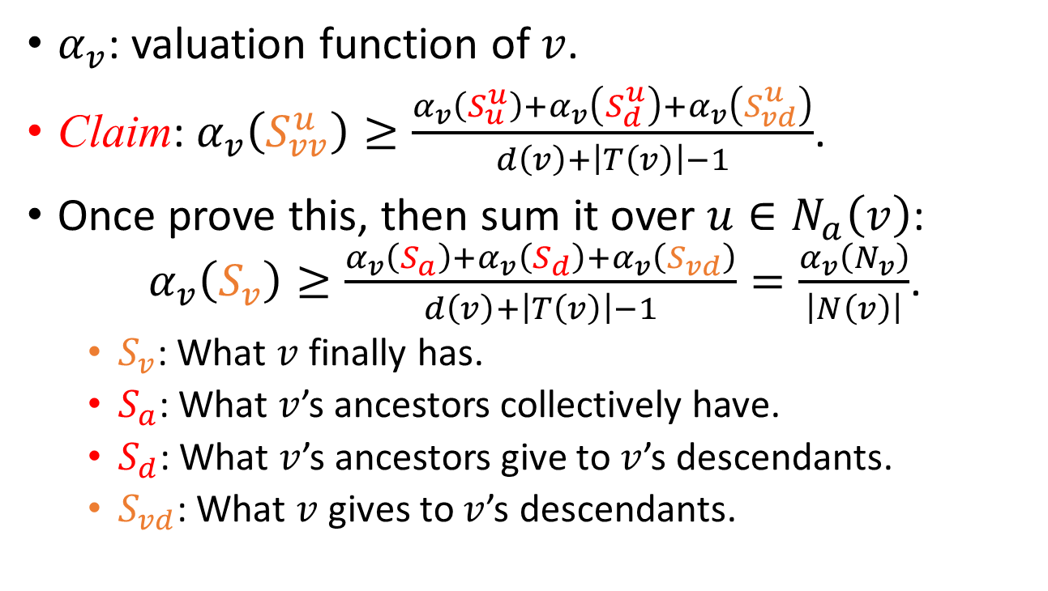
Fairness: Proportional
$$S_{v}^{u}$$
$α_{v}$: valuation function of $v$.
Claim: $α_{v}\left(S_{vv}^{u}\right)≥\frac{α_{v}\left(S_{u}^{u}\right)+α_{v}\left(S_{d}^{u}\right)+α_{v}\left(S_{vd}^{u}\right)}{d\left(v\right)+\left|T\left(v\right)\right|−1}$.
Once prove this, then sum it over $u∈N_{a}\left(v\right)$:
$α_{v}\left(S_{v}\right)≥\frac{α_{v}\left(S_{a}\right)+α_{v}\left(S_{d}\right)+α_{v}\left(S_{vd}\right)}{d\left(v\right)+\left|T\left(v\right)\right|−1}=\frac{α_{v}\left(N_{v}\right)}{\left|N\left(v\right)\right|}$.
  $S_{v}$: What $v$ finally has.
  $S_{a}$: What $v$’s ancestors collectively have.
  $S_{d}$: What $v$’s ancestors give to $v$’s descendants.
  $S_{vd}$: What $v$ gives to $v$’s descendants.
$$u$$
$$S_{v}^{u}$$
$$S_{d}^{u}$$
$$v$$
$$S_{vv}^{u}$$
$$S_{vd}^{u}$$

Slide 36
Conclusion
This work tries to initialize studies of fair allocation on graphs.
Two special classes of graphs are investigated.
  Trees: envy-free
  Descendant graphs: proportional
Many other interesting classes are left open.
  Cycles
  Low-degree
  …

